Slide 2
Agenda
1
SMB networking topology
Difficulties in device monitoring
Zabbix use cases
How to install Zabbix on QNAP NAS
Demo
Recommended QNAP NAS models for Zabbix
2
3
4
5
6

Slide 3
SMB networking topology
1

Slide 4
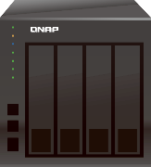
SMB networking topology
Two (or more) tiers of topology
Firewall
Switch
Internet
Routing and security handling by firewall
Company share NAS
Firewall
Devices/endpoints connected with switches
Switch
Switch
NAS deployed in these positions
Public NAS connects to firewall directly, and access management is handled by firewall
Department specific NAS is connected to switch, allowing only access by same subnet, managed by switch
Department NAS

Slide 5
Difficulties in device monitoring
2

Slide 6
Difficulties in monitoring devices in various locations
Logging in to each device and checking status take lots of time
Can't compare stats of multiple devices at same time
Report generation takes too much manual labor
Event notification needs to be set up on each device
What's more, it can't fulfull one of the
most important things for monitoring:
Real time

Slide 7
Zabbix use cases
3

Slide 8
Zabbix introduction
Open source, free install for central network device monitoring platform
Using SNMP or IPMI (Intelligent Platform Management Interface) to monitor enterprise devices
Customization of GUI
Real time visualized reports and notifications
Ref: https://www.zabbix.com/features#metric_collection

Slide 9
Zabbix use case – Centralized monitoring
Zabbix installed on a NAS
Allow NAS to access all devices
Through SNMP, Zabbix can monitor all devices directly
Generate reports by Zabbix
PM
RD
Notes:
Unite

Slide 10
Zabbix use case – Distributed monitoring
Has a NAS for each department or office
Zabbix installed on each NAS, the one put in HQ become central monitoring Zabbix
The Zabbix install in department or brach office become sub monitoring proxy
Central Zabbix aggregates all data coming from sub Zabbix
Generate report from central Zabbix
HQ
Branch
PM
RD
Local Sales
Notes:
Unify

Slide 11
Centralized monitoring vs Distributed monitoring
Centralized monitoring
Distributed monitoring
Less network devices
Simple topology
No isolate network
Centralized office
Numerus of network devices
Complex topology
Including isolate network
Distribute or cross-country office
How you deploy Zabbix depends on your infrastructure. Below will use centralized monitoring deployment for demo purposes.

Slide 12
How to install Zabbix on QNAP NAS
4

Slide 13
Step by step
1
4
Configuration of Zabbix
Configure NAS virtual switch
Get Zabbix webpage IP
Login to Zabbix
Create a host group
Import custom templates
Create host and setup templates
Make sure host is enable
Custom dashboard
2
Downlaod and install Zabbix on NAS
Download Zabbix
Install Zabbix on NAS
3
Configuration of NAS

Slide 14
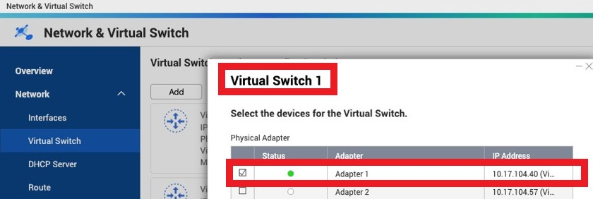
1. Configure NAS virtual switch
Network & Virtual Switch > Virtual Switch
Configure Virtual Switch 1, binding with Adapter 1

Slide 15
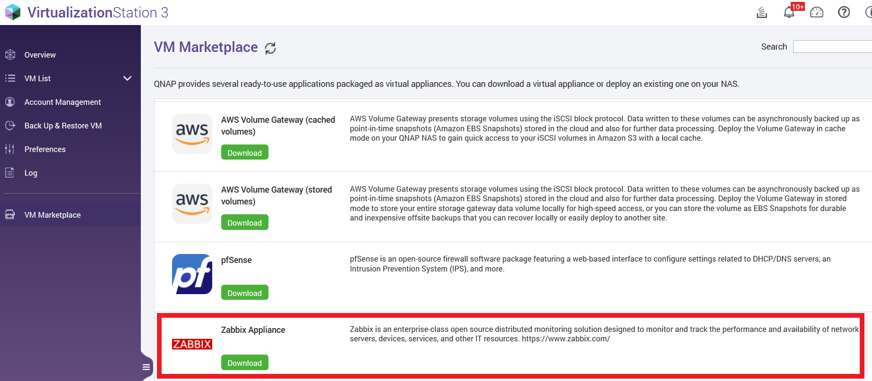
2.Download and install Zabbix - Download Zabbix
Virtualization Station > VM Marketplace, download Zabbix
Note: Zabbix will be available for download from VM Marketplace in Q2 2020

Slide 16
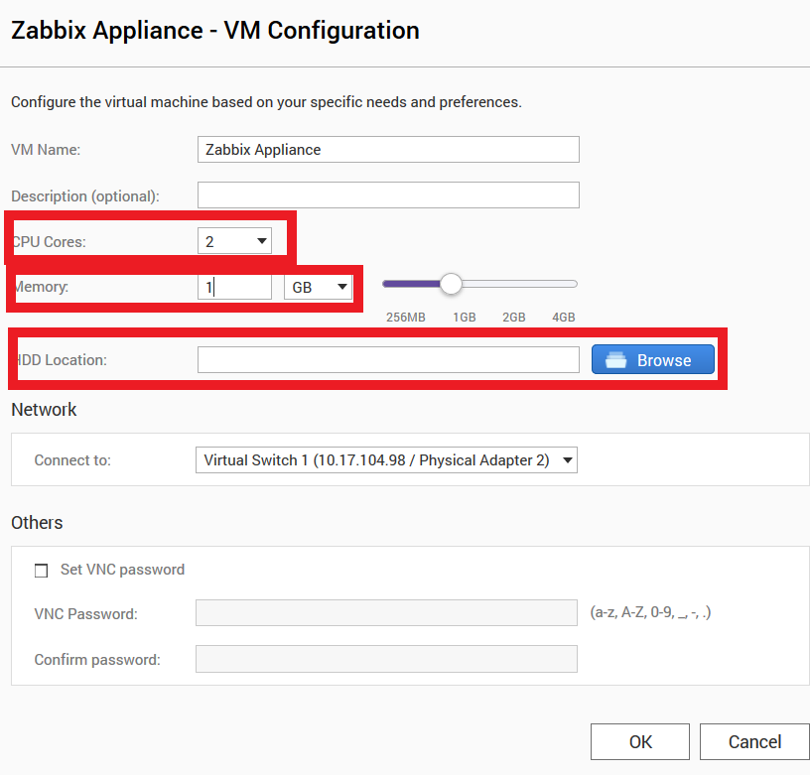
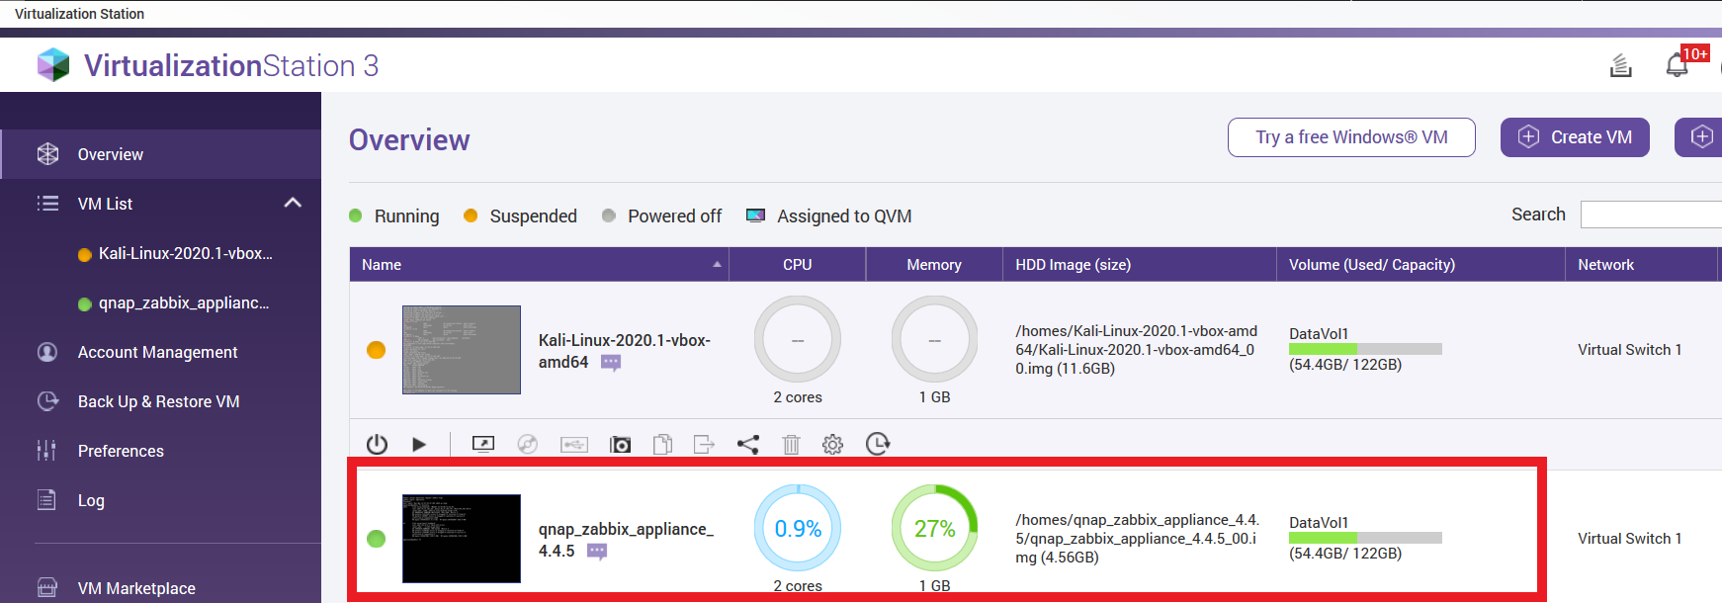
2.Download and install Zabbix - Install Zabbix
1. Install
Suggest 2 cores for CPU
Suggest 1GB for memory
Choose folder for install
2. Will see a Zabbix VM at
Virtualization Station

Slide 17
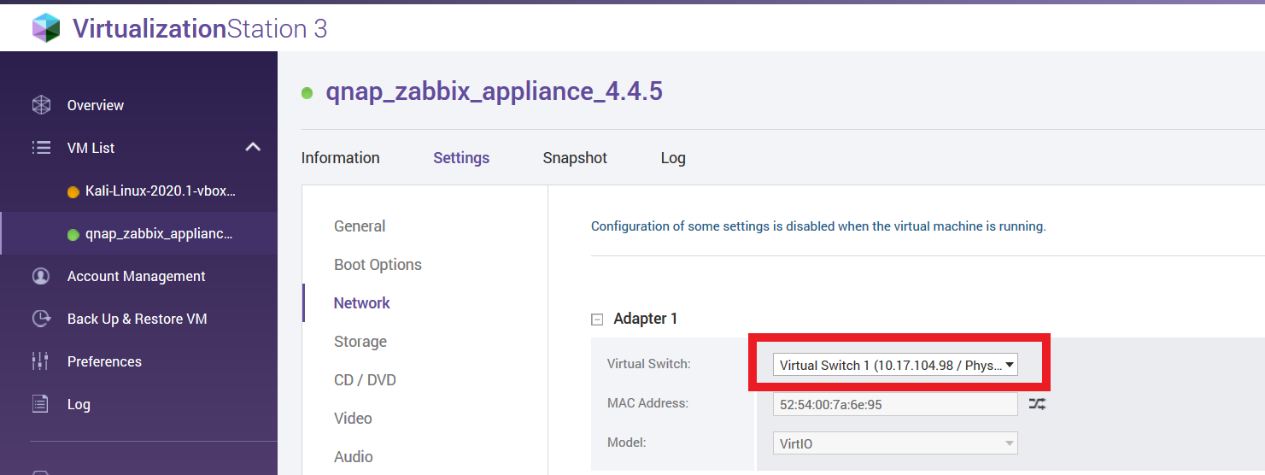
3.Configuration of NAS - Binding Virtual Switch on Zabbix
Virtualization Station > VM list, choose Zabbix VM
Setting > Network
Assign Adaptor 1 to virtual switch 1, Zabbix can get IP from it.

Slide 18
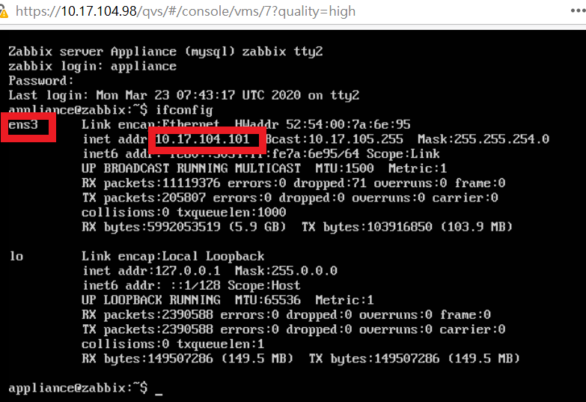
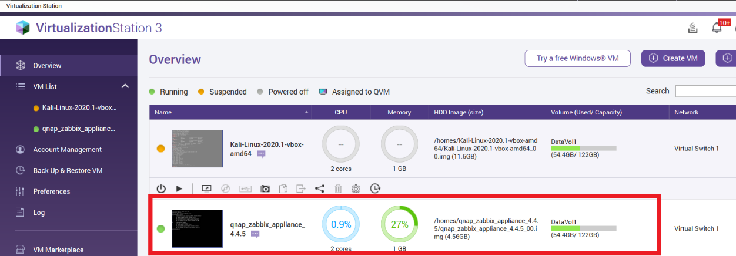
4.Configuration of Zabbix - Get Zabbix webpage IP
In VirtualizationStation, click Zabbix virtual machine, will pop-out a new tab with console access, after virtual machine boot up, terminal become black without any word on it, press Ctrl+Alt+F2, you can see login page, use login account: appliance, password: zabbix
Use CLI command ifconfig, find Zabbix network interface and check IP for login, for example this Zabbix use ens3 for interface, then use this IP for access.

Slide 19
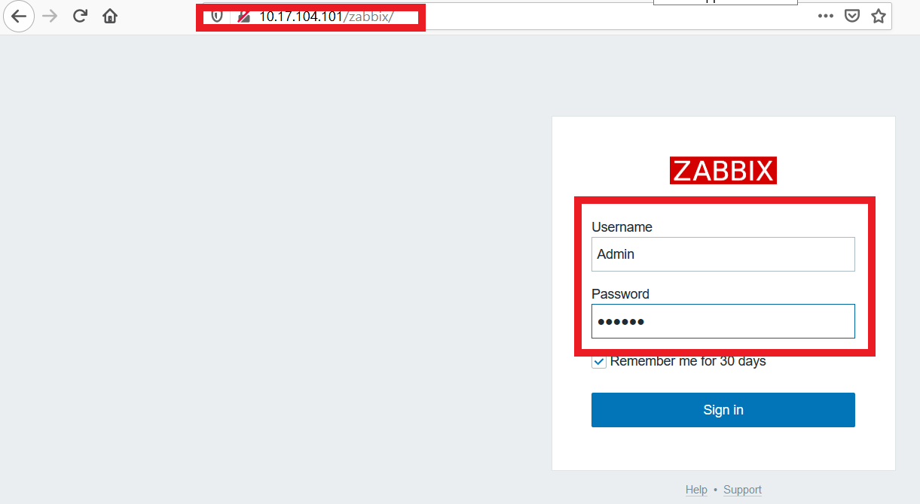
4.Configuration of Zabbix - Log in to Zabbix
Using the IP we get from previous page, with /Zabbix behind, is the login URL
For example: http://xx.xx.xx.xx/Zabbix
Defaul account: Admin, default password: zabbix

Slide 20
4.Configuration of Zabbix -Create host group
Create your own host group, if you want to use default group, ignore this step
Configuration > Host groups > Create host group
Key in Group name and press Add

Slide 21
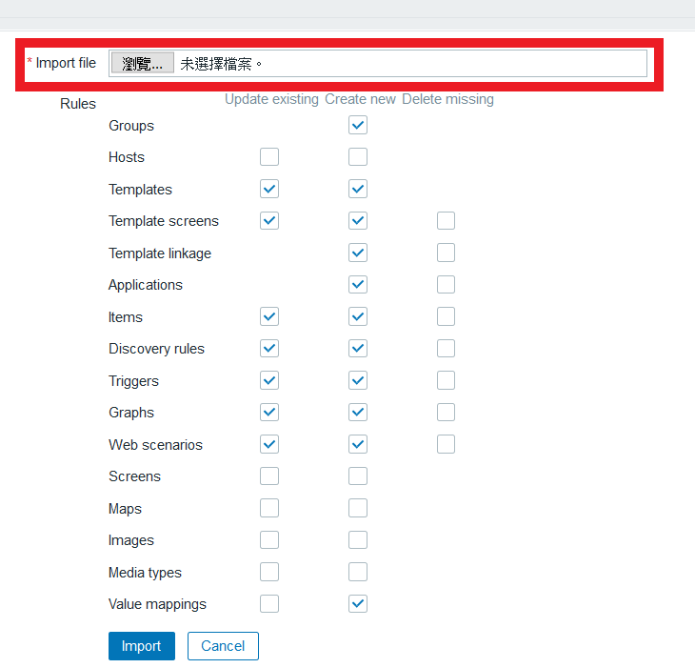
4.Configuration of Zabbix - Import custom templates
Import custom templates, if you want to use default templates, ignore this step
Configuration > Templates > Import
Choose the templates and press import
You can generate template by your selve or download from others, the sample for this demo is download from Zabbix template share
Ref: https://share.zabbix.com/storage-devices/qnap/zabbix-4-2-qnap-nas-snmp-template

Slide 22
4.Configuration of Zabbix -Create host
Create a new host on Zabbix
Configuration > Hosts> Creat host

Slide 23
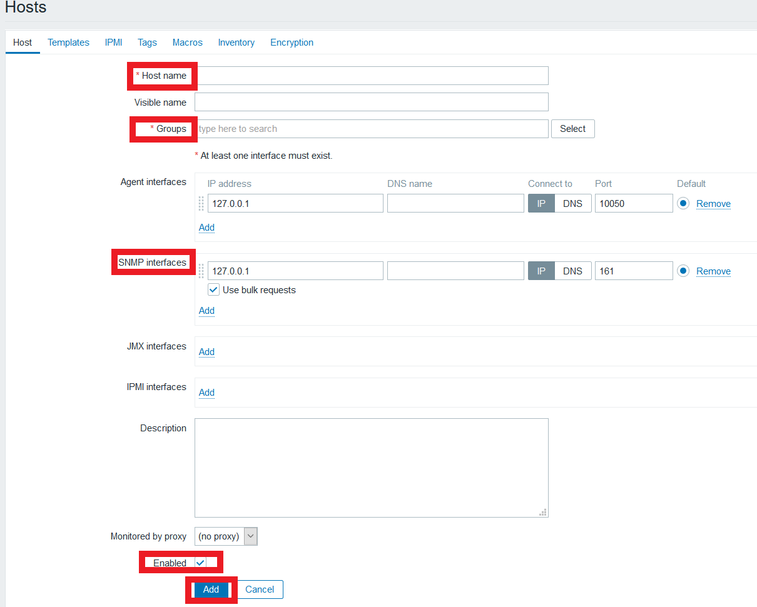
4.Configuration of Zabbix -Create host
Key in the information of Host
Host Name: Name of device
Groups: default or custom generate group
Agent interfaces: choose the connction type and interface info on device, for Zabbix access, like QNAP device managed by SNMP, choose SNMP interface, and can delete others
Enabled: enable host
Press Add to add host

Slide 24
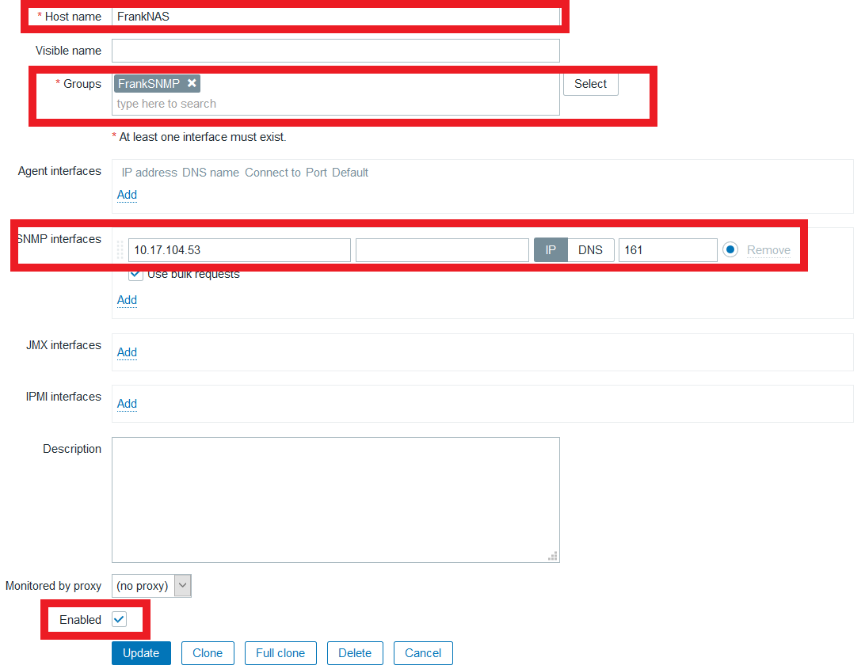
4.Configuration of Zabbix -Create host (example)
Use this host for example
Host Name: FrankNAS
Groups: Custom generate FrankSNMP
Agent interfaces: SNMP interface IP, through IP and port 161
Enabled: enable this host

Slide 25
4.Configuration of Zabbix -Setup templates
Add templates for monitoring host, can be done at the Templates on Host page
Link new templates: choose template, we choose default SNMPv2 from Zabbix and SNMP QNAP NAS templates
Press Update to add

Slide 26
4.Configuration of Zabbix - Make sure host is enable
Check if host is enabled after host added and templates set
Configuration > Hosts, can check devices under monitoring
We are using SNMP for monitoring, you can see for Availability option, the SNMP button diplay in green, means working

Slide 27
Troubleshooting – SNMP button showing red
SNMP button diplay in red means Zabbix can't monitor this device; you can double check below items
Need to wait 5-10min after host setup complete
If button still keep in red after 5-10min, need to check as below
Can Zabbix server connect to host, using ICMP for check
If has firewall on the host, make sure UDP port 161(or custom SNMP port on the host) is bypassed
IP for host is correct or not

Slide 28
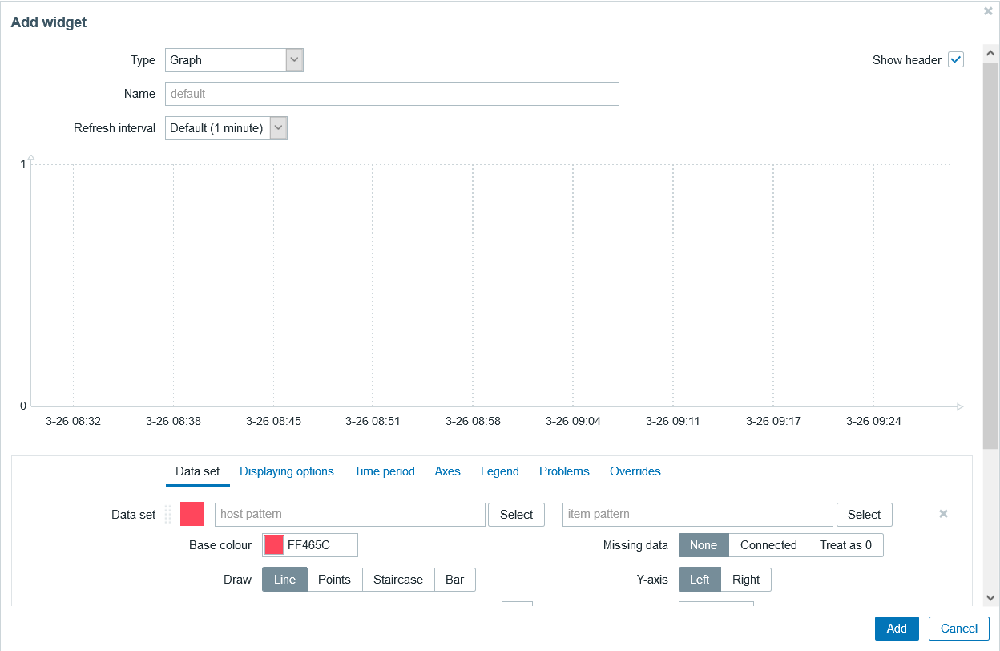
4.Configuration of Zabbix - Custom dashboard
Can custom graphic on Zabbix dashboard
Monitor > Dashboard >Edit dashboard
Can add graphic or others in Add widget page
Back to Dashboard, can drag graphic to the place you want

Slide 29
Troubleshooting – No data on graphic
Configuration is ready, but no data on the graphic
Make sure the display time period on the dashboard is correct (the period need to have data for correct graphic display)
In the terminal page of Zabbix virtual machine, use CLI to restart Zabbix service
sudo service zabbix-server start (start Zabbix)
sudo service zabbix-server stop (stop Zabbix)
sudo service zabbix-server restart (restart Zabbix)
sudo service zabbix-server status (Check Zabbix is active or not, showing 'active' in green means active successfully)

Slide 30
DEMO
5

Slide 31
Recommended QNAP NAS models for Zabbix
6

Slide 32
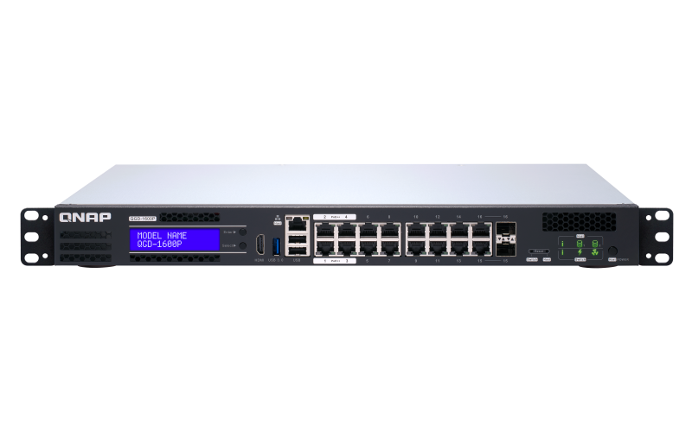
Seamlessly integrated with QNAP
x51 / x53 Series
x72 / x73 / x77 Series
x83 / x85 / x86 / 89 Series
Studio/SOHO
SMB
Enterprise/Data center
QGD1600P switch

Slide 33
IS YOUR BEST CHOICE !
Copyright© 2020 QNAP Systems, Inc. All rights reserved. QNAP® and other names of QNAP Products are proprietary marks or registered trademarks of QNAP Systems, Inc. Other products and company names mentioned herein are trademarks of their respective holders.​​​

