Slide 1
A guide to RAID, storage pool & volume settings, and JBOD storage features

Slide 2
Agenda
QTS 4.4.2 launched:
1
QNAP security architecture improvements: QTS default password changes
Strong support for new expansion device: TL-JBOD
Storage Manager: the guide for RAID/Storage Pool/Volume configuration:
2
Insufficient capacity (RAID expansion) ; Buy a new NAS: (System migration)
Re-configure your RAID by security concern (RAID migration)
How to migrate the data pool (Safely Detach Pool)
How to configure your SSD: (Volume / Qtier / Cache)
How to configure the storage space: (Static/Thin/Thick); (Re-size); (Global settings)
TL-JBOD application mode (External Drive Enclosure or NAS Expansion)

Slide 3
Launched:

Slide 4
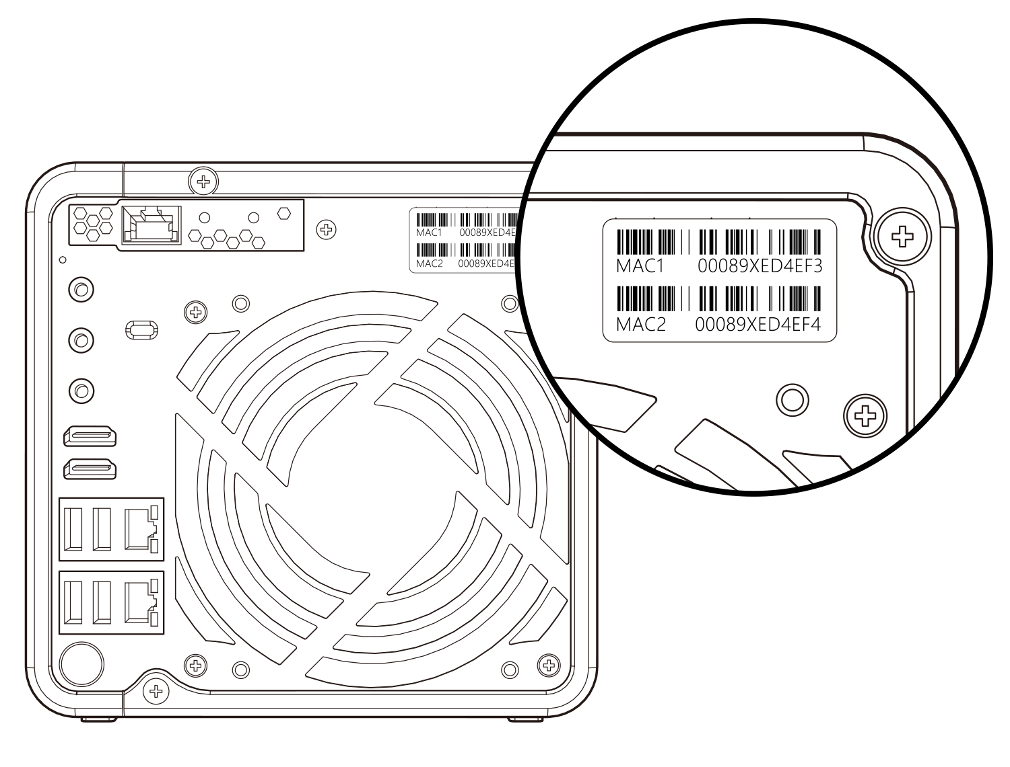
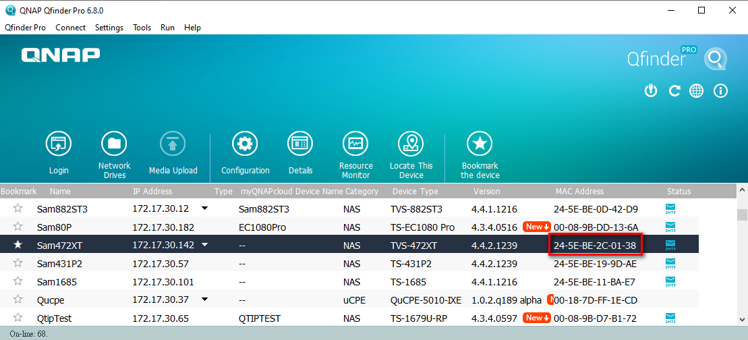
QTS 4.4.2 Launched
QNAP product security improvements: (A) The QTS default password is changed to the first MAC address (all caps).
(B) TLS 1.2 & HTTP compression are now enabled by default.
Notes:
QTS 4.4.2 is a minor revision, and not changed too much. so we quickly sort out the key point here. The first is we make some security improvements, according to the regulations and world trends, we change the QTS default password from admin to the first MAC address, and all use the uppercase.

Slide 5
QTS 4.4.2 Launched
Strong support for new expansion device : TL-JBOD
TL SATA JBOD
TL USB JBOD

Slide 6
Storage Manager:
RAID / Pool / Volume
Practical Guide

Slide 7
Storage Manager - Address the practical needs of your storage configuration
How to use the external JBOD?
Insufficient capacity?
How to configure the storage space?
Buy a new NAS?
Re-configure your RAID due to reliability concerns?
How to configure your SSD?

Slide 8
Practical needs of storage configuration (1)
Insufficient capacity

Slide 9
When capacity is low (RAID expansion)
Replace Disk 1 by 1
Online RAID expansion
1
Prepare new disks with the same number as the NAS’s RAID group
1
Prepare one disk and plug into the free slot of new NAS.
2
Storage & Snapshot > Manage Storage Pool > Select a RAID Group > Manage > Select “Replace disk one by one”
2
Storage & Snapshot > Manage Storage Pool > Expanding storage pool > Add new disk to existing RAID
3
Following wizard guide to unplug, plug in and sync disk one by one
3
Select the plugged disk and re-sync !
Note: only supports RAID 1, 5, 6 & 10.
Note: only supports RAID 5, 6, 50 & 60
Also you can migrate to a new unit with more slots (next page), Or, use the TL JBOD external device. (final chapter)
Notes:
The most economical solution Adjust [Resync Priority] to increase disk re-sync speed

Slide 10
1
TS-873 RAID 1 - Replace disk one by one
2
Online RAID5 expansion

Slide 11
Practical needs of storage configuration (2) Buy a new NAS
for better performance

Slide 12
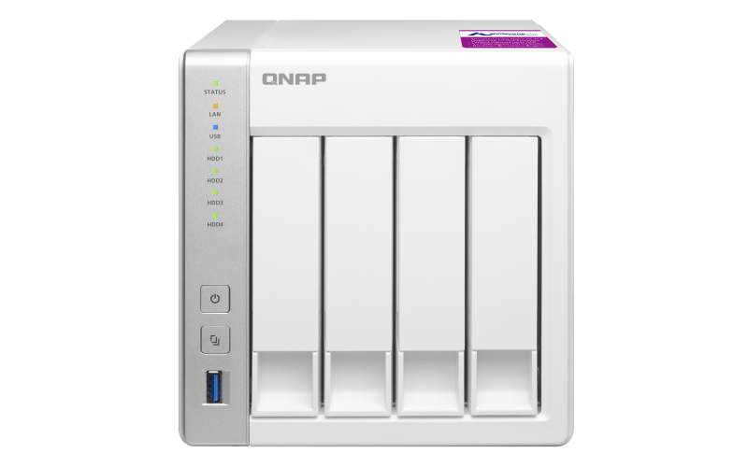
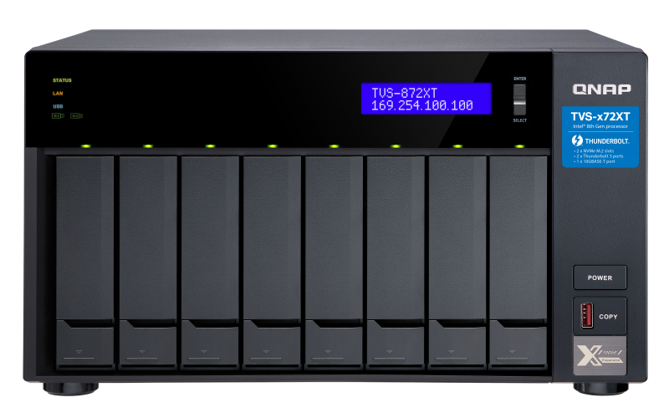
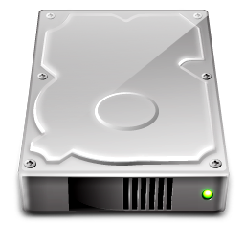
How to migrate existing disks to new NAS?
Ensure 2 NAS have the same OS version (or update both to latest)
1
System Migration
Shutdown both NAS and plug original disks into new NAS
2
Power on new NAS and reconfigure the network.
3
System
System
System migration may not support migrating NAS from an enterprise model back to an entry one. For details please visit: https://www.qnap.com/go/nas-migration

Slide 13
How to migrate the non-system disk to new NAS?
Storage & snapshot > Storage Pool manage > Action > Safely detach
1
Data pool migration
Remove and plug in disks to the free slot of new NAS
2
Disk/VJBOD > Recover > Attach and Recover Storage Pool
3
System
System
Pool
Data
Data

Slide 14
1
System migrate from
TS-431P2 to TVS-472XT
2
Data pool migration from
TS-431P2 to TVS-472XT

Slide 15
Practical needs of storage configuration (3) When RAID type migration is needed

Slide 16
Re-configure and migrate the RAID type
Plug in new disks into the NAS
RAID Migration
1
Storage/Snapshot > Pool management > select RAID > Manage > Migrate
2
Follow the wizard to select new disk for migration
3
Note: only support migrating in this order.
The actual performance may differ based on NAS models. RAID 50 /60 do not support direct RAID migration
Single
RAID 1
RAID 5
RAID 6

Slide 17
TS-873 RAID 5 migrate to RAID 6

Slide 18
Practical needs of storage configuration (4)
SSD Configuration

Slide 19
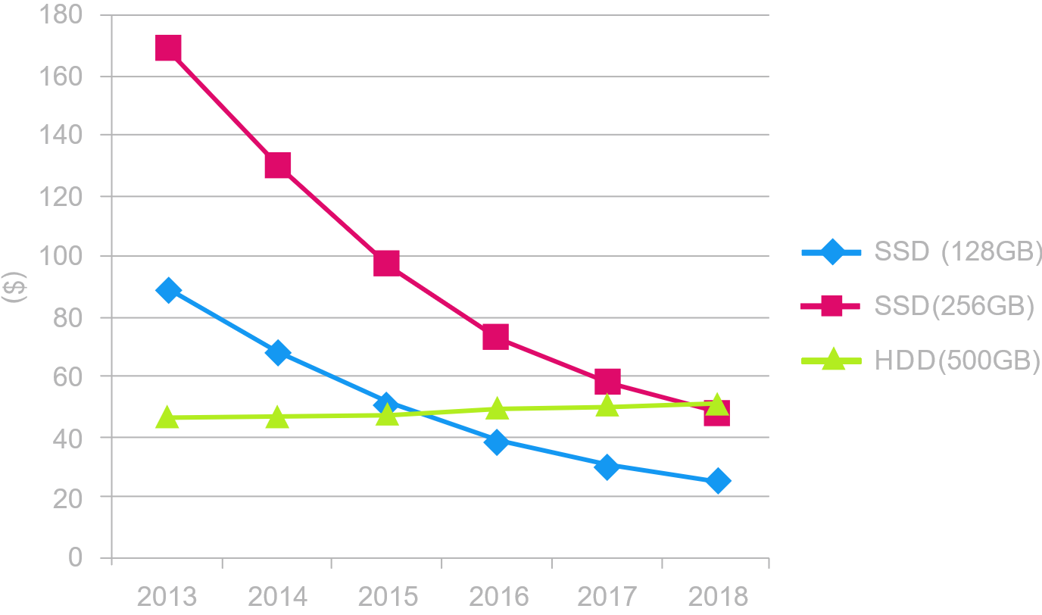
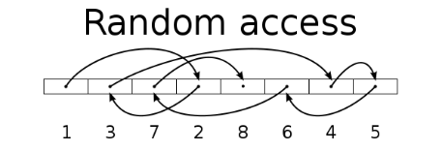
SSD Evolution Trend：Price
In storage devices, in addition to accelerating sequential file access, SSD even provides random performance (IOPS) that is far better than traditional mechanical disks.
With modern applications it is required higher storage performance, SSD is becoming more popular and is being widely used.
Disk | Sequential (MB/s) | Random (IOPS)
HDD | 200 | 350
SSD | 550 | 60000

Slide 20
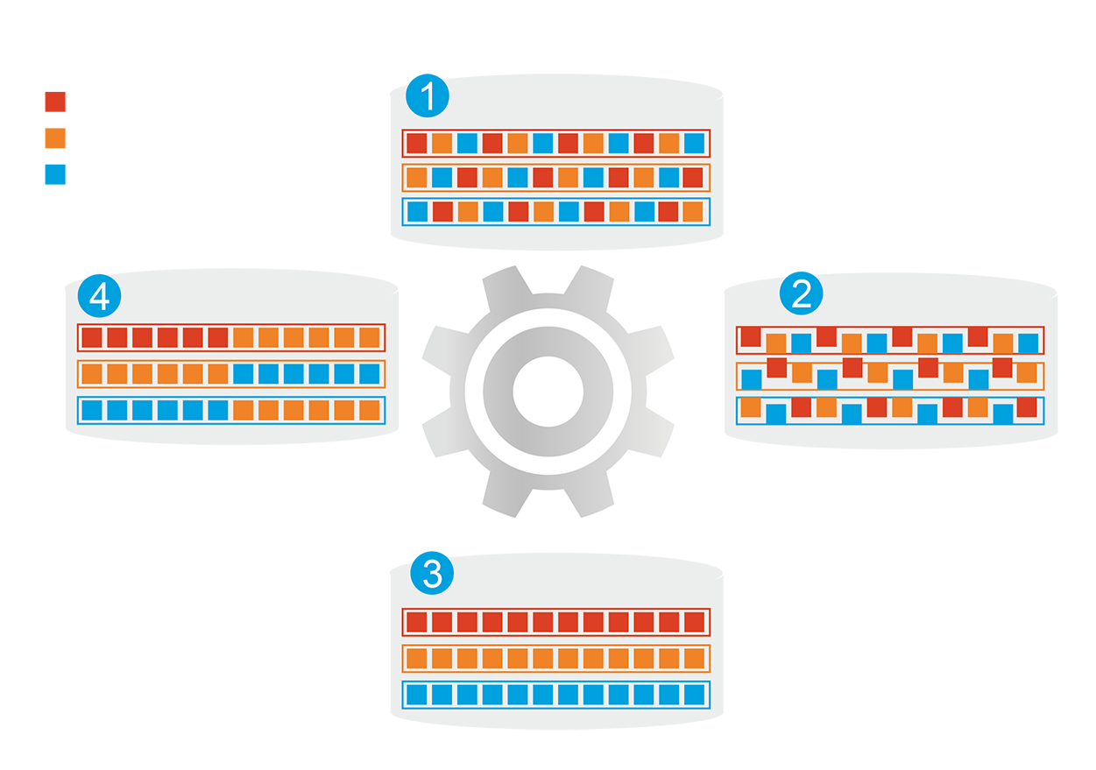
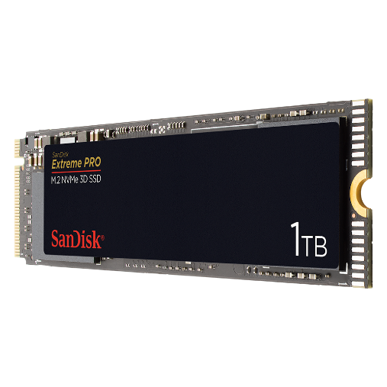
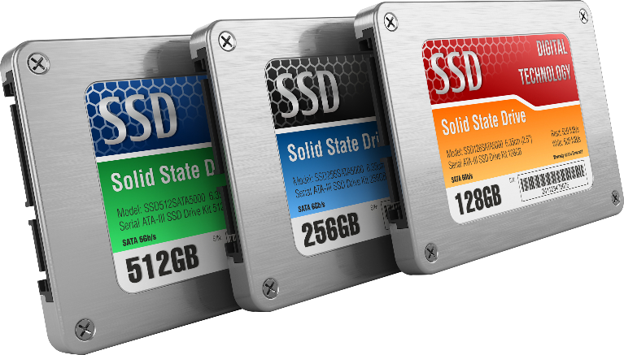
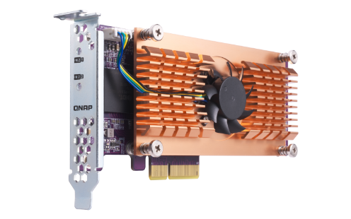
What's Qtier tiered storage?
1
Before Tiering
QNAP allows the combination of SSD and HDD RAID into the same pool and migrate data automatically based on accessing pattern.
Hot data
Warm data
Cold data
4
Data Access Pattern Changed
2
Start Tiering
Support SATA, SAS, M.2, QM2 and U.2 SSD.
Qtier
Engine
Provide higher capacity as SSD can be used to store data
3
After Tiering

Slide 21
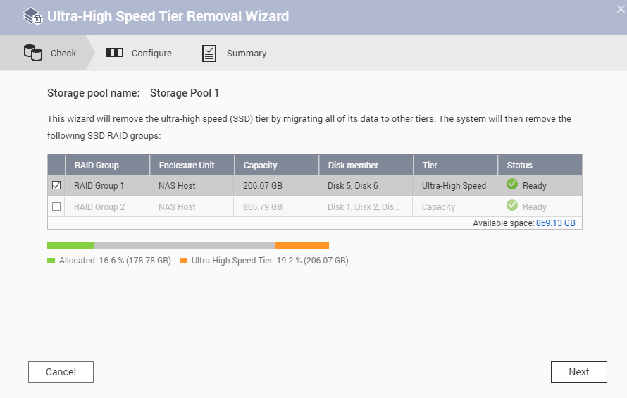
Remove Qtier SSD tier on demand
Remove SSD Tier in 3 steps：
Storage Pool Management >
Remove > Remove SSD Tier
1
It is required that all RAIDs in Qtier Pool are normal and HDD tiers have enough capacity to store all data.
Check if all the RAIDs Group are
ready and have enough space.
2
User confirm to stop the pool`s
service to start the operation.
3

Slide 22
Scenario of QNAP NAS with SSD Configuration
The SSD type will affect the workload, the best SSD configuration may only be measurable once it is configured. The SSD Cache and Qtier have different advantages, the IT manager can freely switch between the SSD Cache and Qtier to adapt to the best configuration：
Scenario | File Server | Web、Virtualized storage server | Editing Storage (raw cut, film cut...) | Editing Storage (Post production) | Log / high speed backup server | Enterprise Database
SSD usage | Qtier | Qtier | SSD RAID volume | SSD R/W cache | SSD write only cache | SSD RAID Pool
RAID type | RAID 6 | RAID 10 | RAID 5 | RAID 5 | RAID 10 | RAID 10
SSD OP | 10% | 20% | 20% | 20% | 30% | 30%

Slide 23
TS-1685 : Re-configure between SSD cache and Qtier

Slide 24
Practical needs of storage configuration (5)
Storage Space Configuration

Slide 25
The difference of Static / Thin / Thick
Thick (under Pool) | Thin (under Pool) | Static
Guaranteed space | Dynamically distributed | Highest performance
free space cannot be utilized, waste too much space | volumes space will be limited and interrupt the important service if badly managed. | Without all advanced features (like snapshot…)
Thick volume
Thick iSCSI LUN
Thin Volume2
Static Volume
Shared space
Thin Volume1
Storage Pool
RAID
HDD
HDD
HDD
HDD
HDD
HDD
HDD
HDD

Slide 26
Flexibly allocate storage space - Pool / Volume resize
Reduce the allocated thick volume space to free space for the storage pool, other volumes, LUN or Snapshot
Reduce the planned thin volume space to avoid risk of "Oversubscription" or taking too much snapshot space.
The space that thin volume has planned but its storage pool cannot currently provide.
Thin Volume
Oversubscription
Thin Volume
Oversubscription
Thick Volume
Storage Pool

Slide 27
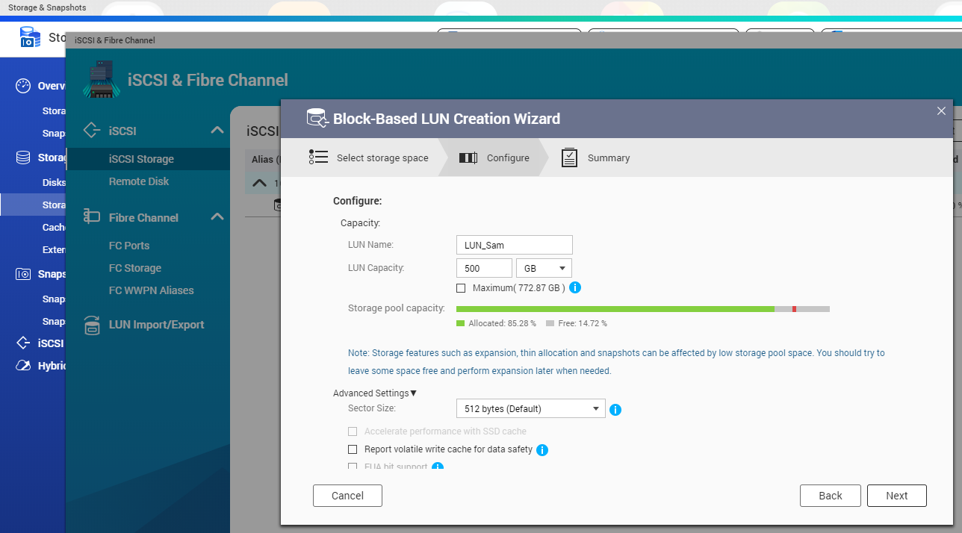
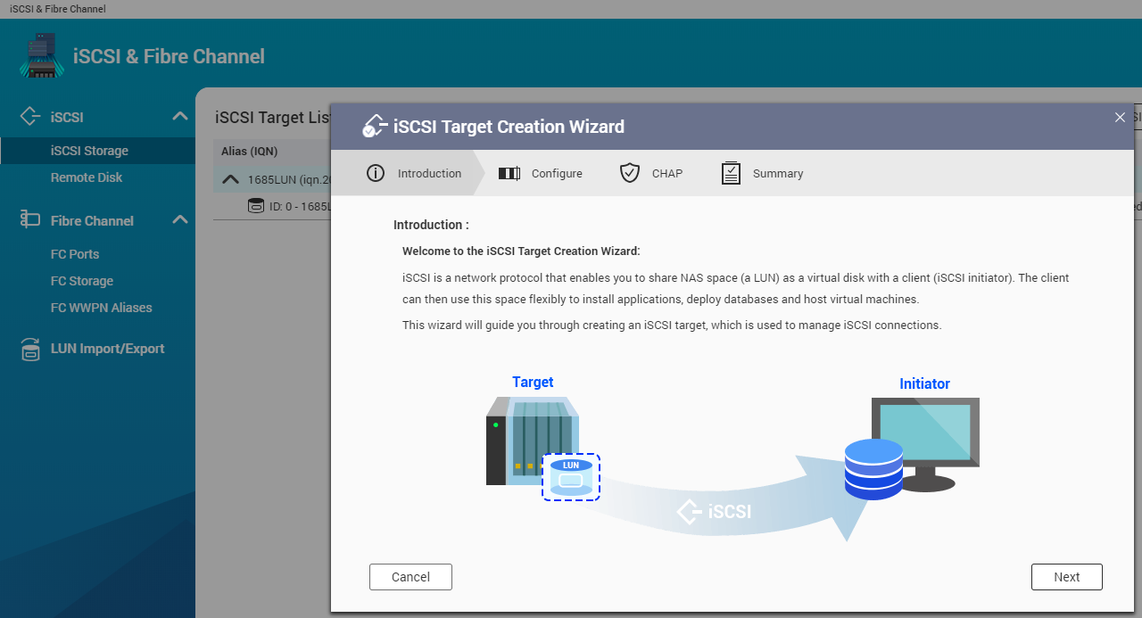
LUN configuration for low latency SAN environment
Create LUN
Create iSCSI target
1
Storage/Snapsot > Create > New Block-Based LUN
1
iSCSI& FC > Create > New iSCSI Target
2
Check the LUN capacity & Sector size
2
Right click on LUN space > Edit the LUN mapping

Slide 28
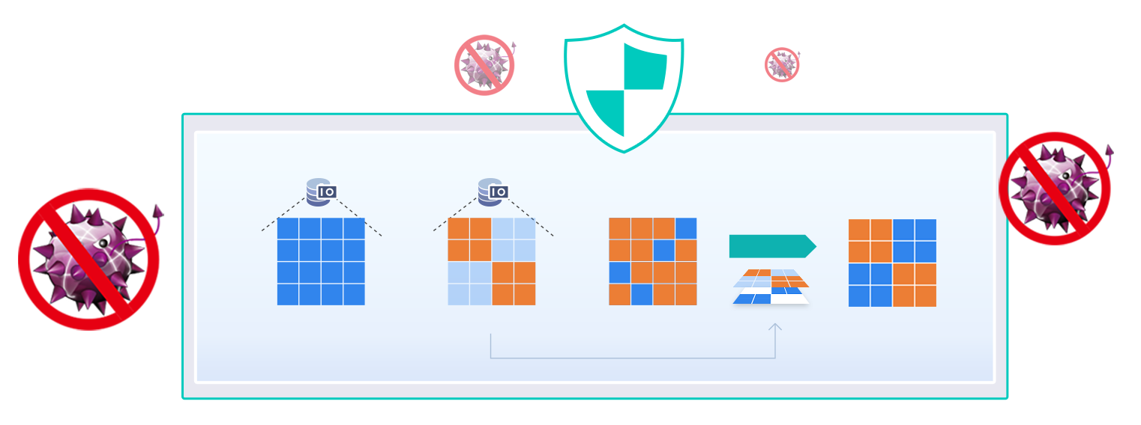
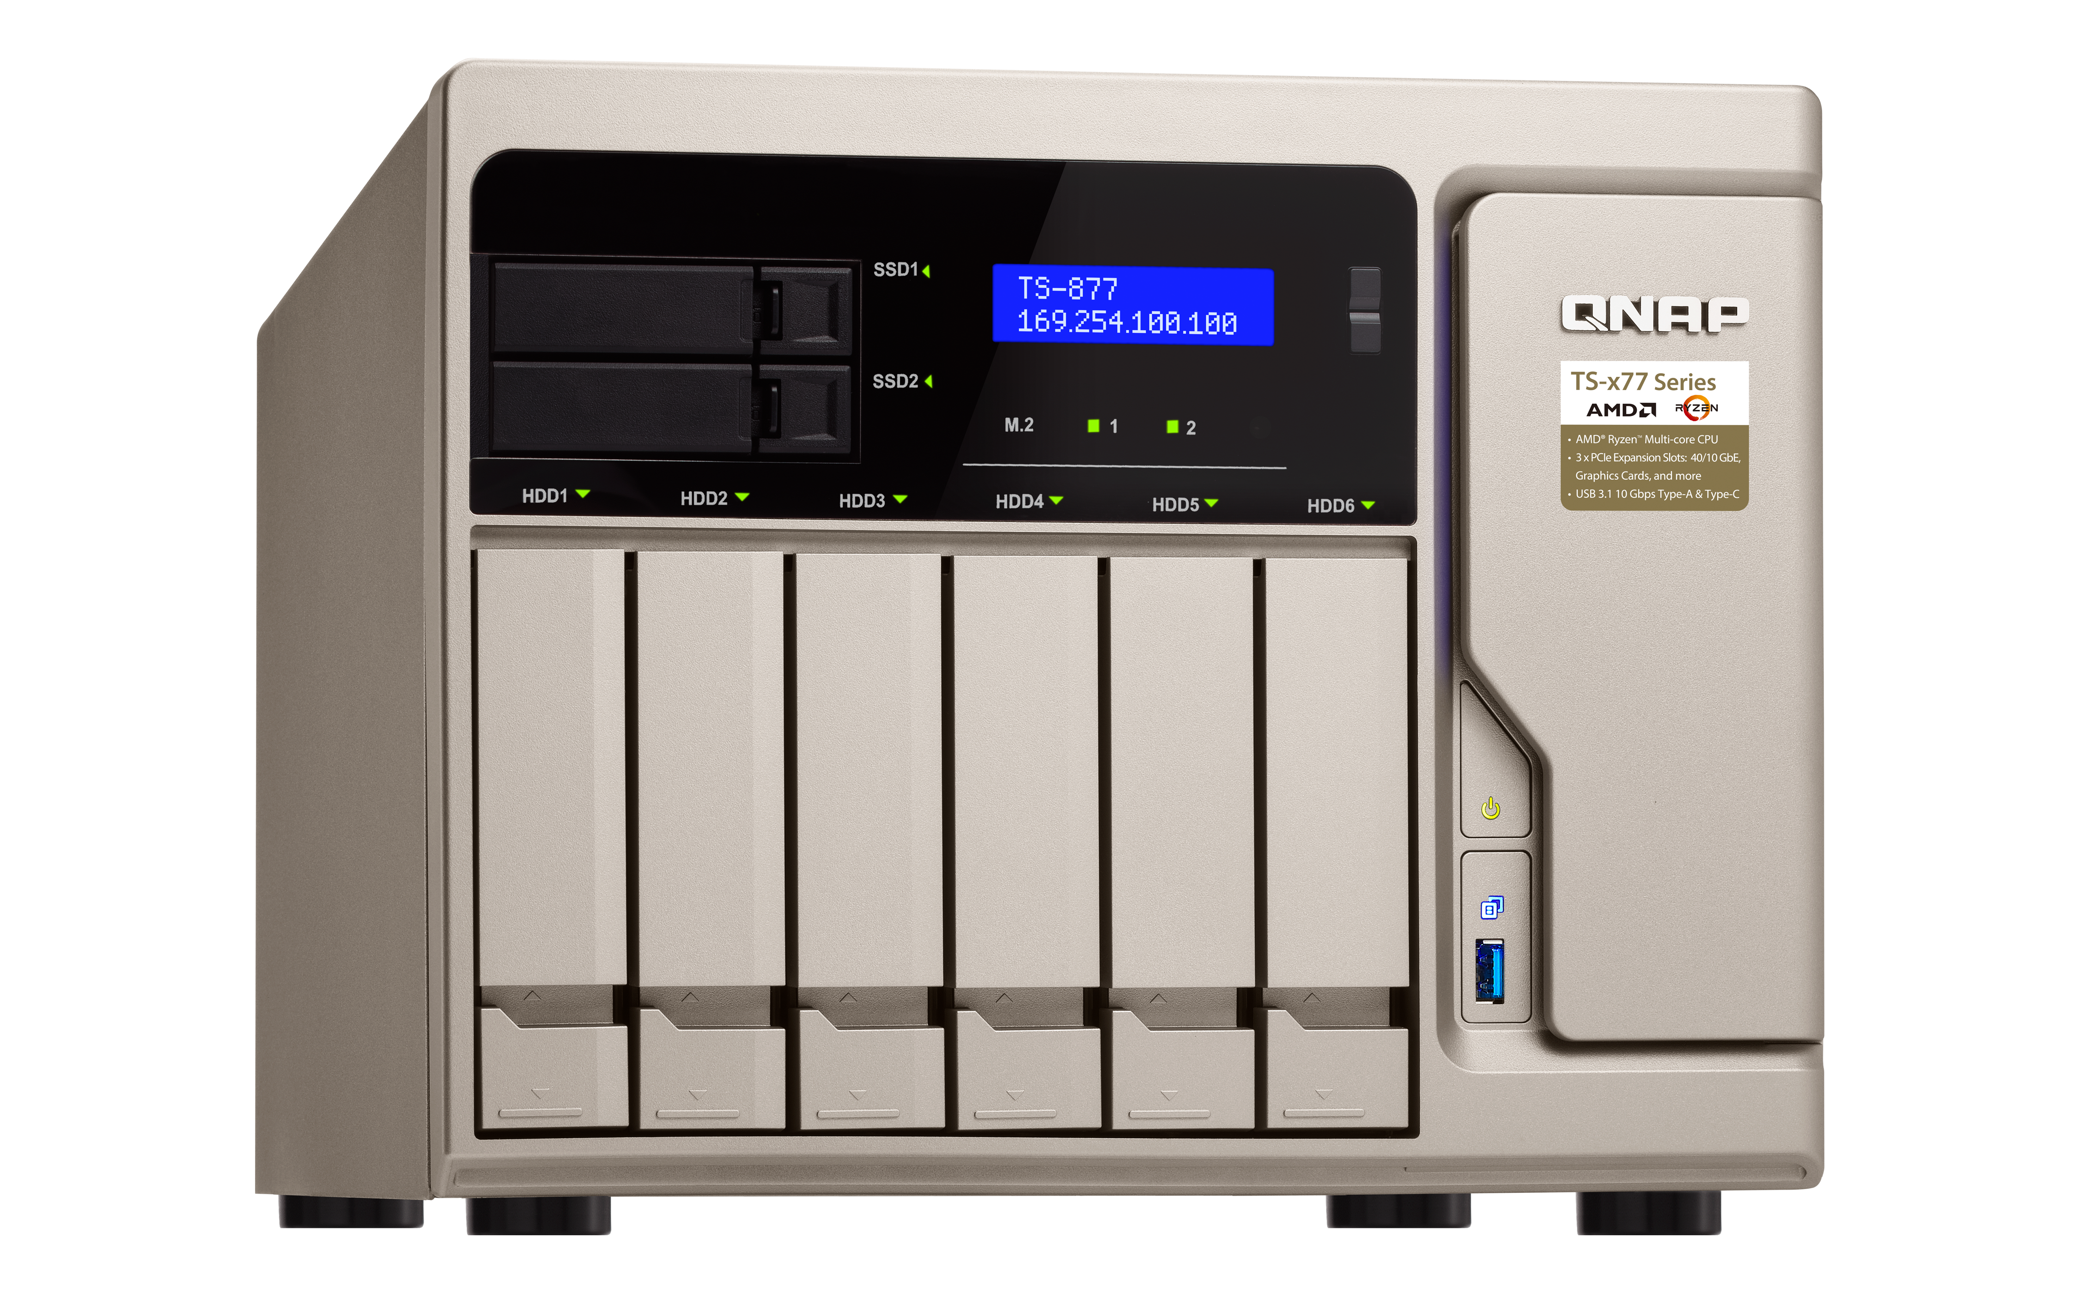
Snapshot - best for fighting against ransomware
Both enterprises and consumer could be targets of ransomware
Data needs to be backed up, while backups also need to be protected.
Snapshots could help you avoid accidental modifications.
QNAP block-based snapshots protect your data from being damaged by ransomware.
Local Snapshot
SnapshotReplica
Storage Pool
Revert
TS-877
Data block
Modified block
Messed by ransomware
Reverted from snapshots
Notes:
Snapshot is another important feature we introduce many times, it is the best solution for fighting against ransomware, protect your backup. And it could avoid the accidental modification, no matter intentional or unintentional.

Slide 29
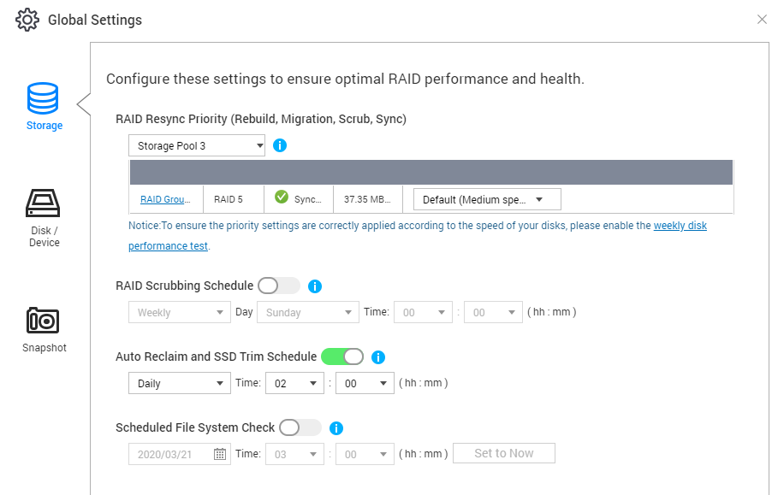
Ensure storage performance and health
Global - Storage
RAID Resync Priority:
Choose between sync speed or NAS performance (suggest to set at high speed)
RAID Scrubbing Schedule:
Scan and repair the failed sectors of RAID automatically. (suggest to enable it if use RAID 5 / 6)
Auto Reclaim:
Default on 2 am, then returns unused space of thin volume.
Check file system:
System will check the unclean file system in the volume.

Slide 30
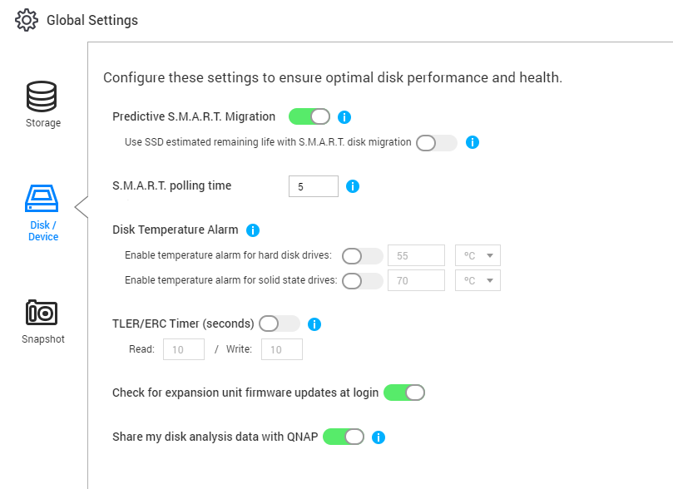
Ensure storage performance and health
Global – Disk/Device
Predictive SMART Migration:
If a SMART error is detected, the system will migrate the data to spare disk immediately.
Check for expansion unit F/W update at login:
Suggest to enable
Disk Temperature Alarm:
The temperature of the M.2 SSD is extremely high, and it must be turned on if used. (And raise the temperature threshold to avoid false alarms)
Share my disk analysis data with QNAP:
QNAP complies with GDPR requirements, will not collect any private info, and only obtains disk data for analysis and optimization of future OS version.

Slide 31
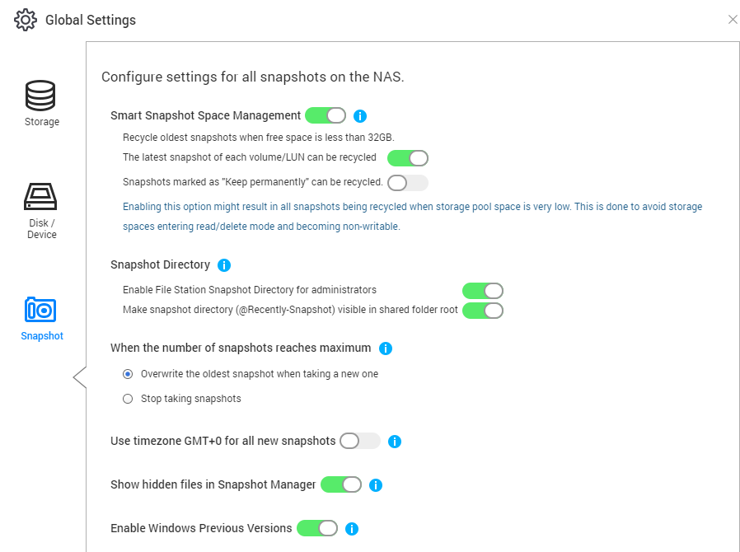
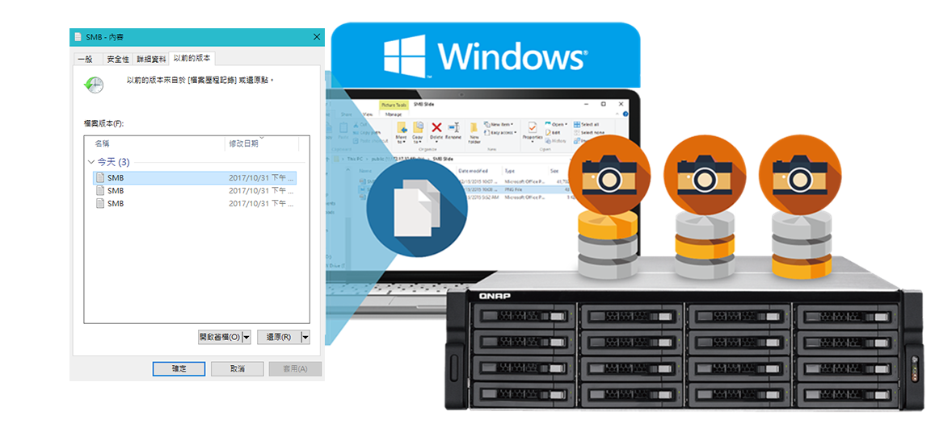
Ensure storage performance and health
Smart Snapshot Space Management options:
Global - Snapshot
When number of snapshots reaches System Max:
Recycle latest snapshot:
When disabled, last snapshot will not be recycled.
Recycle permanently snapshot:
When disabled, the snapshot that is set as permanent will not be recycled.
Replace oldest snapshot with new snapshot
Stop taking new snapshot
Enable all of this part to avoid interrupting storage service.

Slide 32
Practical needs of storage configuration (6)
How to configure
and use the new TL JBOD

Slide 33
QTS 4.4.2 supports both USB & SATA JBOD units
Note: System supported USB endpoints has max limitation, Follow the QNAP website of Expansion compatibility to check the maximum number of supported JBOD units.
SATA JBOD
USB JBOD

Slide 34
Two different usages on NAS
External Drive Enclosure
NAS Expansion
Cross-platform data can be easily copied to NAS for sharing.
Expand and provide more space via a new storage pool
Note: Two modes cannot be used at the same time

Slide 35
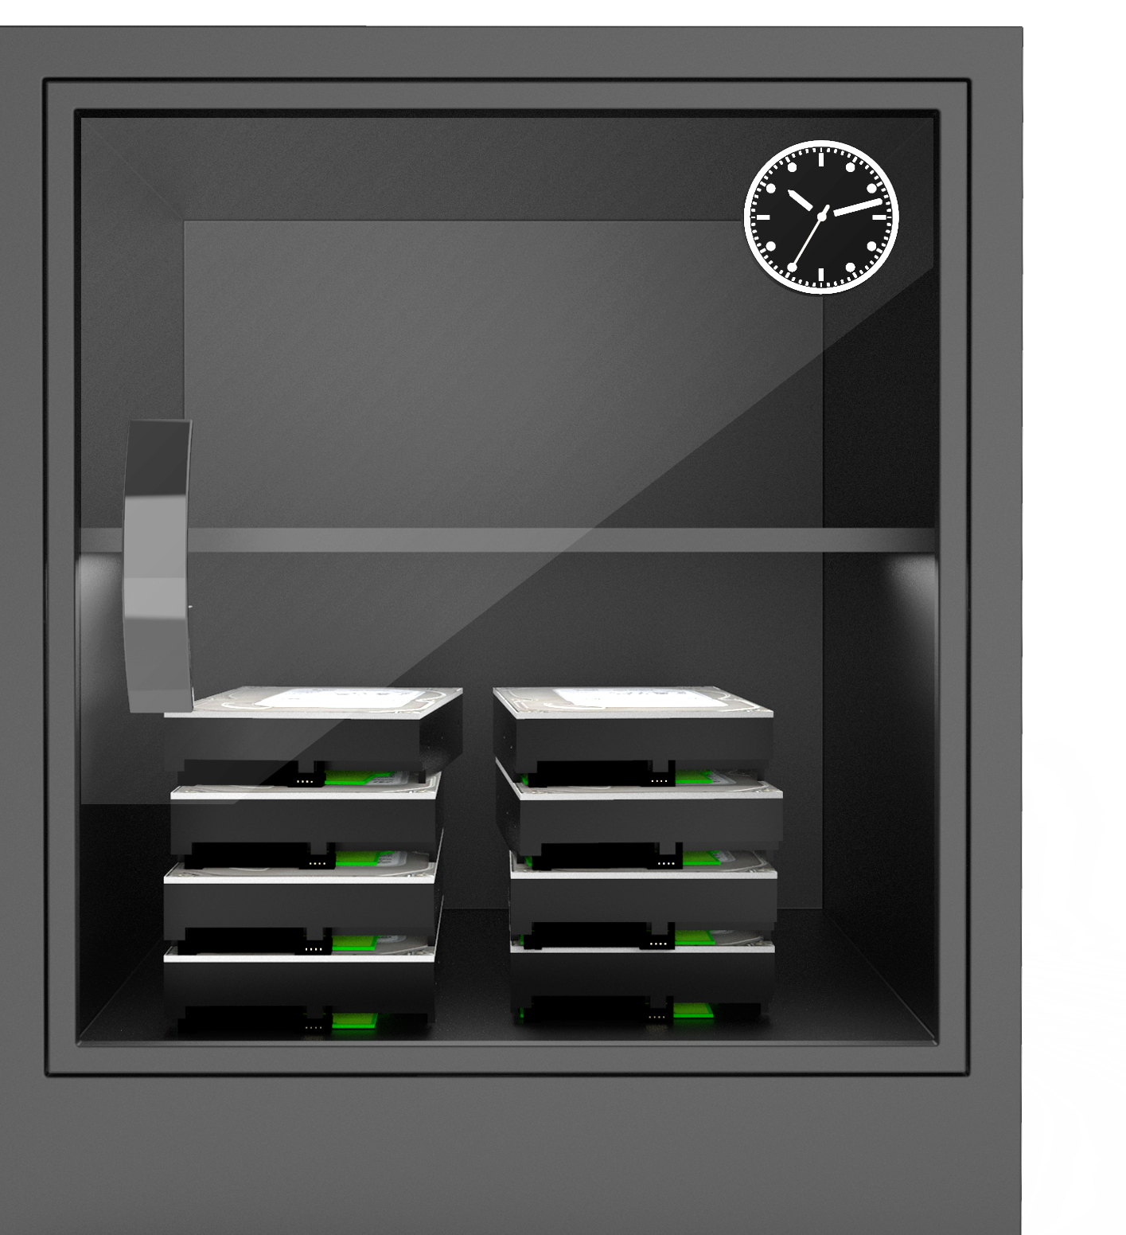
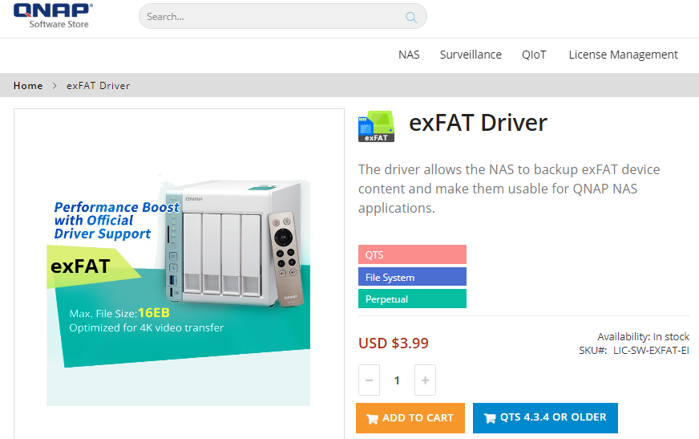
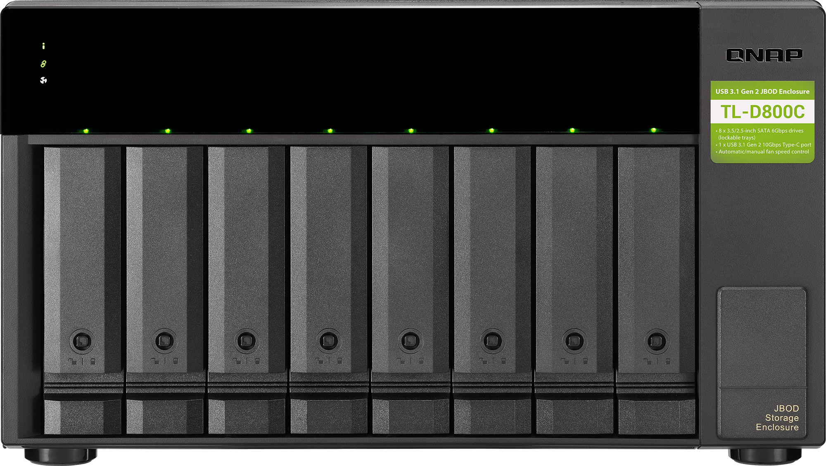
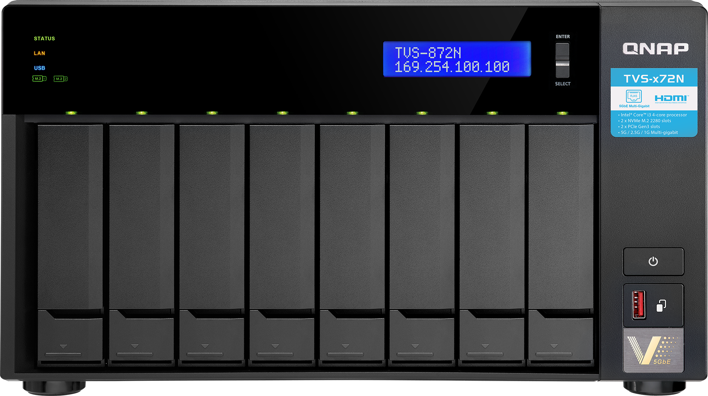
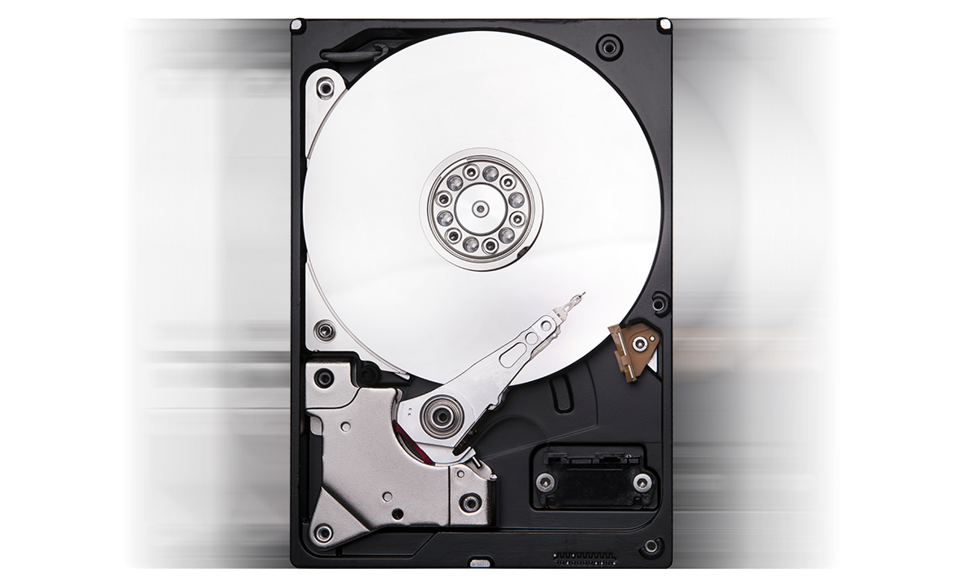
High speed External Drive Enclosure
No matter the disk data stored in your dry cabinet is Linux (EXT4), exFAT for camera / memory card, Windows (NTFS), Mac (HFS +) format, you can easily use QNAP-JBOD as an External Drive Enclosure for data access, Then copy to NAS for protection and data sharing.
NTFS
HFS+
EXT4
Soft Store exFAT Driver

Slide 36
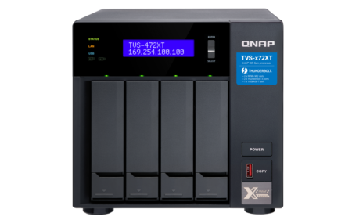
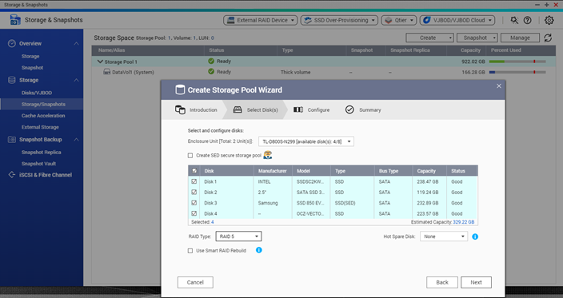
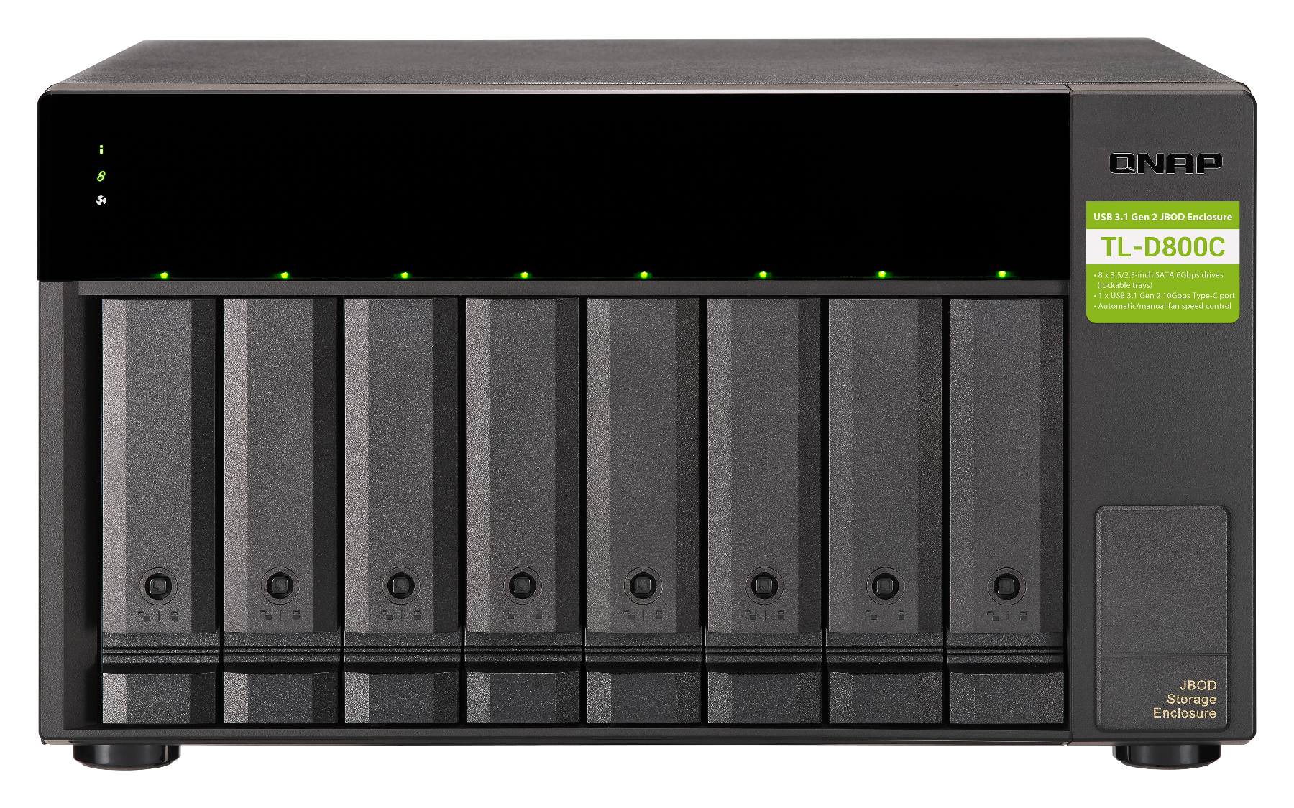
JBOD is your best expansion solution for NAS
The traditional RAID expansion method may result to NAS downtime.
TL-JBOD easily solves the problem of insufficient slots and storage space.
Note: (1) You have to configure the whole new storage pool for JBOD. (2) When configuring the storage pool on JBOD, all disks of this JBOD will be erased for internal usage.
Notes:
Have you found that all RAID expansion methods described above will take a long time, a few hours to a few days? And you may have to interrupt the NAS service for data security?

Slide 37
Easily migrate whole pool data of JBOD
Stop and Unmap the LUN if iSCSI service enabled
1
JBOD Migration
Disks/VJBOD > select JBOD device > Action> Safely detach
2
Shutdown the JBOD, connect to another NAS then startup.
3
NAS will detect automatically and confirm that do you want to "Attach and Recover Storage Pool"
4

Slide 38
1
TVS-472XT : Use TL-D800C as the External Drive Enclosure
2
TS-431P2 to TVS-472XT TL JBOD migration

Slide 39
is your best choice
Copyright© 2020 QNAP Systems, Inc. All rights reserved. QNAP® and other names of QNAP Products are proprietary marks or registered trademarks of QNAP Systems, Inc. Other products and company names mentioned herein are trademarks of their respective holders.​​​​​​​

