Slide 2
Agenda
1
NETWORK TOPOLOGY AND THE THREAT WE MET
2
HOW TO IMPROVE CYBER SECURITY BY OURSELVES
3
HOW TO INSTALL PFSENSE ON NAS
4
DEMO
5
SUGGESTED MODELS FOR INSTALLING PFSENSE
Notes:
-

Slide 3
網路架構及面臨的威脅
1
NETWORK TOPOLOGY AND THE THREAT WE MET

Slide 4
Usual topology for home usage - 1
Internet
Internet connection is provided by an ADSL modem at home, then it's dispatch to each smart device. NAS get dynamic IP for internet access.
ADSL modem
Study room
Bedroom
Living room

Slide 5
Usual topology for home usage - 2
Internet
ADSL modem
Static public IP configured on NAS, NAS access to internet directly
Study room
Bedroom
Living room

Slide 6
Usual topology for home usage - 3
Study room
Bedroom
Living room
NAS is connected to the ADSL modem, and access the Internet through PPPoE, it can be dynamic or static IP depending on ISP setting.
Note: This will not be one of our scenarios in this topic
Internet
ADSL modem
ADSL 數據機
Internet
Study room
Bedroom
Living room

Slide 7
Threat we met : files or photos getting leaked
Phishing Server
Someone hacking into the NAS to get files or photos
Ex.2014 iCloud was hacked and lots of celebrities' photos were leaked
Hacker
Internet
ADSL modem
Accessing phishing networks by accident, causing NAS to send out data sliently
Ex. 2020 Coronavirus-related phishing website
Study room
Bedroom
Living room
Study room
Bedroom
Living room
ADSL 數據機
Internet
Notes:
把相對網路攻擊模式補上

Slide 8
面臨的威脅-被淪陷的設備感染病毒或殭屍網路
Threat we met : infected by bot devices
Devices infected by zombies began to infect more devices.
NAS could be a bot without noticing
Ex. Bitcoin mining
Internet
ADSL modem
Study room
Bedroom
Living room
Notes:
把相對網路攻擊模式補上

Slide 9
如何提升網路及系統的自身安全
2
HOW TO IMPROVE CYBER SECURITY BY OURSELVES

Slide 10
架設防火牆可以提升網路及系統的自身安全
Installing a firewall to improve our cyber security
防火牆是很直接而且很快速提升網路安全的方法
市售常見的防火牆
成本高
設定複雜
通常都是獨立一台硬體，需要額外拉線跟佈建空間
One of the most straight forward way to improve cyber security is
installing a firewall
If you want to buy a firewall you may think about…
High price
Complex setup
Standalone device, which means you need find a place to set it up
If we have a free & open source firewall with rich extensions (like IDS & GeoIP), but w/o additional hardware requirements, it will be an excellent option
IT IS
如果有一個防火牆，開源免費軟體，不需額外硬體，眾多擴充套件如IDS和GeoIP，會是非常好的選擇
就是pfSense

Slide 11
pfSense 簡單介紹
pfSense introduction
開源軟體，可以快速建製防火牆、VPN 與路由服務
Rule based 防火牆
透過虛擬化安裝設定，能完整的與QNAP產品做結合
其他安全元件擴充例如IDS系統，自行客制以符合自身網路需求
相關參考資料
https://www.qnap.com/solution/pfsense/zh-tw/
Easy-to-set up open source firewall with functions including VPN and routing
Rule based firewall
Perfect integration with QNAP NAS, by using VM technologies
Security extensions can be installed to customize your own cyber secure device
Reference https://www.qnap.com/go/solution/pfsense/

Slide 12
利用pfSense可以提升NAS自身安全
Use pfSense to improve cyber security on the NAS
針對不同來源的IP進行不同服務的允許或阻擋
針對不同國家進行不同服務的允許或阻擋
阻擋自動Port 掃描的攻擊
設定通知機制, 通知指定帳號, 當有連線被阻擋時通知
192.168.111.21
210.11.23.22
Allow or deny specific IPs and services
Allow or deny specific IPs by country
Port scan denial
Notification function can send out notification, when rules are triggered like specific IP blocked
HTTP
192.168.111.10
FTP
Port
scanning
192.168.111.21
HTTP
210.11.23.22
HTTP
65.33.10.1
192.168.111.10
FTP
Port scanning
HTTPS
HTTPS
192.168.111.20
91.83.99.10
65.33.10.1
HTTP
91.83.99.10
192.168.111.20

Slide 13
如何在NAS 架設pfSense
3
HOW TO INSTALL PFSENSE ON NAS

Slide 14
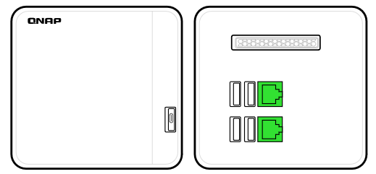
應用情境-NAT mode 可隔離內外網
Scenario: NAT mode to isolate Internet and intranet
Note: All the IP from ADSL are example, depends on your ISP setup.
Internet
pfSense LAN
DHCP server
192.168.1.0/24
pfSense WAN
Get IP from ADSL DHCP
192.168.111.19
Internet
pfSense可以當做DHCP Server，指派IP給LAN端的設備
由於是NAT的關係， pfSense WAN端以外的網路沒有辦法直接連結pfSense LAN端的設備
pfSense WAN
Get IP from ADSL DHCP
192.168.111.19
pfSense LAN
DHCP server
192.168.1.0/24
pfSense can be a DHCP Server, to assign IP for local devices
Because of NAT, devices on the WAN side can’t access the LAN devices directly.
Port1
ADSL modem
DHCP server 192.168.111.0/24
ADSL modem
DHCP server 192.168.111.0/24
DHCP
Port2
Port1
QTS
192.168.1.2S
Port2
DHCP client from pfSense
Note: All the IP from ADSL are example, depending on your ISP setup.
Physical cable connection
192.168.1.3
Virtual network connection
DHCP client from pfSense
Physical cable connection
Note: All the IP from ADSL are example, depends on your ISP setup.
192.168.1.3
Virtual network connection

Slide 15
Scenario: Transparent mode to build up transparent network
Note: All the IP from ADSL are example, depends on your ISP setup.
pfSense LAN
Transparent mode
pfSense WAN
Get IP from ADSL DHCP
192.168.111.19
Internet
pfSense直接讓LAN的設備，與WAN的網路透通，所有LAN端設備都跟WAN取得IP
由於是透通的關係，pfSense WAN端以外的設備只要同一網段，都可以直接連結pfSense LAN端的設備
pfSense can let devices on LAN side get IP from WAN side.
Transparent network lets devices on the pfSense WAN can access devices on the pfSense LAN side directly.
Port1
ADSL modem
DHCP server 192.168.111.0/24
DHCP
Port2
DHCP client from ADSL modem
Note: All the IP from ADSL are example, depending on your ISP setup.
Physical cable connection
192.168.111.21
Virtual network connection
Internet
pfSense WAN
IP from ADSL modem DHCP
192.168.111.19
pfSense LAN
Transparent mode
ADSL modem
DHCP server 192.168.111.0/24
Port1
QTS
192.168.111.20S
Port2
DHCP client from ADSL modem
Physical cable connection
192.168.111.21
Virtual network connection

Slide 16
How to choose between NAT or Transparent modes
When to use NAT mode
Need a DHCP server at home assigning IP
Hide NAS IP from other devices; requires changing usual NAS access behavior
When to use Transparent mode
No DHCP server required; all IPs are assigned by ISP
NAS can be accessed by other devices directly，no needed to change usual NAS access behavior
If you like to put QNAP NAS at home, transparent mode is good choice for you

Slide 17
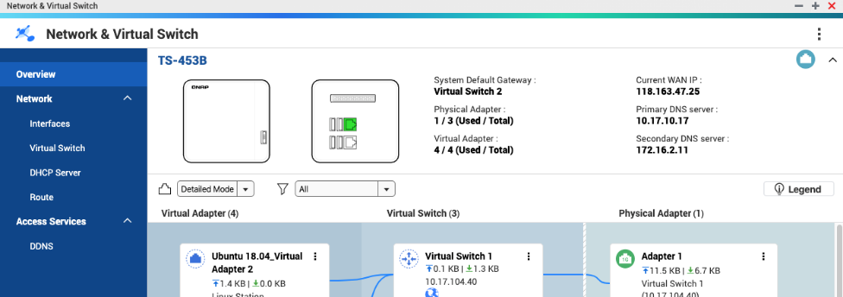
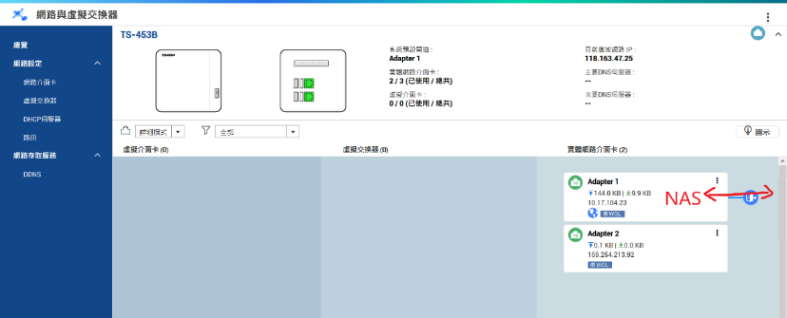
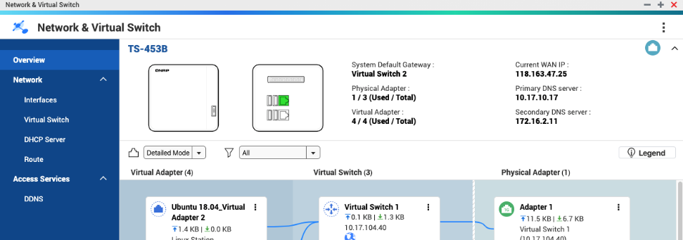
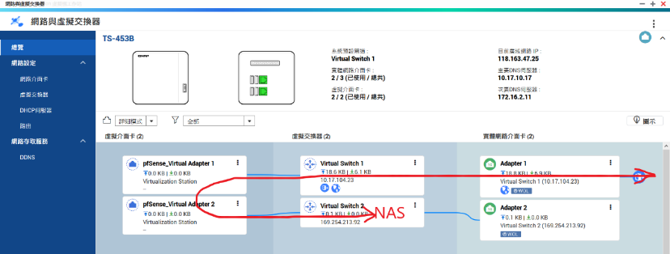
pfSense will not change NAS network behavior under transparent mode
Before install pfSense, NAS access internet and devices behind it through physical network card directly
After install pfSense, NAS access internet and devices behind it through virtual switch, and have pfSense monitor on these interfaces

Slide 18
How to use transparent mode to protect QNAP NAS on both Internet / intranet
Install a pfSense on NAS by using VM
Setup a pfSesne between NAS and networking, NAS can get IP through transparent mode from ADSL modem
Enforcing access control by using the rules on pfSense: allow specific IP access QTS management page by using HTTP
QTS can access internet
Internet
Port1
10.17.104.99
ADSL modem
DHCP server 10.17.0.0/16
10.17.95.21
QTS
10.17.104.56
Port2
Physical cable connection
Virtual network connection
10.17.94.18
Internet
10.17.104.99
ADSL modem
DHCP server 10.17.0.0/16
Port1
QTS
10.17.104.56
Port2
10.17.95.21
Physical cable connection
10.17.94.18

Slide 19
Step by step installing
Before installing pfSense
QTS (NAS) internal network deployed topology – by using TS-251
Step 1: Install pfSense
Config NAS virtual switch
Download pfSense from VM Marketplace on NAS
Install pfSense on NAS
Step 2: networking config. on pfSense
Assign WAN and LAN to pfSense on Virtualization Station
Step 3: configuration changing
Assign gateway for QTS
Setup transparent interface and rule on pfSense
Config firewall rule
Step 4: Verification

Slide 20
QTS(NAS) internal network infrastructure topology by using TS-251
To ADSL modem
To other intranet devices
Port 1
Port 2
Virtual Switch 1
Virtual Switch 2
pfSense WAN
pfSense LAN
QTS default gateway interface
Bridge mode
QTS
QNAP NAS
往ADSL modem
往內網其他設備
Port 1
Port 2
Virtual Switch 1
Virtual Switch 2
pfSense WAN
pfSense LAN
QTS default gateway interface
Bridge mode
pfSense
QTS
QNAP NAS

Slide 21
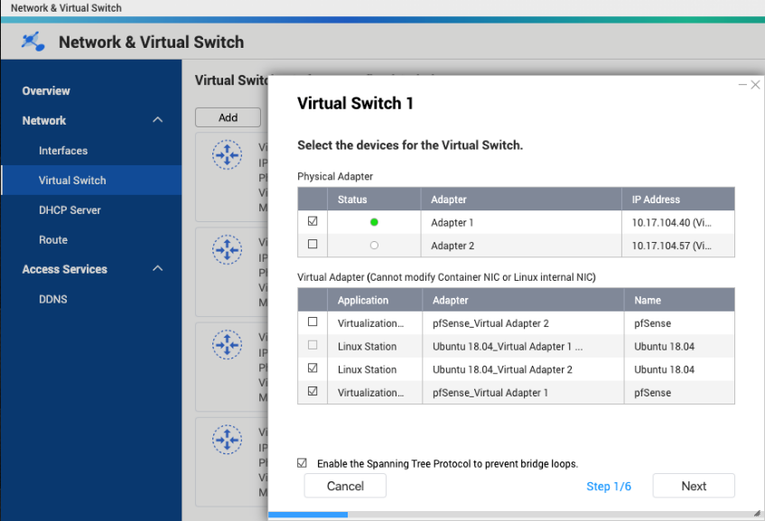
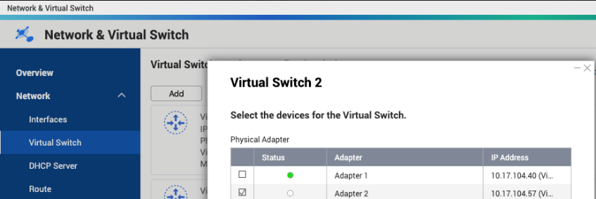
Step 1 : Configure NAS virtual switch
Network & Virtual Switch > Virtual Switch
Configure Virtual Switch 1, binding with Adaptor 1
Configure Virtual Switch 2, binding with Adaptor 2

Slide 22
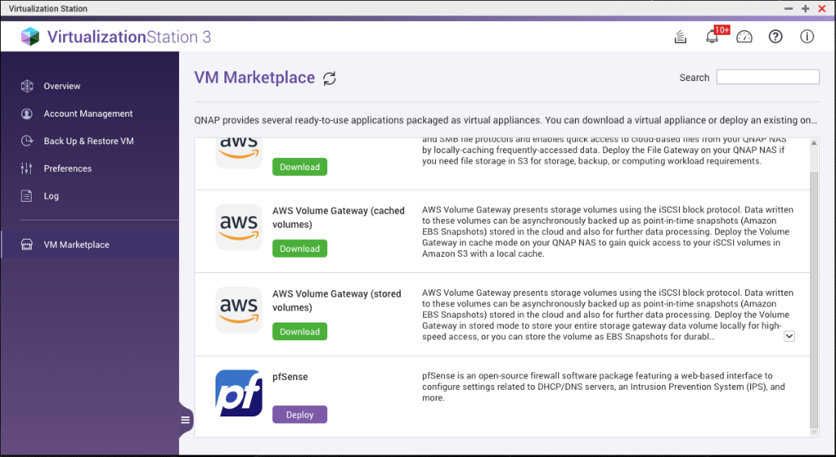
Step 1 : Install pfSense Download pfSense from VM Marketplace on NAS
Virtualization Station > VM Marketplace, download pfSense

Slide 23
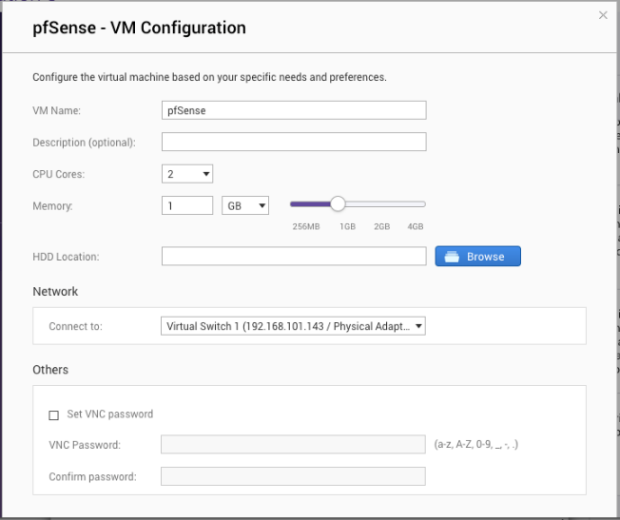
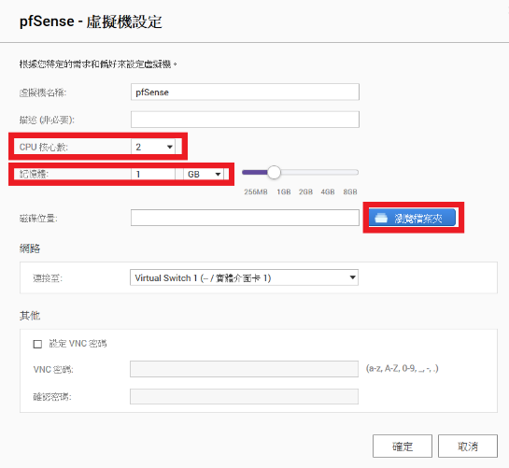
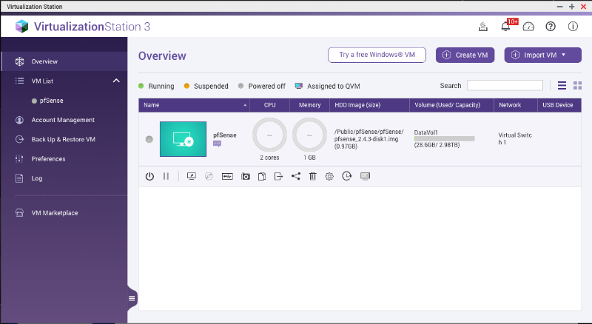
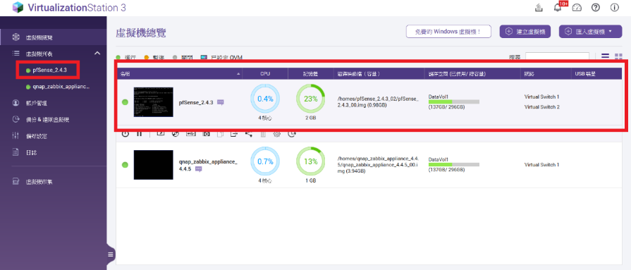
Step 1 : Install pfSense Install pfSense on NAS
Install
Suggest give 2 cores for CPU
Suggest arrange 1GB for memory
Choose folder for install
Will see a pfSense VM at Virtualization Station
Notes:
直接改成預設建議值

Slide 24
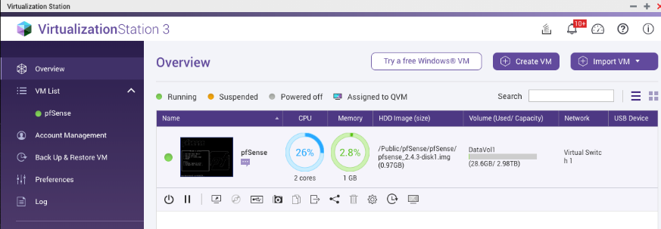
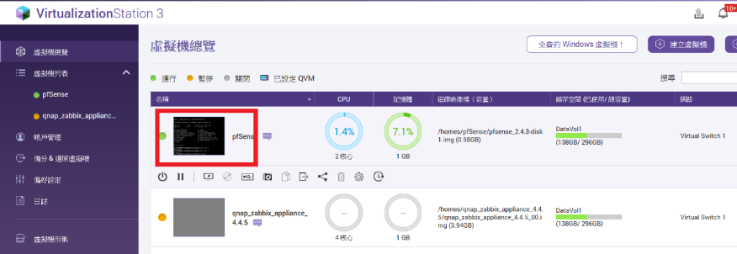
Step 1 : Access pfSense HTTP web management page
At Virtualization Station, click pfSense VM to open terminal page, the IP address on WAN is the IP for pfSense WAN access, can login by using this IP. default login account for pfSense is admin, password is pfsense
Notes:
直接改成預設建議值

Slide 25
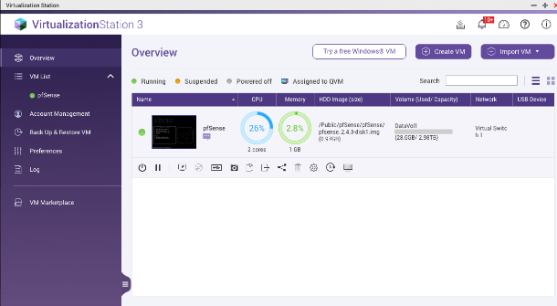
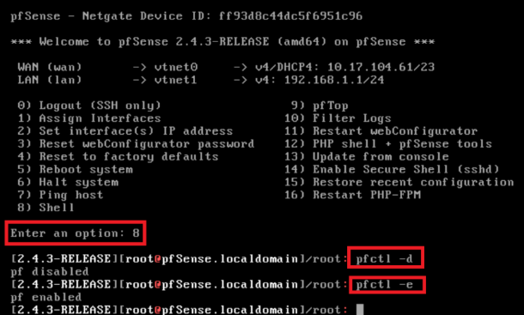
Troubleshooting Administrator deny access management page by pfSense
By default pfSense only allow part of LAN IP accessing management page of pfSense, if administrator access from WAN, or other IP which not in default allow list, it will block admin access after pfSense done the default install
How to disable firewall on pfSense temporarily
At Virtualization Station, click pfSense virtual station to open terminal page
Choose option “8: Shell” in terminal, entering command line
Use pfctl –d to disable firewall, and use pfctl –e enable firewall after finish the configuration
Also can use this command with wrong setup causing lost management, temporary recover the connection make config right
Command can’t disable firewall continually, pfSense will enable it after a period of time

Slide 26
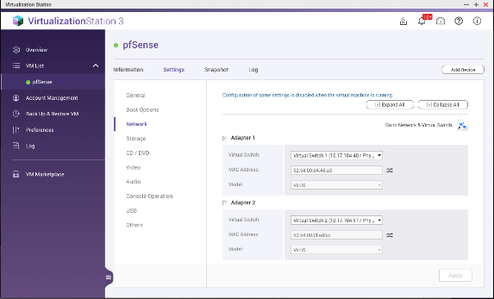
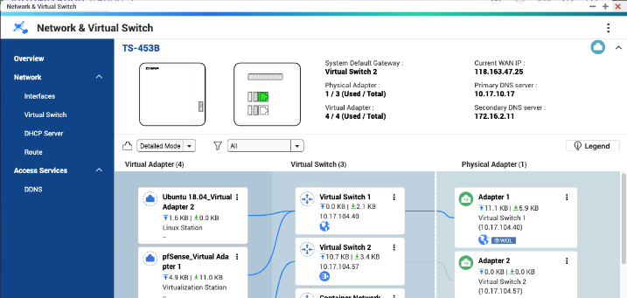
Step 2 : Assign WAN and LAN to pfSense on Virtualization Station
Virtualization Station > VM list, choose pfSense VM
Setting > Network
Assign Adaptor 1(WAN of pfSesne) to virtual switch 1
Assign Adaptor 2(LAN of pfSesne) to virtual switch 2
Network & Virtual Switch > Overview double check deploy of Virtual Switch
WAN
LAN

Slide 27
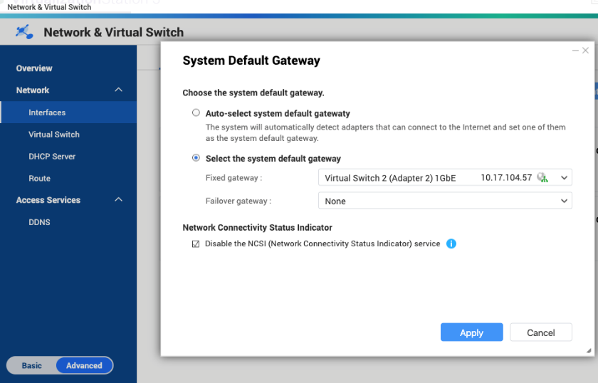
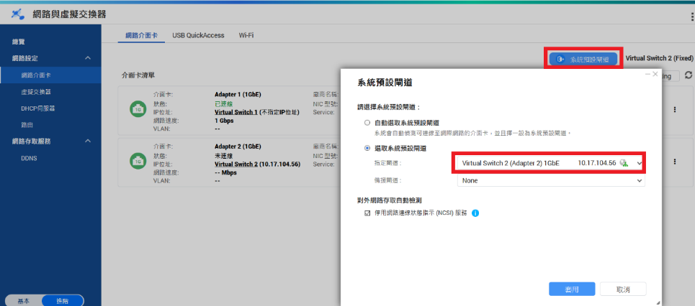
Step 3 : Assign gateway for QTS
Network & Virtual Switch > Interfaces > Interfaces
Click System default gateway，manual assigned virtual switch 2 for QTS gateway
Note: please make sure have coper cable connected on the physical port when setup default gateway.

Slide 28
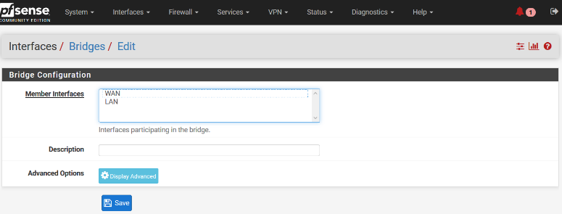
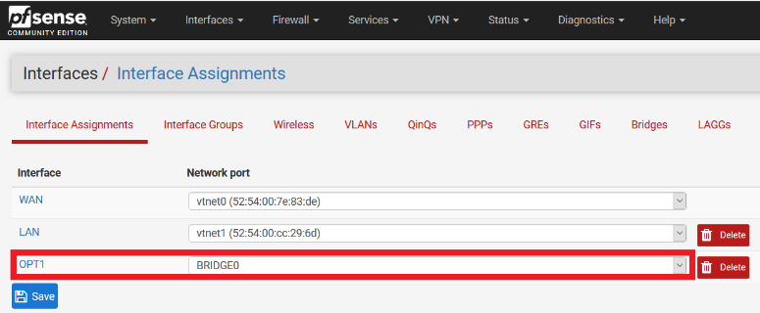
Step 3 : Setup transparent interface and rule on pfSense - 1
pfSense > Interfaces > Bridges
Create a new Bridge interface
Choose WAN and LAN for member
pfSense > Interfaces > Assignment
Add Bridge interface to one of pfSense management interfaces

Slide 29
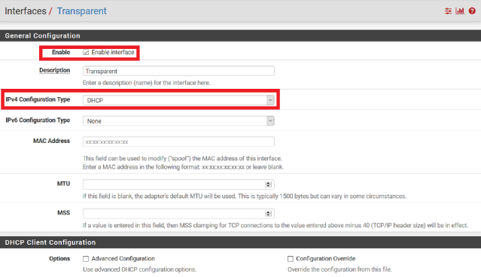
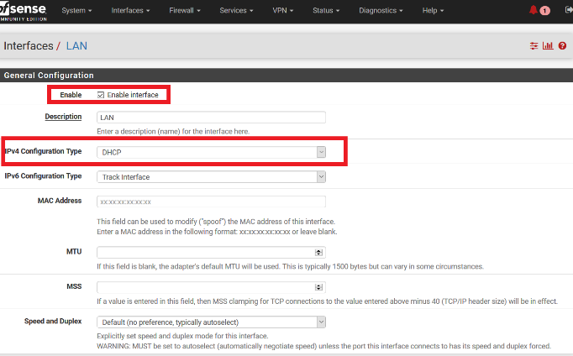
Step 3 : Setup transparent interface and rule on pfSense - 2
pfSense > Interfaces > Bridges interface (description can be defined by yourselves, using transparent for sample)
Enable Bridge interface
IP type set to DHCP client
pfSense > Interfaces > LAN interface
Enable LAN interface
IP type set to DHCP client

Slide 30
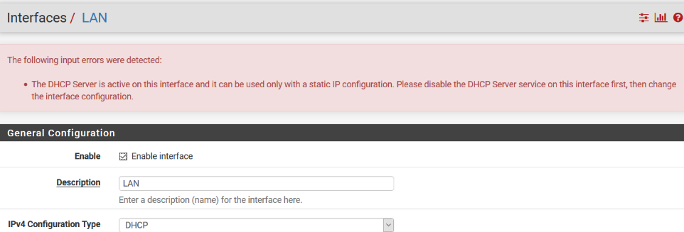
Troubleshooting Can't change interface IP type to DHCP client
Some interfaces on the pfSense, like LAN, will enable DHCP server by default, and causing error when change IP type to DHCP client
How to disable DHCP server on LAN interface
pfSense > Services > DHCP Server > LAN
Uncheck Enable DHCP server on LAN interface
Press Save

Slide 31
Step 3 : Setup transparent interface and rule on pfSense - disable NAT
pfSense > Firewall > NAT > Outbound
Check Disable Outbound NAT rule generation. (No Outbound NAT rules)
pfSense > System > Advanced > System Tunables
Setup net.link.bridge.pfil_bridge to 1
Setup net.link.bridge.pfil_member to 0

Slide 32
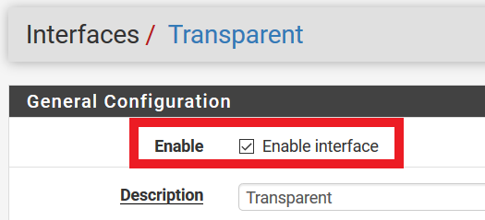
Troubleshooting Bridge interface can't get IP even it is enabled, nor any virtual switch interfaces on NAS
Due to setup of firewall on pfSense is deny all, causing bridge interface on the pfSense, and virtual switch interfaces on the NAS, can’t get DHCP IP
Have to setup DHCP UDP port to allow to get IP
pfSense > Firewall > Rules > Interface name (using transparent for example)
Create a rule with Protocol: UDP, Source IP: Any, Destination: Any, Destination port 67(DHCP), let DHCP pass through
If the bridge interface on the pfSense still fail to get IP， pfSense > Interface name (using transparent for example), disable and enable interface manually, forcing get IP again

Slide 33
Step 3 : Config firewall rule
pfSense > Firewall > Rules > Interface name (using transparent for example)
Create below rules for pass
Protocol: TCP，Source IP: 10.17.94.18， Destination IP: 10.17.104.56
Protocol: TCP，Source IP: 10.17.104.56 ， Destination IP: Any
Protocol: UDP， Source IP: 10.17.104.56， Destination: Any， Destination port 67(DHCP)
Protocol: UDP， Source IP: 10.17.104.56， Destination: Any， Destination port 53(DNS)
pfSense has a rule deny all by default, no needed to create it again manually

Slide 34
Step 4 : Verification
Change default HTTP port for management page to 10001
Verification
Use 10.17.95.21 access to NAS IP 10.17.104.56
Use 10.17.94.18 access to NAS IP 10.17.104.56
Check pfSense > Status > System Logs > Firewall > Normal view
10.17.95.21 block by default rule(Deny all)
10.17.94.18 allow for accessing by rule manual generated

Slide 35
Result
Through the verification we did, it can prove NAS can be protected by setting up pfSense firewall rules
ALLOW OR DENY SPECIFIC IP AND SERVICES
ALLOW OR DENY SPECIFIC IP BY COUNTRY
DENY PORT SCAN

Slide 36
Demo
4
DEMO

Slide 37
5
SUGGESTED MODELS FOR INSTALLING PFSENSE

Slide 38
完美搭配QNAP NAS
Seamlessly integrated with QNAP NAS
x51 / x53 Series
x72 / x73 / x77 Series
x83 / x85 / X86
/ 89 Series
Easy deployment
low bandwidth required
• • •
High performance
high bandwidth required

Slide 39
IS YOUR BEST CHOICE!

