Slide 2
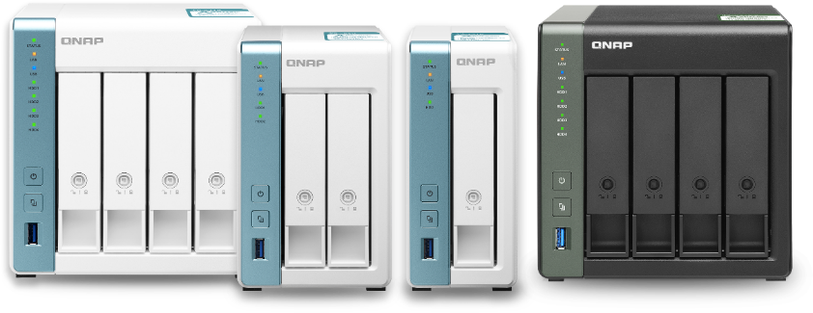
Sharing data and entertainment all form home
New quad-core processor and gigabit network ports for multitasking
Stream content without barriers, connect to data even when on the move
Easily back up data and share it securely to avoid data loss and hackers
Deploy 10GbE in offices quickly
TS-431K
TS-431KX
TS-231K
TS-131K

Slide 3
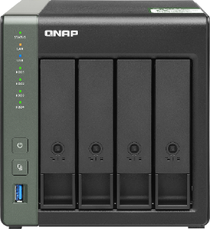
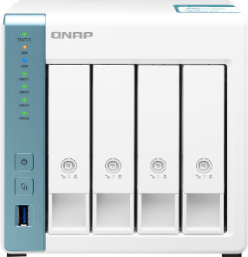
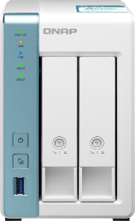
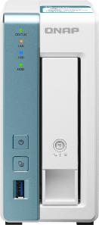




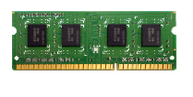
All models with a quad core 1.7GHz CPU
TS-431KX-2G
TS-431K
TS-231K
TS-131K
2 GB RAM (1 x 2 GB), expandable!
1 x SODIMM DDR3L memory slot
1 GB RAM
1 GB RAM
1 GB RAM
Ordering information:
2GB: RAM-2GDR3T0-SO-1600
4GB: RAM-4GDR3-SO-1600
8GB: RAM-8GDR3-SO-1600

Slide 4
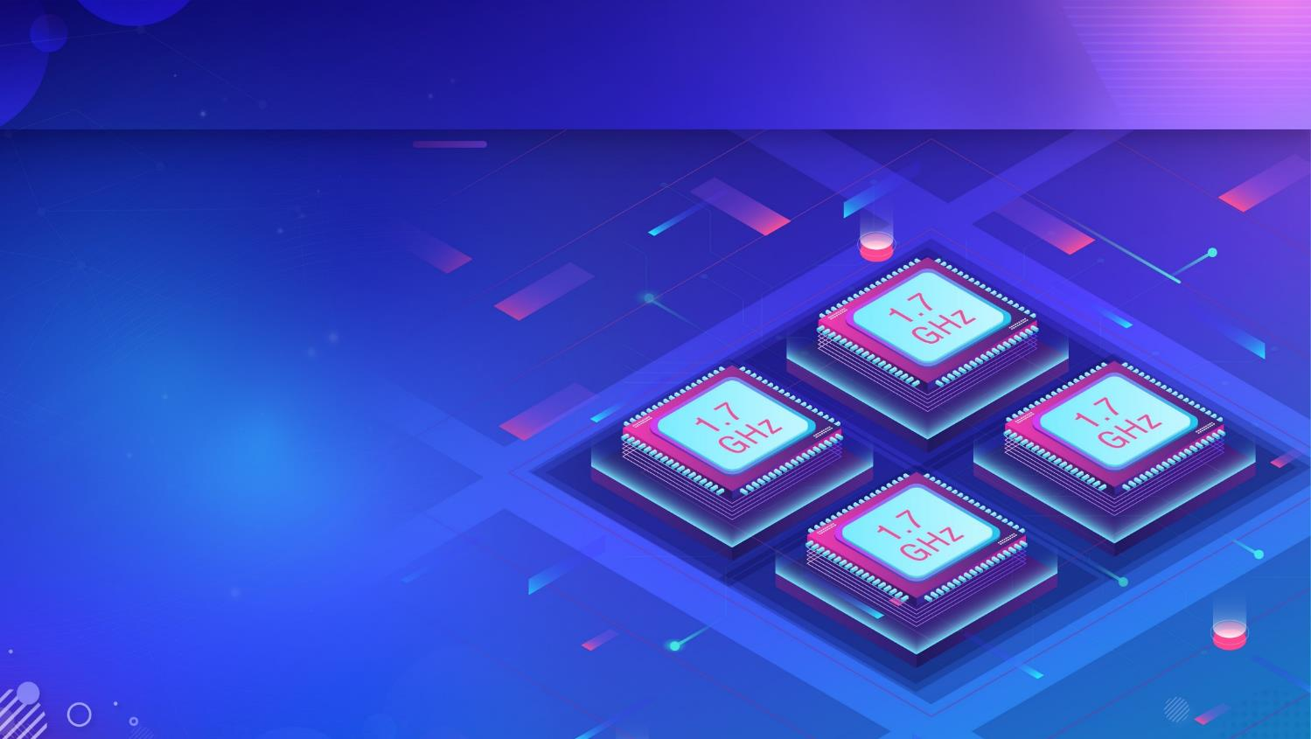


Performance you can count on
4-core 1.7GHz
Alpine AL-214 ARM v7 processor
Native 4 x SATA 6 Gb/s ports for the optimal throughput
Built-in AES 256-bit encryption engine for security and performance
ARM NEON v2 floating point acceleration engine
2MB L2 cache, twice more than the competition!

Slide 5
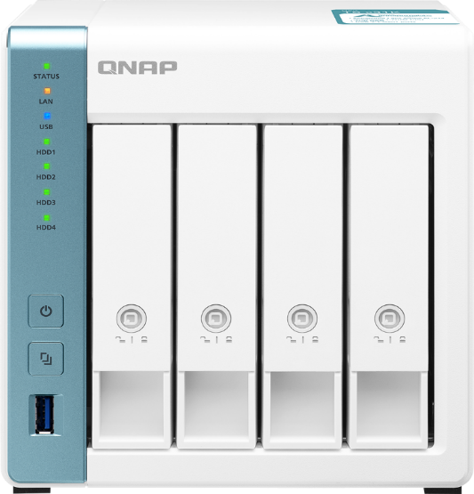
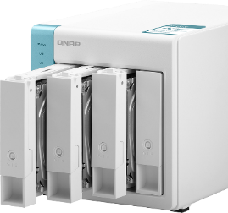
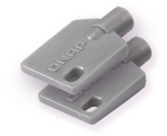



TS-131K, TS-231K, TS-431K front view
4x 3.5-inch/2.5-inch SATA 6Gb/s HDD bays
LEDs:
Status, LAN, USB
Drive LEDs:
HDD 1, HDD 2,
HDD 3, HDD 4
Power
Lockable drive trays with 2 keys provided
Copy
USB 3.2 Gen 1 port

Slide 6
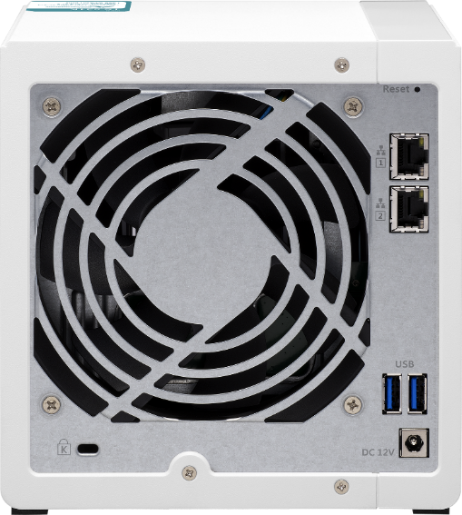


TS-131K, TS-231K, TS-431K rear views
Reset
2 x GbE RJ45 LAN ports
(TS-131K: 1 x GbE RJ45 LAN port)
Smart fan
TS-431K: 1 x 120mm
TS-231K: 1 x 70mm
TS-131K: 1 x 50mm
2 x USB 3.2 Gen 1 (5Gbps)
Kensington security slot
DC 12V power input

Slide 7

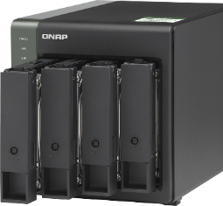
TS-431KX front view
4x 3.5-inch/2.5-inch SATA 6Gb/s HDD bays
LEDs:
Status, LAN, USB
Drive LEDs:
HDD 1, HDD 2,
HDD 3, HDD 4
Power
Lockable drive trays with 2 keys provided
Copy
1 x USB 3.2 Gen 1 port (5 Gbps)

Slide 8
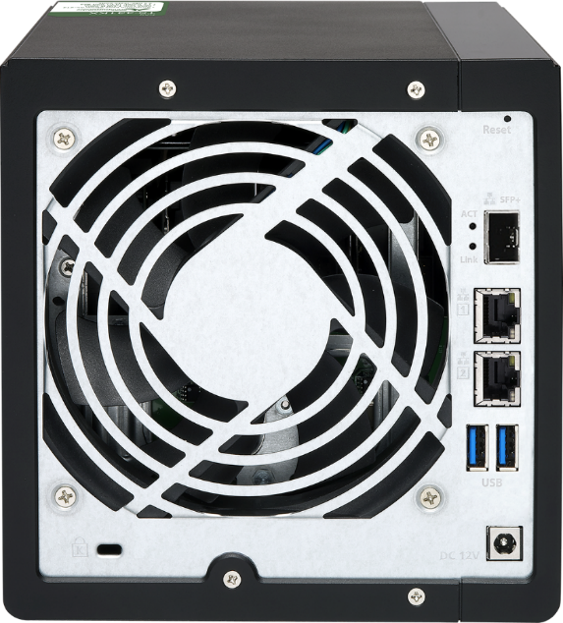
TS-431KX rear view
Reset
1 x 10GbE SFP+ LAN port
1 x 120mm smart fan
2 x GbE RJ45 LAN ports
2 x USB 3.2 Gen 1 ports
(5Gbps)
Kensington security slot
DC 12V power input

Slide 9
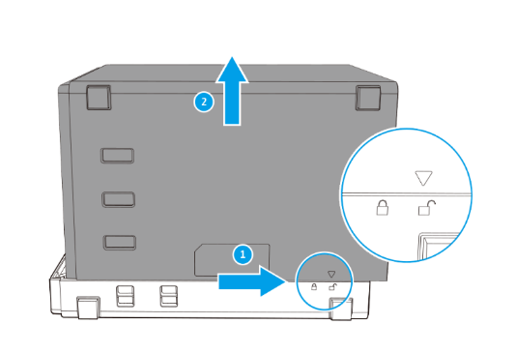

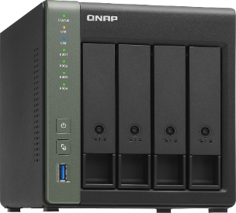

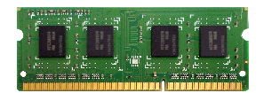


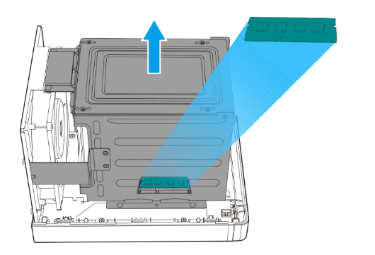
Upgrade TS-431KX memory up to 8GB
1. Remove side cover
1 x DDR3L SO-DIMM RAM slot
Up to 8 GB memory support
2. Remove HDD bracket
Ordering information:
2GB: RAM-2GDR3T0-SO-1600
4GB: RAM-4GDR3-SO-1600
8GB: RAM-8GDR3-SO-1600

Slide 10
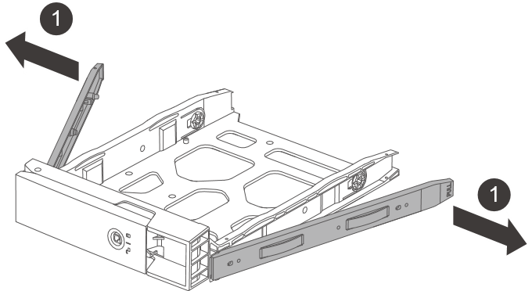
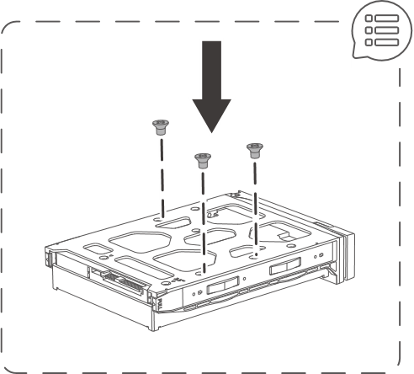
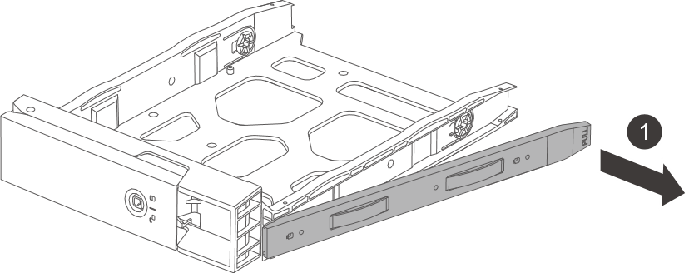
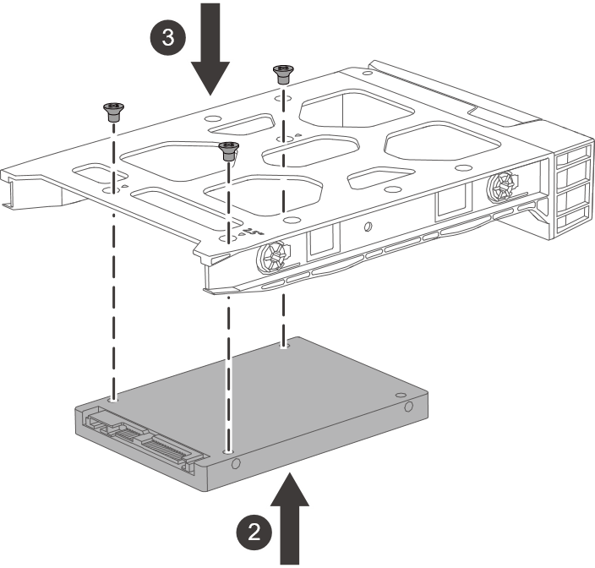
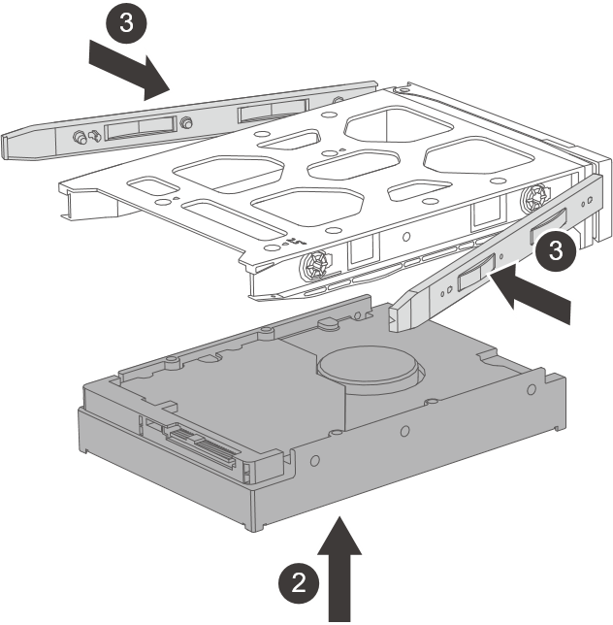
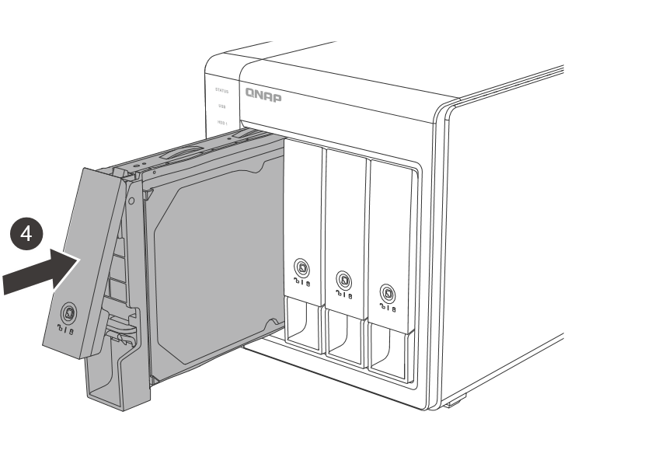
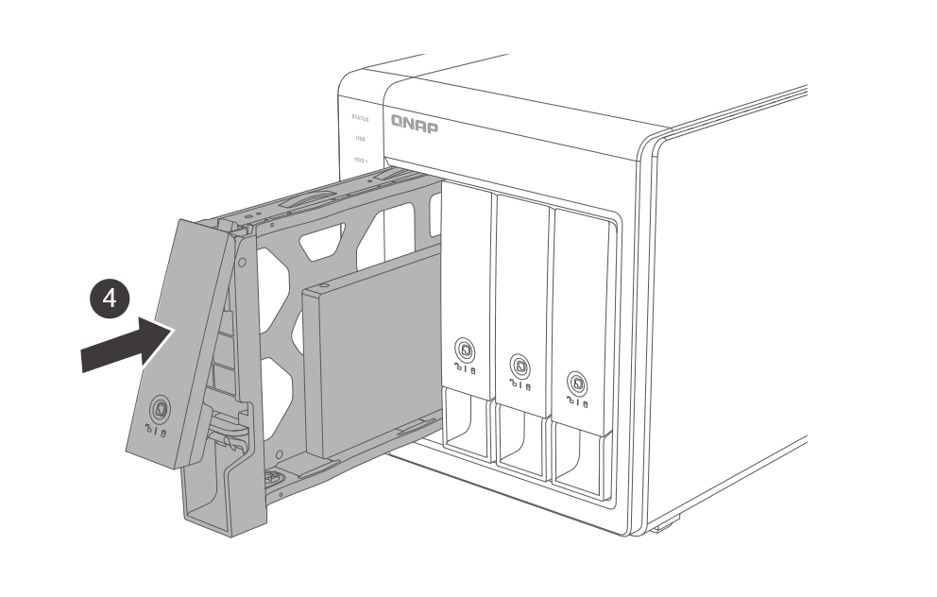
Easy to install HDDs and SSDs
3.5-inch HDD：toolless
2.5-inch HDD/SSD: screws

Slide 11
Stream content without barriers, connect to data even when on the move

Slide 12

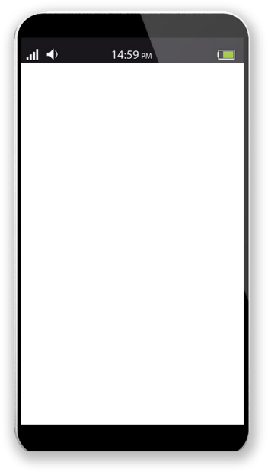










How to manage tons of photos and videos at home?
Take pretty pictures~
Can I do it at home?
How to share content with family/friends without going out?
Any tool to efficiently manage them?

Slide 13

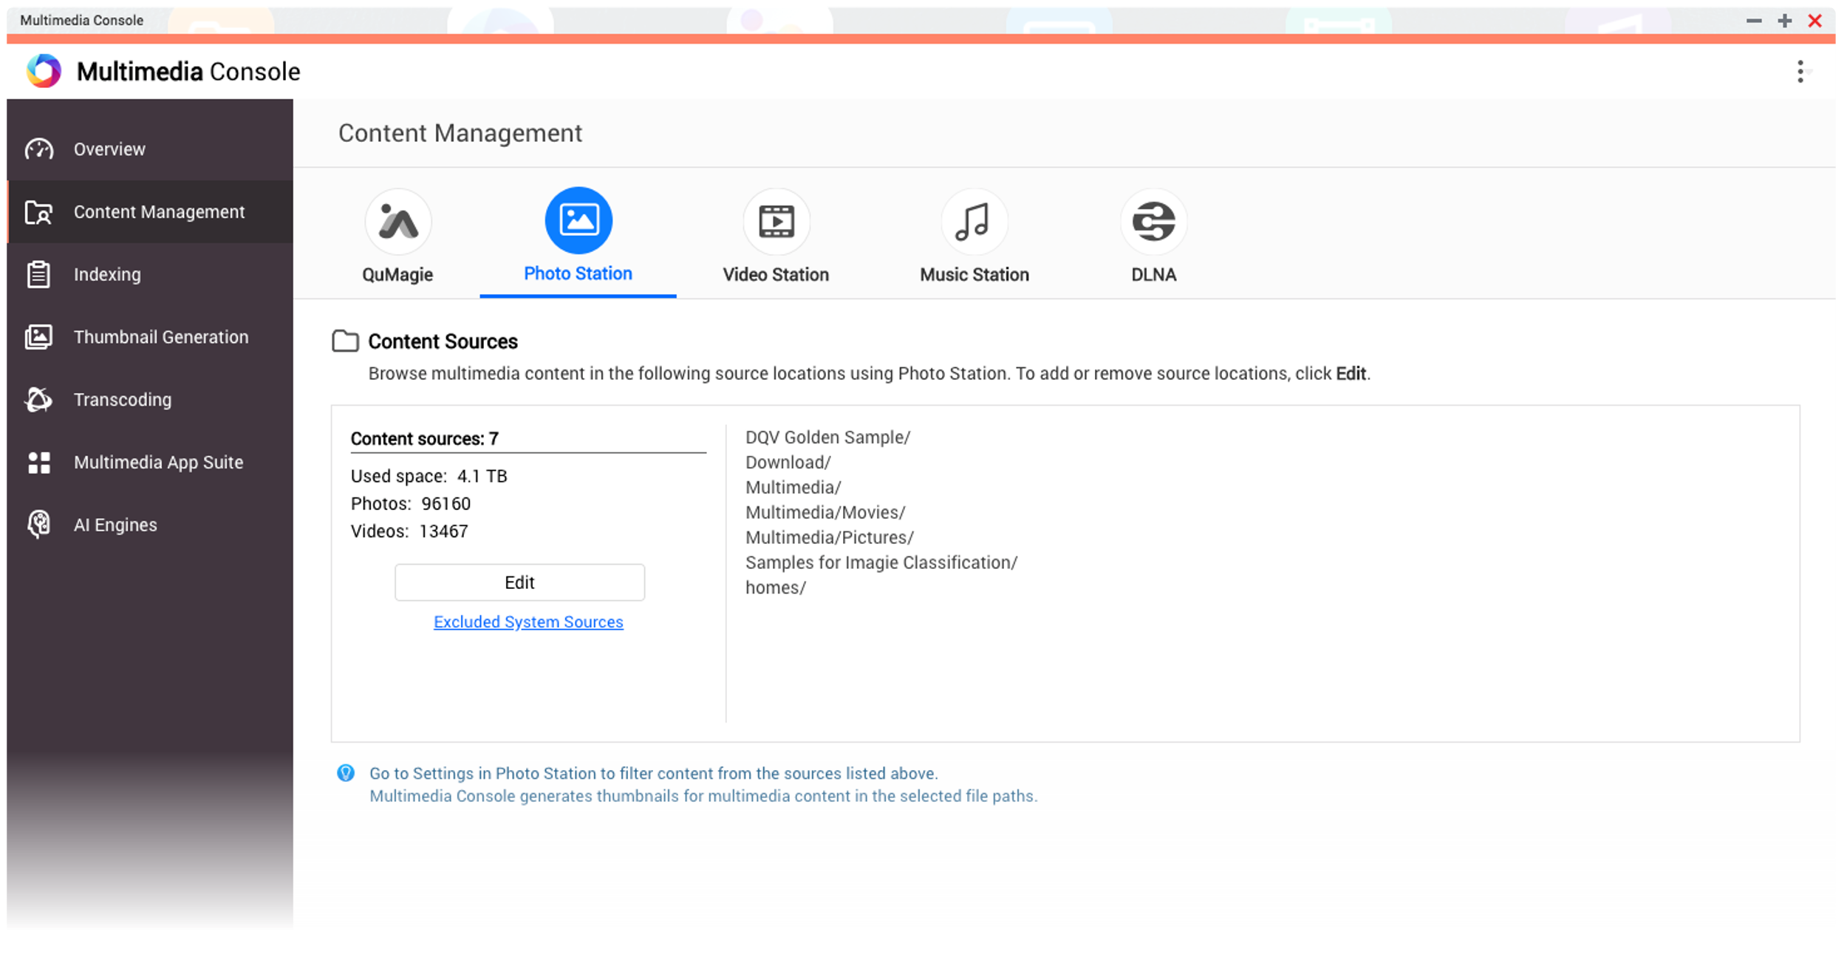
Set content sources for all multimedia applications
Go to Content management in Multimedia Console
Assign folders as content sources for each application

Slide 14
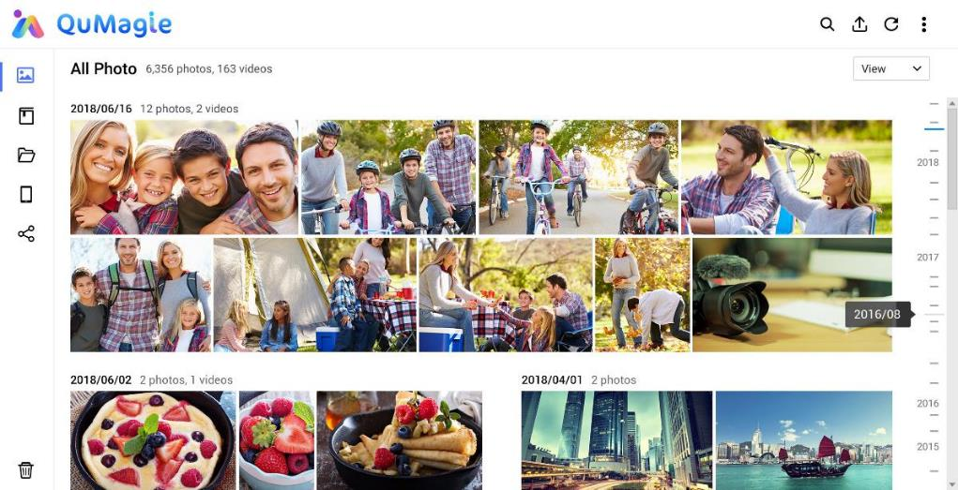
QuMagie photo management
Album View
Folder View
Albums and Smart Albums

Slide 15
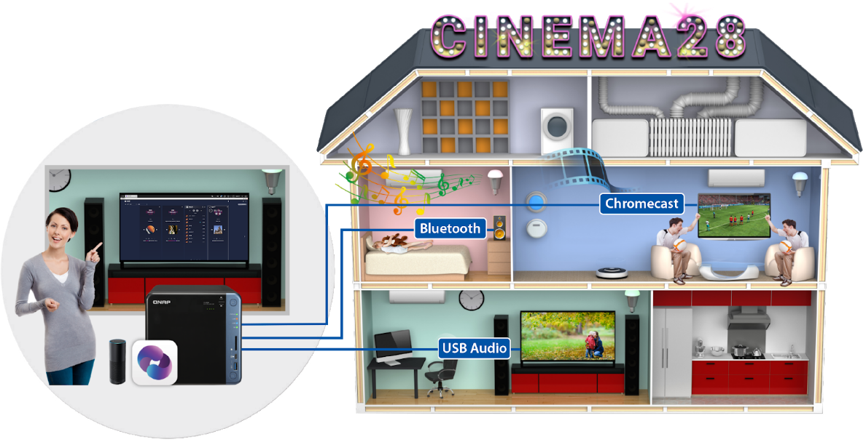

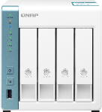


Use Cinema28 for whole-home streaming
Integrate multiple streaming devices and streaming protocols into a single interface for centralized management, allowing users to easily stream digital multimedia files to audio/video devices in every corner of the house.

Slide 16


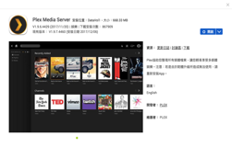
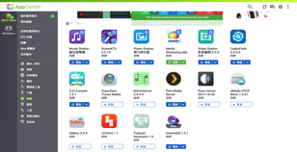



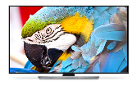





PLEX Server for home media streaming
Internet
LAN/WAN streaming
Smart TV
Computer
Phone
Tablet

Slide 17

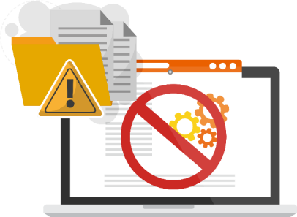

Don't get kidnapped by the so-called free hosting sites
Ads everywhere, bad experience for visitors
Spend lots of time to locate media files
Closure of free sites and forgot to or difficult to back up the content

Slide 18


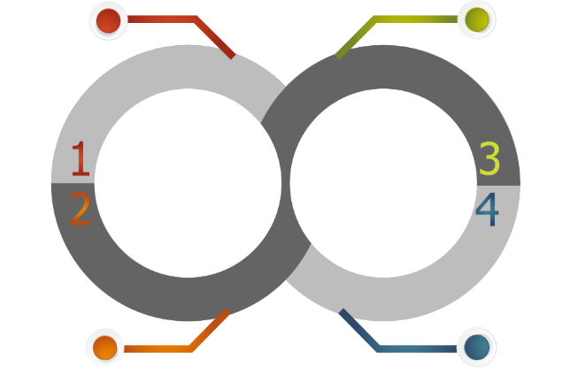



Build your site with the free WordPress
1. Enable SQL server
2. Install phpMyAdmin and create a database
3. Install WordPress from NAS App Center
QNAP file management utilities
Improve content publishing
efficiency
Free personal domain for quickly enabling SSL certificates
From setup to backup, QNAP NAS has it all
Host multiple websites on QNAP NAS with Virtual Hosting
Notes:
網路上有 35% 的網站皆選用 WordPress 服務。

Slide 19

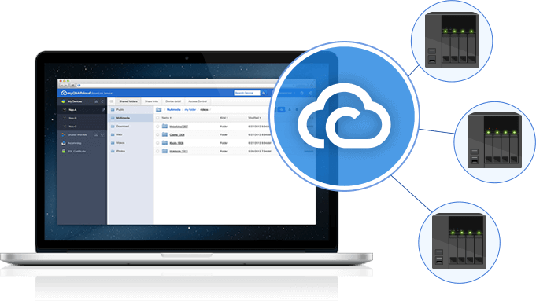
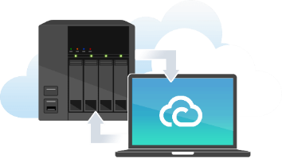


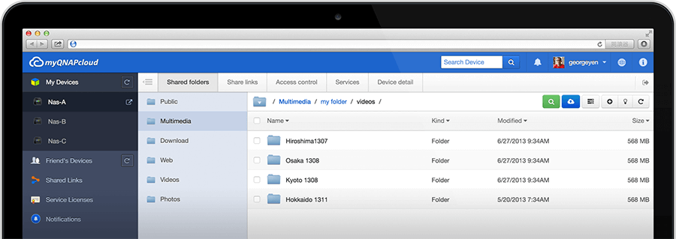
Connect to home NAS with myQNAPcloud and QNAP ID (QID)
Anytime / Anywhere
Register and login with Email or phone number

Slide 20
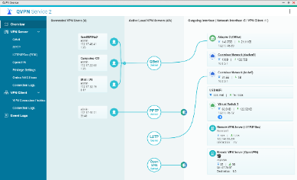



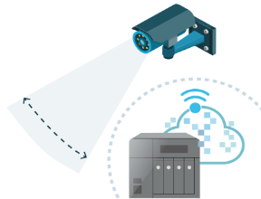



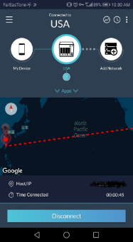
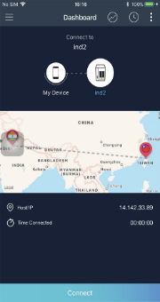
QNAP QVPN and QBelt protocol for anywhere access
Secure Encrypted Connection:
DTLS + SSL + AES-256 encryption
New QBelt protocol:
Works on desktop and mobile devices
Windows, macOS, Android, iOS
Decreases the chance of being detected

Slide 21
Easily back up data and share it securely to avoid data loss and hackers

Slide 22

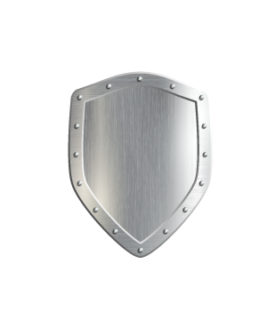
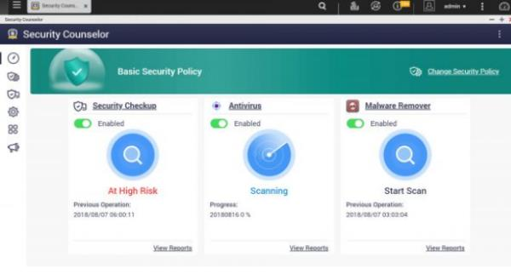


Not just Antivirus, QTS Security Circle！
Beside installing Antivirus to protect the uploaded files, QTS NAS also needs a full circle of protection, such as OS integrity and safe NAS set-up.
QTS
4.4.2
Security Counselor
Free anti-virus
Malware Remover

Slide 23
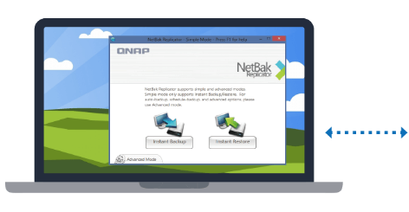

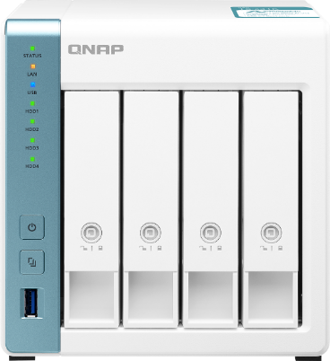
Fight against virus and ransomware
macOS
Time
Machine
Real-time or scheduled data backup
Windows
NetBak
Replicator
TS-431K

Slide 24

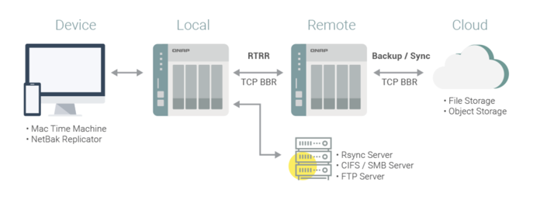


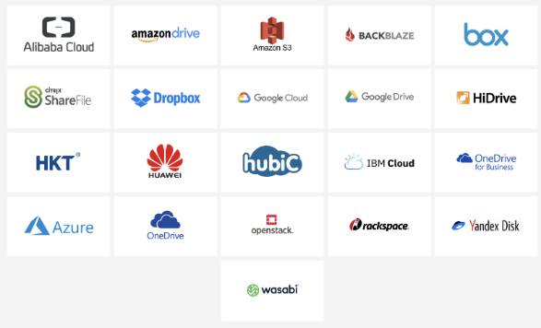

HBS 3 for backup and recovery
Use HBS 3 (Hybrid Backup Sync 3) to easily transfer your data to local, remote and cloud storage spaces as a comprehensive data storage and disaster recovery plan.
Notes:
Carry and use 在不同地點

Slide 25


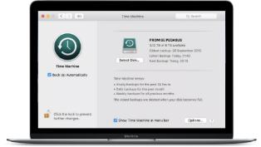
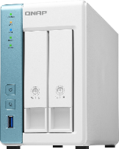

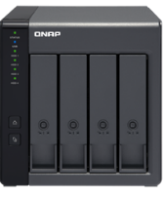



Free Mac Time Machine backup
Mac Time Machine
TS-231K
TR-004
Create the backup job:
1
2
3
Select Time Machine Backup as Source
Select TR-004 as Destination
Setup the backup schedule in HBS 3

Slide 26







QNAP snapshot for file recovery
1. Fully supports all storage configurations at the storage pool level.
2. Easily take, manage and restore snapshots.
3. Using the mature Ext4 file system for "out of volume" snapshots
RAM Size | NAS Models | Maximum Total Snapshot Number | Maximum Snapshot Number per Volume/LUN
1GB | TS-131K, TS-231K, TS-431K | 32 | 16
2GB | TS-431KX | 64 | 32
4GB and more | TS-431KX | 256 | 64
File level
Removeable drives
Block level
A’
B’
C’
D’
E’
Local drives
Cloud / NAS
A
B
C
D
E

Slide 27







Connect to Dropbox, One Drive,
Google Drive and more
Qfile
File Station
Mobile
Computer
Local NAS
Remote NAS
Cloud Storage

Slide 28









24x7 surveillance for home care and anti-theft
Recording Channels
Surveillance Station 5.1
TS-131K/231K/431K/431KX
Free: 2 Max: 16
Vmobile

Slide 29













QNAP mobiles apps for data on the go
File & System
Multimedia
Productivity
Qfile
File management
Qphoto
Photo library
DJ2 Client
Live streaming
QmailClient
E-mail backup
Qsync
File backup
QuMagie
Photo library
Photo Tagger
Classification tool
Qcontactz
Contacts backup
Qmanager
NAS management
Qvideo
Video library
Qget (Android only)
Download management
Qnotes3
Notes taker
Qmusic
Music library
Vmobile
Mobile surveillance

Slide 30








QNAP TR USB RAID & TL USB JBOD support 2 modes on NAS
NAS supports maximum two QNAP TR-002/TR-004 RAID enclosures or one TL-D800C USB JBOD enclosure (Compatibility list).
Internal mode with storage pool support or external mode with cross-platform compatibility with Windows/Mac computers.
Mode 1: Expanding the NAS with new volume
Mode 2: Work as backup destination for snapshot replica
8-bay TL-D800C
4-bay TR-004
2-bay TR-002
TS-231K
8-bay TL-D800C
4-bay TR-004
2-bay TR-002

Slide 31
Deploy 10GbE in offices quickly
Taking ages to transfer many work files if using just 1GbE LAN.

Slide 32



TS-431KX integrates 10GbE SFP+ port
High-speed throughput for large data backup and recovery, multi-user environment, or containerized applications.
QSW-308S

Slide 33






Affordable QNAP unmanaged 10GbE switches
QSW-308-1C
QSW-308S
QSW-1208-8C
QSW-804-4C
Ports:
10GbE SFP+/ RJ-45 Combo * 1
10GbE SFP+ * 2
1GbE RJ45 * 8
Ports:
10GbE SFP+ * 3
1GbE RJ45 * 8
Ports:
10GbE SFP+/ RJ-45 Combo * 8
10GbE SFP+ * 4
Ports:
10GbE SFP+/ RJ-45 Combo * 4
10GbE SFP+ * 4

Slide 34



Short distance SFP+ DAC cables
1.5M SFP+ 10GbE
DAC cable
3.0M SFP+ 10GbE
DAC cable
5.0M SFP+ 10GbE
DAC cable
Part number:
CAB-DAC15M-SFPP-DEC02
Part number:
CAB-DAC30M-SFPP-DEC02
Part number:
CAB-DAC50M-SFPP-DEC02

Slide 35


TS-431KX 10GbE performance
1200
1000
1050
800
600
400
454
388
200
258
0
(MB/s)
Read
Write
Read
Write
Windows sequential transfer (1x 10GbE)
Windows sequential transfer, encrypted volume (1x 10GbE)
Tested in QNAP Labs. Figures may vary by environment.
Test environment
NAS: TS-431KX
OS: QTS 4.4.2
Volume：RAID 5; 4 x Samsung 850 Pro 512GB SSD
Client PC：
Intel Core i7-6700 3.4 GHz; 64GB RAM; LAN-10G2SF-MLX; Microsoft Windows 10 64bit

Slide 36











Use USB to 5GbE/2.5GbE to enhance the performance of PC/NAS
5GbE
Cat 5e
QXG-10G1T
or QNA-UC5G1T
QNAP
QNA-UC5G1T:
USB 3.2 Gen1 to
5GbE/2.5GbE/1GbE
adapter
QNAP 10G 4C switch
5GbE
Cat 5e
Existing wiring
300
TS-231K
Tested in QNAP Labs. Figures may vary by environment.
Test environment
NAS: TS-231K,
QTS 4.4.2, RAID 1: thick volume
2 x 512GB Samsung 850 Pro
Client PC：
Intel Core i7-6700 3.4 GHz; 64GB RAM; Intel X550 網卡; Microsoft Windows 10 64bit
200
260
255
100
0
Exisiting wiring
(MB/s)
Download
Upload
Windows file transfer
QNA-UC5G1T + TS-231K RAID 1

Slide 37
Live Demo
Upgrade TS-431KX memory
TS-431KX 10GbE performance test

Slide 38







All the goodies for homes and offices
2 years of standard warranty with optional 3-year extended warranty for a total of 5 years.
NAS model | TS-431KX | TS-431K/231K/131K | Other vendor DS420j
Processor | Quad-core 1.7 GHz | Quad-core 1.7 GHz | Quad-core 1.4 GHz
Memory | 2GB, max 8GB ( 1 x SODIMM DDR3L RAM slot ) | 1GB, not upgradeable | 1GB, not upgradeable
10GbE LAN | 1 x 10GbE SFP+ | --- | ---
GbE LAN | 2 | 2 (TS-131K: 1) | 1
Performance (MB/s) | 1,050 / 454 | 221 / 195 | 112 / 112
USB 3.0 / 2.0 | 3 / 0 | 3 / 0 | 2 / 0
Hot-swap HDD | Yes | Yes | ---
TS-431KX
TS-431K/231K/131K
Ordering information
EXTW-GREEN-3Y

Slide 39

TS-431KX
TS-x31K
series
for Home and Offices
Copyright© 2020 QNAP Systems, Inc. All rights reserved. QNAP® and other names of QNAP Products are proprietary marks or registered trademarks of QNAP Systems, Inc. Other products and company names mentioned herein are trademarks of their respective holders.​​​

