Slide 2
Agenda
◆ Overture
The problems of network infrastructure for small businesses
Potential issues of current solution
True demands of small businesses
◆ Major Theme
QSW-M408 Series for the true demands of SMBs
Hardware features and benefits
Software features and benefits
◆ Concerto
QSW-M408 series collaborates with other QNAP products

Slide 3
Overture: Look into the problems

Slide 4
The problems of network infrastructure for small businesses
◆ Small Business: Staff < 50 people (Small Businesses, SBs)
◆ Slow LAN speed
- It is particularly a headache on sharing large files or making system backup.
◆ Limited budget
- SBs want to upgrade their network infrastructure but there is no suitable product at affordable price for them to choose.
◆ No dedicated IT Engineer
- The IT helper might have limited time and professional background to configure a managed Ethernet switch properly.

Slide 5
Barely acceptable solutions…
◆ Constrained by budget and lack of dedicated IT engineers, SBs would try to solve the problem by
1. Avoiding upgrade network and waiting until something goes down.
2. Upgrading network with 1GbE instead of 10GbE Ethernet switch.
3. Choosing unmanaged instead of managed Ethernet switch.
4. Assigning non-dedicated helper to configure managed Ethernet switches.
Notes:
逃避並不可恥，但每天都得面對網路好慢、不穩… 真的好崩潰
市面上的 10GbE 機種往往是全 10GbE，作為大型網路末端聚合的一部份，那樣的埠配置對小型企業而言太昂貴且不實用。此外，網路速度快慢是相對的，1GbE 拿來分享多媒體簡報、包裝設計圖檔、影音教學或是系統定期備份還是不夠
非網管機種無法切割 VLAN、不支援 RSTP, LAG, ACL 等重要功能，不能有效管理網路、保障資安
「兼著做」或「幫忙做」的員工通常有其正職工作，沒有足夠時間研究網管型產品的功能、用法，因此該網管設備可能會因設定複雜，而不被確實利用

Slide 6
SB’s true demands for Ethernet switch
◆ Upgrade speed
◆ Affordable price
Upgraded infrastructure, reinforce the strengths of SBs.
Right spec., price and high value.
Solid reliability
◆ Simple to set up
◆ Must-have management
Even non-dedicated IT helper can handle it effortlessly.
Improve the efficiency, safety and expandability.

Slide 7
SB’s true demands by application – Basic
Marketing
Internet
1G * 4
Server
10G * 3
1G
1G * 3
NAS

Slide 8
SB’s true demands by application – Expanded
Marketing
1G * 6
1G * 2
10G
Server
Internet
10G * 2
10G * 2
1G
NAS
1G * 6

Slide 9
SB’s true demands by application – Studio
Multi-media Designer
Internet
Multi-media Designer
1G * 6
TBT * 2
1G
1G
10G * 3
NAS
Sound Editor
3D Drafter

Slide 10
Major Theme: solution to the Problems

Slide 11
QSW-M408 Series – Based on the true demands of Small businesses
◆ Transform your 1GbE network to 10GbE (5-speed) with affordable cost
◆ 10GbE * 4 for the most needed connections and you can feel the difference, worth every penny.
◆ Optimized thermal design, quality components, solid reliability.
◆ Managed to improve the efficiency, safety and expendability significantly.
◆ Simple U/I, guiding in plain words, effortless management.
10Gbps Ethernet
Time consumption of transferring 50GB Blu-ray Disc
1Gbps Ethernet
1GbE
8mins20secs
100Mbps Ethernet
100 MB/s
10GbE
50secs
10Mbps Ethernet
1000 MB/s
* 10 Gigabit Ethernet abbreviation: 10GE、10GbE、10 GigE or 10GE

Slide 12
Pragmatic port configuration, suitable for SB’s basic and expanded applications
Hardware features and benefits
QSW-M408-4C
Backplane
96 Gbps
4 * 10G SFP+/ NBASE-T Combo
8 * 10/100/1000T
QSW-M408-2C
2 * 10G SFP+/ NBASE-T Combo
2 * 10G SFP+
8 * 10/100/1000T
QSW-M408S
4 * 10G SFP+
8 * 10/100/1000T

Slide 13
10G NBASE-T downward compatible
Hardware features and benefits
10G
5G
2.5G
1G
100M

Slide 14
10G NBASE-T downward compatible
Hardware features and benefits
Upgrade the network based on original cabling
Re-cabling is not required, enjoy > 1Gbps with the original Cat5e cabling.
 | CAT 5e | CAT 6 | CAT 6A & CAT 7
100M | V | V | V
1G | V | V | V
2.5G | V | V | V
5G | V | V | V
10G | X | V(55m) | V

Slide 15
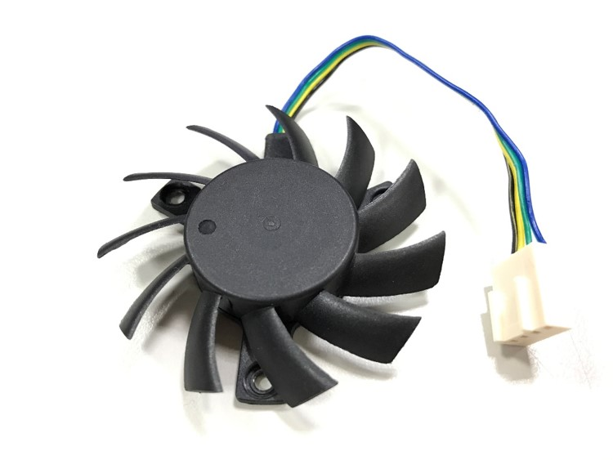
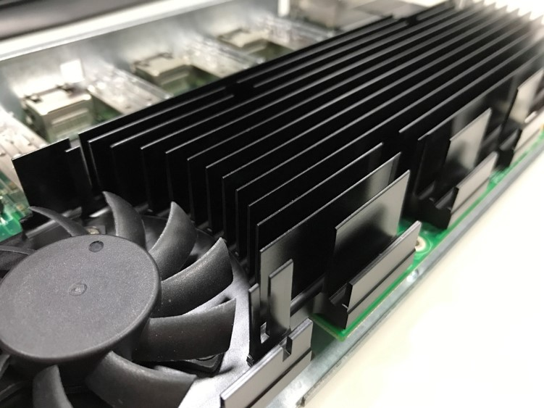
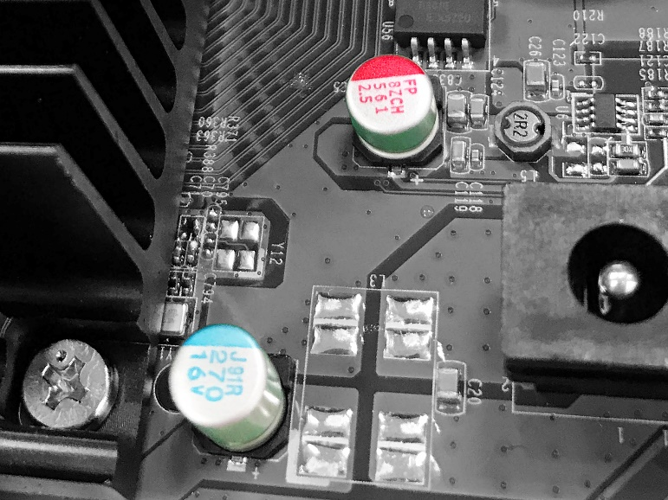
optimized thermal design & quality components
Hardware features and benefits
PWM double ball bearing fan
Large conductive and directive heatsink
All solid capacitors
Notes:
智慧型調速，平衡系統溫度、能耗與噪音值。雙滾珠軸承確保長時使用壽命。
急速導出所有元件的熱，促進引流使風扇發揮最大功效！
壽命長、穩定度高、運作溫度範圍廣。杜絕液態電容電解液揮發、泄漏、易燃等風險。

Slide 16
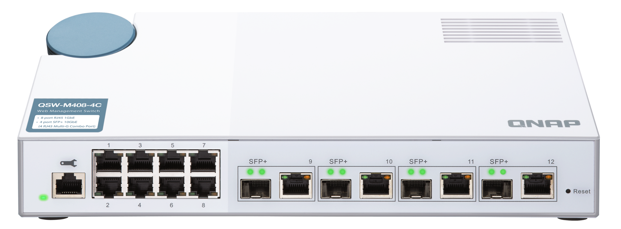
Refined design for elegant desktop placement
Hardware features and benefits
Distinguish 1GbE and 10GbE interfaces by matt and glossy surface treatments which also present the richness of white. Match with 90° rotatable stone blue power jack, QSW-M408 series brings 10GbE network speed and functional, aesthetic design to the office.

Slide 17
Super user friendly Web U/I
Software features and benefits
Walk the user through to quickly and correctly set up the switch!
◆ Simple
- Clear function display, one click for setting
◆ Intuitive
- GUI illustration matches to the real interface
◆ Referencing
- Status charts stand by for setting reference
◆ Guiding
- Functions and settings are guided in plain words

Slide 18
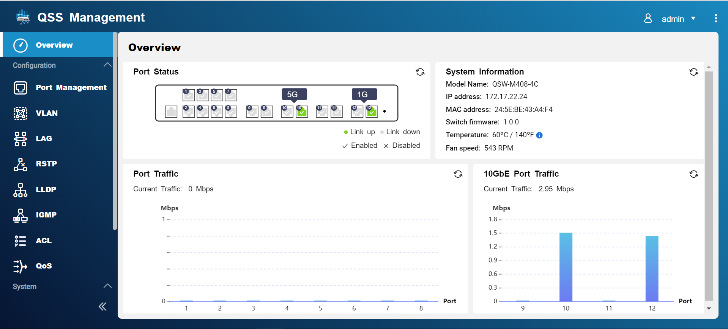
◆ Simple
- Clear function display, one click for setting
Software features and benefits
Make the setting work simple by reducing the complex control layers and parameters.

Slide 19
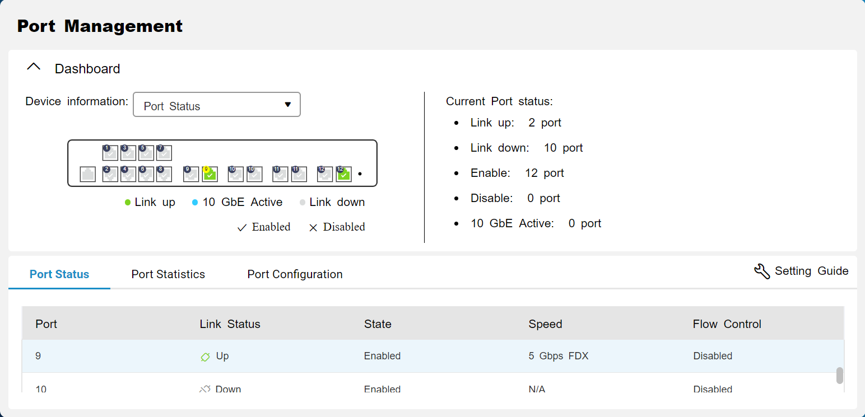
◆ Intuitive
- GUI illustration matches to the real interface
Software features and benefits
GUI interacts with user and switch to enhance the experience.

Slide 20
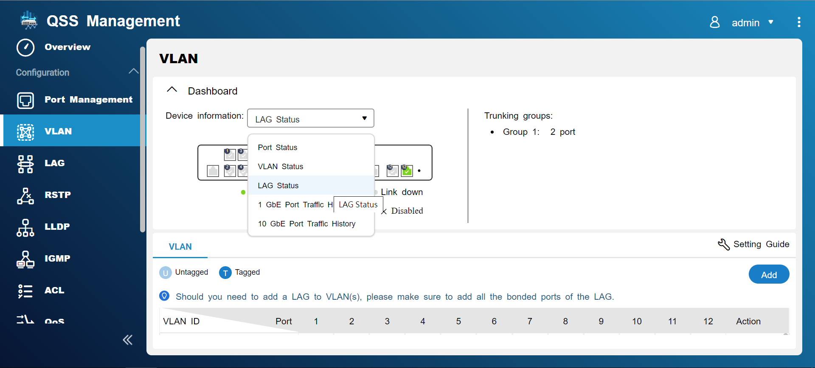
◆ Referencing
- Status charts stand by for setting reference
To avoid going back and forth between different setting pages, four major status charts can be called aside for reference during the configuration.
QNAP 1st
Software features and benefits

Slide 21
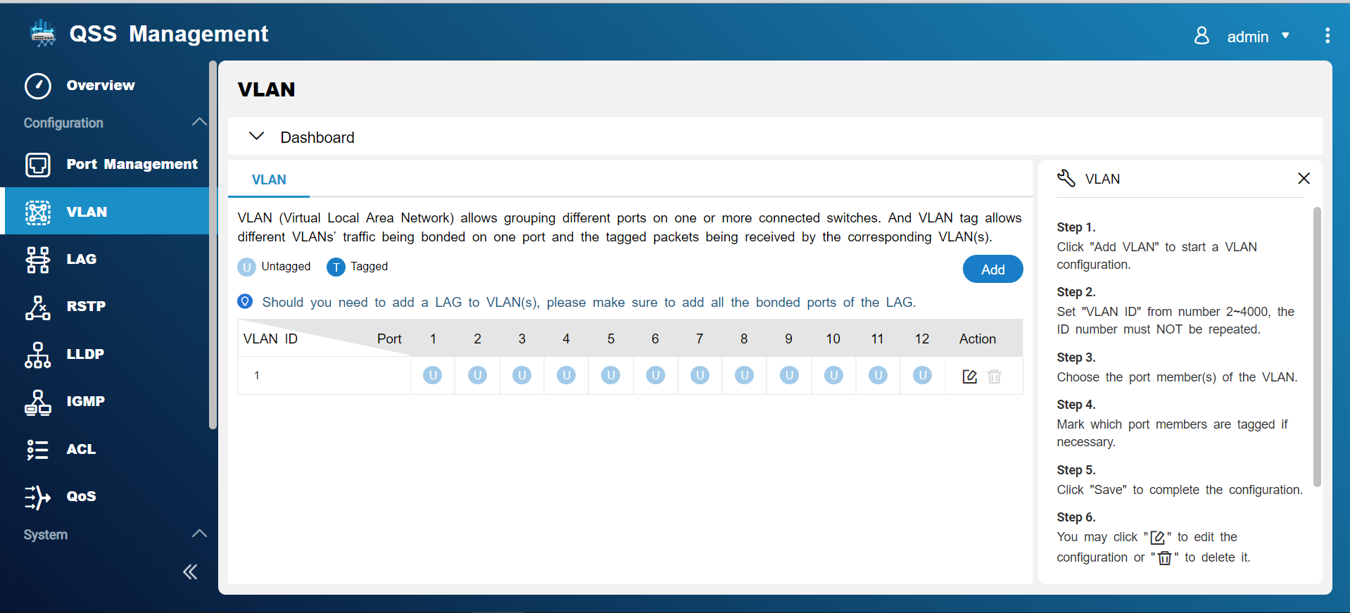
◆ Guiding
- Functions and settings are guided in plain words
Software features and benefits
The Web U/I has introduction and setting guide for each function which allows for studying by practicing.

Slide 22
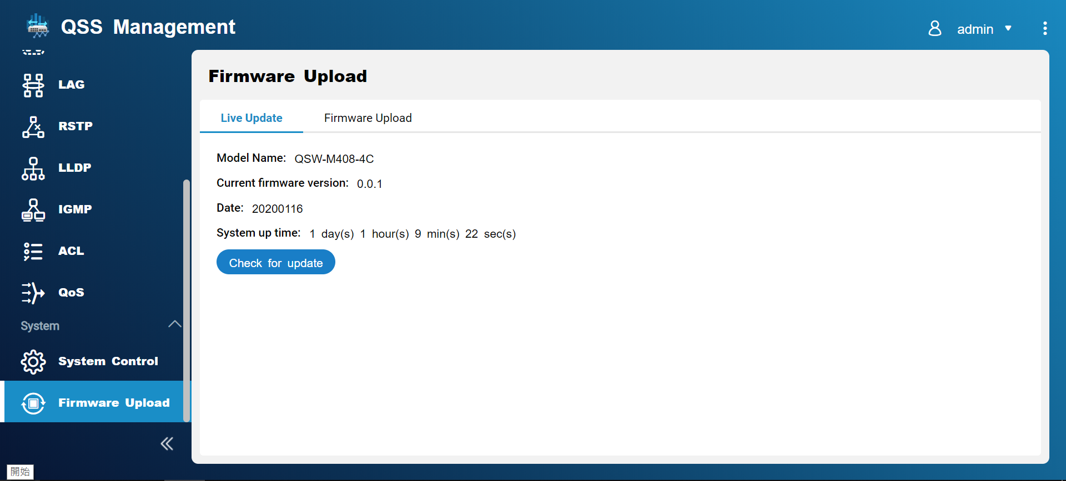
Firmware live update support
Software features and benefits

Slide 23
Support Ethernet management protocols (I)
Software features and benefits
Segmentation
Efficiency
Allocation
Expansion
VLAN
LAG
Anti-loop
Backup path
Access control
Ensure security
RSTP
ACL
Notes:
VLAN : 對區網的裝置進行邏輯分群管理，降低網內因無用封包過多導致的壅塞。效率：減少廣播封包量、提升網路效率。彈性：區隔管理者與一般使用者、 不同部門或員工與訪客。
LAG : 將多個實體埠綁定成單一邏輯埠的作法。配置：打破實體埠的頻寬分割，依照實際需求整併、配置頻寬。擴充：綁定兩台以上 (含兩台) 交換器的對接埠以快速擴充網路規模。
RSTP : 迴圈：防堵交換機備援拓樸產生的迴圈，從而避免廣播風暴造成網路癱瘓。備援：自然產生備援線路 (Blocking Path)，能耐受一條實體線路斷線而通訊不中斷。
ACL : 存取控制清單以 MAC 或 IP Address 描述用戶，以對其進行存取控制權限管理。控管：以建立、執行 ACL 條目對進、出的網路存取進行有效管控。安全：經由有效的進、出存取管控操作，提升網路安全性。

Slide 24
Support Ethernet management protocols (II)
Software features and benefits
Status snooping
Traffic reduction
Device disclose
Aid troubleshoot
IGMP
LLDP
Balance speed
Jam prevention
802.3az
(Energy Efficient
Ethernet)
Energy
saving
802.3x
(Flow Control)
Notes:
IGMP : 用於管理網路多播群組成員的一種通訊協定。學習：M408 實際支援 IGMP Snooping 會學習每埠的多播群組參與狀態，並將每一群組封包僅傳送至參與該群組的埠。減量：大幅減少不必要的轉發流量，從而提升交換器與網路的整體效率。
LLDP : 揭露：使網路中的裝置互相發現並通告彼此狀態及資訊。糾錯：網管人員會更瞭解整個網路拓樸，便於鑑別出可能有問題的裝置。
802.3x : 流量控制，作用於背景的自動流量管控機制。預設開啟，不需設定。平衡：平衡傳送端與接收端的流量，以避免高速傳送端癱瘓了低速接收端。暢流：因平衡兩端流量，使網路暢流無阻。
802.3az : 高能效乙太網路，作用於背景，是一套對雙絞線與標準乙太網路的背板增強，使其在低流量期間消耗較少的功率。預設開啟，不需設定。Energy Efficient Ethernet 其目標是將功耗降低50%以上，同時保持與現有裝置的完全相容。節能減碳省荷包！

Slide 25
Concerto: Collaboration

Slide 26
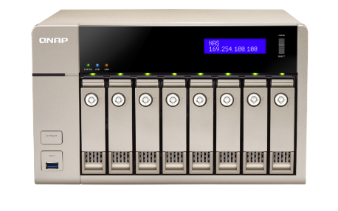
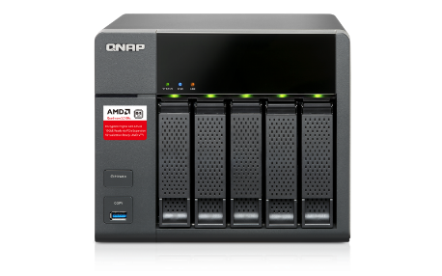
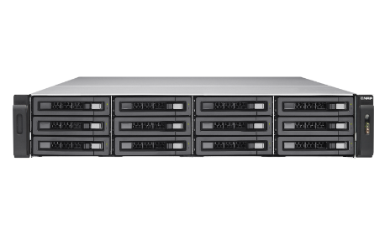
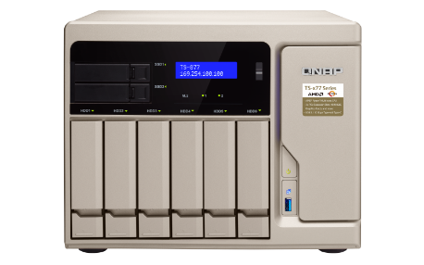
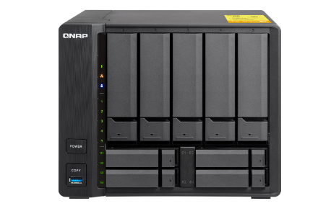
QSW-M408 series + QNAP 10Gb NAS
QNAP 10GbE NAS
Built-in 10GbE | SFP+
 | TES-X85U series、TDS-16489U、TVS-x80U series、TS-x73U series、TS-x63U series、TS-1635、TS-932X、TS-x31X series、TS-x31XU series
 | RJ45 (BASE-T)
 | TS-1685、TS-1677X、TVS-x82T series、TVS-x71T series、TVS-863+
Expandable to 10GbE | SFP+/ RJ45 (BASE-T)
 | TVS-x82 series、TS-x77 series、TVS-x71U-RP series、TVS-x71 series、TVS-x73 series、TVS-x73e series、TS-x73 series、TS-563、TS-x53BU series、TS-x53B series、TS-x53Be series、TS-X32x series
Notes:
QNAP 是 NAS 起家，當我們發現 NAS 的使用者經驗好壞，不只是取決於 NAS 本身，更是在網路的基礎建設。我們就立馬著手開發 10GbE 網路交換器，誓言要給我們的 NAS 使用者一個快速、穩固的網路環境。如今，QSW-M408 簡易網管型交換器上市，QNAP 的 NAS 良駒終於有了可以暢快馳騁的跑道，看倌們的筆電、伺服器也有了最好的升級理由！

Slide 27
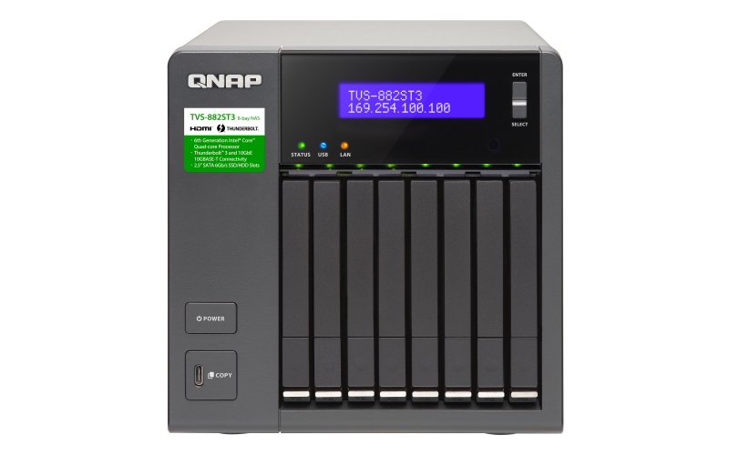
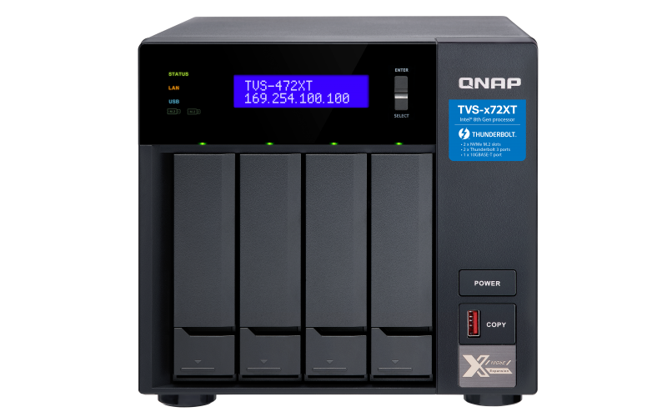
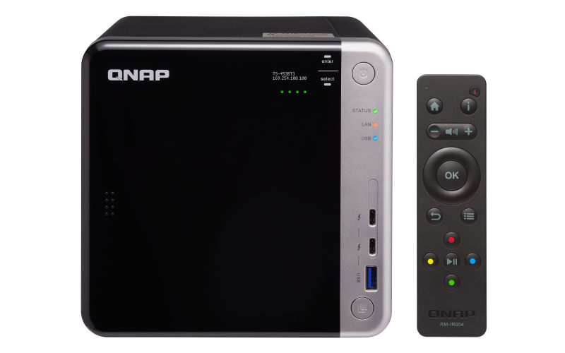
QSW-M408 series + Thunderbolt 3 NAS
TVS-882ST3 | TVS-472XT | TS-453BT3
2 x Thunderbolt 3
2 x 10GBASE-T
2 x 1GbE RJ45
2 x Thunderbolt 3
1 x 10GBASE-T
2 x 1GbE RJ45
2 x Thunderbolt 3
1 x 10GBASE-T
2 x 1GbE RJ45

Slide 28
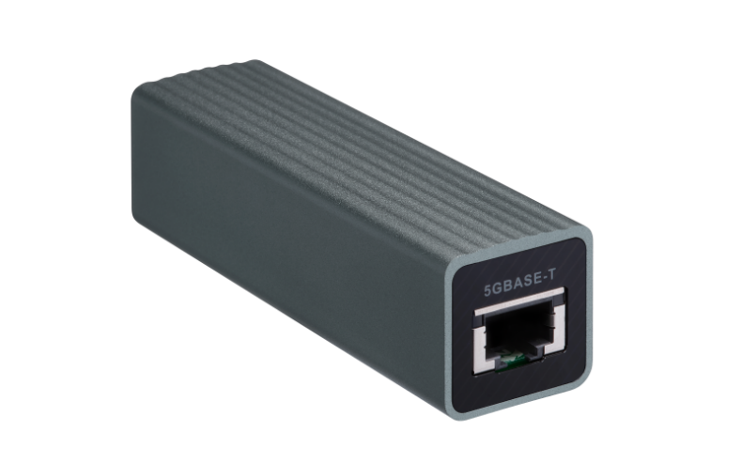
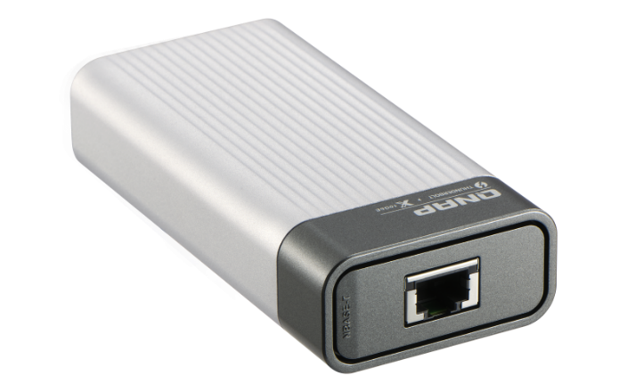
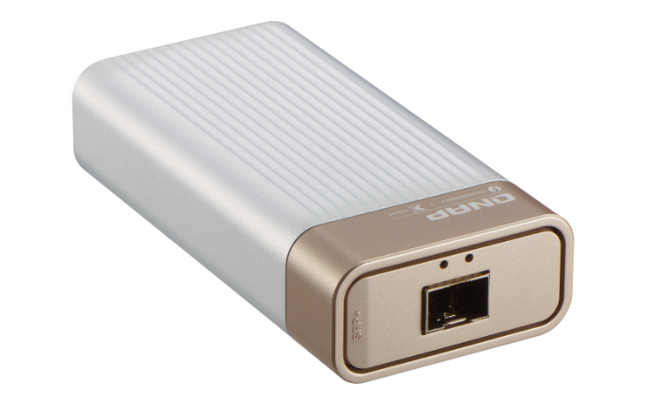
Your notebook + QNA Adapter
(USB 3.2 Gen 1/Thunderbolt 3 to 5/10GbE adapter)
QNA-UC5G1T | QNA-T310G1S | QNA-T310G1T
Built-in USB3.0
Built-in Thunderbolt 3
Built-in Thunderbolt 3
5G, 2.5G, 1G, 100M
RJ45 NBASE-T
10G, 5G, 2.5G, 1G, 100M
RJ45 NBASE-T
10G, 5G, 2.5G, 1G, 100M
RJ45 NBASE-T

Slide 29
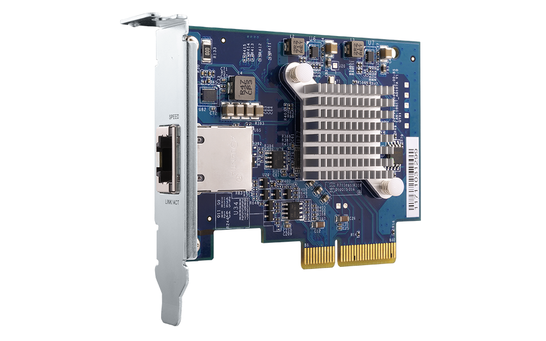
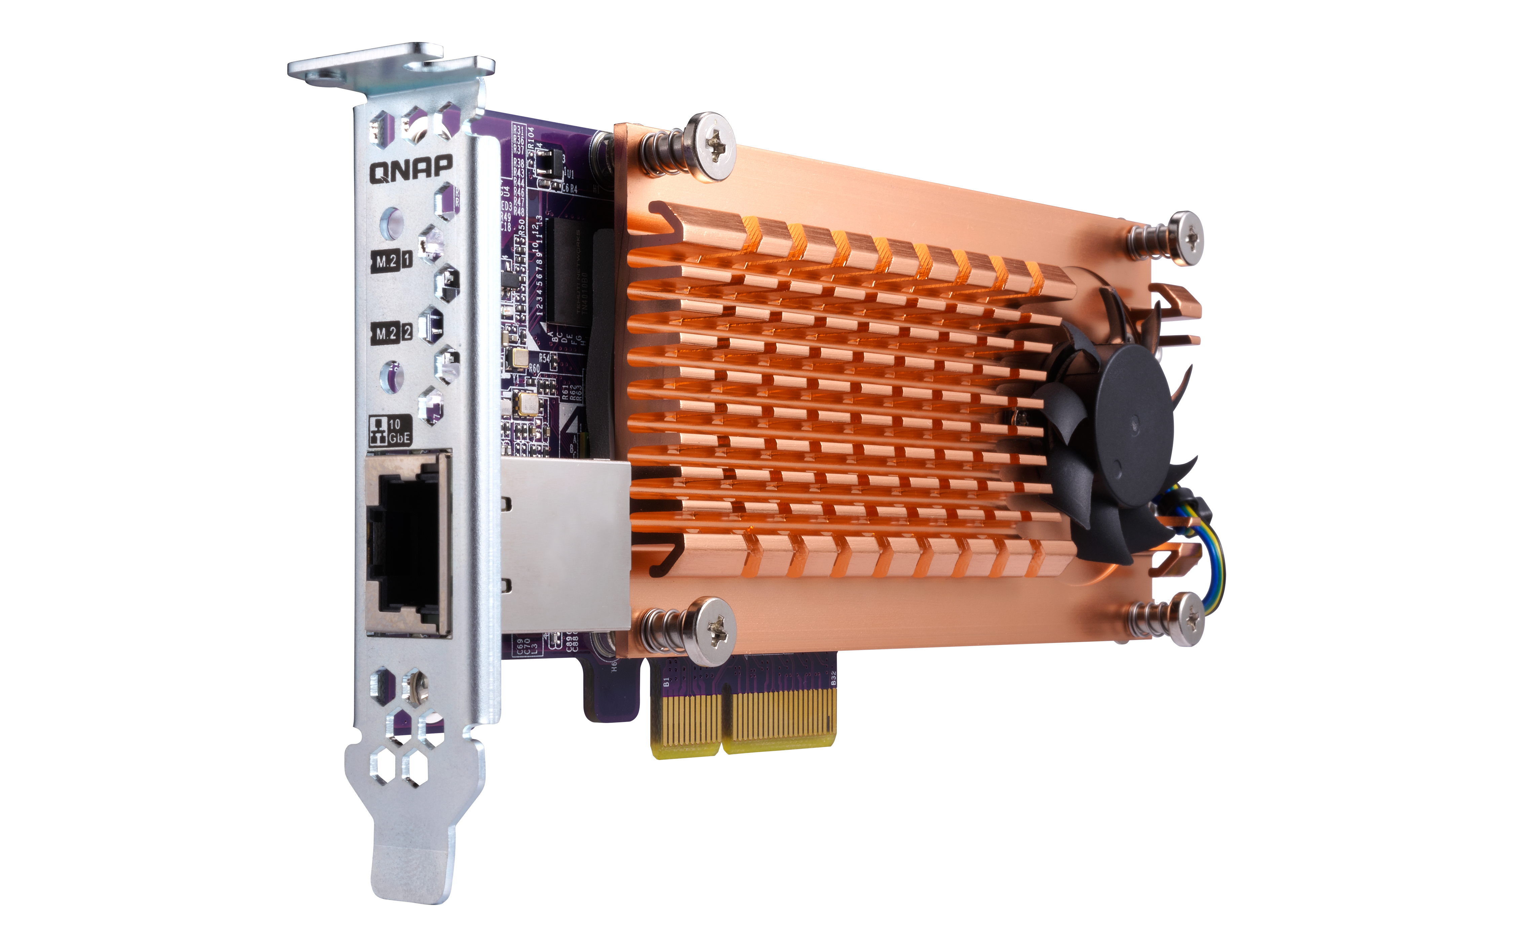
Your server or NAS + QNAP Network Expansion Card
10 GbE Network Expansion Card | QM2 M.2 SSD/10GbE PCIe Expansion Card
- QXG-10G1T
- QXG-10G2T-107
- LAN-10G2T-X550
- QXG-5G1T-111C
- QXG-10G2SF-CX4
- LAN-10G2SF-MLX
- QM2-2S10G1TA
- QM2-2P10G1TA

Slide 30
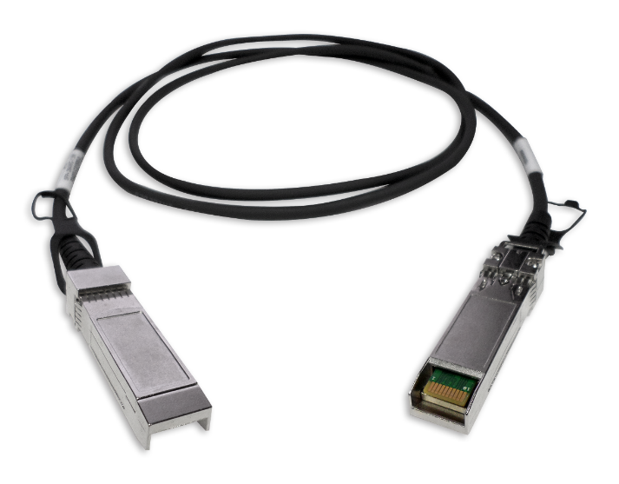
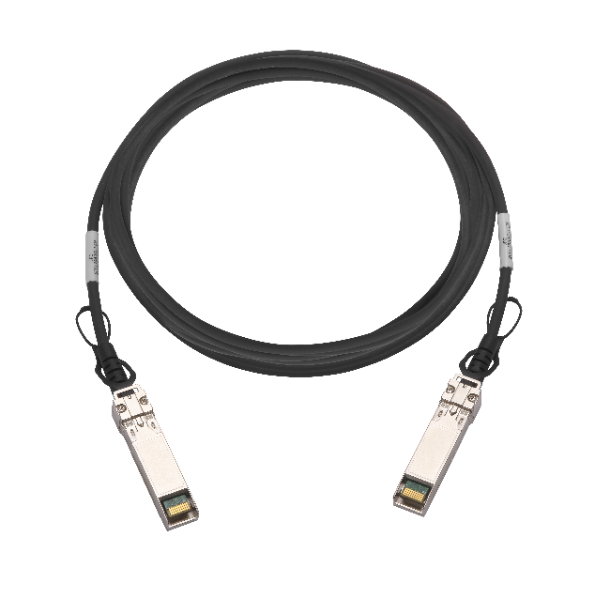
Get the cables for immediate start
1.5M SFP+ 10GbE Direct Attach Cable | 3.0M SFP+ 10GbE Direct Attach Cable | 5.0M SFP+ 10GbE Direct Attach Cable
Ordering code: CAB-DAC15M-SFPP-DEC02 | Ordering code: CAB-DAC30M-SFPP-DEC02 | Ordering code: CAB-DAC50M-SFPP-DEC02

Slide 31
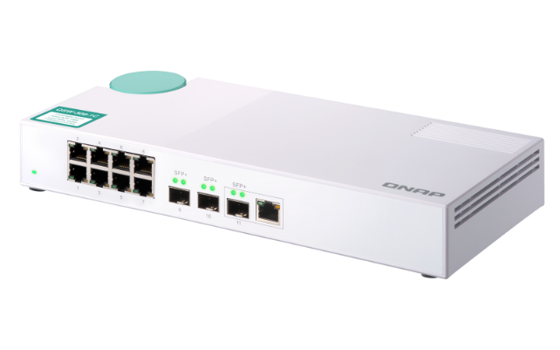
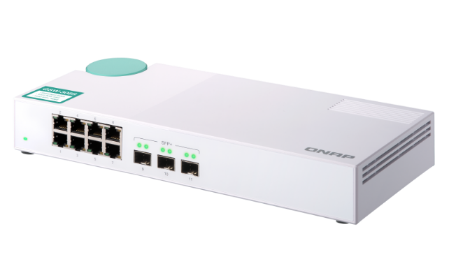
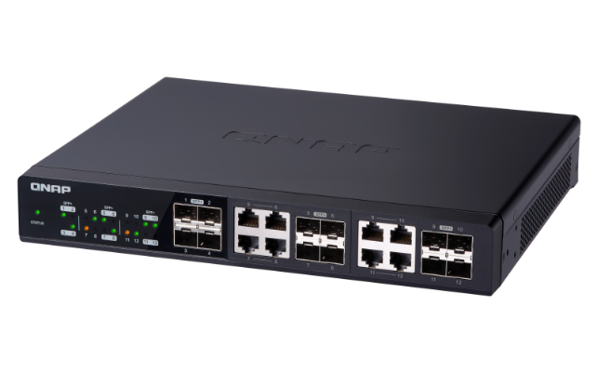
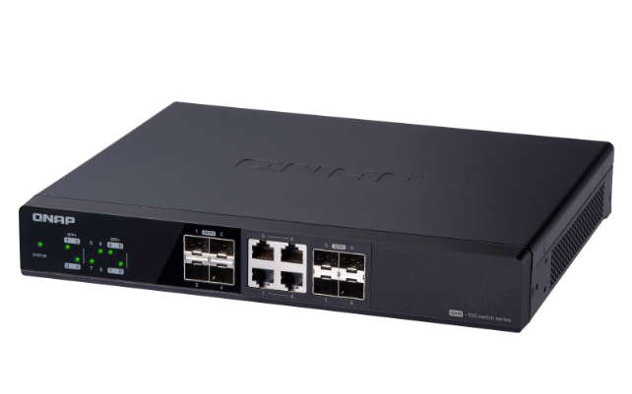
Easter eggs ~ QNAP Unmanaged 10GbE Ethernet Switches
QSW-308-1C | QSW-308S | QSW-1208-8C | QSW-804-4C
Port Configuration: 10GbE SFP+/ RJ-45 Combo * 1 10GbE SFP+ * 2 1GbE RJ45 * 8 | Port Configuration: 10GbE SFP+/ RJ-45 Combo * 1 10GbE SFP+ * 2 1GbE RJ45 * 8 | Port Configuration: 10GbE SFP+/ RJ-45 Combo * 8 10GbE SFP+ * 4 | Port Configuration: 10GbE SFP+/ RJ-45 Combo * 4 10GbE SFP+ * 4

Slide 32
Copyright © 2020 QNAP Systems, Inc. All rights reserved. QNAP® and other names of QNAP Products are proprietary marks or registered trademarks of QNAP Systems, Inc. Other products and company names mentioned herein are trademarks of their respective holders.

