Slide 1
CES’2020
Notes:
型錄上面的照片

Slide 2

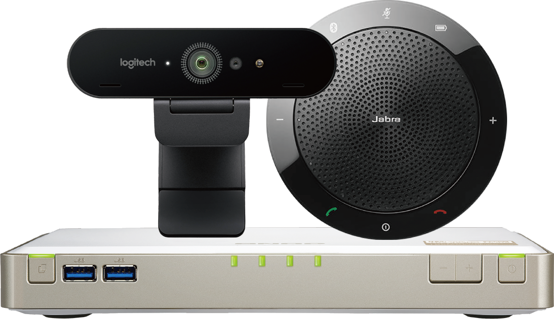
Warm Supporting
Blessed of the original NAS users!
Due to the recent environmental impact,
the demand for remote video continues to increase.
QNAP hereby releases several free video functions (Video Call & Wireless Projection )
hope could accompany you through this difficult times!
Notes:
由於最近環境影響，遠端視訊需求持續增加，QNAP 特此釋出幾項免費視訊功能希望能陪大家度過難關！
To prevent face to face contact, Private Video Conference (SIP) is the best way to avoid ”2019-nCov” expansion
Quick Release KoiMeeter beta version for free (SIP 1-to-1; 30 min wireless projection)

Slide 3



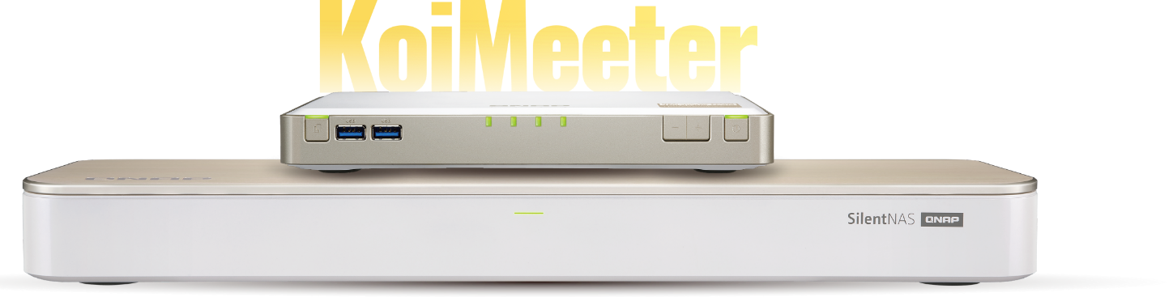


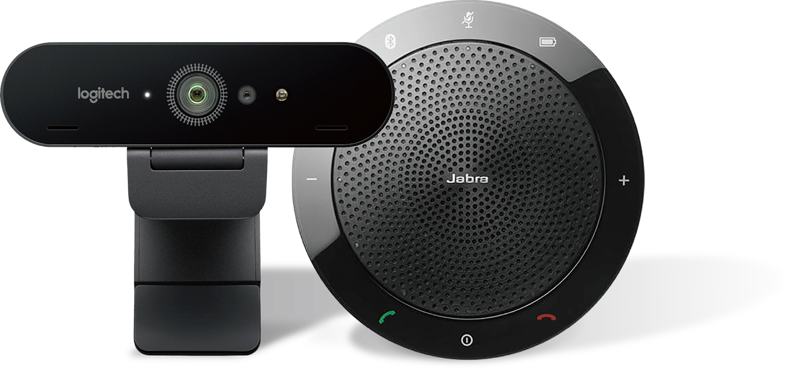
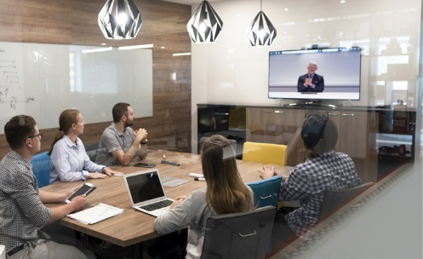
Light Video Conferencing Equipment
TBS–453 DX
HS–453 DX
Logitech-BRIO
Jabra-510+
Laptop

Slide 4

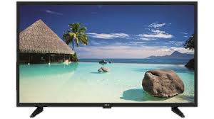
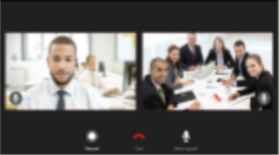
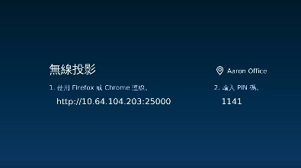

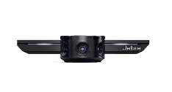
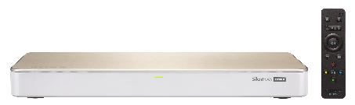
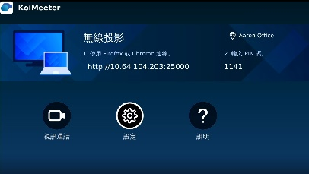
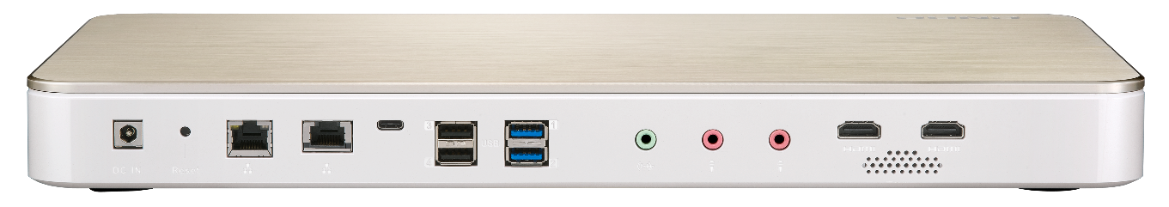
Simple Set up
KoiMeeter
Install KoiMeeter
Plug HDMI (TV), USB (Cam+Mic)
Start using
Notes:
Easy setup
1. Download KoiMeeter
2. Install USB cam + Speaker phone
3. Start using: Video call & Wireless Projection

Slide 5

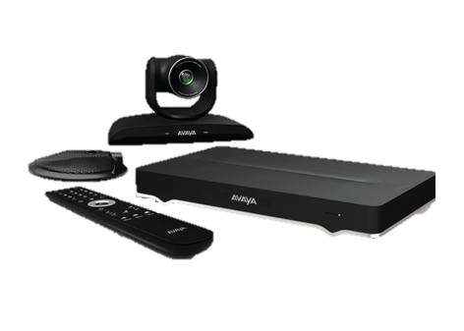
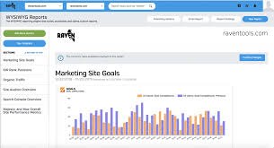
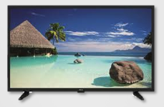

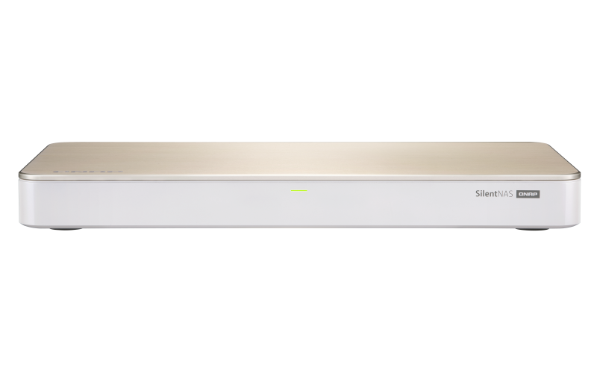

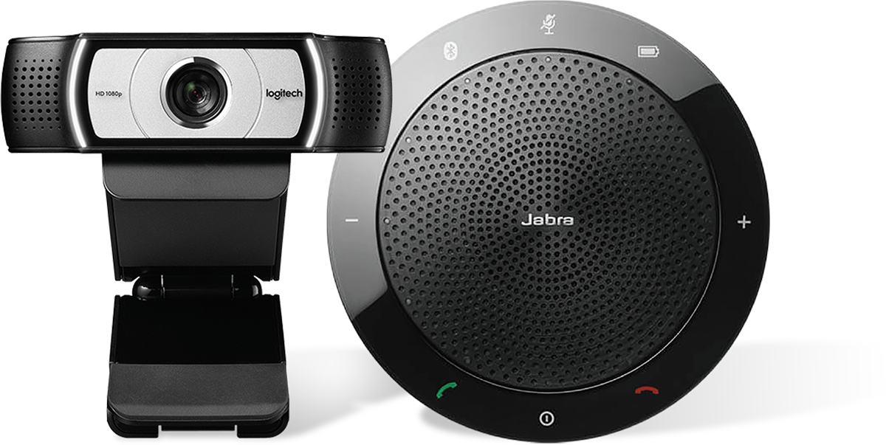

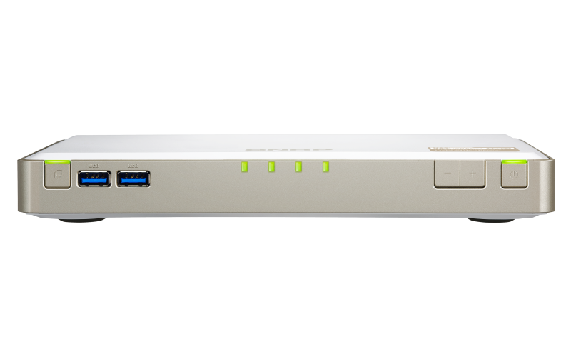
Wireless Projection
1
MULTIPLE LINKAGE PLATFORM
KoiMeeter Single Call
Support Avaya Multiparty Call
Avaya
Intranet
HDMI
HDMI
Intranet
HS-453DX
TBS-453DX
HS-453DX
TBS-453DX
Avaya
Notes:
Scenario : Wireless Projections by using browsers (Chrome or Firefox)

Slide 6
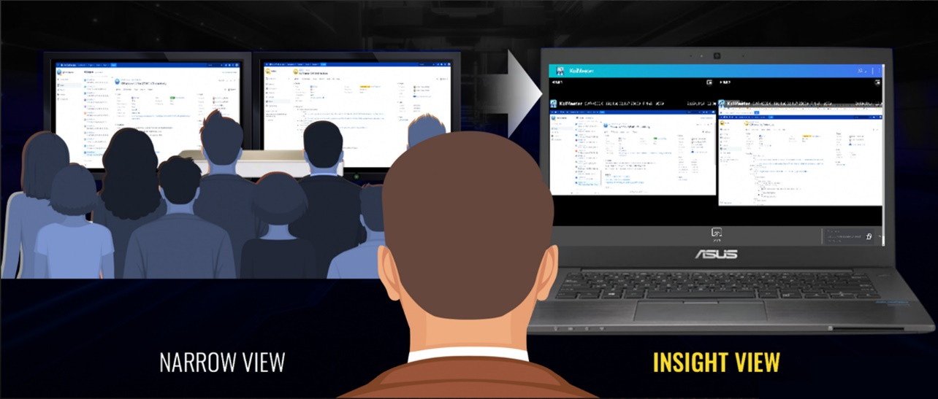
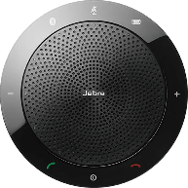



Wireless Projection
2
WIRELESS PROJECTION
PS. 30 minutes limit for Free version
Simultaneous max 2 screen projection
Insight View
HDMI
HDMI
Enter IP/PIN Code to browser, then you can start using
Wireless Projections by using browsers (Chrome or Firefox)
Notes:
Scenario : Wireless Projections by using browsers (Chrome or Firefox)

Slide 7
DEMO

Slide 8


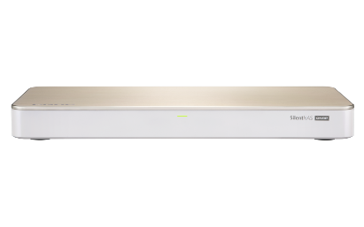

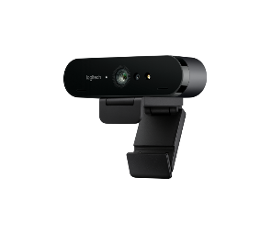
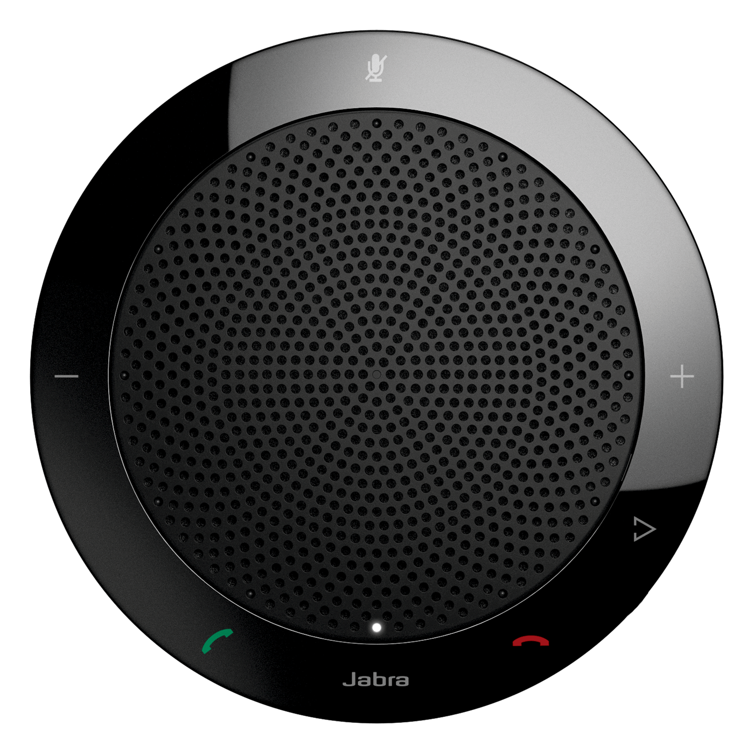
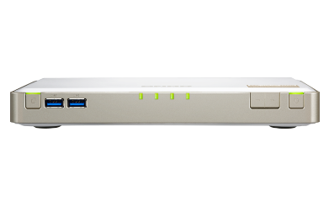
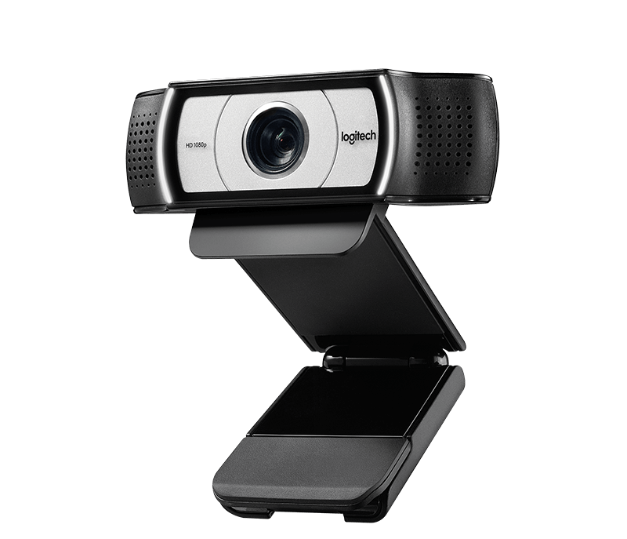
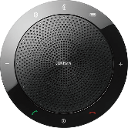
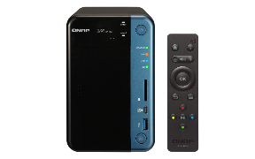
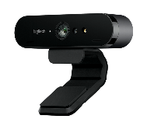
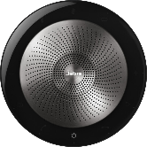
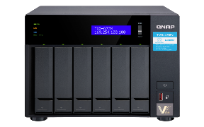
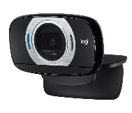
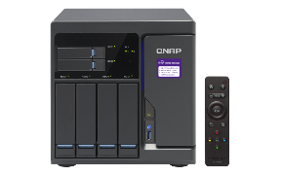
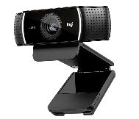
Recommended List
QNAP NAS
Camera
Microphone
HS-453DX
Logitech-BRIO
Jabra-410
TBS-453DX
Logitech-C930E
Jabra-510+
x53-Series
Logitech-C925E
Jabra-710+
x72-Series
Logitech-C615
x82-Series
Logitech-C922
Notes:
QNAP KoiMeeter expand very quickly to make quick expand NAS (2 models -> many current HDMI models: x53/x72/x82)
to become Private Video conference system (with certificated USB Cam (ex: Logi) and SpeakerPhone (ex: Jabra).

Slide 9
NEXT
RELEASE

Slide 10
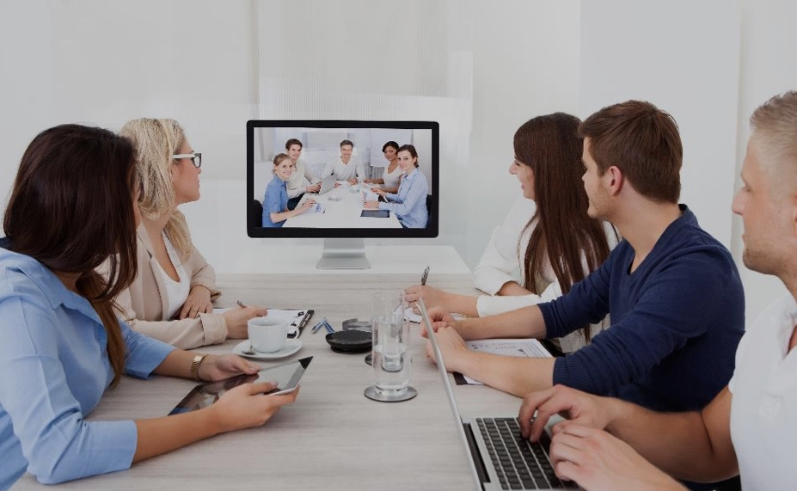
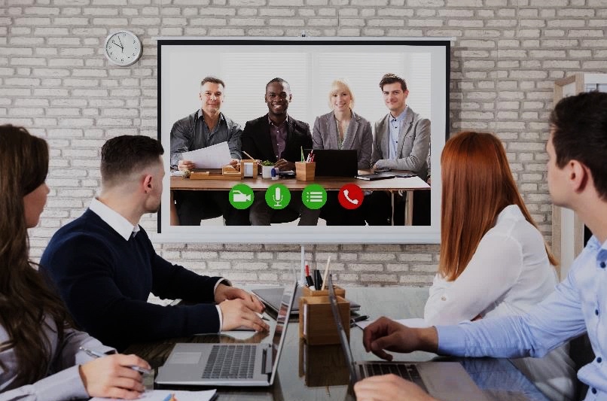

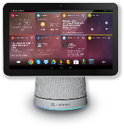






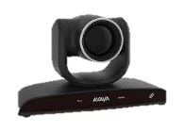

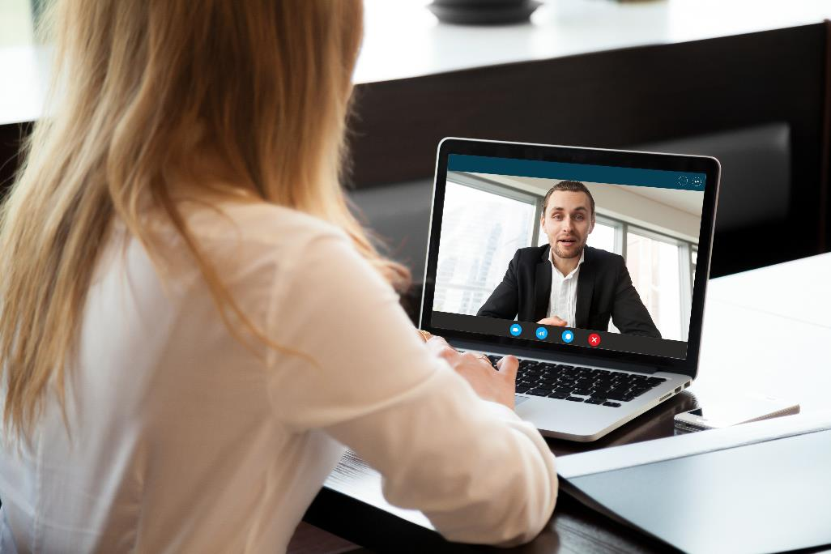
KoiMeeter’s POSITIONING
MOBILE
KoiTalk
MEDIUM-SCALE (2-6)
HUDDLE ROOM (1-3)
PERSONAL/OUTSIDE
LARGE-SCALE

Slide 11
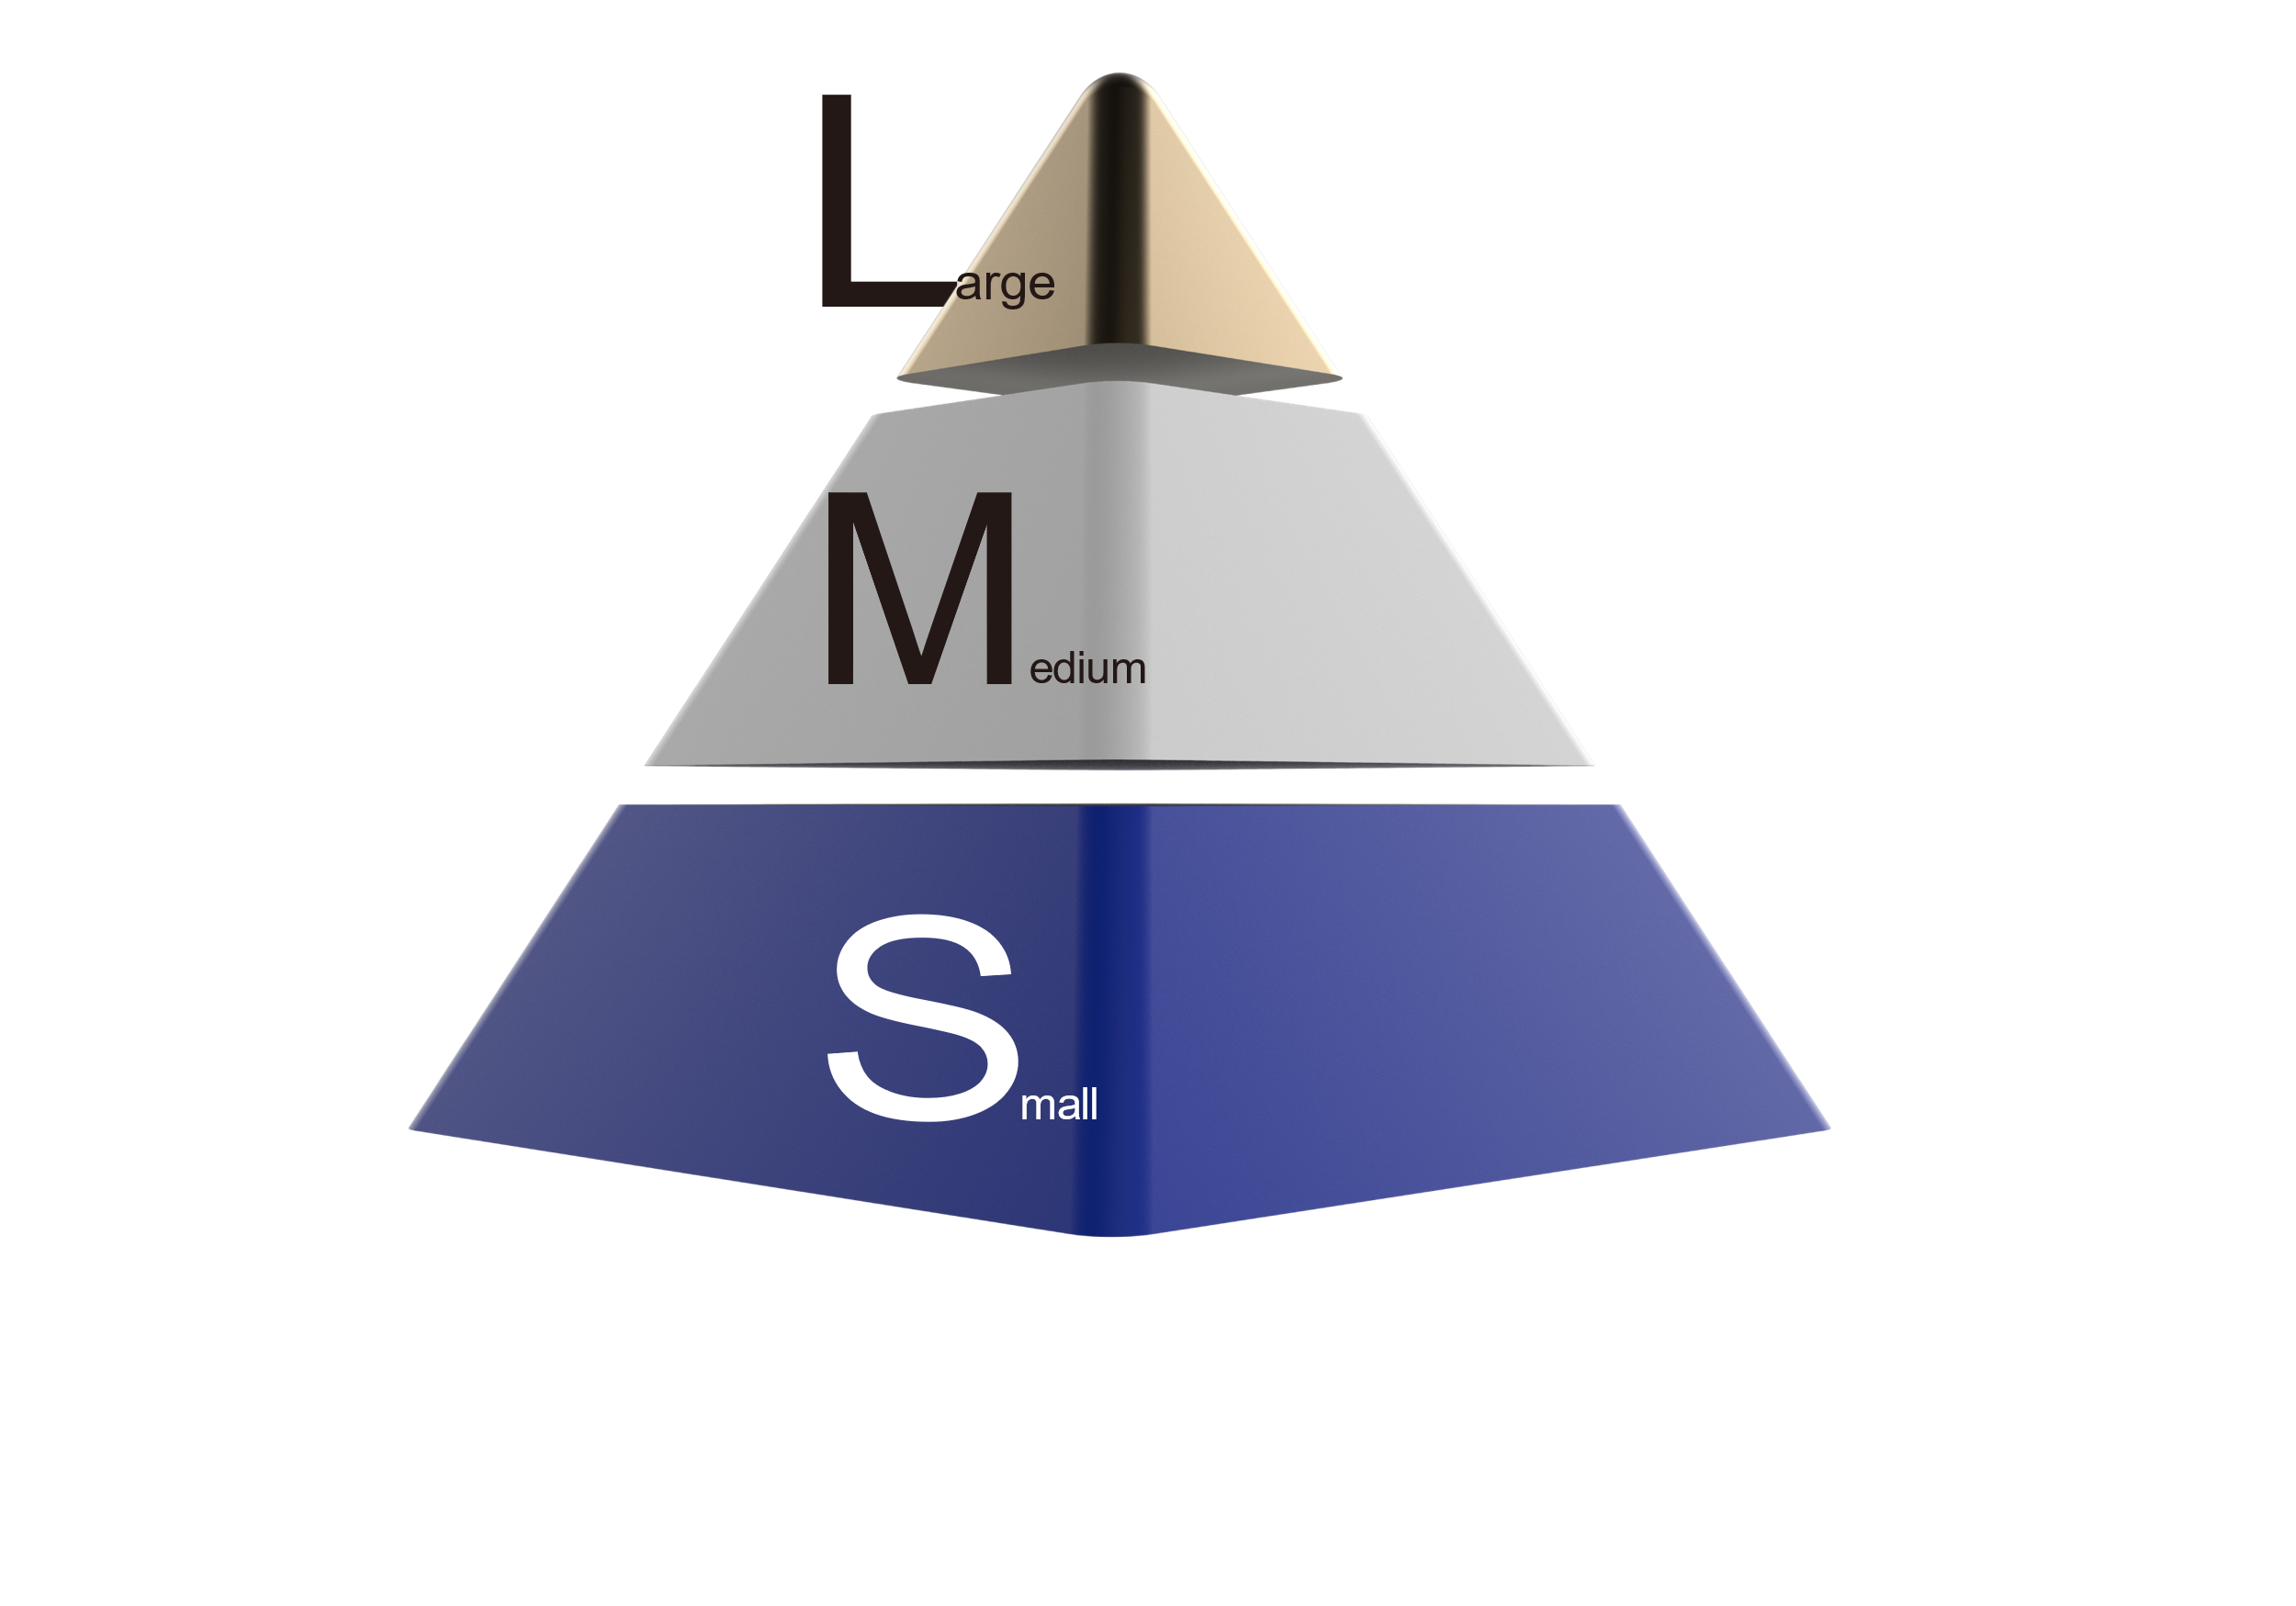
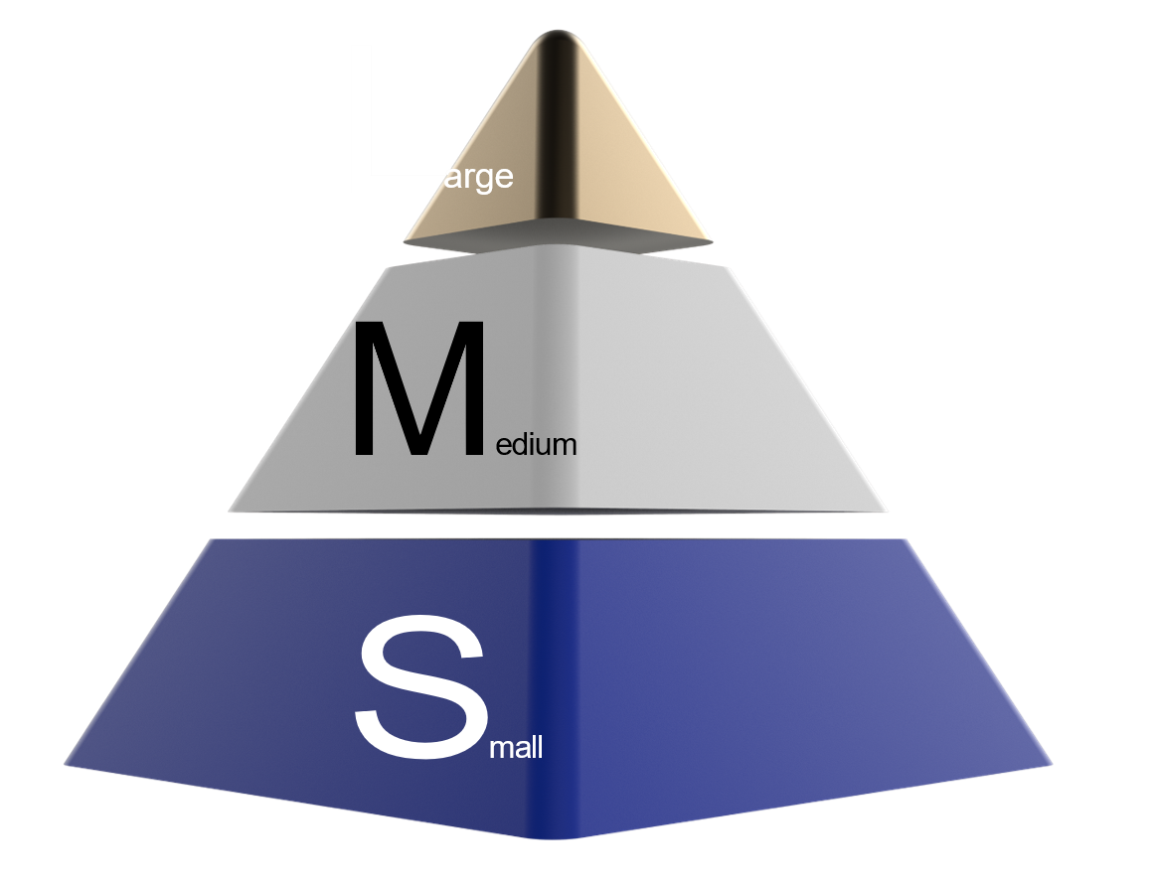
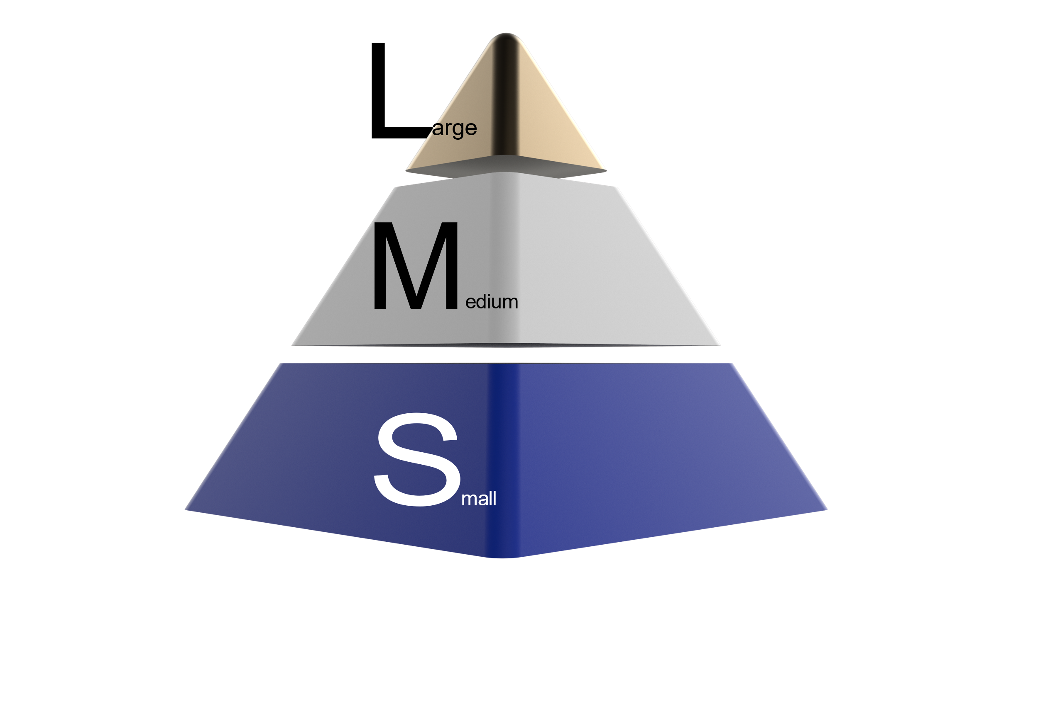

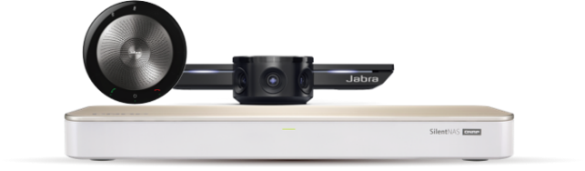
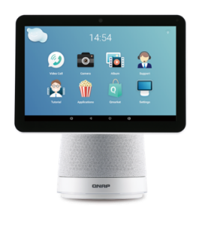
HYBRID VIDEO SYSTEM
A Smart Video Meeting Solution
Supports huddle and medium conference rooms with a smart video conference solution ! Higher quality! Lower price !
More than 80%
of small and medium-sized meeting rooms do not have a video conference system!
MEETING ROOMS

Slide 12





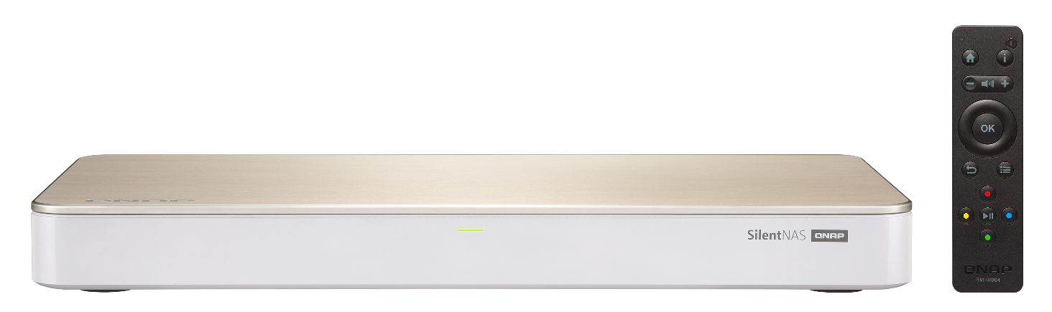



4 Key Value of Video Conference
4 KEY VALUE OF VIDEO CONFERENCE
Strategy for KoiMeeter - The New Generation of Meeting Box Solution
Strategy for KoiMeeter - The New Generation of Meeting Box Solution
Wireless Projection
Multi-platform
Video Calls
Video Recording
AI add-on value
KoiMeeter

Slide 13

KoiMeeter Software License – Features
FREE
BASIC
Wireless Projection
Wireless Projection
30 minutes limit
Simultaneous maximum 2 screen projection
Insight View
Remove time limit
Simultaneous maximum 4 screen projection
Insight View
Video Call
SIP video box single call
Video Call
SIP video box single call
KoiMeeter & Avaya
KoiMeeter & Avaya
Conference Recording
Support local video recording
Notes:
競爭者價格

Slide 14


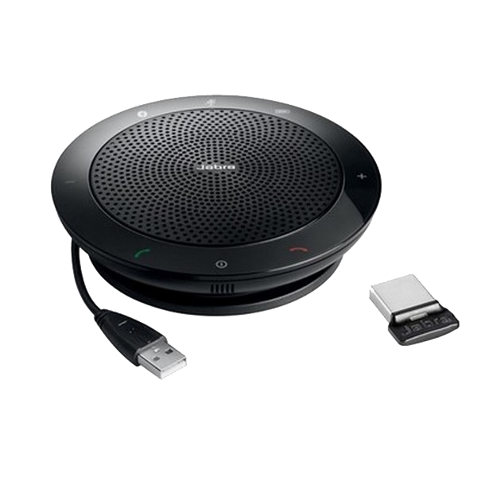
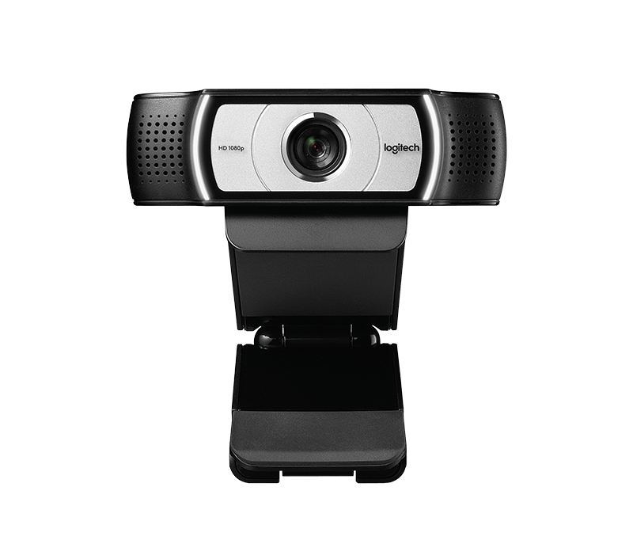




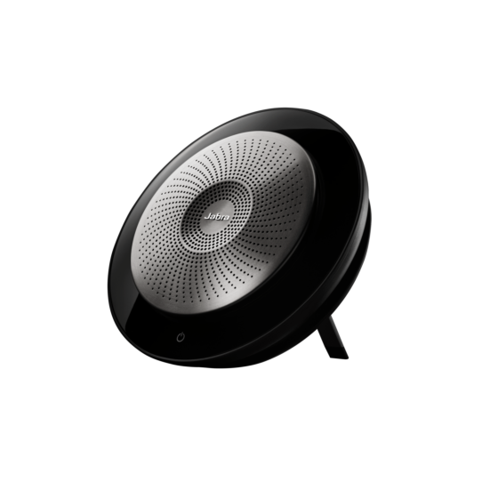
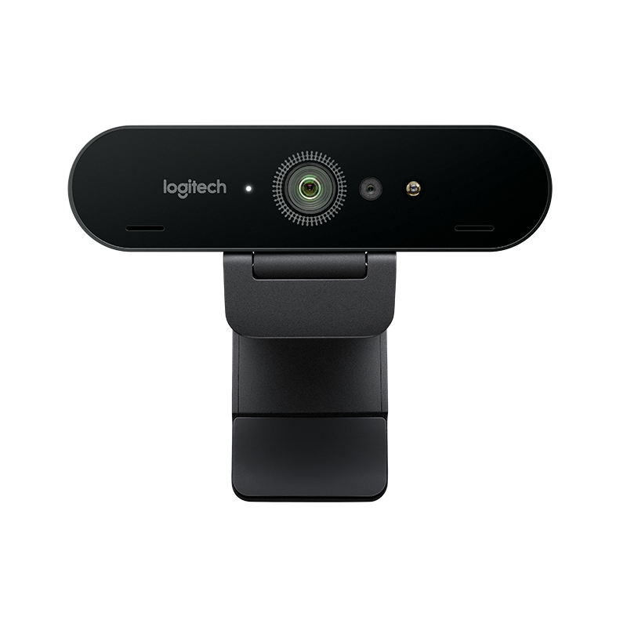


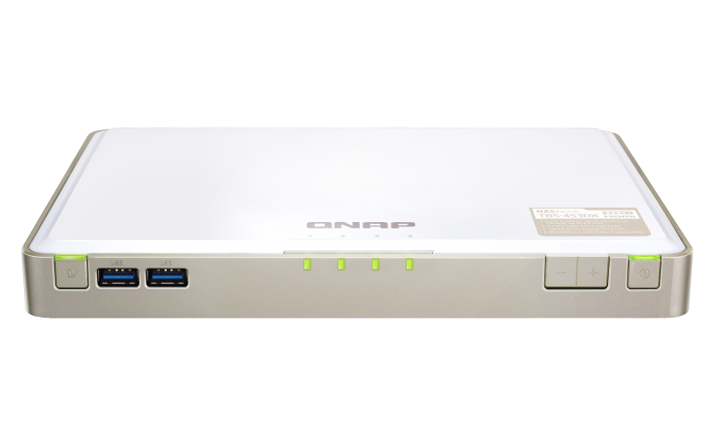
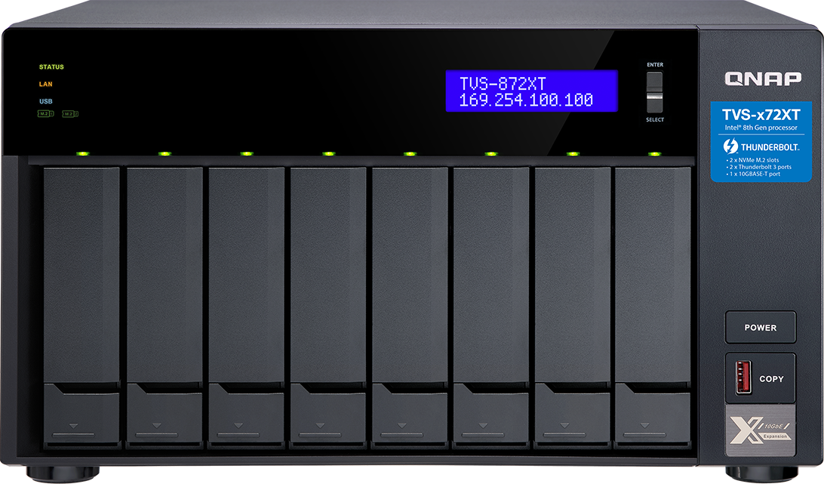
Project Sales
2020 Q1
2020 Q2
2020 Q3
2020 Q4
KoiMeeter Video SW
Free version
KoiMeeter Video System
Basic version
KoiMeeter Video System
Pro version (up to 4 peer)
HUDDLE Room
KB-453DX-H1
MEDIUM Room
KB-453DX-M1
LARGE Room
(MCU) – KB-xxxx – L1

Slide 15
Copyright© 2020 QNAP Systems, Inc. All rights reserved. QNAP® and other names of QNAP Products are proprietary marks or registered trademarks of QNAP Systems, Inc. Other products and company names mentioned herein are trademarks of their respective holders.​​​

