Slide 1
Notes:
QNAP x Achiware P5 and Pure as an ultimate backup solution

Slide 2
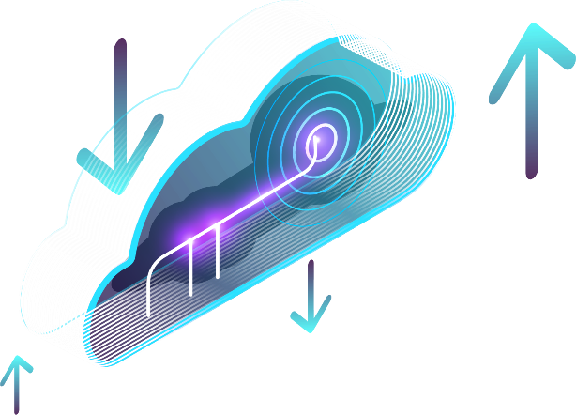
內容大綱
Part 1
Part 2
VM備份很惱人?
QNAP和Archiware Pure解決方案五大優勢
詳細功能大解密
Live Demo
影音工作者檔案保存大不易
職人創作與備份首選QNAP和 Archiware P5五大理由
詳細功能不藏私
Live Demo
Notes:
Agenda
Part 1:
1. Does VM backup drive you crazy?
2. 5 reasons to backup VM with QNAP and Archiware Pure
3. Detailed function introduction
4. Live demo
Part 2:
1. Backup challenges for media and entertainment industry
2. 5 reasons to backup media files with QNAP and Archiware P5
3. Detailed function introduction
4. Live demo

Slide 3
Archiware 產品概觀
Pure 協助您將QNAP NAS變成備份一體機，快速建立永久免費且不受限制的VMware虛擬機備份環境
P5 適合用於影音編輯產業，可協助將QNAP NAS檔案備份、封存、同步到其他NAS, 磁帶或公有雲
Notes:
Archiware Overview
Pure assists you turn QNAP NAS into a backup appliance and efficiently create a permanent and free VMware virtual machine backup environment
P5 is suitable for the M&E industry, assisting you backup, archive, and synchronize QNAP NAS files to other NAS, tape or public cloud

Slide 4
令人又愛又恨的VM備份
VMWARE VM備份很重要，但您可能會遇到以下問題…
沒有足夠預算購買備份軟體
目前沒有額外的備份伺服器可以安裝
設定卡卡
不確定每次備份是不是真的成功
Notes:
Love and Hate VM Backup?
To backup VMware VM is important but you may encounter the following problems...
- no enough budget to buy backup software
- no additional free server
- take a long time to install and configure
- do not know if the previous backups were successful

Slide 5
您該使用QNAP搭配Archiware Pure的五大理由
1 軟硬兼施，直球對決備份難題
2 免費軟體授權，卻又可擁有全部的功能
支援ESXi主機數量無上限
支援虛擬機數量無上限
可額外選擇付費技術支援
3 不須額外尋找伺服器來做備份
4 安裝設定秒完成
5 自動驗證每次備份是否成功
把樸實無華且枯燥的事情交給我們，讓您可以專注在其他重要的工作上
Notes:
5 reasons to use QNAP and Archiware
1. Hardware and software deep integration
2. Free software with full functionality
- support unlimited number of ESXi hosts
- support unlimited number of virtual machines
- optional paid for technical support
3. No need to find one additional server for backup
4. 5-minute installation and setup
5. Optionally perform a data verification for each backup snapshot
Let us simplify the VM backup so that you can focus on other important tasks

Slide 6
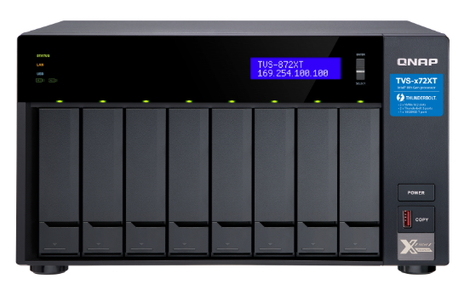
QNAP X Archiware Pure 把您的NAS一秒變成VM備份一體機
VM
VM
VM
VMware ESXi
VM
VM
VM
VMware ESXi
Pure 運作在QNAP NAS上
不需要額外的備份伺服器和儲存
Notes:
QNAP X Archiware Pure
Turn your NAS into a VM backup appliance in seconds
Pure running on QNAP NAS
No need additional backup server and storage

Slide 7
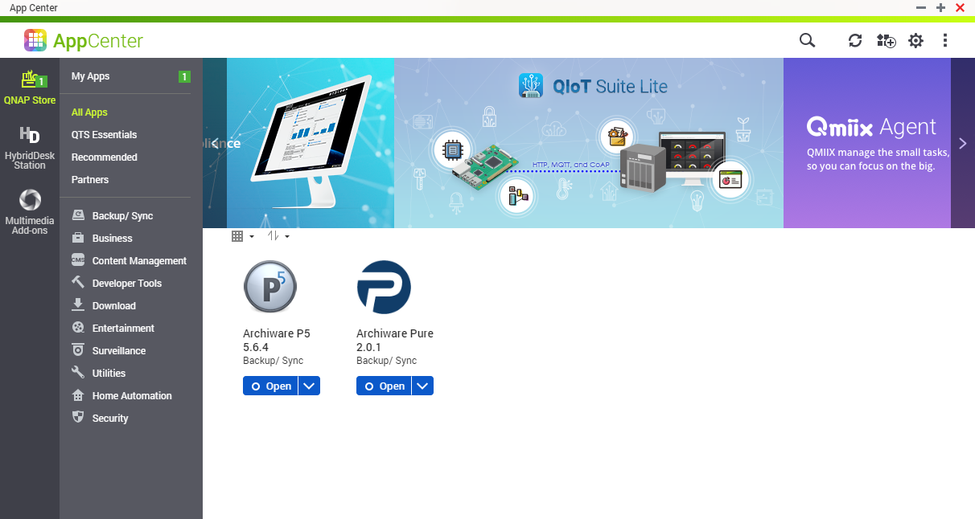
AppCenter 一鍵安裝，立即開始VM備份
Notes:
One-click installation in AppCenter to enjoy your VM backup journey immediately

Slide 8
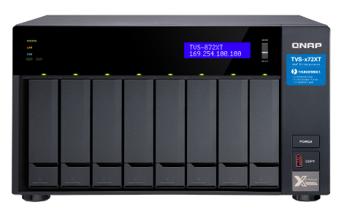
QNAP NAS 全方位的資料保護技術 保護您的VM以及其他珍貴資料
輕鬆打造您的3-2-1備份策略
HybridMount, VJBOD Cloud, HBS 3
Snapshot
RAID

Slide 9
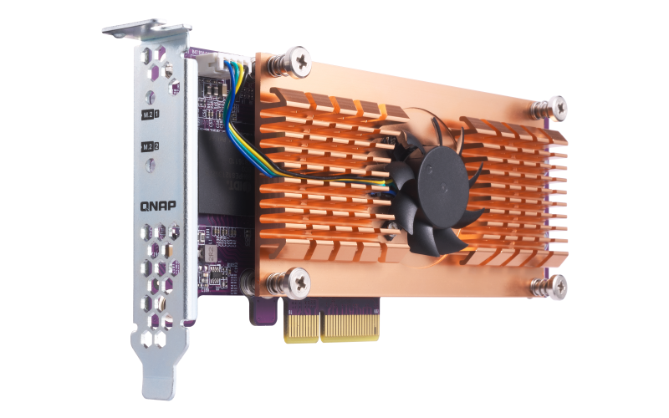
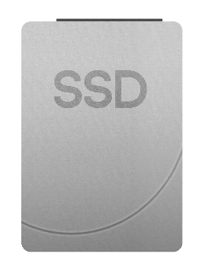
支援使用SSD讓VM備份加速完成
熱資料存到SSD
冷資料存到HDD
QM2 擴充卡
(擴充 M.2 SSD 埠)
Notes:
Support SSD Configuration to boost your VM Backup
QM2 Expansion Card (Add M.2 SSD Slots)
SSDs for Hot Data
HDDs for Cold Data

Slide 10
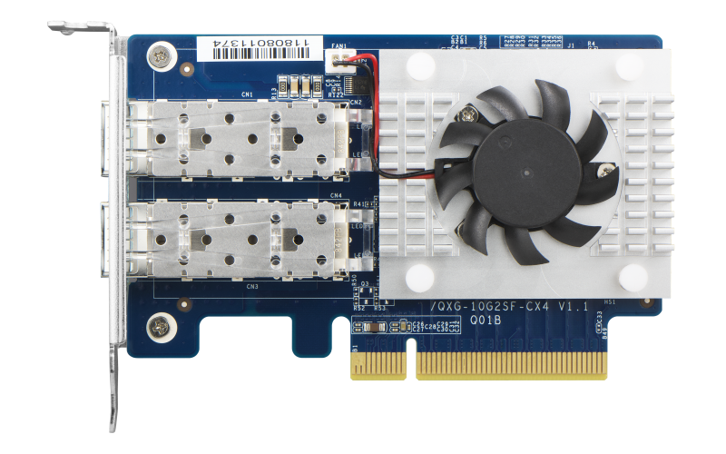
支援建構高速備份網路，加快資料傳輸速度
多元傳輸介面選擇
40GbE/ 25GbE/ 10GbE
Notes:
Support to build high-speed backup networks and speed up data transfer
Multiple PCIe options for network interface 40GbE/ 25GbE/ 10GbE

Slide 11
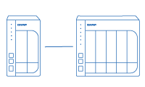
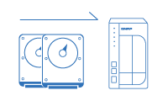
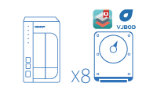
高效經濟、彈性擴充儲存空間
VJBOD
網路虛擬儲存擴充櫃
串接QNAP儲存擴充設備
更換容量更大的硬碟
毋須停機，您可線上以大容量的硬碟取代原先小容量的硬碟，順利升級NAS容量。
透過 VJBOD (Virtual JBOD) 網路虛擬儲存擴充櫃進行容量擴充。以TVS-872XT為例，最多可連接 8 台遠端 NAS，掛載為TVS-872XT 的虛擬硬碟。
Notes:
Flexible and economical storage expansion
Attach Expansion Enclosures
Upgrade RAID Capacity: Hot swap lower-capacity drives with larger-capacity drives so that your QNAP NAS can grow with your business.
VJBOD: Use VJBOD (Virtual JBOD) to expand your storage capacity by using the unused storage of other QNAP NAS. Up to 8 QNAP NAS can be mounted as local disks on the TVS-872XT.

Slide 12
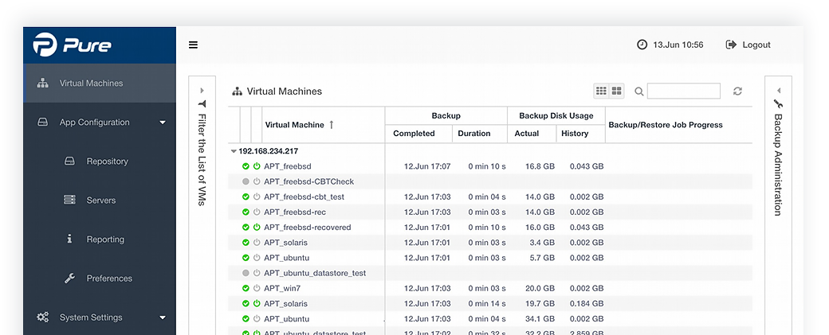
設定超簡單 透過瀏覽器就可快速管理VM備份工作
Notes:
The smartest way to maage VM backup
Get All tasks down just through a web browser

Slide 13
真免費VMware虛擬機備份 沒有惱人的使用限制和複雜的計價模式
Archiware Pure | 他牌產品
支援ESXi主機數量無上限 支援虛擬機數量無上限 享受完整的功能 可根據需求，額外選購5X8原廠技術支援(199USD/yr) | ☹複雜計價方式 X 根據實體機CPU或是核心數量 X 根據虛擬機數量 ☹根據授權等級不同，無法享受完整功能 ☹每年訂閱制
Notes:
VMware VM backup for FREE
No annoying restrictions and complicated pricing models
Archiware Pure
- support unlimited number of ESXi hosts
- support unlimited number of virtual machines
- enjoy full functionality
- optional paid for technical support (199USD/yr)
Others
- complicated pricing models
● by CPU or core number
● by VM number
- Some features are locked based on license types
- Annual subscription fee

Slide 14
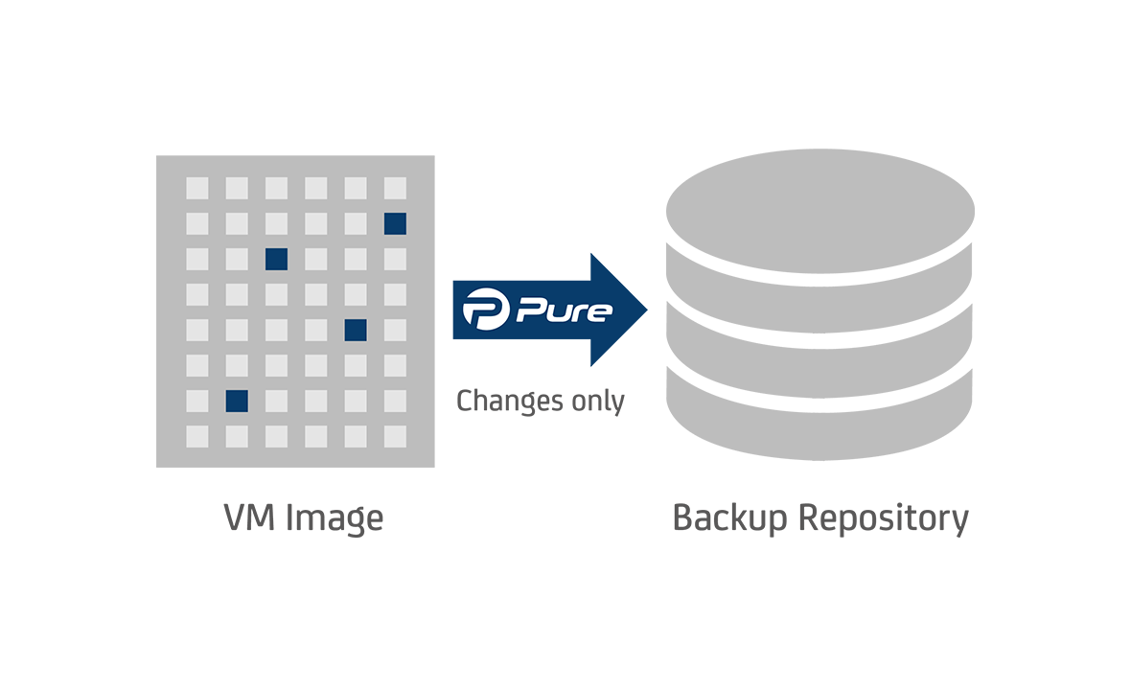
採用變動區塊追蹤技術 優化備份效率與減少資料傳輸
Notes:
All backups use Changed Block Tracking technology which enables Pure to only save the data that was actually changed since the last backup, speeding up backups and decreasing the required storage size.

Slide 15
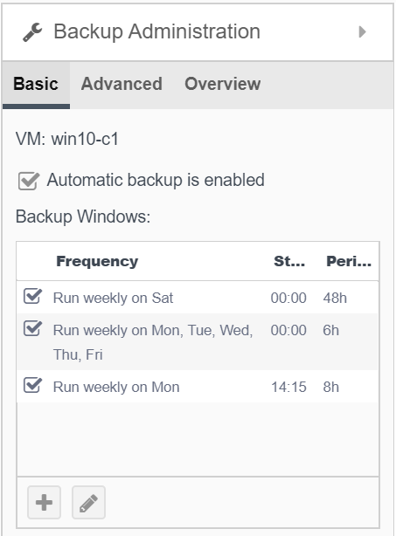
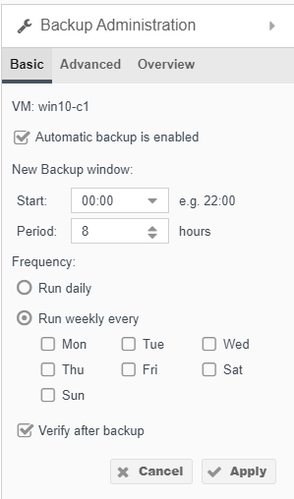
彈性排程規劃與備份完成後自動驗證
根據需求可針對同個VM設置多個排程
僅需一鍵勾選
系統自動驗證VM是否備份成功
Notes:
Flexible schedule automatic backup task and optionally perform a data verification for each backup
- Create multiple and detailed backup schedules that meet your RTO and RPO requirements
- One click to make sure that the data in the backup repository corresponds byte by byte to the actual VM state.

Slide 16
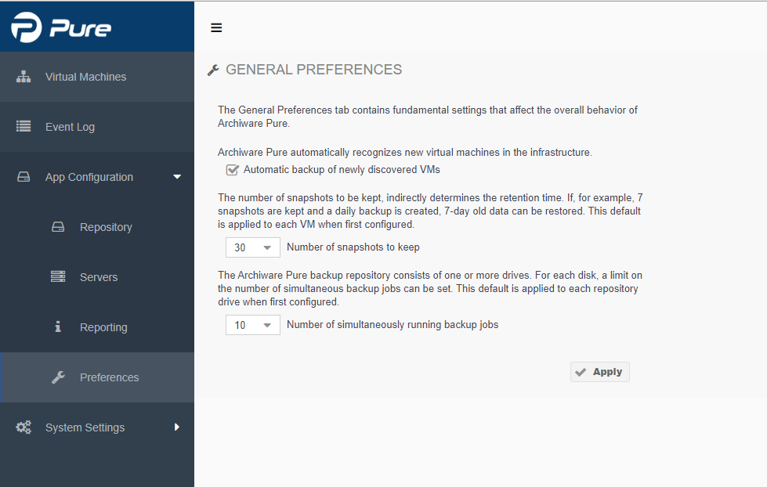
針對同一個VM可保留多達30個快照 並同時執行10個備份任務
Notes:
Keep up to 30 snapshots for the dedicated VM and perform up to 10 backup tasks at the same time

Slide 17
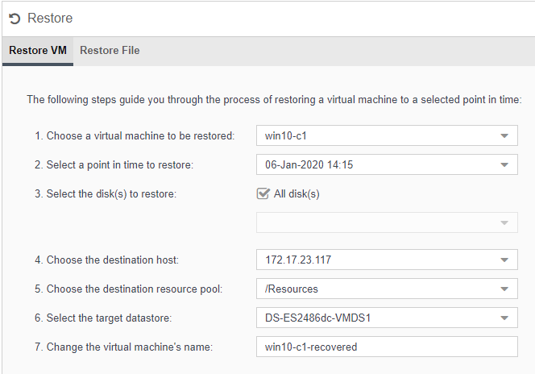
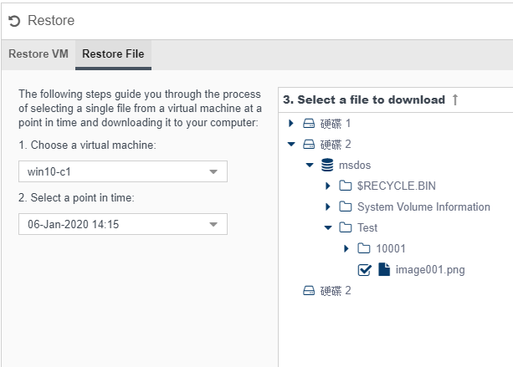
不只VM可以還原 還可針對VM內部的檔案進行還原跟立即下載
單一VM還原
VM內部檔案還原
Notes:
Not only VMs can be restored, but the dedicated file in the VM can also be
Restore a dedicated VM
Restore a single file in the VM

Slide 18
Pure 技術支援
技術支援內容:
提供一年期無數量限制的技術支援英文或德文詢問
如何購買:
可透過Archiware官方Portal線上購買
Notes:
Opional Pure Support Package
What is it?
- One-year unlimited number of technical support
- Support in English and German
How to buy?
You can purchase this service directly via Archiware Portal

Slide 19
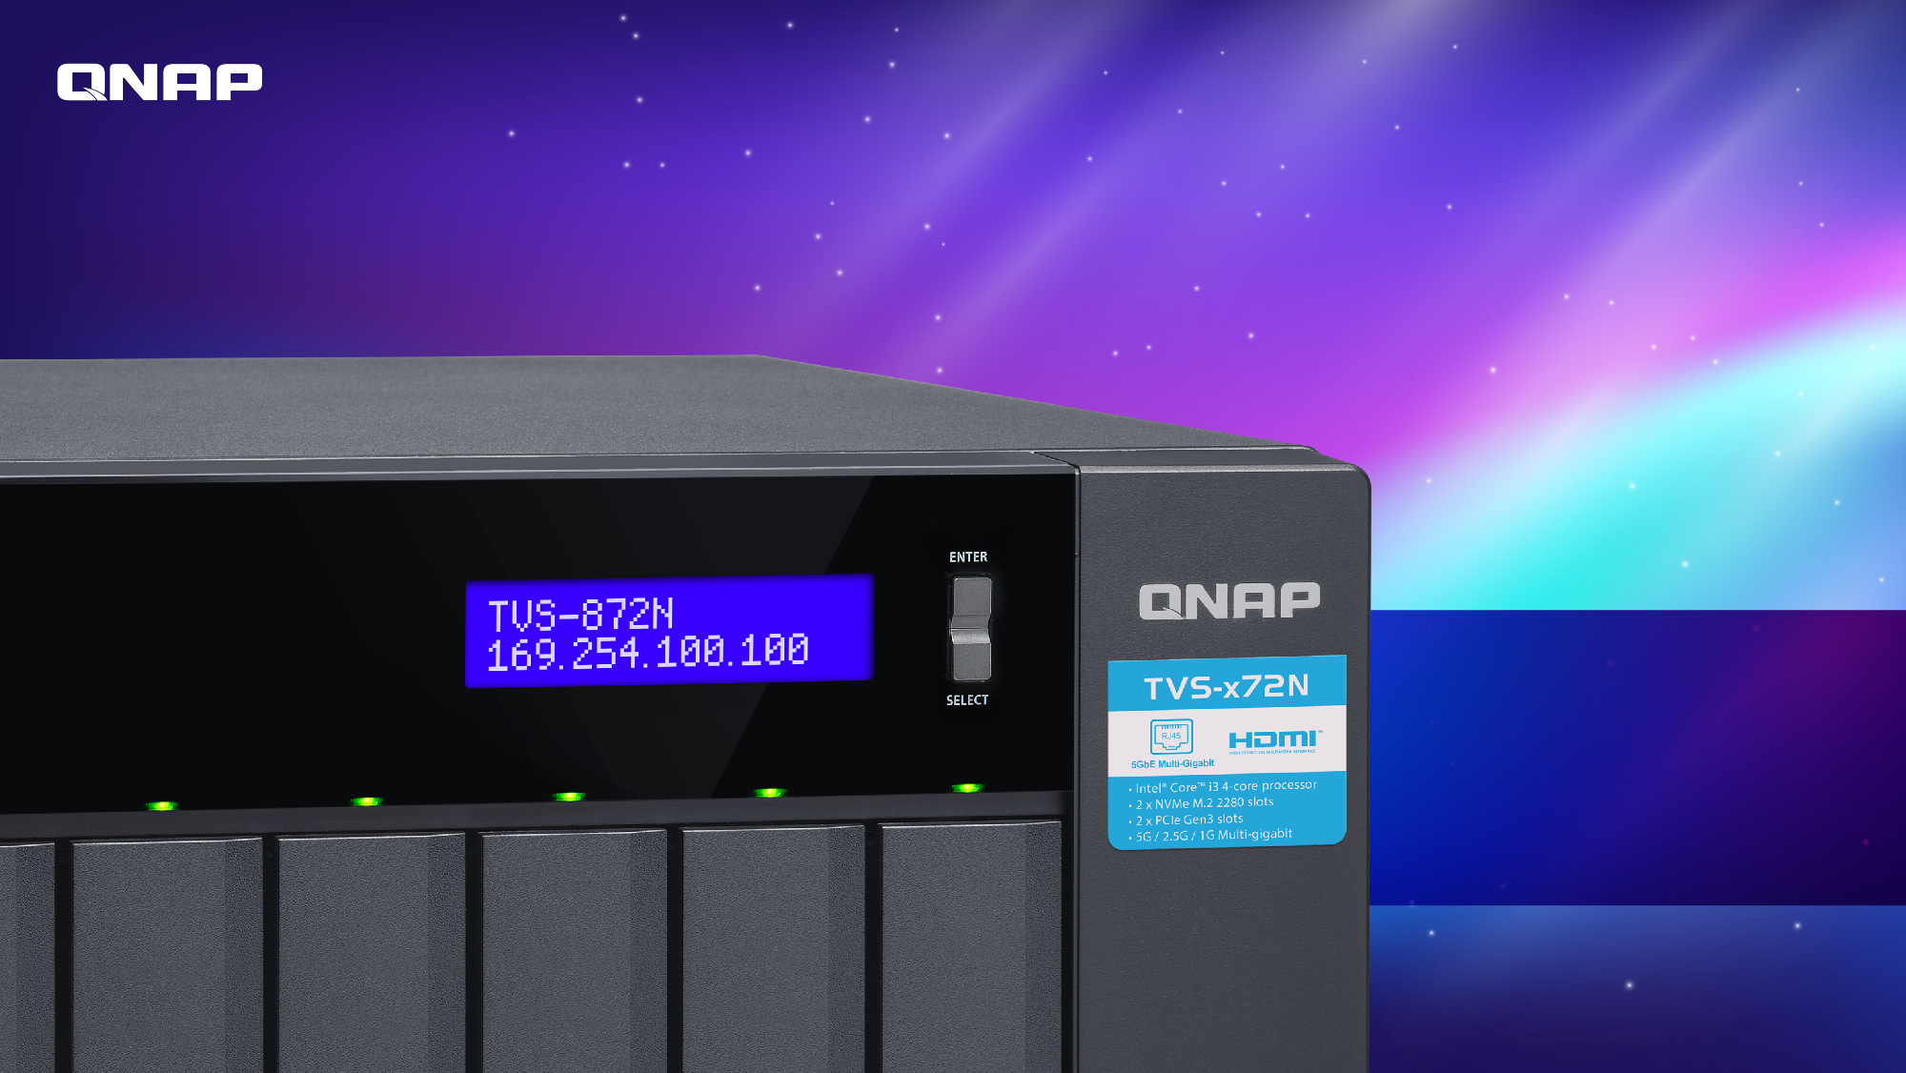
Live Demo
實機操作Part 1

Slide 20
身為影音編輯工作者，以下問題是否困擾著您 ?
隨著高解析度攝影機、相機與4K影片逐漸成為主流，這些因專案產生的龐大檔案該何去何從
在創作的過程中，擔心檔案遺失
該存在哪?
怎麼存?
未來如何再重覆利用?
Notes:
As a video editing professional, you may encounter the following problems.
Due to the increase of high resolution cameras and large 4K video demand, the incoveniences of storing large files becomes a big issue
- worry about losing your original video orimages
- where shoud it be backuped and archived?
- how to backup your videos and images securely?
- how to reuse previous files?

Slide 21
專注創作，告別煩惱 職人首選QNAP x Archiware五大理由
業界效能最強大NAS
NAS內建超實用檔案整理與搜尋工具
珍貴影音檔案多重保護
輕鬆實現3-2-1備份法則(至少3 份副本、2 種不同備份媒體、1 個異地儲存)，影音檔案不再隨便搞失蹤
支援磁帶封存，讓您除了備份到雲端，額外多一種選擇
Notes:
Let’s say goodbye to your nightmare and Focus on creation
5 Reason to use QNAP amd Archiware P5
1. The most powerful NAS
2. Built-in useful file organization and serach tool in the NAS
3. Multiple protection for precious video and image files
4. Easily implement 3-2-1 backup rule (at least 3 copies, 2 different backup media, and 1 off-site storage)
5. Support to archive NAS files to tape devices, offering you one more option besides backing up to the cloud

Slide 22
QNAP NAS是協助您打造爆紅影音最佳利器
致力於為影音編輯工作者，打造地表最強儲存，提供優化影像製作的功能，並具備資料保護、強化協作環境，帶來前所未有的高效能。
Notes:
QNAP offers the best NAS to assist you create the viral video
Provides high-speed storage solutions optimized for Video Production with vital features, data protection, enhanced collaboration and unprecedented performance.

Slide 23
超 殺 特 點
雙埠 Thunderbolt™ 3 高速傳輸，支援 SMB 協定，完美打造 Mac® 與 Windows® 使用者影音編輯協作環境。
支援Thunderbolt
支援PCIe擴充
支援M.2 PCIe SSD
4K Ready
快照
PCIe 擴充多元應用，可安裝圖形顯示卡或 40GbE/ 25GbE/ 10GbE 網路卡增添應用效能。
NVMe SSD 雙插槽，可作為快取應用或配置高速儲存池，提升檔案存取效率。
4K 影音播放與即時轉檔；透過 HDMI 2.0 (4K @60Hz) 輸出影音檔案剪輯成果至大螢幕觀賞。
快照完整記錄系統狀態及資料，當意外發生時，可透過快照將系統迅速還原至正常狀態。
推薦機種: TVS-872XT
Notes:
Killer Features:
Support Thunderbolt
Thunderbolt™ 3 NAS features ultra-high transfer speeds, making collaboration between Mac and Windows users faster and simpler
PCIe Expandability:
Allows for graphics cards or 40GbE/ 25GbE/ 10GbE adapters to increase application performance.
Support M.2 PCIe SSD:
Install M.2 PCIe (Gen 3 x2, 2 GB/s) NVMe SSDs (sold separately) to set up caching or storage pools, improving file access efficiency.
4K Ready:
4K media playback and real-time transcoding; directly view creative works on an HDTV via HDMI 2.0 (4K @60Hz) output.
Snapshots: Fully record system status and data, allowing you to protect files and data from accidental deletion and malware attacks.
Recommended model: TVS-872XT

Slide 24
TVS-872XT 效能無與倫比
Read
1230 MB/s
Write
1209 MB/s
測試環境:
NAS: TVS-872XT OS：QTS 4.4.0 Volume type: RAID 5; 8 x SAMSUNG SSD 860 PRO 512GB Mac-NB： MacBook Pro® (15-inch, 2016), Intel® Core™ i7 2.9GHz CPU, macOS: 10.13.5 High Sierra, 16GB RAM AJA System Test (Version 2.1) resolution 5120*2700 5K RED and 10bit YUV (1GB) codec
Notes:
TVS-872XT offering unprecedented performance for media editing
Thunderbolt™ 3 Single Port Performance (AJA System Test with MacBook Pro)
Test Environment: NAS: TVS-872XT OS：QTS 4.4.0 Volume type: RAID 5; 8 x SAMSUNG SSD 860 PRO 512GB Mac-NB： MacBook Pro® (15-inch, 2016), Intel® Core™ i7 2.9GHz CPU, macOS: 10.13.5 High Sierra, 16GB RAM AJA System Test (Version 2.1) resolution 5120*2700 5K RED and 10bit YUV (1GB) codec

Slide 25
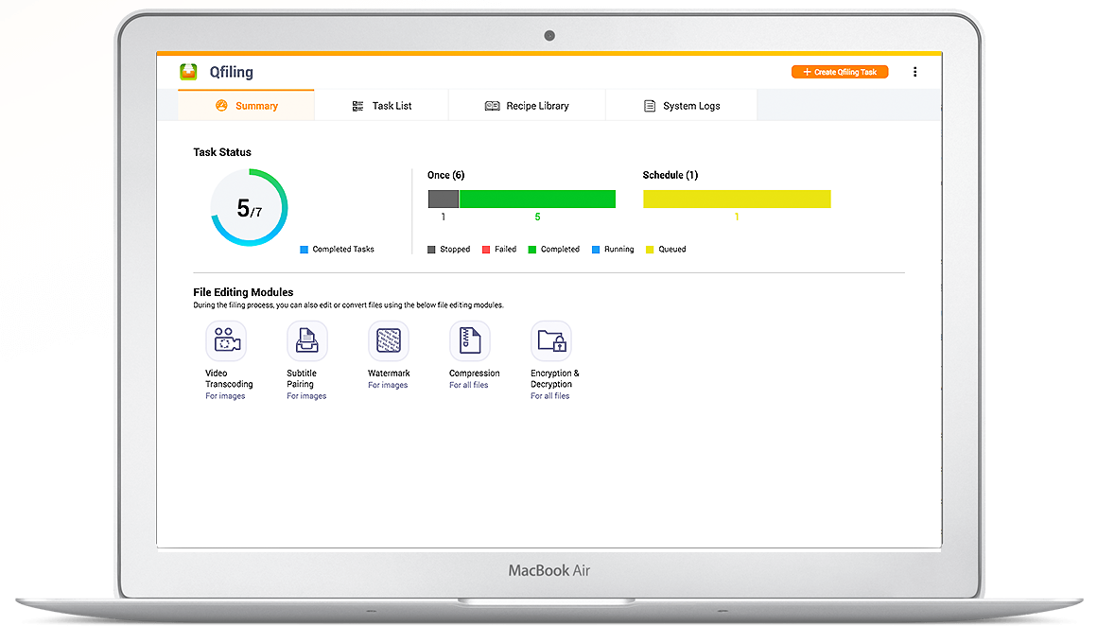
QTS內建 Qfiling 超實用檔案整理術 讓惱人檔案整理工作自動化
三步驟，量身打造您的歸檔規則
步驟 1
Qfiling 提供豐富的篩選條件，如：檔名關鍵字、檔案大小、檔案修改日期等各式條件，讓您輕鬆設定，指定需要歸檔的檔案。
步驟 2
Qfiling 提供實用的檔案編輯模組，讓您在歸檔的同時，一次搞定轉檔、加密、壓縮檔案等任務。
步驟 3
設定目的路徑、歸檔結構，以及其他歸檔細節，如：重新命名所有歸檔的檔案，讓檔案自動歸位。
Notes:
QTS Built-in Qfiling
Super useful file organization tool to automate time-consuming archiving
Create your Qfiling rules in 3 steps
Step 1
Qfiling provides various filters to determine the files you want to organize, including file name, file size, modified date and more.
Step 2
Several editing modules are available for you automate the editing task throughout the file organization process, including video transcoding, encryption & decryption, compression and more.
Step 3
Set the destination path, folder structure, and add more options (such as renaming all the files) and your files will automatically be organized to the right folder.

Slide 26
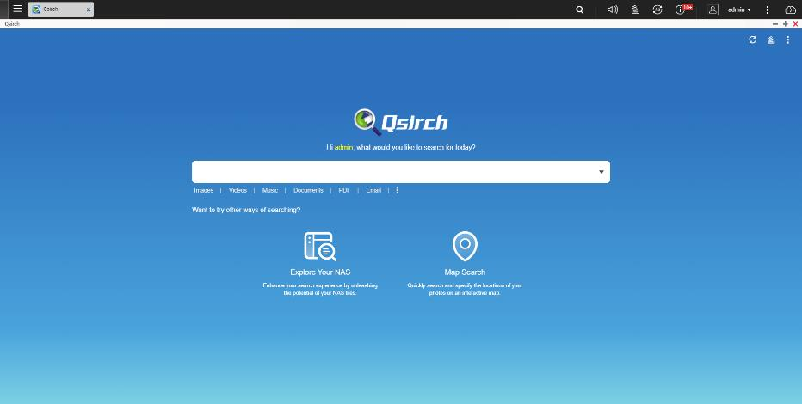
QTS內建 Qsirch 專屬檢索搜尋引擎 協助您在茫茫大海中找到對的檔案
啟用 Qsirch 後，系統將自動檢索在 NAS 上所有的檔案，讓檔案搜尋更快更好用。Qsirch 及 QTS 系統共用相同的隱私權設定，每個使用者只能搜尋到自己有存取權限的檔案。管理者可彈性將機密性的共享資料夾設定成不被檢索，確保機敏資料安全性。管理者還可將備份資料夾排除在檢索名單內，降低占用 NAS 系統資源。
Notes:
QTS Built-in Qsirch
Assist you to efficiently find the right file
After Qsirch is enabled, it will automatically index all the files on NAS, allowing users to quickly find the files they need anytime. Qsirch and QTS share the same privilege settings, so users can only find the files which they are authorized to. Admin can flexibly remove Qsirch shared folders from getting indexed to protect sensitive data. The Admin can also exclude backup folders from getting indexed to avoid using too much system resource.

Slide 27
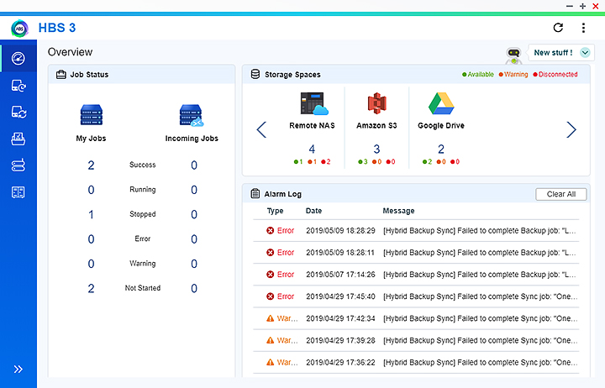
全新 HBS 3 重複刪除，多雲備份，即時回復
QuDedup 黑科技加持，大幅降低備 份及還原時間
備份時間夠短，多版本備份才有意義
使用 QuDedup Extract Tool，數 十 TB 大檔可攜可視
支援 TCP BBR，雲端備份提速翻倍
完整支援雲端物件儲存
輕鬆搞定 3-2-1 備份計畫
Notes:
HBS 3
Multi-cloud backup, data deduplication, instant restoration and flexible synchronization
QuDedup greatly reduces backup and recovery time
Back up multiple versions even faster
Directly view deduped data on computers using the QuDedup Extract Tool
Expedited cloud backup with TCP BBR supported
Over 20 integrated cloud services
Easy to build your 3-2-1 backup strategy and recovery plan

Slide 28
HybridMount 混合雲檔案型網關 支援影音檔案上雲，讓公有雲做您的後盾
Structure Transform
SMB/AFP
Object cloud storage spaces
NAS
Devices
Notes:
HybridMount Hybrid-Cloud File-Based Gateway
supports SMB, NFS, and AFP file transfer protocols for mounting the NAS to your PC. The NAS cloud storage gateway now allows you to seamlessly access cloud-based files on your PC.

Slide 29
檔案備份、封存、同步該選擇哪個
備份 | 封存 | 同步
有備有心安，在影音創作的過程中隨時備份以避免不時之需 | 當作品完成後，我要妥善保存起來，未來也須可以再利用其中的素材 | 在本地與遠端之間即時分享檔案，檔案可能在兩地都有做修改。例如影音編輯共同協作
需求 | 同檔案多版本保存 檔案存取權控制 異地備份到其他NAS或公有雲 | 長期封存到外接式磁帶機或磁帶櫃上 自動連同檔案索引也封存，未來可以方便進行搜索和檢索 | 無須還原的動作 及時異地同步 支援公有雲
QNAP X Archiware P5 可以輕鬆滿足以上全部的需求
Notes:
Backup vs Archive vs Synchronize
Which should you choose?
Backup:
Duplication of data used for daily production
Requirements:
•Multiple file versions protection
•Access rights and ACLs backup
•Offsite backup to another NAS or public cloud
ArchiveL
Migration of finished productions
Requirements:
•Data archive to tape for long-term protection
•Automatic backup of archive indexes for effective search and retrieval
Synchronize
A way to keep data sets identical in two locations (data distribution locally or worldwide) including failover
Requirements:
•No restore is required
•Sync to remote location
•Cloud enabled
QNAP X Archiware P5 can easily meet all the above needs

Slide 30
您也可選擇使用功能齊全的Archiware P5 做為影音編輯備份幫手
Backup
Archive
Synchronize
Backup2Go
創建多個檔案副本，當有需要時能快速進行還原
遷移較不常使用的影音檔案到LTO磁帶或是公有雲
與異地裝置進行同步，提供故障轉移的解決方案
備份電腦的檔案到集中管理的NAS
提供30天試用版，之後可選購單一模組或是同時啟用所有模組在同一台NAS上
Notes:
You could choose the fully featured Archiware P5 as a backup assistant
Backup
Create secure copies of files for quick restoration
Archive
Migrate inactive NAS data offline to cost-effective LTO tape or Cloud
Synchronize
Clone time-critical data to create a failover solution
Backup2Go
Backup desktop and laptop data to central NAS
Offer 30-day trial version, after that you can buy a single module or enable all modules on the same NAS at the same time

Slide 31
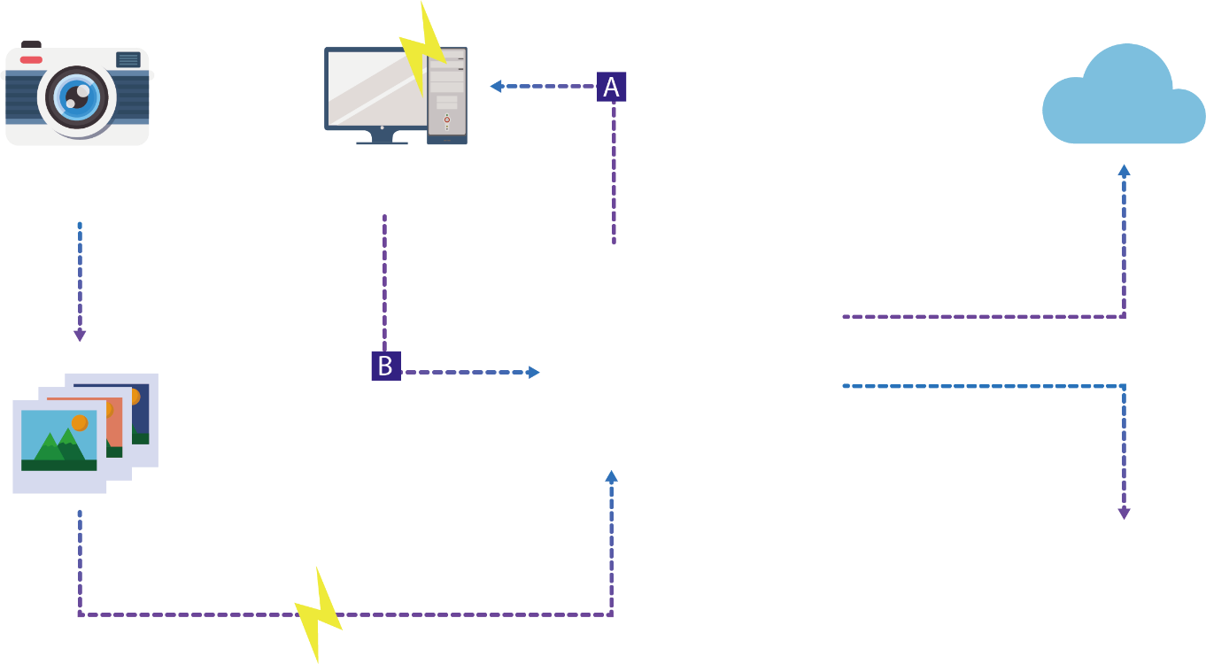
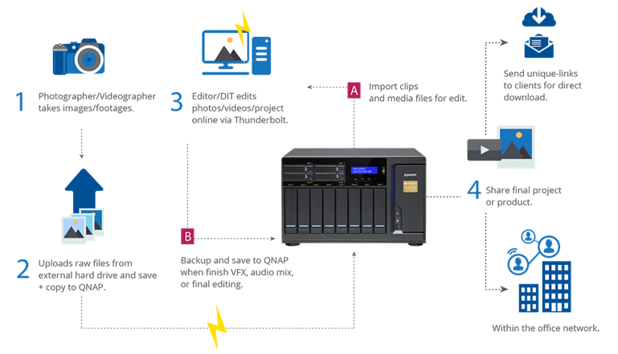
QNAP X Archiware P5 透過完善的備份與歸檔來優化影音編輯製作
Import clips and media files for edit
1
Photographer/Videographer takes images/footages
3
Editor/DIT edits photos/videos/project online via Thunderbolt
Backup/Archive to Cloud for long-term storage or public share
Backup and save to QNAP when finish VFX, Audio mix or final editing
4
Share or backup/archive final project or product
2
Uploads raw files from external hard drive and save + copy to QNAP
Archive to Tape
Notes:
QNAP X Archiware
Optimize video editing flow with comprehensive backup and archival

Slide 32
P5 支援哪些備份目標設備?
磁碟陣列
磁帶
公有雲
Amazon S3 / Amazon Glacier
Microsoft Azure / Backblaze B2
任何與S3相容
(Wasabi, 阿里雲)
相容所有世代LTO磁帶機、磁帶櫃
任何NAS或SAN供應商
Notes:
Target Storage Support by P5
Disk Array
Any NAS and SAN storage vendor
Tape
All LTO generations Tape drive and library
Cloud
Amazon S3
Amazon Glacier
Microsoftware Azure
Backblaze B2
Any S3 compatible (Wasabi, Alibaba)

Slide 33
該如何選擇合適的模組
取決於「您可以忍受要等待多久的時間取回檔案」
Minutes | Cloning/ Failover NO Restore necessary
Hour(s) | Backup to Disk or Tape or Cloud
Day(s) | Long-term Archiving with off-site Storage to Tape or Cloud
Synchronize
Backup
Archive
Notes:
Which module is right for you?
Depends on 'How long can you be without your data?'

Slide 34
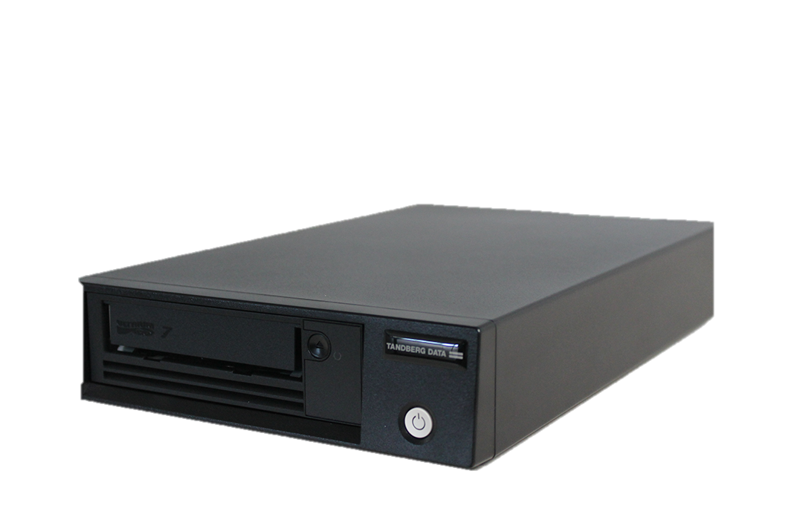
老兵越戰越勇 揭密復古科技「磁帶」的超強優勢
超高安全性
數據資料無法被駭客輕易竄改和抹除，對於數據安全性有較高要求的企業和機構比如銀行、保險公司、國家檔案館，以及科研機構等，其實也還在使用磁帶儲存數據。
不容質疑的耐用和穩定性
相較於使用、存放了數年的硬碟就有磁碟壞軌的可能性，一捲正常使用且保存完善的磁帶壽命可達到數十年 ，對於有資料需要長期保存或是保管的單位來說，磁帶比起硬碟是更好的選項。
Notes:
Tape Backup Advantages You Shoud Know About
1. High security
Data cannot be easily stolen and erased by hackers from outside. Enterprise and institutions, such as banks, insurance copmanies national file archive and scientific research institutions, that have much more concerns about data security still use tape to backup and archive data
2. Incredible durability and stability
Compared with hard drives, a normal-used and well-preserved magnetic tape can be used for decades.

Slide 35
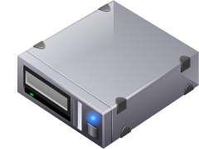
資料長期保存新選擇 您可以透過P5將NAS的資料封存到磁帶
Centralized File Management
SMB/CIFS
NFS
Backup
Archive
AFP
Shared Folders
Archiware P5
SAS Direct Attach Cable
Tandberg Data standalone tape drive
QTS 4.3+
Notes:
New option for long-term data storage: You can archive NAS data to tape devices via P5

Slide 36
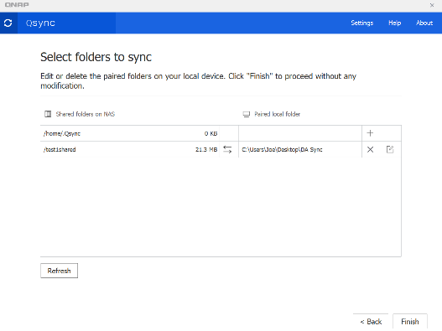
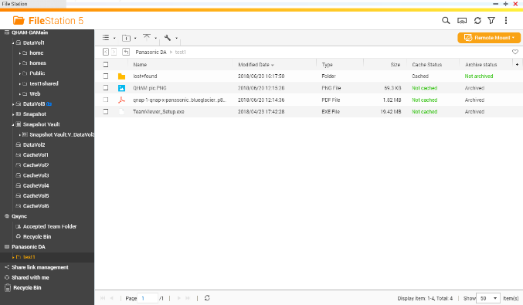
整合QNAP應用程式 完整管理您的影音檔案生命週期
資料生命週期
資料產生
檔案管理
Qsync 將用戶端資料同步至NAS
File Station 有效管理目前儲存於NAS的檔案
QNAP軟體應用
Notes:
Manage Media File Life Cycle Through QNAP Applications
Data Life Cycle
QNAP Applications
Data Generated
Qsync
Sync client data to NAS
File management
File Station
Manage all files stored in NAS

Slide 37
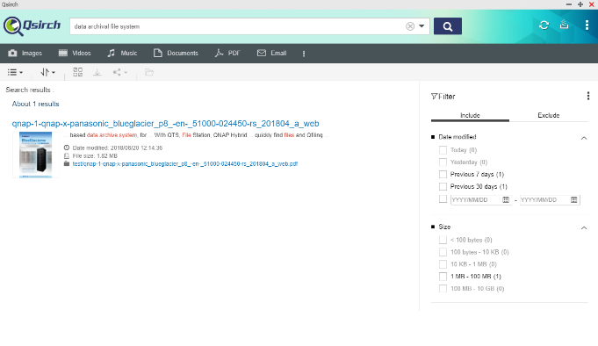
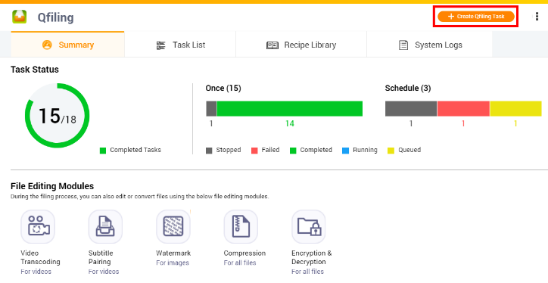
整合QNAP應用程式 完整管理您的影音檔案生命週期
資料生命週期
快速搜尋資料
檔案重新整理
檔案管理
Qsirch 在不停累積的海量資料中快速找到需要的資訊
Qfiling 重新分類並歸檔
QNAP軟體應用
Notes:
Manage Media File Life Cycle Through QNAP Applications
Data Life Cycle
File Mgmt.
QNAP Applications
Bulk Data
Qsirch
Search desire information from accumulating files
File re-organized
Qfiling
automates your file organization. All you need to do is categorize your files, set a schedule

Slide 38
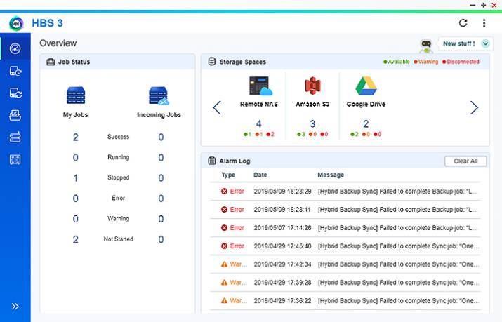
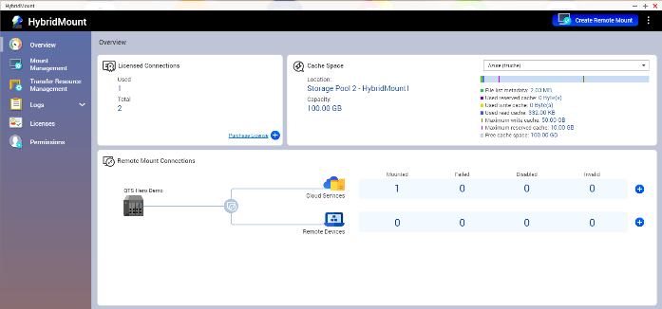
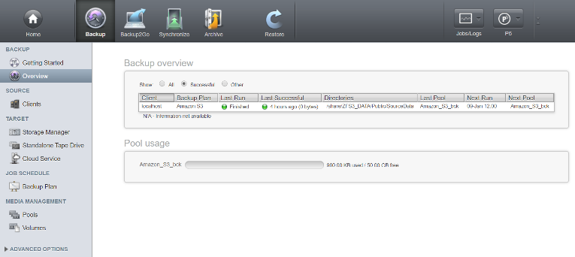
整合QNAP和P5應用程式 完整管理您的影音檔案生命週期
資料生命週期
備份或是封存到雲
檔案管理
QNAP / Archiware 軟體應用
HybridMount / HBS3/ Archiware P5
Notes:
Manage Media File Life Cycle Through QNAP and P5 Applications
Data Life Cycle
File Mgmt.
QNAP & Archiware Applications
Backup or Archive to Cloud

Slide 39
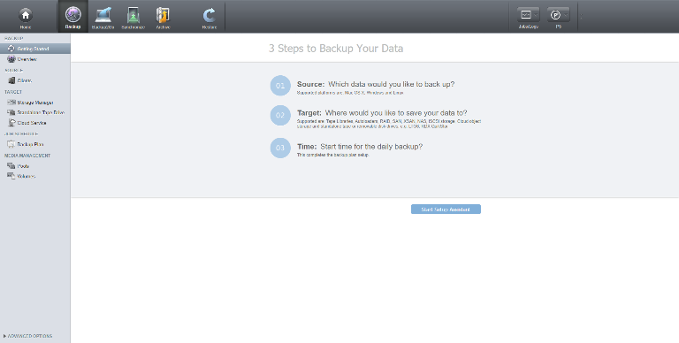
整合P5應用程式 完整管理您的影音檔案生命週期
資料生命週期
封存到磁帶
檔案管理
Archiware P5 Easy archive file to tape
Archiaware 軟體應用
磁帶機或磁帶櫃
Notes:
Manage Media File Life Cycle Through P5 Applications
Data Life Cycle
File Mgmt.
Archiware Applications
Archive to Tape
Tape drive or library

Slide 40
Live Demo
實機操作Part 2

Slide 41
QNAP x Archiware 是您資料保護的最佳選擇
©2020著作權為威聯通科技股份有限公司所有。威聯通科技並保留所有權利。威聯通科技股份有限公司所使用或註冊之商標或標章。檔案中所提及之產品及公司名稱可能為其他公司所有之商標
Notes:
QNAP X Archiware
Best Backup Solution to Secure Your VMs and Digital Assets

