Slide 1
Notes:
QNAP x Achiware P5 and Pure as an ultimate backup solution

Slide 2
Agenda
Part 1
Part 2
1. Does VM backup drive you crazy?
2. 5 reasons to back up VMs with QNAP and Archiware Pure
3. Detailed function introduction
4. Live demo
1. Backup challenges for media and entertainment industries
2. 5 reasons to back up media files with QNAP and Archiware P5
3. Detailed function introduction
4. Live demo
Notes:
Agenda
Part 1:
1. Does VM backup drive you crazy?
2. 5 reasons to backup VM with QNAP and Archiware Pure
3. Detailed function introduction
4. Live demo
Part 2:
1. Backup challenges for media and entertainment industry
2. 5 reasons to backup media files with QNAP and Archiware P5
3. Detailed function introduction
4. Live demo

Slide 3
Archiware Product Overview
Pure assists you turn QNAP NAS into a backup appliance, and efficiently create a permanent and free VMware virtual machine backup environment
P5 is suitable for the M&E industry, assisting you back up, archive, and synchronize QNAP NAS files to other NAS, tape or public cloud
Notes:
Archiware Overview
Pure assists you turn QNAP NAS into a backup appliance and efficiently create a permanent and free VMware virtual machine backup environment
P5 is suitable for the M&E industry, assisting you backup, archive, and synchronize QNAP NAS files to other NAS, tape or public cloud

Slide 4
VM Backup Giving You Headaches?
Backing up VMware VM is important, but you may encounter the following problems...
Not enough budget to buy backup software
No additional free server
Taking too long to install and configure
Not sure if previous backups were successful
Notes:
Love and Hate VM Backup?
To backup VMware VM is important but you may encounter the following problems...
- no enough budget to buy backup software
- no additional free server
- take a long time to install and configure
- do not know if the previous backups were successful

Slide 5
5 Reasons to Use QNAP and Archiware
1 Hardware and software close integration
2 Free software with full functionality
support unlimited number of ESXi hosts
support unlimited number of virtual machines
optional (paid) technical support
3 No need to deploy additional server for backup
4 Five-minute installation and setup
5 Optionally perform a data verification for each backed up snapshot
Let us simplify the VM backup so that you can focus on other important tasks
Notes:
5 reasons to use QNAP and Archiware
1. Hardware and software deep integration
2. Free software with full functionality
- support unlimited number of ESXi hosts
- support unlimited number of virtual machines
- optional paid for technical support
3. No need to find one additional server for backup
4. 5-minute installation and setup
5. Optionally perform a data verification for each backup snapshot
Let us simplify the VM backup so that you can focus on other important tasks

Slide 6
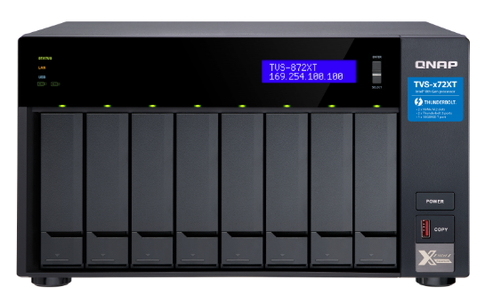
Turn Your NAS into a VM Backup Appliance in Seconds
VM
VM
VM
VMware ESXi
VM
VM
VM
VMware ESXi
Pure running on QNAP NAS
No need for additional server and storage
Notes:
QNAP X Archiware Pure
Turn your NAS into a VM backup appliance in seconds
Pure running on QNAP NAS
No need additional backup server and storage

Slide 7
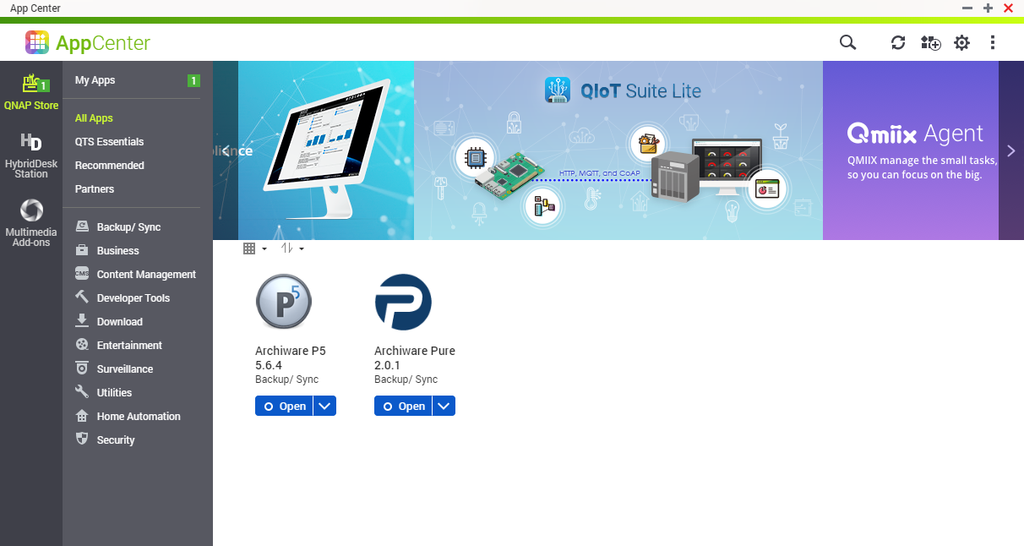
App Center One-click Installation Enjoy Your VM Backup Journey Immediately
Notes:
One-click installation in AppCenter to enjoy your VM backup journey immediately

Slide 8
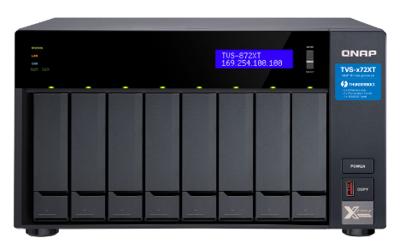
QNAP Advanced Technology to Protect Your VM and Data
Easy to build your 3-2-1 backup Plan
HybridMount, VJBOD Cloud, HBS 3
Snapshot
RAID
Notes:
QNAP NAS Advanced Technology to Protect Your VM and Data
HybridMount VJBOD Cloud, HBS 3 – Easy to build your 3-2-1 backup strategy and recovery plan
Snapshot
RAID

Slide 9
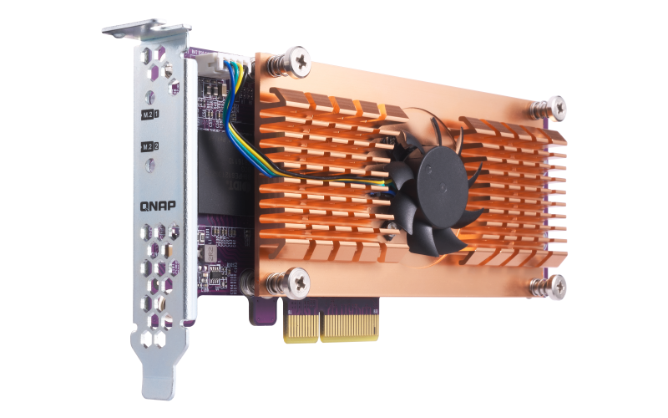
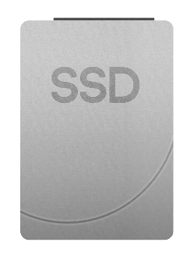
Support SSD Configuration to Boost Your VM Backup
SSDs for Hot Data
HDDs for Cold Data
QM2 Expansion Card
(Add M.2 SSD Slots)
Notes:
Support SSD Configuration to boost your VM Backup
QM2 Expansion Card (Add M.2 SSD Slots)
SSDs for Hot Data
HDDs for Cold Data

Slide 10
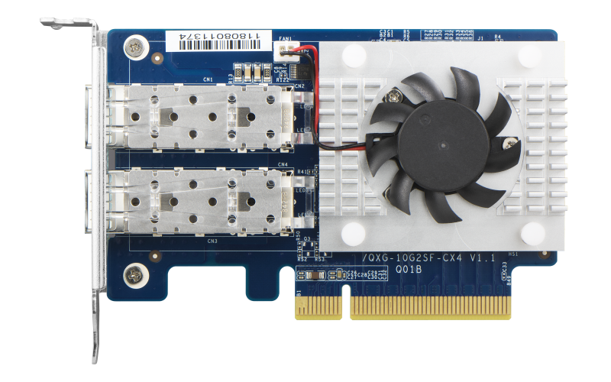
Support for Building High-speed Backup Networks and Speeding up Data Transfer
Versatile PCIe NIC expansion options for 40GbE/ 25GbE/ 10GbE
Notes:
Support to build high-speed backup networks and speed up data transfer
Multiple PCIe options for network interface 40GbE/ 25GbE/ 10GbE

Slide 11
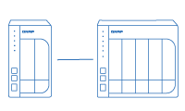
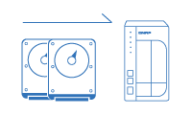
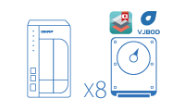
Flexible and Economical Storage Expansion
Attach Expansion Enclosures
Upgrade RAID Capacity
VJBOD
Hot swap lower-capacity drives with larger-capacity drives so that your QNAP NAS can grow with your business.
Use VJBOD (Virtual JBOD) to expand your storage capacity by using the unused storage of other QNAP NAS. Up to 8 QNAP NAS can be mounted as local disks on the NAS.
Notes:
Flexible and economical storage expansion
Attach Expansion Enclosures
Upgrade RAID Capacity: Hot swap lower-capacity drives with larger-capacity drives so that your QNAP NAS can grow with your business.
VJBOD: Use VJBOD (Virtual JBOD) to expand your storage capacity by using the unused storage of other QNAP NAS. Up to 8 QNAP NAS can be mounted as local disks on the TVS-872XT.

Slide 12
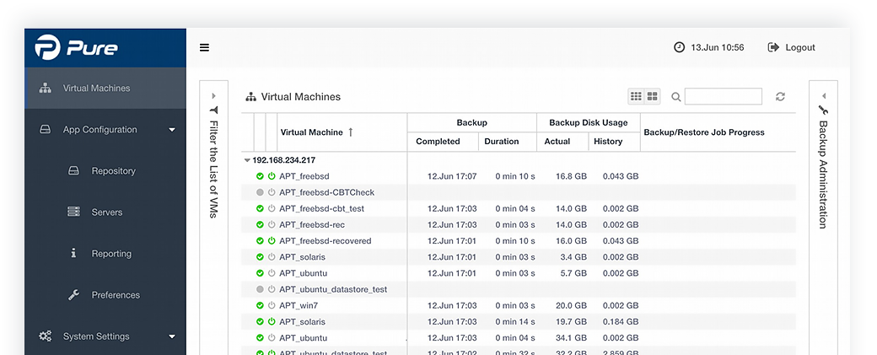
Browser-based Setup and Operation to Get All Backup Tasks Done
Notes:
The smartest way to maage VM backup
Get All tasks down just through a web browser

Slide 13
VMware VM Backup for FREE
Archiware Pure | Others
Support unlimited number of ESXi Support unlimited number of VMs Enjoy full functionality Optional technical support (199USD/yr) | ☹Complicated pricing models - by CPU or core number - by VM number ☹Features are locked based on license types ☹Annual subscription fee
Notes:
VMware VM backup for FREE
No annoying restrictions and complicated pricing models
Archiware Pure
- support unlimited number of ESXi hosts
- support unlimited number of virtual machines
- enjoy full functionality
- optional paid for technical support (199USD/yr)
Others
- complicated pricing models
● by CPU or core number
● by VM number
- Some features are locked based on license types
- Annual subscription fee

Slide 14
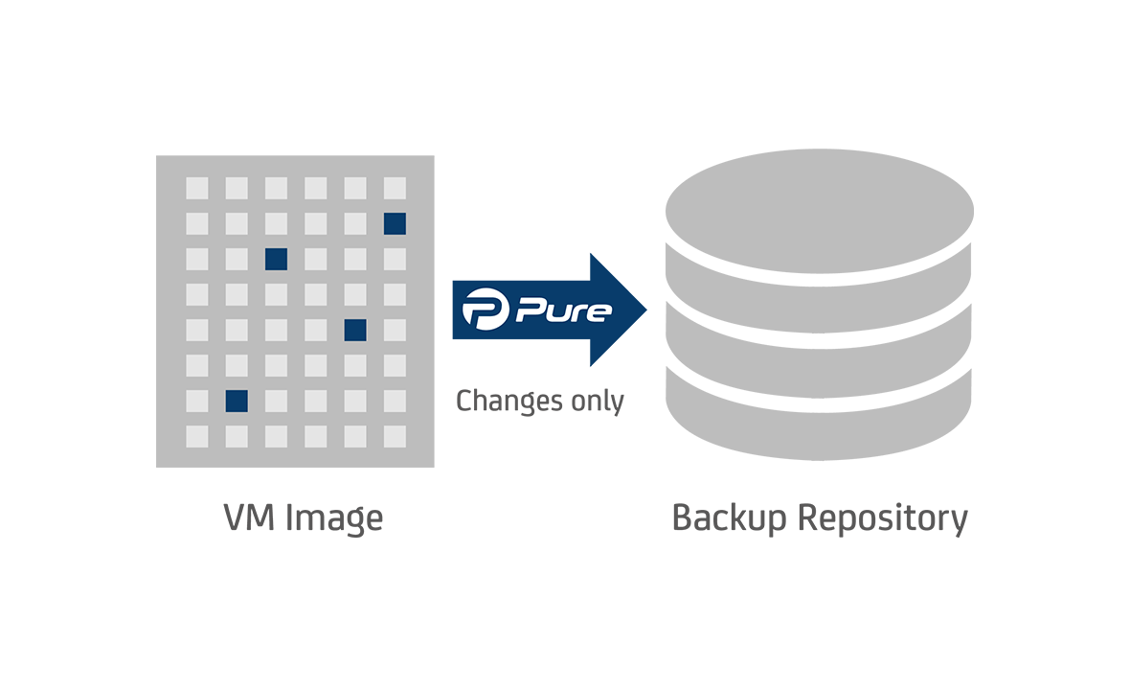
Changed Block Tracking
Only save the data that was actually changed since the last backup, speeding up backups and decreasing the required storage
Notes:
All backups use Changed Block Tracking technology which enables Pure to only save the data that was actually changed since the last backup, speeding up backups and decreasing the required storage size.

Slide 15
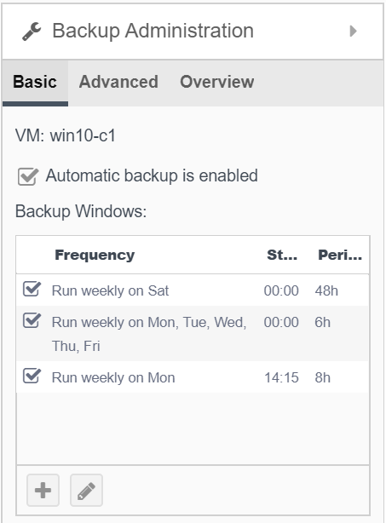
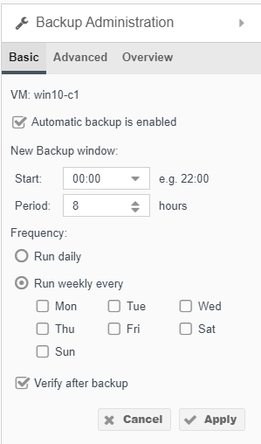
Flexible Backup Task Schedule and Smart Data Verification
Create multiple and detailed backup schedules that meet your RTO and RPO requirements
One click to ensure that the data in the backup repository corresponds byte by byte to the actual VM state.
Notes:
RTO (Recovery Time Objective，復原時間目標)是數據中心可容許服務中斷的時間長度。
RPO（Recovery Point Objective，復原點目標）是指數據中心能容忍的最大數據丟失量

Slide 16
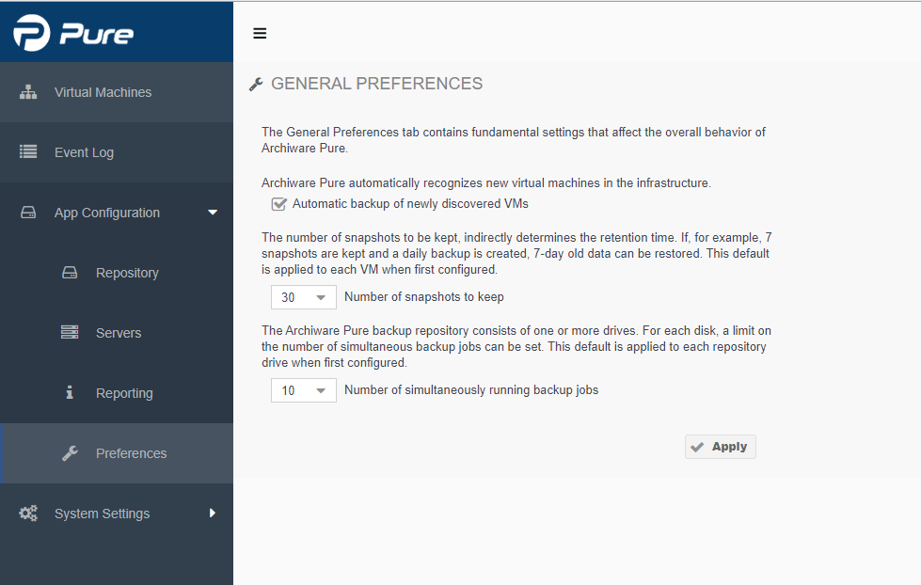
Support Multiple Backup Tasks
Notes:
Keep up to 30 snapshots for the dedicated VM and perform up to 10 backup tasks at the same time

Slide 17
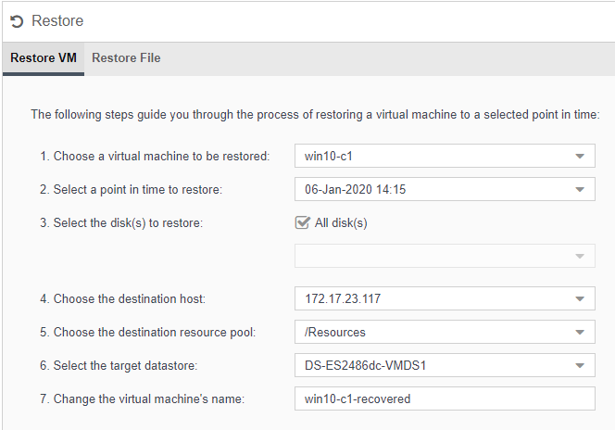
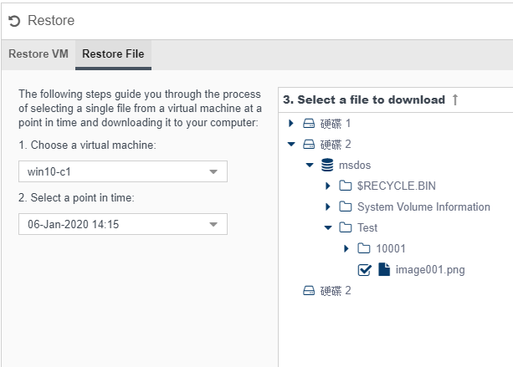
Not Only VMs Can be Restored, But Also Specific File(s) in the VM
Restore a dedicated VM
Restore specific file(s) in the VM
Notes:
Not only VMs can be restored, but the dedicated file in the VM can also be
Restore a dedicated VM
Restore a single file in the VM

Slide 18
Optional Pure Support Package
What is it?
One-year unlimited number of technical support
Support in English and German
How to buy?
Purchase the service directly via Archiware Portal
Notes:
Opional Pure Support Package
What is it?
- One-year unlimited number of technical support
- Support in English and German
How to buy?
You can purchase this service directly via Archiware Portal

Slide 19
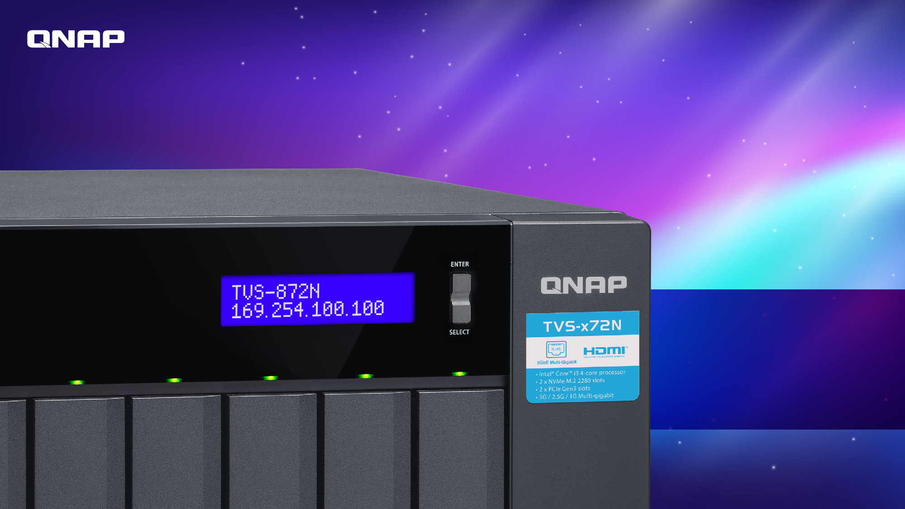
Live Demo
Part 1

Slide 20
Due to the increase of high resolution cameras and large 4K video demand, the incoveniences of storing large files becomes a big issue...
Worrying about losing your original video or images?
What's is the backup and archive destination?
How to back up your videos and images securely?
How to reuse previous files?
Notes:
As a video editing professional, you may encounter the following problems.
Due to the increase of high resolution cameras and large 4K video demand, the incoveniences of storing large files becomes a big issue
- worry about losing your original video orimages
- where shoud it be backuped and archived?
- how to backup your videos and images securely?
- how to reuse previous files?

Slide 21
5 Reason to Use QNAP and Archiware P5
The most powerful NAS
Built-in useful file organization and search tools in the NAS
Multiple protections for precious video and image files
Easily implement the 3-2-1 backup rule (at least 3 copies, 2 different backup media, and 1 off-site storage)
Support NAS file archiving to tape devices, offering you one more option besides backing up to the cloud
Notes:
Let’s say goodbye to your nightmare and Focus on creation
5 Reason to use QNAP amd Archiware P5
1. The most powerful NAS
2. Built-in useful file organization and serach tool in the NAS
3. Multiple protection for precious video and image files
4. Easily implement 3-2-1 backup rule (at least 3 copies, 2 different backup media, and 1 off-site storage)
5. Support to archive NAS files to tape devices, offering you one more option besides backing up to the cloud

Slide 22
The best NAS to help You create the next viral video
Provides high-speed storage solutions optimized for Video Production with vital features, data protection, enhanced collaboration and unprecedented performance
Notes:
QNAP offers the best NAS to assist you create the viral video
Provides high-speed storage solutions optimized for Video Production with vital features, data protection, enhanced collaboration and unprecedented performance.

Slide 23
Killer Features
Thunderbolt Ready
PCIe Expandability
Support M.2 SSD
4K Ready
Snapshot
Thunderbolt™ 3 NAS features ultra-high transfer speeds, making collaboration between Mac and Windows users faster and simpler
Allows for graphics cards or 40GbE/ 25GbE/ 10GbE adapters to increase application performance.
Install M.2 PCIe (Gen 3 x2, 2 GB/s) NVMe SSDs (sold separately) to set up caching or storage pools, improving file access efficiency.
4K media playback and real-time transcoding; directly view creative works on an HDTV via HDMI 2.0 (4K @60Hz) output.
Fully record system status and data, allowing you to protect files and data from accidental deletion and malware attacks.
Recommended Model: TVS-872XT
Notes:
Killer Features:
Support Thunderbolt
Thunderbolt™ 3 NAS features ultra-high transfer speeds, making collaboration between Mac and Windows users faster and simpler
PCIe Expandability:
Allows for graphics cards or 40GbE/ 25GbE/ 10GbE adapters to increase application performance.
Support M.2 PCIe SSD:
Install M.2 PCIe (Gen 3 x2, 2 GB/s) NVMe SSDs (sold separately) to set up caching or storage pools, improving file access efficiency.
4K Ready:
4K media playback and real-time transcoding; directly view creative works on an HDTV via HDMI 2.0 (4K @60Hz) output.
Snapshots: Fully record system status and data, allowing you to protect files and data from accidental deletion and malware attacks.
Recommended model: TVS-872XT

Slide 24
TVS-872XT Offering Unprecedented Performance for Media Editing
Read
1230 MB/s
Write
1209 MB/s
Test Environment:
NAS: TVS-872XT OS：QTS 4.4.0 Volume type: RAID 5; 8 x SAMSUNG SSD 860 PRO 512GB Mac-NB： MacBook Pro® (15-inch, 2016), Intel® Core™ i7 2.9GHz CPU, macOS: 10.13.5 High Sierra, 16GB RAM AJA System Test (Version 2.1) resolution 5120*2700 5K RED and 10bit YUV (1GB) codec
Notes:
TVS-872XT offering unprecedented performance for media editing
Thunderbolt™ 3 Single Port Performance (AJA System Test with MacBook Pro)
Test Environment: NAS: TVS-872XT OS：QTS 4.4.0 Volume type: RAID 5; 8 x SAMSUNG SSD 860 PRO 512GB Mac-NB： MacBook Pro® (15-inch, 2016), Intel® Core™ i7 2.9GHz CPU, macOS: 10.13.5 High Sierra, 16GB RAM AJA System Test (Version 2.1) resolution 5120*2700 5K RED and 10bit YUV (1GB) codec

Slide 25
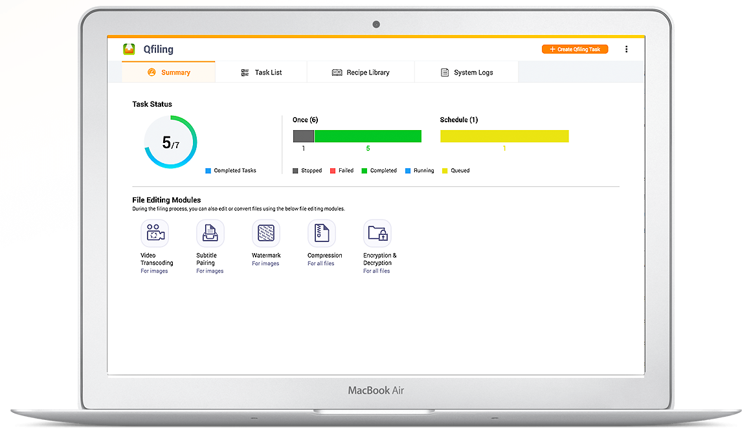
QTS Built-in Qfiling Simplified File Organization
Create your Qfiling rules in 3 steps
Step1
Qfiling provides various filters to determine the files you want to organize, including file name, file size, modified date and more.
Step2
Several editing modules are available for you automate the editing task throughout the file organization process, including video transcoding, encryption & decryption, compression and more.
Step3
Set the destination path, folder structure, and add more options (such as renaming all the files) and your files will automatically be organized to the right folder.
Notes:
QTS Built-in Qfiling
Super useful file organization tool to automate time-consuming archiving
Create your Qfiling rules in 3 steps
Step 1
Qfiling provides various filters to determine the files you want to organize, including file name, file size, modified date and more.
Step 2
Several editing modules are available for you automate the editing task throughout the file organization process, including video transcoding, encryption & decryption, compression and more.
Step 3
Set the destination path, folder structure, and add more options (such as renaming all the files) and your files will automatically be organized to the right folder.

Slide 26
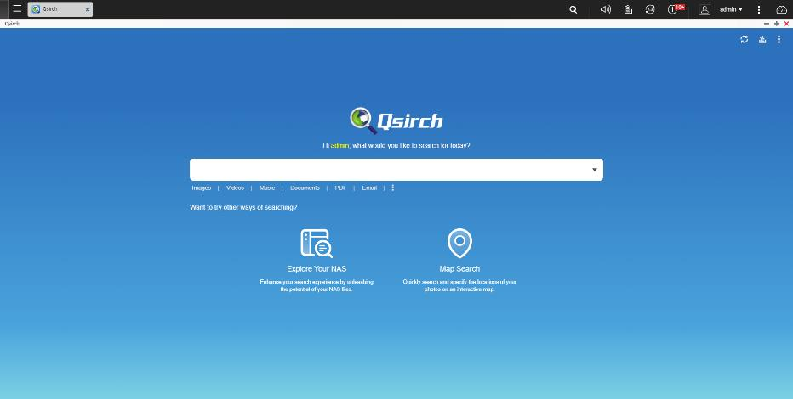
QTS Built-in Qsirch Assist You Efficiently Find the Right File
After Qsirch is enabled, it will automatically index all the files on NAS, allowing users to quickly find the files they need anytime. Qsirch and QTS share the same privilege settings, so users can only find the files which they are authorized to. Admin can flexibly remove Qsirch shared folders from getting indexed to protect sensitive data. The Admin can also exclude backup folders from getting indexed to avoid using too much system resource.
Notes:
QTS Built-in Qsirch
Assist you to efficiently find the right file
After Qsirch is enabled, it will automatically index all the files on NAS, allowing users to quickly find the files they need anytime. Qsirch and QTS share the same privilege settings, so users can only find the files which they are authorized to. Admin can flexibly remove Qsirch shared folders from getting indexed to protect sensitive data. The Admin can also exclude backup folders from getting indexed to avoid using too much system resource.

Slide 27
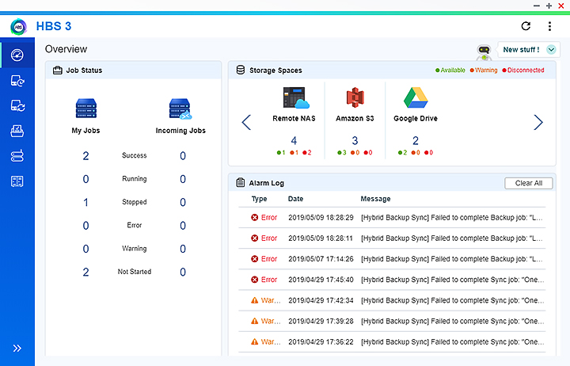
HBS 3 Multi-cloud Backup Data deduplication, instant restoration and flexible synchronization
QuDedup greatly reduces backup and recovery time
Back up multiple versions even faster
Directly view deduped data on computers using the QuDedup Extract Tool
Expedited cloud backup with TCP BBR support
Over 20 integrated cloud services
Easy to build your 3-2-1 backup strategy and recovery plan
Notes:
HBS 3
Multi-cloud backup, data deduplication, instant restoration and flexible synchronization
QuDedup greatly reduces backup and recovery time
Back up multiple versions even faster
Directly view deduped data on computers using the QuDedup Extract Tool
Expedited cloud backup with TCP BBR supported
Over 20 integrated cloud services
Easy to build your 3-2-1 backup strategy and recovery plan

Slide 28
HybridMount Hybrid Cloud File-Based Gateway
Supports SMB, NFS, and AFP file transfer protocols for mounting the cloud storage to your NAS. The NAS cloud storage gateway now allows you to seamlessly access cloud-based files on your PC.​
Structure Transform
SMB/AFP
Object cloud storage spaces
NAS
Devices
Notes:
HybridMount Hybrid-Cloud File-Based Gateway
supports SMB, NFS, and AFP file transfer protocols for mounting the NAS to your PC. The NAS cloud storage gateway now allows you to seamlessly access cloud-based files on your PC.

Slide 29
Backup vs Archive vs Synchronize What Should You Choose?
Backup | Archive | Synchronize
Duplication of data used for daily production | Migration of finished productions | A way to keep data sets identical in two locations (data distribution locally or worldwide) including failover
Needs | Multiple file versions protection Access rights and ACLs backup Offsite backup to another NAS or public cloud | Data archive to tape for long-term protection Automatic backup of archive indexes for effective search and retrieval | No restore is required Sync to remote location Cloud enabled
QNAP X Archiware P5 can easily meet all the above needs
Notes:
Backup vs Archive vs Synchronize
Which should you choose?
Backup:
Duplication of data used for daily production
Requirements:
•Multiple file versions protection
•Access rights and ACLs backup
•Offsite backup to another NAS or public cloud
ArchiveL
Migration of finished productions
Requirements:
•Data archive to tape for long-term protection
•Automatic backup of archive indexes for effective search and retrieval
Synchronize
A way to keep data sets identical in two locations (data distribution locally or worldwide) including failover
Requirements:
•No restore is required
•Sync to remote location
•Cloud enabled
QNAP X Archiware P5 can easily meet all the above needs

Slide 30
You Can Use the Fully Featured P5 as a Backup Assistant
Backup
Archive
Synchronize
Backup2Go
Create secure copies of files for quick restoration
Migrate inactive NAS data offline to cost-effective LTO tape or Cloud
Clone time-critical data to create a failover solution
Backup desktop and laptop data to central NAS
Offer 30-day trial version, you can buy a single module or enable all modules on the same NAS at the same time
Notes:
You could choose the fully featured Archiware P5 as a backup assistant
Backup
Create secure copies of files for quick restoration
Archive
Migrate inactive NAS data offline to cost-effective LTO tape or Cloud
Synchronize
Clone time-critical data to create a failover solution
Backup2Go
Backup desktop and laptop data to central NAS
Offer 30-day trial version, after that you can buy a single module or enable all modules on the same NAS at the same time

Slide 31
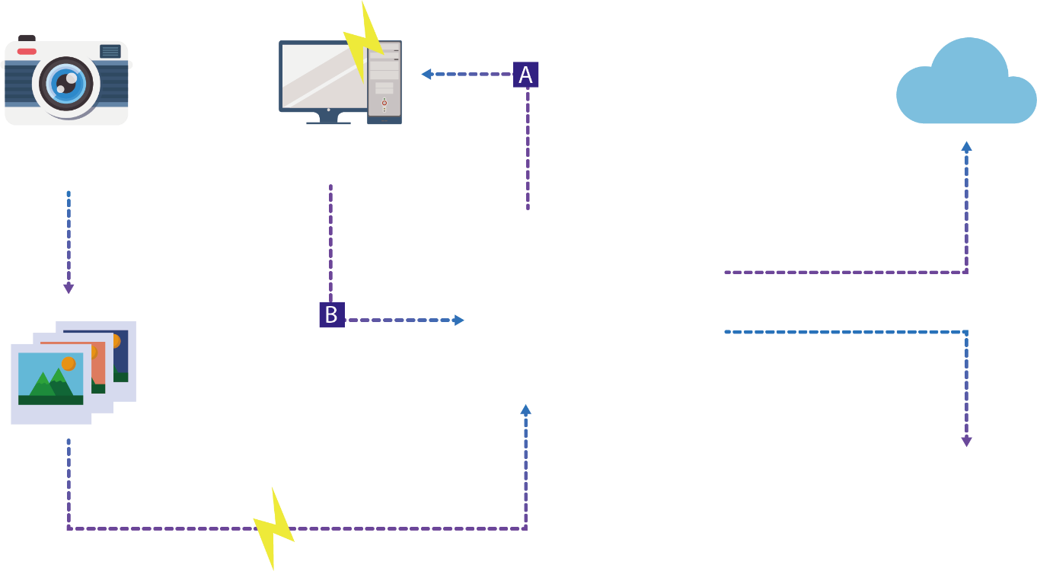
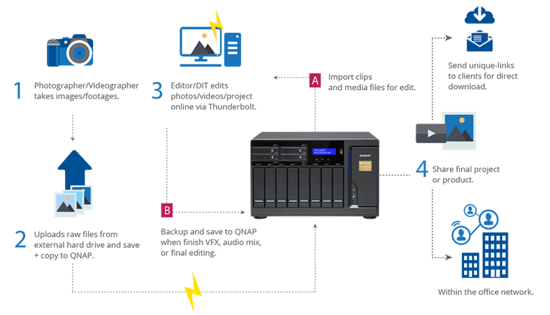
QNAP X Archiware P5 Optimize Your Media Editing Work Flow
Import clips and media files for edit
1
Photographer/Videographer takes images/footages
3
Editor/DIT edits photos/videos/project online via Thunderbolt
Back up/Archive to Cloud for long-term storage or public share
Backup and save to QNAP NAS when finish VFX, audio mix or final editing
4
Share or back up/archive final project or product
2
Uploads raw files from external hard drive and save + copy to QNAP
Archive to Tape
Notes:
QNAP X Archiware
Optimize video editing flow with comprehensive backup and archival

Slide 32
Target Storage Supported by P5
Disk Array
Tape
Cloud
Amazon S3 / Amazon Glacier
Microsoft Azure / Backblaze B2
Any S3 compatible (Wasabi, Alibaba)
All LTO generations Tape drive and library
Any NAS and SAN storage vendor
Notes:
Target Storage Support by P5
Disk Array
Any NAS and SAN storage vendor
Tape
All LTO generations Tape drive and library
Cloud
Amazon S3
Amazon Glacier
Microsoftware Azure
Backblaze B2
Any S3 compatible (Wasabi, Alibaba)

Slide 33
Which Module is Right for You?
It depends on 'How long can you be without your data?'
Minutes | Cloning/ Failover NO Restore necessary
Hour(s) | Backup to Disk or Tape or Cloud
Day(s) | Long-term Archiving with off-site Storage to Tape or Cloud
Synchronize
Backup
Archive
Notes:
Which module is right for you?
Depends on 'How long can you be without your data?'

Slide 34
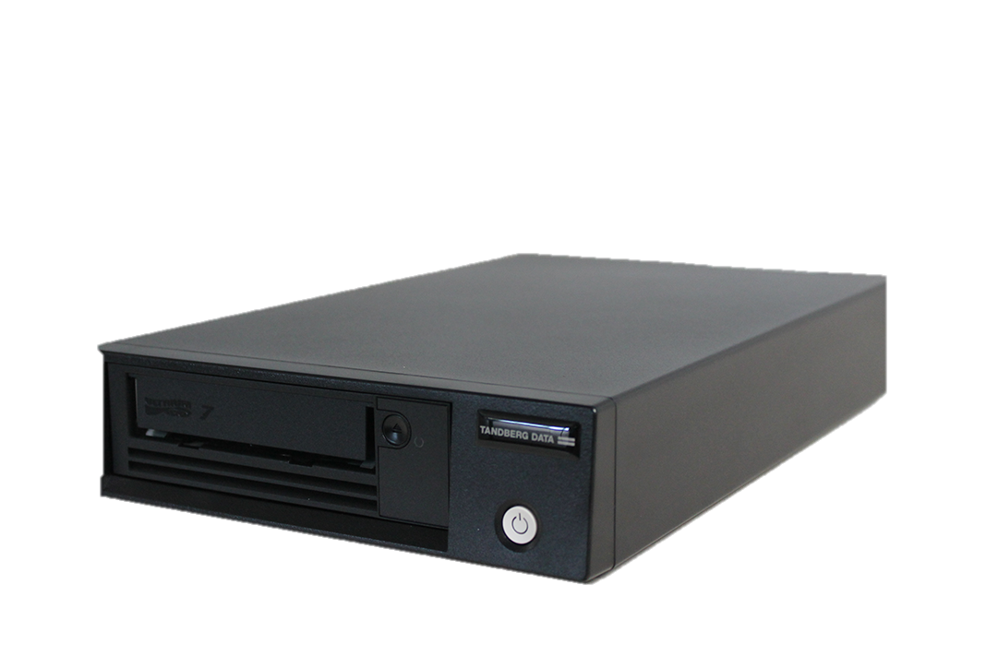
Tape Backup Advantages You Shoud Know
High security
Data cannot be easily stolen and erased by hackers from outside. Enterprise and institutions, such as banks, insurance copmanies, national file archive and scientific research institutions, that have much more concerns about data security still use tape to backup and archive data
Incredible durability and stability
Compared with hard drives, a normal-used and well-preserved magnetic tape can be used for decades.
Notes:
Tape Backup Advantages You Shoud Know About
1. High security
Data cannot be easily stolen and erased by hackers from outside. Enterprise and institutions, such as banks, insurance copmanies national file archive and scientific research institutions, that have much more concerns about data security still use tape to backup and archive data
2. Incredible durability and stability
Compared with hard drives, a normal-used and well-preserved magnetic tape can be used for decades.

Slide 35
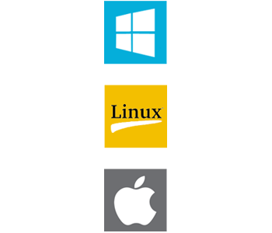
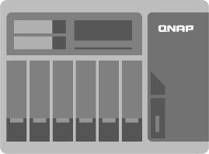
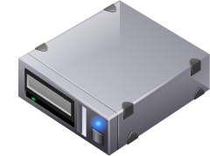
New Option for Long-term Data Storage: You Can Archive NAS Data to Tape Devices
Centralized File Management
SMB/CIFS
NFS
Backup
Archive
AFP
Shared Folders
Archiware P5
SAS Direct Attach Cable
Tandberg Data standalone tape drive
QTS 4.3+
Notes:
New option for long-term data storage: You can archive NAS data to tape devices via P5

Slide 36
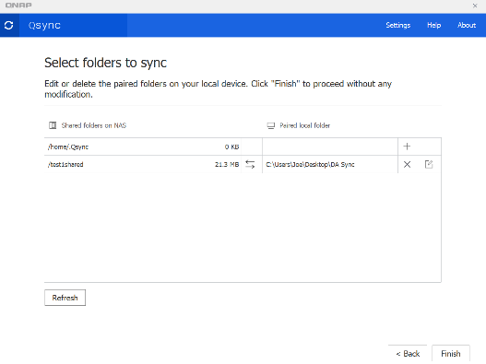
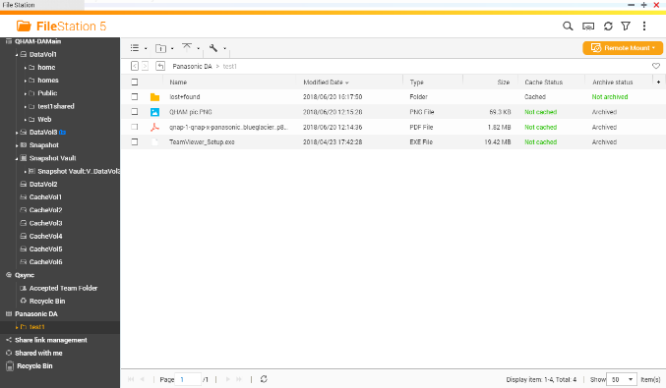
Manage Media File Life Cycle Through QNAP Applications
Data Life Cycle
Data Generated
File management
Qsync Sync client data to NAS
File Station Manage all files stored in NAS
QNAP Apps
Notes:
Manage Media File Life Cycle Through QNAP Applications
Data Life Cycle
QNAP Applications
Data Generated
Qsync
Sync client data to NAS
File management
File Station
Manage all files stored in NAS

Slide 37
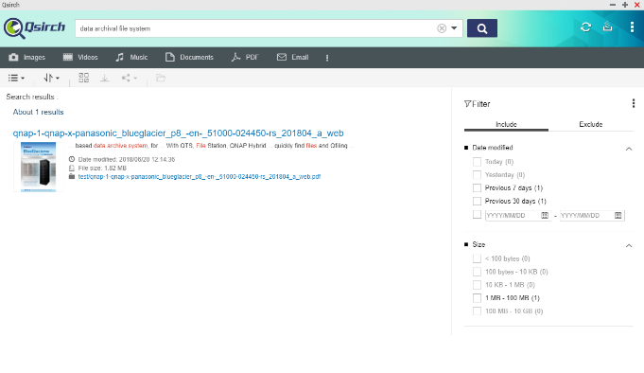
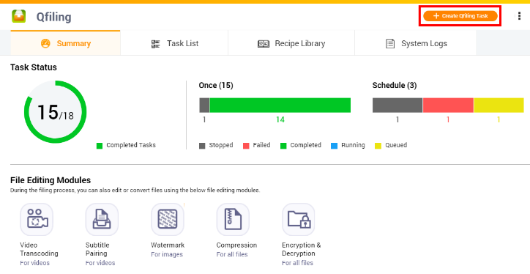
Manage Media File Life Cycle Through QNAP Applications
Data Life Cycle
Bulk Data
File re-organization
File Mgmt.
Qsirch Search desired information from accumulating files
Qfiling Automates your file organizing tasks. All you need to do is categorize your files and set a schedule
QNAP Apps
Notes:
Manage Media File Life Cycle Through QNAP Applications
Data Life Cycle
File Mgmt.
QNAP Applications
Bulk Data
Qsirch
Search desire information from accumulating files
File re-organized
Qfiling
automates your file organization. All you need to do is categorize your files, set a schedule

Slide 38
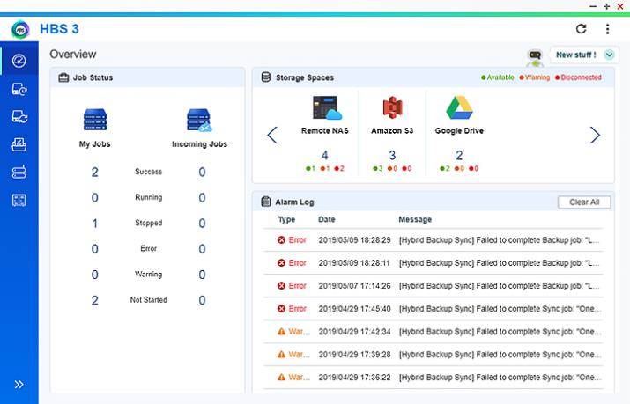
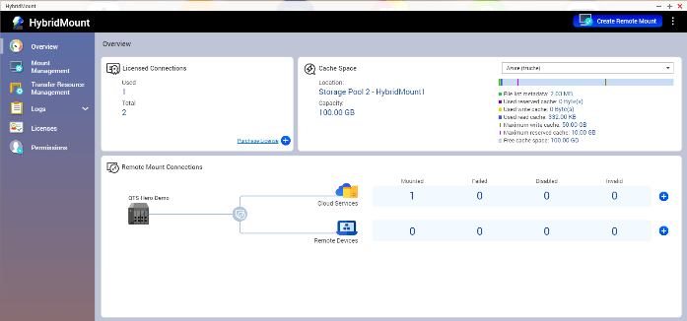
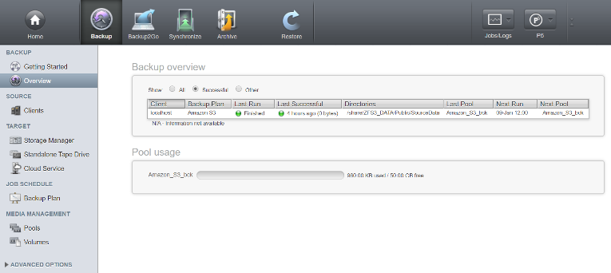
Manage Media File Life Cycle Through QNAP and P5 Applications
Data Life Cycle
Backup or Archive to Cloud
File Mgmt.
QNAP / Archiware Apps
HybridMount / HBS 3/ Archiware P5
Notes:
Manage Media File Life Cycle Through QNAP and P5 Applications
Data Life Cycle
File Mgmt.
QNAP & Archiware Applications
Backup or Archive to Cloud

Slide 39
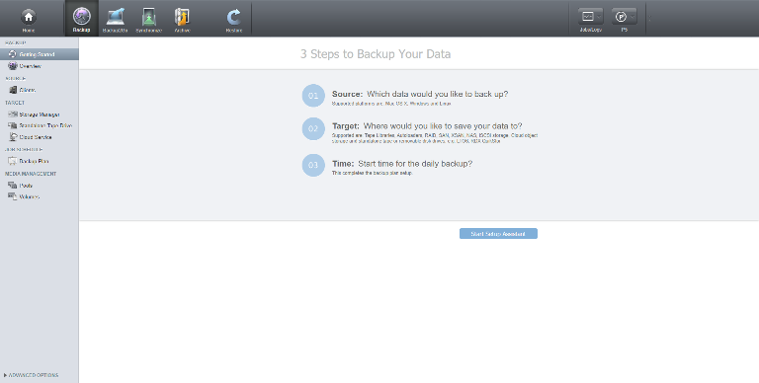
Manage Media File Life Cycle Through P5 Applications
Data Life Cycle
Archive to Tape
File Mgmt.
Archiware P5 Easy archive file to tape
Archiaware App
Tape drive or library
Notes:
Manage Media File Life Cycle Through P5 Applications
Data Life Cycle
File Mgmt.
Archiware Applications
Archive to Tape
Tape drive or library

Slide 40
Live Demo
Part 2

Slide 41
QNAP x Archiware Best Backup Solution to Secure Your VMs and Digital Assets
Copyright © 2020 QNAP Systems, Inc. All rights reserved. QNAP® and other names of QNAP Products are proprietary marks or registered trademarks of QNAP Systems, Inc. Other products and company names mentioned herein are trademarks of their respective holders.
Notes:
QNAP X Archiware
Best Backup Solution to Secure Your VMs and Digital Assets

