Slide 1
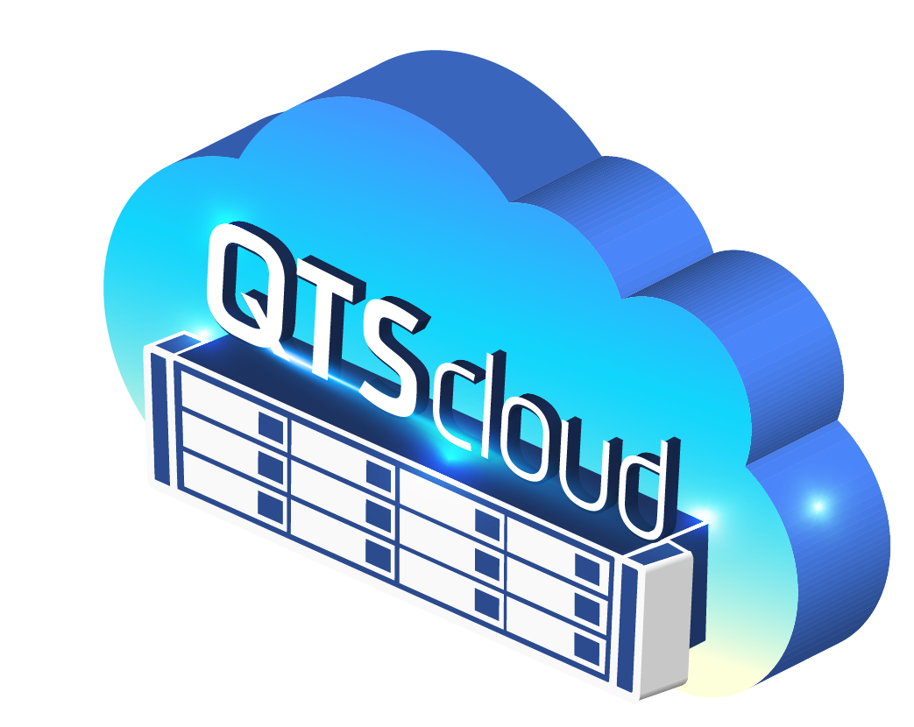
Notes:
QTScloud
A cloud-based OS let users quickly own a NAS service with cloud servers at any time.
https://aws.amazon.com/tw/vmware/?hp=tile&tile=hybridsol

Slide 2
Agenda
1
What is Cloud NAS Solution QTScloud
2
Who needs QTScloud cloud version
3
How to use QTScloud cloud version
4
QTScloud cloud version features

Slide 3
What is Cloud NAS Solution
Notes:
QTScloud
A cloud-based OS let users quickly own a NAS service with cloud servers at any time.

Slide 4
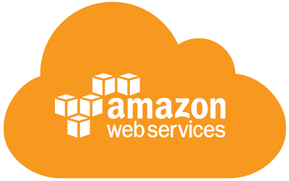
QTScloud QNAP first Cloud NAS Solution
Cloud Platforms
VM Platforms
Public
Cloud
Private
Cloud
Easily Scalable Public Cloud
OR
On-Premise Virtual Machines
"Enjoy the NAS experience brought by QTScloud"
Notes:
Need to show an animation: NAS and Cloud coming together

Slide 5
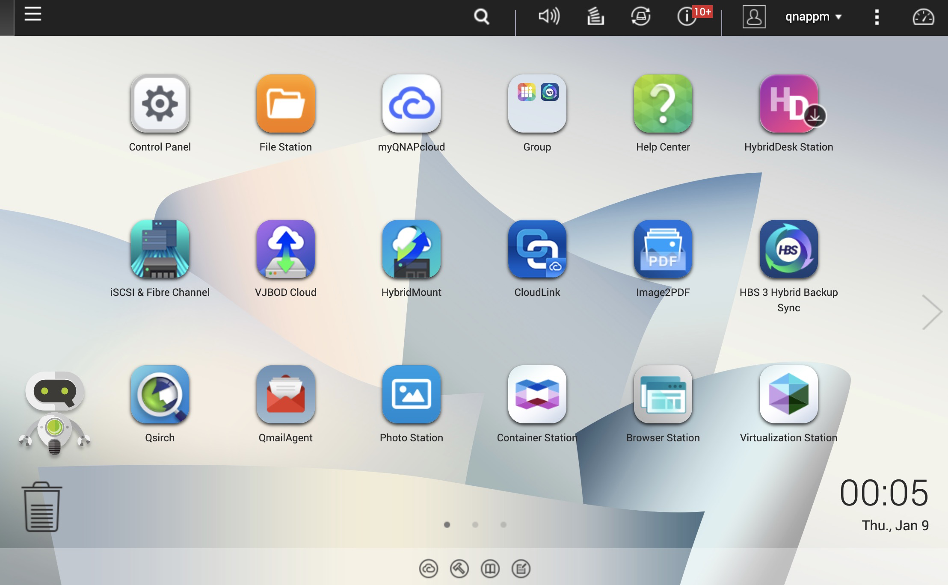
Unlock your Cloud NAS experience with QNAP
QTS Operating System
OS
Multimedia
Mobile Apps
Storage
AI
WIN/MAC Utilities
Network
Notification
Full-text Search
Security
Licenses
& More...

Slide 6
Use QNAP Cloud NAS to Optimize Your Cloud Data Usage
Before
After
* Access data with File station or standard protocols:
SMB/ClFS, NFS, AFP, iSCSl
Download file with Share Link or FTP
External
Customers
Share
Search
Download
View
Branches
* Make data searchable on object storage
with Qsirch.
* Pubilsh/Share photo/video contents with
QuMagie.
Amazon S3
Alibaba Cloud
Amazon EC2
Alibaba Cloud
Server
Cloud
Backup
PC
Cloud
Backup
QNAP NAS
Server
PC
HQ

Slide 7
QTScloud
Is a virtual appliance
Running on public or private cloud platforms
That gives enterprises the control to run mission-critical applications with best performance at affordable pricing

Slide 8
Who needs
Cloud version
Notes:
QTScloud
A cloud-based OS let users quickly own a NAS service with cloud servers at any time.

Slide 9
NFS/CIFS/iSCSI Storage on Cloud
Use Case
1
?
A company needs to quickly deploy a customer facing application with AD/LDAP integrated on AWS/Alibaba Cloud/Azure but the app does not support Cloud Object Storage.
Before need an engineer to re-write app to support Cloud Storage. Use QNAP Cloud NAS Solution just host QTScloud cloud version on AWS/AliCloud/Azure for NFS/CIFS/iSCSI.
Application and Data Servers
CIFS/SMB
NFS
Volume
CIFS,NFS, iSCSI, AFP
CIFS,NFS, iSCSI, AFP
iSCSI
AFP
Storage Pools
User desktops and devices

Slide 10
Disaster recovery on Cloud
Use Case
2
Efficient disaster recovery plan
Enterprises need an affordable and reliable secondary NAS for backup & disaster recovery.
?
QTScloud backs up data from the primary NAS and allows end users everywhere and remote sites to access / recover data.
Fire or explosion
Hacker attacks
Server Failure
Bugs or viruses
Power outage
Unexpected updates
Human errors
Production center

Slide 11
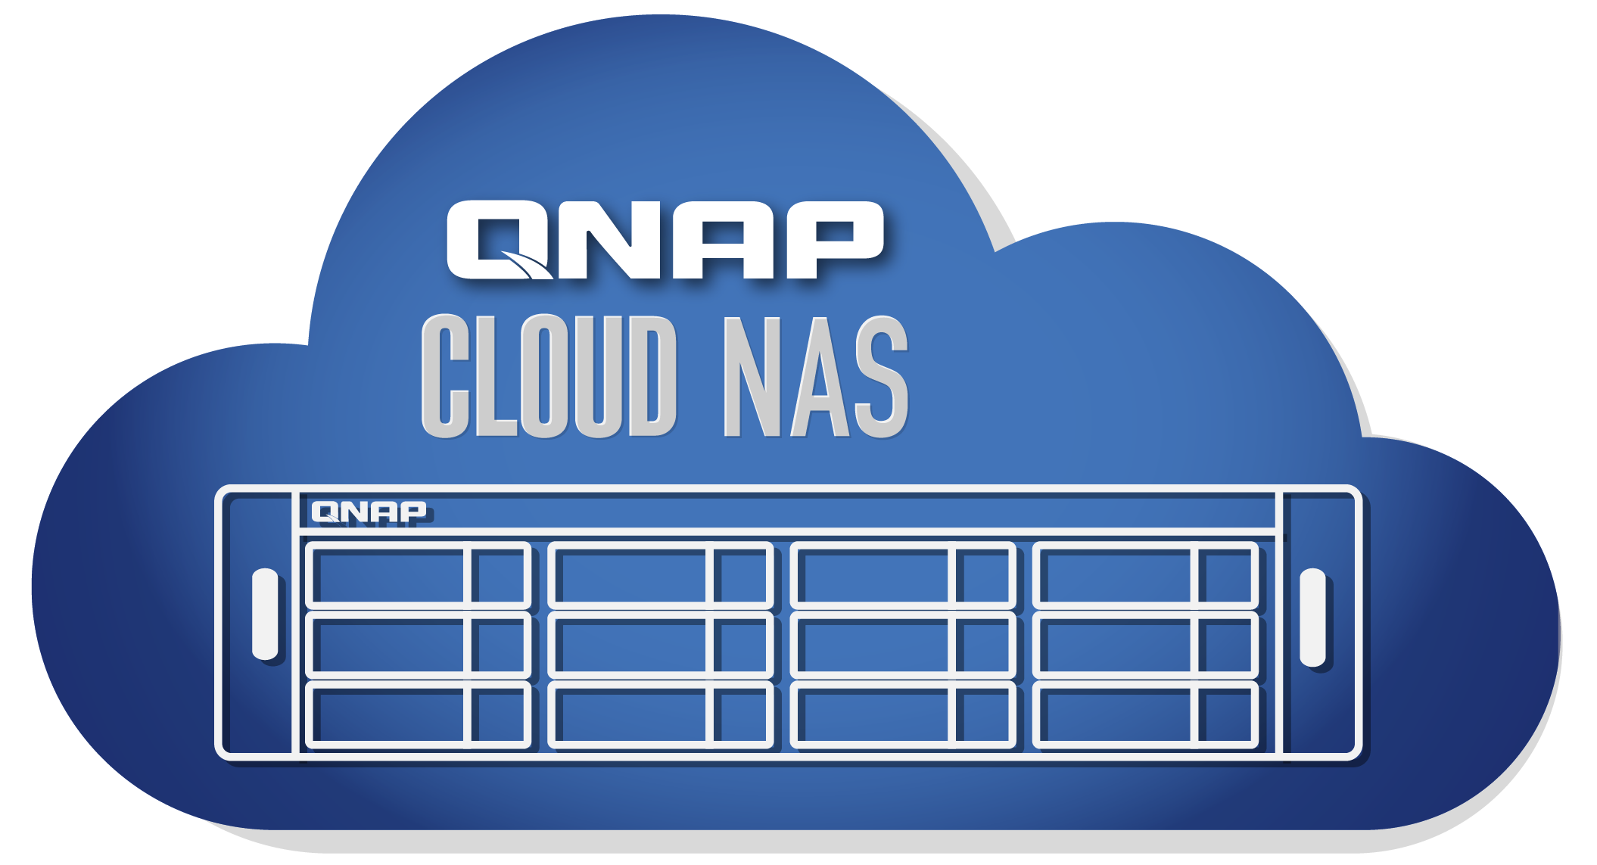
Multi-cloud backup and management for organizations
Use Case
3
?
Businesses demand a comprehensive 3-2-1 backup plan.
The IT team can setup QTScloud and use HBS 3.0/ HybridMount
to avoid backup inefficiencies.
Backup Repository A
Backup Repository B
Onsite Storage
Offsite Storage or Cloud

Slide 12
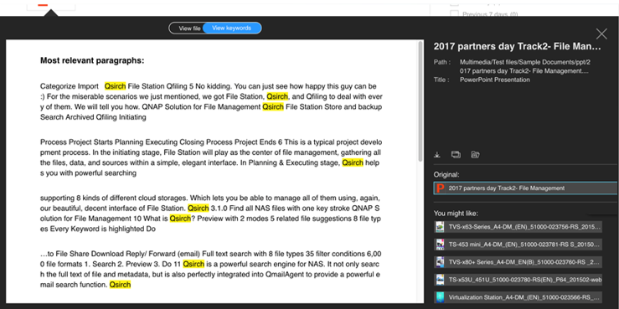
Comprehensive search engine for your enterprise files
Use Case
4
Large enterprises with numerous files want to perform content-based
search to quickly find their files.
?
QTScloud's Qsirch application with advanced search capabilities, enables you to search for files based on their name, content and metadata .
Quickly view key paragraphs, download or share the file after confirmation!
No need to install
other kits; files can be viewed directly!

Slide 13
How to use
Cloud version
Notes:
QTScloud
A cloud-based OS let users quickly own a NAS service with cloud servers at any time.

Slide 15
Demo Scenarios
Getting Started
Initializing QTScloud
Where to find the QTScloud Image
How to purchase License
Upload QTScloud Image in AWS
Enter the License Information
Initialize the QTScloud NAS
Setup storage pool and volume
Setting Up Instance
Mounting Cloud Storage on local machine
How to create an EC2 instance
How to start a virtual machine
How to allocate volume
How to start instance
Setup HybridMount on QTScloud
Mount AWS S3 object storage on HybridMount
Enable SMB on the QTScloud
Use Windows machine to connect to the S3 storage mounted on QTScloud

Slide 16
Features
Cloud version
Notes:
QTScloud
A cloud-based OS let users quickly own a NAS service with cloud servers at any time.

Slide 17
Main features of QTScloud
1
4
Cloud storage gateway and cloud storage mount
Cloud data protection
and security
2
5
Data sharing and directory management
Stay informed of your cloud
NAS status at all times
3
Source-based deduplication for backup
6
Productivity apps for backup, management, and multimedia

Slide 18
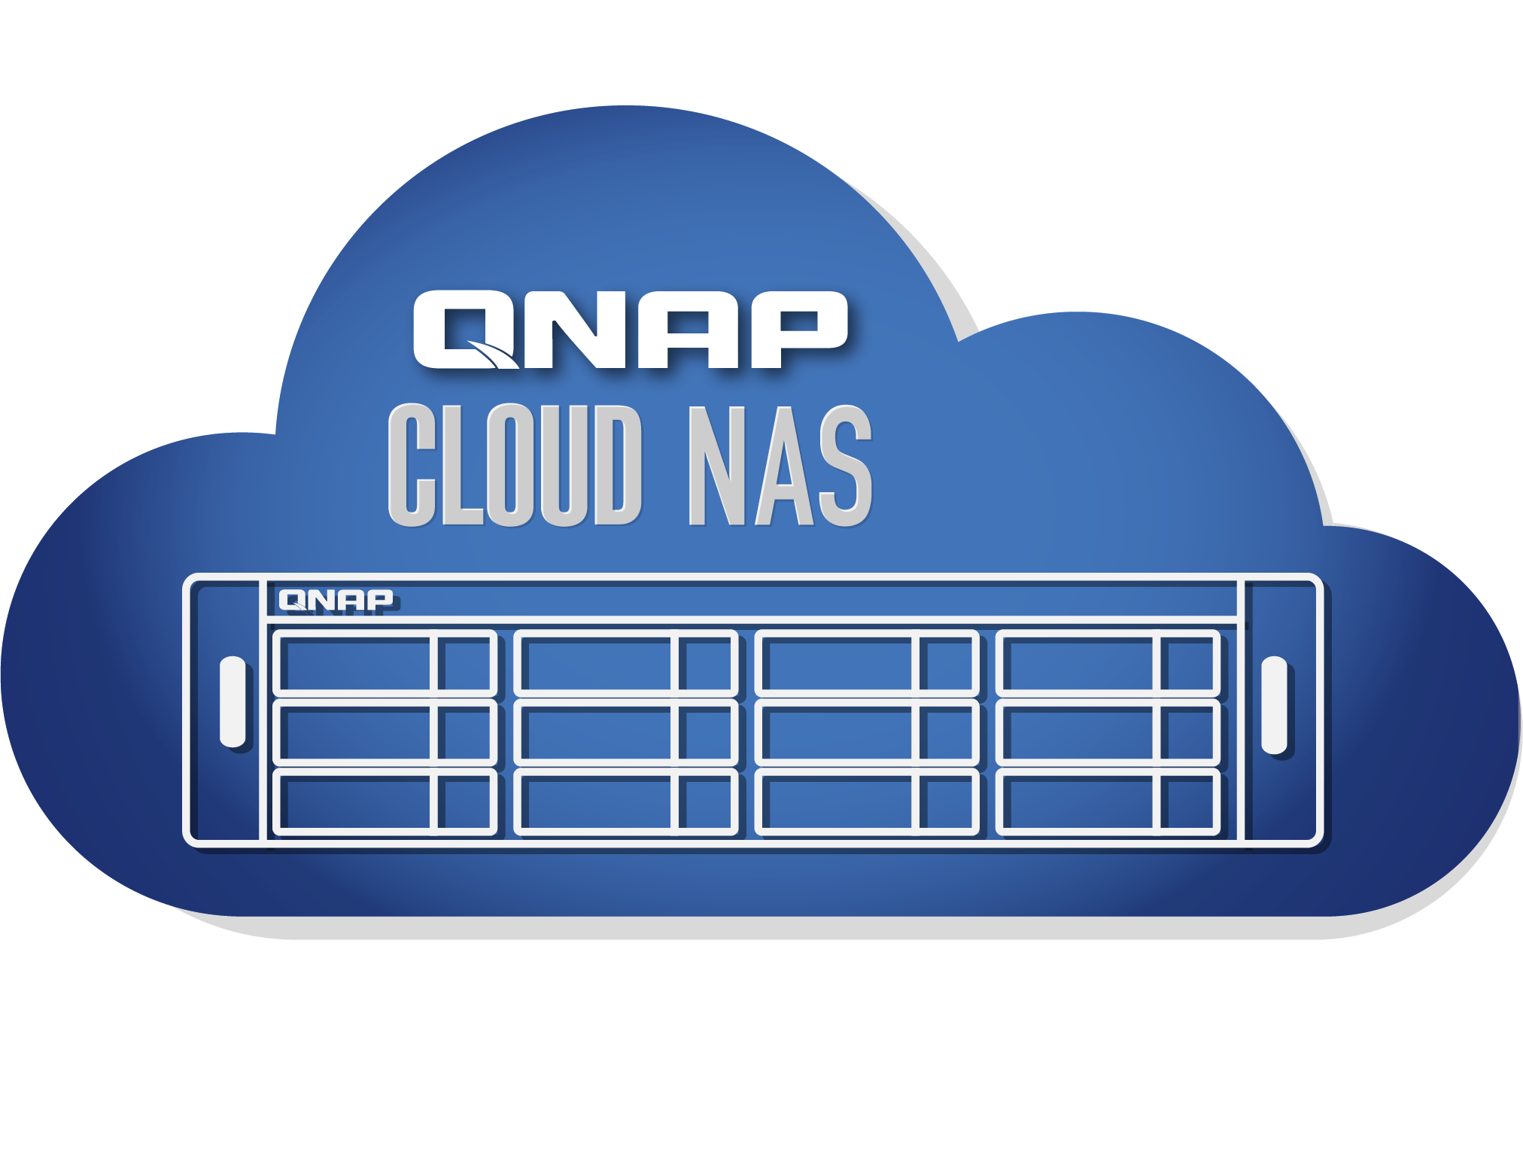
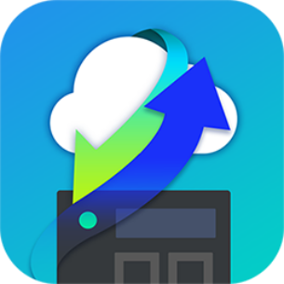
QTScloud Storage Expansion with HybridMount
Mount external storage to QTScloud
Cloud File Storage
AWS
Mount external storage
With Hybridmount
Cloud Object Storage
EBS
S3
Glacier
AWS Local Storage
Unified dashboard to manage all cloud storage

Slide 19
Data sharing and directory management
Data sharing
Privilege management
Standard protocols
SMB/CIFS
NFS
AFP
iSCSI
Basic
1. NAS local users
Domain Security
Active Directory authentication
LDAP authentication
Instant file sharing
Social Media
Security – Password, Valid Date
SmartShare
File Preview
Online Office, Google Doc
Multimedia files
Notes:
No domain security: Only the local users can access the NAS.
•Active Directory authentication (domain members): Join the NAS to an Active Directory. The domain users can be authenticated by the NAS. After joining the NAS to an AD domain, both the local NAS users and AD users can access the NAS via the following protocols/services:
oSamba (Microsoft Networking)
oAFP
oFTP
oFile Station
•LDAP authentication: Connect the NAS to an LDAP directory. The LDAP users can be authenticated by the NAS. After connecting the NAS to an LDAP directory, either the local NAS users or the LDAP users can be authenticated to access the NAS via Samba (Microsoft Networking). Both the local NAS users and LDAP users can access the NAS via the following protocols/services:
oAFP
oFTP
oFile Station

Slide 20
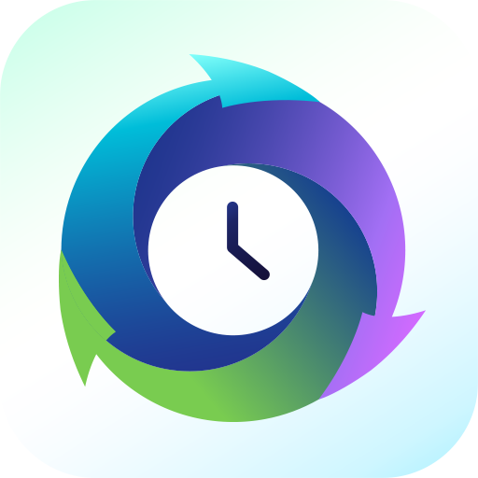
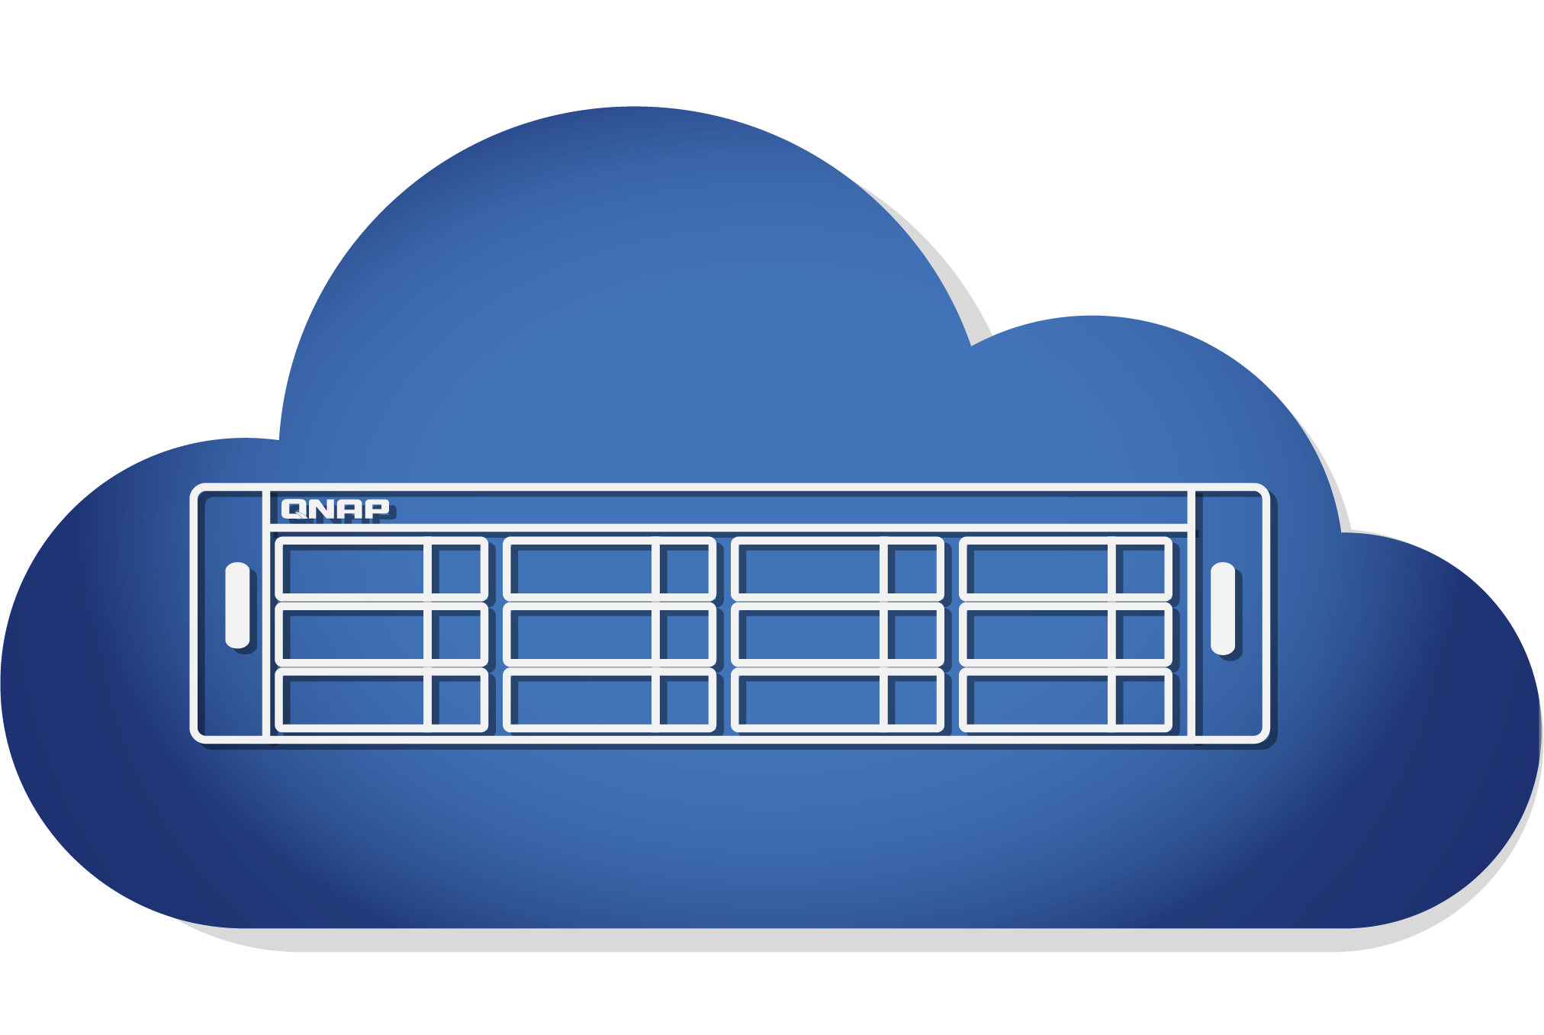
Source-side deduplication for backup
HBS 3 features QuDedup technology that empowers backup tasks with
source-side deduplication for greater time and storage savings.
Without QuDedup
With QuDedup

Slide 21
Cloud data protection and security
Snapshots and versioning
1. Fully supports all storage configurations at the storage pool level.
2. Uses the mature ext4 file system for “out of volume”
Ransomware cannot overwrite snapshots which are stored out of volume
QNAP VPN Service
1. Use QVPN to build a secure connection between your on-premises devices and your Cloud NAS.
2. Supports versatile VPN protocol and QNAP's(QBelt.
QNAP's proprietary VPN protocol to decrease the chance of being detected.

Slide 22
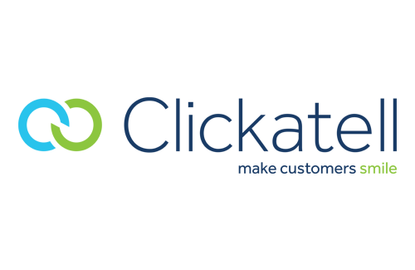
Stay informed of your Cloud NAS status at all times
Notification Center
Consolidates event and alert notification
Double assurance with notification history
Flexible to filter important messages
Multi-language support
Notifications via email, SMS, instant message, and push notifications.
Notes:
Notification Center Provide you with a variety of delivery options, allowing you to choose the most appropriate notification method based on different messages and use cases!

Slide 23
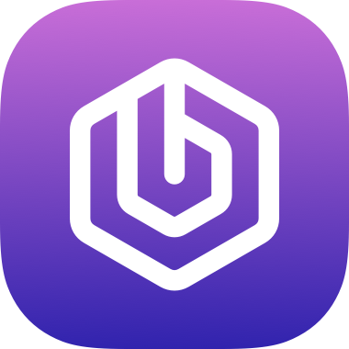
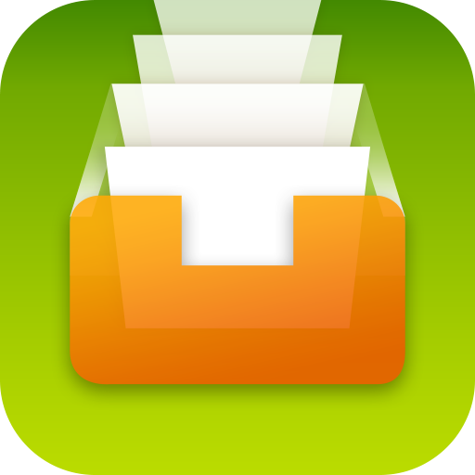
Productivity apps for backup, management, and multimedia
Backup
Management
Multimedia
HBS 3
Qsirch
QuMagie
Multi-site, multi-cloud backup streamlines 3-2-1 backup strategy
A powerful Google like full-text search engine
AI-powered intelligent photo management
Boxafe
Qfiling
Backups up Office 365 & Google G Suite data
Automates your file organization

Slide 24
Supported cloud platforms
Cloud Platforms
Coming soon... and more

Slide 25
QTScloud Pricing
Monthly $ 7
Monthly $ 10
Monthly $ 15
Monthly $ 20
Monthly $ 30
Monthly $ 50
Monthly $ 80
Monthly $ 100
1
Core
2
Cores
4
Cores
6
Cores
8
Cores
12
Cores
16
Cores
24+
Cores
Yearly
$ 70
Yearly
$ 100
Yearly
$ 150
Yearly
$ 200
Yearly
$ 300
Yearly
$ 500
Yearly
$ 800
Yearly
$ 1000
Recommended for:
Recommended for:
Recommended for:
Recommended for:
Recommended for:
Recommended for:
Recommended for:
Recommended for:
Total NAS Users: 1-5
Concurrent Connections: Up to 10
Total NAS Users: 6-10
Concurrent Connections: Up to 10-20
Total NAS Users: 10-20
Concurrent Connections: 20-50
Total NAS Users: 20-50
Concurrent Connections: 50-100
Total NAS Users:
50-100
Concurrent Connections: 100-200
Total NAS Users:
100-200
Concurrent Connections:
200-500
Total NAS Users:
200-500
Concurrent Connections:
500-1000
Total NAS Users: 500+
Concurrent Connections:
1000+

Slide 26
Is your Best Choice !
Copyright© 2020 QNAP Systems, Inc. All rights reserved. QNAP® and other names of QNAP Products are proprietary marks or registered trademarks of QNAP Systems, Inc. Other products and company names mentioned herein are trademarks of their respective holders.​​​

