Slide 2
Agenda
QNAP Solution
VJBOD Cloud - Block Cloud Gateway
The Overall Architecture and Advantages
Application Scenario
Function Introduction
Recommended Models
The demand to backup data on the cloud
The issues of data backup on the cloud

Slide 3
The demand to backup data on the cloud
Increased demand for private and public cloud integration.
Consider the construction cost of remote server center.
Private cloud - enterprise server center
Public cloud- cloud service storage provider
Construction and maintenance of remote server center
Cloud
Backup
Local backup
Notes:
in the past, in many enterprises, they will build the remote server rooms to prevent local storage devices from encountering disaster.
But as the security of public cloud space has increased, many SMEs consider the construction and maintenance cost of a server room is too high, and want to back up the local data to the cloud for another data protection to prevent disaster.

Slide 4
The issues of data backup on the cloud
Is there any way that I don't need to change my existing system or services?
(If you use the cloud gateway of CSP, it requires an additional server host. As of the local cloud resident, the program will slowly transmit, and each computer will take the bandwidth separately).
Is there any way to upload the data to the cloud but make the data unrecognizable? The admin of the cloud operator cannot directly see the data you store?
Is there any way to upload large nonstop data to the cloud and be more efficient?

Slide 5
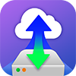
QNAP Cloud Gateway Solutions
 | HybridMount | VJBOD Cloud
Support cloud storag | 20 (Object Storage and File Storage) | 13 (Object Storage)
Gateway type | File-based cloud gateway | Block-based cloud gateway
Feature | 1. Cloud space mount, centralized management 2. Cloud file multi-endpoint synchronization | 1. The best cloud backup solution of Low latency SAN 2. Unrecognizable data on the cloud 3. When the data upload to the cloud, only the amount of change is uploaded, and the backup time is reduced
Snapshot & restore | Not supported | Supported
Scenario | File server online collaboration and file level data analysis | Enterprise LUN backup Large database backup Confidential file backup
Local access protocol | SMB, AFP, NFS, FTP, WebDAV | SMB, AFP, NFS, FTP, WebDAV, Fibre Channel (coming soon)
iSCSI

Slide 6
VJBOD cloud Block-based Cloud Gateway
VJBOD Cloud
Gateway
initiator
Cloud object
storage space
iSCSI
Target
Local user
initiator
iSCSI
Cloud LUN
Clients
Fibre Channel
Application
Server
Snapshot
SMB/NFS/AFP/
FTP/WebDAV
Cloud Volume
/Shared folder
Snapshot
Local user

Slide 7
VJBOD Cloud Architecture and advantages of Block –based Cloud Gateway

Slide 8
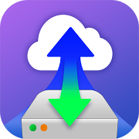
The architecture of VJBOD Cloud
QTS 4.4.1
Cloud Storage
ISCSI (Ethernet)
Object Storage
Client
Block Access
Target
Cloud
LUN
Dedicate
Local Stored
Space
(Local Stored mode)
Customer
File System
Fibre Channel
Object
Storage
Connector
File Services
Local Servers​
Local
Applications
Snapshot
SMB
Cloud
Volume (EXT4 File System)
Dedicate
Local Stored
Space
(Local Stored mode)
File Access
NFS
Object
Storage
Connector
Client
AFP
File Access
Snapshot
FTP
Cache Engine
Snapshot Recovery Point
Web
DAV
Qsync
Local Disks/HDDs/SSDs

Slide 9
Local stored space keeps services on even the cloud service is disconnected
Local Stored Mode
VJBOD Cloud uses the Local Stored Mode, so the cloud data is the same as the local storage space.
You have to set the local storage space larger than the cloud LUN.
Provide data protection when the cloud service is disconnected or when the connection is unstable.
Services will not stop due to cloud service disconnection.
User access is not interrupted.
QTS 4.4.1
Cloud
LUN
Dedicate Local
Stored Space
(Local Stored mode)
Target
Block Access
Cloud object
storage space
Snapshot
！
Cloud Volume (EXT4 File System)
Dedicate Local
Stored Space
(Local Stored mode)
File Access
Snapshot
Cache Engine
Local Disks/HDDs/SSDs

Slide 10
VJBOD Cloud provides snapshot recovery point to ensure data security
QTS 4.4.1
Cloud
LUN
Dedicate
Local Stored
Space
(Local Stored mode)
Target
Block Access
Cloud object
storage space
The local stored space will be preset to be larger than the Cloud Volume/LUN space, and the extra space will store a snapshot of the automatic snapshot restore mechanism.
Snapshot
Cloud
Volume (EXT4 File System)
Dedicate
Local Stored
Space
(LocalStored mode)
File Access
Snapshot
Snapshot Recovery
Point
Cache Engine
Local Disks/HDDs/SSDs

Slide 11
VJBOD Cloud utilizes the system cache engine for better performance
QTS 4.4.1
Any cloud access will go through the local stored space in NAS.
The local storage space is matched with the cache engine, enabling the write performance as if on a local storage.
Local storage space can be full SSD, HDD + SSD Cache, or Qtier Tiered Storage.
Cloud
LUN
Dedicate
Local Stored
Space
(Local Stored mode)
Target
Block Access
Cloud object
storage space
Snapshot
Cloud
Volume (EXT4 File System)
Dedicate
Local Stored
Space
(Local Stored mode)
File Access
Snapshot
Cache Engine
Local Disks/HDDs/SSDs

Slide 12
Users can access cloud services and VJBOD Cloud via any protocol
VJBOD Cloud block cloud gateway, like a translator, can convert the different CSP's storage to the Cloud Volume/LUN.
The IT guys or general users can access Cloud Volume through more familiar file access protocols (such as NFS, SMB, AFP FTP, WebDAV).
Accessing Cloud LUNs using block-type access protocols (iSCSI, Fibre channel).
Users can easily access data without changing the access protocol or the service application.
Customer
File System
QTS 4.4.1
ISCSI (Ethernet)
Cloud
LUN
Dedicate
Local Stored
Space
(Local Stored mode)
Target
Block Access
Local Servers​
Cloud object
storage space
Fibre Channel
Snapshot
Client
SMB
Cloud
Volume (EXT4 File System)
Dedicate
Local Stored
Space
(Local Stored mode)
NFS
File Access
Client
AFP
Snapshot
FTP
Cache Engine
Web
DAV
Local Disks/HDDs/SSDs

Slide 13
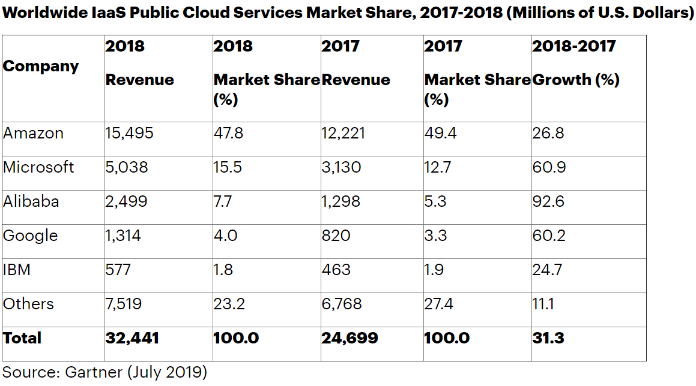
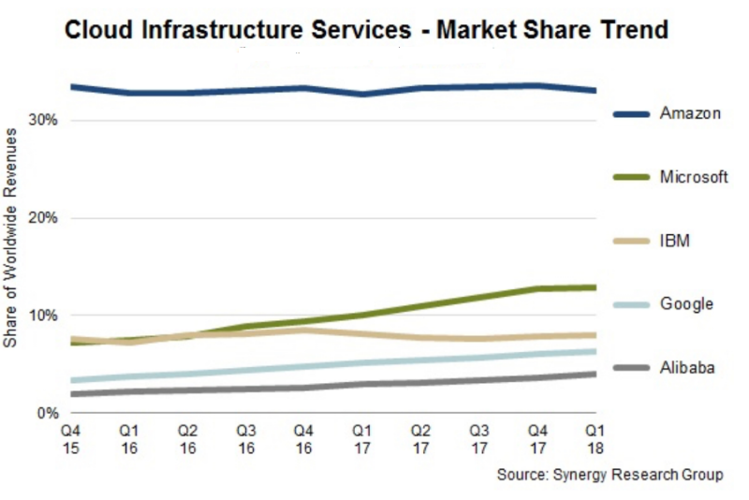
Object cloud storage ranking
Full support for mainstream cloud service providers.
The support for regional cloud service providers is increasing.
Notes:
At present, the top cloud service providers in the market share, VJBOD Cloud block-based cloud gateways have support
If the user has multiple cloud services, the VJBOD Cloud block-based cloud gateway can be used as a relay station for multiple cloud services.

Slide 14
Support up to 13 object cloud storage spaces
Object Storage
Cloud Service Provider
Amazon S3
Azure
Digital Ocean
HiCloud
Huawei Cloud
RackSpace
Wasabi Cloud Storage
Alibaba Cloud
BackBlaze
Google Cloud Storage
HKT
IBM Cloud
Object Storage
OpenStack
Swift
More …...

Slide 15
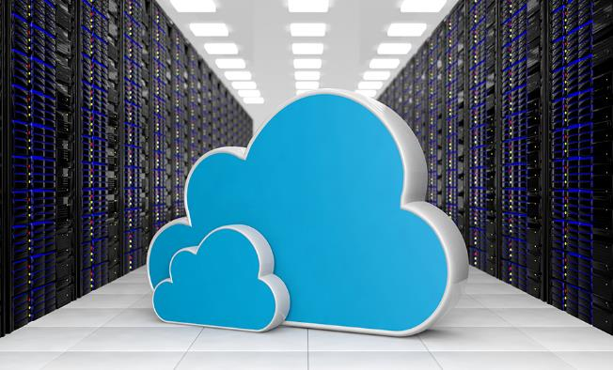
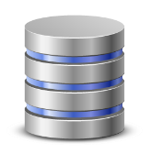
Remote backup can prevent data loss from a disaster, and you can restore all data from a remote NAS
Customer
File System
Production Server
!
!
Local Servers​
Client
Remote Backup
If you backup on the cloud?
Notes:
45859006

Slide 16
How to restore data from cloud storage to another NAS
Cloud object
storage space
Step 1.
At the time of the disaster.
Snapshot
Step 3.
Step 2.
In the new NAS, the cloud space will be connected back to the Cloud volume/LUN by using the snapshot recovery point.
And restore to all the cloud space data in the local storage space, you can continue the service.
Prepare another
NAS for service rescue.
Snapshot

Slide 17
The advantage of VJBOD Cloud Block-based Cloud Gateway
VJBOD Cloud uploads file by blocks, which cannot be indientified on the cloud.
If enterprises backup their databases daily, then only the modified blocks (variables) will be backed up. It will reduce the backup time drastically.
Number of files
Original
data
File-level
Log file
To modify a file, all files must be re-uploaded.
Upload the
entire file
Modified
data
Image
Block-level
VM Volume
Only the blocks (variables) of the modified data need to be transmitted to the cloud.
Large Database
Only upload blocks that have been modified
File size
Notes:
VJBOD Cloud cuts the uploaded file into blocks, which cannot be read in the cloud.
If the enterprise does a daily database backup, it will only back up the modified blocks (variables), no need to backup the entire database, and reduced the backup time.
Email backup is another reference case, it is a kind of large nonstop data file, I assume you will receive the 100 emails every day, and those increasing part is around 100MB, but the whole email core file is 10GB, Now with VJBOD Cloud, it means you don't need to backup 10GB per day, only backup the increased 100MB per day, it reduces the amount of cloud transmission and reducing the cloud cost.

Slide 18
VJBOD Cloud
Block-based Cloud Gateway Benefits
Data unrecognizable, provide excellent data security.
The data could be accessed continuously when the cloud service is disconnected, and the service is not stopped.
Provide snapshot recovery point, data protection is guaranteed.
With the system cache engine, provide the better performance.
Reduce enterprise cloud space costs.
Reduce cloud traffic.
Low latency and reduce backup time.
IT staff can easily install and set up.
Reduce enterprise cloud space expenditure costs

Slide 19
VJBOD Cloud Application Scenarios

Slide 20
Back up data from local application services to the cloud
Scenario
1
Application Case
SMEs have many important log files or sensitive data generated by local applications. For example, customer order data, financial information, or the system login data, and it is hoped that the process of backing up to the cloud can be fast. And it can't be recognized in the cloud space, it can keep the security and privacy of enterprise data.
按一下以新增文字
Notes:
SMEs have many important log files or sensitive data generated by local applications. For example, customer order data, finical information, or the system login data, and it is hoped that the process of backing up to the cloud can be fast. And it can't be recognized in the cloud space, it can keep the security and privacy of enterprise data.

Slide 21
VJBOD Cloud – Cloud Volume
APP Center
VJBOD Cloud – Cloud Volume allows users to easily connect to the cloud storage space and convert it to volume disk at the local end.
Enterprise IT guys or general users can use the more familiar file access protocol (NFS, SMB, AFP, FTP, WebDAV) for access.
After the files in these application services are backed up to the cloud through the block cloud gateway, the block space data is unrecognizable in the cloud space.
Cloud object
Storage space
VJBOD Cloud
Snapshot
SMB
NFS
AFP
FTP
Client
WebDAV
本地存放空間
Cloud Volume
(EXT4 file system)/Shared Folder

Slide 22
Local database backup
Scenario
2
Application Case
In addition to the backup of the local storage device, the SME database hopes to back up the database to the cloud every day , and hopes to quickly and reduce the network transmission during the backup process.
* A cloud volume or LUN can only be connected to a NAS at a time.
Notes:
In addition to the backup of the local storage device, the SME database hopes to back up the database to the cloud every day , and hopes to quickly and reduce the network transmission during the backup process.

Slide 23
Block-based Database Cloud Backup Solution
initiator
QNAP NAS's VJBOD Cloud also provides block-type logical unit LUNs.
Enterprise users can access through block-type access protocols (iSCSI, Fibre Channel).
When enterprises want to back up the database to the cloud, they can also use the block-based gateway to achieve the backup difference variation, thereby reducing the overall cloud transmission volume and backup time and cloud usage.
Cloud object
Storage space
VJBOD Cloud
Client
iSCSI
initiator
Target
Snapshot
Application
Server
Cloud LUN
Fibre Channel
(coming soon)
Notes:
QNAP NAS's VJBOD Cloud also provides block-type logical unit LUNs
Enterprise users can access through block-type access protocols (iSCSI, Fibre Channel)
When enterprises want to back up the database to the cloud, they can also use the block-based gateway to achieve the backup difference variation, thereby reducing the overall cloud transmission volume and backup time and cloud usage.

Slide 24
VJBOD Cloud Function Introduction

Slide 25
3 steps to create a Cloud Volume / LUN
Download the VJBOD Cloud program from the App Center.
Follow VJBOD Cloud Wizard to build a cloud volume/LUN.
1
Choose the cloud service provider and cloud space bucket.
2
Set cloud volume/LUN and storage space.
3
Create the shared folder for Cloud volume or map the LUN to iSCSI target.

Slide 26
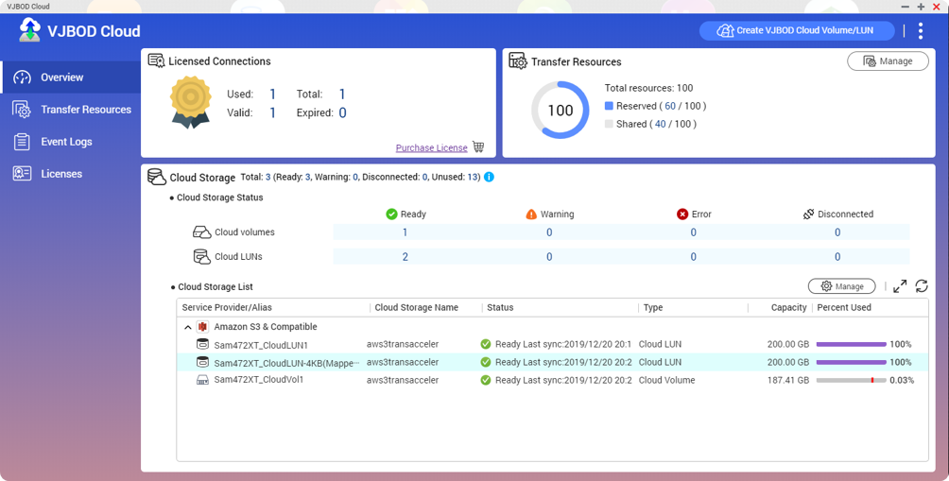
Overview & storage list
User will be able to view the cloud-volume / LUN created by VJBOD Cloud, and manage storage spaces at once.

Slide 27
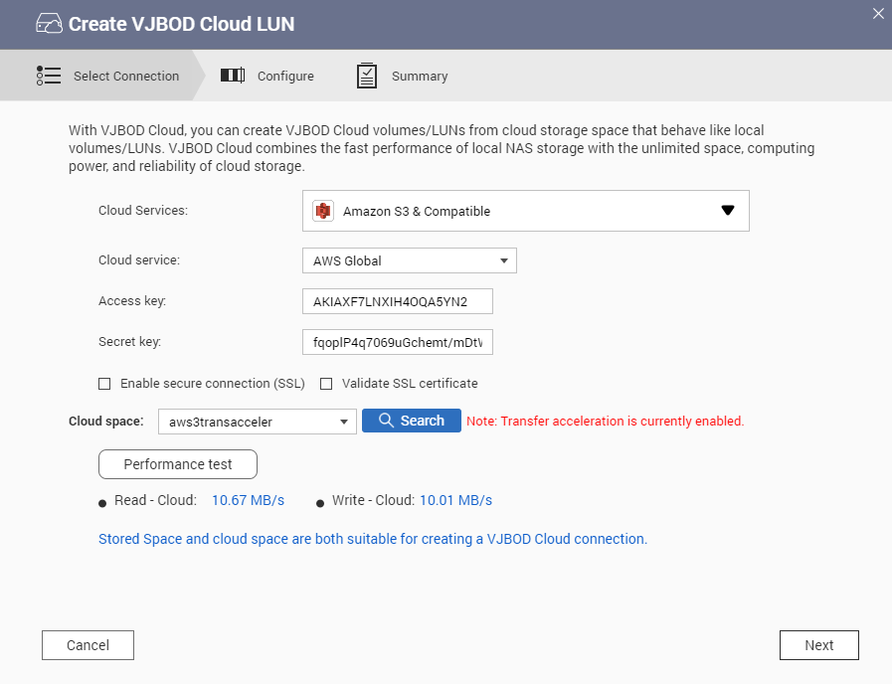
Cloud connection speed measurement and CSP transfer acceleration support
VJBOD Cloud supports cloud connection speed measurement.
IT staff can confirm the transmission speed of the cloud connection to know whether there is enough to cope to adjust the network disk area or the connection resources of the LUN.
Support AWS transfer acceleration.
Notes:
We will continue to support the transfer acceleration of other CSPs if they provided

Slide 28
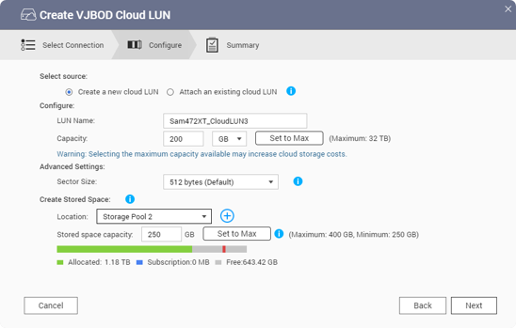
VJBOD Cloud Local Storage Mode for continuous data access
VJBOD Cloud Local Storage Mode allows users to store main data on the NAS and back up to the cloud. A Cloud Volume allows on-premise applications to access data with low latency.
The local storage space will be preset to be larger than the VJBOD Cloud Volume space, and the extra space will store a snapshot of the automatic snapshot restoration mechanism.

Slide 29
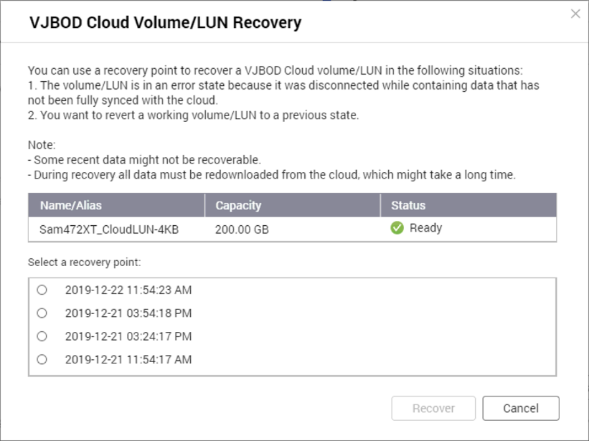
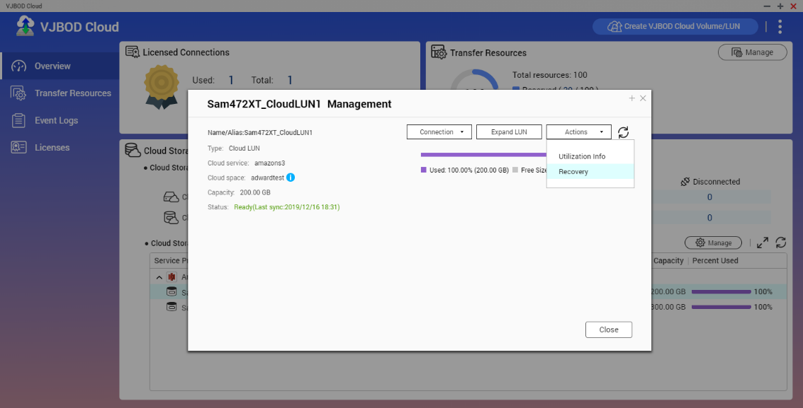
Snapshot Restore Mechanism protects users' data
Snapshots will be automatically enabled when the block change is greater than 10%.
Snapshots will be automatically enabled every 30 minutes when any block changed.

Slide 30
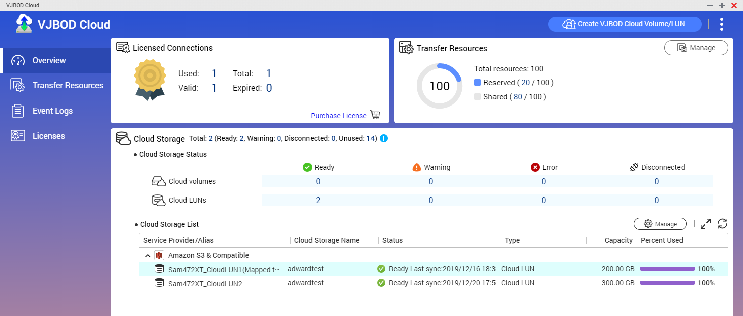
VJBOD Cloud Licenses
VJBOD Cloud supports max 9 Cloud Bucket (include one free license).
Free to connect to the first Cloud Bucket.
VJBOD Cloud could create at least 16 Cloud Volume or LUN.

Slide 31
Subscription packages
1 Space For Block-Based Cloud Gateway
BASIC
USD $19.99
/ Year
4 Space For Block-Based Cloud Gateway
STANDARD
USD $59.99
/ Year
8 Space For Block-Based Cloud Gateway
Professional
USD $99.99
/ Year

Slide 32
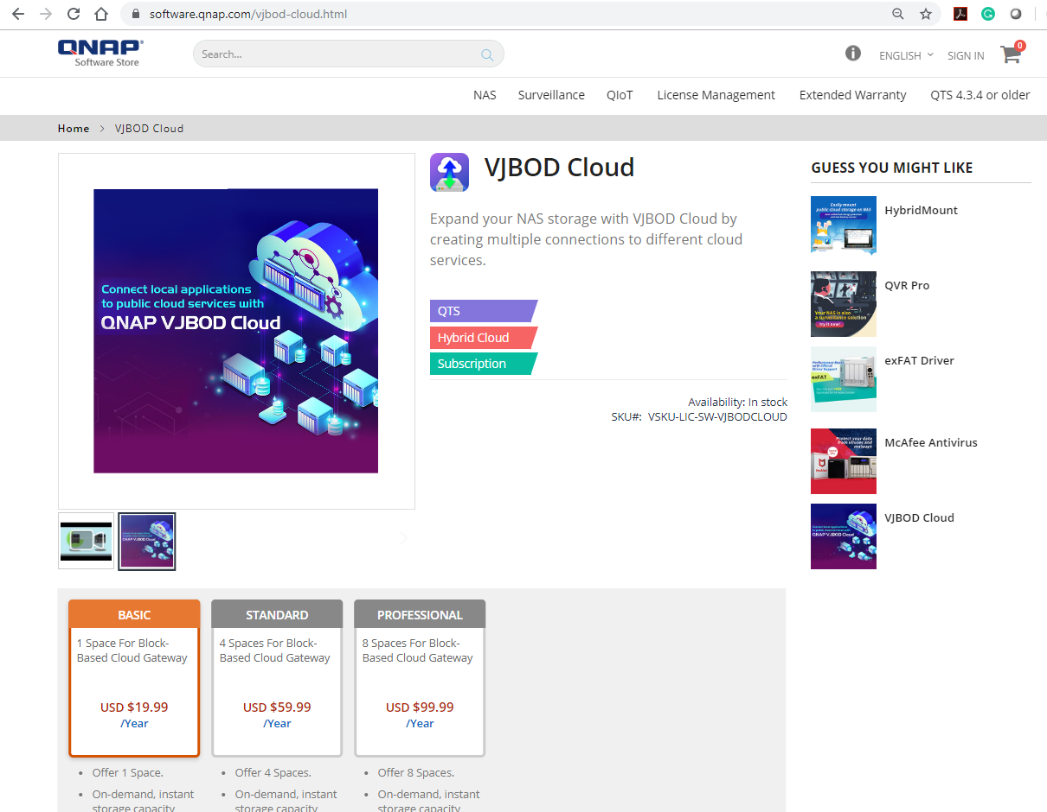
Subscribe a license from QNAP Software Store
When customers have multiple different bucket connection requirements.
Customers want to use multiple cloud services at the same time because they are considering using their different promotional plans to save costs.
Purchase a license from QNAP Software Store.
https://software.qnap.com

Slide 33
How to process the forced transfer and keep services ongoing?
Step.1
The user chooses which cloud service provider to connect to and enters the Access key and test connection.

Slide 34
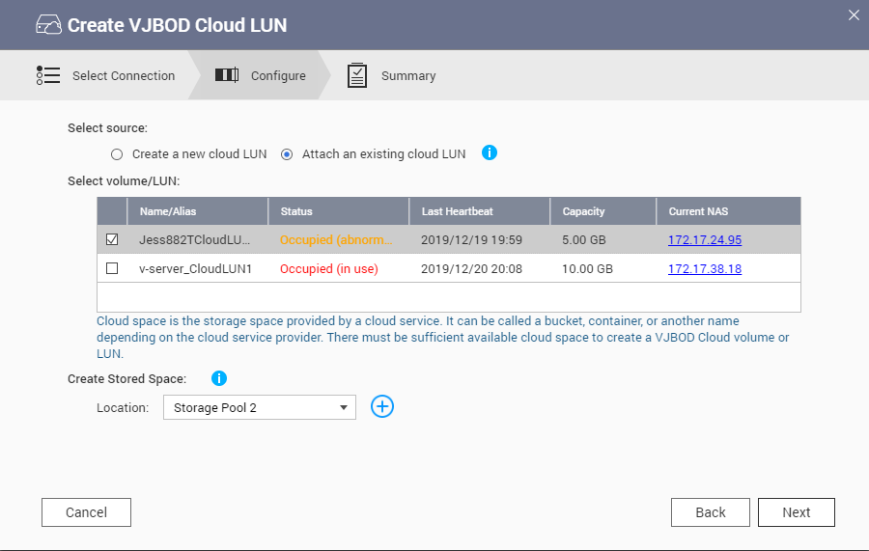
Forced Transfer and Secure Transfer steps
Step.2
User selects [Attached an existing cloud LUN.
Status: Divided into three states, occupied (using), occupied (abnormal), idle (secure transfer).
Show last heartbeat time and NAS IP being occupied.
After the user selects the cloud Volume/LUN of the two states of occupied (using) and occupied (unused), pressing "Next" will pop up the window to warn the user and inform that the most recent snapshot will be restored.

Slide 35
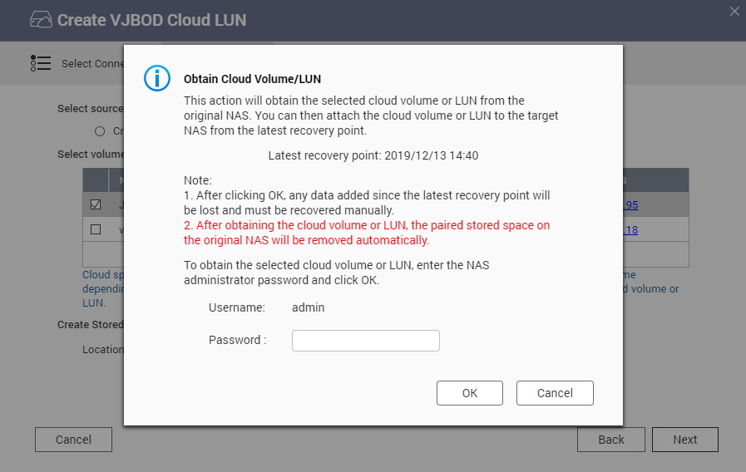
Forced Transfer and Secure Transfer steps
Step.3
Press “Next” will pop up the confirm window to warn the user. And told that it will be restored by a recent snapshot.
And show the time point of this snapshot restore.
Please enter the admin password of this NAS, press "OK" to continue.

Slide 36
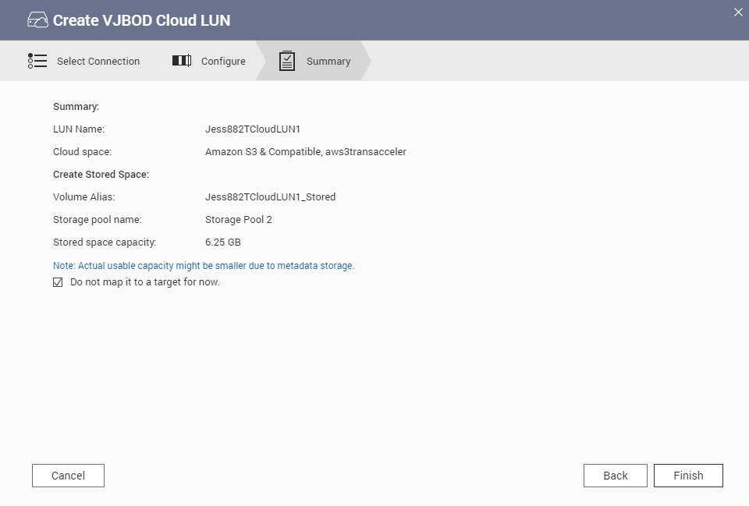
Forced Transfer and Secure Transfer steps
Step.4
The user presses "Finish" to start execution.

Slide 37
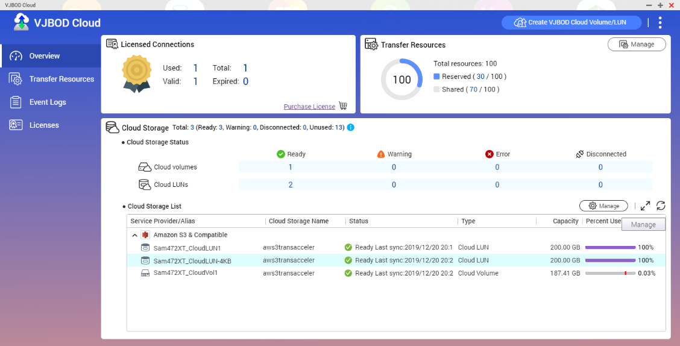
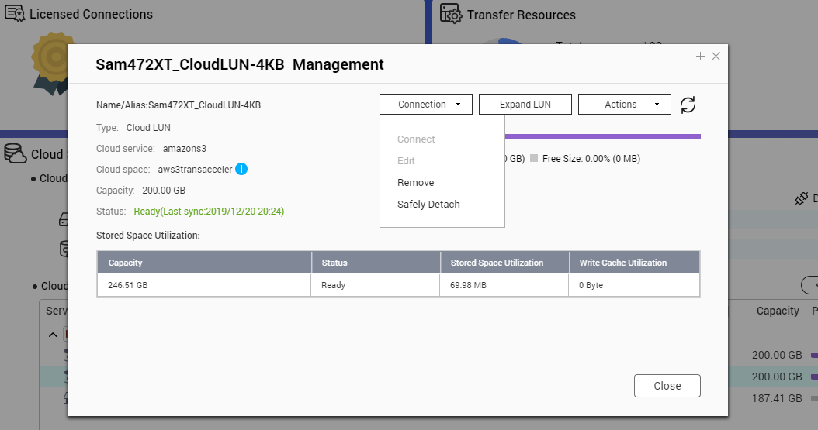
How to safely uninstall a cloud volume / LUN?
With the application of VJBOD Cloud, select a cloud volume or LUN and press "manage" on the top right.
Go to the management page and select [Connection] > [ Safely Detach].
,
,

Slide 38
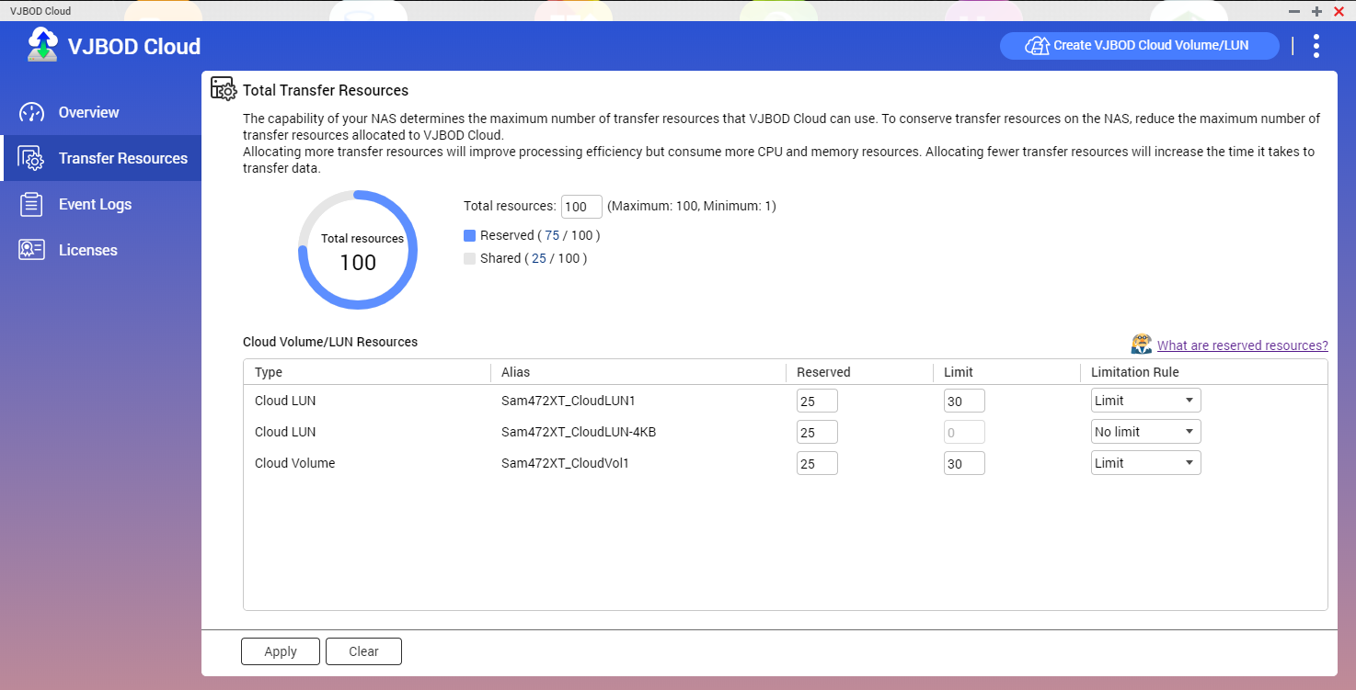
Transfer Resource Management
IT staff can assign connectivity resources of cloud volumes or LUNs for different applications or temporary tasks.
Settings like this set the highest priority:
,
Notes:
When all three LUNs are being accessed, this LUN can obtain 40-50 guaranteed threads.
If only this LUN has been accessed, then it will gets totally 100 threads full resource.

Slide 39
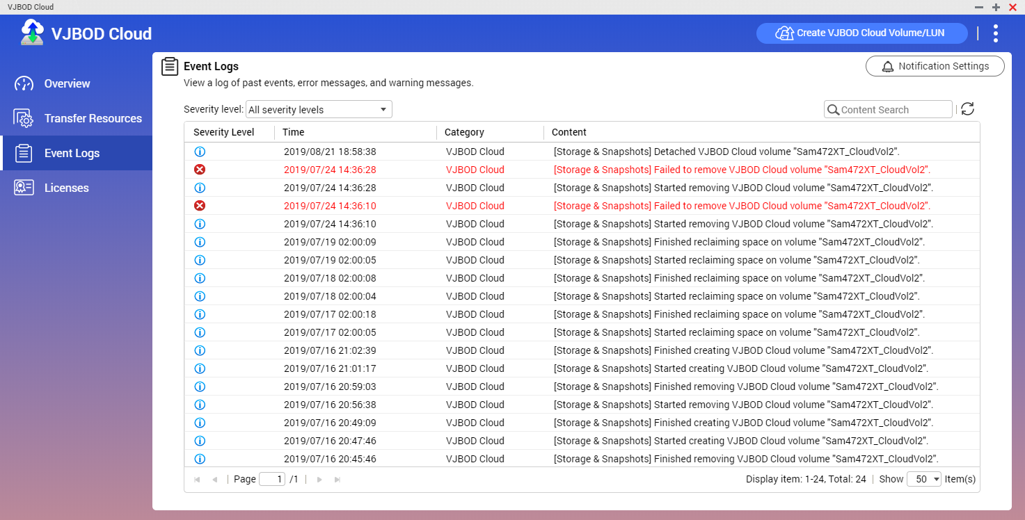
Event Log Management
Through Notification Center, IT managers can send the warning to users.
Notes:
We will provide detailed event log here and the IT manager can send the warning message via the Notification Center.

Slide 40
Cloud Volume supports encryption
Cloud Volume supports encryption with AES-256bit.
Even if a NAS is stolen, the encryption mechanism can protect confidential data and information.
Notes:
Cloud Volume supports encryption feature, allowing enterprise users to add a layer of data protection to confidential information. We encrypt the Cloud Volume with AES 256 bit in the NAS.
The encrypted cloud volume Cloud Volume can only be read and written normally through the previously set password. Even if the NAS is stolen, the encryption mechanism can protect the data and prevent theft of confidential information.

Slide 41
Live Demo

Slide 42
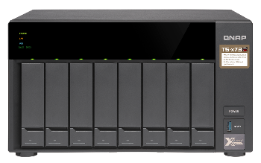
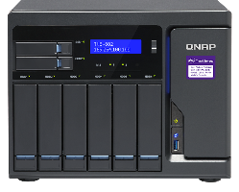
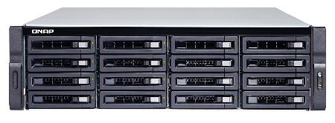
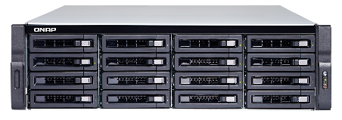
Recommended Models
SMB Entry-level
TS-873
SMB Intermediate
TVS-882
SMB Advanced
TS-1683XU-RP
Enterprise
TDS-16489U R2
Suggested Cloud Volume/LUN:4
8 bay
AMD R-Series RX-421ND
quad-core 2.1 GHz processor
(Turbo Core to 3.4 GHz)
Max 8GB RAM
Suggested Cloud Volume/LUN:8
8 bay
Intel® Core™ i5-7500
quad-core 3.4 GHz processor,
Max turbo to 3.8 GHz
Max 64GB RAM
Suggested Cloud Volume/LUN:16
16 bay
Intel® Xeon® E-2124 quad-core 3.3 GHz processor (burst up to 4.3 GHz)
Max 64GB RAM
Suggested Cloud Volume/LUN:16
16 bay
Intel® Xeon® E5-2630 v4
10-core 2.2 GHz
Max 256GB RAM
* Depending on the memory requirements, the model will have maximum support cloud volume / LUN number limit.

Slide 43
© 2019 Copyright is owned by QNAP Technology Co., Ltd. QNAP Technology reserves all rights. A trademark or mark used or registered by QNAP Technology Co., Ltd. The products and company names mentioned in the file may be trademarks owned by other companies.

Slide 44
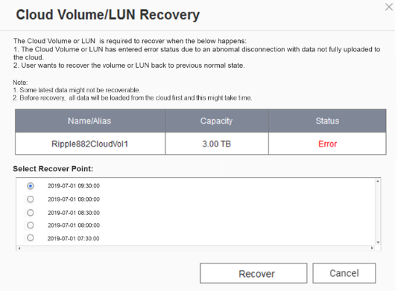
Snapshot Restore Mechanism
A cloud disk/LUN in the entire system will need to set a local storage space.
The default local storage space will be larger than the cloud volume/LUN, and the extra space will help you automatically take snapshots.
With the local storage mode, even if the cloud storage space is disconnected, the application data can be completely saved in the NAS storage space.
Users can select the snapshot restore point that they want to return, perform snapshot restore, and currently support up to 20 snapshot restore points.
Snapshot restore will first take a snapshot on the NAS side Local Stored Space and then back up the snapshot to the cloud.
* Functional schematic flow diagrams, etc. may differ from final product features

Slide 45
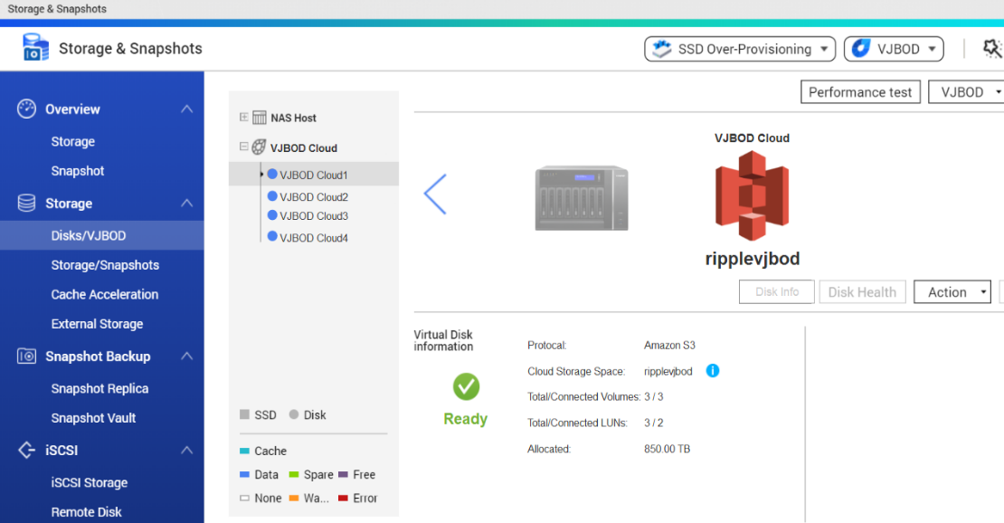
VJBOD Cloud Block-based Cloud Gateway Authorization Mechanism
VJBOD Cloud supports up to 9 cloud storage spaces (including a free connection).
Free connection to the first cloud storage bucket
VJBOD Cloud can create up to 16 Cloud Volumes or LUNs*.
* According to the memory requirements, the model will have the maximum support.
Cloud disk area / LUN number limit.
* Functional schematic flow diagrams, etc. may differ from final product features

Slide 46
When A Disaster Occurs
Forced Disconnection Of The Original NAS Cloud Volume Or LUN Connect To The Original Cloud Volume Or LUN With Another NAS
On another NAS, choose to connect to an existing cloud volume or LUN.
Forced disconnection This has a cloud disk or LUN in the original NAS.
After the forced disconnection, you can select the existing cloud volume or LUN and re-link and reply the data to the local storage space.
Let local application services and backup tasks continue. However, since it is a way to restore points with snapshots, it should be noted that there are still very few parts of the data window period.

