Slide 1




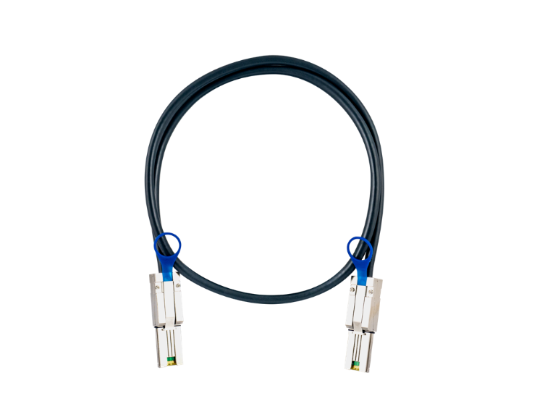

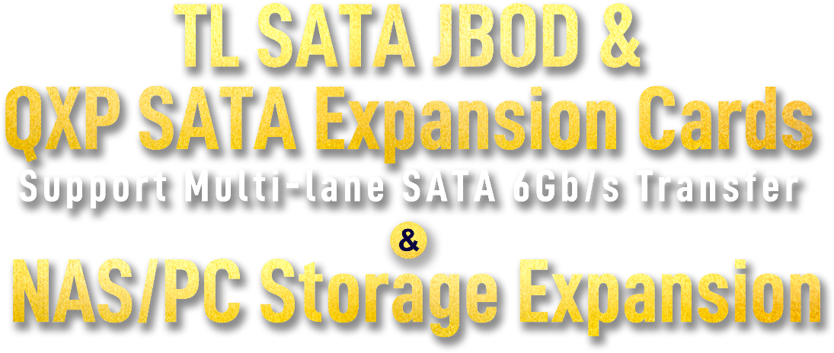
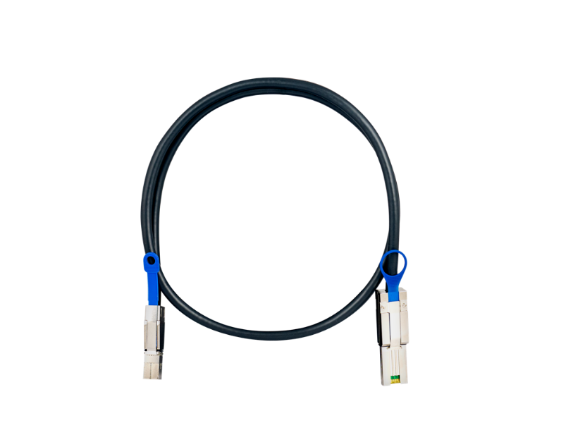
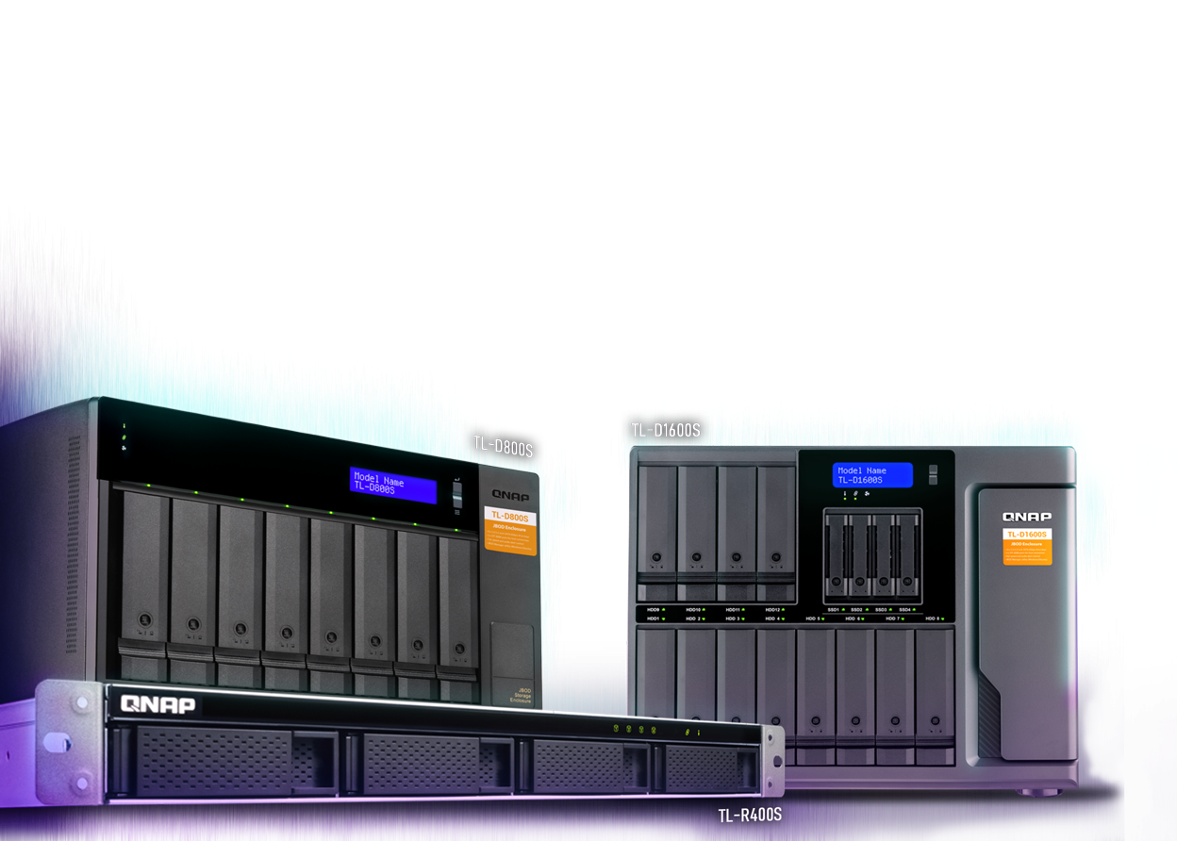
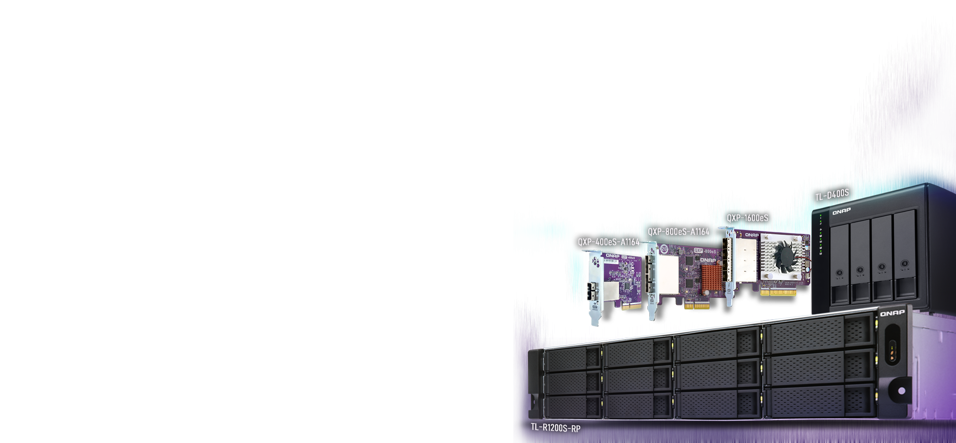

Slide 2
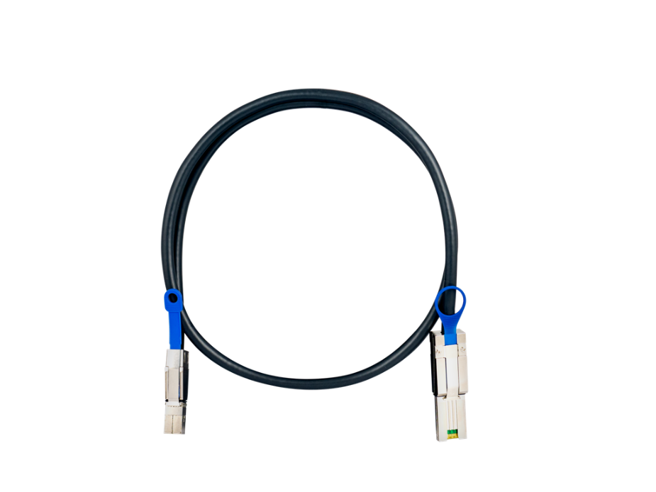




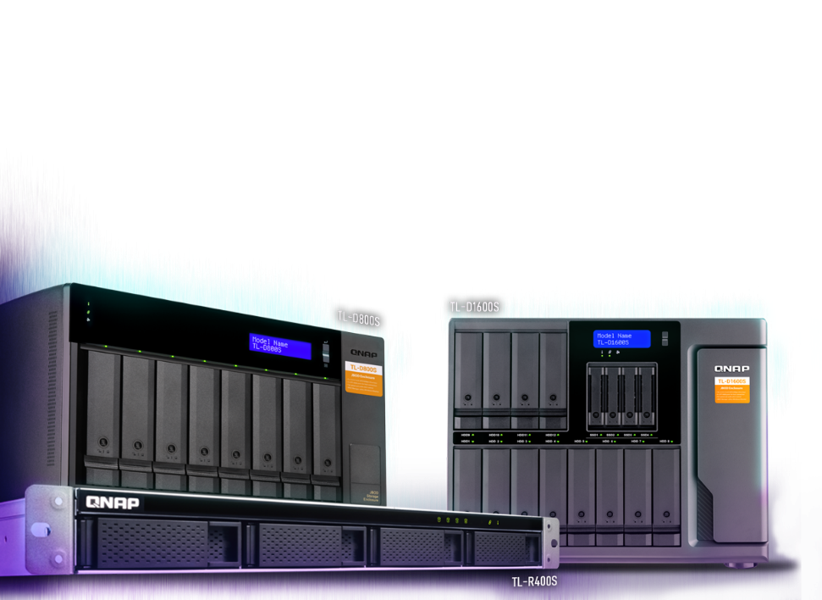
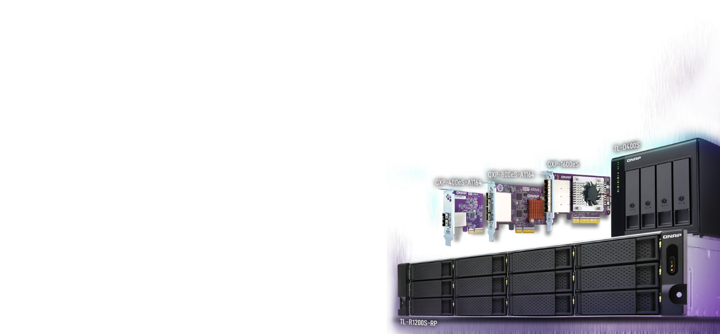
Ways to expand the storage capacity
High-speed TL SATA JBOD series overview
Use QNAP JBOD Manager to manage JBOD enclosures on Windows/Ubuntu
Expand QNAP NAS storage capacity

Slide 3

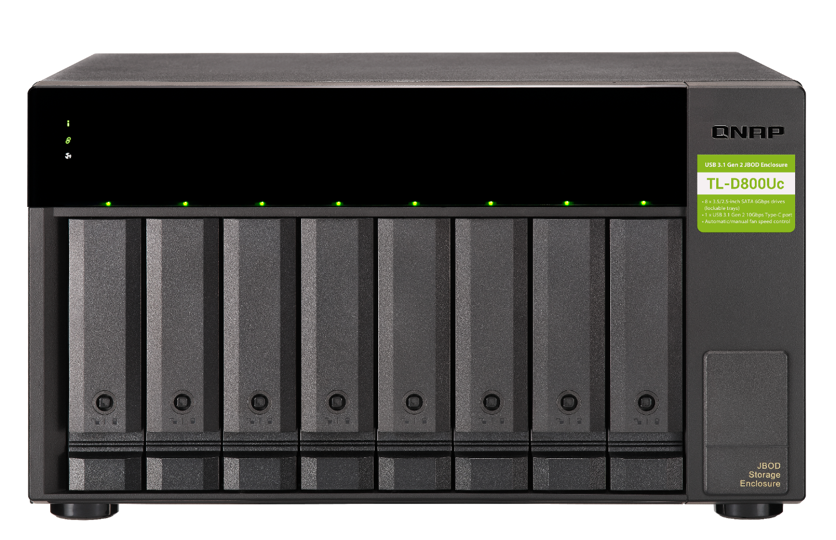



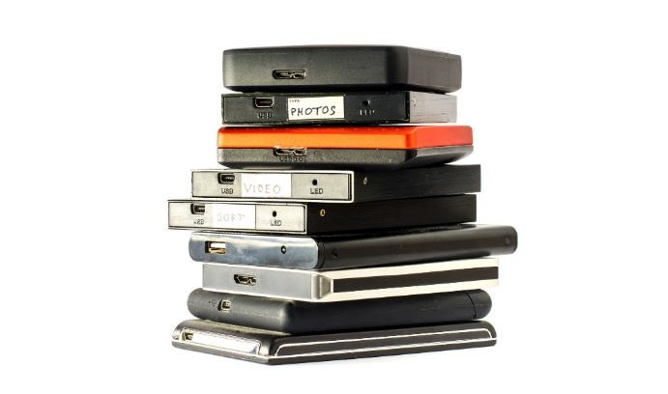
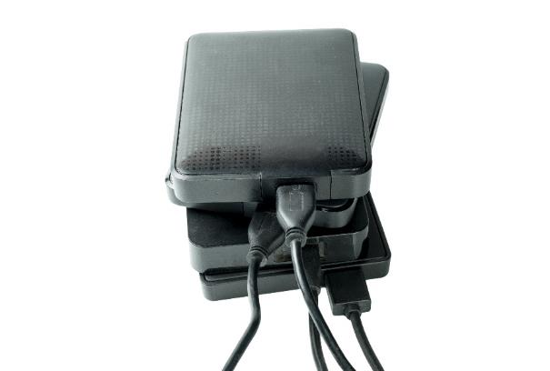
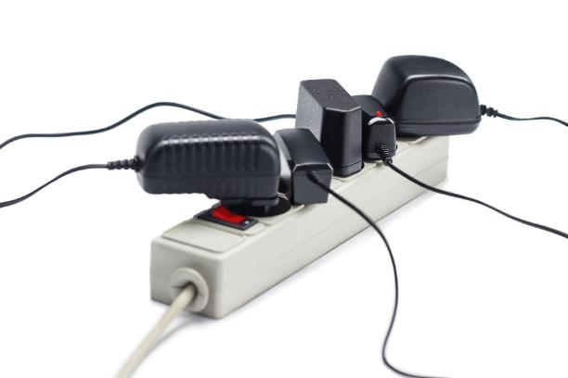

Messy workplace and low productivity?
Multiple external drives and enclosures: files scattered in multiple places
Multiple external drives and enclosures makes the host computer out of resources.
Out of available power outlets

Slide 4





Where is the high speed and affordable storage option for 2D/3D content creators and NAS expansion?
Popularity
Connectivity
Theoretical performance
eSATA
3 Gb/s
6 Gb/s
USB 3.0/3.1 Gen1
USB 3.1/3.2 Gen2
USB 3.2 Gen2 x2
5 Gb/s
10 Gb/s
20 Gb/s
Any other high performance and economical option?
Thunderbolt 3
40 Gb/s
SAS 6Gb/s
24 Gb/s
SAS 12Gb/s
96 Gb/s

Slide 5

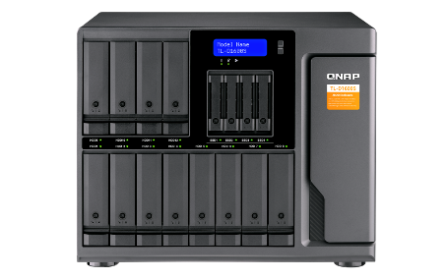
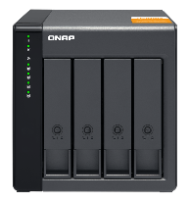
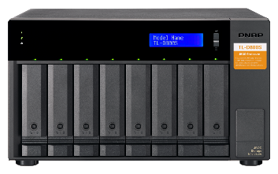

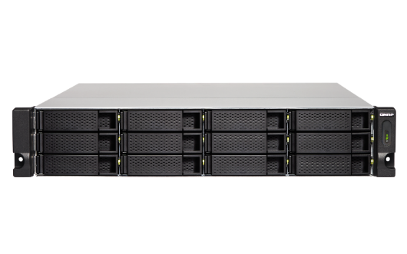
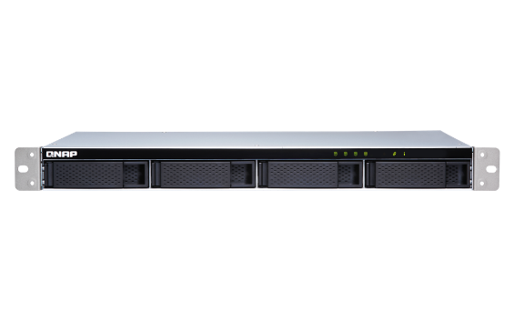

TL SATA JBOD series enclosures with multi-channel SATA 6Gb/s transfer
A single SFF-8088 cable for up to 4 x SATA 6Gb/s = 24 Gb/s transfer speed. Using multiple cables can achieve up to 64 Gb/s between the host and JBOD.
TL-D400S
TL-D800S
TL-D1600S
Ready to use by including a QXP PCIe SATA expansion card and SFF cable(s)
Support NAS QTS / QTS hero, Windows, Ubuntu / Linux
TL-R1200S-RP
TL-R400S

Slide 6
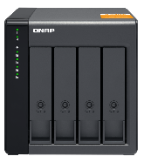
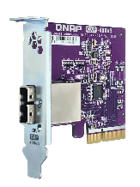
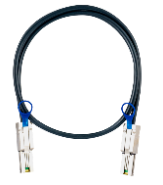
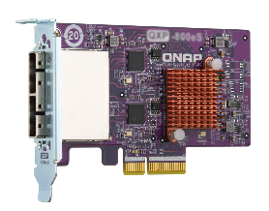
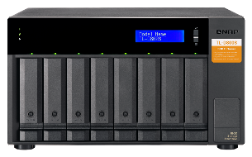

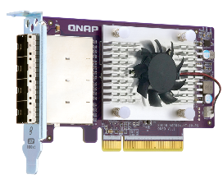
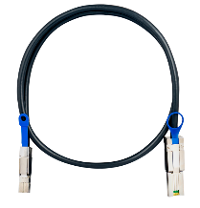
Ready to use with included QXP card and cables
+
+
+
+
TL-D400S
1 x QXP-400eS-A1164
PCIe 4-port SATA card
1 x 1M SFF-8088 cable
TL-D800S
1 x QXP-800eS-A1164
PCIe 8-port SATA card
2 x 1M SFF-8088 cables
+
+
TL-D1600S
1 x QXP-1600eS
PCIe 16-port SATA card
4 x 1M SFF-8088 to SFF-8644 cables

Slide 7
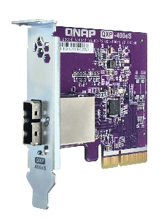
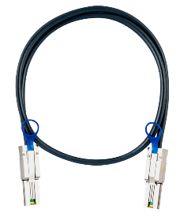
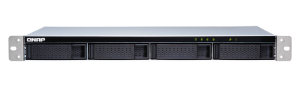

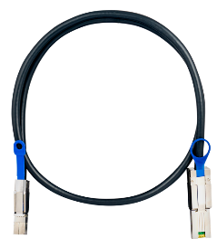
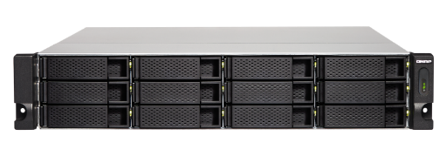
Ready to use with included QXP card and cables
+
+
TL-R400S
1 x QXP-400eS-A1164
PCIe 4-port SATA card
1 x 1M SFF-8088 cable
+
+
TL-R1200S-RP
1 x QXP-1600eS
PCIe 16-port SATA card
3 x 1M SFF-8088 to SFF-8644 cables

Slide 8

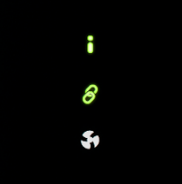
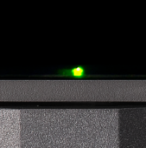
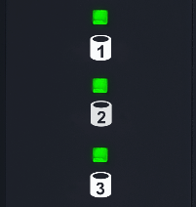
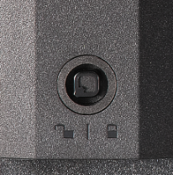
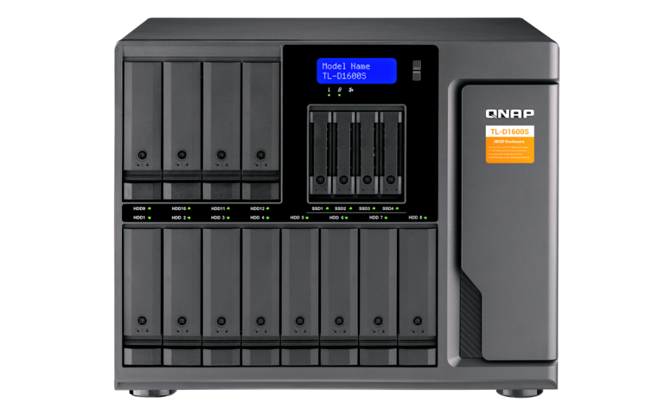
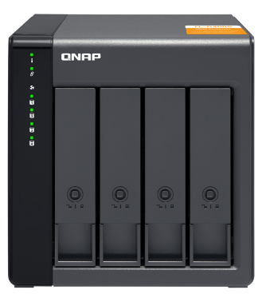

TL-D400S, TL-D800S & TL-D1600S front views
Status
Drive status
Lockable drive trays
LCD info display
TL-D800S & TL-D1600S
provide LCD for advanced info for troubleshooting
System
JBOD link
Fan error
2 keys
TL-D400S
TL-D800S
TL-D1600S

Slide 9
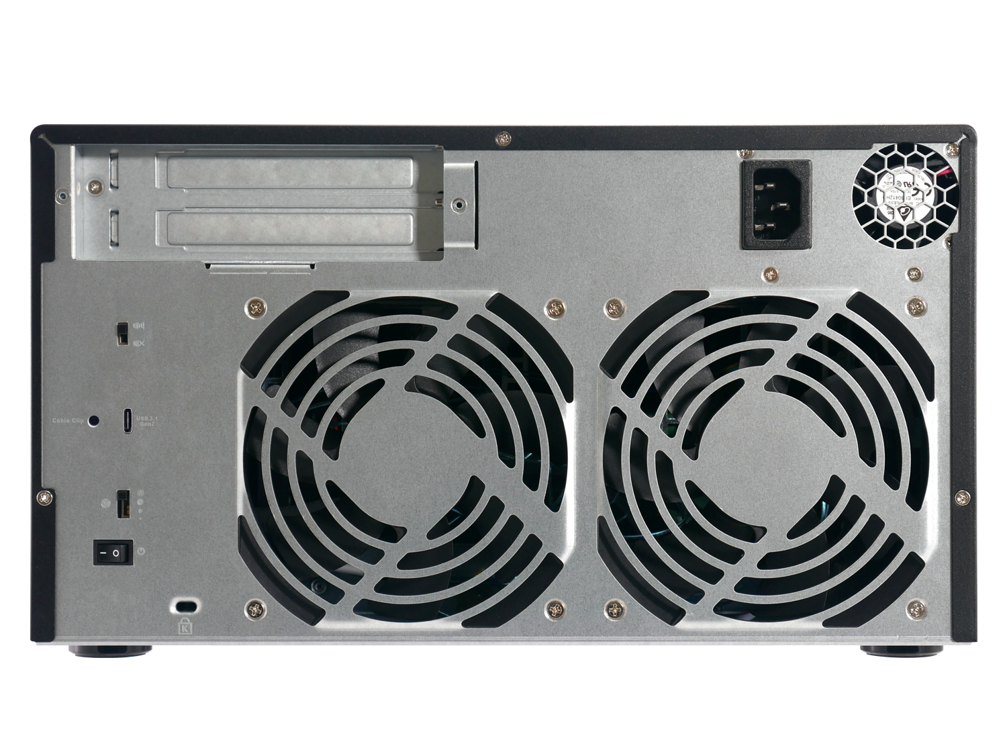

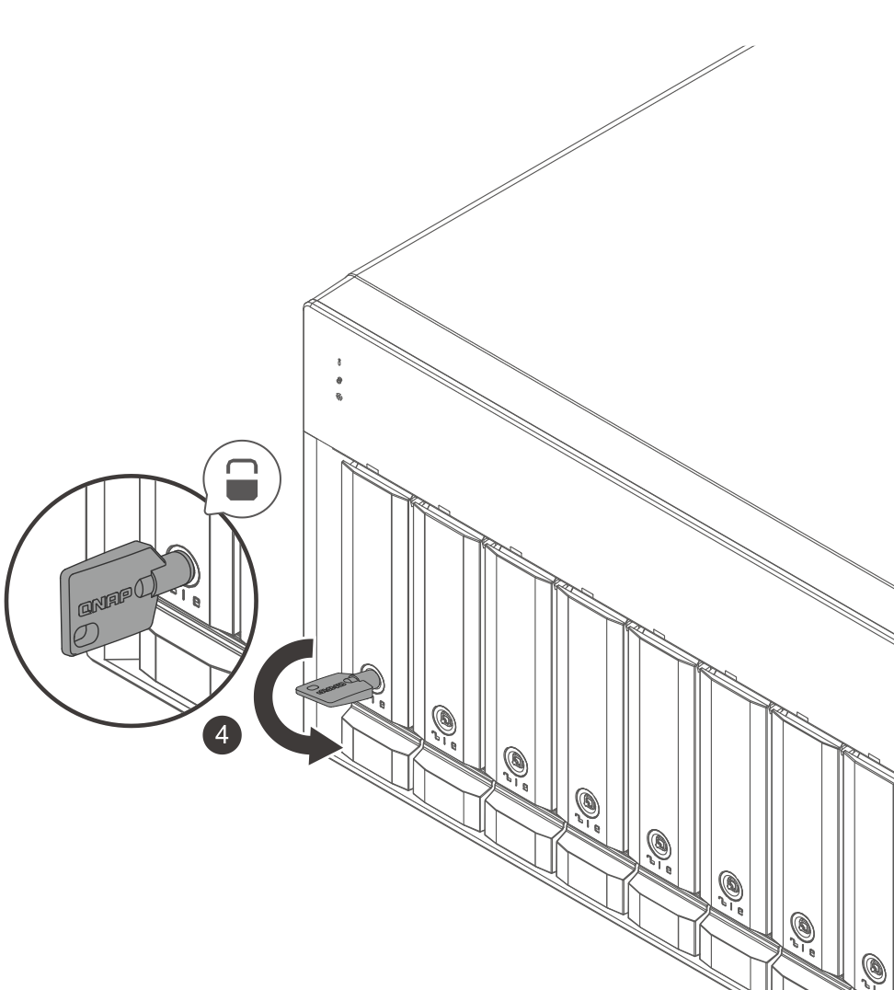
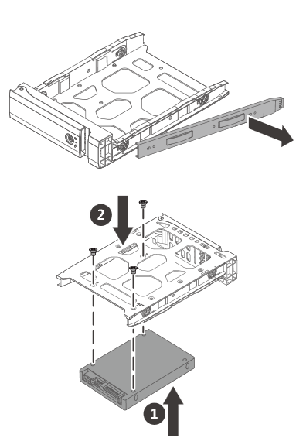
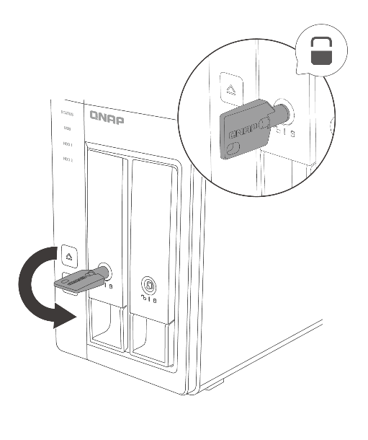
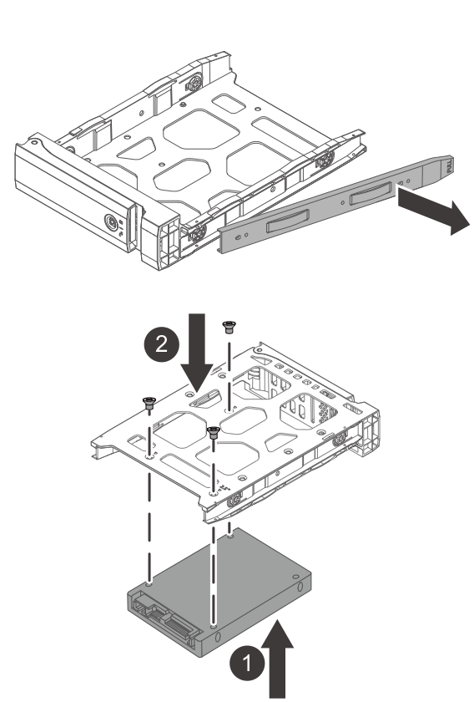
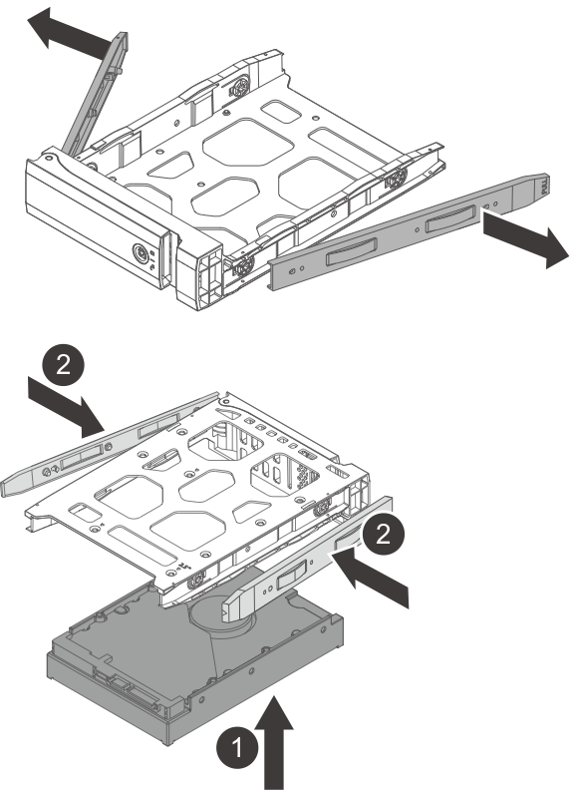
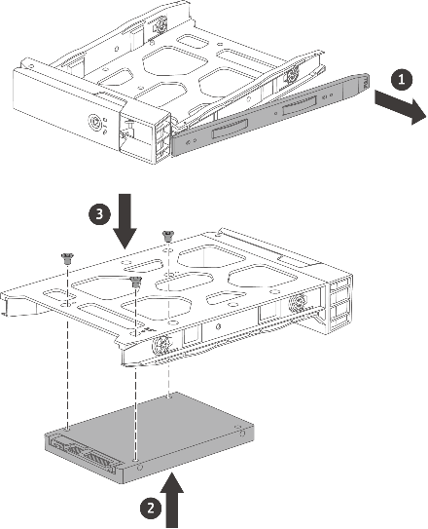
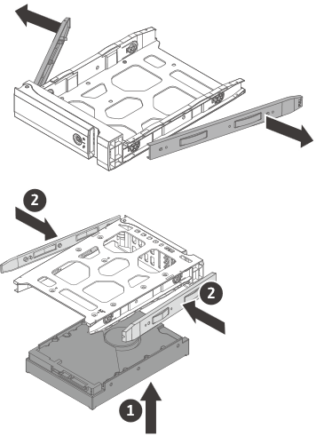

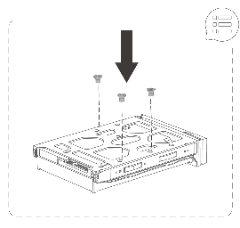




TL-D400S, TL-D800S, TL-D1600S drive installation
3.5-inch HDD
2.5-inch HDD / SSD
Toolless 3.5” drive installation
Use screws during transportation

Slide 10
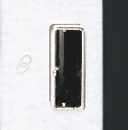
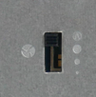
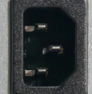
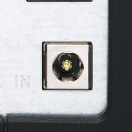
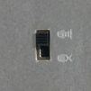
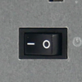






TL-D400S, TL-D800S & TL-D1600S rear views
SFF-8088 port
TL-D400S: 1
TL-D800S: 2
TL-D1600S: 4
Fan speed
(Auto, high, med, low)
AC100-240V power input
TL-D800S, TL-D1600S: internal 250W PSU
TL-D400S: external 65W adapter
Audio alert
(On, off)
Power switch
TL-D400S
TL-D800S
TL-D1600S

Slide 11





TL-R400S & TL-R1200S-RP front views
Drive status
Status
Optional rail kit
RAIL-B02
System
JBOD link
Fan error
TL-R400S
TL-R1200S-RP

Slide 12














TL-R400S, TL-R1200S-RP drive installation
21
3.5-inch HDD
2.5-inch HDD / SSD
2
2
1
1

Slide 13






TL-R400S & TL-R1200S-RP rear views
Fan speed
(Auto, high, med, low)
SFF-8088 port
TL-R400S: X1
TL-R1200S-RP: X3
Audio alert
(On, Off)
Power switch
AC100-240V power input
TL-R400S:
Internal 100W PSU
TL-R1200S-RP:
Internal 2 x 250W PSU

Slide 14




A QXP card adds multiple SATA 6Gb/s connectivity capability to the host for fast transfer
QXP-400eS-A1164
PCIe 4-port SATA card
QXP-800eS-A1164
PCIe 8-port SATA card
QXP-1600eS
PCIe 16-port SATA card
External port: 1 x SFF-8088
Disk drive: 4 x SATA 6Gb/s
Max speed: PCIe 3.0 x2 (1.97 GB/s)
Dimension: 78.8 x 68.9 mm half-height
Bundled in TL-D400S & TL-R400S
External port: 2 x SFF-8088
Disk drive: 8 x SATA 6Gb/s
Max speed: PCIe 3.0 x4 (3.94 GB/s)
Dimension: 117.15 x 68.9 mm half-height
Bundled in TL-D800S
External port: 4 x SFF-8644
Disk drive: 16 x SATA 6Gb/s
Max speed: PCIe 3.0 x8 (7.88 GB/s)
Dimension: 117.15 x 68.9 mm half-height
Bundled in TL-D1600S & TL-R1200S-RP
Different brackets included for various hosts
Can be purchased separately for installation in multiple hosts and future card replacement.

Slide 15




SAS/SATA 6Gb/s external cables
1-meter (3.28 ft.) SFF-8644 to
SFF-8088 cable
P/N: CAB-SAS10M-8644-8088
1-meter (3.28 ft.) SFF-8088 to
SFF-8088 cable
P/N: CAB-SAS10M-8088
For QXP-1600eS PCIe SATA card
Support SATA 6Gb/s and SAS 6Gb/s
Compatible with 3rd-party SAS 6Gb/s JBOD products
For QXP-400eS-A1164 and QXP-800eS-A1164 PCIe SATA cards
Support SATA 6Gb/s and SAS 6Gb/s
Compatible with 3rd-party SAS 6Gb/s JBOD products
SFF-8644 connector
SFF-8088 connector
SFF-8088 connector
SFF-8088 connector

Slide 16






High speed architecture from TL-D400S &
TL-R400S JBOD and QXP-400eS-A1164 card
TL-D400S/R400S design diagram
PCIe card QXP-400eS-A1164
Host with a PCIe slot:
NAS, Windows, Ubuntu / Linux
HDD
SATA redriver
SFF-8088 connector
SFF-8088 connector
1
Asmedia
ASM1164
PCIe Gen3 x2
to SATA controller
2
SFF-8088 cable
3
4
4 x SATA 3.0
4 x 6 Gb/s (4 x 600 MB/s)
4 x SATA 3.0
4 x 6 Gb/s (4 x 600 MB/s)
PCIe Gen3 x2
16 Gb/s (1.97 GB/s)

Slide 17

High speed architecture from TL-D800S JBOD and QXP-800eS-A1164 card
TL-D800S design diagram
PCIe card QXP-800eS-A1164
Host with a PCIe slot:
NAS, Windows, Ubuntu / Linux
HDD
SATA redriver
SFF-8088 connector
SFF-8088 connector
PCIe Gen3 x2
16 Gb/s
(1.97 GB/s)
1
Asmedia
ASM1164
PCIe Gen3 x2
to SATA controller
2
3
SFF-8088 cable
PCIe Gen3
switch
4
5
Asmedia
ASM1164
PCIe Gen3 x2
to SATA controller
6
PCIe Gen3 x2
16 Gb/s
(1.97 GB/s)
7
SFF-8088 cable
8
8 x SATA 3.0
8 x 6 Gb/s (8 x 600 MB/s)
8 x SATA 3.0
8 x 6 Gb/s (8 x 600 MB/s)
PCIe Gen3 x4
32Gb/s (3.94 GB/s)

Slide 18

High speed architecture from TL-D1600S JBOD and QXP-1600eS card
TL-D1600S design diagram
PCIe card QXP-1600eS
Host with a PCIe slot:
NAS, Windows, Ubuntu / Linux
HDD
SATA redriver
SFF-8088 connector
SFF-8644 connector
1
2
3
SFF-8088 to SFF-8644 cable
4
5
6
7
SFF-8088 to SFF-8644 cable
Marvell
88SE1475
PCIe Gen3 x8 to SATA controller
8
9
10
11
SFF-8088 to SFF-8644 cable
12
PCIe Gen3 x8
64 Gb/s (7.88 GB/s)
SSD
1
2
SFF-8088 to SFF-8644 cable
3
4
16 x SATA 3.0
16 x 6 Gb/s (16 x 600 MB/s)
16 x SATA 3.0
16 x 6 Gb/s (16 x 600 MB/s)

Slide 19


High speed architecture from TL-R1200S-RP JBOD and QXP-1600eS card
TL-R1200S-RP design diagram
PCIe card QXP-1600eS
Host with a PCIe slot:
NAS, Windows, Ubuntu / Linux
HDD
SATA redriver
SFF-8088 connector
SFF-8644 connector
1
2
3
SFF-8088 to SFF-8644 cable
4
5
6
7
SFF-8088 to SFF-8644 cable
Marvell
88SE1475
PCIe Gen3 x8
to SATA controller
8
9
10
11
SFF-8088 to SFF-8644 cable
12
PCIe Gen3 x8
64 Gb/s (7.88 GB/s)
12 x SATA 3.0
12 x 6 Gb/s (12 x 600 MB/s)
Reserved port
12 x SATA 3.0 12 x 6 Gb/s (12 x 600 MB/s)

Slide 20






Compatible with NAS, Windows,
Ubuntu / Linux
Exclusive JBOD utility to monitor JBOD and disk drive status
Follow these steps to connect or disconnect the JBOD enclosure:
  Windows / Linux Ubuntu users with QNAP JBOD Manager utility to manage JBOD enclosure
  QTS 4.4.2+ & QTS hero for JBOD management

Slide 21




Build a software RAID 0/1/5 volume with native Windows utility
Create a new pool and storage space on Windows
Resiliency type: [Simple], [Two-way mirror], [Three-way mirror] and [Parity]
Please download the windows driver for QXP-1600eS on QNAP download center.
https://support.microsoft.com/zh-tw/help/12438/windows-10-storage-spaces

Slide 22

Create a RAID 0/1/5 pool with Linux
*Please DO NOT unplug the cable while RAID space is connected & mounted, which may cause unexpected data loss or trigger RAID degrade.
Please download the Linux driver for QXP-1600eS on QNAP download center.
Install mdadm via terminal
sudo apt-get install –y mdadm
Build RAID 5 with mdadm
sudo mdadm --create --verbose /dev/md0 --level=5 --raid-devices=3 /dev/sda /dev/sdb /dev/sdc
Create & mount RAID pool
sudo mkfs.ext4 -F /dev/md0
sudo mkdir -p /mnt/md0
sudo mount /dev/md0 /mnt/md0
https://www.digitalocean.com/community/tutorials/how-to-create-raid-arrays-with-mdadm-on-ubuntu-18-04

Slide 23











Use a third-party hardware RAID card on Windows with SATA JBOD
Connect your JBOD to a third-party RAID controller card with its RAID utility for advanced hardware RAID 1/5/6/10/50/60 protection on Windows.
Windows utility from card vendors:
MRAID
MegaRAID Storage Manager
Storage manager
RAID Management
ARC-1883x
MegaRAID SAS 9286-8e (6 Gb/s)
MegaRAID SAS 9380-8e (12 Gb/s)
SmartRAID 3154-8e
RocketRAID 3742A

Slide 24


Manage the JBOD with your PC

Slide 25






QNAP JBOD Manager
QNAP JBOD Manager will let you know the information and status of JBOD device and each disk.
Supported OS:
Windows: Windows 8 (or newer), Server 2012 R2 (or newer)
Linux: Ubuntu 18.04

Slide 26


Monitor the disk health
Quickly Explore
Detailed Info
The color of the disk allows you to easily identify the disk status. Click it to get more details like type, manufacturer, capacity...etc.
The tab of "Disk Information" will provide you the detailed SMART info of each disk.

Slide 27



Device Information and Health View
Detail information of each enclosure :
Enclosure health
Bus type
PSU status
(only for RP model)
System temperature
Fan speed
Port connection status

Slide 28


Device Temperature Threshold
You can set up the temperature threshold from 55 to 69 degree C, and when the temperature exceeds the threshold, the enclosure will alarm and the health status will change to red. (Warning)
You can also see that the fan speeds up automatically when encountering high temperatures. (FAN set Auto)

Slide 29


Log history and Notification
Utility UI + desktop notification
Independent log: it recordall events that occur in the TL JBOD, and allows to export events for analysis.

Slide 30






Customizable naming & SATA wiring determination
Identify Enclosure by LCM
Easily check the connection

Slide 31




Based on Software RAID: manage JBOD with QTS
TL SATA JBOD can be monitored and managed in the storage and snapshot manager. Without external RAID chip, compared to the TR series, it supports more QTS local disk management features.
Enclosure & QTS Disk related features:
Temperature warning
S.M.A.R.T test
Seagate IHM
Disk Scan
Disk Erase
Disk performance test

Slide 32





QTS integrates customized enclosure management for TL
When SSD becomes more popular, the temperature management of the enclosure is more important than before.
Monitor the FAN speed of TL-JBOD via NAS UI, and configure the threshold of temperature warning.

Slide 33




One machine for two uses: internal expansion or external disk mode
RAID & Storage Pool
External Disk Mode
All disks of TL JBOD would be identified by Storage & Snapshot manager, then configure as a RAID of storage pool.
The storage is individual for each disk, it will show 8 independent external disks on UI.
開啟儲存與快照總管 >
進入儲存 / 快照
選擇建立 >
新儲存池或新磁碟區
選擇 TL 系列 JBOD 並指定
RAID 類型即完成建立

Slide 34


Easily create the storage in QTS / QTS hero
Different than the TR series, TL-JBOD is based on QNAP software RAID: supports all local RAID operations as well ass RAID migration and RAID expansion. TL-R1200S-RP can even be configured as RAID 50 / 60.
In three steps, it will change the TL JBOD from an external storage device to the expansion storage.
[ Storage & Snapshot
Manager ] > [ Storage / Snapshots ]
Create new
[Storage Pool]
Select TL JBOD and set up the RAID type

Slide 35









Flexible Storage Expansion or as a backup space
應用情境
TL SATA JBOD can expand QNAP NAS storage capacity. It supports either the configurations of the storage pool, or the snapshots storage from volume and LUN.
Based on the structure of software RAID, TL JBOD units are more suitable for expansion devices than TR series.
Be the Snapshot Vault
Be the Storage Expansion
TL-D800S
TS-877

Slide 36







Use QXP card for connecting more JBOD
NAS supports 2 x TL SATA JBOD.
QNAP TL SATA JBOD & QXP expansion card
NAS requirement:
With the PCIe slot
QTS 4.4.2 or higher
TS-877
TL JBOD needs to created as a separate storage pool, and cannot be used to expand the original pool on NAS.
TL-R1200S-RP
TL-D800S

Slide 37




Reach high-bandwidth with multi-channel SATA 6Gb/s transfer
IOmeter performance tests of TL-D800S with 8 x SSDs
3546
MB/s
3129
MB/s
3100
MB/s
3119
MB/s
3079
MB/s
2997
MB/s
Read
Write
Read
Write
Read
Write
SW RAID 0
SW RAID 0
SW RAID 0
Windows 10 Pro
Ubuntu
NAS

Slide 38
DEMO
TL-D1600S
Hardware overview and Software overview
TL-D800S

Slide 39


Comparison of various QNAP enclosures
 | TL-D400S, TL-D800S, TL-D1600S, TL-R400S, TL-R1200S-RP | TL-D800C & TL-R1200C-RP | TR-002 & TR-004 & TR-004U
Connectivity | SFF-8088 multi-lane SATA 6Gb/s | USB 3.1 Gen2 | TR-002 USB 3.1 Gen2 TR-004 USB 3.1 Gen1
Number of bays | TL-D400S, TL-R400S: 4 TL-D800S: 8 TL-R1200S-RP: 12 TL-D1600S: 16 | TL-D800C: 8 TL-R1200C-RP: 12 | TR-002: 2 TR-004, TR-004U: 4
Supported O.S. | QNAP QTS/QTS hero, Windows, Linux | QNAP QTS/QTS hero, Windows, Linux, macOS​
QTS drive monitoring and storage pool support | Yes
QTS advanced drive features such as bad block scan | Yes | Yes | ---
Integrated hardware RAID | --- | --- | Yes
RAID migration, expansion | Yes | Yes | ---
When to use | High capacity for expansion | High capacity for expansion | Cross paltform / plug & play
功能 | QNAP TL USB JBOD | QNAP TR-002/004
連線類型 | USB 3.1 Gen2 | USB 3.1 Gen2/3.0
槽位數 | 8, 12 | 2, 4
分割區可使用系統 | QNAP QTS, Windows, Mac, Linux 等 | QNAP QTS, Windows, Mac, Linux 等
QTS 磁碟監控、建立儲存池 | 支援 | 支援
QTS 磁碟操作如壞軌掃描 | 支援 | 不支援
外接 RAID 保護 | 不支援 | 支援
RAID 遷移、替換磁碟 | 支援 | 不支援
適用情境 | 單一平台大量 儲存空間擴充 | 跨平台擴充與資料傳輸

Slide 40





Extend the warranty for up to 5 years
Available 2-Year or 3-Year Extended Warranty
For 2-year standard warranty
TL-D400S, TL-D800S, TL-D1600S
For 3-year standard warranty
TL-R400S,
TL-R1200S-RP
Standard Warranty
Warranty service that comes in effect at the time of purchase.
Free repair and part replacement for products under normal use during warranty period. (Spare parts and consumables are excluded)
Extended Warranty (optional)
Extending your warranty, available within 90 days of the initial unit purchase.
Offers identical service to standard warranty.
Order P/N:
LIC-NAS-EXTW-GREEN-3Y
Order P/N:
LIC-NAS-EXTW-ORANGE-2Y

Slide 41



High-speed TL SATA JBOD series
TL-D400S / TL-D800S
TL-D1600S / TL-R400S
TL-R1200S-RP
QNAP JBOD Manager
QNAP NAS expansion
Flexible 2 usage modes (internal and external modes) with comprehensive QTS/QTS hero features
The new TL SATA JBOD with multi-lane SATA 6Gb/s for high-performance NAS, Windows, Ubuntu/Linux capacity expansion.
Monitor JBOD enclosure. and disk drive status on Windows/Ubuntu

Slide 42


多通道 SATA 6Gb/s 外接
高速儲存應用
Fast and economical!
Copyright © 2019 QNAP Systems, Inc. All rights reserved. QNAP® and other names of QNAP Products are proprietary marks or registered trademarks of QNAP Systems, Inc.
Other products and company names mentioned herein are trademarks of their respective holders.

