Slide 1



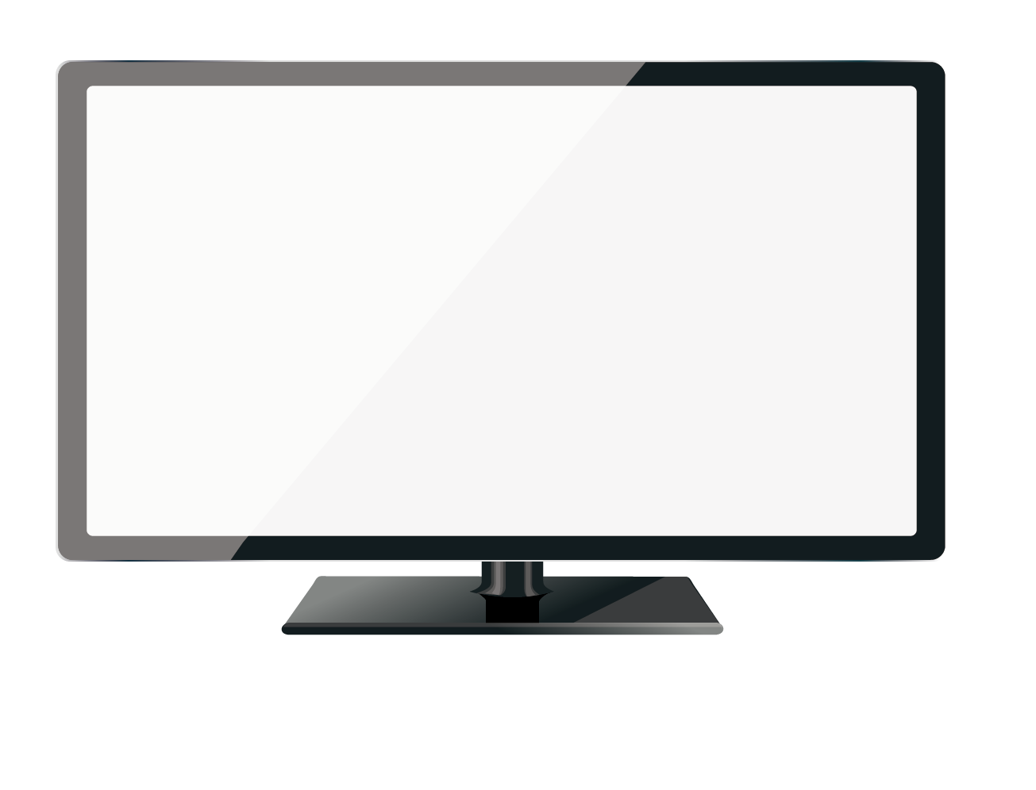

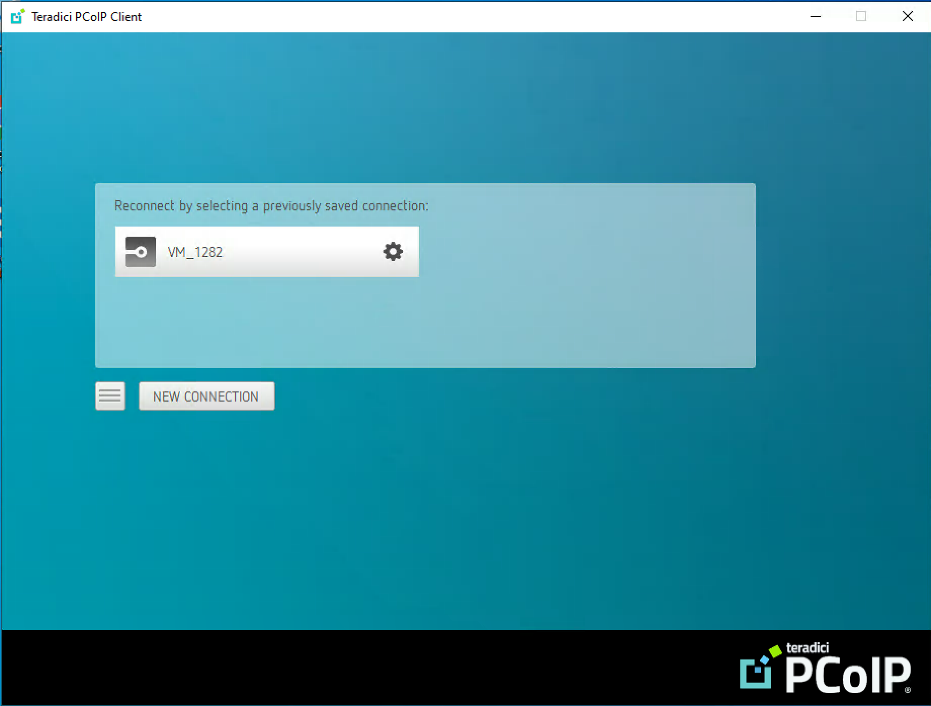
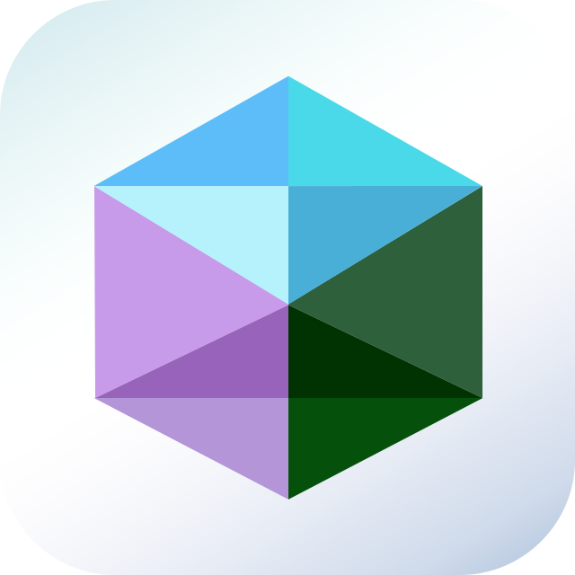
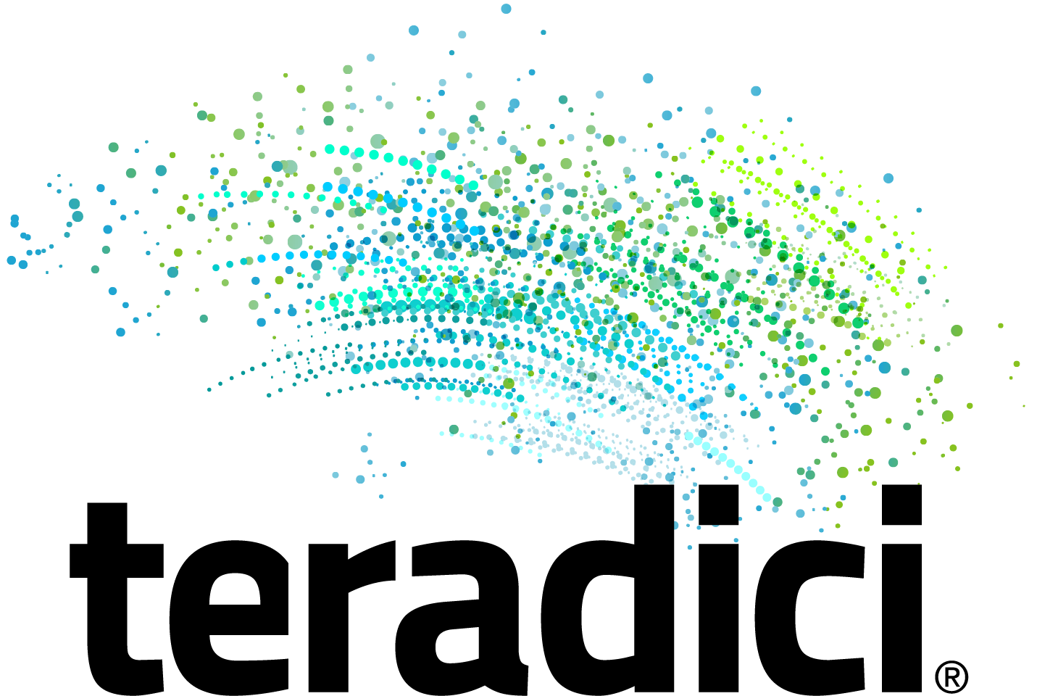
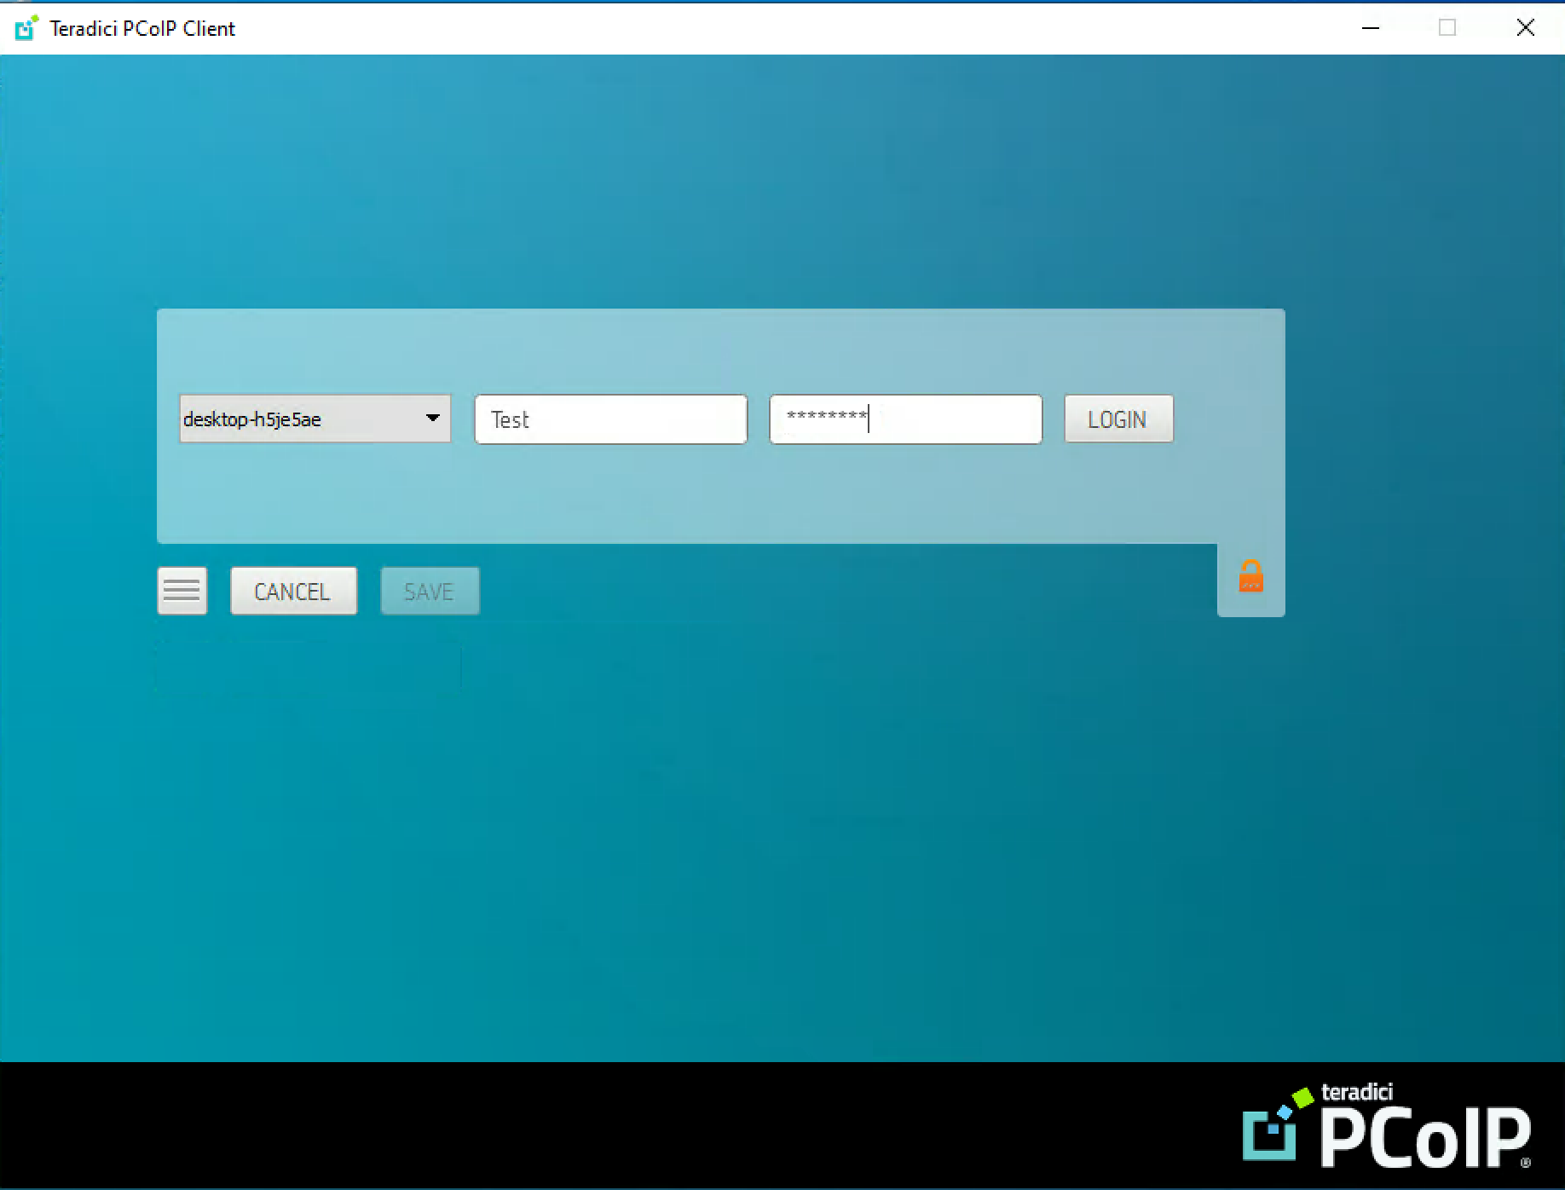

Slide 2

Outline
Ways to connect VM desktops
Remote Access Tools
Teradici PCoIP – Cloud Access Software
Demo

Slide 3
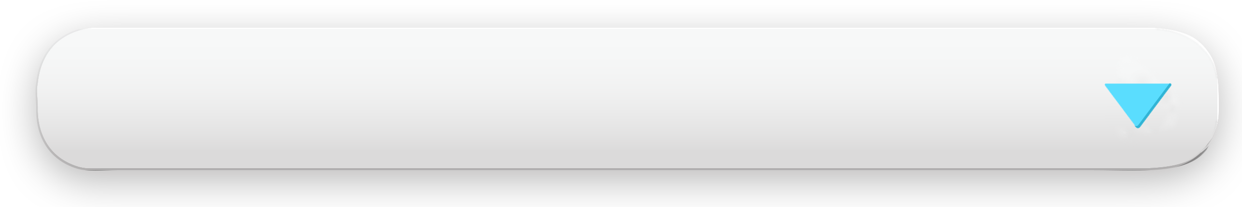

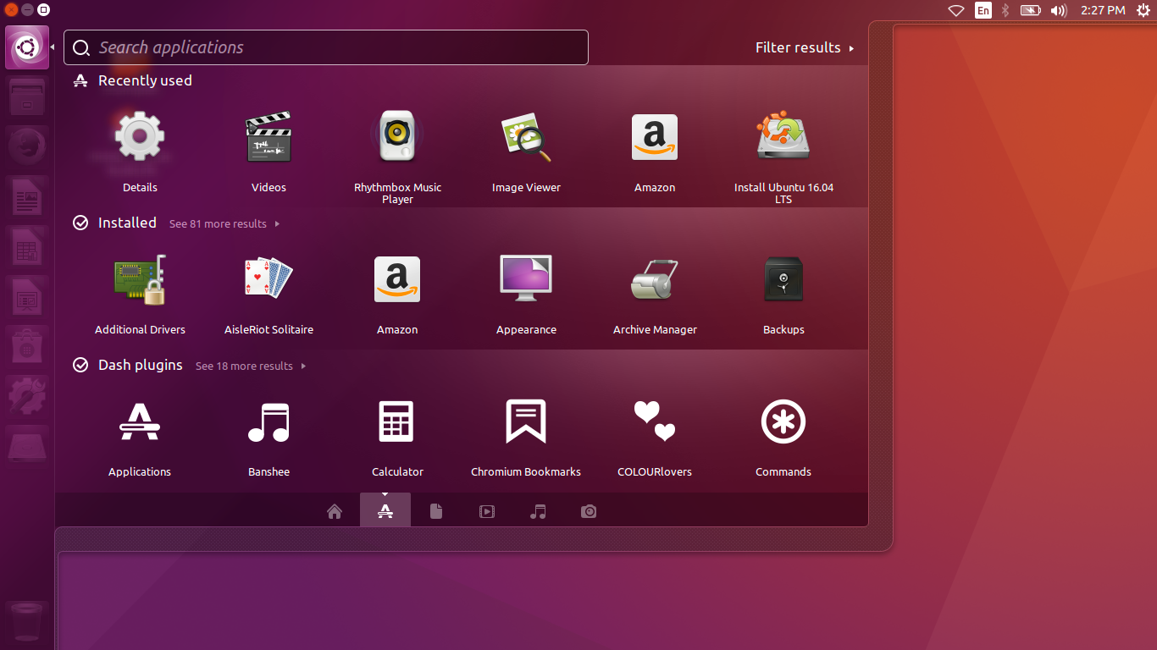

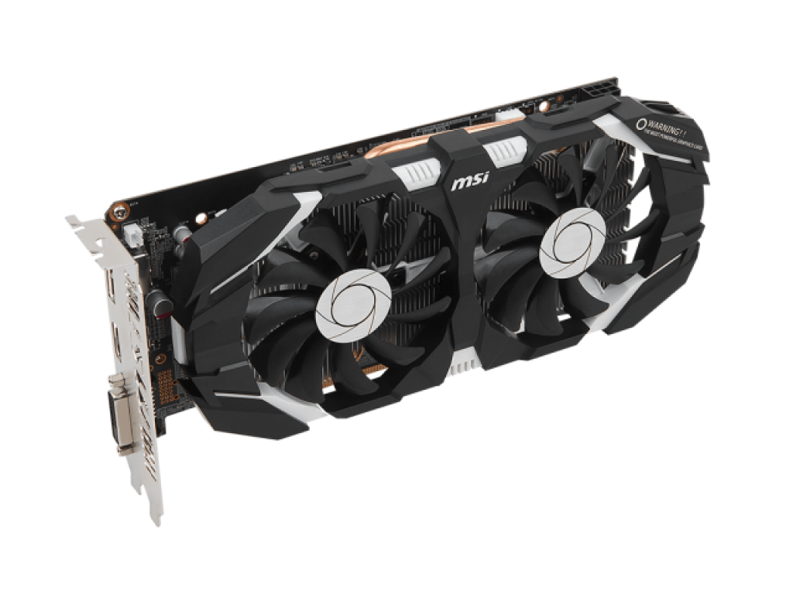
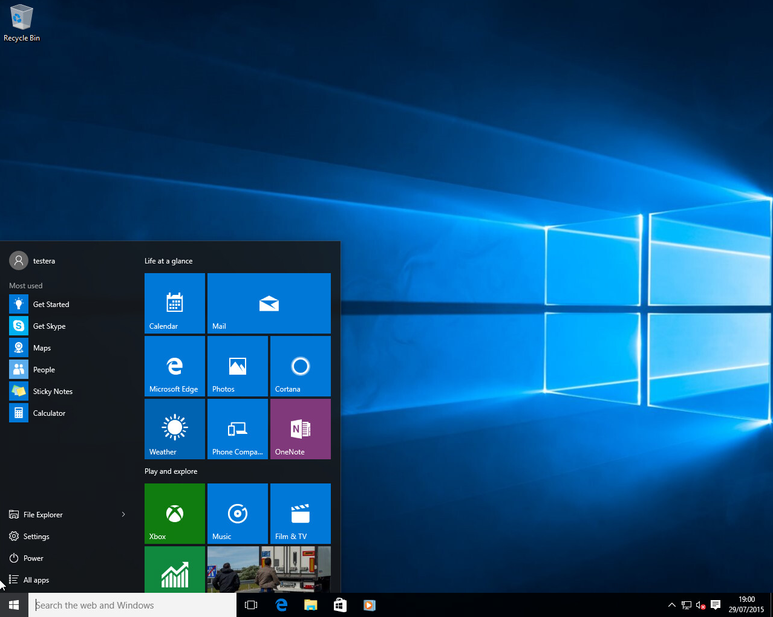

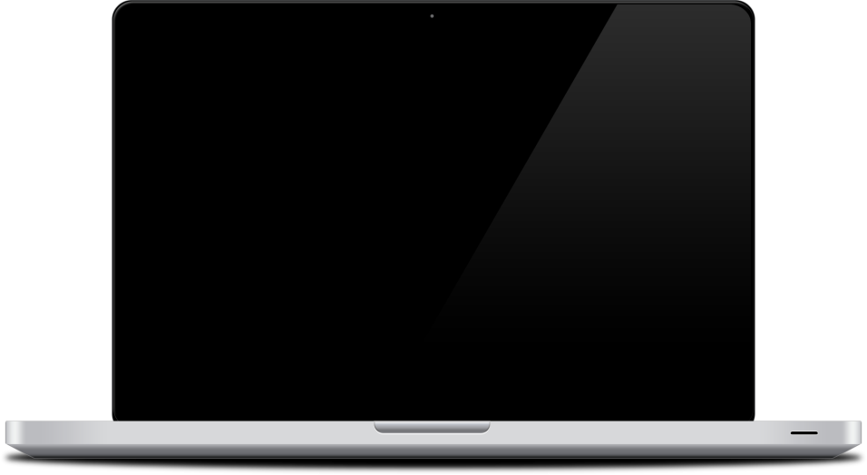


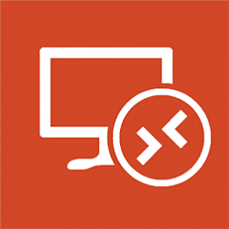

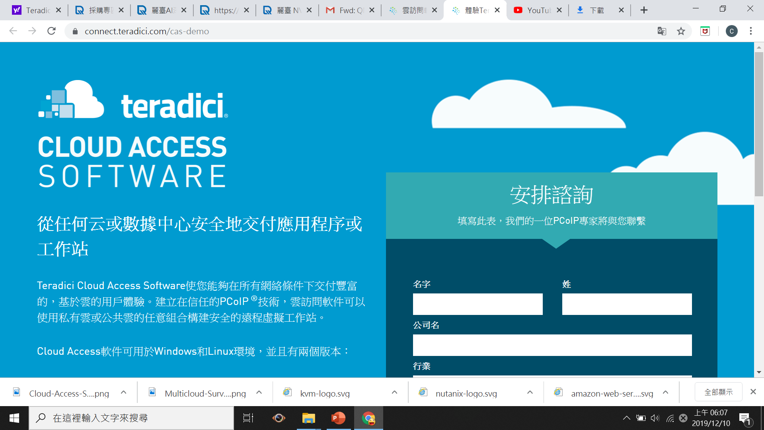
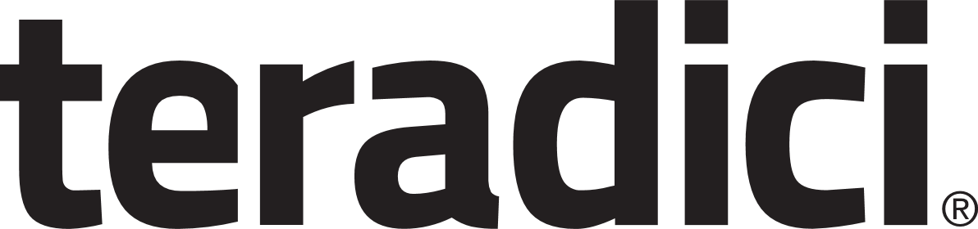
Ways to Connect VM Desktops
Web browser (HTML5)
Discrete GPU direct output
HybridDesktop Station
Remote Access Tools
VNC
  Windows Remote Desktop
  Teradici Cloud Access Software

Slide 4

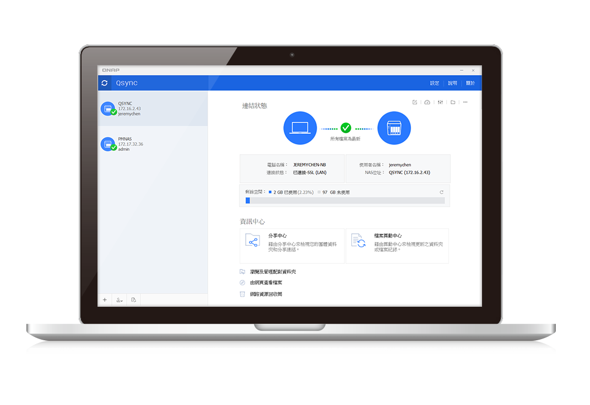
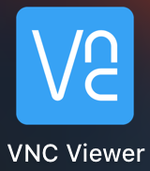
Remote Access Tools

Slide 5

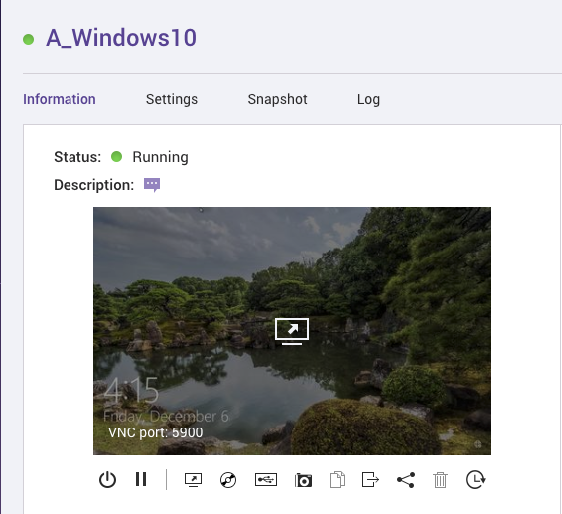
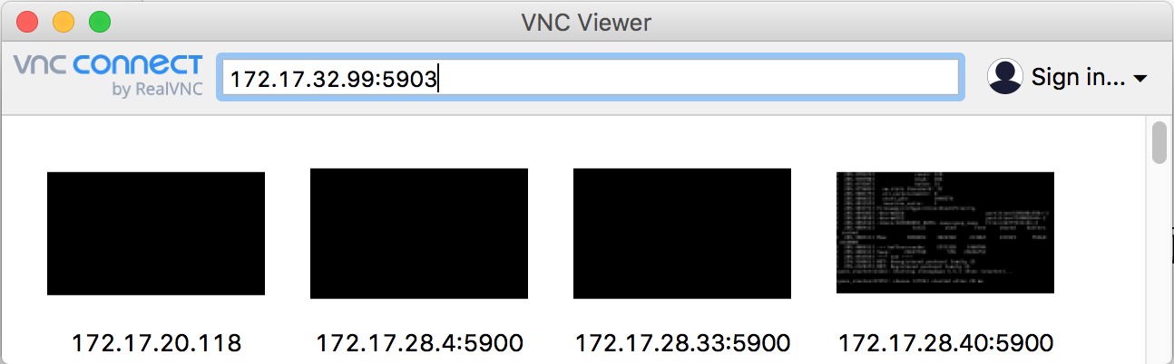
VNC
Built-in VNC Server in Virtualization Station
All VMs can be accessed by VNC clients
Default ports: 5900-5930
Step
Download VNC client (e.g. UltraVNC
or VNC Viewer)
Step
Verify VNC port
Step
Launch VNC client and enter [NAS IP:port]
1
2
3
Notes:
https://www.realvnc.com/en/connect/trial/

Slide 6

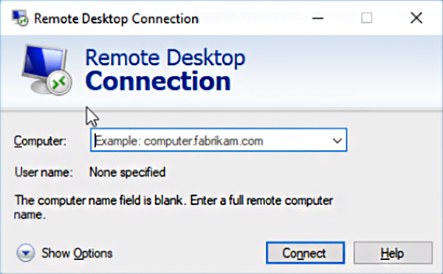
Windows Remote Desktop (1/2)
Used for connecting a Windows Server/Client VM
> If the OS of your client NB/PC is Windows, no Windows Remote Desktop installation is needed
Windows Client
Step
Within Windows VM, go to System > Remote Desktop and enable Remote access
1
Step
Inside your client, launch Remote Desktop Connection, and enter the Windows VM IP/Hostname
2

Slide 7
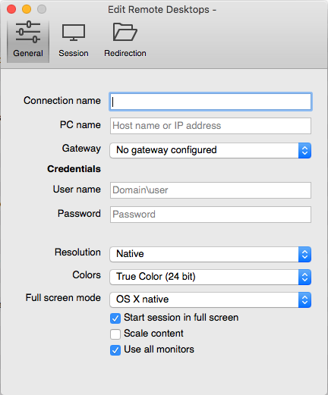

Windows Remote Desktop (2/2)
macOS requires the Windows RD app to be installed
Mac Client
Step
Inside Windows VM, go to System > Remote Desktop and enable Remote access
1
Install Microsoft Remote Desktop and enter the VM IP or hostname.
Step
2

Slide 8
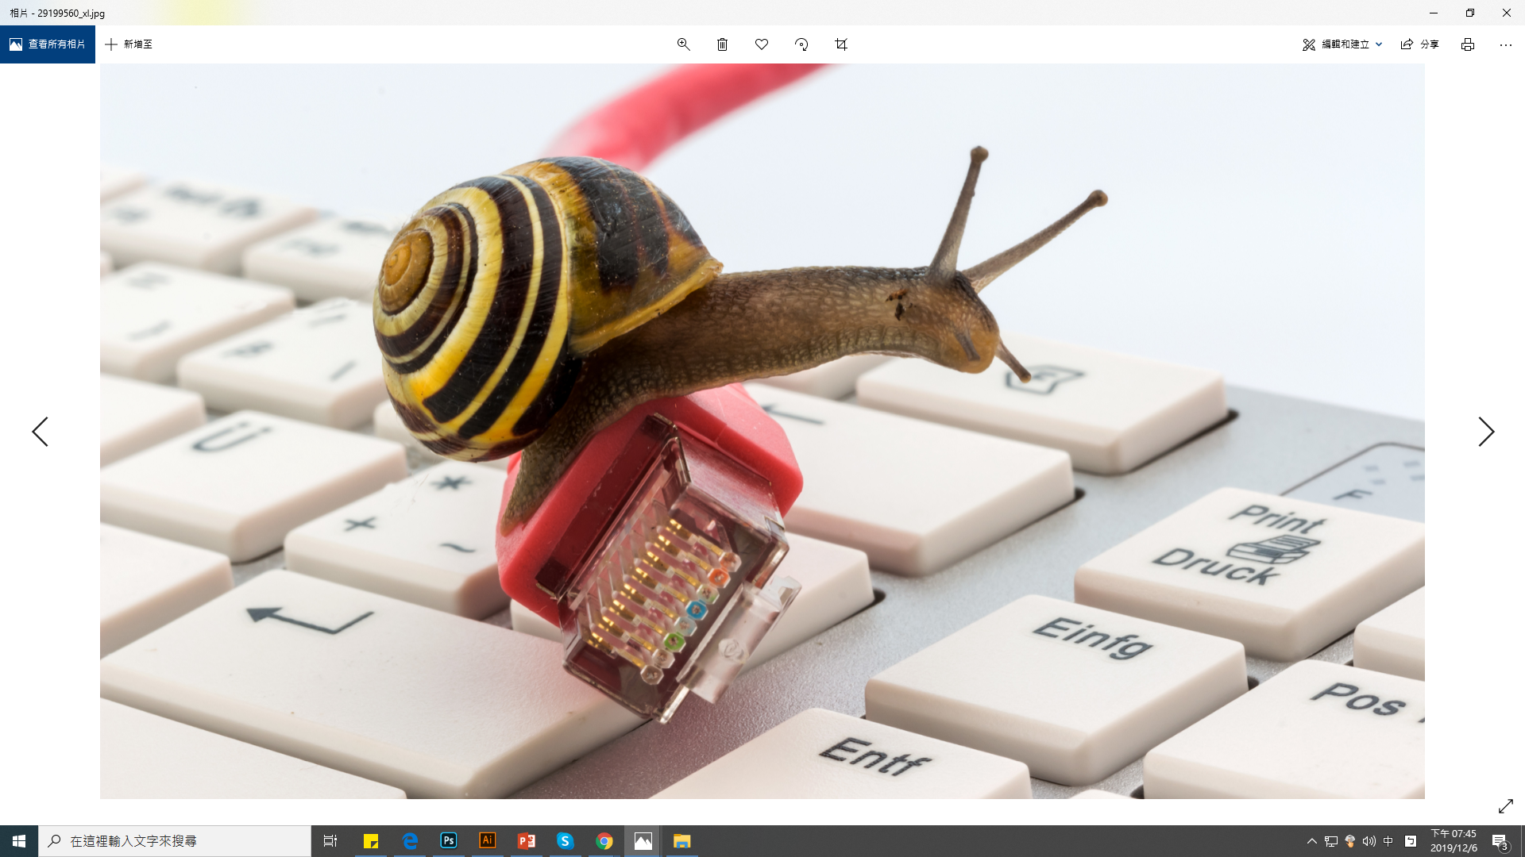

Can't find a remote connection utility that is smooth in operation?
Is the connection
secure?

Slide 9
You may consider
Do applications running on the VM require GPU acceleration ?
How to choose the most suitable remote access tool ?

Slide 10

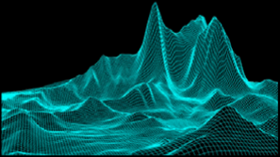
VM with
GPU computing
Passing through a discrete GPU to a VM accelerates image processing and computer graphics, offloading CPU utilization.

Slide 11
VNC v.s. Windows Remote Desktop
 | VNC | Windows Remote Desktop
Pros | Broad free client choices with support for most OSes | Superior user experience compared to most VNC clients; built-in in Windows
Cons | Sharing keyboard/mouse for multi user access; and not secure enough compared with Windows RDP (which use user credentials for login) | Only works for Windows VMs

Slide 12
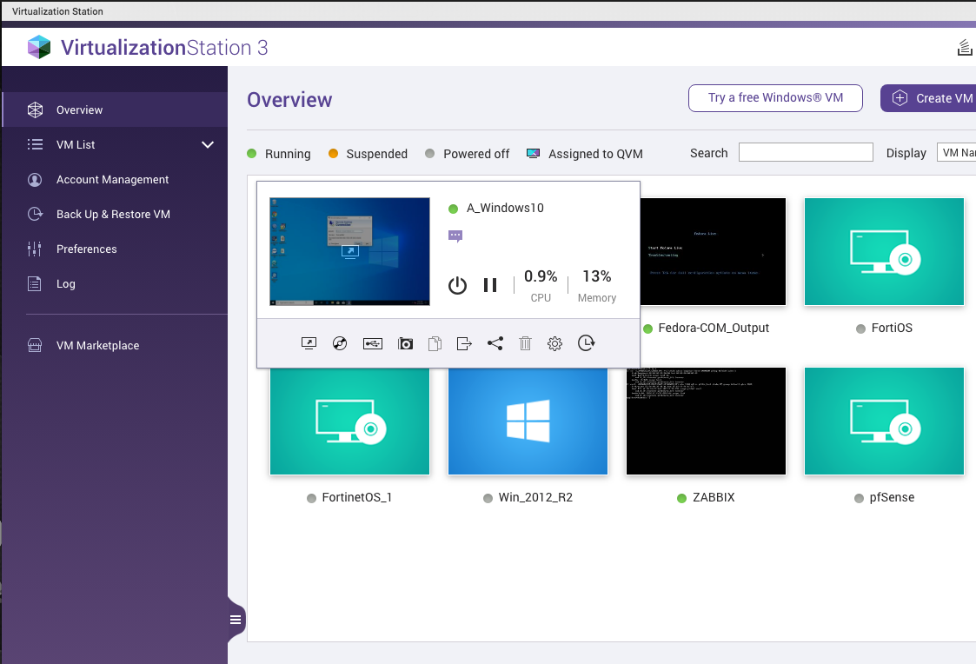
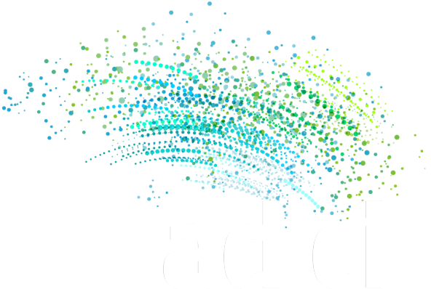
A secure, high image quality and highly responsive VM experience..
Teradici Cloud Access Software
QNAP NAS VM

Slide 13

Teradici PCoIP (1/3)
PCoIP (PC-over-IP) is a proprietary remote display protocol developed by Teradici. Images rendered on the server are captured as pixels, compressed/ encoded and sent to the client for decryption/ decompression. PCoIP provides a highly responsive experience for the customer who requires high image quality and security.
H.264
PColP
Original
Notes:
PCoIP is already optimized, compressed and encrypted so you have to play more attention if you add this kind of features.
PCoIP is a UDP-based protocol that is host rendered, multi-codec and dynamically adaptive.^{[clarification needed]} Images rendered on the server are captured as pixels, compressed and encoded and then sent to the client for decryption and decompression. Depending on the image, different codecs are used to encode the pixels sent since techniques to compress video images differ in effectiveness compared to those for text.^{[15][24]} The protocol also dynamically adapts its encoding based on the available bandwidth. In low-bandwidth environments it uses lossy compression where a highly compressed image is quickly delivered, followed by additional data to refine that image, a process termed "build to perceptually lossless". The default is to use lossless compression which is used when there is minimal network congestion or when explicitly configured, as might be required for scenarios where image fidelity is more important than conserving bandwidth, e.g. for medical imaging.^{[25][26]}
Secures data: Data never leaves the cloud as the PCoIP protocol compresses and encrypts the desktop and only transfers pixels to endpoints

Slide 14


Teradici PCoIP (2/3)
Compared to Windows RDP, PCoIP provides a better user experience because of low latency and security.
Supported client platforms include Windows, Linux, macOS, Chrome, Android, and iOS tablets。
Notes:
In low-bandwidth environments it uses lossy compression where a highly compressed image is quickly delivered, followed by additional data to refine that image, a process termed "build to perceptually lossless". The default is to use lossless compression which is used when there is minimal network congestion or when explicitly configured, as might be required for scenarios where image fidelity is more important than conserving bandwidth, e.g. for medical imaging.^{[25][}
Secures data: Data never leaves the cloud as the PCoIP protocol compresses and encrypts the desktop and only transfers pixels to endpoints

Slide 15
Teradici PCoIP Solution (3/3)
Cloud Access Software
Desktop Access
For VMware Horizon or Amazon WorkSpaces user, and PCoIP Zero Client.
Cloud Access
Connects Windows/ Linux workloads (e.g. VM)
Cloud Access Plus
Connects Windows/ Linux workloads with GPU acceleration.
Notes:
the latency, throughput, reactivity
PCoIP is already optimized, compressed and encrypted so you have to play more attention if you add this kind of features.
Secures data: Data never leaves the cloud as the PCoIP protocol compresses and encrypts the desktop and only transfers pixels to endpoints

Slide 16

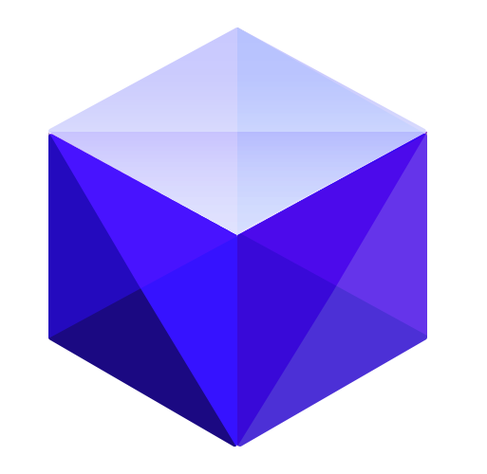


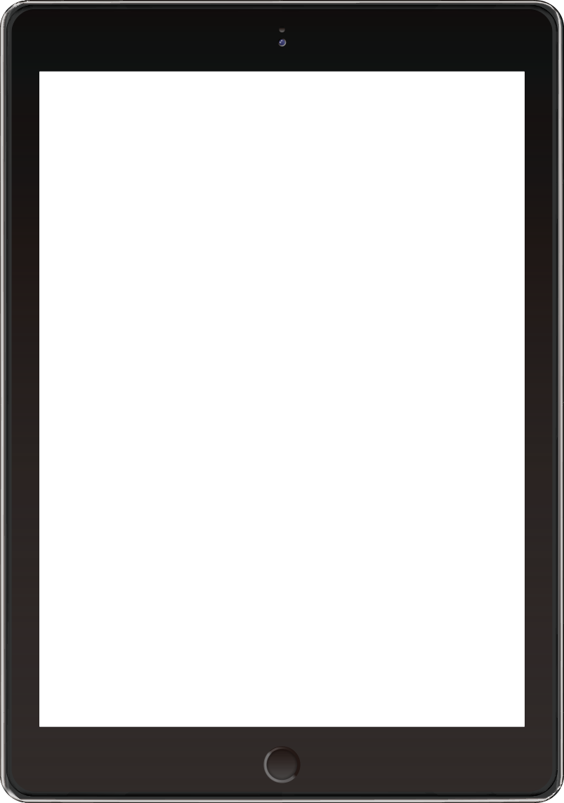

Teradici Cloud Access Software (CAS)
Cloud Access & Cloud Access Plus
PCoIP Hosts
VM
VM
VM
VM
PCoIP Software Client
Transmit only encrypted pixels

Slide 17
Teradici CAS Installation
Step
Step
Step
1
2
3
Download PCoIP Hosts Agent and install it on the VM.
Enter and validate the license.
  Download Software Client and install it in your PC/laptop.
  Note: two different agents for Standard and Graphics, depending on GPU acceleration support or not.

Slide 18
Demo
Connects to a PCoIP Agent
Log in the VM

Slide 19
Reminder
Teradici Cloud Access Software Required
ports:
TCP 7070 (In) > License Validation
TCP 443 (In/Out) > Client Authentication
UDP 4172 (In/Out) > PCoIP Session

Slide 20

Advanced
If there are many VMs among different environments, how to manage them and assign them to a proper user ?
Is there a central management system ?

Slide 21

Cloud Access Manager Cloud Access Connector
+
PUBLIC
CLOUD
Cloud
ACCESS
MANAGER
TCP
60443
TCP
443
SERVICE
REMPTE
WORKSTATOPNS
CLOUD ACCESS
CONNECTOR
Using Cloud Access Manager to manage all VMs equipped with PCoIP agents by deploying a Cloud Access Connector of different environments
Domain Controller is required.
PColP AGENT
CAM ADMIN
CONSOLE
VPN
ON-PREMISES
TCP
636
REMPTE
WORKSTATOPNS
TCP
1812
RADIUS
SERVER
(Optional)
TCP
443
PColP AGENT
TCP
60443
CLOUD ACCESS
CONNECTOR
TCP
1812
PColP CLIENTS
USERS IN ANY REGION
ADMIN
TCP
443
TCP
443/
636
TCP
443
PColP CLIENTS
USERS IN ANY REGION
DOMAIN
CONTROLLER

Slide 22
© 2019 Copyright is owned by QNAP Technology Co., Ltd. QNAP Technology reserves all rights. A trademark or mark used or registered by
QNAP Technology Co., Ltd. The products and company names mentioned in the file may be trademarks owned by other companies.

