Slide 1
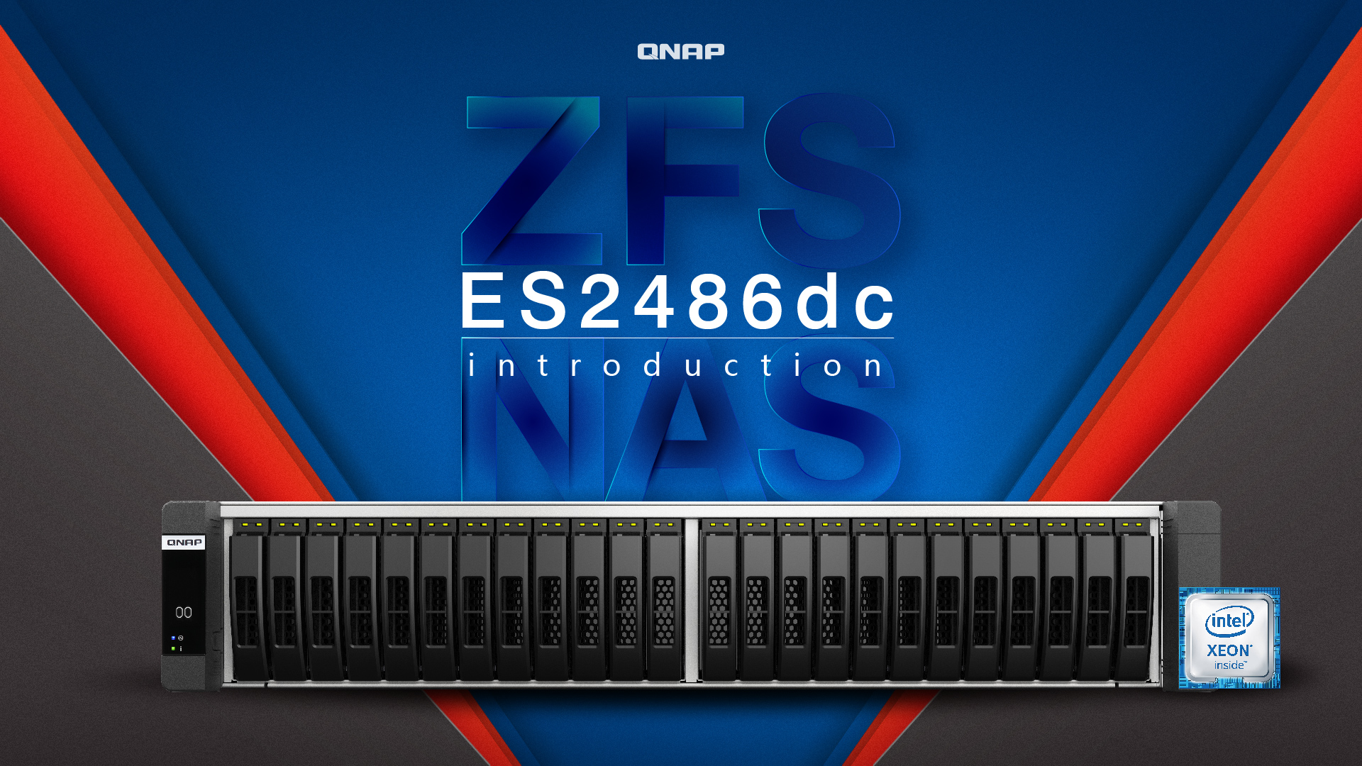
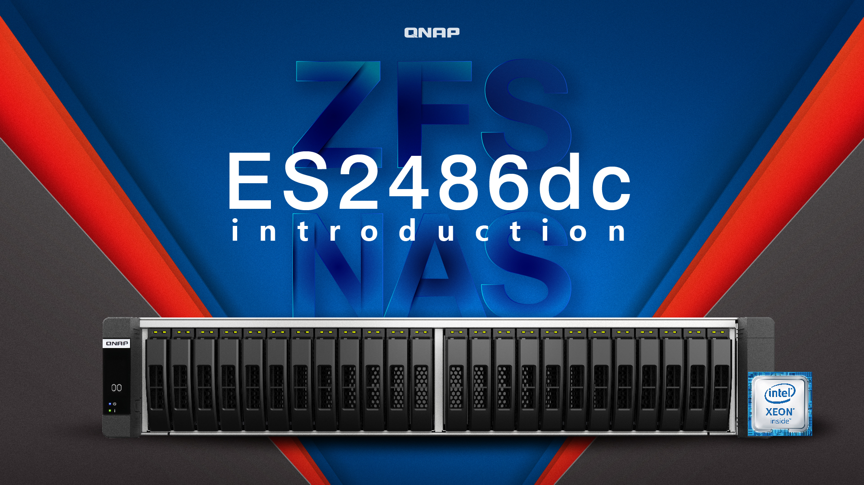
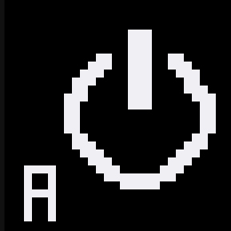




Slide 2
Business storage requirements
Hardware introduction
Accessories
QES 2.1
01
02
03
04

Slide 3
Business Storage Requirements

Slide 4
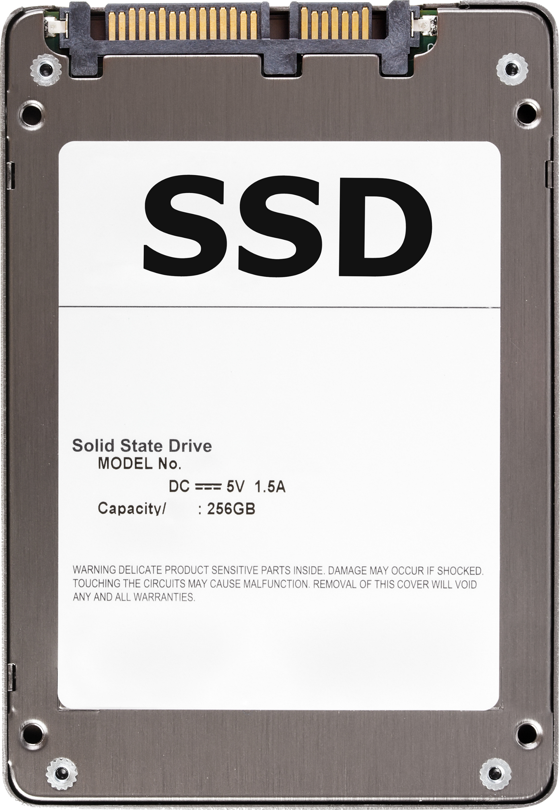

All Flash Storage Applications
SSD is high speed, low latency and low power consumption
SSD random access performance is 500X better than hard drive
Exchange Mail
Random 64K
OLTP
Random 4-8K
VDI
Random 4-8K

Slide 5
Enterprise Storage Requirements
High availability
System can prevent single point of failure and remain working
High reliability
System can provide stable services
High performance
System can provide enough performance for applications

Slide 6
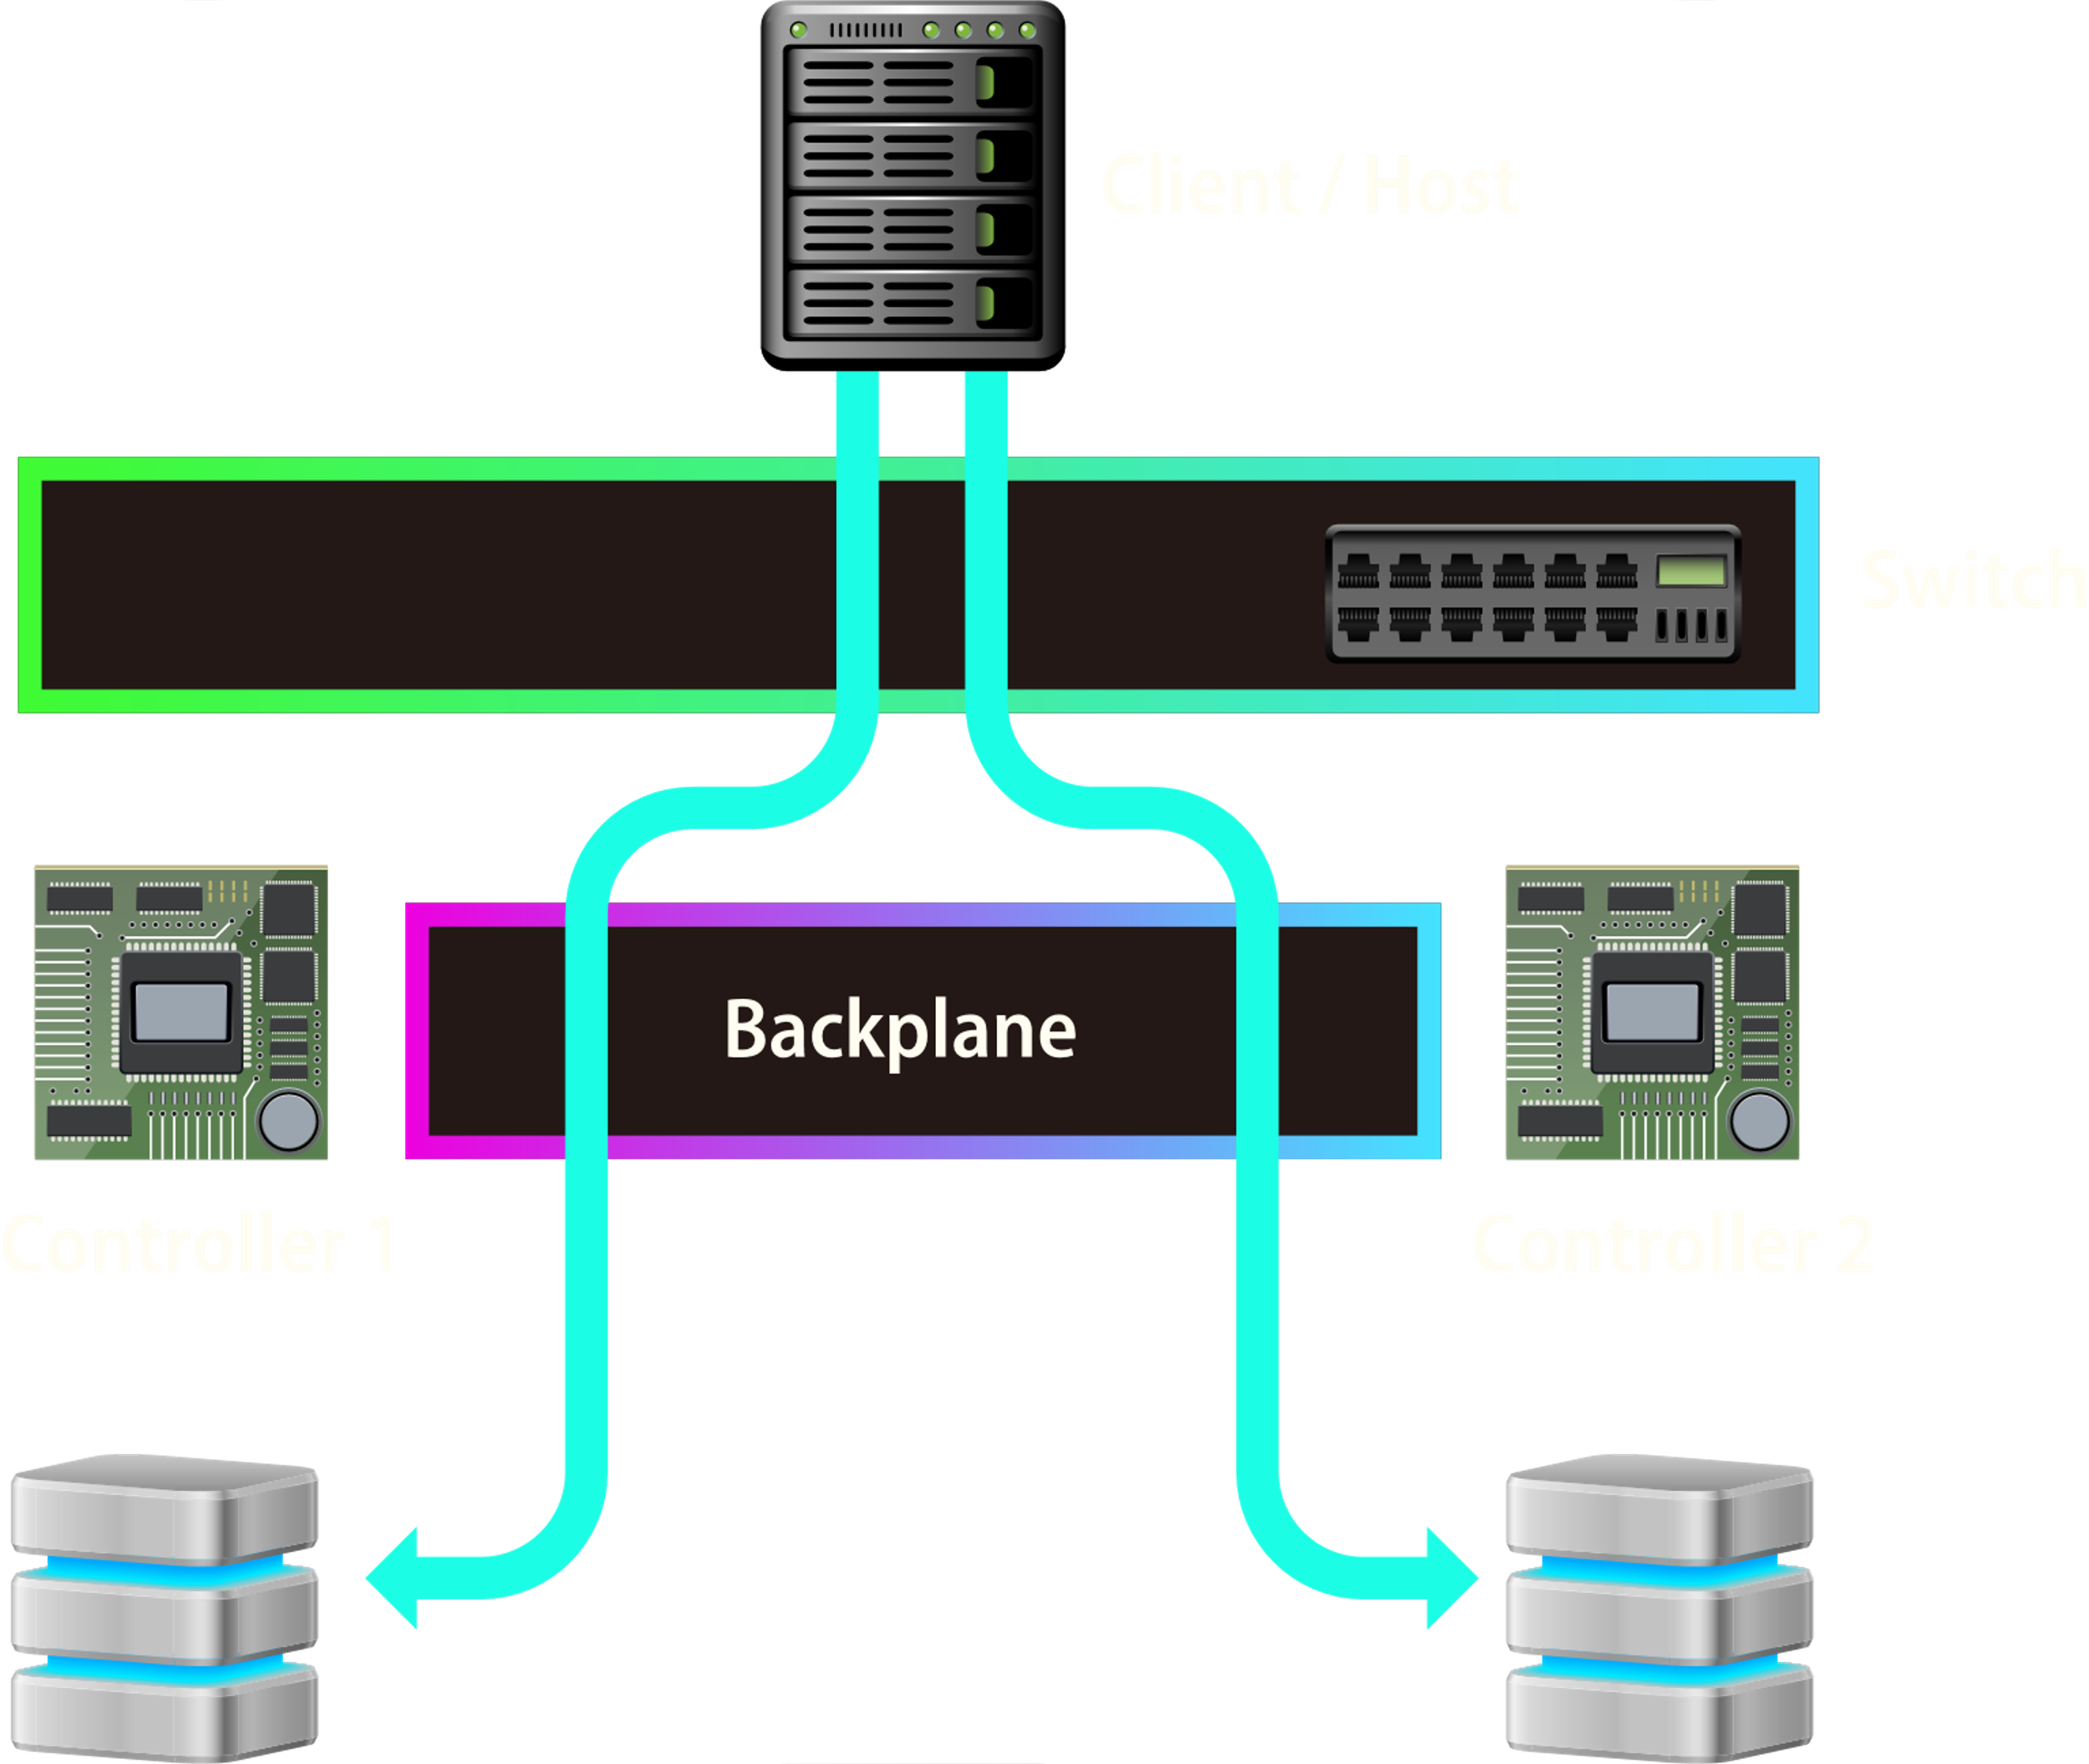
Solutions for Business Storage
Designed for mission critical applications
Dual controller storage for high availability
Active-active architecture​
Asymmetric Logical Unit Access
Near zero down time
ZFS for data consistency
Notes:
Asymmetric Logical Unit Access
原文網址：https://kknews.cc/tech/gbnjpv9.html

Slide 7
ES2486dc
Hardware Introduction

Slide 8

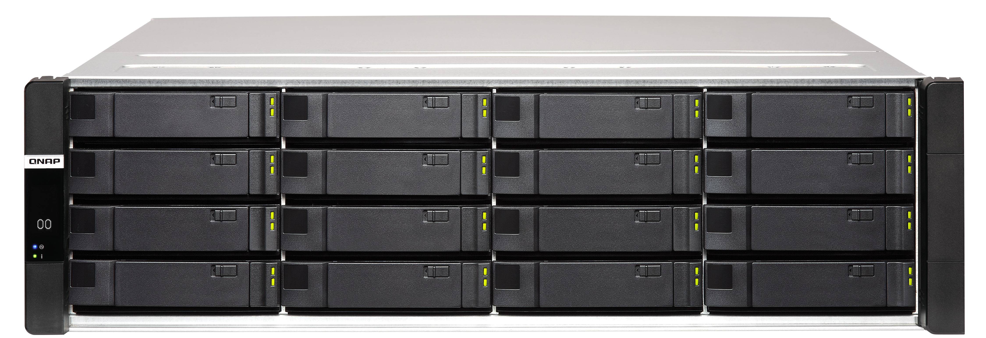
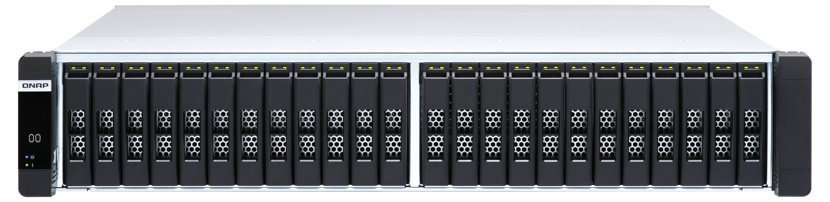
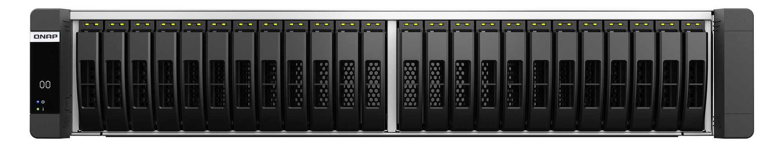
New Member in QNAP Dual-controller NAS Family
ES1686dc
ES2486dc
3U 16-bay 2.5”/3.5”
SAS/ SATA high capacity NAS
2U 24-bay 2.5”
SAS/ SATA all flash NAS

Slide 9
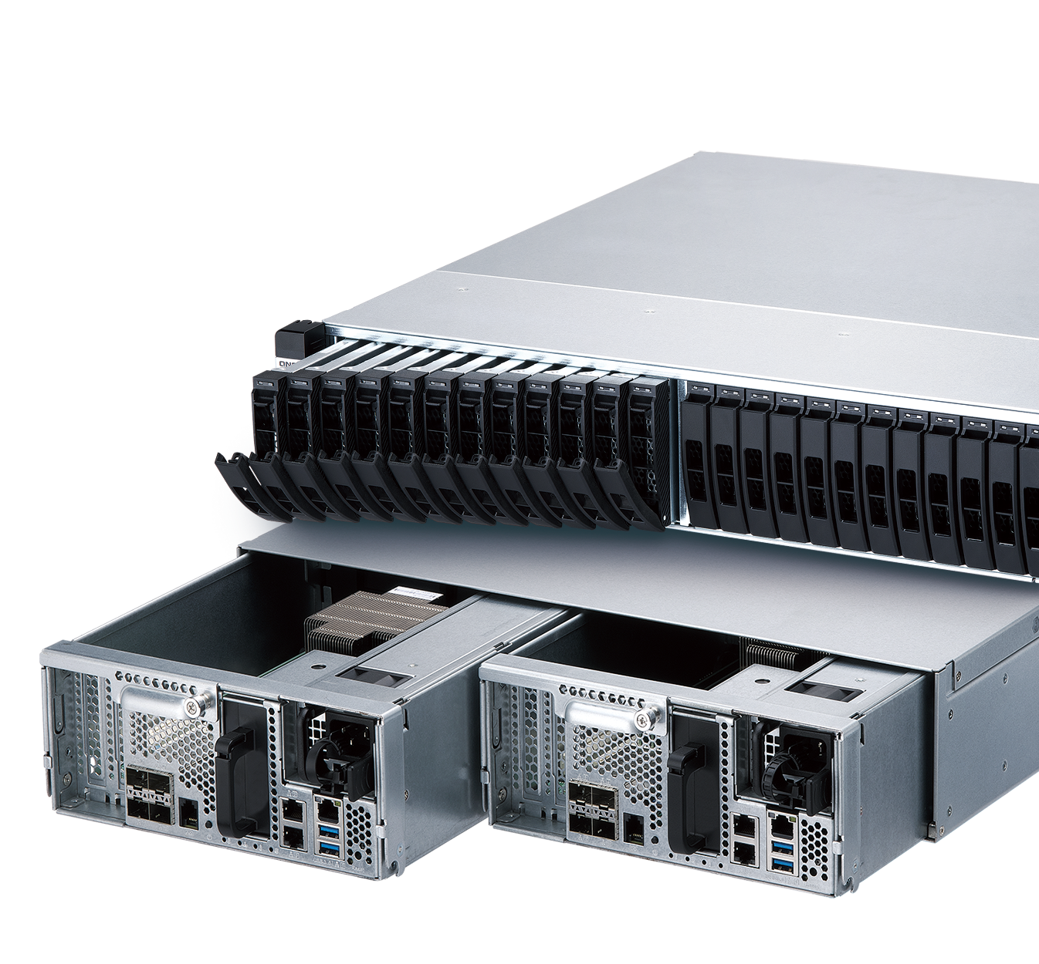





ES2486dc Dual-controller NAS
Dual controller
Multiple LAN
Dual PSU
QES OS
Firmware Rolling Update

Slide 10

Intel Xeon Enterprise Processor
Intel Xeon D-2142IT
8-core/ 16-thread
1.9 GHz (Max. 3.0GHz)

Slide 11
Ordering Information
ES2486dc-2142IT-96G
Intel D-2142T 8-core/16-thread,
1.9 GHz (Max. 3.0GHz)
96GB DDR4 ECC memory
(48GB per controller)
ES2486dc-2142IT-128G
Intel D-2142T 8-core/16-thread,
1.9 GHz (Max. 3.0GHz)
128GB DDR4 ECC memory
(64GB per controller)

Slide 12
5-Year Standard Warranty

Slide 13
Optimize System Design

Slide 14
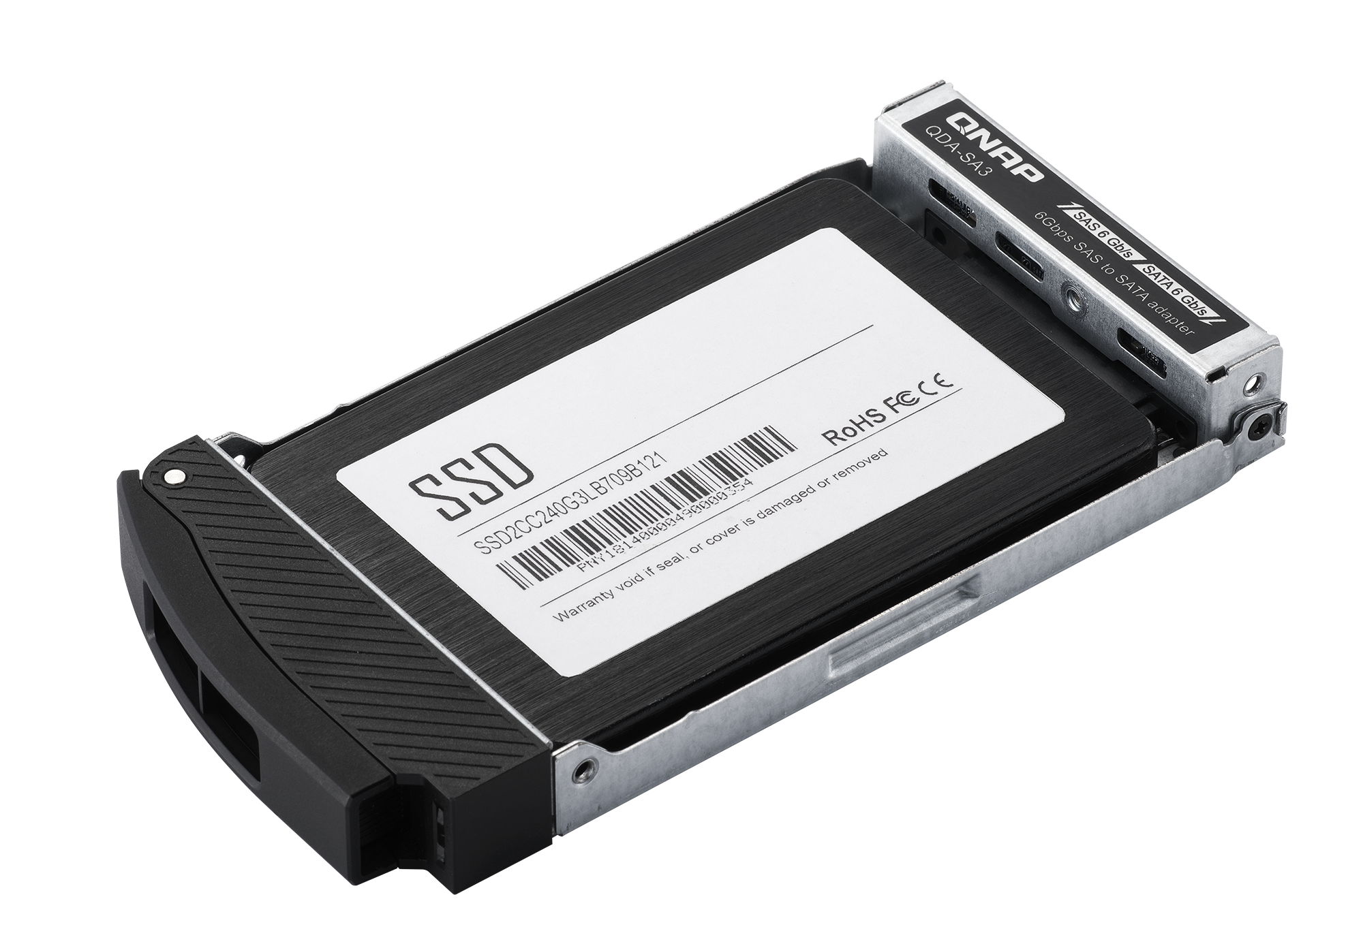
Front View
QDA-SA3
24 x 2.5”HDD/ SSD Tray
  Supports SAS 12Gb/s SSD and HDD
  Supports SATA SSD via QDA-SA3* adapter
*QDA-SA3 is optional purchased

Slide 15




Clear Information with OLED Indicator
Provides system status for each controller
Power status
HA status
Fan status
Controller status
Battery status
OLED ON/OFF button

Slide 16
Rear View
PCIe Gen3 x8 slot
1 x 1GbE
management port
Reset button
770W
redundant PSU
4 x 10GbE SFP+
LAN port
Power button
2 x 1GbE LAN port
BBU
2 x USB 3.0

Slide 17
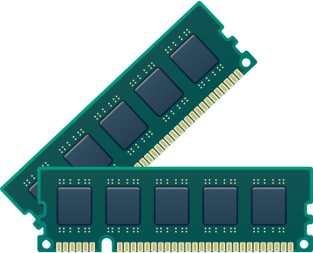
Inside the Controller
2 x PCIe Gen3 x8 slot
Fan module
(3 x 6cm 16000rpm)
8 x DDR4 RAM Slot
Max. 512GB
Built-in 64GB M.2 for Battery
Backup Storage
(under the fan module)
Intel Xeon CPU
and heat sink

Slide 18
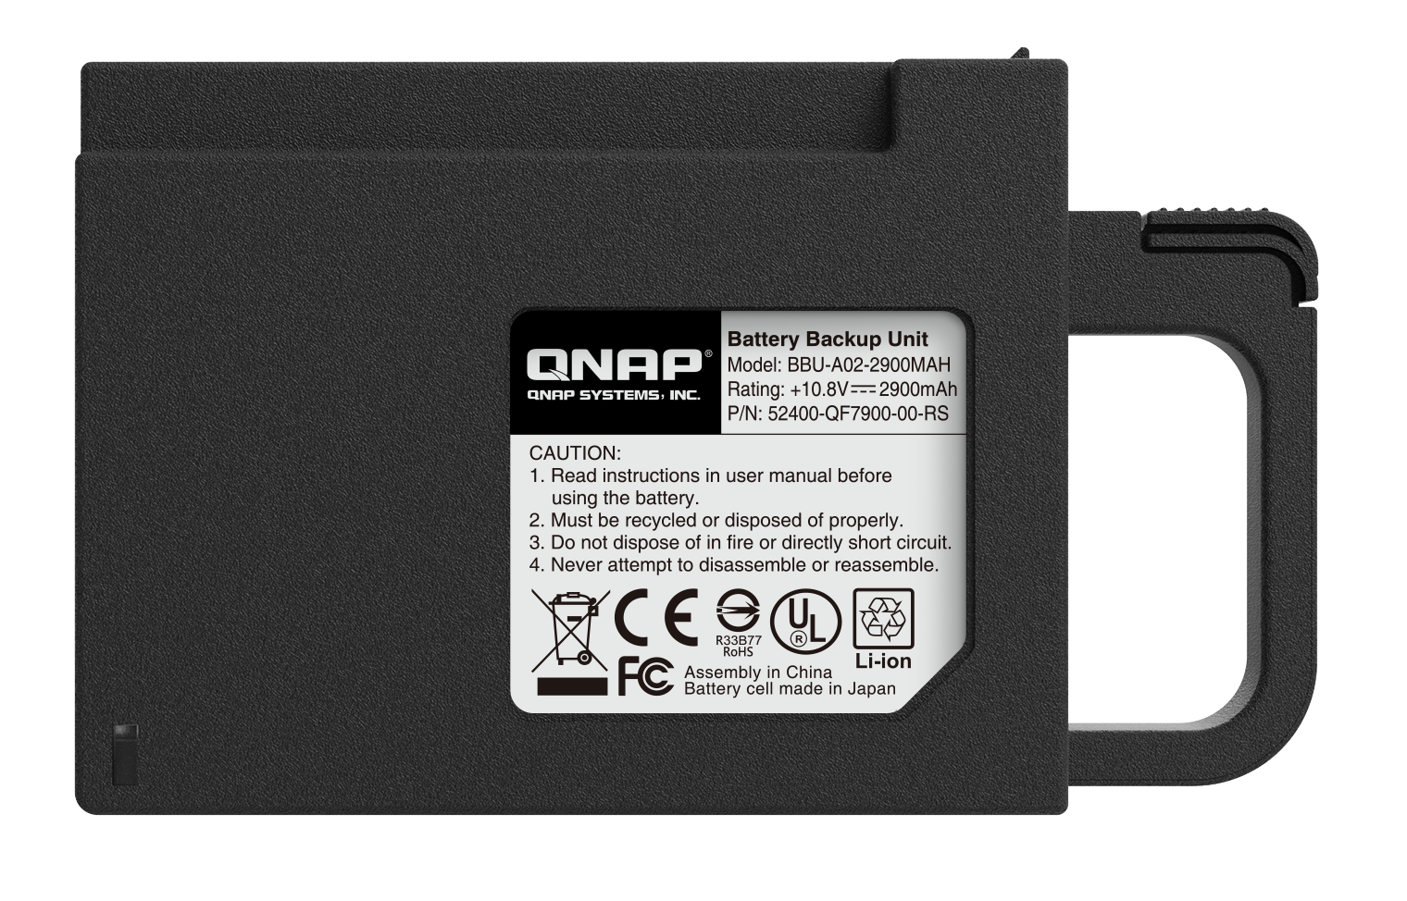
Battery Backup Unit (BBU)
Ensuring data consistency when encounter power outage
Model: BBU-A02-2900MAH
Battery type: LI-ion
Rating: 10.9V 2200mAh
Dimension (H x W x D): 118 x 79 x 32 mm
Weight: 218 g

Slide 19
How BBU Protect Your Data
Copy data to M.2 cache
Copy data back
Write to pool
Power has
returned
Normal
Power loss
Cache in memory
Pool
Pool
Pool

Slide 20
Accessories

Slide 21

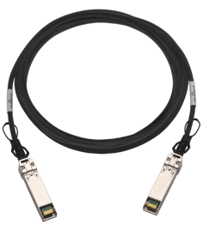
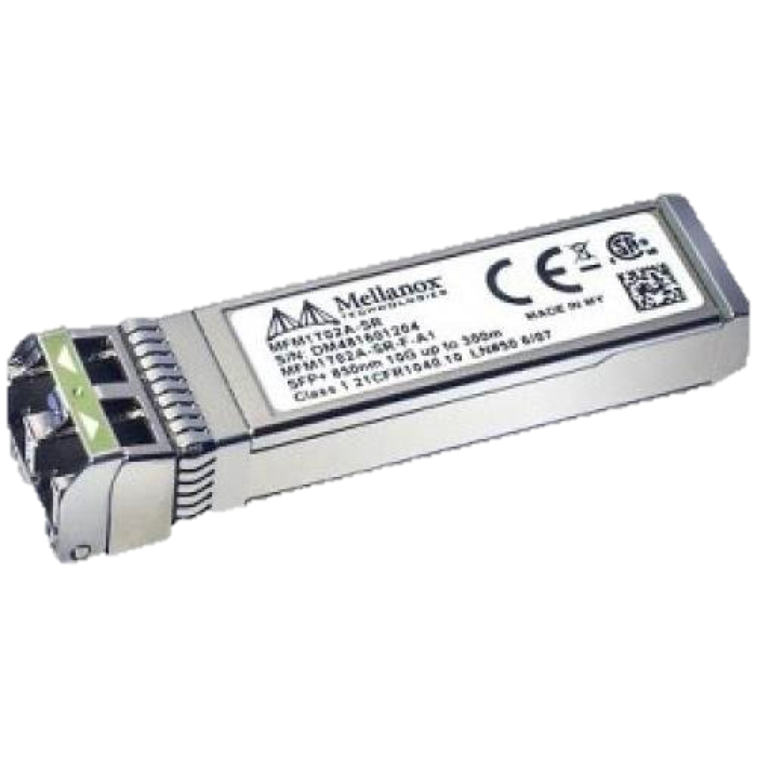

QNAP Dual-port 10GbE NIC
QXG-10G2SF-CX4
Cooling system
Mellanox ConnectX®-4 Lx NIC
2 x 10GbE SFP+ port
Accessory
SFP+ 10GbE DAC cable or TRX-10GSFP-SR-MLX optical transceiver
Notes:
QNAP 雙埠25GbE 擴充卡
QNAP Dual ports 25GbE NIC
採用Mellanox ConnectX®-4 Lx 網路晶片
Mellanox ConnectX®-4 Lx ethernet chip
2 x SFP28 ports
Supports 25GbE/10GbE
Supports iSER/RoCE hardware offload
需搭配SFP28 25/10GbE網路線
Compatible cable
SFP28 25/10GbE DAC cable
2019 一月上市
Soon to market on January/2019
晶片散熱模組
Cooling system

Slide 22
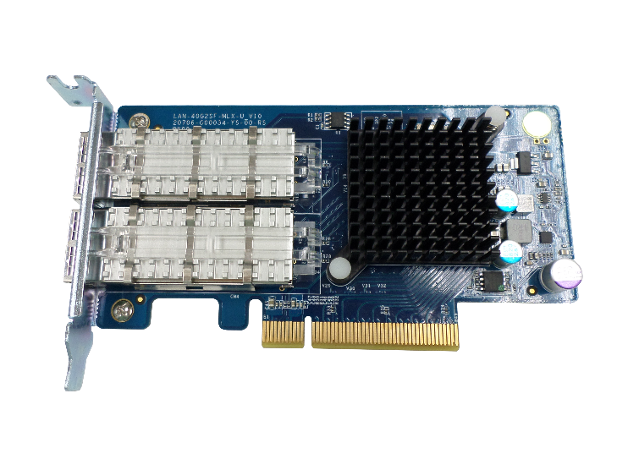
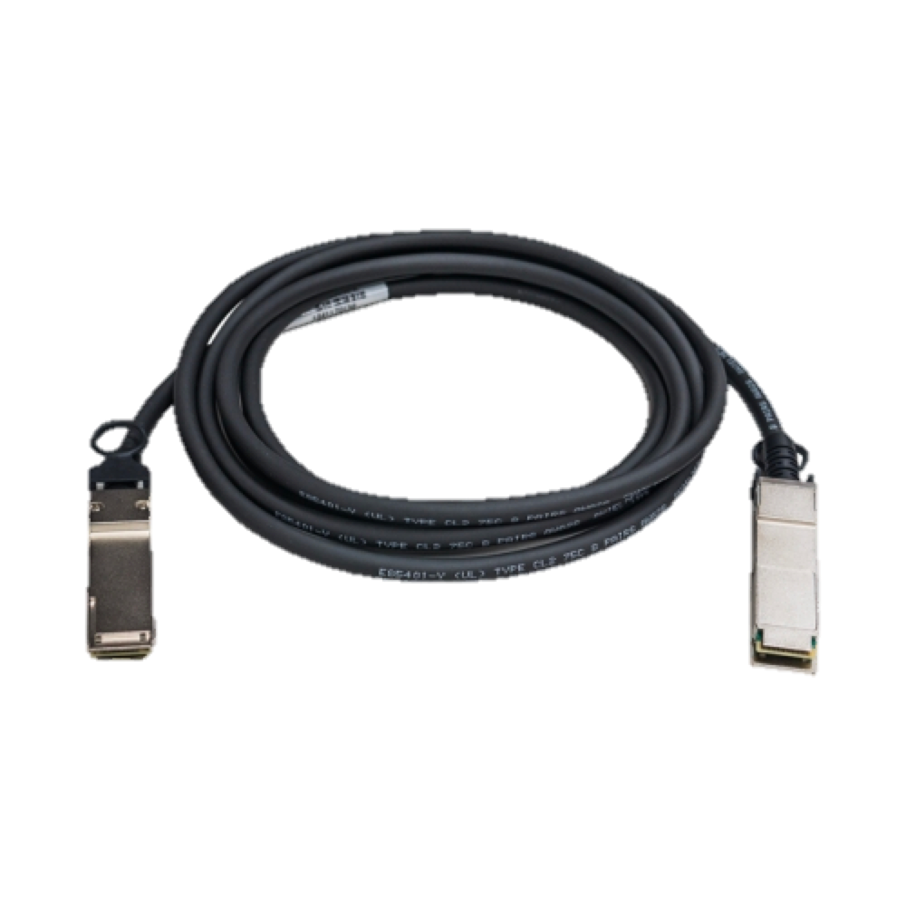
QNAP Dual-port 40GbE NIC
LAN-40G2SF-MLX
Mellanox ConnectX®-3 Pro NIC
2 x 40GbE QFP+ port
Supports iSER/RoCE
Hardware Offload
Cooling system
QSFP+ 40GbE DAC cable
Notes:
QNAP 雙埠25GbE 擴充卡
QNAP Dual ports 25GbE NIC
採用Mellanox ConnectX®-4 Lx 網路晶片
Mellanox ConnectX®-4 Lx ethernet chip
2 x SFP28 ports
Supports 25GbE/10GbE
Supports iSER/RoCE hardware offload
需搭配SFP28 25/10GbE網路線
Compatible cable
SFP28 25/10GbE DAC cable
2019 一月上市
Soon to market on January/2019
晶片散熱模組
Cooling system

Slide 23
Dual-Path Mini-SAS Expansion
SAS-12G2E
SAS 12Gb/s expansion card
EJ1600 v2
SAS 12Gb/s Dual-controller expansion
Avoid single point of failure
Cascade up to 7 JBODs
48Gb/s high-speed transmission

Slide 24
QDA-SA3 6Gbps SAS/SATA adapter
Enterprise dual-controller ZFS NAS Series can flexibly install SATA 6Gbps SSD or HDD to save costs.

Slide 25
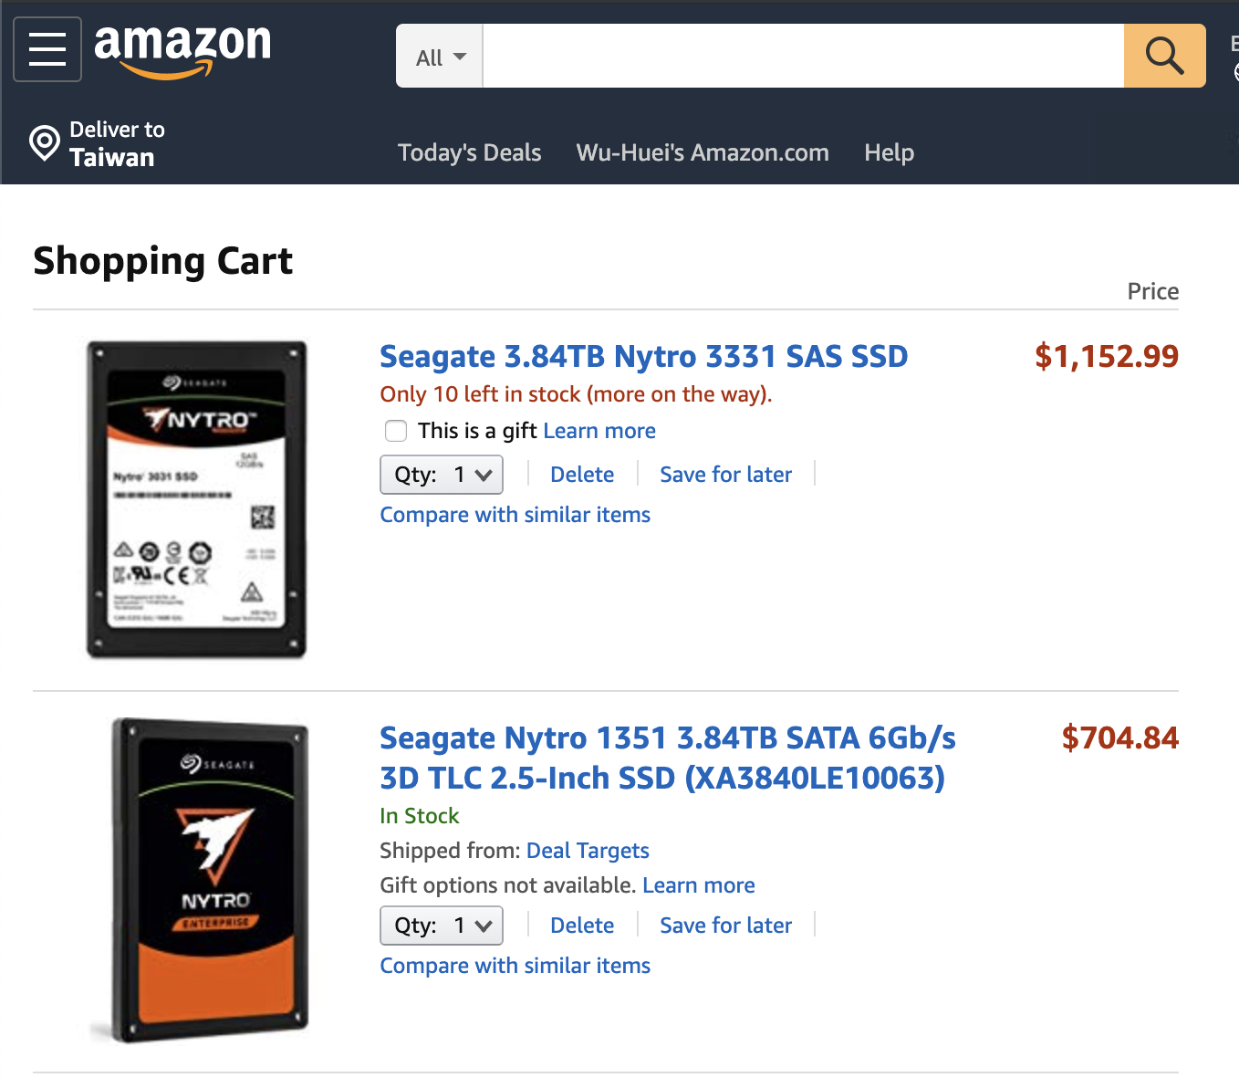
SAS SSD vs SATA SSD
Price in Amazon, 12/04/2019
SATA SSD provides lower TCO
Nytro 3331 SAS SSD XS3840SE70004
Capacity: 3.84TB
Random read: 230K IOPS
Random write: 80K IOPS
Nytro 1351 SATA SSD XA3840LE10063
Capacity: 3.84TB
Random read: 94K IOPS
Random write: 61K IOPS

Slide 26


Full-duplex data transfer and dual-port
Controller 1
Controller 2
Controller 1
SAS drives are dual-port
Designed for high-availability(HA) architecture
SATA drives are single-port
Not for high-availability (HA) architecture
Channel 1
Channel 2
Channel 1
SAS drives
SATA drives

Slide 27
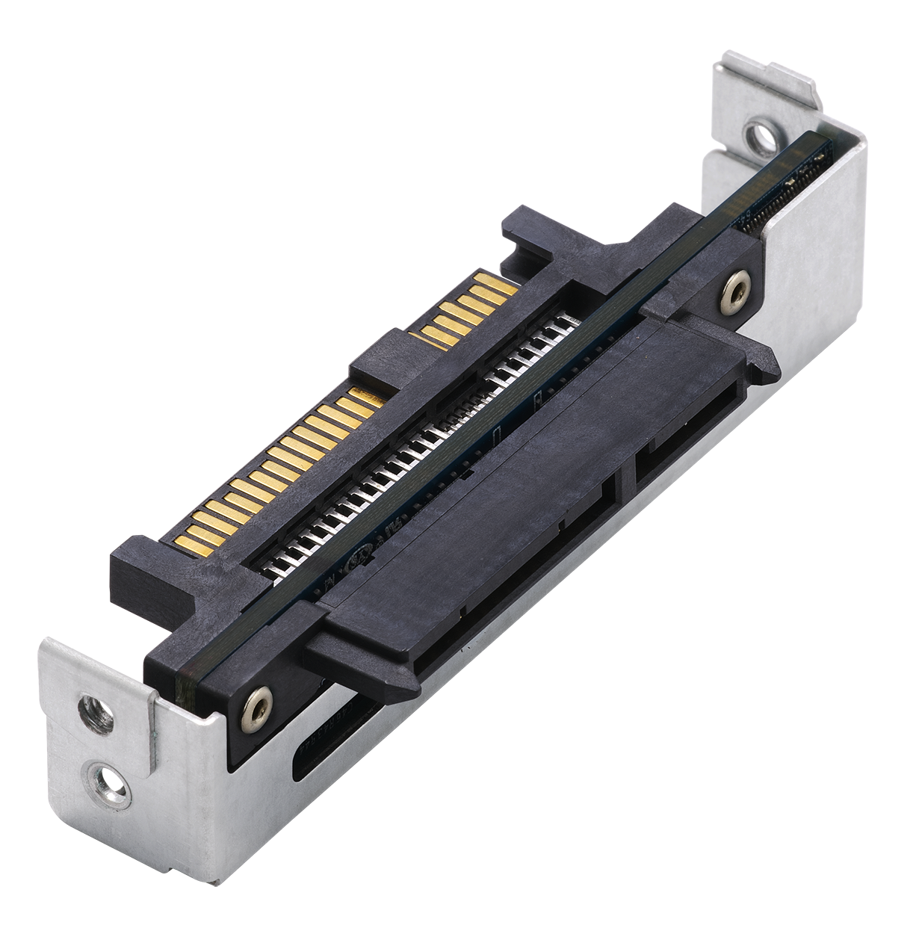
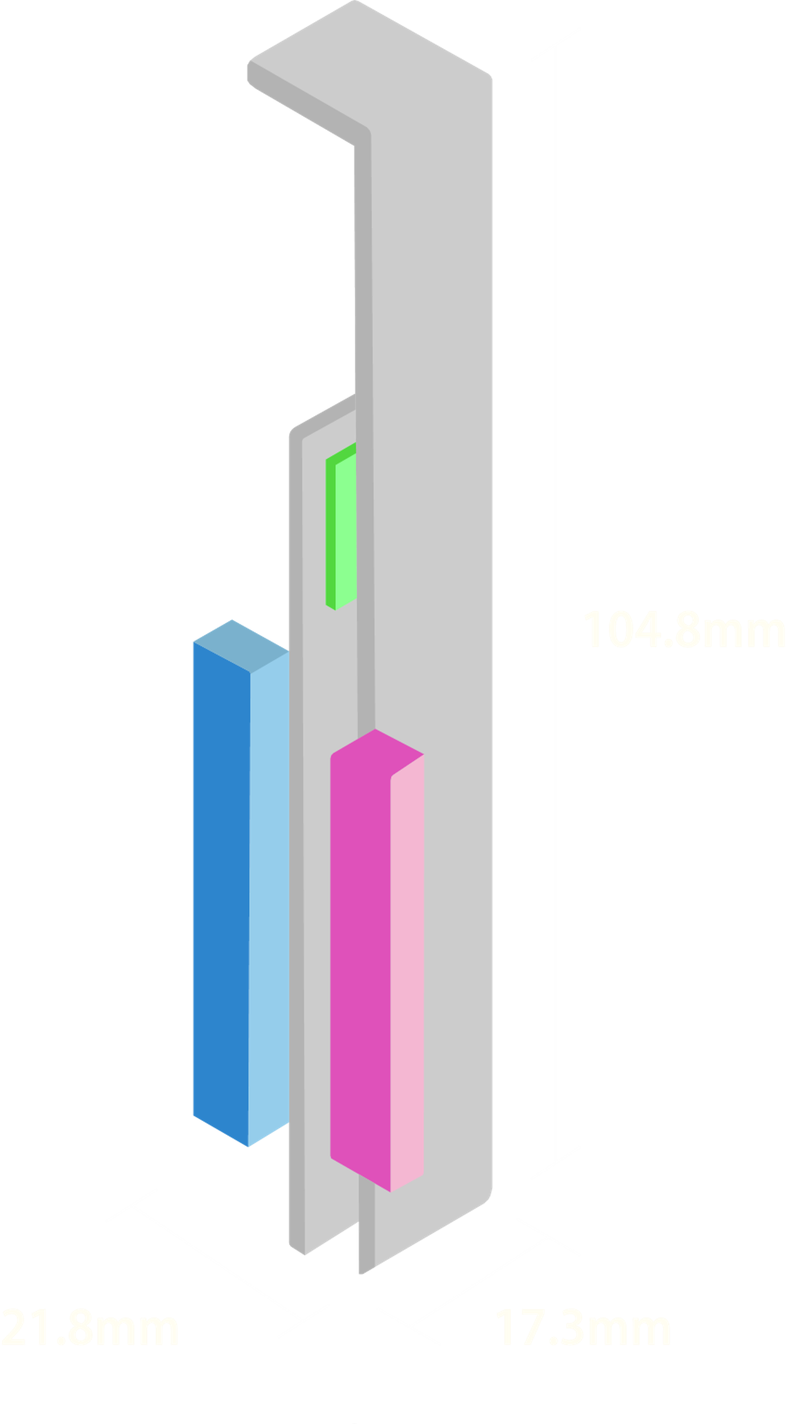
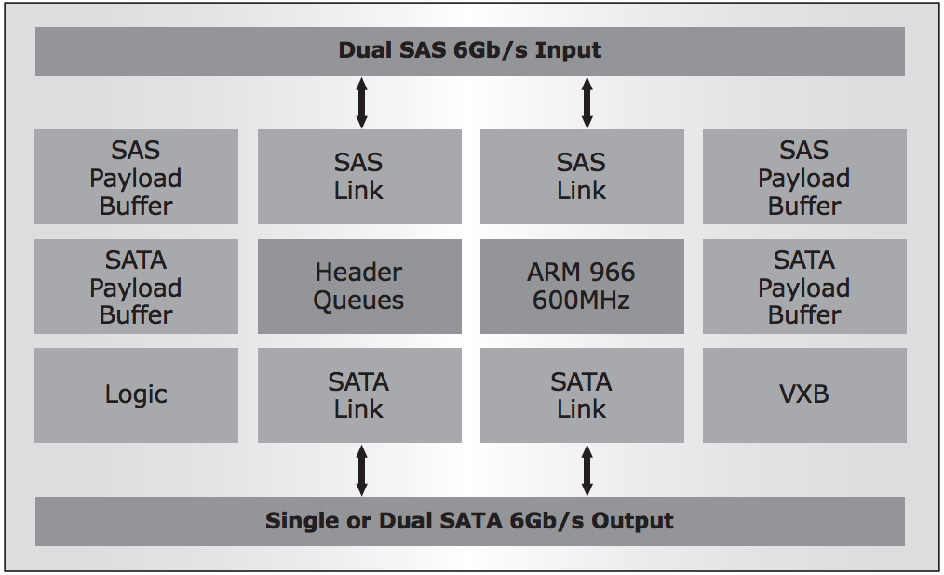
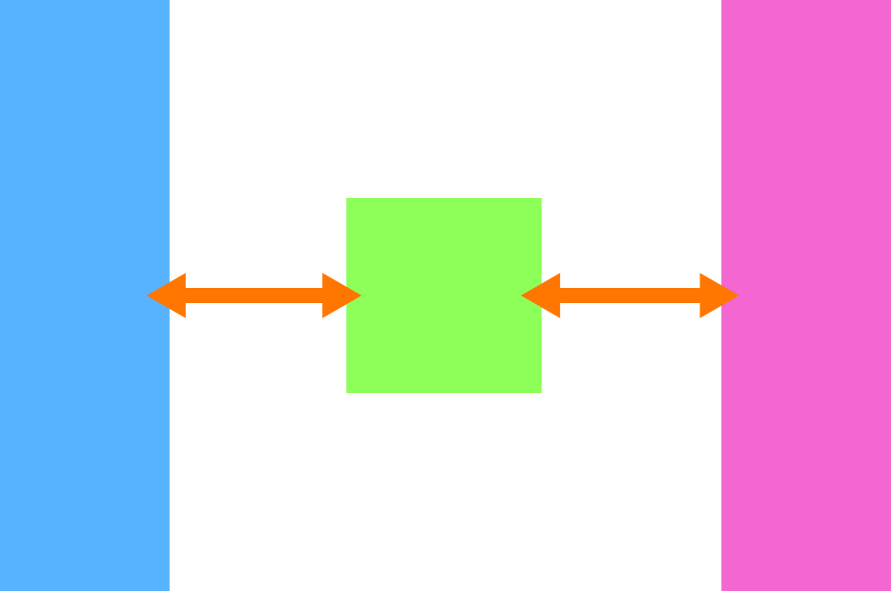
QDA-SA3 6Gb/s SAS to SATA adapter
Optional Accessory
Ordering information: QDA-SA3-4PCS (4 units)
Marvell 9110 6Gb/s SAS to SATA bridge IC
SAS
6Gb/s
SATA
6Gb/s
SAS 6Gb/s
SATA 6Gb/s
Marvell 9110 600 MHz
processor

Slide 28
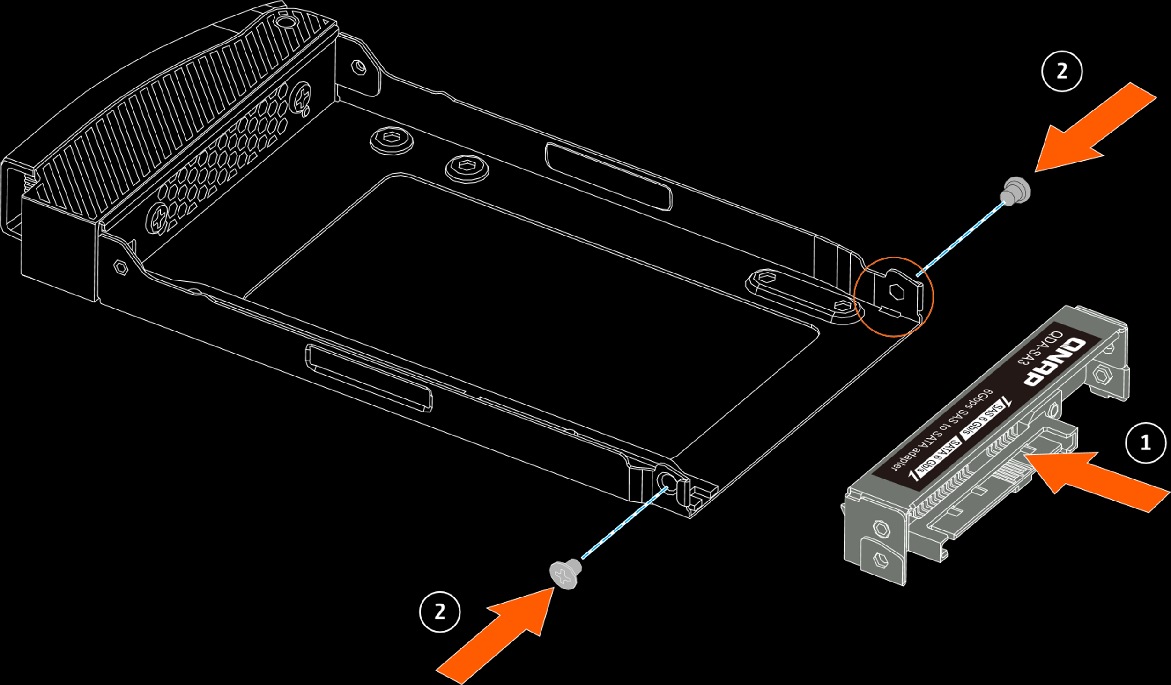
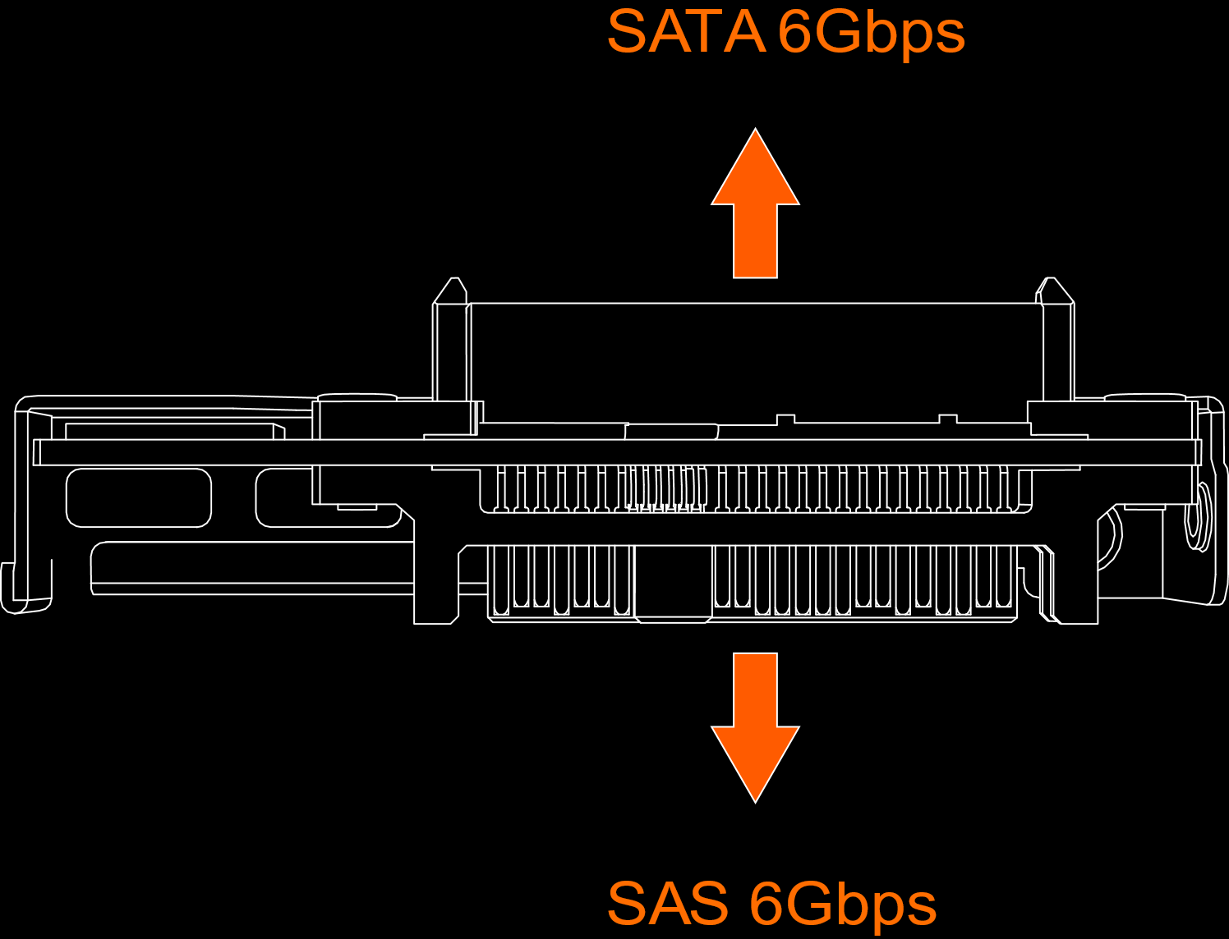
Compatible with Enterprise ZFS NAS 2.5”drive trays

Slide 29
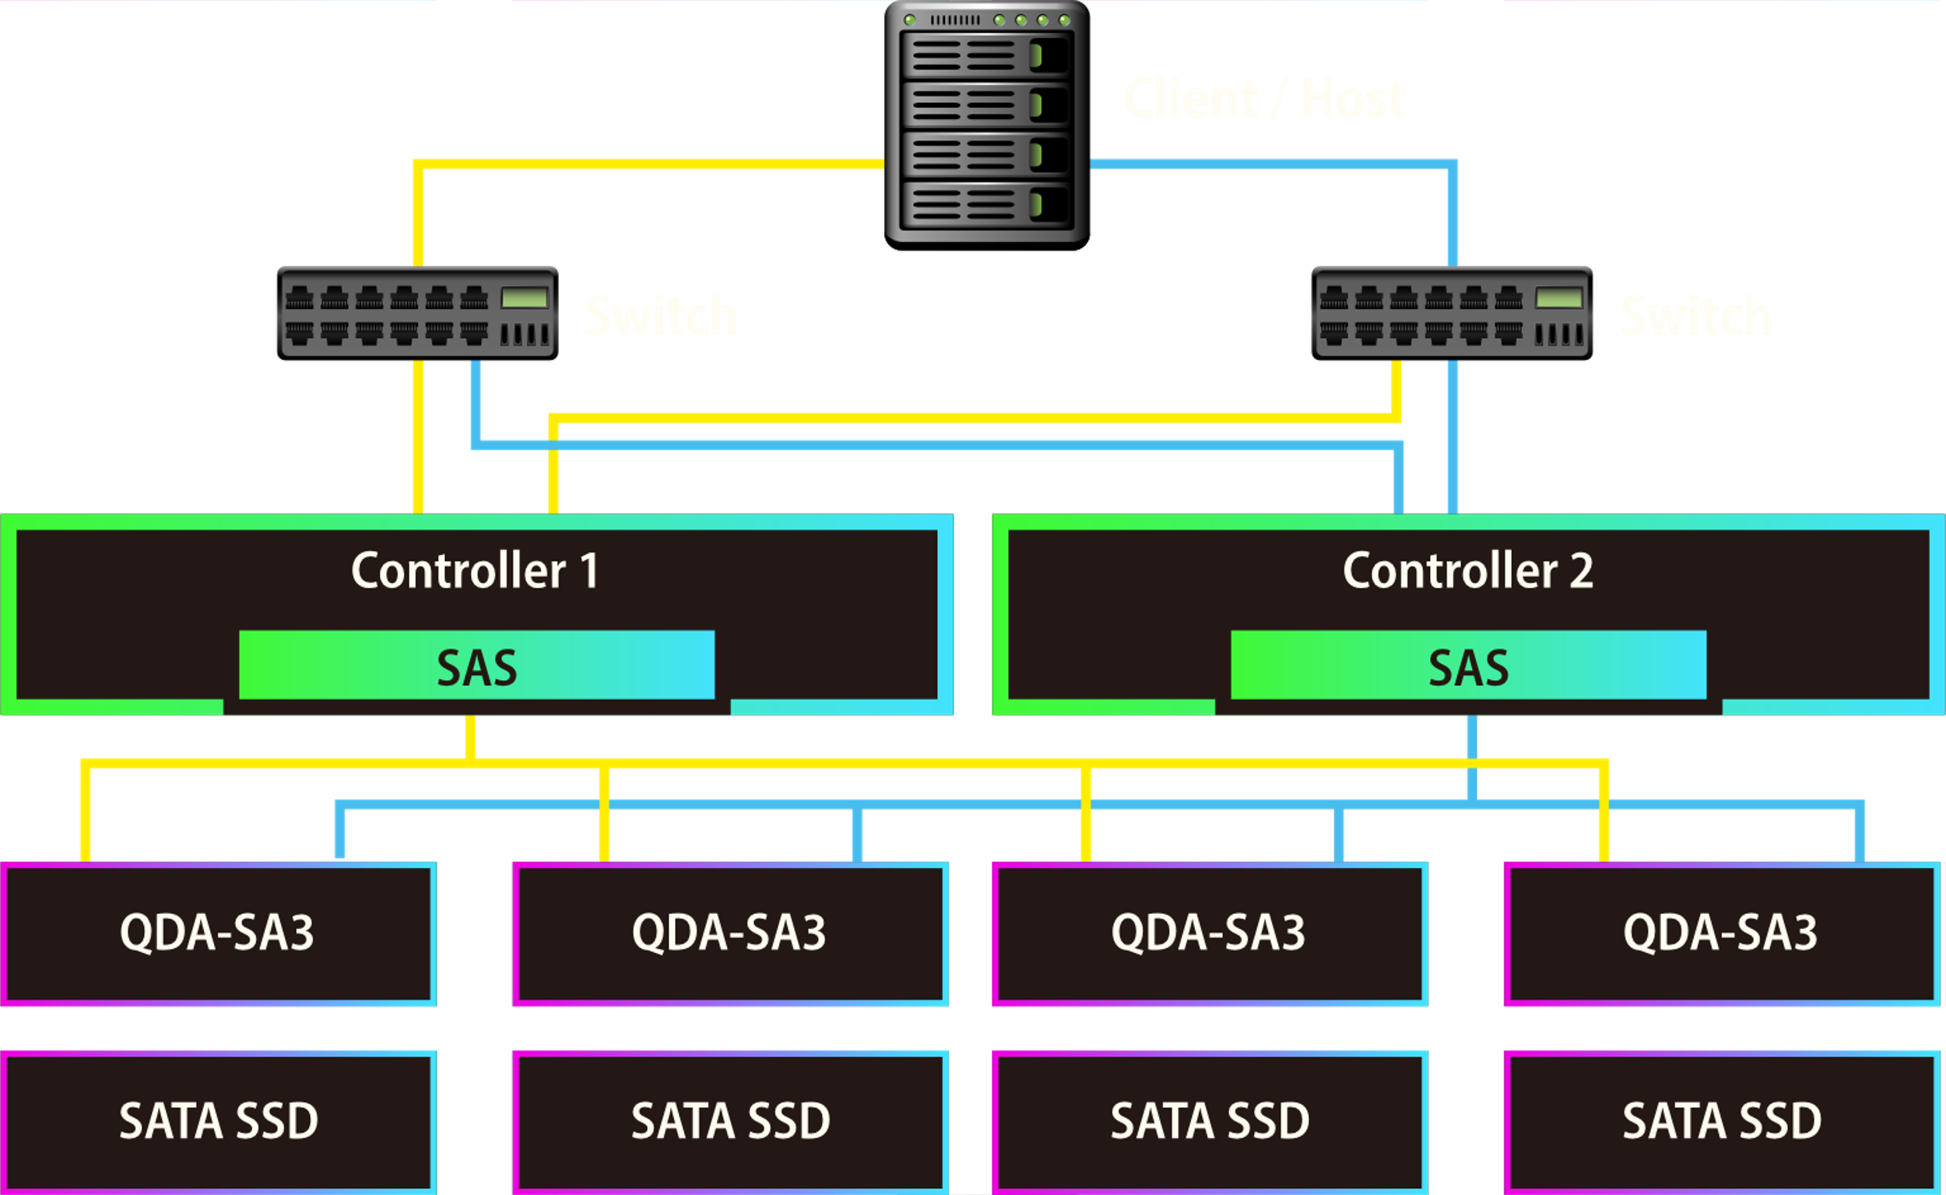
Support HA in dual-controller

Slide 30
QES 2.1
For All Flash Storage

Slide 31






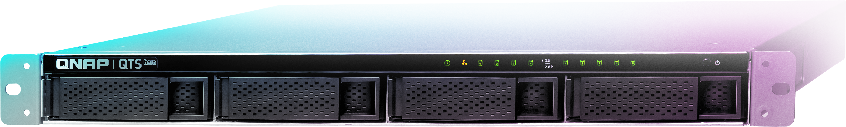
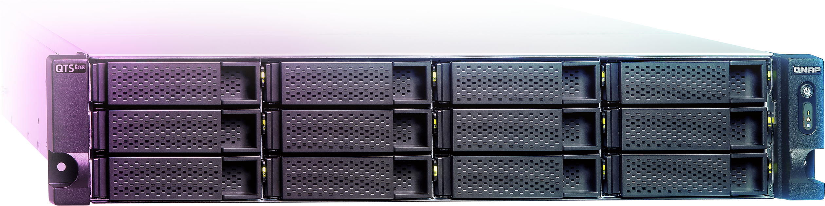


ZFS File System Highlights
Data Efficiency
Data Protection
Data Integrity
System Stability
Offers inline compression & inline deduplication for better storage utilization​
ZIL / L2ARC: provides a better cache mechanism
The native ZFS snapshot feature allows smart definitions of guaranteed snapshots​
A nearly unlimited number of 65,536 snapshots​ (supports folder/LUN)​
SnapSync
More RAID types available
WORM (write once read many)​
QES longer needs file system checks (FSCK), with ZFS Mirror layer, COW (copy on Write) could keep the data integrity
Provide ECC RAM supported model to reach the enterprise level stability​
Provide the faster RAID Rebuild function: Resilver

Slide 32


Near-unlimited Snapshots
Shared folder snapshot
LUN snapshot
Snapshot Manager is operated based on shared folder.​ With [Clone], [Restore] & [Folder Revert] support.​​
NAS Maximum Snapshot 65,536
  Shared Folder Snapshot
  iSCSI LUN Snapshot

Slide 33
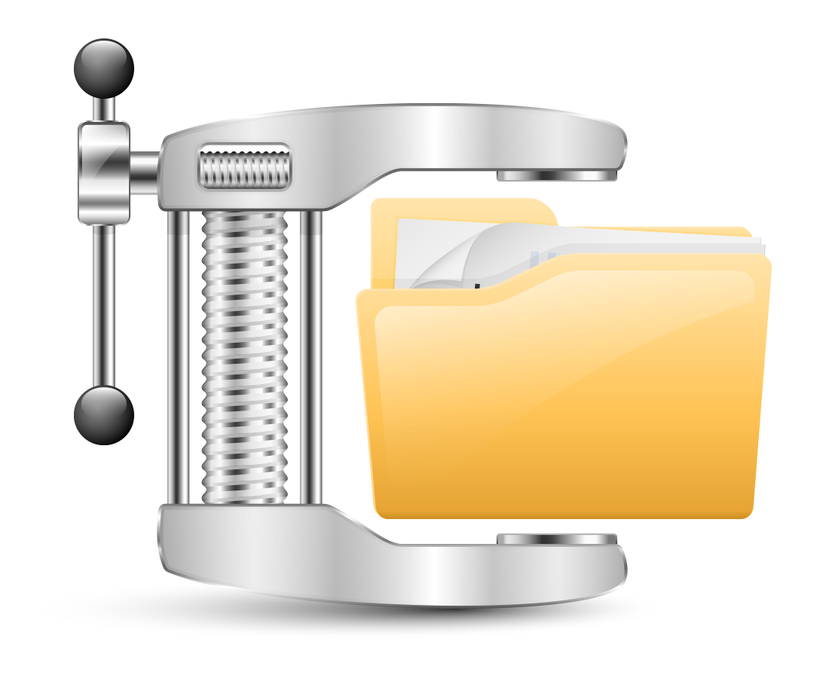
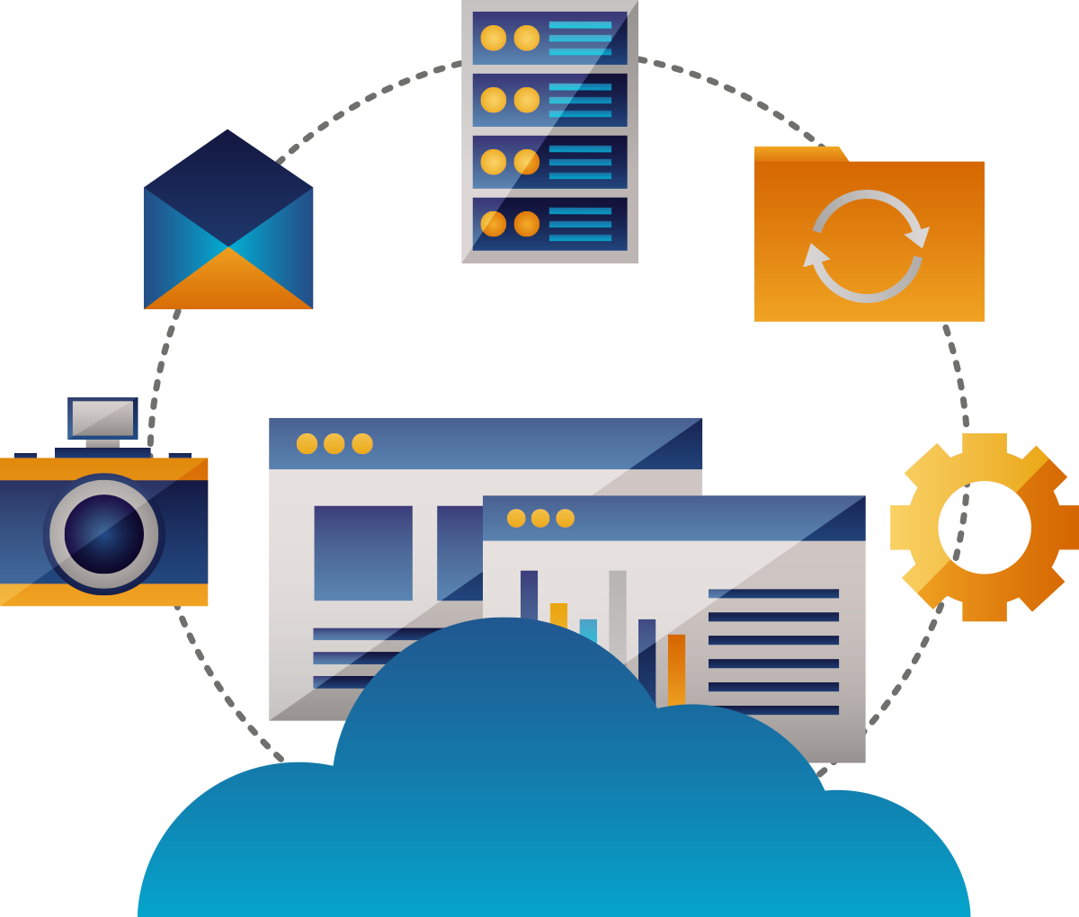
In-line Compression
Traditional storage
Deduplication
Data Compression
(LZ4 algorithm)
ES NAS
50%
Thin Provisioning
with Space Reclaim
Less capacity

Slide 34
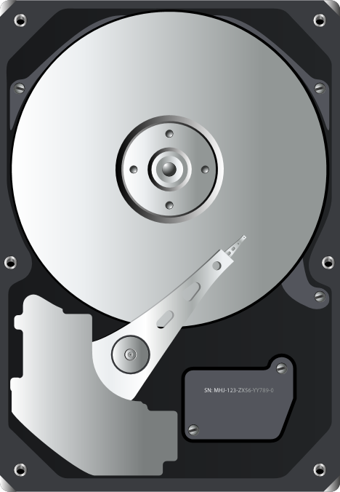

In-line Deduplication
C | A | B | C | D
B | A | B | A | A
D | B | B | C | A
A | B
C | D
Deduplication rates for VM deployments can range as high as 95% savings.
Deduplicated data is cached for much better performance by reducing disk access!​​
A
B
C
D
A
Deduplication
B
C
D
D
C
A
B
C
A
B
A
A
Compressed Data
B
B
Original Data
15GB (5A+5B+3C+2D)
4GB (A+B+C+D)
Note: In-Dedup will uses a LOT of RAM (deduplication table),
- 32GB RAM is highly recommended.
- Add 1 GB RAM per 1 TB data of deduplicated storage.
- BTRFS uses Out-of-band dedupe.

Slide 35


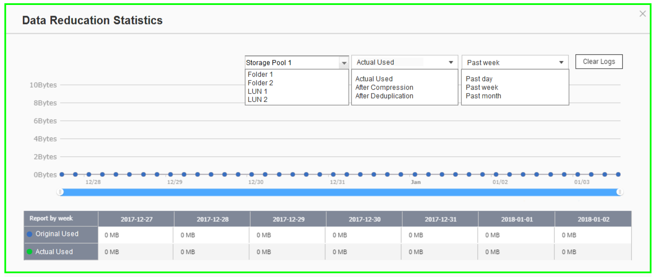

Extend SSD Endurance by Data Reduction
ZFS File System With Deduplication & Compression Features.​​
The ZFS File System can be the best choice to pair with the SSD with its Deduplication and Compression functions by reducing the data size and pattern that need to be written to the SSD directly. ​​
Write
A
B
C
D
A
B
C
D
A
B
C
D
D
C
A
B
Original Data
Deduplicated Data
Compressed Data
SSD Pool
Deduplication
Compression
Write to SSDs as sequential as much as possible.

Slide 36
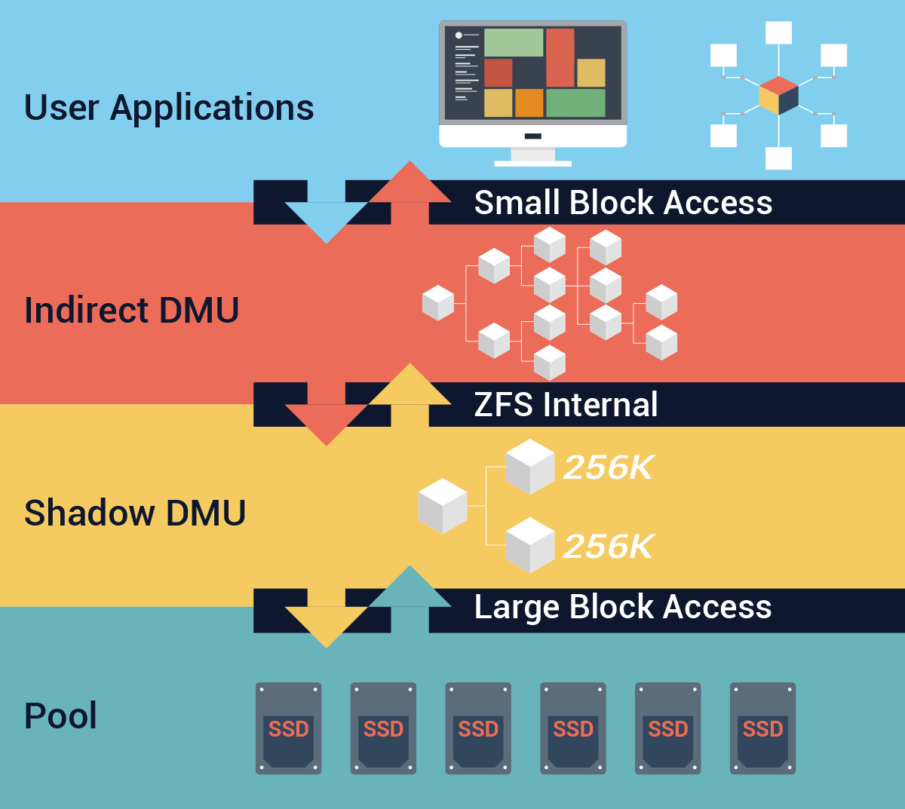
Write Coalescing
QES 2.1.0 features QNAP’s exclusive Write Coalescing algorithm that is engineered for flash optimization by transforming all random writes to sequential writes along with reduced I/O. It not only effectively increases random write performance for all-flash environments, but also can improve SSD lifespan.

Slide 37
ES2486dc iSCSI Performance
Random read 600K+ IOPS
Sequential read 8,700+ MB/s

Slide 38
Over-Provisioning Ensures Consistently Performance
Layer 1 – pool over-provisioning
Pool
Usable pool capacity
Dynamic OP
Usable SSD capacity
Dynamic OP
Factory-set OP
Usable SSD capacity
Dynamic OP
Factory-set OP
Usable SSD capacity
Dynamic OP
Factory-set OP
SSD 2
Layer 2 – SSD over-provisioning
Notes:
QES 2.1提供2層過度配置，第1層在池級別，另一層在SSD級別。當池非常滿或非常分散時，會發生性能下降。如果池已經攜帶了大量數據，則很容易理解，可能會獲得大量小區域的空閒塊，而不是少量大區域。如果系統需要分配2 MB的空間，它將開始讀取和評估所有適合的空間，以找到合適的block存放數據或將2 MB分解為更小的塊。這當然需要一些時間並降低性能。
因此，通過池級過度配置，系統可以通過為文件系統保留部分空間來快速找到適當的寫入空間。
另一方面，所有SSD都為這些額外的寫入操作以及SSD本身的firmware和壞損的block替換保留了一定的空間。 SSD製造商保留7.37％的空間作為GC等後台活動的配置。因此，即使SSD似乎已滿，它仍將具有7.37％的可用空間，以便繼續運行並執行寫入。
事實上，SSD的性能在達到約50％滿後開始下降。不同的超額配置百分比會影響SSD性能和耐用性。這就是為什麼除了內置的7.37％之外，QES還提供了不同超額配置百分比的設置。借助QES過度配置解決方案，用戶可以使用簡單的UI設置評估實際工作負載並相應地配置過度配置空間。它們具有自由度和靈活性，可以優化配置SSD，具有7％，14％，28％或任何百分比的OP空間，以實現最佳性能和耐用性。
通過使用戶能夠根據實際需求配置OP設置，QES動態過度配置解決方案可最大限度地提高SSD的性能和使用壽命，從而提高生產力並提高運營效率。

Slide 39
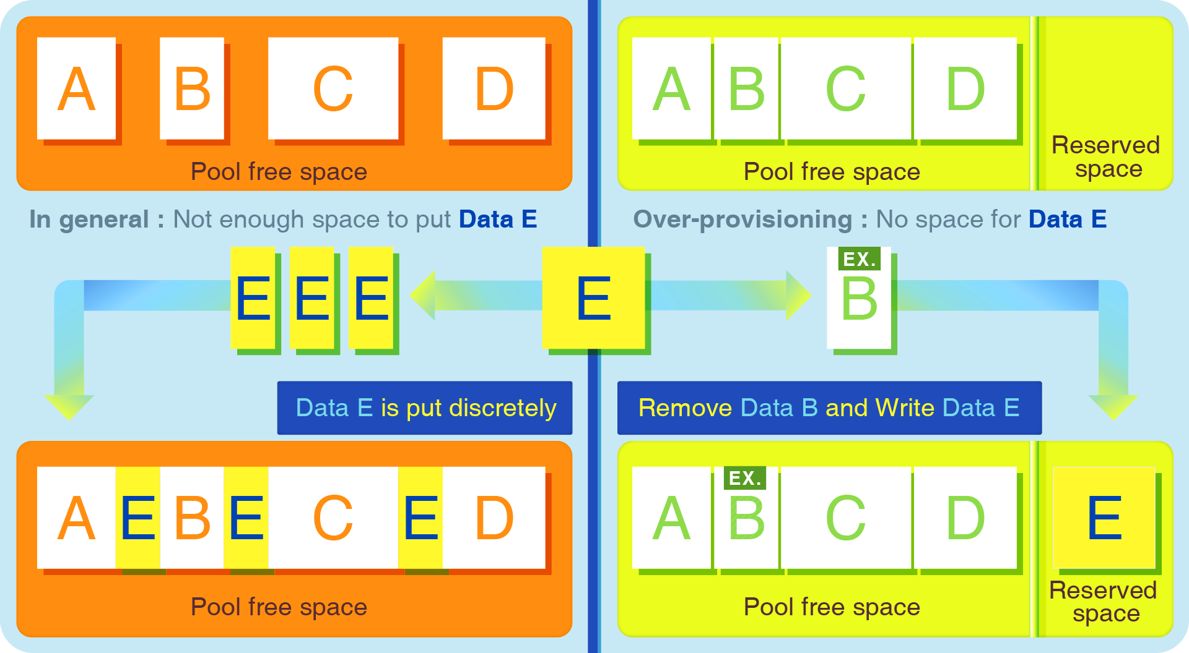
QES Pool Over Provisioning
Provides More Stable Performance
Notes:
QES 2.1提供2層過度配置，第1層在池級別，另一層在SSD級別。當池非常滿或非常分散時，會發生性能下降。如果池已經攜帶了大量數據，則很容易理解，可能會獲得大量小區域的空閒塊，而不是少量大區域。如果系統需要分配2 MB的空間，它將開始讀取和評估所有適合的空間，以找到合適的block存放數據或將2 MB分解為更小的塊。這當然需要一些時間並降低性能。
因此，通過池級過度配置，系統可以通過為文件系統保留部分空間來快速找到適當的寫入空間。
另一方面，所有SSD都為這些額外的寫入操作以及SSD本身的firmware和壞損的block替換保留了一定的空間。 SSD製造商保留7.37％的空間作為GC等後台活動的配置。因此，即使SSD似乎已滿，它仍將具有7.37％的可用空間，以便繼續運行並執行寫入。
事實上，SSD的性能在達到約50％滿後開始下降。不同的超額配置百分比會影響SSD性能和耐用性。這就是為什麼除了內置的7.37％之外，QES還提供了不同超額配置百分比的設置。借助QES過度配置解決方案，用戶可以使用簡單的UI設置評估實際工作負載並相應地配置過度配置空間。它們具有自由度和靈活性，可以優化配置SSD，具有7％，14％，28％或任何百分比的OP空間，以實現最佳性能和耐用性。
通過使用戶能夠根據實際需求配置OP設置，QES動態過度配置解決方案可最大限度地提高SSD的性能和使用壽命，從而提高生產力並提高運營效率。

Slide 40
QoS ensures consistent primary storage performance
Maximum IOPS
Workload 2
Maximum IOPS
Workload 1
Workload 2
Minimum IOPS
Minimum IOPS
Workload 1
Noisy neighbor
QoS protects against noisy neighbor
Notes:
限制噪聲鄰居效應的一種方法是確保應用程序僅通過將資源移動到其他工作負載來接收必要的資源。設置限制可以控制每個工作負載接收的資源量。因此，沒有一個應用程序擁有太多資源並且阻礙了其他應用程序的性能。
QES的OoS允許用戶設置最小和最大目標。當系統具有公平資源時，最小值可確保性能。另一方面，最大值禁止應用程序超出此級別並影響其他應用程序。
在此示例中，由於工作負載2需要太多資源甚至超過目標最大IOPS，因此工作負載1無法將其服務級別維持在最小IOPS之上。但是，通過QoS設置，系統將在最大設置下控制工作負載2的性能，並將資源切換到工作負載1，因此兩個工作負載都可以將其服務維持在預期的性能級別。
基於QES的QoS旨在獨立於容量控制性能，並在單個存儲系統中為多個應用程序提供可預測的性能。

Slide 41

QNAP NAS
is ​Your ​Best Choice​​
Copyright© 2019 QNAP Systems, Inc. All rights reserved. QNAP® and other names of QNAP Products are proprietary marks or registered trademarks of QNAP Systems, Inc. Other products and company names mentioned herein are trademarks of their respective holders.​​​​​​

