Slide 2
An easy to use personal backup solution
Secure your memories
Media streaming
Mobile photography enthusiast

Slide 3
An easy to use personal backup solution

Slide 4
Dedicated for HOME users
I’d like to buy a home NAS and I want it to be…
Affordable price
Elegant style
Data security
Media streaming
Backup photos from phone

Slide 5
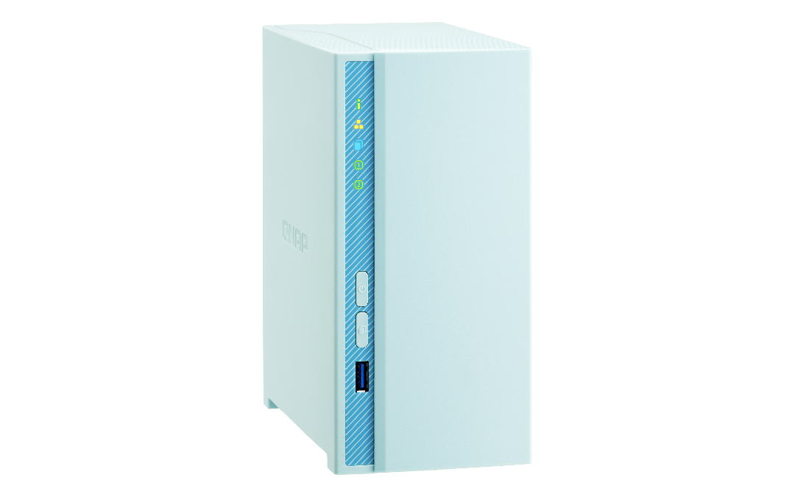
Friendly design for entry users
Baby blue fits your home style
Quiet cooling fan
Snapshot secure your data
4K H.264 video transcoding
Plex media server
Easily backup/sync photos from phone to NAS

Slide 6
Baby Blue suites varied home style
Nordic
Country
Jananese
Notes:
請合成三種風格居家角落
北歐—俐落
鄉村--木頭
日式—空空沒東西

Slide 7
Energy saving ARM 64-bit processor
Realtek RTD1296 Quad-core 64-bit 1.4G Processor
DDR4 2GB Built-in memory (not expandable)
Energy saving ARM® Cortex-A53 architecture
HDD standby：4.5W
HDD operating：12.3W

Slide 8
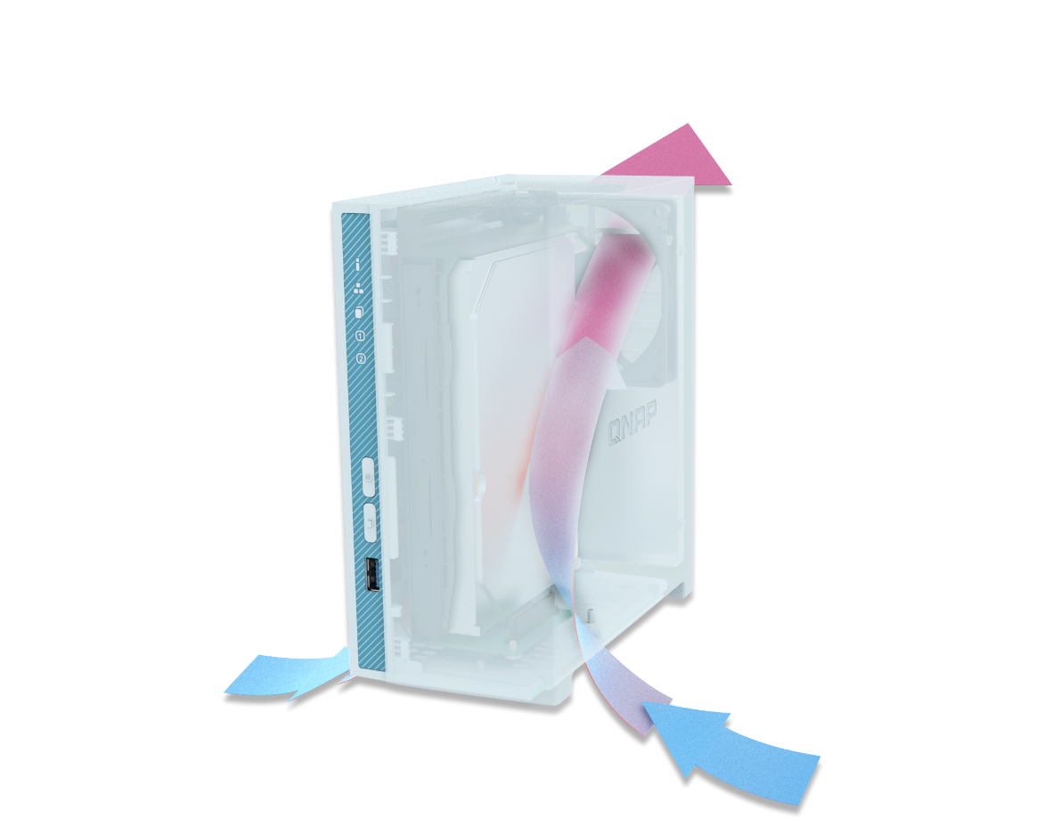
Effective heat dissipation
Smart cooling fan
Produce only 18dB while working at room temperature (25℃ )
Working stable even at 40℃
16TB HDD supported
Sound Level Test Environment: Refer to ISO 7779; Maximum HDD loaded; Bystander Position; Average data from 1 meter in front of operating NAS.

Slide 9
Minimal Design
LED indicator:
Power/Status
LAN
USB copy
HDD 1~2
8cm SINTETICO Bearing-HDB fan
90mm
Power button
Reset
188mm
USB copy
GbE port
USB2.0/
USB3.0 port
USB 3.0 copy port
156mm
Power input

Slide 10
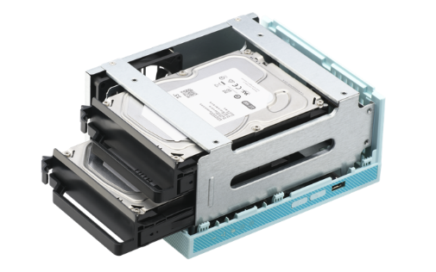
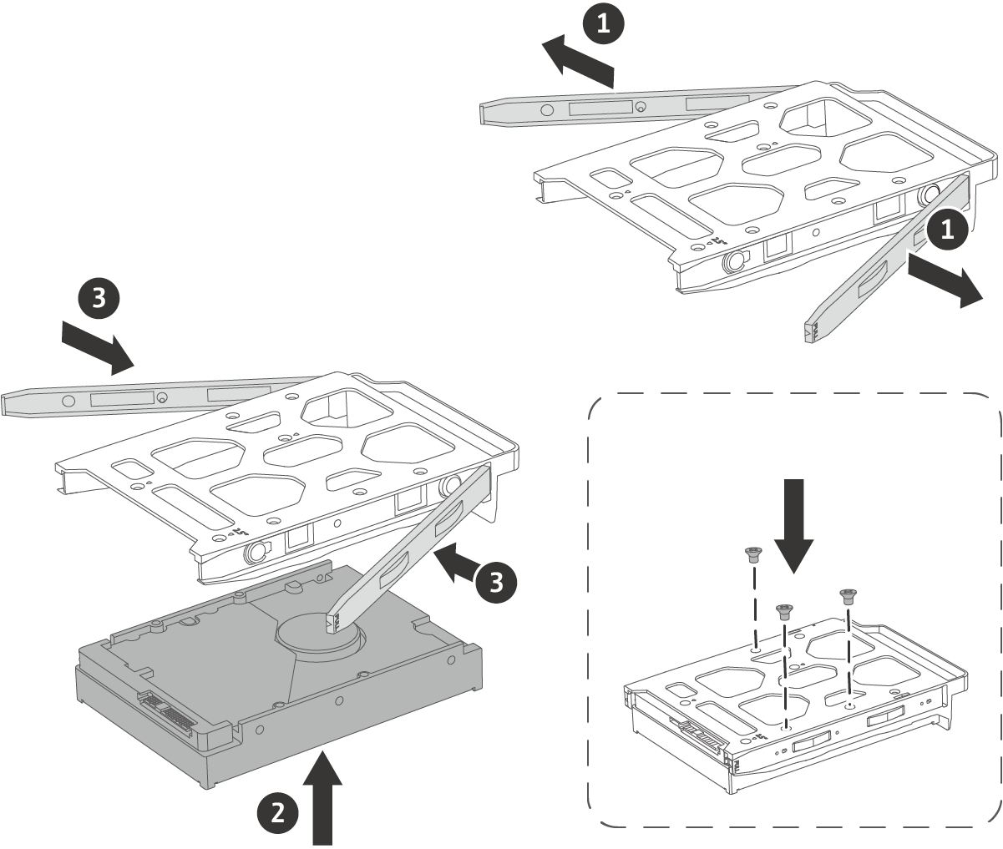
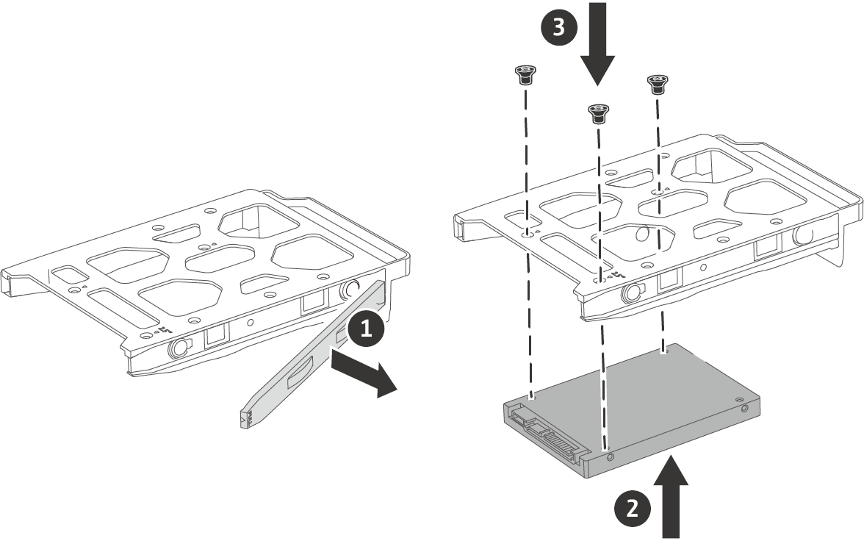
Tool-less drive installation
Supports 3.5”6Gb/s HDD and 2.5” 6Gb/s SSD/HDD
3.5-inch HDD
2.5-inch HDD/SSD
Optional

Slide 11
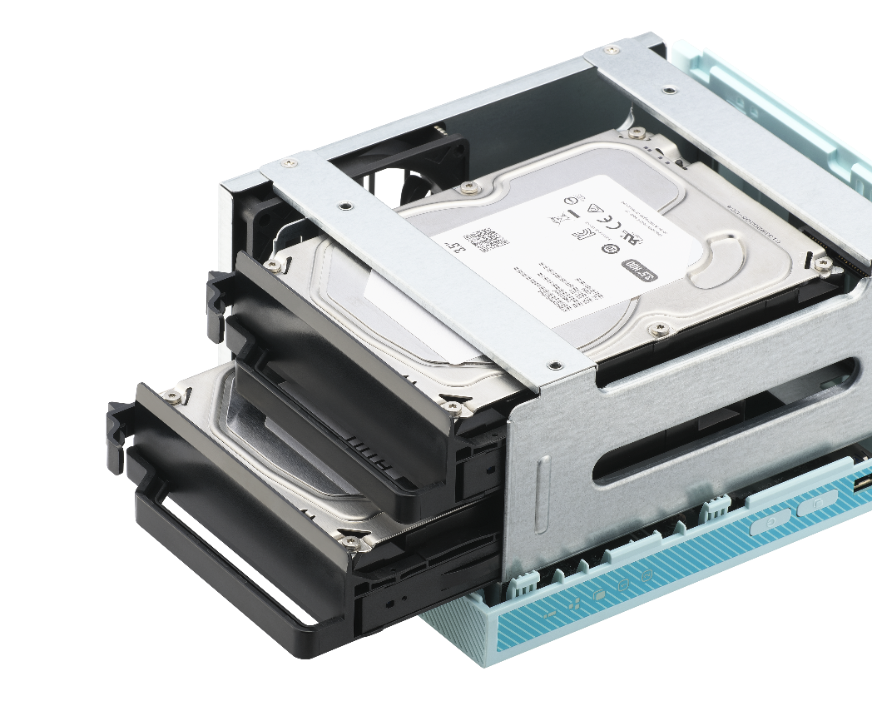
RAID1 Protection Support Hot-Swapping

Slide 12
Open Box

Slide 13
Data security and synchronization

Slide 14
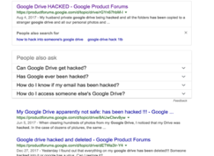
Public cloud risks
Service discontinued
Flickr replaced the 1TB of storage offered to free accounts with 1,000 photos or videos regardless of their size. If you need more than that, Flickr Pro is $49.99 a year
Data leak

Slide 15
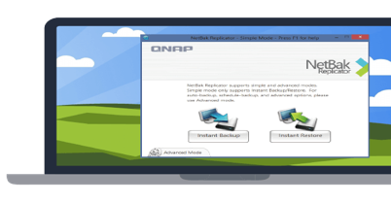
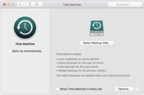
A complete backup solution
Data backup is the most effective way against ransomware!
Real-time or scheduled back up to the NAS easily.
Mac O.S.
Time Machine
Windows
NetBak Replicator

Slide 16
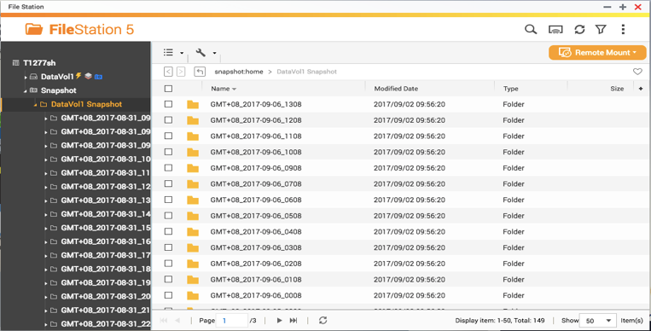
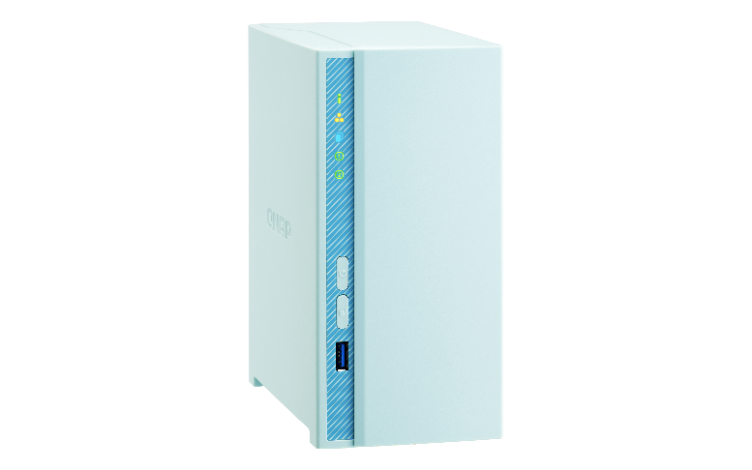
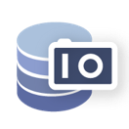
Protect your backup with snapshots
For the
whole NAS
64
-----------------------------------
-----------------------
For a single volume/LUN
32

Slide 17
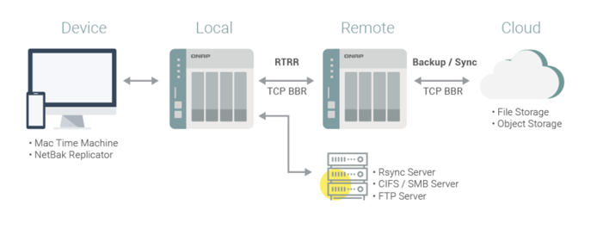
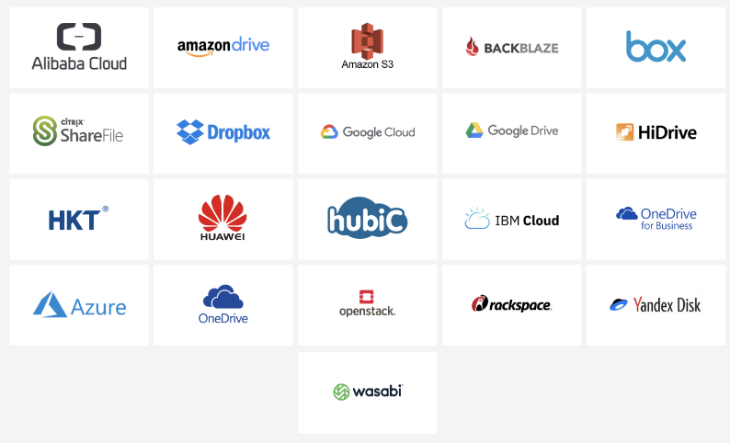
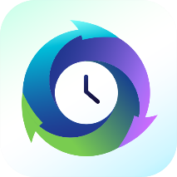
HBS 3 Hybrid Backup Sync
A single QTS app for you to easily transfer your data to local, remote and cloud storage spaces as a comprehensive data storage and disaster recovery plan.

Slide 18
Set Qfile Auto upload
Support Background uploading

Slide 19
Upload status overview
Uploading status
Pause , Delete and Info

Slide 20
Qsync Pro synchronizes data and folders between mobile and NAS
Only Auto-Sync Charging Devices
or Those with Wi-Fi Connection
Flexibly Pair Folders
Upload Photos to Your NAS
Users with NAS running on QTS versions earlier than QTS 4.3.4, or devices running on Android 5.0 (or earlier) can download the Qsync application.
Users with devices running on iOS 10 (or later) can download Qsync Lite.

Slide 21
Media streaming

Slide 22
Plex Supported
Easy to use
Rich media information
Supports various devices
Available anywhere
Supports most formats
Sharing
To experience the best performance of Plex please select x86 NAS.

Slide 23
Support 4K H.264 Hardware transcoding
support 10-bit H.264
Supports 4K video source format
MP4 / AVI / MOV / MKV / MPEG / FLV……..
FHD H264 30fps

Slide 24
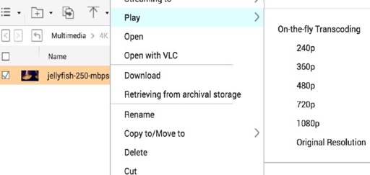
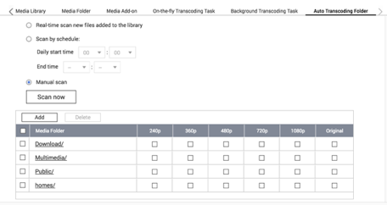
Real-time or background transcoding
On the fly transcoding
Background transcoding
Play on different devices with high quality
Set the auto transcoding folder
TS-230 reserves some RAM for use as shared graphics memory.

Slide 25
Mobile photography enthusiast

Slide 26
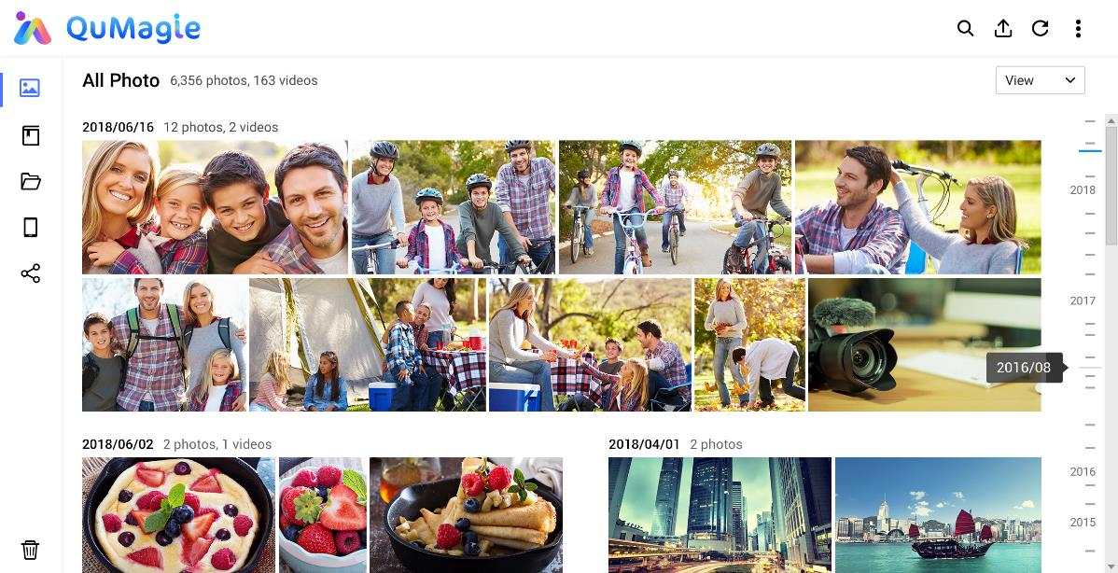
Create and manage your personal album
By QuMagie, I can return to that wonderful day by using the timeline scroll and I can make every journey to be a personalized album.

Slide 27
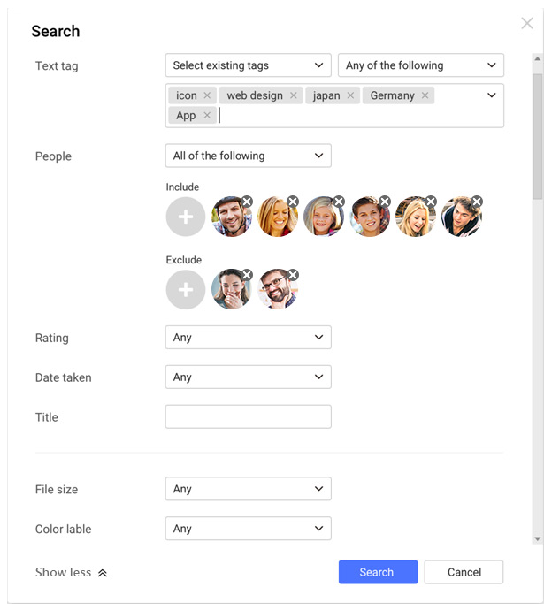
Find your photos faster
2
1
1
2
3
People
Keywords
Date Taken
Include this person
Exclude that person
Satisfy all keywords
Satisfy any keywords
Specific period
3
QuMagie provides comprehensive search filters, allowing you to quickly find photos using tags, people, date and title

Slide 28
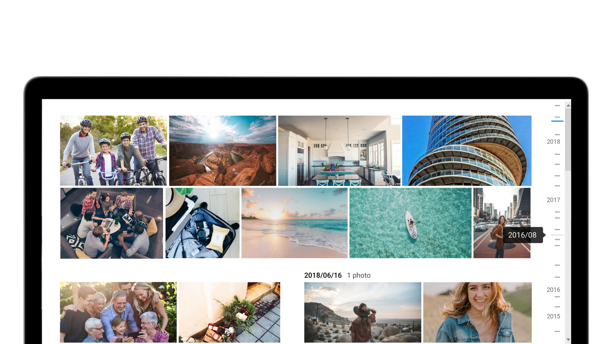
Scroll back to the day in your history
Timeline view

Slide 29
Organize with Albums and Folders
Album View：Albums and Smart Albums
Folder View

Slide 30
More features of QuMagie
Download QuMagie Mobile app for your Iphone or Android devices, auto upload function is coming soon!
Backup photos from all your devices
Private collection
Easily share your photos
iOS® Live Photo display

Slide 31
Meet all you need
Enjoy with parants
Secure and store every moment
Backup precious memory

