Slide 2
QNAP Single/Dual/Quad port Multi-Gig 5GbE expansion card
QNAP Multi-Gig NICs and accessory product line
Build a flexible networking environment by QNAP NAS and networking product line

Slide 3



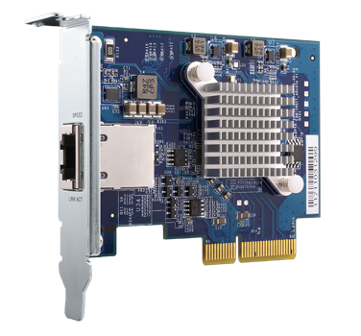




Flexible options between 1 to 10Gbps
QXG-10G1T
QXG-10G2T-107
1Gbps
10Gbps
100Mbps
1Gbps
2.5Gbps
5Gbps
10Gbps
Original CAT 5e can reach to 5Gbps
CAT 6 above cable reaches 10Gbps
Affordable 10GbE NBASE-T switch
CAT 6 above cable is required
10GbE switch investment

Slide 4


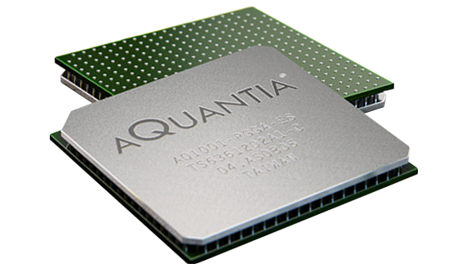
Multi-Gig leader
Gaming
Built-in Multi-gig 5GbE NAS
5Gbps
2.5Gbps
1Gbps
100Mbps
ASUS ROG Formula
QNAP TVS-x72N
Multi-Gig leading provider
Marvell Aquantia
Gigabyte TRX40
Notes:
Gigabyte: https://www.gigabyte.com/tw/Motherboard/TRX40-AORUS-MASTER-rev-10#kf
ASUS: https://www.asus.com/Motherboards/ROG-Crosshair-VIII-Formula/

Slide 5



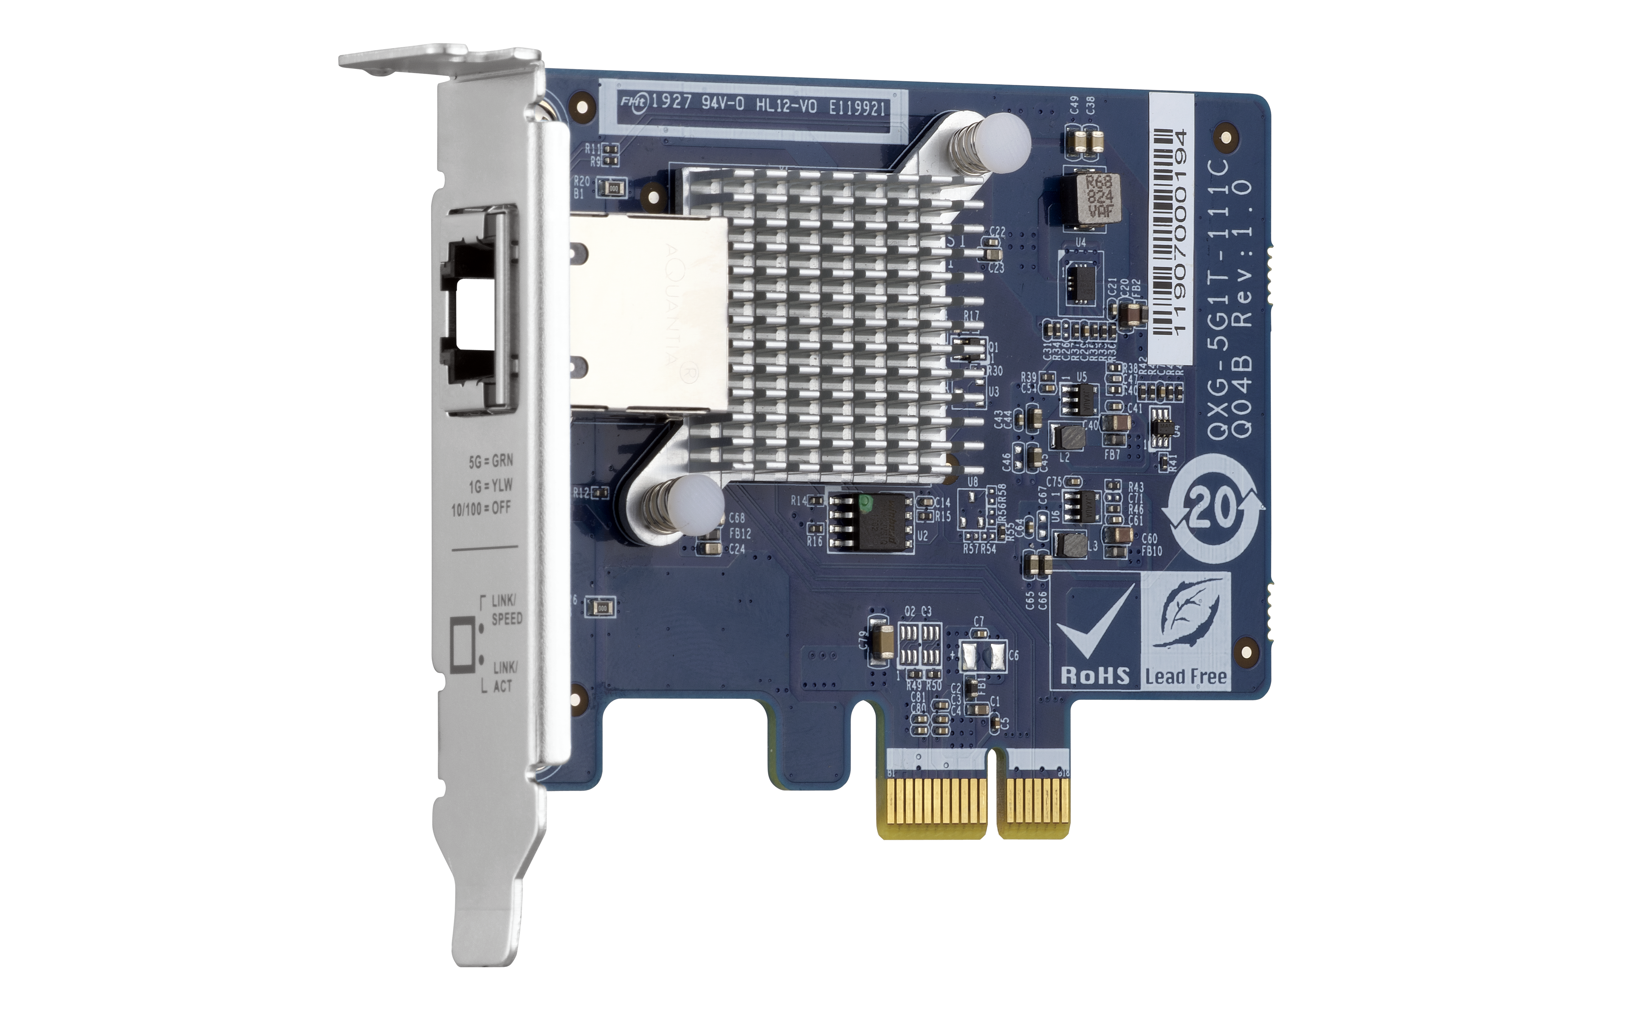

Take advantages of existing infrastructure
Current LAN cables may already be capable for > 1Gbps speeds!
CAT 5e
1 Gbps
 | CAT 5e | CAT 6 | CAT 6A & CAT 7
100M | ✔ | ✔ | ✔
1G | ✔ | ✔ | ✔
2.5G | ✔ | ✔ | ✔
5G | ✔ | ✔ | ✔
10G | X | ✔(55m) | ✔
TS-453Be
CAT 5e
5 Gbps
TS-453Be

Slide 6


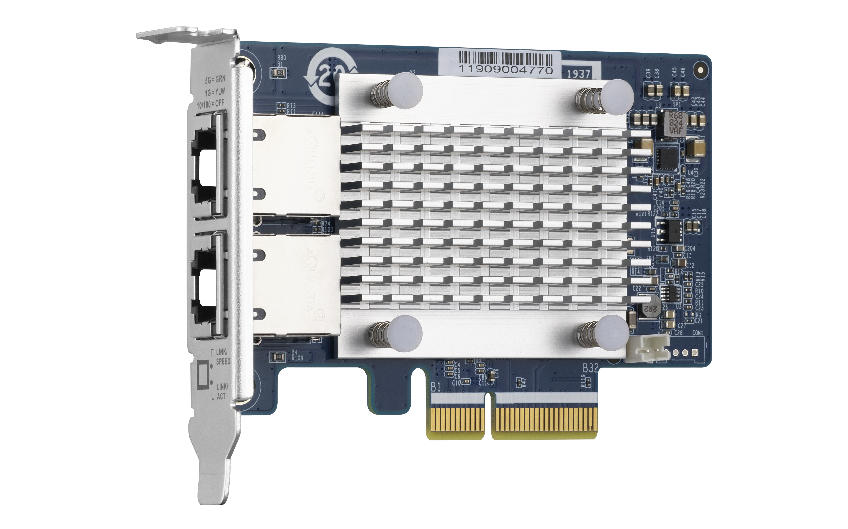
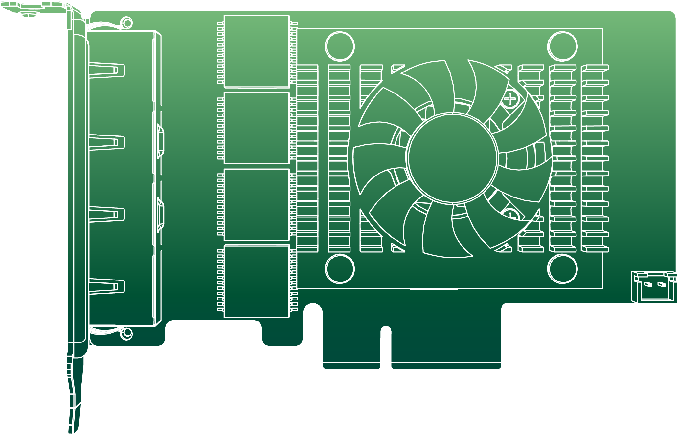
QNAP Multi-Gig 5GbE Expansion card
Single port
Dual port
Coming soon
Quad port
Coming soon
Marvell AQC-111C
QXG-5G1T-111C
QXG-5G2T-111C
QXG-5G4T-111C
PCIe Gen2 x1
PCIe Gen3 x2
PCIe Gen3 x4

Slide 7

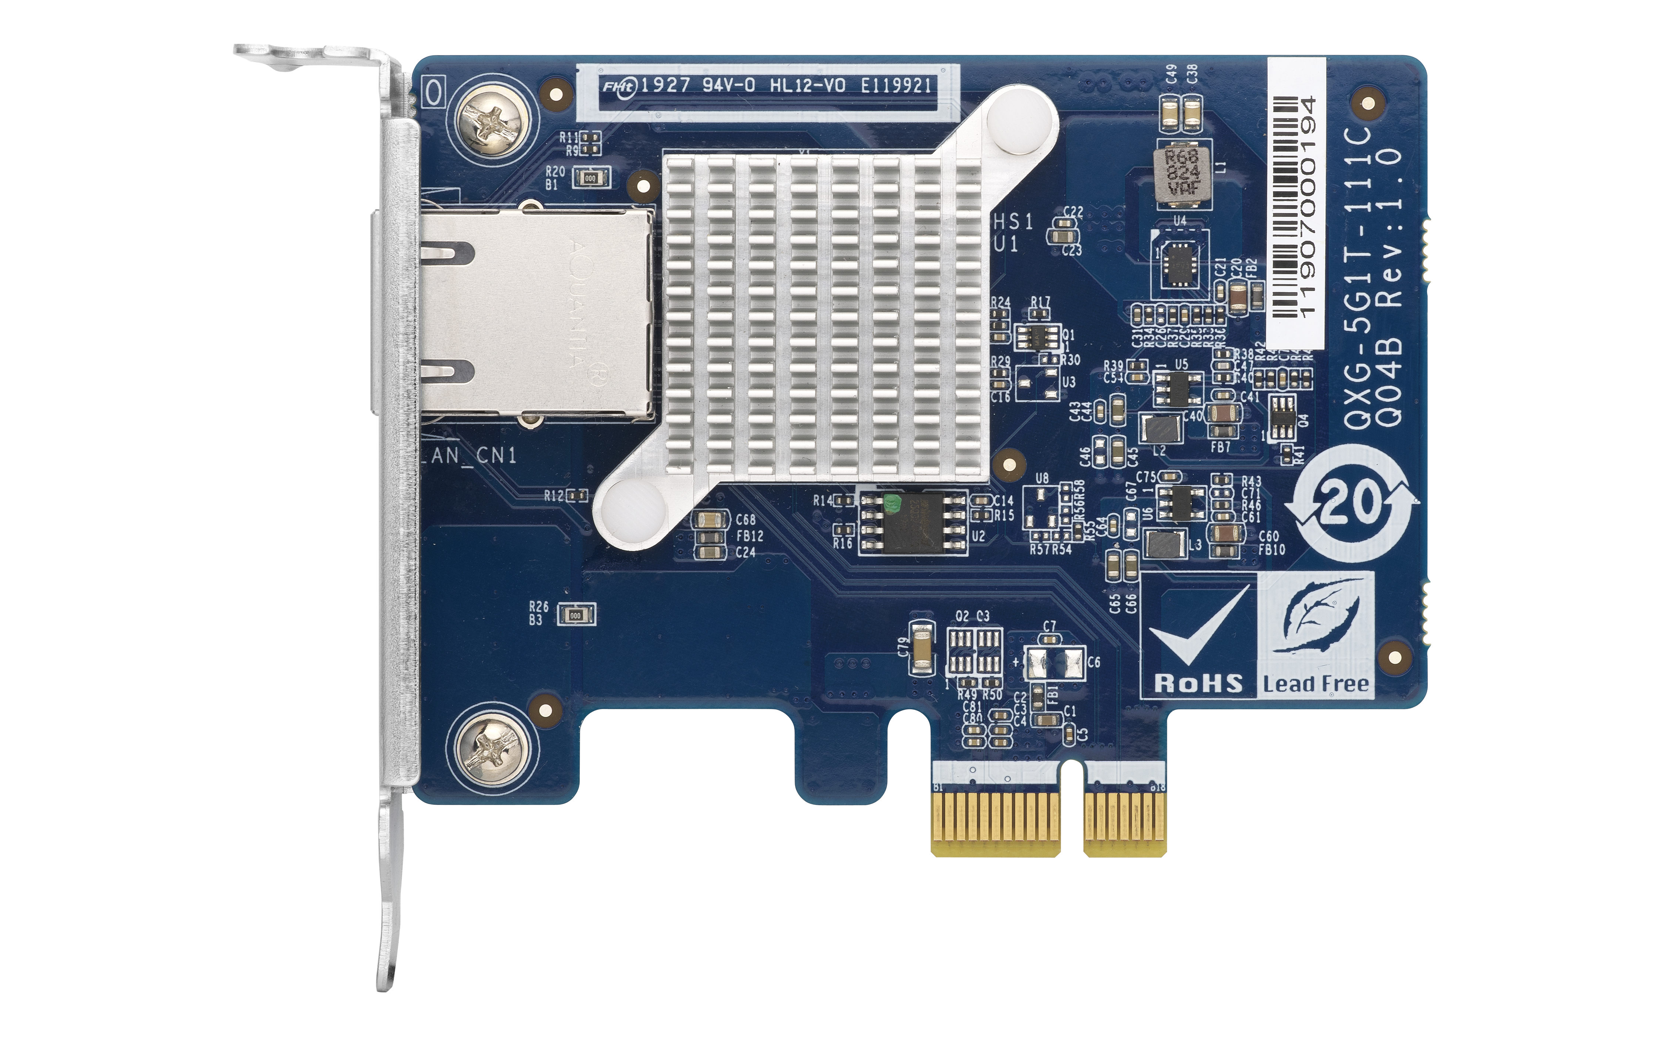



Low profile form factor
101.5 mm
QXG-5G1T-111C
68.9 mm
PCIe Gen 2 x1
Full height and QNAP flat bracket is bundled
Low profile bracket is pre-installed
Cooling heatsink

Slide 8
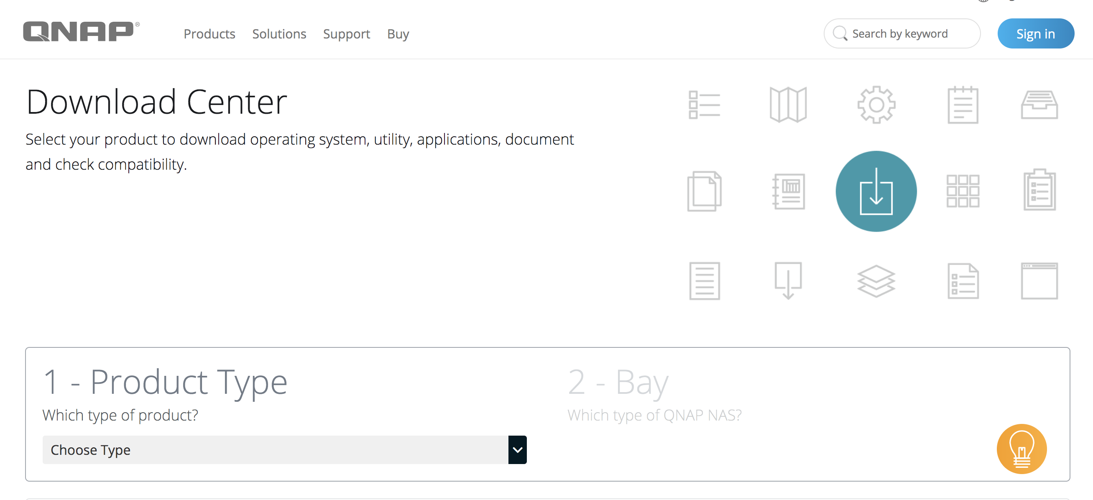

Supports QTS, Windows and Linux
The driver is featured in QTS, Please update to latest QTS version
Driver is required to download and install to your PC from QNAP Download Center
PCIe supported NAS
PCIe supported PC/Workstation
*the compatible QNAP NAS can be found in QNAP compatibility list

Slide 9




Multi-speed on different infrastructure
Install QXG-5G1T-111C on PC and drag and drop 10GB file to TVS-672N,
PC spec:
1. CPU: Intel (R) Core(TM) i7-6700U @ 3.40GHz.
2. OS: Windows 10 Pro
3. Memory: 32 GB.
4. 1GbE NIC On board
5. 10GbE NIC: QXG-5G1T-111C
Download: 118MB/s
1GbE
Upload: 118MB/s
Download: 590MB/s
5GbE
Upload: 586MB/s
MB/s

Slide 10

Performance Demo
10GB file drag-and-drop via 1Gbps and 5Gbps

Slide 11

QNAP Multi-Gig NICs and accessory product line

Slide 12

QNAP Multi Gig NICs
Intel
Mellanox
Aquantia
5 speed Multi- Gig
4 speed Multi- Gig
QXG-5G1T-111C
QXG-5G2T-111C
QXG-5G4T-111C
QXG-10G1T
QXG-10G2T-107
Aqtion AQC107
Single port 10GbE NBase-T
PCIe Gen3 x8
Low Profile
Aqtion AQC107S
Dual port 10GbE NBase-T
PCIe Gen3 x8
Low Profile
Aqtion AQC111C
Single/Dual/Quad port 5GbE NBase-T
PCIe Gen2 x1, Gen3 x2, Gen3 x4
Low Profile
10GbE
5GbE

Slide 13
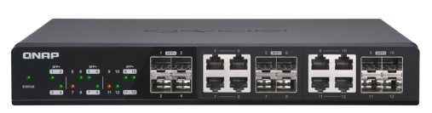
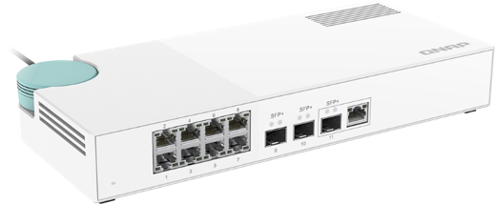


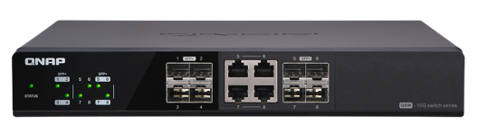
QSW 10GbE NBASE-T Switch
QSW-1208-8C
QSW-308-1C
Provides 12 ports of 10Gbps transfer
Small office or Workshop
QSW-808-4C
Use 10G-SFP-T copper transceiver module
for link up copper cable
3 x SFP+ 10GbE port
(built-in 1 x 10GbE NBASE-T Combo port)
Support: 10Gbps/5Gbps/2.5Gbps/1Gbps/100Mbps
8 x 1GbE RJ45 port
Home users
Provides 8 ports of 10Gbps transfer
Notes:
QSW-308

Slide 14
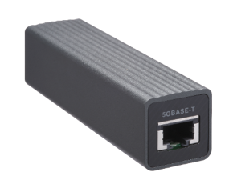
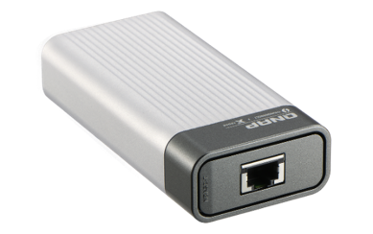
QNA series for 10GbE
QNA-UC5G1T
QNA-T310G1T
USB 3.0
Thunderbolt 3
Update your network to 10Gbps by Thunderbolt3 ports on your PC and laptop
Update your network to 5Gbps by USB ports on your PC and laptop
RJ45 NBASE-T
4 speed: 5G/2.5G/1G/100M
10GbE NBASE-T port
5 speed: 10G/5G/2.5G/1G/100M
Notes:
QSW-308

Slide 15







Update to 5 times speed
1GbE
Cat 5e
10G/5G/2.5G/1G/100M Switch
1GbE
Cat 5e
QNAP 10G 8C switch
TS-453Be
PC + QXG-5G1T-111C
or QNA-UC5G1T
1GbE
Cat 5e
5GbE
Cat 5e
QXG-10G1T
or QNA-UC5G1T
10G/5G/2.5G/1G/100M Switch
5GbE
5Gb
Cat 5e
5GbE
Cat 5e
QNAP 10G 8C switch
Update to 5Gbps by existed Cat 5e
Update to 5Gbps by existed Cat 5e

Slide 16

Build a flexible networking environment by QNAP NAS and networking product line

Slide 17




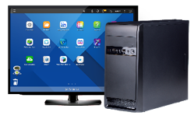

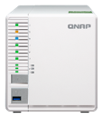


Wifi 6 High speed environment
WiFi 6 AP
Netgear Nighthawk AX12
Internet
5 Gbps
Wifi 6 wireless devices
QSW 10G Switch
5 Gbps
5 Gbps
1 Gbps
5Gbps RJ 45
10Gbps SFP+
PC +
QXG-5G1T-111C
Notebook + QNA-UC5G1T
Smart TV
NAS+
QXG-5G1T-111C
NAS
Notes:
QSW-308簡報

Slide 18

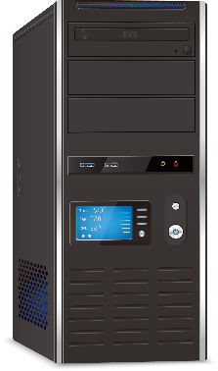
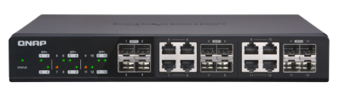
PC/ workstation 10GbE ft. Cache solution
QM2-2P10G1TA
TS-453Be
Install 2 x M.2 SSD to improve the system cache and enjoy the 5Gbps transfer.
TVS-x72N
Built-in 5GbE

Slide 19
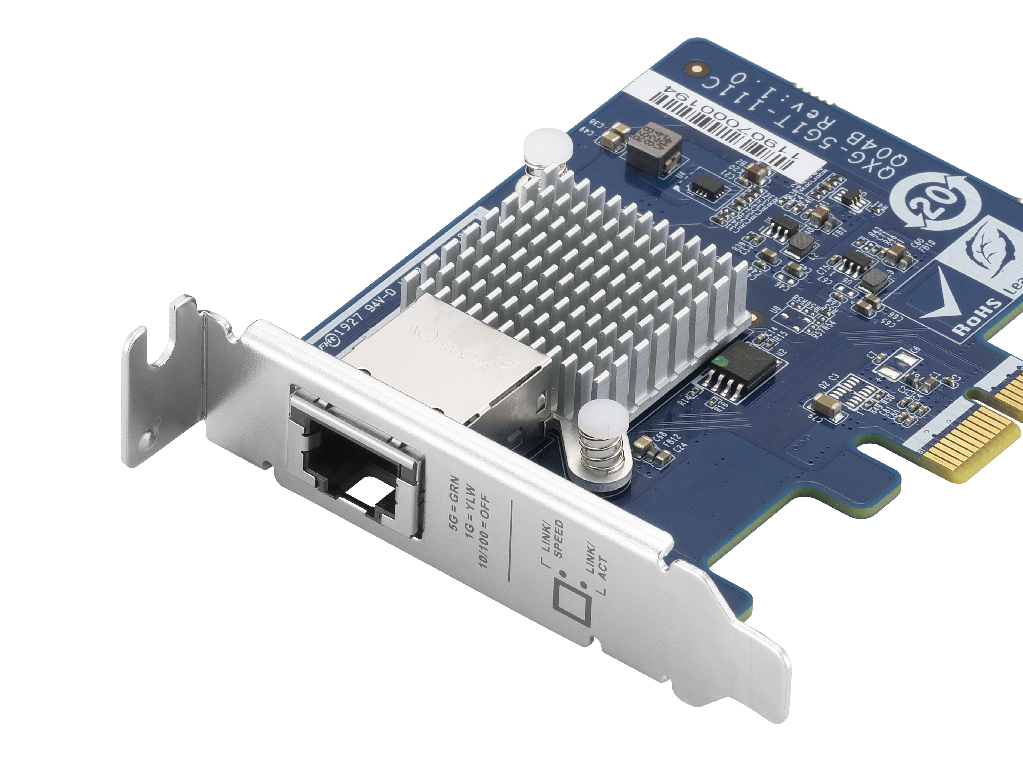
QXG-5G1T/2T/4T
Your Best Choice!
Copyright © 2019 QNAP Systems, Inc. All rights reserved. QNAP® and other names of QNAP Products are proprietary marks or registered trademarks of QNAP Systems, Inc. Other products and company names mentioned herein are trademarks of their respective holders.

