Slide 1


Slide 2

See Boxafe in three faces
Why I need to backup G suite / Office 365?
Boxafe provides a secure and friendly backup solution
Demo

Slide 3





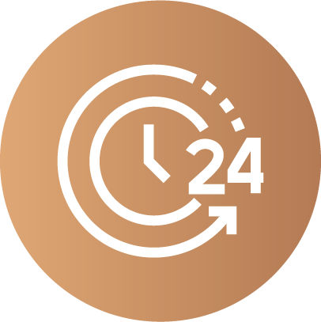
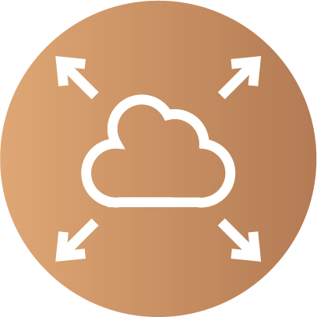

Benefits of SaaS
SaaS
Service Continuity
Accessibility
Availability
Scalability
When it comes to some challenges to deal with,
you need a cloud data backup solution.

Slide 4
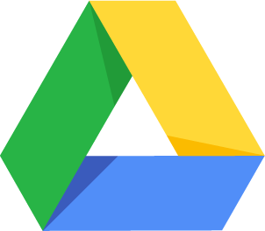


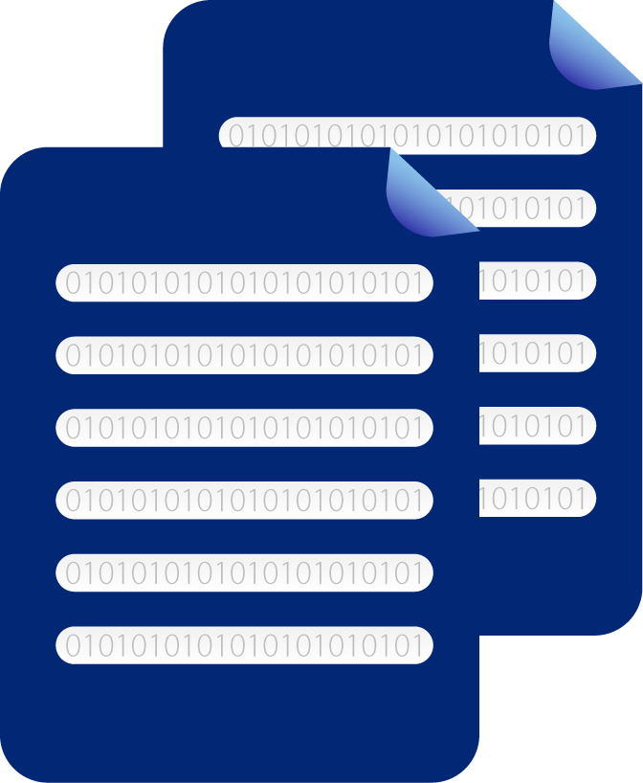



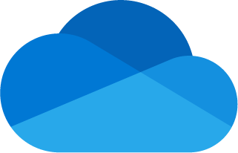






Prevent data loss due to malicious action or human error
Gone Forever
Trash
(Recycle Bin)
for data restore
Gone Forever
 |  | Time of keeping in trash | After delete from trash
 |  | 30 days | It is gone forever.
 |  | 30 days | It is gone forever.
 |  | No limit | 25 days for restoration. After that, it is gone.
 |  | 30 days | 14 days for restoration. After that, it is gone.
 |  | 30 days | 14 days for restoration. After that, it is gone.
 |  | 93 days | 14 days for requesting restoration from Microsoft support. After that, it is gone.

Slide 5
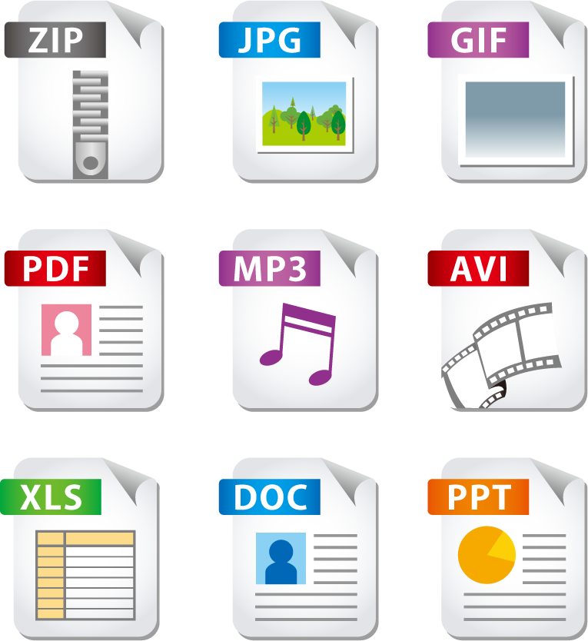




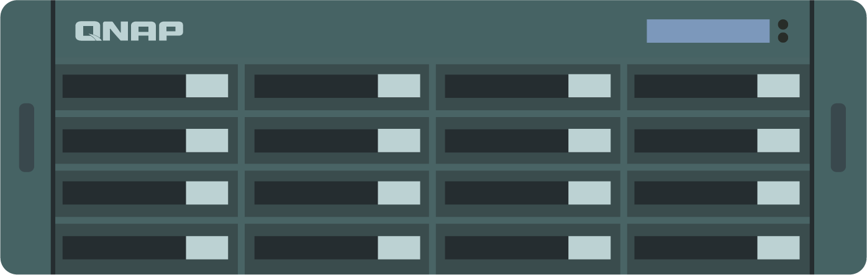



Quickly recover from ransomware attack
Restore
Even if data is stored on the cloud, it still might face malicious attack.
Your data might be lost forever and you need to pay the ransom.

Slide 6





Move older data out of the cloud to reduce cost
Legal Compliance & Litigation Purpose
Keep former employee’s data

Slide 7






Easy to Use
Security
Reliability
Boxafe
Data Centralization
Keep company cloud data safe!

Slide 8

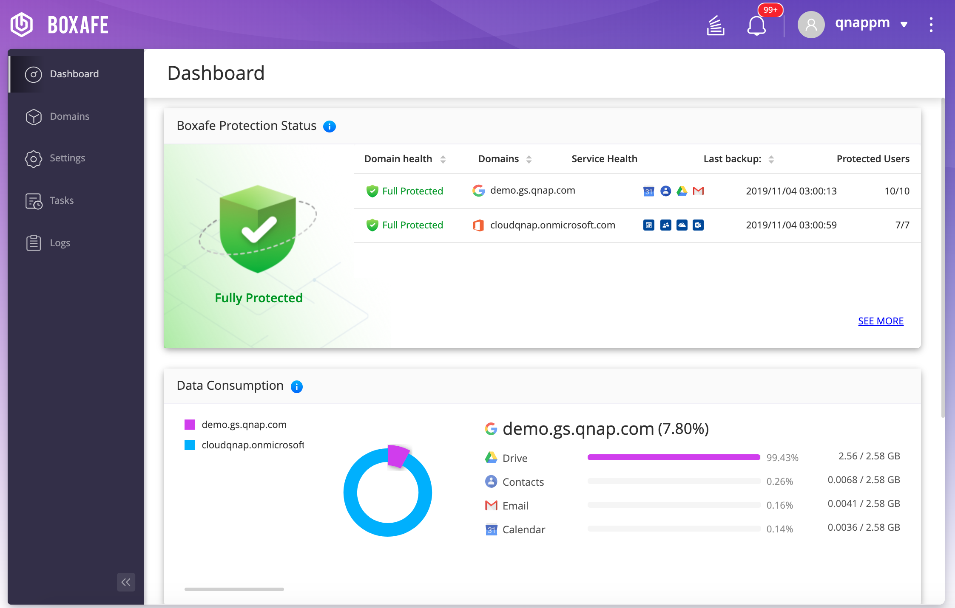
Backup G suite & Office 365 in Boxafe
All in one application:
G suite & Office 365
Backup & restore
IT Management
User login portal

Slide 9


Easy to backup thousands of accounts
As a domain admin, IT can backup thousands of accounts and their data in the domain in one time.

Slide 10


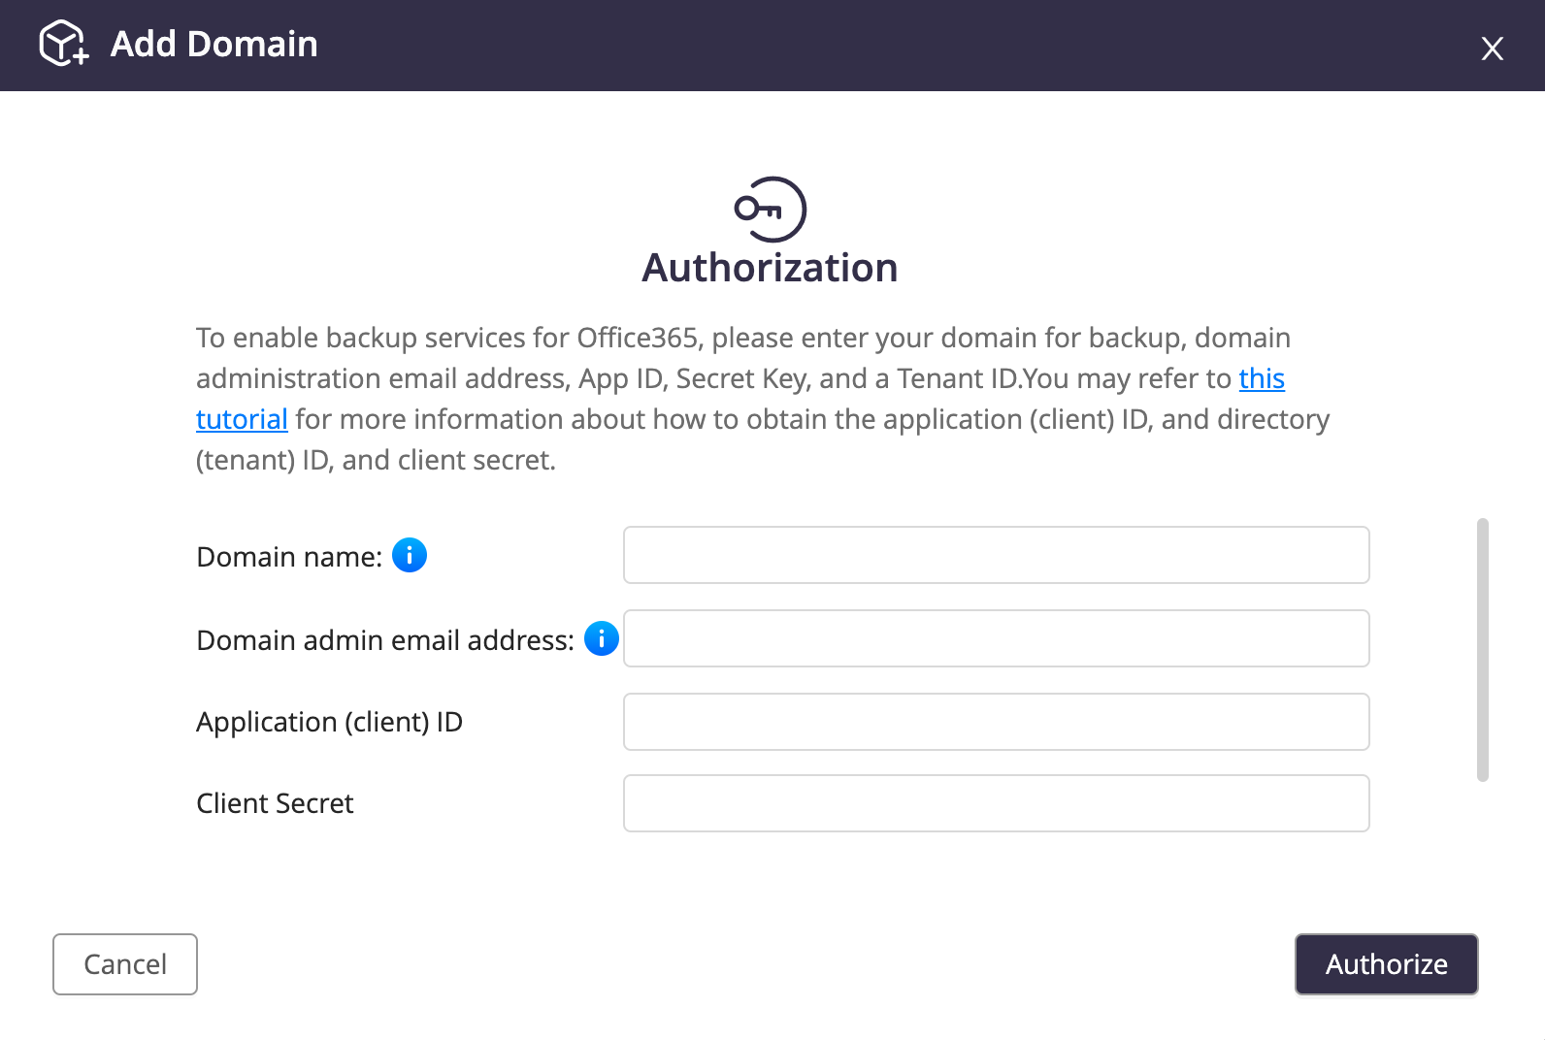
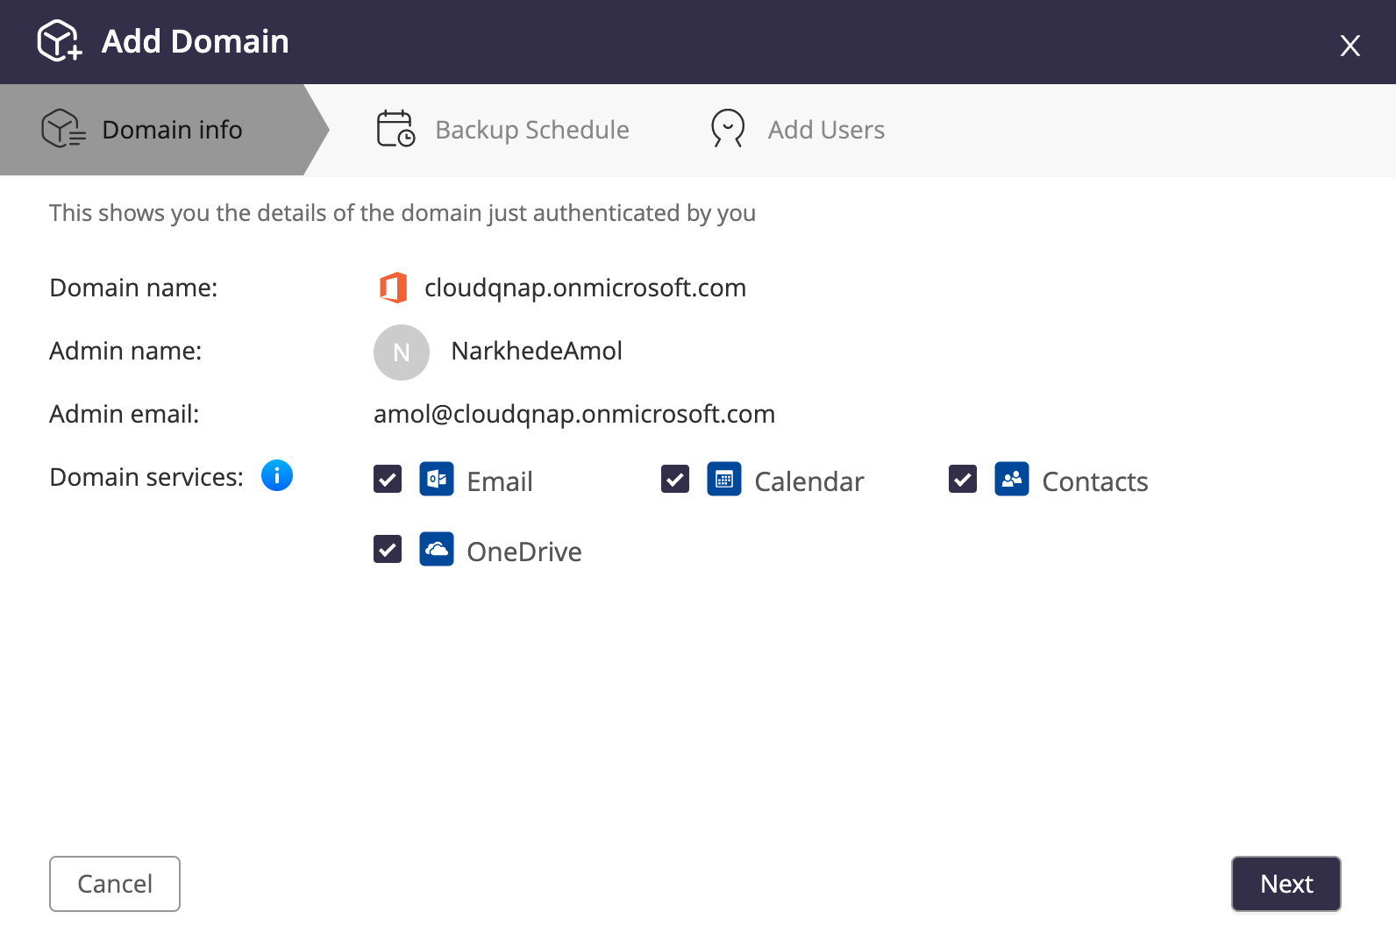
4 steps to backup thousands of accounts
Authorization
Select Services
Follow the tutorial steps to get the keys from G suite or Office 365.
Select and backup the services:
Mail, Calendar, Contacts, Drive

Slide 11


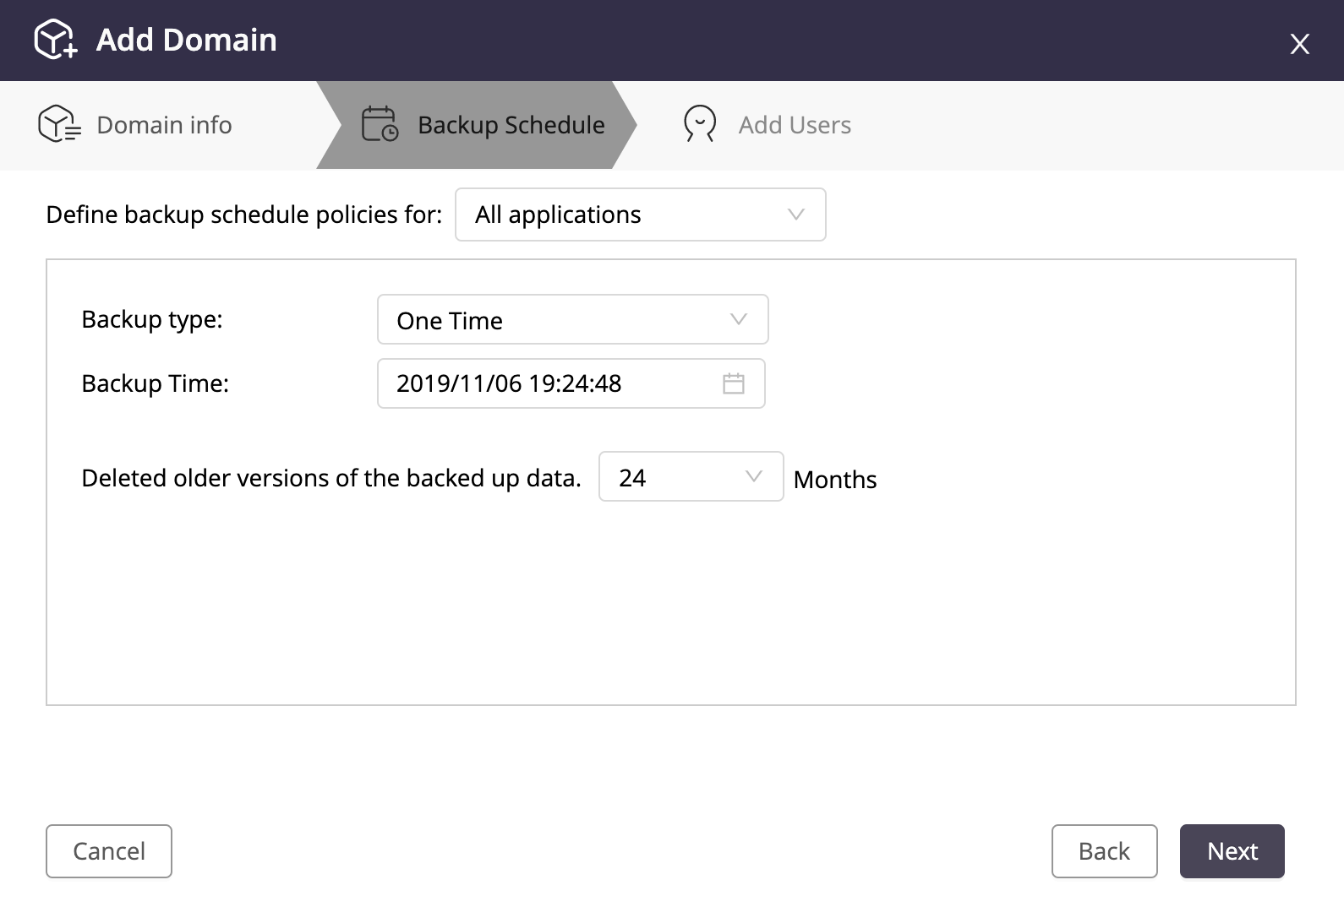
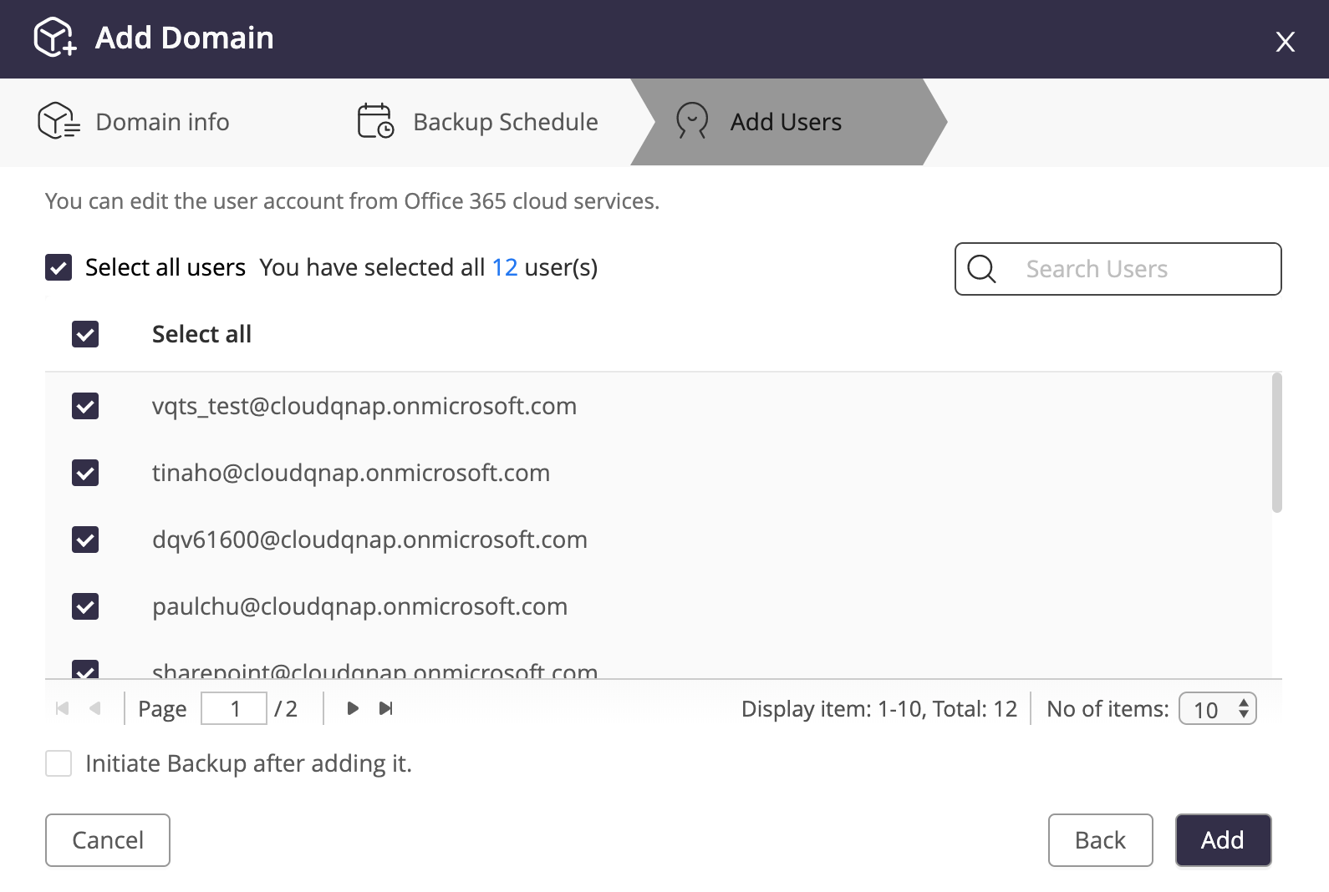
4 steps to backup thousands of accounts
Backup Schedule
Add Users
Three backup types:
One time, Manual, Schedule
Select and add users for backup.

Slide 12
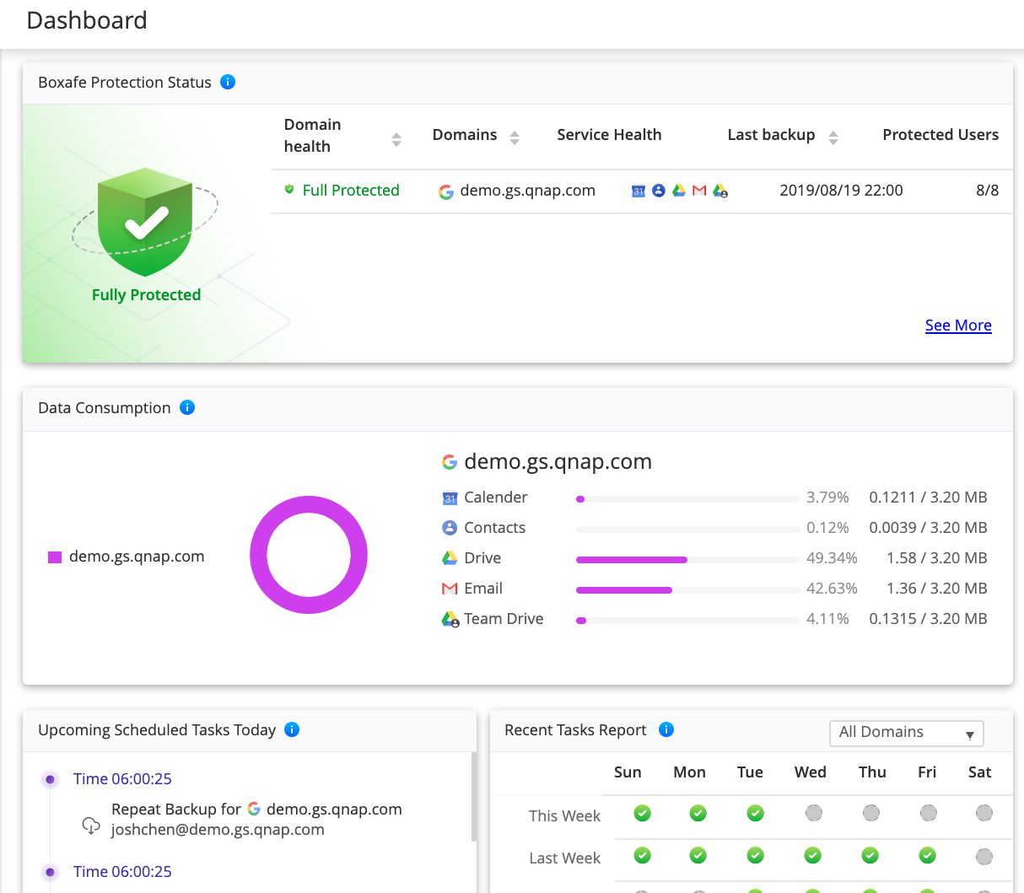
Overview the backup status
Protection Status:
to know if the domain is full protected or not.
Data Consumption:
backup data consumption of each service of the domain.
Recent Tasks Report:
a calendar to show recent backup task status.

Slide 13








Keep business data in your hands
Is your data really safe storing in the cloud owned by other?
SaaS
Other cloud
backup solution
Instead of store your important data in other’s storage, keep in your hands:
1. On premise NAS
2. Cloud storage owned by you

Slide 14

3-2-1 Backup rule
SaaS
Boxafe on QNAP Cloud NAS
Install Boxafe in local NAS and QNAP cloud NAS to realize 3-2-1 Backup Rule:
3 copies of your data
2 on different storage media
1 offsite
Boxafe on premise in QTS

Slide 15

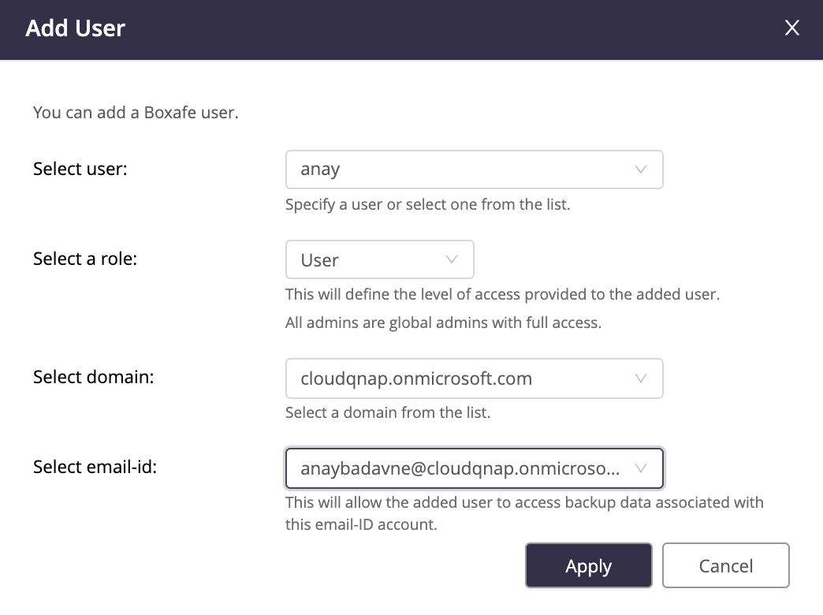
NAS user permission mapping
Backup data cannot be accessed by unauthorized personnel.
Multiuser solution for various G Suite/ O 365 users can also access their own backup data.
View then select and restore data to user’s cloud account by user

Slide 16
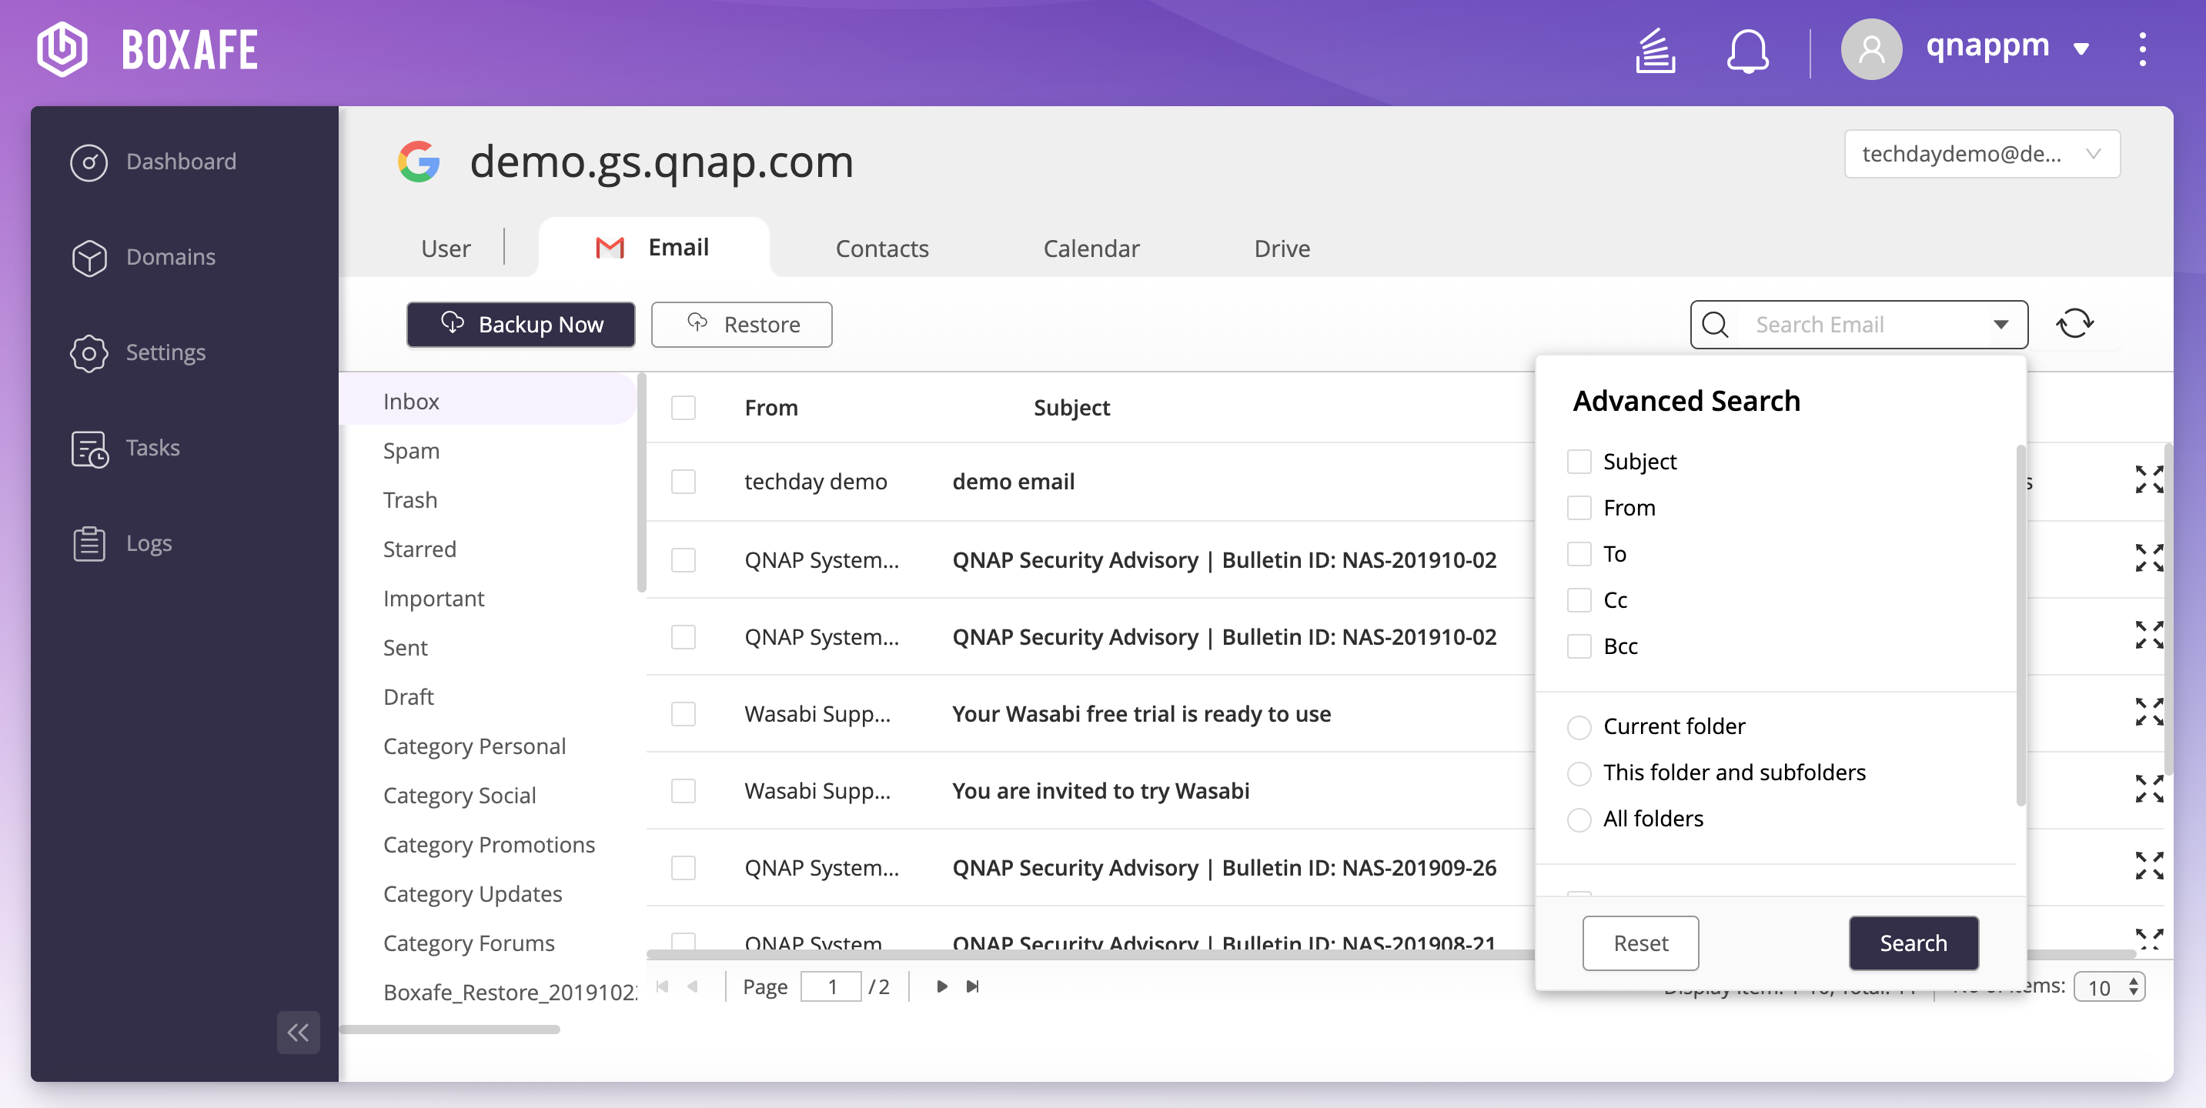
Data preview and search
Data preview before restore
Search for specific data by:
  Mail: subject, from, to, cc, bcc
  Contacts: name, email, nicknames, occupations, phone numbers
  Calendar: organizer, title, event location
  Drive: type, owner, date modified, item name

Slide 17

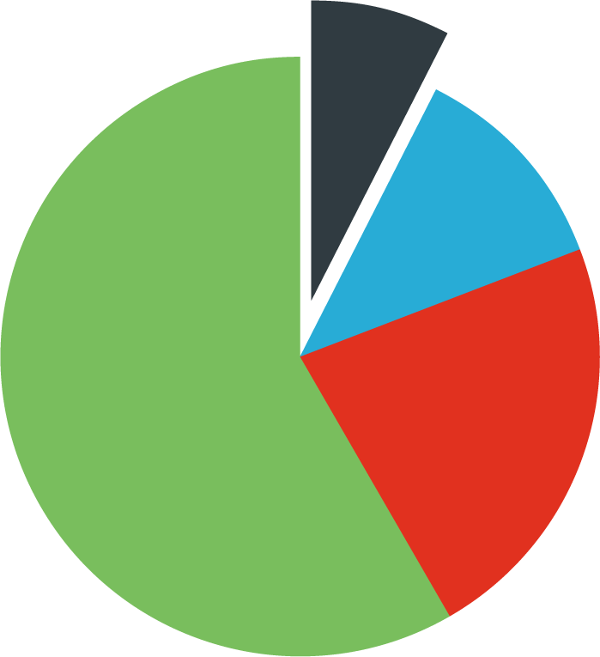

Schedule multi-version backup reduces RPO
Multi-version backup.
View and select any version to restore.
Only backup the different

Slide 18
Boxafe Architecture Diagram

Slide 19
LIVE
DEMO

Slide 20
Data Safety
Keep import data in your hands.
Realize 3-2-1 backup rule.
IT Friendly
Easy to backup thousands of accounts.
Users search & restore their own data.

Slide 21

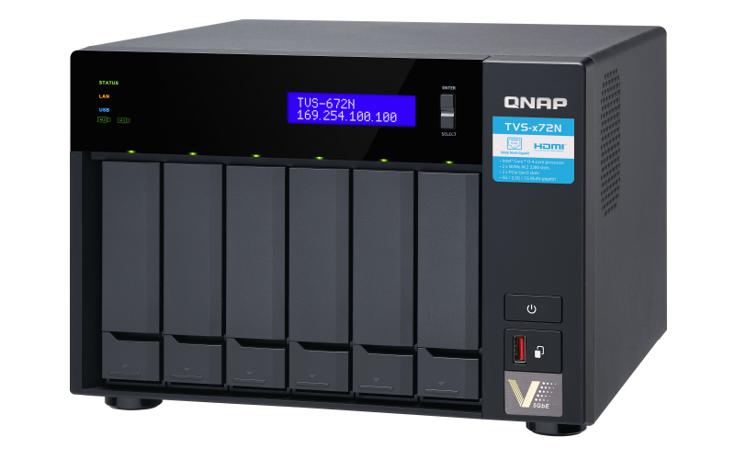
Recommended Model
TVS-672N
Mid-level for SMB less than 100 users
Intel® Core™ i3-8100T 4-core 3.1 GHz Processor
Maximum Memory: 32 GB ( 2 x 16 GB)
6 Drive Bay
Space and deploy by trial:
Total Space: 20TB (6 x 4TB HDD, RAID 5)
Backup Domain：G Suite Basic with 100 users
Allow to backup 6 totally different versions.

Slide 22
Keep your cloud data safe by
Boxafe
Copyright © 2019 QNAP Systems, Inc. All rights reserved. QNAP® and other names of QNAP Products are proprietary marks or registered trademarks of QNAP Systems, Inc. Other products and company names mentioned herein are trademarks of their respective holders.

