Slide 2
Storage Media Strategy in Business
Capacity
Performance
Cost

Slide 3
QNAP SSD Caching and Auto Tiering
Maximized capacity
Minimal cost
Optimal performance

Slide 4
TS-1886XU-RP
Best NAS for SSD caching and Qtier
12 x 3.5”HDD slot
Up to 192 TB raw capacity*
*calculate by 16TB disk
6 x2.5”SSD slot
Free front HDD slots for storage capacity

Slide 5
Intel 2019 Latest Enterprise Xeon D Processor
Intel® Xeon® D-1622
4-core / 8 thread processor
2.6 GHz，max boost to 3.2 GHz
Intel® Xeon® D-1602
2-core / 4-thread processor
2.5 GHz ，max boost to 3.2 GHz

Slide 6
Support ECC Memory (Error Correcting Code)
Running reliably without data corruption
Intel Xeon processors support ECC which automatically detects and repairs single-bit error on-the-fly.
Supports up to 128GB

Slide 7
TS-1886XU-RP Rackmount NAS
TS-1886XU-RP-D1602-4G
Intel® Xeon® D-1602 2-core / 4-thread 2.5 GHz processor，max boost to 3.0 GHz
4GB DDR4 ECC RAM (1 x 4GB)
2 x 10GbE SFP+ port
TS-1886XU-RP-D1622-8G
Intel® Xeon® D-1622 4-core / 8-thread 2.6 GHz processor，max boost to 3.2 GHz
8GB DDR4 ECC RAM (2 x 4GB)
2 x 10GbE SFP+ port

Slide 8
TS-1886XU-RP Front View
12 x 3.5/ 2.5”SATA 6Gb/s HDD port
Power Button
LED indicator:
System status, network, storage expansion, HDD

Slide 9
TS-1886XU-RP Rear View
550W Redundant PSU
6 x 2.5”SATA 6Gb/s SSD slot
4 x 1 GbE port
3 x PCIe slot
2 x USB 3.1 Gen1 port
2 x 10GbE SFP+ port

Slide 10
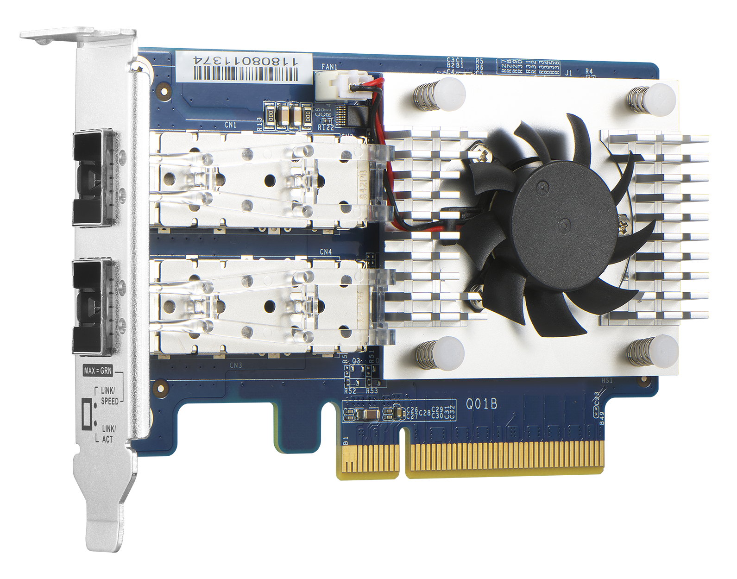
Broadcom BCM57412 NIC Chip
NetXtreme®-E Series PCIe 3.0 network controller
2 x SFP+ 10GbE port
Supports RoCE v1/ v2

Slide 11
RDMA Over Converged Ethernet (RoCE)
RoCE (L2) and RoCEv2 (L3) hardware offload
Ideal for low latency and high-speed big data transferring
Increasing performance, lower CPU loading
Server-Initiator
Server-Target
Server-Initiator
Server-Target
Application
Application
Application
Application
Buffer
Buffer
Buffer
Buffer
Sockets
Sockets
Sockets
Sockets
Buffer
Buffer
Buffer
Buffer
Transport Protocol Driver
Transport Protocol Driver
Transport Protocol Driver
Transport Protocol Driver
Buffer
Buffer
Buffer
Buffer
NIC Driver
NIC Driver
RoCE NIC Driver
RoCE NIC Driver
NIC
NIC
RoCE NIC
RoCE NIC
w/o RoCE
With RoCE

Slide 12
TS-1886XU-RP Internal Design
PCIe slot X3
DDR4 memory DIMM X4
Intel Xeon D processor
Air duct X2
Fan( 6 cm 17K RPM ) X3

Slide 13
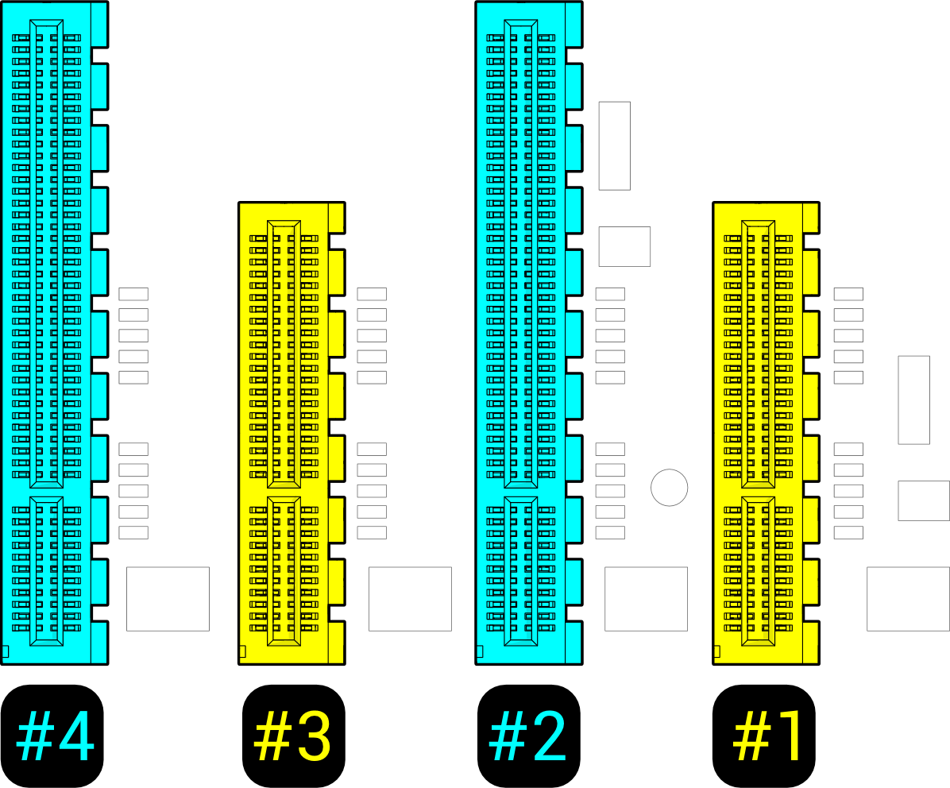
PCIe Slot Specification
PCIe x8 or x4
PCIe x8 or x4
Supports 4 x PCIe Gen3 slots
Versatile expansion ability
PCIe x4
PCIe x4
A 10GbE adapter is preinstalled in slot 4
Slot 2 and 4 provides the width of PCIe Gen.3 x8 when Slot 1 and 3 is not in use.

Slide 14
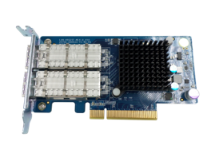
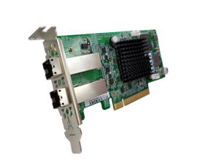
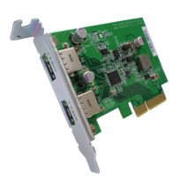
Versatile Expansion Possibilities
QNAP QM2 expansion card
40/25/10GbE network adapter
Fibre channel adapter
USB 3.1 Gen 2 expansion card
SAS 12Gb/s storage expansion card

Slide 15
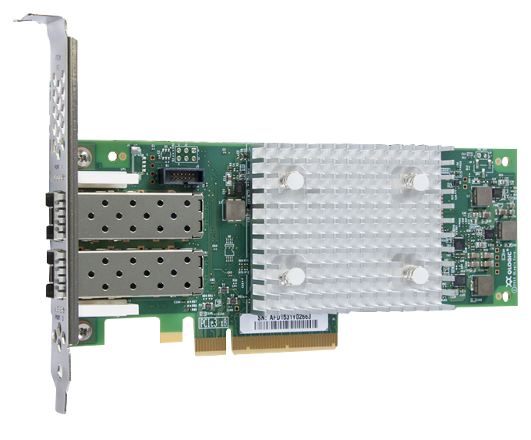
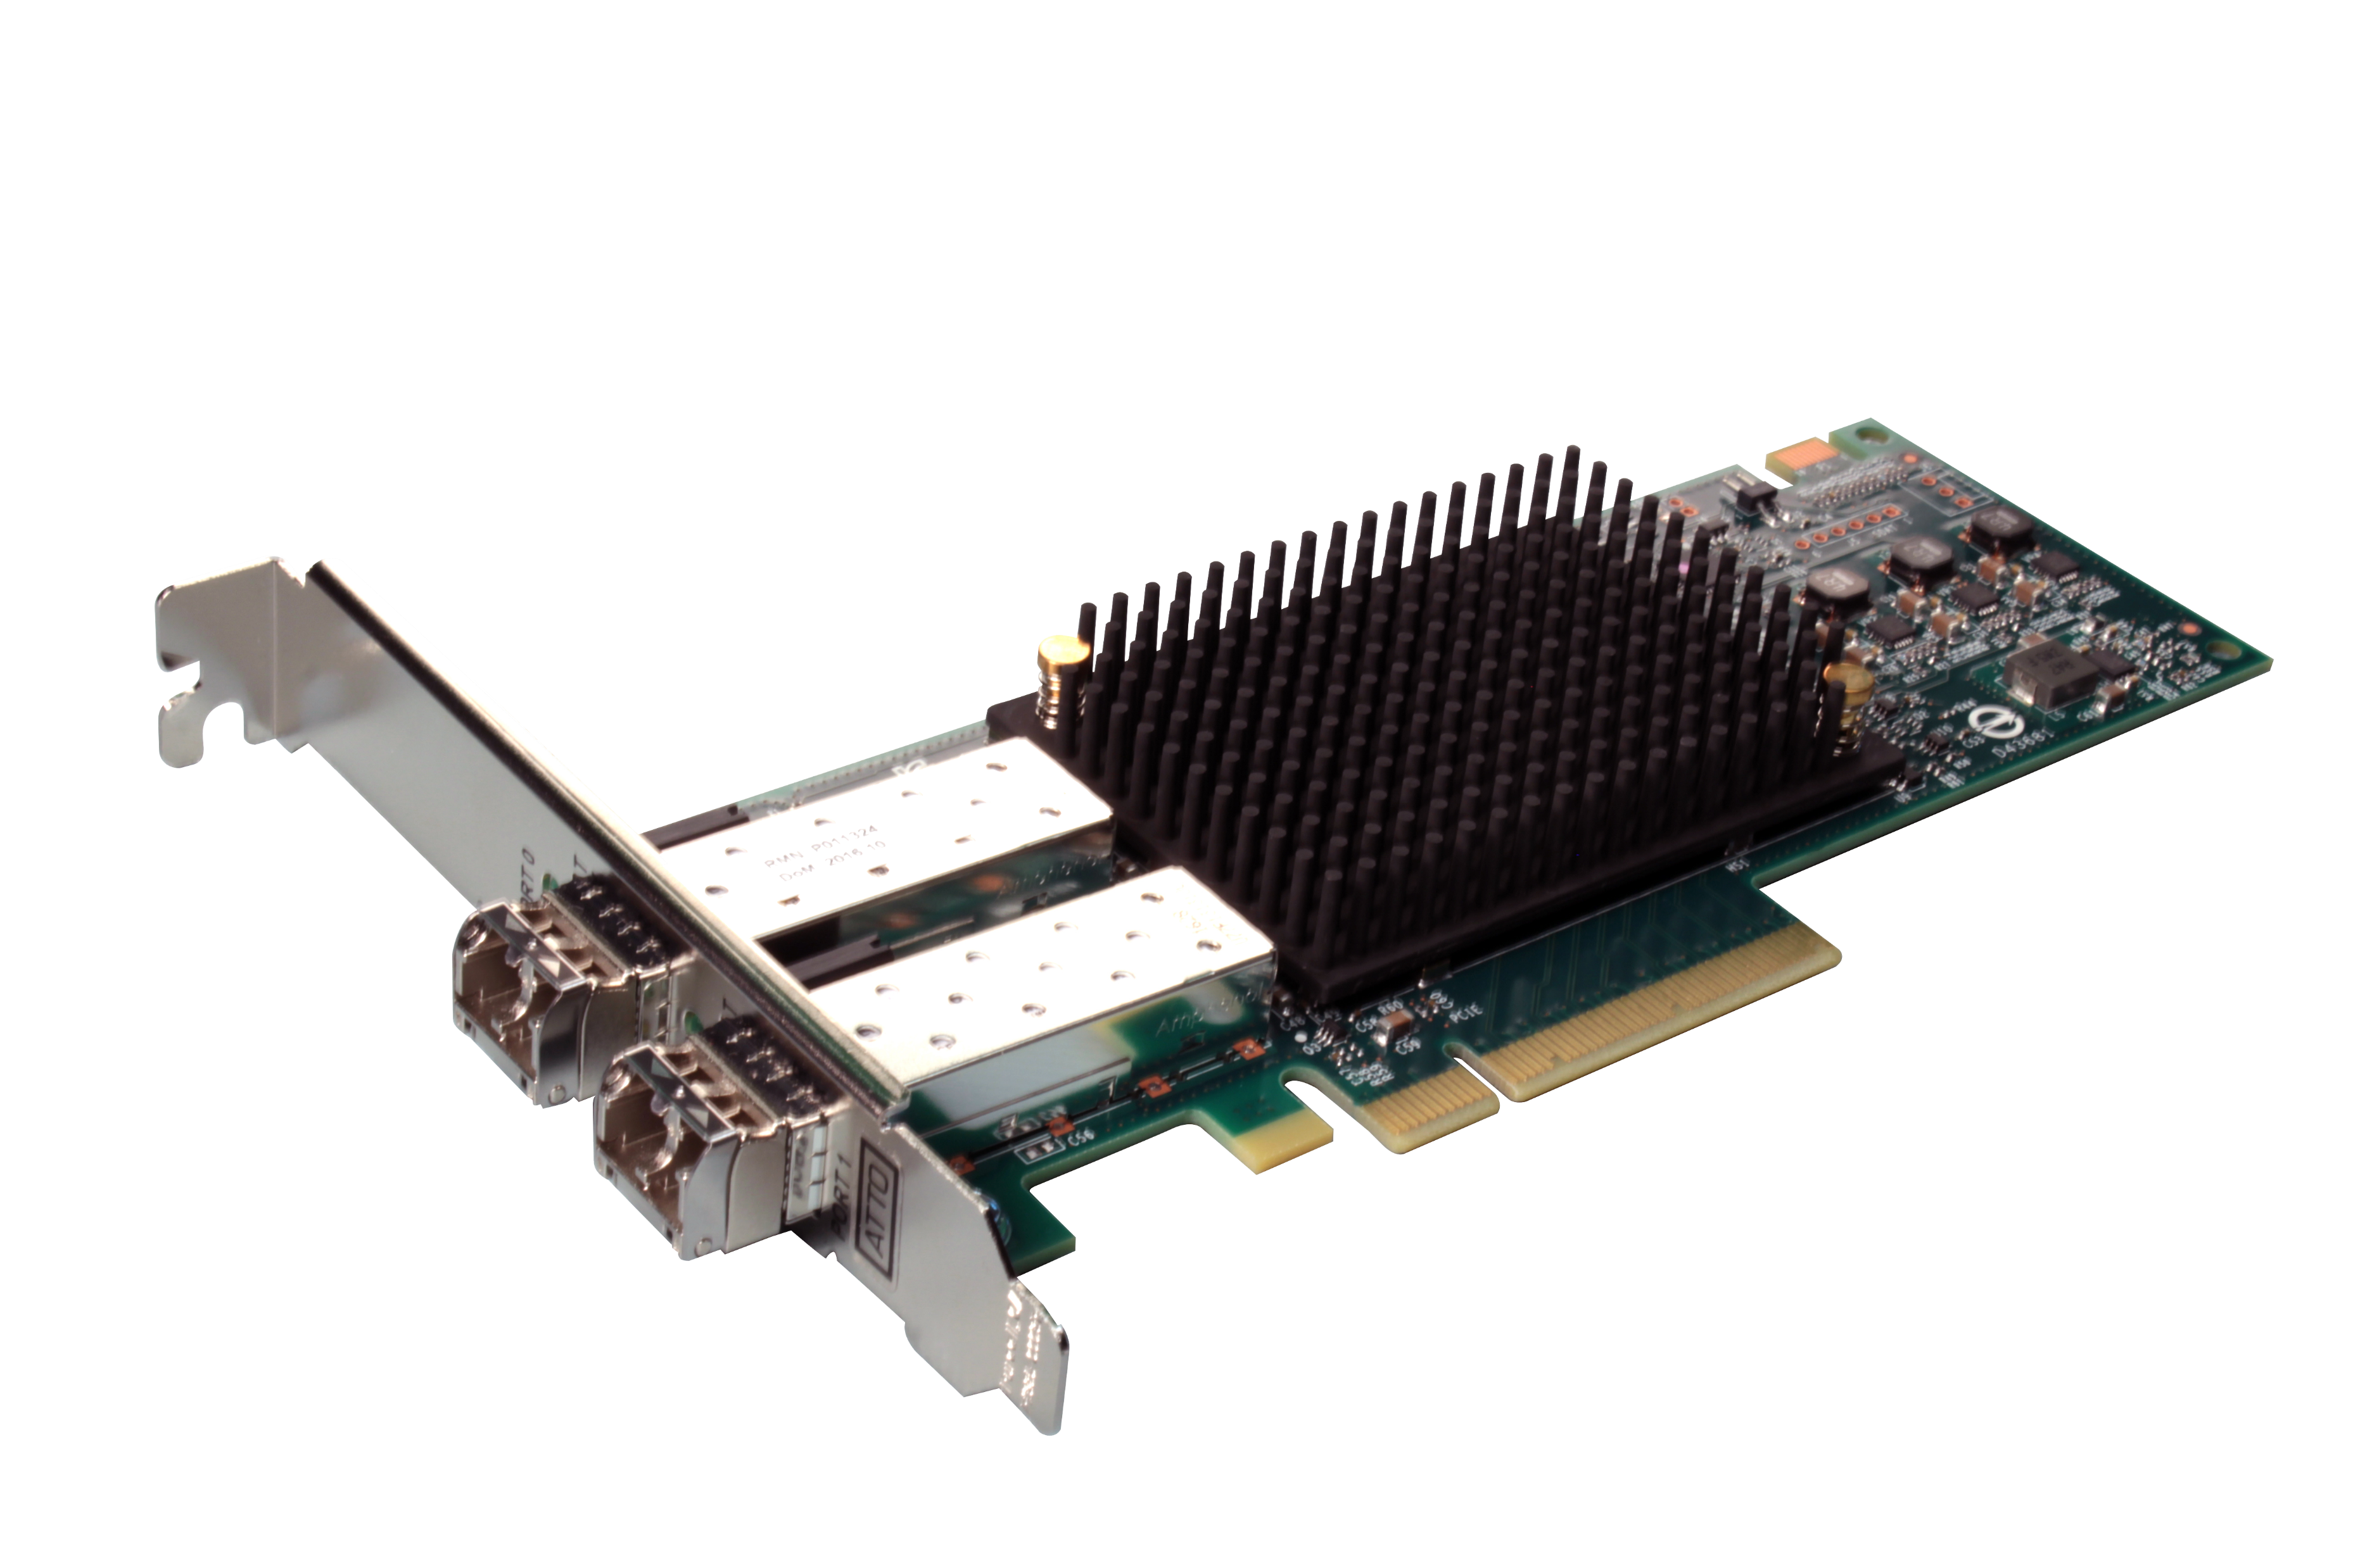
Supported Fibre Channel adapters
Partnering with industry-leading FC adapters vendors for the most economical FC SAN storage solution
Support Marvell
Qlogic 32Gb/16Gb/8Gb/4Gb FC adapters
Support ATTO
Celerity 32Gb/16Gb FC adapters
Compatibility list:qnap.com/compatibility/

Slide 16
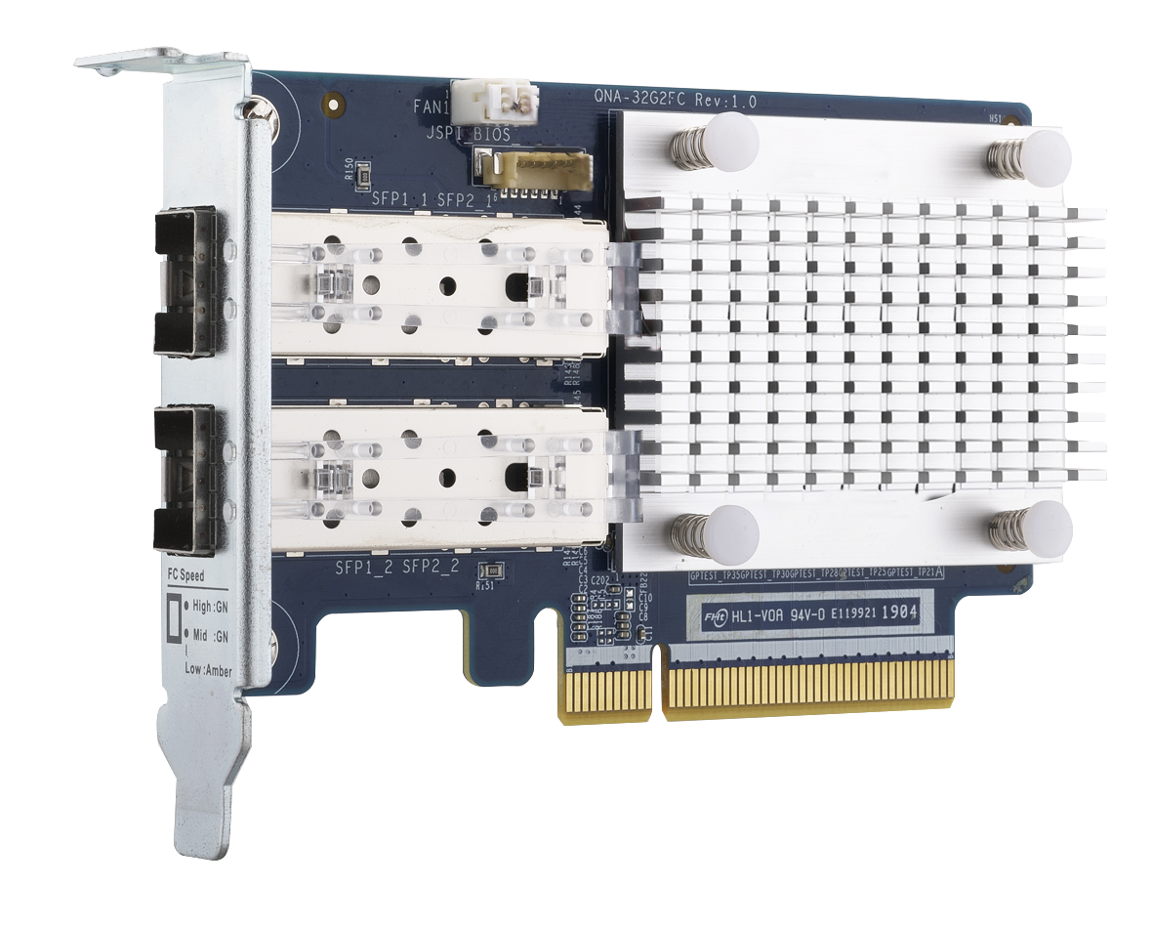
QNAP 32Gb/16Gb Fibre Channel Adapters
QNA-32G2FC
Dual-port 32Gbps
FC adapter
High-speed yet economical QNAP FC storage adapters for QNAP NAS*
*Not supporting Windows/Linux hosts
QNA-16G2FC
Dual-port 16Gbps
FC adapter
Optional FC Transceiver
TRX-32GFCSFP-SR
32Gb/16Gb/8Gb
TRX-16GFCSFP-SR
16Gb/8Gb/4Gb

Slide 17
iSCSI & Fibre Channel user scenario
Production
Server(s)
Backup Server
Server
Server can access it via iSCSI
FC
LAN
QNAP NAS
QNAP NAS
SAN Fabric
LUN
LUN
Snapshot Replica for offsite backup
Scheduled Snapshot for local protection (either LUN is access via iSCSI or FC)
Qtier
SSD Cache
Overprovisioning
SAN Storage
LUN
LUN
LUN

Slide 18
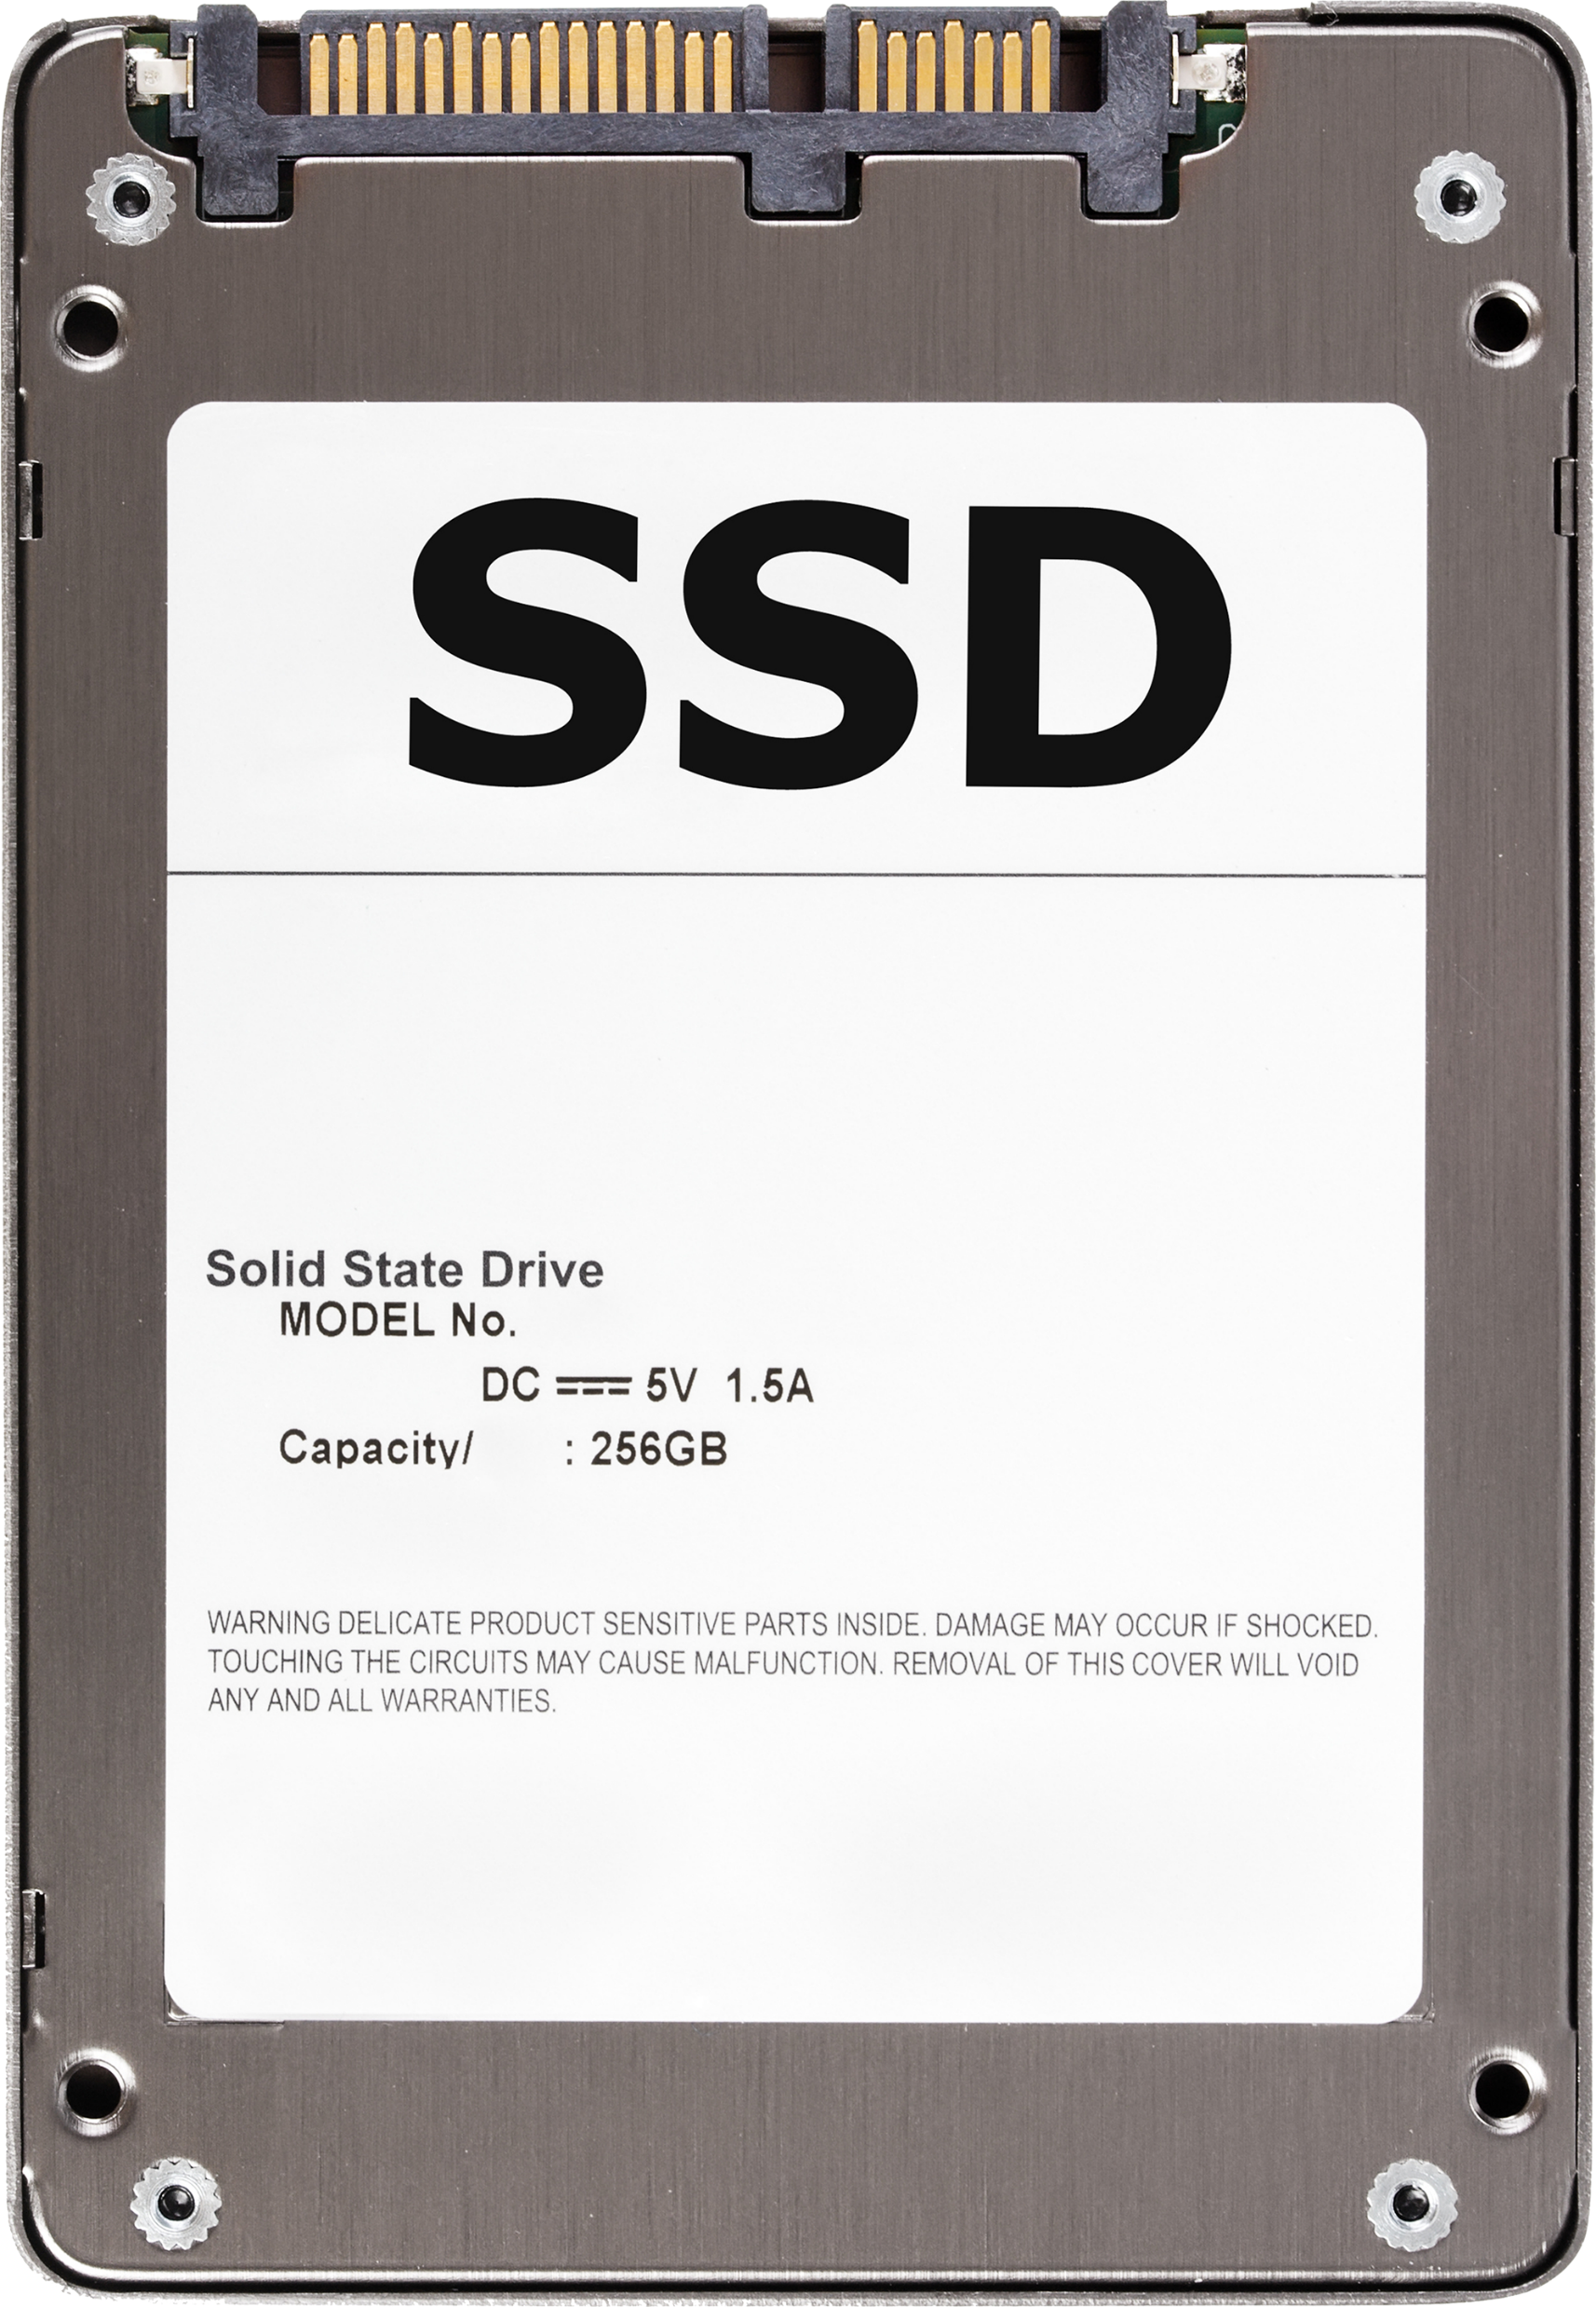
SSD Applications

Slide 19
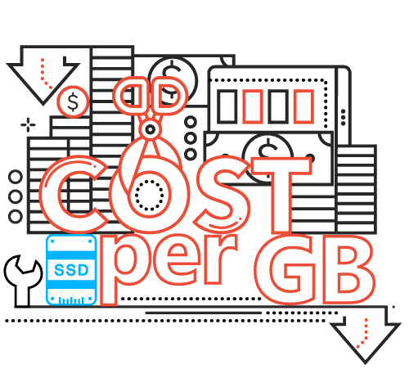
Improve System IOPS with SSD Cache
The economic way to improve system performance
Supports Read-only, Read-Write and Write cache
Support more than a volume /LUN at the same time
No interruption of storage services when replacing SSD

Slide 20
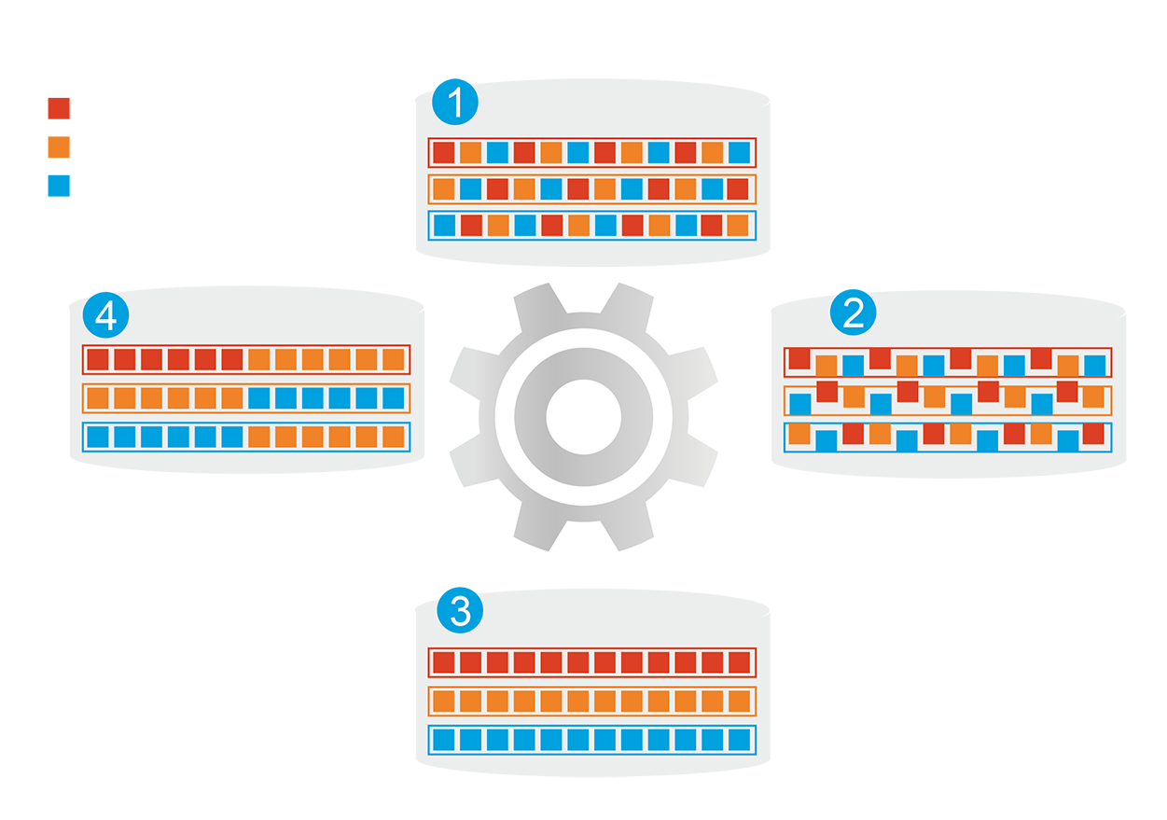
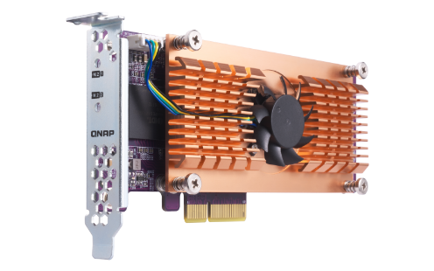
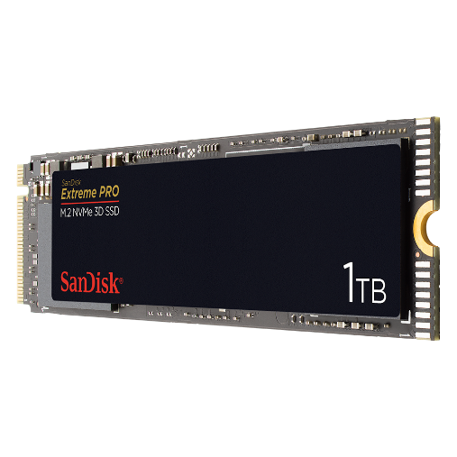
Qtier introduction
1
Before Tiering​
Hot data
QNAP allows the combination of SSD and HDD RAID into the same pool and migrate data automatically based on accessing pattern.
Warm data
Cold data
4
Data Access Pattern Changed​
Qtier Engine
2
Start Tiering​
Support SATA, SAS, M.2, QM2 and U.2 SSD.
Provide higher capacity as SSD can be used to store data
3
After Tiering​
On QTS, not QM2 PCIe NVMe SSD can only work as SSD Cache currently. ​

Slide 21
How to choice SSD cache and Qtier?
The best SSD configuration may only be measurable once it is configured. The SSD Cache and Qtier have different advantages.
Sequential Read/Write (MB/s)
Random Read/Write (IOPS)
SSD Cache
1400
80000
Real Time Performacne Boost
1. For accessing with burst IO such as file syncing and video editing.
2. Can be changed to Read or Write only with bypass block size.
1200
70000
1000
60000
50000
800
40000
600
Qtier 2.0
30000
400
Fully use SSD Capacity
1. For boosting IO with fixed pattern such as mail server.
2. With IO Aware Qtier can also support database operations.
20000
200
10000
0
0
SSD Cache
Qtier
write
SSD Cache
Qtier
read
Notes:
Qtier

Slide 22
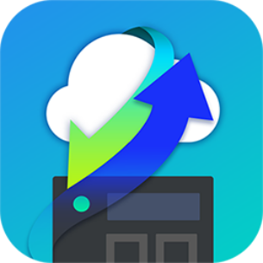
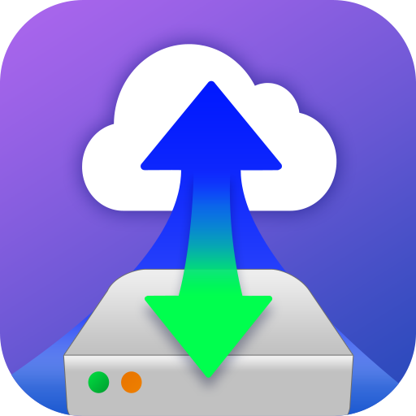
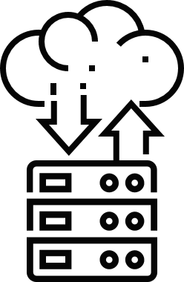
QNAP Cloud Gateway
File-based Cloud Gateway
HybridMount
Block-based Cloud Gateway
VJBOD Cloud
區塊型雲網關
VJBOD Cloud
Multi-point file sharing and syncing
Local data cloud backup
1
Protocol conversion
Low-latency access
Multi-cloud managemen
Storage space transformation
Snapshot Protection
Local service uninterrupted

Slide 23
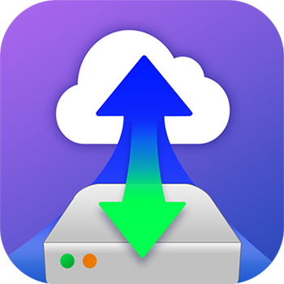
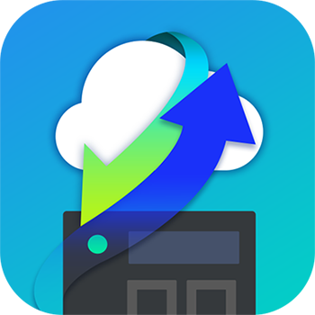
QTS cloud storage gateway and mount
VJBOD Cloud
Block-based Cloud Gateway
Cloud Storage​
Customer​
File System​
Object Storage
Object Storage
Object Storage
Block Access​
iSCSI Target
LUNs
Dedicate​
Stored space​
Object Storage Connector
Ethernet
Snapshot
本地伺服器
Local​
Applications​
VJBOD Cloud​
Volume​
(EXT4 File System)​
Dedicate​
Stored space​
Object Storage Connector
File Services​
File Access​
Snapshot
SMB
HybridMount (Mode 1)
File based Cloud Gateway​
NFS
Cloud File​
Storage​
Cloud File​
Storage​
Cloud File​
Storage​
Dedicate​
Cache space​
File Access​
AFP
Virtual​
File System​
Object Storage Connector
本地使用者
File Access​
Local Users​
Dedicate​
Cache space​
FTP
Cache Engine
Cloud File Connector
Web
DAV
Local Disks/SSDs
Remote Storage
Qsync
HybridMount (Mode 2)
File Station Mount
Cloud​
File​
Connector​
WebDAV
File
Station
File Station Access​
SMB
NAS
File Access​
File Access​
Remote​
File​
Connector​
Qfile
FTP
Data center

Slide 24
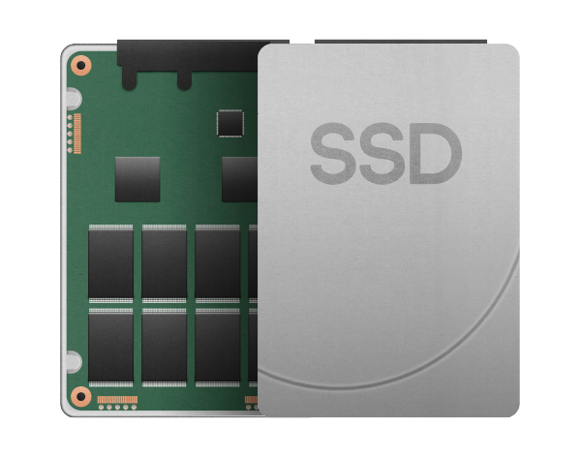
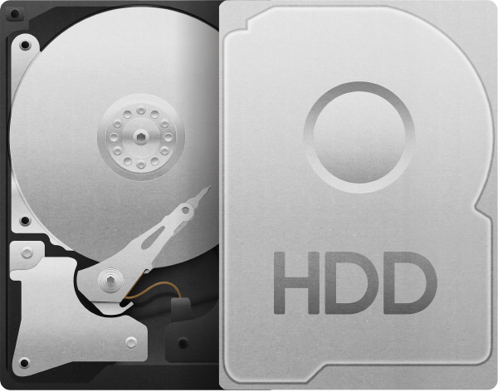
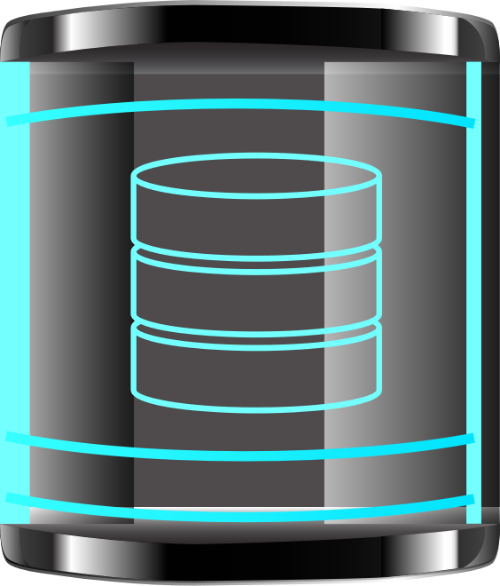
Cloud Gateway and NAS in a Box
Cloud File Storage
Cloud Object Storage
SSD volume for cloud gateway
HDD volume for local service
SMB、AFP、NFS、FTP、WebDAV
2U

Slide 25
TS-1886XU-RP is your best choice!
Copyright© 2019 QNAP Systems, Inc. All rights reserved. QNAP® and other names of QNAP Products are proprietary marks or registered trademarks of QNAP Systems, Inc. Other products and company names mentioned herein are trademarks of their respective holders.​
​

