Slide 2
QXP FC adapter. Made for NAS
Why use fibre channel?
Use QNAP NAS plus FC to easily expand block-level SAN storage
QNAP QXP-32G2FC & QXP-16G2FC fibre channel adapter
Backup FC SAN data with Copy Data Management (CDM)

Slide 3
Why Should Companies Build Fibre Channel Storage Area Network?
Good Connectivity
Good Expandability
In a Fibre Channel Storage Area Network (SAN) architecture, any server can be directly connected to any storage device, and any storage device can be directly connected to each other.
Enterprises can do extended action without increasing the load on the server and the local area network.
Good Data Sharing Ability
Fast and Stable Performance
Since the storage device is no longer connected to a specific server, resources can be shared by many servers and the main network performance is not affected when a large number of files are transmitted.
Continue to use the same video editing software as a local drive with high and stable performance.

Slide 4
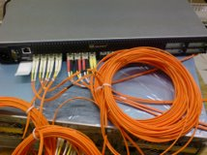
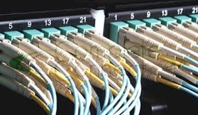
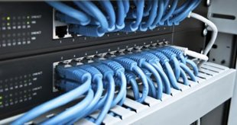
iSCSI vs. Fibre Channel Architecture
Fibre Channel does not need to pass through Ethernet, and the physical layer in the system is less than iSCSI. When expanding the block-level storage network, Fibre Channel can be used to avoid network load.
Operating System/Application
SCSI Layer
SCSI Layer
FCP
(FC cable)
TCP
iSCSI needs to expand the block-level storage network via Ethernet. (fibre or ethernet cable)
IP
Ethernet
FC
iSCSI
Fibre Channel

Slide 5
Fibre Channel Reduces CPU Load
Test environment: TS-1283XU-RP
Speed/CPU |  | iSCSI |  | FC
 |  | 25GbEx1 | CPU% | 32G | CPU%
Throughput (MB/s) | SW-1M | 2709 | 56% | 2944 | 39%
 | SR-1M | 2755 | 32% | 2772 | 30%
 | SW-512K | 2707 | 61% | 2951 | 37%
 | SR-512K | 2825 | 43% | 2872 | 35%
IOPS | RW-4K | 154793 | 81% | 155197 | 77%
 | RR-4K | 108263 | 69% | 113162 | 67%
F/W: 4.4.1
CPU: Intel(R) Xeon(R) E-2124 CPU @ 3.30GHz
Tested SSD: Samsung SSD 850 PRO 512GB SATA*12, RAID 0
RAM: 8 GB (4GB x 2)
Block-based LUN; AIO enable
FC 32G: QLogic Fibre Channel Adapter-QLE2742-SR-CK
25GbE: QXG-25G2SF-CX4, MTU 9000
IOmeter Global Configuration: Maximum Disk Size: RAM*4/ Ramp Up Time: 30 seconds Seq / Run Time: 3 Minutes / 2-workers/ 64-outstanding Random / Run Time: 3 Minutes / 4-workers/ 32-outstanding
PC Environment
CPU: Intel(R) Xeon(R) CPU E5-2630 v3 @ 2.40GHz
OS: Windows Server 2016 Database Evaluation.
Version: 10.0.14393 Build 14393
Memory: 128 GB.
FC 32G: QLogic Fibre Channel Adapter-QLE2742-SR-CK
25GbE: QXG-25G2SF-CX4, MTU 9000
Note: the test environment is RAID 0.

Slide 6
Fibre Channel Performance is Good
Speed/CPU |  | FC
 |  | 2 x 32GFC | CPU%
Throughput (MB/s) | SW-1M | 3133 | 30%
 | SR-1M | 4797 | 25%
 | SW-512K | 3154 | 29%
 | SR-512K | 2772 | 28%
IOPS | RW-4K | 92632 | 40%
 | RR-4K | 195360 | 36%
Test environment: TS-2483XU-RP
F/W: 4.4.1.0955 build 20190603
CPU: Intel(R) Xeon(R) E-2136 CPU @ 3.30GHz
SSD: Samsung SSD 850 PRO 512GB SATA*24,RAID 5
RAM: 16GB, 8GB*2
Thick volume; Block-based LUN; AIO enable; MPIO
FC32G: QLogic Fibre Channel Adapter
PC Environment
CPU1: Intel(R) Xeon(R) CPU E5-2630 v3 @ 2.40GHz, 2401 Mhz, 8 Core(s), 16 Logical Processor(s)
OS: Windows Server 2016 Datacenter Evaluation Build 14393
Memory: 128 GB.
FC32G: QLogic Fibre Channel Adapter
Note: the test environment is RAID 5.
IOmeter Global Configuration: Maximum Disk Size: RAM*4/ Ramp Up Time: 30 seconds Seq / Run Time: 3 Minutes / 2-workers/ 64-outstanding Random / Run Time: 3 Minutes / 4-workers/ 32-outstanding

Slide 7
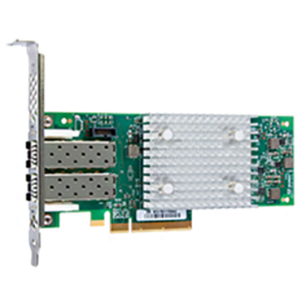
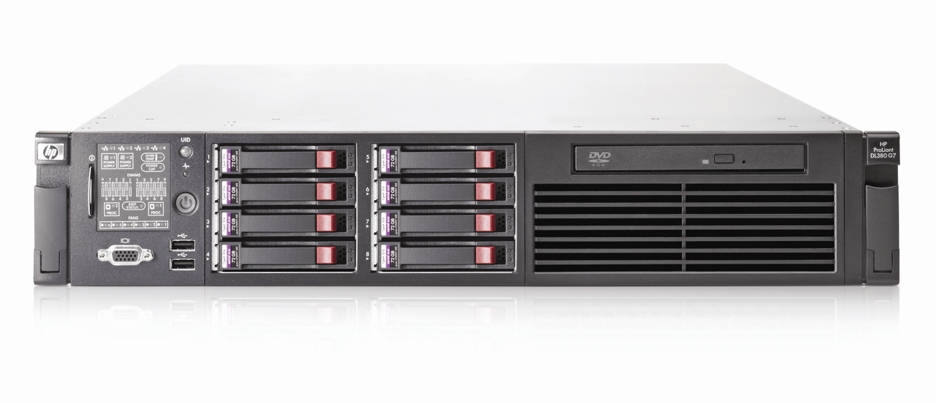
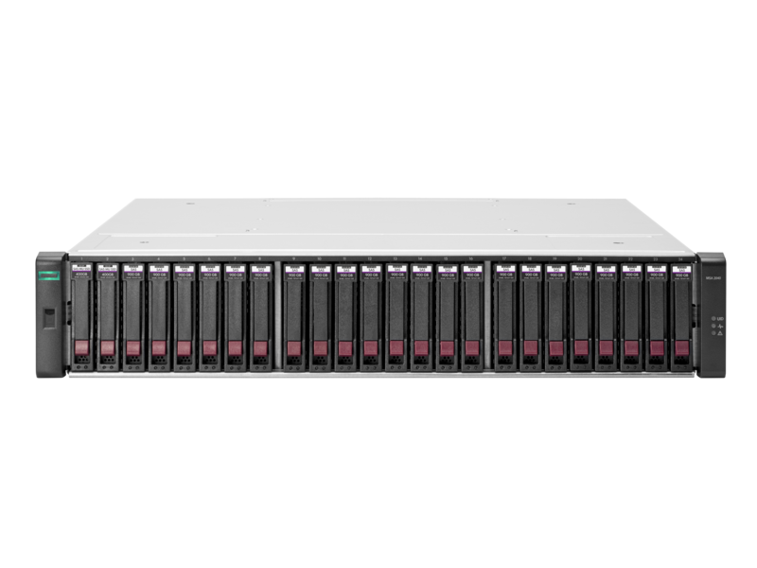
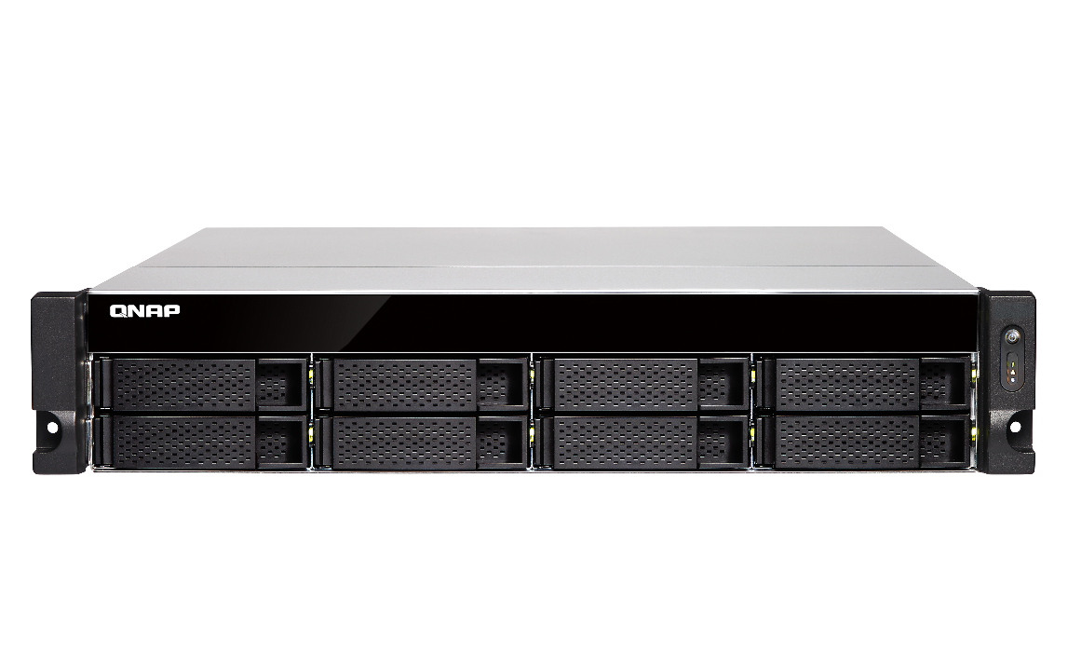
Lowering the Cost to Add a NAS to a FC SAN
Windows / Linux / VMware host server (imitator mode) + NAS (target mode):
Marvell® QLogic® 2670
(16Gb) Fibre Channel adapter
Windows / Linux / VMware server
HP DL360 G7 server
ATTO Celerity 16Gb
Fibre Channel adapter
Storage Area Network
(SAN)
Fibre Channel switch
Fibre channel
Other Fibre SAN storage
QNAP QXP-16G2FC fibre channel adapter
TVS-872XU
TVS-872XU
QNAP QXP-16G2FC fibre channel adapter

Slide 8
QXP-32G2FC 2-Port 32Gbps FC Adapter
Ordering info.
QXP-32G2FC
Includes the necessary brackets for all NAS models.
2 x 32Gbps FC ports
Gen 6 fibre channel host bus adapter, supporting 32Gbps/16Gbps/8Gbps speed.
Low profile 10.68 x 6.89 cm (4.20 x 2.71 inches) .
Bundled with 2 x 32Gbps SFP+ short wavelength short distance multi-mode fibre channel transceivers.
Not supported on non-QNAP NAS QTS and QTS Hero operating systems such as Windows and Linux.
FC LC cables are not included.

Slide 9
QXP-16G2FC 2-Port 16Gbps FC Adapter
Ordering info.
QXP-16G2FC
Includes the necessary brackets for all NAS models.
2 x 16Gbps FC ports
Enhanced Gen 5 fibre channel host bus adapter, supporting 16Gbps/8Gbps/4Gbps speed.
Low profile 10.68 x 6.89 cm (4.20 x 2.71 inches).
Bundled with 2 x 16Gbps SFP+ short wavelength short distance multi-mode fibre channel transceivers.
Not supported on non-QNAP NAS QTS and QTS Hero operating systems such as Windows and Linux.
FC LC cables are not included.

Slide 10
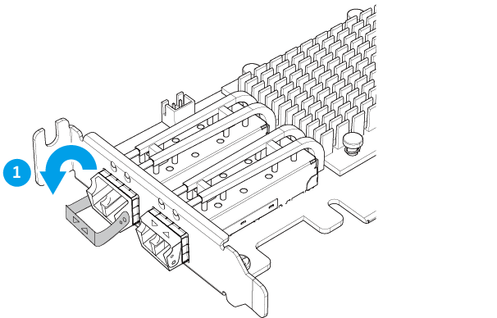
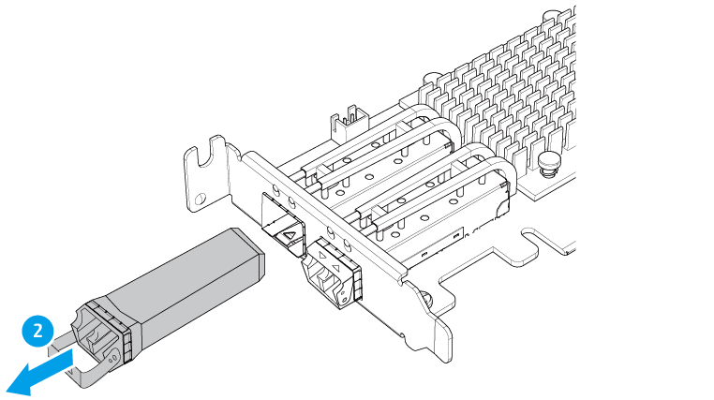
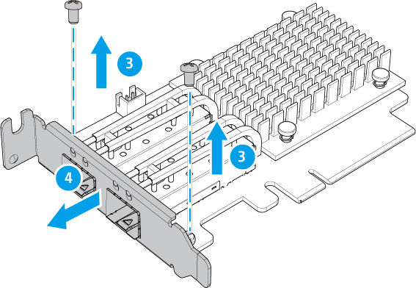
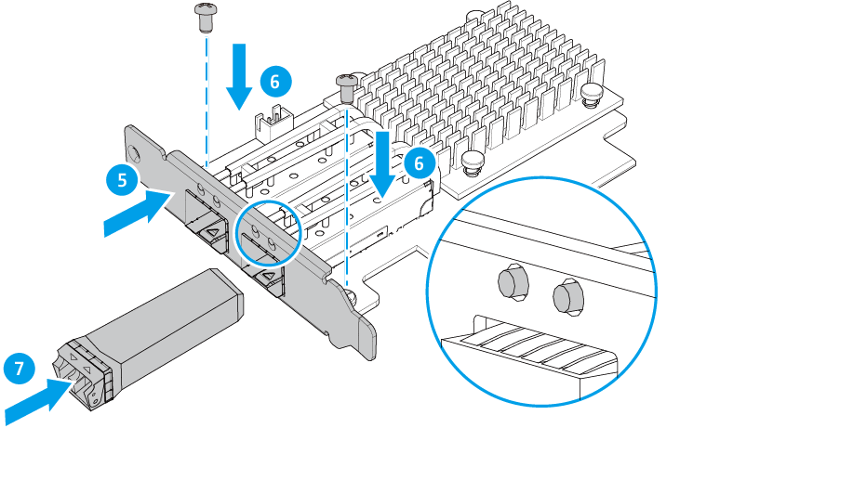
How to Replace the Bracket For a Different NAS or Server Model

Slide 11
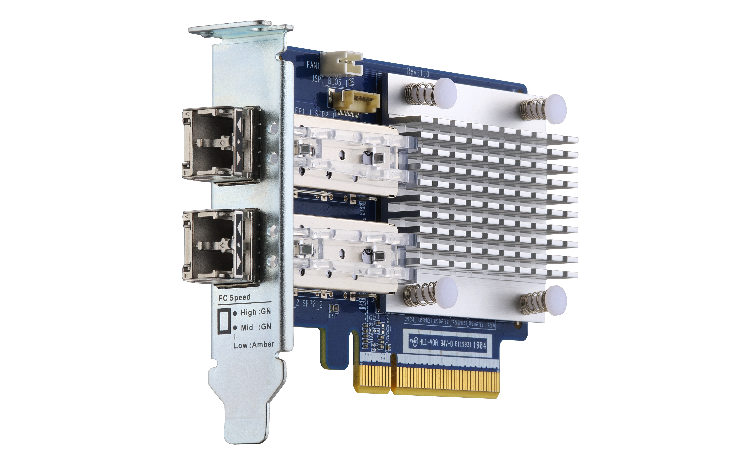
LED Indicator For Various Status Display
 | LED 1 (Green) | LED 2 (Green / Amber)
Speed: High | On/Flashing* | Off
Speed: Mid | Off | Green /Flashing*
Speed: Low | Off | Amber/Flashing*
FW not initialized | On | On (Both)
FW initialized | Flashing | Flashing (Both)
*Note: LED flashing occurs during I/O activity.
LED 1
LED 2
LED 1
LED 2

Slide 12
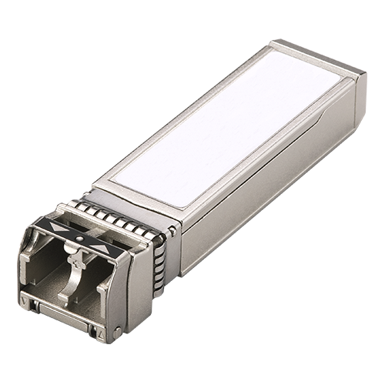
32Gbps and 16Gbps FC Transceiver Accessories
You can buy additional FC transceivers if the included ones are broken or missing.
32Gb fibre channel SFP+ transceiver
16Gb fibre channel SFP+ transceiver
Ordering info.
TRX-32GFCSFP-SR
Ordering info.
TRX-16GFCSFP-SR
Tri-speed: 28.05Gbps/14.025Gpbs/8.5Gbps
Support multimode LC FC cables with 32Gbps up to 100 meters (328.08 ft.)
Tri-speed: 14.025Gbps/8.5Gpbs/4.25Gbps
Support multimode LC FC cables with 16Gbps up to 125 meters (410.10 ft.)

Slide 13
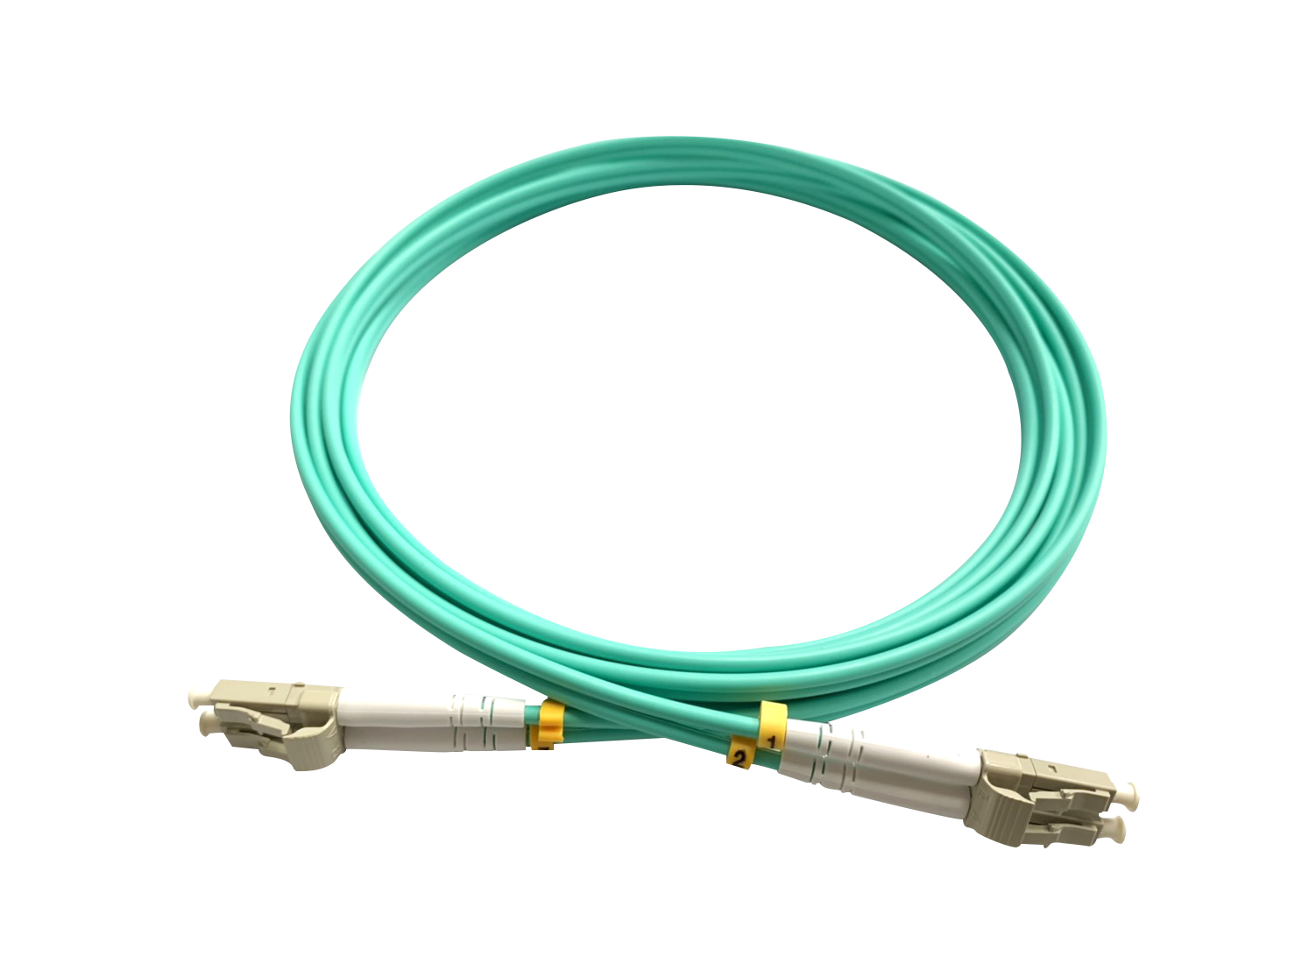
How to Choose the Right FC Cable
Speed | Multimode optic cable and distance (m)
 | OM1 | OM2 | OM3 | OM4
4GFC | 70 | 150 | 380 | 400
8GFC | 21 | 50 | 150 | 190
16GFC | --- | 35 | 100 | 125
32GFC | --- | 20 | 70 | 100
LC (Little Connector) cable

Slide 14
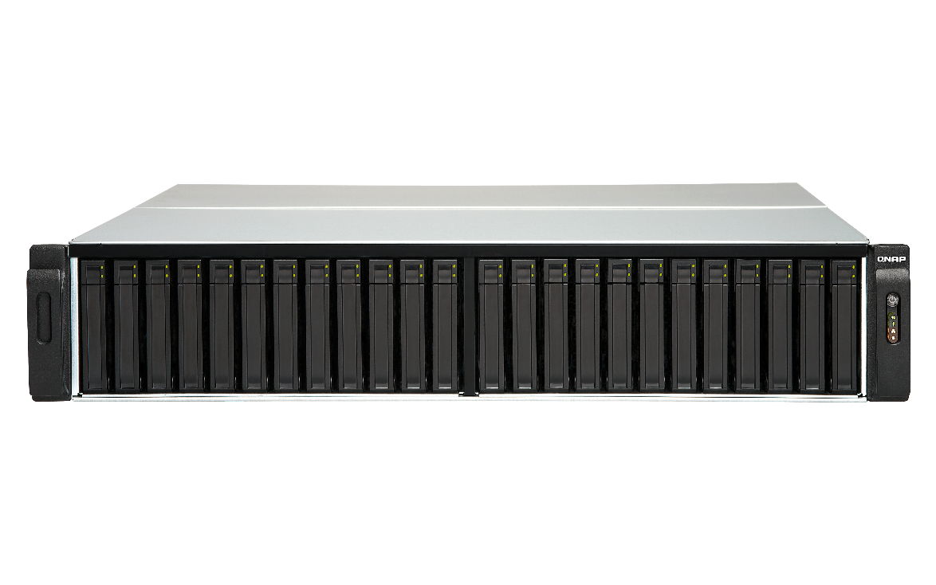
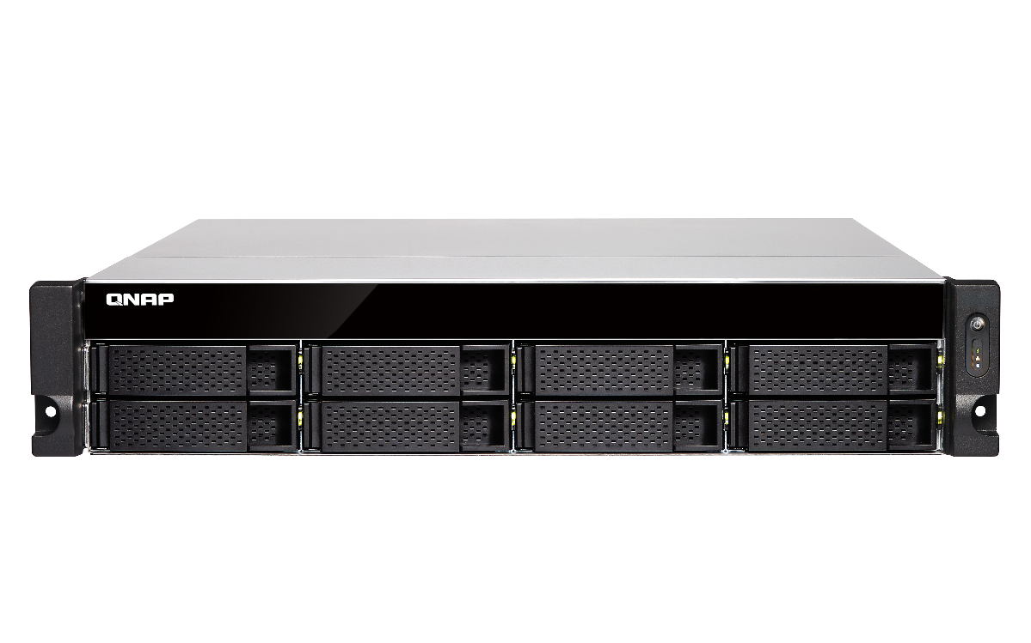
QXP FC Adapter Supported Rackmount NAS
With Intel processors
TES-3085U (QTS), TES-1885U (QTS), TDS-16489U
TS-2483XU, TS-1683XU-RP, TS-1283XU-RP, TS-983XU-RP, TS-983XU, TS-883XU-RP, TS-883XU
TVS-EC2480U/1680U/1580MU/1280U, TS-EC880U
TVS-2472XU-RP, TVS-1672XU-RP, TVS-1272XU-RP, TVS-972XU-RP, TVS-972XU, TVS-872XU-RP, TVS-872XU
With AMD processors
TS-2477XU-RP, TS-1677XU-RP, TS-1277XU-RP, TS-977XU-RP, TS-977XU, TS-877XU-RP, TS-877XU

Slide 15
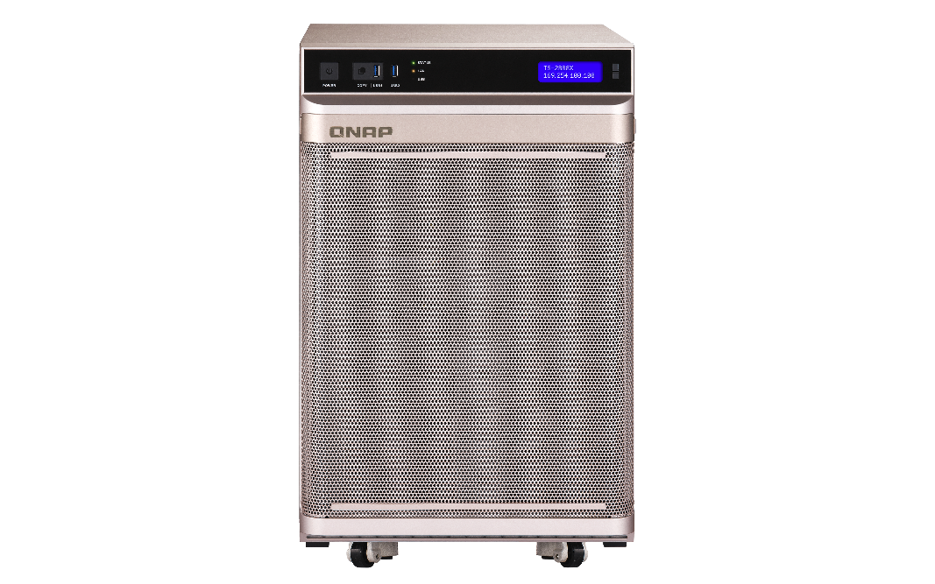
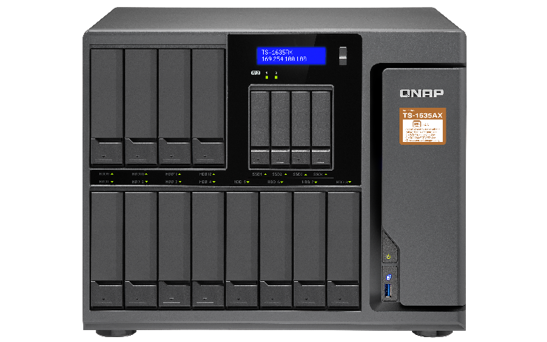
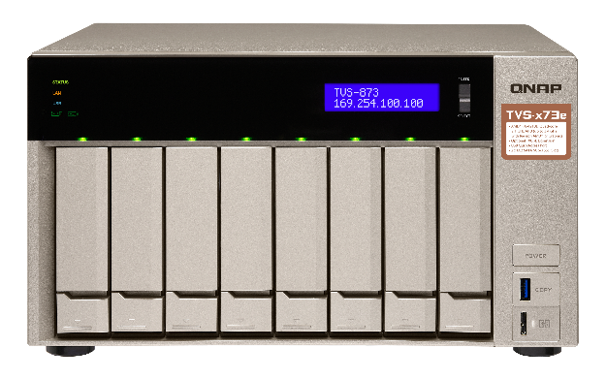
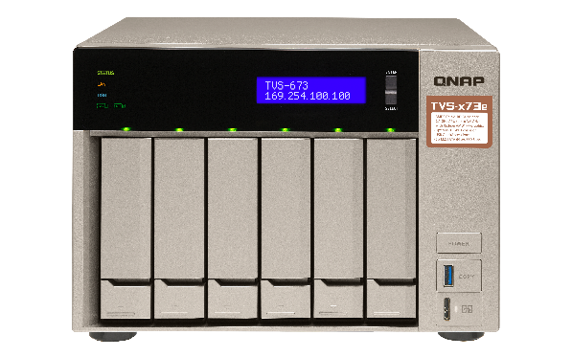
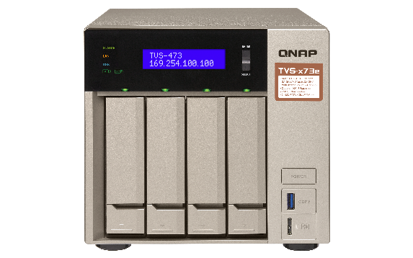
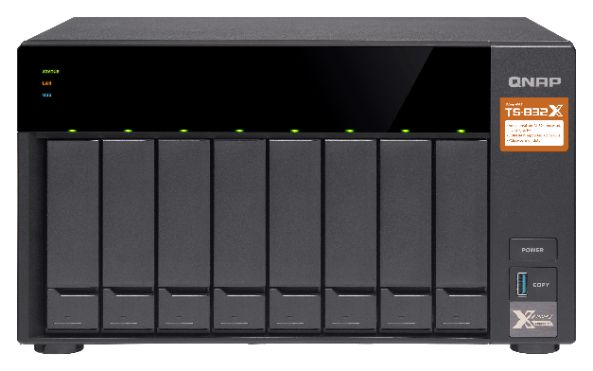
QXP FC Adapter Supported Desktop NAS
With Intel processors
TS-2888X
TS-1685
TVS-1282, TVS-882, TVS-682
TVS-872XT, TVS-672XT, TVS-472XT
TVS-872N, TVS-672N
With AMD processors
TS-1677X, TS-1277, TS-877, TS-677
TVS-863, TVS-663, TVS-463

Slide 16
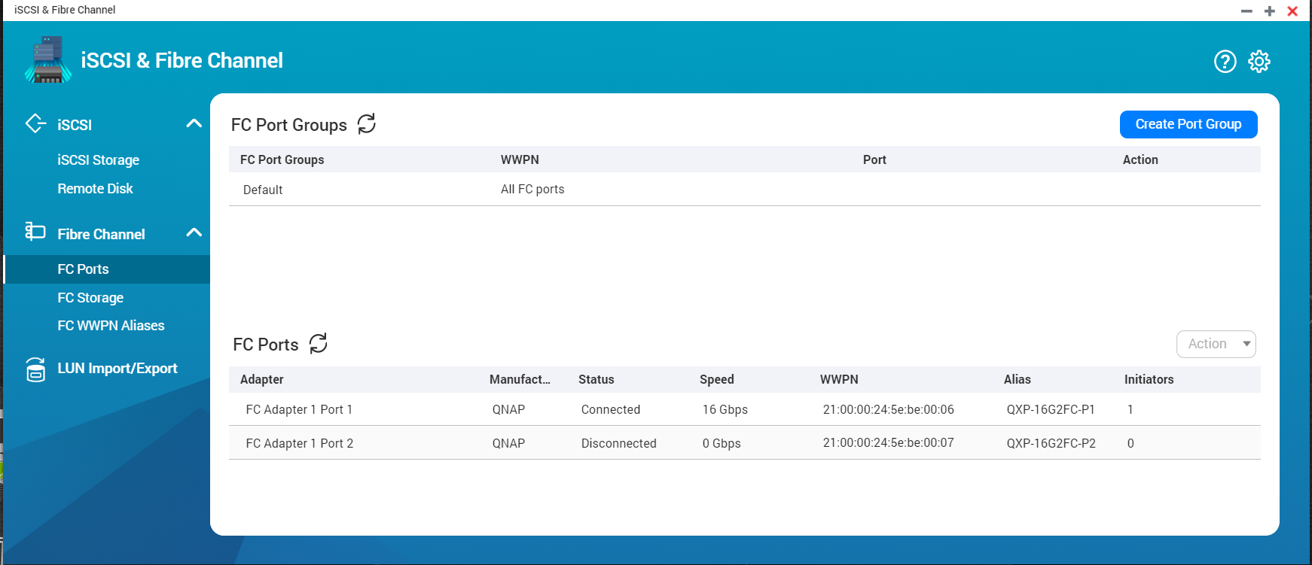
iSCSI and Fibre Channel on QTS
Install the QNAP Fibre Channel adapter on a compatible QNAP NAS and use QTS iSCSI & Fibre Channel app to setup fibre channel target and add NAS to the FC SAN. Furthermore, LUN Masking and Port Binding provide additional layer of security to protect your data.

Slide 17
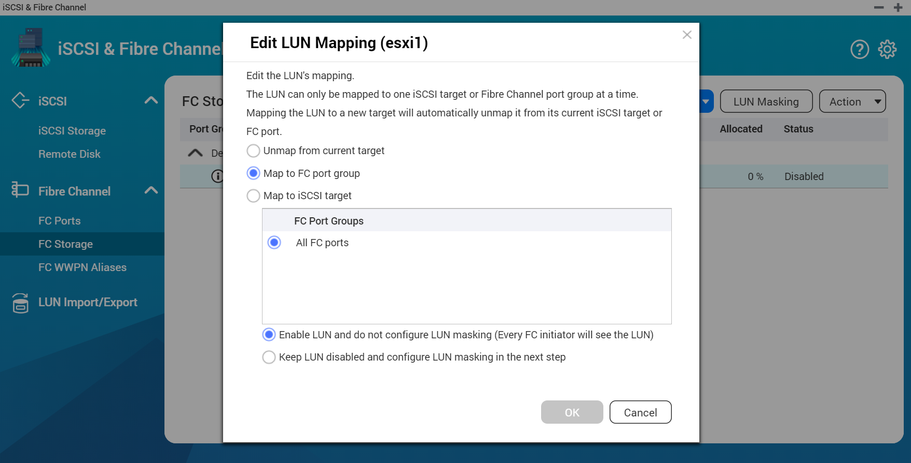
Setup the FC Connection on NAS QTS
Features
Flexible settings
1. LUN Mapping : LUN can be mapped to iSCSI or FC.
2. LUN Masking: Set which server access LUN.
3. FC Port Binding: which server can access which ports.
Easy to identify
Fibre Channel's WWPN can edit aliases.

Slide 18
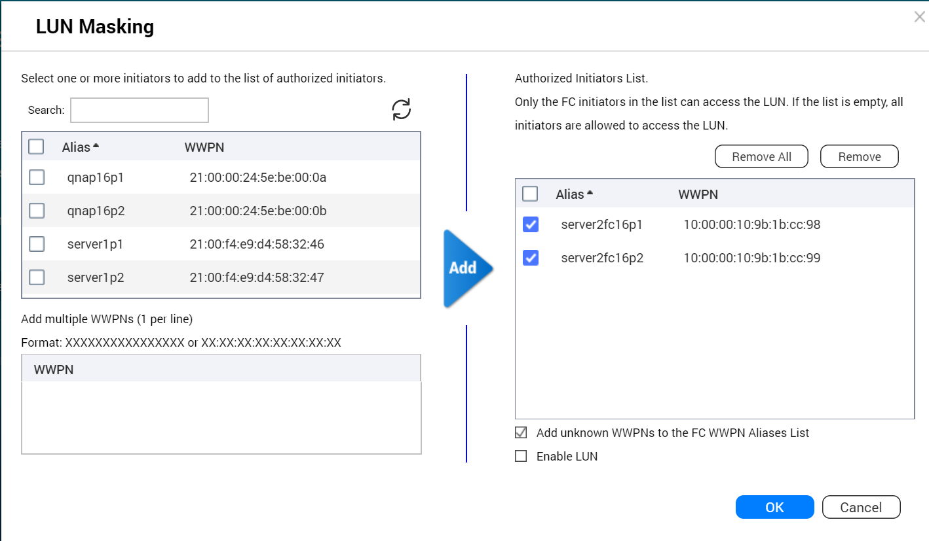
Set LUN Masking
LUN masking:
Specify which server can access which LUN.

Slide 19
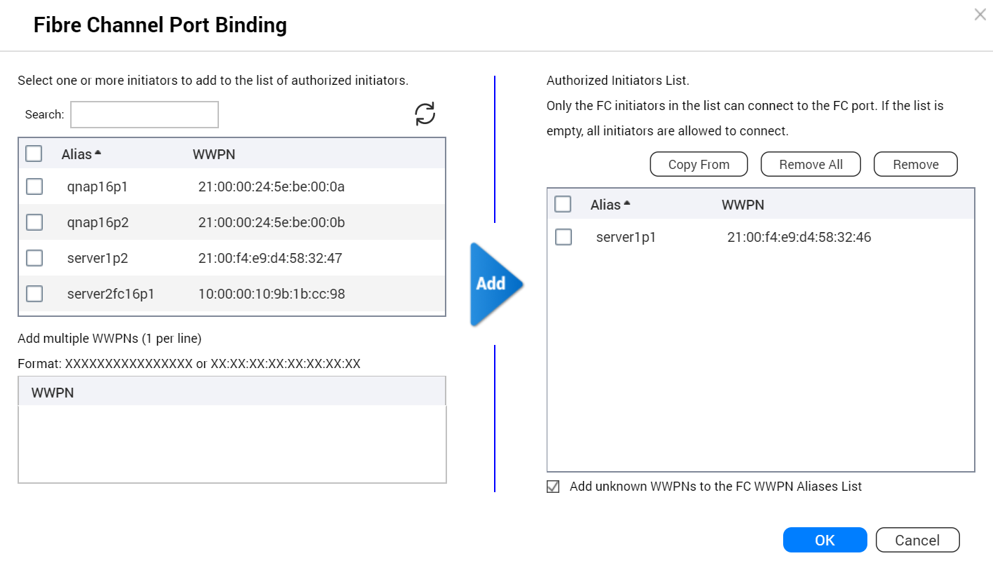
Set FC Port Binding
FC port binding:
Set which server can bind which ports.

Slide 20
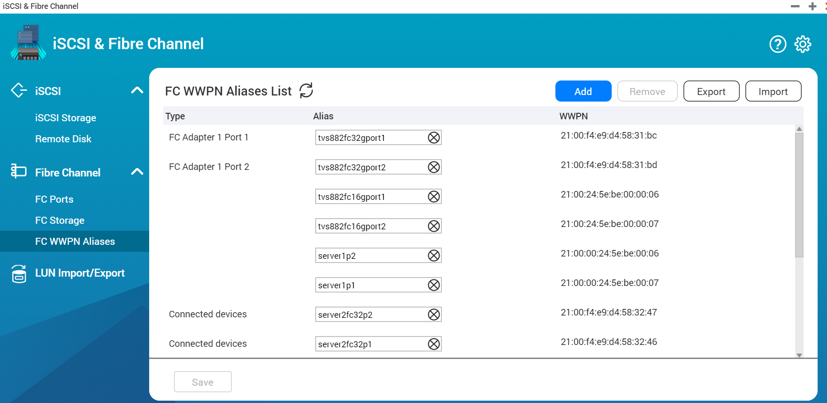
Identify the Server and Fibre Channel Connections Through the Alias List
Edit alias:
Specifies a list of WWPN aliases for Fibre Channel. The user can easily identify the server and Fibre Channel ports in the storage area network.

Slide 21
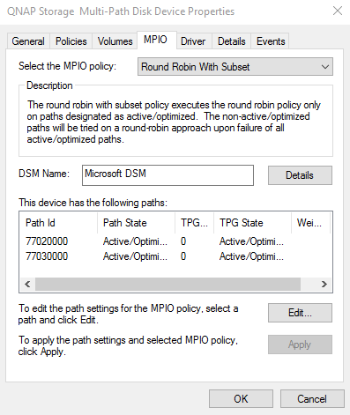
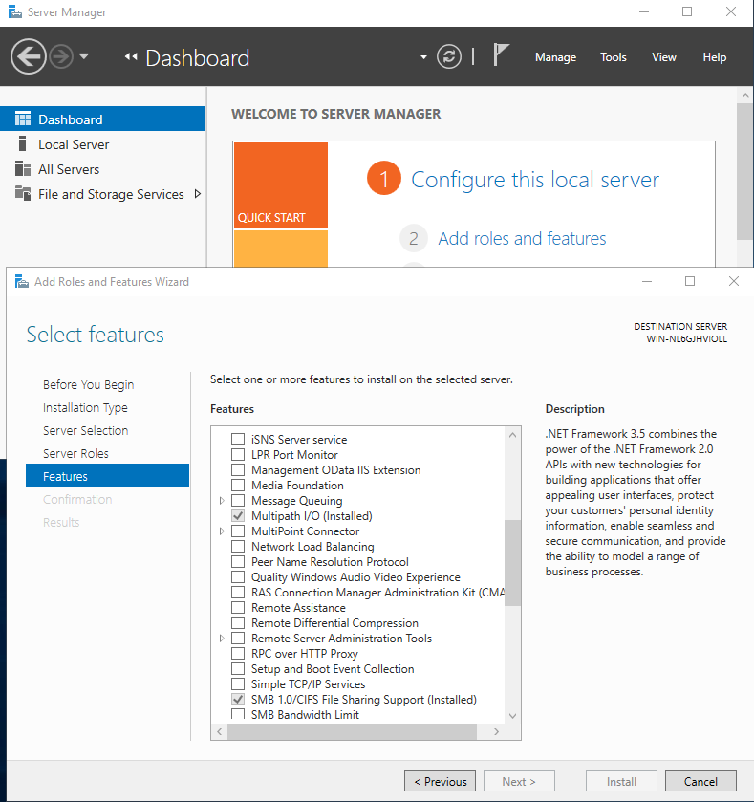
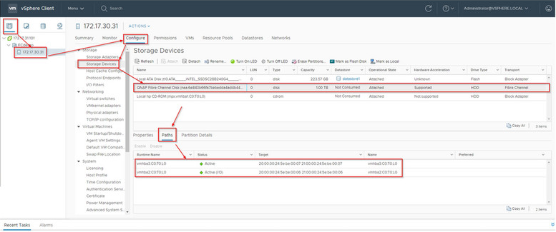
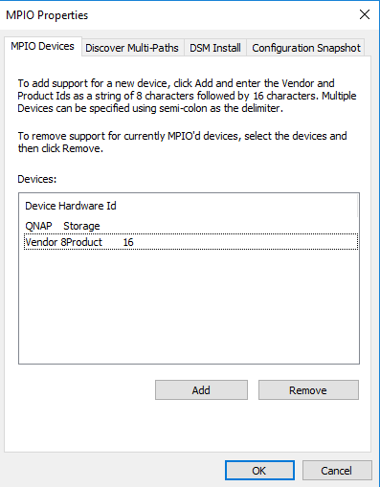
Support server FC multi-path I/O
Windows Server
VMware vSphere

Slide 22
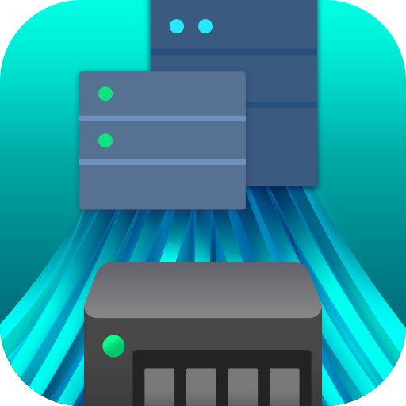

Slide 23
FC Solution for High Performance and Low CPU Utilization
TS-2483XU-RP speed / CPU usage |  | Fibre channel RAID 0 performance
 |  | 1 x 32GFC | NAS CPU usage | 2 x 32GFC | NAS CPU usage
Throughput (MB/s) | SW-1M | 3082 | 13% | 3559 | 20%
 | SR-1M | 3125 | 9% | 5253 | 18%
 | SW-512K | 3101 | 12% | 4065 | 18%
 | SR-512K | 3130 | 13% | 5233 | 21%
IOPS | RW-4K | 129528 | 19% | 165295 | 27%
 | RR-4K | 51590 | 10% | 98389 | 20%
Test environment: TS-2483XU-RP
F/W: QTS 4.4.1
CPU: Intel(R) Xeon(R) E-2136 CPU @ 3.30GHz
SSD: 16 x ADATA SU900 + 8 x Intel SSDSC2BB240G4,RAID 0
RAM: 16GB
Thick volume; Block-based LUN; AIO enable; MPIO
FC32G: QNAP QXP-32G2FC
PC Environment
CPU: Intel(R) Xeon(R) CPU E5-2630 v3 @ 2.40GHz, 2401 Mhz, 8 Core(s), 16 Logical Processor(s)
OS: Windows Server 2016 Datacenter Build 14393
Memory: 128 GB.
FC32G: Marvell QLogic QLE2742-SR-CKFibre Channel Adapter
IOmeter Global Configuration: Maximum Disk Size: RAM*4/ Ramp Up Time: 30 seconds Seq / Run Time: 3 Minutes / 2-workers/ 64-outstanding Random / Run Time: 3 Minutes / 4-workers/ 32-outstanding

Slide 24
FC SAN Combines Snapshot Protection, Qtier and SSD Cache for Data Safety and Performance
iSCSI & Fibre Channel manager
Add NAS to your
Fibre channel SAN easily
Snapshot
Snapshot for volume and LUN
Qtier, SSD cache
Enhance performance with SSDs

Slide 25
Snapshot and Snapshot Replica
Snapshot Space Management
Local Snapshot
Snapshot Replica
Using QNAP NAS to easily create, manage and restore your file with snapshot
The “Out of volume” snapshot allows a Conservative but Completed snapshot protection
Backup your snapshot to a remote NAS and enjoy a fast restoration experience with remote restore and 10GbE solution

Slide 26
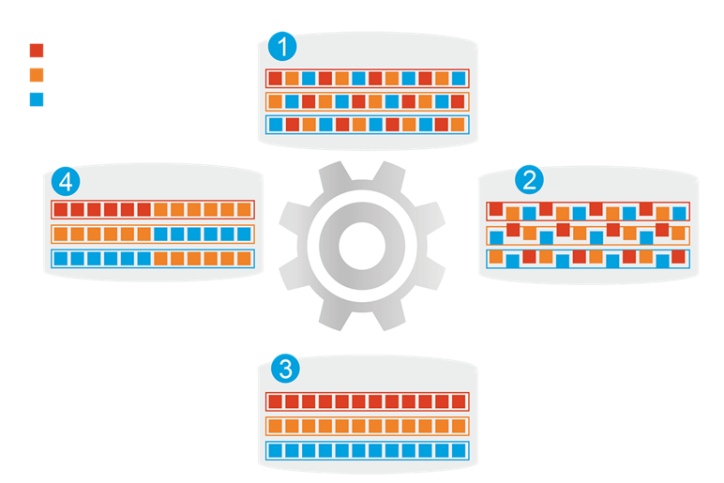
Qtier auto tiering storage
1
Before tiering
QNAP allows the combination of SSD and HDD RAID into the same pool and migrate data automatically based on accessing pattern.
Hot data
Warm data
Cold data
4
Data access pattern changed
2
Start tiering
Support SATA, SAS, M.2, QM2 and U.2 SSD.
Qtier
Engine
Provide higher capacity as SSD can be used to store data.
3
After tiering

Slide 27
Enterprise Fibre Channel Storage Area Network and CDM Application with QNAP NAS
VMware
VMware
Server
Server can access it via iSCSI
FC
Production DB server (s)
Backup Server
LAN
Data
QNAP NAS
QNAP NAS
SAN Fabric
DB
LUN
LUN
Snapshot Replica for offsite backup
Scheduled Snapshot for local protection (either LUN is access via iSCSI or FC)
Qtier
SSD Cache
SAN Storage
DB
LUN
LUN
LUN

Slide 28
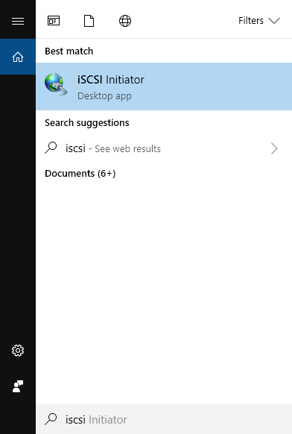
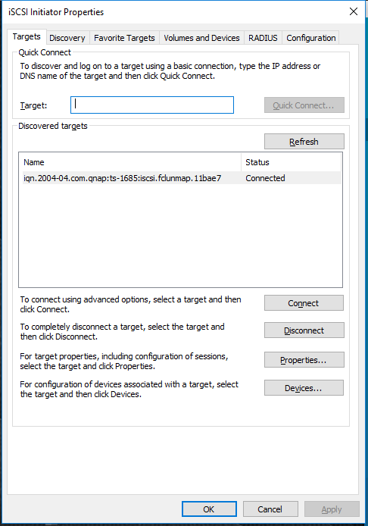
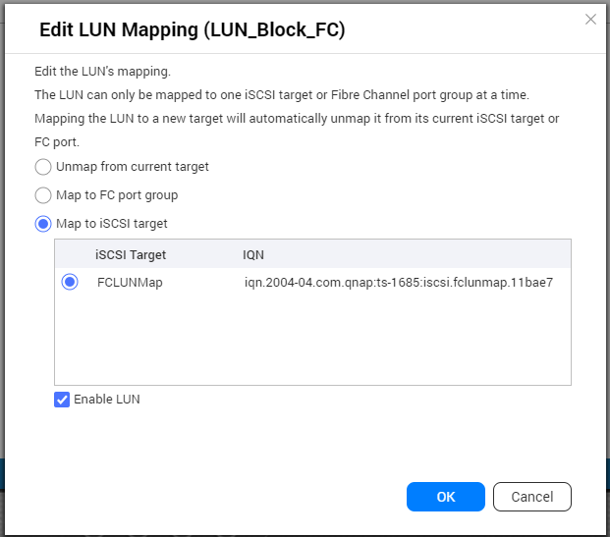
[CDM] Easily Analyze LUN Data Without Any Risk
QNAP FC NAS
Open iSCSI Initiator on Windows
Connect to the
iSCSI Target
(1) Create a snapshot of a FC LUN on the QNAP NAS (e.g. a database)
(2) Clone the snapshot to create the LUN copy to be analyzed
(3) Map this copy to iSCSI or FC while the original LUN remains online !
(4) Perform the necessary operations on this new LUN without any consequences on the original LUN

Slide 29
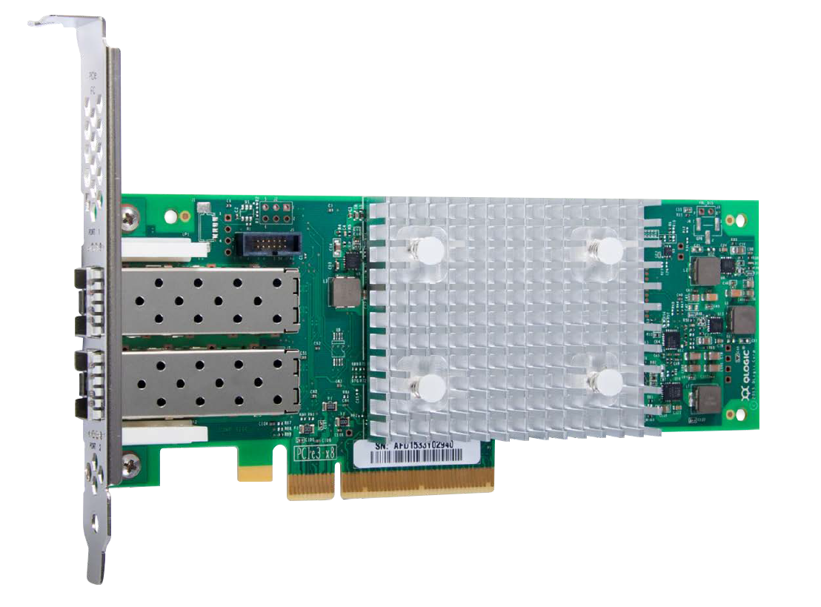
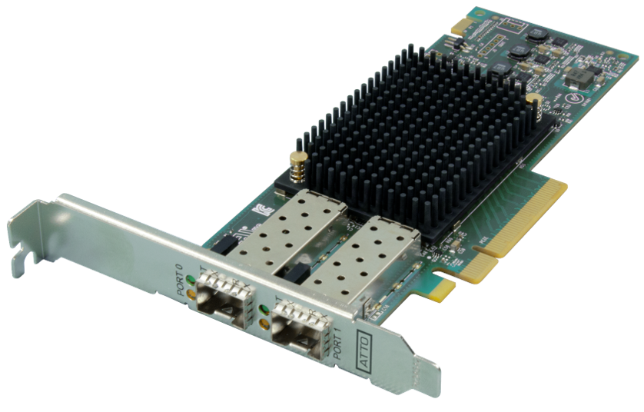
NAS QTS 4.4.1 Also Supports Multiple Marvell & ATTO FC Adapters
Brand | FC adapter | Interface | Speed | Generation | PCIe | Profile
Marvell | QLE2742-SR-CK | 2 X 32GFC | 32G/16G/8G | Gen 6 | 3.0 x8 | Low profile
Marvell | QLE2740-SR-CK | 1 X 32GFC | 32G/16G/8G | Gen 6 | 3.0 x8 | Low profile
Marvell | QLE2692-SR-CK | 2 X 16GFC | 16G/8G/4G | Enhanced Gen 5 | 3.0 x8 | Low profile
Marvell | QLE2690-SR-CK | 1 X 16GFC | 16G/8G/4G | Enhanced Gen 5 | 3.0 x8 | Low profile
Marvell | QLE2672-CK | 2 X 16GFC | 16G/8G/4G | Gen 5 | 3.0 x8 | Low profile
Marvell | QLE2670-CK | 1 X 16GFC | 16G/8G/4G | Gen 5 | 3.0 x8 | Low profile
Marvell | QLE2562-CK | 2 X 8GFC | 8G/4G/2G | N/A | 2.0 x8 | Low profile
Marvell | QLE2560-CK | 1 X 8GFC | 8G/4G/2G | N/A | 2.0 x8 | Low profile
ATTO | CTFC-322E​ | 2 X 32GFC​ | 32G/16G/8G​ | Gen 6​ | 3.0 x8​ | Low profile​
ATTO | CTFC-321E​ | 1 X 32GFC​ | 32G/16G/8G​ | Gen 6​ | 3.0 x8​ | Low profile​
ATTO | CTFC-162P​ | 2 X 16GFC​ | 16G/8G/4G​ | Gen 6​ | 3.0 x8​ | Low profile​
ATTO | CTFC-161P​ | 1 X 16GFC​ | 16G/8G/4G​ | Gen 6​ | 3.0 x8​ | Low profile​
相容性列表: qnap.com/compatibility/
NAS FC compatibility list: qnap.com/compatibility/

Slide 30
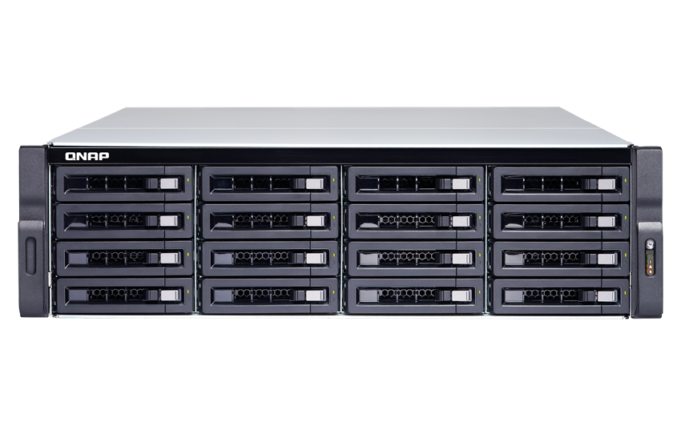
High-Speed Fibre Channel Recommended Models
SMB
TS-1677XU-RP
16G FC
SMB
TS-2483XU-RP
32G FC
Enterprise
TDS-16489U R2
32G FC
16 x 3.5”SATA
AMD Ryzen™ 5 2600 6-core 3.4 GHz (up to 3.9 GHz)
Max 64GB RAM
24 x 3.5”SATA
Intel® Xeon® E-2136 6-core 3.3 GHz (up to 4.5 GHz)
Max 64GB RAM
16 x 3.5”SAS/SATA + 4 x 2.5” SAS/SATA
Dual Intel® Xeon® E5-2630 v4 10-core 2.2 GHz
Max 256GB RDIMM RAM

