Slide 1
2019/09/17

Slide 2
File based cloud storage gateway
HybridMount
The reasons you need a cloud storage gateway
Create a global file share
Hot data storage trends
Benefits of cloud storage gateway
Multiple location file synchronization
Permission management with local users
Cost Reduction
Integration of QTS applications
HybridMount, new file based cloud storage gateway
File Station mount mode
File gateway mode
Demo

Slide 3
Hot data storage trends
Cloudifying storage
This means the capability of storage to transparently move data from on-premises configurations to public clouds and across private cloud deployments
Multiple Cloud Storage
As businesses start to ascertain the weakness and strengths of numerous cloud vendors, deriving optimum value would involve both cloud and on premise administration. Finally, it would need a multiple cloud storage management solution.
Notes:
https://www.ibm.com/blogs/systems/the-5-hot-storage-trends-for-2019/

Slide 4
Create Enterprise File Share and Sync
You might face problems when using cloud to create file share and sync system
How do applications access numerous data on the cloud directly?
How to easily manage multiple cloud storage?
Can users in each locations access files with low latency?
How to set up the user permission for local users?
read only

Slide 5
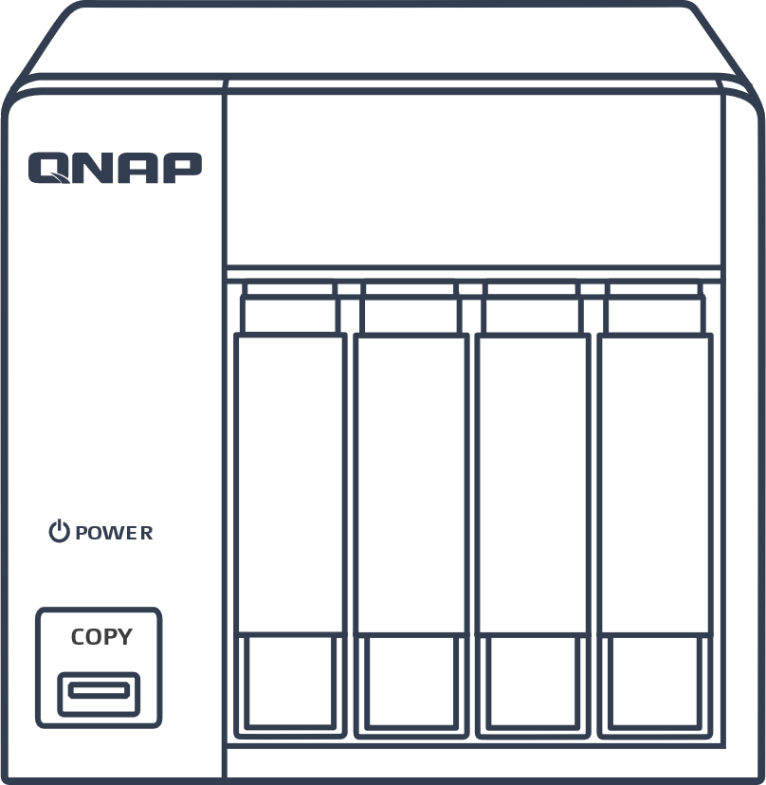
Cloud Gateway lets you access cloud like local
You might face problems when accessing cloud directly
Cloud gateway is like a translator
Access cloud
storage directly
Access cloud
storage by a
gateway
It is technical to deploy file share and application.
Unlike accessing local storage, it is inconvenient to access the cloud.
Accessing the cloud is slow through Internet.
Transfer the cloud storage to local file system or volume.
Protocol conversion use of familiar access protocols, SMB, NFS, iSCSI to access the cloud.
NAS local cache lowers the access latency.
Cloud Gateway
Local service

Slide 6
Benefits of cloud storage gateway
1
2
Support more access protocols
Local like access speed
Cloud gateway can transfer the access protocol so that you can access the cloud storage through CIFS/SMB, FTP, NFS, AFP, iSCSI. Windows, MAC, Linux can all easily access the cloud.
Keep the accessed file in NAS cache space to transfer the experience of Internet to LAN and lower the access latency.
3
4
Efficient cloud usage
Reduce cost of bandwidth
Enterprises can centrally store all data from different offices by using the public cloud. It can also enjoy the elasticity advantage for storage extension​.
When many users need to access the same file, they can access the cached file. It only needs to be downloaded by NAS once time instead of downloaded by everyone many times.

Slide 7
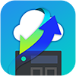
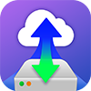
QNAP Cloud Storage Gateway
File based cloud gateway
Block based cloud gateway
HybridMount
VJBOD Cloud
Suitable for multiple location office to share file, easily access the cloud and reduce bandwidth.
Suitable for local NAS, service’s database backing up to the cloud with snapshot protection.
Cloud storage | 11 Object Storages and 7 File Storages | 11 Object Storages
Features | Multiple cloud space mount and centralized management. Cloud file synchronization with multi-endpoint. | Data on the cloud is not identified to keep data security. Only upload the amount of change to reduce the backup time.
Snapshot & restore | Not Support | Support
Access on cloud | Support | Data on the cloud can not be identified
Local access protocol | SMB/AFP/NFS/FTP/WebDAV | SMB/AFP/NFS/FTP/WebDAV/iSCSI/Fibre Channel

Slide 8
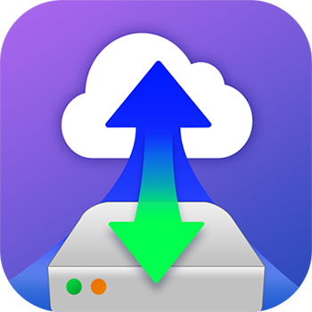
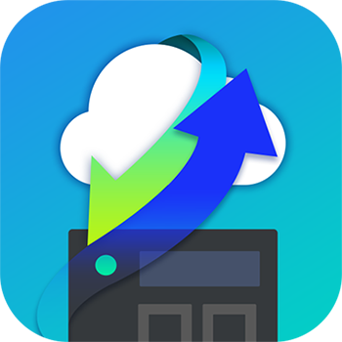
QTS cloud storage gateway and mount
vJBOD Cloud
Block based Cloud Gateway
Cloud Storage​
Customer​
File System​
Fibre Channel
Object Storage
Object Storage
Object Storage
Block Access​
Target
VJBOD Cloud LUNs​
Dedicate​
Stored space​
Object Storage Connector
Ethernet
Snapshot
Local Servers​
Local​
Applications​
VJBOD Cloud​
Volume​
(EXT4 File System)​
Dedicate​
Stored space​
Object Storage Connector
File Services​
File Access​
Snapshot
SMB
HybridMount (Mode 1)
File based Cloud Gateway​
NFS
Cloud File​
Storage​
Cloud File​
Storage​
Cloud File​
Storage​
Dedicate​
Cache space​
File Access​
AFP
Virtual​
File System​
Object Storage Connector
Local Users​
File Access​
FTP
Dedicate​
Cache space​
Cache Engine
Cloud File Connector
Web
DAV
Local Disks/SSDs
Remote Storage
Qsync
HybridMount (Mode 2)
File Station Mount
Cloud​
File​
Connector​
WebDAV
File
Station
File Station Access​
SMB
NAS
File Access​
File Access​
Remote​
File​
Connector​
Qfile
FTP
Data center

Slide 9
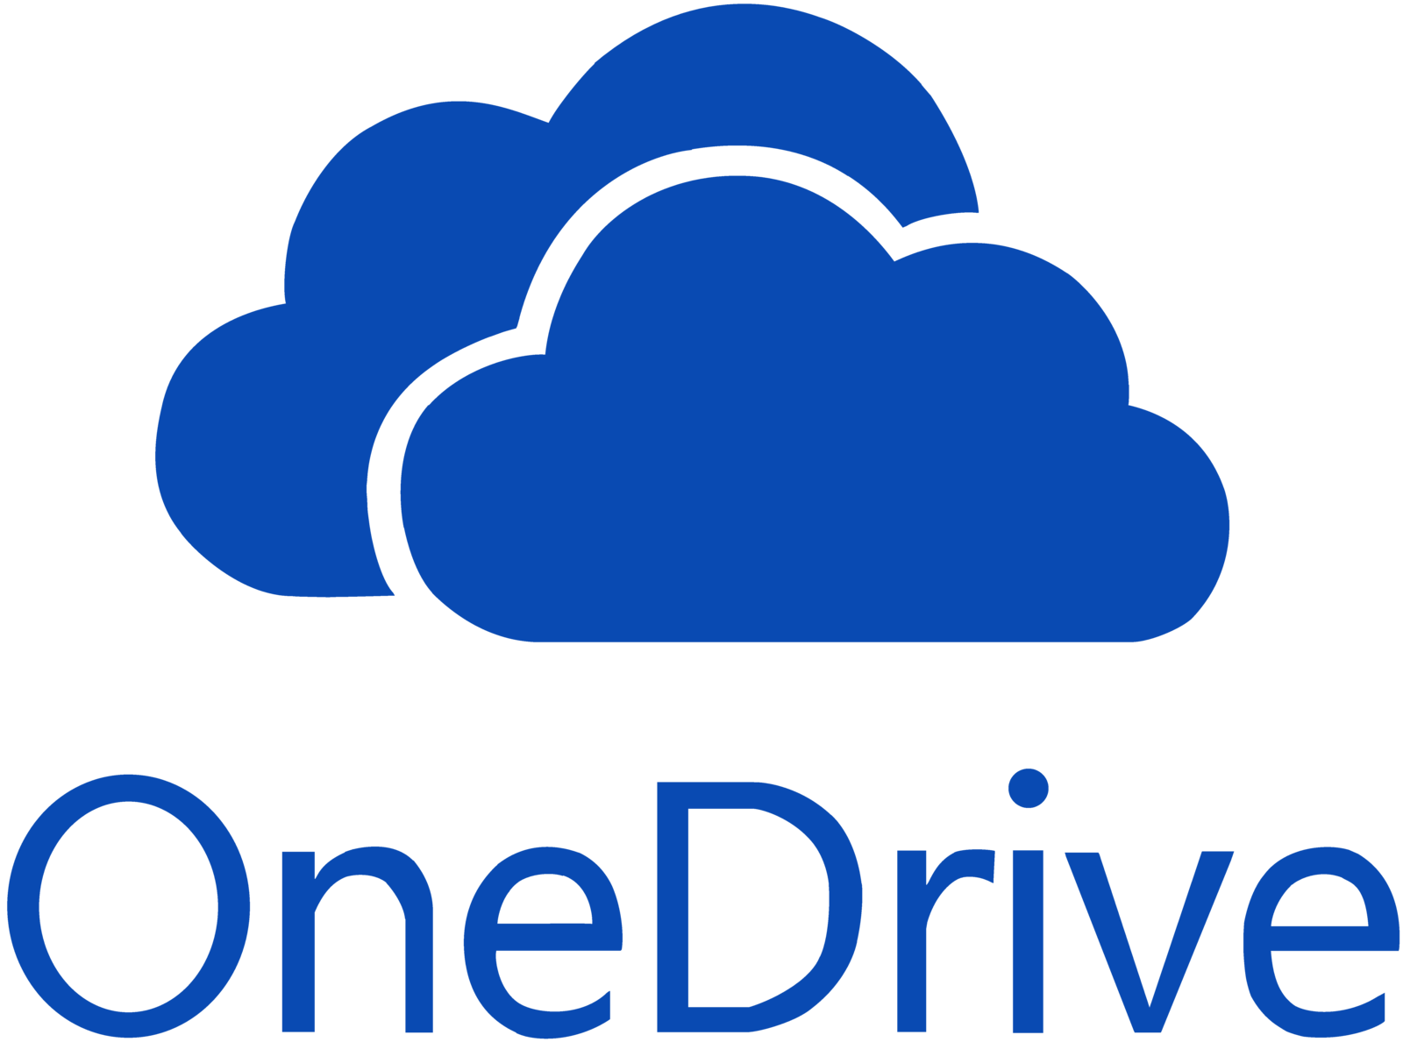
QNAP File Based Cloud Storage Gateway
HybridMount
Bring clouds closer!
Allocate a part of NAS storage to enjoy the hybrid cloud!
Enjoy QTS applications at the same time.
Local cache
SMB / NFS / AFP

Slide 10
HybridMount Provides 2 modes on your demand
 | File Station Mount | File Cloud Gateway
Setup Method | Mount cloud drives | Select “File Cloud Gateway” mode and create a dedicated cache space
Connections | No limit | 2 free and perpetual connections. Purchase license for more connections
Accessing Performance | Depends on network speed | High performance due to the cache
Access in File Station | Support | Support
Access through SMB / NFS / AFP | No support | Support
Sync with cloud | Sync only when browsing | Sync constantly for quickly access
Integration with QTS APPs | Not support | Support ...

Slide 11
Bring and manage your own cloud
With HybridMount create your own cloud to enjoy the storage gateway benefit.
BYOC benefits
BYOC limits
Manage your own cloud storage with numerous data.
Support many different cloud storage.
Manage multiple clouds in the same page.
Can not manage the gateway through your cloud user interface.
File modification on the cloud can only be detected after gateway sync with the cloud.

Slide 12
Mount Mode
File Station

Slide 13
File Station Mount Mode
Cloud File Storage
Cloud Connector
Cloud Object Storage
Web, Mobile Device Access
File Station
Manage all public and private clouds in File Station
Remote File Connector
SMB, FTP, WebDAV
Support 2 types of cloud and 3 access protocol for remote device.

Slide 14
Support 2 types of cloud and 3 access protocol for remote device.
File Station Mount Mode
File-based
Storage
Storage data by the folder structure.
Pricing depending on the fixed capacity.
Remote Device
Mount remote device through the access protocols.
Amazon Drive
BOX
Dropbox
Google Drive
HiDrive
CIFS/SMB
OneDrive Business
OneDrive
Share Drive
YanDex
FTP
Object-based Storage
Storage unstructured data in the flat environment.
Pricing depending the actual storage usage.
WebDAV
Alibaba
AWS S3
Azure
Backblaze
Google Cloud Storage
IBM Object
HKT
Huawei
Shift
Rackspace
Wasabi

Slide 15
File Cloud Gateway Help To Access Object Storage Service
HybridMount can transform the unstructured data into file structure for easy management of object cloud storage spaces.
/a/b
/a
/a
/a/d
/a/c
Structure Transform
b
c
d
SMB/AFP
object cloud storage spaces
Devices
NAS

Slide 16
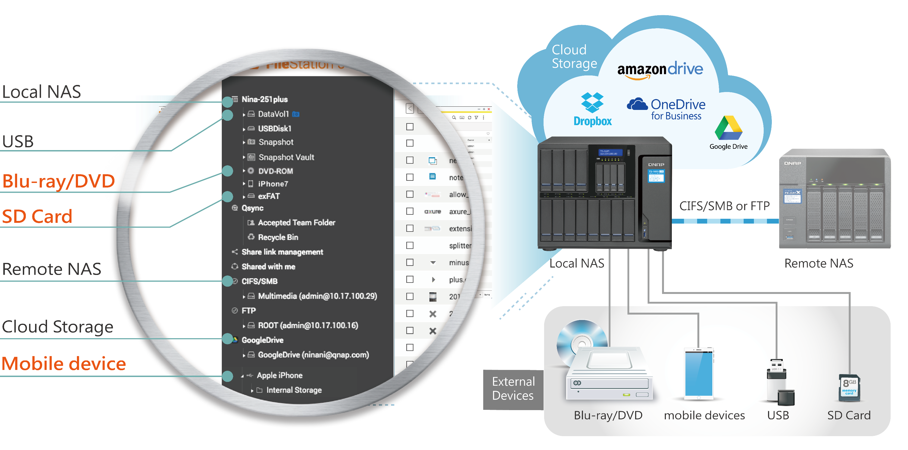
Manage all public and private clouds in File Station
File Station Mount Mode
1 management page
20 cloud storage
Remote NAS
4 external devices

Slide 17
File Gateway
Mode

Slide 18
File Gateway mode
Cloud File Storage
Cloud File Connector
File Access
Dedicate Cache Volume & Cache Engine
SMB, NFS, AFP, FTP, Web
Cloud Object Storage
Support more access protocols
NAS local cache lower the access latency.
Object Storage Connector
Sync the file in NAS and on the cloud
Support 2 types of cloud

Slide 19
Support 2 types of cloud
File Cloud Gateway Mode
Type I: File-based Storage
Type II: Object-based Storage
Storage data by the folder structure.
Pricing depending on the fixed capacity.
Storage unstructured data in the flat environment.
Pricing depending the actual storage usage.
BOX
Dropbox
Google Drive
HiDrive
Alibaba
AWS S3
Azure
Backblaze
Google Cloud Storage
IBM Object
OneDrive Business
OneDrive
YanDex
HKT
Huawei
Shift
Rackspace
Wasabi
Amazon Drive & ShareFile do not support File Cloud Storage Mode sue to their limitations.

Slide 20
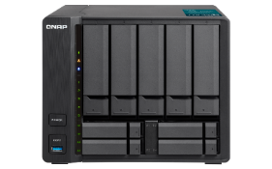
Support more access protocols
File Cloud Gateway Mode
With Cloud Storage Gateway protocol conversion, you can access your cloud data on any of your external devices regardless if you are connected using SMB, NFS, AFP, FTP, or other protocols.
Connect to the cloud
CIFS/SMB, AFP, NFS, FTP, WebDAV

Slide 21
NAS local cache lower the access latency.
File Cloud Gateway Mode
Create a proper size of cache volume to help smoothly access unlimited cloud storage like local transferring.
Each gateway file share needs a dedicated cache space
Minimum space: 20 GB
Suggested size of cache space＝
( Speed of writing to NAS (MB/s)-Speed of uploading to cloud (MB/s) ) x time(s) x 1.4 + demand of data always kept in cache
Ex: ( 100 MB/s – 50 MB/s) x ( 4 x 60 x 60 s ) x 1.4 = 1,000,800 MB ≈ 1 TB

Slide 22
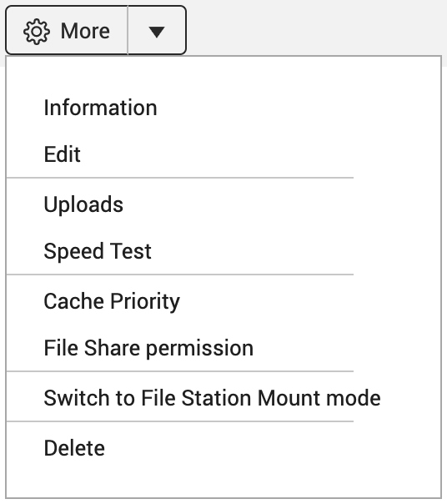
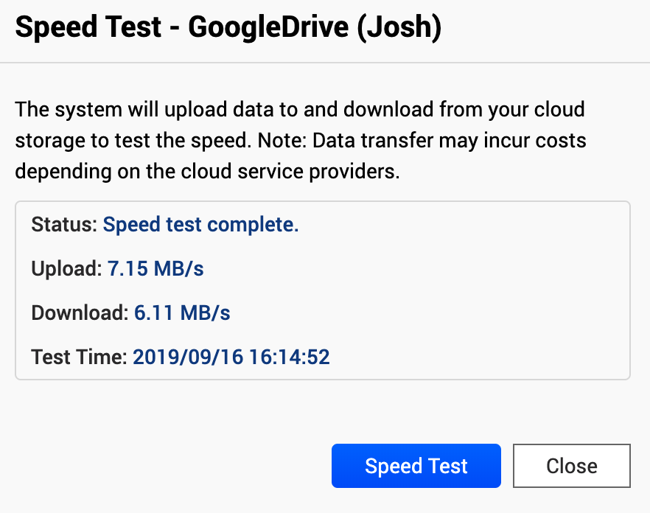
Suggested size of cache space＝
( Speed of writing to NAS-Speed of uploading to cloud) x time x 1.4 + demand of data always kept in cache
(MB/s)
(MB/s)
(s)
(MB)
You can download and keep files into cache space in advance to reduce the first reading time.
Data always kept in cache will not be removed by cache algorithm. Please assign enough space for this data in advance.
Speed test for selecting faster cloud storage.
If it is too slow to upload data to the cloud, there will accumulate too much data in cache to influent the cache mechanism and cause a bad experience.

Slide 23
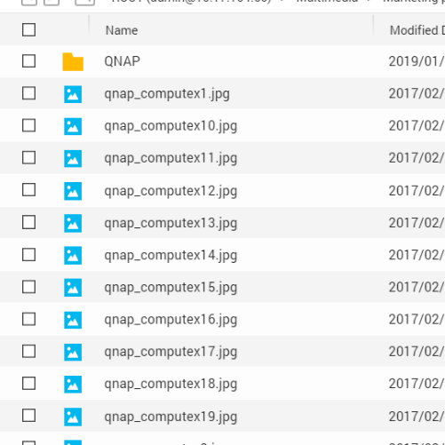
Fast access cloud like local experience
File Cloud Gateway Mode
Keep the accessed file in NAS cache space to transfer the experience of Internet to LAN and lower the access latency.
1. Sync Metadata To Read File List Fast
Internet
SLOW
Mount and then use without download all cloud data to the local NAS.
2. Accelerate When Reading Cached Files
1
2
3
The file will be downloaded from the cloud to the local cache volume and kept after first access. After that, it will read the cached file and doesn’t need to download again.
META
DATA
NAS
Cache Space
3. Cache Uploading Files To Reduce Waiting Time
LAN
FAST
Upload the files to NAS through LAN and then upload to the cloud in the background. It helps you reduce waiting uploading in front of your computer.

Slide 24
When opening a multimedia file
子頁
File Cloud Gateway Mode
Cache Hit
Cache Miss
3.1
Download from cloud
Cloud Connector
2
Confirm data cached or not
Cache Engine
File System
3
3.2
Read the cached file
Read the cached file
1
Request of reading file
Support reading and downloading file at the same time to enhance the multimedia reading experience.

Slide 25
When editing then syncing the file
子頁
File Cloud Gateway Mode
Read the file on the cloud to edit
Finish file sync
1
Download the whole file from the cloud to NAS cache space to read.
3
Cloud Connector
Edit then sync to the cloud
4
2
Write the file into file system and replace the original file. Finish the local write process.
Finish local write process
Check the file on the cloud to make sure if there is a new version edit by others.
3
Cache Engine
File System
4
Upload file to the cloud. Finish file sync.
If the file in the cloud is edited by others, local file will be renamed then uploaded.
Set up the transfer rule to let specific file, like small file, upload first.
Upload will be stopped if the local file is edited again.
Read the file on the cloud to edit
1
2
Edit then sync to the cloud

Slide 26
Efficiently using the cache space by customized rule
File Cloud Gateway Mode
When cache volume is full and there is more file space needed, the system will remove the least recently used file and only keep its metadata.
least recently used file will be removed
3 Customized cache rule:
Always keep in cache
When downloading or uploading files
Files are treated as high priority and are cached in advance to ensure cache hit. Always keep important, frequently accessed files in the cache.
Normal
Always keep in cache
Normal files are cached and kept in the local cache space. When the cache space is full, the least recently used files will be removed to make space for new cached files.
Normal cache file
Low priority cache file
Low Priority
Writing file
Low-priority files are cached and kept in the local cache space. When the cache space is full, the least accessed files are first removed. Set the less important file as low priority.
NAS
Cache space
File metadata

Slide 27
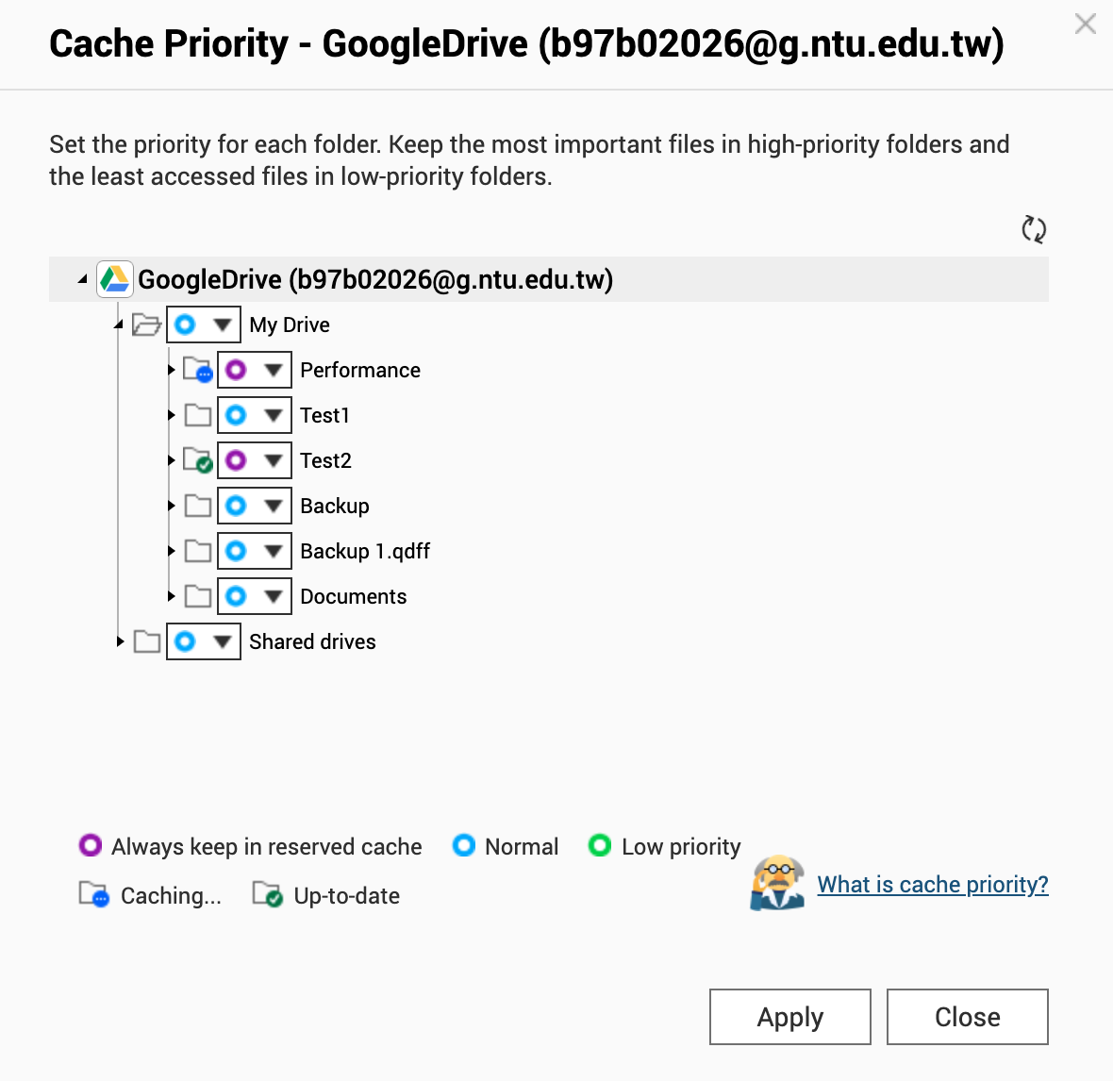
Keep files in cache in advance to reduce the first reading time
子頁
File Cloud Gateway Mode
Files are treated as high priority and are cached in advance to ensure cache hit. Always keep important, frequently accessed files in the cache.
1
2
Distribute reserved cache space
Select cache priority of the folder to always keep in reserved cache.
Select the priority
Download progress of always in cache file
When reserved cache space is insufficient, some files will still be removed by cache algorithm.
When reserved cache space is insufficient, alter the cache space distribution rate or expand the whole cache space.
設定快取優先順序，將特定資料夾設為保留快取

Slide 28
Visible Usage Status of Cache Space
File Cloud Gateway Mode
View the space usage and based your experience to adjust the cache space.
 | Item | Description | Remark
 | File list metadata | Sync and keep all file’s metadata to list the file list. | Will not be remove by cache algorithm.
 | Reserved cache | Store the data with “always keep in cache” priority. | Will not be remove by cache algorithm.
 | Used write cache | Data cached in cache space and ready to upload to the cloud. After uploading, it will turn to read cache. | Will not be remove by cache algorithm.
 | Used read cache | Store the read data. | Will be remove by cache algorithm.
 | Reserved cache limit | The maximum of storage for data with “always keep in cache” priority. | When the space is not used, it might be used by read cache.
 | Maximum write cache | The maximum of cached data which is ready to upload to the cloud | When the space is not used, it might be used by read cache.
 | Free cache space | Space is not used.

Slide 29
Sync the file in NAS and on the cloud
File Cloud Gateway Mode
Synchronize mechanism keep the files in local and on the cloud consistent.
1. Data Sync management
2. Resource Management
3. Uploads Management
4. File Conflict Management
5. File sync status

Slide 30
1. Data Sync management
子頁
File Cloud Gateway Mode
File-base Storage
Constantly synchronize to make sure data is all up to date.
*HiDrive, Yandex and Sharefile will synchronize by schedule or manually.
Object-base Storage
Synchronize by customized schedule or manually.
Synchronize with the cloud might incur cost. We suggest you only update in the time period you access frequently.

Slide 31
2. Resource Management
子頁
File Cloud Gateway Mode
A: QoS resource
When uploading or downloading file via File Cloud Gateway, HybridMount uses CPU and RAM resources. Based on NAS model, there is a restriction of the amount of uploading and downloading data at the same time. You can reserve and limit transfer resources for each gateway.
A: reserved resource(8)
B: reserved resource(7)
Download
Reserved
Shared resource(5)
Reserved resources are the transfer resources guaranteed to the connection. These resources are always available to the connection.
Upload
B: QoS resource
Limit
Total transfer resource (take mid-NAS as example: 20)
The free resource can be shared to each gateway. You can limit the maximum number of transfer resources available to the connection.
 | Total upload resource | Total download resource
High | 80 | 80
Mid | 20 | 20
Low | 10 | 10
QoS Rule
Create QoS rules for uploading and downloading files.
For example: Set the file size smaller than 5 MB upload first.

Slide 32
3. Uploads Management
子頁
File Cloud Gateway Mode
Uploading
Uploaded
Upload Errors
Show the uploading file list with their file name and progress.
Display the last 200 uploaded record.
List the files failed to upload and the reasons. Please resolve the problem and retry upload.
The following file types are not uploaded to the cloud and are not shown on the upload error list:
System files: .DS_Store, thumbs.db,...
Application temporary files: .Qsync, .@qsys,...
Network trash folder: @Recycle
File name format: starts with: '~$' and '.~', starts with '~' and with '.tmp' extension, starts with '.' and with '.swp' extension
Cloud document: .gdoc, .gslides, .onenote.url, .boxnote...
When the file share can not connect to the cloud, the “uploading” and “upload error” file will not sync to the cloud.
When you need to delete the file share, you must wait for all data uploaded successfully or backup those data.

Slide 33
4. File Conflict Management
子頁
File Cloud Gateway Mode
File on the cloud might be edited by the way besides HybridMount. When the file edit in local and uploading by HybridMount, it will be renamed and uploaded if the file on the cloud is edited by others.
File on the cloud
has new version
To detect the file version on the cloud to avoid overwrite the new version on the cloud, select the upload policy:
Check for conflicts and rename local files
2. Detect file version
on the cloud
3. Rename local
file then upload
If you don’t check for conflicts and HybridMount don’t detect the version on time due to missing updates schedules, the local edited file might overwrite the cloud file directly.
Checking conflicts might incur cost based on cloud providers. If there is only one HybridMount access the cloud storage, we suggest you not to check.

Slide 34
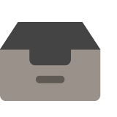
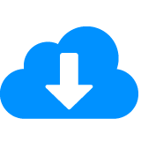
5. See the file cache status in File Station
子頁
File Cloud Gateway Mode
Upload error
See all file cache and sync status in File Station.
Download error
Ignored
Read a file:
Edit a cached file:
Cloud Only
Downloading
Cached & synced
Cached & synced
Cached & wait for uploading
Cached & uploading
Cached & synced
Upload a file:
Cached file is edited on the cloud:
Cached & wait for uploading
Cached & uploading
Cached & synced
Cached & synced
Downloading
Cached & synced

Slide 35
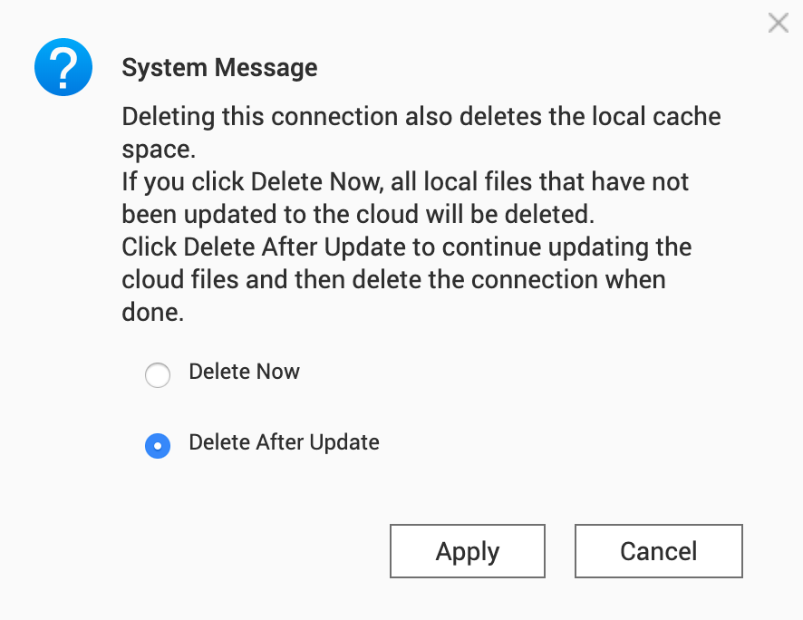
Safely remove to prevent data loss
File Cloud Gateway Mode
Delete gateway file share or switch to File Station Mount Mode will remove the cache space and all cache data. Please confirm that all data is synced to the cloud. Otherwise, the data which is not yet synced will loss.
1
2
3
Delete File Share or Switch
to File Station Mount Mode
Check if all data synced
Delete or switch mode
System check all data are synced.
Remove cache space
Successfully delete or switch mode
System check there is data not synced
All data synced

Slide 37
HybridMount
Create a Global
File Share

Slide 38
Create Global File Share with Cloud Gateway
Advantages
The cloud storage can be accessed from anywhere in the world. The public can centralize all data from different location and be elasticity extended.
User can access cloud by familiar way with protocol conversion.
Accelerate cloud access with local cache.
Integrate the NAS user permission.
Tokyo
Taipei
New York
read
only
File synced
(Read only)
Write a file
File synced

Slide 39
Assign permission of cloud storage to local users
With NAS and HybridMount as a gateway, administrators can arrange the permissions of cloud storage to certain users. Domain user settings by LDAP/AD can also work.
User permissions management
Domain User

Slide 40
Reduce bandwidth cost and time
When many users access the same cloud storage from their own PC, downloading and synchronizing will consume lots of bandwidth and time.
With NAS and HybridMount as a gateway, downloading and synchronizing one time can satisfy the need of all users.
Internet
Internet
Local Network
Desktop applications
SMB/AFP/NFS

Slide 41
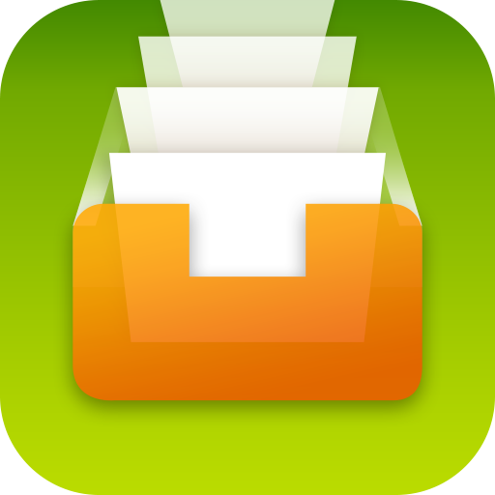
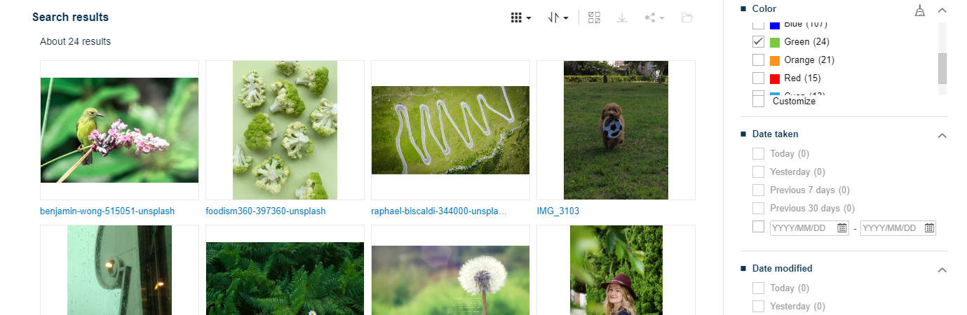
Integration with QTS Apps
Search data across clouds
Cloud-to-cloud migration and archive
Enjoy better multimedia service
Qsirch helps to search data across different cloud storage with one search criteria and show all results in one page.
Different cloud providers can be source or destination when filing by Qfiling . There are also multiple editing modules can be apply to the filing.
You can have the same excellent experience using QTS multimedia services, Video Station, Music Station, QuMagie.
Qfiling
Video Station
Filing
Rule
Music Station
QuMagie

Slide 42
Recommended Models
SMB Entry
TS-873
SMB Mid-level
TVS-882
SMB High-level
TS-1683XU-RP
Enterprise
TDS-16489U R2
Recommended maximum file share:2
8 bay
AMD R-Series RX-421ND
quad-core 2.1 GHz processor
(Turbo Core to 3.4 GHz)
Max 8GB RAM
Recommended maximum file share:4
8 bay
Intel® Core™ i5-7500
quad-core 3.4 GHz processor,
Max turbo to 3.8 GHz
Max 64GB RAM
Recommended maximum file share:16
16 bay
Intel® Xeon® E-2124 quad-core 3.3 GHz processor (burst up to 4.3 GHz)
Max 64GB RAM
Recommended maximum file share:16
16 bay
Intel® Xeon® E5-2630 v4
10-core 2.2 GHz
Max 256GB RAM

Slide 43
Have a better hybrid
cloud experience!
© 2019 Copyright is owned by QNAP Technology Co., Ltd. QNAP Technology reserves all rights. A trademark or mark used or registered by QNAP Technology Co., Ltd. The products and company names mentioned in the file may be trademarks owned by other companies.

