Slide 1
Introducing
The block-based cloud
storage gateway
2019/09/12

Slide 2
Agenda
Why Is There A Need To Back Up Data On The Cloud?
The Issue About User Data Backup On The Cloud
QNAP Solution-VJBOD Cloud
Block-based Cloud Gateway
VJBOD Cloud Block-based Cloud Gateway-
introduction To The Overall Architecture And Advantages Of The Cloud Gateway
VJBOD Cloud Block-based Cloud Gateway Application Scenario
VJBOD Cloud Block-based Cloud Gateway Function Introduction
Recommended Model

Slide 3


Why Is There A Need To Back up Data
On The Cloud?
increased demand for integration of private and public cloud
In recent years, as the security of public cloud space has increased, in many SMEs, local data that is expected to continue to grow can be backed up to the cloud for another data protection to prevent local storage devices from encountering disaster events.
Private cloud-Enterprise server room
Public cloud- cloud service storage provider
Cloud
Backup
Local backup

Slide 4

The Issue About User Data backup On The cloud
Is there any way I can use the custom protocol and don't want to change the backup application to access the application service data?
Is there any way to get the local application service on the cloud but keep the data to be identified and achieve the effect of data security protection?
Is there any way to upload a large amount of data with a large file to the cloud and be more efficient?

Slide 5



VJBOD cloud Block-based Cloud Gateway
VJBOD Cloud
Block-based Gateway
Cloud object
Storage space
initiator
iSCSI
Target
Local user
Client
Fibre
Channel
Application
Server
Cloud LUN
Snapshot
SMB/NFS/AFP/
FTP/WebDAV
Local user
Client
Cloud Volume
/Shared folder
Snapshot

Slide 6
VJBOD Cloud
Block-based Cloud Gateway
Introduction To The Overall Architecture And Advantages Of Block Cloud Gateway

Slide 7
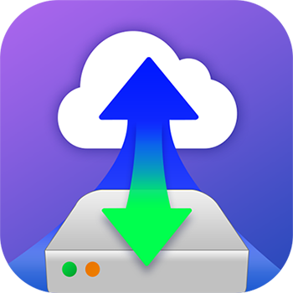




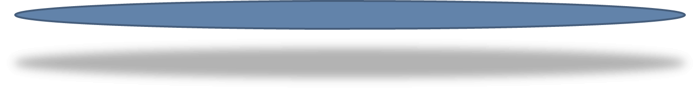








VJBOD Cloud Block-based Cloud Gateway
Architecture
QTS 4.4.1
ISCSI (Ethernet)
Cloud Storage
Customer
File System
Block Access
Target
Cloud
LUN
Dedicate
Local Stored
Space
(Local Stored mode)
Object Storage
Fibre Channel
Object
Storage
Connector
Local Servers​
File Services
Local
Applications
Snapshot
SMB
Cloud
Volume
(EXT4 File System)
Dedicate
Local Stored
Space
(Local Stored mode)
File Access
NFS
Object
Storage
Connector
Client
AFP
File Access
Snapshot
FTP
Web
DAV
Cache Engine
Qsync
Local Disks/HDDs/SSDs
Snapshot

Slide 8
VJBOD Cloud Local stored Mode And Snapshot
Restore Make Data Secure And Access Continuous
VJBOD Cloud use the local stored mode, which means that data can be stored on the NAS and the data can be backed up to the cloud.
The local stored space is paired with a cache engine that allows on-premise applications to access their entire database with low latency.
The local stored space will be preset to be larger than the Cloud Volume/LUN space, and the extra space will store a snapshot of the automatic snapshot restore mechanism.
Each Cloud Volume/LUN has a corresponding storage space (Stored space). In addition to storing snapshots, when the cloud is disconnected, data access is not interrupted.
QTS 4.4.1
Cloud
LUN
Dedicate
Local Stored
Space
(Local Stored mode)
Target
Block Access
Cloud object
Storage space
Snapshot
Cloud
Volume
(EXT4 File System)
Dedicate
Local Stored
Space
(Local Stored mode)
File Access
Snapshot
Snapshot
Cache Engine
Local Disks/HDDs/SSDs

Slide 9
Even if the cloud service is interrupted
Local Stored Mode Makes Backup Work
Will Not Stop Because The Cloud Service Is Disconnected
QTS 4.4.1
Cloud
LUN
Dedicate Local
Stored Space
(Local Stored mode)
Local Stored Mode
  The user uploads the data to the cloud because the VJBOD Cloud uses the Local Stored Mode method, and the data is stored in the local storage space (Local Stored Space).
  You need to set the local storage space larger than the cloud disk area or LUN on the local device to avoid data corruption caused by abnormal cloud connection.
Provide data protection when the cloud service is disconnected or when the connection is unstable
Backup work will not be stopped due to cloud service disconnection
User access is not interrupted
Target
Block Access
Cloud object
Storage space
Snapshot
Cloud
Volume
(EXT4 File System)
Dedicate Local
Stored Space
(Local Stored mode)
File Access
Snapshot
Cache Engine
Local Disks/HDDs/SSDs

Slide 10


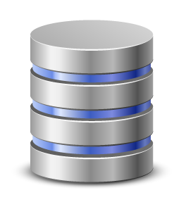
In The Event Of A Disaster, The NAS Is Damaged.
VJBOD Cloud Can Be Used On Another NAS
Block Cloud Gateway For Easy Backup Data
When a NAS is damaged (such as the A path), another NAS (such as the B path) can be used to connect to the cloud disk area and LUN established in the original cloud space by using the snapshot restore point, so that the local service application or The backup schedule continues, but since it is the previous snapshot restore point, it should be noted that there are still very few parts of the data window period.
Customer
File System
A path
!
Local Servers​
Client
B path
Snapshot
Notes:
45859006

Slide 11
When A Disaster Occurs
How To Use Another NAS To Migrate Data
Cloud object
Storage space
Step 1.
Step 3.
On the new NAS
Forced with cloud space cloud volume/ LUN disconnection
At the time of the disaster
Found NAS damaged
Snapshot
Step 4.
In the new NAS, the cloud space will be connected back to the Cloud volume/LUN by using the snapshot restore point.
And reply to all the cloud space data in the local storage space, after the data transfer, you can continue the service or backup task
Step 2.
Prepare another
NAS to do service rescue
Snapshot

Slide 12
VJBOD Cloud Local Stored Space
Local Storage Space With Cache Engine For Better Performance
QTS 4.4.1
Cloud
LUN
Dedicate
Local Stored
Space
(Local Stored mode)
Any cloud access will go through the local stored space in NAS.
The local storage space is matched with the cache engine, which enjoys the write performance like local storage, and can store a copy of the local storage space.
Local storage space can be full SSD, full HDD, HDD + SSD Cache or Qtier Tiered Storage.
Target
Block Access
Cloud object
Storage space
Snapshot
Cloud
Volume
(EXT4 File System)
Dedicate
Local Stored
Space
(Local Stored mode)
File Access
Snapshot
Cache Engine
Local Disks/HDDs/SSDs

Slide 13
Access Protocol Through VJBOD Cloud Block-based Cloud Gateway
No Burden On The Conversion Data
QTS 4.4.1
VJBOD Cloud block cloud gateway, like a translator, can convert the cloud storage device interface to Cloud Volume/LUN
General corporate IT staff or users can access Cloud Volume through more familiar file access protocols (such as NFS, SMB, AFP FTP, WebDAV).
Accessing Cloud LUNs using block-type access protocols (iSCSI, Fibre channel)
Users can easily access data without changing the custom access protocol and without changing the backup application.
Customer
File System
ISCSI (Ethernet)
Cloud
LUN
Dedicate
Local Stored
Space
(Local Stored mode)
Target
Block Access
Cloud object
Storage space
Local Servers​
Fibre Channel
Snapshot
SMB
Cloud
Volume
(EXT4 File System)
Dedicate
Local Stored
Space
(Local Stored mode)
NFS
File Access
AFP
Snapshot
Client
FTP
Cache Engine
Web
DAV
Local Disks/HDDs/SSDs

Slide 14









Support Up To Eleven Object Cloud
Storage Service Space
Object Cloud Storage
Object
Storage
Object
Storage
Object
Storage
Amazon S3
Azure
BackBlaze
HuaWei Cloud
IBM Cloud
Object Storage
Wasabi Cloud Storage
Alibaba Cloud
HKT
Google Cloud Storage
OpenStack
RackSpace

Slide 15
Introduction To Object Cloud Storage
 | Wasabi Cloud Storage | Microsoft Azure Storage | Alibaba Cloud Object Storage
Price plan | Unlimited Egress Pricing Plan | LRS Hot | Standard Storage(US East)
Cloud storage fee | $0.0059/GB/month | $0.0184/GB/month | $0.0185/GB/month
Feature | Fast | integrating them with Azure Active Directory (AD ) | Integrated with comprehensive extract, transform, and load (ETL) services
 | No API request charges | Achieve more with open source on Azure | Minimum guaranteed service availability of 99.9%
 | Quick uploads & downloads | including 70+ compliance certifications | Cross-region replication and remote disaster recovery

Slide 16
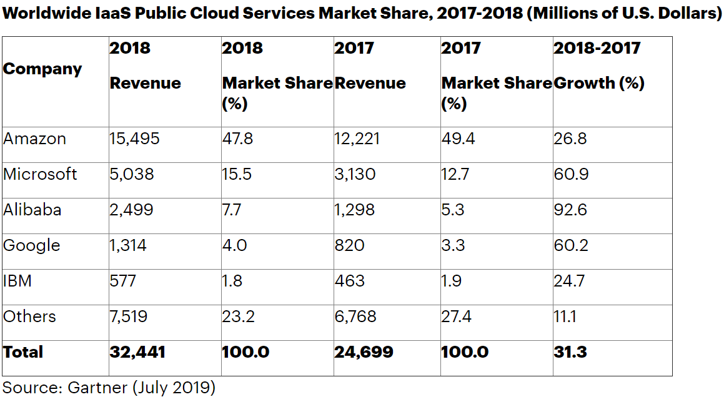
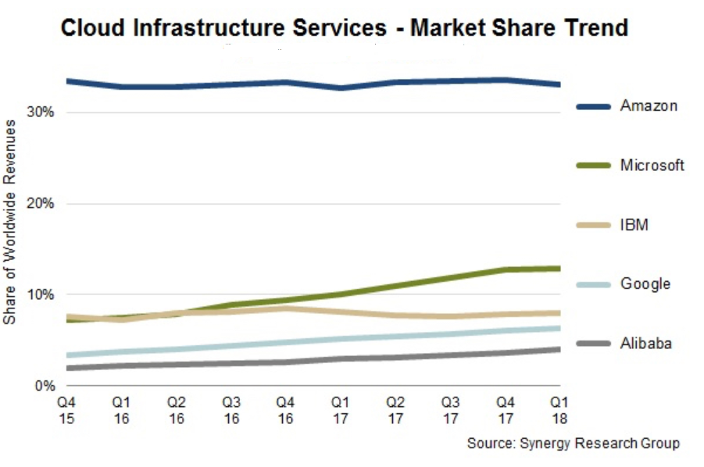
Object Cloud Storage Ranking
At present, the top cloud service providers in the market share, VJBOD Cloud block-based cloud gateways have support
If the user has multiple cloud services, the VJBOD Cloud block-based cloud gateway can be used as a relay station for multiple cloud services.

Slide 17
VJBOD Cloud
Block-based Cloud Gateway Advantage
VJBOD Cloud cuts the uploaded file into blocks, which cannot be read in the cloud, and can be used to identify the data.
The block-based VJBOD Cloud is suitable for transferring a large number of small files and a single large file to the cloud, because only the modified blocks (variables) will be uploaded in the future, reducing the amount of cloud transmission and reducing the cloud expenditure cost.
If the enterprise does a daily database backup, it will only back up the modified blocks (variables), no need to back up the entire database, and speed up the backup time.
Number of files
File-level
Log file
To modify a file, all files must be
re-uploaded.
Upload the
entire file
Image
Original
data
VM Volume
Block-level
Only the blocks (variables) of the modified data need to be transmitted to the cloud.
Large
Database
Modified
data
Only upload blocks that have been modified
File size

Slide 18

VJBOD Cloud
Block-based Cloud Gateway Benefits
Data Identification, Excellent Data Security Protection
The Local Storage Mode Allows The Data To Be Accessed Continuously When The Cloud Service Is Disconnected, And The Backup Work Is Not Stopped.
Snapshot Protection Mechanism, Data Security Is Guaranteed
Local Storage Space With Cache Engine For Better Performance
Reduce Cloud Traffic
Reduce Enterprise Cloud Space Expenditure Costs
Low Latency And Faster Backup Time
IT Staff Can Easily Install And Set Up
Reduce enterprise cloud space expenditure costs

Slide 19

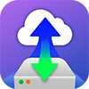
VJBOD Cloud vs HybridMount
 | HybridMount | VJBOD Cloud
Support cloud storage | 20 (Object Storage and File Storage) | 11 (Object Storage)
Gateway type | File-based cloud gateway | Block-based cloud gateway
Feature | 1. Cloud space mount, centralized management 2. Cloud file multi-endpoint synchronization | 1. Low latency 2. Up to cloud data to identify, excellent data security protection 3. When the data is on the cloud, only the amount of change is uploaded, and the backup time is reduced.
Snapshot & restore | Not supported | Support
Scenario | File server online collaboration and file level data analysis | Enterprise application or QTS application data on the cloud Large database backup Massive small file backup
Local access protocol | SMB AFP NFS FTP WebDAV | SMB AFP NFS FTP WebDAV iSCSI Fibre Channel

Slide 20
VJBOD Cloud
Block-based Cloud Gateway Application Scenario

Slide 21

Back Up Data From Local Application Services To The Cloud
Scenario
1
Application Case
SMEs have many important log files or sensitive data generated by local applications. For example, customer order data, system login data files are usually a large number of small files, and it is hoped that the process of backing up to the cloud can be fast. And it can't be recognized in the cloud space, it can keep the security and privacy of enterprise data.
按一下以新增文字
* A cloud volume or LUN can only be connected to a NAS at a time.
Notes:
45859006

Slide 22
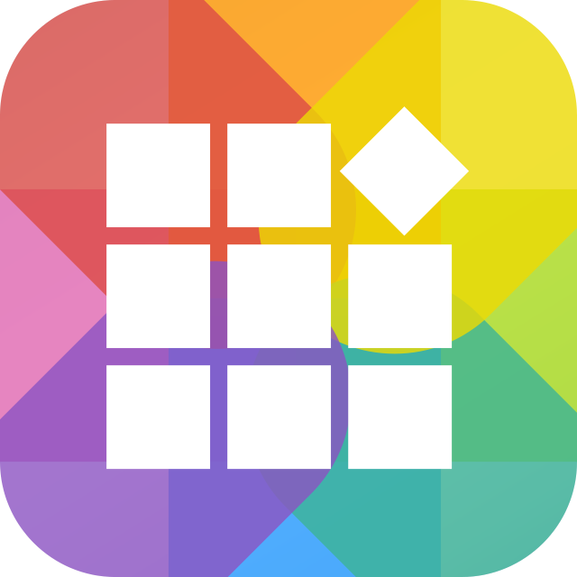
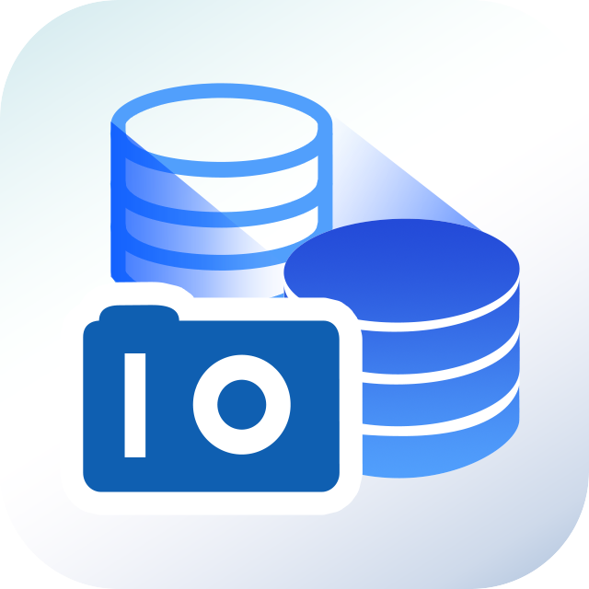
Local Data Cloud Backup Solution
Cloud object
Storage space
QNAP's VJBOD Cloud feature is a block-based Gateway block cloud gateway
VJBOD Cloud block cloud gateway allows users to easily connect to the cloud storage space and convert it to disk at the local end.
Enterprise IT staff or general users can use the more familiar file access protocol (NFS, SMB, AFP, FTP, WebDAV) for access
Use this cloud volume to store data generated by various application services on the NAS that support the cloud volume.
After the files in these application services are backed up to the cloud through the block cloud gateway, the block space data is unrecognizable in the cloud space.
APPCenter
Storage & Snapshots
Snapshot
SMB
NFS
AFP
FTP
Client
WebDAV
Local Stored
Space
Cloud Volume
(EXT4 file system)/Shared Folder

Slide 23



Local Database Backup
Scenario
2
Application Case
In addition to the backup of the local storage device, the SME database hopes to back up the database to the cloud every day or every week, and hopes to quickly and reduce the network transmission during the backup process.
* A cloud volume or LUN can only be connected to a NAS at a time.

Slide 24

Block-based Database Cloud Backup Solution
Cloud object
Storage space
QNAP NAS's VJBOD cloud block-based Gateway block cloud gateway function also provides block-type logical unit LUNs
Enterprise users can access through block-type access protocols (iSCSI, Fibre Channel)
When enterprises want to back up the database to the cloud, they can also use the characteristics of the block-based gateway block cloud gateway to achieve the backup difference variation, thereby reducing the overall cloud transmission volume and backup time and cloud usage.
Stoerage & Snaphots
Target
initiator
iSCSI
快照
Snapshot
Fibre
Channel
Application
Server
Cloud LUN

Slide 25
VJBOD Cloud
Block-based Cloud Gateway Function Introduction
Create A Cloud Volume/LUN
Local Stored Mode
Snapshot Restore And Data Protection Mechanism
Snapshot Operation Principle And Process
VJBOD Cloud Block-based Cloud Gateway Authorization Mechanism

Slide 26

Create A Cloud Volume / LUN
To use VJBOD Cloud, after downloading the Plug-in program from the App Center, you can unlock the related functions in the Storage and Snapshot Explorer and complete the Cloud Volume/LUN creation as directed by the wizard.
VJBOD Cloud Wizard guides and easily builds a cloud volume/LUN.
Choose to connect to the cloud service provider and cloud space bucket
1
2
Set cloud volume/LUN and storage space
3
Overview setting
Create a cloud volume/LUN
* Functional schematic flow diagrams, etc. may differ from final product features

Slide 27
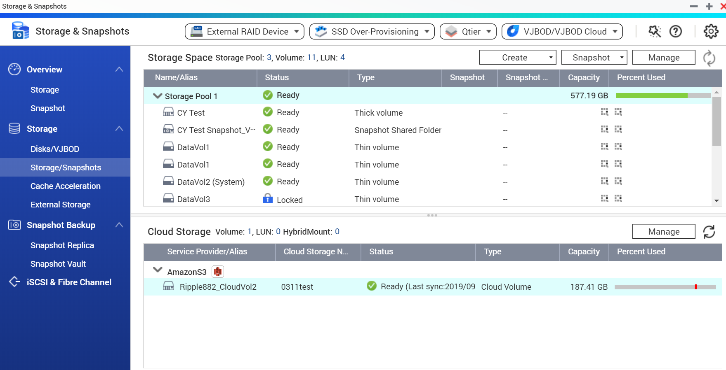
Create A Cloud Volume/LUN
In the tab that stores the snapshot manager, the user will be able to view the local volume/LUN and the cloud volume/LUN created by VJBOD Cloud. Manage all the space at once.
* Functional schematic flow diagrams, etc. may differ from final product features

Slide 28
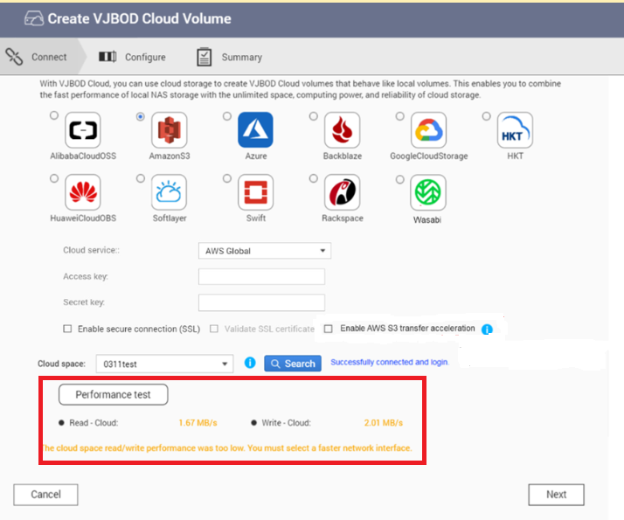
Cloud Connection Speed Measurement
VJBOD Cloud supports cloud connection speed measurement.
Let IT staff first confirm the transmission speed of the cloud connection, whether it is enough to cope with its application and adjust the network disk area, or the connection resources of the LUN.

Slide 29
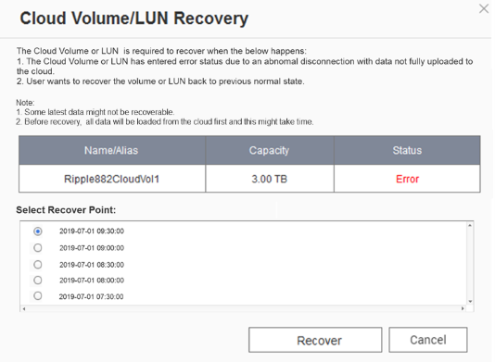
Snapshot Restore Mechanism
A cloud disk/LUN in the entire system will need to set a local storage space.
The default local storage space will be larger than the cloud volume/LUN, and the extra space will help you automatically take snapshots.
With the local storage mode, even if the cloud storage space is disconnected, the application data can be completely saved in the NAS storage space.
Users can select the snapshot restore point that they want to return, perform snapshot restore, and currently support up to 20 snapshot restore points.
Snapshot restore will first take a snapshot on the NAS side Local Stored Space and then back up the snapshot to the cloud.
* Functional schematic flow diagrams, etc. may differ from final product features

Slide 30
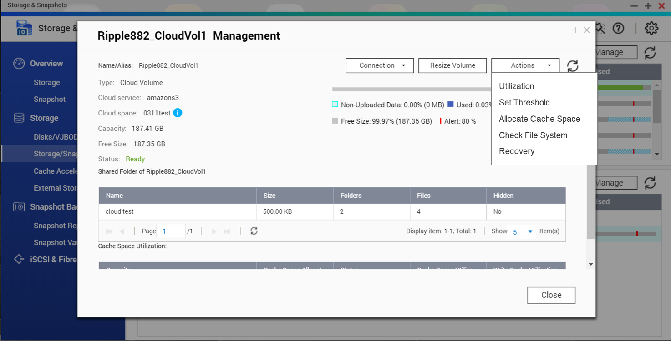
Snapshot Restore Mechanism Protect User's Data
Snapshots are automatically enabled when the block change is greater than 10%.
Snapshots are also automatically enabled every 30 minutes.

Slide 31

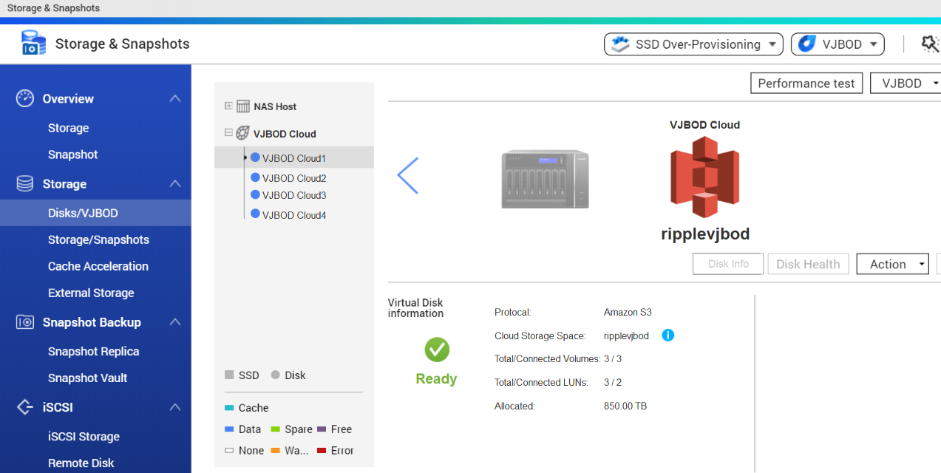
VJBOD Cloud Block-based Cloud Gateway Authorization Mechanism
VJBOD Cloud supports up to 9 cloud storage spaces (including a free connection).
Free connection to the first cloud storage bucket
VJBOD Cloud can create up to 16 Cloud Volumes or LUNs*.
* According to the memory requirements, the model will have the maximum support.
Cloud disk area / LUN number limit.
* Functional schematic flow diagrams, etc. may differ from final product features

Slide 32
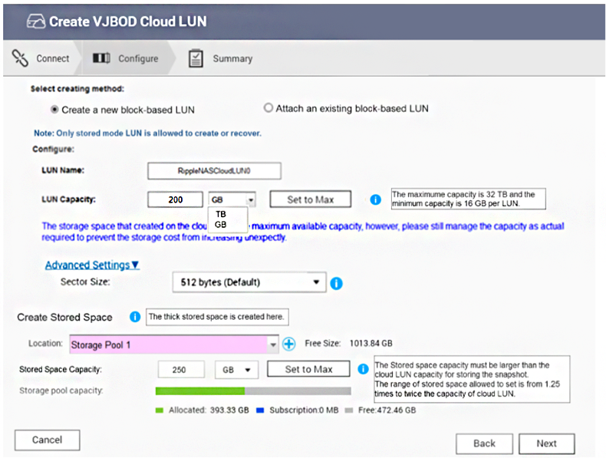
VJBOD Cloud Local Storage Mode
Let Data Access Continuously
VJBOD Cloud uses the local storage mode to store the main data on the NAS and back it up to the cloud. Storing a volume allows the on-premises application to access its entire database with low latency.
The local storage space will be preset to be larger than the VJBOD Cloud Volume space, and the extra space will store a snapshot of the automatic snapshot restoration mechanism.

Slide 33
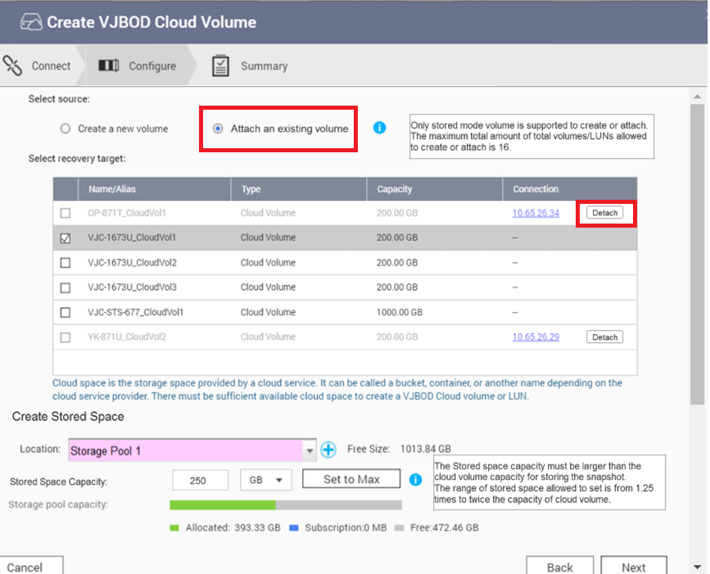
When A Disaster Occurs
Forced Disconnection Of The Original NAS Cloud Volume Or LUN Connect To The Original Cloud Volume Or LUN With Another NAS
On another NAS, choose to connect to an existing cloud volume or LUN.
Forced disconnection This has a cloud disk or LUN in the original NAS.
After the forced disconnection, you can select the existing cloud volume or LUN and re-link and reply the data to the local storage space.
Let local application services and backup tasks continue. However, since it is a way to restore points with snapshots, it should be noted that there are still very few parts of the data window period.

Slide 34
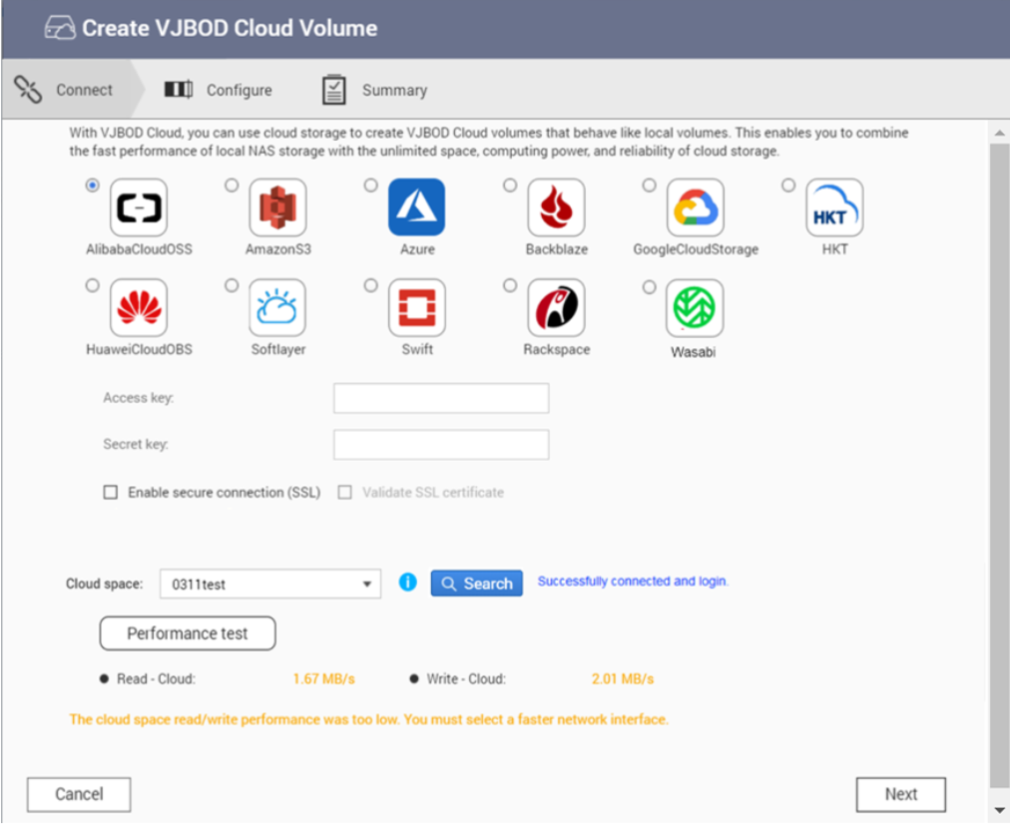
Forced Transfer Or Secure Transfer Process
Step.1
The user chooses which cloud service provider to connect to and enters the Access key and test connection.

Slide 35
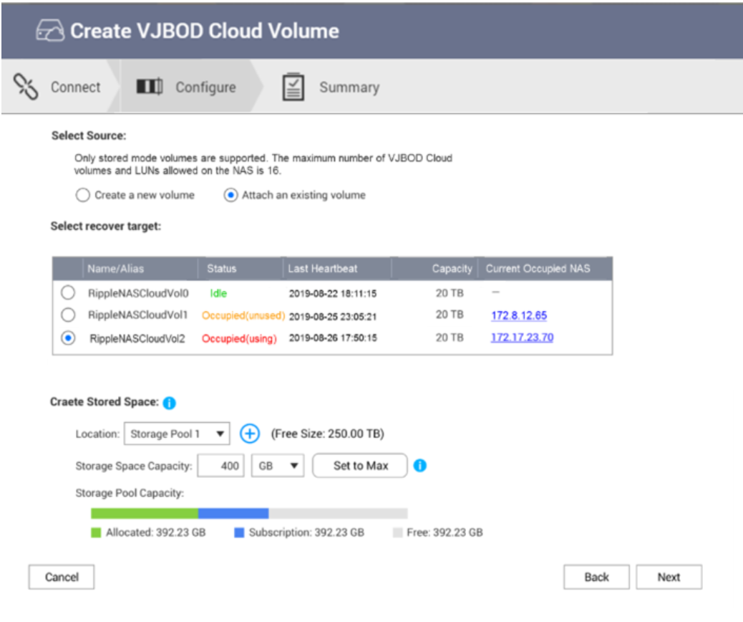
Forced Transfer Or Secure Transfer Process
Step.2
User selects Attached Cloud Volume/LUN
Status: Divided into three states, occupied (using), occupied (abnormal), idle (secure transfer)
Show last heartbeat time and NAS IP being occupied
After the user selects the cloud Volume/LUN of the two states of occupied (using) and occupied (unused), pressing "Next" will pop up the window to warn the user and inform that the most recent snapshot will be restored.

Slide 36
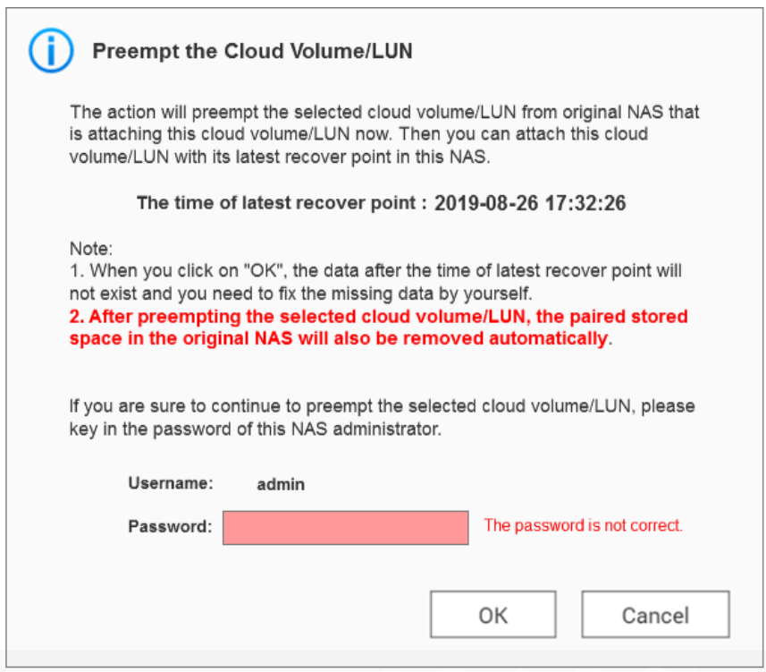
Forced Transfer Or Secure Transfer Process
Step.3
Pressing “Next” will pop up the window to warn the user. And told that it will be restored by a recent snapshot.
And show the time point of this snapshot restore
Please enter the admin of this NAS / User password, press "OK" to continue

Slide 37
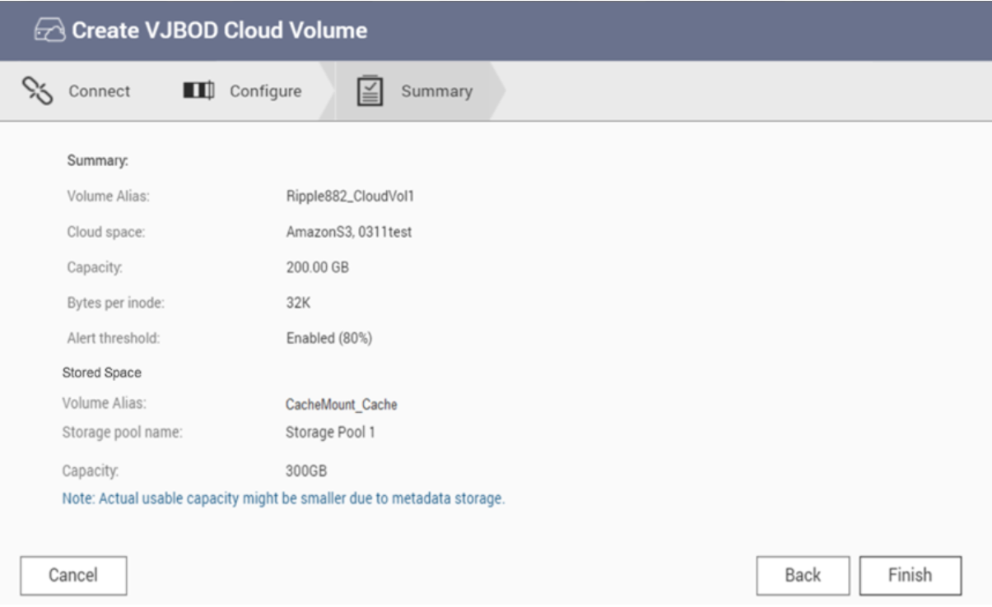
Forced Transfer Or Secure Transfer Process
Step.4
The user presses "Finish" to start execution.

Slide 38
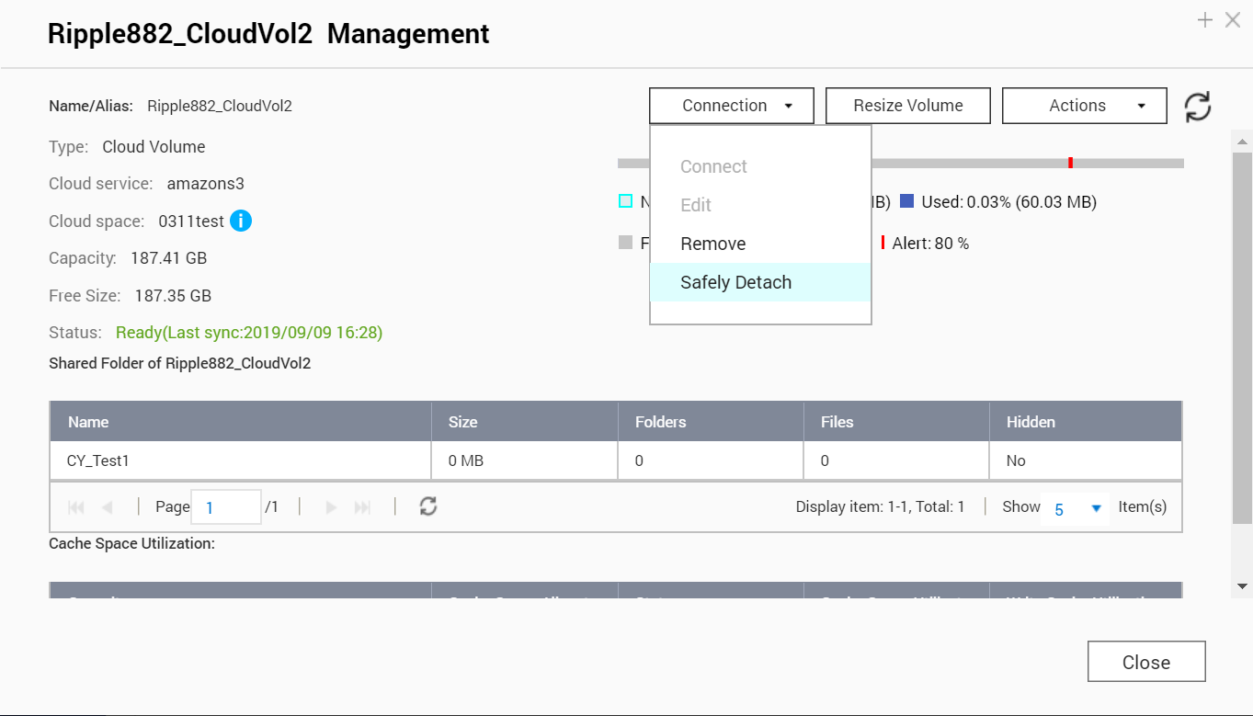
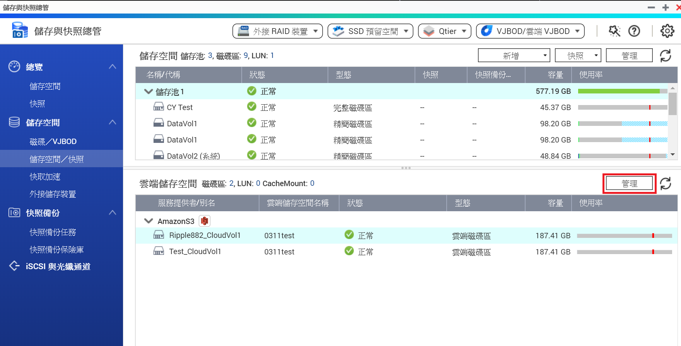
How To Safely Uninstall Cloud Volume Or LUN
In the storage and snapshot explorer, select A cloud volume or LUN and press "manage" on the top right.
Go to the administration page and select wired > secure uninstall.

Slide 39
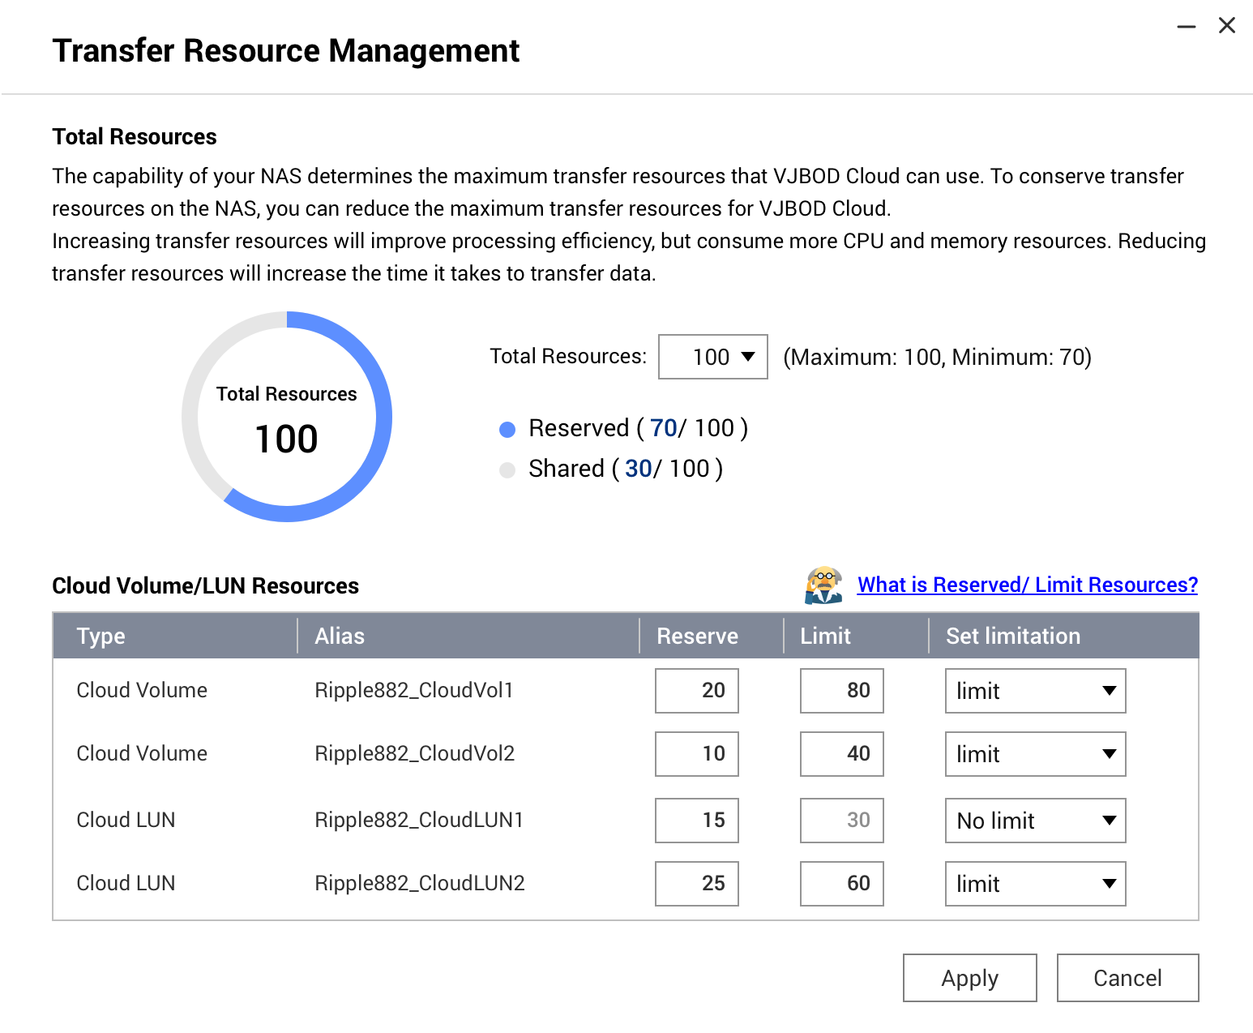
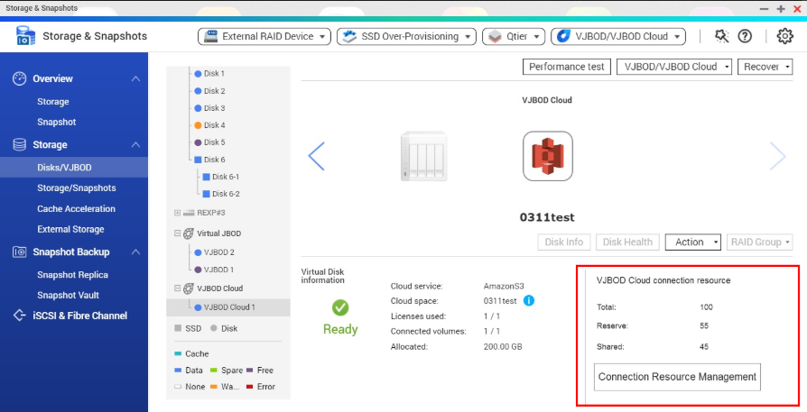
Connection Transmission Resource Management
VJBOD Cloud supports connection transmission resource management.
Enables IT to tune the connectivity resources of individual cloud volumes or LUNs for different applications or temporary needs.

Slide 40
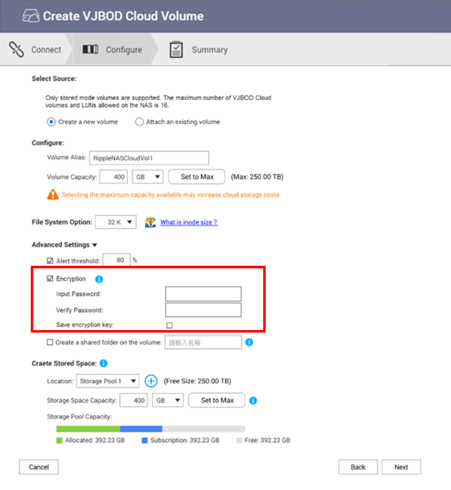
Cloud Volume Supports Encryption
Cloud Volume supports encryption, allowing enterprise users to add a layer of data protection to confidential information.
Provides data encryption, which allows you to encrypt the Cloud Volume with AES 256-bit in the NAS. The encrypted cloud volume Cloud Volume can only be read and written normally through the previously set password. Even if the NAS is stolen, the encryption mechanism can protect the data and prevent theft of confidential information.

Slide 41
LIVE dEMO

Slide 42
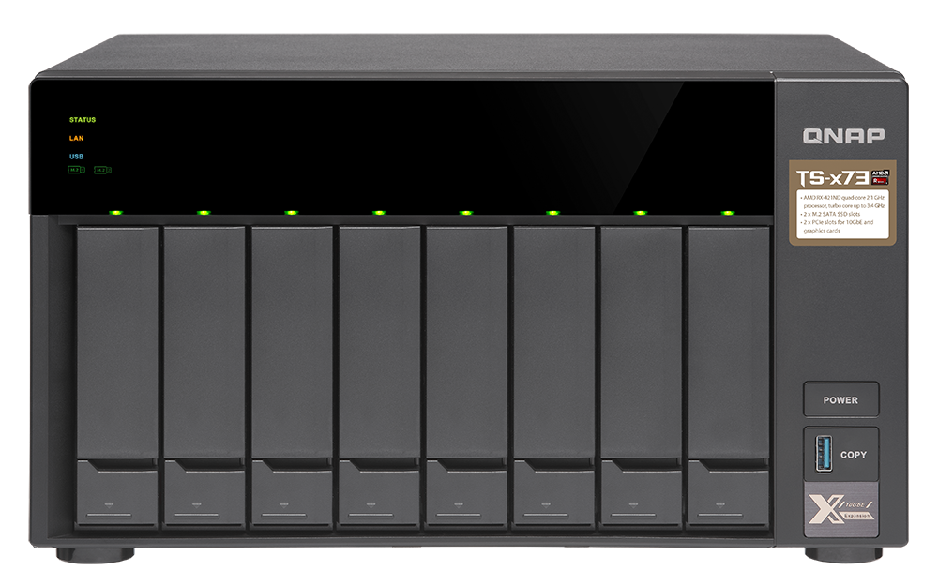
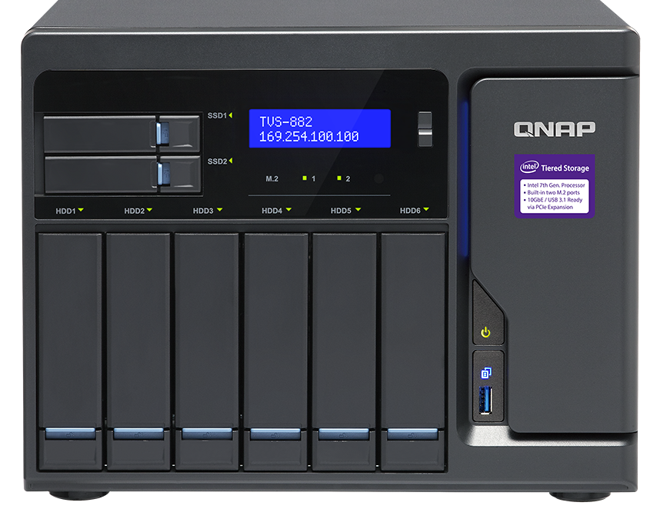
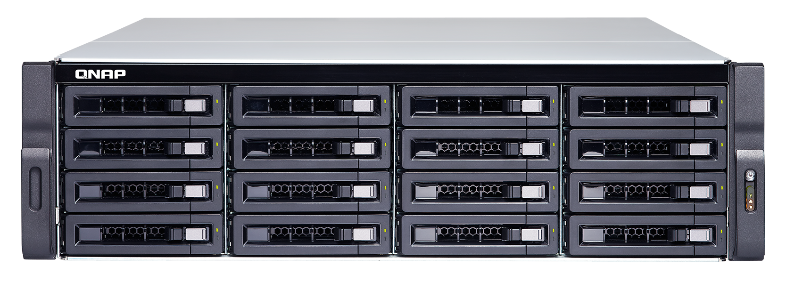
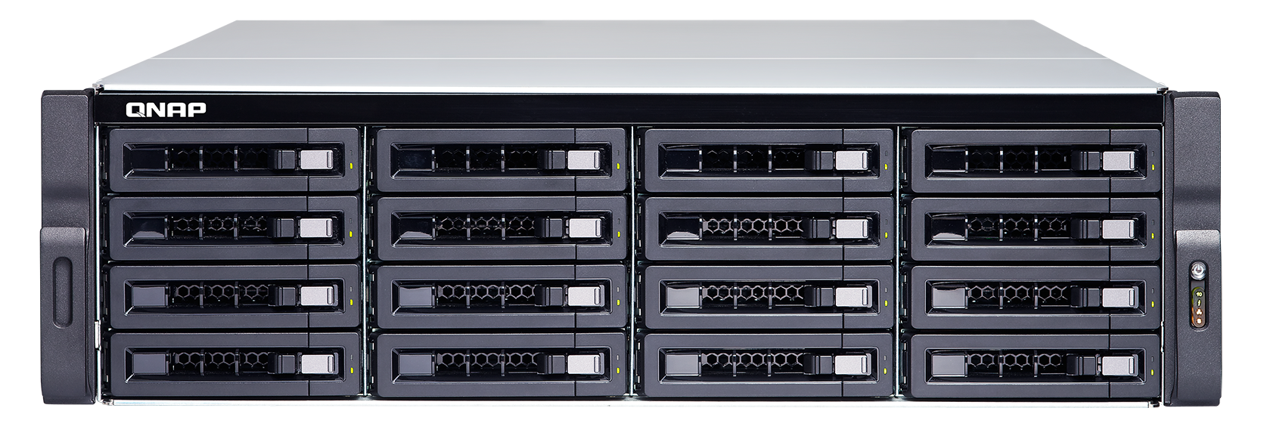
Recommended Model
SMB Entry
TS-873
SMB Middle level
TVS-882
SMB High level
TS-1683XU-RP
Enterprise
TDS-16489U R2
Suggested Cloud Volume/LUN:4
8 bay
AMD R-Series RX-421ND
quad-core 2.1 GHz processor
(Turbo Core to 3.4 GHz)
Max 8GB RAM
Suggested Cloud Volume/LUN:8
8 bay
Intel® Core™ i5-7500
quad-core 3.4 GHz processor,
Max turbo to 3.8 GHz
Max 64GB RAM
Suggested Cloud Volume/LUN:16
16 bay
Intel® Xeon® E-2124 quad-core 3.3 GHz processor (burst up to 4.3 GHz)
Max 64GB RAM
Suggested Cloud Volume/LUN:16
16 bay
Intel® Xeon® E5-2630 v4
10-core 2.2 GHz
Max 256GB RAM
* Depending on the memory requirements, the model will have maximum support.
Cloud disk area / LUN number limit.

Slide 43
VJBOD Cloud
Block-based Cloud Gateway Solution
Is The Best Choice For
Connecting Your Private Cloud
To A Public Cloud
© 2019 Copyright is owned by QNAP Technology Co., Ltd. QNAP Technology reserves all rights. A trademark or mark used or registered by QNAP Technology Co., Ltd. The products and company names mentioned in the file may be trademarks owned by other companies.

