Slide 2
Overview
Power over Ethernet Market Status and Challenges
Hardware Features & Advantages
Software Features & Advantages
    PoE Features
    L2 Network management functions
    QTS applications
Multi-purpose for one machine: support PoE, network management, storage, computing, etc.
Guardian’s diverse use scenes
Notes:
數位轉型，帶來的是利潤而不是負擔
工具：Guardian
更少的投資，帶來更多的利益
輕鬆，過去做不到的，一台設備就能協助你完成數位轉型。

Slide 3

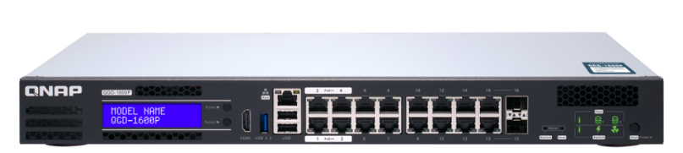

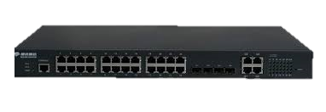
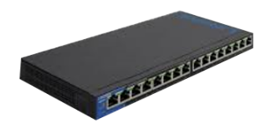
Power Sourcing Equipment
product evolution
3rd Generation
Guardian Smart Edge PoE Switch
2ST Generation
1ST Generation
L2/ L3 Managed PoE Switch
Unmanaged PoE switch
Equipped with QTS
Virtual machine
Hybrid cloud storage
IEEE 802.3bt Ready

Slide 4


Expected requirements and solutions for power sourcing equipment
Current Issures for PoE
Want to have a high wattage, high-power equipment to meet all types of powered devices
Want integrated solutions that reduce learning, maintenance and cost
Want a high-expansion, high-elastic device to meet the future growing network needs

Slide 5







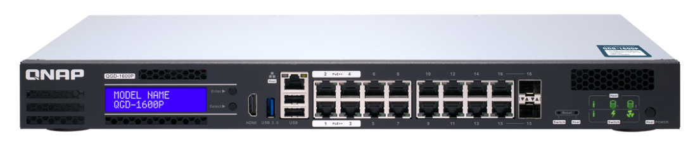
Guardian Smart Edge PoE Switch
Best Solution for PoE
Guardian QGD-1600P
Layer 2
Management
370W PoE Budget
IEEE 802.3bt Ready
QTS compatible
VM / Container supported
QVR Pro
Surveillance solution

Slide 6
  Guardian's hardware advantages
Guardian's unique strengths and features

Slide 7



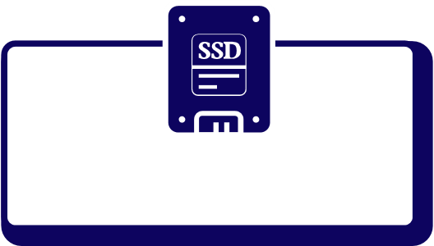




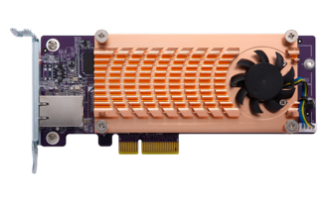




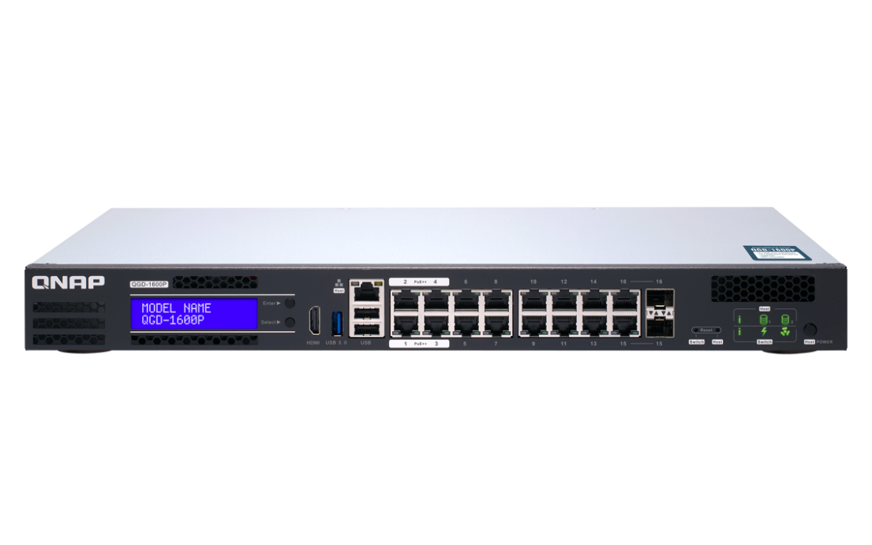








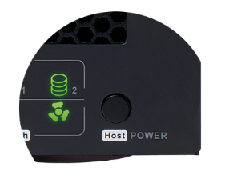

QGD-1600P hardware architecture
System power button (Rear)
Power Supply Total: 418W
System Power
Max: 48W
PoE Power Max:
370W
2 x 2.5" SSD/HDD
Intel J4115
Quad-core
8GB RAM
Host power controller
System power controller
PCIe Interface
2 x Internal LAN GbE
2 x PCIe Gen 2 x 2
Switch
HDMI 2.0
USB 3.0
USB 2.0
Host Interface
2 x GbE
Microchip VSC7425
PoE
Controller
x 1
x 1
x 2
x 1
16-port GbE RJ45 with 2port SFP combo
Host power button

Slide 8
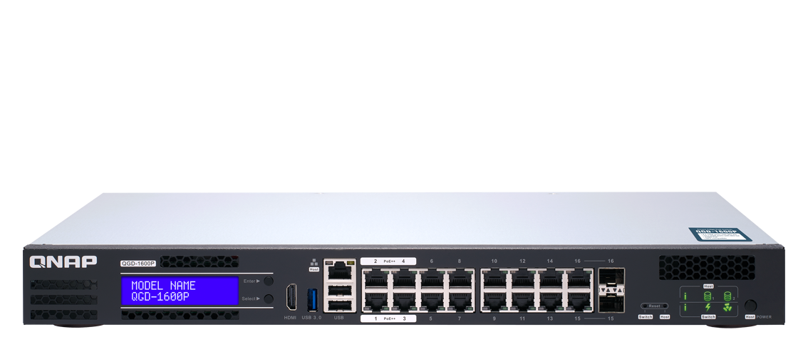
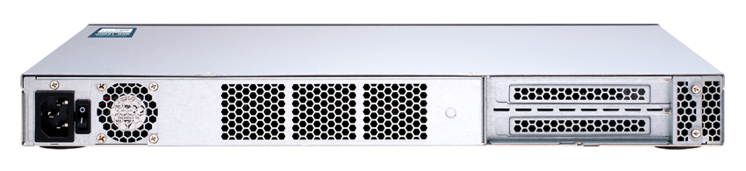
QGD-1600P hardware features
PoE 802.3bt
Combo Port
(RJ45,SFP)
LED Status
LCM
HDMI
Host Interface
Front
USB 3.0
PoE 802.3at/af
Reset button
(QTS / Switch)
Host
Power Button
USB2.0
Back
System power button
PCIe Slot 2.0 x 2

Slide 9
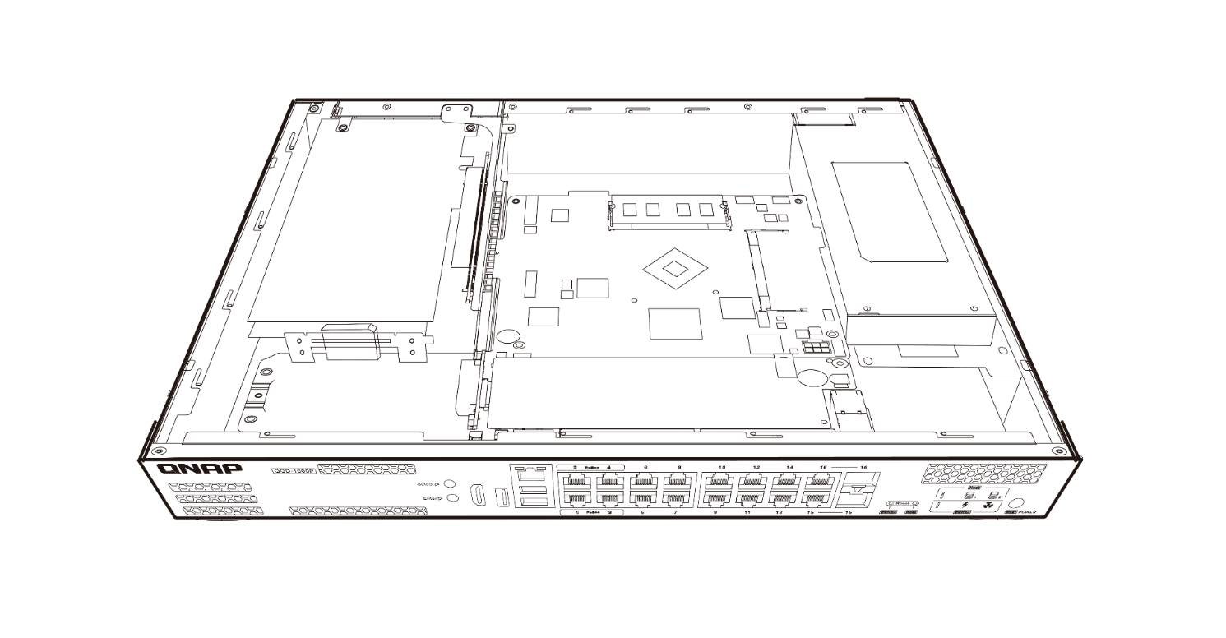
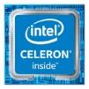
QGD-1600P Internal View
2 X PCIe Gen2 Slot
DDR4 Memory
Supports installation of 10GbE NICs, QM2 expansion cards or USB 3.1 Gen 2 (10Gbps) expansion cards for maximum application expansion flexibility.
Supports two DDR4 dual-channel SO-DIMM memory slots up to 8GB.
2 X 2.5” SATA 6Gb/s SSD/HDD Slot
Intel® Celeron® CPU
Two 2.5” SSD/ HDD SATA slots are built in, allowing you to store surveillance video files
The Intel® Celeron® J4115 quad-core 1.8 GHz processor delivers efficient computing power to Guardian.

Slide 10
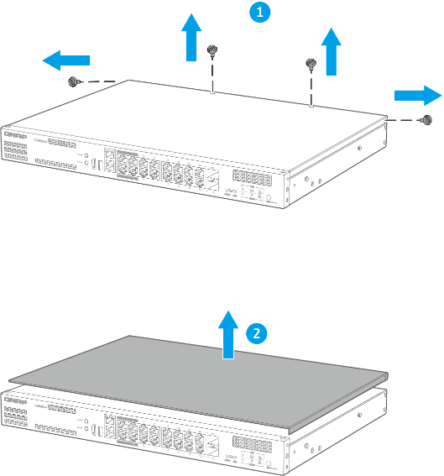
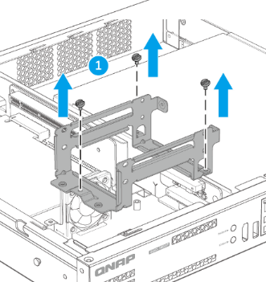
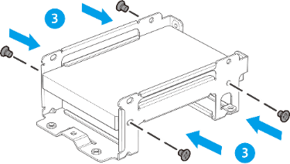
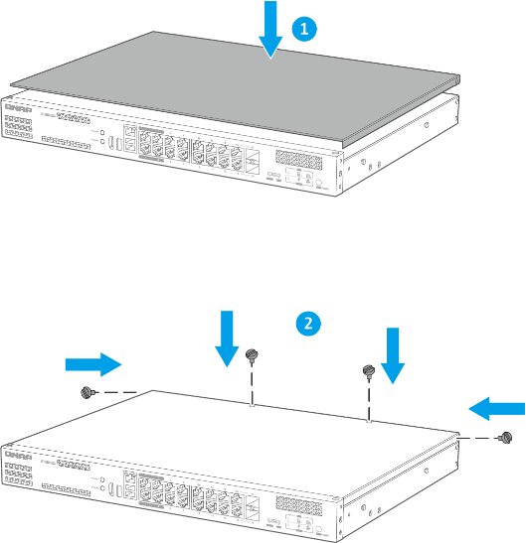
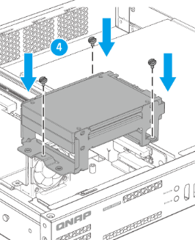
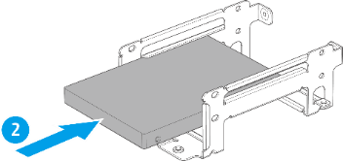
Hard disk and SSD installation
Step 1
Step 2
Step 3
Open the cover of the switch
Remove the hard disk slot, put it in the hard disk and fix it, and then fix the hard disk slot
Cover the cover of the switch
2.5-inch HDD / SSD

Slide 11
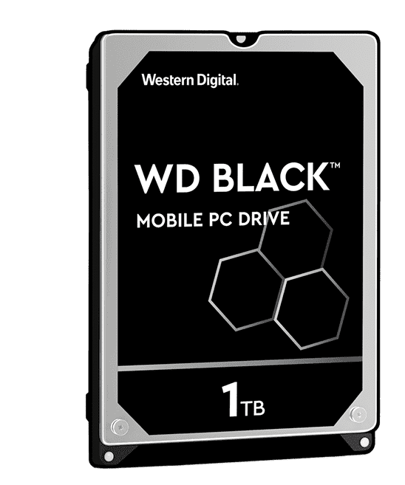
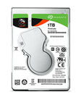

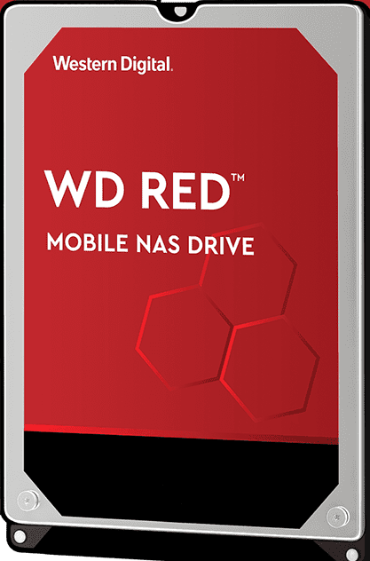
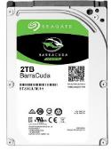

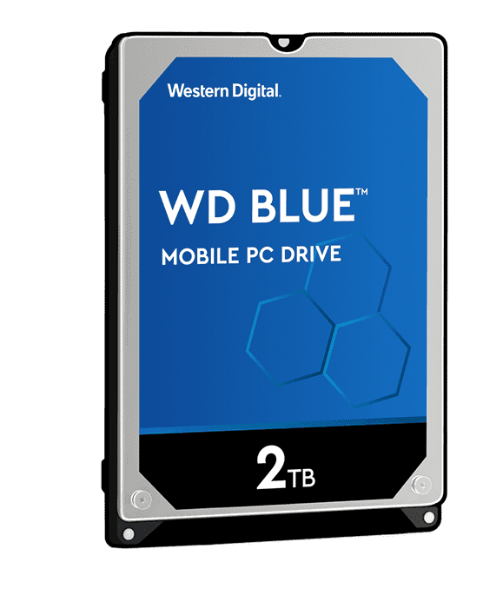
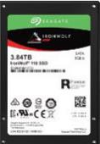

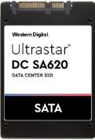
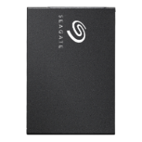
Choose the HDD/SSD for Guardian
Hard Disk
(HDD)
For long-term continuous writing applications (e.g. surveillance), mass storage users
Suitable for NAS
Maximum capacity up to 2TB
High performance & capacity
Maximum capacity up to 2TB
General PC storage use
Maximum capacity up to 2TB
Solid State (SSD)
For users who are looking for efficient computing power
High performance & capacity
Maximum capacity up to 1.92TB
General PC storage use
Maximum capacity up to 2TB
Suitable for NAS
Maximum capacity up to 3.84TB
Visit QNAP website for more supported HDD

Slide 12
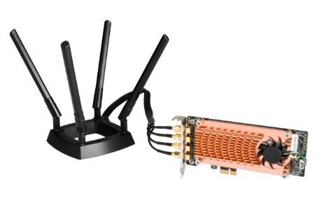
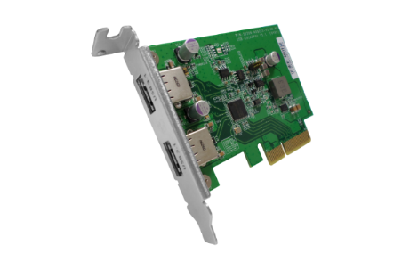
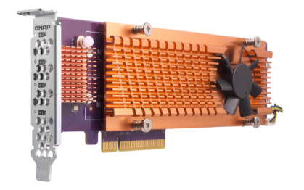
Extend Guardian functionality with the PCIe slot
The Guardian QGD-1600P features two PCIe expansion slots, and you can flexibly configure a variety of QNAP PCIe expansion cards as needed.
QM2
QWA-AC2600
USB 3.1 Gen 2 (10Gbps)
SSD
QM2-2S-220A
QM2-2P-244A
QM2-2P-344
SSD+NIC
QM2-2S10G1T
QM2-2P10G1T
QWA-AC2600
USB-U31A2P01
Notes:
QGD-1600P具備二個 PCIe 擴充槽，讓應用更廣、效率更高。您可依需求彈性配置 QNAP QM2 M.2 SSD/10GbE PCIe 擴充卡，在QGD-1600P上增添 M.2 SSD 快取或 10GbE 網路傳輸；相容無線網卡 (如：QNAP QWA-AC2600) 搭配 WirelessAP Station 讓QGD-1600P成為無線網路基地台；USB 3.1 10Gbps 擴充卡可輕鬆連結外接式 USB 儲存裝置，透過 USB 介面快速完成影音媒體等大檔傳輸。

Slide 13

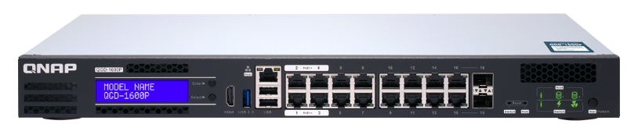
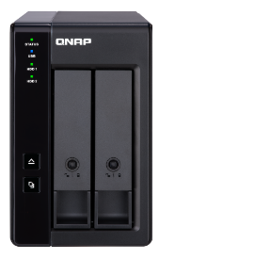
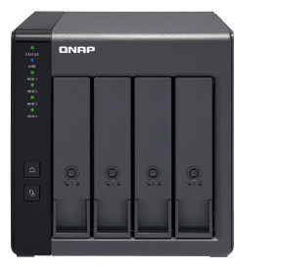
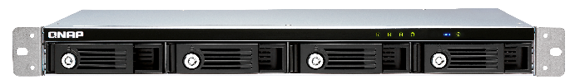
Efficient and economical, flexible expansion of storage space
The TR-002/004 and TR-004U are the best choice for you to expand your Guardian storage space. The USB 3.0 Type C transmission interface makes storage and backup tasks smoother!
USB 3.0
USB 3.0
USB 3.0
TR 002
RAID enclosure
TR 004
RAID enclosure
TR 004U
RAID enclosure
Notes:
iSCSI initiator, VJBOD, USB JBOD (3.0, 3.1), USB External RAID Device, External Storage Device (USB Disk), HybridMount, VJBOD Cloud.
Thunderbolt JBOD, SAS JBOD, TL SATA JBOD

Slide 14
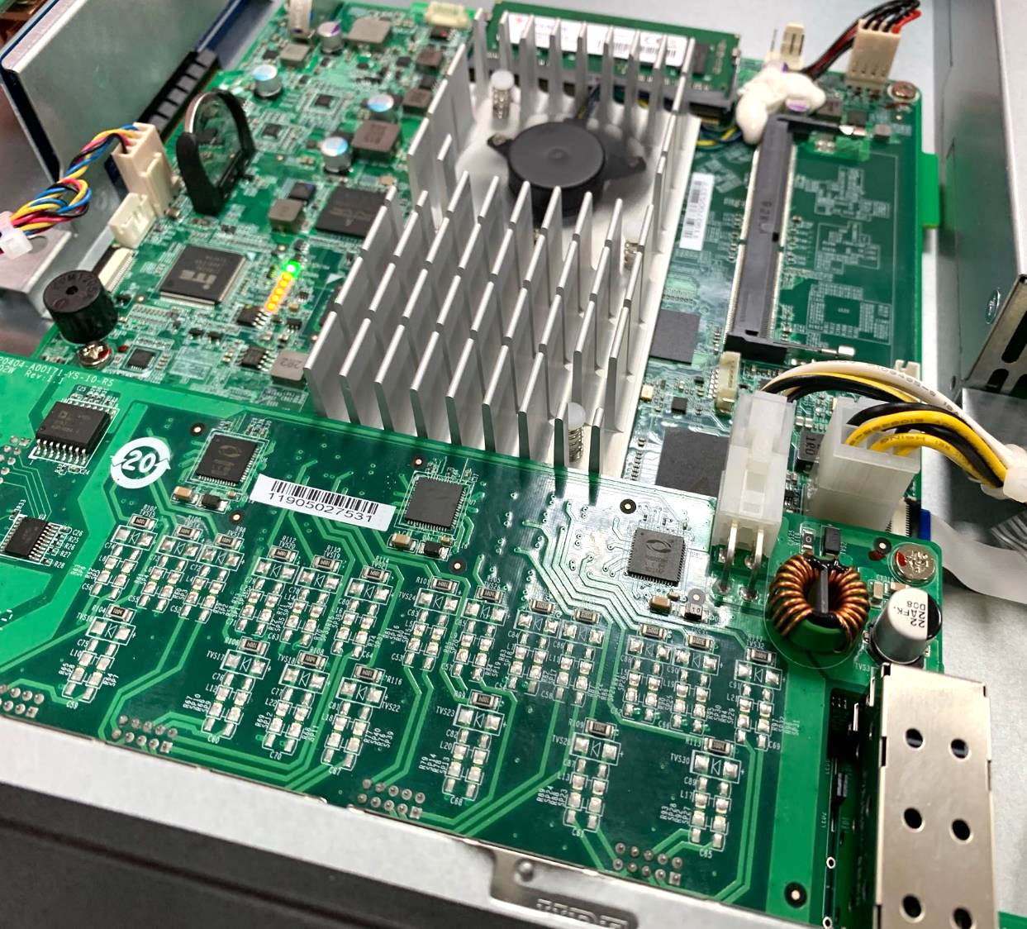
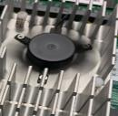
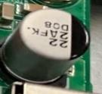

High quality hardware components
Smart fan heat sink
Support automatic and manual adjustment of fan speed, effectively improve the hardware cooling capacity of the mechanism
All solid capacitor
Long life, high thermal stability and low impedance at high frequencies
Power noise filter
Reduce electromagnetic interference conducted on the power line between the device and the power supply
Notes:
fan-cooled heat sink

Slide 15
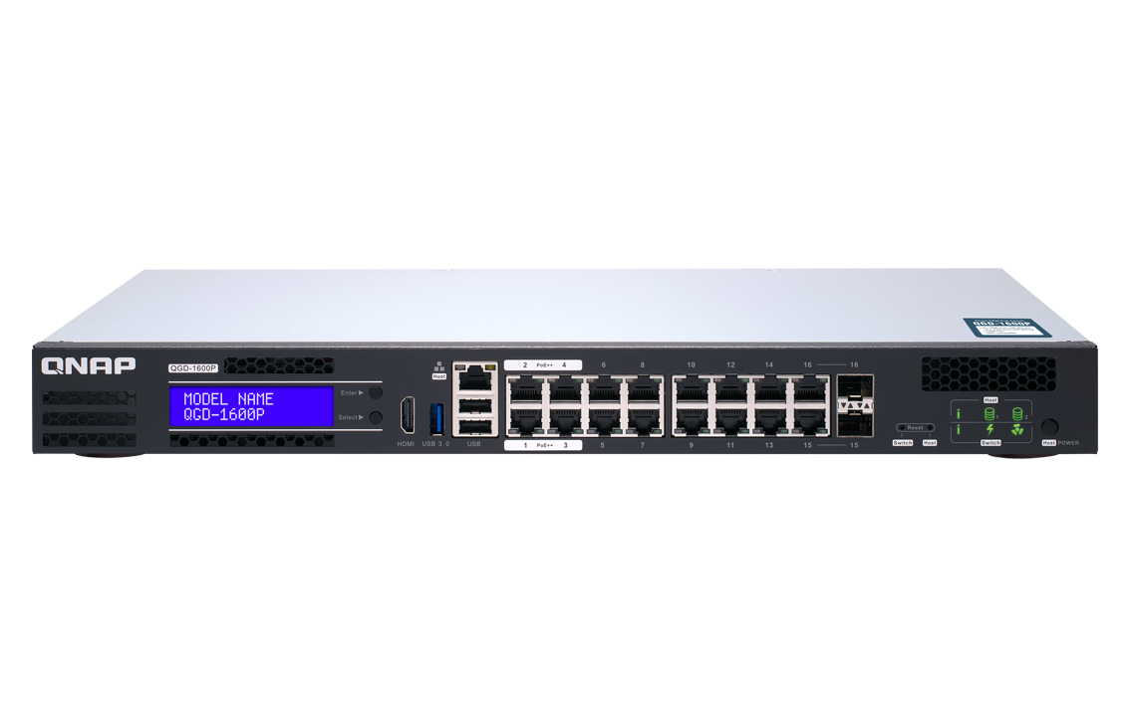
Metal body, efficient heat dissipation and anti-interference
With metal body design, the thermal conductivity is better, the heat dissipation is more outstanding, and the electromagnetic interference can be effectively shielded to ensure long-term stable operation, which provides a strong guarantee for the efficient and stable operation of the overall network.

Slide 16
LIVE DEMO

Slide 17

































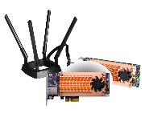





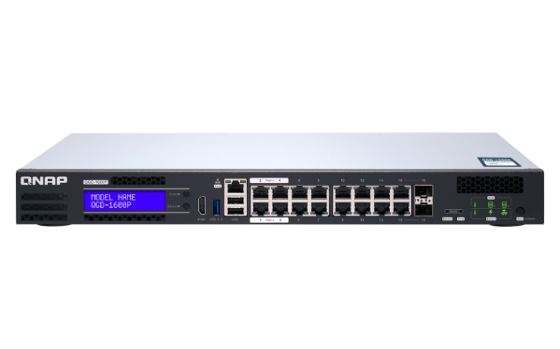


QGD-1600P software architecture
Docker Service
Support remote storage, cloud storage via VJBOD Cloud or HybridMount
QTS Operating System
CentOS
Cloud manager
SMB / NFS / AFP / FTP / RTRR / iSCSI
QVR Pro
MySQL
Ubuntu
Cloud agent
Mobile apps and utilities
VJBOD
App Center
VM Service
Container Station
RouterOS
AP Controller
Storage management
Object-based Storage
File-based Storage
QTS
App Center
VM management
(KVM)
Linux Host
SIP Server
device management
RAID expansion enclosure
Guardian Network Switch Manager
Virtualization Station
Network & Virtual Switch
External devices
Network & Virtual Switch
Physical Switch
Virtual Switch

Slide 18
L2 Network Management advantages
Guardian's unique strengths and features

Slide 19
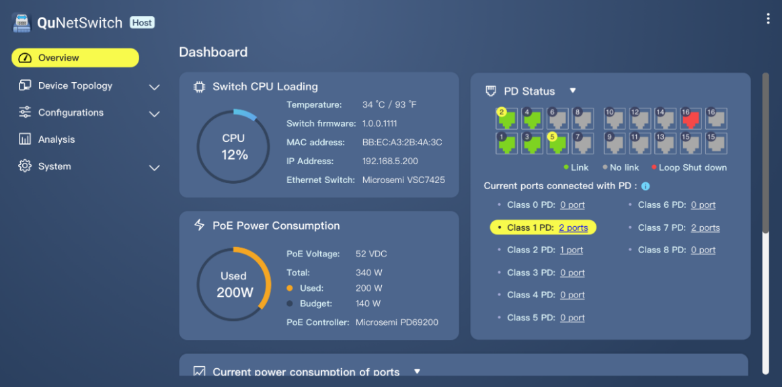
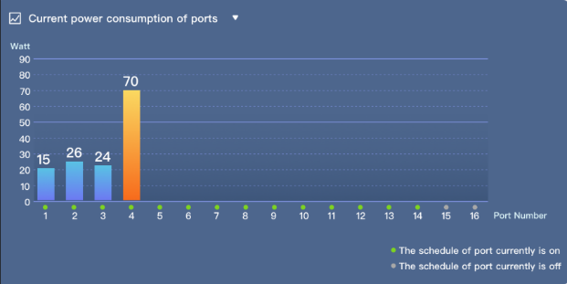
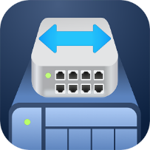
QuNetSwitch's friendly and intuitive graphical management interface
Guardian provides an intuitive and friendly web management interface that allows users to easily perform device monitoring, configuration, firmware updates, and advanced network management functions.

Slide 20
Complete Layer 2 network management function
IGMP Snooping
VLAN
Optimizing multicast performance helps in-line media streaming, VoIP and other bandwidth-intensive applications that are sensitive to time delays.
Enhance network security by isolating traffic within the enterprise based on requirements such as administrators, general users, employees, or visitors.
Link Aggregation (LACP)
Quality of Service
Combine two physical lines to form a high-speed virtual data transmission path, increase transmission speed, and enhance network connection reliability.
Different network usage priorities can be configured according to the port or VLAN group to ensure the quality of service and optimize network transmission efficiency.

Slide 21
Complete Layer 2 network management function
Access-Control List (ACL)
Loop detection and protection
Support for access control mechanisms, you can set multiple access rules, specify specific protocols, IP addresses, subnet masks, and port access conditions.
When the network generates a loop, the network that generates the loop will be closed, effectively avoiding network interruption.
Port Mirroring
Jumbo frame
Allows network administrators to capture data (packets) for specific ports to monitor the network or troubleshoot.
Support Jumbo fram huge packet selection, which helps improve overall data transmission efficiency.

Slide 22
PoE Features and advantages
Guardian's unique strengths and features

Slide 23
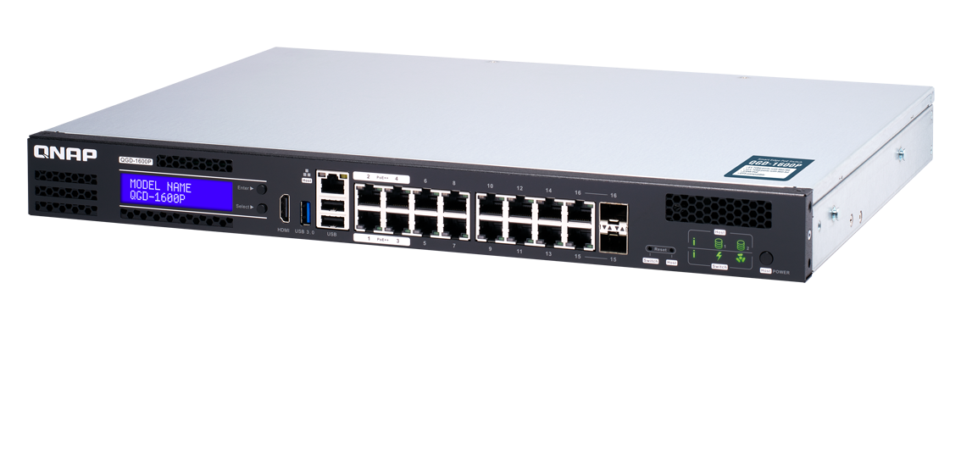
Guardian Smart Edge PoE Switch- PoE Advantages
Supports the new generation of IEEE 802.3 bt
power supply standard
Camera device remote restart
PoE scheduling
Power supply priority configuration
High total power supply rate design 370 watts PoE power supply budget
Remote intelligent monitoring and management interface
Support 4 Port 60 watt (PoE++)
12 Port 30 watt(PoE+)

Slide 24
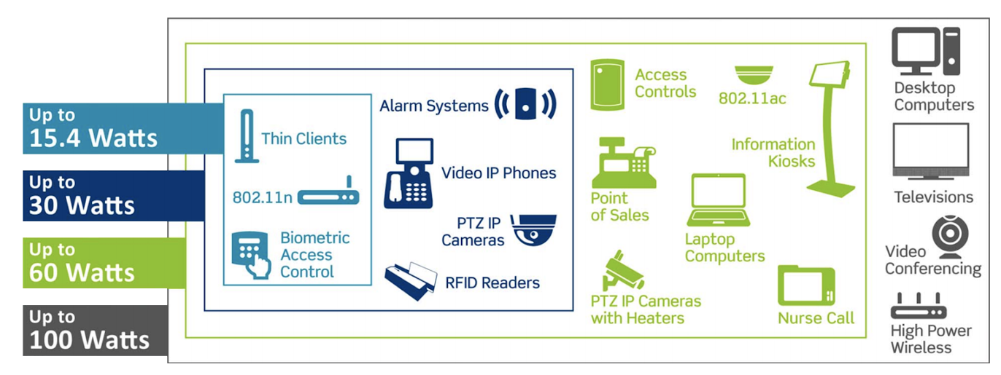
QGD-1600P support the new generation of
IEEE 802.3 bt power supply standard
Supports the latest IEEE 802.3bt power protocol, supporting 60 watts per port, compatible with IEEE 802.3at / af power standard, with 4 ports 60 watts and 12 ports 30 watt PoE ports, capable of outputting up to 370 watts of total power, meeting various high-power PoE power supply devices.

Slide 25


Support PoE device remote restart
When the administrator finds that the PoE device is not working properly, for example, PoE camera is down. Administrators can remotely reboot the device through the Guardian managed interface, saving time and effort.

Slide 26
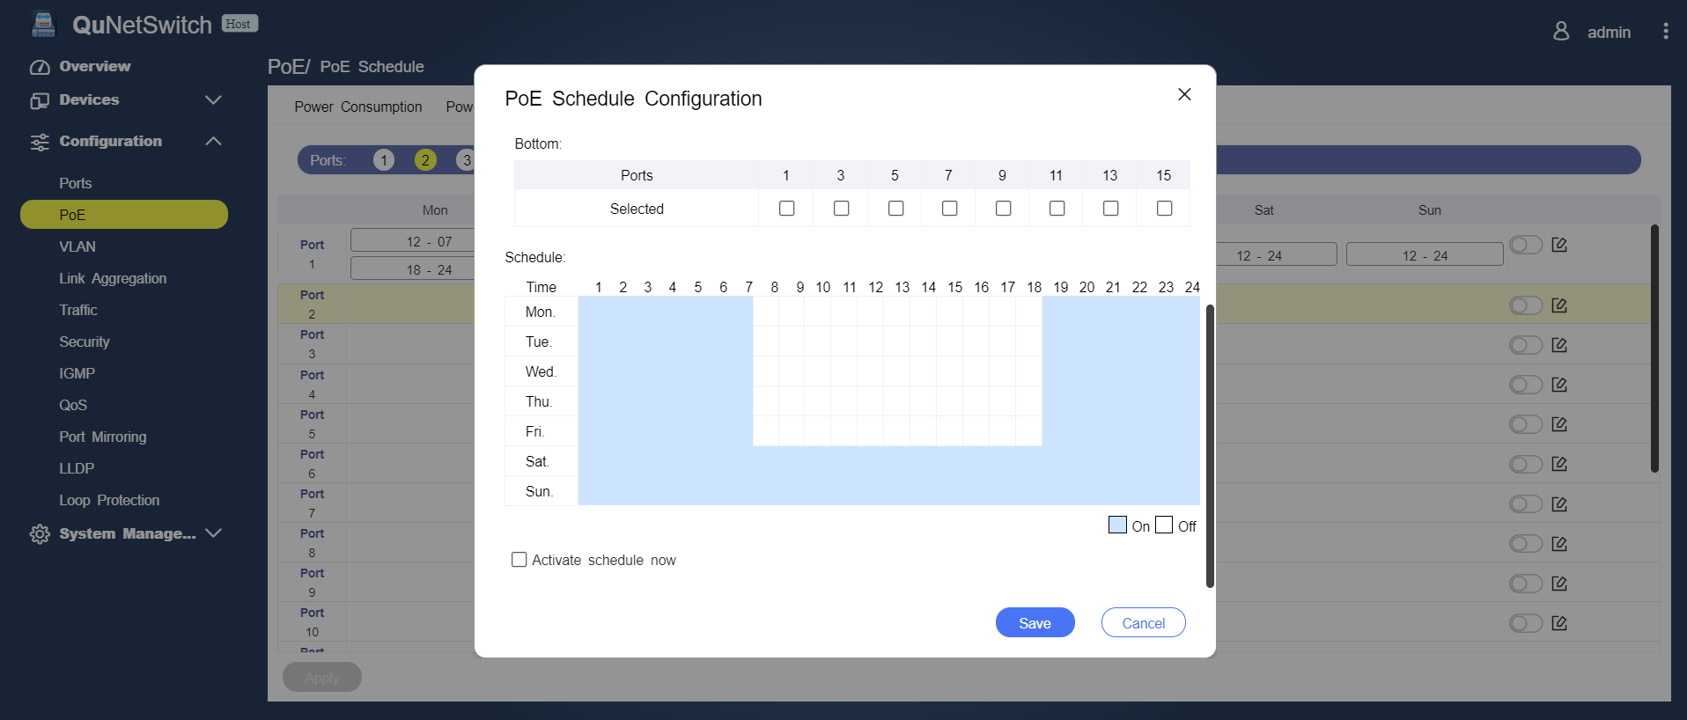
Support PoE power scheduling management
With PoE scheduling function, it can set the power supply only on the specified working day and time to save energy and save electricity, and save extra power cost for you!

Slide 27
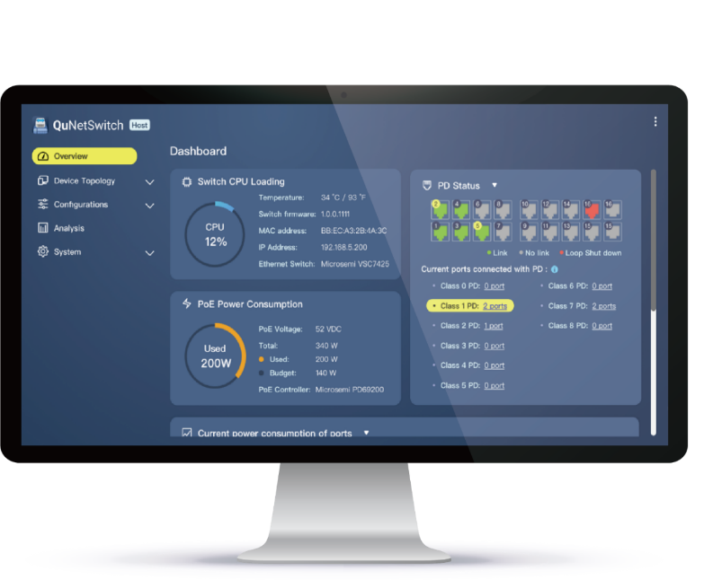


Support remote login management interface
Guardian supports the PoE remote management interface, allowing you to remotely log in and manage your PoE devices wherever you are, allowing you to monitor your device's power usage immediately.

Slide 28
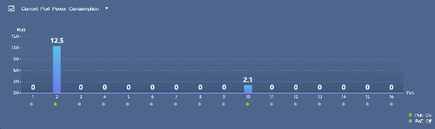
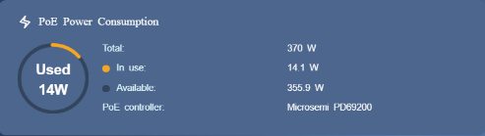
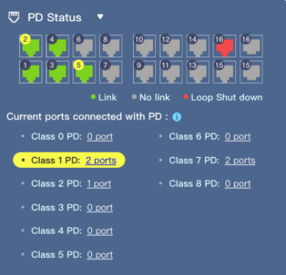
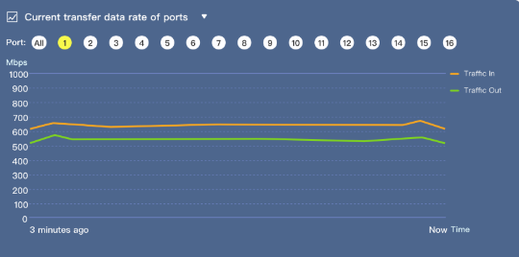

Rich graphical data display
Guardian provides rich graphical PoE data information, including timely power consumption status, available wattage information, and various PoE operation status, so that enterprises can effectively grasp the power usage status of the equipment.
Graphical Dispaly

Slide 29
QTS Applications
Guardian's unique strengths and features

Slide 30








Guardian X QVR Pro complete solution
QVR Pro
QVR Pro Client
QVR Center
QVR Guard

Slide 31



Guardian X QVR Pro complete solution
Instant Playback
Dynamic Layout
Region of Interest
Monitor the live view of multiple channels and play recordings on a single interface. With just one click you can switch between live, individual playback and sync playback modes. You can also view recordings at a specific time by clicking the time line or by selecting a time range.
The QVR Pro Client provides a highly-customizable display panel. You can change each channel’s display ratio, arrange the display, or use the built-in display module to fulfill your surveillance needs.
The updated Region of Interest (ROI) feature supports multiple regional images from the same camera in live view and playback mode. You can define and enlarge multiple areas on the overview image with no selection limitations or additional licenses required.

Slide 32



Guardian X QVR Pro complete solution
Qdewarp Technology
E-map
Multiple Notification Methods
The innovative Qdewarp enables users to view standard fisheye camera recordings in proportional ratios and sizes without affecting original recordings. The distorted parts on the edges can be turned into a clear panoramic view.
If an event occurs, you can quickly know the camera’s location on the e-map to ensure a timely response.
The event notification provides multiple ways of being informed of emerging events, including flashing red borders of channels, alert buzzers, and the motion icon on the e-map.

Slide 33






Run virtual machine and container, one machine and multiple systems
Virtualization Station and Container lead a full range of hybrid virtual application solutions. Regardless of your needs, you can rely on QNAP's complete virtualization application support. Choosing the right deployment strategy for your virtualization needs can be easy!
Virtualization Station
Container Station
Notes:
Virtualization Station 可讓您在 QGD-1600P上運行多個 Windows®、Linux®、UNIX® 及 Android™ 虛擬機 (Virtual Machine)，並透過瀏覽器或 Virtual Network Computing (VNC) 連線管理虛擬機。企業組織可利用 NAS 上的多個虛擬機執行不同的伺服器應用。
Container Station 整合 LXC 與 Docker® 兩項輕量級技術。您可在 Docker Hub® 線上市集下載來自全球各地數以千計的應用程式，輕鬆匯入/匯出軟體容器與設定存取權，享有安裝簡便，可移動、有效率的諸多好處。

Slide 34

Guardian provides fast and convenient VM build services
Traditional NAS + Switch
Guardian solution
RouterOS
VM
VM
RouterOS
VM
VM
Virtualization Station
Guardian vSwitch Mode VM Installer
Virtual Switch
Virtual Switch
NIC
NIC
WAN
LAN
Internet
LAN Networking Devices
Internet
LAN Networking Devices

Slide 35



Support VM Installer for quick and easy VM software setup
Simple installation three steps, saving a lot of construction troubles.
1
Select the VM service you want to install
2
Set the corresponding WAN Port
3
Finish the settings

Slide 36




Double your productivity
Access files on external devices
Full-text Search
File Digitalization
Smart Filing
File Station
Use File Station to directly access files on USB devices - including optical disc drives. Files from USB devices can be easily backed up to the TS-328.
Qsirch
Qsirch supports keyword search for finding images, music, videos, documents, and emails, making it easier than ever to locate files.
OCR Converter
OCR Converter extracts text from images, helping to facilitate file organization, editing, and searching.
Qfiling
Qfiling automates file organization. Files are automatically archived into folders based on your settings.

Slide 37























QTS / Guardian Storage
VJBOD Cloud
Block based Cloud Gateway
Cloud Storage
Customer
File System
Ethernet
iSCSI
Target
Object
Storage
Object
Storage
Object
Storage
Block Access
VJBOD Cloud LUNs
LUN Size Provisioning
Dedicate
Stored space
Object
Storage
Connector
Fibre Channel
Local
Applications
VJBOD Cloud
Volume
(EXT4 File System)
Dedicate
Stored space
Object
Storage
Connector
Local Servers
File Access
File Services
SMB
HybridMount (Mode 1)
File based Cloud Gateway
NFS
Dedicate
Cache Volume
Cloud File
Storage
Cloud File
Storage
Cloud File
Storage
File Access
AFP
Virtual
File System
Object
Storage
Connector
Local Users
File Access
FTP
Dedicate
Cache Volume
Cache Engine
Cloud
File
Connector
Web
DAV
Local Disks/SSDs
Remote Storage
Qsync
HybridMount (Mode 2)
File Station Mount
Cloud
Connector
WebDAV
File
Station
SMB
NAS
File Access
File Access
File Station Access
Qfile
Remote
File
Connector
FTP
Data center

Slide 38












Local data cloud backup solution
Cloud object
storage space
APP Center
Stoerage & Snaphots
QNAP's VJBOD Cloud feature is a block-based Gateway block cloud gateway.
The VJBOD Cloud Gateway allows users to easily connect to the cloud's storage and convert it to disk on the local side.
Enterprise IT staff or general users can use the more familiar file access protocol (NFS, SMB, AFP, FTP, WebDAV) for access.
Snapshot
SMB
NFS
AFP
FTP
Client
WebDAV
Storage Space
Cloud Volume
(ext4 file system)/Shared Folder

Slide 39




HybridMount 2 Modes On Your Demand
 | File Station Mount | File Cloud Gateway
Setup Method | Mount cloud drives | Choose ”File Cloud Gateway” mode and create a cache space
Connections | No limit | 2 life-time free connections Buy license for more connections
Accessing Performance | Depends on network speed | High performance due to the cache space
Access in File Station | Supported | Supported
Access in SMB / NFS / AFP | NOT Supported | Supported
Sync with Cloud | Sync only when browsing | NOT Supported
Support QTS application | NOT Supported | Supported ...

Slide 40




Synchronization and co-management of global multi-site office files
With a cloud space, it can be accessed all over the world and achieve file synchronization. Collect data from global locations and freely expand space.
Configure Guardian as a file-based cloud gateway at each point office.
Easy and efficient access to the cloud by office users
Support access protocol
local cache allows access to cloud files as if it were a local experience
Taipei
Tokyo
New York
Eliminate the traditional VPN time-consuming and laborious access method

Slide 41




QNAP QvPC Innovation Technology
With QNAP's exclusive QvPC technology (QNAP virtualized Personal Computer Technology), you can connect your Guardian to a keyboard, mouse, and connect to the monitor via HDMI to use the Guardian switch as a PC.
Connect the mouse keyboard,
Guardian Switch can also be used as a PC

Slide 42




HD Station rich application
A variety of web apps let you get started quickly.
QTS
QVR Pro Client
QVR Pro Client can also view monitoring screens directly
File Station
QuNetSwitch

Slide 43
  Multi-purpose for one machine: Guardian's practical application in various environmental architectures

Slide 44




Guardian brings a new IP surveillance integrated solution
Traditional IP monitoring Deployment
Guardia IP monitoring Deployment
Internet
Internet
Managed
Switch
IP Camera
IP Camera
Router
NVR
PoE
Router
Guardian Smart PoE Switch
Monitor
Monitor
Need to buy a variety of equipment, cost increases
Complex wiring, difficult to build and maintain
Low scalability, difficult to cope with future changes
One machine can meet storage, NVR, router, PoE power supply
A new generation of IEEE 802.3bt PoE power supply for all kinds of high-profile cameras
Highly flexible function deployment, high scalability
Notes:
https://www.unifore.net/ip-video-surveillance/network-video-surveillance-visio-icon-library-free-download.html

Slide 45

ISP
internet
TS-1685
Guardian X QVR Pro
Individual User Deployment Diagram
VJBOD
USB 3.0
TR-002 / TR-004
RAID expansion enclosure

Slide 46




Guardian X QVR Pro
Enterprise User / Multipoint Management
A
VJBOD
C
VJBOD
QVR Pro
QVR Pro
Internet / Intranet
PoE Switch
PoE Switch
VJBOD
VJBOD
B
D
QVR Pro
QVR Pro
PoE Switch
PoE Switch
Remote NAS

Slide 47












Guardian Commercial Wireless AP Integrated Solution
Traditional Deployment
Guardian solution
UniFi Cloud Key
UAP-AC-PRO
UAP-AC-LR
UAP-AC-M
UAP-AC-PRO
UAP-AC-LR
UAP-AC-M
Advantages
One machine covers all features, saving a lot of space
Highly expandable capabilities to meet future growth needs
Integrated solution
myQNAPcloud
UniFi
Controller
pfSense
(DHCP Server)
US-16-150W
LAN
WAN
Guardian Smart PoE Switch
USG-PRO-4
Remote Access to UniFi Controller
Remote Access to UniFi Controller
Hybrid Cloud
Internet
Notes:
https://fccid.io/SWX-UAPACM/User-Manual/User-Manual-3092355
https://www.amazon.com/Ubiquiti-Unifi-Security-Gateway-USG-PRO-4/dp/B019PBEI5W
US-16-150W 279USD
Cloud Key 195USD
USG-Pro-4 287USD

Slide 48

Guardian X RouterOS X QWA-AC2600 network solution
Support for installing RouterOS, OpenWrt
VPN encryption transmission can be established at each office
Share the wireless network to the device with the QWA-2600AC wireless network card
WiFi
NAS
Device
Access Control
IP CAM
IoT
IP CAM
LAN
LAN
QWA-2600AC
HQ QGD with RouterOS
WAN3
Branch QGD with RouterOS
WAN1
Internet
WAN2
VPN Tunnel
Internet

Slide 49







Guardian X pfSense solution
QGD-1600P supports the installation of pfSense firewall software on virtual machines to effectively block external network intrusion threats. In addition, for enterprise intranets, protection and blocking can be implemented according to requirements, which can effectively improve the information security of devices in each intranet.
Office A
Office B

Slide 50

Guardian brings IP Phone integrated solution
Traditional VoIP Phone Deployment
IP PBX
IP PBX
Internet
Internet
Location B
Location C
IP PBX
Internet
Router
Location A
Voice Gateway
PSTN
Voice Gateway
Notes:
http://www.sipnet.com.tw/voip-sip/fxs-fxo.htm

Slide 51

Guardian brings IP Phone integrated solution
Guardian solution
IP PBX
IP PBX
Internet
Internet
Location B
Location C
Router
Internet
Location A
Voice Gateway
PSTN
Voice Gateway

Slide 52
  Guardian’s diverse use scenes

Slide 53













Guardian solution for
Restaurant and Retail Store
PoE
Surveillance
Powering multiple cameras and integrating QVR Pro solution
Electronic menu
Provide power and networking capabilities
Point of Sales
Consumption behavior analysis and data storage
Wireless Access
Provides AP device power and supports installation of AP Controller software
Digital Signage
Provide power and content management
Data storage/backup
Save customer data, work documents, letter materials

Slide 54














Guardian solution for
SMB and workstation
PoE
Surveillance
Powering multiple cameras and integrating QVR Pro solution
Wireless Access
Provides AP device power and supports installation of AP Controller software
Network device
Provide Network management and Internet access requirements for devices
Firewall
Protect corporate internal network from external intrusions and internal network attacks
Wake on Lan
allows a computer/ NAS to be turned on or awakened by a network message

Slide 55







Chain store solution
Install a Guardian switch at each branch to create a complete solution and back up the data to headquarters through remote storage.

Slide 56

Create a one-machine surveillance solution
Live Demo
TS-1685
ISP
Internet
Description：
Soft routing software installed on a virtual machine
Install QVR Pro
Expand your storage with VJBOD & USB RAID
With QWA-2600AC network card, support more devices wireless networking
VJBOD
QWA-AC2600
USB 3.0
TR-002 / TR-004
RAID expansion enclosure

Slide 57
Different from the traditional PoE exchangers on the market, you have a better choice!
Guardian
Smart Edge PoE Switch

Slide 58
Guardian Smart Edge PoE Switch：
Four benefits of all-in-one integrated solution
1
2
3
4
Reduce costs
No need to buy a variety of different equipment, a single device can meet the needs of use; and save the cost of AC power, power lines, plugs and other materials.
Reduce learning costs
A single centralized management interface that saves you the cost of learning familiar with the operation of different devices.
Reduce maintenance costs
Provide you with a safer and more secure enterprise solution, no need to worry about the risk of single equipment damage, and effectively reduce the cost of subsequent maintenance.
High expandability
Highly flexible functional design to effectively meet the needs of the company's future growth environment.
Guardian QGD-1600P

Slide 59
Your Best Choice

