Slide 2
Dual port 10GbE Multi-Gig Expansion Card QXG-10G2T-107
QNAP Unmanaged 10GbE Switch
QNAP High Speed NIC series

Slide 3
Dual port 10GbE Multi-Gig Expansion Card QXG-10G2T-107

Slide 4
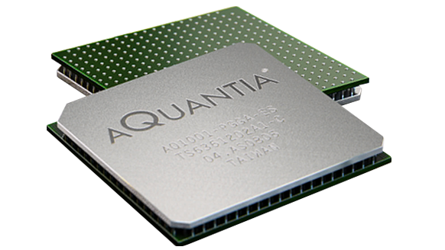
10GbE Multi-Gig Alliance
Strong investors & NBASE-T Alliance
Multi-Gig Leading solution Aquantia
10Gbps
5Gbps
2.5Gbps
1Gbps
100Mbps
Used in various solutions
Notes:
QXG-10G1T 中文簡報
https://www.google.com/search?rlz=1C5CHFA_enTW756TW756&biw=1440&bih=637&tbm=isch&sa=1&ei=UN1kXZiSL5bi-AalmZ3IDA&q=nbase-t+alliance&oq=nbase-t+all&gs_l=img.1.0.0i24.109121.110302..112358...1.0..0.49.211.5......0....1..gws-wiz-img.......0i30._zAQ-T5AKIc#imgrc=8zR5tpChhW-eTM:

Slide 5
Flexible options between 1 to 10Gbps
1Gbps
10Gbps
100Mbps
1Gbps
2.5Gbps
5Gbps
10Gbps
CAT 6 above cable is required
10GbE switch investment
Original CAT 5e can reach to 5Gbps
CAT 6 above cable reaches 10Gbps
Low cost 10GbE NBASE-T switch

Slide 6
Take advantages of existing infrastructure
Current LAN cables may already be capable for > 1Gbps speeds!
 | CAT 5e | CAT 6 | CAT 6A & CAT 7
100M | ✔ | ✔ | ✔
1G | ✔ | ✔ | ✔
2.5G | ✔ | ✔ | ✔
5G | ✔ | ✔ | ✔
10G | X | ✔(55m) | ✔
Notes:
QXG-10G1T 中文簡報

Slide 7
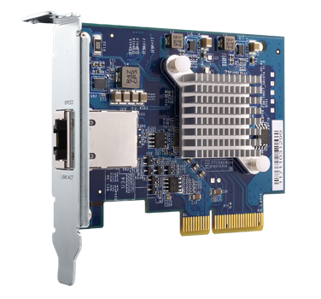
QNAP Multi-Gig Expansion Cards
Single-port
QXG-10G1T
Dual-port
QXG-10G2T-107
Single-port 5-speed 10GBASE-T (RJ45)
Dual-port 5-speed 10GBASE-T (RJ45)
AQtion AQC-107
AQtion AQC-107S

Slide 8
Low profile form factor
106.8 mm
68.9 mm
PCIe Gen 2 x4 interface
Full height and QNAP flat bracket is bundled
Low profile bracket is pre-installed
Cooling heatsink and active fan

Slide 9
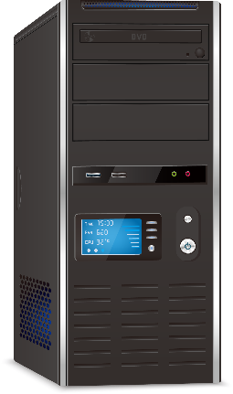
Supports QTS, Windows and Linux
PCIe supported NAS
PCIe supported PC/Workstation
The driver is featured in QTS, Please update to latest QTS version
Driver is required to download and install to your PC from Aquantia website
*the compatible QNAP NAS can be found in QNAP compatibility list
Notes:
QNA-T310G1T/QNA-T310G1S 簡報
https://www.aquantia.com/support/driver-download/

Slide 10
Multi-speed on different infrasturcture
1GbE
Download: 118MB/s
Upload: 118MB/s
Download: 581MB/s
5GbE
Upload: 581MB/s
Download: 1157MB/s
10GbE
Upload: 1134MB/s
MB/s
PC featured QXG-10G2T-107 transfer 10GB file to TVS-672N via QSW-1208-8C
CPU: Intel (R) Core(TM) i7-6700 CPU@ 3.40GHz. 2. OS: Windows 10. 3. Memory: 64 GB. 4. 1GbE NIC On board 5. 10GbE NIC: QXG-10G2T-AQC107

Slide 11
Performance Demo
10GB file drag-and-drop via 10Gbps

Slide 12
QNAP Unmanaged 10GbE Switch

Slide 13
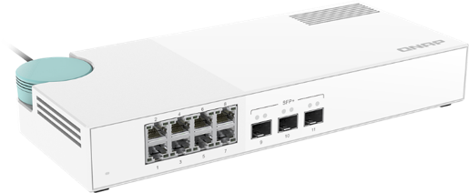
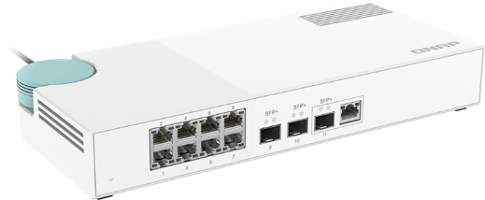
QSW 10GbE NBASE-T Switch
QSW-1208-8C
QSW-308S
QSW-308-1C
Provides 12 ports of 10Gbps transfer
QSW-804-4C
Use 10G-SFP-T copper transceiver module
for link up copper cable
Use 10G-SFP-T copper transceiver module
for link up copper cable
3 x SFP+ 10GbE
8 x 1GbE RJ45
3 x SFP+ 10GbE port
(built-in 1 x 10GbE NBASE-T Combo port)
Support: 10Gbps/5Gbps/2.5Gbps/1Gbps/100Mbps
8 x 1GbE RJ45 port
Provides 8 ports of 10Gbps transfer
Notes:
QSW-308

Slide 14
Multi-Gig Port
Automatically adapts to the required speed and supports 5 networking speeds.
10G
5G
2.5G
1G
100M
Supports Multi-Gigabit NBASE-T by QSW-308-1C combo port
Notes:
QSW-308簡報

Slide 15
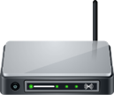
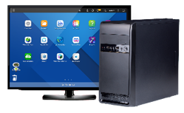
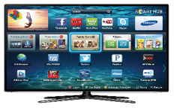
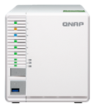
Build a high-speed home network
1G Wifi Router
Internet
1 Gbps WiFi device
QSW series 10GbE switch
1 Gbps
1 Gbps
10Gbps RJ 45
10Gbps SFP+
PC + QXG-10G2T-107 10GbE LAN Card
1G Notebook
Smart TV
NAS
NAS
Notes:
QSW-308簡報

Slide 16
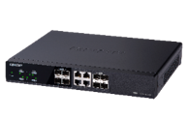
QSW series product comparison
 | QSW-308S | QSW-308-1C | QSW-1208-8C | QSW-804-4C
Gigabit Ethernet Port (RJ45) | 8​ | 8​ | - | -
10GbE – RJ45 |  | 1 | 8 | 4
10GbE – SFP+​ | 3​ | 3​ | 12 | 8
10GbE RJ45/SFP+ (Combo port) | ​-- | 1 | 8 ​ | 4
Dimensions | 290 x 50 x 42.5 mm (11.4 x 2.0 x 16.7 in) |  | 285 x 43 x 233 mm (11.2x 1.7 x 9.2 in)
Net Weight: | 820g |  | 2150g | 2100g
Power ​ | AC adapter , 36W, 100 - 240V​ |  | AC adapter , 50W, 100 - 240V​ | AC adapter , 41W, 100 - 240V​
Operating temperature | 0°C to 40°C (32°F to 104°F) |  | 0°C to 40°C (32°F to 104°F)
Fan | Fan less design |  | 2 x 4cm fan (12V DC)
Management Type | Unmanaged switch |  | Unmanaged switch
Notes:
QSW-308

Slide 17
QNAP High Speed NIC series

Slide 18
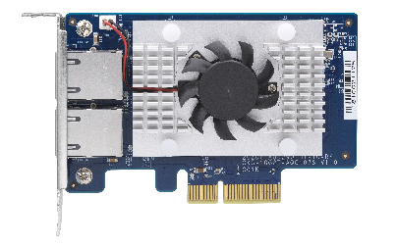
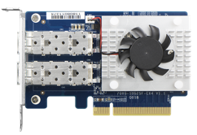
QNAP 10GbE above NIC product line
Intel
Mellanox
Aquantia
LAN-10G2T-X550
X550
Dual-port 10GbE BaseT
PCIe Gen3 x4
Low Profile
LAN-10G2SF-MLX
QXG-25G2SF-CX4
QXG-10G1T
QXG-10G2T-107
ConnectX-4
Dual-port 10GbE SFP+
PCIe Gen3 x8
Low Profile
ConnectX-4
Dual-port 25GbE SFP+
PCIe Gen3 x8
Low Profile
Aqtion AQC107
Single-port10GbE NBase-T
PCIe Gen3 x8
Low Profile
Aqtion AQC107S
Dual-port 10GbE NBase-T
PCIe Gen3 x8
Low Profile
iSER / RoCE offload
5-speed Multi- Gig

Slide 19
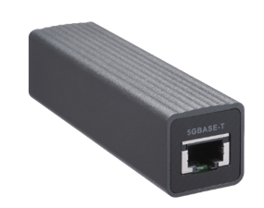
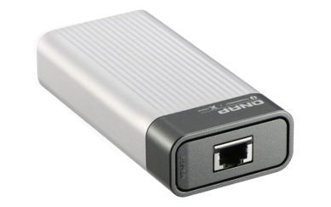
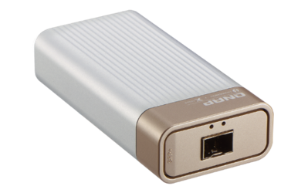
QNA series for 10GbE
QNA-UC5G1T
QNA-T310G1T
QNA-T310G1S
USB 3.0
Thunderbolt 3
Thunderbolt 3
RJ45 NBASE-T
4 speed: 5G/2.5G/1G/100M
10GbE NBASE-T port
5 speed: 10G/5G/2.5G/1G/100M
10GbE SFP+ Port
Supported speed:10Gbps/1Gbps
Notes:
QSW-308

Slide 20
QNAP Cache and 10GbE series: QM2
5-speed Multi-Gigabit NBASE-T
QM2-2P10G1TA
Single-port 10GbE NBASE-T
2 x NVMe SSD slots
PCIe Gen2 x4
Low Profile
QM2-2S10G1TA
Single-port 10GbE NBASE-T
2 x SATA M.2 SSD slots
PCIe Gen2 x4
Low Profile

Slide 21
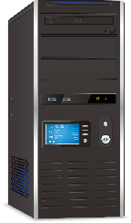
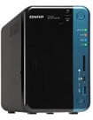
PC/ workstation speed up
1GbE
CAT 5e
CAT 5e
1GbE Switch
CAT 6
10Gbps
SFP+ or CAT 6
QNAP
10GbE NAS
CAT 5e
CAT 5e
QXG-10G2T-107
5Gbps
TVS-672N
QNAP 5GbE NAS
QSW-1208-8C

Slide 22
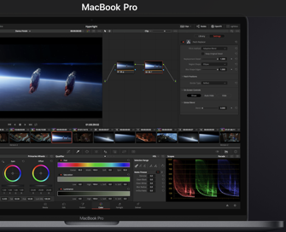
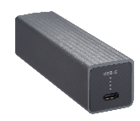
Mac/Windows laptop speed up instantly
Backup to
QNAP 10G/5GbE NAS
Video Editing workstation
Back-up your masterpiece
Thunderbolt 3
10GbE
TS-932X
Laptops for cooperation
USB 3.0
5GbE
TVS-672N

Slide 23
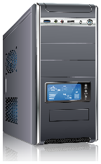
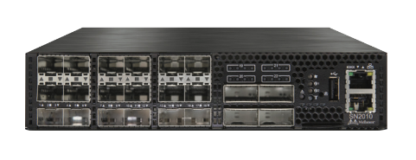
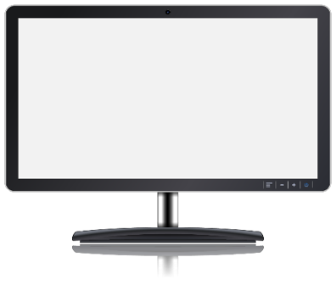
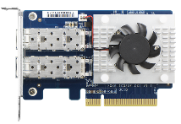
PC/Workstation 25GbE ultra speed
Speed : 962 MB/s
Speed : 0.98 GB/s
Speed : 940 MB/s
Recommended PC/ Workstation spec
Intel x86 i5/i7(or same level) above
Minimum Basic clock rate :3.3 GHz
NVMe SSD
QXG-25G2SF-CX4
QXG-25G2SF-CX4
QXG-25G2SF-CX4
QXG-25G2SF-CX4
2.9GB/s
Recommended Server spec
QNAP Intel X72 / AMD x77 above
12 x enterprise SATA SSD, RAID5 or RAID10
Notes:
25G-CX4 直播

Slide 24
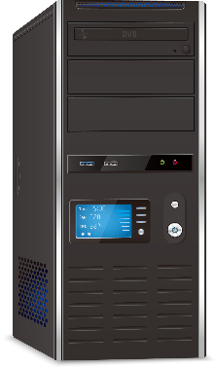
PC/ workstation 10GbE ft. Cache solution
QM2-2P10G1TA
Install 2 x M.2 SSD to improve the system cache and also enjoy the 10GbE transfer.

Slide 25
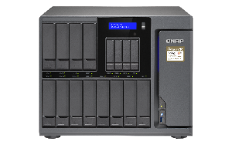
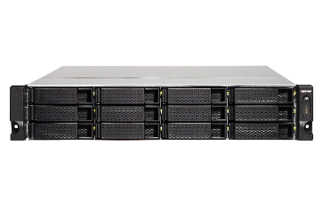
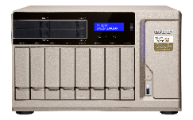
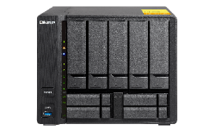
QNAP 10GbE NAS
SFP+
Internal 10GbE/5GbE
Series
ES1686dc，TES-x85U ，TDS-16489U，TVS-x80U ，TS-x83XU，TVS-1582TU，TS-x77XU，TVS-x72XU，TS-x73U ，TS-x63XU ，TS-1635AX，TS-x32X，TS-x32XU，TS-431X，
TS-431XeU
RJ45 (BASE-T)
TS-2888X，TS-1685，TS-1677X，TVS-x82T ，TVS-951X，TVS-963X，TVS-x72N，TVS-x72XT，TS-453BT3，TBS-453DX，HS-453DX
SFP+ / RJ45 (BASE-T)
Extendable 10G series
TVS-x82 ，TS-x77 ，TVS-x73 ，TVS-x73e ，TS-x73 ，TS-x53BU ，TS-x53B ，TS-x53Be ，TVS-x63
Please check the compatibility list

Slide 26
QXG-10G2T-107
is your Best Choice
Thank you !
Copyright © 2019 QNAP Systems, Inc. All rights reserved. QNAP® and other names of QNAP Products are proprietary marks or registered trademarks of QNAP Systems, Inc. Other products and company names mentioned herein are trademarks of their respective holders.

