Slide 1
Manages your small tasks so that you can focus on the bigger ones
What is Qmiix
Why we need Qmiix
What can Qmiix do
Who can use Qmiix
How to use Qmiix
Current Scope
Use Qmiix to manage daily tasks and enhance cross-platform automation
聰明管理工作任務
跨平台服務自動化，你說的算！

Slide 2
Agenda
What is Qmiix
Why we need Qmiix
What can Qmiix do
Who can use Qmiix
How to use Qmiix
Current Scope
Use Qmiix to manage daily tasks and enhance cross-platform automation

Slide 3
What is Qmiix

Slide 4
Why we Need Qmiix
What is Qmiix
Qmiix is a solution that connects your apps and devices to automate your everyday tasks
Manages your small tasks so that you can focus on the bigger ones

Slide 5
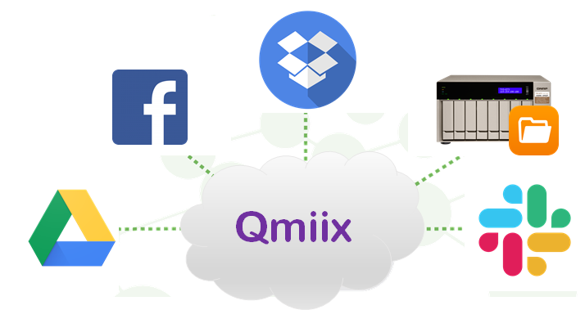
What is Qmiix
Step 1:
Qmiix can connect with different apps
Step 2:
Create workflows to boost productivity
New presentation file uploaded in a specific folder.
Backup the file on my NAS.
Additionally backup the file to my Dropbox.

Slide 6
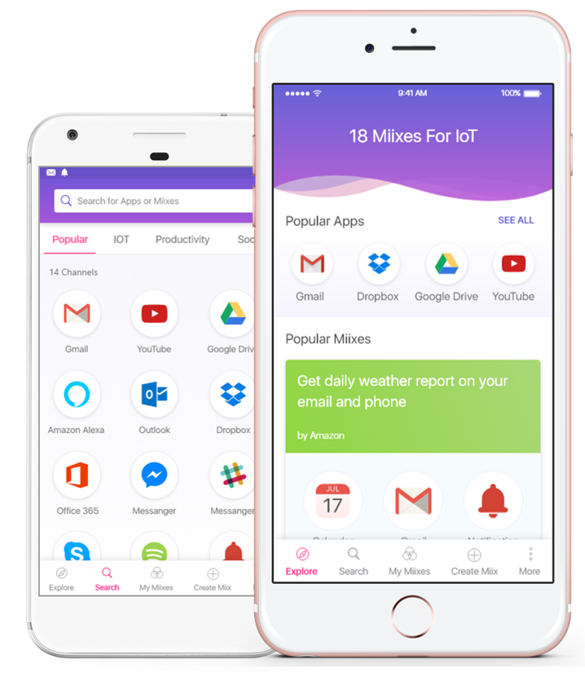
What is Qmiix
Step 1:
Qmiix can connect with different apps
Step 2:
Create workflows to boost productivity
New presentation file uploaded in a specific folder.
Backup the file on my NAS.
Additionally backup the file to my Dropbox.

Slide 7
Supported Platforms
Web
Android and iOS
Create and manage your miixes
Limited channels supported for mobile

Slide 8
Why We Need Qmiix

Slide 9
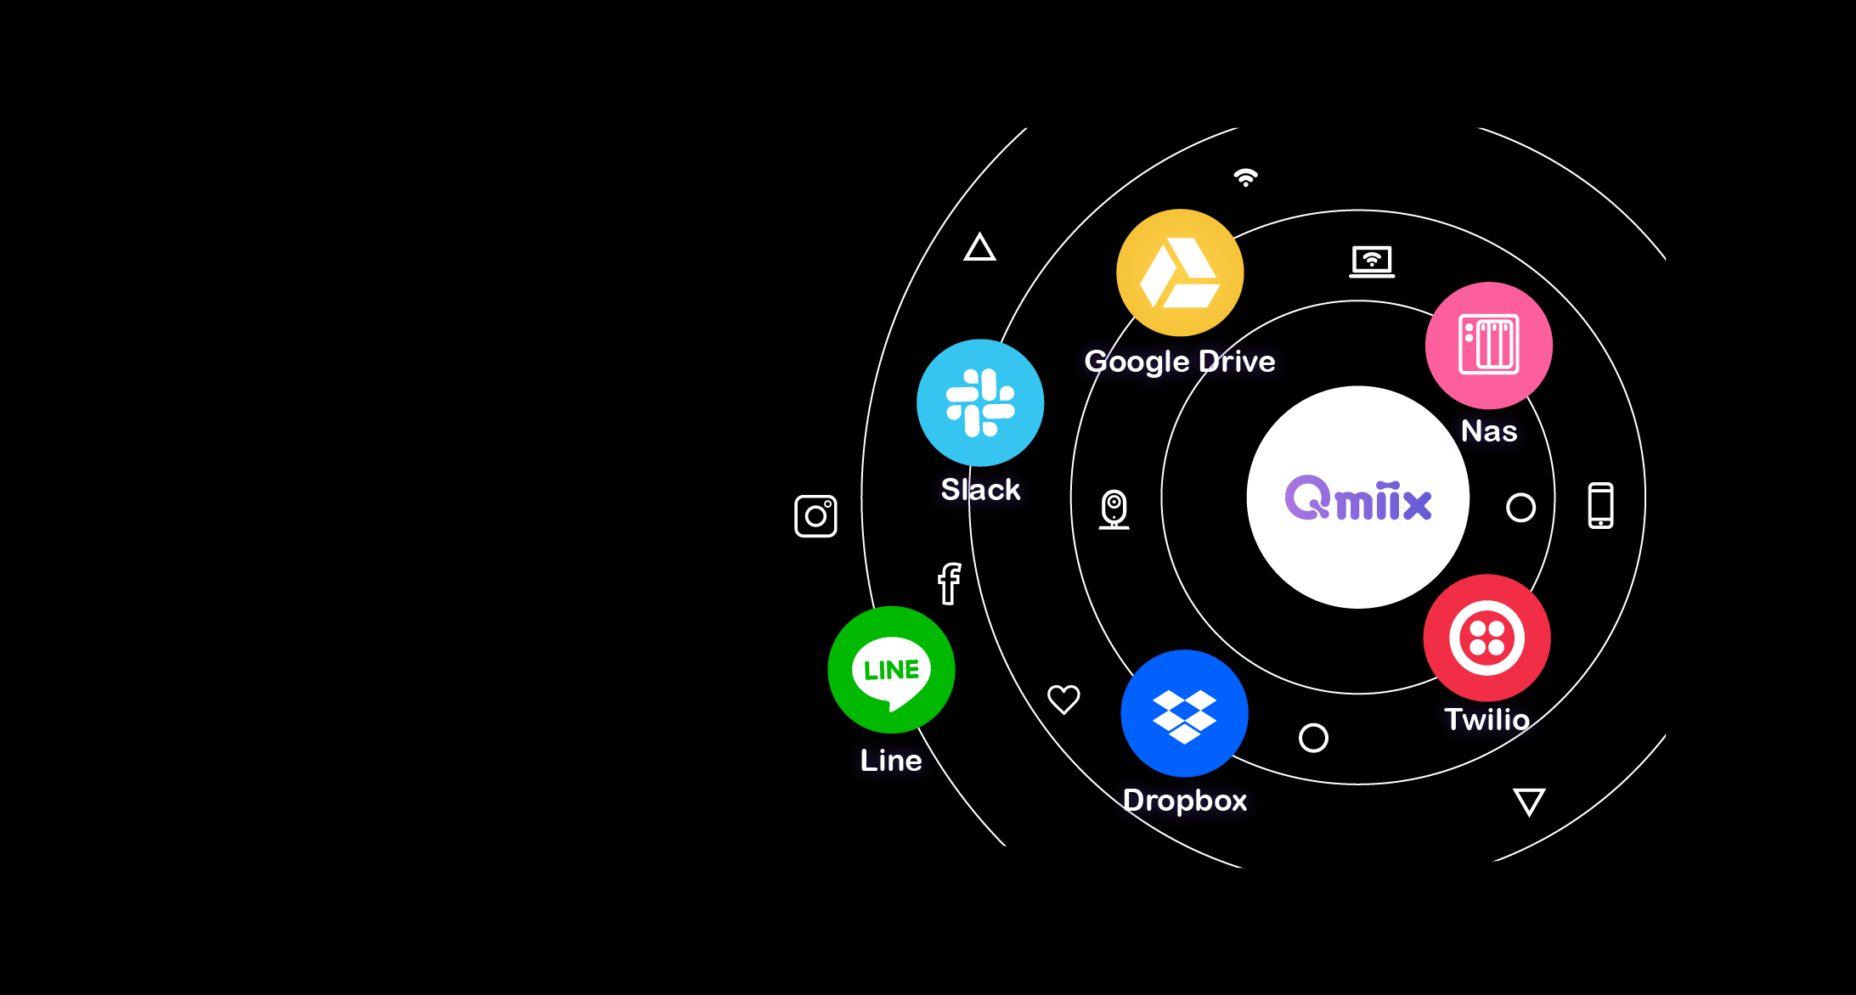
Qmiix is a solution that connects your apps and devices to automate your everyday tasks
Smart car
Qmiix brings different apps and devices together and hence bridges the gap
Nas
Smart Home
Manages your small tasks so that you can focus on the bigger ones
Surveillance
Social media
Entertainment

Slide 10
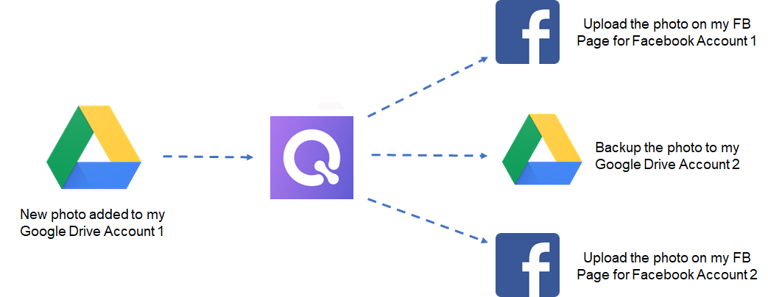
Why We Need Qmiix
Upload the photo in my Dropbox folder
Backup the photo to my Google Drive Account 2
New photo added to my Google Drive Account 1
Share the file link on our team Slack channel
Gets more work done with fewer workflows
Connects multiple accounts and devices
Saves precious time and supercharges productivity

Slide 11
What Can Qmiix Do

Slide 12
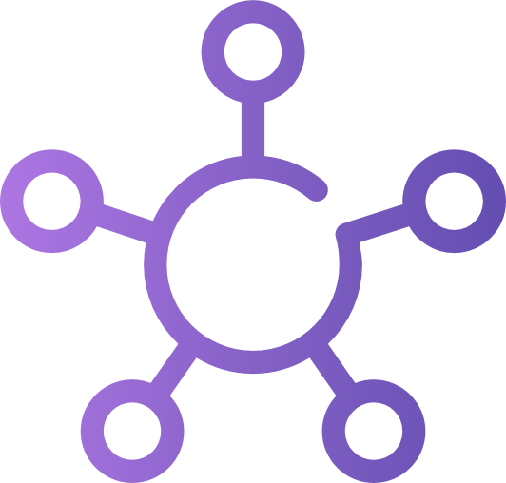
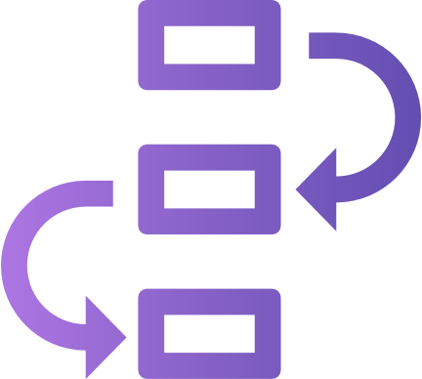
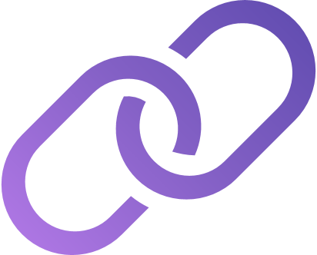
What Can Qmiix Do
Centralized Management
Advanced Workflows
Near-Zero Latency
Multiple Connections
Manage all your workflows or miixes from Web, Android or iOS
Create workflows with one Trigger and upto 5 actions
Real-time execution of your workflows
Connect with multiple accounts of the same app
Notes:
NO NEED TO CHANGE

Slide 13
Who Can Use Qmiix

Slide 14
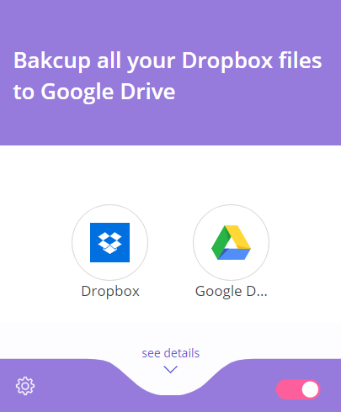
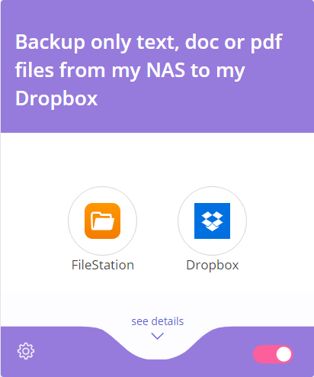
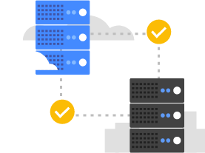
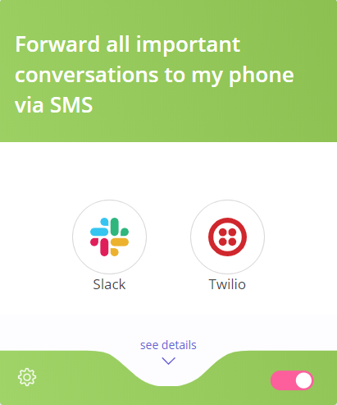
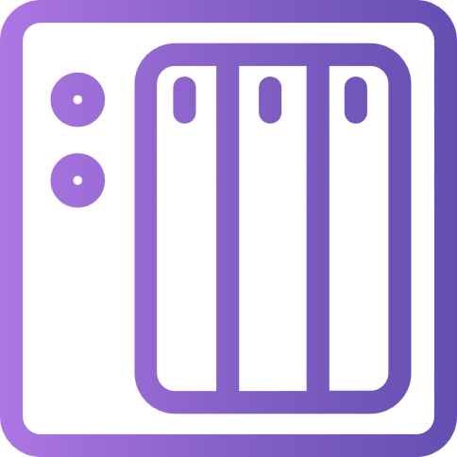
Small Business Owners Can Use Qmiix
Multi Cloud Data Transfer: Free of cost
Selective file backups for QNAP NAS
Notes:
1. Need one image here for Multi-Cloud data transfer

Slide 15
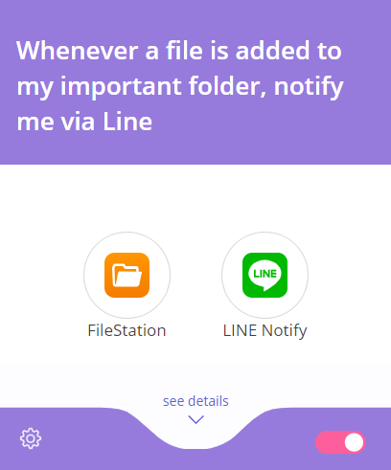
Collaborative Teams Can Use Qmiix to Save Time
Save Time and boost productivity
Never miss out on important discussions with prompt replies

Slide 16
How to Use Qmiix

Slide 17
Demo
Basic Introduction
Show all the apps
Show the Triggers and Actions for Dropbox or Google Drive
Show authentication step with Google Drive
Connect one account
Connect second account
Miix Creation: Google Drive to Dropbox
Configure Trigger: Focus on Multiple Google Drive Accounts
Tell users about Trigger Essentials
Configure Action
Finish miix and show working file transfer
Show execution History and focus on real-time execution
Advanced Miix Creation: New file in NAS folder, inform everyone on Slack and inform myself via Twilio Voice call​
Configure Trigger quickly​
Configure Action 1​
AND and OR action sequences focus​
Configure Action 2​
Show miix execution

Slide 18
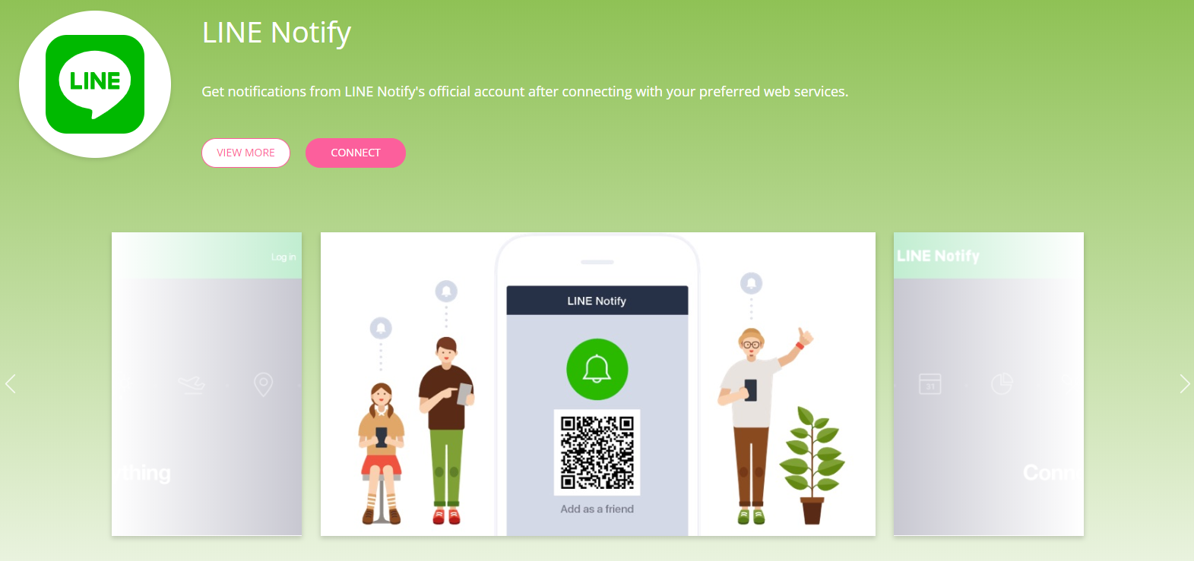
Account Management
Single-click app authentication
Multiple accounts supported for each application

Slide 19
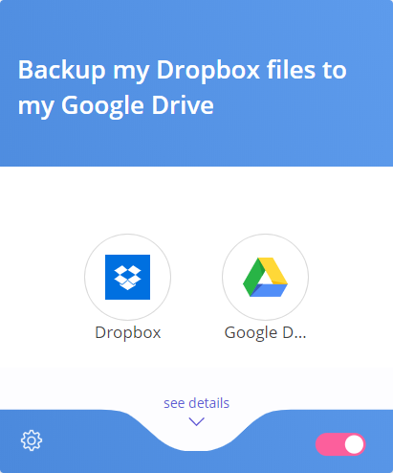
What is a Miix
A Miix is a combination of a Trigger and one or more Actions
Trigger
from one app
Action(s)
from another or same app
New file added to a specific folder in Dropbox
Download file to Google Drive

Slide 20
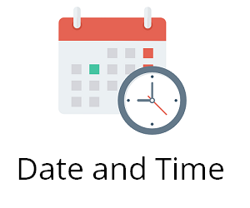
Qmiix Triggers
Trigger is a pre-defined condition which tells Qmiix to execute an action
App
File station
Trigger
example
New file uploaded in a specific folder
Every day
at 8 a.m.
A new file is uploaded in a
Specific folder
Notes:
NO NEED TO CHANGE

Slide 21
Qmiix Actions
Action is an execution of pre-defined task within the specified app
App
File station
Action
example
Post a message using Line Notify
Post a message on your Slack channel
Download a file from URL
Notes:
NO NEED TO CHANGE

Slide 22
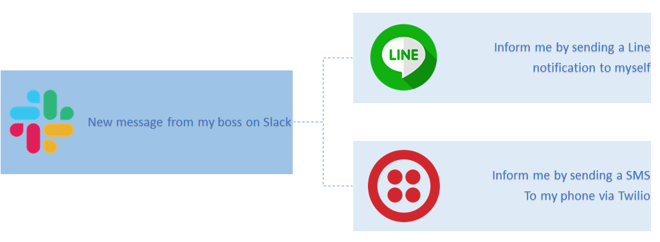
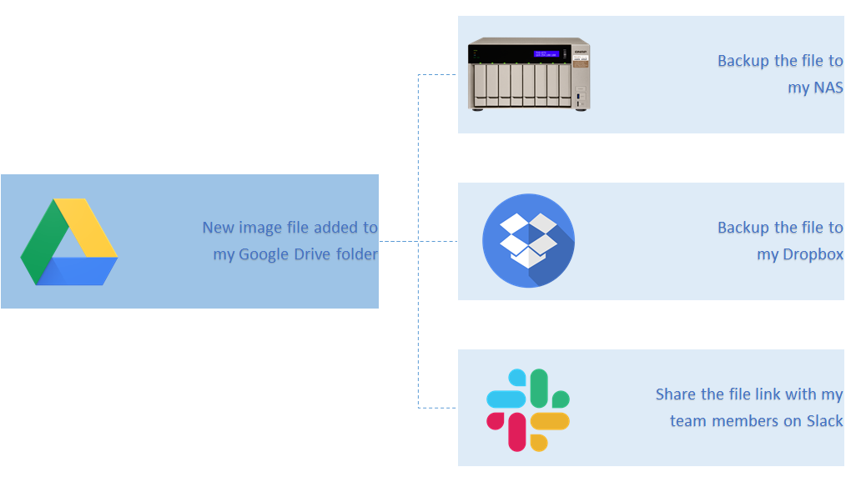
Advanced Miix
Get more work done with fewer miixes with AND miixes
Ensure execution of critical cases with OR miixes
Backup the file to my NAS
Inform me by sending a Line notification to myself
AND
Backup the file to my Dropbox
OR
AND
Inform me by sending a SMS to my phone via Twilio
New image file added to my Google Drive folder
Backup the file with my team members on Slack
New message from my boss on Slack

Slide 23
Current Scope

Slide 24
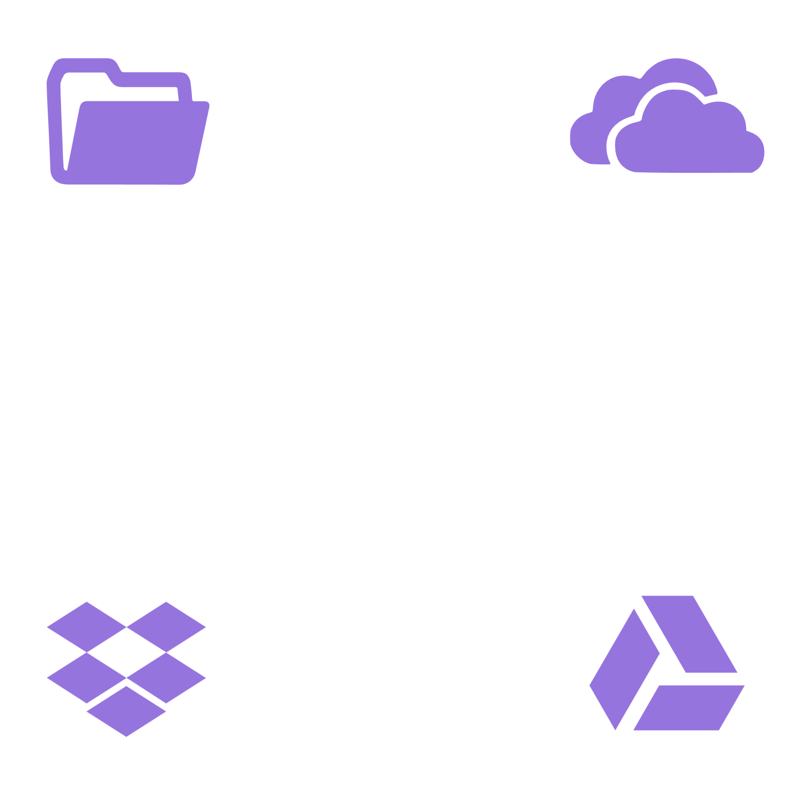
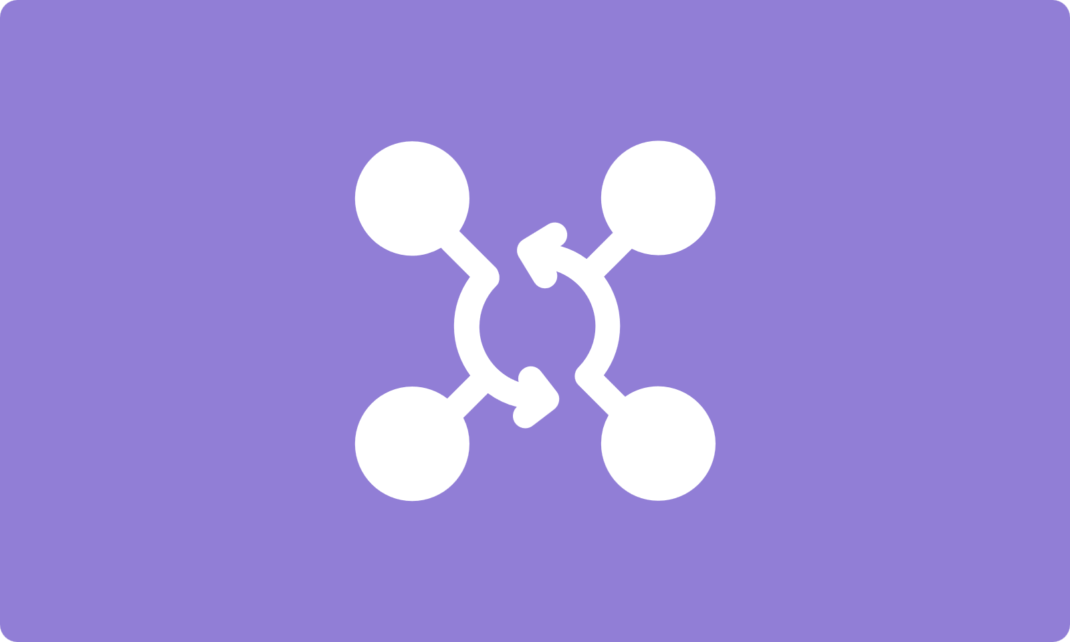
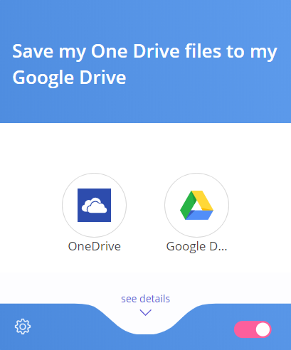
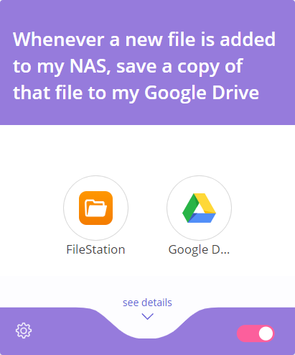
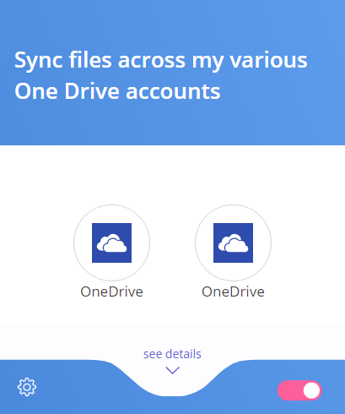
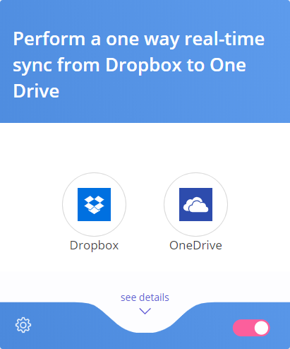
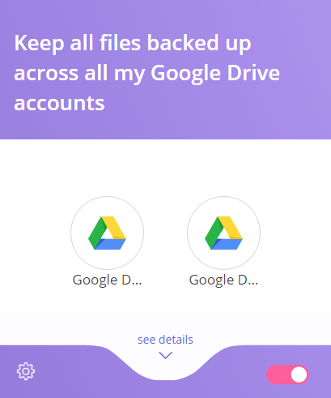
Miixes for Data Transfer Across Cloud Platforms
Tile image to show cross-data platform
Size: 400 x 240
Type: PNG (transparent)
A banner image for data transfer across various
Cloud platforms
Banner Size needed: 1366 x 472
Notes:
Tile Color: #917ed6

Slide 25
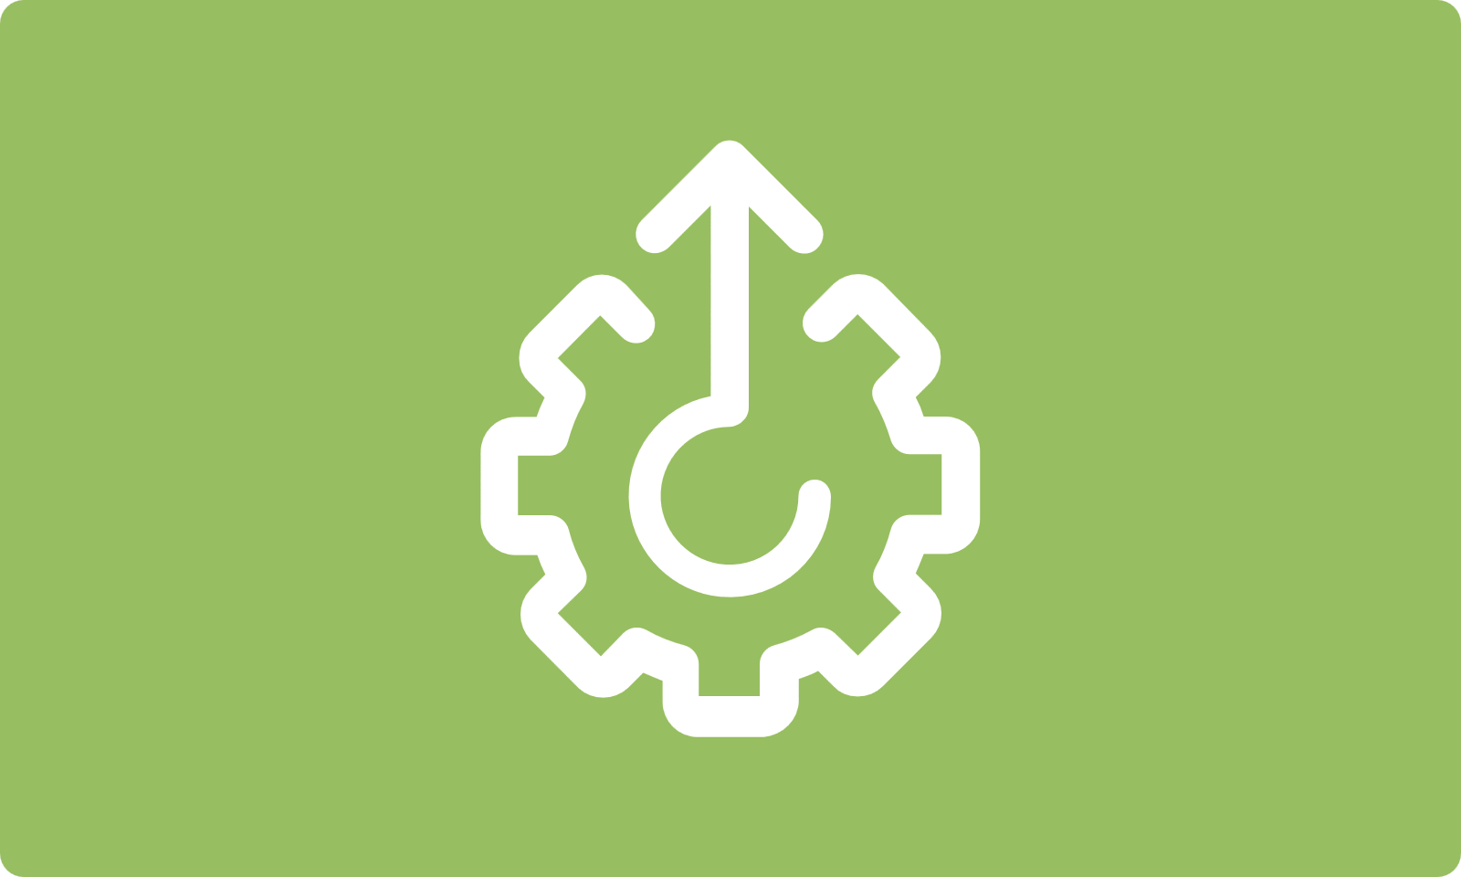
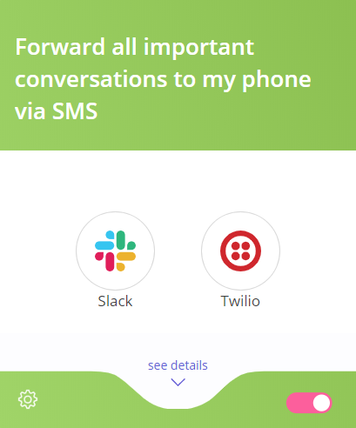
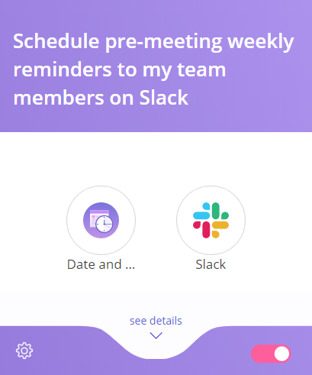
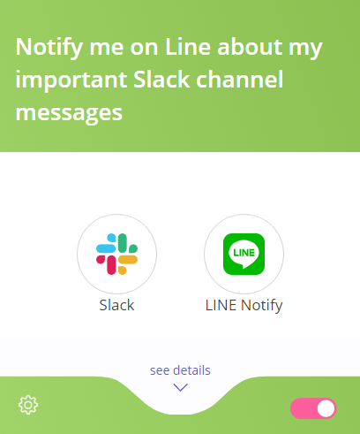
Miixes to Enahnce Work Productivity
Tile image to show enhance teamwork productivity
Size: 400 x 240
Type: PNG (transparent)
A banner image for enhancing teamwork productivity
Banner Size needed: 1366 x 472
Notes:
Tile Color: #97be60

Slide 26
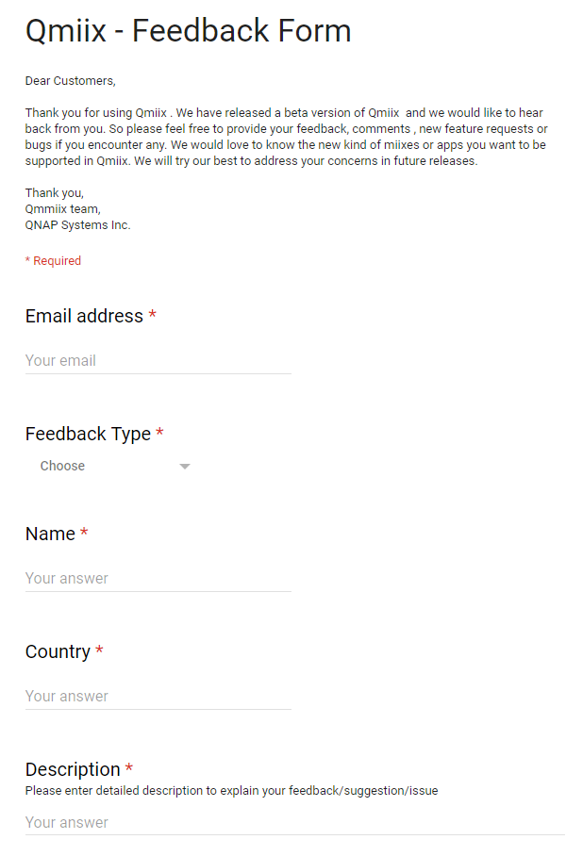
Join Beta Program
Try premium features for free
Give us ideas
Free TS-328 for most insightful feedback

Slide 27
Thank You
is Your Best Choice
Copyright © 2019 QNAP Systems, Inc. All rights reserved. QNAP® and other names of QNAP Products are proprietary marks or registered trademarks of QNAP Systems, Inc. Other products and company names mentioned herein are trademarks of their respective holders.

