Slide 2

QNAP NAS： How to become the best choice of Time Machine
Mac user's favorite backup software-Time Machine
Comparsion of storage devices for Time Machine
Makes Time Machine backup more complete
Helps you to copy Time Machine up to cloud
Live Demo: Mac Time Machine & QNAP NAS
Easy to change Mac device
HBS 3 achieve Backup 3-2-1 with lower cost

Slide 3
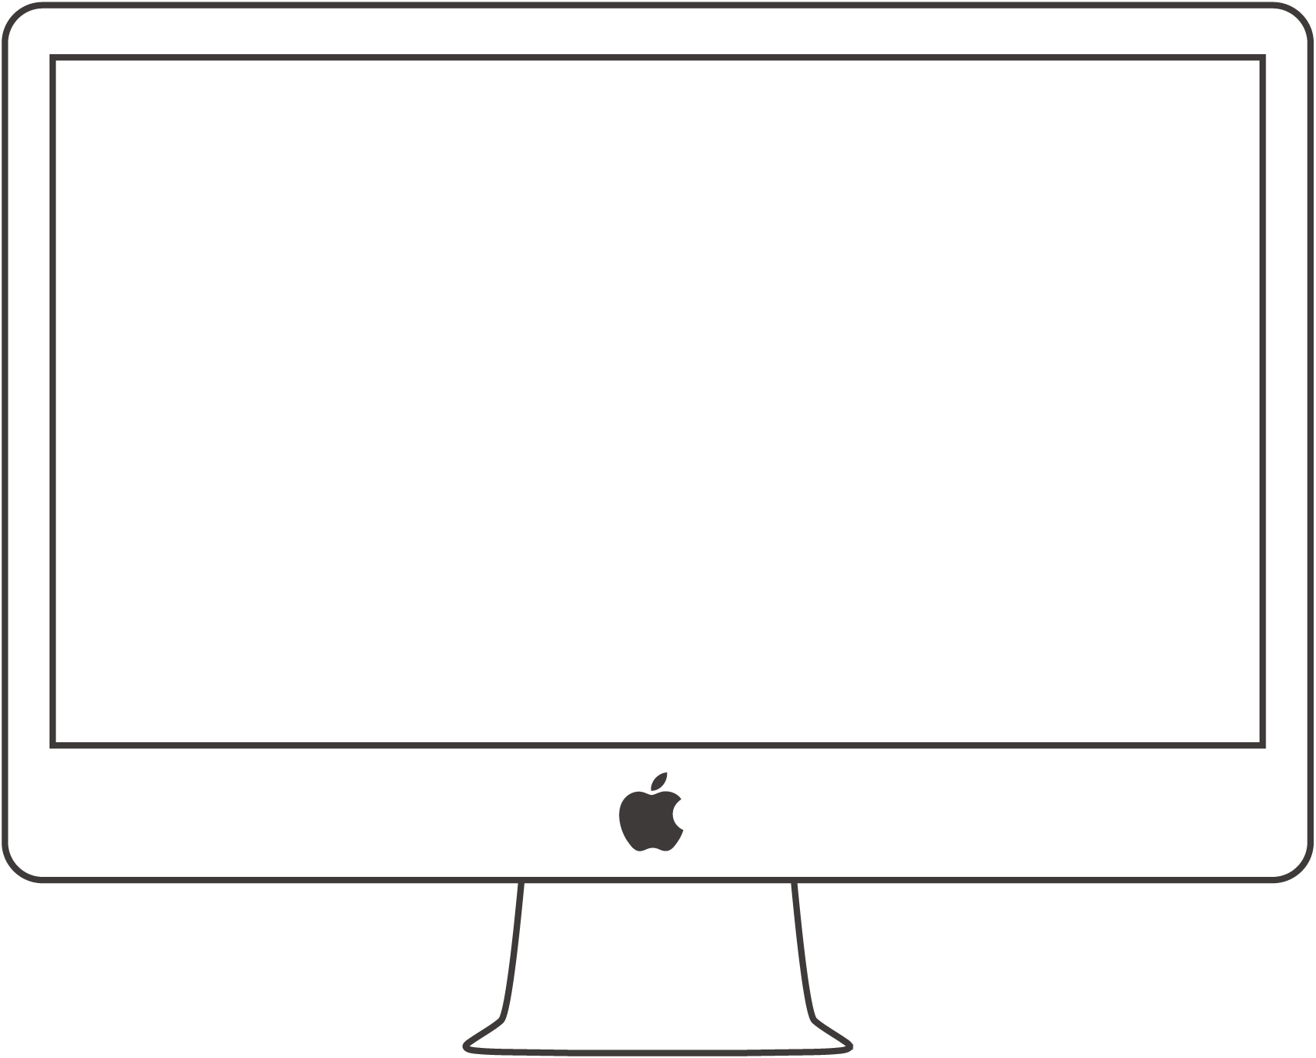
Mac user's backup habits
Common situations...
  Copy the important data only.
  Never do it.
Why?
  Forgot it.
  Must plug in the external storage.
  Manual backup wastes time.

Slide 4

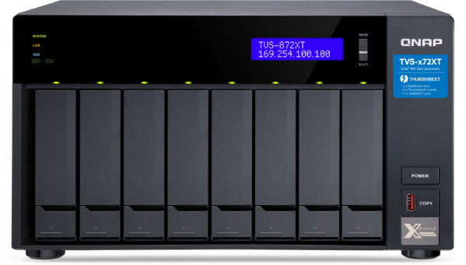
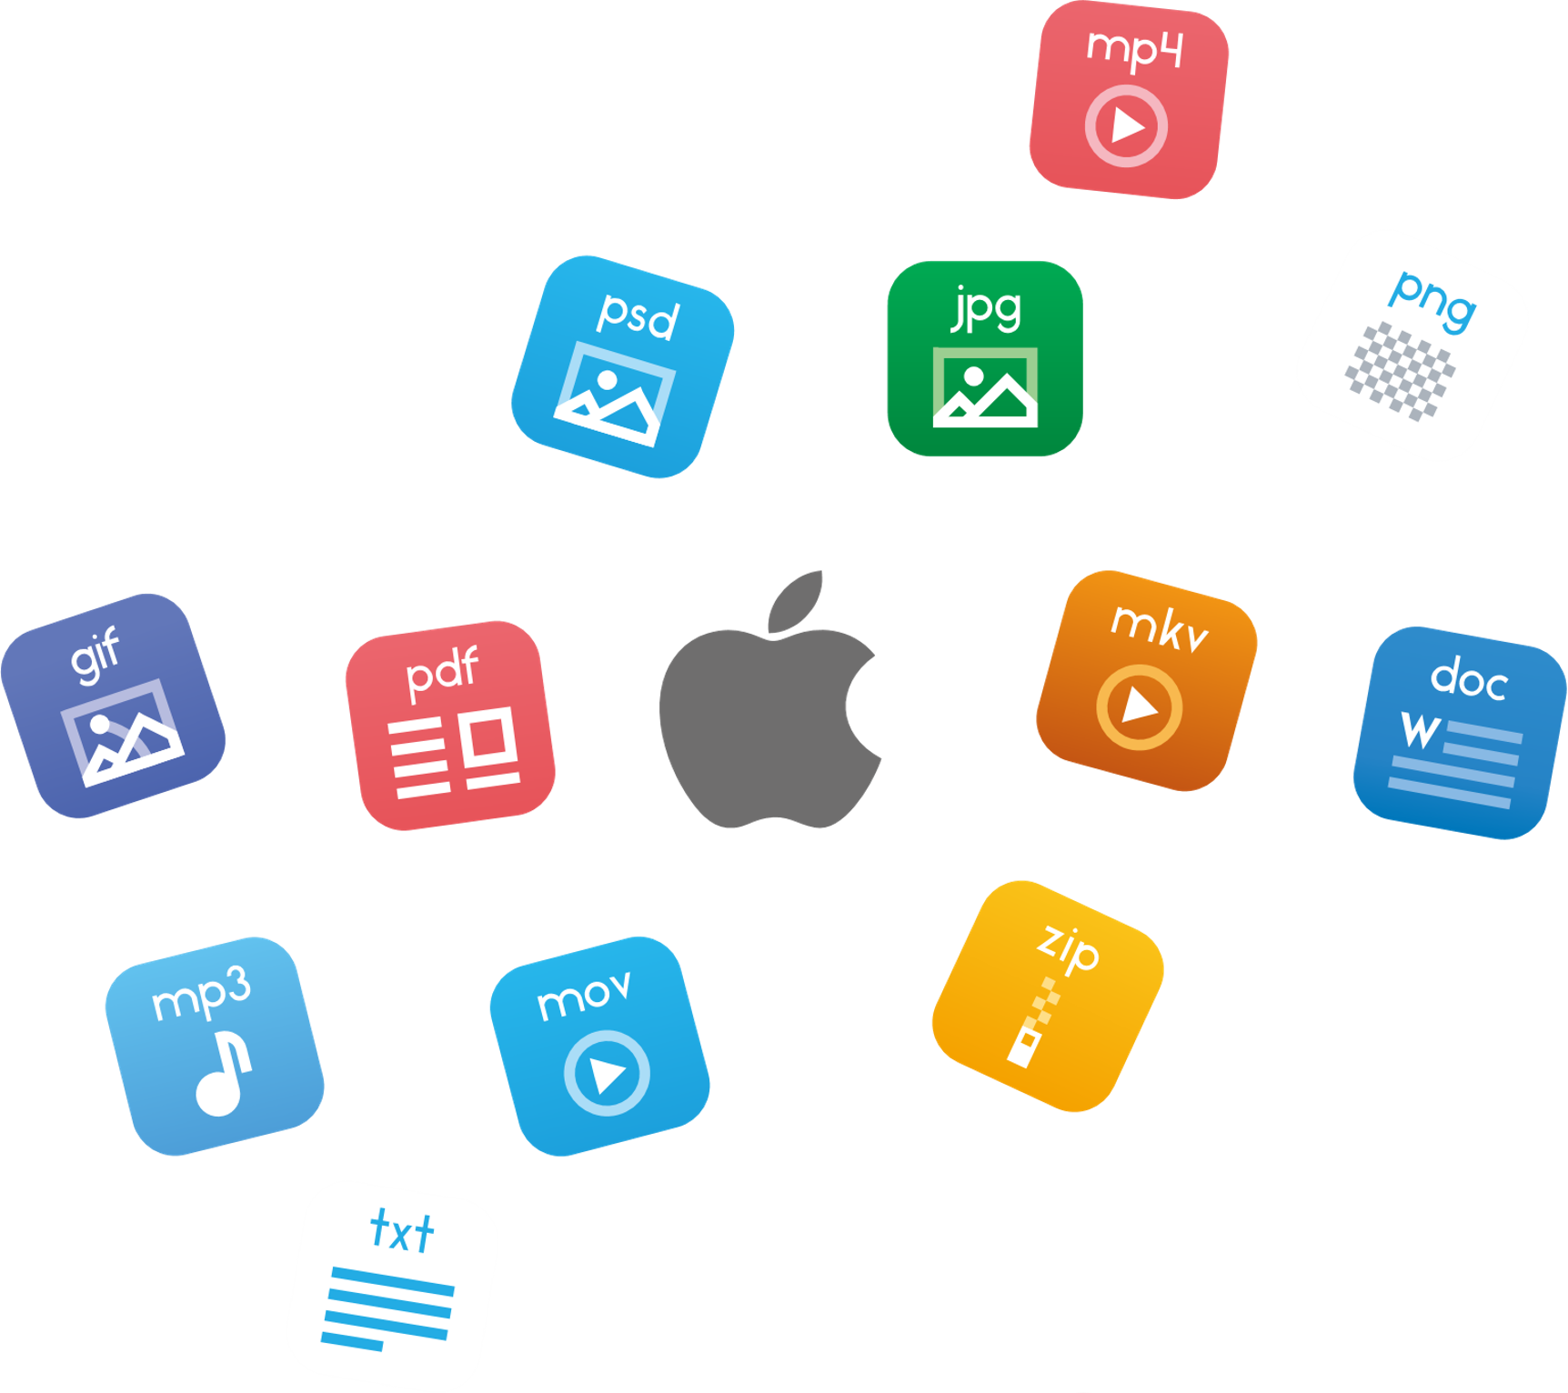
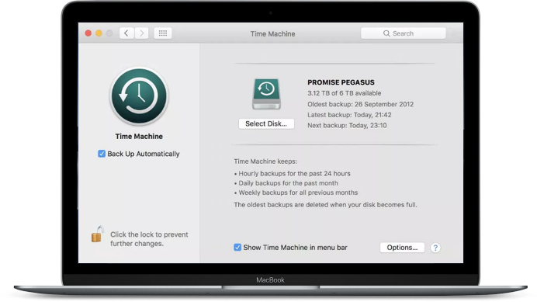

Mac user's favorite backup software "Time Machine"
Time Machine provides
Comprehensive backup system and file levels at the same time
Multi-version backup
Easy and intuitive file restore or system restore
Backup encryption
Time Machine
Notes:
Time Machine

Slide 5
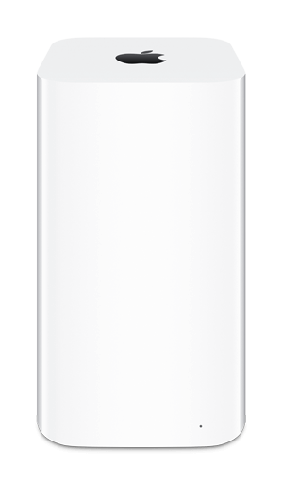
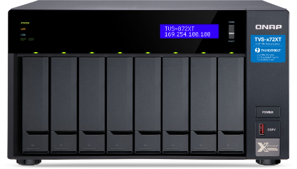
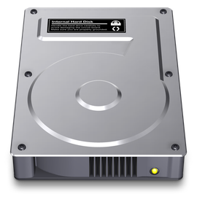

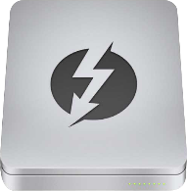

Comparsion of storage devices for Time Machine
 | Mac Local | External Storage | Time Capsule | QNAP NAS
Storage Capacity | Fixed | Fixed | Fixed | Expand on demand
Storage Protection | NA | Lower RAID | NA | Higher RAID Snapshot Hybrid Backup Sync
Data access speed | faster | USB : Slower Thunderbolt : Faster | 1GbE : Slower | 10GbE : Faster Thunderbolt 3 : Faster
Supports multiple users | NA | NA | Yes | Yes
Backup space management | NA | NA | NA | Yes
Notes:
講稿：
對於可作為TimeMachine備份的儲存裝置做一個比較,
首先針對儲存容量的部分, 像是mac本身, 外接裝置或是Apple自身提出的Time Capsule都會依照先前所購買的大小而固定
NAS則可依使用狀況去做擴充
備份資料保護的部分, 除了有部分外接裝置有支援RAID外, mac和 time capsule其實都沒有針對資料作保護, 但外接裝置支援RAID的價格相對也較為昂貴, 而NAS除了有提供各式的RAID外, 針對系統也做了volume或是Lun的快照作為備份, 除此之外也提供HBS 做異地的備份, 包含像是儲存到雲端等.
資料存取速度上, 除了mac本幾, 外接裝置直接連接較快外, 透過網路的time capsule僅提供一般的1G網路, QNAP NAS還提供了較快的10G網路以及Thunderbolt3的傳輸介面來做備份及還原
在備份管理部分, time capsule提供了多使用者帳戶設定來管理，但並未針對使用者帳戶做空間的分配管理, QNAP NAS在這部分是有提供的
ref:
Title: Time Machine 儲存裝置大比拚
比較item
儲存容量
儲存保護
資料存取速度
備份管理
Time Capsule: 可透過帳號存取，個帳號僅能看到個帳號的內容
進入成本

Slide 6
QNAP NAS makes Time Machine backup more complete
Simple Management
Data Protection
High-speed transmission interface
Scalable Storage Capacity
Cloud Backup

Slide 7
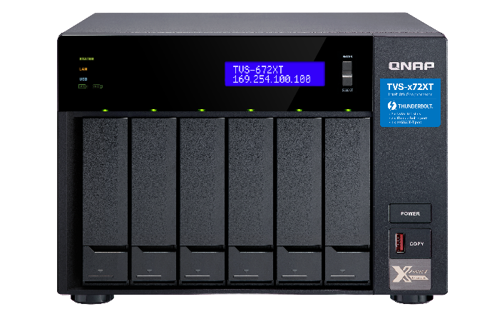







QNAP Thunderbolt NAS add value to Time Machine
TVS-x72XT
10GBASE-T and Thunderbolt™ 3 high-bandwidth connectivity for tackling heavy workloads and smoothly transferring
M.2 SSD cache to speed up data access
Both storage and NAS applications are elastically expandable
TVS-672XT
High-speed Thunderbolt™ 3 with SMB protocol, allowing Mac® and Windows® users to collaborate on media editing.
5-speed 10GBASE-T RJ45 connectivity accelerates virtualization applications and file sharing across teams and devices.
PCIe expandability allows for graphics cards or 40GbE/ 25GbE/ 10GbE adapters to increase application performance.
Install M.2 PCIe (Gen 3 x2, 2 GB/s) NVMe SSDs (sold separately) to set up caching or storage pools, improving file access efficiency.
4K media playback and real-time transcoding; directly view creative works on an HDTV via HDMI 2.0 (4K @60Hz) output.
Snapshots fully record system status and data, allowing you to protect files and data from accidental deletion and malware attacks.
https://www.qnap.com/zh-tw/product/tvs-872xt

Slide 8




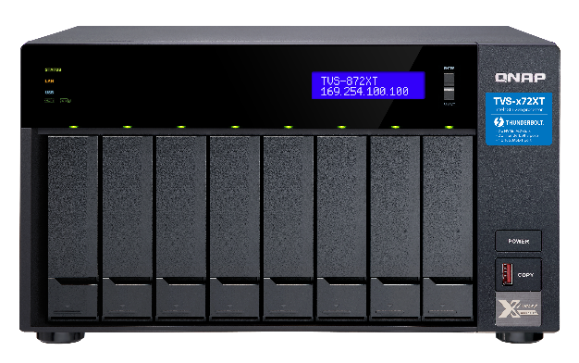

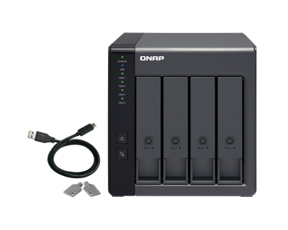
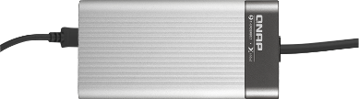
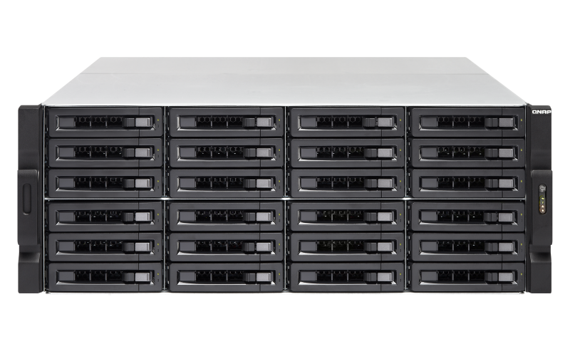


Make complete Time Machine backup
High-speed transmission interface
Data Protection
4. Snapshot
5. RAID
6. HBS 3
1. Thunderbot 3
7. VJBOD Cloud
2. 10 GbE
TVS-872XT
Scalable Storage Capacity
TR-004
Simple Management
9. VJBOD
3. M.2 SSD
8. UBS 3.0
10. UI
QTS

Slide 9




Easy to copy Time Machine to Cloud
NAS: Creating a LUN to connect to the object storage cloud​
Mac: Mounting NAS's LUN as a Time Machine backup destination via iSCSI​
After the backup file is transferred to NAS's LUN, it is also copied to the cloud automatically via the VJBOD Cloud Gateway.​
LUN
LUN
Object

Slide 10
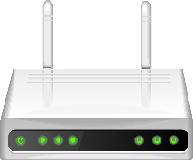
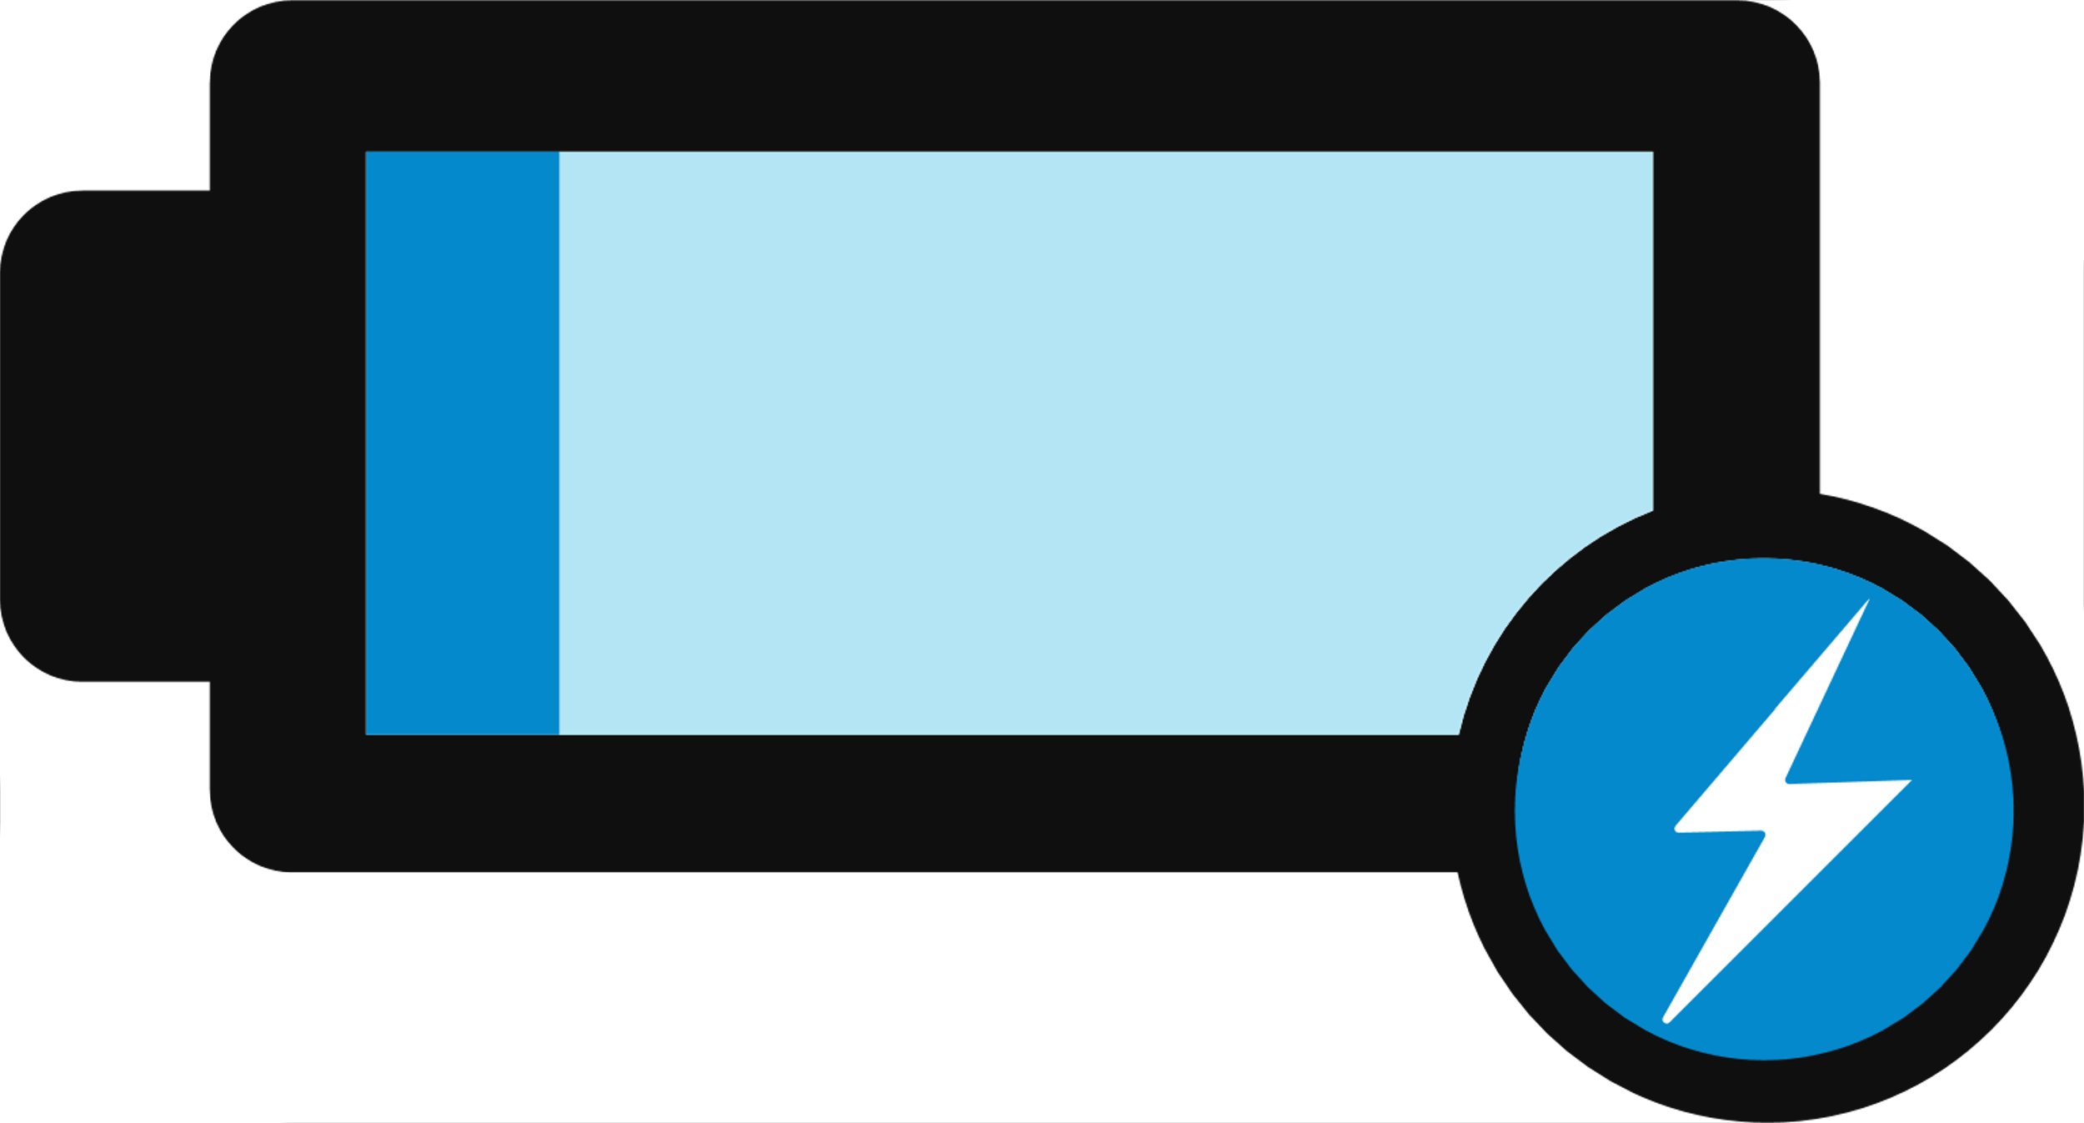

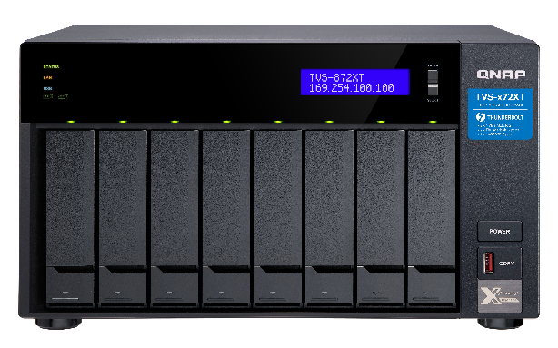

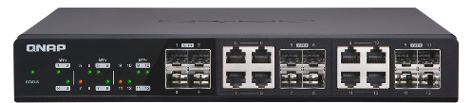

How to connect Mac to QNAP NAS
Connect with WiFi、Thunderbolt、1GbE/10GbE
Wi-Fi AP​
Thunderbolt​
1G/10Gbps Ethernet​
Notes:
引導網路存取到自動備份
連線架構圖 （包含電員, 網路, 接上外接螢幕）
有線 /無限

Slide 11

Live Demo
Mac Time Machine & QNAP NAS

Slide 12
Enterprise's problems of Mac backup
Too many people
- Space management is difficult
- Storage space is not enough
- Backup cannot be completed in time
- Affect the bandwidth usage of work

Slide 13


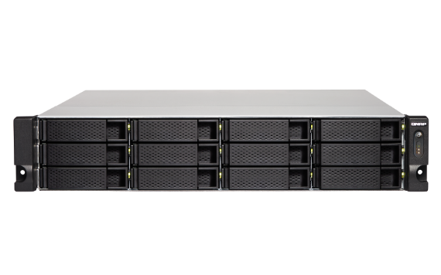


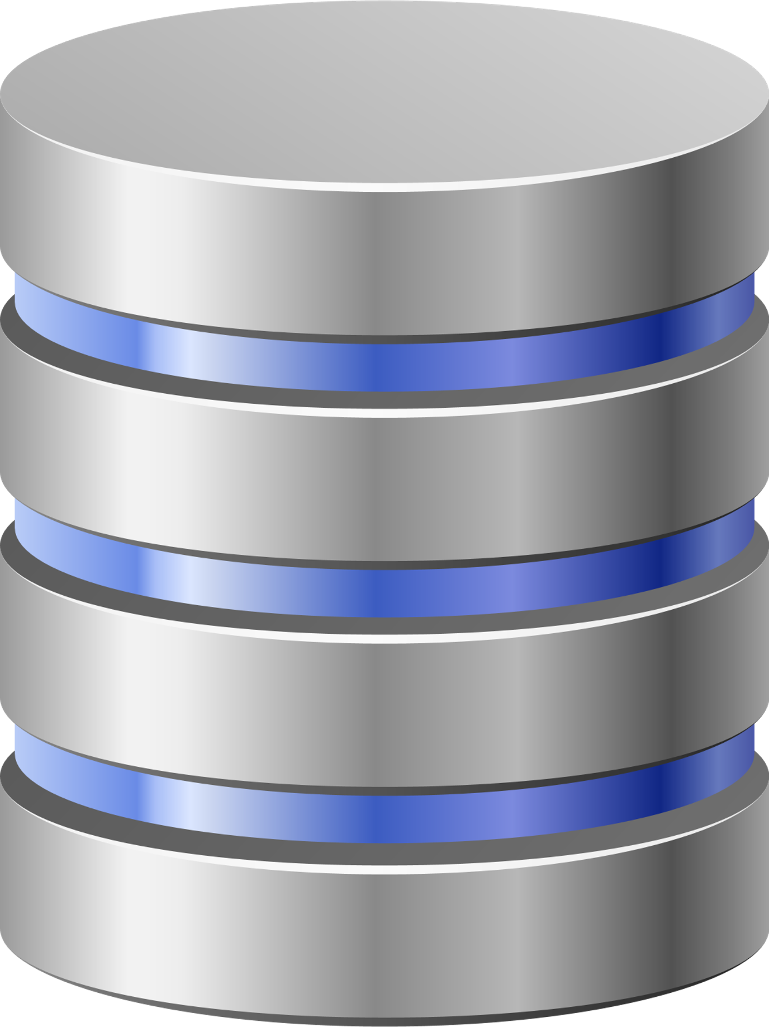
Mac backup solution for enterprises
Backup space quota allocation for multple users
Suitable for different network segments
- How to backup via SMB across network segments?
High-speed transmission interface and technology
$ sudo tmutil setdestination smb://{USER_NAME}:{PASSWORD}@{NAS_IPADDRESS}/{SHARED_FOLDER_NAME}
Centralized storage management, easy to back up again
40 Gb bandwidth​
Port Trunking
10GbE Switch
Domain Users
> 100 Mac PCs

Slide 14

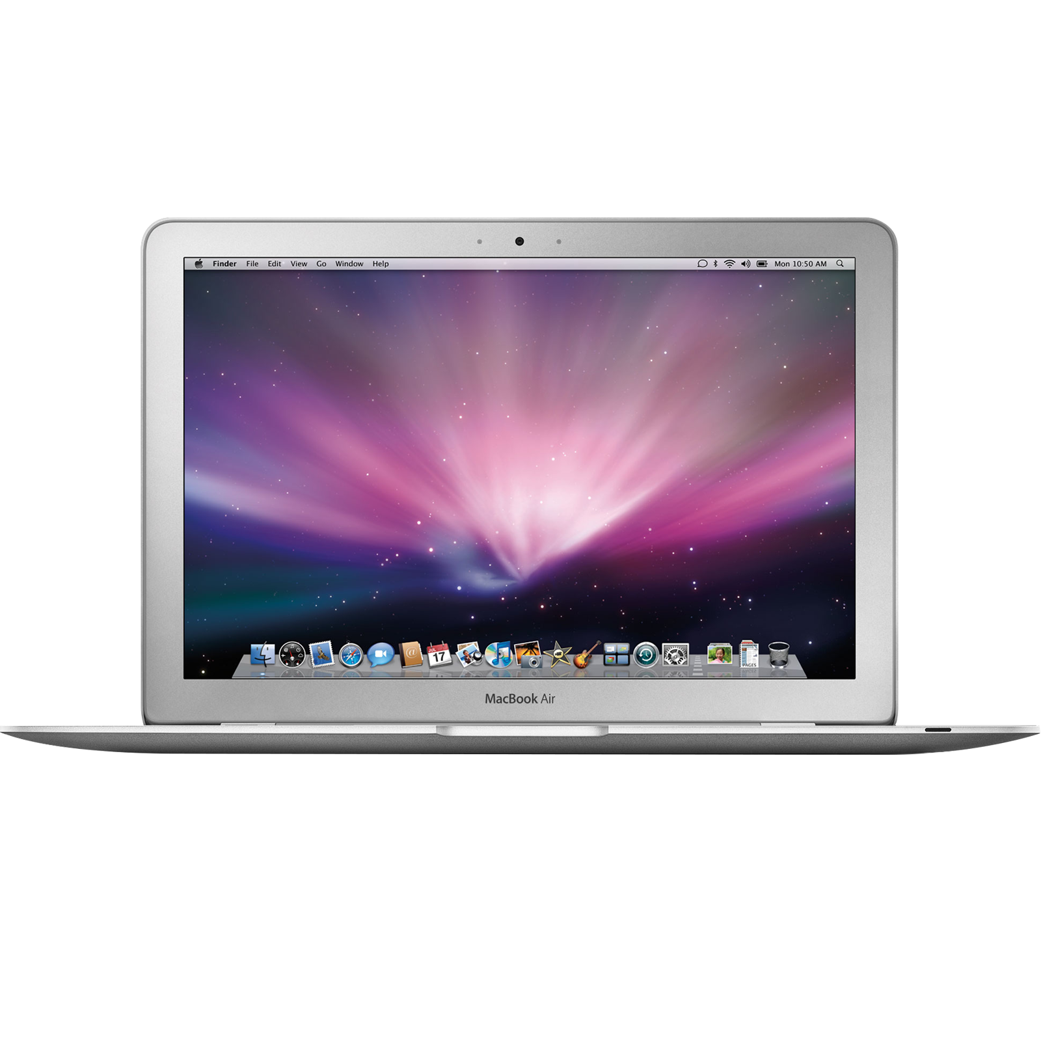
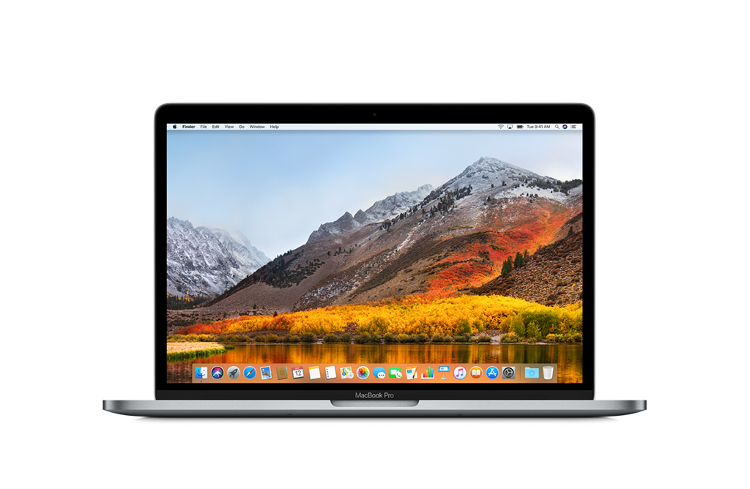
Easy to change Mac device
Old Mac Air
New Mac Pro
Change

Slide 15





3-2-1 Backup Strategy
What is the safe backup solution?
  - How many copies?
  - Where to store?
Best strategy for complete backup
  - Recommend backup approach by the U.S. government
  -『3-2-1 Backup Strategy』
3
2
1
3 copies
On 2 formats
With 1 offsite

Slide 16

HBS 3.0 achieve Backup 3-2-1 with lower cost
Save time and space
QuDedup: Source-side data deduplication
TCP BBR
Support 23 cloud providers (continue increasing...)
Up to 30 schedule settings

Slide 17



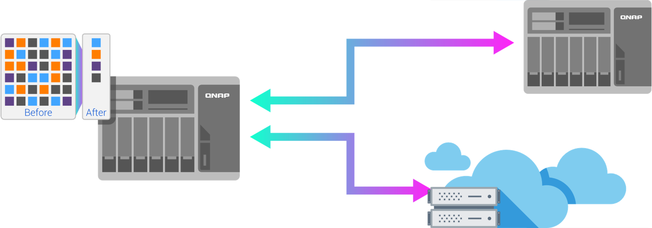



QuDedup: Data reduction, lower cost
Future highlights
Block level analysis and comparison
Source-side data deduplication framework
3 Advantages: Bandwidth reduction, space saving, support multiple cloud providers
VM Image Size | Deduped File Size | Compression Rate
15.48 GB | 7.59 GB | 2.04:1
Note: The compression ration of one VM image file
1
Bandwidth
Reduction
2
Space Saving
頻寬減量
3
Support multiple
cloud providers
QuDedup support model: x86

Slide 18

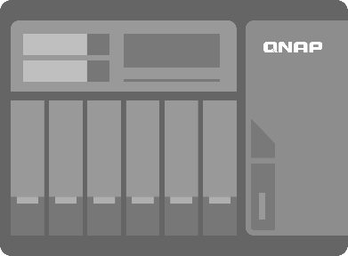





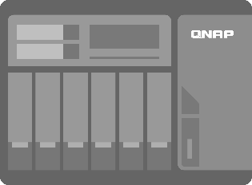

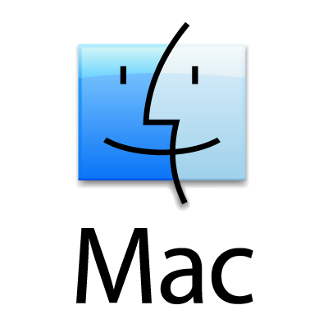





One Backup , Restore Everywhere
QDFF

Slide 19
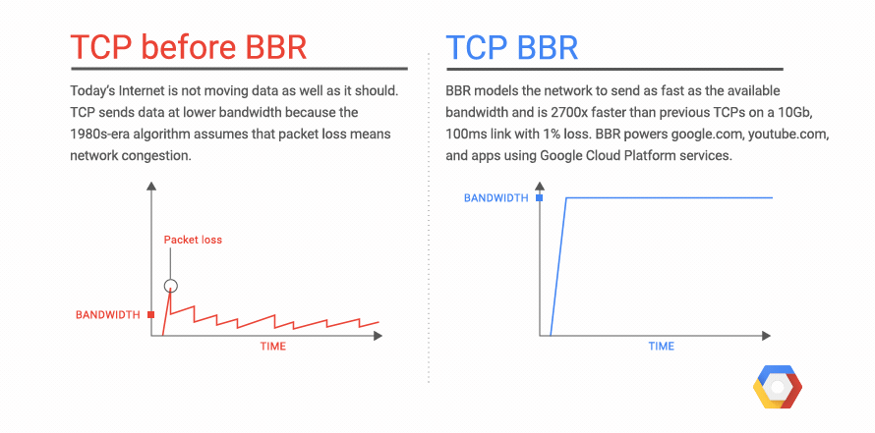
What is BBR
(Bottleneck Bandwidth and Round-Trip Time)
BBR is a congestion control technology suitable for modern network environment
BBR is Google's new congestion control algorithm designed for TCP
Supported by Linux kernel 4.9 and above
Fully improve bandwidth utilization in a network environment where the packet loss rate is too high
Notes:
https://cloud.google.com/blog/products/gcp/tcp-bbr-congestion-control-comes-to-gcp-your-internet-just-got-faster
https://notfalse.net/28/tcp-congestion-control

Slide 20

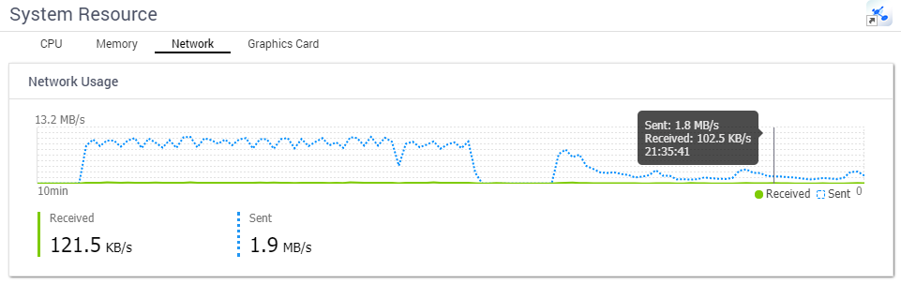
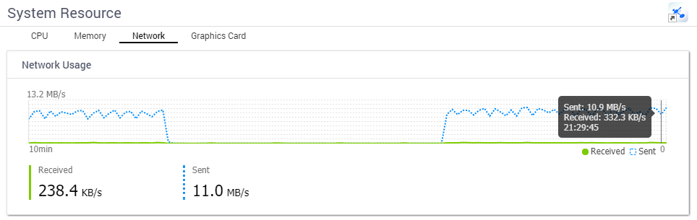


Network Speed Measurement of TCP BBR
Connect to the cloud service through the Heterogeneous network. Enable TCP BBR to improve the transmission efficiency!
Source: QNAP NAS in Taiwan
Destination: AWS S3 EU(London) Zone
Disable TCP BBR
4 ~ 5 times increase
Enable TCP BBR
Notice: TCP BBR is suitable for WAN, it will not have effect in network env. without packet loss(e.g. LAN).

Slide 21

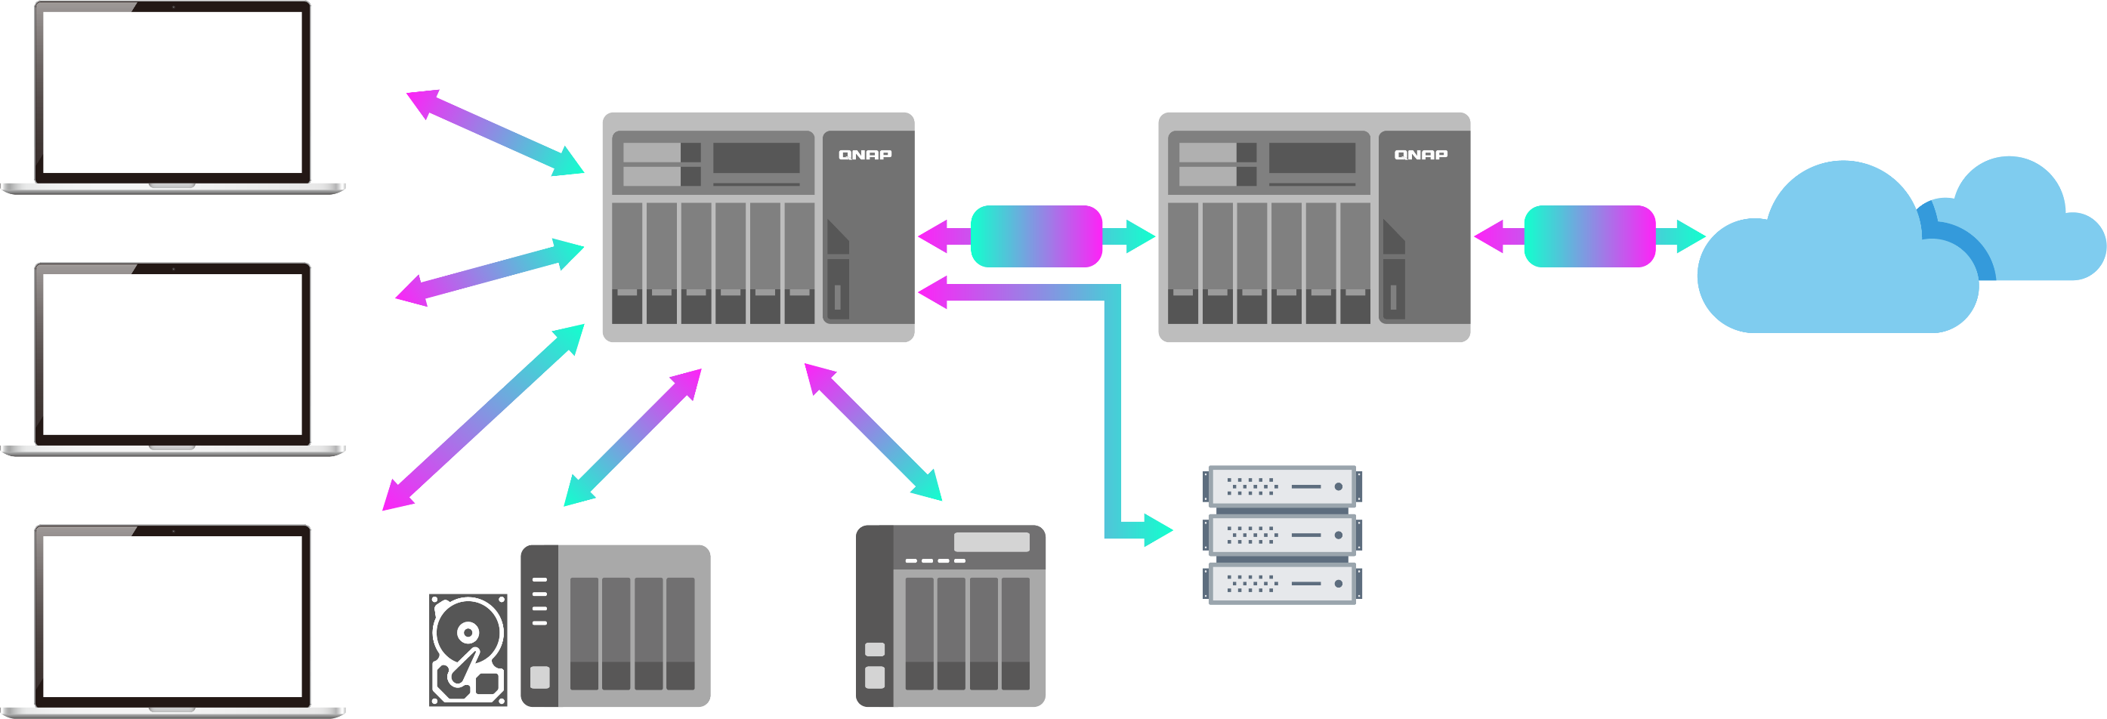

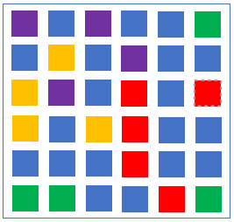

QNAP & Time Machine's Complete Data Protection Plan complies with the 3-2-1 Principle
Local
Remote
Cloud
Mac Time Machine
Backup/ Sync
RTRR
TCP BBR
File Storage
Object Storage
Mac Time Machine
Rsync Server
CIFS / SMB Server
FTP Server
Mac Time Machine
External Device / TR-004
VJBOD

Slide 22
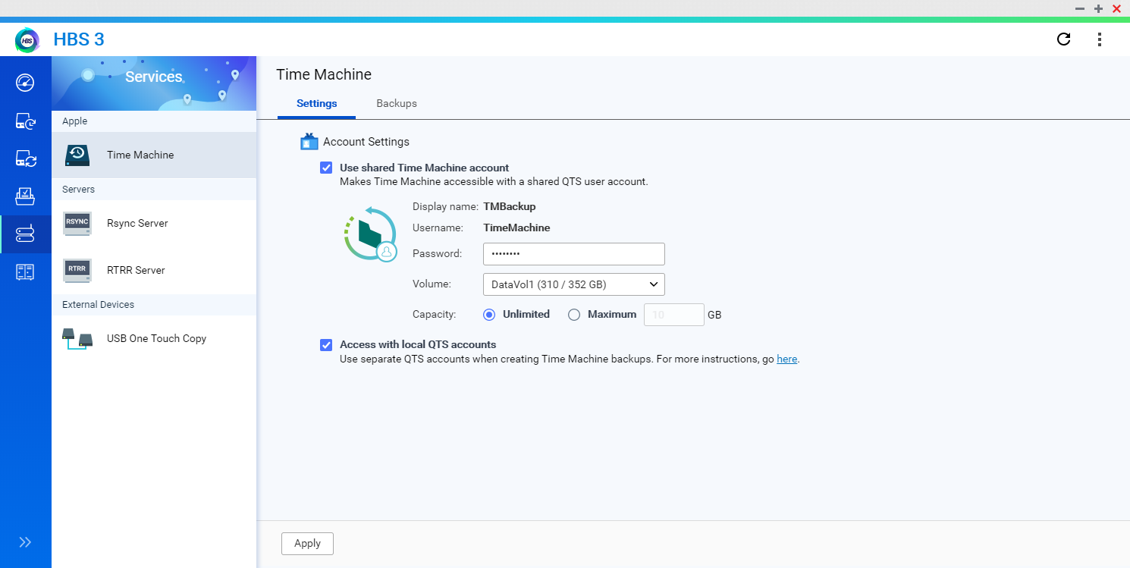
HBS 3 support Time Machine backup settings
Support the dedicated Time Machine account
Support multiple accounts of QTS

Slide 23



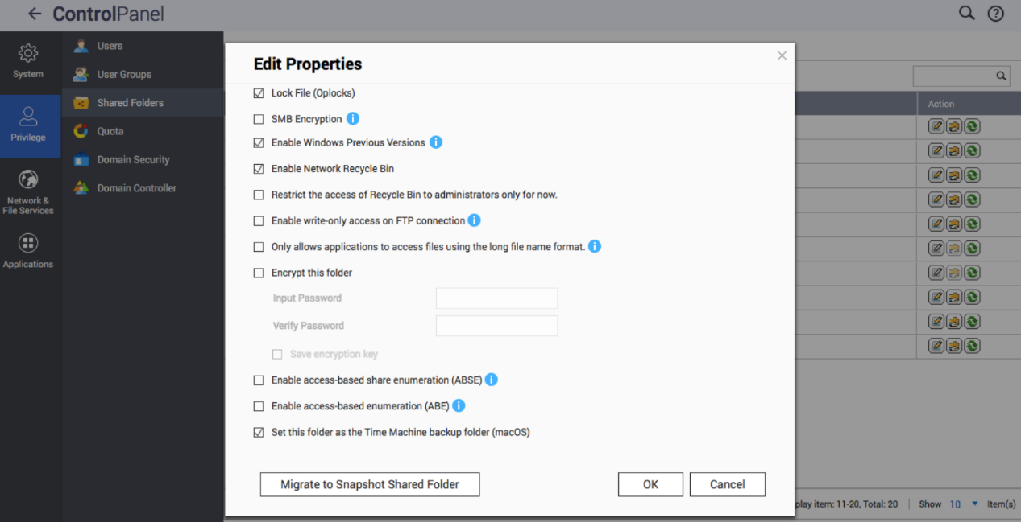
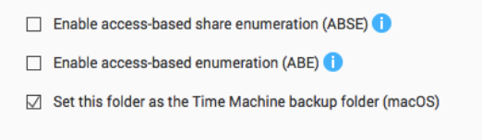
How to prepare the NAS
1
2
3
Set up account
Backup Space Management
Set up the Shared Folder
Notes:
講稿：
針對TimeMachine的使用設定ＮＡＳ的環境, 建立使用者帳號並設定可使用的備份空間, 並建立共享資料夾設定為TimeMachine存取資料夾即可被TimeMachine存取
帳號設定: 設定備份帳號
備份空間管理: 設定各帳戶的備份空間
啟動Time Machine: 建立共用資料夾並啟動Time Machine作為備份用途

Slide 24
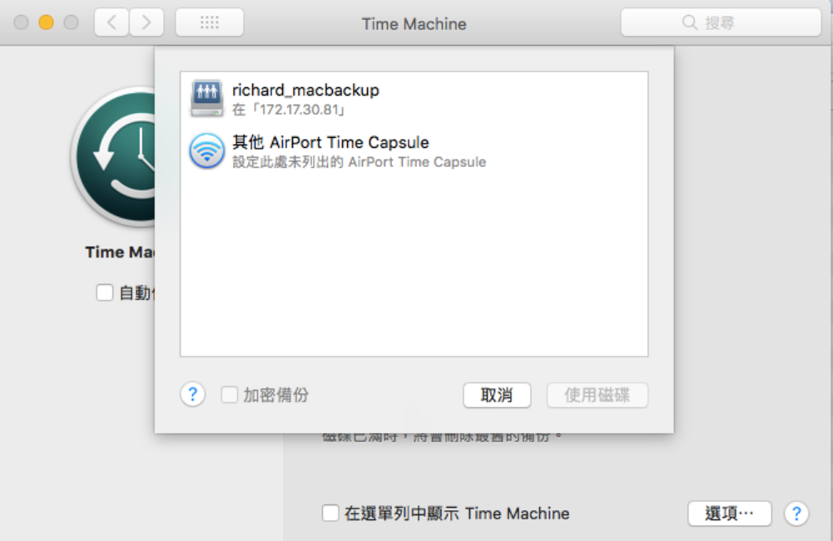
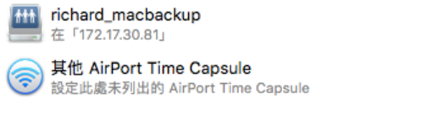
How to set up on Mac
1
2
Select Disk for Time Machine backup
Set up file exclusion rules
Notes:
講稿：
連結到剛剛設定的

Slide 25
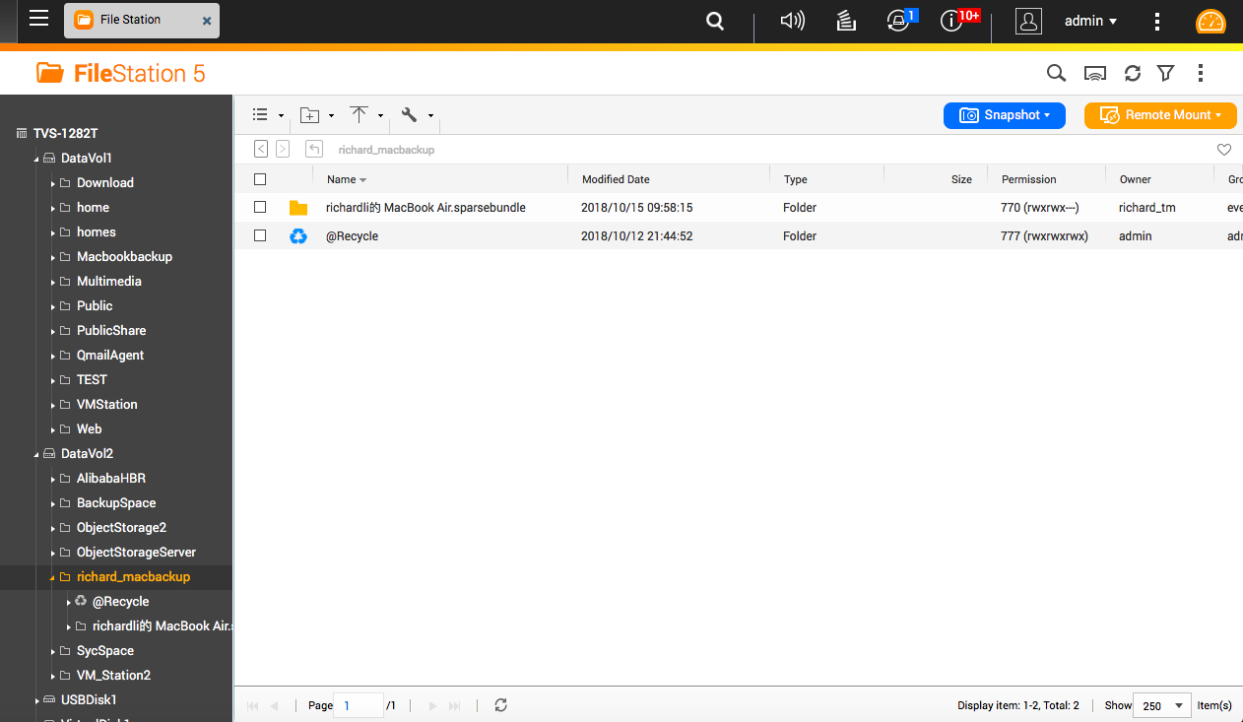
View the Time Machine backup

Slide 26

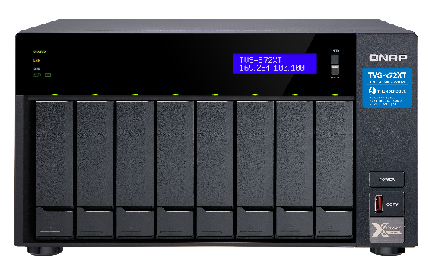



Customer's situation
Back up the Time Machine backup file to the external device TR-004 via HBS 3
TR-004
Mac Time Machine
Create backup job：
1
2
3
Select Time Machine Backup as Source
Select TR-004 as Destination
- Set up Schedule
- Enable QuDedup

Slide 27
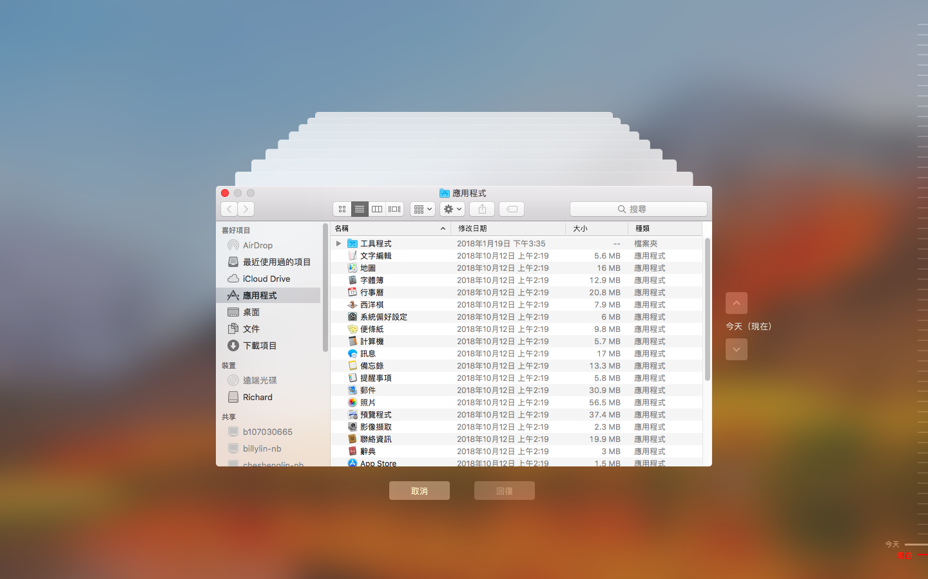
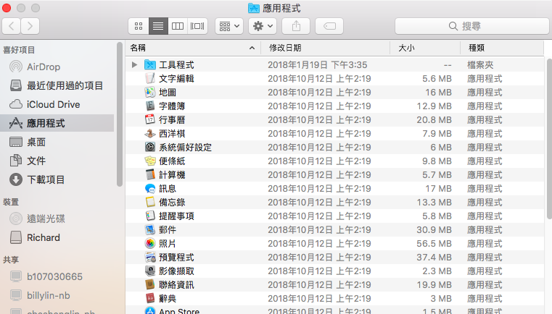
Timeline brings your file back to life

Slide 28

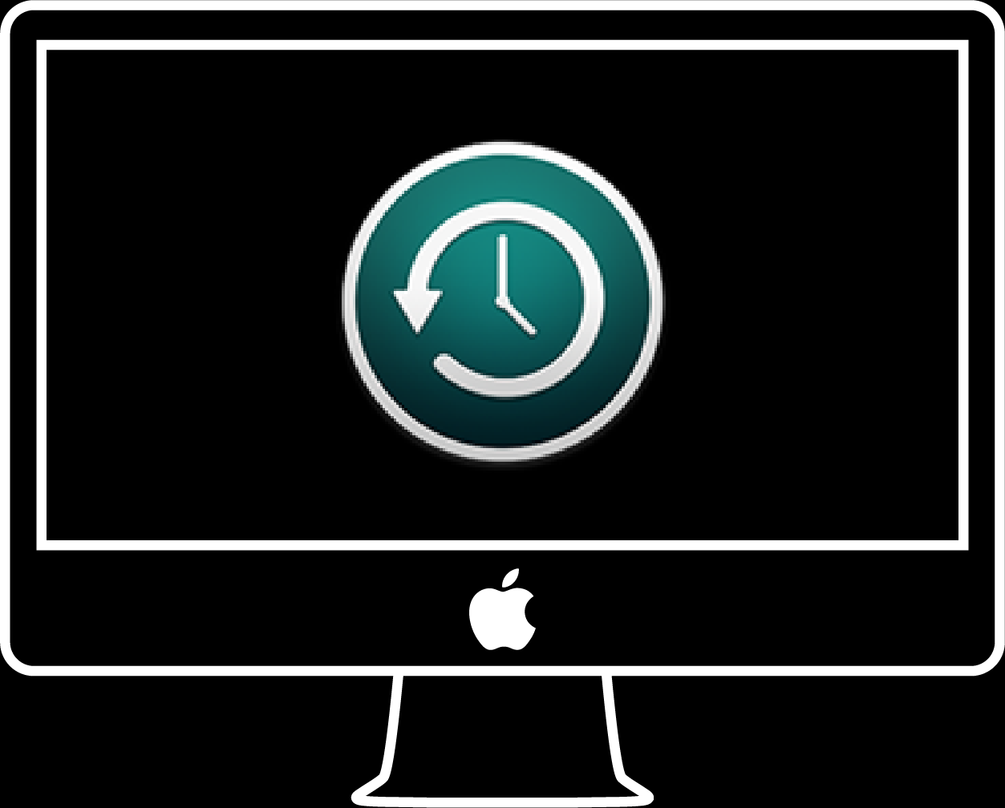
QNAP NAS is the best choice for Mac users
Copyright © 2019 QNAP Systems, Inc. All rights reserved. QNAP® and other names of QNAP Products are proprietary marks or registered trademarks of QNAP Systems, Inc. Other products and company names mentioned herein are trademarks of their respective holders.

