Slide 2
Manage Multimedia Contents in Hybrid Cloud
Reveal the truth about Multimedia Console
HybridMount – Connecting Cloud Drives and NAS
Multimedia Console x HybridMount

Slide 3
Reveal the truth about Multimedia Console
Set content sources
Smoothly upgrade from Media Library

Slide 4
Why don’t my photos appear in Photo Station?
Scattered
Complicated
Collected
Simplified
Before QTS 4.4.1, you have to choose 1 method from the following 3:
From QTS 4.4.1, you only need to go to Multimedia Console:
Set the folder as a “Media Folder” in Control Panel.
Set the folder property as “Photo”, “Video”, or “Music” in File Station.
Set content sources in different applications.
Set content sources for all multimedia applications in Multimedia Console!

Slide 5
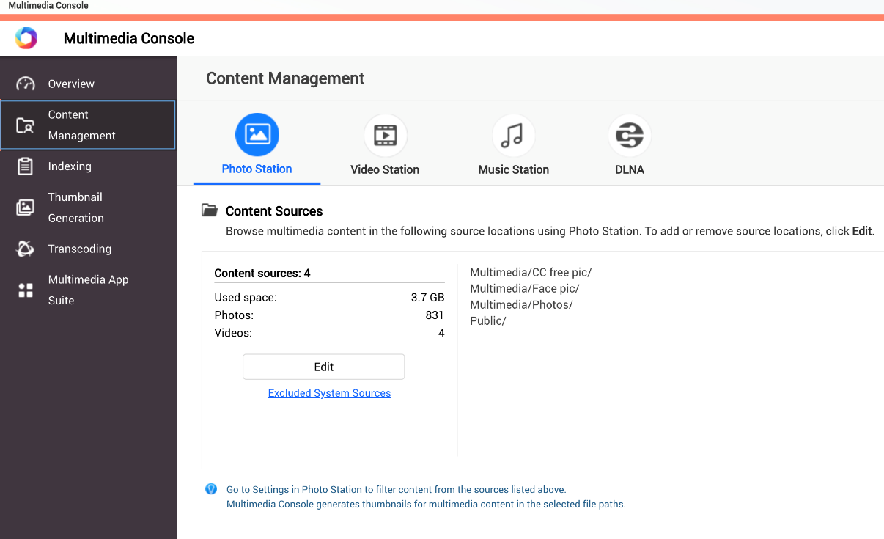
Set Content Sources for All Multimedia Applications
Go to
Content Management
Assign folders as content sources for each application.

Slide 6
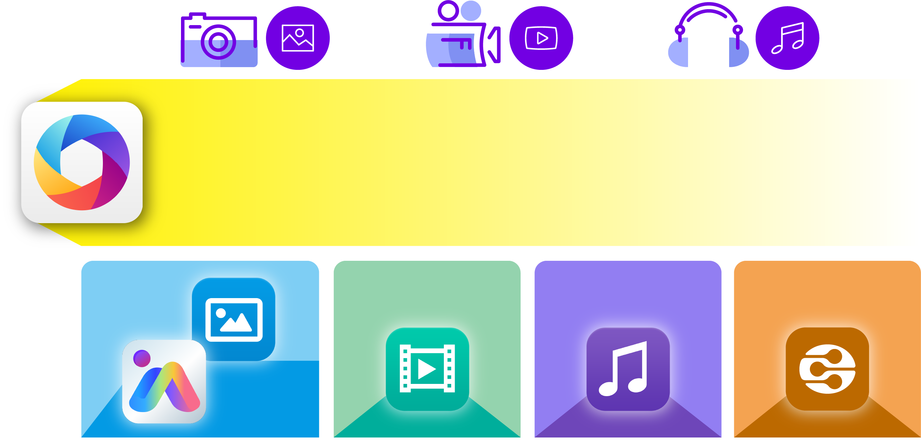
Smoothly Upgrade from Media Library to Multimedia Console
Photo
Video
Music
Upgrade to
Multimedia Console
Photo Station
Video Station
Music Station
DLNA
Upgrade to content sources for each application based on folder properties.
QuMagie

Slide 7
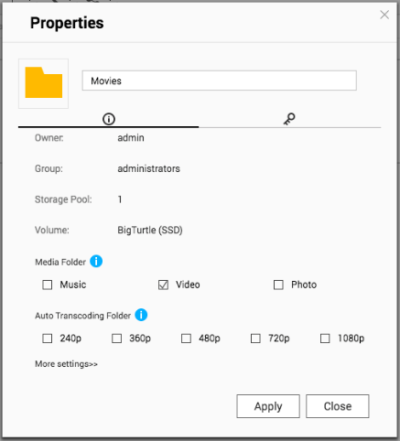
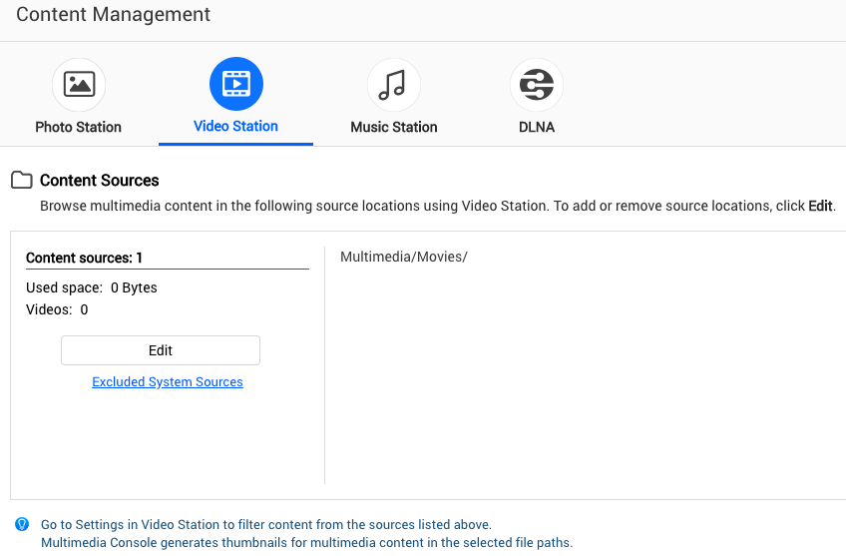
Smoothly Upgrade from Media Library to Multimedia Console
Before
After
Folder Properties: “Video”
Assigned as a content source for Video Station

Slide 8
HybridMount Connecting Cloud Drives and NAS
Set up a File Cloud Gateway
Keys of Fast Transferring

Slide 9
The New Hybrid Cloud Gateway
HybridMount
Bring Clouds Closer!​
Allocate a part of NAS ​
storage to enjoy the hybrid cloud! ​
SMB / NFS / AFP
Local Cache

Slide 10
2 Modes On Your Demand
 | File Cloud Gateway | File Station Mount
Setup Method | Choose ”File Cloud Gateway” mode and create a cache space | Mount cloud drives
Connections | 2 life-time free connections Buy license for more connections | No limit
Accessing Performance | High performance due to the cache space | Depends on network speed
Access in File Station | Supported | Supported
Access in SMB / NFS / AFP | Supported | NOT Supported
Sync with Cloud | Sync constantly | Sync only when browsing
Access with Multimedia Applications on QTS | Supported | NOT Supported
Choose this!

Slide 11
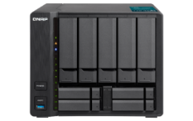
Set up a File Cloud Gateway and Speed Up Transferring
After connecting public and private cloud with HybridMount as a gateway, the transferring between cloud drives and the NAS is simplified, and the user could access files with fast local network.
Meanwhile, the user can access files in cloud drives through common protocols like SMB, AFP, and NFS.
Internet
Local Network
SMB/AFP/NFS

Slide 12
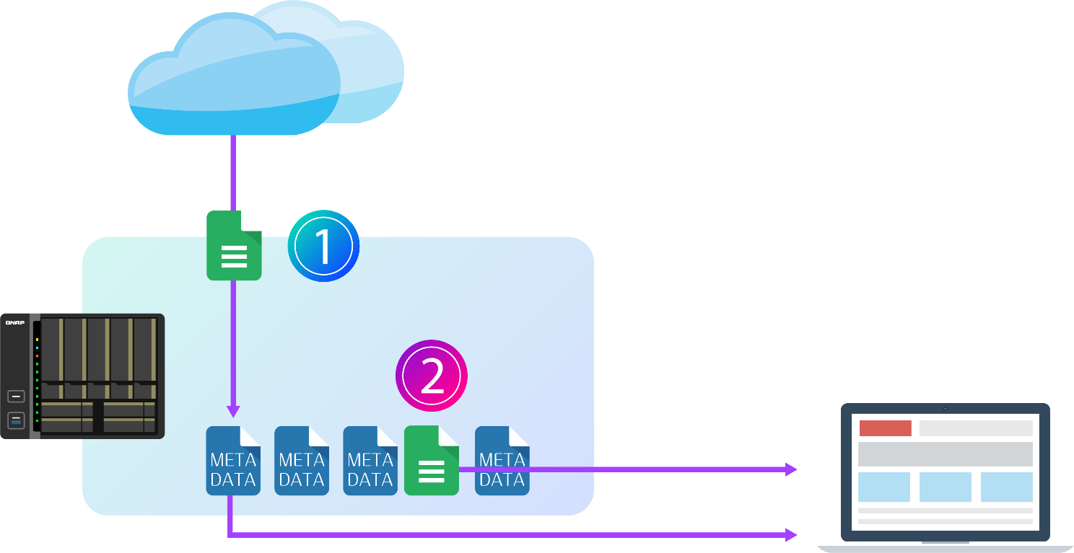
Accelerate When Reading Cached Files​
When first reading, the file will be downloaded from the cloud to the local cache volume and kept.​
When reading the cached files, it will read the files in local cache volume to avoid download again.​
Internet
Slower
Cache Space
in NAS
LAN
Faster

Slide 13
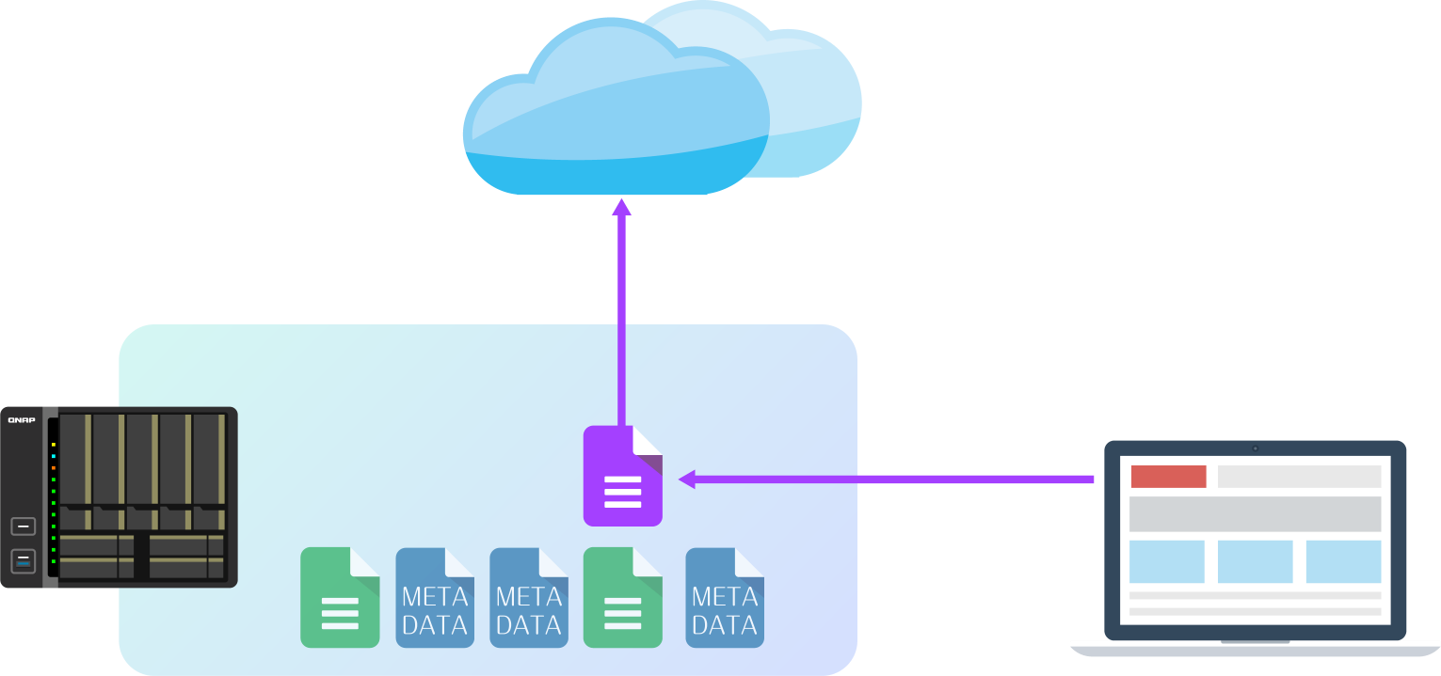
Cache Uploading Files To Reduce Waiting Time​
When uploading data to the cloud​
Upload the files to NAS through LAN and then upload to the cloud in the background. It helps you reduce waiting uploading in front of your computer.​
Internet (in background)
Slower
LAN
Faster
Cache Space in NAS

Slide 14
Multimedia Console x HybridMount
Manage Multimedia Contents
in Hybrid Cloud

Slide 15
If you store all your photos on the cloud, but cannot find a good management application.
If you store all your videos on the cloud, and you get tired of waiting for the download.
QNAP Hybrid Cloud
is your best choice!

Slide 16
Step 1: Build a Hybrid Cloud with HybridMount
Set up a File Cloud Gateway by connecting QNAP NAS to cloud drives with HybridMount, then access the cloud drive in fast transferring performance.

Slide 17
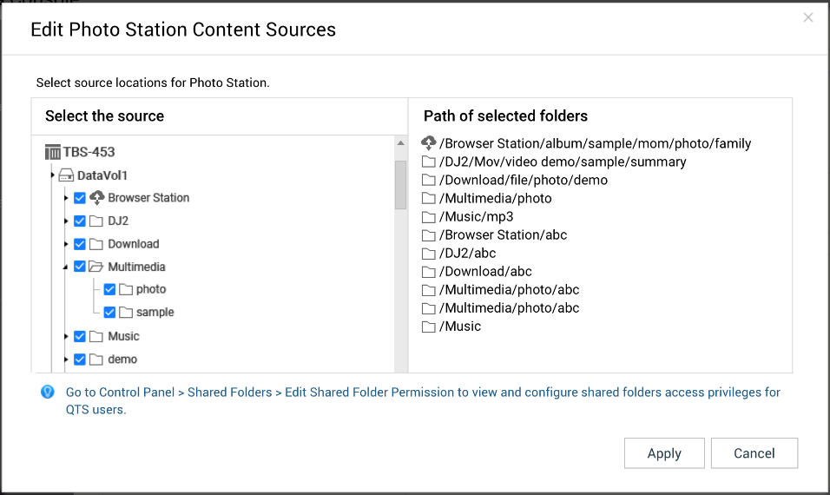
Step 2: Set Cloud Drives as Content Sources
Multimedia Console
x
HybridMount
Dropbox
Dropbox
Set the HybridMount Volume as a content source, and you can browse contents on the cloud in multimedia applications.

Slide 18
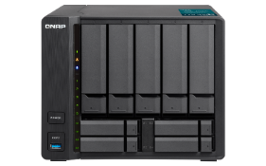
Step 3: Enjoy Multimedia Entertainment on QTS
Enjoy large storage space on cloud drives and various multimedia services on QTS:
Use QuMagie to smartly organize your photos.
Build your video library with Video Station.
Stream videos to different displayers with DLNA Server.
QuMagie
Video Station
Music Station

Slide 19
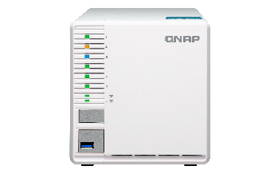
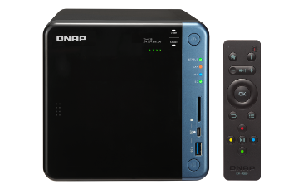
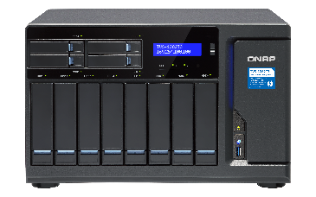
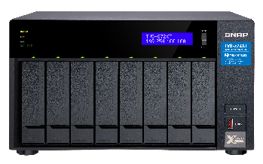
Recommended Models
Personal
TS-351
Family
TS-453B
Professional
TVS-1282T3
Studio
TVS-872XT
3 Bay
Intel® Celeron® J1800 Duo Core
4GB RAM
HDMI Output
4 Bay
Intel® Celeron® J3455 Quad-Core
4GB RAM
HDMI Output
Built-in SD Card Slot
12 Bay
Intel® Core™ i5-7500 / i7-7700 Quad-Core
Up to 64GB RAM
HDMI Output
Thunderbolt 3
8 Bay
Intel® Core™ i5-8400T 6-core
16GB RAM
HDMI Output
Thunderbolt 3

Slide 20
QNAP Hybrid Cloud is your best choice!
Copyright © 2019 QNAP Systems, Inc. All rights reserved. QNAP® and other names of QNAP Products are proprietary marks or registered trademarks of QNAP Systems, Inc. Other products and company names mentioned herein are trademarks of their respective holders.

