Slide 2
Outline
Virtualization Station
VM Introduction
VM HDD Disks
VM Disaster Recovery
VM Snapshot, Backup & Restore
QTS Snapshot
Data high availability
NAS Mount NAS storage remotely
Hybrid Cloud solution: VJBOD Cloud x CacheMount
Other settings and applications for security

Slide 3
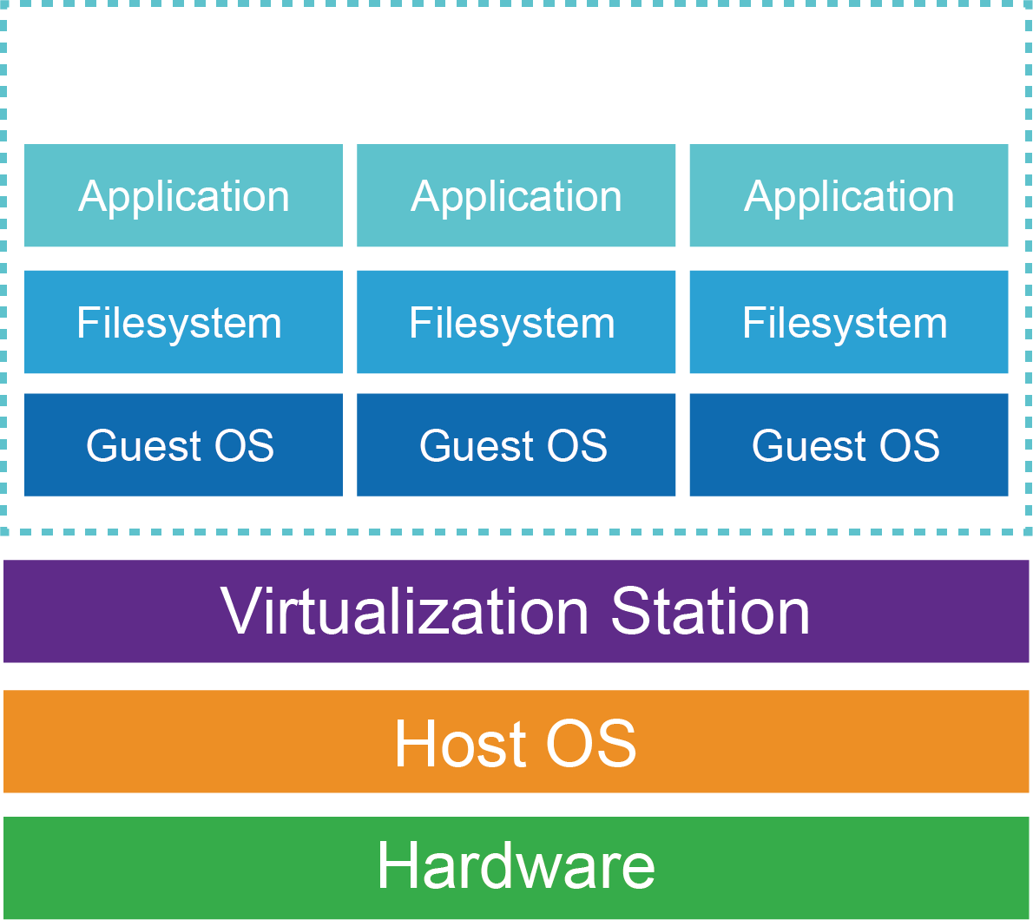
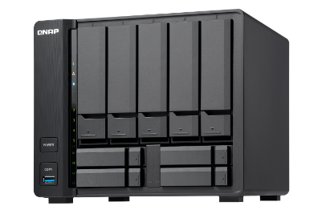
Virtualization Station
A type-2 hypervisor running on top of NAS (Host).
All VM configurations are stored in a centralized database.
VM HDD disks are stored in the NAS folders.
Specify a volume to install VS and both system and VM configurations are saved in with a database.
VM HDD disks are stored in the NAS folders.
System Volume
Volume 1
Volume 2

Slide 4
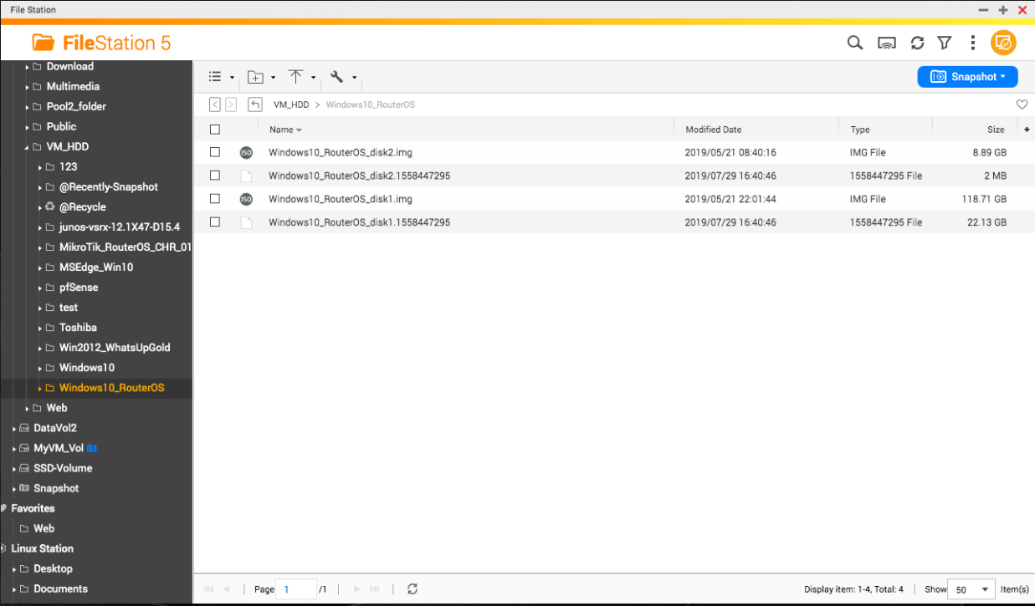
VM HDD Disk image (1/2)
Bases on KVM (Kernel-based Virtual Machine) and uses qcow2 image format to be managed.
Disk image
Supports read-only backing
Supports snapshot
Compress and encryption
Hint：all extension of VM HDD disks image is *.img shown in the File Station.
Disk Image snapshot

Slide 5
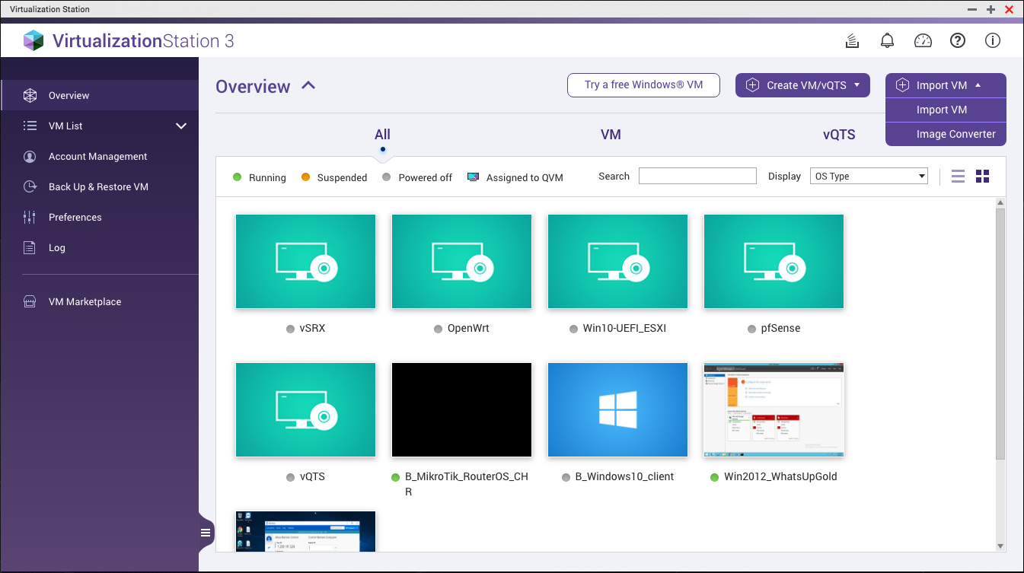
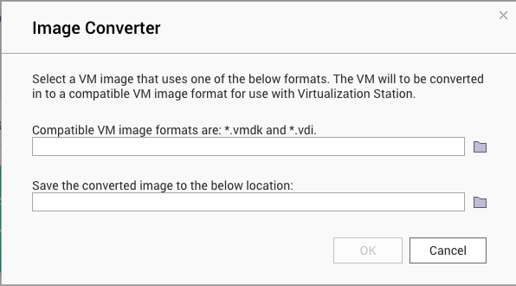
VM HDD Disk image (2/2)
Besides qcow2 image format:
RAW: Plain binary image of the disc image. Simple but doesn’t support snapshot feature.
VMDK: VMware proprietary image format, used in VMware WorkStation, vSphere…etc.
VDI: used in VirtualBox.
Hint：Image Convertor can be found in the Overview.

Slide 6
VM Disaster Recovery
Guest OS crash because of unexpected shut-down
Ransomware attack, malicious application…
Physical disks corrupted
Power outage

Slide 7
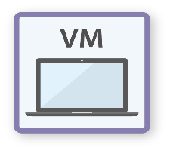
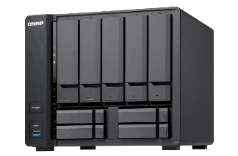
Disaster Recovery: Leveraging Snapshot & Backup
Revert a snapshot to the normal status of VM
Restore a remote VM backup directly

Slide 8
DR – Snapshot mechanism (1/2)
Bases on External Snapshot structure and manage multiple snapshot files with Blockcommit design.
While taking a snapshot, the disk image (backing file) enters the read-only status to create an overlay disk image (current) to keep record of the changes.
Base Image
Snapshot
1
Snapshot
2
Current
(Active)
Commit
Base Image
Current
(Active)
Merging the snapshot 2 into snapshot 1 when the snapshot 2 is being deleted.
Snapshot
1
Snapshot
2
Hint: all snapshots record its backing file while Virtualization Station saves all VM HDD disk configurations. Regarding snapshot management, please manage them in the Virtualization Station instead of QTS File Station.

Slide 9
DR – Snapshot (2/2)
Supports Copy-on-write without shutting down the VM
Quickly revert to a known state
Snapshot scheduling
Snapshot keep and retention

Slide 10
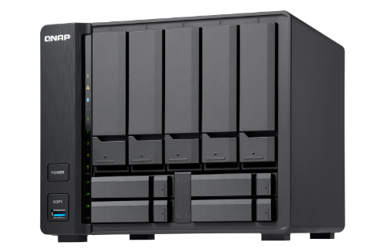
DR – Back Up VM (1/2)
System creates a snapshot first and flushes memory data to HDD disk image while backing up the VM.
VM
VM
Base Image
Snapshot
1
Snapshot
2
Current
(Active)
Base Image
Snapshot
1
Snapshot
2

Slide 11
DR – Back Up VM (2/2)
Supports backing up VM locally/remotely
Non-stop VM back up
Backup scheduling*
Retention
Restore VM backup remotely
Hint: A VM backup contains whole created snapshots. If the VM would be imported in the future, you may consider using to export the VM instead. The exported VM does not include snapshots.

Slide 12
DR – leveraging QTS Snapshot
Restores Virtualization Station settings and all VMs simultaneously (both of VS and VM has to be stored in the same volume).
Volume Snapshot 20190630
Volume
Volume
VM
VM
VM
VM
VM
VM
Restore
Volume Snapshot 20190731
Volume
VM
VM
VM
VM

Slide 14
Lots of data inside VM
Taking such a long time to back up VM
Cannot access data inside the VM directly
Less of data availability

Slide 15
Data high availability: guest OS + mounted storage
VM HDD disk is used to running guest OS, while data storage capacity leverages external storages throughout iSCSI or SAMBA.
iSCSI
VM
Guest OS
CIFS/SMB
NFS
外部空間

Slide 16
Data availability – remote mount & hybrid cloud solution
File-level
Block-level
Mount NAS shared folders via CIFS/SMB
Hybrid Cloud: VJBOD Cloud, CacheMount
Mount NAS iSCSI LUN
Hybrid Cloud: VJBOD Cloud

Slide 17
Data Availability – File Level (1/2)
Using CacheMount to mount public cloud storage as folders and allowing VM to access folders via SMB/AFP.
CacheMount
Convert
(object storage)
SMB/AFP
NAS
VM
Public Cloud service
(file or object)

Slide 18
Data Availability – File Level (2/2)
A NAS can be used as Edge Storage by connecting to a Cloud Object Storage provider, create a cloud volume on the cloud, and mount it for application usage.
VJBOD Cloud
SMB/AFP
iSCSI
Cloud Volume
Cloud Object Storage providers
NAS Cache Space
VM

Slide 20
Other settings and applications for security
Cache modes for VM HDD image
VM console configuration
Running a virtual router to apply for firewall rules

Slide 21
Settings – VM HDD Cache Mode
Writeback
Using the host page cache to execute read/write data provides the better performance. But if a VM is closed unexpectedly and the data in the cache cannot be written to the HDD in time, there may be a risk of data inconsistency.
ForceWriteback
Similar to the Writeback but all flush commands from the guests are ignored (i.e. forcing to use the host page cache). It is a trade-off of performance over risk of data loss in case of a host failure.
Writethrough
Use NAS caching to read, but doesn’t go through disk caching to write directly onto the drive. Its write performance is worse than Writeback, but doesn’t risk data inconsistency.
None
Bypass the host page cache and leveraging hypervisor user space buffer to write data into the disk cache directly. Its read performance is worse than Writeback and Writethrough, but it has the best write speeds.

Slide 22
Settings – VM HDD Cache Mode
Mode | Performance | Security
WriteBack | High | Low
ForceWriteback | High | Low
WriteThrough | Low | High
None | High (write) | Low
Hint: We suggest installing UPS (Uninterruptible Power Supply) to avoid unexpected power failure and provide the better security of WriteBack/ ForceWriteback.

Slide 23
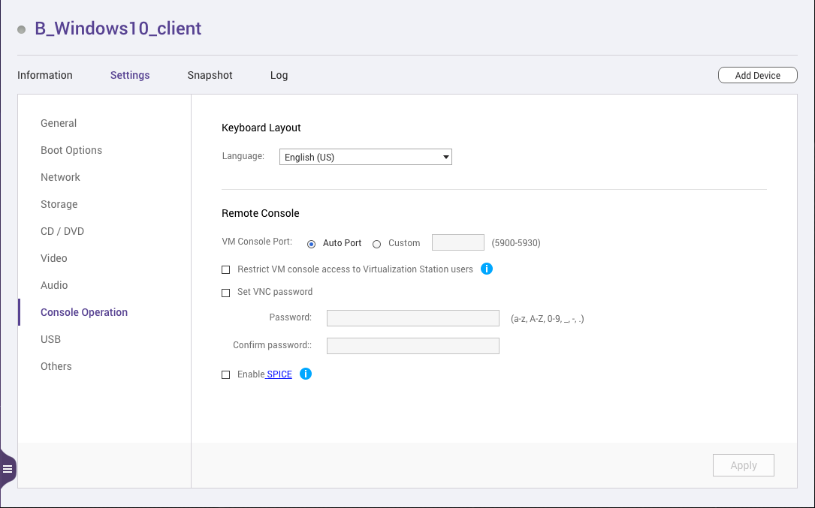
Settings – VM console
Virtualization Station provides a VNC server for VMs, but restrict VM console access to Virtualization Station users.
Setup VNC password
Enable “Restrict VM console..”

Slide 24
Applications – Virtual Router
Running a virtual router such as RouterOS, pfSense® to provide firewall rules.
Internet
Physical NIC
Virtual_NIC_1 (WAN)
vNIC 1:
WAN interface, all the traffic throughout virtual router first.
Virtual Switch
VM
vNIC 2:
LAN interface, applying network settings of virtual router via Virtual Switch.
Virtual Switch
Virtual_NIC_2 (LAN)
VM
Hint：pfSense® can be deployed from the VM Marketplace of Virtualization Station.

Slide 25
Notes:
Co-presenter by Don & Amol

