Slide 2
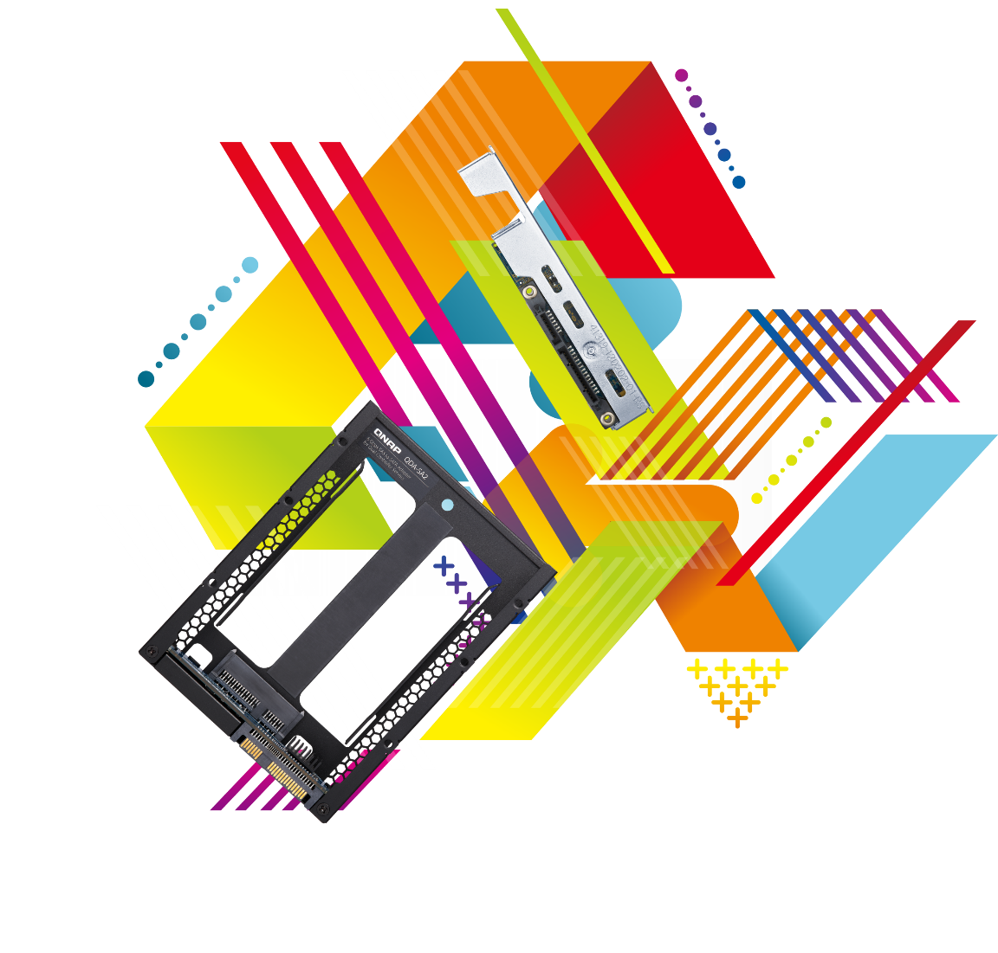
How to Cost-Effectively use SATA SSDs in Dual-Controller Servers?
Why Do You Need a Dual-Controller Server
Use SATA SSDs on Dual-Controller Servers with QDA-SA & QDA-SA2
Reliable Performance with SATA SSDs

Slide 3
What if The Following Systems Stop Working
CCTV camera for schools / communities / hotels
Hospital X-ray scanning and medical record systems
Not that it might cause monetary losses only
But might endanger the lives and social security of the general public
Critical data and daily operation systems in companies
Various financial services of banks

Slide 4
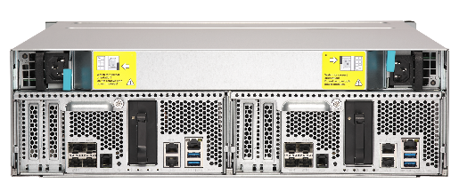
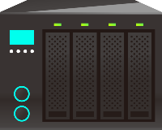
Common High Availability Storage Architecture
Active-Standby
Active-Active
Twice HDD and system cost
Unbalanced system load
Data loss when power outage
Network becomes risky
Dual standby path
Standby path
Dual active path
Active path
Sync data
Active
Standby
Active
Active

Slide 5
Full-duplex data transfer and dual-port
Controller 1
Controller 2
Controller
SAS drives are dual-port
Designed for high-availability(HA) architecture
SATA drives are single-port
Not for high-availability (HA) architecture
Channel 1
Channel 2
Channel 1
SAS drives
SATA drives

Slide 6
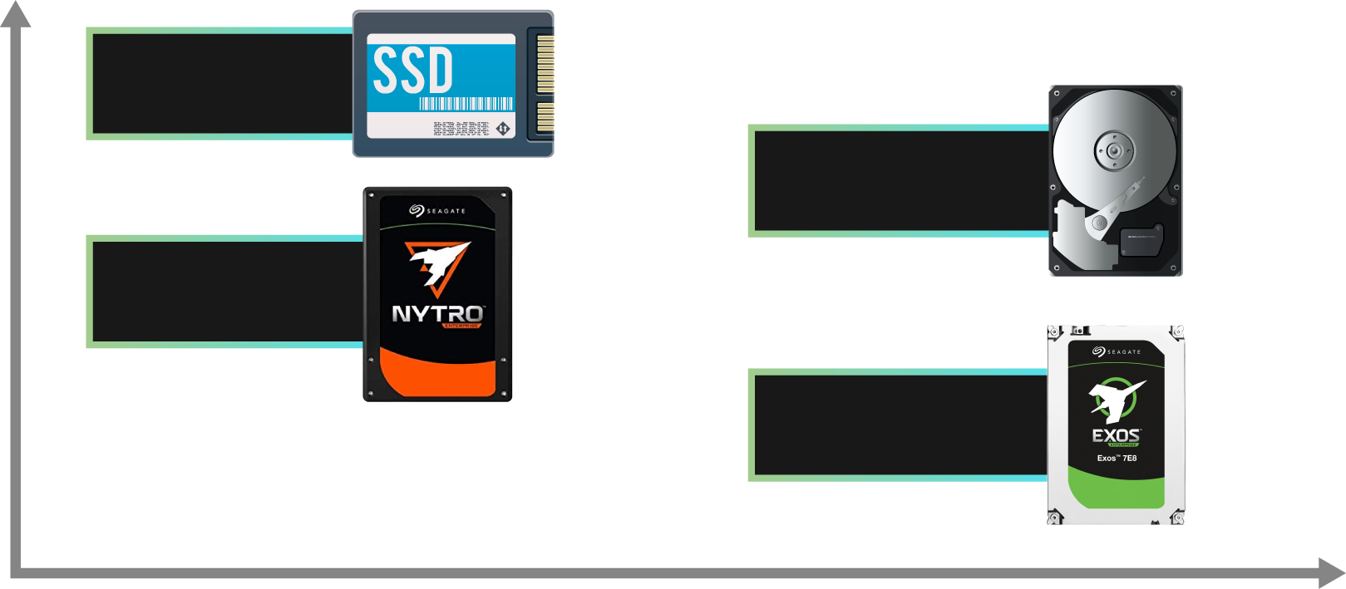
What kind of storage are supported by dual-controller servers
Higher price per GB
OEM SAS SSD
OEM SAS HDD
SAS SSD
SAS HDD
Lower price per GB
Smaller capacity
Larger capacity

Slide 7
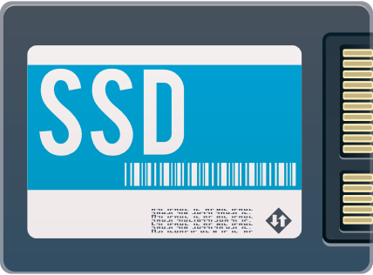
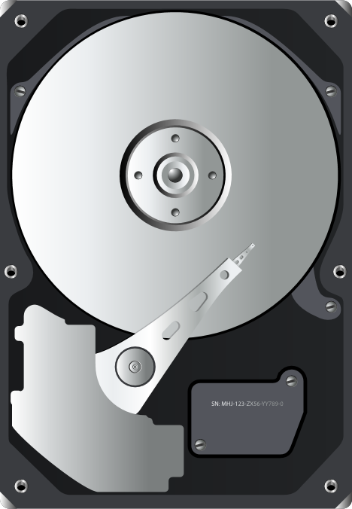
Large-capacity HDD and SSD are becoming popular
With the rapid increase in HDD and SSD capacity
RAID-6 has gradually failed to meet the reliability needs
128TB
64TB
32TB
16TB
20 - 40TB
Disk Capacity (TB)
10TB
2015
2016
2017
2018
2019
2020
Source: https://focalstyle.wordpress.com/2016/03/19/toshiba-announced-ssd-solid-state-disk-roadmap-2018-capacity-up-to-128tb/
Notes:
https://www.storagereview.com/seagate_announces_64tb_nvme_ssd_new_nytro_ssds_at_fms

Slide 8
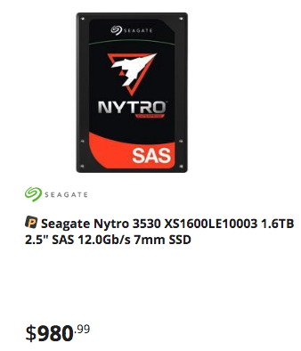
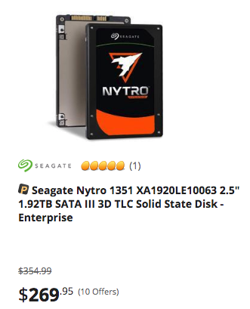
Cost-effective enterprise SATA SSD do exist
2019/07/26 Newegg.com USD prices
Enterprise-grade SATA SSD designed for data centers and cloud server applications
Cost saving compared to SAS SSD
Up to 3.8TB storage capacity
Enhanced enterprise reliability with up to 564MB/s seq. read and 536 MB/s seq. write performance

Slide 9
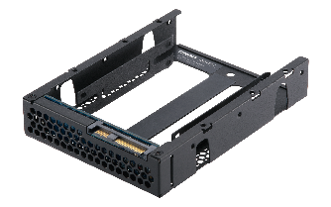
QDA-SA & QDA-SA2 adapters let dual controller servers use SATA SSDs
QDA-SA
QDA-SA2
QNAP Enterprise ZFS NAS
Dual-controller Windows/Linux servers
ES1686dc
ES1640dc / E1640dc v2

Slide 10
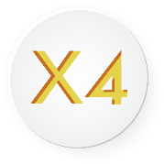
For dual-controller Windows/Linux servers and QNAP Enterprise ZFS NAS
Note: NAS must run on QES 2.0.0 or a later version.
QDA-SA for QNAP Enterprise ZFS NAS 3.5” SAS drive trays
QDA-SA2 for dual-controller Windows®/Linux® SAS servers, and QNAP Enterprise ZFS NAS 3.5” SAS drive trays
Order number: QDA-SA-4PCS (4 in a bundle)
Order number: QDA-SA2-4PCS (4 in a bundle)

Slide 11
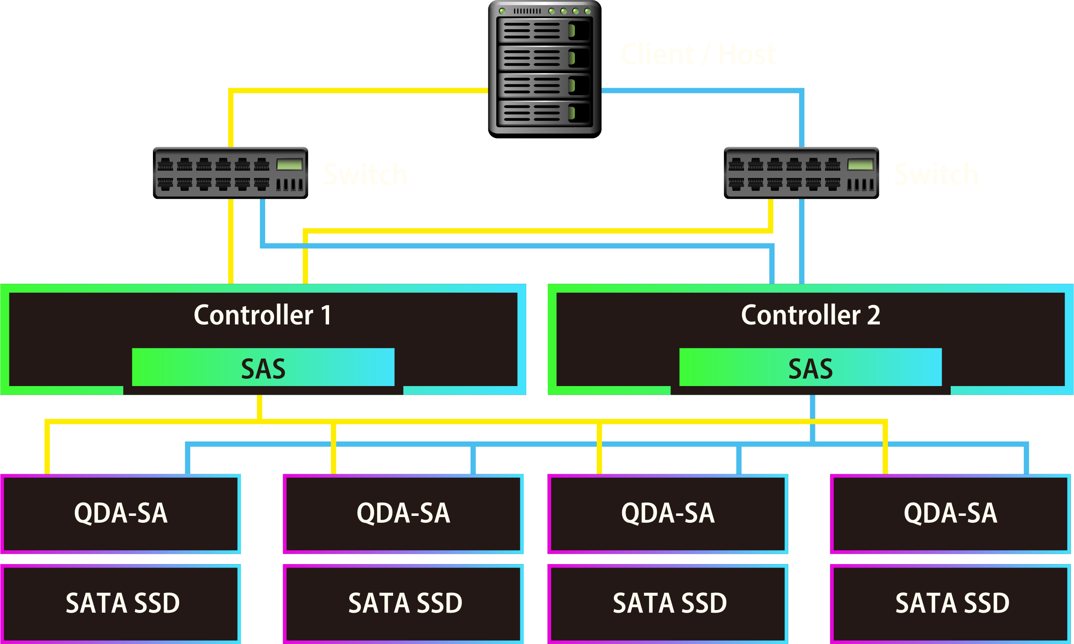
Let SATA SSD support SAS dual-port capability

Slide 12
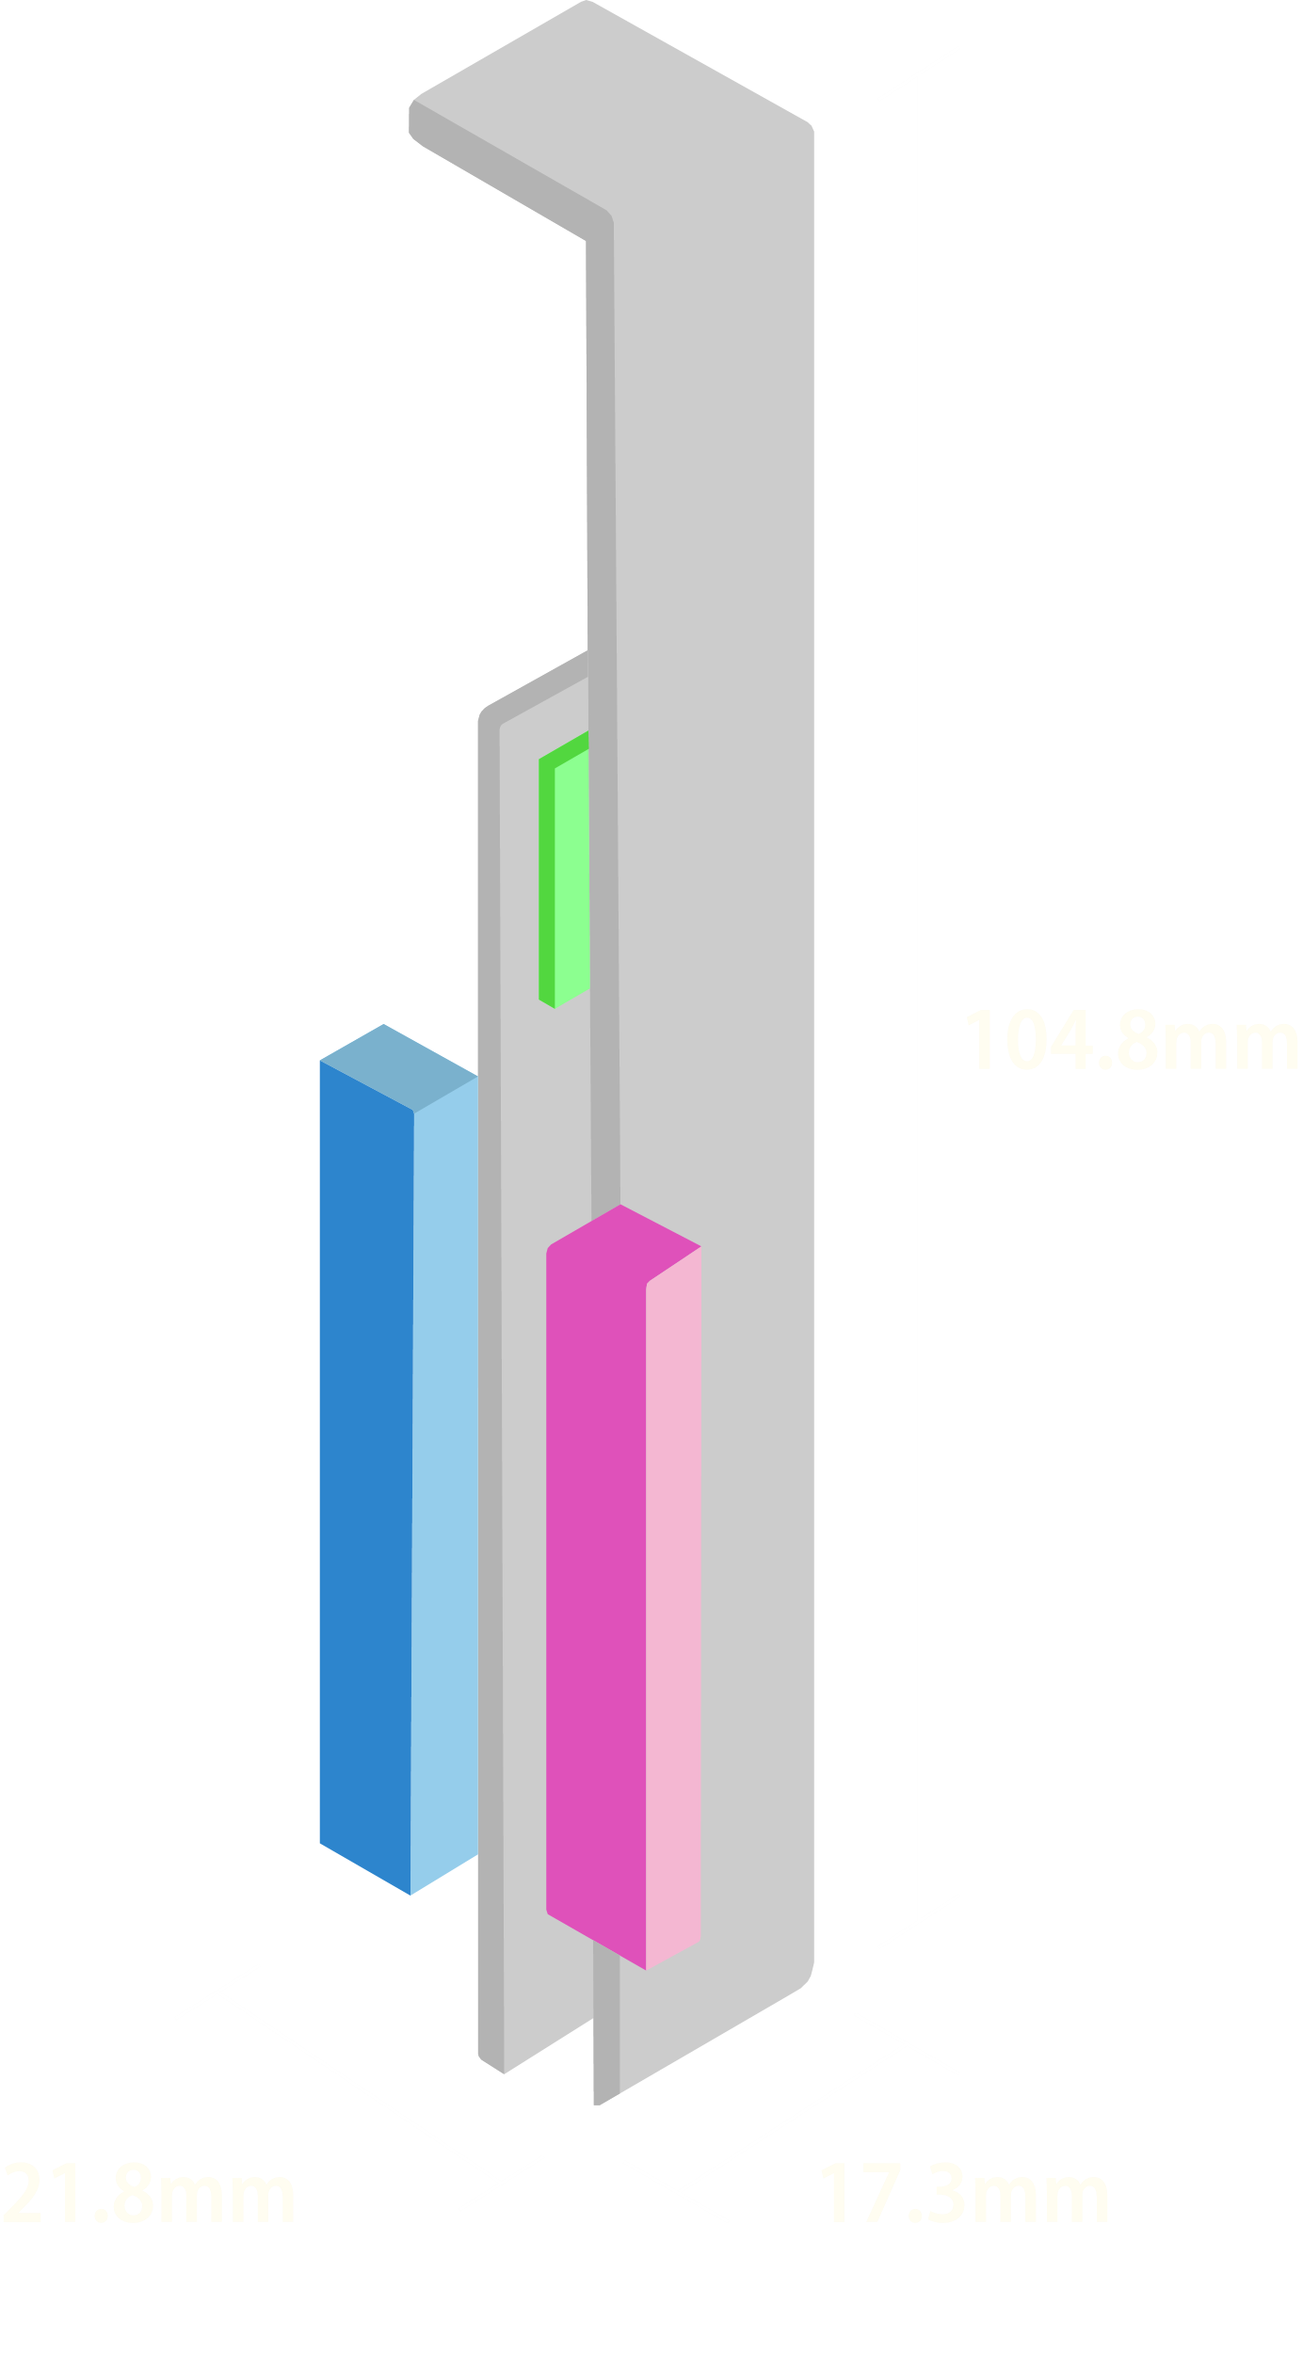
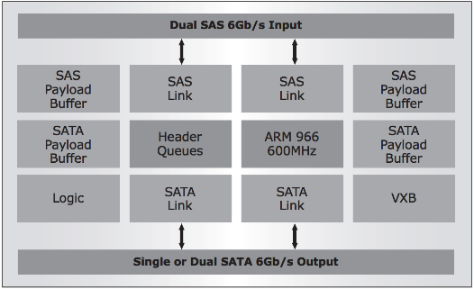
QDA-SA: 6Gb/s SAS to SATA adapter
Marvell 9110 6Gb/s SAS to SATA IC
SAS 6Gb/s
SATA 6Gb/s
SAS 6Gb/s
SATA 6Gb/s
Marvell 9110
600 MHz processor

Slide 13
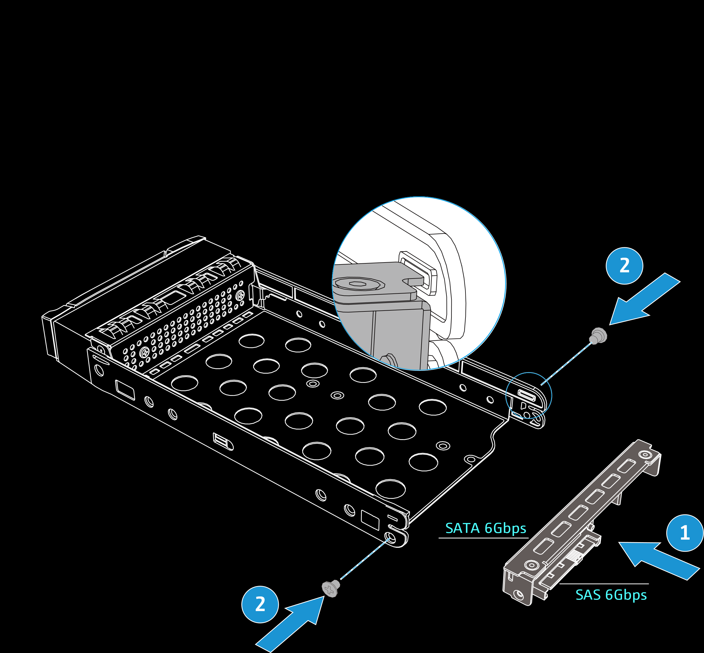
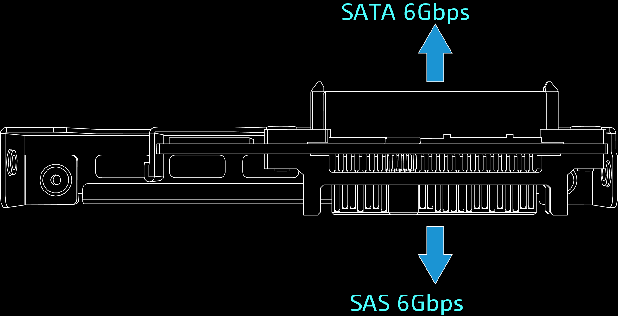
Support Enterprise ZFS NAS 3.5” drive trays
ES NAS 3.5” drive tray
Order number: SP-ES-TRAY-WOLOCK

Slide 14
QDA-SA2: 6Gb/s SAS to SATA adapter
SAS 6Gb/s
Marvell 9110 6Gb/s SAS to SATA IC
2.5”
SATA SSD
25mm
SATA 6Gb/s
SAS 6Gb/s
2.5”
SATA SSD
25.9mm
Marvell 9110
600 MHz processor
SATA 6Gb/s
138.2mm
101.6mm

Slide 15
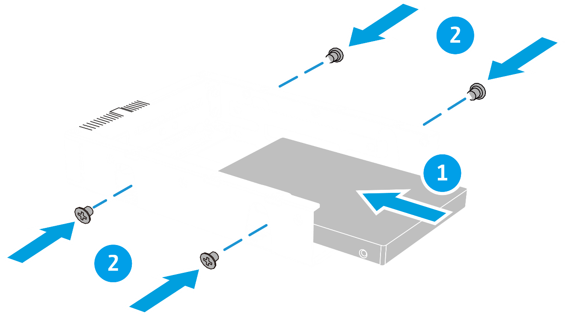
Install 2.5” SATA SSD to QDA-SA2 adapter

Slide 16
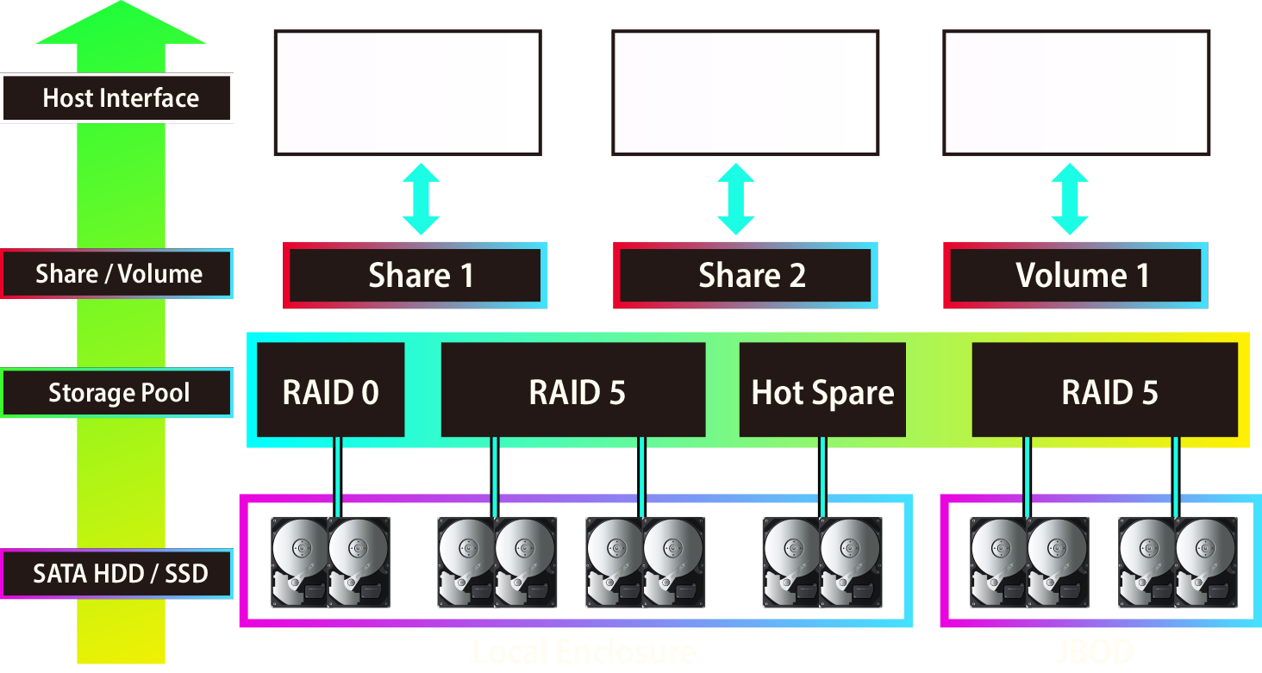
SATA HDD/SSD for NAS storage pool

Slide 17
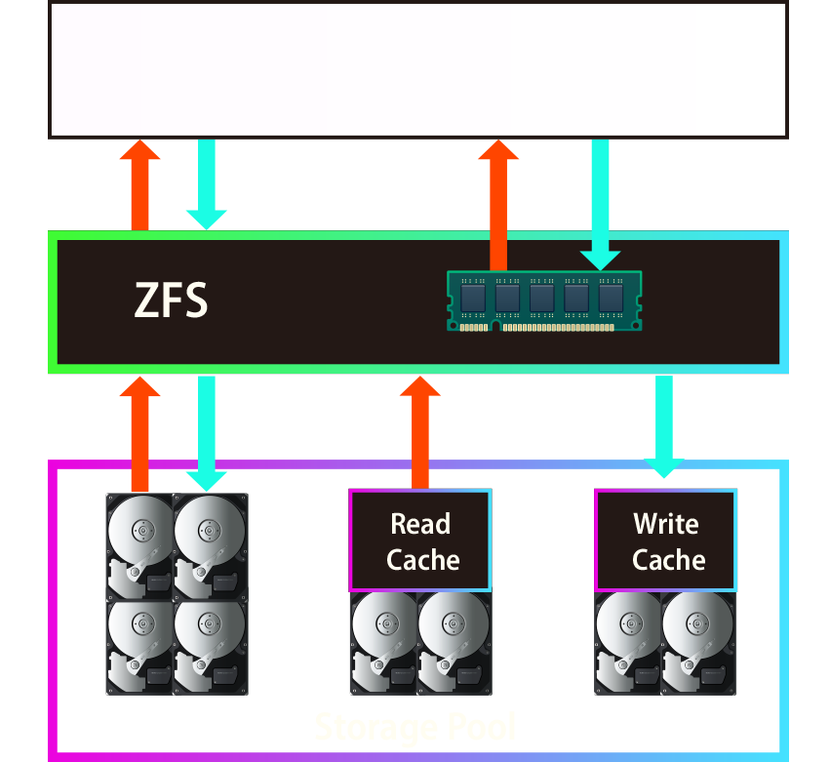
SATA HDD/SSD for NAS SSD cache
Improves random read IOPS
Accelerate file and block access performance
Support multiple SATA SSDs
Hot-swappable drive in SSD cache
NAS QES 2.1.1 O.S. will support HDD/SSD S.M.A.R.T health monitoring
*QDA-SA & QDA-SA2 do not support SSD TRIM and the HDD/SSD S.M.A.R.T. This feature is not supported on non-QES operating systems.

Slide 18
SATA SSD for reliable performance
10GbE x 2 (SMB seq. transfer)
+
2100
2099
1786
1400
700
0
Read
Write
(MB/s)
Tested in QNAP Labs. Figures may vary by environment. Test environment: ES1686dc Xeon E5-2420 v2 80GB RAM RAID 5 2 x 10G SFP+ + 16 x QDA-SA + 16 x Intel SSDSC2BB240G4 SATA SSD

Slide 19
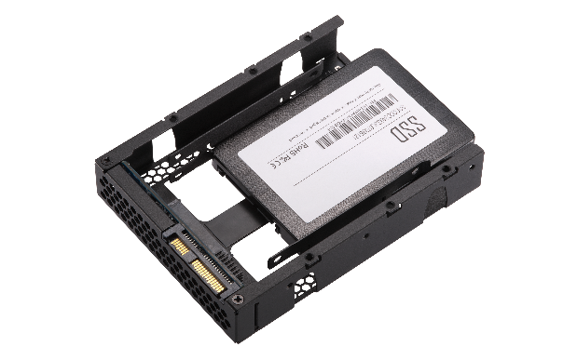
Testing the ES1686dc 4 x 10GbE iSCSI performance
with QDA-SA2 and SATA SSD in RAID 60

Slide 20
QDA-SA & QDA-SA2 6Gb/s SAS to SATA adapter Let SATA SSD become dual-path for dual-controller servers
Copyright © 2019 QNAP Systems, Inc. All rights reserved. QNAP® and other names of QNAP products are proprietary marks or registered trademarks of QNAP Systems, Inc. Other products and company names mentioned herein are trademarks of their respective holders.

