Slide 2
Backup - Wikipedia
Are Backup, Synchronization, and Replication the same?
Data deduplication technology QuDedup greatly reduces backup and restore time
QuDedup Extract Tool makes your backup data visible and portable
Scenario of QuDedup

Slide 3
User's Problem: Are Backup, Sync, and Replication the same？
What is difference ?
How should I choose ?
？
？
Backup = Synchronization = Replication

Slide 4
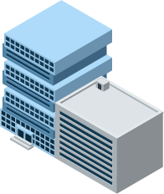
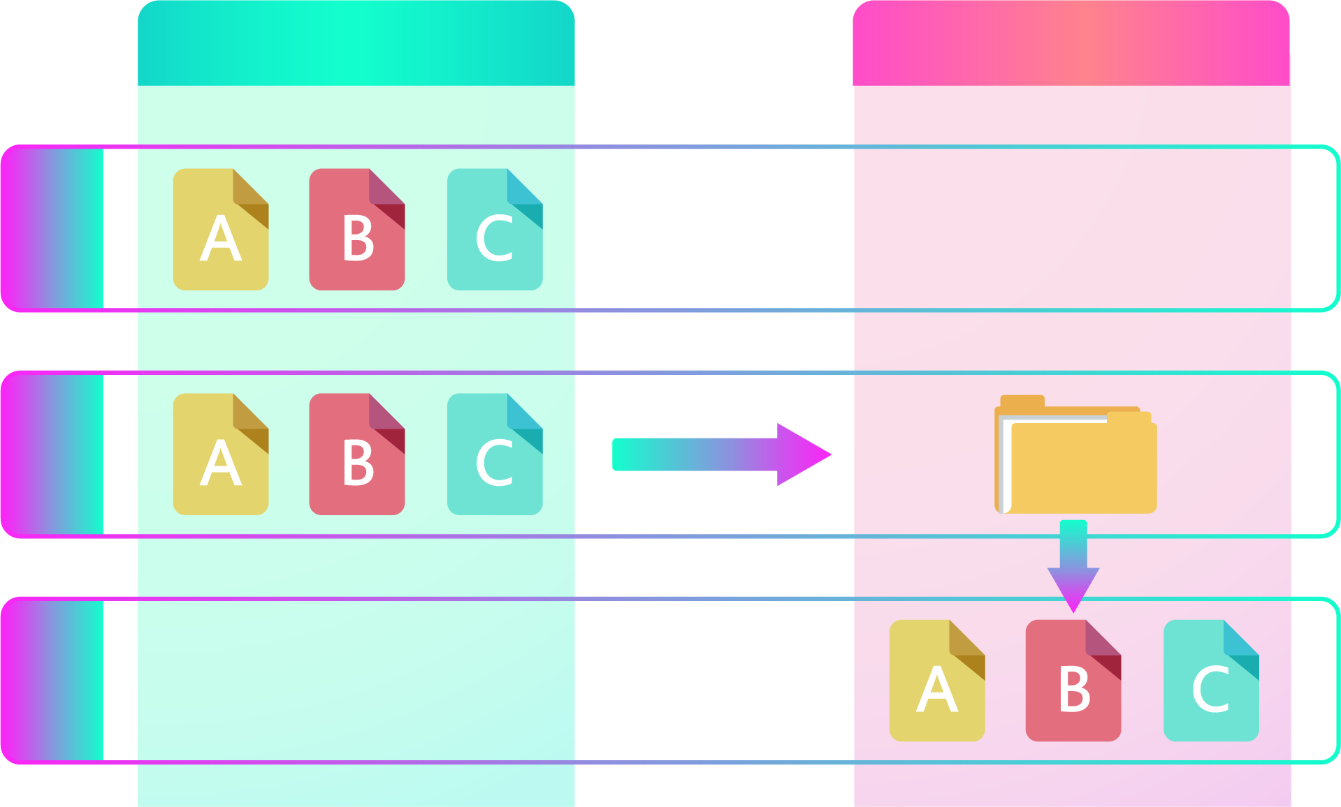
"Backup" and restore are inseparable. Extract your data.
Taipei Office
Kaohsiung Office
1
2
Backup
Restore
3

Slide 5
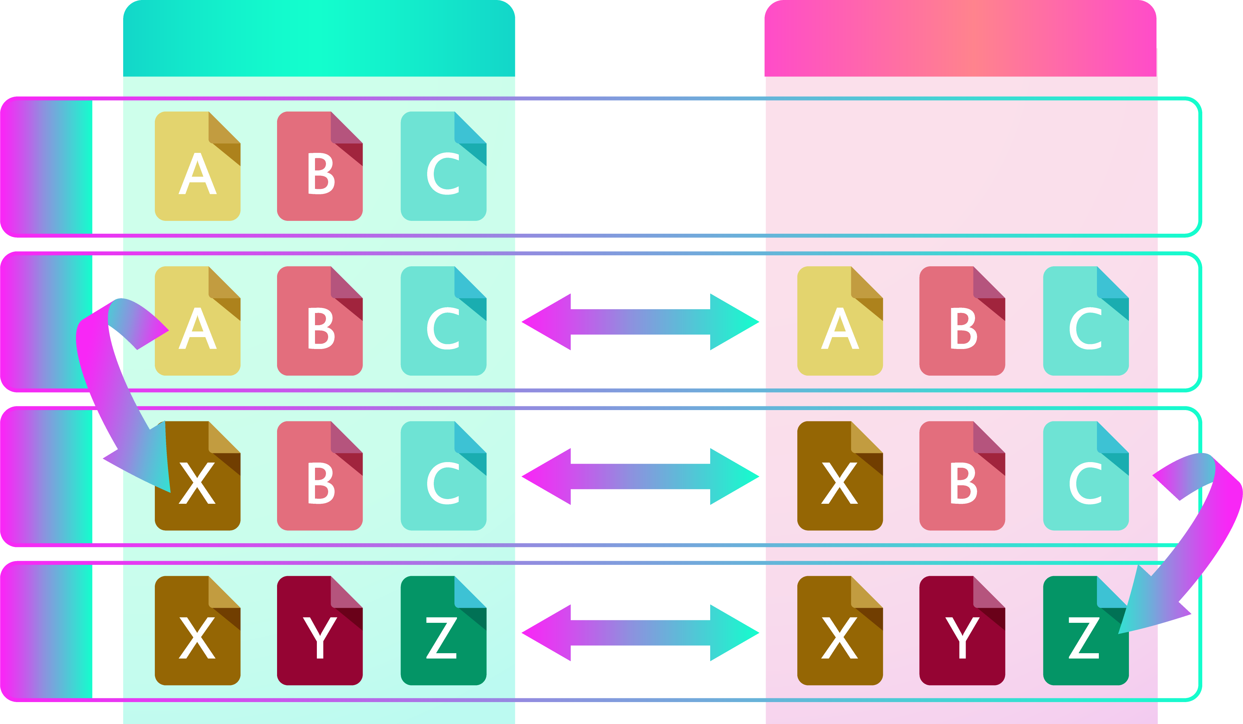
"Synchronization" is a two-way road. The same data.
Taipei Office
Kaohsiung Office
1
2
Sync
3
Sync
Data Modification
Data Modification
4
Sync

Slide 6
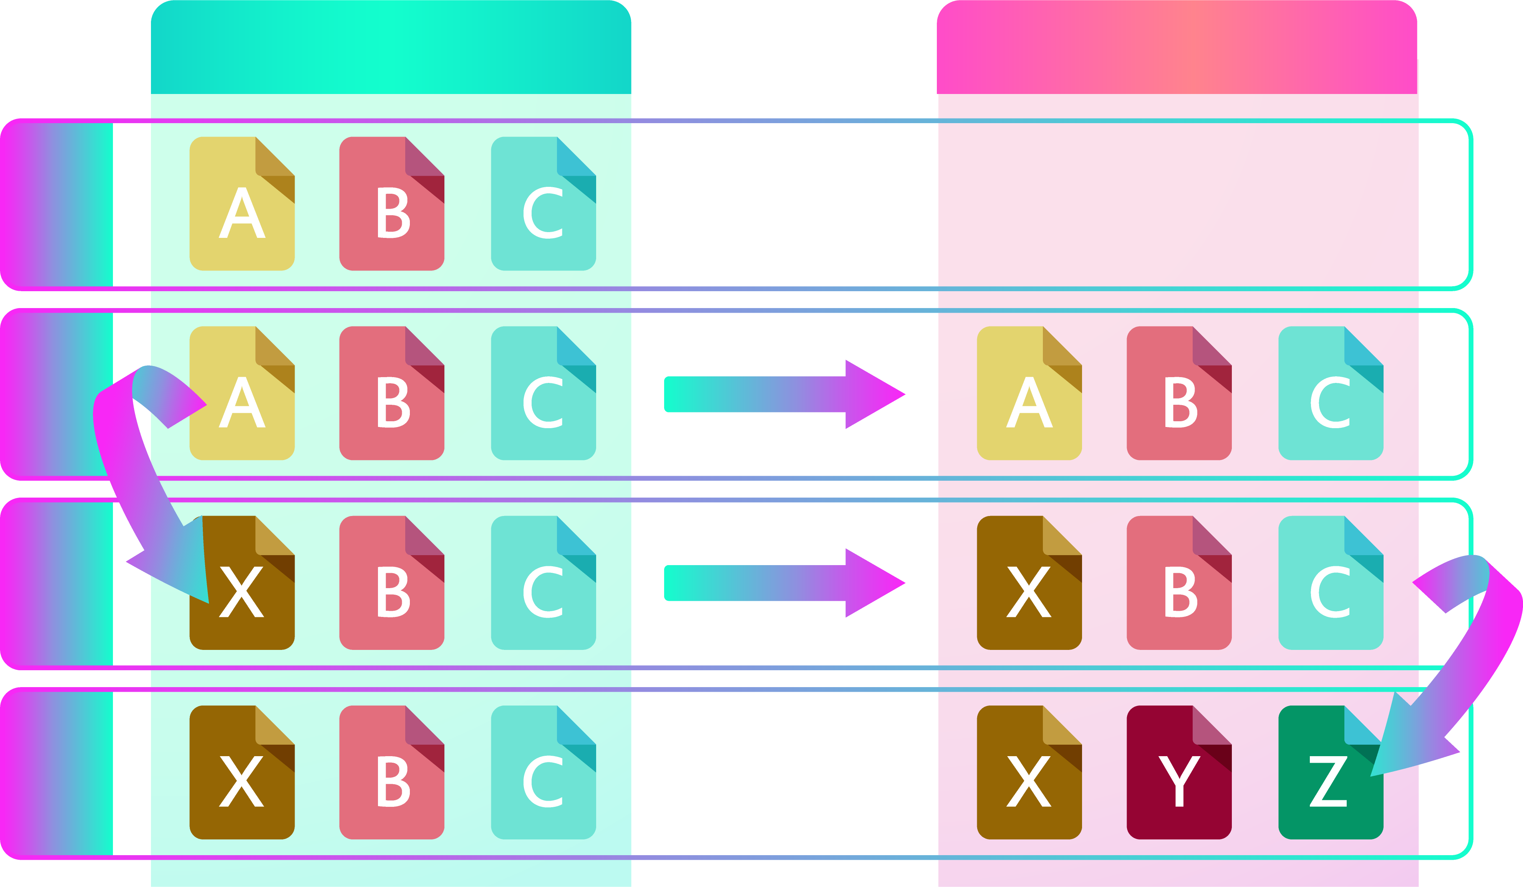
"Replication" is an one-way road of Synchronization. Data migration.
Taipei Office
Kaohsiung Office
1
2
Replication
3
Replication
Data Modification
Data Modification
4

Slide 7
Backup - Wikipedia : Easy to Choose
HBS provides three kind of services to achieve your demands
HBS 3 Levels up "Backup"
 | Backup | Replication | Sync
Pithy | "Copy cannot be accessed" | "Copy can be accessed" | "Copy and original are the same"
Size of Copy | smaller | same | same
Format of Copy | different | same | same
Instant Access | N (must Restore) | Y | Y
Direction | One-way | One-way | Two-way
Scenario | The amount of data is large, the data is packaged and stored. And it can be restored to access while the disaster occurs. | Share the data to the remote location (branch office), and the modification of data will not change the original data. | Share and edit data together on the different locations (branch offices).

Slide 8
Data deduplication technology QuDedup greatly reduces backup and restore time

Slide 9
Reduces backup file, backup and restore no problem
Issues you might encounter while backing up data...
Transmission time is too long and bandwidth resources are consumed for a long time.
Backup taked too long to achieve intensive backup cause data loss risk raising.
Without data reduction pre-processing will cause increased storage costs.
Notes:
放技術報告 https://www.ithome.com.tw/node/45228
https://www.ithome.com.tw/node/38018

Slide 10
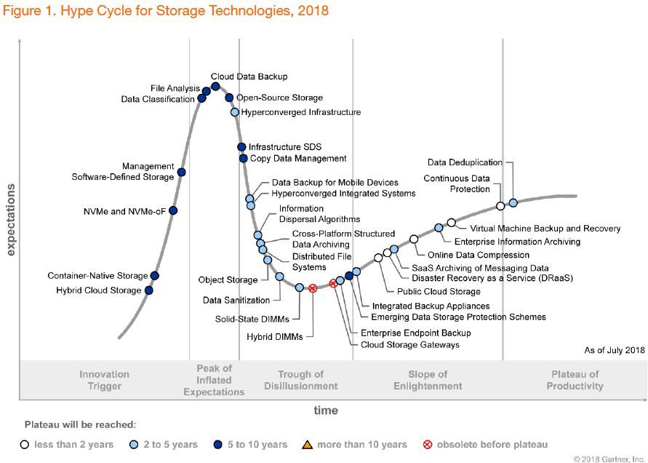
Gatner: Deduplication will be the transformational technology in near future
Technical Point
​Block level analysis and comparison, removing redundant data from finer levels.
Cross-file comparison instead of single file compression.​
3 Major Scenarios
Backup Application
Virtual Tape Library(VTL)
Storage Server
Image source:
Gartner 2018 Hype Cycle for Storage Technologies
Notes:
放技術報告 https://www.ithome.com.tw/node/45228
https://www.ithome.com.tw/node/38018

Slide 11
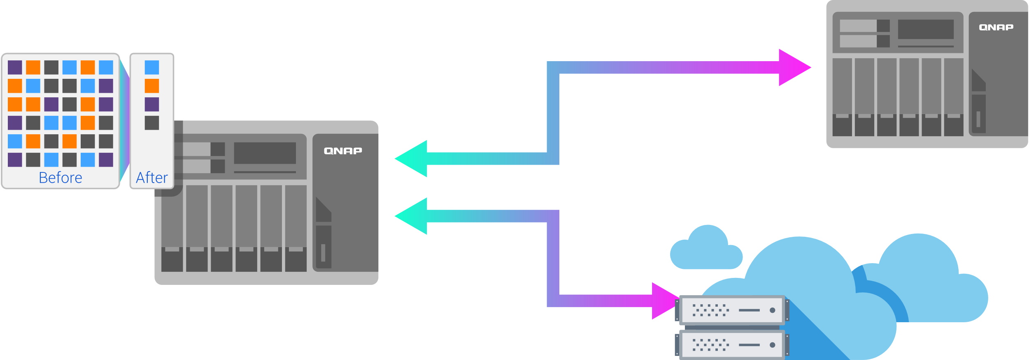
QuDedup Technology: Data reduction, small is fast!
VM Image Size | Deduped File Size | Compression Rate
15.48 GB | 7.59 GB | 2.04:1
Future highlights
Block level analysis and comparison
Source-side data deduplication framework
3 Advantages
Bandwidth reduction,
Space saving
Support multiple cloud providers
Note: The compression ration of one VM image file.
01
Bandwidth Reduction
02
Space Saving
頻寬減量
03
Support multiple cloud providers
QuDedup support model: x86

Slide 12
Source-side data deduplication technology is in line with modern enterprise needs
81% of enterprises have adopted the cloud solution, therefore source-side data deduplicated is more suitable for their needs.
Highly compatible with different backup destinations
Reduce backup storage space and data transmission bandwidth
Source-side Data Deduplicaiton Technology
Notes:
https://blog.csdn.net/liuaigui/article/details/5829083

Slide 13
High compression ratio, surpassing traditional data reduction technology
Category | File Compression | Single Instance Storage | Data Deduplication
Comparison Level and Scope | Byte / Single file | File / Specified disk area | Block / Specified disk area
Suiteable Scenario | Single file | Cross-files | Both single file and cross-files
Typical Data Compression Rate | 2:1 ~ 5:1 | 3:1 ~ 5:1 | 5:1 ~ 20:1

Slide 14
QuDedup Extract Tool makes your backup data visible and portable

Slide 15
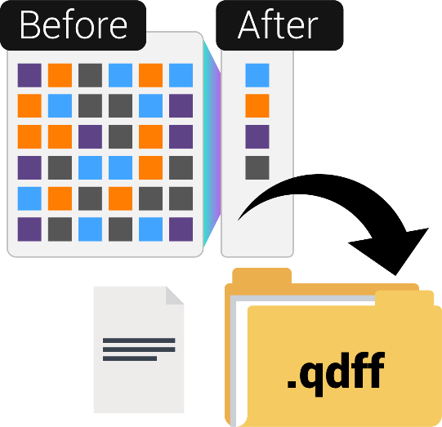
What is .qdff？
Backup Knowledge of .qdff
(QNAP Dedup File Format)
Storage format for deduplicated data
Backup data is deduplicated in block level
Unable to see the file directory structure and file contents
File needs to be extracted before it can be accessed.

Slide 16
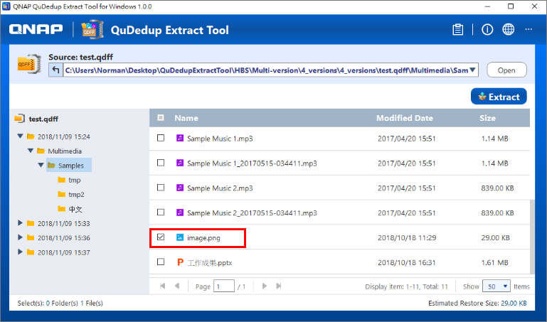
QuDedup Extract Tool makes .qdff restore without constraints
The after effect of data deduplication
Backup files cannot be viewed after deduplication.
Backup files need to be restored to the source before access.
All new QuDedup Extract Tool allows you to take TB-level file with you.
File Restore Anywhere
Bakcup files can be resotred directly on multiple platforms(Windows / Mac / Linux(Ubuntu)
File Preview
The backup file can be previewed before restoration to view the content differences in each version.
Single folder/file restoration
Notes:
輕量化應用程式，佈署攜帶更便利
跨平台支援，讓備份資料便於隨處還原存取
Windows / Mac / Linux(Ubuntu)
簡單一致的使用者介面 跨平台使用更上手

Slide 17
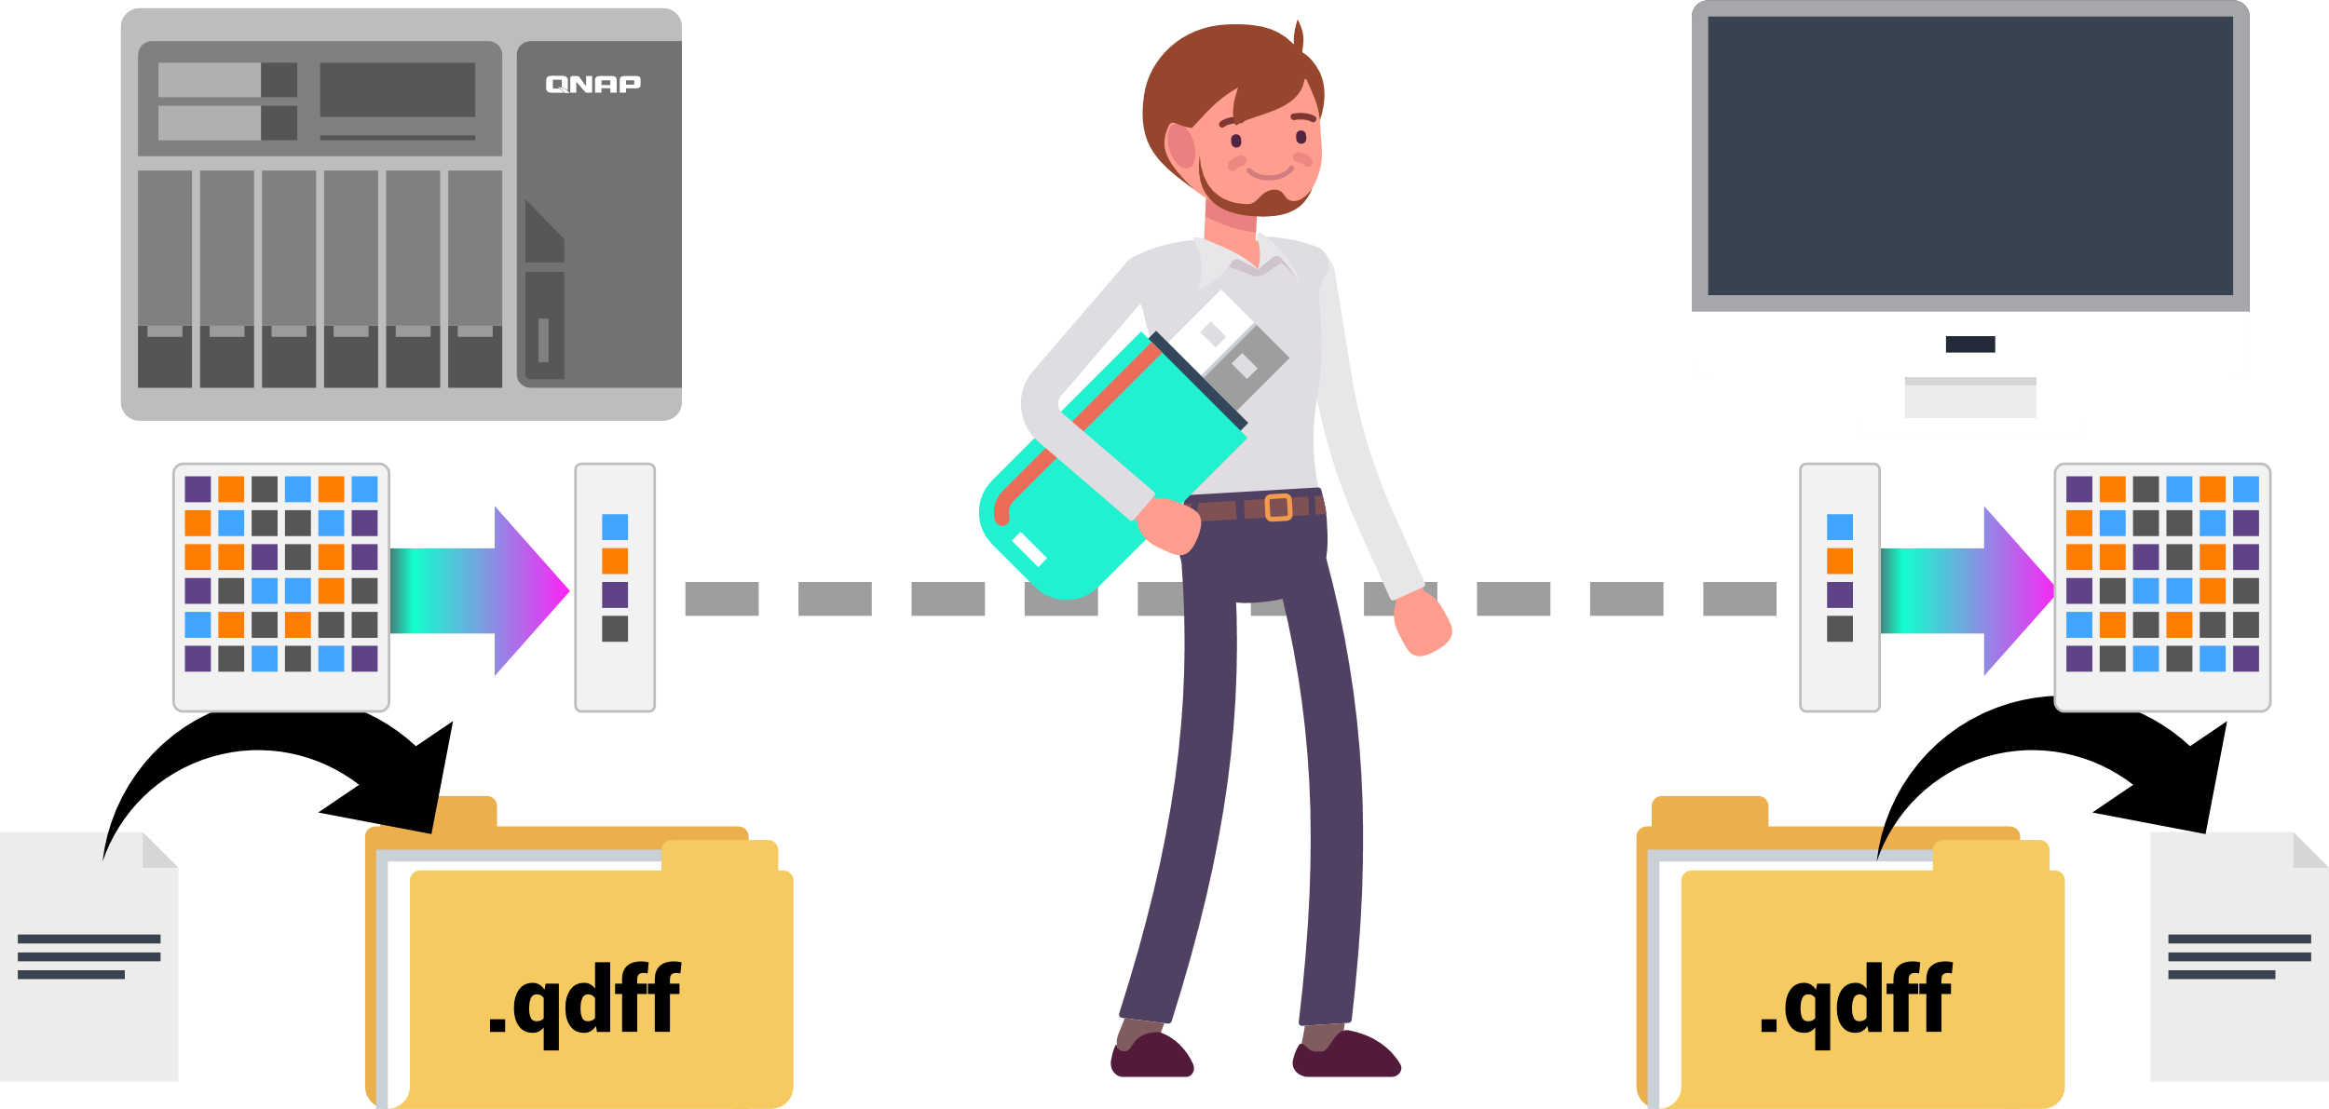
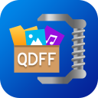
Bring your backup data by a single USB drive
10 TB
1~2.5 TB
1~2.5 TB
10 TB
Notes:
TR-004
NAS backup to TR-004
PC connect TR-004 w/ Extract Tool

Slide 18
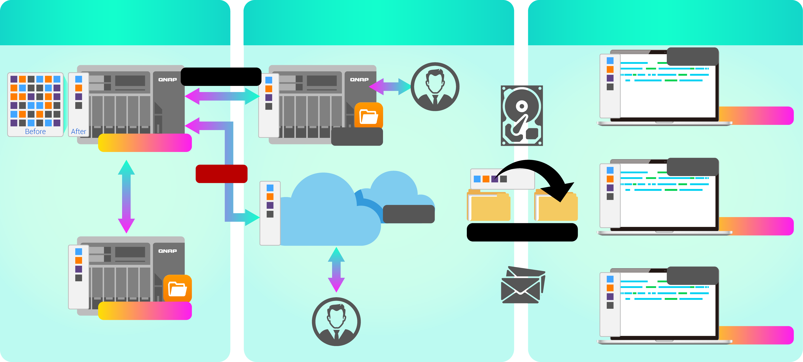
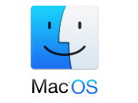
Backup data can be restored in different places and taken anywhere
Access from local NAS(via HBS)
Access from remote NAS (via File Station)
Carry and Use
.qdff
Backup/Restore
Tokyo
Taipei
.qdff
File Station with QuDedup, coming soon...
.qdff
TCP BBR
.qdff
CIFS / NFS / FTP
New York
.qdff
Taipei
File Station with QuDedup, coming soon...
Access from Cloud
Beijing
Notes:
Carry and use 在不同地點

Slide 19
Scenario of QuDedup
Scenario 1
IT staff who needs to back up a large amount of data every day
IT needs back up a lot of mail and database every day. A large amount of data must be backed up even after the working hours. And the backup should be stored with multi-version on the limited storage space.

Slide 20
Scenario of QuDedup
Scenario 2
User who wants to reduce the cost of backup
To reduce the risk of data loss and cost both, user wants to back up data on the limited storage space of hard drive, external device, and even the cloud.

Slide 21
Live Demo
To save the storage space: Operates to back up data with QuDedup on HBS 3
To access ".qdff" everywhere: Restore backup data on QuDedup Extract

Slide 22
HBS 3 Beta program finished
According to statistics, more than 90% of HBS 3 users can meet their demands.
QuDedup is highly acclaimed
• Save cost and storage space
• More completed solution with QuDedup Extract Tool, restore on PC directly
Support more cloud services, Flexible use
Backup with encryption, data is safer on the public cloud
Thank you for your support and look forward to HBS 3 official version.

Slide 23
QuDedup
is your best choice!
Copyright © 2019 QNAP Systems, Inc. All rights reserved. QNAP® and other names of QNAP Products are proprietary marks or registered trademarks of QNAP Systems, Inc. Other products and company names mentioned herein are trademarks of their respective holders.

