Slide 1
QTS 資安防護之必要
App Center 應用程式數位簽章功能 & Security Counselor 讓您遠離資安風險

Slide 2
OUTLINE
How Much Security Awareness Do You Have?
Where Did The Mining Virus And Ransomware Come From?
ech0raix Ransomware Issue
QNAP Response Team Processing Flow
How To Avoid It.
The Security Protection Is Not In Trouble! Security Counselor Will Take Care Of You.
Digital Signature Makes Sure The App Is Authentic
General Review Of Security Awareness.
Basic Security & Self-protection For Anyone!
Notes:
、

Slide 3
Security Awareness Quiz： Are You In This Dangerous Group?
1
1
2
3
使用弱密碼且未定期更換
內網和外網接在一起使用
機敏資料沒有設定存取權限
Use weak password, and never change it
Intranet and extranet are used together
Sensitive data does not have access rights
The risk of being attacked by a ransomware is as high as 90%! ! !
Who stole the secret data, Nothing to know!
After being infected by the virus, it spreads horizontally to the whole company.

Slide 4
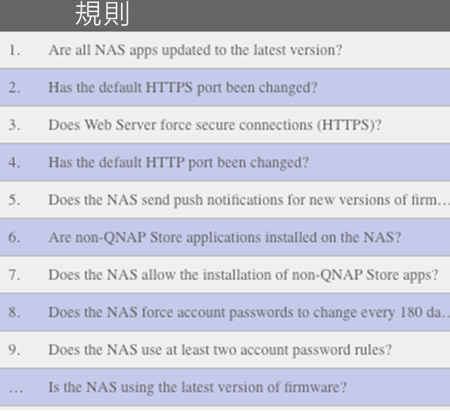
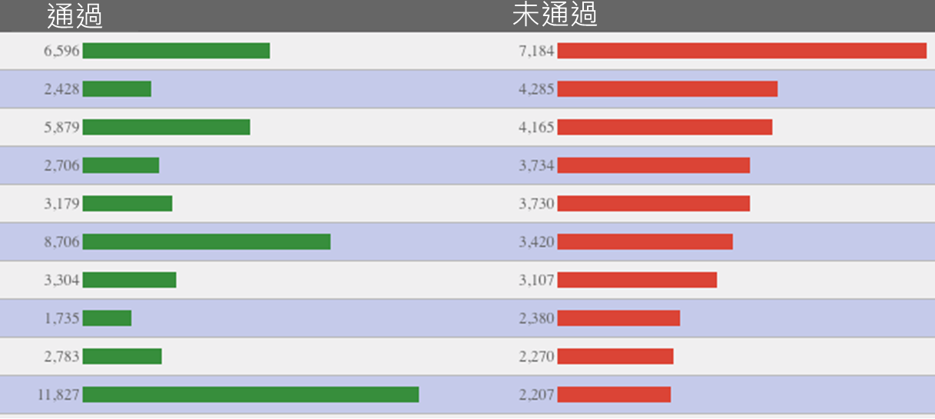
Most People Do Not Take These Settings Seriously!
(直播前要抓最新的圖) (自製圖表，不要使用GA上的)
(規則會換成中文)
Security Checkup rule：Pass / Fail ranking
Duration：2019/7/1-7/7
Unique Device：4,406
Rule
Pass
Fail
安全檢查規則：通過/未通過排名
規則
通過
未通過

Slide 5
Mining Virus, Ransomware, Where Did It Come From?
Using firmware or software that has stopped updating to come in through unpatched vulnerabilities.
Using a weak password, be careful! This set of passwords is in the dictionary of the malware.
Open unusable external services or use default ports, ex: SSH, Telnet
2018 Top Ten Most Unsafe Passwords
#10 iloveyou #9 qwerty #8 sunshine #7 1234567 #6 111111 #5 12345 #4 12345678 #3 123456789 #2 password #1 123456
圖片來源：https://steachs.com/archives/43477
#10 iloveyou #9 qwerty #8 sunshine #7 1234567 #6 111111 #5 12345 #4 12345678 #3 123456789 #2 password #1 123456

Slide 6
eCh0raix Ransomware Issue, How Does The QNAP Response Team Deal With It?
In July 2019, the eCh0raix ransomware locks the QNAP NAS and encrypts user data for ransom.
General deal process
The whole process takes within 1~4 weeks, depending on the severity/priority of the issue
Awareness
Preliminary assessment
Investigate & Determine Mitigation
Integration and Mitigation
Notification
eCh0raix deal process
Customer report
urgent meeting
Study case
Fix the problem or draft a solution
Release Security Advisory
Awareness
Preliminary assessment
Investigate & Determine Mitigation
Integration and Mitigation
Notification
Customer report
urgent meeting
Study case
Fix the problem or draft a solution
Release Security Advisory
Notes:
When we are aware of the problem, the problem may come from the customer or the sales
Sometime our RD founds the issue, then QNAP response team will make a preliminary assessment, our RD will analyze the virus,
We will collaborate with PM/RD/sales to make a decisions. After that, we will release a Security Advisory for exposing the security issue.
For this issue. The customer report this ransomware, and QNAP team opened a urgent meeting in the same time. After that the Security RD studies this case.

Slide 7
How to Minimize Risks of Being Infected by eCh0raix
According to user reports, infected QNAP NAS are either with older versions of QTS, or had recorded multiple unrecognized login attempts before eCh0raix began encrypting users’ data. A strong password shall be used to prevent brute force attacks.
QNAP strongly urges all NAS users to take the following actions:
Update QTS to the latest version.
Install and update Malware Remover to the latest version.
Use a stronger admin password.
Enable Network Access Protection to protect accounts from brute force attacks.
Disable SSH and Telnet services if not in use.
Avoid using default port numbers 443 and 8080.

Slide 8
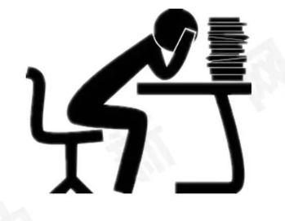
The Security Protection Is Not Difficult, But Very Troublesome!
These are all handed over to
Security Counselor
Let us help you solve this for you
and make you feel comfortable
using NAS's various services
There are a lot of items that need to set them up.
There are too many details to pay attention to!
Which services should be opened? Which should be closed?

Slide 9
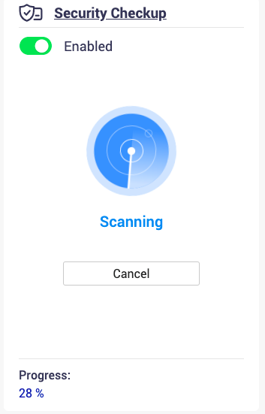
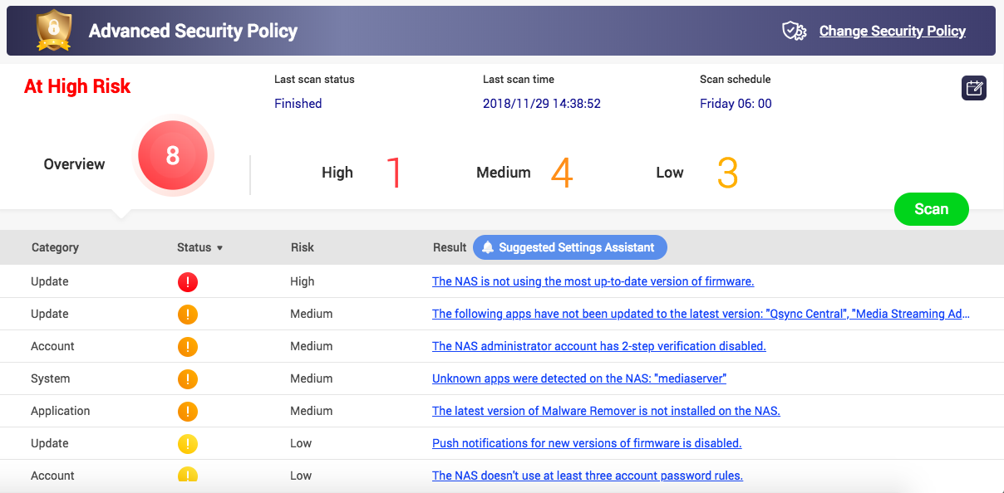
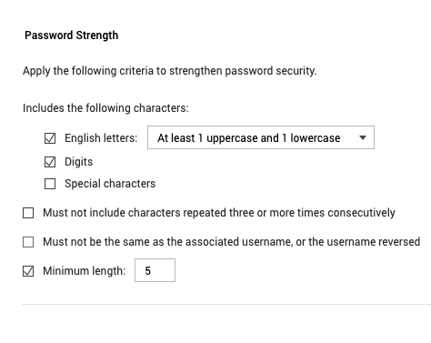
How To Prevent The Risk? Let Security Counselor Help You
Run a scan
View the report
Correct the risks
Change setting

Slide 10
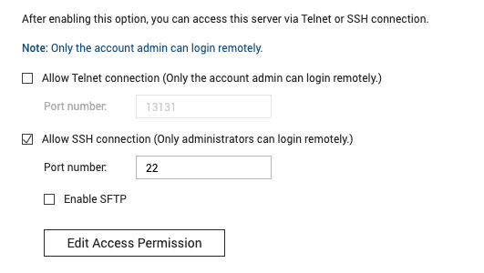
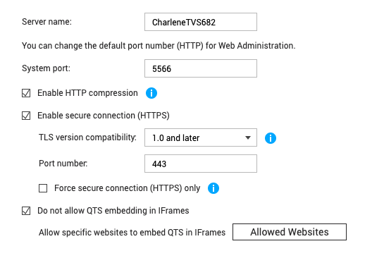
The Devil Is Hidden In The Details. These Places Security Counselor Help You Pay Attention!
Password strength option is not enabled, not updated regularly, and the default password is used.
SQL server (phpMyAdmin) uses the default password.
Enable SSL/Telnet connection.
Use the default connection port number.
Use an application that is not on the QNAP store or has no digital signature.
Notes:
There are a lot of settings in the NAS
But some settings we need to pay attention it, but we usaully ignore it.
For example, your password strength option is not enabled or SQL server password use the default password.
These settings are located deffrent place, we have to set up one by one. So it‘s very troublesome for some user
So Security Counselor will help you check up these settings.

Slide 11
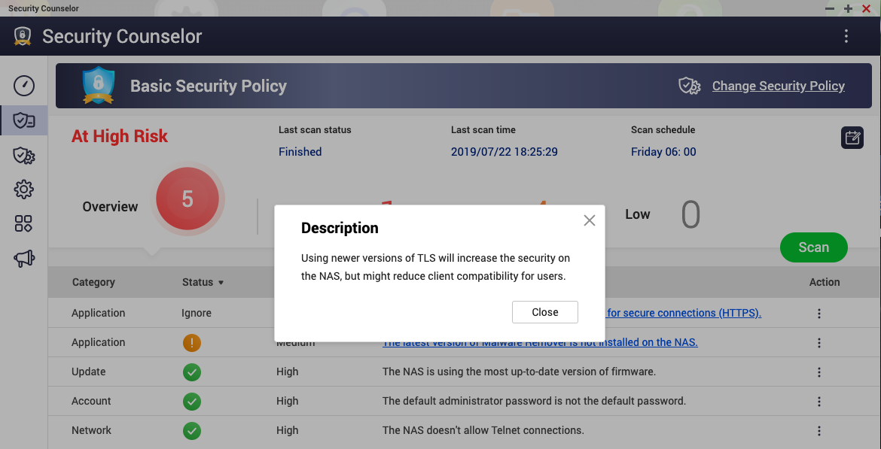
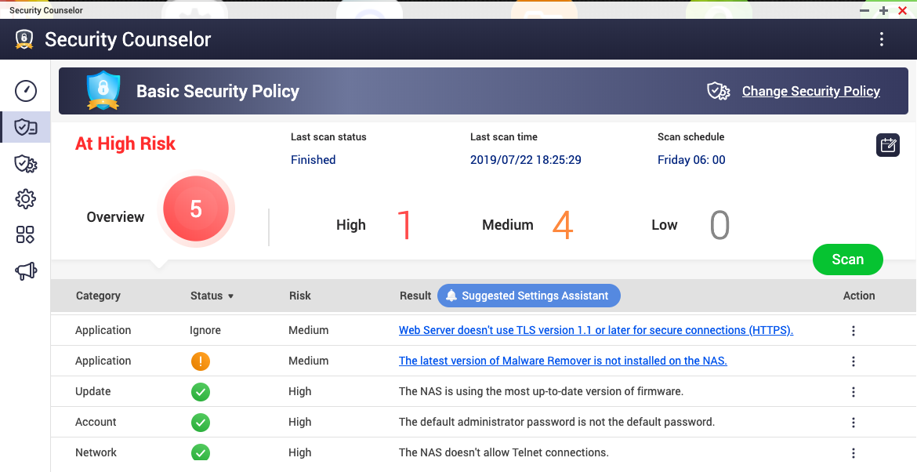
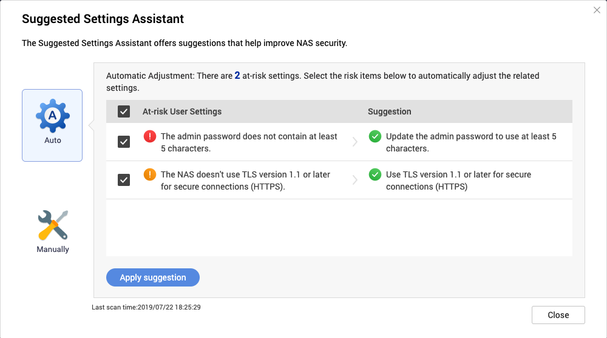
New Update To Better Meet Your Security Needs
Ignore features increase flexibility
View description and strengthen awareness of security
Suggested Setting Assistant, the right hand of the security setting
Notes:
And now we release a new version for SC, the following is the new enhancement
SC will check up your NAS, if the NAS got a fail result, that is means this setting is not safe. But sometimes we really need to keep this setting and we don't want to change it. Then SC will send an alarm for you. That's very noisy. So now you can ignore it. But you can resume the ignore result anytime.
We have Suggested Settings Assistent, that can help you correct the risk on your NAS more easier.

Slide 12
DEMO
LIVE

Slide 13
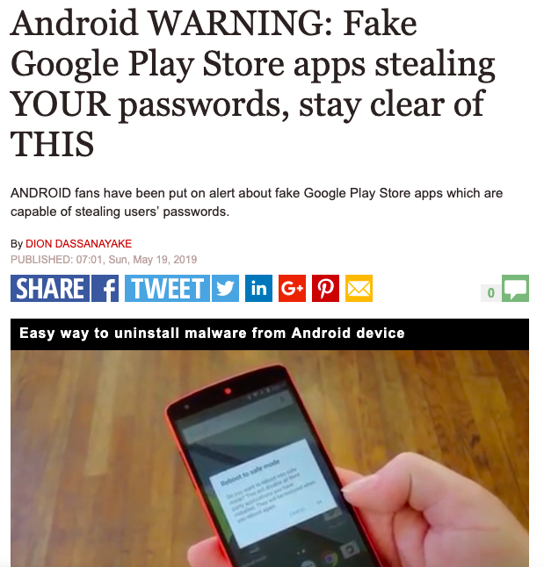
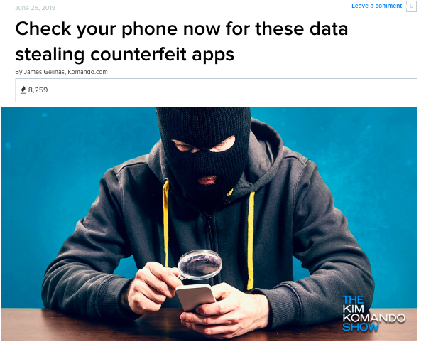
Watch Out! Malwares Pretend To Be Commonly Used Applications
Is the popular app on the web safe?
The application has been tampered; how do I know?
Have you ever worried about installing an unsafe app?

Slide 14
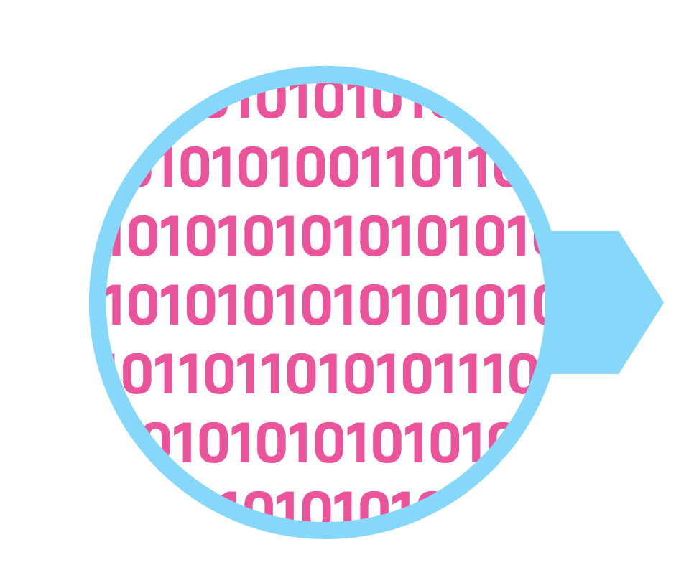
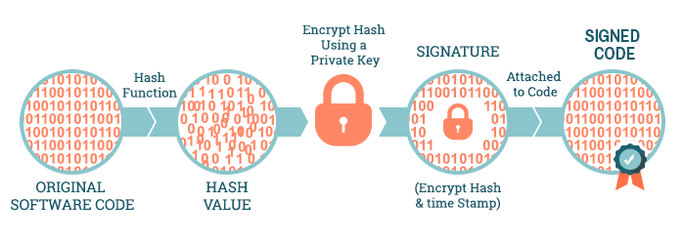
Don’t Worry！ QNAP NAS Has Digital Signature
The Digital signature is a verification mechanism for digitally signing an application to confirm the source of the software publisher and to ensure that the software has not been modified or corrupted.
App that has not been signed yet
Add certificate and signatures to the app
App that has been signed
When user install an app from App Center
1. Confirm that the certificate issuer is correct.
2. Use the certificate to confirm that the file content is correct.
Notes:
1. 確認憑證是否正確：用QNAP發的 root CA (private key)
2. 確認檔案是否遭到修改
我們把經認證的app給予一個獨一無二的簽名，並且可以辨識簽名的真假，任何人都無法模仿
當Appcenter要安裝時，我們就去檢查這個簽名是否是真的，如果是真的才能安裝
實現方式 private-key public-key 原理
數位簽章使用公開金鑰加密技術，以保護和驗證程式碼。
開發人員使用來自程式碼簽章憑證獨一無二的私密金鑰，將數位簽章添加到程式碼或內容中
當使用者下載已簽章的程式碼時，系統會使用公開金鑰解密簽章
系統會搜尋附有它所信任或認識的身分，以驗證該簽章
然後，系統會將用於應用程式簽章的雜湊與下載應用程式上的雜湊比對
如果系統信任此根憑證且雜湊相符，就會繼續執下載或執行
如果系統不信任此根憑證或雜湊不相符，系統將中斷下載，發出警告或下載失敗

Slide 15
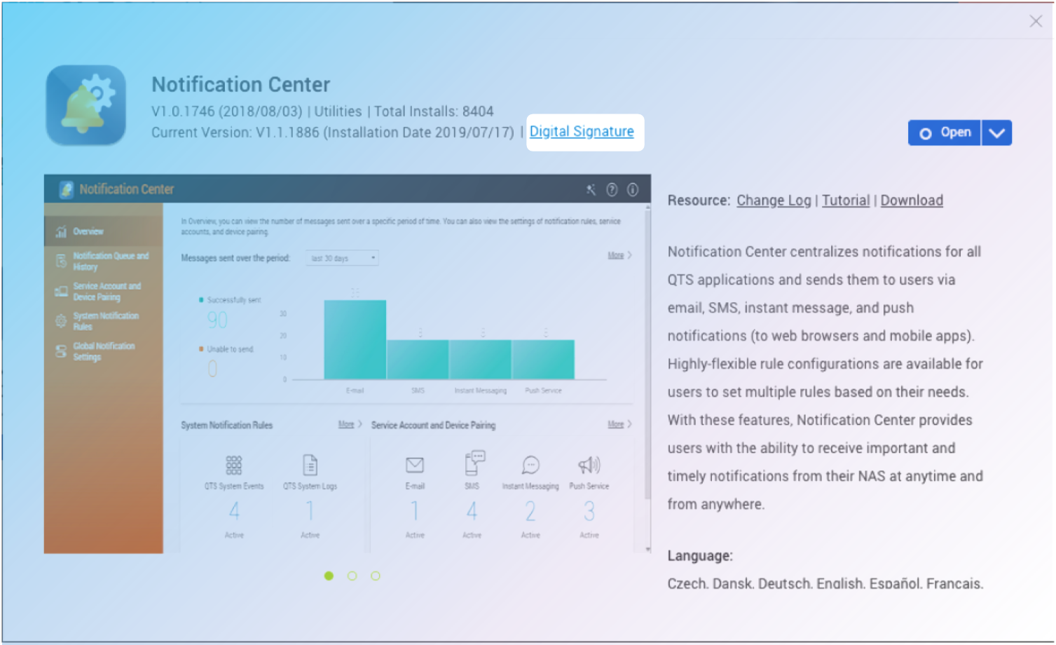
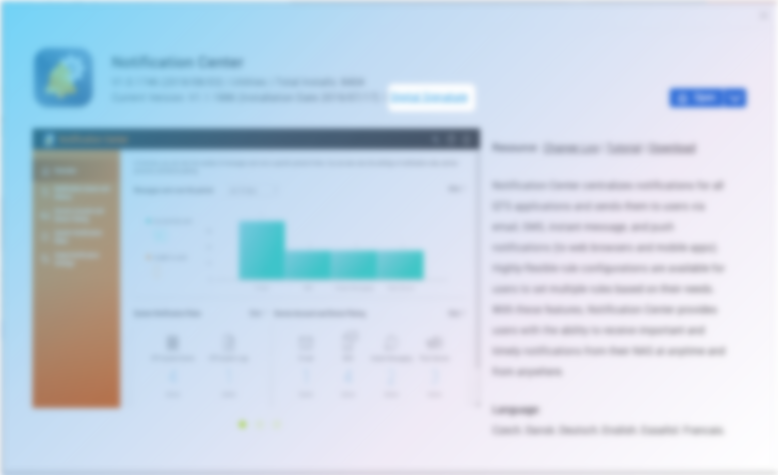
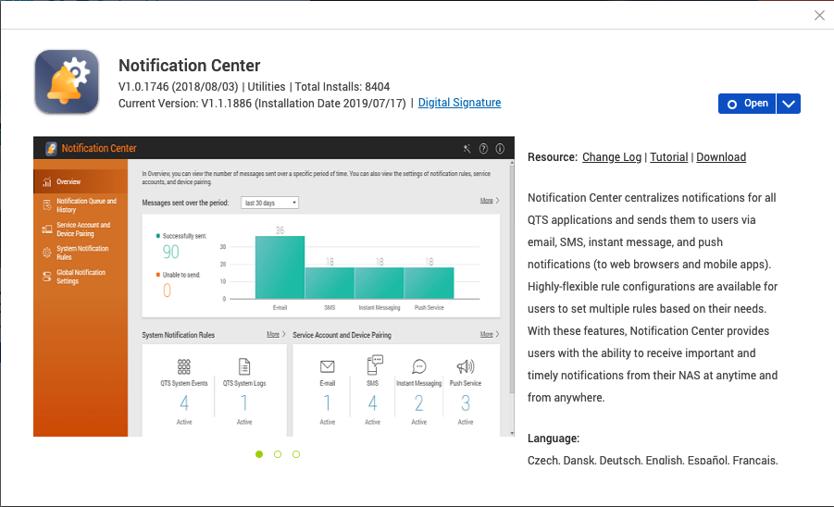
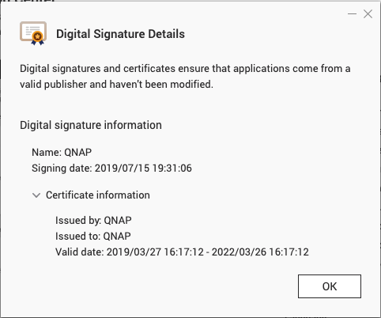
App Center Supports The Digital Signature Now
The application in App Center starts to support the digital signature from QTS 4.4.1 to ensure application security.
Digital Signature

Slide 16
Each Application Can View Digital Signature Information.

Slide 17
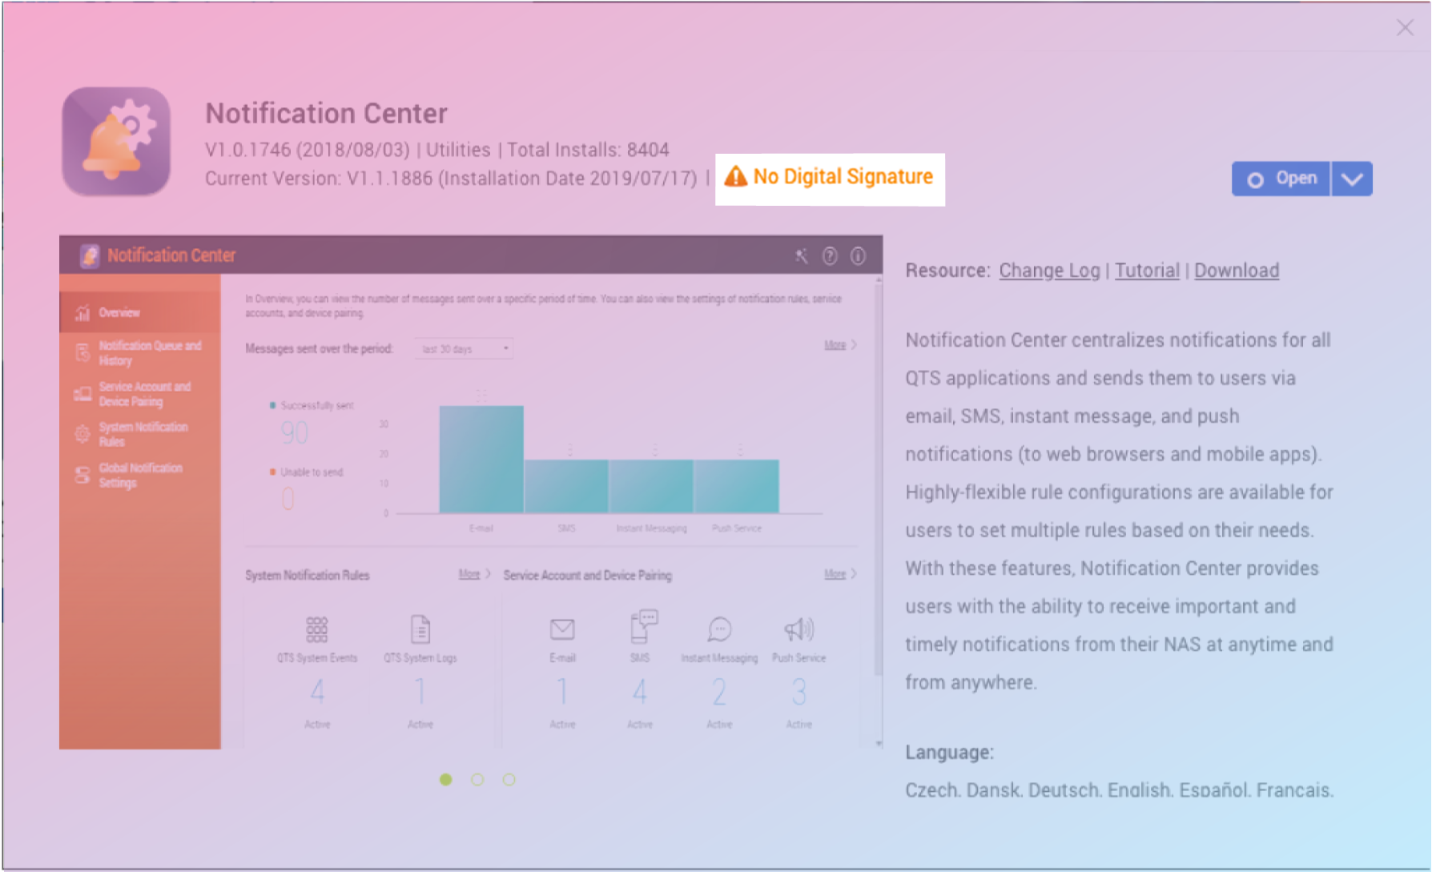
When Does The Application Have An Invalid Digital Signature?
No digital signature
Digital signature expired.
Digital signature is not issued by QNAP
Digital signature was tampered
No Digital Signature

Slide 18
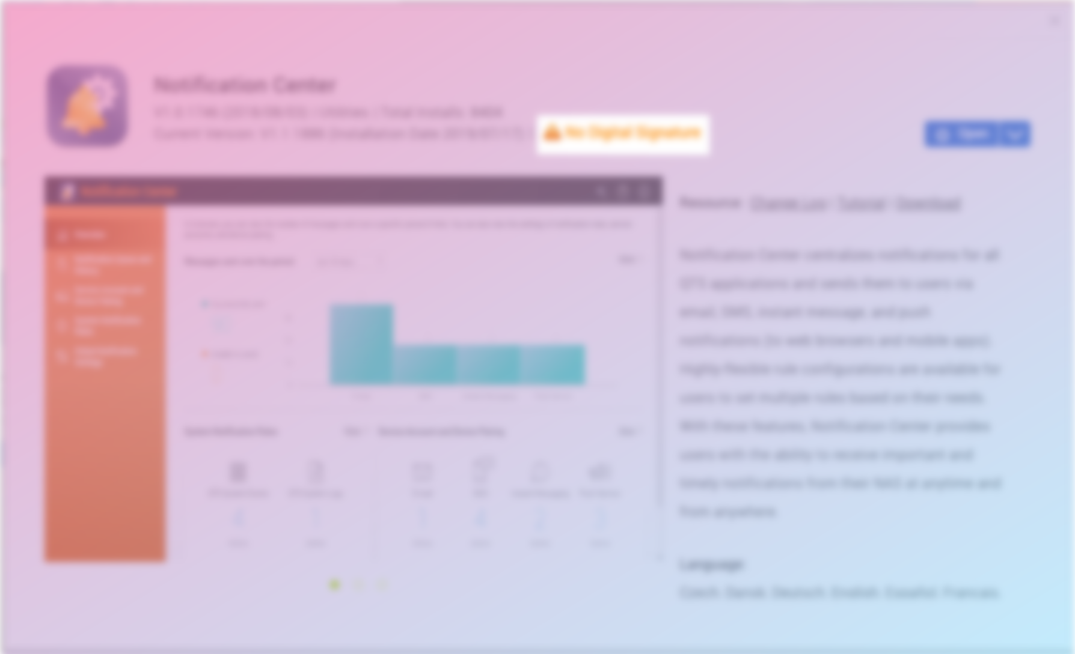
What Should I Do When The App Has “No Digital Signature“?
A notification warning will be issued, please pay attention to this application.
If the QNAP application issues a warning, contact QNAP support immediately.

Slide 19
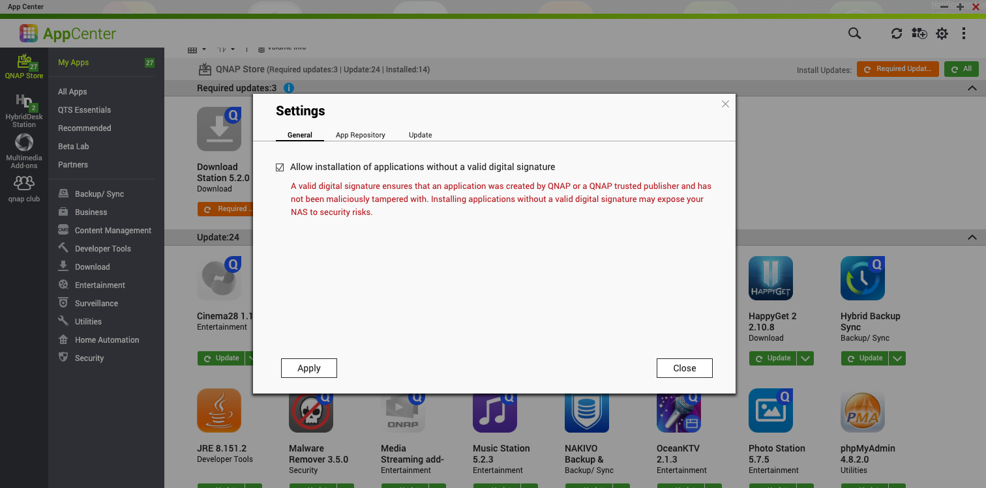
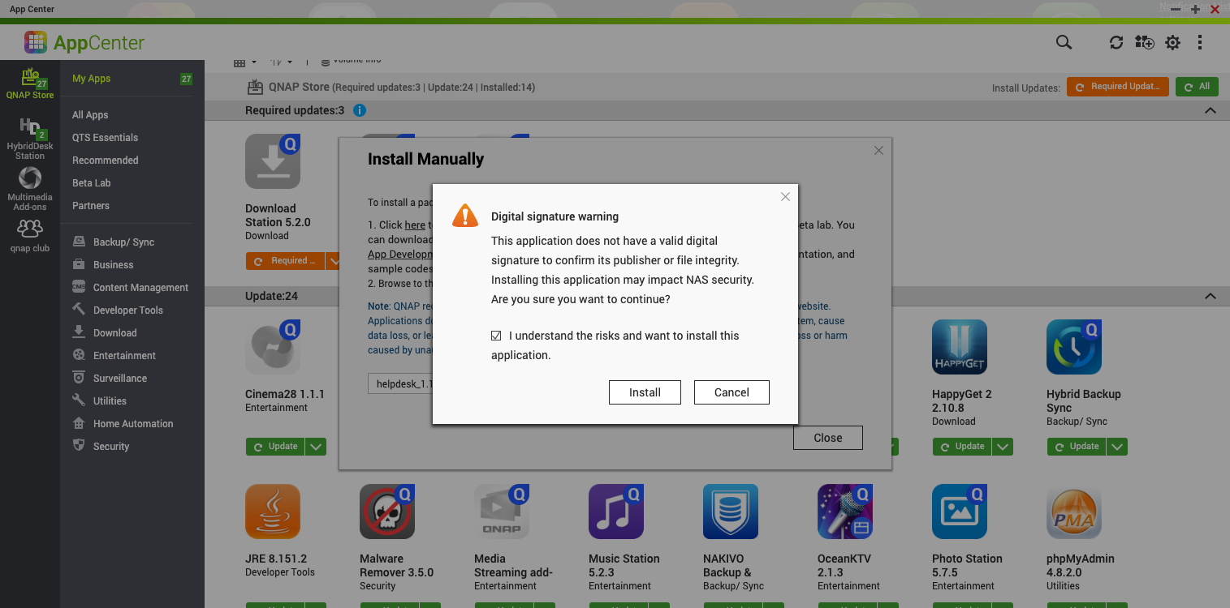
If I Am A Developer, I Really Need To Install The App Which Has No Digital Signature.
1. Allow install
Go to ‘’App Center’’ > ‘’Settings’’ > ‘’General’’ > Checks ’’ Allow installation of applications without a valid digital signature.’’
This will not be limited by the digital signature but will be exposed to risk.
2. Install manually
For manual installation, be sure to evaluate the risk before installing.

Slide 20
DEMO
LIVE

Slide 21
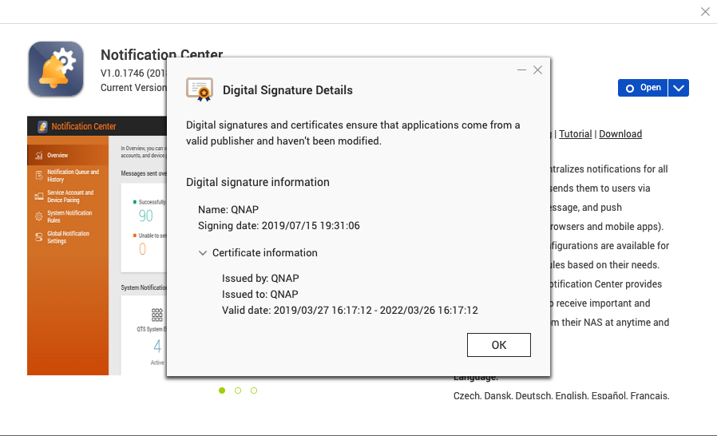
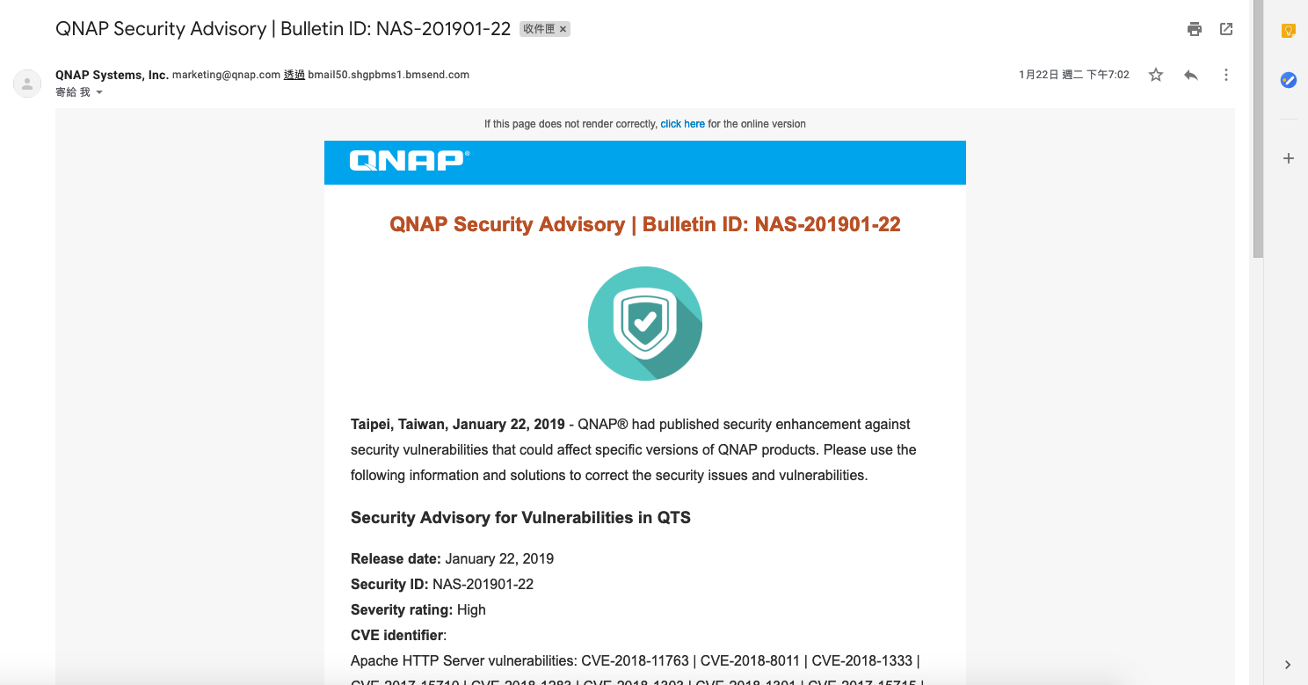
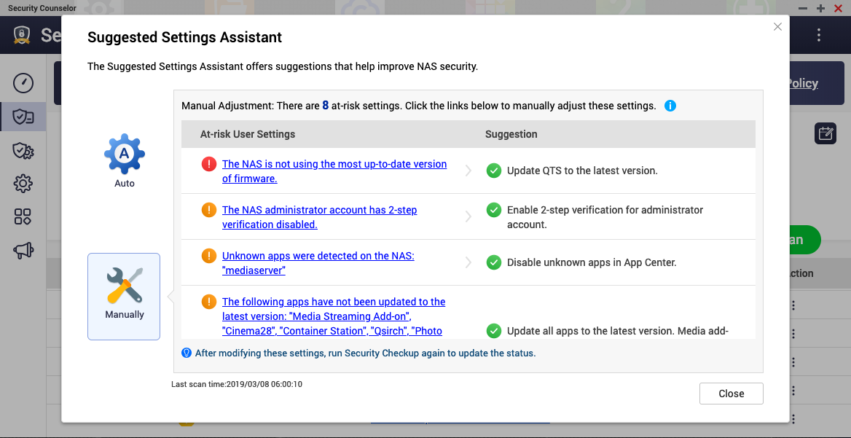
6 Minutes Set To Complete, The Basic Self-protection For Beginners
How to avoid installing the Unsafe app?
How do I know if there are any vulnerabilities in the service I use?
How do I know if there are any non-QNAP store apps, abnormal login and improper access control in my NAS?
What can I do when my NAS was infected?
Use an app with a QNAP digital signature
1 min
The application in App Center is start to support the digital signature from QTS 4.4.1 to ensure application security.

Slide 22
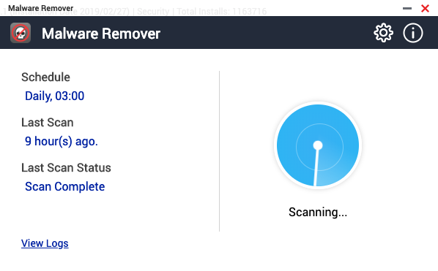
6 Minutes Set To Complete, The Basic Self-protection For Beginners
How to avoid installing to Unsafe app?
How do I know if there are any vulnerabilities in the service I use?
How do I know if there are any non-QNAP store apps, abnormal login and improper access control in my NAS?
What can I do when my NAS was infected?
Subscribe to Security Advisory
1 min
Summarizes security vulnerabilities impacting QNAP products and provides patches and/or other solutions.
How to receive notice：
1. Go to official website to subscribe to Security Advisory newsletter.
2. Via Security Counselor, notify you of new when logging into QTS.

Slide 23
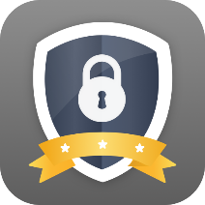
6 Minutes Set To Complete, The Basic Self-protection For Beginners
How to avoid installing to Unsafe app?
How do I know if there are any vulnerabilities in the service I use?
How do I know if there are any non-QNAP store apps, abnormal login and improper access control in my NAS?
What can I do when my NAS was infected?
Use Security
Counselor
2 min
This app can find out above problems, provide risks report and help you to setup a safety NAS.
Tips: You must use it to check up your NAS regularly and correct the risks, so that you can avoid some risks.

Slide 24
6 Minutes Set To Complete, The Basic Self-protection For Beginners
How to avoid installing to Unsafe app?
How do I know if there are any vulnerabilities in the service I use?
How do I know if there are any non-QNAP store apps, abnormal login and improper access control in my NAS?
What can I do when my NAS is infected?
Install Malware Remover & McAfee
2 min
Malware Remover can detect and remove malware from your NAS. You can also use McAfee extra.
Post processing SOP:
1. Update firmware and apps to the latest version.
2. Update all account passwords.
3. Contact QNAP support if necessary.

Slide 25
DEMO
IS YOUR BEST CHOICE!
Copyright © 2019 QNAP Systems, Inc. All rights reserved. QNAP® and other names of QNAP Products are proprietary marks or registered trademarks of QNAP Systems, Inc. Other products and company names mentioned herein are trademarks of their respective holders.

