Slide 2
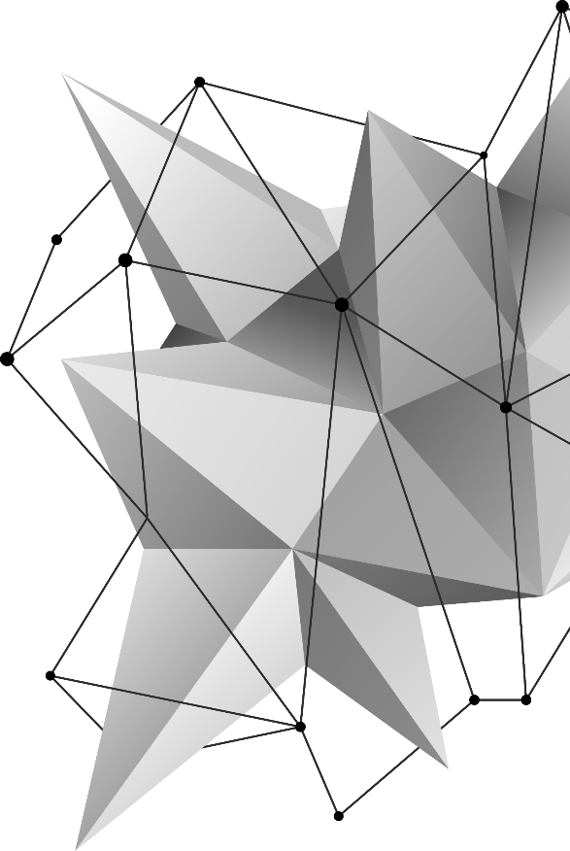
NVS Features

Slide 3
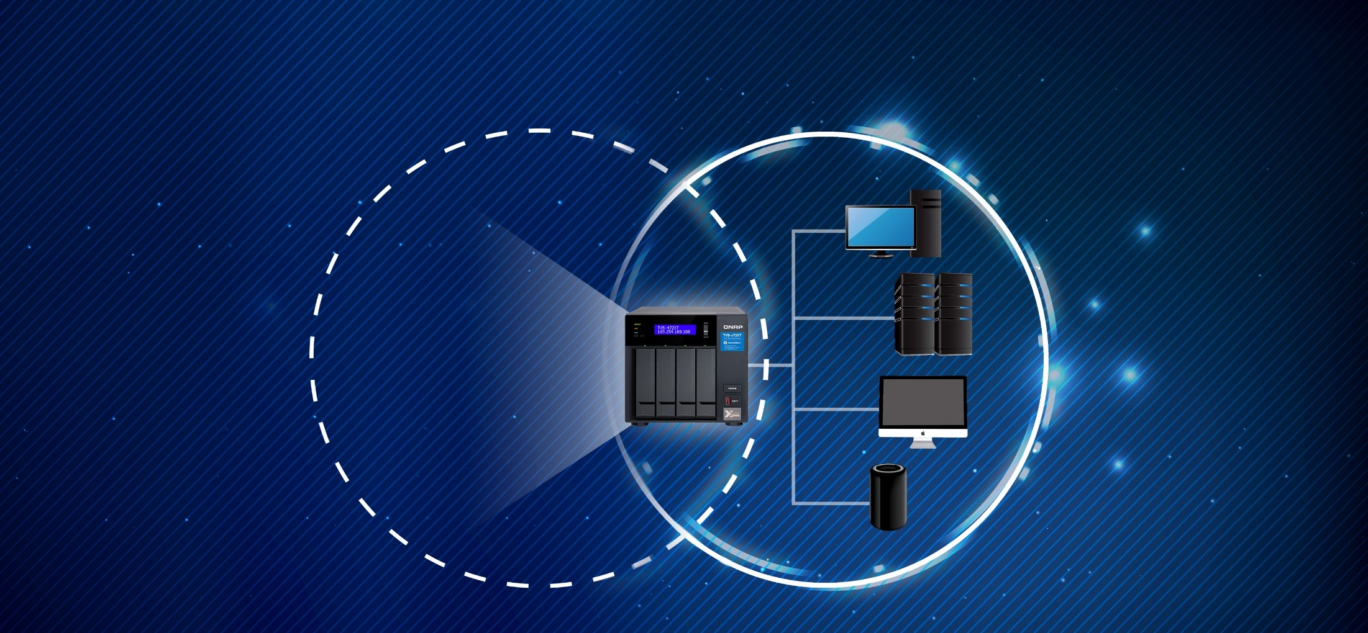
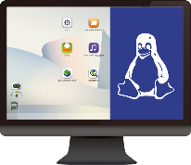
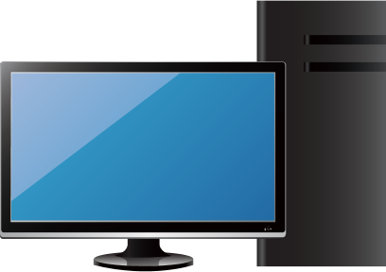
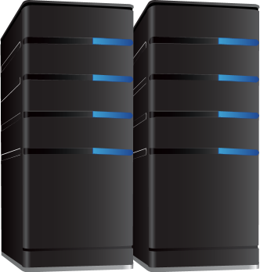
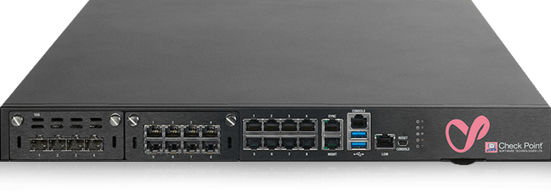
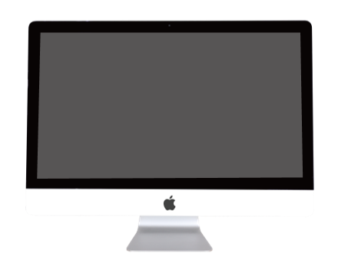
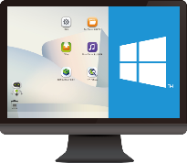
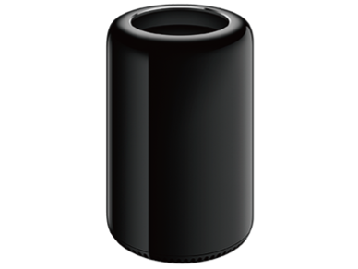
Network & Virtual Switch
NVS mainly provides network services and assists customers in connecting virtual services to high-speed physical network connections.
vRouter
Firewall
Virtual
Physical

Slide 4
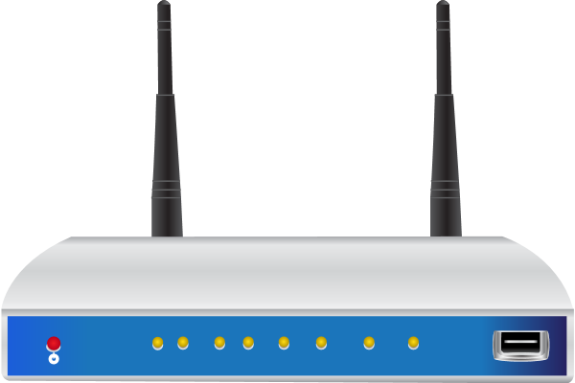
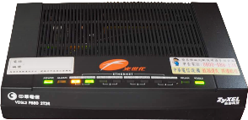
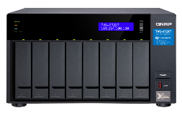
Use Case 1 : Help customers to extend their network service via some virtual network function
vRouter can easily provide the VPNs and stable connections. vFirewall can easily protect your network security.
vRouter:
RouterOS
vFirewall:
pfSense
ISP
VPN Tunnel
Virtual Switch
Connect to Intranet
(All protected)
Internet

Slide 5
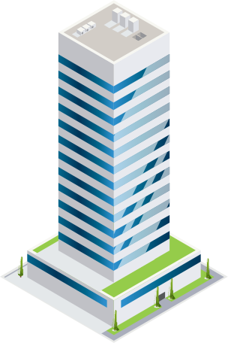
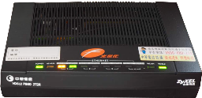
Use Case 2: For virtualized E-commerce platforms
Some enterprise customers want to develop and maintain a B2C online store – they can dynamically combine the micro-service and network as needed.
AAA online Store
ISP leased line
E-shop Webpage / UI
Nginx
Top selling list
Redis
Seckilling
Virtual
Switch
Product Management
MangoDB
Order Management

Slide 6
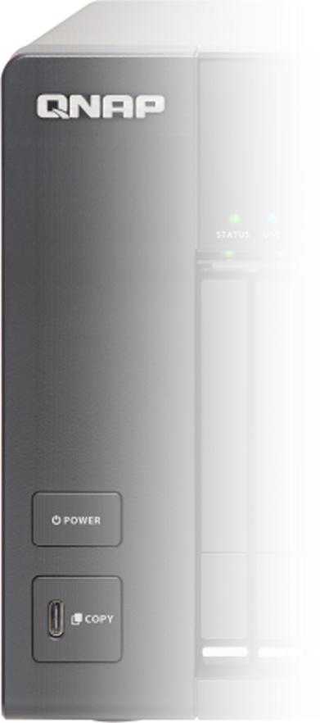
Dynamically build the micro-segment network via virtual switch for different service requirements.
It can effectively reduce the operating costs if you can flexibly use the H/W computing resources to run the services and dynamically adjust the network structure.
O/S Client
Web server
Cache DB
Database
Virtual Machine
Virtual Appliance
Ubuntu
Nginx
Redis
MangoDB
WinServer 2016
vRouter
Debian
WordPress
Couchbase
WinServer
2019
vFirewall
CentOS
Httpd
PostgreSQL
Win10
OpenWRT
BusyBox
Tomcat
Container Station
Virtualization Station
Virtual Switch
Virtual Switch
Virtual Switch
Virtual Switch

Slide 7
QTS Network Architecture :
It is the basis for the NAS system to easily string the entire virtualized network service
Virtual Layer
Virtualization
LXC
Docker
IoT
VM 1
VM 2
LXC 1
LXC 2
Docker 1
Docker 2
QuAI
Container
LXC 3
…..n
Docker 3
…..n
IFTTT
VM 3
VM…..n
QNAP Apps......
Virtual Switch
Bridge
Link
Aggregation
IPv4
IPv6
DNS
DHCP Service
RADVD Service
SR-IOV
Network
VPN
PPPoE
VLAN
DDNS Service
NCSI Service
Routing Table
Static Route
NAT
HAL
Kernel
Physical
NIC
Thunderbolt
Wireless
USB QuickAccess
1G / 10G / 25G / 40G / 100G Ethernet
Thunderbolt 2
Thunderbolt 3
AC-2600
Wi-Fi dongle
USB 3.0 TypeA
USB 3.0 typeC

Slide 8
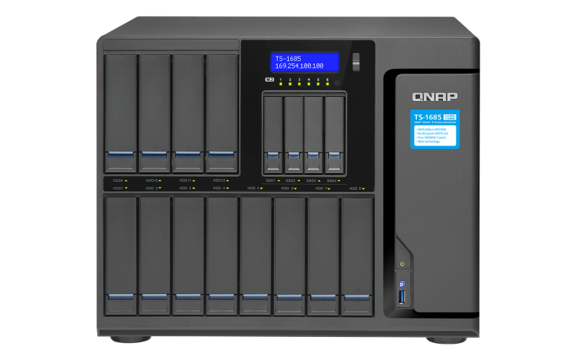
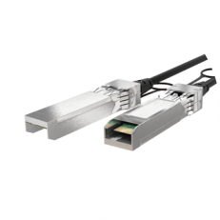
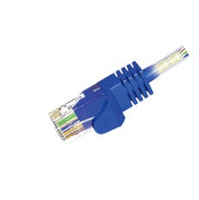
String your internal high speed transmission​
NVS connect internal and external environment with 10G speed​
NVS
(Network & Virtual Switch)
High speed 10G
vRouter / vFirewall: 10G
vRouter
Firewall
Container: 10G
VM: 10G

Slide 9
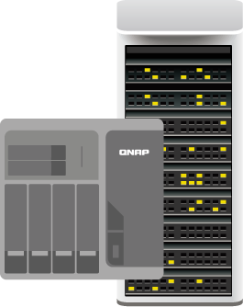
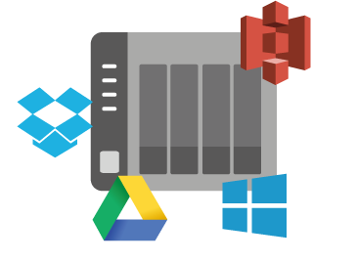
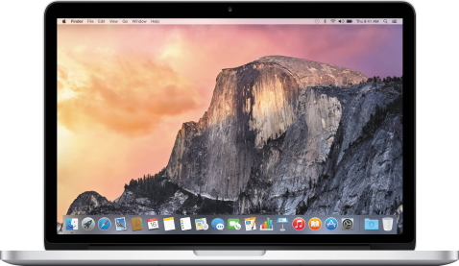
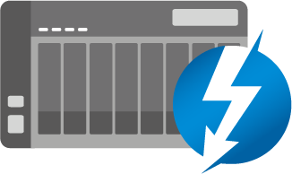
Supports various high-speed network interfaces for access to external connection services
GbE
10GbE
Thunderbolt

Slide 10
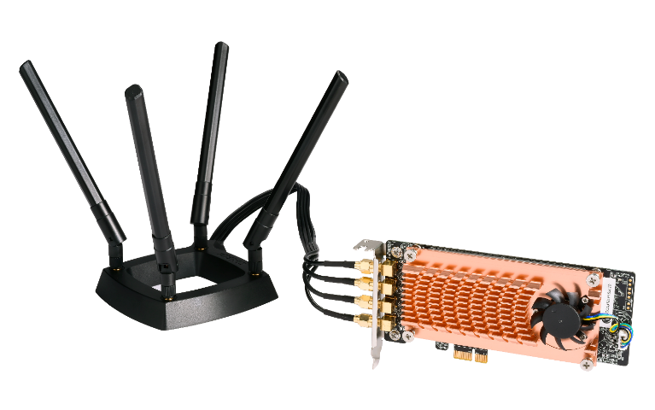
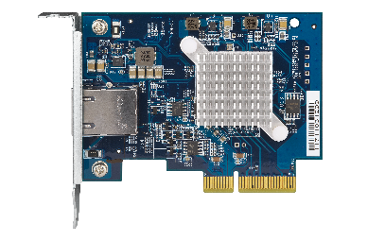
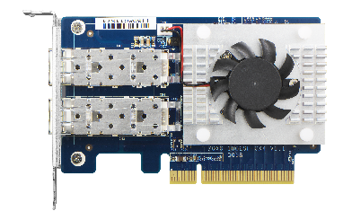
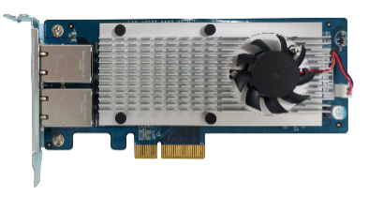
Also supports Wireless extensions and various expansion cards
QWA-AC2600 PCIe WiFi AC adapter
10 GbE Aquantia
40 GbE Mellanox
25 GbE Mellanox
10 GbE Intel X550

Slide 11
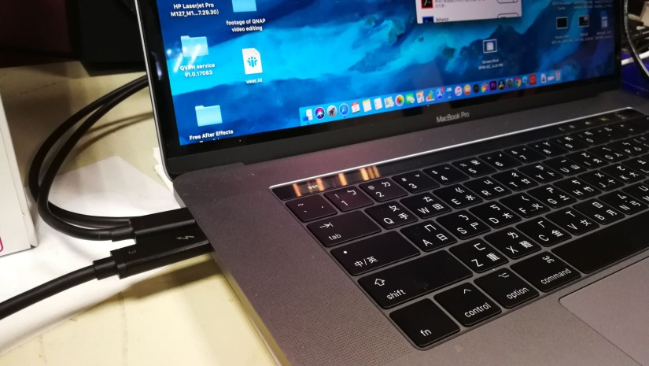
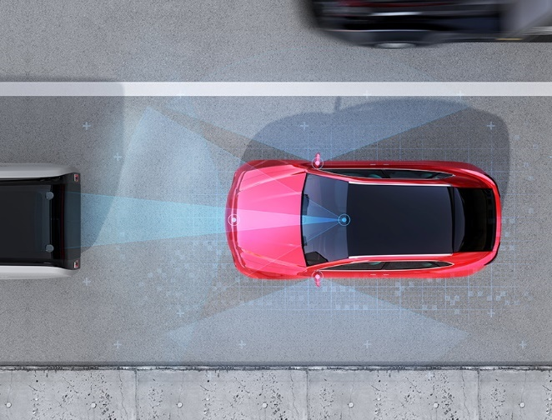
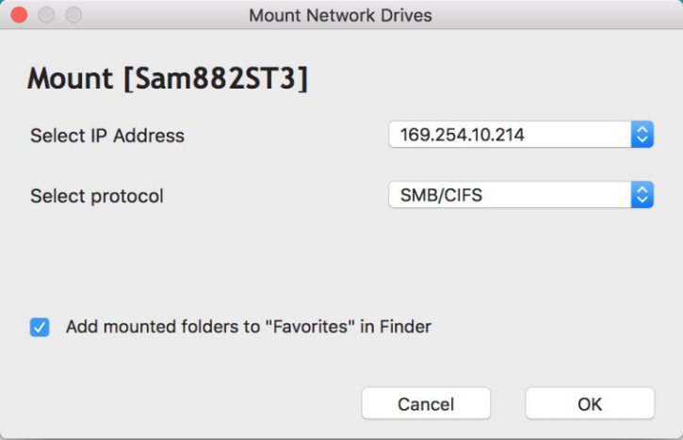
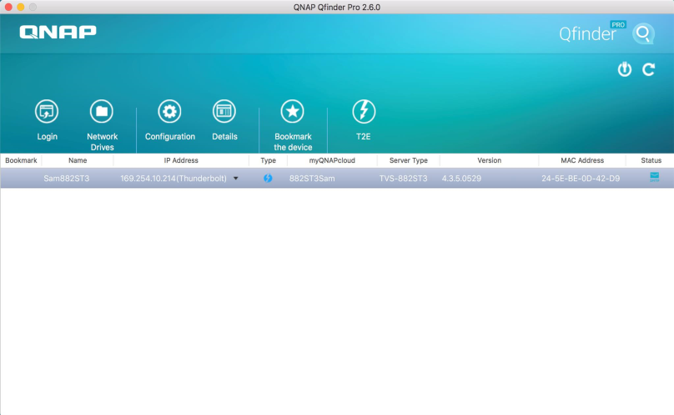
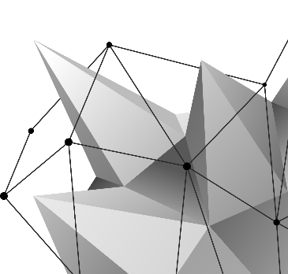
Offer Mac users a flexible and exclusive
interface - Thunderbolt​
Mount & auto adjustment
Plug in
Qfinder Pro
Auto scan
Easy to use for all Mac users !!!​

Slide 12
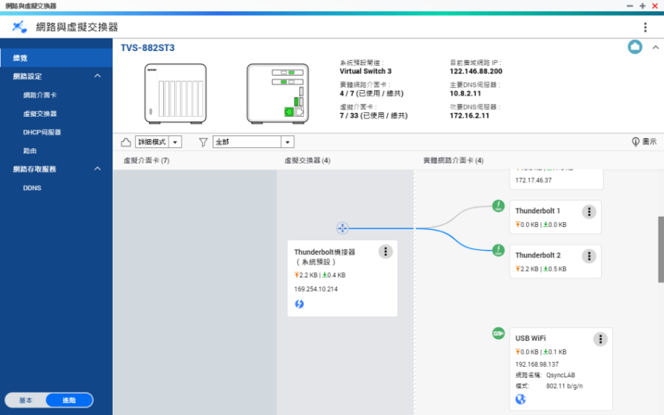
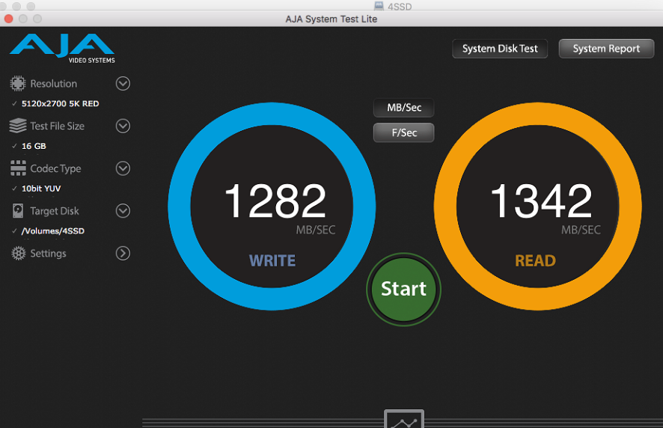
Thunderbolt high performance
Exclusive UI
MacBook performance
It’s equal to built-in 10~20G NIC, some Windows have almost 2000 MB/s performance.​

Slide 13
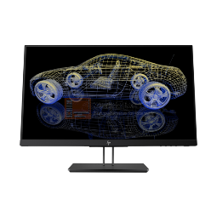
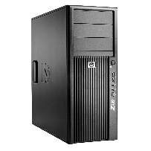
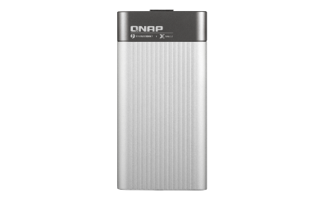
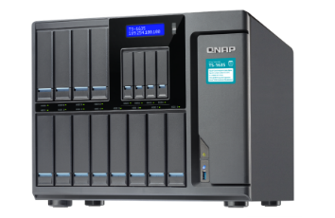
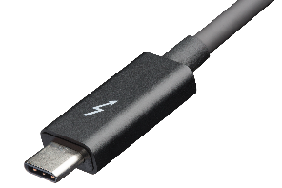
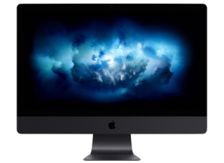
Explosive 10G Generation
Not only QNAP NAS, all elements support high speed 10G transmission now. QNAP also provides the best 10G turnkey package for you.
VM
QNAP 10G Switch
10G Windows
Workstation
10G VM
QNAP 10G NAS
10~20G Thunderbolt network
10G Mac desktop

Slide 14
NVS Network Features
Easy UI Design (Help you to locate the ethernet port)
Clear topology for virtual and physical networking
And:
Interfaces can now display customized names
Support customized DDNS and allows multiple service
Support stateful/stateless auto-configuration of IPv6 address
Support IPv6 RADVD service on each port
Support reserved IPs with the IPv4 DHCP service.​
Auto Default Gateway + NCSI service
Support Static Route.
One new function will be announced soon

Slide 15
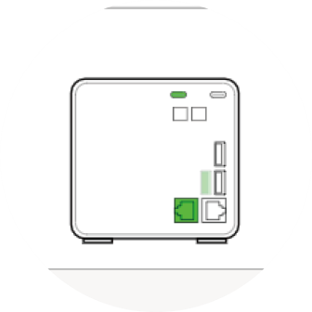
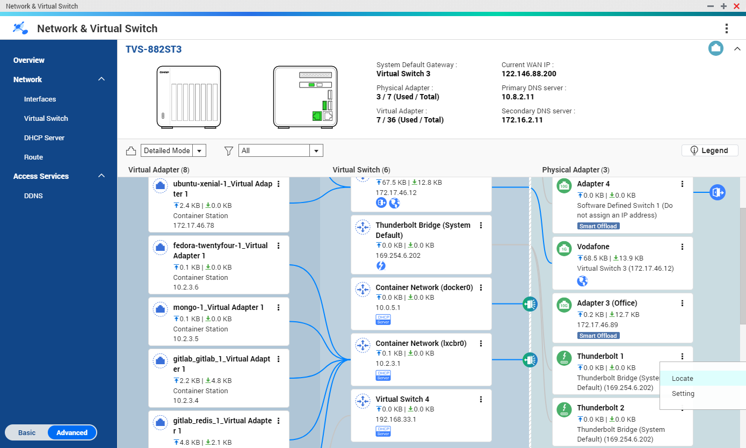
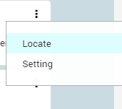
Clear UI of overview, easy to identify the position​
Just click the location button, find out where is it on your NAS immediately.​

Slide 16
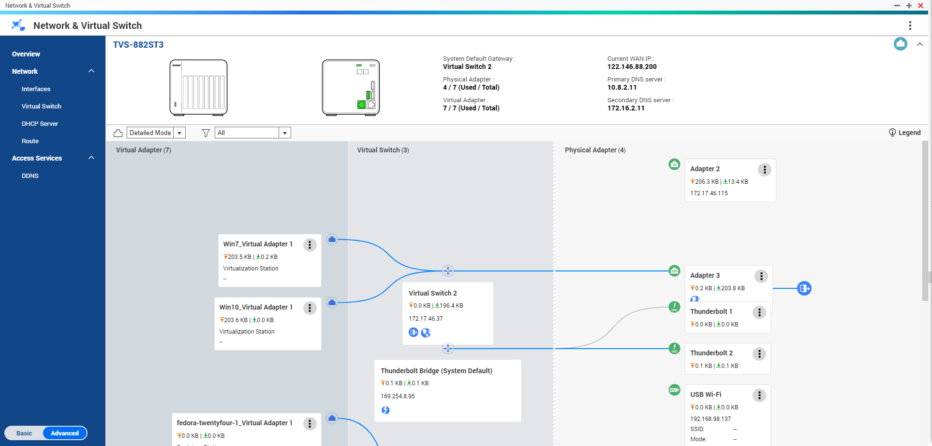
Clear network topology for virtual and physical networking
Virtual machines can bridge to external network by virtual switch + physical LAN port.​

Slide 17
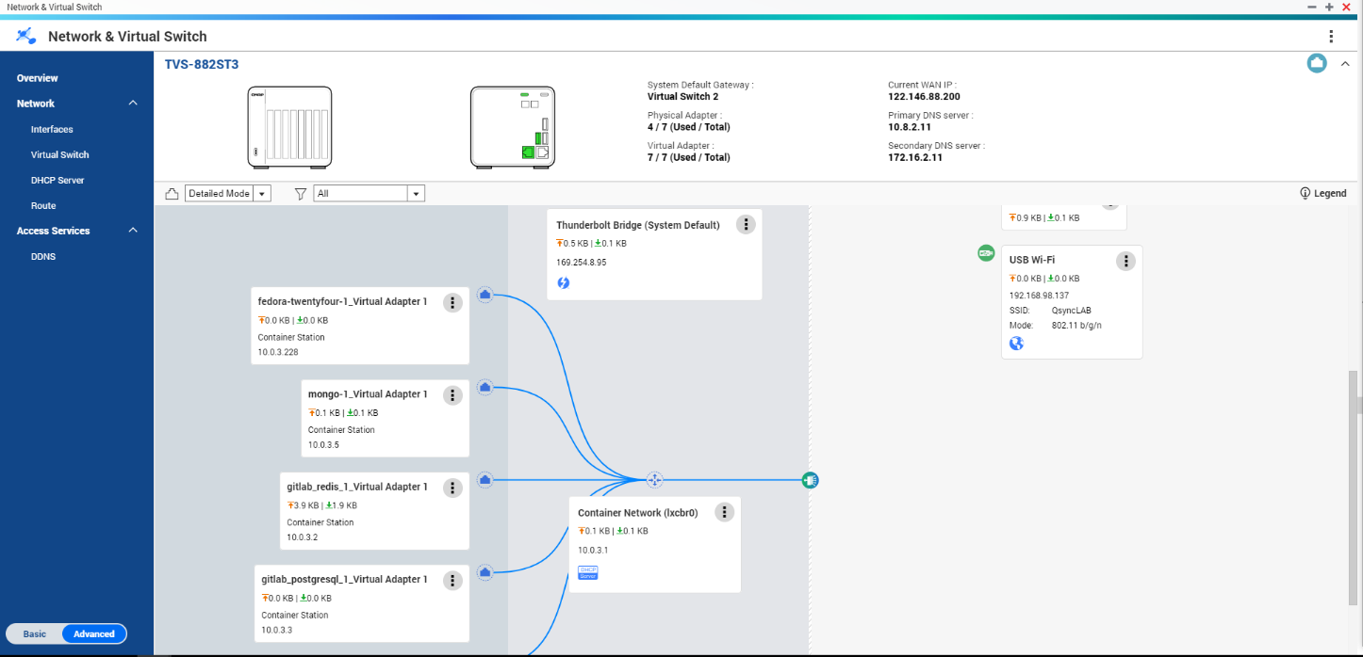
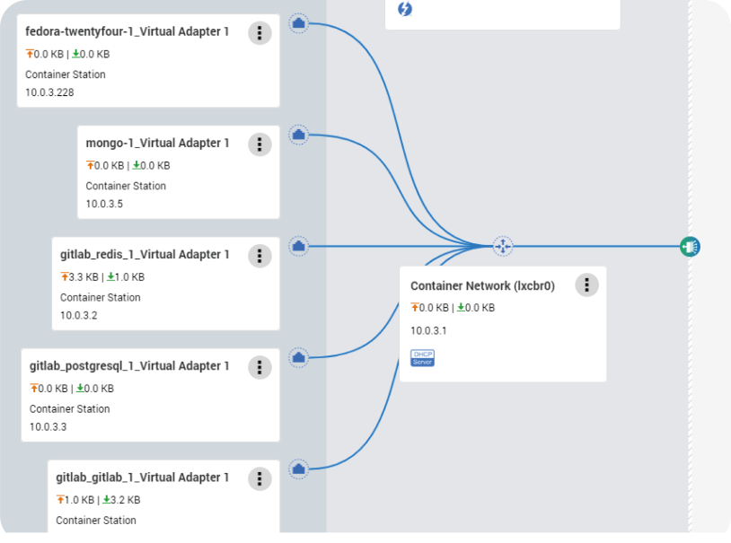
Virtual network won’t be your problem anymore
Container will build up a closed and independent network by virtual switch, and only allows internal access. (assign DHCP IP automatically, and enable NAT if need to access internet)​

Slide 18
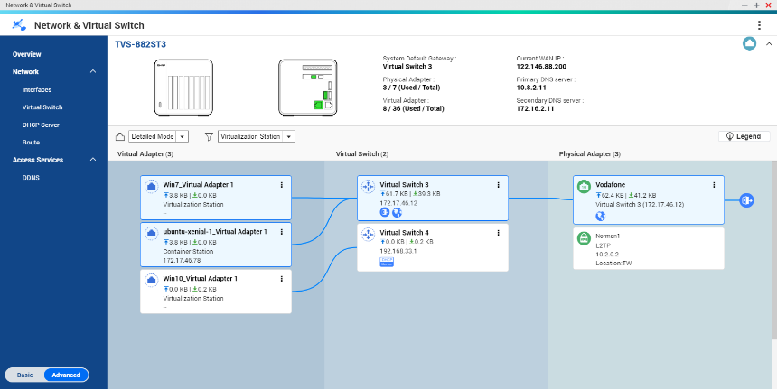
Overview lets you quickly distinguish​ them apart
Connected to external network by the physical 1G adapter through the virtual switch 3,​ Earth symbol shows that the environment can access the internet.​
This group of VM connect by virtual switch 4. Without earth and NAT symbol indicate the environment is a independent network​

Slide 19
Virtual Switch
Flexibly config virtual services
How to config the network for vRouter
How to config the network for vFirewall to protect your device

Slide 20
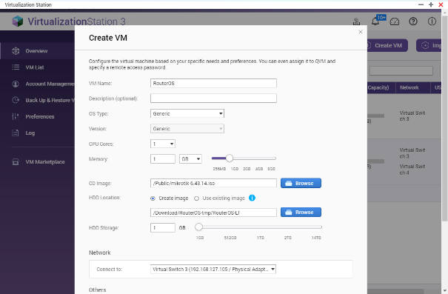
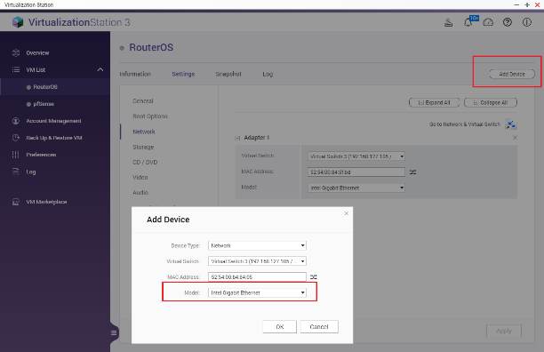
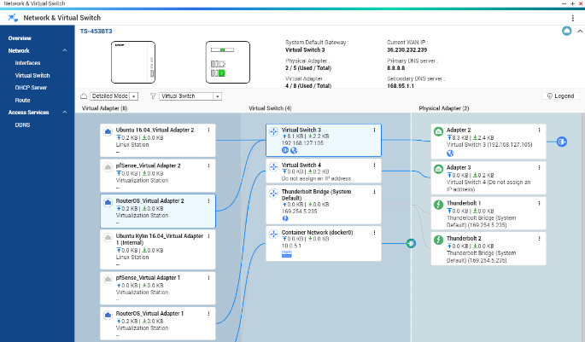
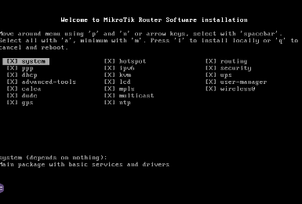
How to config the network for vRouter
Install VM
Define the WAN/LAN quantity first,
ISP => free port => vRouter WAN
vRouter LAN => multiple free ports for LAN
One device for one ISP provider
No matter how many free ports, just one device for LAN
One more device for 10G segment
Use AC2600 to extend
LAN via WiFi

Slide 21
How to configure the network for vRouter
192.168.11.1/24
NAS + vRouter
Internet
VPN Tunnel
(unencrypted Tunnel + IPsec)
IoT
10.112.20.1/24
192.168.99.1/24

Slide 22
vRouter
vRouter

Slide 23
Create a vFirewall to protect your device anytime! anywhere
Install VM
ISP => free port =>Firewall WAN
Isolated config
Launch VM

Slide 24
vFirewall : dynamically config the network path
Connect to home intranet
(All protected)
NAS Service IP
LAN
WAN

Slide 25
vFirewall
Firewall

Slide 26
Will be announced soon

Slide 27
Multiple VLAN
The strong weapon for SMB / Enterprise network: VLAN trunk
NAS Servers: VLANs: 1 & 10 & 20 & 30 & 40
LAN/WAN
Router
192.168.0.1/16
VLAN 1
(Default)
VLAN 40 R&D
192.168.40.1/24
Core Switch
VLAN
Trunk
11F
VLAN 10 Sales
192.168.10.1/24
VLAN 20 Finance 192.168.20.1/24
VLAN 30 Marketing 192.168.30.1/24
10F

Slide 28
Copyright © 2019 QNAP Systems, Inc. All rights reserved. QNAP® and other names of QNAP Products are proprietary marks or registered trademarks of QNAP Systems, Inc. Other products and company names mentioned herein are trademarks of their respective holders.

