Slide 1
Notes:
QNAP QIoT 如何進入工業物聯網和自動化控制的領域

Slide 2
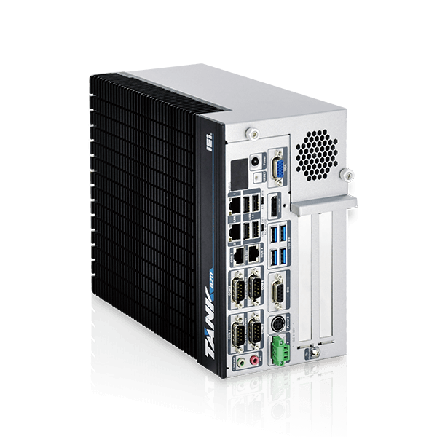
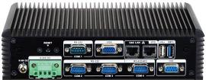
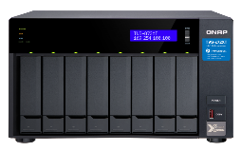
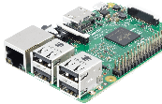
Industrial IoT Solution
QIoT Suite
Database
Rules Engine
LoRaWAN
Network Server
MDC
Machine Data Collector
Dashboard
Management
Industrial Devices
IoT Sensors
and Peripherals
OPC UA
HTTP
MQTT
CoAP
TCP
UDP
Notes:
藉由 QNAP QIoT 與集團內的 IEI, 洋威的合作，我們可以建立一個完善的軟硬體工業物聯網解決方案
更重要的是，我們支援 OPC統一架構 (OPC UA)，可提升工業自動化的 IoT 應用潛能。

Slide 3
Easy to Deploy, Simple to Collect, Rapidly Develop IIoT
QIoT Suite Basic Introduction
Motivation for QIoT Suite to step into IIoT
How to use QIoT Suite with OPC UA protocol
QIoT Suite Application Instructions
Computex Interview
Successful Case

Slide 4
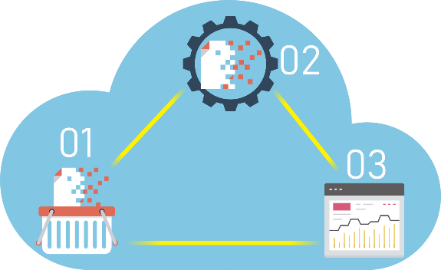
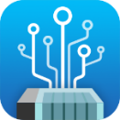
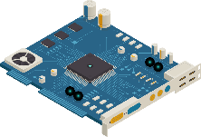
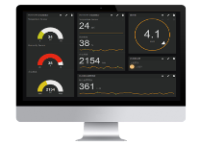
QIoT Suite - Rapidly Develop IIoT in just 3 Steps
01
02
Data Collection
Data Processing
Sensors
Devices
Machines
Development Boards
Rules Engine
Threshold Triggers
Protocols Convert
Data Transfer
03
Data Visualization
MQTT
HTTP
CoAP
Show Data in Charts & Widgets
OPC UA
Notes:
QIoT Suite允許軟件開發人員和製造商在QNAP NAS上輕鬆構建強大的物聯網應用程序，提供私有，安全和內部部署的環境，並將您的NAS轉變為專業的物聯網平台。
QIoT Suite provides software developers and makers with the ability to easily build robust IoT applications on their QNAP NAS, providing a private, secure and on-premises environment.

Slide 5
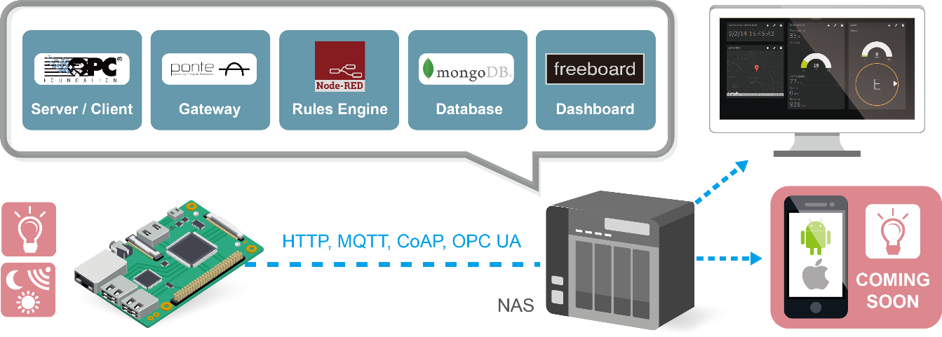
QIoT Suite - Components

Slide 6
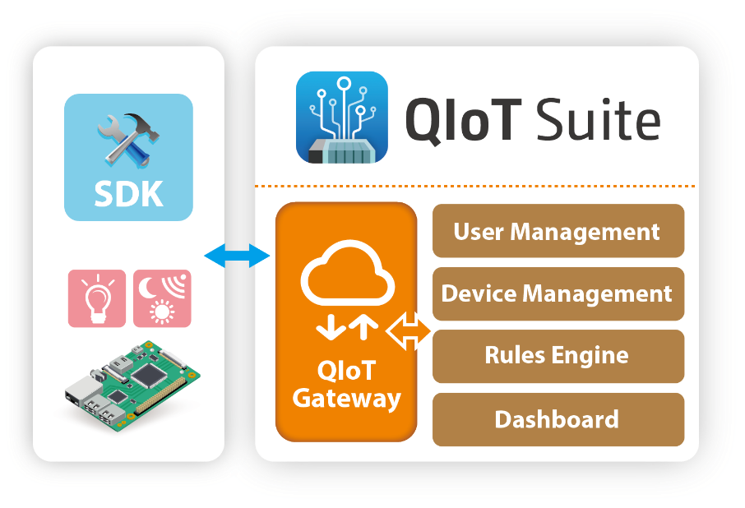
QIoT Suite - Private Cloud
Private Cloud
Edge Computing.
Easy to access data on local.
Better security & Privacy.
Support MQTT, CoAP, HTTP, OPC UA etc.
Support multiple development boards.
Notes:
Mainly can do environmental monitoring, such as air quality monitoring, power usage monitoring

Slide 7
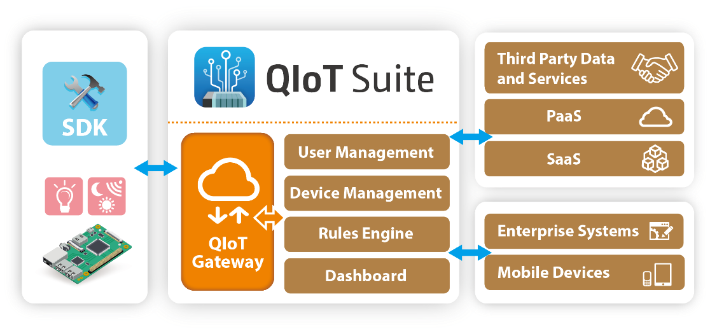
QIoT Suite - Hybrid Cloud
Hybrid Cloud
Remain the flexibility to scale.
More Security: selected data to use cloud service.
Cost control.

Slide 8
Easy to Deploy, Simple to Collect, Rapidly Develop IIoT
QIoT Suite Basic Introduction
Motivation for QIoT Suite to step
Into IIoT
How to use QIoT Suite with OPC UA protocol
QIoT Suite Application Instructions
Computex Interview
Successful Case

Slide 9
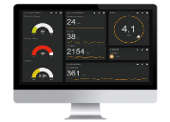
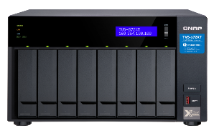
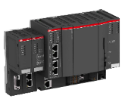
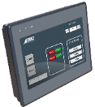
Step into IIoT – Motivation
Advantages
More Security
More Capability
Friendly Web UI
Multiple Users
Privilege Mngt
PC
OPC UA Server
SCADA
OPC UA Client
PLC
OPC UA Server
HMI
OPC UA Client
Gateway
OPC UA Server
ERP / MES
OPC UA Client
Notes:
詢問在場是否有人知道 OPC UA？介紹 OPC UA 是甚麼
越來越多大公司支援 OPC UA: Cisco, Siemens, TTTech and QNAP
PLC Server 效能不足，無法同時提供多個 Clients 讀取寫入，只要加入一台 QNAP NAS 作為 OPC UA Gateway，即可有效降低延遲時間。
每個 OPC UA clients 都要針對每台 OPC UA servers 去做設定，但是有了 QNAP NAS ，即可做集中化管理和資料儲存。
此時就需要一個資料集中處理的裝置與產品 -> QNAP QIoT
More Security -> NAS 擋在 OPC UA Server 前面，更安全，大家都躲在 NAS 後面。NAS 有六大護法:網路環境防護、帳戶安全和系統通知、傳輸加密保護、資料加密防護、本機快照、異地異機同步快照
Capability -> PLC 不見得可以連那麼多 Client, 但是透過 QIoT OPC UA Gateway 可以產生 Buffer。吞吐量更大。提供很大的連線數。透過 QNAP QIoT 作為 Buffer，可使 Latency 有效降低。

Slide 10
QIoT Suite - OPC UA Data Flow
ERP
SCADA
MES
Rules Engine
Database
Data Centralized
Value Mapping
OPC UA Client
OPC UA Client
OPC UA Client
OPC UA
OPC UA Server
Rules Engine
QIoT Suite
Database
OPC UA Client
OPC UA
OPC UA Server
Vendor 1
OPC UA Server
Vendor 2
OPC UA Server
Vendor 3
OPC UA Server
Vendor 4
OPC UA Server
Vendor 5

Slide 11
Before Using QNAP QIoT
Set up the identical connections for two times.
Complicated connection network.
Difficult for maintenance.
SCADA 1
SCADA 2
MQTT
OPC UA
OPC UA
OPC UA
Environment Sensors
Gateway
OPC UA Server
PLC
OPC UA Server
PC
OPC UA Server
MQTT sometime is not supported by upper layer software.
More connections, more latency.
Notes:
現在用 OPC UA，怎麼用？如何連線？原先 Sensors 轉 OPCUA 要透過額外程式上層與下層

Slide 12
Benefits for Using QNAP QIoT
SCADA 1
SCADA 2
Set up the connection once.
OPC UA
OPC UA
OPC UA Server
Simple connection network. Easily maintain for all connected servers and clients.
Environment Sensors
MQTT
QIoT Suite
Rules Engine
Dashboard
OPC UA Client
Support most commonly used protocols:
MQTT, HTTP,
TCP, UDP, CoAP.
OPC UA
OPC UA
OPC UA
Gateway
OPC UA Server
PLC
OPC UA Server
PC
OPC UA Server
Requires only one connection. Reducing the system usages and data transferring latency..
Notes:
OPC UA Gateway
Rules Engine
Database
Dashboard
Data Centralized
Value Mapping
Migration is really easy. NAS 接上網路，安裝 QIoT Suite，簡單 UI 設定，就可以建構好架構。沒有痛苦的轉移，沒有痛苦的開始 。

Slide 13
Easy to Deploy, Simple to Collect, Rapidly Develop IIoT
QIoT Suite Basic Introduction
Motivation for QIoT Suite to step Into IIoT
How to use QIoT Suite with OPC UA
protocol
QIoT Suite Application Instructions
Computex Interview
Successful Case

Slide 14
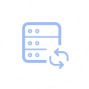
QIoT Suite 2.0 – Features
Support OPC UA protocol
Default Supporting
Be Clients: Connect to other OPC UA servers.
Be Servers: Create your own OPC UA servers.
Be Gateway: Value mapping among servers and clients.
Rules Engine: Read, Subscribe and Write specific tag value.
QIoT OPC UA server with 200 tags.
QIoT OPC UA clients with unlimited tags.
A Tag refers to a unique identifier for a data point within the OPC application.
Notes:
QIoT Suite 支援 OPC UA 伺服器/客戶端功能，亦可作為 Gateway 傳遞伺服器與客戶端設備的 IoT 數值，協助企業組織更快速的採用 IIoT 方案，提升企業生產力並減少設備支出。
說明 Tags 是甚麼？
在OPC術語中，Tag指的是OPC應用程序內數據點的唯一識別碼。 標記用於讀取和寫入數據源的實時數據。

Slide 15
OPC UA Tag
OPC UA Tag
A Tag refers to a unique identifier for a data point within the OPC application.
The concept is the same as resources inside a thing, and each thing resource represents a dynamic property (data point).
The data points can be environmental data (temperature, humidity, brightness, etc.) or industrial related data (machine speed, CPU usage, blade thickness, production yield, etc.).
PRM
Power
Quality
Blade Status
Vibration
Idle Time
IIoT
OPC UA Servers
OPC UA Tags
IoT
Things
Thing Resources

Slide 16
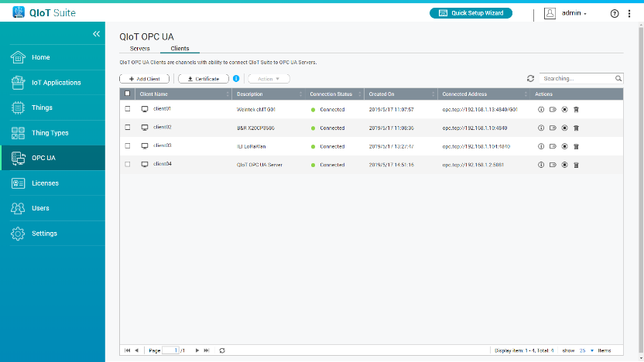
1
No Pain but More Gain
Be Clients
Connecting to other OPC UA servers.
OPC UA clients management with UI.
Retrieve and monitor latest tag value and list.
Notes:
有多個 HMI/SCADA，必須每一台進去控管 OPC UA Servers。
有了 QIoT Suite，就可以進行集中化管理。

Slide 17
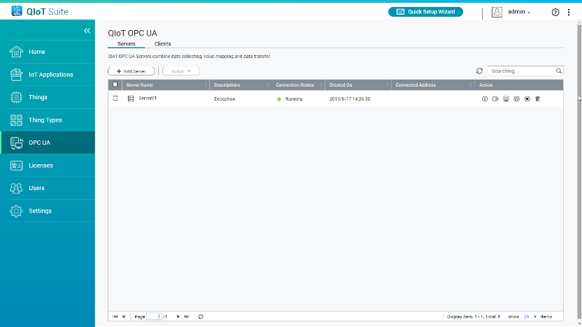
2
No Pain but More Gain
Be Servers
Connecting to other OPC UA clients.
OPC UA servers management with UI.
Manage the tag list, user list and server status of QIoT OPC UA servers in ease.
Notes:
若是有很多 OPC UA Server (PLC, PC, Gateway)，常常會需要在 HMI 設定一次連線，在 SCADA 又要再設定一次。
有了 QIoT Suite，就可以進行集中化管理。

Slide 18
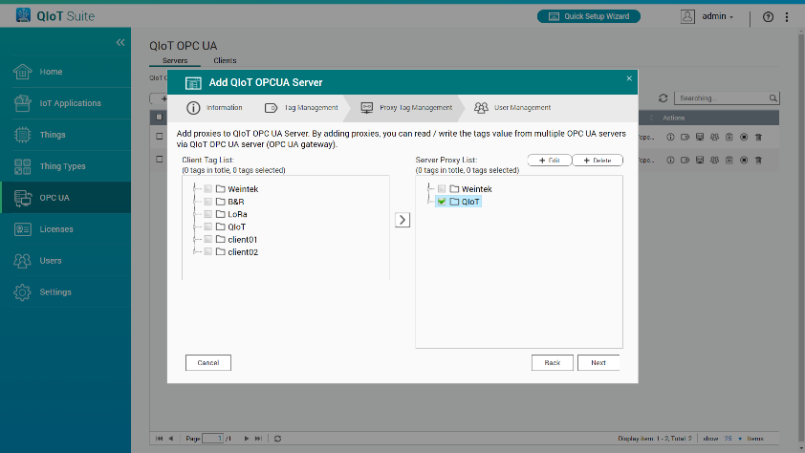
3
No Pain but More Gain
Be Gateway
Mapping the tag value from client to server by simple click.
No learning curve.
Notes:
建立好和外部 OPC UA Servers 的連線後，可以透過簡單 UI 的方式將 Tag Value 加入 QIoT OPC UA server，如此就可以利用 QIoT OPC UA server 作為 OPC UA Gateway，幫助上層 clients 讀取或寫入下層的 servers。

Slide 19
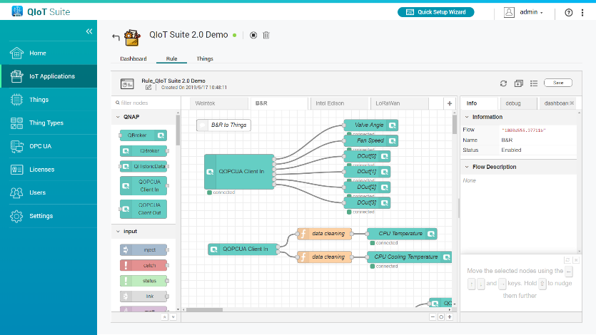
4
No Pain but More Gain
Be More
Rules Engine.
Protocols convert.
Connecting to 3rd-party applications.
Threshold triggers.
Data cleaning and calculating.
Notes:
除了 OPC UA Gateway 以外，我們也提供 Rules Engine，讓進階開發者可以將資料進一步處理之後再送到 QIoT OPC UA server 裡面。

Slide 20
Easy to Deploy, Simple to Collect, Rapidly Develop IIoT
QIoT Suite Basic Introduction
Motivation for QIoT Suite to step Into IIoT
How to use QIoT Suite with OPC UA protocol
QIoT Suite Application Instructions
Computex Interview
Successful Case

Slide 22
Easy to Deploy, Simple to Collect, Rapidly Develop IIoT
QIoT Suite Basic Introduction
Motivation for QIoT Suite to step Into IIoT
How to use QIoT Suite with OPC UA protocol
QIoT Suite Application Instructions
Computex Interview
Successful Case

Slide 23
Video
https://www.youtube.com/watch?v=zzEYK4jBMwc

Slide 24
Easy to Deploy, Simple to Collect, Rapidly Develop IIoT
QIoT Suite Basic Introduction
Motivation for QIoT Suite to step Into IIoT
How to use QIoT Suite with OPC UA protocol
QIoT Suite Application Instructions
Computex Interview
Successful Case

Slide 25
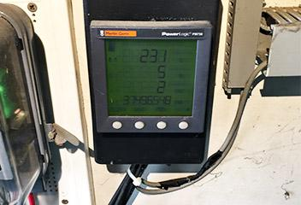
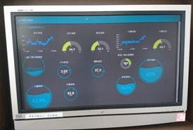
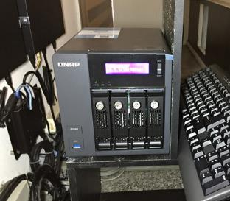
Successful Scenario
Artisantech Computer Engineering Co.,Ltd.
New Taipei City Department of Education
Background
Platform to connect with multiple power related IoT sensors.
Storage volume to store massive electricity data.
Rules engine to clean, data analysis.
Dashboard to visualize IoT sensor data.
Solution
QNAP TVS-471 + QIoT Suite
Notes:
誠德科技 新北市教育局
過去提供免費軟體平台做資料收集來讓 NAS 銷售更多元，而 QIoT Suite Lite 也成功打下了一定的基礎
因此 QIoT Suite 2.0 決定進入含金量相對較高的製造業，提供完善的工業物聯網平台與收費機制。

Slide 26
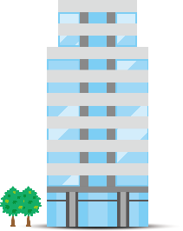
Qpower Case Study (Hybrid Cloud)
Power Monitoring Device HQ 5F
Power Monitoring Device HQ 4F
Modbus
Device Management
Power Monitoring Device HQ 3F
QIoT Suite
Rules Engine
Rules Engine
Power Monitoring Device HQ 2F
Rules Engine
Splunk Analysis Tools
Notes:
OPC UA Gateway
Rules Engine
Database
Dashboard
Data Centralized
Value Mapping
Migration is really easy. NAS 接上網路，安裝 QIoT Suite，簡單 UI 設定，就可以建構好架構。沒有痛苦的轉移，沒有痛苦的開始 。

Slide 27
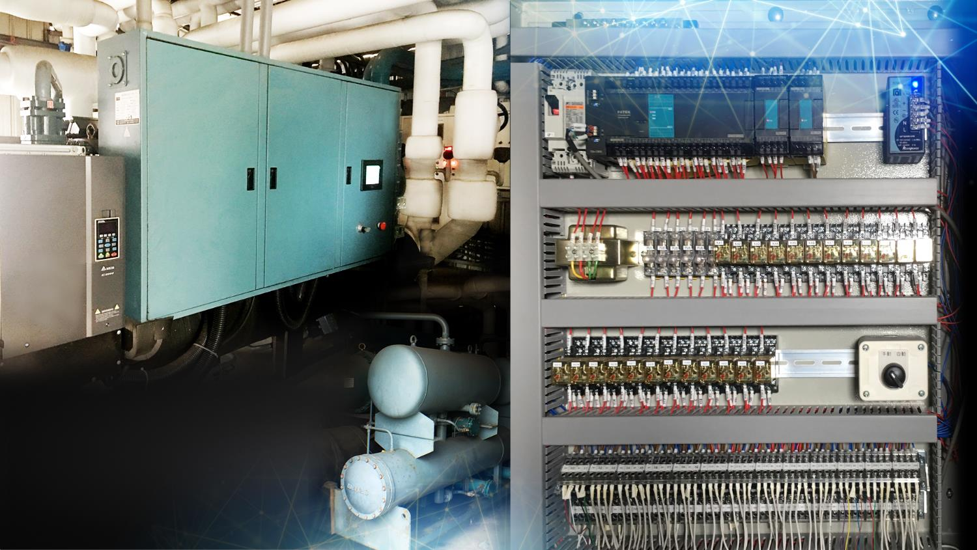
Qpower Case Study
7F Top Floor
Water-cooled
Machines
Notes:
現場照片: 要重拍的多一些 , 有質感些

Slide 28
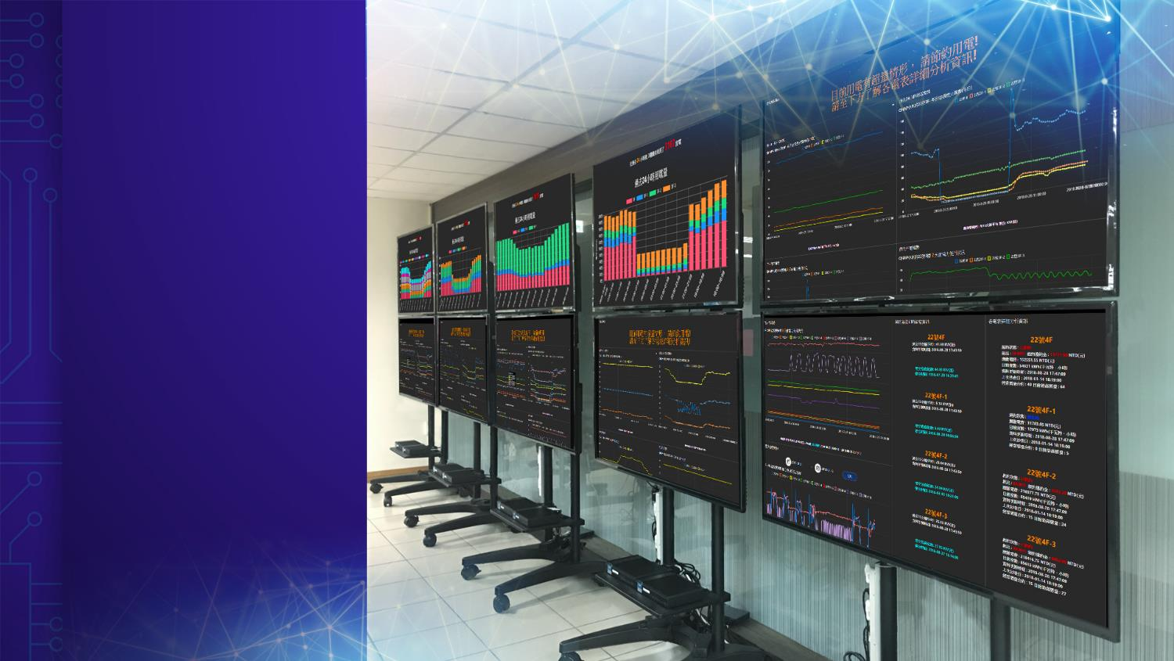
Qpower Case Study
3F TV Wall
Electricity
Information
Notes:
現場照片: 要重拍的多一些 , 有質感些

Slide 29
Conclusion
IIoT in Industrial Development and Application
Private clouds, hybrid clouds and public clouds have their own advantages, which one to choose depends on its use case scenario.
Selecting the proper devices and protocols can reduce the costs, such as: OPC UA, LoRa, Sigfox, etc.
In manufacturing, QNAP Hybrid Cloud can quickly and efficiently connect OT and IT.

