Slide 3
FAQ for Visitors and Visitor Center Service Staff
Where could get fun?
What is the weather recently?
Is there a package trip that can be recommended?
Is there any recommended accommodation information?
Is there any transportation traffic nearby?
Hire a lot of service staff is too expensive!
Lots of foreigners! I don't know that much languages!
How to promote the itinerary?
Reduce costs? Provide digital information to passengers? And reduce unnecessary paper DM?

Slide 4
Help you solve the pain points that all service personnel will encounter.
Translation….
Promotion
Customer Service
Check sights/weather...
Reception？

Slide 5
What mobiles and tablets can't do! AfoBot helps you!
Automatic angle adjustment and tracking
The screen is moderate and well placed
Voice control
Automatically answer customer service and automatically track faces
Inconvenient angle
The screen is too small
Hands wet or busy
Insecure, machine sense

Slide 6
What mobiles and tablets can't do! AfoBot helps you!
Operation multi-step & time-consuming
Must find the application by yourself, low integration
Can't hear the sound when the environment is noisy
Semantic analysis! One sentence in place!
Integration of multiple services, including entertainment, education, and medical care
The speaker sounds clear and loud

Slide 7
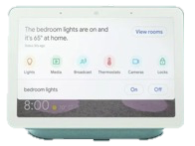
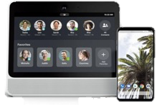
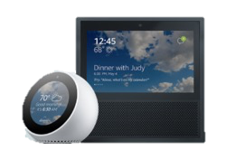
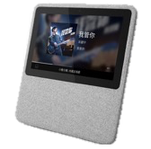
How to choose Desktop Robot?
Only for Home...
For Business！ For Home！
Smart Home (IoT)
Social conecting & sharing
I can rotate freely!
Can also automatically track!
Google-Home Hub
Facebook- Portal
Amazon alexa- Echo Show
A.I. Nemo- 小度在家
Smart Home (IoT)
Entertainment & Education
I can address all kinds of needs,
Customized solutions! ! !

Slide 8
Travel Smart Robot
One click Home
4-peer
Video Call
Remote Desktop
Automatic answering
Face tracking
Recording Videos/Photoes (Cloud,USB)
Features by voice control
Service
Global Weather/ Broadcast
Support (AfoCS)
Instant Translation
Voice Options

Slide 9
TRAVEL
Use Case

Slide 10
Travel Reception Smart Robot

Slide 11
Auto answer Face tracking
Follow the face and turn and speak on your own.
And also can guide customers to use.

Slide 12
Global Weather/ Broadcast
Provides Global Weather and Radio to be voice commanded querying.
Let customers know the weather that they can more accurately order the trip, reduce the risk of return!

Slide 13
Instant Translation
Instant translation at the counter (display subtitles and voice broadcasts) Help employees not specialize in national languages.

Slide 14
Voice Options
The voice assistant voice can also be selected (such as male voice, female voice, etc.).
Not afraid of boredom

Slide 15
Support (AfoCS)
Remote customer service.
Instant support to serve.
Can extend services to multiple branches.

Slide 16
Remote Desktop
Different branches can also be easily operated and maintained remotely.
Remote control AfoBot desktop by Mobile (APP).
Can video call and remote desktop simultaneously to help customers solve problems clearly.

Slide 17
The slide is not fun! I want to see the entity!
Where is AfoBot?

Slide 18
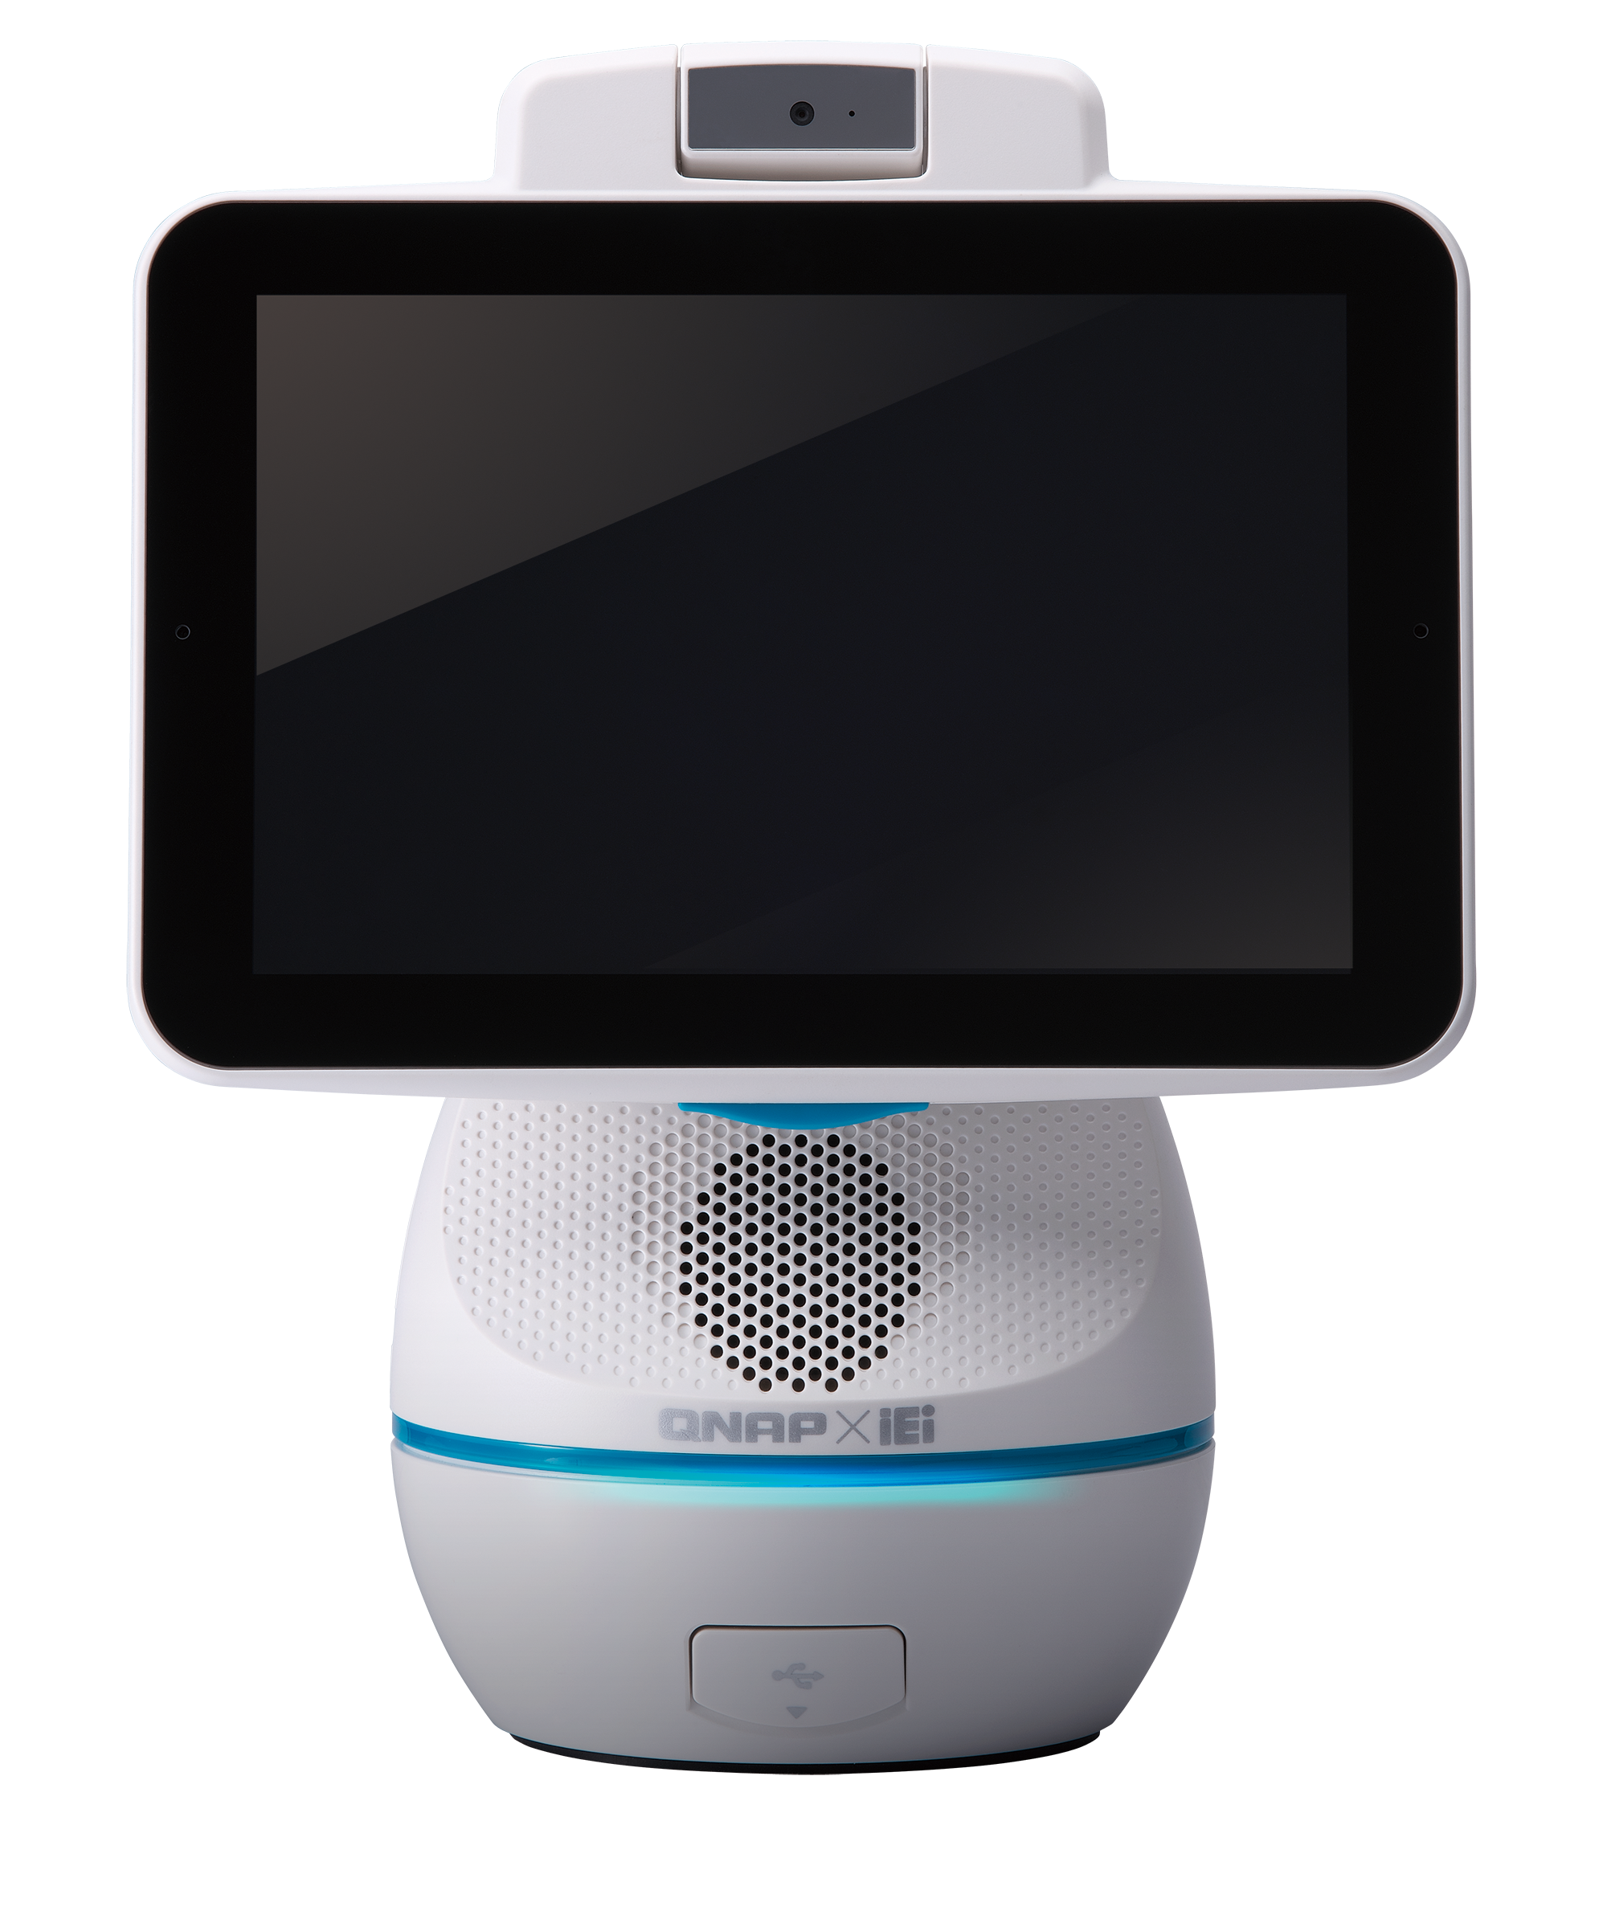
It's you！Let's find AfoBot！
Business
Highly customized ability!
Customer
Vendors
Highly integrated ability!
Full functions！
Use directly!

Slide 20
Is your Best Choice ！
Copyright© 2019 QNAP Systems, Inc. All rights reserved. QNAP® and other names of QNAP Products are proprietary marks or registered trademarks of QNAP Systems, Inc. Other products and company names mentioned herein are trademarks of their respective holders.​​
​
​​

