Slide 2
3 faces let File Station become your good partner!
Document collaboration - NAS is the workspace for your team
Security upgraded - prevent files not to be leaked
HBS 3.0 QuDedup integration - let File Station restore your file

Slide 3
Document Collaboration- NAS is the work space for your team

Slide 4
Completely supports 3 types of documents
Microsoft Office - editing and collaboration
Google documents - opening to edit and converting to backup
iWork documents - converting to preview and edit

Slide 5
Seamlessly edit and collaborate on Microsoft Office files with Office Online
QNAP X Office Online

Slide 6
Start to use complete Office Online editing function by a click!

Slide 7
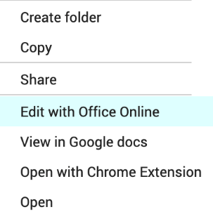
NAS is not only storage, but team’s workspace!
Save back to NAS in time
Upload documents to NAS
Support multiple users online editing
Select “Edit with Office Online” to Microsoft Office file in File Station
Office Online recommended number of concurrent editors is 10. The maximum is 99.

Slide 8
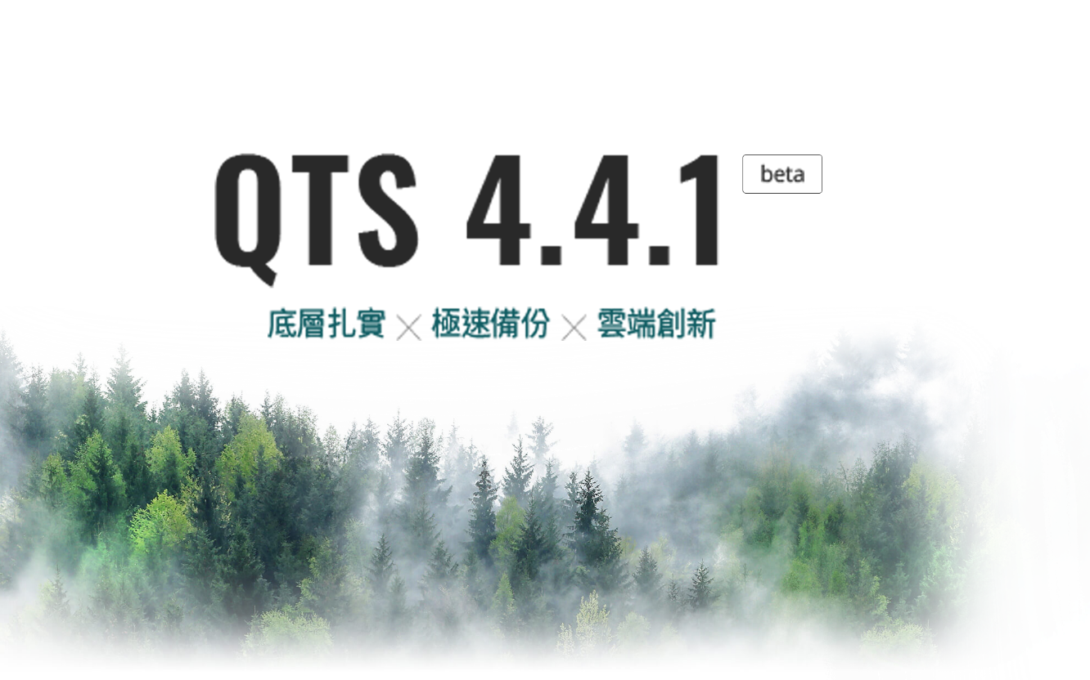
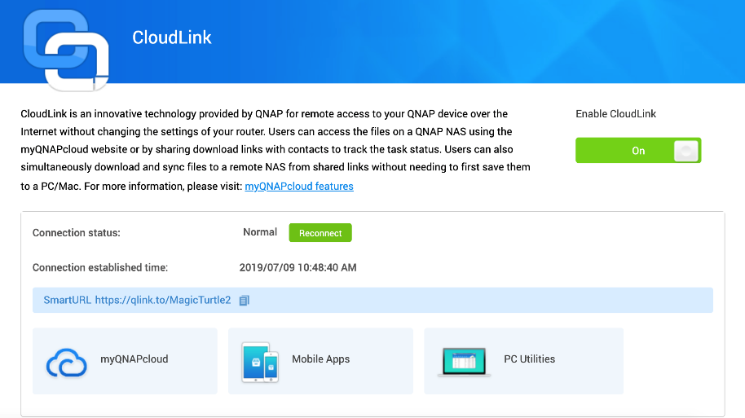
Easy set to use
Upgrade
Enable CloudLink

Slide 9
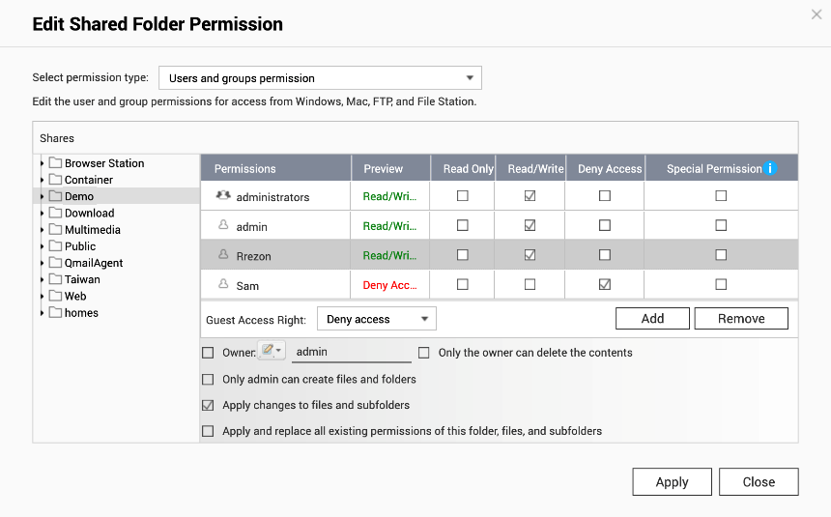
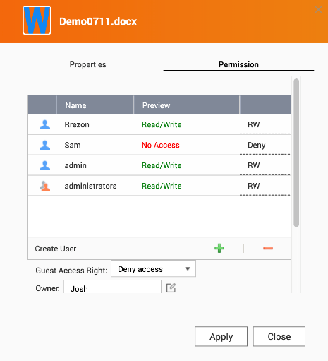
Manage file permission for NAS users to collaboration
Permission of Shared Folder
Advanced folder permission
Control Panel > Shared Folder > Edit shared folder permission
Control Panel > Shared Folder > Enable Advanced folder permission
File Station > File Properties > Permission

Slide 10
Google Documents opening to edit and converting to backup

Slide 11
Take a deep look of Google document files
Google documents are easy and convenient to edit. However, if you open it by the third-party applications, you will find…
gdoc
gsheet
gslides
How do I open the Google documents mounted by CacheMount?
How can I backup these kind of files?
The files look like this

Slide 12
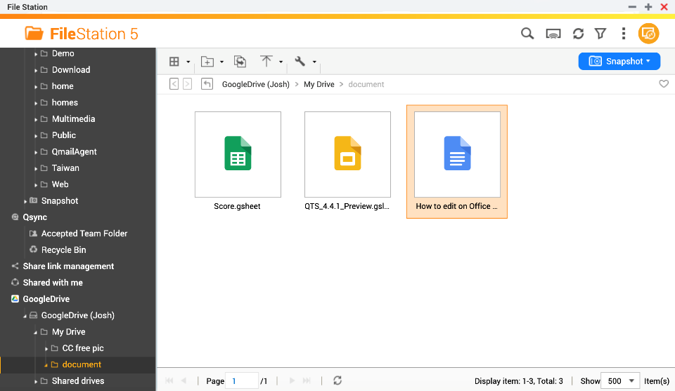
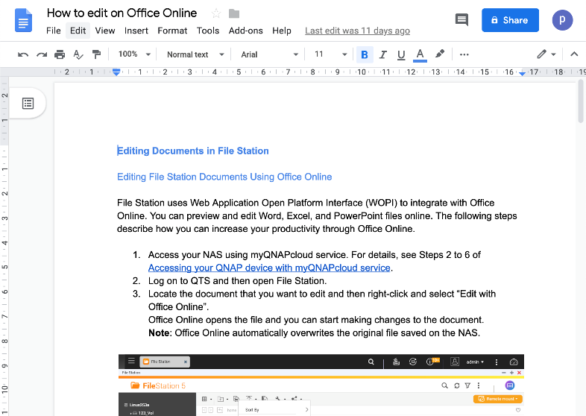
Directly open and access Google document
Mount your Google Drive by CacheMount.
Double click to the *.gdoc, *.gsheet, *gslides file. It will open the Google document in the new browser page to preview and edit.

Slide 13
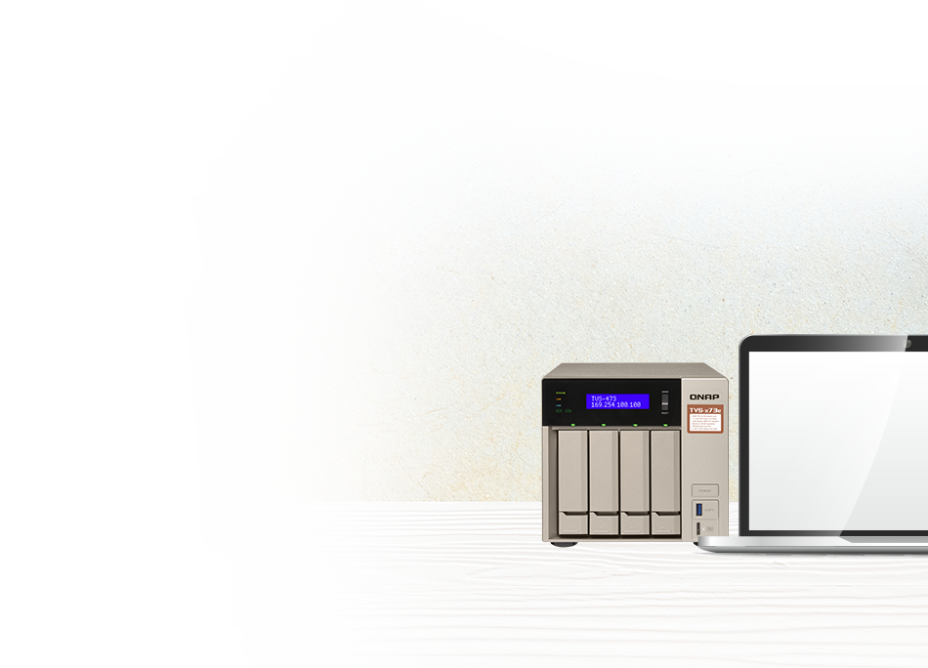
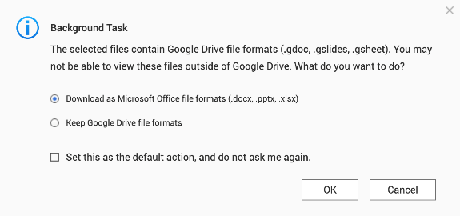
Download as Office format to backup!
When the files move outside of Google Drive, choose to download as the Microsoft Office format to preview, edit and backup.
.gdoc
.gsheet
.gslides
.docx
.xlsx
.pptx
Note: If you choose to download files as Microsoft Office file formats when moving files, the source files will be deleted from the source locations.

Slide 14
iWork documents- converting to preview and edit

Slide 15
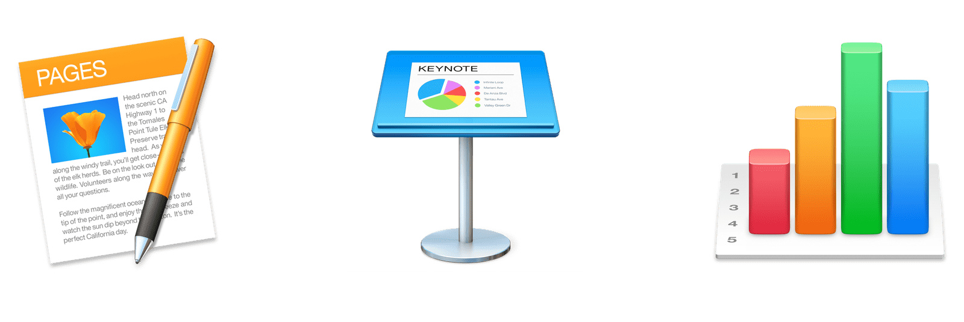
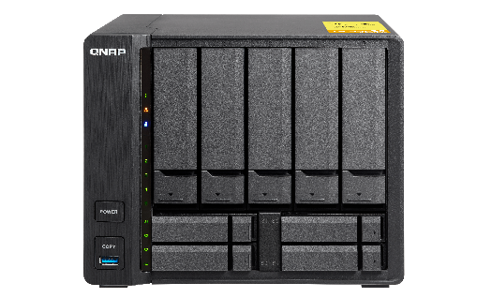
iWork documents can only access with Apple OS?
How can the teams edit the iWork file backed up to the NAS?
How can the Windows users access the shared backed up iWork file?

Slide 16
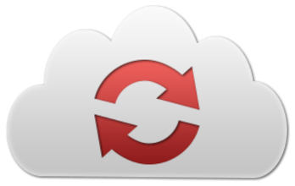
Convert to Office format!
File Station integrates CloudConvert to let you convert the iWork file to Office format for the convenient reading, editing, and sharing.
.pages
.key
.numbers
.docx
.pptx
.xlsx

Slide 17
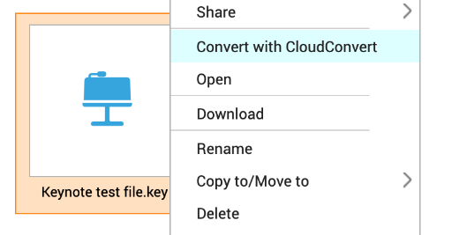
CloudConvert Authenticate and start to convert
1
2
Get the API key form your CloudConvert account
Authentication in File Station
3
4
Convert the iWork file
Open with Office Online and edit

Slide 18
3 file preview and edit ways
 | Edit with Office Online | View in Google Docs | Open with Chrome Extension
Requirement | Enable CloudLink | Enable CloudLink | Use Chrome with extension “Office Editing for Docs, Sheets & Slides” to open
Supporting format | .docx, .pptx, .xlsx | .doc, .ppt, .xls .docx, .pptx, .xlsx | .doc, .ppt, .xls .docx, .pptx, .xlsx
Functions | File collaboration Auto saved back to NAS in time. | Documents preview. Convert to Google docs to edit and save in your Google Drive. | Documents preview. Convert to Google docs to edit and save in your Google Drive.
Go to Settings > Documents to setup the opening that you prefer as default!

Slide 20
Security Upgraded- Prevent file not to be leaked

Slide 21
Security is important when sharing data
Protecting data is a responsibility to the enterprise.
Customer information, employees personal data, trade secrets, and new product plans.
Data breach causes loss of money and reputation, furthermore, legal responsibility.
The GDPR became effective in 2018. The CCPA becomes effective on 2020. How to process and store personal data need to follow the regulations.
So do individuals
Financial and medical data as well as credit card number and health records.
It would cause a huge loss if sensitive personal data was stolen or used in illegal way.

Slide 22
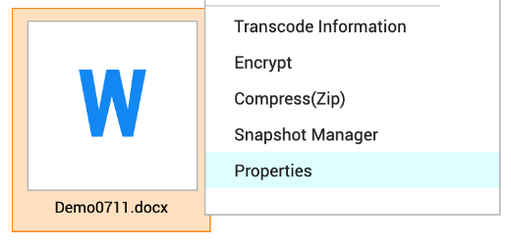
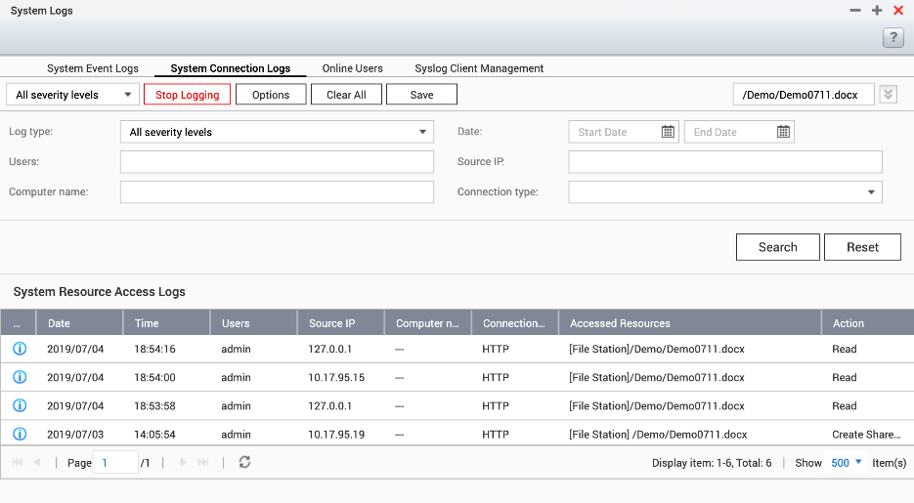
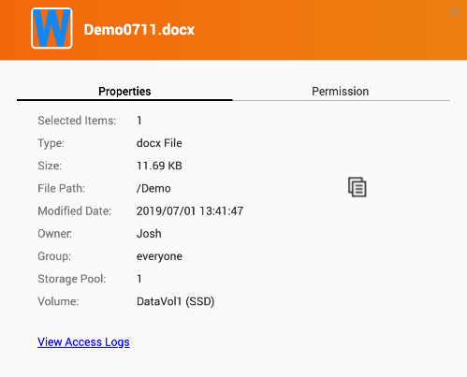
Who has accessed the sensitive file?
1
3
See properties of specific file/ folder
See all access log of the file
2
Click “View access log”

Slide 23
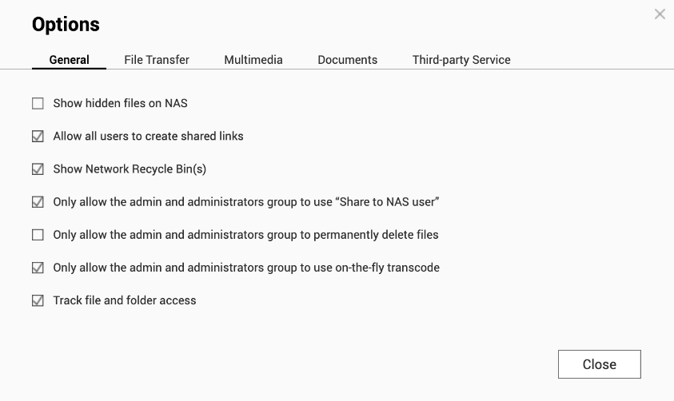
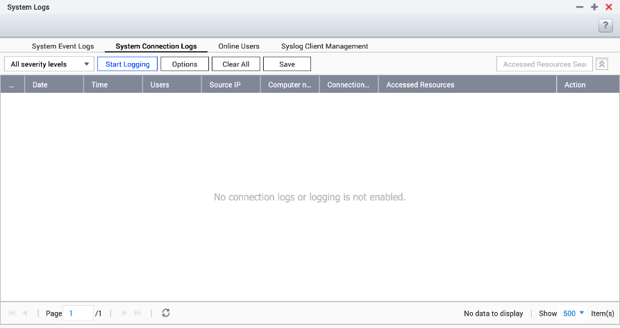
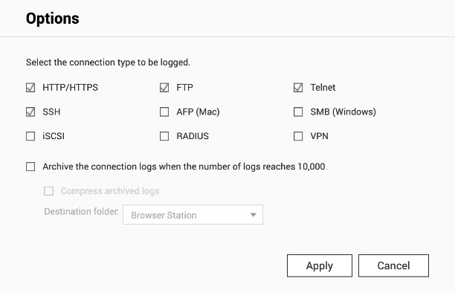
Remember to “start logging”
Enable logging may affect data access performance.
File Station > Settings
Control Panel > System Logs
1
Click “Start Logging”
2
Select the type to be logged

Slide 24
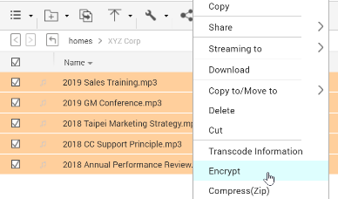
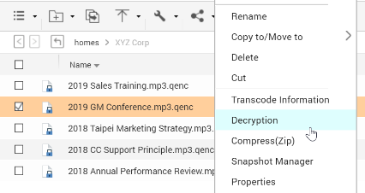
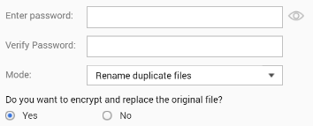
QENC encryption for the sensitive files
Step 1.
Select files, Right click and choose “Encrypt”.
Step 2.
Input password: up to 32 characters, special characters allowed.
Step 3.
Encryption finished. Filename extension became qenc.

Slide 26
HBS 3.0 QuDedup Integration- Let File Station restore your file

Slide 27
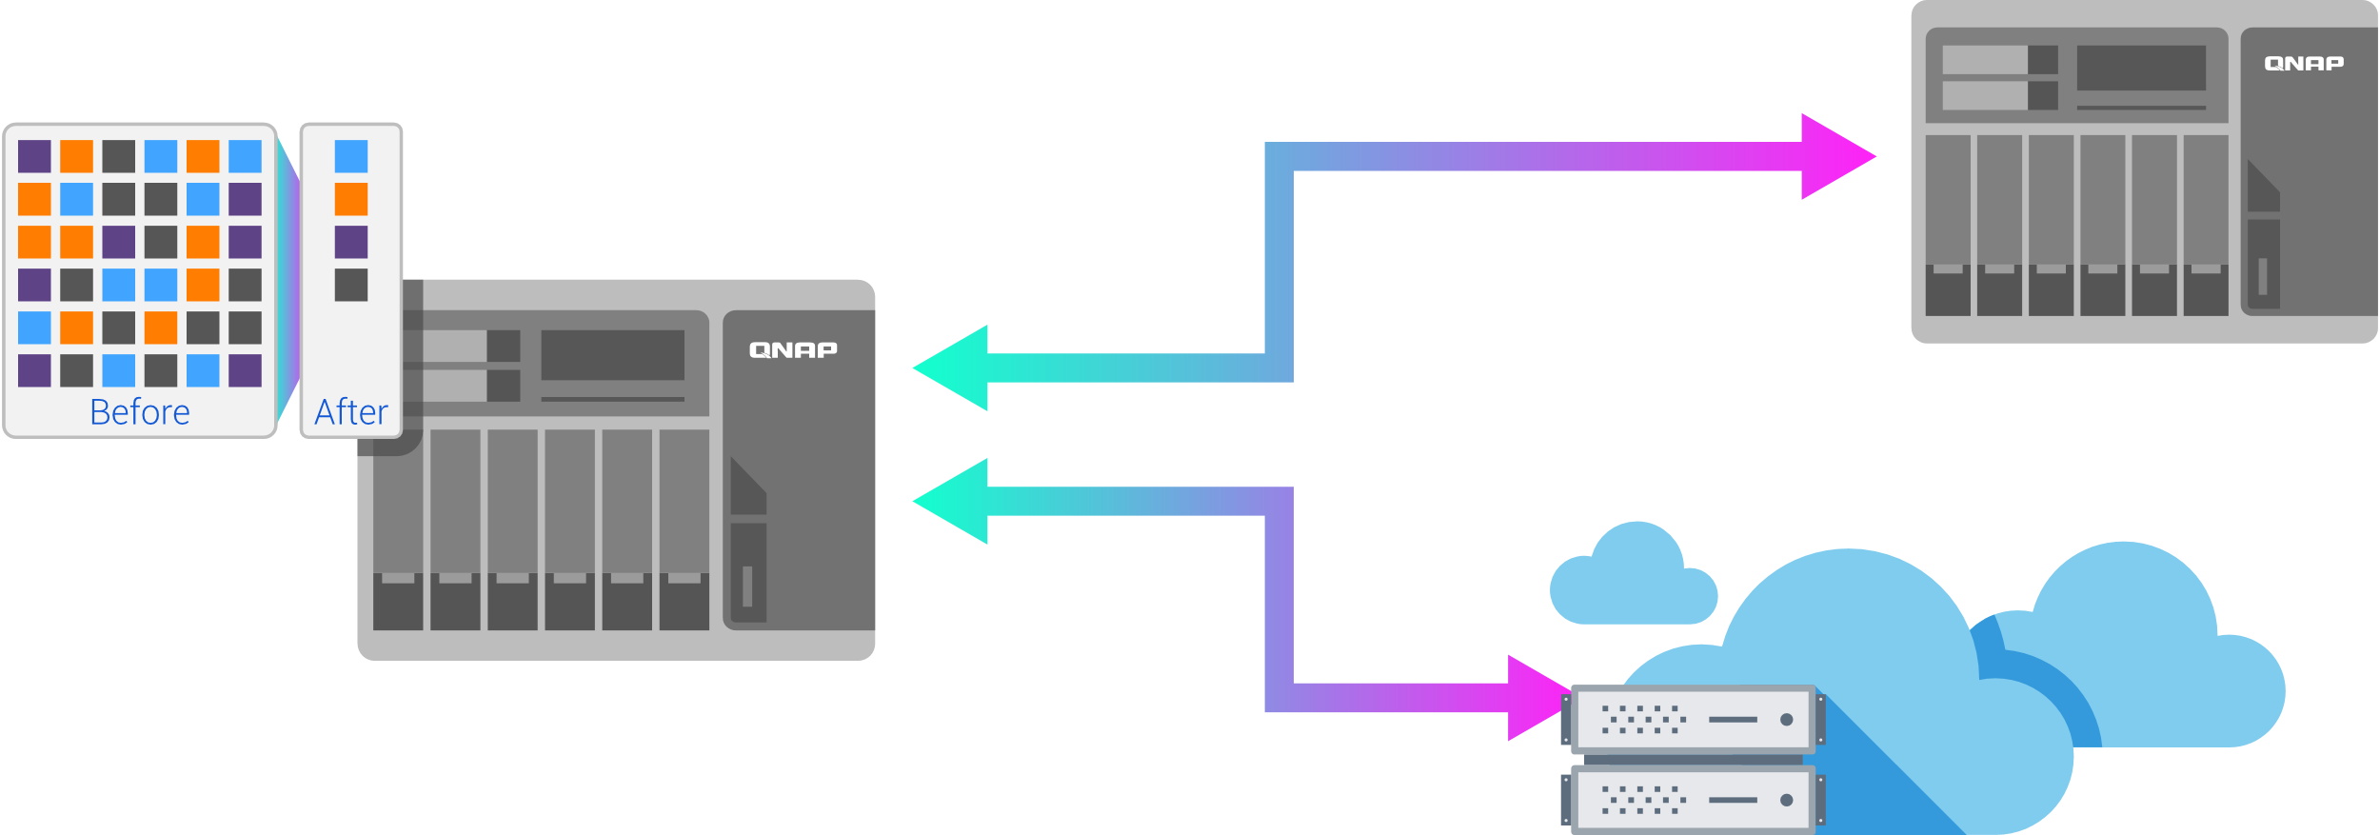
QuDedup Technology: Data Reduction, Small is Fast!
VM Image Size | Deduped File Size | Compression Rate
15.48 GB​ | 7.59 GB​ | 2.04:1​
Source-side data deduplication
Three Advantages
Bandwidth reduction
Storage space saving
Highly compatible with cloud services
Note: This is the compression rate of one VM image file.
01
Bandwidth reduction
02
Storage space saving
03
Compatible with cloud services
QuDedup support model: x86

Slide 28
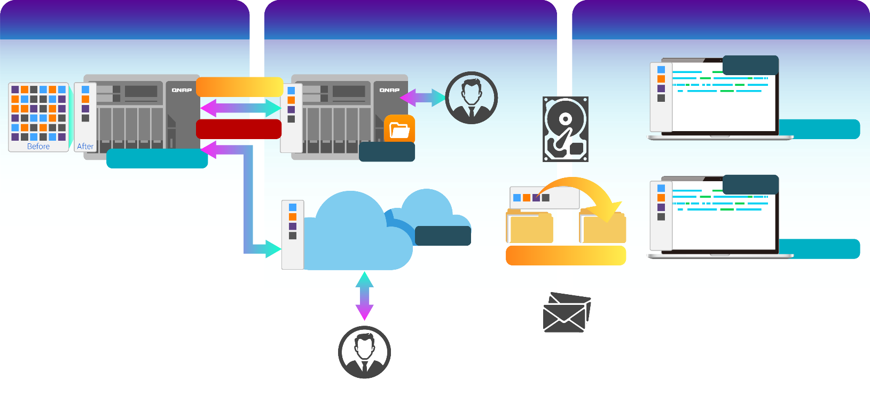
Restored Backup data Anywhere
Restore via HBS
Access from remote
Carry and restore any file
.qdff
Backup/ Restore
TCP BBR
Access from remote NAS
Tokyo
Taipei
.qdff
.qdff
.qdff
CIFS / FTP / WebDAV
Beijing
Access from cloud

Slide 29
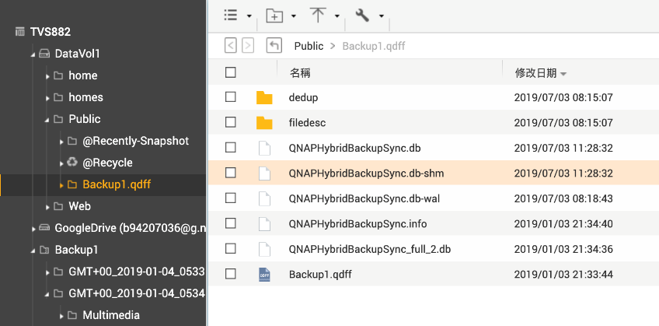
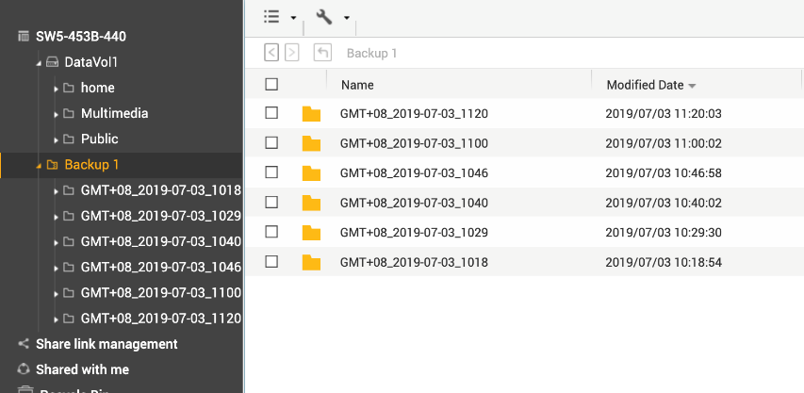
View the version and restore in File Station
Data is already deduplicated, why should I restore all version to see the files?
View first and restore the files of the specific version.
Install latest HBS 3.0 is required.
Before
After
Deduplicated backup data is not able to view
Multi-version viewable
Single folder/file restoration

Slide 31
File Station is the best partner of your team!
Copyright © 2019 QNAP Systems, Inc. All rights reserved. QNAP® and other names of QNAP products are proprietary marks or registered trademarks of QNAP Systems, Inc. Other products and company names mentioned herein are trademarks of their respective holders.

