Slide 2
常見的客戶需求有哪些？
有甚麼方式能讓我快速且安全地存取資料？
如何輕鬆地擴建區塊層級的網路儲存空間？
有甚麼方式可以備份 SAN 的資料，並實現複本資料管理 (CDM) 應用？

Slide 3

QNAP NAS x ATTO 光纖通道擴充卡
QNAP NAS 高效能儲存空間
跨界支援 Fibre Channel SAN 給用戶高可靠、可擴充、且價格更實惠的 FC-SAN 儲存方案
QNAP 支援 ATTO CelerityTM FC 32Gb & 16Gb 擴充卡

Slide 4

企業為什麼要建置 FC-SAN
連接性佳：
在光纖通道儲存網路 (FC-SAN) 架構下，任一伺服器可與任一儲存裝置直接相連，任一儲存裝置也可彼此直接相連。
擴充性佳：
企業可以在不增加伺服器與區域網路負擔的情況下進行擴充。
資料分享能力佳：
因儲存裝置不再與特定的某一伺服器相連，所以多部伺服器可共享資源，且大量檔案傳輸時亦不影響主網路效能。

Slide 5








iSCSI 與 FC 架構比較
Operating System/Application
光纖通道不需透過乙太網路，且在系統中的物理層比 iSCSI 較少 ，在擴建區塊層級的儲存網路時，用光纖通道可免去網路負擔。
iSCSI 需透過乙太網路 ，擴建區塊層級的儲存網路。
SCSI Layer
SCSI Layer
FCP
TCP
IP
Ethernet
FC
iSCSI
光纖通道

Slide 6

光纖通道可減輕 CPU 負擔
測試環境：TS-1283XU-RP
Speed/CPU |  | iSCSI |  | FC
 |  | 25GbEx1 | CPU% | 32G | CPU%
Throughput (MB/s) | SW-1M | 2709 | 56% | 2946 | 39%
 | SR-1M | 2755 | 32% | 2770 | 30%
 | SW-512K | 2707 | 61% | 2950 | 37%
 | SR-512K | 2825 | 43% | 2870 | 35%
IOPS | RW-4K | 154793 | 81% | 155197 | 77%
 | RR-4K | 108263 | 69% | 113162 | 67%
F/W: 4.4.1
CPU: Intel(R) Xeon(R) E-2124 CPU @ 3.30GHz
Tested SSD: Samsung SSD 850 PRO 512GB SATA*12, RAID 0
RAM: 8 GB (4GB x 2)
Block-based LUN; AIO enable
FC 32G: ATTO Fibre Channel Adapter
25GbE: QXG-25G2SF-CX4, MTU 9000
IOmeter Global Configuration:
Maximum Disk Size: RAM*4/ Ramp Up Time: 30 seconds Seq / Run Time: 3 Minutes / 2-workers/ 64-outstanding Random / Run Time: 3 Minutes / 4-workers/ 32-outstanding
Server Environment:
CPU: Intel(R) Xeon(R) CPU E5-2630 v3 @ 2.40GHz
OS: Windows Server 2016 Database Evaluation.
Version: 10.0.14393 Build 14393
Memory: 128 GB.
FC 32G: ATTO Fibre Channel Adapter
25GbE: QXG-25G2SF-CX4, MTU 9000
備註：此測試環境為 RAID 0

Slide 7
光纖通道效能佳
Speed/CPU |  | FC
 |  | FC32Gx1(PC) | CPU%
Throughput (MB/s) | SW-1M | 3132 | 30%
 | SR-1M | 4798 | 25%
 | SW-512K | 3154 | 29%
 | SR-512K | 2772 | 28%
IOPS | RW-4K | 92632 | 40%
 | RR-4K | 195360 | 36%
測試環境：TS-2483XU-RP
F/W: 4.4.1.0955 build 20190603
CPU: Intel(R) Xeon(R) E-2136 CPU @ 3.30GHz
SSD: Samsung SSD 850 PRO 512GB SATA*24,RAID 5
RAM: 16GB, 8GB*2
Thick volume; Block-based LUN; AIO enable; MPIO
FC32G: ATTO Fibre Channel Adapter
PC Environment
CPU1: Intel(R) Xeon(R) CPU E5-2630 v3 @ 2.40GHz, 2401 Mhz, 8 Core(s), 16 Logical Processor(s)
OS: Windows Server 2016 Datacenter Evaluation
Build 14393
Memory: 128 GB.
FC32G: ATTO Fibre Channel Adapter
備註：此測試環境為 RAID 5
IOmeter Global Configuration: Maximum Disk Size: RAM*4/ Ramp Up Time: 30 seconds
Seq / Run Time: 3 Minutes / 2-workers/ 64-outstanding
Random / Run Time: 3 Minutes / 4-workers/ 32-outstanding

Slide 8
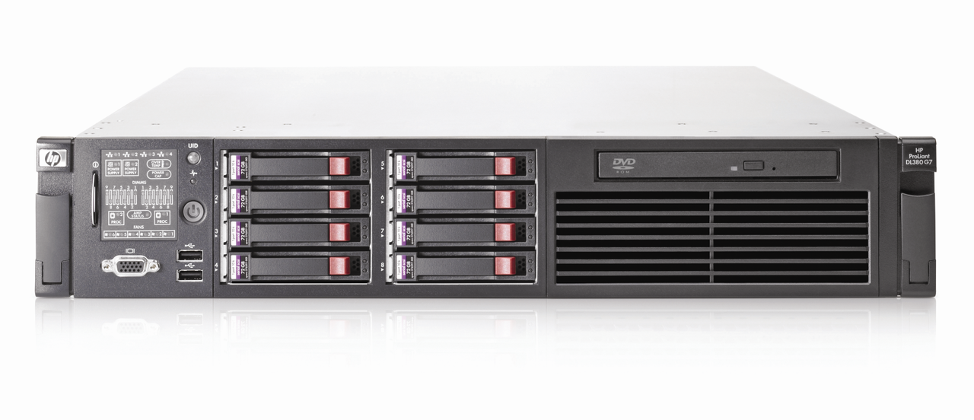
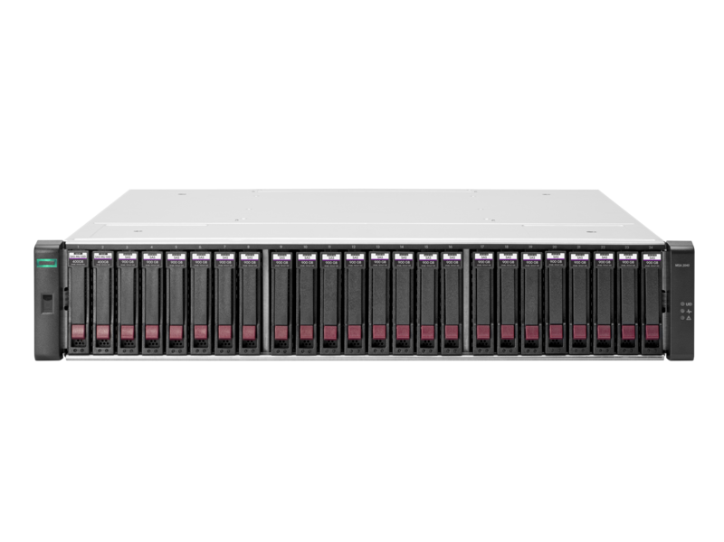
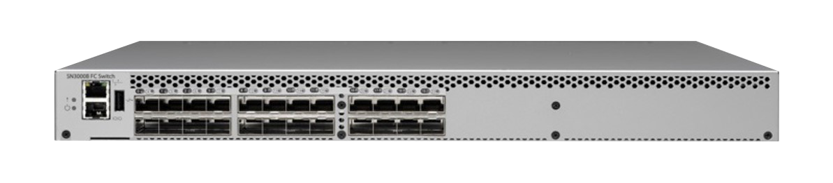
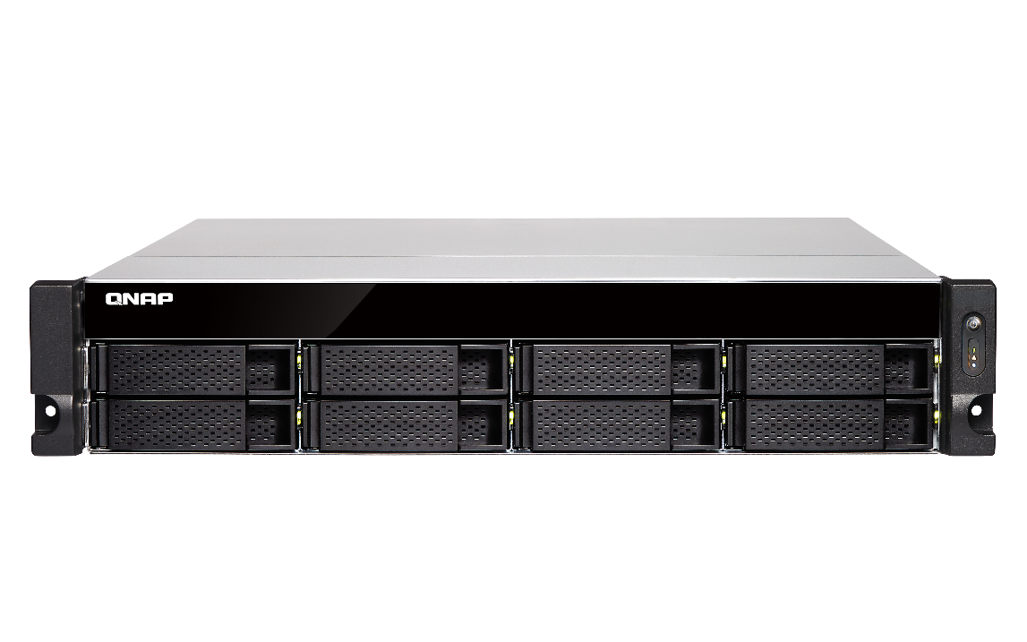
QNAP FC-SAN 解決方案
Windows / Linux / VMware 主機 (啟動器模式) + NAS (目標模式)：
ATTO Celerity 16Gb
Fibre Channel adapter
Windows / Linux / VMware 主機
HP DL360 G7 server
儲存區域網路
(SAN)
Fibre Channel Switch
光纖通道
Other FC-SAN Storage
ATTO Celerity 16Gb
Fibre Channel adapter
TVS-872XU
TVS-872XU
ATTO Celerity 16Gb
Fibre Channel adapter

Slide 9

企業 FC-SAN 與 QNAP NAS 達成 CDM 應用
伺服器
伺服器可以透過iSCSI 存取資料
FC
正式工作環境
備份伺服器
LAN
QNAP NAS
QNAP NAS
SAN Fabric
LUN
LUN
用於異地備份的快照副本
用於本地快照保護
(LUN 可透過 iSCSI 或 FC 存取)
Qtier
SSD 快取
SAN 儲存空間
LUN
LUN
LUN

Slide 10
支援市場 ATTO CelerityTM Fibre Channel 介面卡
與業界領先的 FC 介面卡供應商合作，提供最經濟的 FC-SAN 存儲解決方案。
支援 ATTO CelerityTM
32Gb & 16Gb FC 擴充卡
相容性列表: qnap.com/compatibility/

Slide 11
相容多款 FC 介面卡，支援 4G/8G/16G/32G
ATTO FC 卡 | 介面 | 支援速度 | 技術世代 | PCIe | 高度規格
CTFC-322E | 2 X 32GFC | 32G/16G/8G | Gen 6 | 3.0 x8 | Low profile
CTFC-321E | 1 X 32GFC | 32G/16G/8G | Gen 6 | 3.0 x8 | Low profile
CTFC-162P | 2 X 16GFC | 16G/8G/4G | Gen 6 | 3.0 x8 | Low profile
CTFC-161P | 1 X 16GFC | 16G/8G/4G | Gen 6 | 3.0 x8 | Low profile
相容性列表: qnap.com/compatibility/

Slide 12
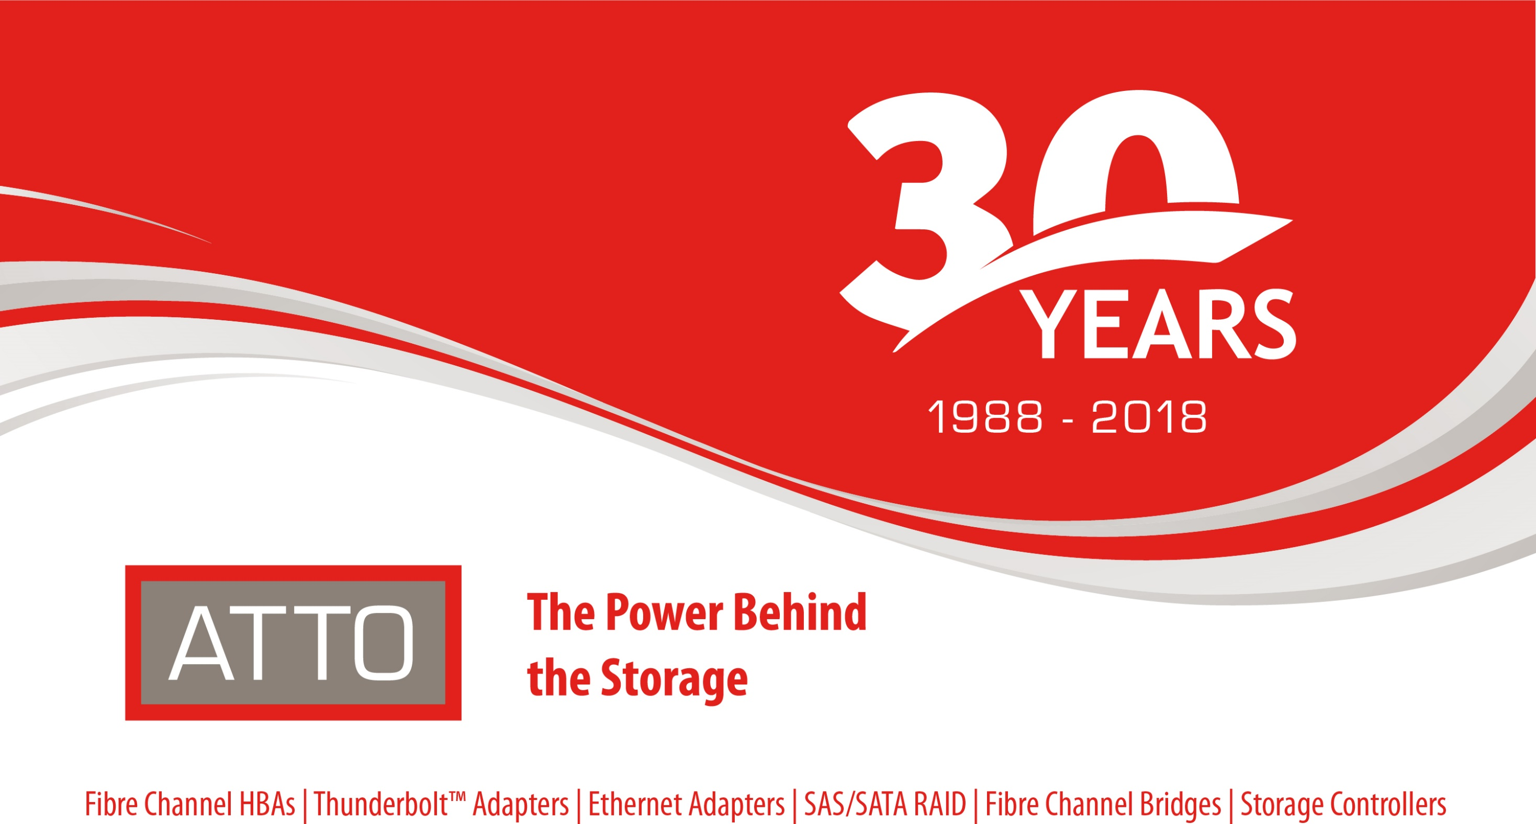
Notes:
封面

Slide 13
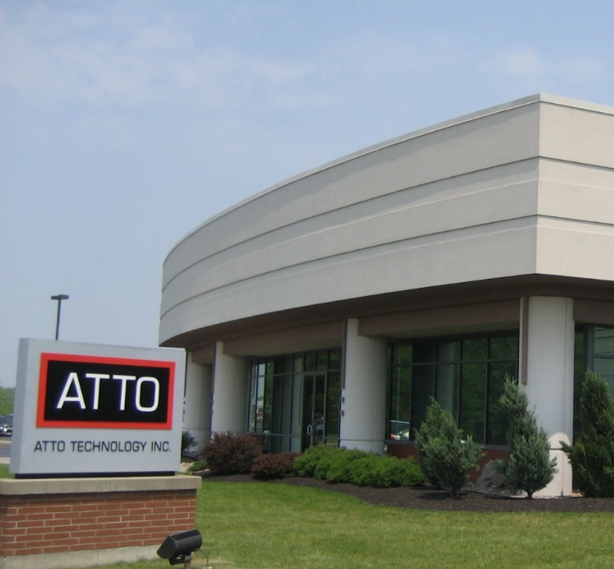
Corporate Overview
Established in 1988 – Upstate NY Headquarters
Experienced engineering leadership
Scalable manufacturing capacity
Products – host bus adapters, NICs, storage controllers, bridging appliances and software
Interconnect expertise – Fibre Channel, SAS, Ethernet, SATA, iSCSI, Thunderbolt, NVMe
Customers – Original Equipment Manufacturers
through End Users (supported with a robust channel)
Worldwide distribution
2

Slide 14
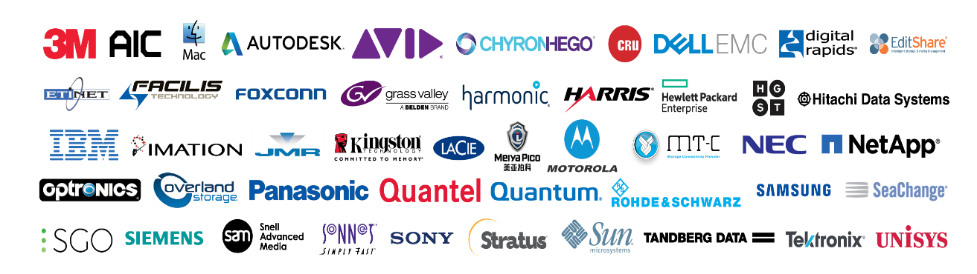
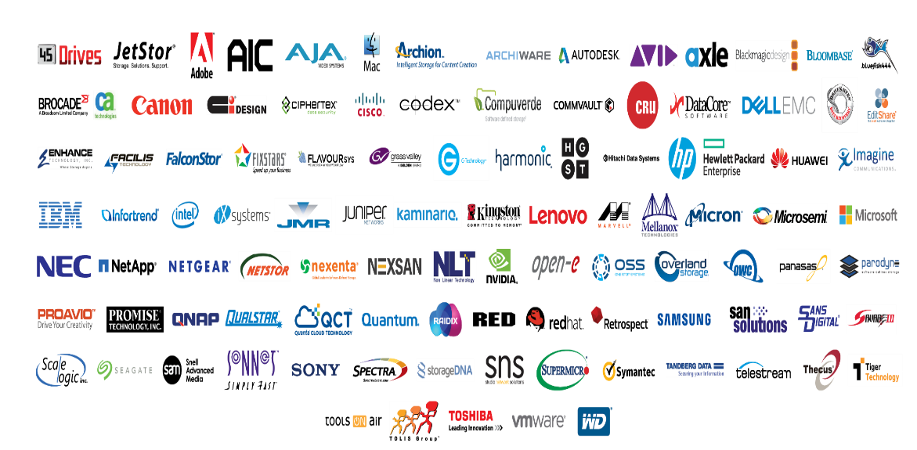

Customers and Partnerships
OEM Customers
Technical Alliances
End Customers
6

Slide 15
Technology Meets Products
Bridges
Thunderbolt™ Adapters
Storage Controllers
RAID Adapters
Network Interface Cards
Host Bus Adapters
SAS/SATA
Thunderbolt
Ethernet
Fibre Channel
NVMe
Core Technology
Latency Management
Bandwidth Optimization

Slide 16
Data Intensive Environments
ATTO develops high-performance products that manage latency in the most demanding, real-time environments, resulting in accelerated application performance and enhanced transaction processing
MB/s Streaming Sequential/Real-Time
CAD/CAE Video post-production Broadcast video Medical imaging Seismic/oil & gas
Mixed Environment Randomized Sequential
Business analytics Financial/OLTP Content distribution Asset management Cloud-based applications
IOPS Random Non-Sequential
Database ERP Web servers Email Servers Back-office ops
ATTO
ATTO
Competitors
Competitors

Slide 17
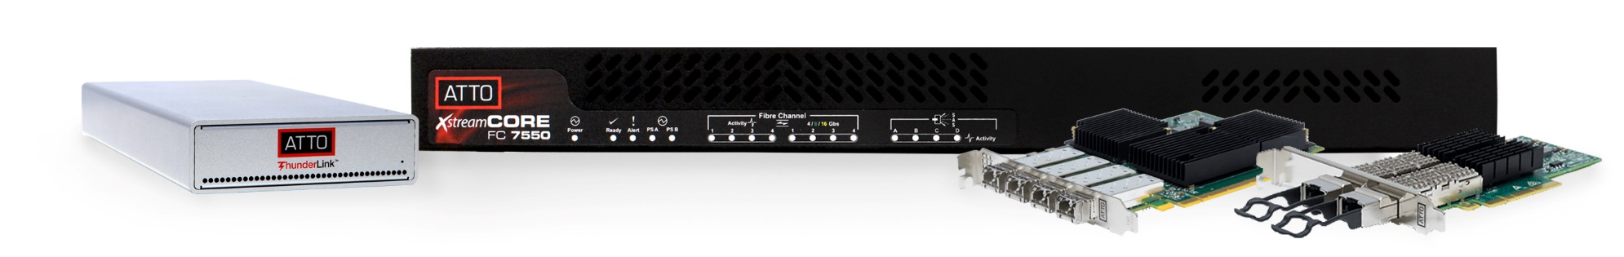
Product Line
Host Bus Adapters
  Fibre Channel
  SAS/SATA
Network Interface Cards
  10/25/40/50/100Gb Ethernet
Thunderbolt™ Adapters
  Fibre Channel
  Ethernet
  SAS/SATA
Storage Controllers
  Fibre Channel-to-SAS/SATA
  Ethernet-to-SAS/SATA
Software
  ATTO ConfigTool™
  Latency Scout™

Slide 18
Technical Differentiators
ATTO Advanced Data Streaming (ADS™)Technology
  Provides controlled acceleration of data to ensure smooth streaming and most consistent performance
ATTO MultiPath Director™
  Enables macOS®, Windows® and Linux® workstations and servers to connect directly to enterprise-class storage with redundant controllers, providing failover and load balancing capabilities across multiple paths to the storage
ATTO DriveAssure™ Technology
  Compensates for misbehaving drives to prevent premature drive failures and slow downs to maximize system uptime and ensures 100% throughput during
  data rebuilds
ATTO intelligent Bridging Architecture™
  Combines powerful hardware with an efficient software data engine to deliver the flexibility of “anything-to-anything” connectivity
ATTO vConfigTool™
  A software plug-in to integrate centralized management and monitoring within a VMware vCenter® environment to accelerate adapter deployment; optimize configurations and reduce VMware host infrastructure costs
ATTO Latency Scout™
  A storage I/O diagnostic utility that boosts data center performance by identifying bottlenecks, allowing for the optimization of system performance and infrastructure uptime

Slide 19
Fibre Channel Competitive Review
Company | Strength | Weakness | Market Perception | Competitive Strategy
ATTO | High Performance products and solutions, Support & Service | Brand awareness in IT | Performance and support leader | Niche Markets, Responsiveness, Customer Support
Marvell Cavium QLogic | Market share leader focused on driving incremental revenue from the target solutions | Limited mindshare to T2/3; so many acquisitions … are they really focused on their channel customers? |  | I/O solution provider focused on storage connectivity
Broadcom Emulex | Focus is on IT markets, Strong T1/T2 OEM relationships for both Silicon and HBA | Lacking mindshare to T3; so many acquisitions … are they really focused on their channel customers? | Strong feature set, IT market leader | IT and T1/T2 OEM focus

Slide 20

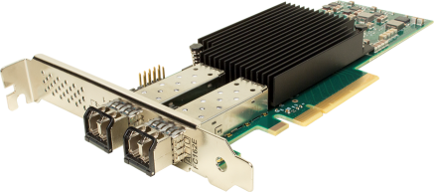
Target Mode Support
Celerity 32Gb/s and 16Gb/s Fibre Channel HBAs
Target Mode Support
  Design solutions from ground up for the greatest flexibility with ATTOs Software Developers Kit (SDK)
    Provides the ability to offer value added features/software
    Available for Linux, Windows and FreeBSD platforms
  Design solutions from pre-set modules for quicker time to market with ATTOs SCST
    Available for Linux platforms
SCST Option
Select the desired SCST module to connect to desired devices.
SDK Option
Write specific code to connect to desired devices.
SCST Core
ATTO SCST Driver Interface
(Linux)
ATTO SCSITMD Source Code
(Linux and Windows)
Celerity Fibre Channel Target Mode Driver

Slide 21
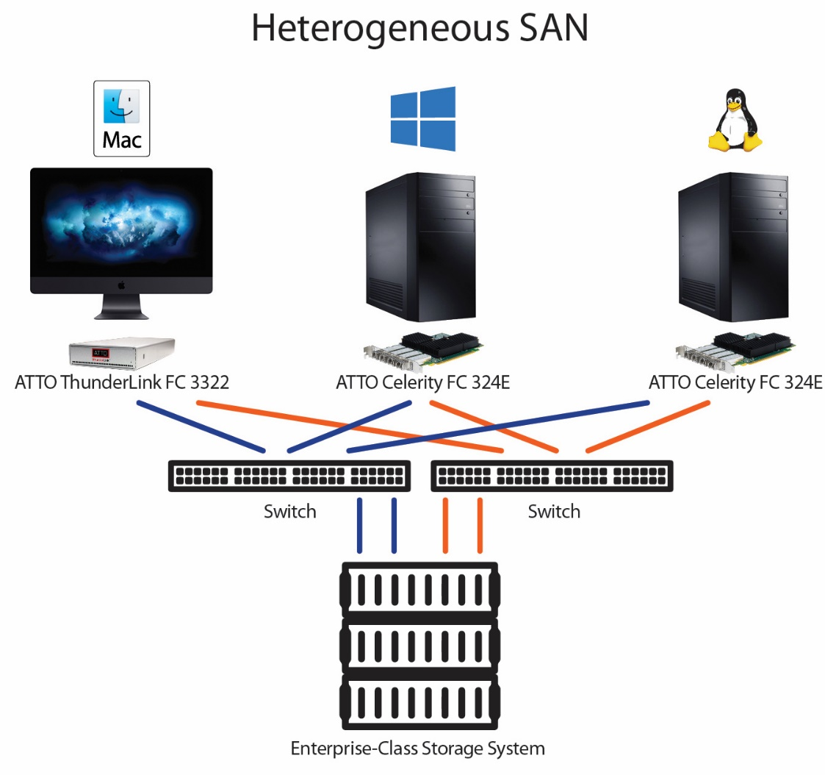
MultiPath Director
High-Availability Storage - Automatic path failover and failback provides uninterrupted access to storage.
Superior Performance - Load balancing increases overall system performance by using more than one Fibre Channel path to transfer data.
Improved Productivity - Workstations can share storage, enabling collaborative workflows and real-time access to content to meet project deadlines.
Flexible Connectivity - Ability to mix Windows, Linux and Mac workstations in a heterogeneous environment.
Simplified Management - ATTO Configuration Tool simplifies administration, troubleshooting and management of multiple paths to storage.
* ATTO is the ONLY Fibre Channel HBA manufacturer with its own multipathing driver – MultiPath Director.
* In addition to Server environments, ATTO’s MultiPath Director allows workstations to connect directly to Enterprise-class storage enclosures with dual controllers. (All competitors are forced to use multipathing functions available only in Server Operating Systems.)
Notes:
“We already have multipathing, why to we need ATTO’s MultiPath Director?”
The ATTO FC HBA standard drivers provide standard support to operate in each operating system. It also allows the user to have multiple paths using built-in multipathing tools such as MPIO in Windows and DM-Multipath in Linux. This is often enough for server based installations (Windows Server 2008 and up and any Linux distribution that we support), but it leaves a hole in the workstation market.
Workstation operating systems such as Windows 7, 8 and 10 do not include MPIO, and MacOS only supports certain vendors with their implementation of multipathing. But many professional users run on these operating systems. Additionally, they need to connect to high-end storage and they want to take full advantage of the performance features of the storage. ATTO grabbed this opportunity and we developed our own multipath driver for Windows, Linux and Mac.
ATTO Multipath Director (MPD) is based on the ALUA standard (Asymmetric Logical Unit Access).
ATTO has designed MPD to be easy to use. The ALUA standard helps make the solution almost "Plug-n-play" when configuring your SAN. Only storage configuration (LUN creation and mapping) is needed.
ATTO MPD also provides path statistics down to the LUN level that are easy to read and monitor.
For the expert user, MPD allows you to manage your paths down to the LUN level (whereas the operating system versions only allow you to manage to the target level).
ATTO MPD provides 3 load balancing policies (Round Robin, Queue depth and Pressure (default)).
ATTO MPD provides consistent performance across all 3 platforms supported (Windows, Linux and Mac).
IT managers do not have to become multipath experts. They do not need to learn DM-multipath (Linux), MPIO (Windows) and/or ALUA (MacOS) to implement a SAN in a heterogeneous environment. MPD provides a uniform application experience across all 3 platforms.
While MPD was designed for workstation operating systems, it will also work in the server environments. ATTO has found that many IT managers prefer ATTO MPD over the operating system options because ATTO MPD often performs better and it is easier to user and monitor your SAN.

Slide 22


Where to Purchase
Solkenix has been ATTO’s Distributor in Taiwan since 2001
  Experts in first-line support for ATTO product & solutions. Fibre Channel, iSCSI/Ethernet, SAS, and Thunderbolt products
  https://www.solkenix.com/
Rest of the World
  https://www.atto.com/howtobuy/
7

Slide 23


QNAP x ATTO Summary
Together QNAP and ATTO offer the highest-performing and lowest cost solutions
Take advantage of the Try-before-you-buy offer before it expires
&
7

Slide 24
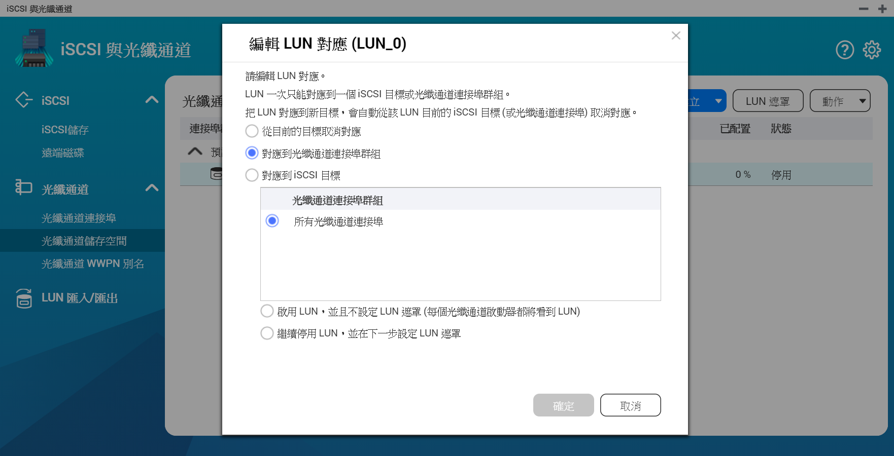
QTS iSCSI 與光纖通道管理員
功能特色
設定彈性
1. LUN 對應：輕鬆對應到 iSCSI
或光纖通道。
2. LUN 遮罩：設定伺服器存取
LUN。
3. 光纖通道連接埠繫結：
綁定連接埠與伺服器。
易於辨識
光纖通道的 WWPN 可以編輯別名。

Slide 25
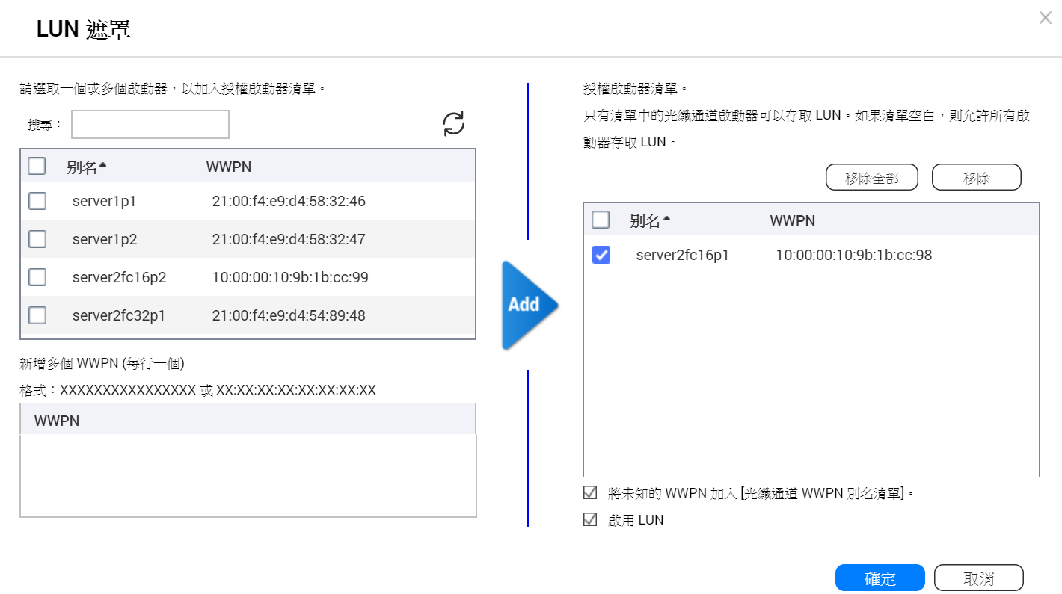
設定 LUN 遮罩
LUN 遮罩：
指定哪個伺服器可以存取哪個LUN 。

Slide 26
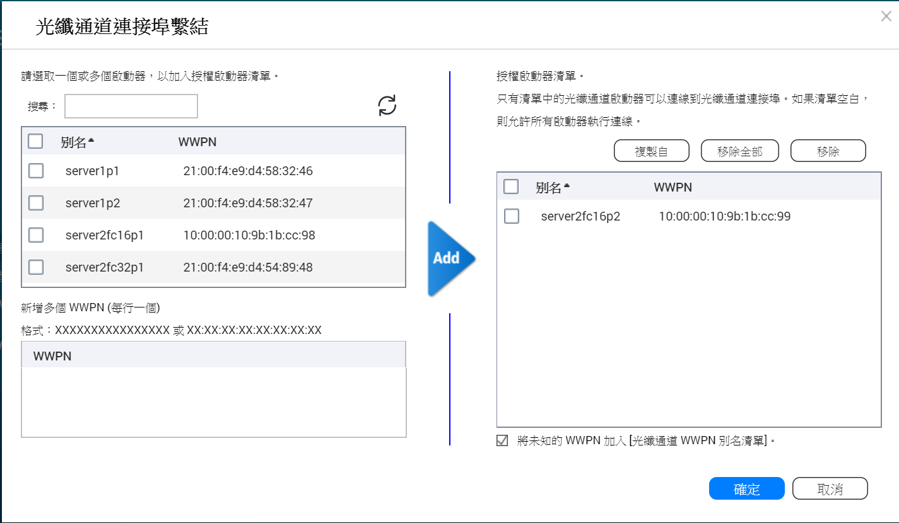
設定光纖通道連接埠繫結 (Binding)
光纖通道連接埠繫結：
編輯哪個伺服器可以綁定哪個連結埠。

Slide 27
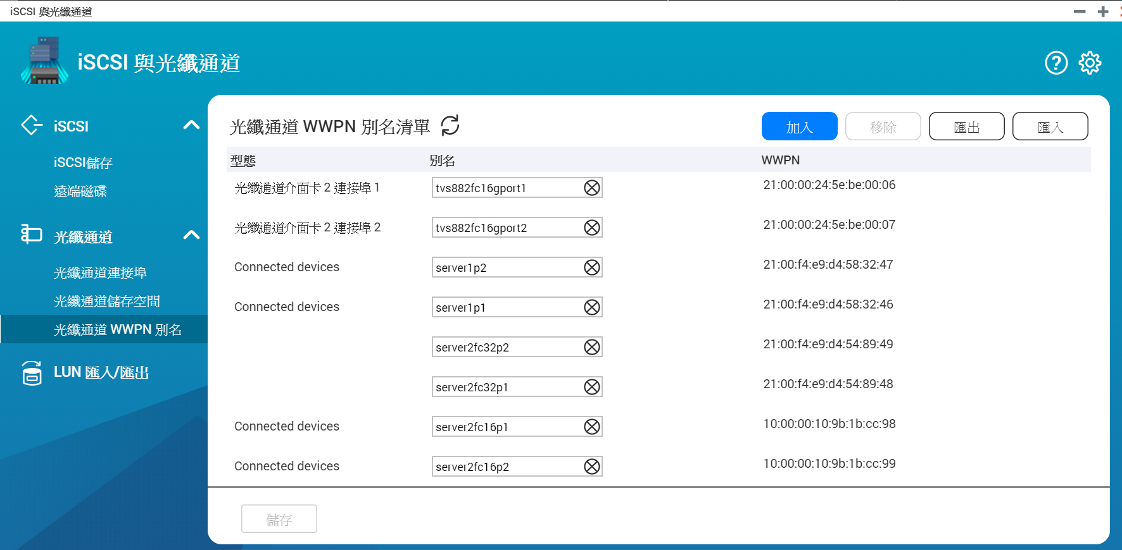
透過別名清單來辨識伺服器與光纖通道連接埠
編輯別名：
指定光纖通道的 WWPN 別名清單。使用者易於辨識儲存區域網路中的伺服器及光纖通道連接埠。

Slide 28



FC-SAN 搭配快照保護及 Qtier / SSD 快取
兼顧資料安全及操作效能
iSCSI & Fibre Channel management
簡單又快速打造 FC-SAN 環境
快照功能
快照備份任務
快照保險庫
Qtier, SSD 快取
加速傳輸效能

Slide 29

快照與快照備份任務
本地快照支援
快照空間管理
快照備份任務
QNAP NAS 內建支援快照保護，可在儲存與快照或檔案總管輕易擷取、閱覽、還原快照。
建立完整磁碟區或 LUN，若欲啟用快照應以少量分配逐步擴充為原則。
建立快照差異備份任務，並且透過遠端快照還原直接由網路還原回本機。

Slide 30
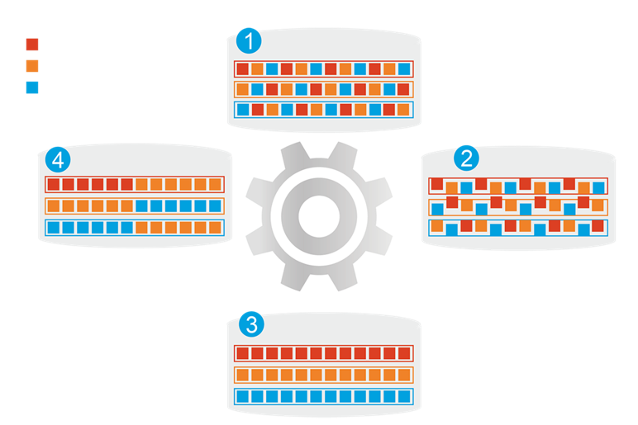
Qtier
1
分層前
頻繁存取資料效能未優化
熱資料
除了全 SSD 儲存，QNAP Qtier 自動分層可將 SSD 和 HDD RAID 整合為一組儲存池，並智能判斷冷熱資料，自動在分層間移動。
暖資料
冷資料
4
資料存取行為改變
2
開始分層
一般 SATA/SAS SSD 外，也支援 M.2 與 QM2 PCIe 外接卡。
Qtier
引擎
儲存不僅受惠於 SSD 的強大效能，更保有最大的儲存大容量。
3
分層後
頻繁存取資料效能已優化

Slide 31
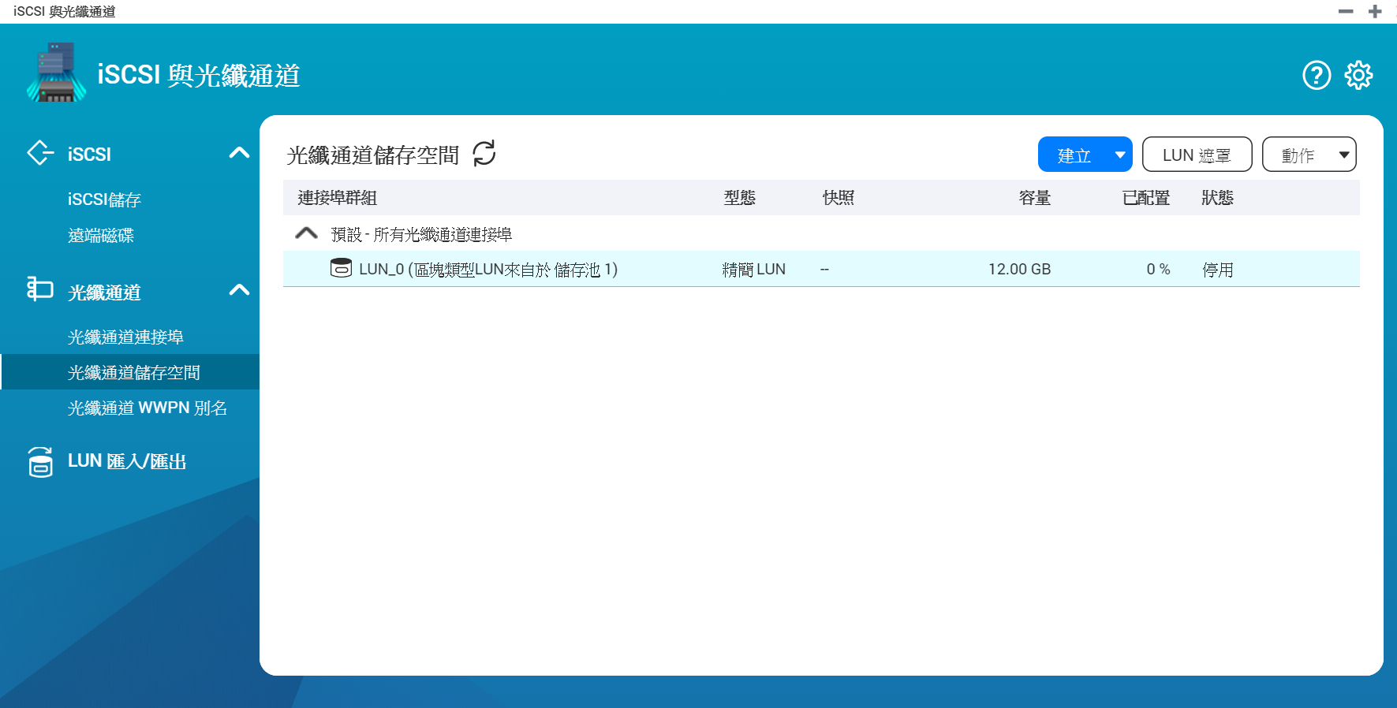
Live Demo

Slide 32
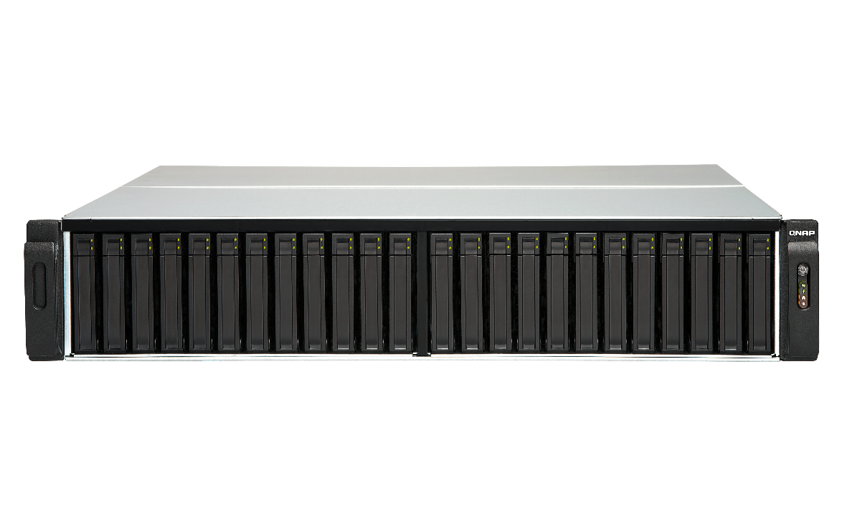
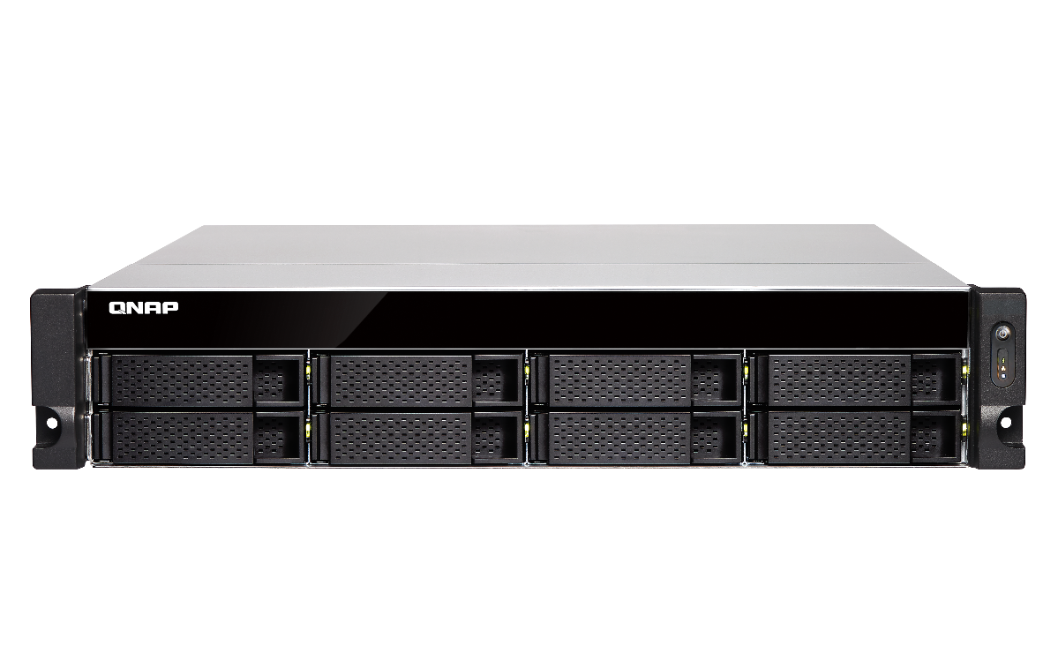
Fibre Channel 支援的機架型 NAS 型號
Intel & AMD NAS 支援 32Gb/s & 16Gb/s ATTO FC 介面卡
TES-3085U (QTS), TES-1885U (QTS), TDS-16489U
TS-2483XU, TS-1683XU-RP, TS-1283XU-RP, TS-983XU-RP, TS-983XU, TS-883XU-RP, TS-883XU
TVS-EC2480U/1680U/1580MU/1280U, TS-EC880U
TS-2477XU-RP, TS-1677XU-RP, TS-1277XU-RP, TS-977XU-RP, TS-977XU, TS-877XU-RP, TS-877XU
TVS-2472XU-RP, TVS-1672XU-RP, TVS-1272XU-RP, TVS-972XU-RP, TVS-972XU, TVS-872XU-RP, TVS-872XU

Slide 33
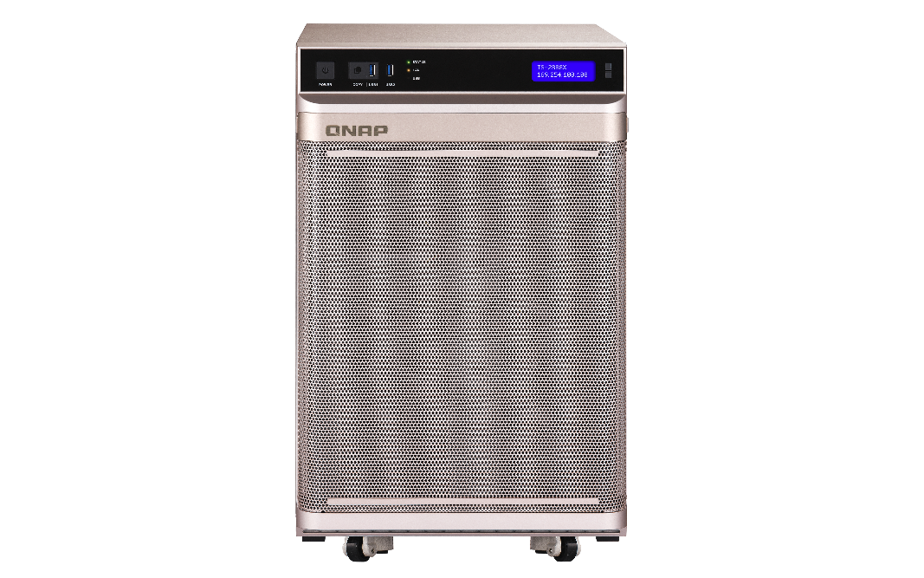
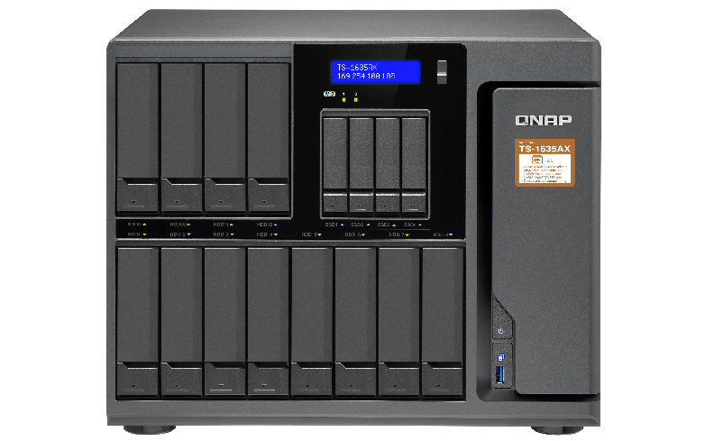
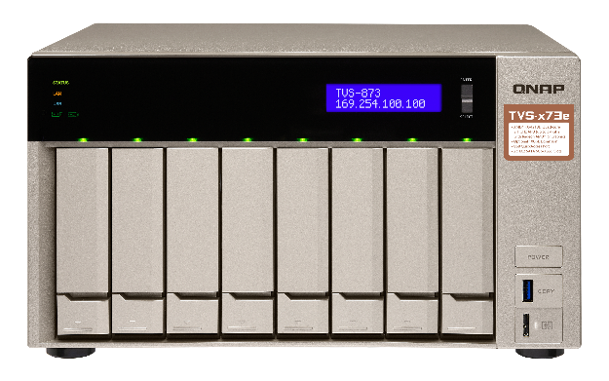
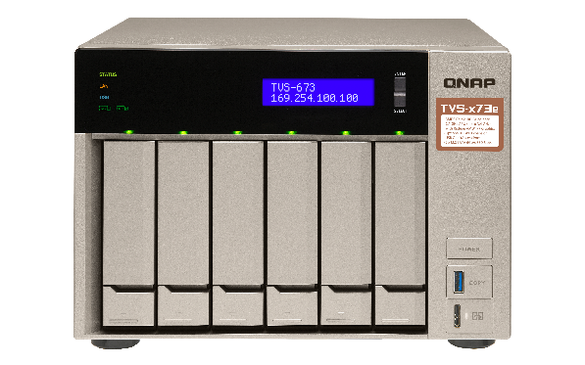
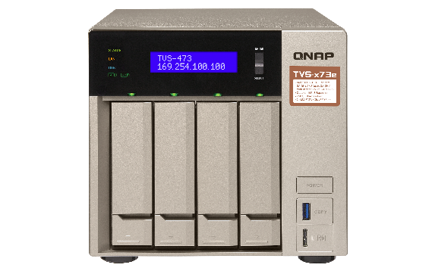
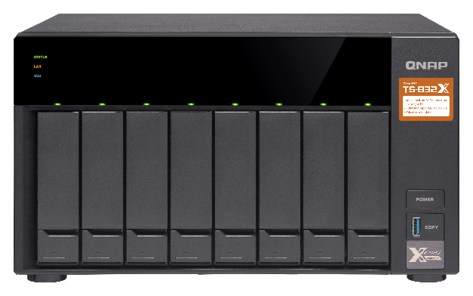
Fibre Channel 支援的直立 / 桌上 NAS 型號
Intel & AMD NAS 支援 32Gb/s & 16Gb/s ATTO FC 介面卡
TS-2888X
TS-1685
TVS-1282, TVS-882, TVS-682
TS-1677X, TS-1277, TS-877, TS-677
TVS-872XT, TVS-672XT, TVS-472XT
TVS-863, TVS-663, TVS-463

Slide 34
Fibre Channel 的建議機種
FC 16Gb
TS-1277
FC 32Gb
TS-2483XU
FC 32Gb
TDS-16489U R2
12 bay (8 x 3.5” + 4. 2.5”)
AMD Ryzen 7 8-core 3.0GHz
Max 64GB RAM
24 bay (24 x 3.5”)
Intel® Xeon® E-2136 6-core 3.3 GHz
Max 64GB RAM
16 bay (16 x 3.5”)
Intel® Xeon® E5-2630 v4 10-core 2.2 GHz
Max 256GB RAM

Slide 35




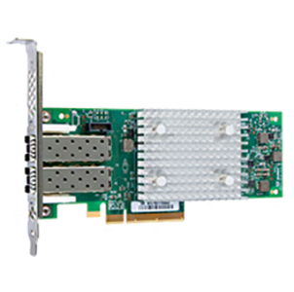
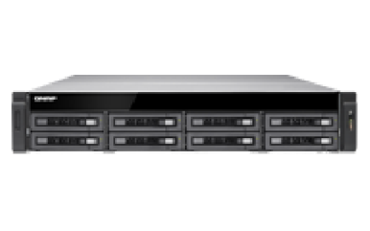
價格親民
操作簡單
設定彈性
QNAP NAS
X
ATTO CelerityTM
FC 擴充卡
光纖通道儲存網路
最佳解決方案

Slide 36
©2019著作權為威聯通科技股份有限公司所有。威聯通科技並保留所有權利。威聯通科技股份有限公司所使用或註冊之商標或標章。檔案中所提及之產品及公司名稱可能為其他公司所有之商標 。

