Slide 2
What is the user's wish?
Is there any way I can enjoy faster and safer data access?
How to easily expand block-level storage area network (SAN)?
Is there any way to back up data in the SAN and implement copy data management (CDM) application?

Slide 3

QNAP NAS x ATTO fibre channel adapters
QNAP NAS high performance storage space
Cross-border support Fibre Channel SAN provides users with a highly reliable, scalable, and affordable storage are network (SAN) solution
QNAP support ATTO CelerityTM FC 32Gb & 16Gb HBAs

Slide 4

Why should companies build Fibre Channel storage area network?
Good connectivity：
In a Fibre Channel Storage area Network (SAN) architecture, any server can be directly connected to any storage device, and any storage device can be directly connected to each other.
Good expandability：
Enterprises can perform extended actions without increasing the load on the server and the local area network.
Good data sharing ability：
Since the storage device is no longer connected to a specific server, resources can be shared by many servers and the main network performance is not affected when a large number of files are transmitted.

Slide 5








iSCSI vs. Fibre Channel Architecture
Operating System/Application
Fibre Channel does not need to pass through Ethernet, and the physical layer in the system is less than iSCSI. When expanding the block-level storage network, Fibre Channel can be used to avoid network load.
iSCSI needs to expand the block-level storage network via Ethernet.
SCSI Layer
SCSI Layer
FCP
TCP
IP
Ethernet
FC
iSCSI
Fibre Channel

Slide 6

Fibre Channel Reduces CPU Load
Test environment: TS-1283XU-RP
Speed/CPU |  | iSCSI |  | FC
 |  | 25GbEx1 | CPU% | 32G | CPU%
Throughput (MB/s) | SW-1M | 2709 | 56% | 2946 | 39%
 | SR-1M | 2755 | 32% | 2770 | 30%
 | SW-512K | 2707 | 61% | 2950 | 37%
 | SR-512K | 2825 | 43% | 2870 | 35%
IOPS | RW-4K | 154793 | 81% | 155197 | 77%
 | RR-4K | 108263 | 69% | 113162 | 67%
F/W: 4.4.1
CPU: Intel(R) Xeon(R) E-2124 CPU @ 3.30GHz
Tested SSD: Samsung SSD 850 PRO 512GB SATA*12, RAID 0
RAM: 8 GB (4GB x 2)
Block-based LUN; AIO enable
FC 32G: ATTO Fibre Channel Adapter
25GbE: QXG-25G2SF-CX4, MTU 9000
IOmeter Global Configuration:
Maximum Disk Size: RAM*4/ Ramp Up Time: 30 seconds Seq / Run Time: 3 Minutes / 2-workers/ 64-outstanding Random / Run Time: 3 Minutes / 4-workers/ 32-outstanding
Server Environment:
CPU: Intel(R) Xeon(R) CPU E5-2630 v3 @ 2.40GHz
OS: Windows Server 2016 Database Evaluation.
Version: 10.0.14393 Build 14393
Memory: 128 GB.
FC 32G: ATTO Fibre Channel Adapter
25GbE: QXG-25G2SF-CX4, MTU 9000
Note: This test environment is RAID 0

Slide 7
Fibre Channel performance is good
Speed/CPU |  | FC
 |  | FC32Gx1(PC) | CPU%
Throughput (MB/s) | SW-1M | 3132 | 30%
 | SR-1M | 4798 | 25%
 | SW-512K | 3154 | 29%
 | SR-512K | 2772 | 28%
IOPS | RW-4K | 92632 | 40%
 | RR-4K | 195360 | 36%
Test environment: TS-2483XU-RP
F/W: 4.4.1.0955 build 20190603
CPU: Intel(R) Xeon(R) E-2136 CPU @ 3.30GHz
SSD: Samsung SSD 850 PRO 512GB SATA*24,RAID 5
RAM: 16GB, 8GB*2
Thick volume; Block-based LUN; AIO enable; MPIO
FC32G: ATTO Fibre Channel Adapter
PC Environment
CPU1: Intel(R) Xeon(R) CPU E5-2630 v3 @ 2.40GHz, 2401 Mhz, 8 Core(s), 16 Logical Processor(s)
OS: Windows Server 2016 Datacenter Evaluation
Build 14393
Memory: 128 GB.
FC32G: ATTO Fibre Channel Adapter
Note:This test environment is RAID 5
IOmeter Global Configuration: Maximum Disk Size: RAM*4/ Ramp Up Time: 30 seconds
Seq / Run Time: 3 Minutes / 2-workers/ 64-outstanding
Random / Run Time: 3 Minutes / 4-workers/ 32-outstanding

Slide 8
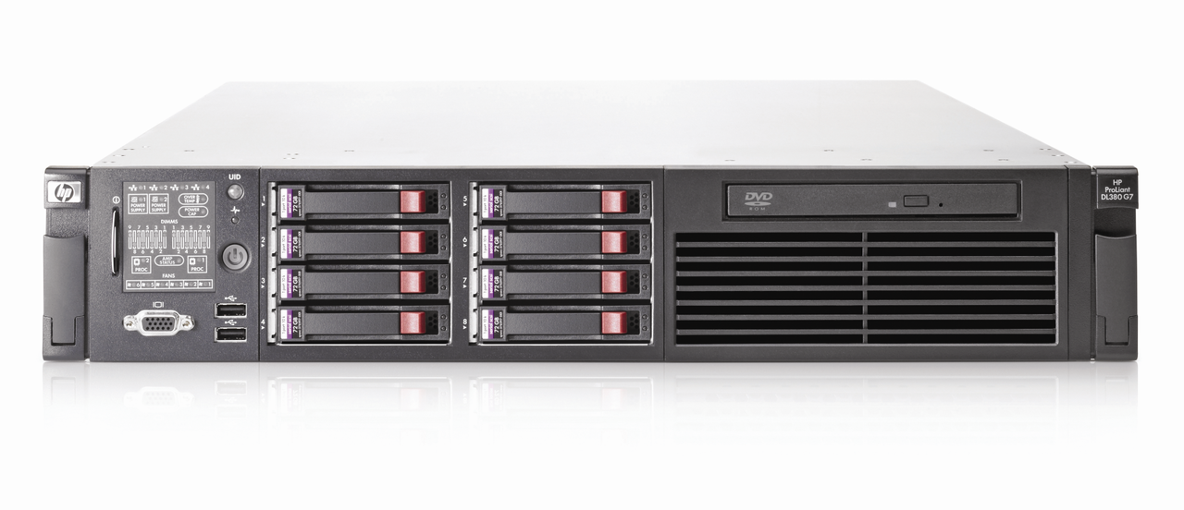
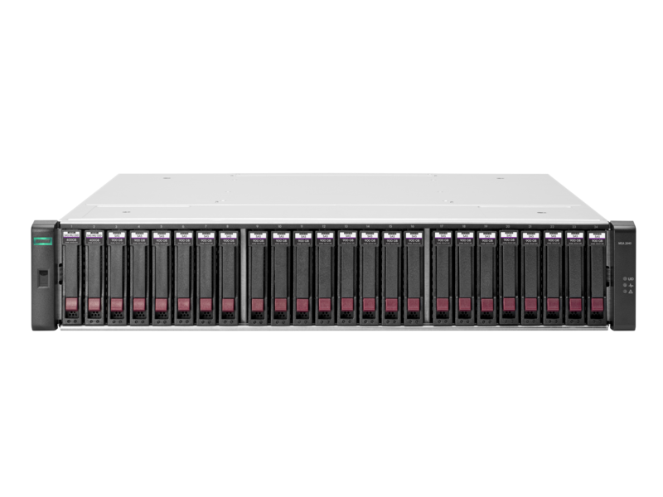
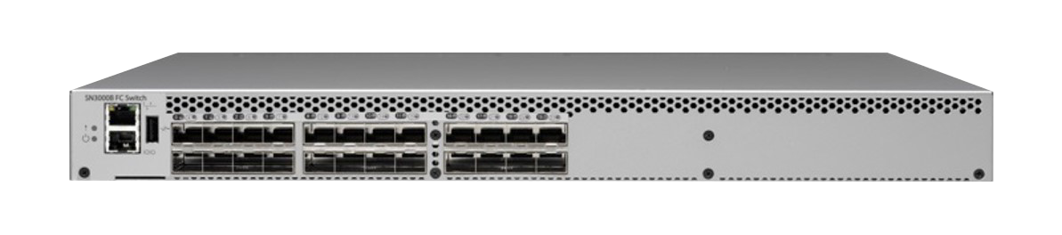
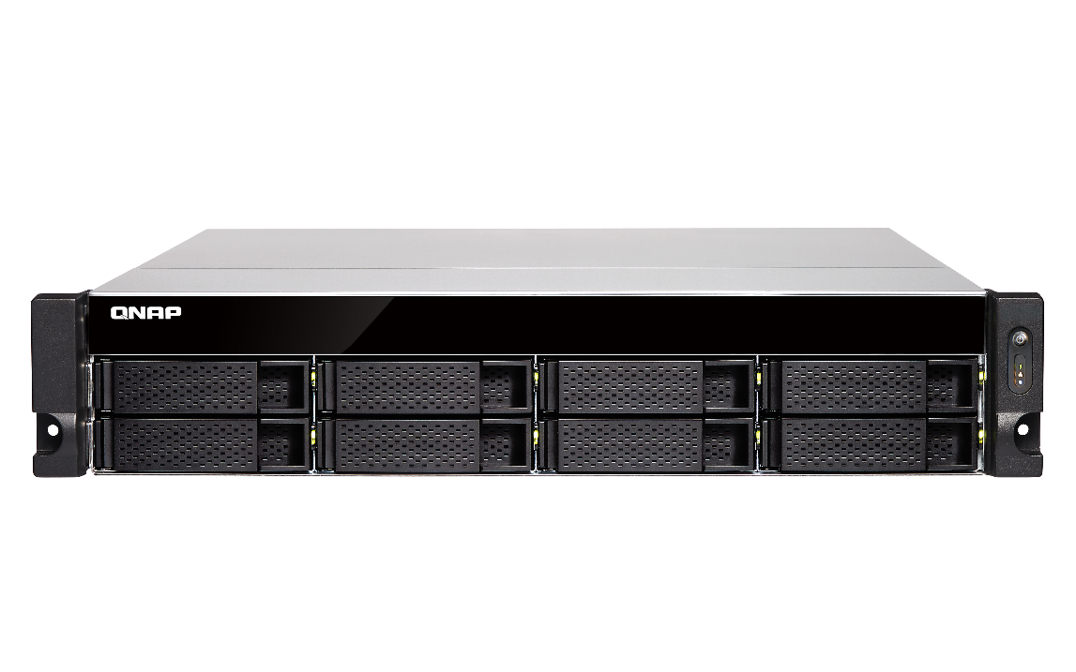
QNAP Fibre Channel Storage Area Network (SAN) Solution
Windows / Linux / VMware Server (Initiator node) + NAS(Target mode):
ATTO Celerity 16Gb
Fibre Channel adapter
Windows / Linux / VMware Server
HP DL360 G7 server
Storage Area Network (SAN)
Fibre Channel Switch
Fibre Channel
Other Fibre SAN Storage
ATTO Celerity 16Gb
Fibre Channel adapter
TVS-872XU
TVS-872XU
ATTO Celerity 16Gb
Fibre Channel adapter

Slide 9

Enterprise Fibre Channel Storage Area Network and CDM Application with QNAP NAS
Server
Server can access it via iSCSI
FC
Production
Server(s)
Backup Server
LAN
QNAP NAS
QNAP NAS
SAN Fabric
LUN
LUN
Snapshot Replica for offsite backup
Scheduled Snapshot for local protection (either LUN is access via iSCSI or FC)
Qtier
SSD Cache
SAN Storage
LUN
LUN
LUN

Slide 10
Support ATTO CelerityTM Fibre Channel Adapters
Partner with industry-leading FC adapters vendors to provide the most economical FC SAN storage solution.
Support ATTO CelerityTM
32Gb & 16Gb FC HBAs
NAS Compatibility: qnap.com/compatibility/

Slide 11
Compatible with a variety of FC Adapters
Support 4G/8G/16G/32G
ATTO FC adapter | Interface | Speed | Tech. generation | PCIe | Spec
CTFC-322E | 2 X 32GFC | 32G/16G/8G | Gen 6 | 3.0 x8 | Low profile
CTFC-321E | 1 X 32GFC | 32G/16G/8G | Gen 6 | 3.0 x8 | Low profile
CTFC-162P | 2 X 16GFC | 16G/8G/4G | Gen 6 | 3.0 x8 | Low profile
CTFC-161P | 1 X 16GFC | 16G/8G/4G | Gen 6 | 3.0 x8 | Low profile
NAS Compatibility: qnap.com/compatibility/

Slide 12
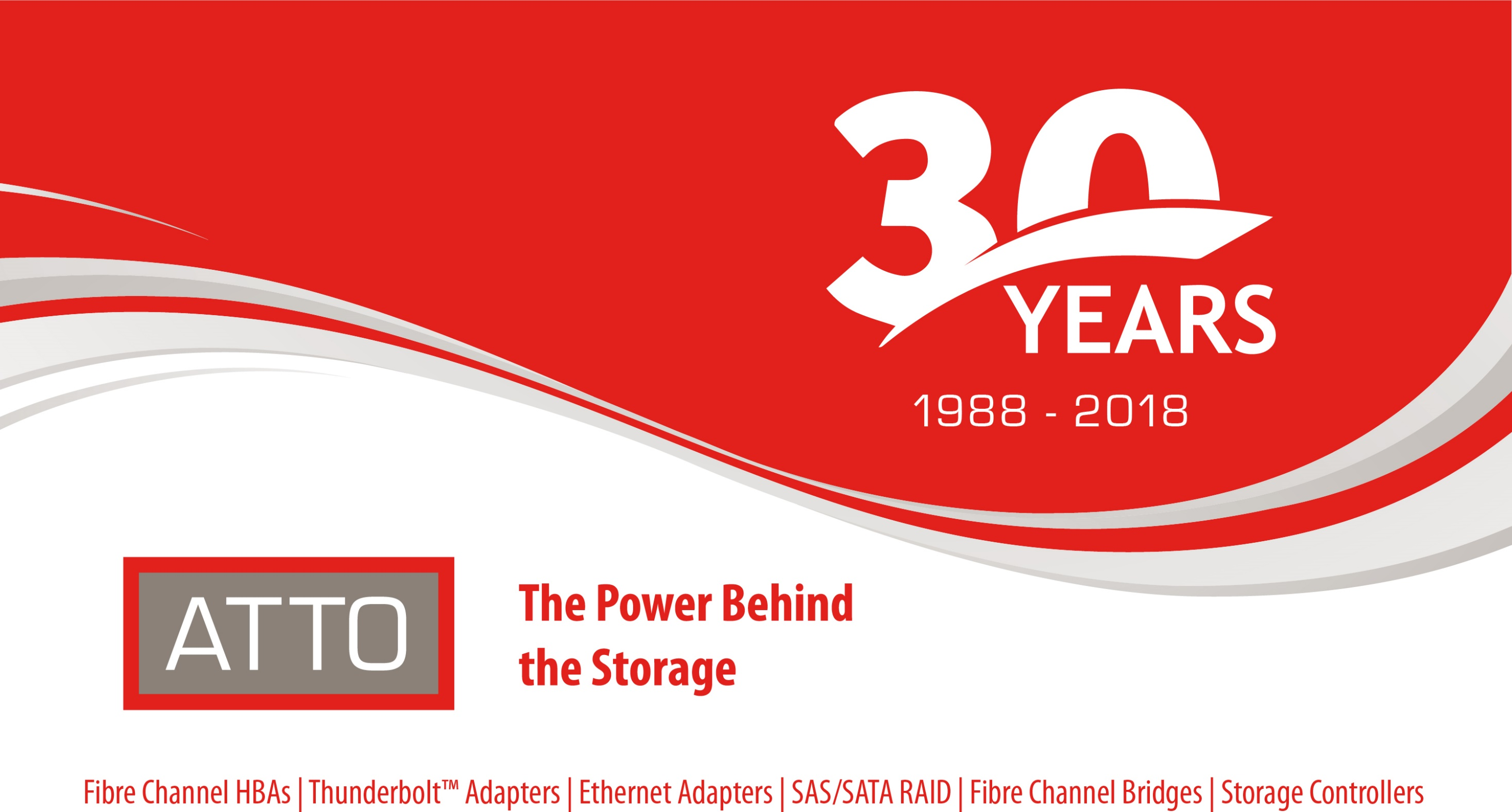
Notes:
封面

Slide 13
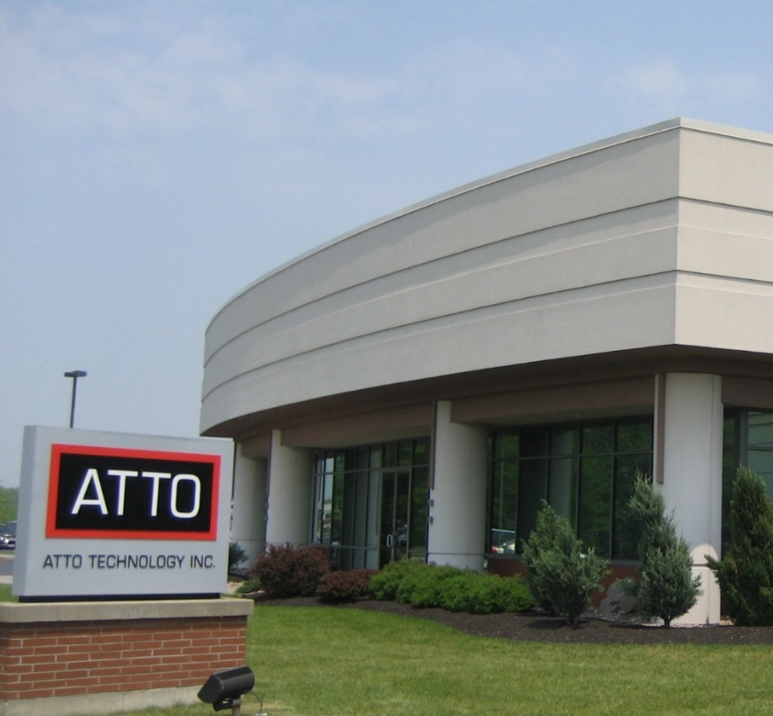
Corporate Overview
Established in 1988 – Upstate NY Headquarters
Experienced engineering leadership
Scalable manufacturing capacity
Products – host bus adapters, NICs, storage controllers, bridging appliances and software
Interconnect expertise – Fibre Channel, SAS, Ethernet, SATA, iSCSI, Thunderbolt, NVMe
Customers – Original Equipment Manufacturers
through End Users (supported with a robust channel)
Worldwide distribution
2

Slide 14
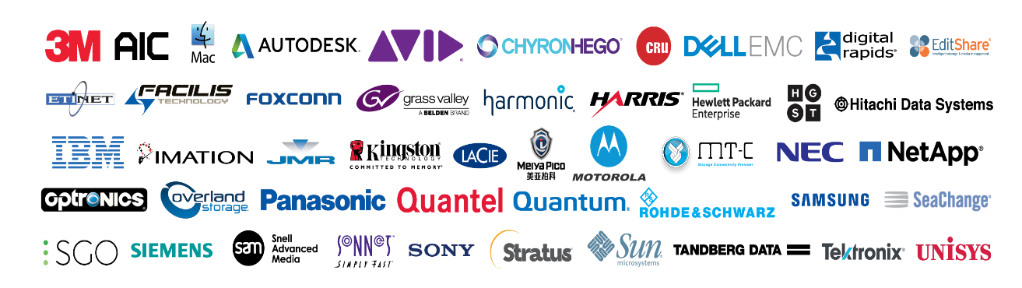
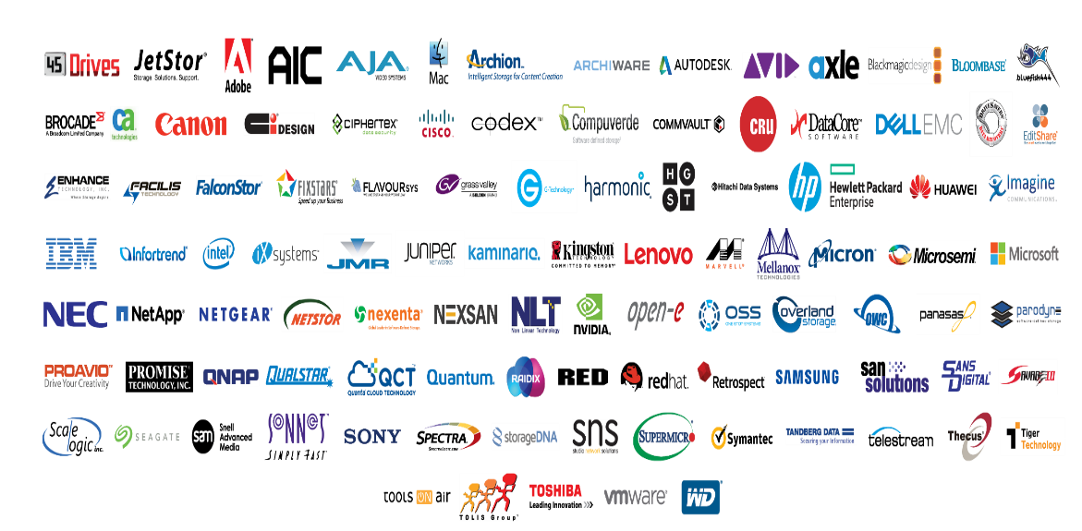

Customers and Partnerships
OEM Customers
Technical Alliances
End Customers
6

Slide 15
Technology Meets Products
Bridges
Thunderbolt™ Adapters
Storage Controllers
RAID Adapters
Network Interface Cards
Host Bus Adapters
SAS/SATA
Thunderbolt
Ethernet
Fibre Channel
NVMe
Core Technology
Latency Management
Bandwidth Optimization

Slide 16
Data Intensive Environments
ATTO develops high-performance products that manage latency in the most demanding, real-time environments, resulting in accelerated application performance and enhanced transaction processing
MB/s Streaming Sequential/Real-Time
CAD/CAE Video post-production Broadcast video Medical imaging Seismic/oil & gas
Mixed Environment Randomized Sequential
Business analytics Financial/OLTP Content distribution Asset management Cloud-based applications
IOPS Random Non-Sequential
Database ERP Web servers Email Servers Back-office ops
ATTO
ATTO
Competitors
Competitors

Slide 17
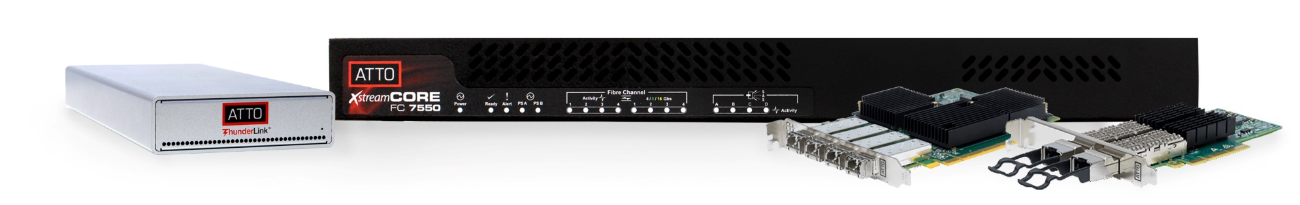
Product Line
Host Bus Adapters
  Fibre Channel
  SAS/SATA
Network Interface Cards
  10/25/40/50/100Gb Ethernet
Thunderbolt™ Adapters
  Fibre Channel
  Ethernet
  SAS/SATA
Storage Controllers
  Fibre Channel-to-SAS/SATA
  Ethernet-to-SAS/SATA
Software
  ATTO ConfigTool™
  Latency Scout™

Slide 18
Technical Differentiators
ATTO Advanced Data Streaming (ADS™)Technology
  Provides controlled acceleration of data to ensure smooth streaming and most consistent performance
ATTO MultiPath Director™
  Enables macOS®, Windows® and Linux® workstations and servers to connect directly to enterprise-class storage with redundant controllers, providing failover and load balancing capabilities across multiple paths to the storage
ATTO DriveAssure™ Technology
  Compensates for misbehaving drives to prevent premature drive failures and slow downs to maximize system uptime and ensures 100% throughput during
  data rebuilds
ATTO intelligent Bridging Architecture™
  Combines powerful hardware with an efficient software data engine to deliver the flexibility of “anything-to-anything” connectivity
ATTO vConfigTool™
  A software plug-in to integrate centralized management and monitoring within a VMware vCenter® environment to accelerate adapter deployment; optimize configurations and reduce VMware host infrastructure costs
ATTO Latency Scout™
  A storage I/O diagnostic utility that boosts data center performance by identifying bottlenecks, allowing for the optimization of system performance and infrastructure uptime

Slide 19
Fibre Channel Competitive Review
Company | Strength | Weakness | Market Perception | Competitive Strategy
ATTO | High Performance products and solutions, Support & Service | Brand awareness in IT | Performance and support leader | Niche Markets, Responsiveness, Customer Support
Marvell Cavium QLogic | Market share leader focused on driving incremental revenue from the target solutions | Limited mindshare to T2/3; so many acquisitions … are they really focused on their channel customers? |  | I/O solution provider focused on storage connectivity
Broadcom Emulex | Focus is on IT markets, Strong T1/T2 OEM relationships for both Silicon and HBA | Lacking mindshare to T3; so many acquisitions … are they really focused on their channel customers? | Strong feature set, IT market leader | IT and T1/T2 OEM focus

Slide 20

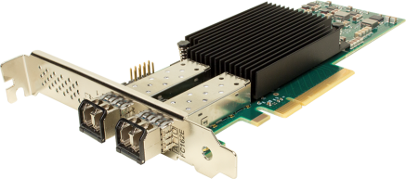
Target Mode Support
Celerity 32Gb/s and 16Gb/s Fibre Channel HBAs
Target Mode Support
  Design solutions from ground up for the greatest flexibility with ATTOs Software Developers Kit (SDK)
    Provides the ability to offer value added features/software
    Available for Linux, Windows and FreeBSD platforms
  Design solutions from pre-set modules for quicker time to market with ATTOs SCST
    Available for Linux platforms
SCST Option
Select the desired SCST module to connect to desired devices.
SDK Option
Write specific code to connect to desired devices.
SCST Core
ATTO SCST Driver Interface
(Linux)
ATTO SCSITMD Source Code
(Linux and Windows)
Celerity Fibre Channel Target Mode Driver

Slide 21
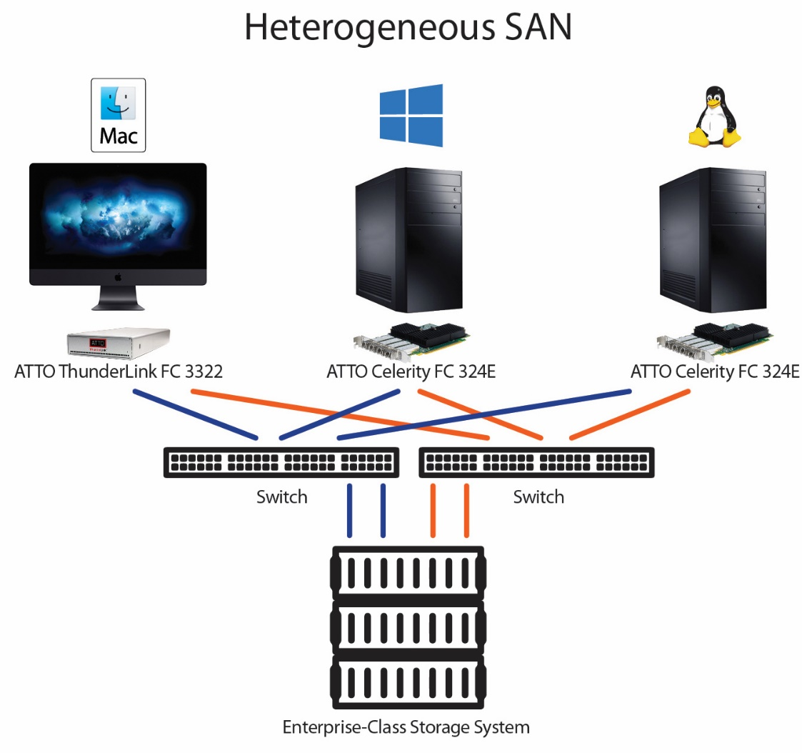
MultiPath Director
High-Availability Storage - Automatic path failover and failback provides uninterrupted access to storage.
Superior Performance - Load balancing increases overall system performance by using more than one Fibre Channel path to transfer data.
Improved Productivity - Workstations can share storage, enabling collaborative workflows and real-time access to content to meet project deadlines.
Flexible Connectivity - Ability to mix Windows, Linux and Mac workstations in a heterogeneous environment.
Simplified Management - ATTO Configuration Tool simplifies administration, troubleshooting and management of multiple paths to storage.
* ATTO is the ONLY Fibre Channel HBA manufacturer with its own multipathing driver – MultiPath Director.
* In addition to Server environments, ATTO’s MultiPath Director allows workstations to connect directly to Enterprise-class storage enclosures with dual controllers. (All competitors are forced to use multipathing functions available only in Server Operating Systems.)
Notes:
“We already have multipathing, why to we need ATTO’s MultiPath Director?”
The ATTO FC HBA standard drivers provide standard support to operate in each operating system. It also allows the user to have multiple paths using built-in multipathing tools such as MPIO in Windows and DM-Multipath in Linux. This is often enough for server based installations (Windows Server 2008 and up and any Linux distribution that we support), but it leaves a hole in the workstation market.
Workstation operating systems such as Windows 7, 8 and 10 do not include MPIO, and MacOS only supports certain vendors with their implementation of multipathing. But many professional users run on these operating systems. Additionally, they need to connect to high-end storage and they want to take full advantage of the performance features of the storage. ATTO grabbed this opportunity and we developed our own multipath driver for Windows, Linux and Mac.
ATTO Multipath Director (MPD) is based on the ALUA standard (Asymmetric Logical Unit Access).
ATTO has designed MPD to be easy to use. The ALUA standard helps make the solution almost "Plug-n-play" when configuring your SAN. Only storage configuration (LUN creation and mapping) is needed.
ATTO MPD also provides path statistics down to the LUN level that are easy to read and monitor.
For the expert user, MPD allows you to manage your paths down to the LUN level (whereas the operating system versions only allow you to manage to the target level).
ATTO MPD provides 3 load balancing policies (Round Robin, Queue depth and Pressure (default)).
ATTO MPD provides consistent performance across all 3 platforms supported (Windows, Linux and Mac).
IT managers do not have to become multipath experts. They do not need to learn DM-multipath (Linux), MPIO (Windows) and/or ALUA (MacOS) to implement a SAN in a heterogeneous environment. MPD provides a uniform application experience across all 3 platforms.
While MPD was designed for workstation operating systems, it will also work in the server environments. ATTO has found that many IT managers prefer ATTO MPD over the operating system options because ATTO MPD often performs better and it is easier to user and monitor your SAN.

Slide 22


Where to Purchase
Solkenix has been ATTO’s Distributor in Taiwan since 2001
  Experts in first-line support for ATTO product & solutions. Fibre Channel, iSCSI/Ethernet, SAS, and Thunderbolt products
  https://www.solkenix.com/
Rest of the World
  https://www.atto.com/howtobuy/
7

Slide 23
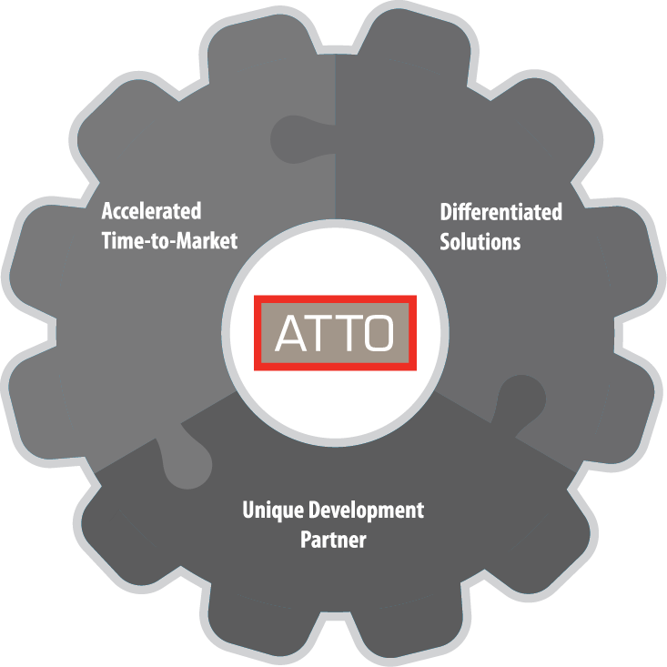

QNAP x ATTO Summary
Together QNAP and ATTO offer the highest-performing and lowest cost solutions
Take advantage of the Try-before-you-buy offer in 2019 Q3
&
7

Slide 24
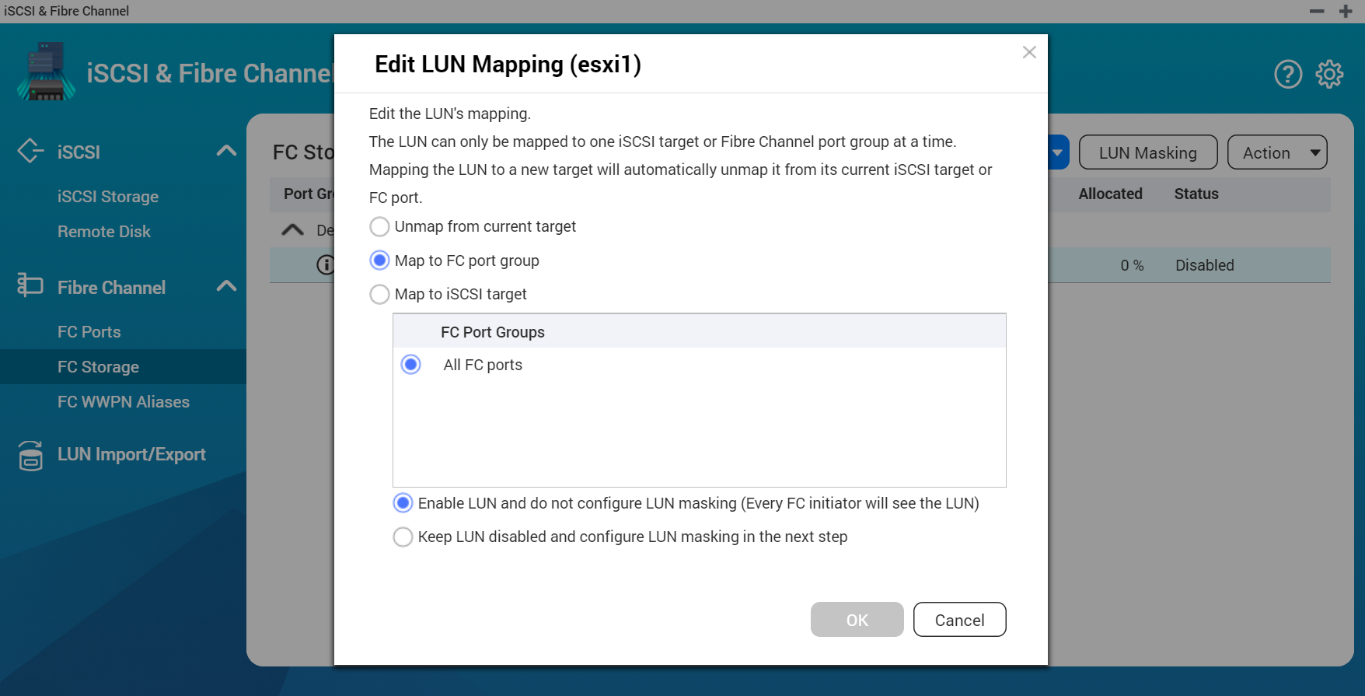
iSCSI and Fibre Channel manager
Features
Flexible settings
1. LUN Mapping : LUN can be mapped to iSCSI or FC.
2. LUN Masking: Set which server can access LUN.
3. FC Port Binding: which server can access which ports.
Easy to identify
Fibre Channel's WWPN can edit aliases.

Slide 25
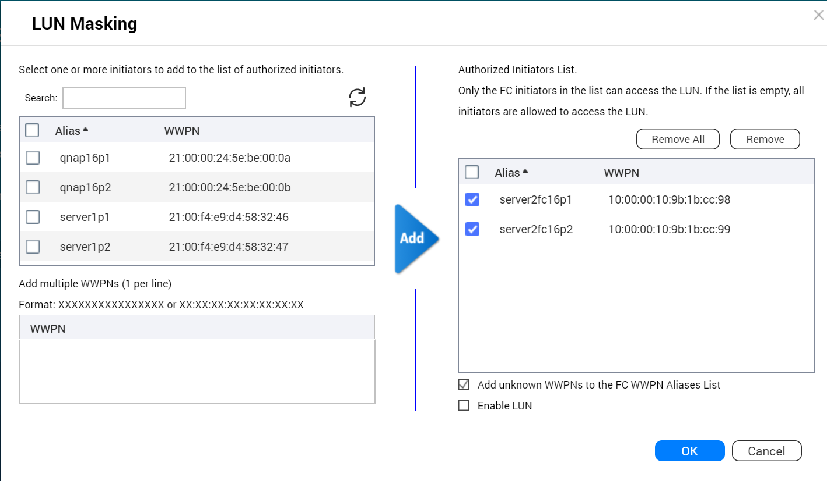
Set LUN Masking
LUN Masking:
Specify which server can access which LUN.

Slide 26
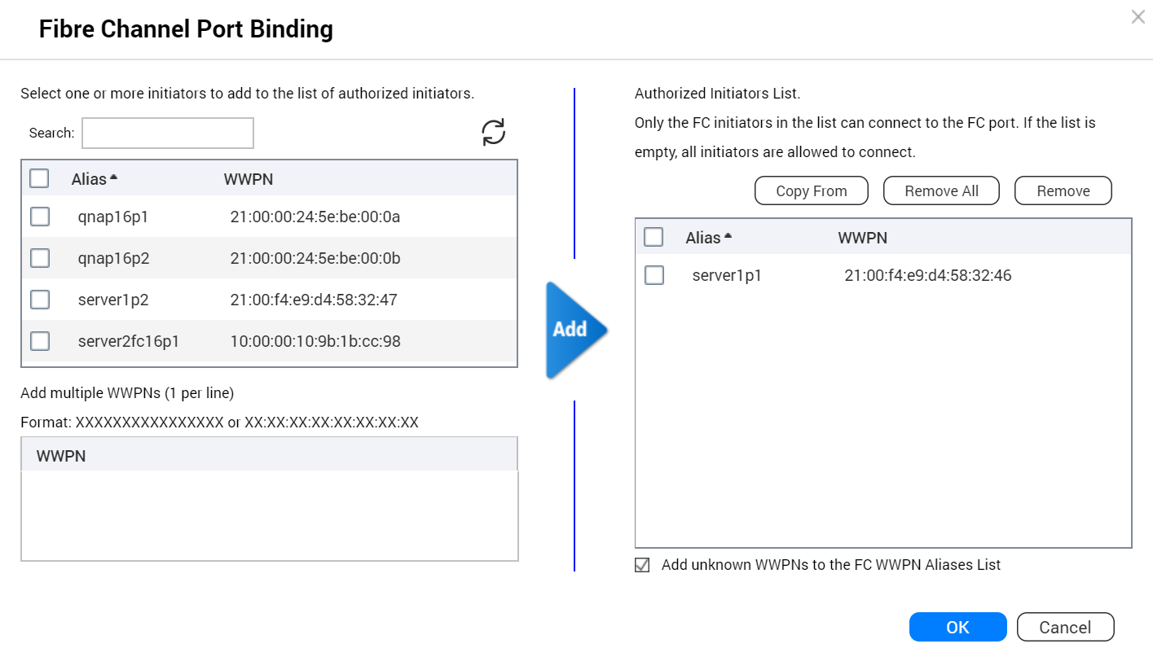
Set FC Port Binding (Binding)
FC Port Binding :
Set which server can bind which ports.

Slide 27
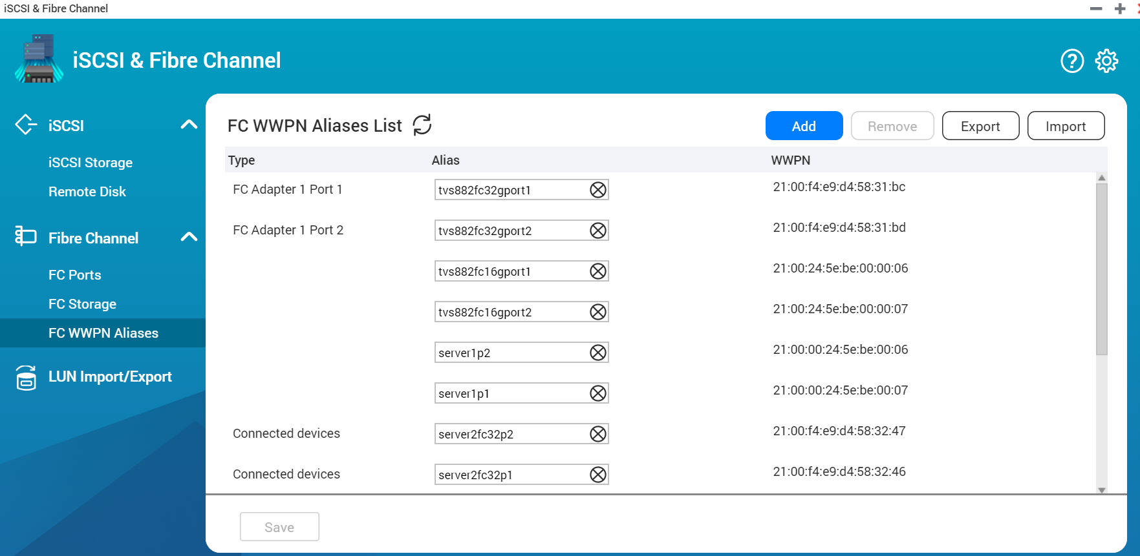
Identify the server and Fibre Channel connections through the alias list
Edit alias :
Specifies a list of WWPN aliases for Fibre Channel. The user can easily identify the server and Fibre Channel ports in the storage area network.

Slide 28



Fibre Channel SAN with snapshot protection and
Qtier, SSD cache function
Data security, Operational efficiency
iSCSI & Fibre Channel management
Simple and fast creation of a Fibre SAN environment
Qtier, SSD cache
Accelerate transmission efficiency
Snapshot
Snapshot Replica
Snapshot Vault

Slide 29

Snapshot and Snapshot Replica
Snapshot Space Management
Snapshot Replica
Local Snapshot
Backup your snapshot to a remote NAS and enjoy a fast restoration experience with remote restore and 10GbE solution
The “Out of volume” snapshot allows a Conservative but Completed snapshot protection
Using QNAP NAS to easily create, manage and restore your file with snapshot

Slide 30
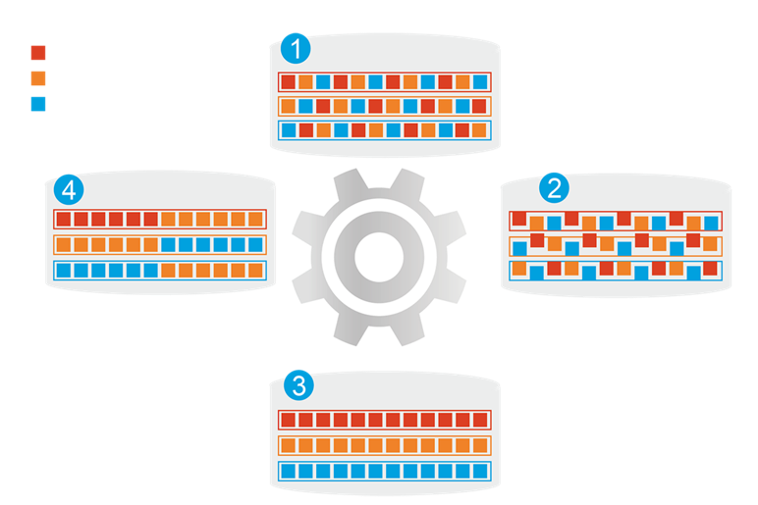
Qtier
1
Before Tiering
Hot data
QNAP allows the combination of SSD and HDD RAID into the same pool and migrate data automatically based on accessing pattern.
Warm data
Cold data
4
Data Access Pattern Changed
2
Start Tiering
Support SATA, SAS, M.2, QM2 and U.2 SSD.
Qtier
Engine
Provide higher capacity as SSD can be used to store data.
3
After Tiering

Slide 31
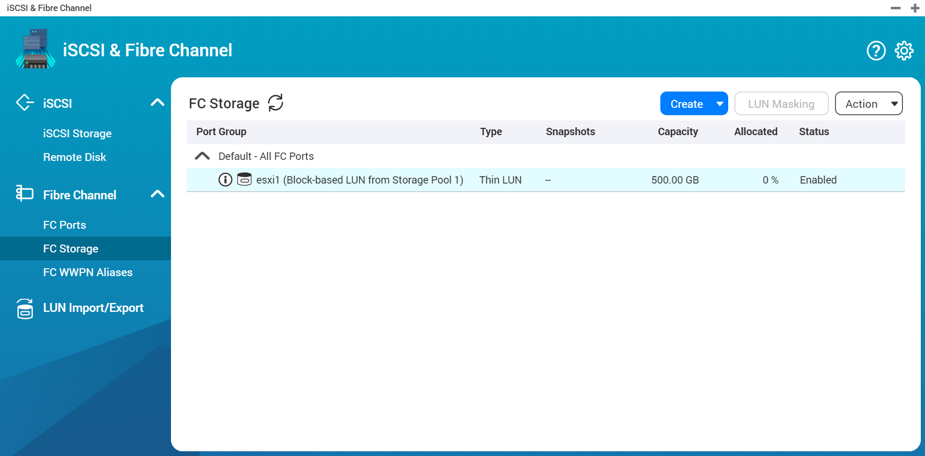
Live Demo

Slide 32
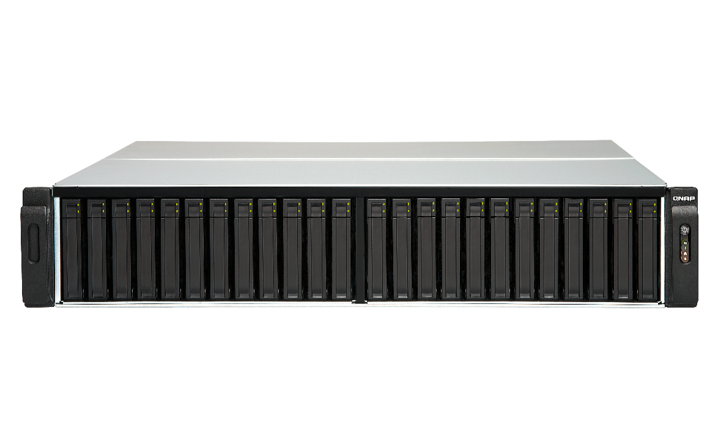
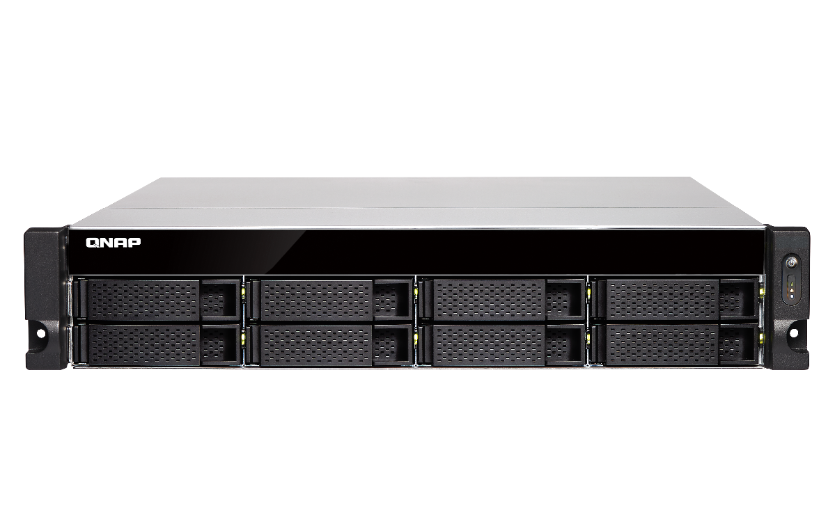
Fibre Channel Supported Rackmount NAS
Intel & AMD NAS support 32Gb/s & 16Gb/s ATTO FC adapters
TES-3085U (QTS), TES-1885U (QTS), TDS-16489U
TS-2483XU, TS-1683XU-RP, TS-1283XU-RP, TS-983XU-RP, TS-983XU, TS-883XU-RP, TS-883XU
TVS-EC2480U/1680U/1580MU/1280U, TS-EC880U
TS-2477XU-RP, TS-1677XU-RP, TS-1277XU-RP, TS-977XU-RP, TS-977XU, TS-877XU-RP, TS-877XU
TVS-2472XU-RP, TVS-1672XU-RP, TVS-1272XU-RP, TVS-972XU-RP, TVS-972XU, TVS-872XU-RP, TVS-872XU

Slide 33
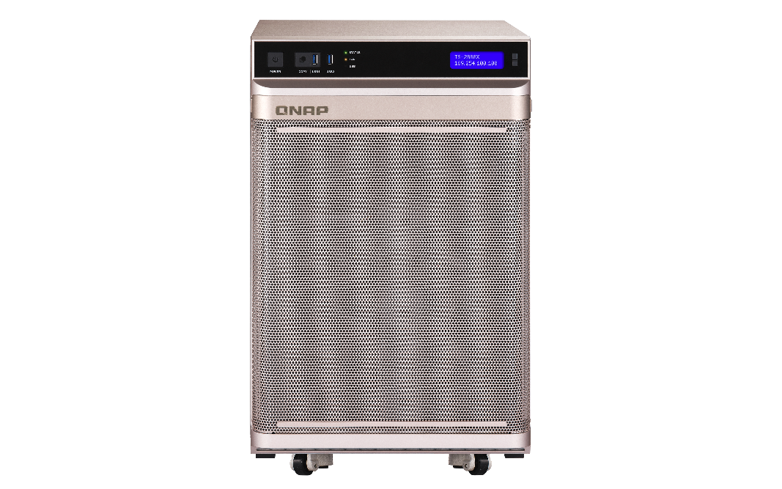
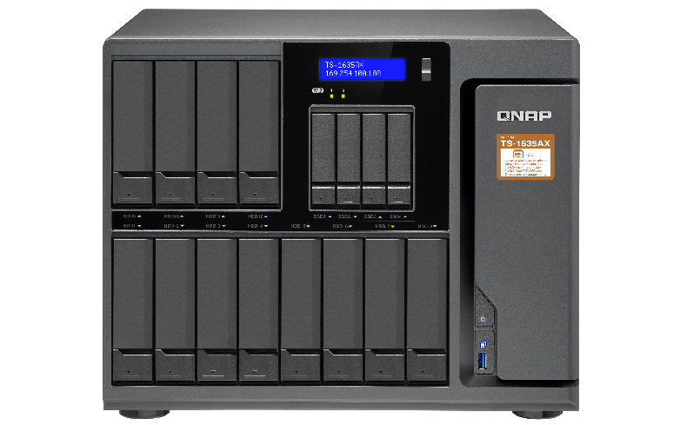
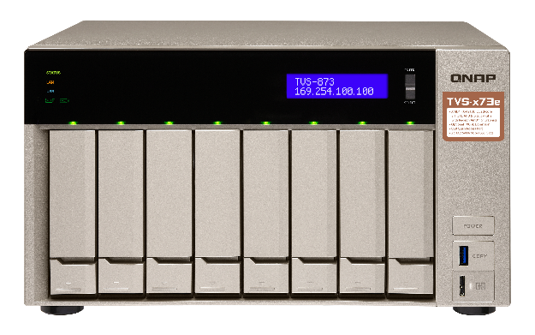
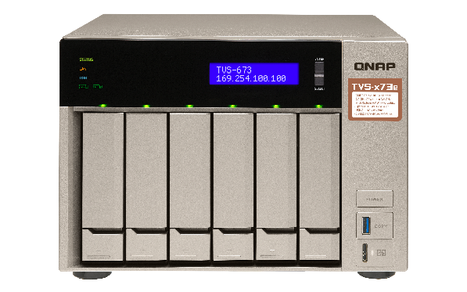
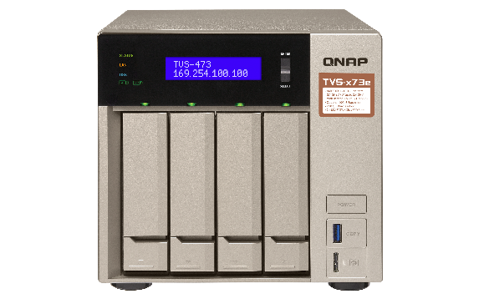
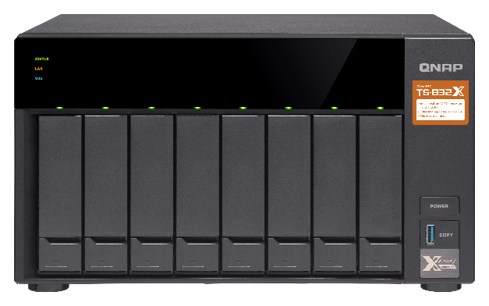
Fibre Channel Supported Desktop NAS
Intel & AMD NAS support 32Gb/s & 16Gb/s ATTO FC adapters
TS-2888X
TS-1685
TVS-1282, TVS-882, TVS-682
TS-1677X, TS-1277, TS-877, TS-677
TVS-872XT, TVS-672XT, TVS-472XT
TVS-863, TVS-663, TVS-463

Slide 34
Suggested models for Fibre Channel
FC 16Gb
TS-1277
FC 32Gb
TS-2483XU
FC 32Gb
TDS-16489U R2
12 bay (8 x 3.5” + 4. 2.5”)
AMD Ryzen 7 8-core 3.0GHz
Max 64GB RAM
24 bay (24 x 3.5”)
Intel® Xeon® E-2136 6-core 3.3 GHz
Max 64GB RAM
16 bay (16 x 3.5”)
Intel® Xeon® E5-2630 v4 10-core 2.2 GHz
Max 256GB RAM

Slide 35




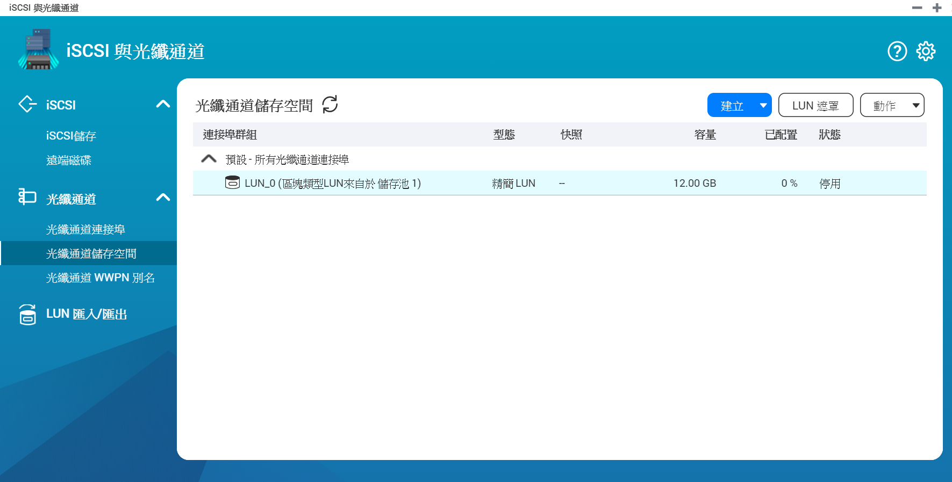
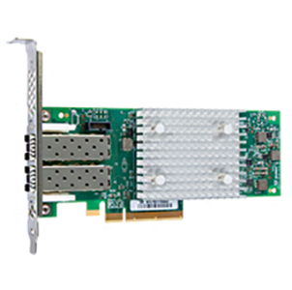
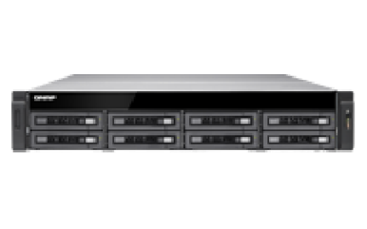
Affordable price
Easy to use
Flexible settings
QNAP NAS
X
ATTO CelerityTM
FC adapters
Fibre Channel
Storage Area Network Solution

Slide 36
Copyright © 2019 QNAP Systems, Inc. All rights reserved. QNAP® and other names of QNAP Products are proprietary marks or registered trademarks of QNAP Systems, Inc. Other products and company names mentioned herein are trademarks of their respective holders.

