Slide 2
What is the user's wish?
Is there any way I can enjoy faster data access?
How to easily expand block-level storage area network (SAN)?
Is there any way to back up data in the SAN and implement copy data management (CDM) application?

Slide 3
QNAP wizard leads you to fulfill three wishes
QNAP NAS high performance storage space
Cross-border support Fibre Channel SAN provides users with a highly reliable, scalable, and affordable storage are network (SAN) solution
QNAP support Marvell QLogic 32Gb/16Gb/8Gb/4Gb FC adapters

Slide 4
Why should companies build Fibre Channel storage area network?
Good connectivity： In a Fibre Channel Storage area Network (SAN) architecture, any server can be directly connected to any storage device, and any storage device can be directly connected to each other.
Good expandability： Enterprises can do extended action without increasing the load on the server and the local area network.
Good data sharing ability： Since the storage device is no longer connected to a specific server, resources can be shared by many servers and the main network performance is not affected when a large number of files are transmitted.

Slide 5
iSCSI vs. Fibre Channel Architecture
Fibre Channel does not need to pass through Ethernet, and the physical layer in the system is less than iSCSI. When expanding the block-level storage network, Fibre Channel can be used to avoid network load.
iSCSI needs to expand the block-level storage network via Ethernet.
Operating System/Application
SCSI Layer
SCSI Layer
FCP
TCP
IP
Ethernet
FC
iSCSI
Fibre Channel

Slide 6
Fibre Channel Reduces CPU Load
Test environment：TS-1283XU-RP
Speed/CPU |  | iSCSI |  | FC
 |  | 25GbEx1 | CPU% | 32G | CPU%
Throughput (MB/s) | SW-1M | 2709 | 56% | 2944 | 39%
 | SR-1M | 2755 | 32% | 2772 | 30%
 | SW-512K | 2707 | 61% | 2951 | 37%
 | SR-512K | 2825 | 43% | 2872 | 35%
IOPS | RW-4K | 154793 | 81% | 155197 | 77%
 | RR-4K | 108263 | 69% | 113162 | 67%
F/W: 4.4.1
CPU: Intel(R) Xeon(R) E-2124 CPU @ 3.30GHz
Tested SSD: Samsung SSD 850 PRO 512GB SATA*12, RAID 0
RAM: 8 GB (4GB x 2)
Block-based LUN; AIO enable
FC 32G: QLogic Fibre Channel Adapter-QLE2742-SR-CK
25GbE: QXG-25G2SF-CX4, MTU 9000
IOmeter Global Configuration: Maximum Disk Size: RAM*4/ Ramp Up Time: 30 seconds Seq / Run Time: 3 Minutes / 2-workers/ 64-outstanding Random / Run Time: 3 Minutes / 4-workers/ 32-outstanding
PC Environment
CPU: Intel(R) Xeon(R) CPU E5-2630 v3 @ 2.40GHz
OS: Windows Server 2016 Database Evaluation.
Version: 10.0.14393 Build 14393
Memory: 128 GB.
FC 32G: QLogic Fibre Channel Adapter-QLE2742-SR-CK
25GbE: QXG-25G2SF-CX4, MTU 9000
Note: This test environment is RAID 0

Slide 7
Fibre Channel performance is good
Speed/CPU |  | FC
 |  | FC32Gx1(PC) | CPU%
Throughput (MB/s) | SW-1M | 3133 | 30%
 | SR-1M | 4797 | 25%
 | SW-512K | 3154 | 29%
 | SR-512K | 2772 | 28%
IOPS | RW-4K | 92632 | 40%
 | RR-4K | 195360 | 36%
Test environment：TS-2483XU-RP
F/W: 4.4.1.0955 build 20190603
CPU: Intel(R) Xeon(R) E-2136 CPU @ 3.30GHz
SSD: Samsung SSD 850 PRO 512GB SATA*24,RAID 5
RAM: 16GB, 8GB*2
Thick volume; Block-based LUN; AIO enable; MPIO
FC32G: QLogic Fibre Channel Adapter
PC Environment
CPU1: Intel(R) Xeon(R) CPU E5-2630 v3 @ 2.40GHz, 2401 Mhz, 8 Core(s), 16 Logical Processor(s)
OS: Windows Server 2016 Datacenter Evaluation Build 14393
Memory: 128 GB.
FC32G: QLogic Fibre Channel Adapter
Note: This test environment is RAID 5
IOmeter Global Configuration: Maximum Disk Size: RAM*4/ Ramp Up Time: 30 seconds Seq / Run Time: 3 Minutes / 2-workers/ 64-outstanding Random / Run Time: 3 Minutes / 4-workers/ 32-outstanding

Slide 8
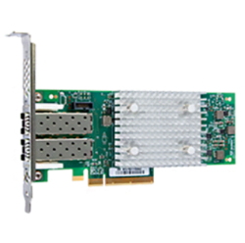
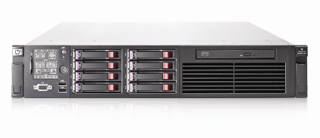
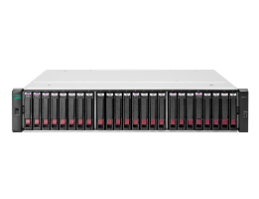
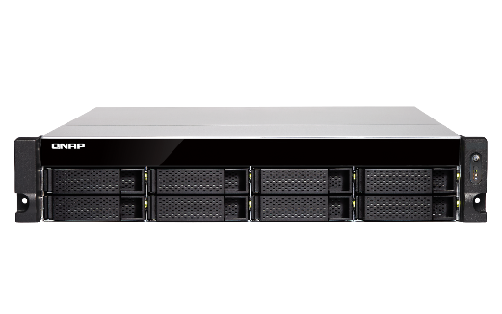
QNAP Fibre Channel Storage Area Network (SAN) Solution
Windows / Linux / VMware Server (Initiator node) + NAS(Target mode):
Marvell® QLogic® 2670
(16Gb) Fibre Channel adapter
Windows / Linux / VMware Server
HP DL360 G7 server
Storage Area Network (SAN)
Fibre Channel Switch
Fibre Channel
Other Fibre SAN Storage
Marvell® QLogic® 2670
(16Gb) Fibre Channel adapter
TVS-872XU
TVS-872XU
Marvell® QLogic® 2670 (16Gb) Fibre Channel adapter

Slide 9
Enterprise Fibre Channel Storage Area Network and CDM Application with QNAP NAS
Server
Server can access it via iSCSI
FC
Production
Server(s)
Backup Server
LAN
QNAP NAS
QNAP NAS
SAN Fabric
LUN
LUN
Snapshot Replica for offsite backup
Scheduled Snapshot for local protection (either LUN is access via iSCSI or FC)
Qtier
SSD Cache
SAN Storage
LUN
LUN
LUN

Slide 10
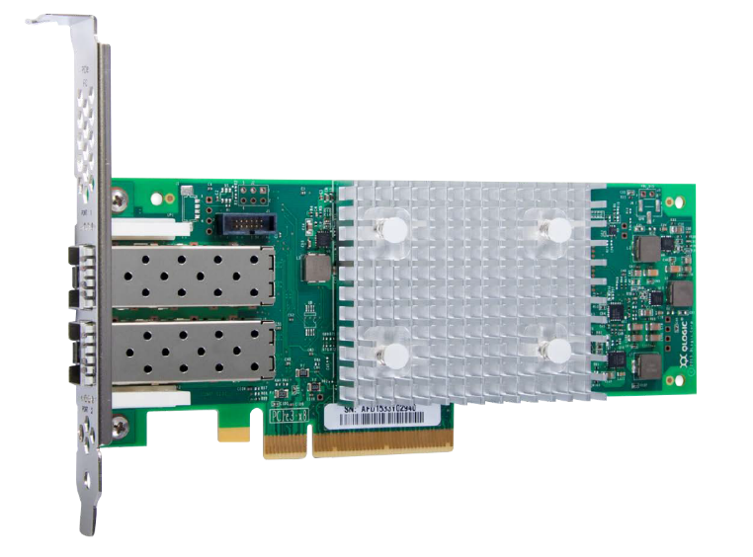
Support Marvell QLogic Fibre Channel Adapters
Partner with industry-leading FC adapters vendors to provide the most economical FC SAN storage solution.
Support Marvell QLogic
32Gb/16Gb/8Gb/4Gb FC Adapters
Compatibility list: qnap.com/compatibility/

Slide 11
Compatible with a variety of FC Adapters Support 4G/8G/16G/32G
Marvell FC model | Interface | Support Speed | Technology generation | PCIe | Spec
QLE2742-SR-CK | 2 X 32GFC | 32G/16G/8G | Gen 6 | 3.0 x8 | Low profile
QLE2740-SR-CK | 1 X 32GFC | 32G/16G/8G | Gen 6 | 3.0 x8 | Low profile
QLE2692-SR-CK | 2 X 16GFC | 16G/8G/4G | Enhanced Gen 5 | 3.0 x8 | Low profile
QLE2690-SR-CK | 1 X 16GFC | 16G/8G/4G | Enhanced Gen 5 | 3.0 x8 | Low profile
QLE2672-CK | 2 X 16GFC | 16G/8G/4G | Gen 5 | 3.0 x8 | Low profile
QLE2670-CK | 1 X 16GFC | 16G/8G/4G | Gen 5 | 3.0 x8 | Low profile
QLE2562-CK | 2 X 8GFC | 8G/4G/2G | N/A | 2.0 x8 | Low profile
QLE2560-CK | 1 X 8GFC | 8G/4G/2G | N/A | 2.0 x8 | Low profile
Compatibility list: qnap.com/compatibility/

Slide 12
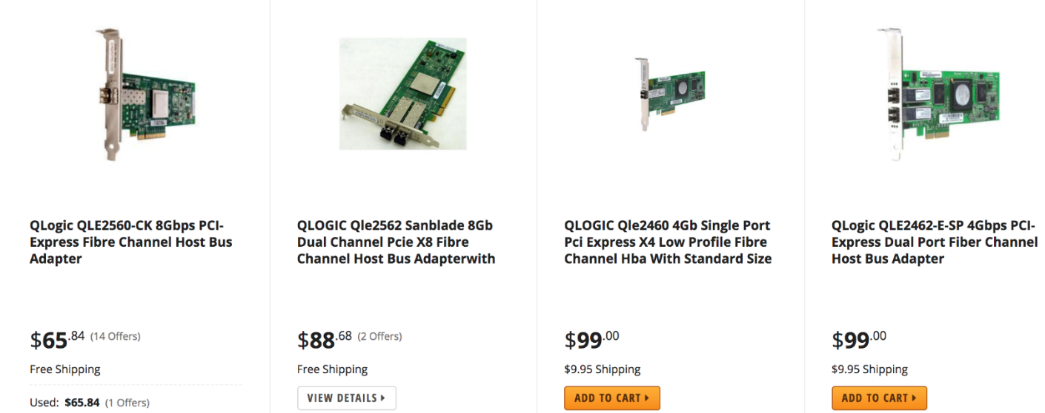
4Gb & 8Gb FC Adapters market price
Build the most economical FC storage solution with QNAP NAS and 4Gb / 8Gb FC Adapters
Compatibility list: qnap.com/compatibility/
Source: 2019 May 21 https://www.newegg.com/p/pl?Submit=ENE&N=100158104%2050013335%20600013863%20600013869&IsNodeId=1&Manufactory=13335&bop=And&Order=PRICE&PageSize=36

Slide 13
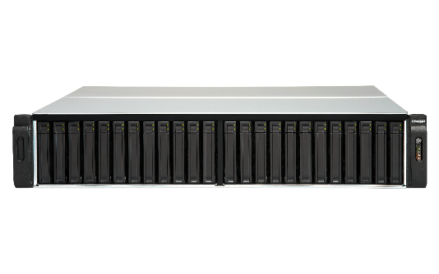
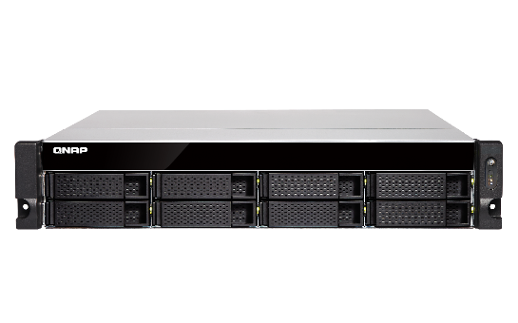
Fibre Channel Support Rackmount NAS Models
Intel & AMD NAS support 32Gb/s FC Adapters
TES-3085U (QTS), TES-1885U (QTS), TDS-16489U
TS-2483XU, TS-1683XU-RP, TS-1283XU-RP, TS-983XU-RP, TS-983XU, TS-883XU-RP, TS-883XU
TVS-EC2480U/1680U/1580MU/1280U, TS-EC880U
TS-2477XU-RP, TS-1677XU-RP, TS-1277XU-RP, TS-977XU-RP, TS-977XU, TS-877XU-RP, TS-877XU
TVS-2472XU-RP, TVS-1672XU-RP, TVS-1272XU-RP, TVS-972XU-RP, TVS-972XU, TVS-872XU-RP, TVS-872XU
ARM-NAS support 8Gb/s FC Adapters
TS-1232XU, TS-1232XU-RP, TS-832XU, TS-832XU-RP, TS-432XU, TS-432XU-RP

Slide 14
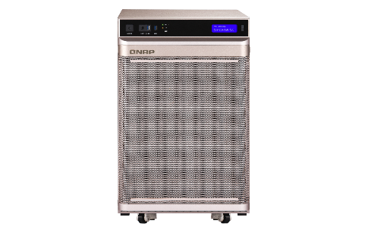
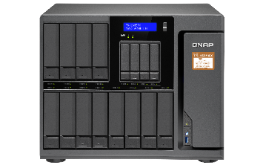
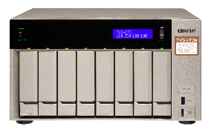
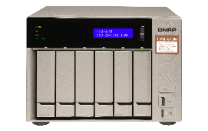
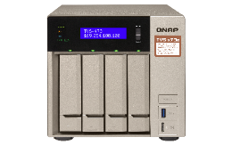
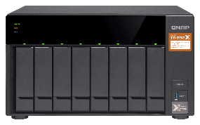
Fibre Channel Support desktop NAS models
Intel & AMD NAS support 32Gb/s FC Adapters
TS-2888X
TS-1685
TVS-1282, TVS-882, TVS-682
TS-1677X, TS-1277, TS-877, TS-677
TVS-872XT, TVS-672XT, TVS-472XT
TVS-863, TVS-663, TVS-463
ARM NAS support 8Gb/s FC Adapters
TS-1635AX
TS-832X

Slide 15
Fibre Channel Suggested model
Entry-level SMB
TS-1635AX
SMB
TS-2483XU
Enterprise
TDS-16489U R2
16 bay (12 x 3.5” + 4. 2.5”)
Marvell Armada 8040 4-core 1.6 GHz
Max 16GB RAM
24 bay (24 x 3.5”)
Intel® Xeon® E-2136 6-core 3.3 GHz
Max 64GB RAM
16 bay (16 x 3.5”)
Intel® Xeon® E5-2630 v4 10-core 2.2 GHz
Max 256GB RAM

Slide 16
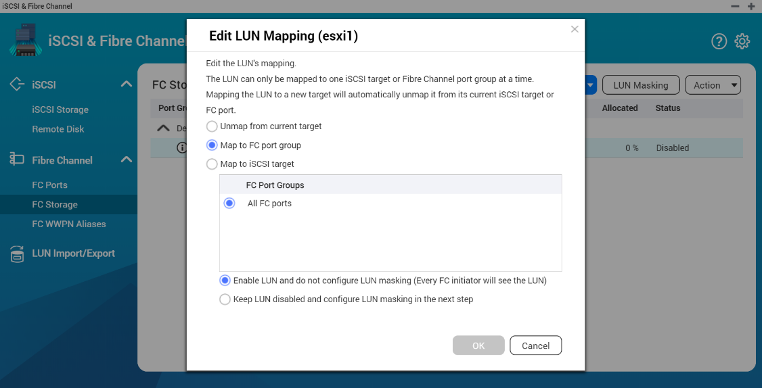
iSCSI and Fibre Channel manager
Features
Setting flexibility
1. LUN Mapping : LUN can be mapped to iSCSI or FC.
2. LUN Masking: Set which server access LUN.
3. FC Port Binding: which server can access which ports.
Easy to identify
Fibre Channel's WWPN can edit aliases.

Slide 17
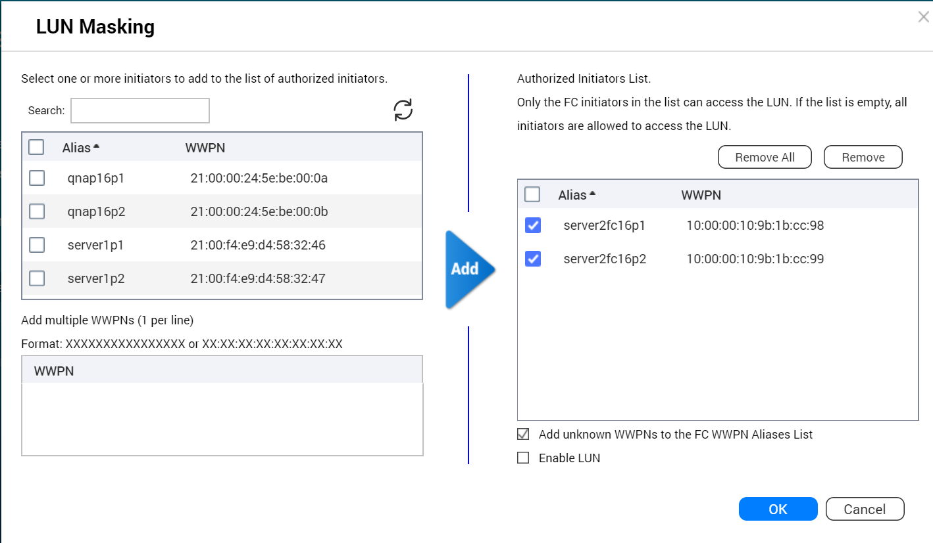
Set LUN Masking
LUN Masking:
Specify which server can access which LUN.

Slide 18
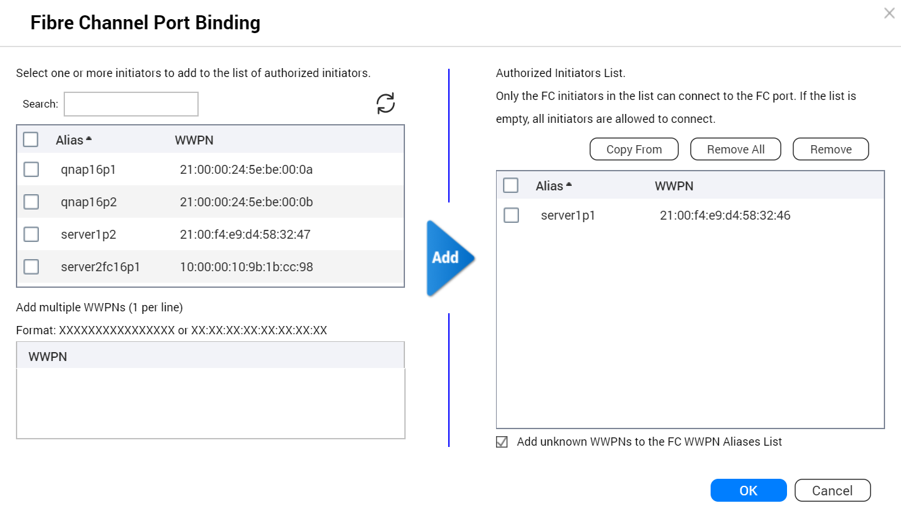
Set FC Port Binding (Binding)
FC Port Binding :
Set which server can bind which ports.

Slide 19
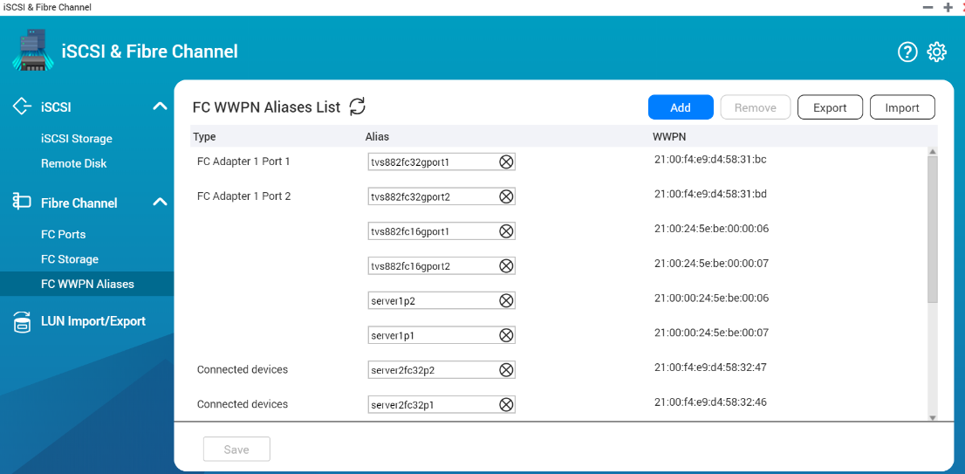
Identify the server and Fibre Channel connections through the alias list
Edit alias :
Specifies a list of WWPN aliases for Fibre Channel. The user can easily identify the server and Fibre Channel ports in the storage area network.

Slide 20
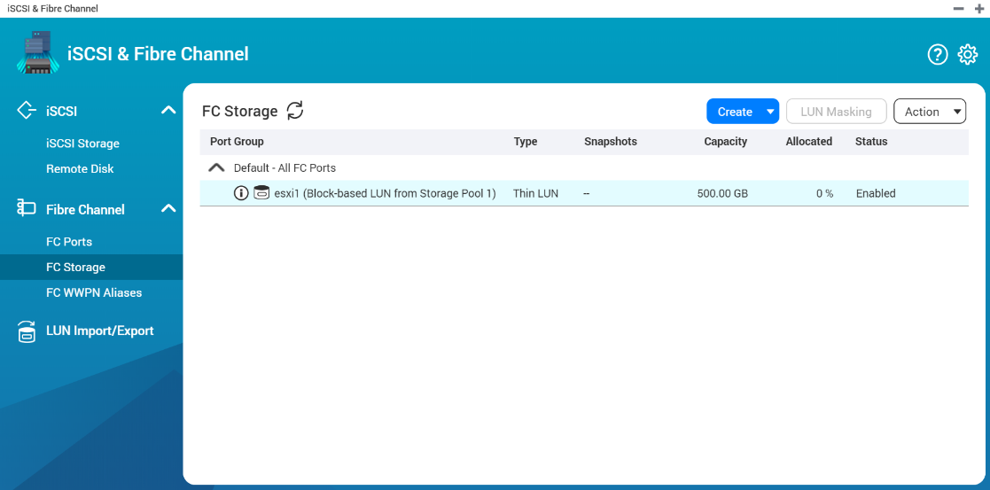
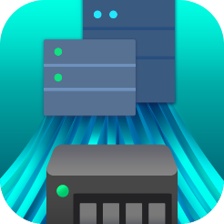
Live Demo

Slide 21
Fibre Channel SAN with snapshot protection and
Qtier, SSD cache function Data security, Operational efficiency
iSCSI & Fibre Channel management
Simple and fast creation of a Fibre SAN environment
Qtier, SSD cache
Accelerate transmission efficiency
Snapshot
Snapshot Replica
Snapshot Vault

Slide 22
Snapshot and Snapshot Replica
Snapshot Space Management
Snapshot Replica
Local Snapshot
Backup your snapshot to a remote NAS and enjoy a fast restoration experience with remote restore and 10GbE solution
The “Out of volume” snapshot allows a Conservative but Completed snapshot protection
Using QNAP NAS to easily create, manage and restore your file with snapshot

Slide 23
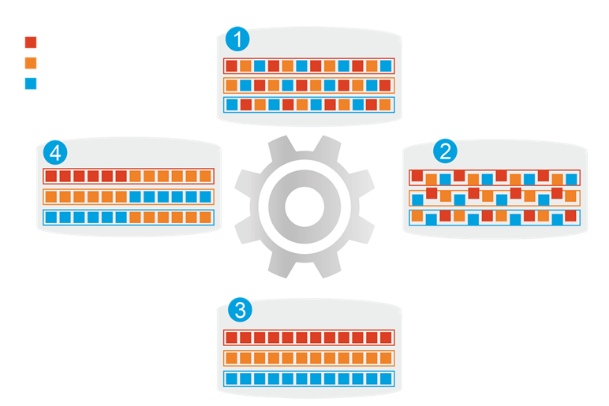
Qtier
1
Before Tiering
QNAP allows the combination of SSD and HDD RAID into the same pool and migrate data automatically based on accessing pattern.
Hot data
Warm data
Cold data
4
Data Access Pattern Changed
2
Start Tiering
Support SATA, SAS, M.2, QM2 and U.2 SSD.
Qtier
Engine
Provide higher capacity as SSD can be used to store data.
3
After Tiering

Slide 24
QNAP Suggested model
Entry-level SMB
TS-1635AX
SMB
TS-2483XU
Enterprise
TDS-16489U R2
16 bay (12 x 3.5” + 4. 2.5”)
Marvell Armada 8040 4-core 1.6 GHz
Max 16GB RAM
24 bay (24 x 3.5”)
Intel® Xeon® E-2136 6-core 3.3 GHz
Max 64GB RAM
16 bay (16 x 3.5”)
Intel® Xeon® E5-2630 v4 10-core 2.2 GHz
Max 256GB RAM

Slide 25
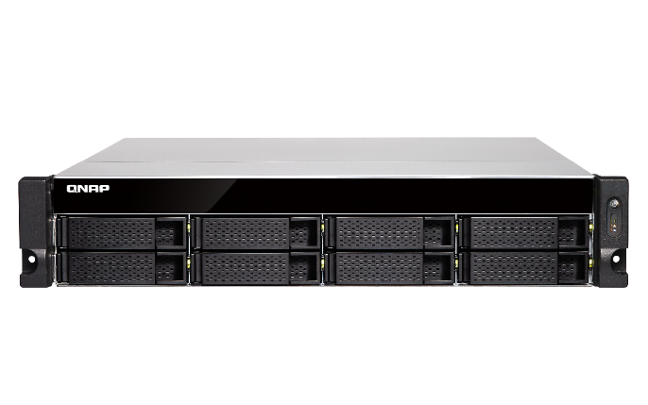
Affordable price Easy to use Setting flexibility
QNAP NAS
X
Marvell QLogic
FC adapters
Fibre Channel Storage Area Network
Best solution

Slide 26
Copyright © 2019 QNAP Systems, Inc. All rights reserved. QNAP® and other names of QNAP Products are proprietary marks or registered trademarks of QNAP Systems, Inc. Other products and company names mentioned herein are trademarks of their respective holders.

