Slide 2
QNAP x CAYIN Create Smart Signage Solutions for Your Creative Ideas
Signage expert – CAYIN Technology
Digital signage create new information x interaction
Live demo for QNAP x CAYIN solution

Slide 3
QNAP x CAYIN Create Smart Signage Solution for Your Creative Ideas
Signage expert – CAYIN Technology
Digital signage create new information x interaction
Live demo for QNAP x CAYIN solution

Slide 4
Who is CAYIN

Slide 5
Who is CAYIN?
15
+
1,000
+
90
+
years
brands
countries
15 years of experience in developing
digital signage solutions
Have connected more than 1,000 brands and institutions with digital signage
Support clients in more than 90 countries

Slide 6
Who is CAYIN?
Expert of digital signage solutions
Own branded developer and manufacturer
Self-owned software and system teams
Supplier of B2B products specialized in SI channels

Slide 7
QNAP x CAYIN Create Smart Signage Solutions for Your Creative Ideas
Signage expert – CAYIN Technology
Digital signage create new information x interaction
Live demo for QNAP x CAYIN solution

Slide 8
What
is Digital Signage

Slide 9
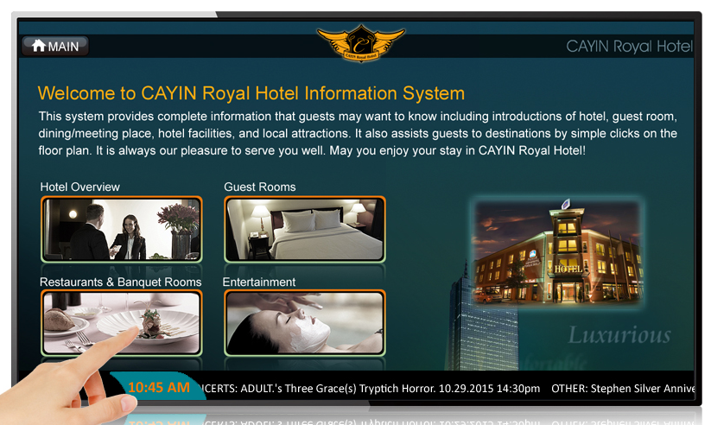
What is Digital Signage?
Public displays and today’s sign boards,
but dynamic, digital, and networkable.

Slide 10
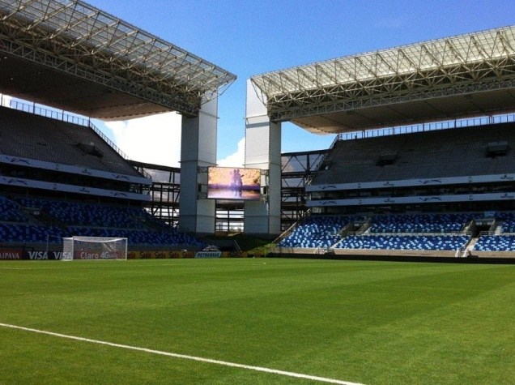
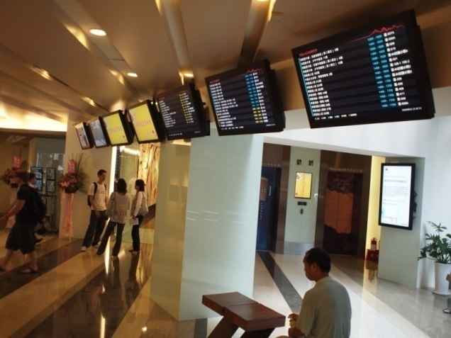
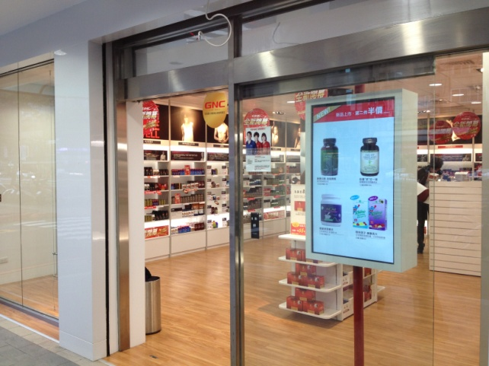
What is Digital Signage?
To inform, advertise, educate, and entertain.
FIFA, Brazil
PCCU, Taiwan
GNC, Taiwan

Slide 11
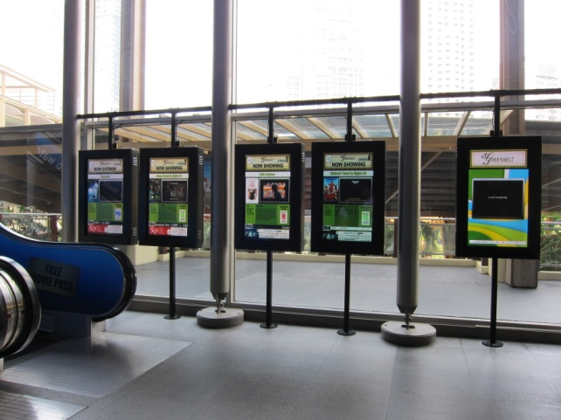
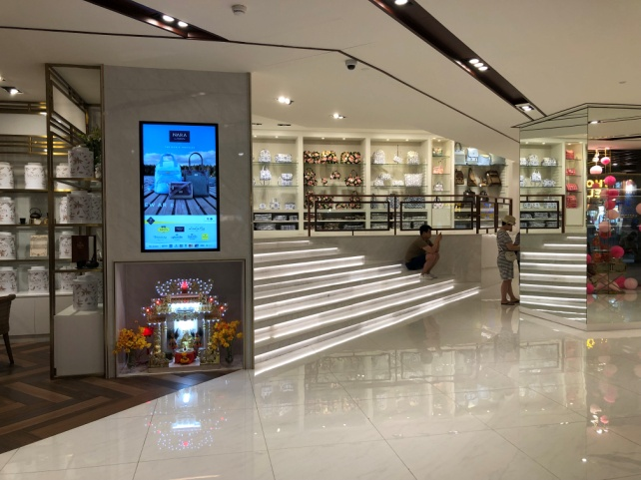
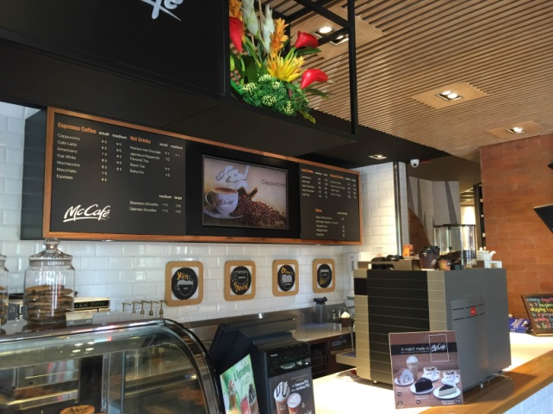
What is Digital Signage?
Applications everywhere: retails, restaurants, banks,
schools, offices, transportation hubs, cinemas, etc.
Ayala Cinema, Philippines
NaRaYa, Thailand
McDonald's, Philippines

Slide 12
QNAP x CAYIN Create Smart Signage Solutions for Your Creative Ideas
Signage expert – CAYIN Technology
Digital signage create new information x interaction
Live demo for QNAP x CAYIN solution

Slide 13
Introduction of CAYIN Digital Signage Solutions

Slide 14
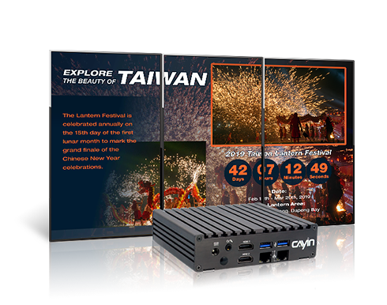
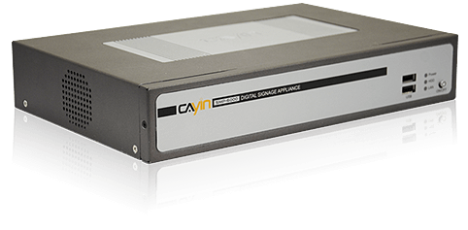
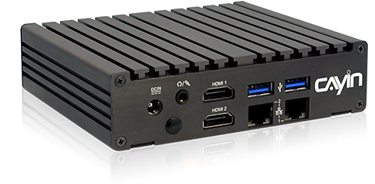
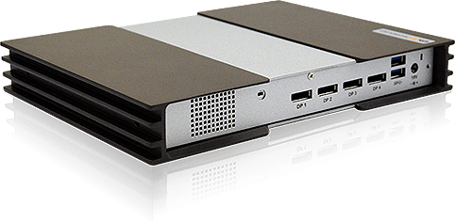
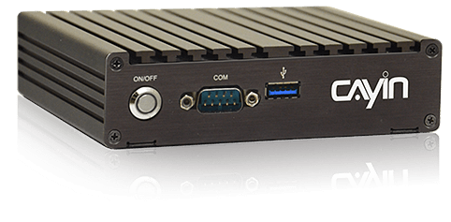
Introduction of CAYIN Digital Signage Solutions
SMP Players
The core of the content display

Slide 15
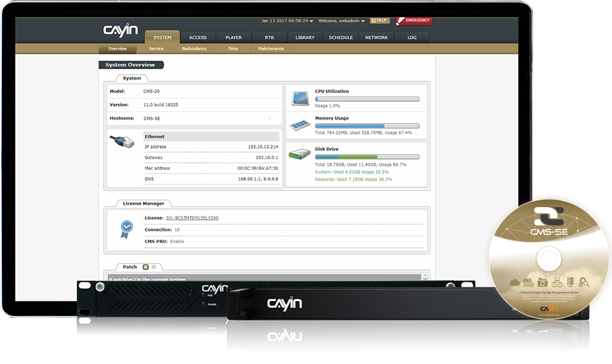
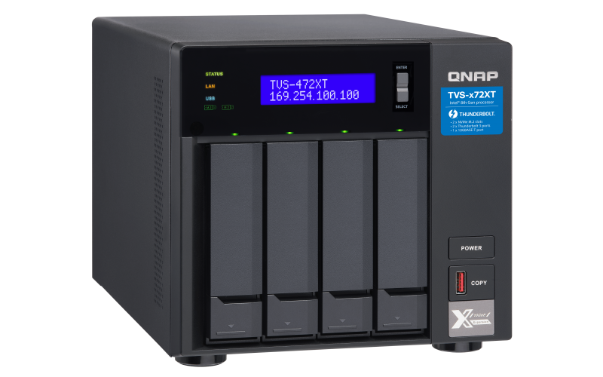
Introduction of CAYIN Digital Signage Solutions
CMS Servers
The soul of content management and distribution
QNAP NAS TVS-472XT

Slide 16
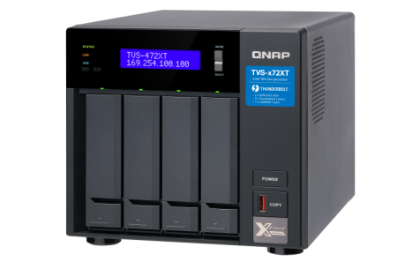
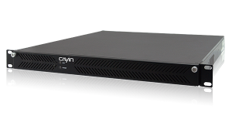
CAYIN Digital Signage Solutions
3 levels of digital signage deployments:
Small-scale
projects
Medium-scale
projects
Large-scale
projects
SMP players only
SMP players + CMS main server
SMP players + CMS main server + CMS site server + CMS backup server
SMP-2200
CMS-60
TVS-472XT

Slide 17
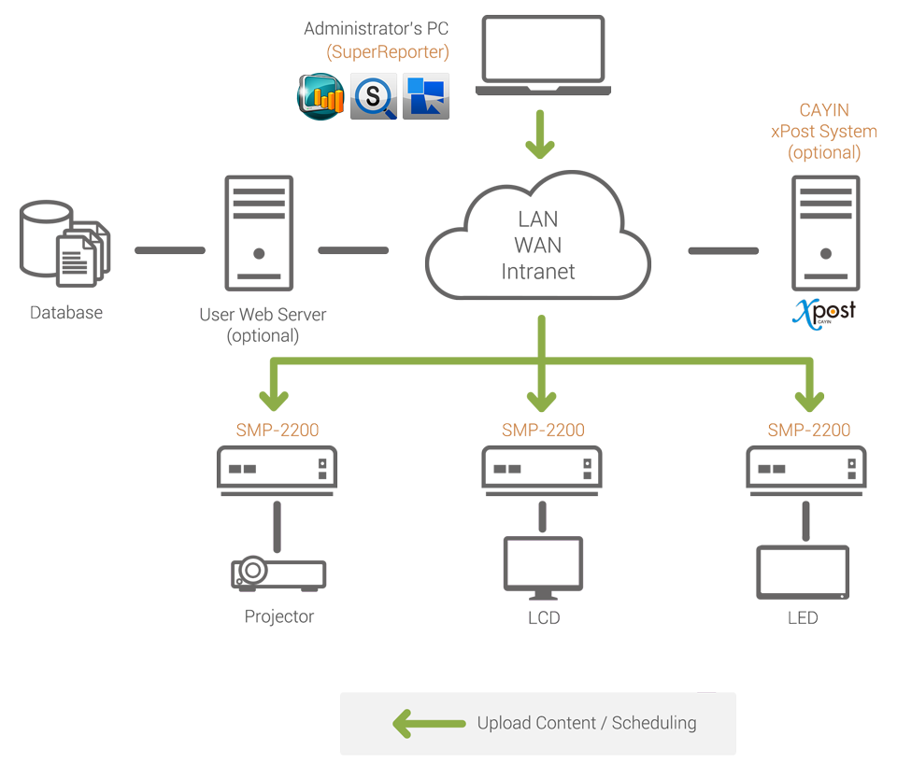
3 levels of digital signage deployments:
CAYIN Digital Signage Solutions
Small-scale
projects
SMP players only
SMP-2200

Slide 18
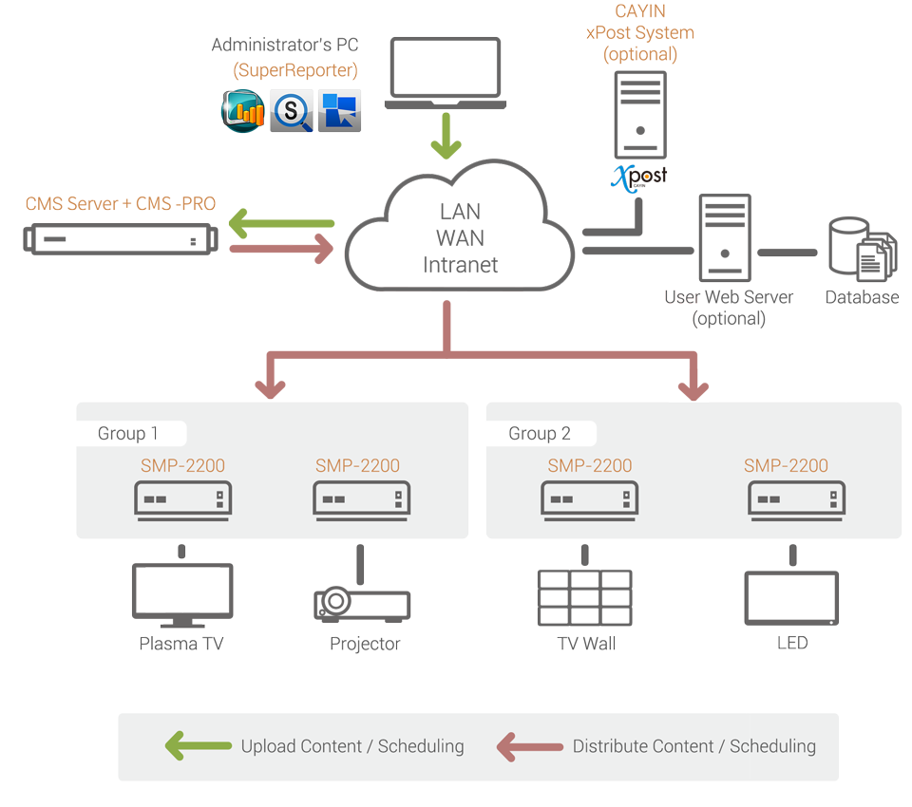
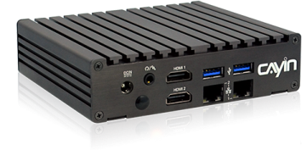
3 levels of digital signage deployments:
CAYIN Digital Signage Solutions
Medium-scale
projects
SMP players + CMS main server

Slide 19
3 levels of digital signage deployments:
CAYIN Digital Signage Solutions
SMP players + CMS main server + CMS site server + CMS backup server
Large-scale
projects
High Reliability & Scalability
Manage up to 4,000 players per server
& an unlimited number of players in the whole network!

Slide 20
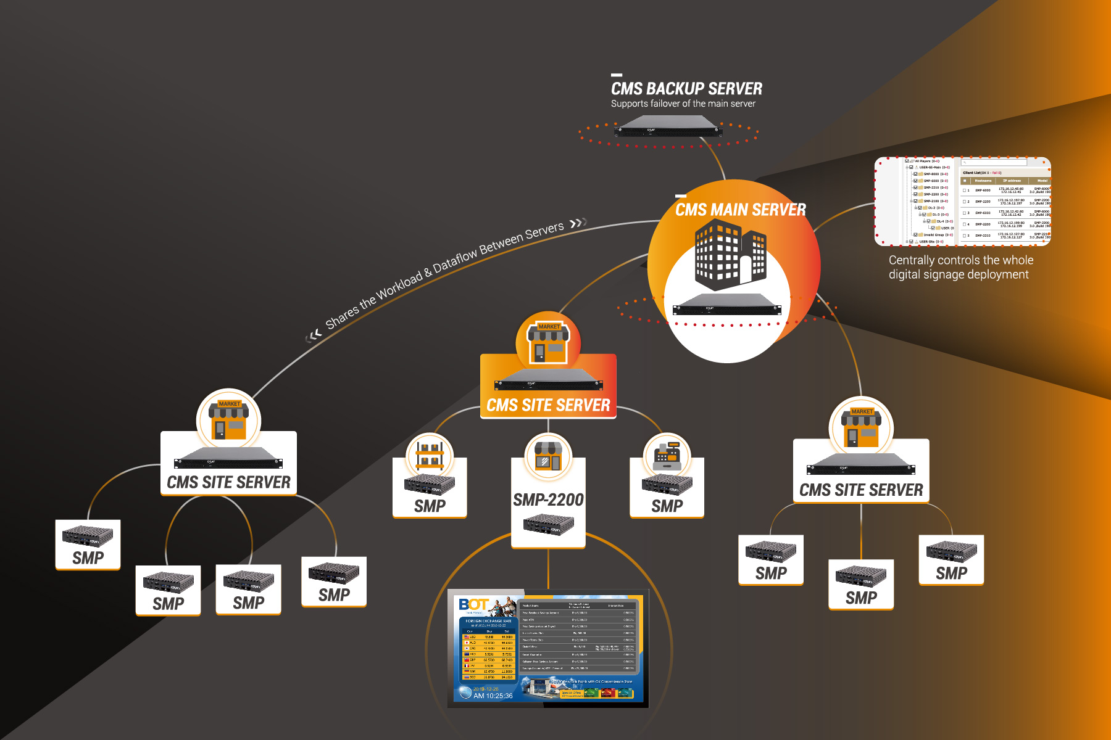
Large-scale projects
Manage up to 4,000 players per server &
unlimited number of players in the whole network!

Slide 21
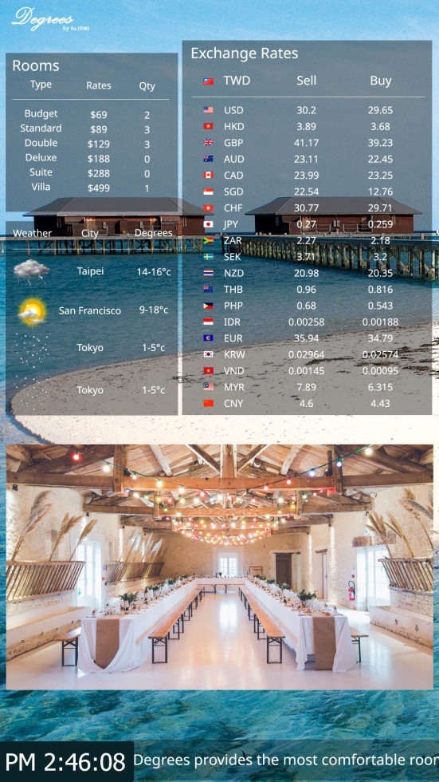
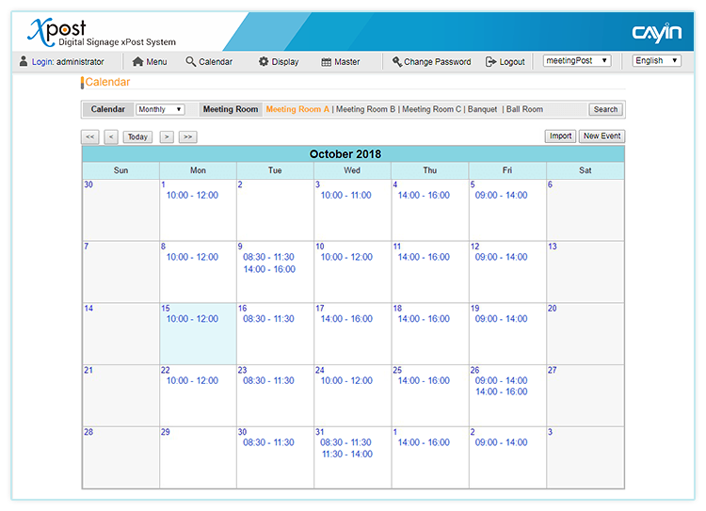
CAYIN Digital Signage Solutions
Optional Software
Xpost: lobbyPost, meetingPost, wayfindingPost
The web-based package software can show weather, exchange rates and event information for lobbies, meeting room, and wayfinding display.

Slide 22
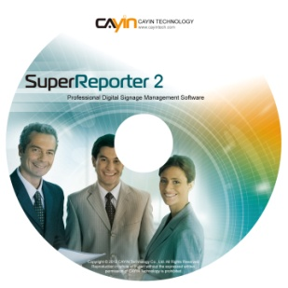
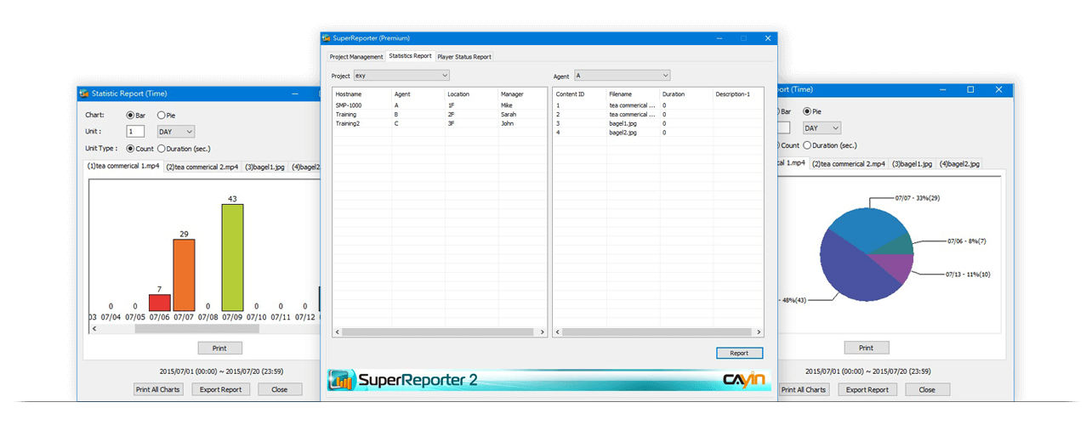
CAYIN Digital Signage Solutions
Optional Software
SuperReporter
The Windows®-based package software can generate reports and diagrams for billing and performance analysis.

Slide 23
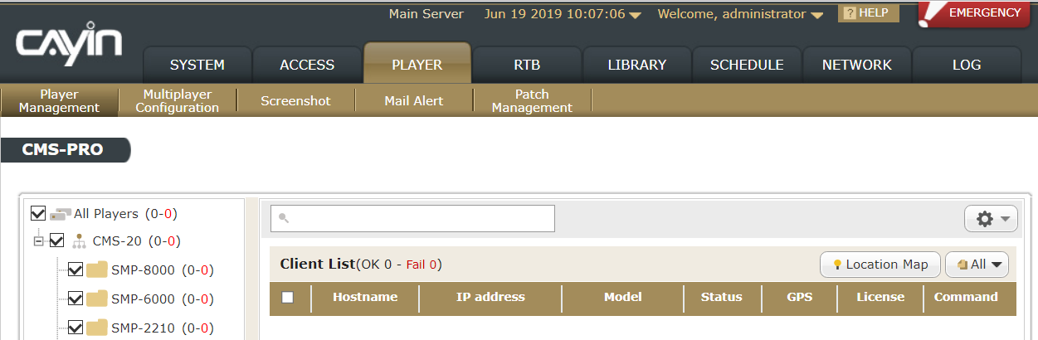
CAYIN Digital Signage Solutions
Optional Software
An Add-On Module For Advanced Management
CMS-PRO provides administrators with more efficient and advanced central management, especially when it comes to implementing digital signage projects of different scales.

Slide 24
CAYIN Hardware & Software UI & Live Demo

Slide 25
CAYIN Digital Signage Player Hardware & Software
SMP-2210: Compact 4K Digital Signage Player

Slide 26
CAYIN Digital Signage Player Hardware & Software
SMP-NEO2: Sophisticated Embedded Software for SMP Digital Signage Player
5 Main Features
Intuitive UI Design
Intuitive Multi-Touch Gestures
Artificial Intelligence Detection
Rich Library & Cloud Resources
Flexible Task Scheduling

Slide 27
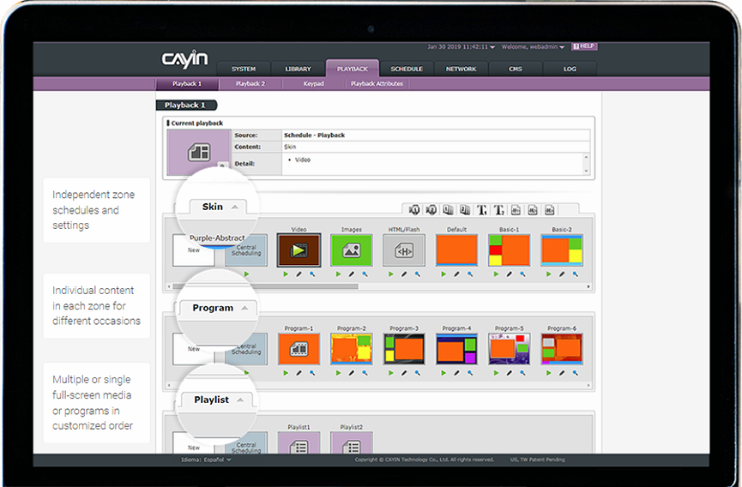
CAYIN Digital Signage Player Software UI
SMP-NEO2
Intuitive UI Design

Slide 28
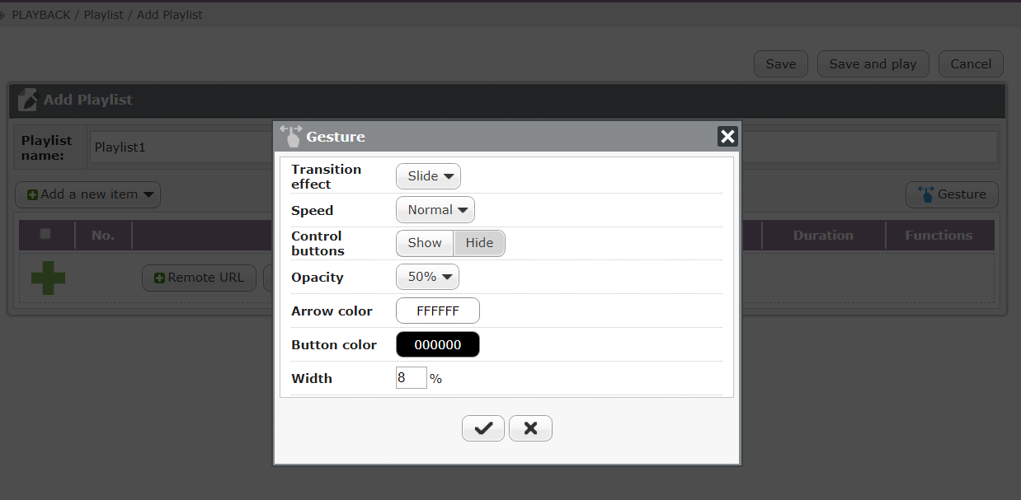
CAYIN Digital Signage Player Software UI
SMP-NEO2
Support Intuitive Multi-Touch Gestures

Slide 29
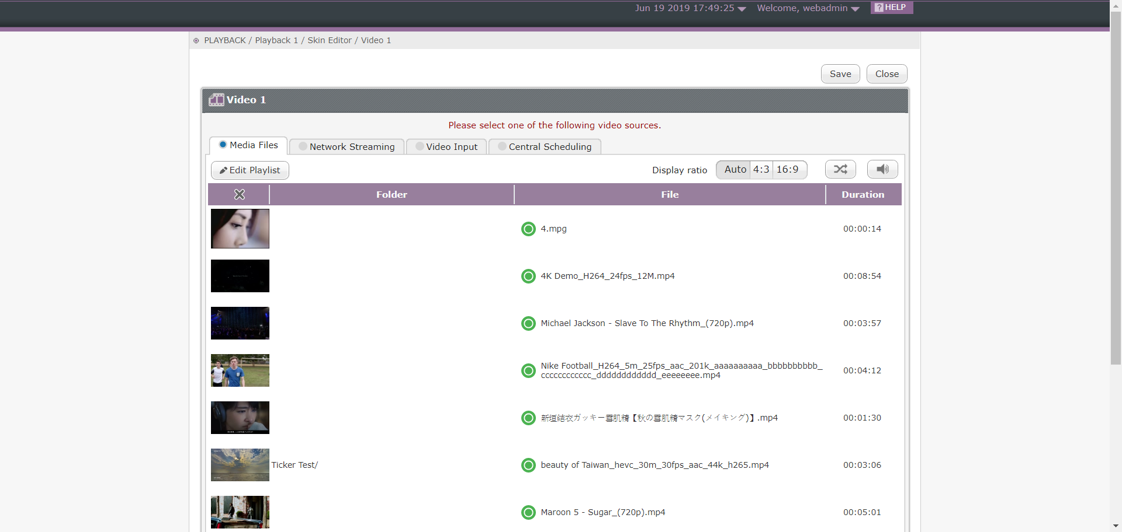
CAYIN Digital Signage Player Software UI
SMP-NEO2
Artificial Intelligence Detection

Slide 30
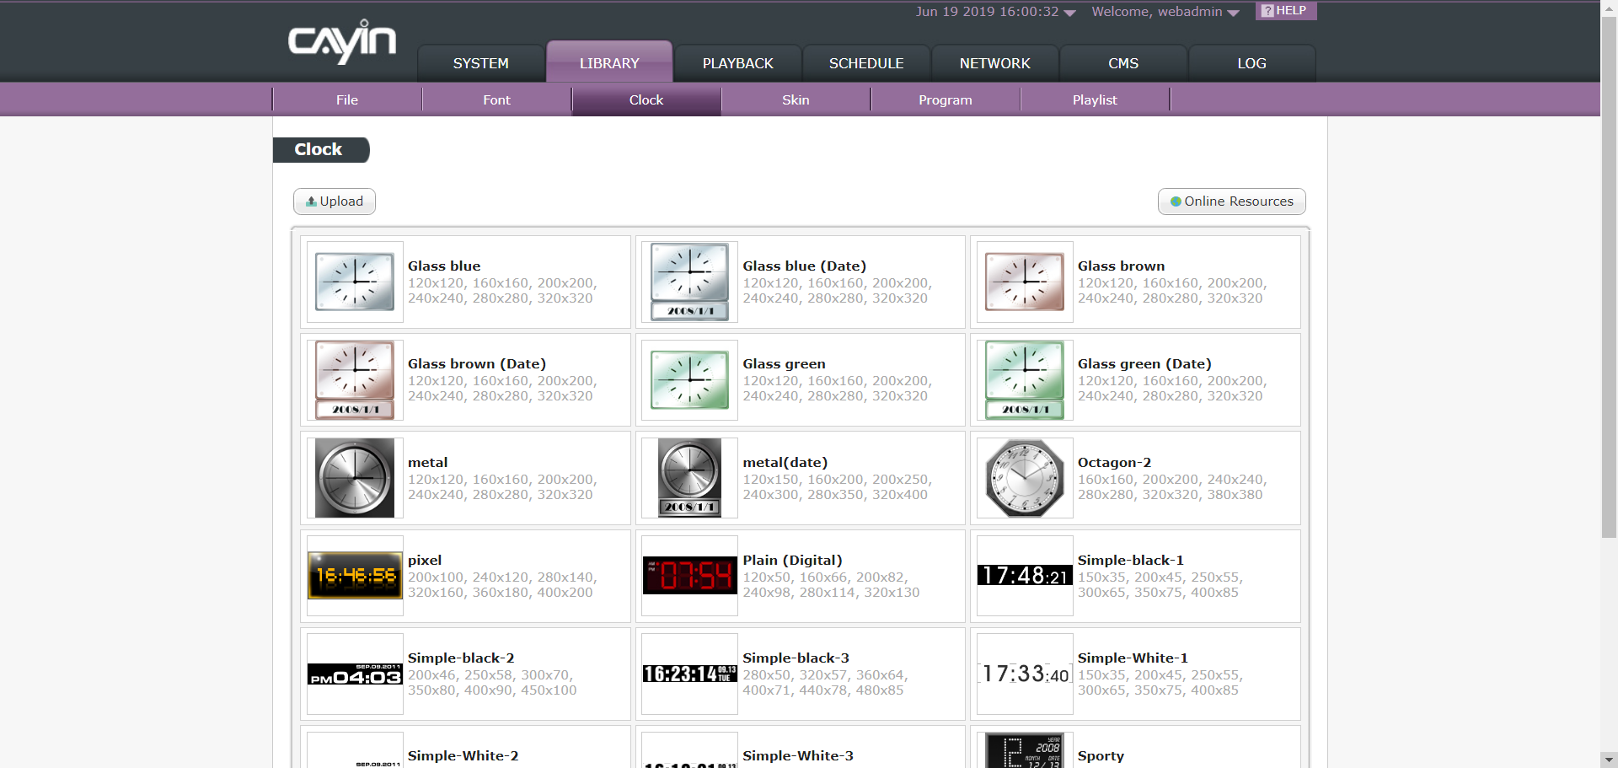
CAYIN Digital Signage Player Software UI
SMP-NEO2
Rich Library & Cloud Resources

Slide 31
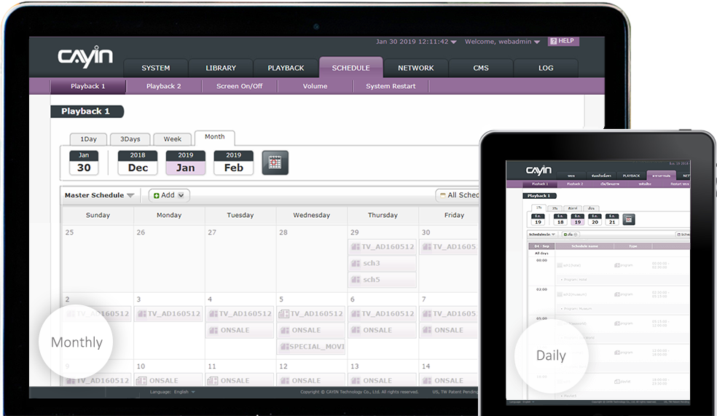
CAYIN Digital Signage Player Software UI
SMP-NEO2
Flexible Task Scheduling

Slide 32
Live Demo of CAYIN Digital Signage Player UI
SMP Player Web UI Demonstration

Slide 33
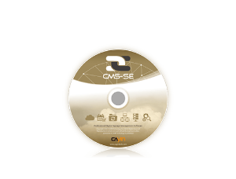
CAYIN Digital Signage Server Software
CMS-SE: Digital Signage Content Management Server Software
5 Main Features
Multi-server Architecture
Five-layer Group Management
Allocate Account Access
Broadcast Emergency Messages with Just 2 Clicks
Supported in Virtual Machines (PC) & Cloud-based VMs (QNAP NAS)

Slide 34
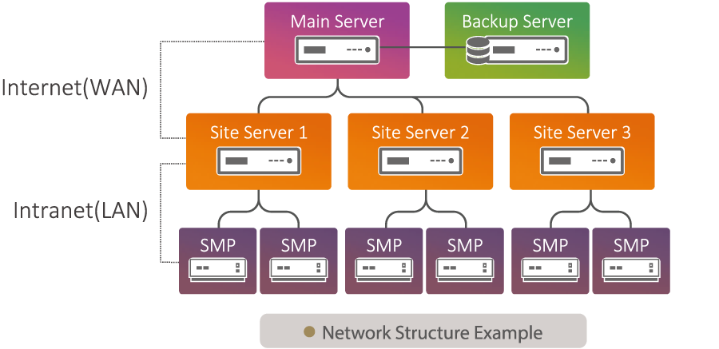
CAYIN Digital Signage Server Software
CMS Server
Designing a Multi-server Environment

Slide 35
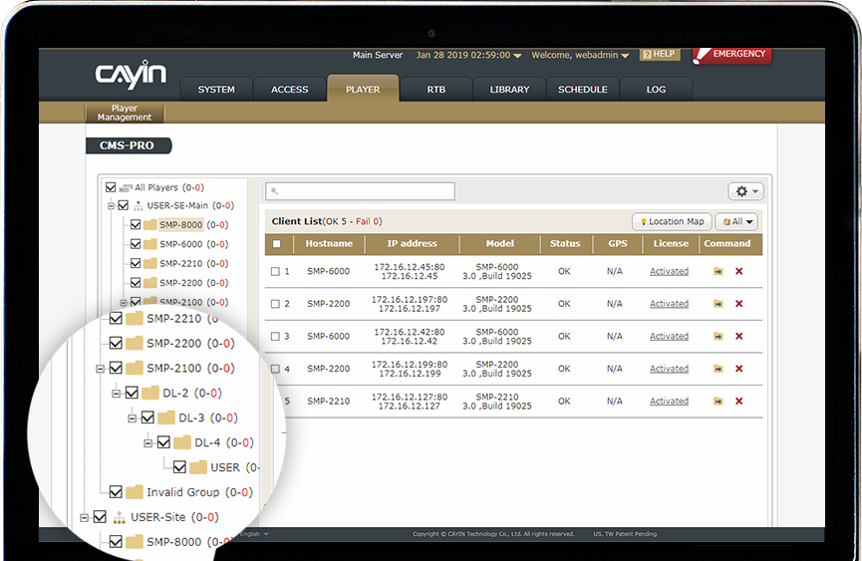
CAYIN Digital Signage Server Software UI
CMS Server
Five-layer Group Management

Slide 36
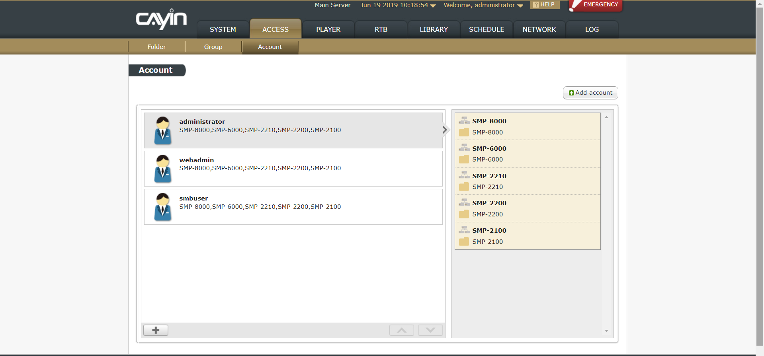
CAYIN Digital Signage Server Software UI
CMS Server
Allocate Account Access

Slide 37
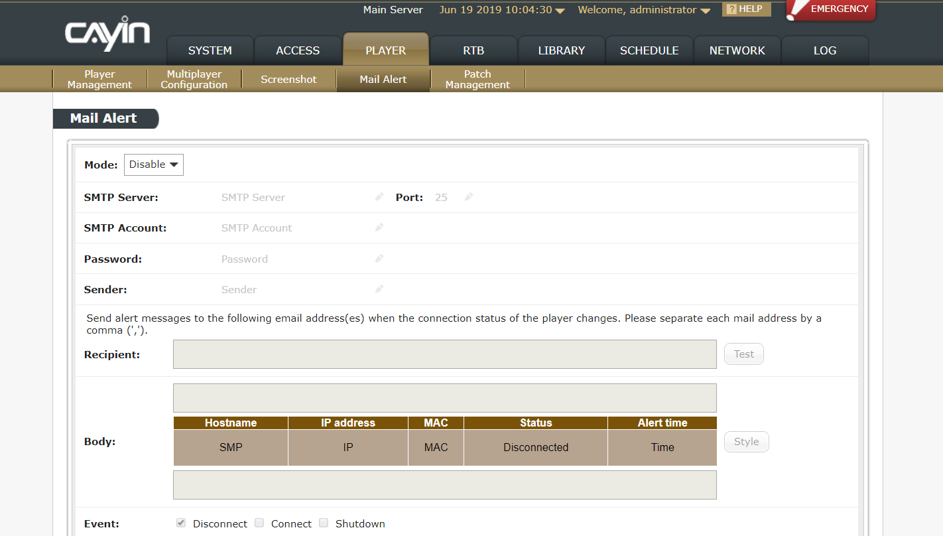
CAYIN Digital Signage Server Software UI
CMS Server
Broadcast emergency messages with just two clicks

Slide 38
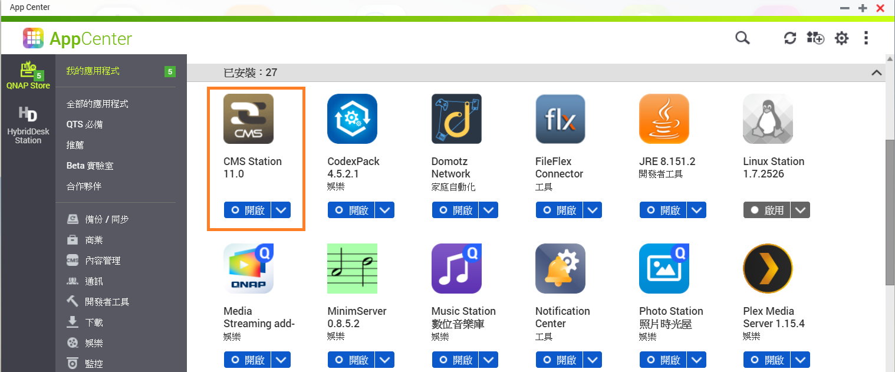
Live Demo of CAYIN Digital Signage Server Software UI
CMS on QNAP NAS UI Demonstration

Slide 39
Benefits of
QNAP X CAYIN

Slide 40
from the viewpoint of CAYIN’s existing channels
Benefits of QNAP X CAYIN
NAS x CMS
Home of contents, home of assets
Save time on moving content from content storage to CMS, and better security
Great hardware local support
QNAP has worldwide branch offices and distributors
Not only NAS; not only CMS
Abundant add-on features for choices
Related to various AV and building project requirements

Slide 41
from the viewpoint of new user
Benefits of QNAP X CAYIN
Device Management
QNAP NAS with Network/Storage management tool
Qfinder Pro allows you to quickly find and easily access all QNAP NAS over the same LAN
Content Management
QNAP NAS support various file format and file transfer protocol and provide content management tool
Qsync enables automatic file synchronization across different devices
QNAP AIoT Solution
QVR Pro provide surveillance solution
QIoT Suite – IoT hub for sensors / devices, create more interactive solution

Slide 42
CAYIN x QNAP
Your Best Choice!
Copyright © 2019 QNAP Systems, Inc. All rights reserved. QNAP® and other names of QNAP Products are proprietary marks or registered trademarks of QNAP Systems, Inc. Other products and company names mentioned herein are trademarks of their respective holders.

