Slide 2
QNAP X WoMaster Create more potential for industrial IoT applications
Industrial IoT Leading Company - WoMaster
ThingsMaster OTA Overview
Application Examples
Install ThingsMaster OTA on QNAP NAS
Easy Installation
Advantages for using ThingsMaster OTA on QNAP NAS
Demo
Supporting NAS Models

Slide 3
Industrial IoT Leading Company - WoMaster
WoMaster has more than 20 years of experience in the field of Industrial IoT.
Industry Contribution: Provides high quality industrial products and critical applications in the field of railways, electricity, utilities, intelligent transportation and smart city surveillance.
Product lines: Routers, Wireless AP, Switch and Central management products on the cloud.
Company website: https://www.womaster.eu/

Slide 4
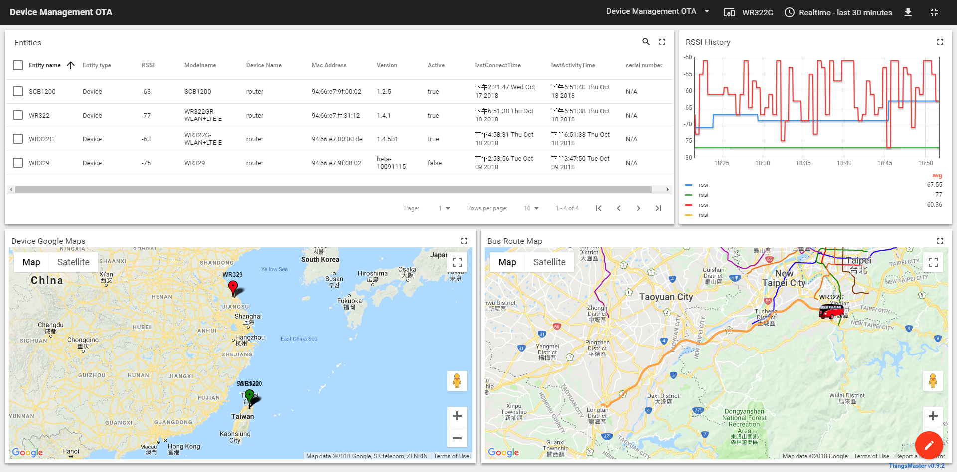
ThingsMaster OTA Product Overview
ThingsMaster is an intelligent industrial network IIoT central control platform
It manages field devices anytime, anywhere
It supports multiple popular web browsers for instant and secure access from your PC or smartphone
ThingsMaster provides a fast, flexible, and secure dashboard for multiple users
It supports MQTT and RESTful APIs
The global map shows the location and status of the device. Example: Device connection - Green, Device warning - Red
Remote adjustment device setting
WoMaster Supporting Models: SCB (Smart City box) and WR series

Slide 5
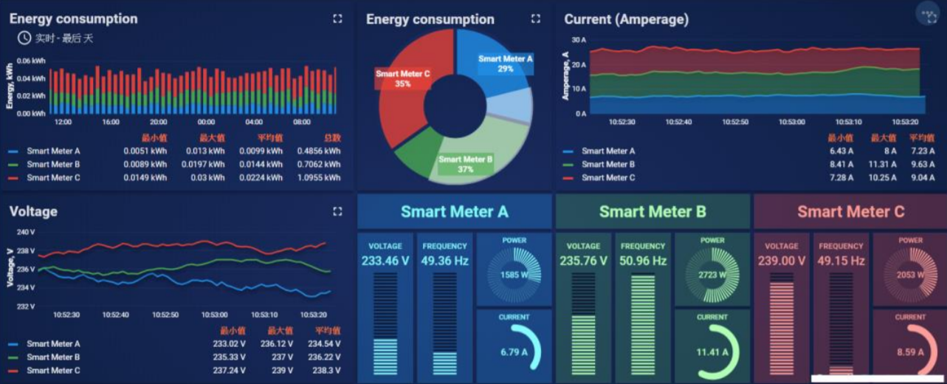
ThingsMaster OTA Application Examples
Use ThingsMaster OTA's IIOT central control to quickly manage energy usage at each point of operation
For example: Temperature, humidity and energy consumption returns for Bio-cultivation laboratory

Slide 6
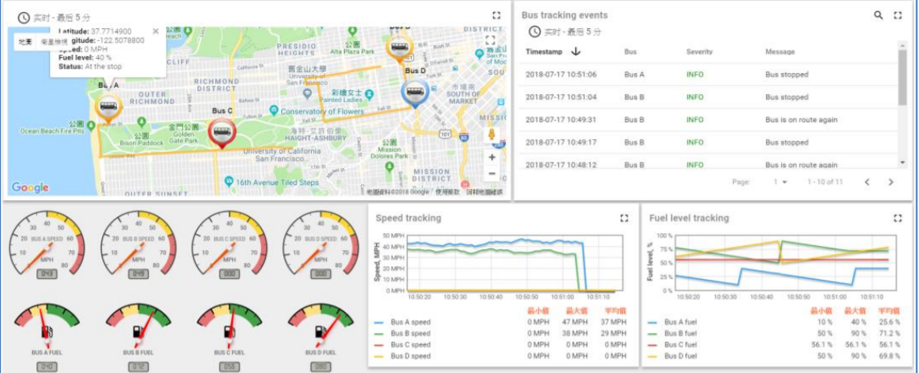
ThingsMaster OTA Application Examples
Monitor the status and location of the mobile device on the map through the ThingsMaster OTA
For example: Truck delivery status

Slide 7
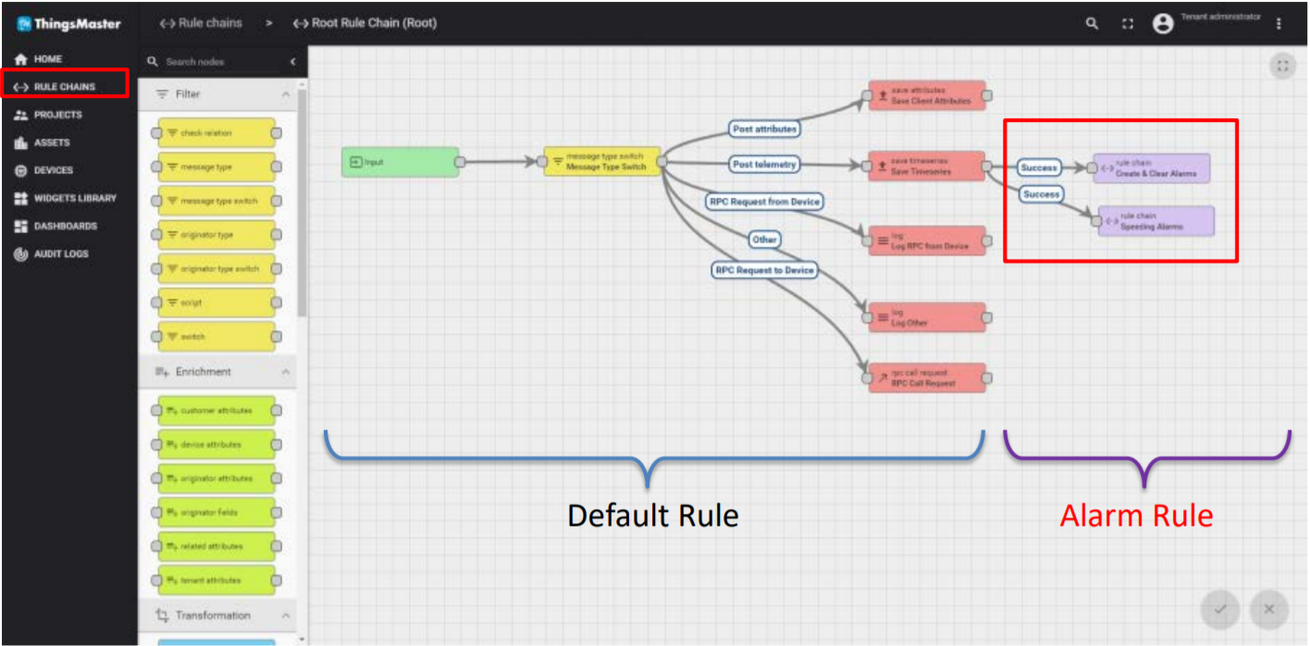
ThingsMaster OTA Application Examples
The Graphical Rule Chain design helps you customize the message rules for devices and alerts
For example: When the temperature exceeds 28 degrees C, the user is notified and the ventilation device is turned on.

Slide 8
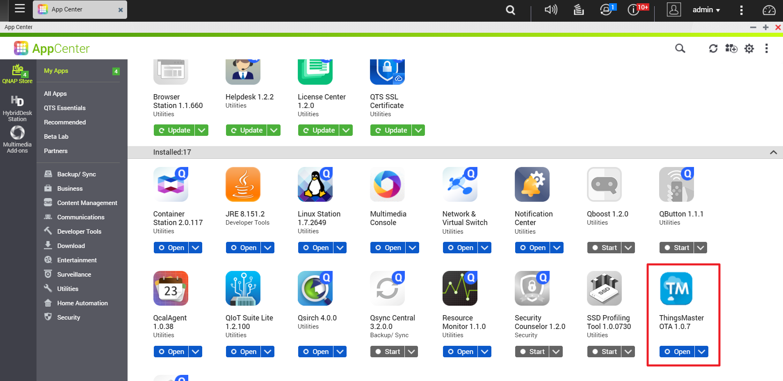
QNAP NAS Exclusive Integration
Provides one-click installation of ThingsMaster OTA on App Center

Slide 9
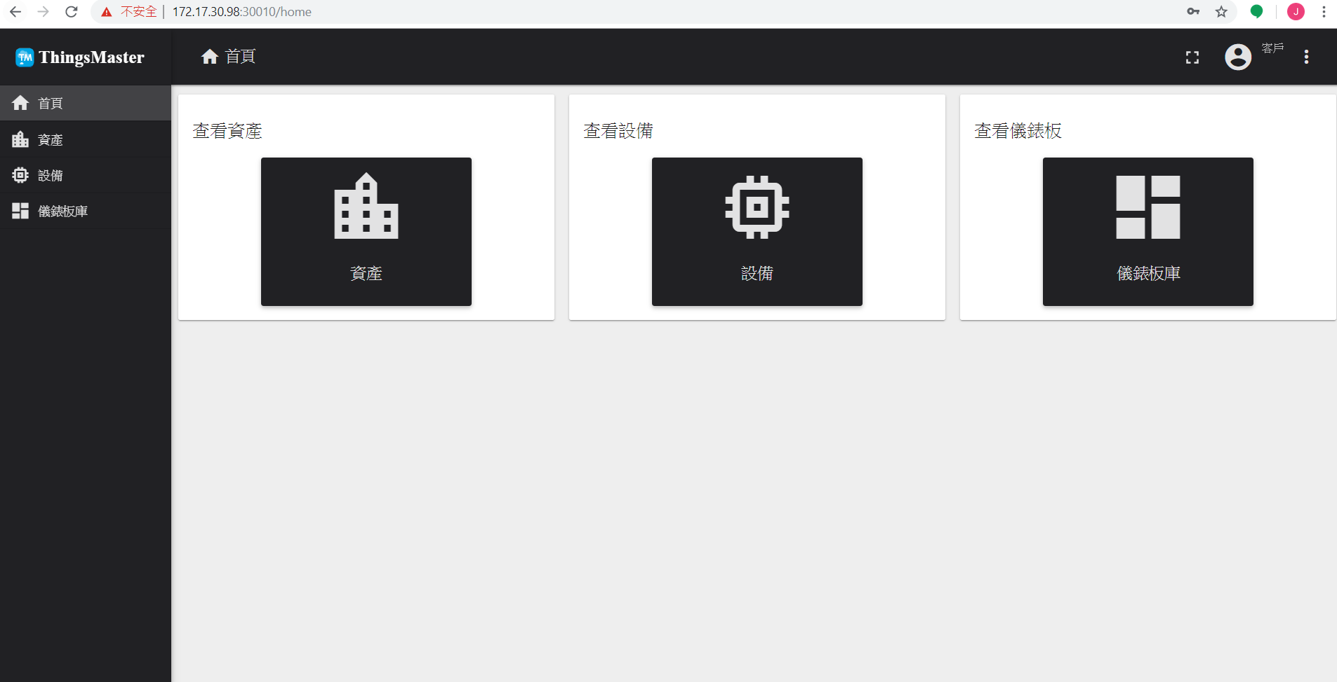
Easy Installation of ThingsMaster OTA
Install Container Station and ThingsMaster OTA on App Center
Log in to ThingMaster OTA admin@cloud.io admin
Port Usage
Web: 30010
MQTTs: 30011
Https: 30012
** Require at least 8GB free Memory to successfully install application.
** Default login account and password are on WoMaster website

Slide 10
Advantages for using ThingsMaster OTA on QNAP NAS
Provides convenient, multiple security and protection solutions
Security Counselor conducts security risk assessments for NAS and suggests appropriate security settings to guard against possible risks and crises. It also integrates anti-virus software and applications that scan for malicious programs to ensure the security of the NAS environment.
Multi-network security settings to maintain data security for IIOT systems
Uable to manage some public cloud functions (For Example: Transmission costs and data backup, etc.)
QNAP NAS provides multiple hardware configurations
Supports 4 to 30 hard drives, desktop to rack, and can be found in QNAP's diverse range of products for corporate or personal use.

Slide 11
Advantages for using ThingsMaster OTA on QNAP NAS
There are multiple storage and backup solutions on NAS to manage data. For example: Snapshot, Qtier, etc
Customized network settings for network and virtual switches
To use it with other NAS applications such as: QuAI, Container Station and other AI-related applications to achieve AIOT environment set-up.

Slide 12
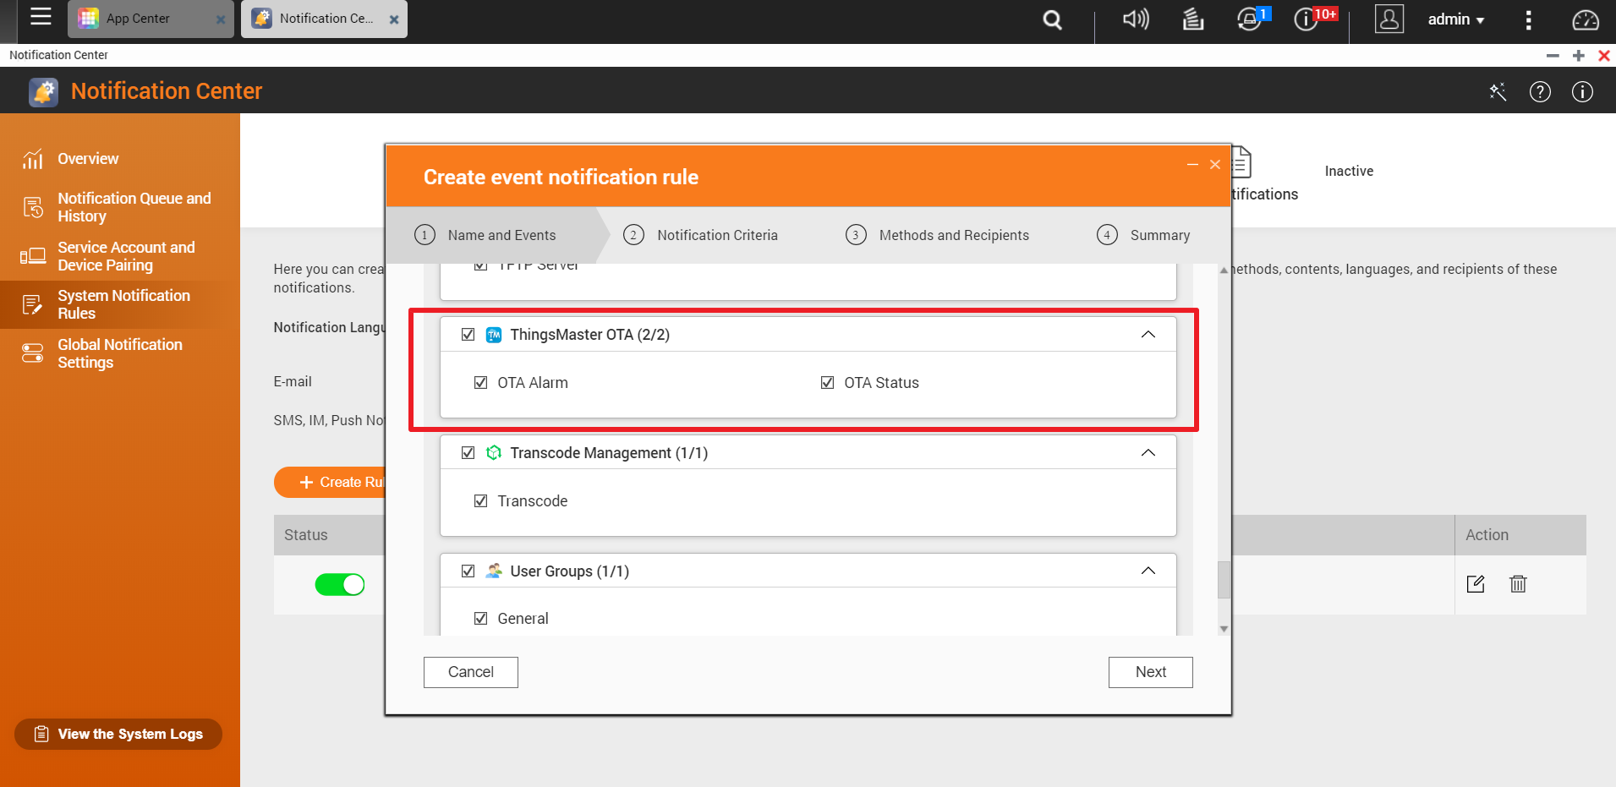
Advantages for using ThingsMaster OTA on QNAP NAS
ThingsMaster supports Notification Center, which allows you to receive event notifications or alert notifications for instant notifications via email, SMS, instant messaging or push.

Slide 13
Advantages for using ThingsMaster OTA on QNAP NAS
Add QNAP Notification rule chain node in ThingMaster OTA to achieve timely notification of sms, push service. You can monitor the system status at any time!

Slide 14
Welcome special guest
Tom from WoMaster

Slide 15
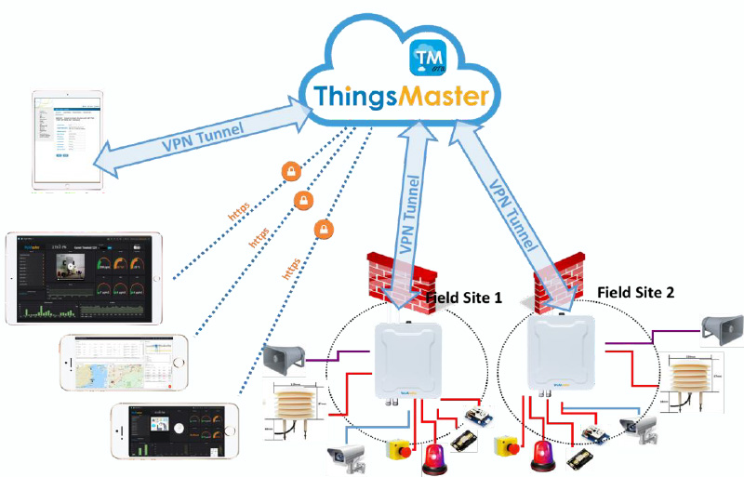
What is OTA(Over-the-Air) ?
A Cloud server developed by WoMaster
OTA can collect the device information from anywhere, and then display, monitor, analyze, action and manage
Easy to access OTA via NB/Phone
According to the big data analysis, prevent and prepare early
Anywhere, Anytime, Real time

Slide 16
What OTA can offer for you?
Interactive monitoring dashboard and map shows the status, signal strength, and location
It provides to define rule chain function. When the data changed, it can trigger some action automatic, such as : change the color in the map , send out the alarm message.
Supports over-the-air batch device firmware upgrade scheduling* , reboot, restore a new configuration
Support Over 10,000 nodes device management

Slide 17
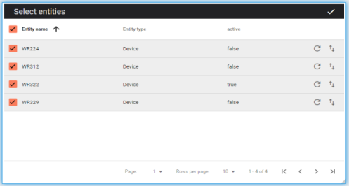
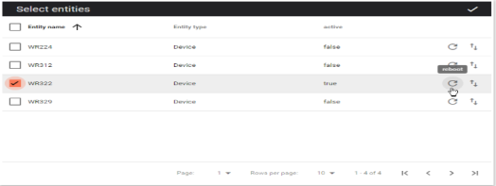
Batch management
Drag and drop configuration file
01
02
Reboot
03
Config update
Notes:
This slide is for the configuration and reboot, as I mentioned, we support the batch configuration.
You just need to select the device that you want to config, and drag and drop your config file into the box, press OK, then it will start to update your config.
Of course you can do the one device reboot or config update.

Slide 18
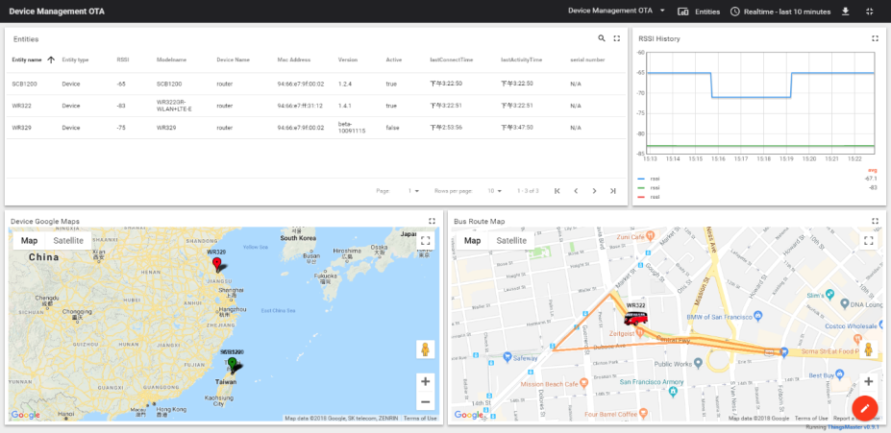
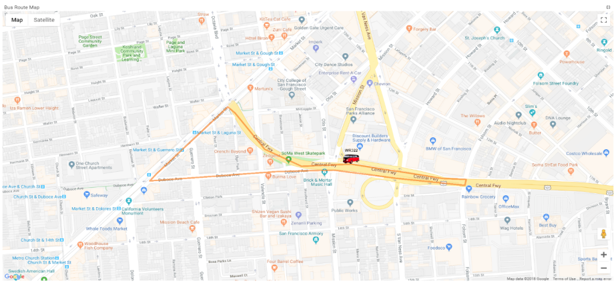
Route
Display Bus Route and Bus Speed on the Map
Notes:
This is the Route MAP of ThingsMaster OTA
As you can see on the map, it displays the bus route path and speed. You can also set the alarm for over speed to inform the driver and manager.

Slide 19
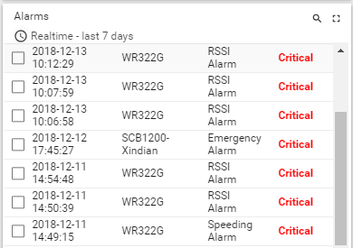
Alarm summary
RSSI Signal too low, Over Speed, Push Button trigged
Notes:
This is about the alarm log. When RSSI signal is too low or a car over speed , and someone press the push button, you all can see a alarm here.

Slide 20
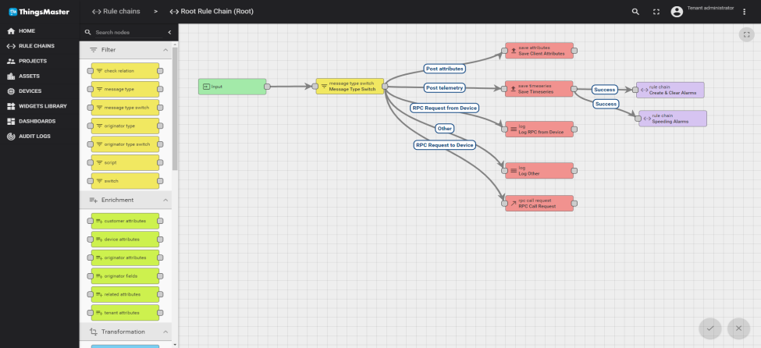
Programming the rule
預設規則
新增警報規則
Default Rule
Alert Rule
Notes:
This slide is about how to add alarm rule.
WoMaster provide a friendly Rule Engine for the alarm setting, that calls Rule Chain.
As the picture shown, here we have the Default Rule, that’s about the device info and logs. That will be automatically created.
And then is the Alarm rules, that’s we can set.

Slide 21
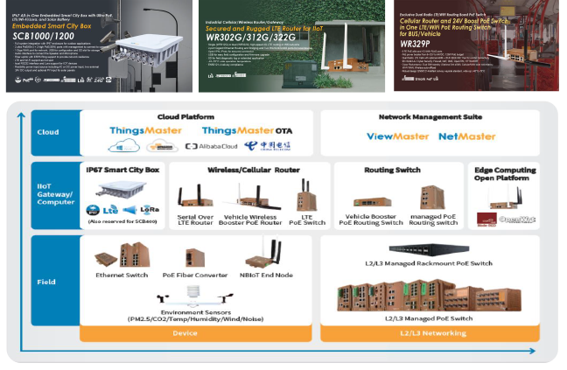
ThingsMaster OTA - Supported Products
All SCB (Smart City box) series and all WR series

Slide 22
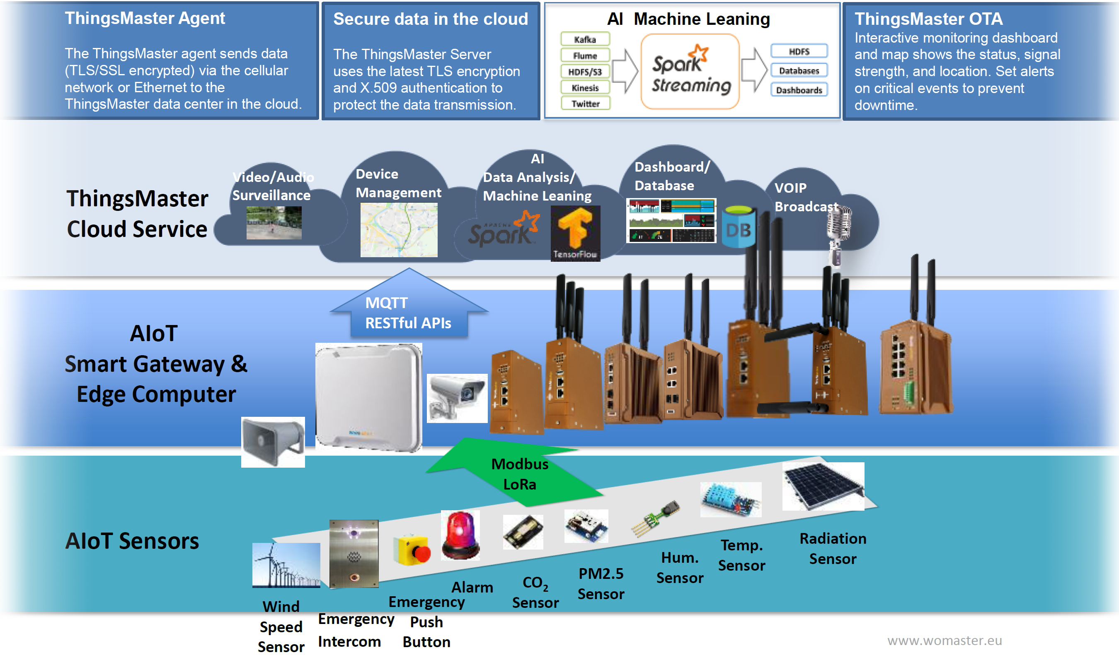
ThingsMaster IIoT Platform

Slide 23
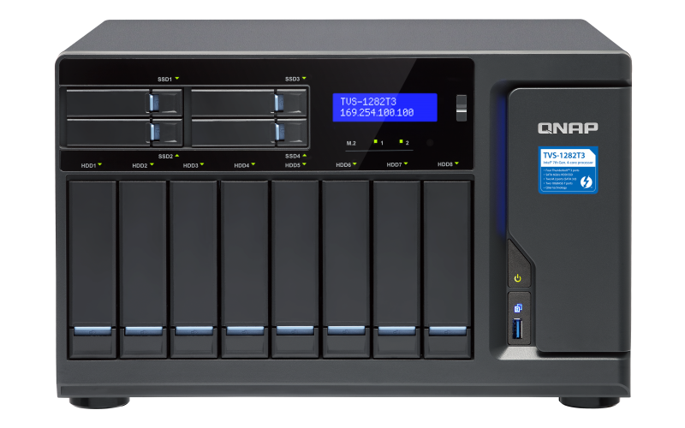
Secure Multi-Sites Management Any Time, Any Where
N-to-N VPN Technology
The latest TLS encryption and X.509 authentication to protect the data transmission

Slide 24
ThingsMaster OTA Multi-Tenant Architecture
Grouping and organize tasks for IoT deployment
Each project has his own Device, Member, Dashboard
sysadmin@cloud.io for some major function setting
admin@cloud.io for Tenant A

Slide 25
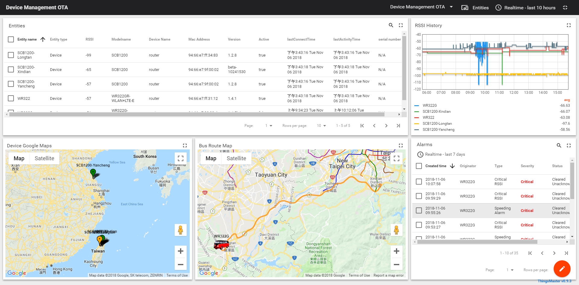
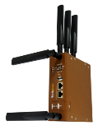
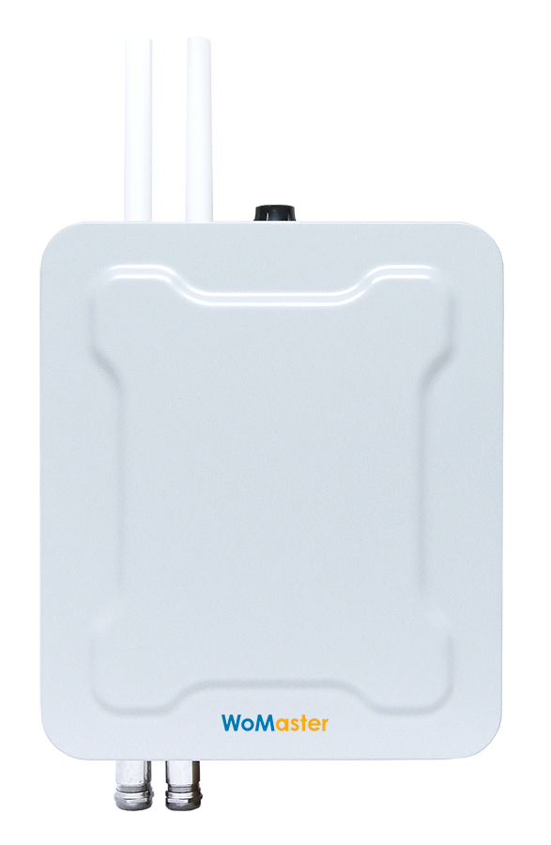
OTA Network Topology
QNAP NAS gets a private IP
Firewall and port forwarding
Public IP
https
https
LTE Network
Field Site 1
Field Site 2

Slide 26
NAS Supporting Models
Supports X86 NAS Models with memory able to be expanded to 16GB:
TVS/TS-951X, X63, X73, X77, X82, X85
Has Container Station

Slide 27
Install ThingsMaster OTA on QNAP NAS
Is your BEST choice
Copyright © 2019 QNAP Systems, Inc. All rights reserved. QNAP® and other names of QNAP Products are proprietary marks or registered trademarks of QNAP Systems, Inc. Other products and company names mentioned herein are trademarks of their respective holder​

