Slide 2
Summary:
QNAP NAS cybersecurity protection
Non-fiction and Quarantine
The Demo of setting up McAfee notification in a NAS

Slide 3
Will NAS get a virus? Why do we need Antivirus?
NAS usually does not get PC virus? But the files it carries could contain viruses, the virus will infect all PCs and NBs connecting to the NAS.

Slide 4
QNAP NAS Cybersecurity Protection

Slide 5
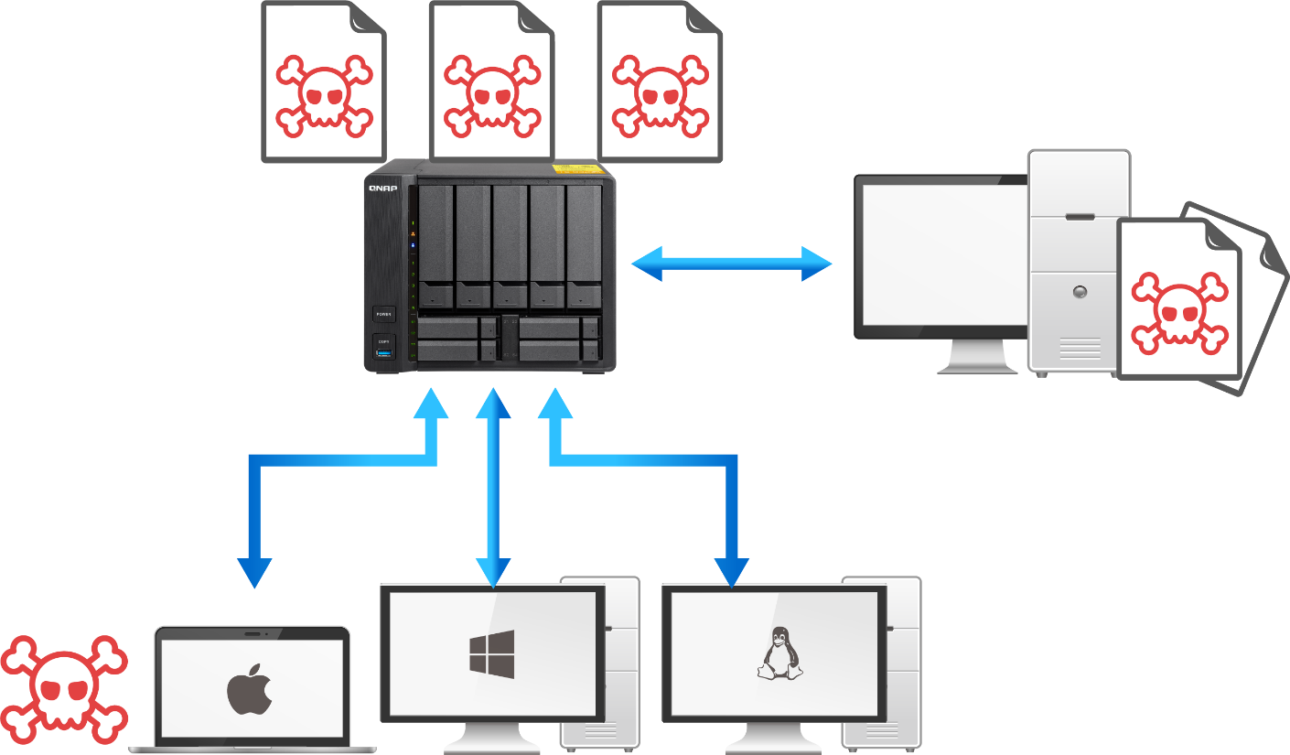
Virus Protection of QTS Files
NAS would get files from various sources, like uploaded files, pictures, or document files, which may carry virus, or malwares.
Need to regularly use Antivirus app to scan and clean up uploaded files, so that the virus would not infect other connected PC, or NBs.
AFP
SMB

Slide 6
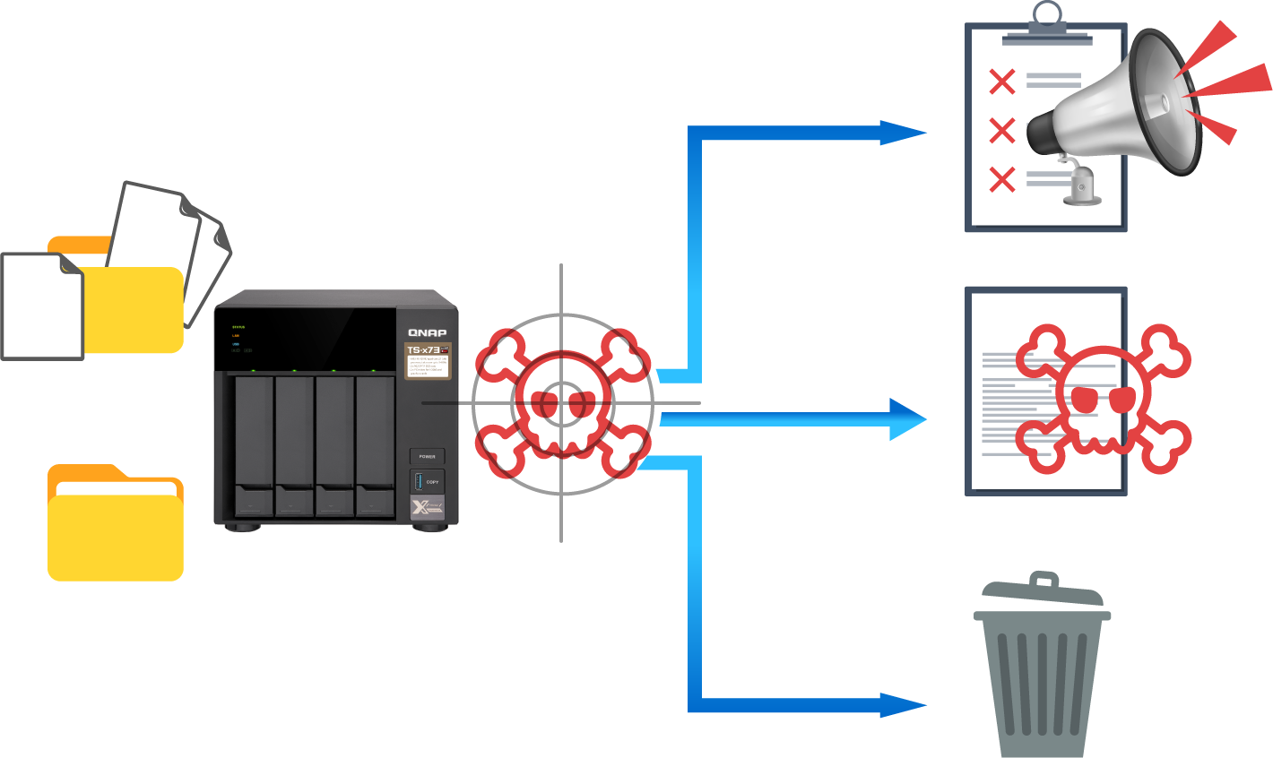
The Main Tasks of NAS Antivirus App
Antivirus scans the NAS regularly and deal with the infected files separately.
Report
Quarantine
Antivirus Scanning
Delete

Slide 7
A Comparison of McAfee and ClamAV in QTS
Virus Analysis Team: | World-class, professional, global threat analysis teams | Mainly from global cybersecurity enthusiasts
Virus Signature Update: | At least, daily, virus signature update | Experts will provide the updates from time to time
Advantage: | -one of the top choices of enterprise antivirus and can satisfy the requirement for enterprise cybersecurity audits. -Can clean trojan horse, virus, worm, Adware and spyware from different operating systems. -supports only QNAP x86 models | -Contains at least 3.7 million virus signatures. -Lightweight, supports both x86 and ARM QNAP models.
Price: | USD$25/one year USD$50/two years | Free

Slide 8
Not just Antivirus, QTS Security Circle!
QTS
4.4.1
beta
Beside installing Antivirus to protect the uploaded files, QTS NAS also needs a full circle of protection, such as OS integrity and safe NAS set-up.

Slide 9
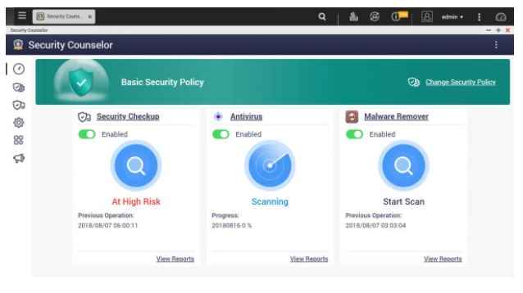
Security Counselor, for an overall safety review
Based on the security requirements of your network environment, you can choose one of the three default security policies (Basic/Intermediate/Advanced). The Security Checkup function will use your selected policy to conduct overall cybersecurity check to yours NAS OS and setup.
You can click on scan results, and Security Counselor will take you to the relevant system section to change associated settings for securing your NAS.

Slide 10
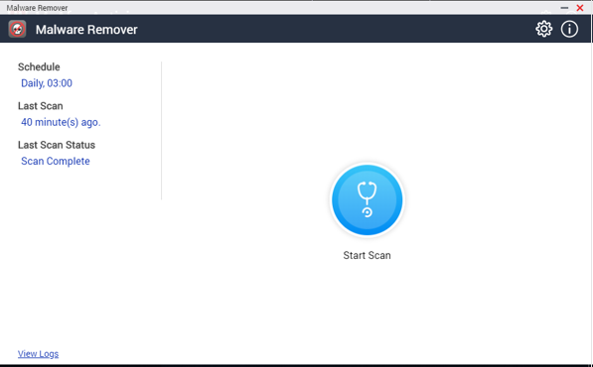
Malware Remover cleans Malwares for QTS
Some of QTS NAS may be infected with malwares, like mining malwares, which can greatly reduce NAS performance.
Malware Remover can immediately, or regularly, scan OS and clean some QTS-targeted malwares.

Slide 11
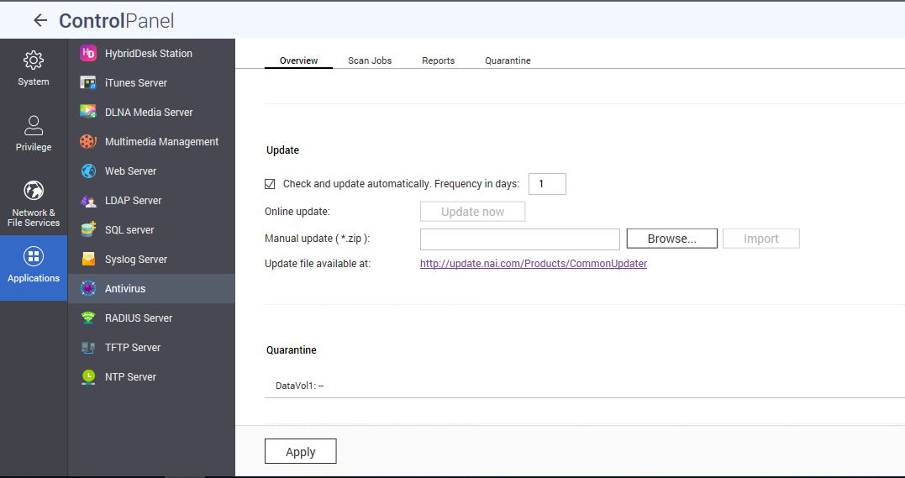
Virus Signature Auto-update
Remember to enable the daily virus signature update of McAfee and ClamAV, in order to obtain the latest global antivirus update.

Slide 12
Good habits are never enough: QTS Autoupdate
Hackers always keep looking for holes in an operating systems.
QNAP Security Team constantly monitors and analyzes the global threats and provide fixes and updates to QTS so that hackers cannot find their ways into QTS.
So, always keep QTS updated!

Slide 13
Sending Notification and Quarantine Infected Files

Slide 14
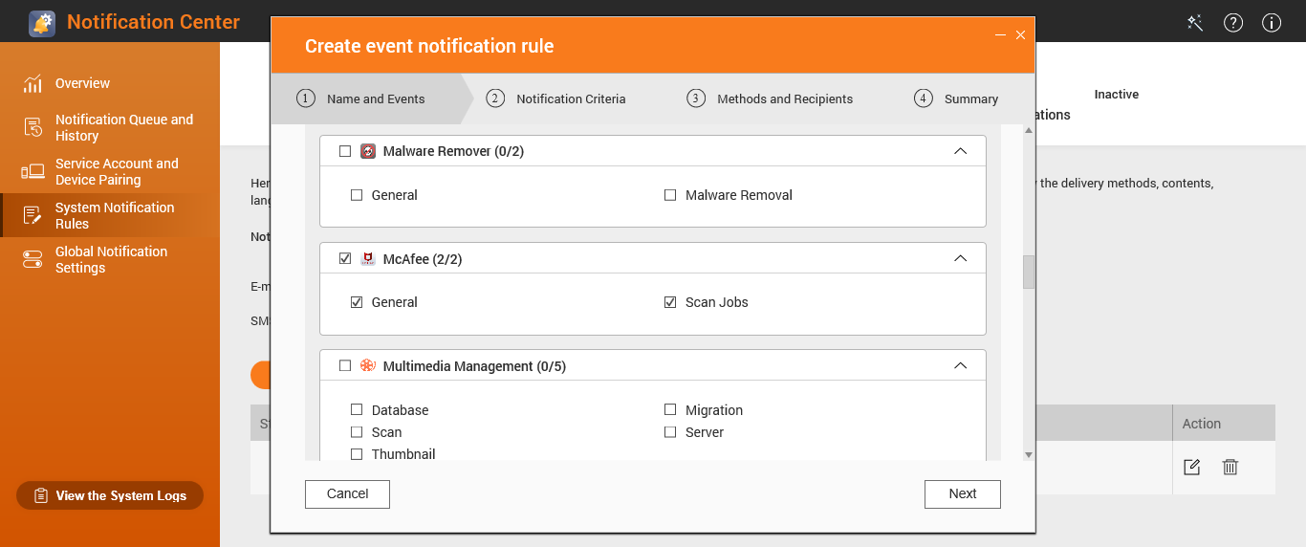
Set up rules in Notification Center of QTS
First, need to set up rules at Notification Center, so that QTS can send out text messages to Skype in mobile phones, or to send out emails.
Notes:
In NC, select “Antivirus”, or “McAfee”, to set up a rule to send out Skype messages.

Slide 15
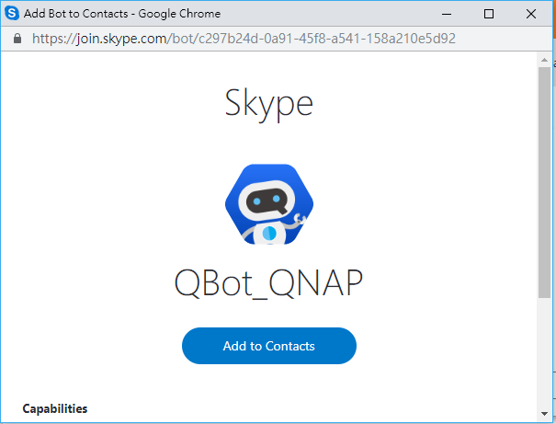
Install Skype in your mobile phone
Install Skype App in the mobile phone to receive verification message from QTS Qbot and begin to receive text messages from QTS.
Notes:
https://blog.qnap.com/av-notification-en/

Slide 16
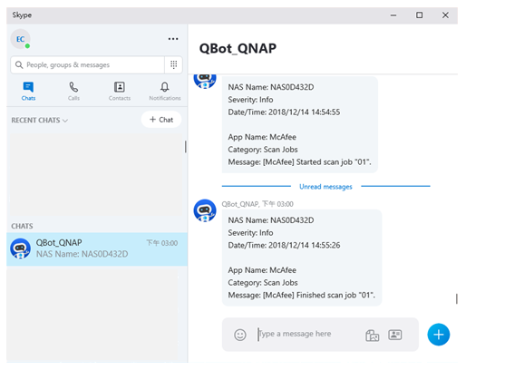
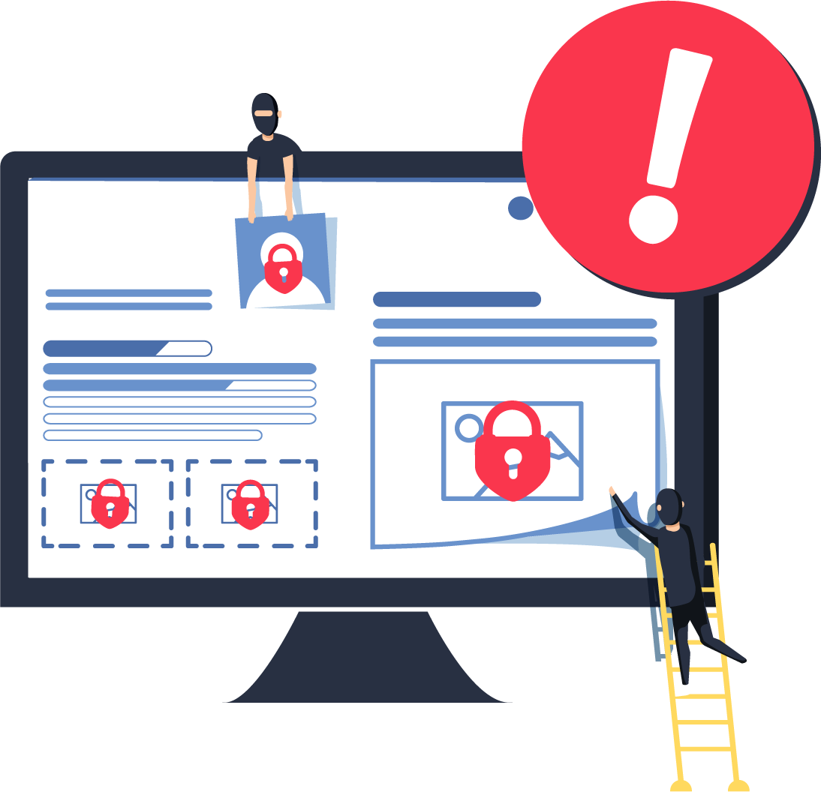
If a virus is found, a text message would be sent out.
When virus signatures are updated, a scan job is turned on, or off, or a virus is found, your mobile phone can receive text messages, anywhere anytime.

Slide 17
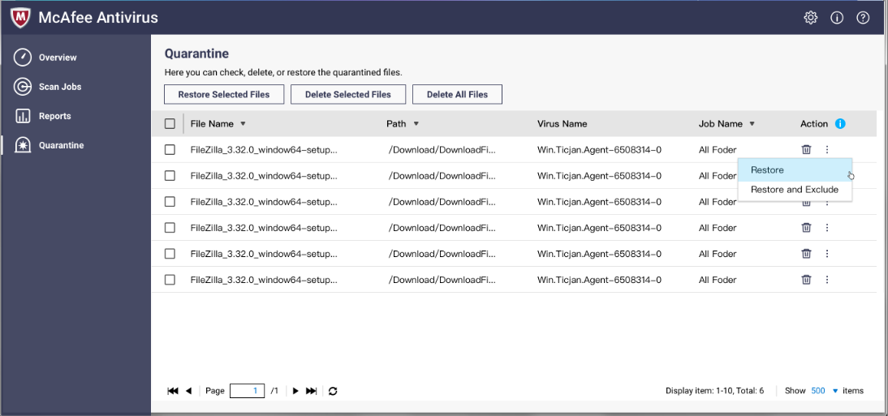
Quarantine a virus
If a file is found with a virus, it can be left at a Quarantine folder. The file can be checked later to see if it needs to be deleted.
“Restore and Exclude” can also be used to restore the file back to the original path and exclude the file from virus scanning again.

Slide 18
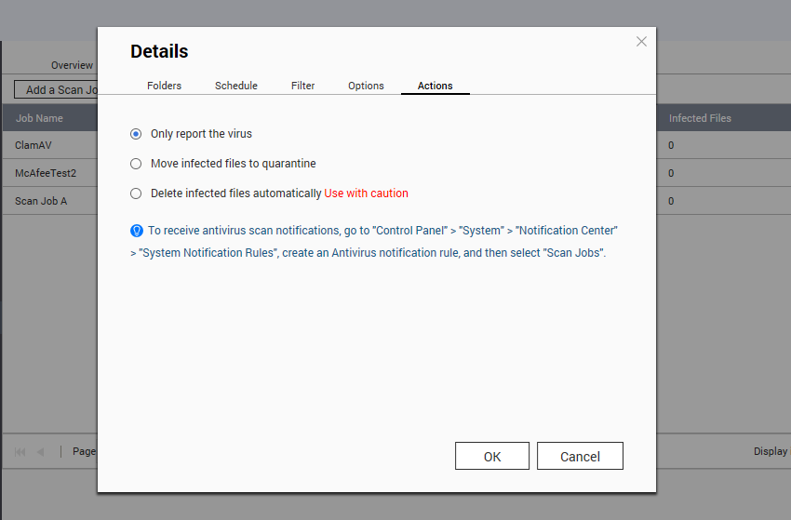
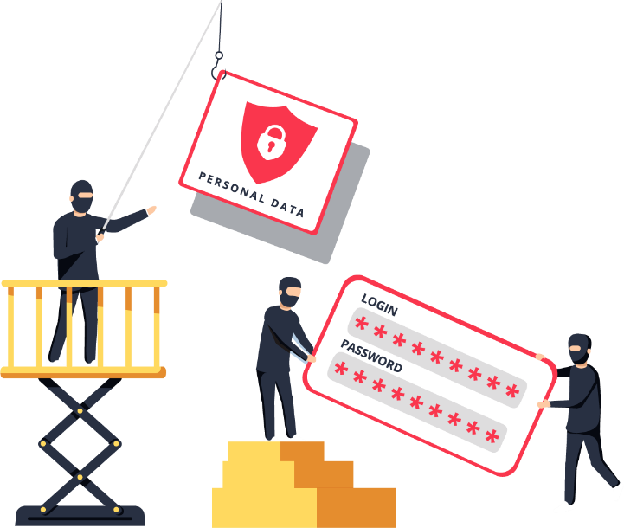
Several actions can be taken to a virus found
In Details> Actions, an admin can choose to send out a text message, quarantine the infected files, or delete the infected files automatically.

Slide 19
The Demo of Setting Up McAfee

Slide 20
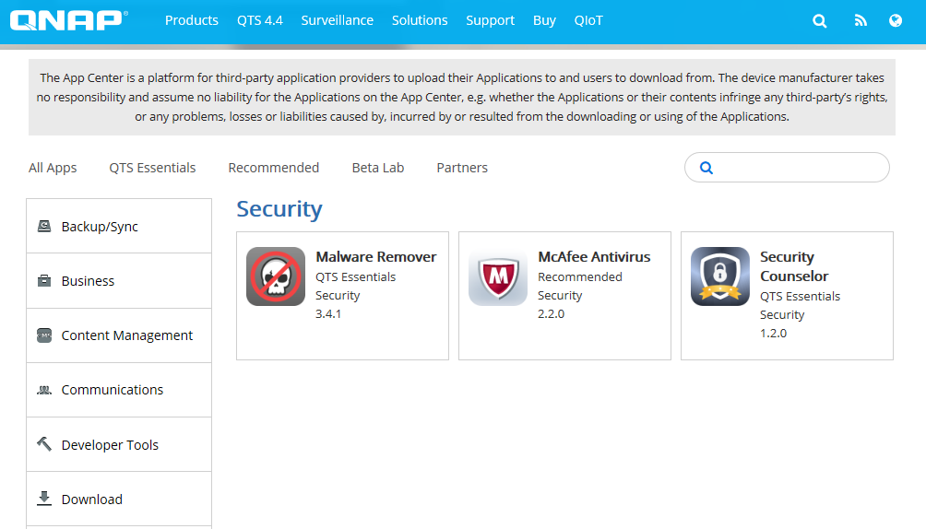
Download McAfee Antivirus from the App Center

Slide 21
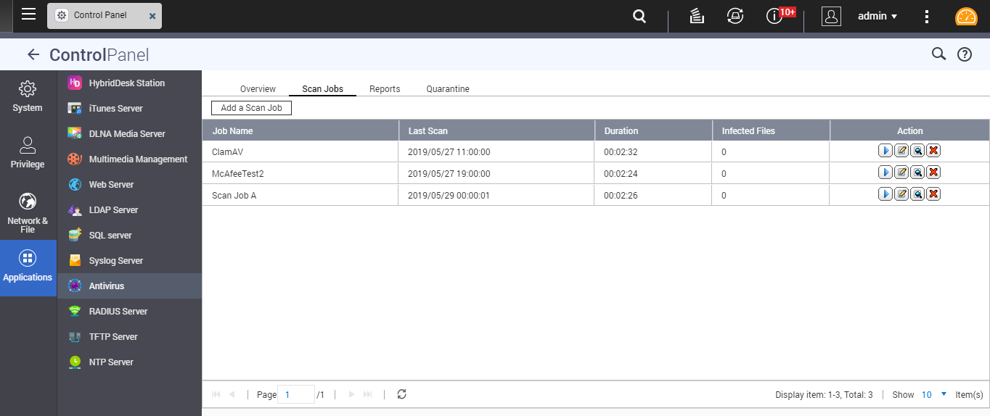
Add virus scan jobs in McAfee

Slide 22
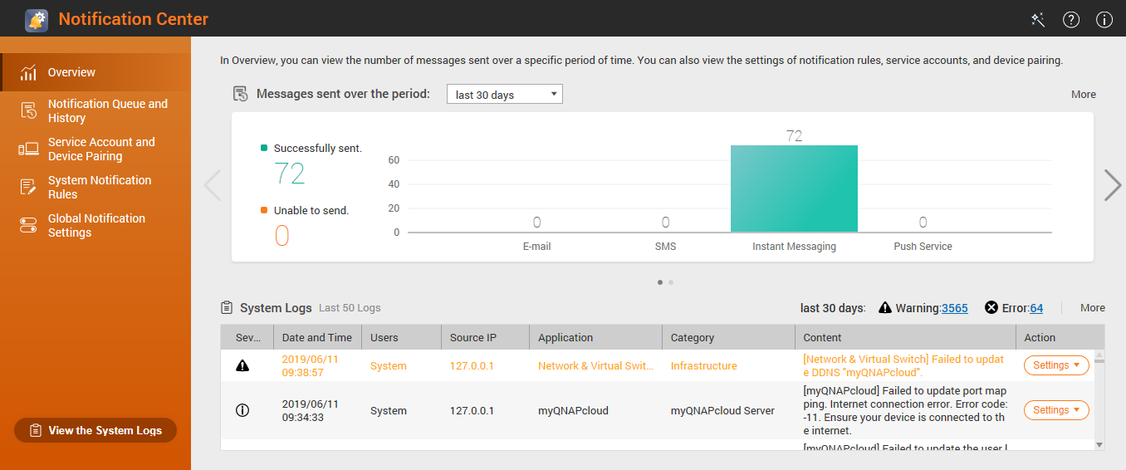
Setup rules in Notification Center

Slide 23
Use Skype in your mobile phone, or notebook to receive text messages

Slide 24
One more thing...

Slide 25
Promotion for McAfee, only until 6/28
To support QNAP exhibition in Computex and raise the cybersecurity awareness, a promotion of McAfee Antivirus in QTS has been launched.
 | Orginal Prices | Promotional Prices (6/03~6/28)
Prices | One year:USD$25 | USD$8.99/NTD$299
 | Two years:USD$50 | USD$13.99/NTD$469
 | Three years:N/A (Only during Promotion) | USD$18.99/NTD$599

Slide 26
QNAP Products, your best choice!
Copyright © 2019 QNAP Systems, Inc. All rights reserved. QNAP® and other names of QNAP Products are proprietary marks or registered trademarks of QNAP Systems, Inc. Other products and company names mentioned herein are trademarks of their respective holders.

