Slide 1
Notes:
Co-presenter by Don & Amol

Slide 2
Agenda
Turn Your NAS
into a Virtual Router
Profound environment
Flexible virtual infrastructure on demand
Easy to manage
Router Software Introduction
How to set it up
What is Router Software?
What is router software?
Turn your NAS into a virtual router
Profound environment
Flexible virtual infrastructure on demand
Easy to manage
Router software introduction
How to setup it

Slide 3
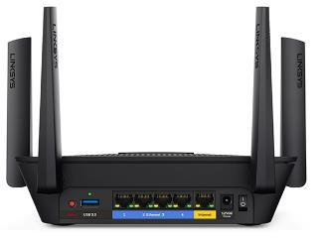
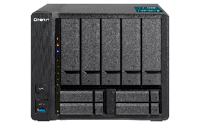
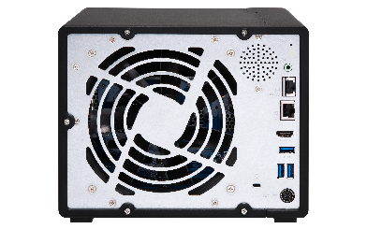
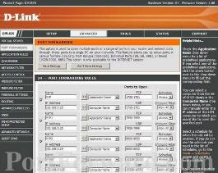
Router Software
Routers
Router Software
Forwards data between computer and network.
Running software-based routers in a virtual
environment or an appliance.

Slide 4
Why You Need It
If the router firmware is out-of-date and no longer updates it
Continuous community support for router software protects your devices against Internet malicious activities.
Leveraging you NAS as a high-performance router.
Utilizing AC 2600 for WiFi usage
If the router firmware is out-of-date and the vendor no longer updates it any more.
Continually community support for router software keeps your devices from Internet malicious activities.
Leveraging your NAS as a high-performance router.

Slide 5
Turn Your NAS into a Virtual Router
Running router software in Virtualization Station
Profound
Environment
Supports all x86 NAS from SOHO to SMB
QWA-AC2600 WiFi expansion card
1GbE to 40 GbE network expansion card
Flexible
Infrastructure
VM resource allocation: vCPU, memory and interfaces
Connect virtual network interfaces to Virtual Switches
Easy to manage
Central management via Virtualization Station, e.g. VM resources consumption
Ready-to-use, downloading from VM Marketplace
Profound Environment
All x86 NAS support from SOHO to SMB
1GbE to 40 GbE network expansion card
Flexible infrastructure
VM resource allocation: vCPU, memory and interfaces
Connects virtual network interfaces to Virtual Switches
Easy to manage
Central Management via Virtualization Station, e.g. VM resources consume
Ready-to-use, downloading from VM Marketplace

Slide 6
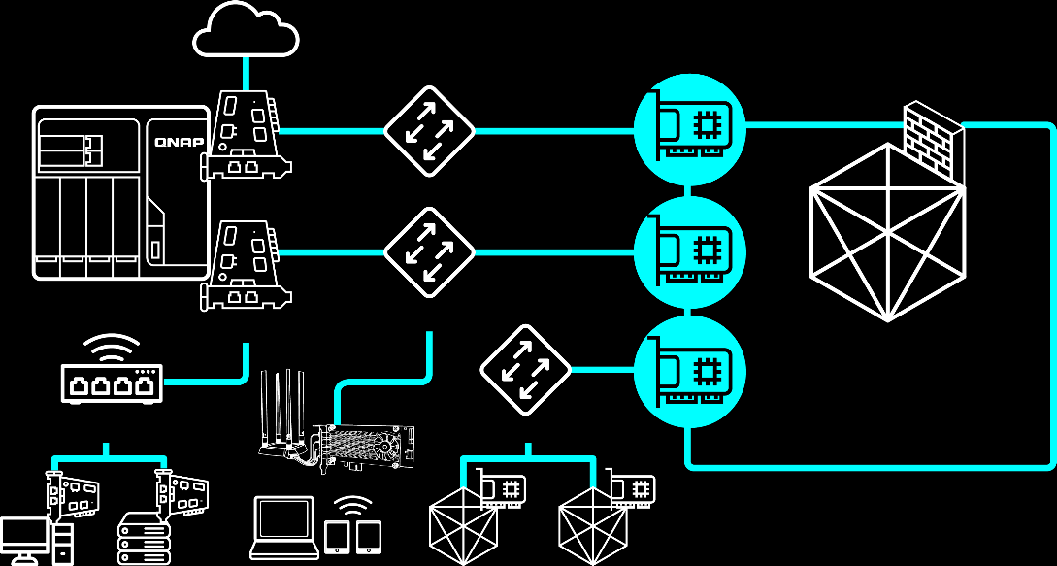
Virtual Router Topology
Internet
vNIC 1:
WAN interface, all the
traffic throughout virtual router first.
Virtual_NIC_1 (WAN)
Physical NIC
Virtual Switch (external-only)
vNIC 2:
LAN interface, applying
network settings of virtual
router via physical NIC and QWA-AC2600.
Virtual Switch (Bridged)
Virtual_NIC_2 (LAN)
VM
Physical NIC
Physical Switch
vNIC 1:
LAN interface, applying
network settings of virtual
router via Virtual Switch.
Virtual_NIC_3 (LAN)
PC
Sever
VM
VM

Slide 7
Router Software
Open source
Linux-based firmware
Allows to install in different router brands
Open source
FreeBSD-based firmware
Support service subscription provided from Netgate®
Notes:
RouterOS command:
https://mikrotik.com/testdocs/ros/2.9/guide/basic.php
RouterOS ova download:
https://mikrotik.com/download
OpenWrt download:
https://downloads.openwrt.org/releases/18.06.2/targets/x86/64/
OpenWrt image convert command:
/QVS/usr/bin/qemu-img convert -p -f raw -O qcow2 openwrt-1.img openwrt-2.img

Slide 8
How to Setup It in VS
Create/Import VM
Create a VM and mount the router software image
Import a virtual appliance
Download router software image or virtual appliance
Add virtual network interfaces for WAN/ LAN
Set up a LAN interface IP address
Download router software image or virtual appliance
Create/Import VM
Create a VM and mount the router software image
Import VM from a virtual appliance
Add virtual network interfaces for WAN/LAN (optional)
Setup a LAN interface IP address

Slide 9
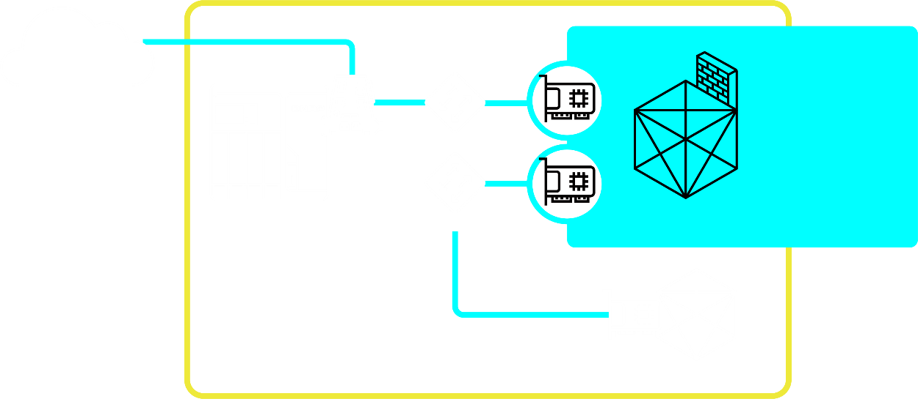
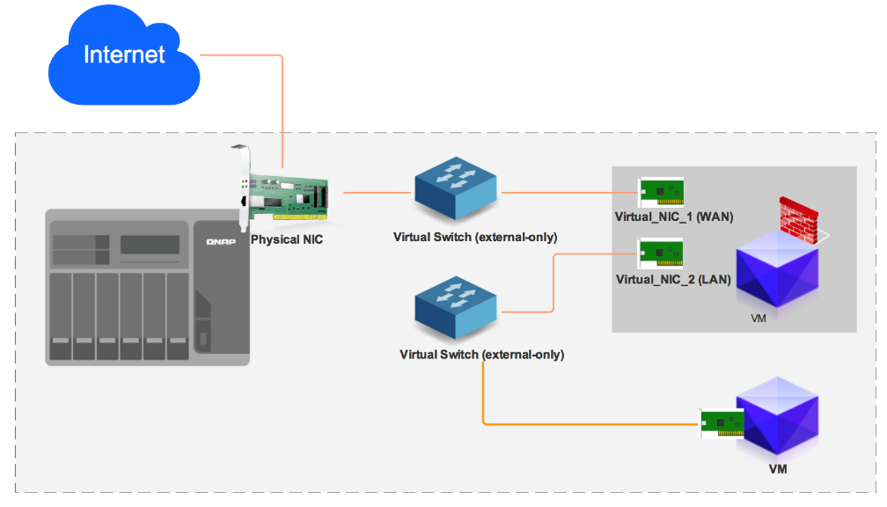
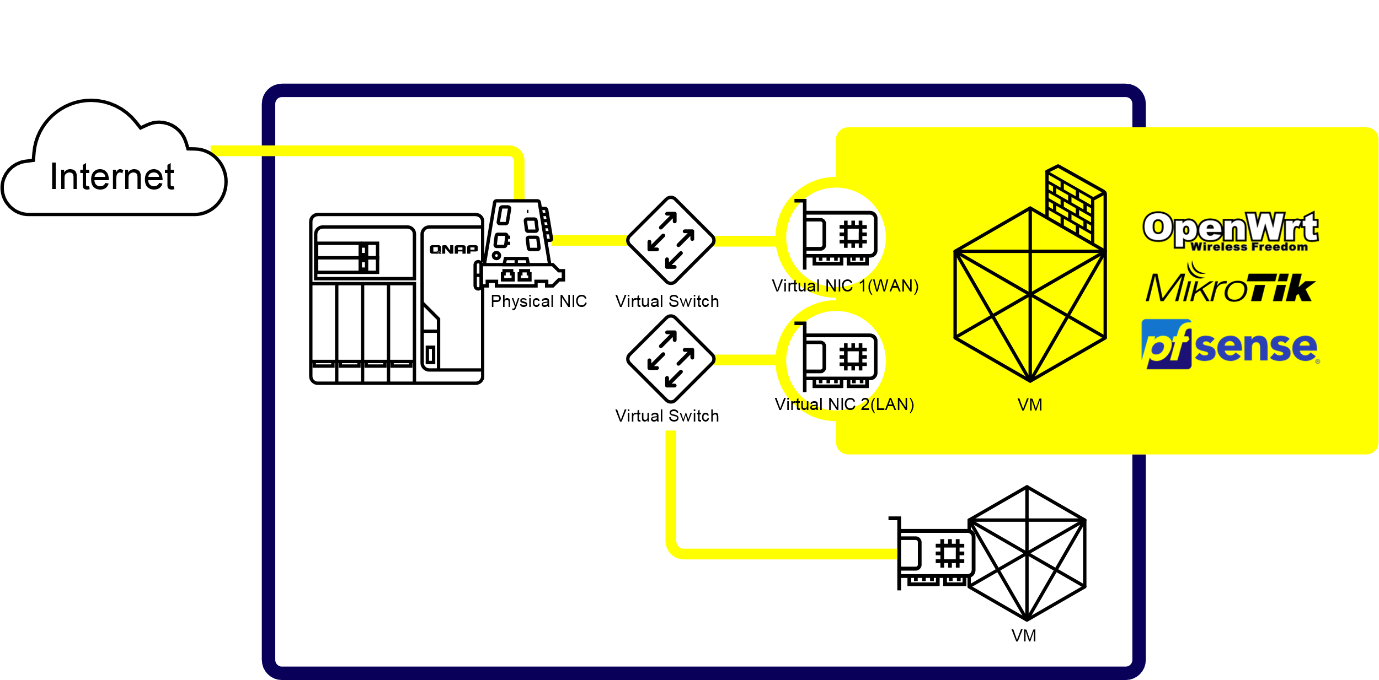
Demo Environment Topology
Internet
Virtual_NIC_1 (WAN)
Physical NIC
Virtual Switch
VM
Virtual Switch
Virtual_NIC_2 (LAN)
VM
Notes:
RouterOS command:
https://mikrotik.com/testdocs/ros/2.9/guide/basic.php
add address 192.168.1.1/24 interface ether1
RouterOS ova download:
https://mikrotik.com/download
OpenWrt download:
https://downloads.openwrt.org/releases/18.06.2/targets/x86/64/
OpenWrt image convert command:
/QVS/usr/bin/qemu-img convert -p -f raw -O qcow2 openwrt-1.img openwrt-2.img

Slide 10
Demo

Slide 11
OpenWrt – Configuration
The first interface configures as LAN in default
Access Web UI via
192.168.1.1

Slide 12
pfSense – Configuration
Disable hardware checksum.
[System] >[Advanced] > [Networking]
Access Web UI via
192.168.0.1
(admin/pfsense)
Go through initial wizard

Slide 13
Copyright © 2019 QNAP Systems, Inc. All rights reserved. QNAP® and other names of QNAP Products are proprietary marks or registered trademarks of QNAP Systems, Inc. Other products and company names mentioned herein are trademarks of their respective holders.
Notes:
Co-presenter by Don & Amol

