Slide 2
Computing in a Storage

Slide 3
High Performance Computing is the Foundation of Data Science
AI/DL
(GPU/VPU)
3D/2D Rendering
(GPU/CPU)
Data Compression/Encryption
(CPU/FPGA)
VM GPU
Passthrough (GPU)

Slide 4
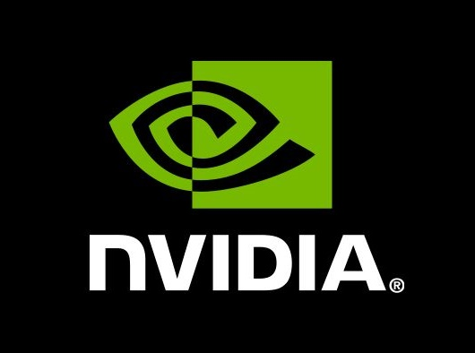
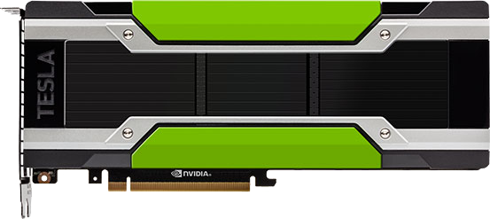

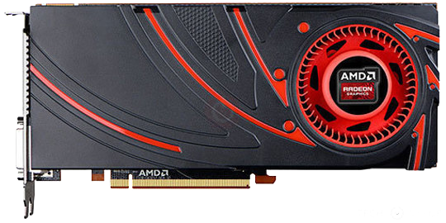
Tools for Acceleration
DL Graphic Card(PCIe Gen3 x16)
Mustang-F100 FPGA Card (PCIe Gen3 x8)
Mustang-V100 VPU Card (PCIe Gen2 x4)
GPU Card(PCIe Gen3 x16)

Slide 5
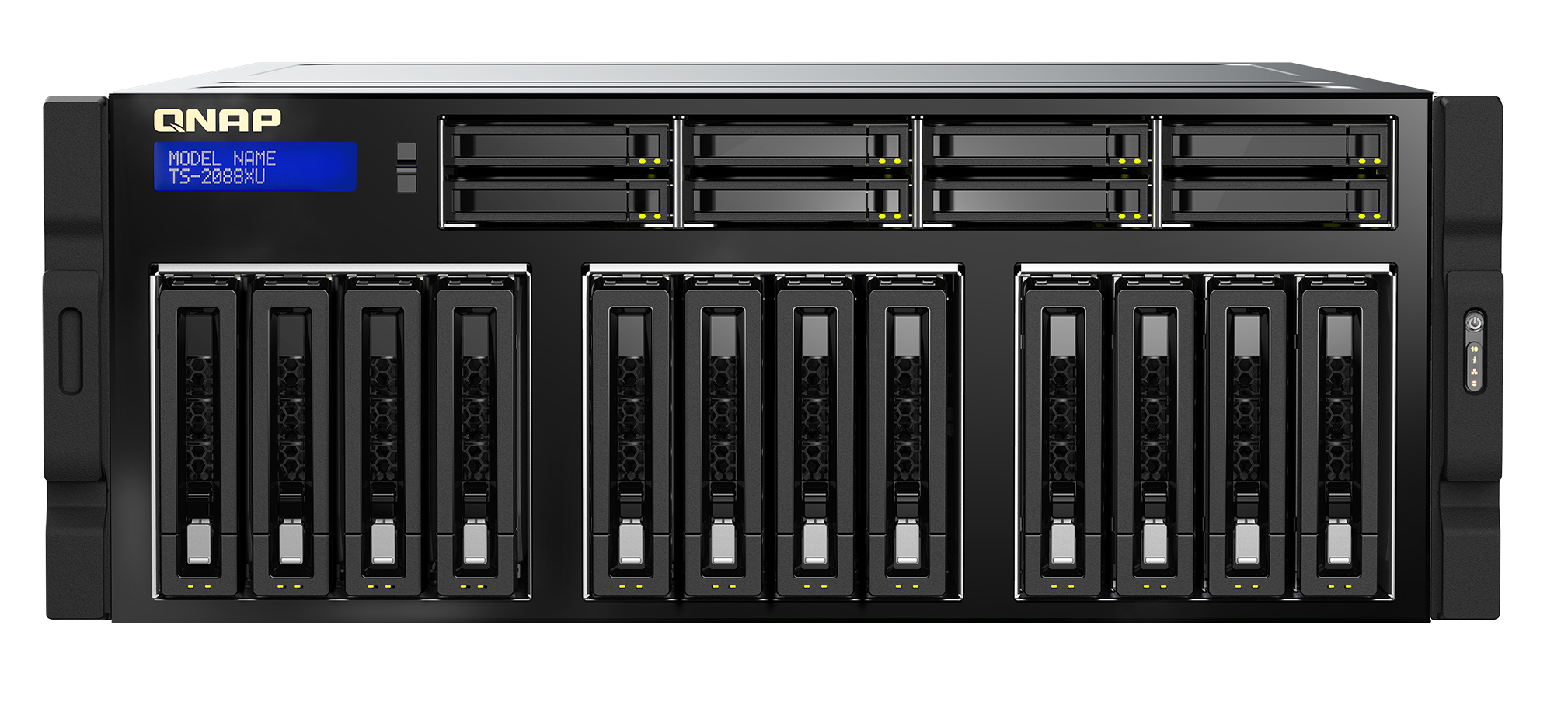

TS-2088XU
Intel Xeon W Processor
Up to 18 cores and 36 threads with up to 4.5 GHz Intel® Turbo Boost Technology 2.0 frequency, combined with DDR4 ECC RDIMM 2666 MHz memory support delivering rapid workload loading and processing.

Slide 6
Compute and Storage in a Box
​Versatile storage interface
Take care for the demand of storage capacity and performance
2.5”U.2 SSD port
(PCIe Gen3 x4)
2.5” SATA 6Gb/s SSD port
3.5” SATA 6Gb/s HDD port

Slide 7
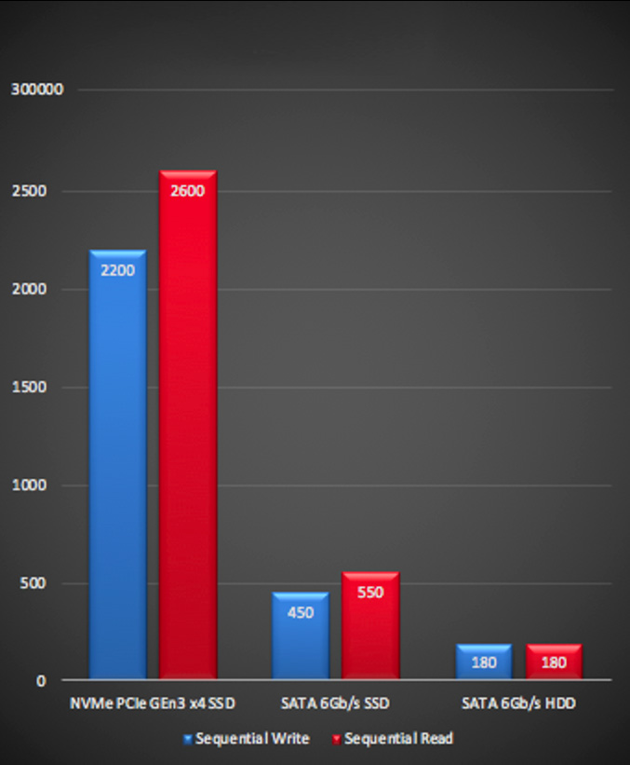
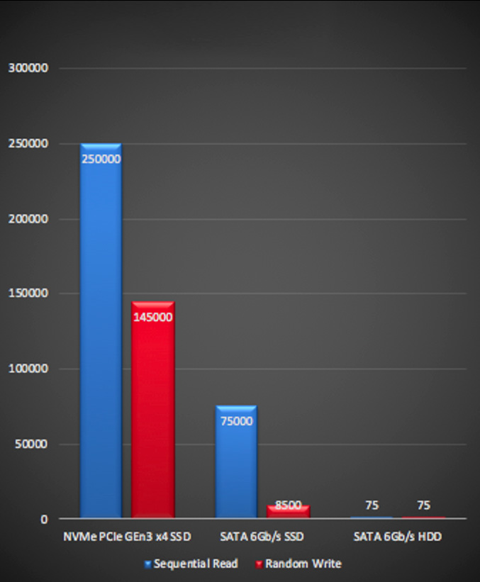
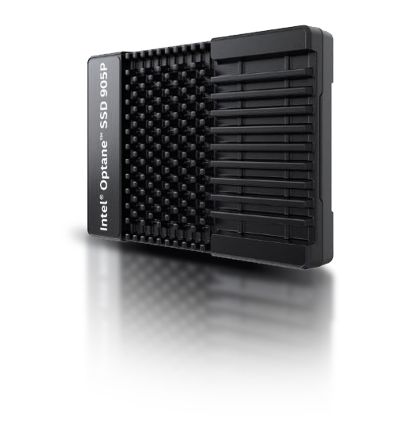
PCIe Gen3 x4 U.2 NVMe SSD
Sequential(MB/s)
Random IOPS
Notes:
https://ark.intel.com/products/147526/Intel-Optane-SSD-905P-Series-1-5TB-2-5in-PCIe-x4-3D-XPoint-

Slide 8





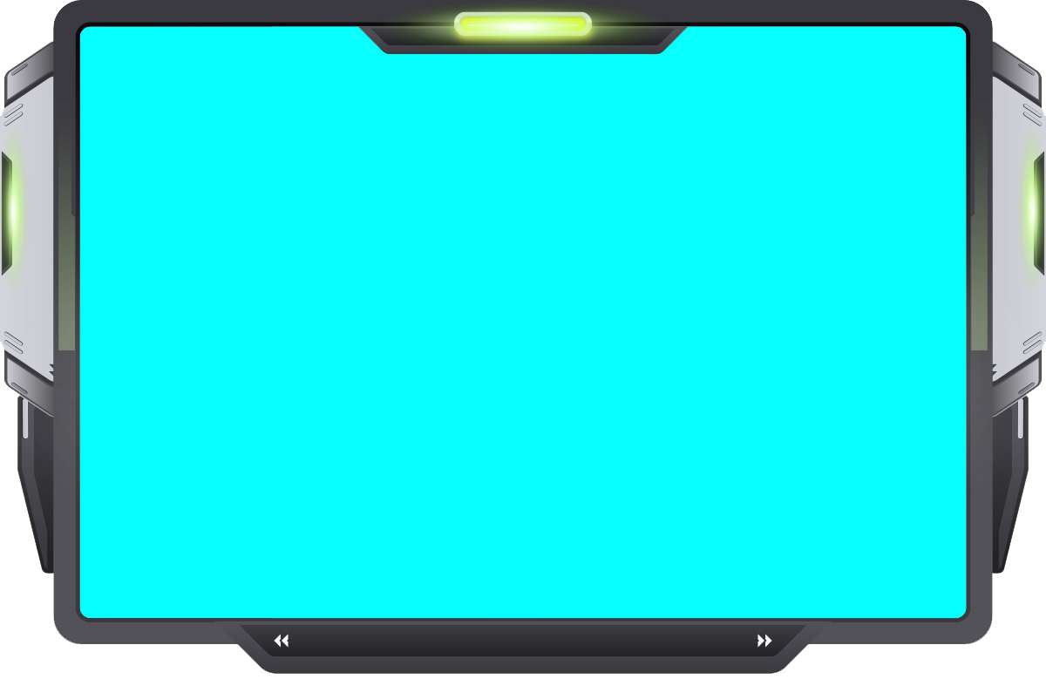

System Block Diagram
ECC RDIMM x4
Backplane
Gold Finger
PCI-E Gen3 x 16
PCI-E Gen3 x 16
4 x PCIe Gen3 x8
PCI-E Gen3 x 16
PCI-E Gen3 x 16
2 x
U.2 SSD x4
PCI-E Gen3 x 8
PCI-E Gen3 x 16
12 x
SATA HDD
PCI-E Gen3 x 8
DMI channel
2 x PCIe Gen3 x4
2*PCI-E Gen3 x 4
2*PCI-E Gen3 x 4
1 x GbE LAN
8 x
SATA HDD
C422
1 x 10GbE LAN
1 x
M.2 SSD

Slide 9
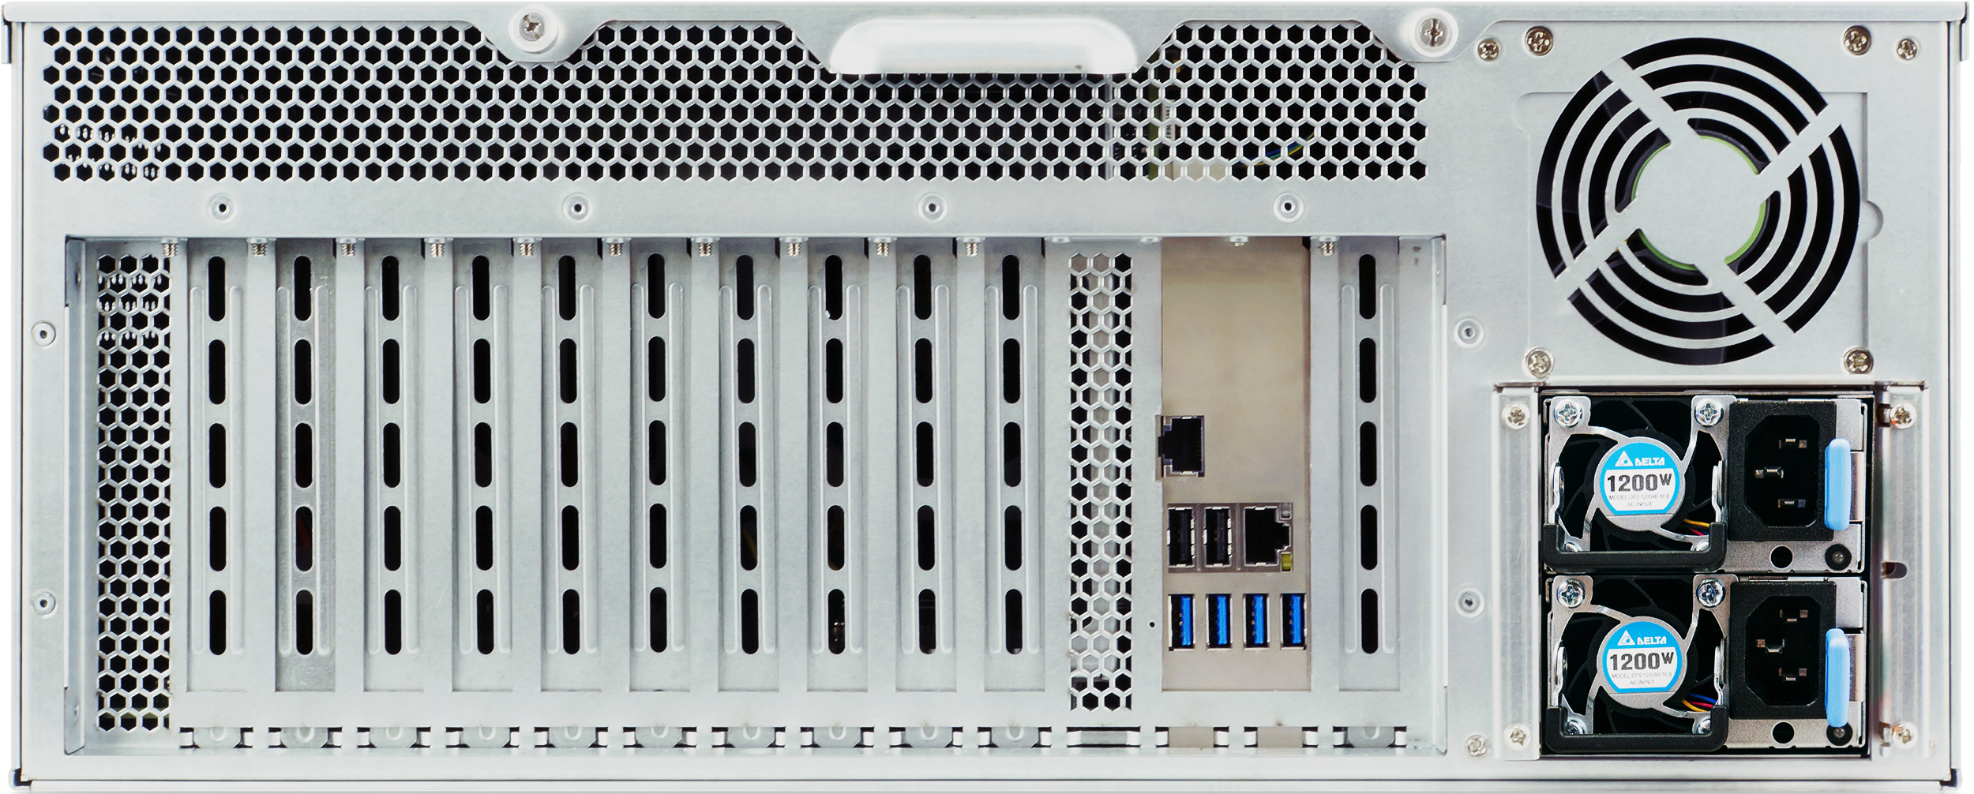
Rear View
1 Gigabit LAN port
4 x USB 3.0 port
1200W redundant PSU
2 x USB 2.0 port
10GBase-T LAN port

Slide 10

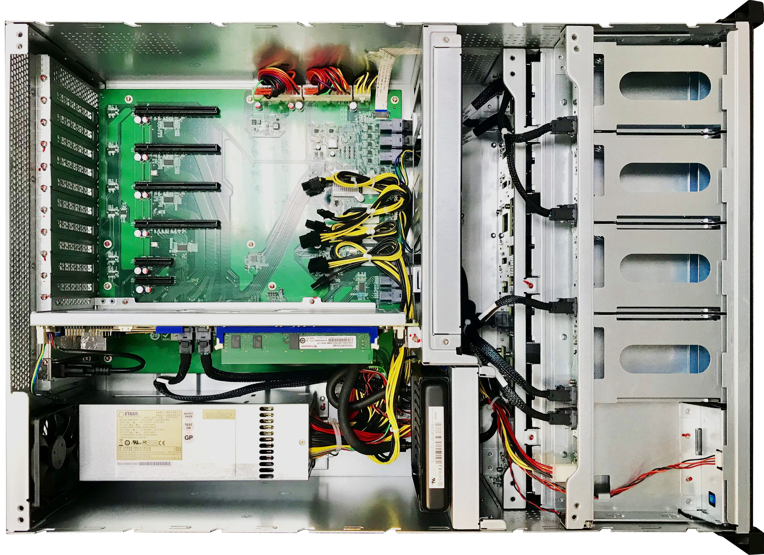
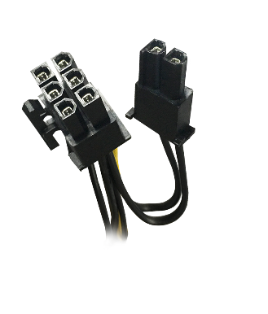
Top View
3x 12 cm cooling fan
Front-to-back airflow for HDD and GPU cards
12cm quiet cooling fans
4 x 6+2 pin PCIe power connector
Four PCIe Gen3 x8 slot
Max depth 330mm
Fit for GPU cards in the market
330 mm
Main Board
Liquid cooling radiators

Slide 11
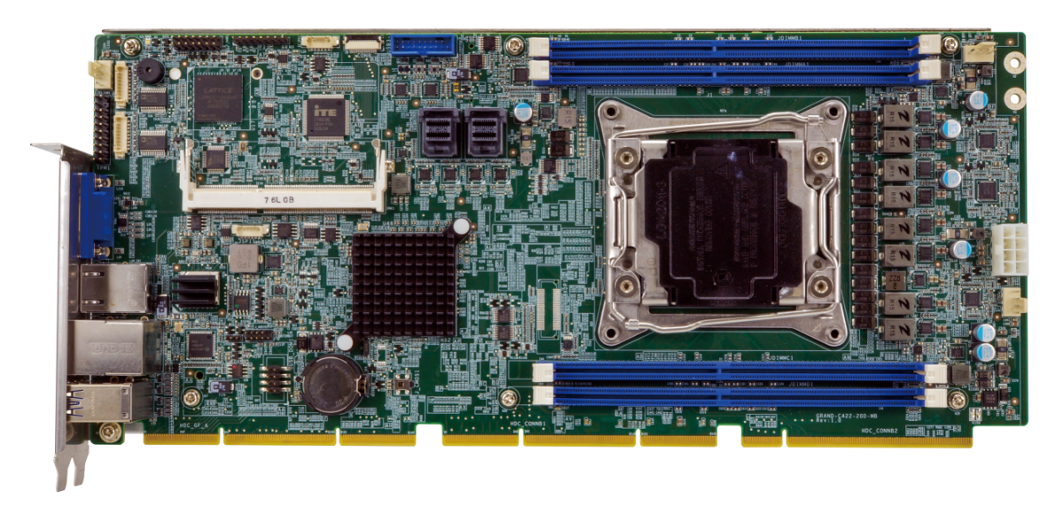
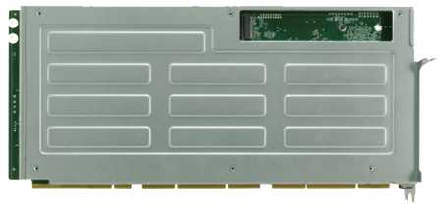
SBC Main Board
M.2 2280 nVMe SSD
High Speed Signal
General Signal
PCIE : 56 lanes to gold finger
USB 3.0: 4 ports
Mini SAS on-board
10GbE ethernet
Front panel
SMBUS
CLOCK
SGPIO for HDD LED

Slide 12
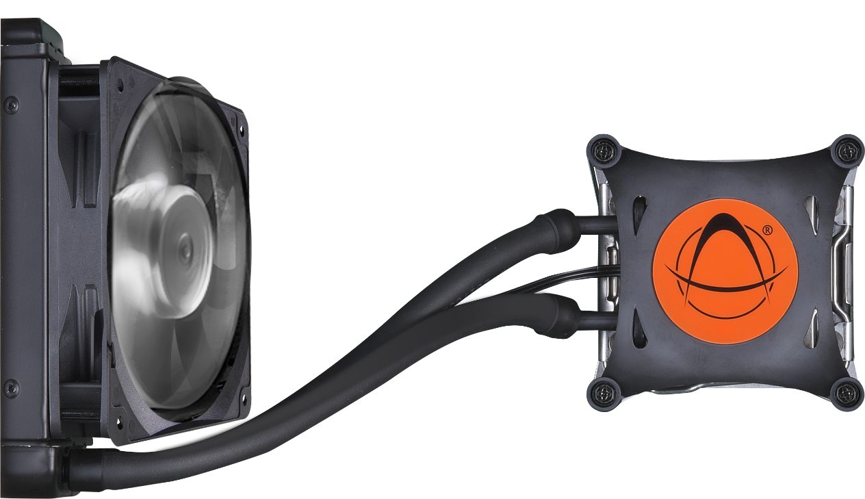
ASETEK CPU Liquid Cooling System
Unparalleled Cooling Performance for 140W Xeon
Cooled
water inlet
Liquid cooling pump
Liquid cooling radiators
12 cm Cooling Fan
Heated water
outlet

Slide 13
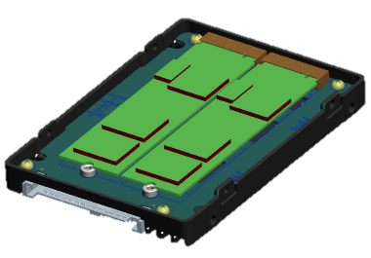
QDA U.2 to M.2 Drive Converter
QDA-U2MP
QDA-U2MPR
Dimension：100.2 x 69.85 x 15mm (2.5” HDD)
Controller：Asmedia 2812X
RAID：N/A
U.2 interface： PCIe Gen3 x4
M.2 interface：2 x PCIe Gen3 x4 M.2 port, 2280.
Dimension：100.2 x 69.85 x 15mm (2.5” HDD)
Controller：Marvell NevoX
RAID：Hardware RAID0，RAID1
U.2 interface：PCIe Gen3 x4
M.2 interface： 2 x PCIe Gen3 x4 M.2 port, 2280.
U.2 port

Slide 14
4-Channel DDR4 Memory
4 Memory Slot
Up to 256GB
Installing memory in 4 to take advantage of 4-channel
Notes:
CPU左右各四條

Slide 15


Memory Accessory
Ordering P/N | Specification
RAM-8GDR4ECK0-RD-2666 | DDR type: DDR4(288PIN) ECC RDIMM Capacity: 8 GB Manufacturer: Kingston Frequency: DDR4-2666 Manufacturer P/N: KSM26RS8/8MEI
RAM-16GDR4ECK0-RD-2666 | DDR type: DDR4(288PIN) ECC RDIMM Capacity: 16 GB Manufacturer: Kingston Frequency: DDR4-2666 Manufacturer P/N: KSM26RS4/16MEI
RAM-32GDR4ECK0-RD-2666 | DDR type: DDR4(288PIN) ECC RDIMM Capacity: 32 GB Manufacturer: Kingston Frequency: DDR4-2666 Manufacturer P/N: KSM26RD4/32MEI
RAM-64GDR4ECS0-LR-2666 | DDR type: DDR4(288PIN) ECC LRDIMM Capacity: 64 GB Manufacturer: Kingston Frequency: DDR4-2666 Manufacturer P/N: M386A8K40BM2-CTD
LRDIMM & RDIMM cannot be used at the same time.

Slide 16
Choose Your TS-2088XU
TS-2088XU-W2123-32G
Xeon® W-2123 4-core/8-thread 3.6GHz processor(Turbo 3.9 GHz)
32GB DDR4 ECC RDIMM (4 x 8GB)
TS-2088XU-W2133-64G
Xeon® W-2133 6-core/12-thread 3.6GHz processor(Turbo 3.9 GHz)
64GB DDR4 ECC RDIMM (4 x 16GB)
TS-2088XU-W2145-128G (BTO)
Xeon® W-2145 8-core/16-thread 3.7GHz processor(Turbo 4.5 GHz)
128GB DDR4 ECC RDIMM (4 x 32GB)
TS-2088XU-W2175-128G (BTO)
Xeon® W-2145 14-core/28-thread 2.5GHz processor(Turbo 4.3 GHz)
128GB DDR4 ECC RDIMM (4 x 32GB)
TS-2088XU-W2195-256G (BTO)
Xeon® W-2195 18-core/36-thread 2.3GHz processor(Turbo 4.3 GHz)
256GB DDR4 ECC RDIMM (4 x 64GB)

Slide 17
Build Up High Performance Computing Storage with QTS 4.4.1

Slide 18


Fibre Channel Adopt Industries
"Fibre Channel is safe. It's trusted. It's still a rock-solid solution. And customers aren't looking to rip everything out and change their protocols. Changing protocols is something that usually takes many years to happen," said Stuart Miniman, principal research contributor at Wikibon, a community-focused research and analyst firm based in Marlborough, Mass.
Banking
Online e-commerce
Low latency
High security
Database transaction
Notes:
https://searchstorage.techtarget.com/tip/FC-technology-still-dominates-enterprise-storage-networking

Slide 19

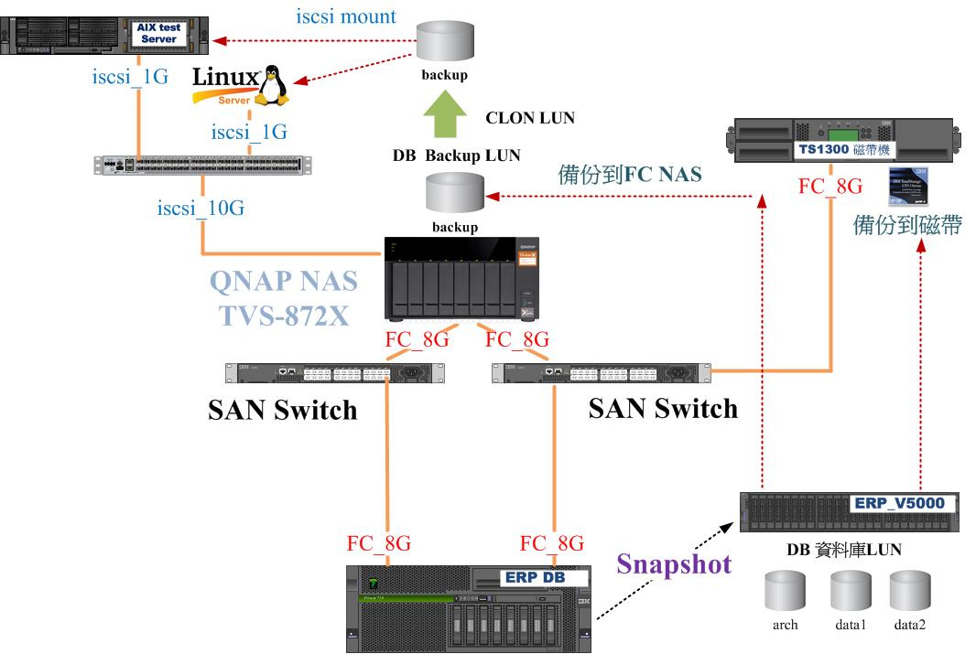
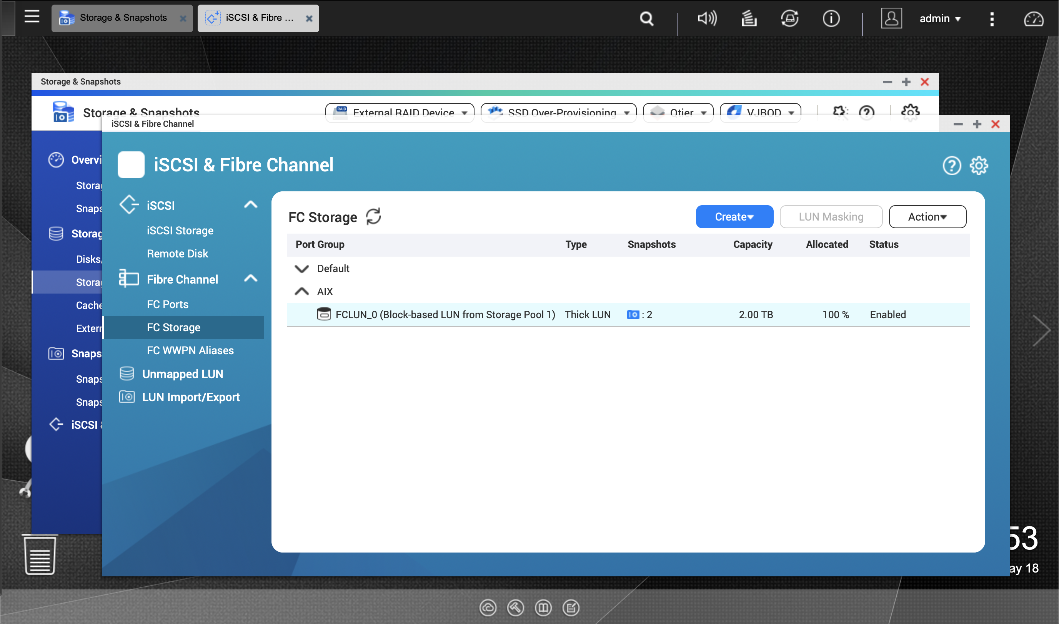
Fibre Channel & CDM​
QTS 4.4.1 will support iSCSI & FC Manager​
LUN (LUN clone) can be mapped between iSCSI target and FC port group for copy data management (CDM) ​
Application
Backup to NAS
TS-2088XU

Slide 20

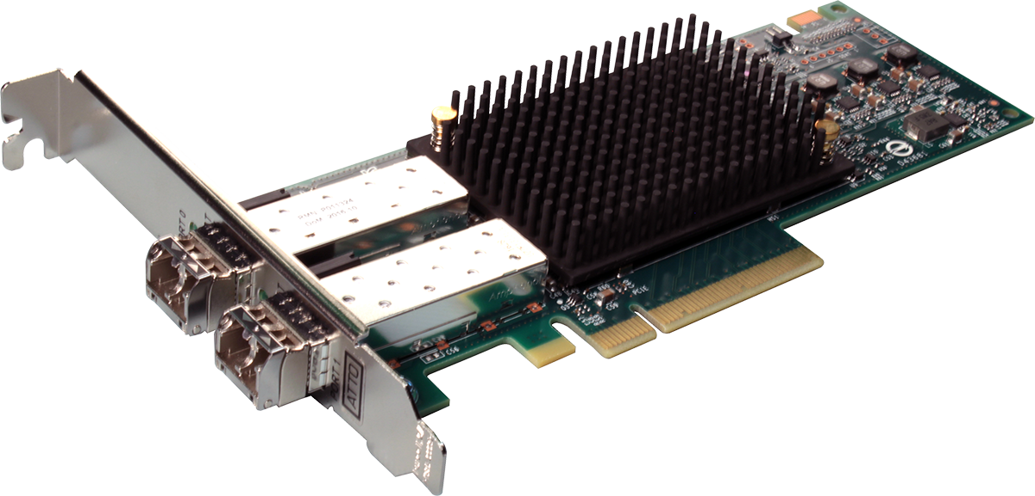

Supported Fibre Channel adapters
Partnering with industry-leading FC adapter vendors for the most economical FC SAN storage solution
Support Marvell
Qlogic 32Gb/16Gb/8Gb/4Gb FC adapters
Support ATTO
Celerity 32Gb/16Gb FC adapters
HAL : http://www.qnap.com/compatibility/

Slide 21
Deep Learning NAS- TS-2088XU
Deep Learning Models
Framework
Caffe
Caffe2
CNTK
MXNet
Neon
PyTorch
Tensorflow
…
Image Classification
AlexNet, VGG16, GoogLeNet, ResNet, MobileNet, etc.
Object Detection
SSD, Yolo v1/v2/v3,
R-FCN, RCNN,
Faster RCNN, etc.
Image Segmentation
SegNet, U-Net, FCN, DeepLab v1/v2, etc.
The all-in-one solution for computing and storage
Face Recognition
MTCNN, DeepFace, Facenet, etc.
Video Classification
RNN, LSTM, etc.
Vocie Recognition
DeepVoice, WaveNet, etc
Training
Intel® MKL/ NVIDIA® CUDA/ OpenCL
Inference(tool kit/SDK)
CoreML (iOS)/ OpenVINO/ Tensorflow Lite (Android) / TensorRT (Nvidia)
Container Station
NVIDIA Driver
IGD Driver
QTS 4.4.1

Slide 22
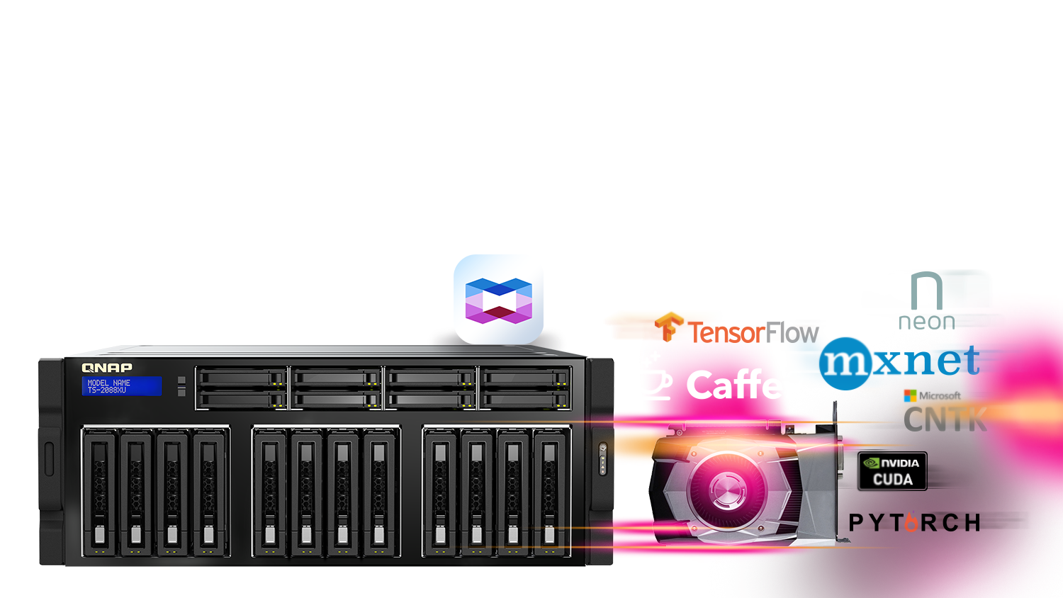
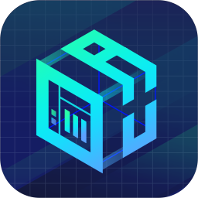
The ready-to-use AI environment -QuAI​
Ready-to-use GPU driver and Container Station enable users to easily and quickly construct containers such as Caffe, TensorFlow, MXNet, and pytorch with GUI in QTS.​

Slide 23
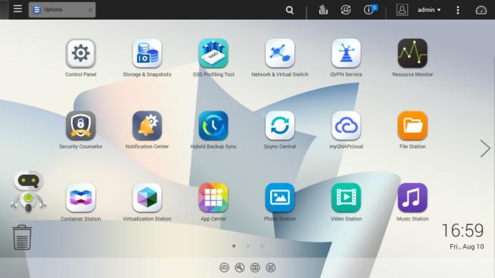



QTS & virtualization increase productivity
Supports Windows/Linux VMs and containers
Virtualization Station
Container Station
Notes:
請確認 QTS 4.3.5 的 UI 要不要換 (by Teresa)

Slide 24
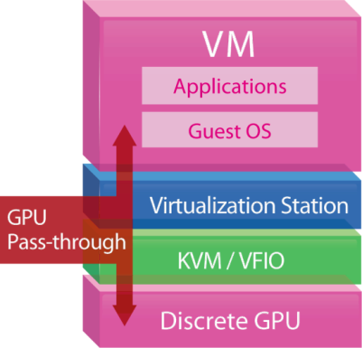
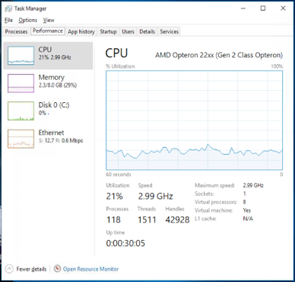
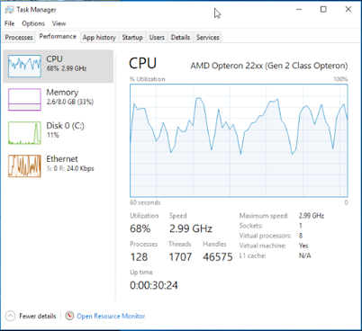


GPU boosts image/video processing​
For OpenGL & DirectX applications
H/W accelerated with GPU to lower CPU usage.​
w/ GPU
w/o GPU

Slide 25
vQTS – Virtual QTS
Host multiple virtual NAS in a physical NAS
Resource segregation (CPU, memory and networking)
Savings on energy, cost and physical space.
Notes:
https://www.figure-eight.com/dataset/open-images-annotated-with-bounding-boxes/
https://storage.googleapis.com/openimages/web/download.html
http://academictorrents.com/details/9e9194e21ce045deee8d811481b4cd676b20b06b

Slide 26


HBS 3.0 Back up with source-side data deduplication
Feature highlights
Source-side data deduplication
VM image Size | Deduped File Size | Compression Rate
15.48 GB | 7.59 GB | 2.04:1
Advantages
Bandwidth reduction
Storage space saving
Highly compatible with cloud services
Note: This is the compression rate of one VM image file.
01
02
Bandwidth reduction
Storage space saving
03
Compatible with cloud services
QuDedup support model: x86

Slide 27





Hybrid Cloud Solution to Embrace The Advantages of Both
Security
Storage extension
Access speed
Powerful computing
Access anywhere
Taipei
Tokyo
New York
Hybrid cloud solution is one of the best choices for the enterprise!
Keep the old service investment and get the elasticity advantage!

Slide 28
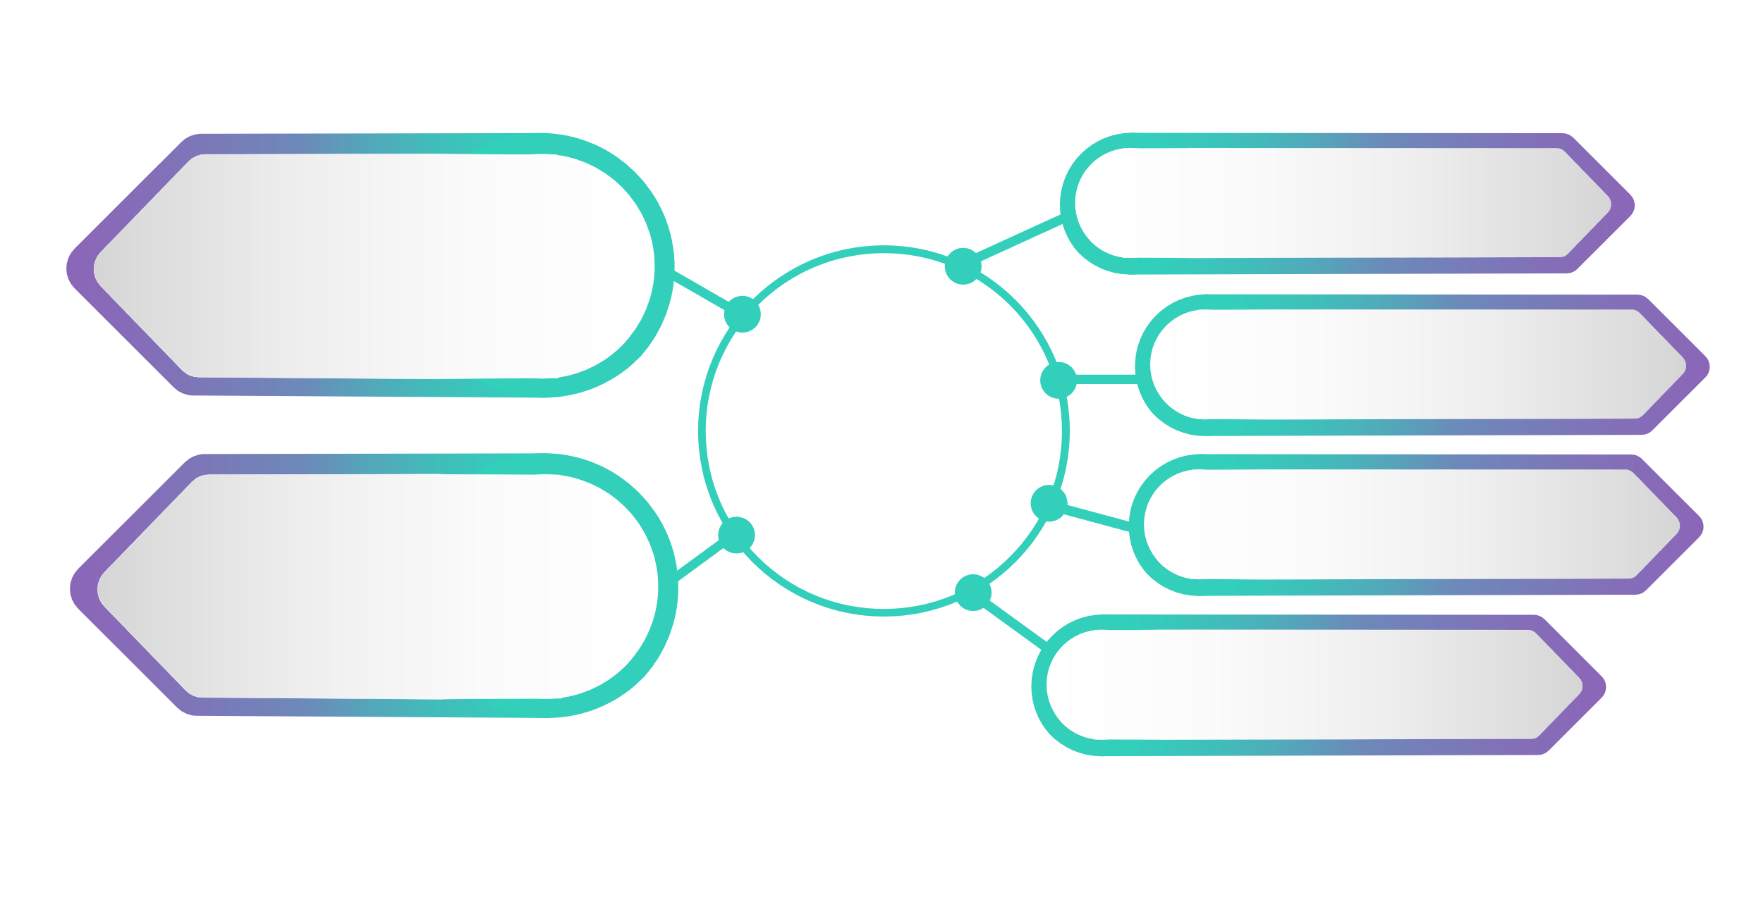





















QNAP Hybrid Cloud Solution: CacheMount
Supports 20 Cloud Services
4 New experiences
File-based Storage
Cache Function:
Much smoother access
PC can access cloud storage through SMB/AFP
Object-based Storage
Share files between multiple site office on time
CacheMount
Horizontally integrate QTS APPs to use cloud data

Slide 29








CacheMount as a Bridge to the Cloud
Cloud Service
CacheMount
Data Usage
User Interface
Object-based storage service
NAS Applications
File management, editing, multimedia services
Cache Volume
User Interface
File Transfer Agent
…
Sync Agent
Metadata
File-based storage service
Network Protocol Access
Samba, NFS, FPT, AFP, WebDAV
Authorization
Agent
Cached Data
Cache
Algorithm
…
Storage & Snapshot
User Interface

Slide 30


QNAP NAS
is ​Your ​Best Choice​​
Copyright© 2019 QNAP Systems, Inc. All rights reserved. QNAP® and other names of QNAP Products are proprietary marks or registered trademarks of QNAP Systems, Inc. Other products and company names mentioned herein are trademarks of their respective holders.​​​​​​

