Slide 2
QSW-308 series unmanaged switch
1
Surf your 10GbE network
2
QSW-308 series 10GbE switch has been unveiled
3
Best combination for 10GbE soho/office
4
QSW-308 series specification and upgrade guide

Slide 3
Surf your 10GbE Network

Slide 4
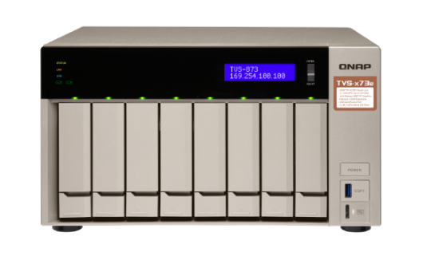
Spent most time for transfer file?
How long does it take to
copy 300GB of videos?
How to reduce the time？
1GbE
50 min
10GbE
1GbE
5GbE
2.5GbE

Slide 5
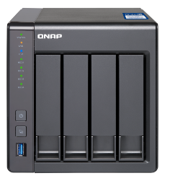
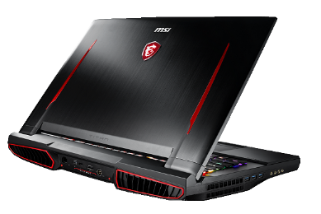
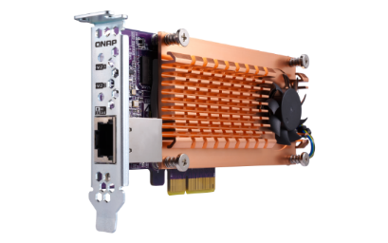
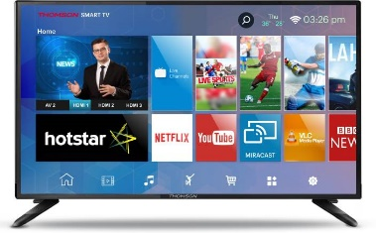
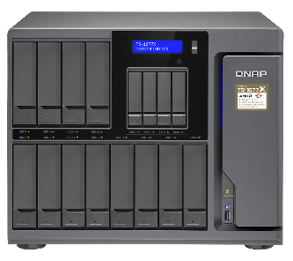
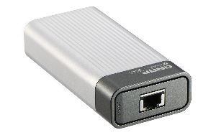
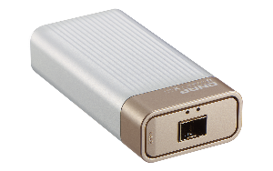
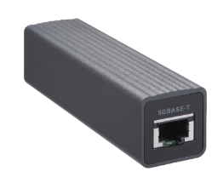
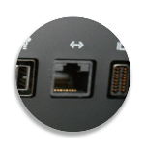
10Gbps products for business/home
10G SFP+
NAS
10G Ethernet Port
Notebook
10G Network Interface Card
1G Multimedia Device
10G BASE-T
NAS
10G/5G QNA
Network Adapter
10G Ethernet Computer
1G Wi-Fi Router

Slide 6
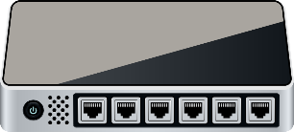
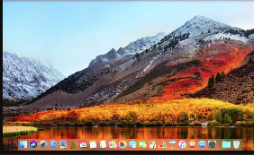
Barriers of 10G
10GbE SFP+
NAS
10GbE Ethernet
Port Notebook
TS-431X
10GbE Ethernet
Port Computer
1G Switch
10GbE BASE-T
NAS
Apple iMac Pro
1GbE Wi-Fi Router
1GbE Apple TV

Slide 7
High cost to build your 10GbE network?
10GbE SFP+
NAS
10GbE Ethernet Port Notebook
TS-431X
10G switch
10GbE Ethernet Port Computer
10GbE BASE-T
NAS
Apple iMac Pro
1G switch
1GbE Wi-Fi Router
1GbE Apple TV

Slide 8
QSW-308 series 10GbE switch has been unveiled

Slide 9
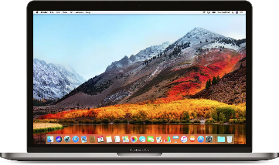
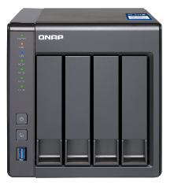
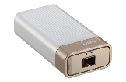
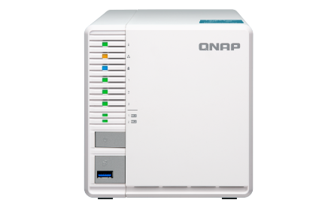
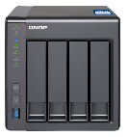
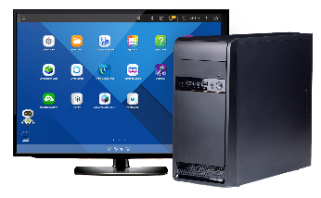
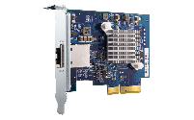
Flexibility from 10GbE and 1GbE port
Combo port supports 5 networking speeds
Internet
Solve all network building problem
10G
1G
Cloud backup
10G
1G
1G
1G
10G
Remote backup
Home device

Slide 10
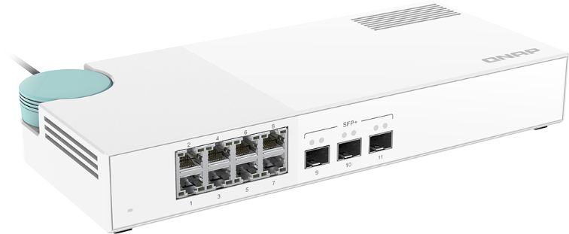
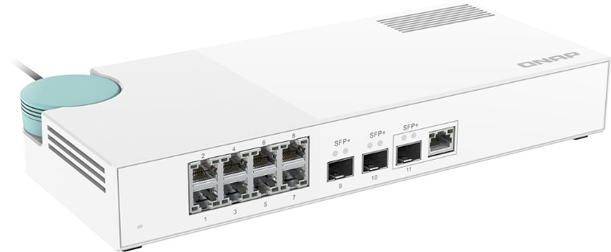
QSW-308 series features
QSW-308S
QSW-308-1C
Use 10G-SFP-T copper transceiver module
for link up copper cable
Use 10G-SFP-T copper transceiver module
for link up copper cable
3 x 10GbE SFP+ port
8 x 1GbE RJ45 port
3 x SFP+ 10GbE port
(built-in 1 x 10GbE NBASE-T Combo port)
Support: 10Gbps/5Gbps/2.5Gbps/1Gbps/100Mbps
8 x 1GbE RJ45 port

Slide 11
Multi-Giga port
Automatically adapts to the required speed and supports 5 networking speeds.
10G
5G
2.5G
1G
100M
Supports Multi-Gigabit NBASE-T by QSW-308-1C combo port

Slide 12
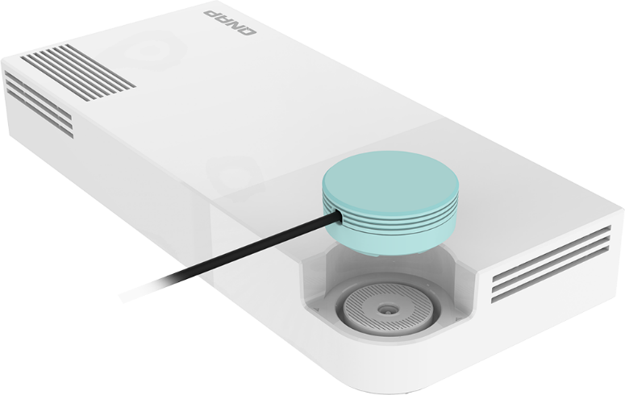
Thin and light design
Sleek design for desktop placement​
90 degree
Adjustable angle power cable design

Slide 13
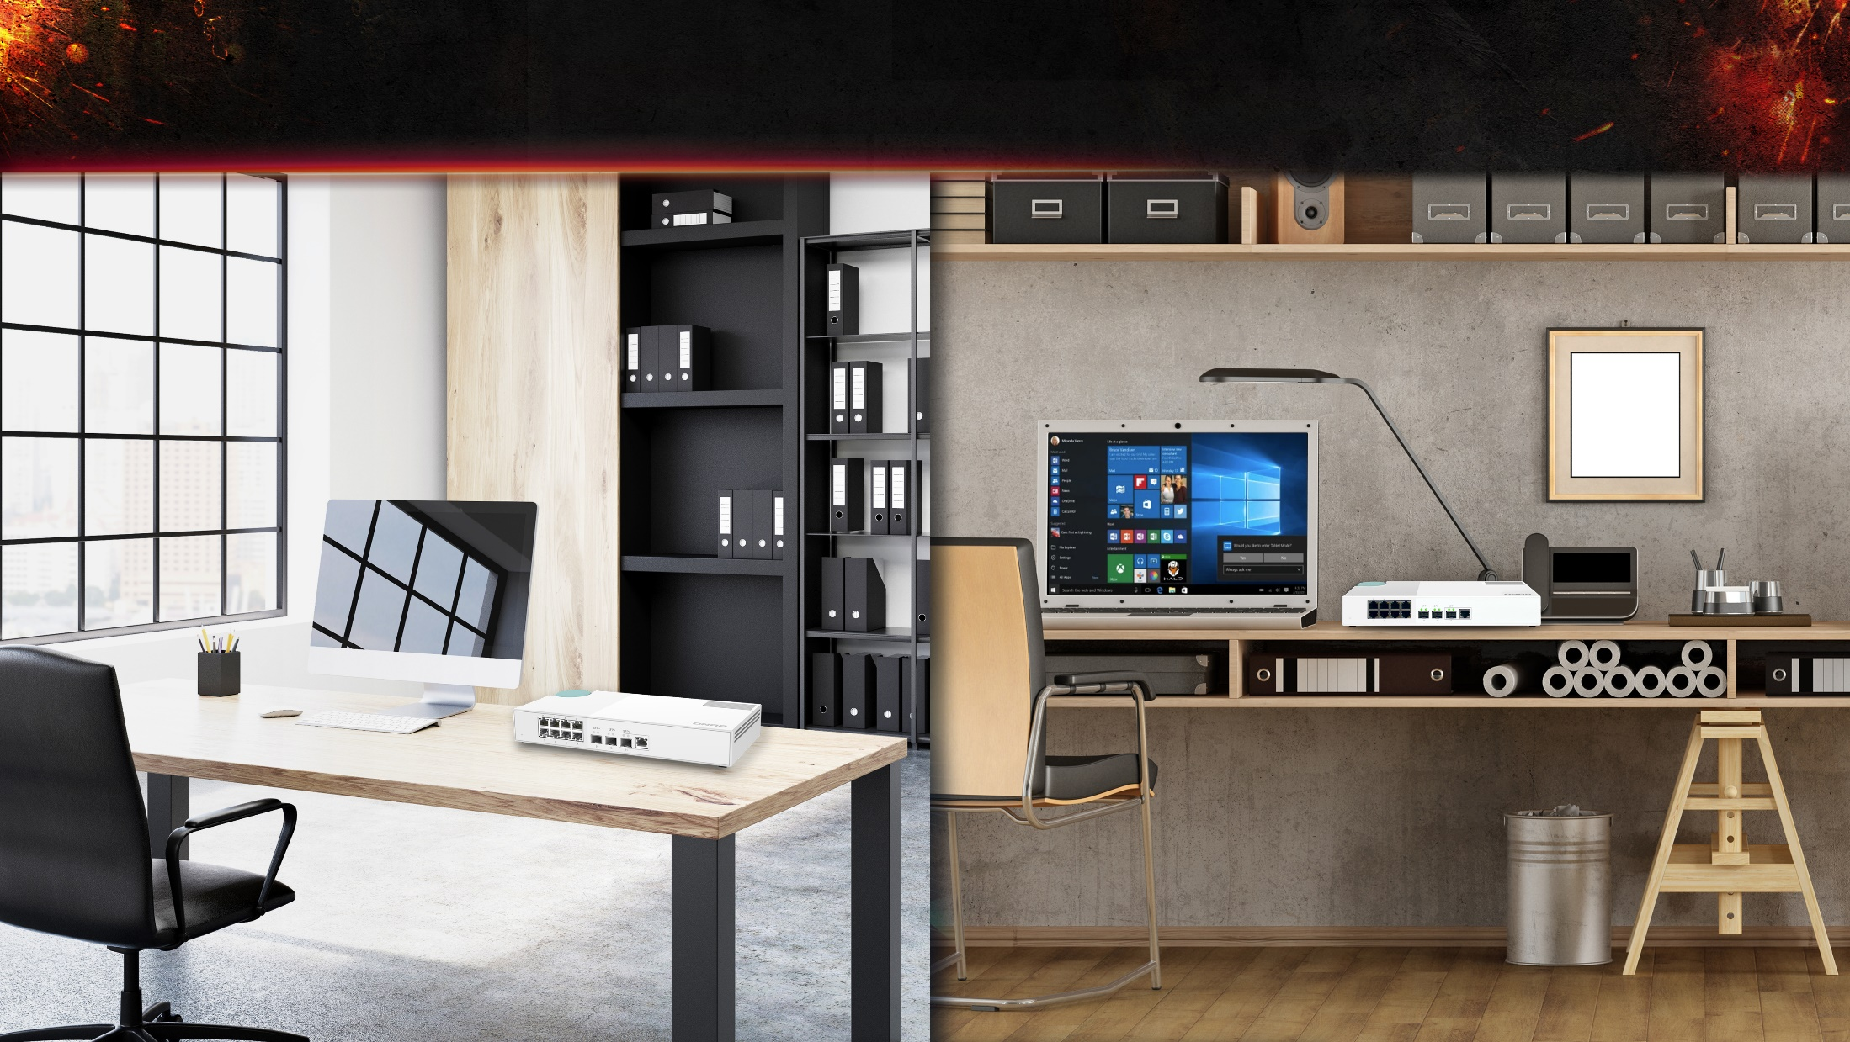
Fanless design

Slide 14
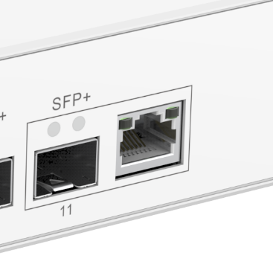
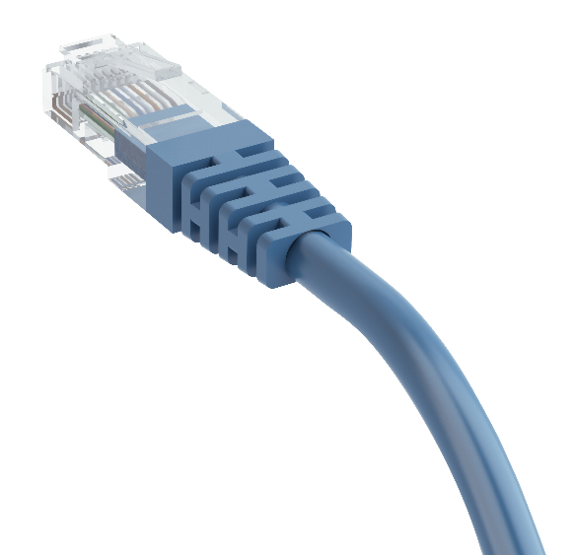
Upgrade with existing cable wiring
Supports Multi-Gigabit NBASE-T by QSW-308-1C combo port, existing RJ45 cables can be used for faster speeds!
 | CAT 5e | CAT 6 | CAT 6A & CAT 7
100M | √ | √ | √
1G | √ | √ | √
2.5G | √ | √ | √
5G | √ | √ | √
10G | X | √(55m) | √

Slide 15
Best
combination for 10G SOHO/office

Slide 16
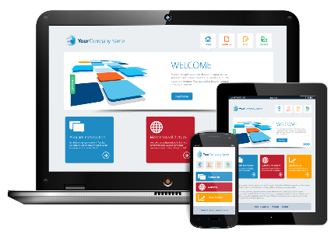
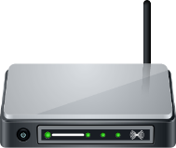
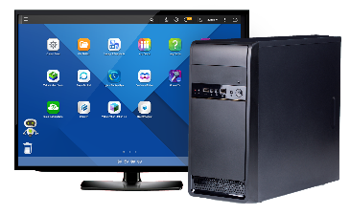
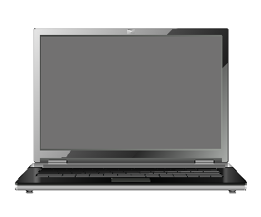
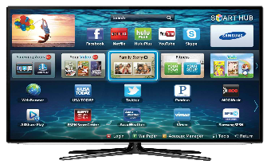
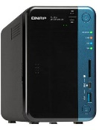
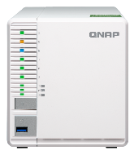
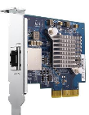
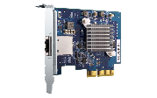
Build a high-speed home network
1G WiFi router
Internet
1 Gbps WiFi device
QSW series 10GbE switch
1 Gbps
1 Gbps
10Gbps RJ 45
10Gbps SFP+
PC + QXG-10G1T 10GbE LAN Card
1G Notebook
Smart TV
NAS
NAS

Slide 17
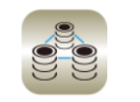
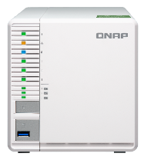
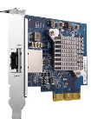
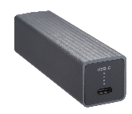
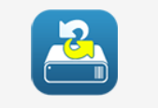
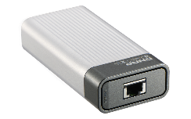
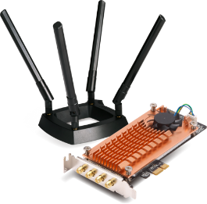
Build a high-speed office network
10G Backup NAS
QNAP 10G switch
10Gbps SFP+
10Gbps RJ45
QSW-308-1C
File Storage &
Sharing
Storage
Management
Internet
Privileges & Security
Virtualization
QNA 10G/5G
network adapter
Backup & Recovery
Network
Management
Productivity
QNAP provide
More QPKG for
office user
MacBook Pro
Windows PC
QWA-AC2600
Thunderbolt 3 and USB 3.0
Wireless AP NIC

Slide 18
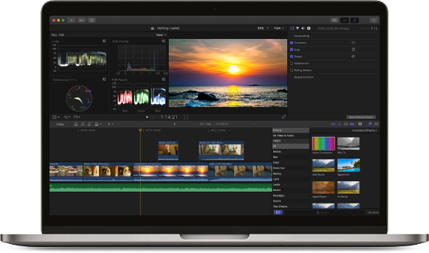
Build a high-speed workstation network
Back up to
QNAP 10GbE NAS
Video Editing workstation
Back-up your masterpiece
QSW series switch
TS-963X
10GbE
Thunderbolt 3
10GbE
TS-332X
Find more QNAP 10GbE NAS
https://www.qnap.com/en/product/?conditions=2-4,2-5

Slide 19
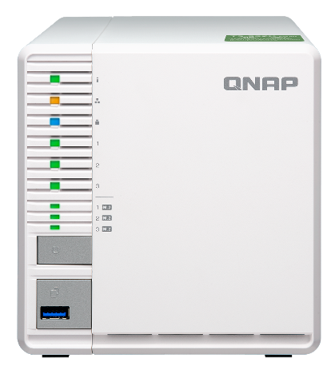
Quad-core NAS for 10 GbE environment
TS-332X
AL324 4-core
64-bit 1.7G CPU
Hardware Encryption Acceleration Engine
Up to 16GB DDR4 SO-DIMM

Slide 20
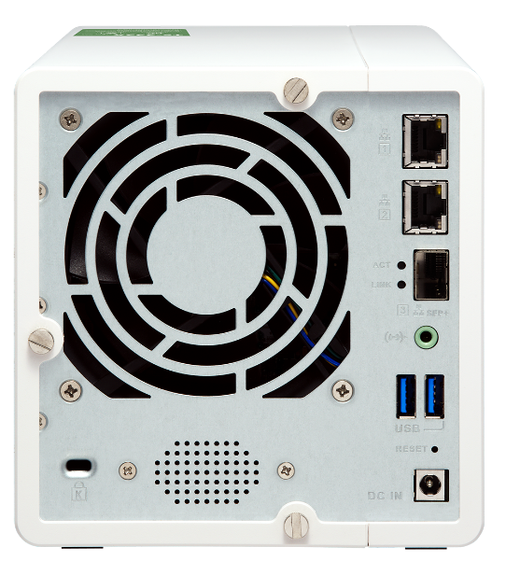
Built-in single 10GbE SFP+ port
Fully support 10GbE high-speed networks, delivering a major speed increase for virtualization tasks, fast backup & restoration, and large-data applications.
QSW-308S
QSW-308-1C

Slide 21
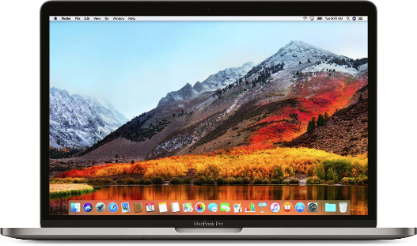
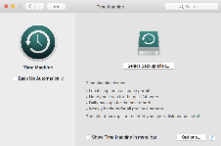
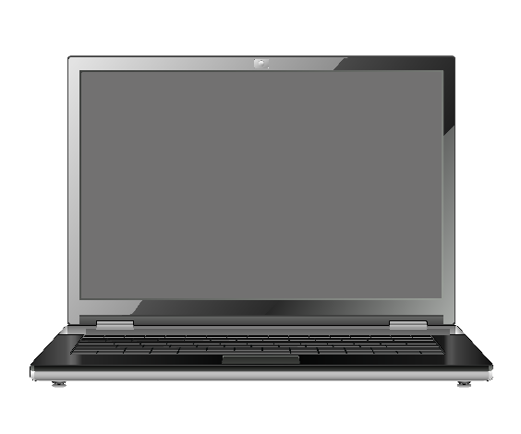
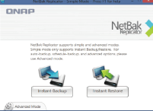
A complete backup solution
Data backup is the most effective way against ransomware
Mac O.S.
Time
Machine
Real-time or scheduled back up to the TS-332X easily.
Windows
NetBak
Replicator

Slide 22
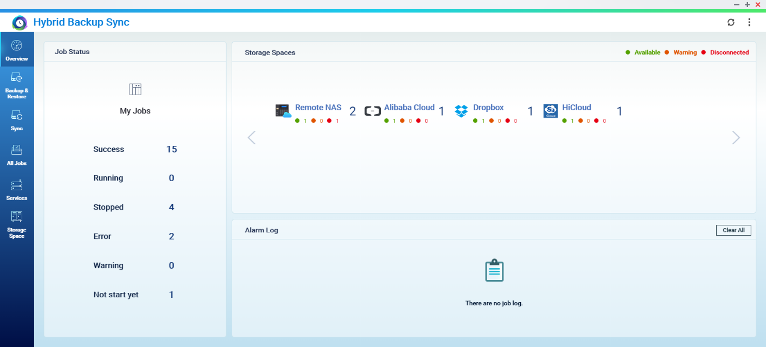
QNAP Hybrid Backup Sync
1
2
3
Backup
Restore
Sync
Intuitive operation design Improve backup management efficiency
Task overview page Manage multiple tasks at once

Slide 23
QSW-308 series
specification and
upgrade guide

Slide 24
QSW308 series product feature
Affordable 10GbE high-performance solution and also provide 1GbE network
Ideal for home and SOHO networks requiring intensive data traffic
Simple Plug-and-play set-up
Sleek design for desktop placement
QSW-308S
QSW-308-1C

Slide 25
QSW series product comparison
 | QSW-308S | QSW-308-1C | QSW-1208-8C | QSW-804-4C
Gigabit Ethernet Port (RJ45) | 8​ | 8​ | - | -
10GbE – RJ45 |  |  | 8 | 4
10GbE – SFP+​ | 3​ | 3​ | 12 | 8
10 Gigabit Ethernet Port (RJ45) | ​-- | 1 (Combo port)​ | 8 (Combo port)​ | 4 (Combo port)​
Dimensions | 290 x 50 x 42.5 mm (11.4 x 2.0 x 16.7 in) |  | 285 x 43 x 233 mm (11.2x 1.7 x 9.2 in)
Net Weight: | 820g |  | 2150g | 2100g
Power ​ | AC adapter , 36W, 100 - 240V​ |  | AC adapter , 50W, 100 - 240V​ | AC adapter , 41W, 100 - 240V​
Operating temperature | 0°C to 40°C (32°F to 104°F) |  | 0°C to 40°C (32°F to 104°F)
Fan | Fan less design |  | 2 x 4cm fan (12V DC)
Management Type | Unmanaged switch |  | Unmanaged switch

Slide 26
Simple identification of LED Status
Power on/off
Power on/off
RJ45 Giga port status
Left (green) - connected to a gigabit network.
Right (Amber) - not connected to a
gigabit network.
RJ45 Giga port status
Left (green) - connected to a gigabit network.
Right (Amber) - not connected to a
gigabit network.
SFP+ 10GbE port status
Green - connected to a 10GbE network.
SFP+ 10GbE port status
Green - connected to a 10GbE network.
RJ45 Combo port status
Left (green) - connected to a gigabit network.
Right (Amber) - not connected to a
gigabit network.
QSW-308S
QSW-308-1C

Slide 27
Plan for workstation and home
Plan A - Workstation
10G Switch x 1
1G Switch x 1
Soho PC
QXG-10G1T NIC
TS-332X
QSW-308 Series
10G/1G Port Switch

Slide 28
Plan for collaborative office
Plan B - Collaborative office
10G Switch x 1
1G Switch x 1
Built-in 10/5 GbE Port
NB/MAC
WiFi 5G/2.4G
Network
TS-932X
QSW-308 Series
10G/1G Port Switch
QNA Network Adapter
TB3/USB NB/MAC
QWA-AC2600
Wireless AP Card

Slide 29
Plan for collaborative office
Plan C – High-end office
10G Wwitch x 1
1G Wwitch x 1
10G Combo Port Switch
TVS – X82 Series
Built-in 10/5 GbE Port
NB/MAC
WiFi 5G/2.4G
Network
QSW-308 Series
10G/1G Port Switch
QSW-1208 Series
10G Combo Port Switch
QNA Network Adapter
TB3/USB NB/MAC
QWA-AC2600
Wireless AP Card

Slide 30
QNAP 10GbE NAS
Internal 10G series
SFP+
TES-x85U series, TDS-16489U，TVS-x80U series, TS-x73U series, TS-x63U series, TS-1635, TS-932X, TS-x31X, TS-x31XU
RJ45 (BASE-T)
TS-1685, TS-1677X, TVS-x82T series, TVS-x71T series, TVS-863+
Extendable 10G series
SFP+ / RJ45 (BASE-T)
TVS-x82 series, TS-x77 series, TVS-x71U-RP series, TVS-x71 series, TVS-x73 series, TVS-x73e series, TS-x73 series, TS-563, TS-x53BU series, TS-x53B series, TS-x53Be series, TS-x32X series

Slide 31
QNA series for 10GbE
QNA-UC5G1T
QNA-T310G1T
QNA-T310G1S
USB 3.0
Thunderbolt 3
Thunderbolt 3
RJ45 NBASE-T
4 speed: 5G/2.5G/1G/100M
10GbE NBASE-T port
5 speed: 10G/5G/2.5G/1G/100M
10GbE SFP+ Port
Supported speed: 10Gbps

Slide 32
Easily upgrade to 10GbE PC/NAS
QM2-2S10G1TA
QM2-2P10G1TA
Dual M.2 2280 SATA/PCIe NVMe SSD slots + single port 10GbE expansion card
PCIe expansion
slots
Support PCIe
expansion NAS
QXG-10G1T
Single port five speed 10GbE network expansion card
More NAS with PCIe expansion slots : https://www.qnap.com/zh-tw/product/?conditions=2-5

Slide 33
More accessories for 10GbE
Buy now
1.5M SFP+ 10GbE DAC
SN:
CAB-DAC15M-SFPP-DEC02
3.0M SFP+ 10GbE DAC
SN:
CAB-DAC30M-SFPP-DEC02
5.0M SFP+ 10GbE DAC
SN:
CAB-DAC50M-SFPP-DEC02
Mellanox MFM1T02A-SR SFP+ optical module for 10GBASE-SR
SN:
TRX-10GSFP-SR-MLX
Your can buy SFP+ Optical Module for 10GBASE-T on market

Slide 34
Copyright © 2019 QNAP Systems, Inc. All rights reserved. QNAP® and other names of QNAP Products are proprietary marks or registered trademarks of QNAP Systems, Inc. Other products and company names mentioned herein are trademarks of their respective holders.

