Slide 1
Notes:
https://heimdalsecurity.com/blog/free-encryption-software-tools/
https://www.g2.com/categories/encryption#learn-more
https://www.ncipher.com/2019/global-encryption-trends-study

Slide 2
Outline
The importance of encryption
What is QENC
How to secure files with QENC
Demo: File Station, Qfiling

Slide 3
The importance of encryption

Slide 4
Do you know...
McAfee made a survey to 30 million Skyhigh cloud service users
18%
of files uploaded to cloud-based file-sharing and collaboration services contain sensitive data*
* Categories of sensitive data
Confidential (44.4％)
- Financial records, business plans
Personally identifiable information (3.9％)
- ID numbers, dates of birth
Password (3.2％)
Payment information (2.3％)
- Credit and debit card numbers
Protected health information (1.6％)
- Patient diagnoses, medical treatments
Technology media CSO from IDG pointed
58%
of senior managers had accidentally sent the wrong person sensitive information
Ponemon Institute (U.S.) released a survey at 2019
54%
rank employee mistakes as the top threat to sensitive data; more than external hackers(30%) and malicious insiders(21%) combined

Slide 5
Protect data, prevent from risk
Protecting data is a responsibility to the enterprise.
Customer information, employees personal data, trade secrets, and new product plans.
Data breach causes loss of money and reputation, furthermore, legal responsibility.
The GDPR became effective in 2018. The CCPA becomes effective on 2020. How to process and store personal data need to follow the regulations.
So do individuals
Financial and medical data as well as credit card number and health records.
It would cause a huge loss if sensitive personal data was stolen or used in illegal way.

Slide 6
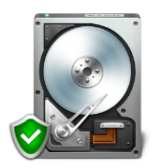
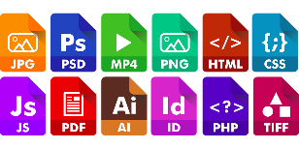
QENC - File Encryption on QNAP NAS
Existing encryption features
New Feature:
QENC File Encryption
Disk
Encryption
Share Folder Encryption
File Encryption
Encrypted qenc files can’t be read or open. Are secured when shared.
Disk and Share Folder Encryption protect data from unauthorized access even if the hard drives or the entire NAS were stolen.
Coming soon with QTS 4.4.1!
Notes:
It would prevent access to that folder if the physical unit or drives are stolen

Slide 7
Encrypt Files to Safely Share Them!
When sharing files via Email, communication app, files leave the protection of QNAP NAS.
Providing health records to your doctor
Send ID via LINE to apply for a loan. (Taiwan government listed Communication App into financial examination.)
You might do it very carefully. But, how to make sure every recipient never makes mistake to send sensitive data to unwanted parties?
QENC protects files even if the files are breached.

Slide 8
What is QENC

Slide 9
QENC, A File Encryption Module for QTS
Specially designed for QNAP NAS, QENC encrypts files so that no one can open or view until they input the correct password. Encrypted files become QENC files. You can tell them by the file name extension.
Encrypted file extension: .qenc
Encryption algorithm: AES 256
Password length: Up to 32 characters, special characters allowed.

Slide 10
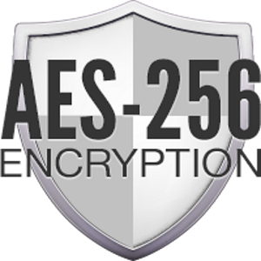
Adopt AES as encryption algorithm
Efficient in encryption
Adopted by mainstream encryption solution
World most widely used
Certified by NIST

Slide 11
AES: NIST Certified Encryption Standard
Adopted by the U.S. government.
The U.S. National Institute of Standards and Technology, NIST published AES as FIPS 197 in 2001
More efficient than DES (Data Encryption Standard, the former encryption standard). Less memory requirements .
Source: http://en.wikipedia.org/wiki/Advanced_Encryption_Standard

Slide 12
AES is widely used in mainstream encryption
Operation Systems
Microsoft EFS (Encrypting File System)
Apple macOS
Cloud Storages
Google Drive
Dropbox
All use AES-256 and AES-128 as algorithm to encrypt files.
Encryption software
World famous encryption software use AES too.
Software name | Download times | algorithm
AxCrypt | 20M | AES
Folder Lock | 1M | AES
Folder Password Lock Pro | 143K | AES
VeraCrypt | 41K | AES
Notes:
https://www.makeuseof.com/tag/google-drive-security-privacy-tools/

Slide 13
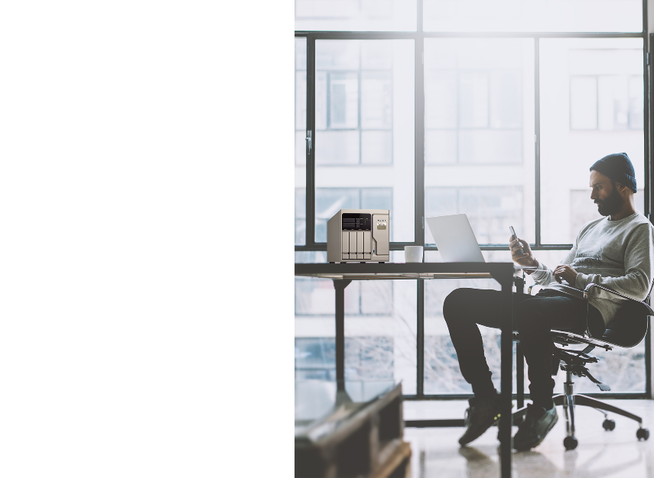
3 benefits of encrypting in QNAP NAS
1. Fasten another Lock to sensitive files
Encrypted files cannot be read without the password.
If a QNAP NAS is a bank, QENC is a portable safe box.
2. Solve file level encryption demands on QTS
Decrease the risk when transfer files to other site or device
No need to install any other software.
3. Support decryption on Windows, macOS and Mobile devices.

Slide 14
How to secure files with QENC
Notes:
https://en.wikipedia.org/wiki/Encryption

Slide 15
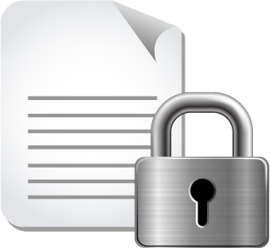
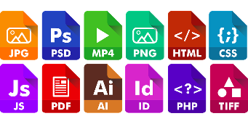
2 Steps to Encrypt, Securely Share
From QTS 4.4.1, you could encrypt, decrypt in File Station
Any type of file can be encrypted
Photos, document, sheets, audios, videos, web page ...
1
2
Select File
Input Password
QENC

Slide 16
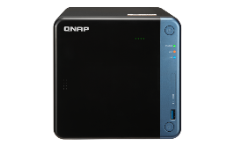
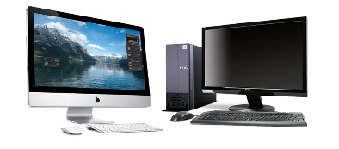
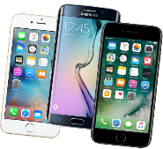
4 ways to encrypt or decrypt
File Station
Manage, encrypt, share
QENC Decrypter
Decrypt files on Windows mac Device
Qfiling
Organize files and batch encrypt
Qfile
Encrypt and share anytime, anywhere
Using QTS
Can’t connect to the NAS/
Share files to those that don’t own a NAS
Using Mobile Device
Notes:
image source:
https://www.compareandrecycle.co.uk/mobile-phones/refurbished

Slide 17
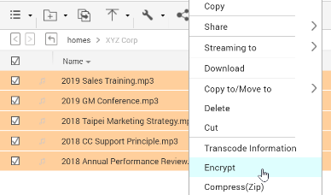
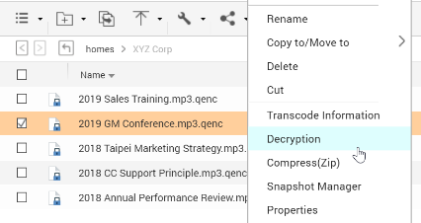
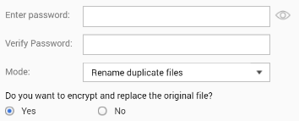
File Station - Manage files and Encrypt/Decrypt
Step 1.
Select files, Right click and choose “Encrypt”.
Step 2.
Input password: up to 32 characters, special characters allowed.
Step 3.
Encryption finished. Filename extension became qenc.

Slide 18
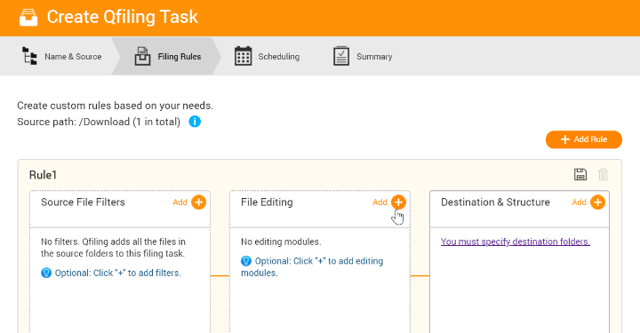
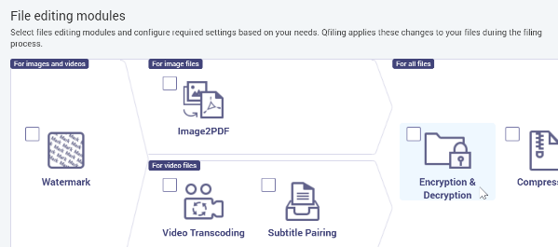
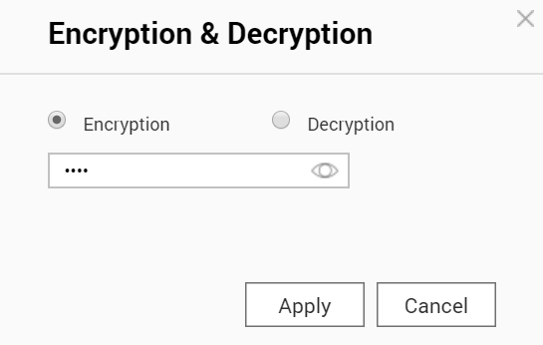
Qfiling - Organize files and batch encrypt
1
Select Encryption/Decryption in File Editing Modules.
2
Input password to set batch Encryption/Decryption.

Slide 19
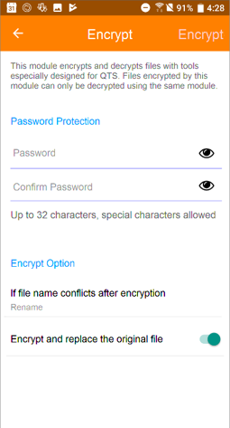
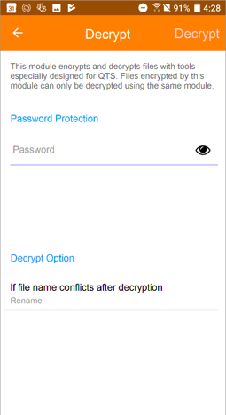
Qfile – Encrypt/Decrypt and share anytime, anywhere
Access QNAP NAS, encrypt or decrypt files on Android, iOS devices with Qfile. (Coming soon)

Slide 20
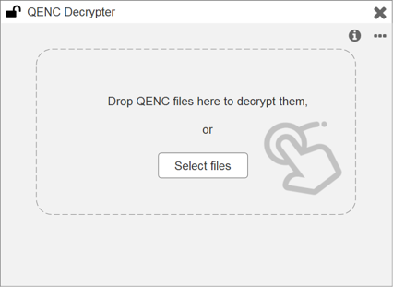
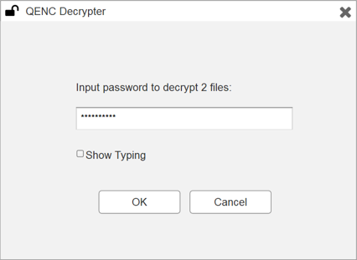
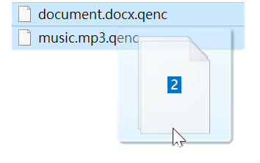
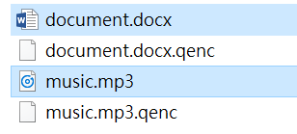
QENC Decrypter - Decrypt on PC Locally
QENC Decrypter (Coming soon)
Support Windows/ macOS

Slide 21
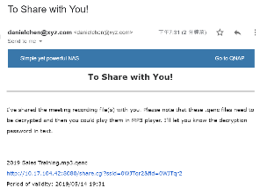
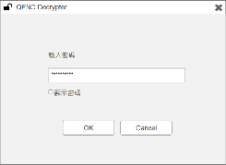
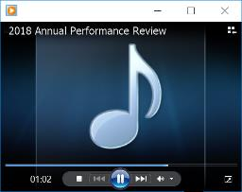
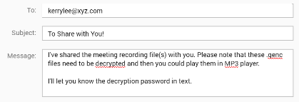
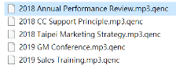
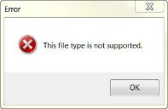
Share encrypted files, easily and securely
Encrypt before share, send password in another way. Make sure only specific people can open the file.
File Owner
Recipient
Hi, password for recording files is "Achg194=\5"
19:08
Read 19:12
Got it. Thanks!

Slide 22
Encryption on File Station and Qfiling

Slide 23
Reminder: Protect password
Even with strict information security technology and hard-to-crack encryption algorithms, you still need to use them correctly to truly protect your confidentiality.
Do not record password where others can reach.
Only send password via trustable communication app. Carefully choose recipients to provide password.
REMEMBER your password! Even QNAP cannot decrypt files for you without the password you set.

Slide 24
Securely share your sensitive files, with QENC file level encryption.
Copyright © 2019 QNAP Systems, Inc. All rights reserved. QNAP® and other names of QNAP Productsareproprietary marks or registered trademarks of QNAP Systems, Inc. Other products and company names mentioned herein are trademarks of their respective holders.

