Slide 1
Notes:
Apple tv/ Fire TV Qmedia

Slide 2
Home multimedia entertainment upgrades, everything is on your hand!​
The generation of smart living room is coming.​
Smart TV is coming, so is your multimedia!​
Qmedia for APPLE / FIRE TV software introduction
The most useful home multimedia feature is here for you!​
Set up your own multimedia server, it is so easy! ​
Total solution from download to playback, let us help you!​
Recommended Models：For new QNAP NAS users!​
There are lots of models, let me give you some suggestions!​

Slide 3
Making entertainment fun and easy!​
Media entertainment after work​
20
years ago​
10
years ago​
Now​
Watch movies on DVD player, watch photos on physical albums, and listen to music on cassette recorders.
Watch movies, photos, and listen to music on computer.​
??

Slide 4
The generation of smart living room is coming.​
Notes:
我們在想，如何結合現代科技，帶入智慧家庭的概念，智慧家庭就是 簡單好用嘛～～～ 越簡單越好

Slide 5
Smart living room, better life
Return to the appearance of live by a TV and a remote​
Before
My dad asked me before, why not project the photos you have taken to the TV screen? ​
I had no idea, so we just showed it on computer screen. It's very inconvenient.​
Now
Qmedia is coming! Just a click on remote, every multimedia shows up! ​
Even your grandpa may know how to use it！​
​
Qmedia can easily stream all your photos, videos and music to your TV screen!​
Notes:
我們在想，電視普及至今已有40年，那是否有可能讓我們自己拍的照片影片音樂，都投到電視上來操作。 這就是最舒服的生活樣貌
現在電視能聽音樂、看youtube、看netflix… 那有沒有可能 今天自己拍的照片、自己下載的影片與音樂，都能直接用電視來播！！！！
生活應該越來越簡單，
你阿公也會用啊啊啊啊啊啊，電腦好麻煩啊啊啊，用遙控器就好簡單啊啊啊啊
I’m a photographer on holiday.
Today, we are not just introduce a product, we are leading you to a whole new lifestyle!!!!
Your tv is not just a TV, it is a new experience!
生活.... 視覺與聽覺的饗宴
過去我們聽音樂看電影看照片都在電腦螢幕，麻煩不直覺。
現代得使用情境！！！！
In my real case,
Now , you have Qmedia, you can lay on your sofa and just use a remote to see everything. Even your grand pa, can use it!

Slide 6
Qmedia, makes your life better.​

Slide 7
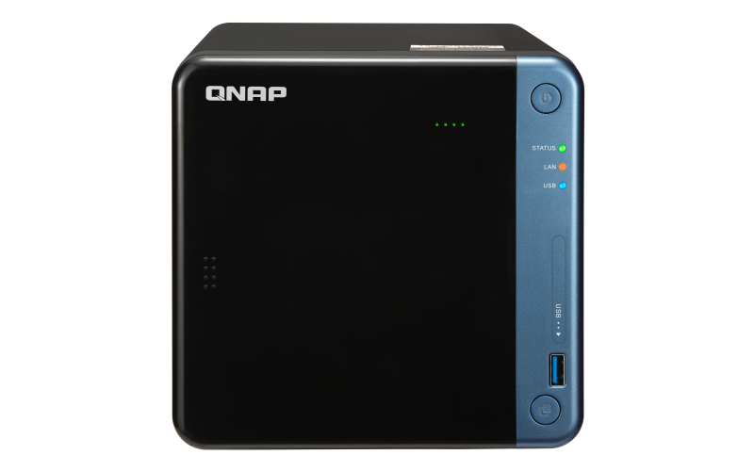
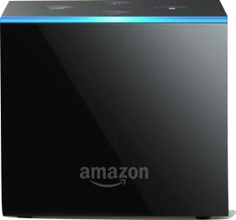
How do you set it all up?​
Qmedia is an app on smart TV, that helps you stream your multimedia file on NAS to Smart TV. ​
streaming​
streaming​
Apple TV
Amazon
Fire TV
Qmedia
Notes:
Qmedia is an app on the apple tv platform!!!!!

Slide 8
Qmedia support TV platform​
New !
New !
Apple TV
Fire TV
Roku TV
Android TV
Notes:
Qmedia is an app on the apple tv platform!!!!!

Slide 9
Qmedia for APPLE / FIRE TV software introduction​

Slide 10
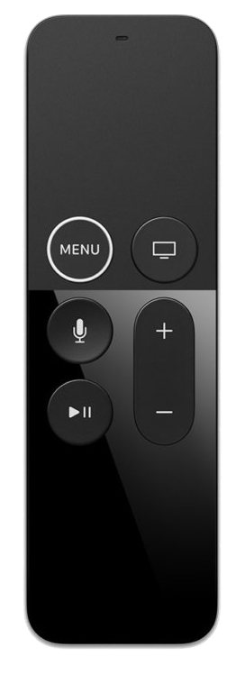
Qmedia for Apple TV / Fire TV​
A new and simple user interface
01
Designed with the control intuition of Remote.​
02
Integrated with three powerful stations for video, photo and music.
03
Easy find, easy play your tons of multimedia file.
Qmedia for Apple TV version 2.0.0​ will release on June!
Notes:
Version 2.0.0

Slide 11
Six highlights
Qmedia = Video + Photo + Music
01
Home page：The most useful multimedia items are all here!​
02
Video：Even though you have 500 videos, it still is easy to use.​
03
Photo：A treasure for photographers！Evolution of slideshow!​
04
Music：A concise platform to listen music conveniently.
05
Search： Systematic search, helps you save the time!​
06
A useful hidden menu, switch music and photos quickly!​
Notes:
1. 讓你意想不到的影音劇院
請背一下遙控器行為代稱
Sidemenu is around almost every page.
No matter which page you are, just slide left you can call the sidemenu!!!!!

Slide 12
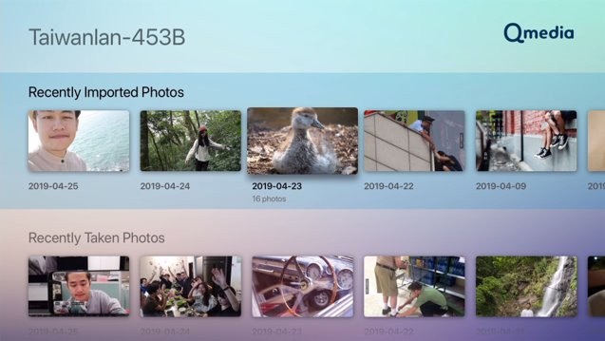
Home page: To fulfill your 80% need on multimedia!​
Is there any page to show common multimedia?​
The most common video, photo and music are all in home page!
Video
Recently watched, recently imported
Photo
Recently imported, recently taken（Arranged by date）
Music
Radom 100, recently imported, most played, top rated, un-played songs​
Display priority setting: Lets you change the sequence of station depending on your habit!
Your casual needs are all arranged here!
Notes:
最貼心，滿足你80%需求
2. 照片牆不是夢。
3.什麼時候拍了多少照片一目了然

Slide 13
Common questions asked by video users!
Tons of movies, which one to watch?​
After watching an exciting movie, what else should I watch?​
I have different kinds of videos, is there any good suggestion to arrange videos?
There are many seasons, with a lot of episodes on my TV shows, is that easy to find out?​
How to identify "watched videos" and "not watched videos"? ​
My video codec is in non-supported format, what can I do?​

Slide 14
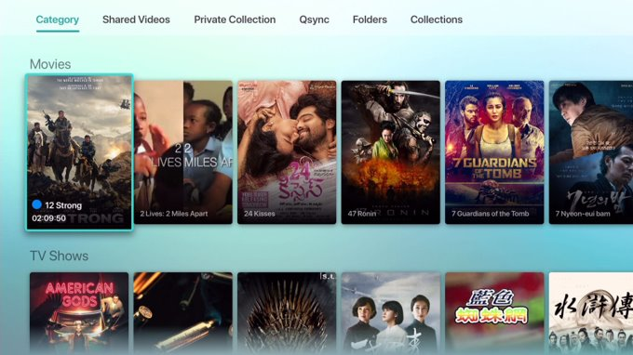
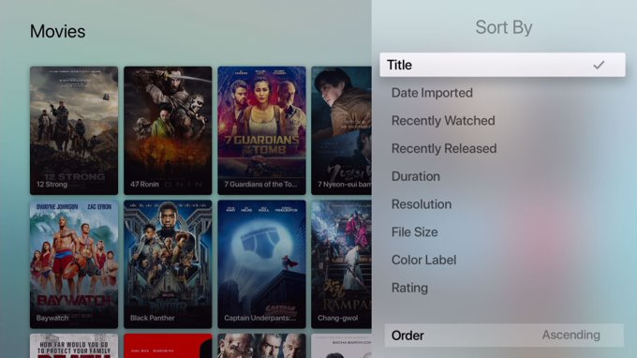
Take a good look on your movies and TV shows！
I have different kind of videos, is there any good suggestion to arrange videos?​
Use category, shared videos, collections, Private collection, Qsync and folders to manage videos flexibly!​
Sorting feature, make it easy to find your video！
Gorgeous decoration, let you enjoy in it!
Sort videos according to the rules you want!​

Slide 15
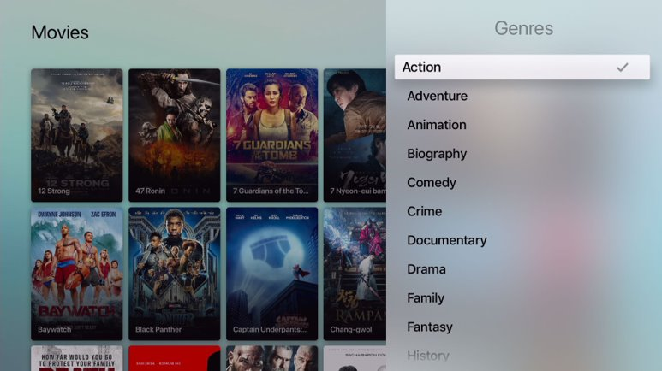
Movie filter, the most practical feature!！
Unique
Tons of movies, which one to watch?​
Must learn!​
Filter your movies! Supports 4 types of filters by genres, years, directors and cast​
Let you quickly screen out what movie you want!
With filter, finding a movie by genres is super easy!​
Notes:
2. 照片牆不是夢。
3.什麼時候拍了多少照片一目了然

Slide 16
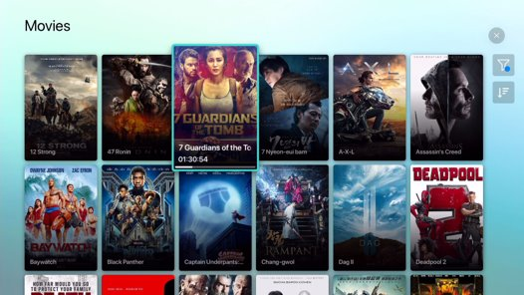
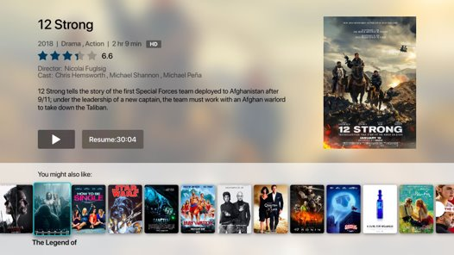
A smarter video info tip just let you know
How to identify "watched videos" and "not watched videos"? ​
Smarter video status indicator!​
Before playing, remind you to continue playing or not!
Indicator: never watch
Indicator: watched video with time scope
Indicator: resume?

Slide 17
Don't know what to watch? Let me recommend you!​
After watching an exciting movie, What else should I watch​
Yes! We will give you a new recommendation list by the same genre!
Recommend similar movies to you​

Slide 18
TV shows can be easily selected , no matter how many seasons are there.
There are many seasons on my TV show, is that easy to find out ?​
Don't worry, we have already solved the problem!
1. More intuitive UI design! You can easily select the season you want!​
2. Resume feature : Go back to the part you never watched!

Slide 19
TV shows can be easily selected, no matter how many episodes you have.
There are lots of episodes on my TV shows, is that easy to find out?
Don't worry, we already solved the problem!
1. Especially for Asian market! You can easily select the episodes you want!​
2. Resume feature : Go back to the part you never watched！

Slide 20
Doesn't support the codecs? Here is the trick!​
Unique
My video codec is not a supported format, what can I do?
Apple TV:
-> The system will automatically use the original apple player if the codec is not supported! Fire TV:
- > Supported for using third-party player!（OS unique！）
Let your playback experience not be interrupted!​

Slide 21
Common questions asked from photographers​
I have plenty of photos, are there any suggestions how to arrange them?
Is there an efficient way to arrange photos?
Is it possible to use slide shows to project my photos on TV?
Tons of photos, how to select what I want?​
Can timeline do more than just look at the date?​
While browsing photos, how to switch photos quickly​

Slide 22
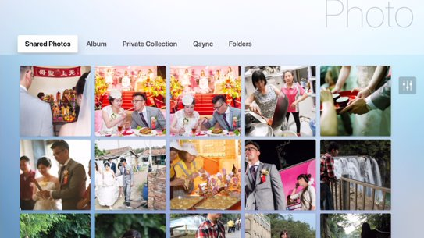
There are lots of manners to arrange your photos!
I have plenty of photos, are there any suggestions how to arrange them? ​
Use shared photos, albums, folders, private collection and Qsync to arrange photos accordingly!​
Sorting feature, makes it easy to find your photos！​
Shared Photos mode​
Folder mode​
Album mode​
Notes:
2. 照片牆不是夢。
3.什麼時候拍了多少照片一目了然

Slide 23
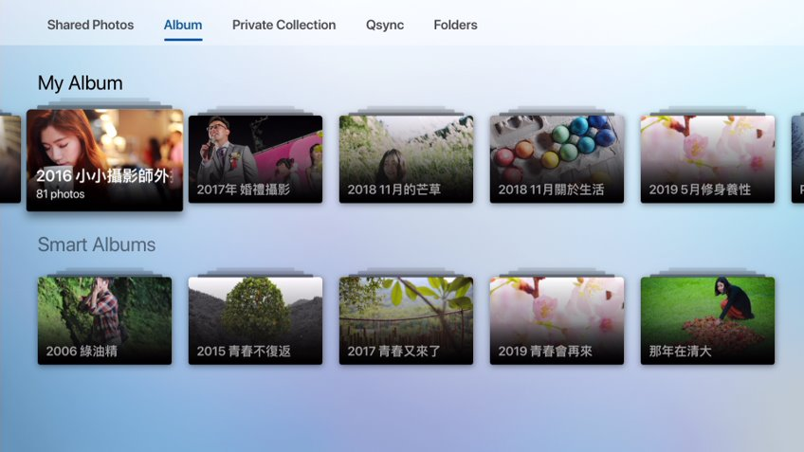
Smart Album, a big hand to arrange your photos automatically!​
Is there an efficient way to arrange photos?​
Smart Album​
Develop your own favorite album rules based on time, preferences, color labels, labels, titles, file size, resolution, camera brand, description, and characters!​
​
How to sort out, do whatever you want!

Slide 24
Lets filter your photo!
Unique
Tons of photos, how to select what I want?​
Apple TV
Filter your photos! Supports 6 types of filters by date taken, tag, camera brand, file size, resolution, description.​
You can quickly screen out what photos you want!
Support for Apple TV
Notes:
2. 照片牆不是夢。
3.什麼時候拍了多少照片一目了然

Slide 25
Photo browsers should be easy to use
Apple TV
While browsing photos, how to switch between them quickly​
Support for preview photos, a fingertip slip, lets you switch quickly!​
Only put the key parameters, designed for photographer!​
Support for Apple TV
Notes:
2. 照片牆不是夢。
3.什麼時候拍了多少照片一目了然

Slide 26
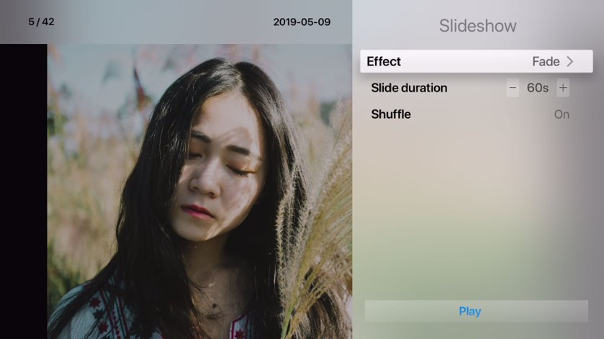
A huge TV screen, why not be a photo wall?​
Is it possible to use slideshows to project my photos on TV ?​
The most useful slideshow is just coming !
Provide 8 kinds of slideshow effects to make your screen beautiful!​
Slide duration: 5s -1000s, depends on your usage!​
A slideshow mode designed for photographers to make your amazing photos and share with your whole family on TV screen!
Notes:
2. 照片牆不是夢。
3.什麼時候拍了多少照片一目了然

Slide 27
Timeline evolution: Sorting by month!​
Unique
Can the timeline do more than just look at the date?​
Apple TV
Sorted by month, make arrangement and display easier.​
When browsing photos, the month will be changed simultaneously!
Makes it easy to understand, when were the photos taken by year date or month through this timeline.
Support for Apple TV
Notes:
2. 照片牆不是夢。
3.什麼時候拍了多少照片一目了然

Slide 28
Common question from music lovers
I have so many songs, how to efficiently arrange them?
Is there a way to change songs faster?
Look at photos while listening to music, want to change a song, how to do it quickly?​
Suddenly, heard a great song, want to add on the playlist, how to do so?​

Slide 29
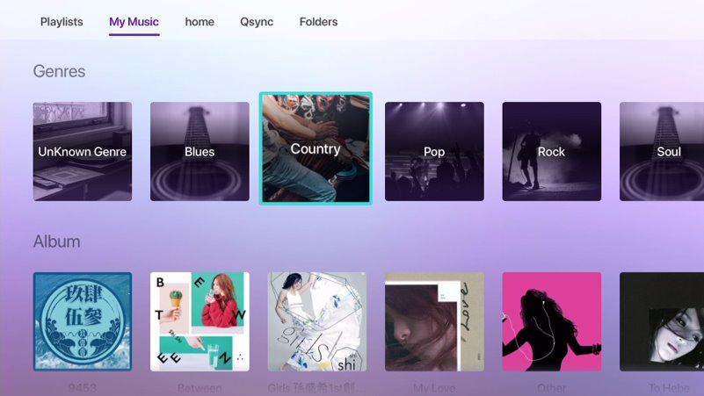
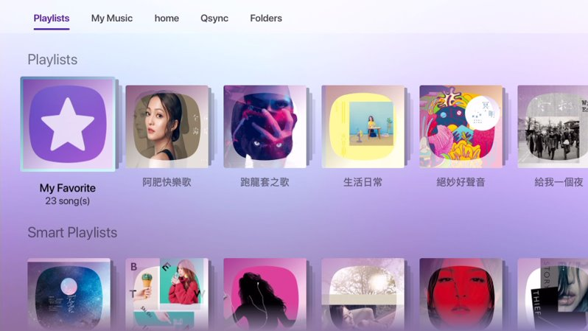
Arranging your music is very simple!​
I have so many songs, how to efficiently arrange them?​
Automatically create various catalogs ：Genres, albums, singers, songs​
Manually create various catalogs: Playlists, folders, Private collections, Qsync​

Slide 30
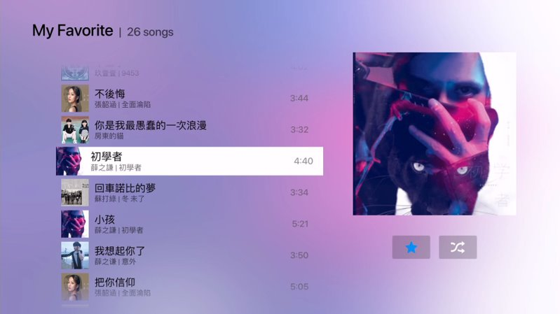
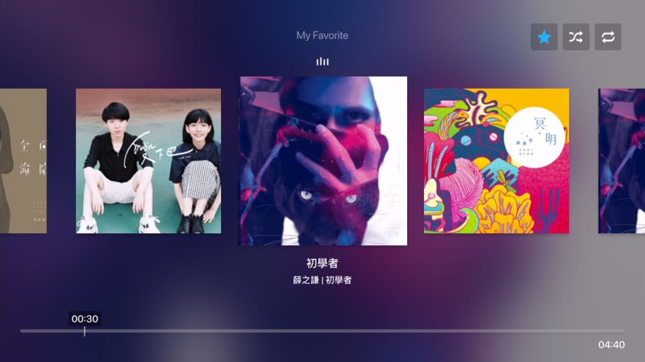
Exclusive playlist for TV, you will not miss any songs​
Unique
What will you do if you heard a good song?​
Apple TV
We provide exclusive playlist "My Favorite" for Apple TV​
Add songs to My Favorite with only one click in any time!​
Support for Apple TV

Slide 31
Player can be simple and easy to use
Apple TV
Is there a way to change song faster?​
Design with the remote, it is light and smooth, and makes your sliding quicker!​
Support for Apple TV

Slide 32
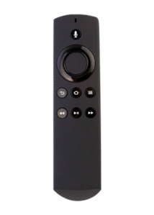
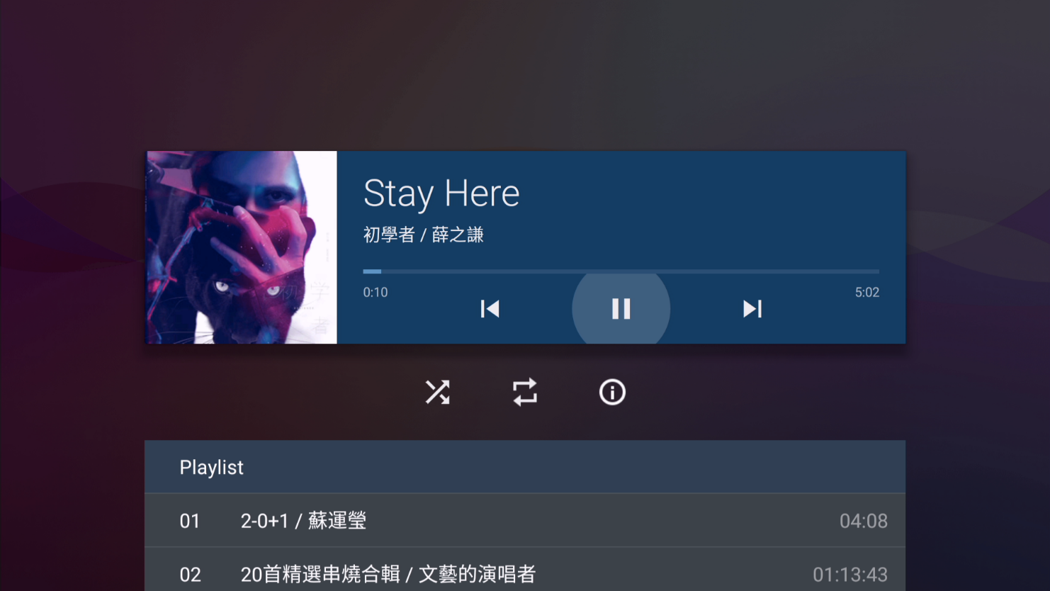
The player can be simple and easy to use​
Amazon
Fire TV
Is there a way to change songs faster?
Design with the remote, it is light and smooth, and makes you sliding faster!​

Slide 33
Only three steps to switch between music and photo​ pages
Unique
How to do when you want to play another song while browsing photos? ​
Apple TV
01
Left slide to open the hidden main menu
02
Click the now playing song
03
After choosing another song, click the back button to return to the photo page.
Support for Apple TV
Notes:
優化

Slide 34
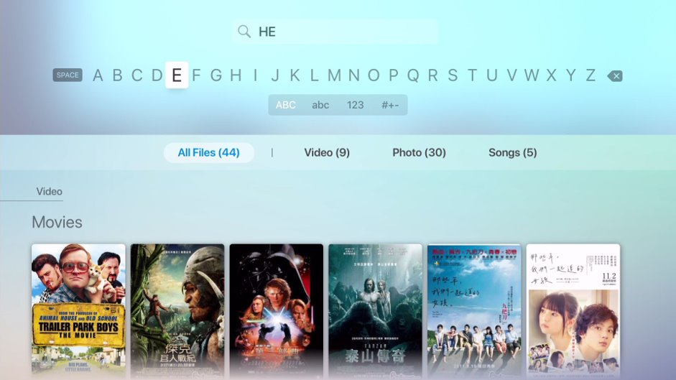
Search: Where is the file, let Qmedia help you find it!​
Apple TV
Suddenly looking for a multimedia file, what should I do?​
Separate each station, make your searching experience efficiently！​
Support for Apple TV
Notes:
2. 照片牆不是夢。
3.什麼時候拍了多少照片一目了然

Slide 35
The complete process of smart livingroom on Qmedia​
Hardware requirement
NAS x 1
Smart TV x1
Total solution from download to playback, let us help you!
Step.1
Step.2
Step.3
Step.4
Buy a suitable QNAP NAS !​
Install mutimedia
software on the QNAP NAS​
1. Video Station​
2. Photo Station​
3. Music Station​
Upload videos, photos, music to your NAS.​
Install Qmedia on your TV platform!​
GO!
Download Tips:​
Helpful download software​
1. Download Station (BT)​
2. Happy Get (YouTube)​
Upload to your NAS directly!​
Smart TV: Qmedia support for Apple TV, Amazon fire TV, Android TV and Roku TV!
Notes:
What we provide is a tool, copyright you need to take care by yourself.
像是 Sony Sharp 有內建 Android TV

Slide 36
Set up your own multimedia server it is so easy! ​
Notes:
更智慧化的搜尋功能 – 針對超大量多媒體資料
Happyget -> Facebook, youtube
Download station -> 弄什麼呢？

Slide 37
Comprehensive comparison​
​ | ​ | QNAP ​ | Other brand​
Video​ | Movie, TV show info page​ | Yes​ | Yes​
 | Video filter​ | Yes (4 ways)​ | No​
 | Smart collection​ | Yes​ | No​
Photo​ | Timeline​ | Yes (smarter)​ | Yes​
 | Photo filter​ | Yes (6 ways)​ | No​
 | Preview photo​ | Yes​ | No​
 | Slideshow effect​ | Yes (8 effects)​ | Yes (only 1)​
 | Slide duration​ | 5s - 1000s​ | 2s - 60s​
Music​​ | Support for Music Station​ | Yes!​ ​ | Non-support music station on TV platform.​
 | See photo and listen to music at the same time​
 | ​Independent playlist for TV​
Qmedia support Apple TV, Amazon fire TV, Android TV and Roku TV!
Notes:
Our for this version quite good!!!! Good enough to compare!!!

Slide 38
Recommended Models: For new QNAP NAS users!​

Slide 39
NAS Recommended model for home users!
The most economical choice, only around $350!
high performance
Large volume​
Intel Celeron dual-core CPU 2.0 GHz, 2GB RAM​
2-ch 4K real-time transcoding​
4K HDMI output​
Support PCIe expandability​
2 Bays design
ARM dual-core CPU 1.7 GHz, 1GB RAM​
4 Bays design
TS-431P
TS-251B
A lot of storage space for you!​
Up to storage 28TB (RAID 1) ​
= 280,000 photos​
= 5,600 movies (Full HD)
Works with built-in graphics cards for superior processing performance!
Notes:
萬元機種！！！ What a good deal~
馬上推薦最適合機種！！！
Only takes 299 dollar, we can bring you a whole new lifestyle. Make your multimedia streaming much more easy!!!!
TS-251B 裝置
https://www.youtube.com/watch?v=ymlpf4vVPS
Ts 431P
We pay a lot on our camer lens, but no place to put our masterpiece!!!! You need to share with your family let them proud of you!!!

Slide 40
NAS Recommended model for advanced home users
4 bays design, build-in graphic card, your best choice!​
Advanced suggestion​
Intel Celeron four-core CPU, 2GB RAM​
2-ch 4K real-time transcoding​
4K HDMI output x2​
Support PCIe expandability​
4 Bays design
TS-453Be
Meet the storage and performance requirements, more powerful CPU, improve operational
efficiency, larger hard disk space to meet your entertainment needs in all aspects!
Notes:
最後！！！！！ 要能將人氣變現，轉銷量！！！！！ 馬上推薦最適合機種！！！
Only takes 299 dollar, we can bring you a whole new lifestyle. Make your multimedia streaming much more easy!!!!
TS-251B 裝置
https://www.youtube.com/watch?v=ymlpf4vVPS
We pay a lot on our camer lens, but no place to put our masterpiece!!!! You need to share with your family let them proud of you!!!

Slide 41
The best choice for home multimedia!
Copyright © 2019 QNAP Systems, Inc. All rights reserved. QNAP® and other names of QNAP Products are proprietary marks or registered trademarks of QNAP Systems, Inc. Other products and company names mentioned herein are trademarks of their respective holders.

