Slide 2
AI Inference Ecosystem with Intel® OpenVINO™, IEI, and QNAP NAS
QNAP® OpenVINO™ Workflow Consolidation Tool
on QTS 4.4
Intel® OpenVINO™ Toolkit
IEI® Mustang Inference Accelerators

Slide 4
High performance, perform AI at the edge
Streamlined & Optimized deep learning inference
Heterogeneous,
cross-platform flexibility
What it is
A toolkit to accelerate development of high performance computer vision & deep learning inference into vision/AI applications used from device to cloud. It enables deep learning on hardware accelerators and easy deployment across multiple types of Intel® platforms.
Who needs this product?
Computer vision, deep learning software developers
Data scientists
OEMs, ISVs, System Integrators
Usages
Security surveillance, robotics, retail, healthcare, AI, office automation, transportation, non-vision use cases (speech, text) & more.
Free Download  software.intel.com/openvino-toolkit
Open Source version  01.org/openvinotoolkit
Latest version is 2019 R1
Notes:
Together, Intel® Hardware & Software delivers high performance deep learning inference, analytics, & real-time image analysis for vision solutions, providing customers flexibility, cost-efficiencies & faster deployments.
Advance AI Performance in Edge Devices with Intel® Distribution of OpenVINO™ toolkit
Advancing vision solutions for AI at the edge, the latest release of the Intel® Distribution of OpenVINO™ toolkit (2018 R4) supports new Intel® Vision Accelerator Design products—that when used together, deliver high performance deep learning inference, analytics, and real-time image analysis.
This hardware/software combination unleashes new levels of performance¹, and provides flexibility, cost-efficiencies and faster deployments. Other new features in the toolkit expand support for public deep learning topologies and add three pretrained models.
Yolo V3 - Not available in downloader, but tested and validated
NCS2 - JB announcing in Beijing at AIDC, available on Amazon for purchase
Demand is growing for intelligent vision solutions.
Deep learning revenue is estimated to grow from $655M in 2016 to $35B by 2025¹.
This requires developer tools to integrate computer vision, deep learning, and analytics processing capabilities into applications, so they can help turn data into insights that fuel artificial intelligence.
¹Tractica 2Q 2017

Slide 5
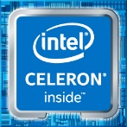
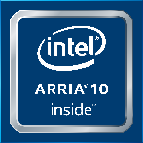
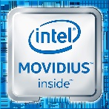
What’s Inside Intel® Distribution of OpenVINO™ Toolkit
Intel® Deep Learning Deployment Toolkit
Traditional Computer Vision
Model Optimizer Convert & Optimize
IR
Inference Engine
Optimized Inference
Optimized Libraries & Code Samples
OpenCV*
OpenVX*
Samples
Open Model Zoo (30+ Pre-trained Models)
Samples
For Intel® CPU & GPU/ Intel ® Processor Graphics
Tools & Libraries
IR = Intermediate Representation file
Increase Media/Video/Graphics Performance
Intel® Media SDK Open Source version
OpenCL™ Drivers & Runtimes
For GPU/Intel® Processor Graphics
Optimize Intel® FPGA (Linux* only)
FPGA RunTime Environment (from Intel® FPGA SDK for OpenCL™)
Bitstreams
OS Support: CentOS* 7.4 (64 bit), Ubuntu* 16.04.3 LTS (64 bit), Microsoft Windows* 10 (64 bit), Yocto Project* version Poky Jethro v2.0.3 (64 bit), macOS* 10.13 & 10.14 (64 bit)
Intel® Architecture-Based Platforms Support
Intel® Vision Accelerator Design Products &
AI in Production/ Developer Kits
An open source version is available at 01.org/openvinotoolkit (some deep learning functions support Intel CPU/GPU only).
OpenVX and the OpenVX logo are trademarks of the Khronos Group Inc.
OpenCL and the OpenCL logo are trademarks of Apple Inc. used by permission by Khronos
Notes:
This toolkit is designed to increase performance and reduce development time for computer vision solutions. It simplifies access to the benefits from the rich set of hardware options available from Intel which can increase performance, reduce power, and maximize hardware utilization – letting you do more with less and opening new design possibilities.
Deep Learning Deployment Toolkit
A Cross-platform Tool to Accelerate Deep Learning Inference Performance
Model Optimizer, converting Caffe, TensorFlow, & MXnet to IR.
Inference Engine, with plugins for CPU, GPU, FPGA & VPU – what it is… across multi-platform support
OpenCV
Pre-compiled OpenCV 3.3, Full Intel CPU optimizations
New Intel Photography Vision Library, with face detection/ recognition, blink detection, and smile detection
OpenVX
Graph-based implementation of a short list of traditional CV operations and CNN primitives.
Khronos OpenVX* Neural Networks Extension 1.2
Visual Algorithm Designer
Eclipse* plugin enabling integrated OpenVX* application development
Miscellaneous
OpenCL™ Drivers & Runtimes, and Media drivers are included to ease Computer Vision SDK working with Intel® Media SDK and Intel SDK OpenCL™ Applications
MKL-DNN, CLDNN are included in common API – no need to download separate

Slide 6
Benefits of Intel® Distribution of OpenVINO™ Toolkit
Maximize the Power of Intel® Processors: CPU, GPU/Intel ® Processor Graphics, FPGA,VPU
Accelerate Performance
Speed Development
Integrate Deep Learning
Innovate & Customize
Access Intel computer vision accelerators. Speed code performance. Supports heterogeneous execution.
Reduce time using a library of optimized OpenCV* & OpenVX* functions, & 15+ samples.
Develop once, deploy for current & future Intel-based devices.
Unleash CNN-based deep learning inference using a common API, 30+ pre-trained models, & computer vision algorithms. Validated on more than 100 public/custom models.
Use OpenCL™ kernels/tools to add your own unique code. Customize layers without the overhead of frameworks.
Deep learning revenue is estimated to grow from $655M in 2016 to $35B by 2025¹.
¹Tractica 2Q 2017
OpenVX and the OpenVX logo are trademarks of the Khronos Group Inc.
OpenCL and the OpenCL logo are trademarks of Apple Inc. used by permission by Khronos
Accelerate Performance
Integrate Deep learning
Access Intel computer vision accelerators. Speed code performance. Supports heterogeneous execution.
Unleash CNN-based deep learning inference using a common API, 30+ pre-trained models, & computer vision algorithms. Validated on more than 100 public/custom models.
Speed development
Innovate & customize
Reduce time using a library of optimized OpenCV* & OpenVX* functions, & 15+ samples.
Develop once, deploy for current & future Intel-based devices.
Use OpenCL™ kernels/tools to add your own unique code. Customize layers without the overhead of frameworks.
Notes:
Using a common api across CPU, GPU, FPGA and Movidius VPU allows for heterogeneity, fallback to CPU &/or GPU and no need to recode when testing on different HW.
10x improvement was achieved by GE when comparing a standard tensorflow model they were using for image classification vs. when they used the DLDT - on a Xeon system& allowed GE to increase its performance without adding discrete GPU cards.
Over, 50 models & samples are included in the package. there is a model downloader that will also download public models.
Easy way to create an operation that isn't covered by the IE out of the box. You can express that as a composition of existing IE ops or register the op in the MO & connect it to the entirely new IE layer in C++ or OpenCL. The existed layers were reorganized to “core” (general primitives) & “extensions” (topology-specific, for example DetectionOutput for SSD). These “extensions” should be built and loaded explicitly.
Speed development – auto fallback to CPU/GPU for FPGA
¹Performance increase comparing certain standard framework models vs. Intel-optimized models in the Intel® Deep Learning Deployment Toolkit. Performance results are based on testing as of June 13, 2018 and may not reflect all publicly available security updates. See configuration disclosure for details. No product can be absolutely secure. For more complete information about performance and benchmark results, visit www.intel.com/benchmarks. Testing by Intel as of June 13, 2018. See Benchmark slide 14 for configuration details.
Demand is growing for intelligent vision solutions.
Deep learning revenue is estimated to grow from $655M in 2016 to $35B by 2025¹.
This requires developer tools to integrate computer vision, deep learning, and analytics processing capabilities into applications, so they can help turn data into insights that fuel artificial intelligence.
¹Tractica 2Q 2017

Slide 7
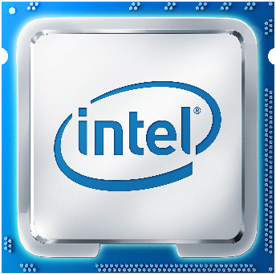
Intel as the Best Choice for Vision Solutions
Deliver High Performance Computer Vision & Deep Learning Transform Data & Results into Artificial Intelligence
Intel offers the broadest portfolio of hardware and software that helps you:
Accelerate workloads for a wide range of solutions and vertical use cases
Increase application performance through Intel accelerators and flexible heterogeneous architectures¹ (CPU, CPU w/integrated graphics (GPU), FPGA, and Vision Processing Units (VPU))
Drive power, cost and development efficiencies to designs and applications for cameras, gateways, network video recorders, and servers
Enable deep learning capabilities for smarter, faster analytics —transform data into artificial intelligence for competitive advantage
¹Certain technical specifications and select processors/skus apply. See product site for more details.
Notes:
Together, the best hardware and software give the media industry the tools they need to accelerate content creation to mass distribution to millions of consumers.
HW details
Core & Xeon processors are a great choice for video gateway and network video recorder solutions, data center media workflows in comms & cloud infrastructure: video transcode & analytics, remote desktop & gaming. Intel Media Server Studio is a comprehensive set of tools for such applications that provides access to Quick Sync Video – hardware accelerated encode, decode & processing – that allows to achieve high density transcoding with up to 18 AVC HD@30fps sessions per Xeon E3 v5 socket (refer to benchmarks)
And at clients side with collection of Atom & Core chips, for video players and editors, as well as car infotainment & cluster display, Media SDK for Windows & Embedded Linux delivers easy to use API for encode & playback.
Intel Atom system on chips fit perfectly for edge and video acquisition step, with smart cameras and connected cars designs, & Intel delivers Media SDK for Embedded Linux with support of Yocto OS to give developers outstanding video processing performance in a compact form factor.
For software –
Intel provides developer tools that bring out all the great capabilities of Intel hardware: media accelerators, Intel Quick Sync Video, along with media codecs,
and performance and quality analysis that drive fast video processing and ensure efficient density and high quality

Slide 8
Speed Deployment with Pre-trained Models & Samples
Expedite development, accelerate deep learning inference performance, and speed production deployment.
Pretrained Models in Intel ® Distribution of OpenVINO™ toolkit
Age & Gender
Face Detection–standard & enhanced
Head Position
Human Detection–eye-level & high-angle detection
Detect People, Vehicles & Bikes
License Plate Detection: small & front facing
Vehicle Metadata
Human Pose Estimation
Action recognition – encoder & decoder
Text Detection & Recognition
Vehicle Detection
Retail Environment
Pedestrian Detection
Pedestrian & Vehicle Detection
Person Attributes Recognition Crossroad
Emotion Recognition
Identify Someone from Different Videos–standard & enhanced
Facial Landmarks
Gaze estimation
Identify Roadside objects
Advanced Roadside Identification
Person Detection & Action Recognition
Person Re-identification–ultra small/ultra fast
Face Re-identification
Landmarks Regression
Smart Classroom Use Cases
Single image Super Resolution (3 models)
Instance segmentation
and more…
Deep Learning Samples
Object Detection
Standard & Pipelined Image Classification
Hello Infer Classification
Interactive Face Detection
Image Segmentation
Multi-channel Face Detection
Notes:
The toolkit includes optimized pre-trained models to expedite development and improve deep learning inference on Intel® processors, and speed production deployment without the need to search for or to train your own models.

Slide 10
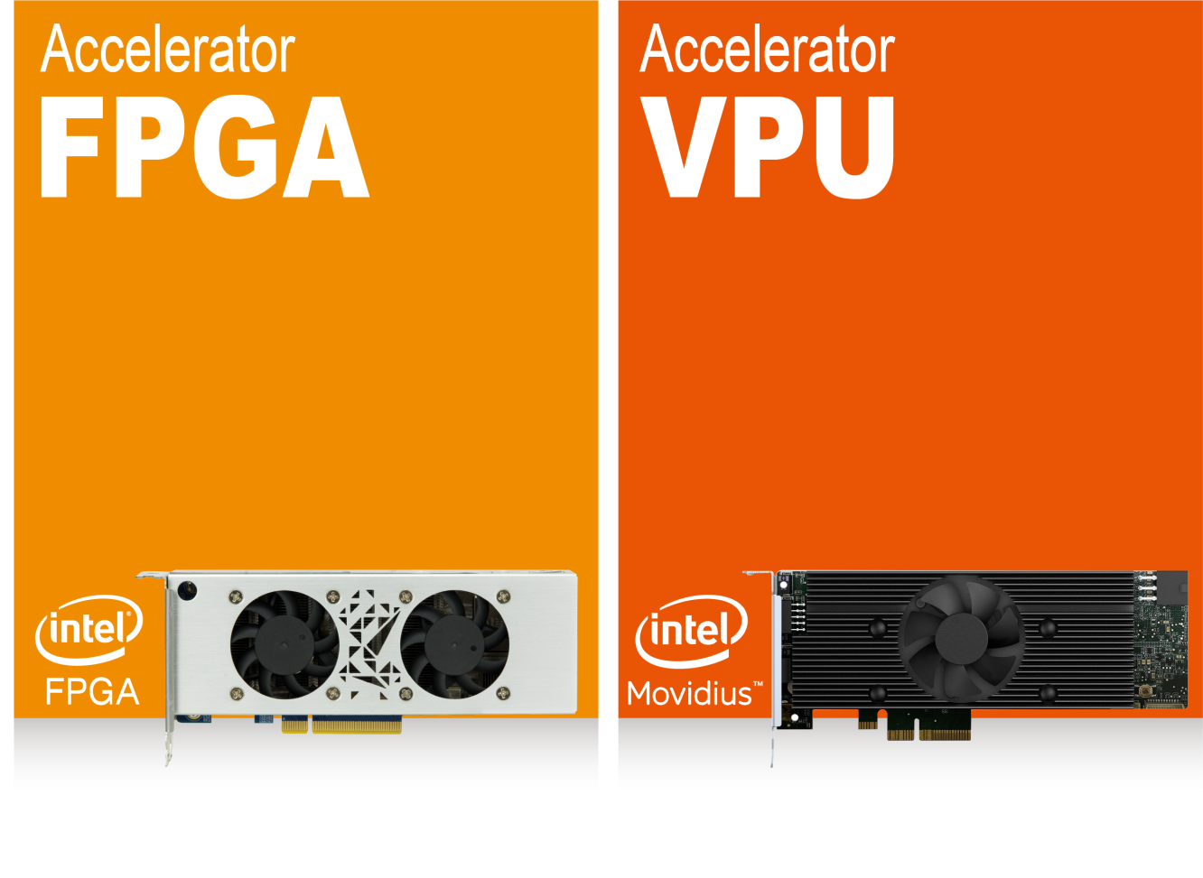
Inference with Mustang Accelerators
Intel ® Vision Accelerator Design
Perfect Choices for AI Deep Learning Inference Workloads
Mustang-F100-A10
Mustang-V100-MX8
Intel Arria 10 GX 1150 FPGA
PCIe Gen3 x8
Low profile, half size
Intel Movidius solution
8 x Myriad X VPU
PCIe Gen2 x4
Low profile, half size
Notes:
Here are IEI acceleration cards, including Cpu FPGA and VPU
And it all based on Openvino toolkit

Slide 11
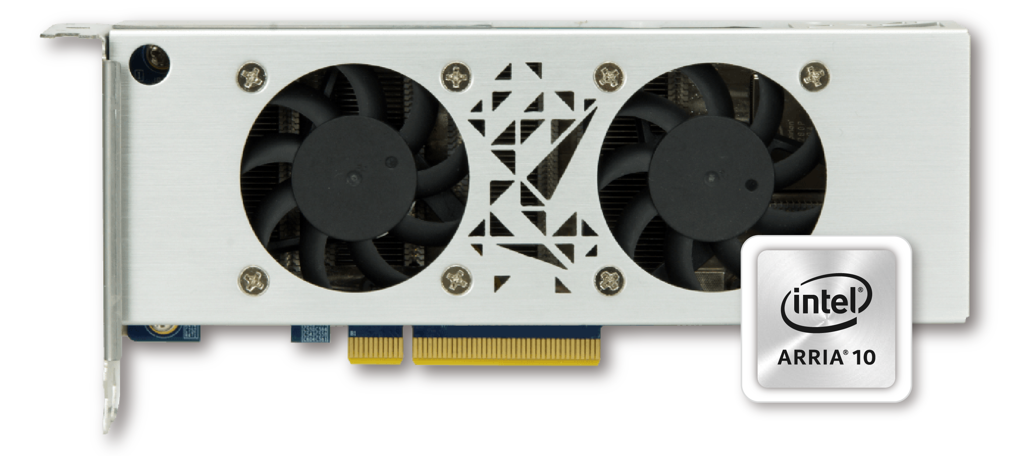
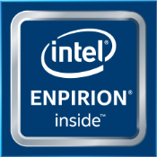
Mustang-F100-A10
Accelerate To The Future
Intel® Vision Accelerator Design with Intel® Arria® 10 FPGA
A Perfect Choice for AI Deep Learning Inference Workloads

Slide 12
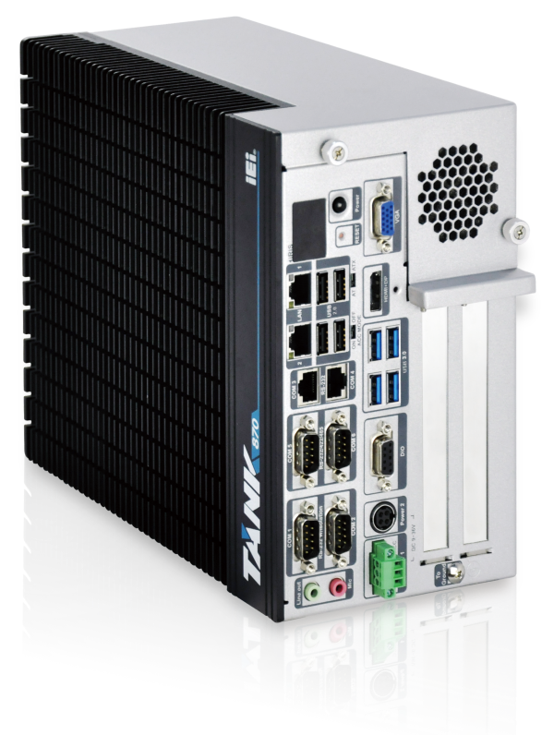
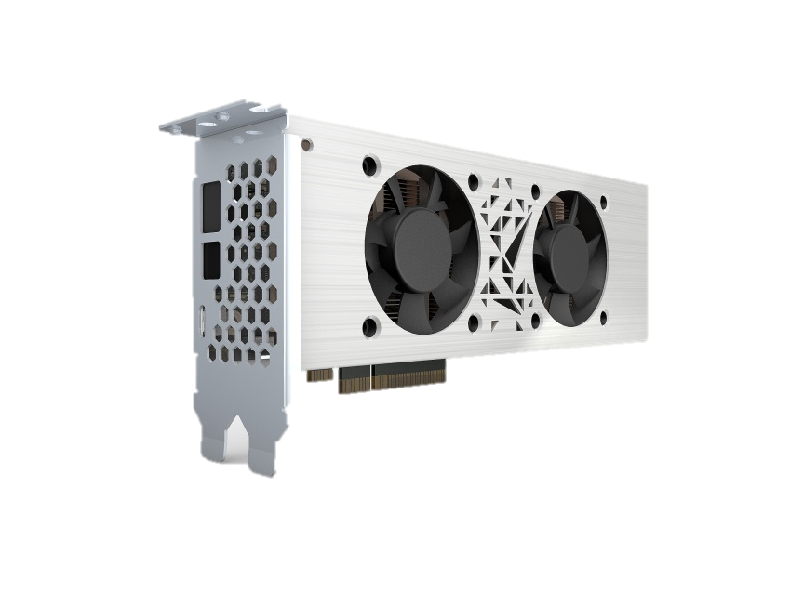
Mustang-F100-A10
High Flexibility FPGA can assign different optimize Bitstream for different topologies.
Optimized Bitstream
ResNet
GoogleNet
AlexNet
.
.
.

Slide 13
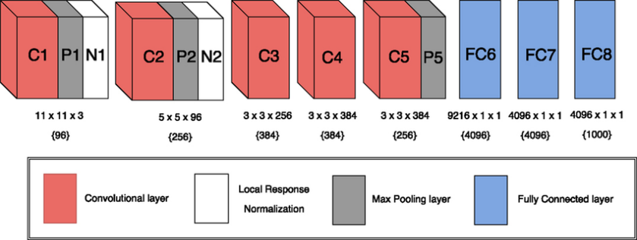
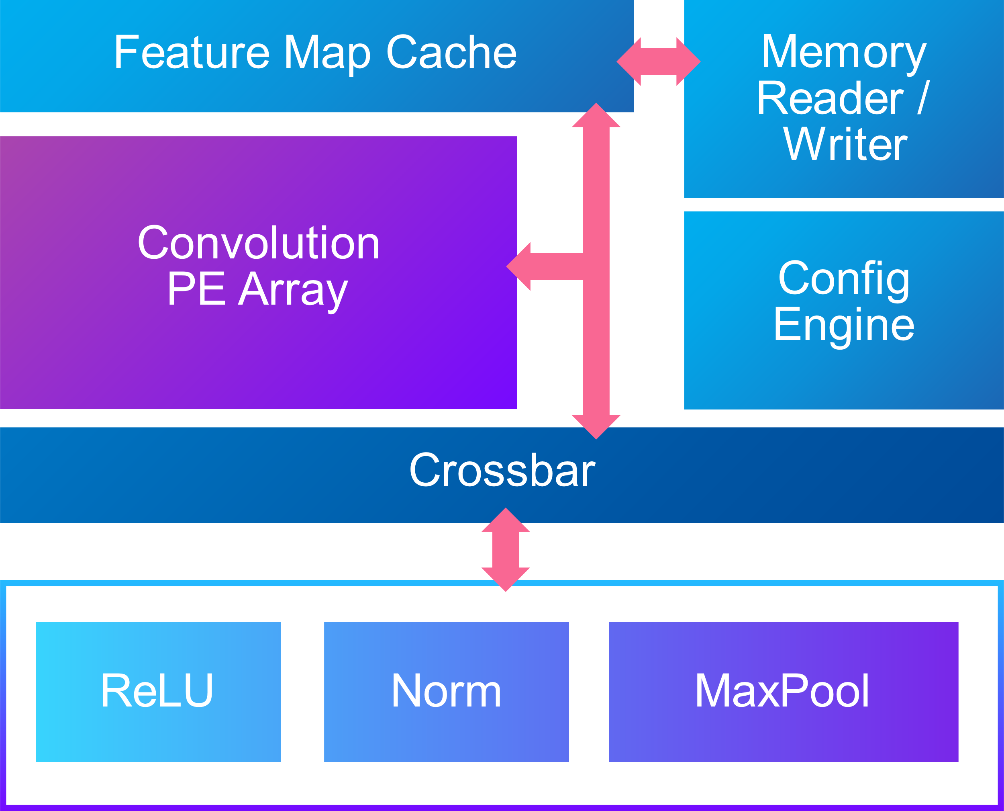
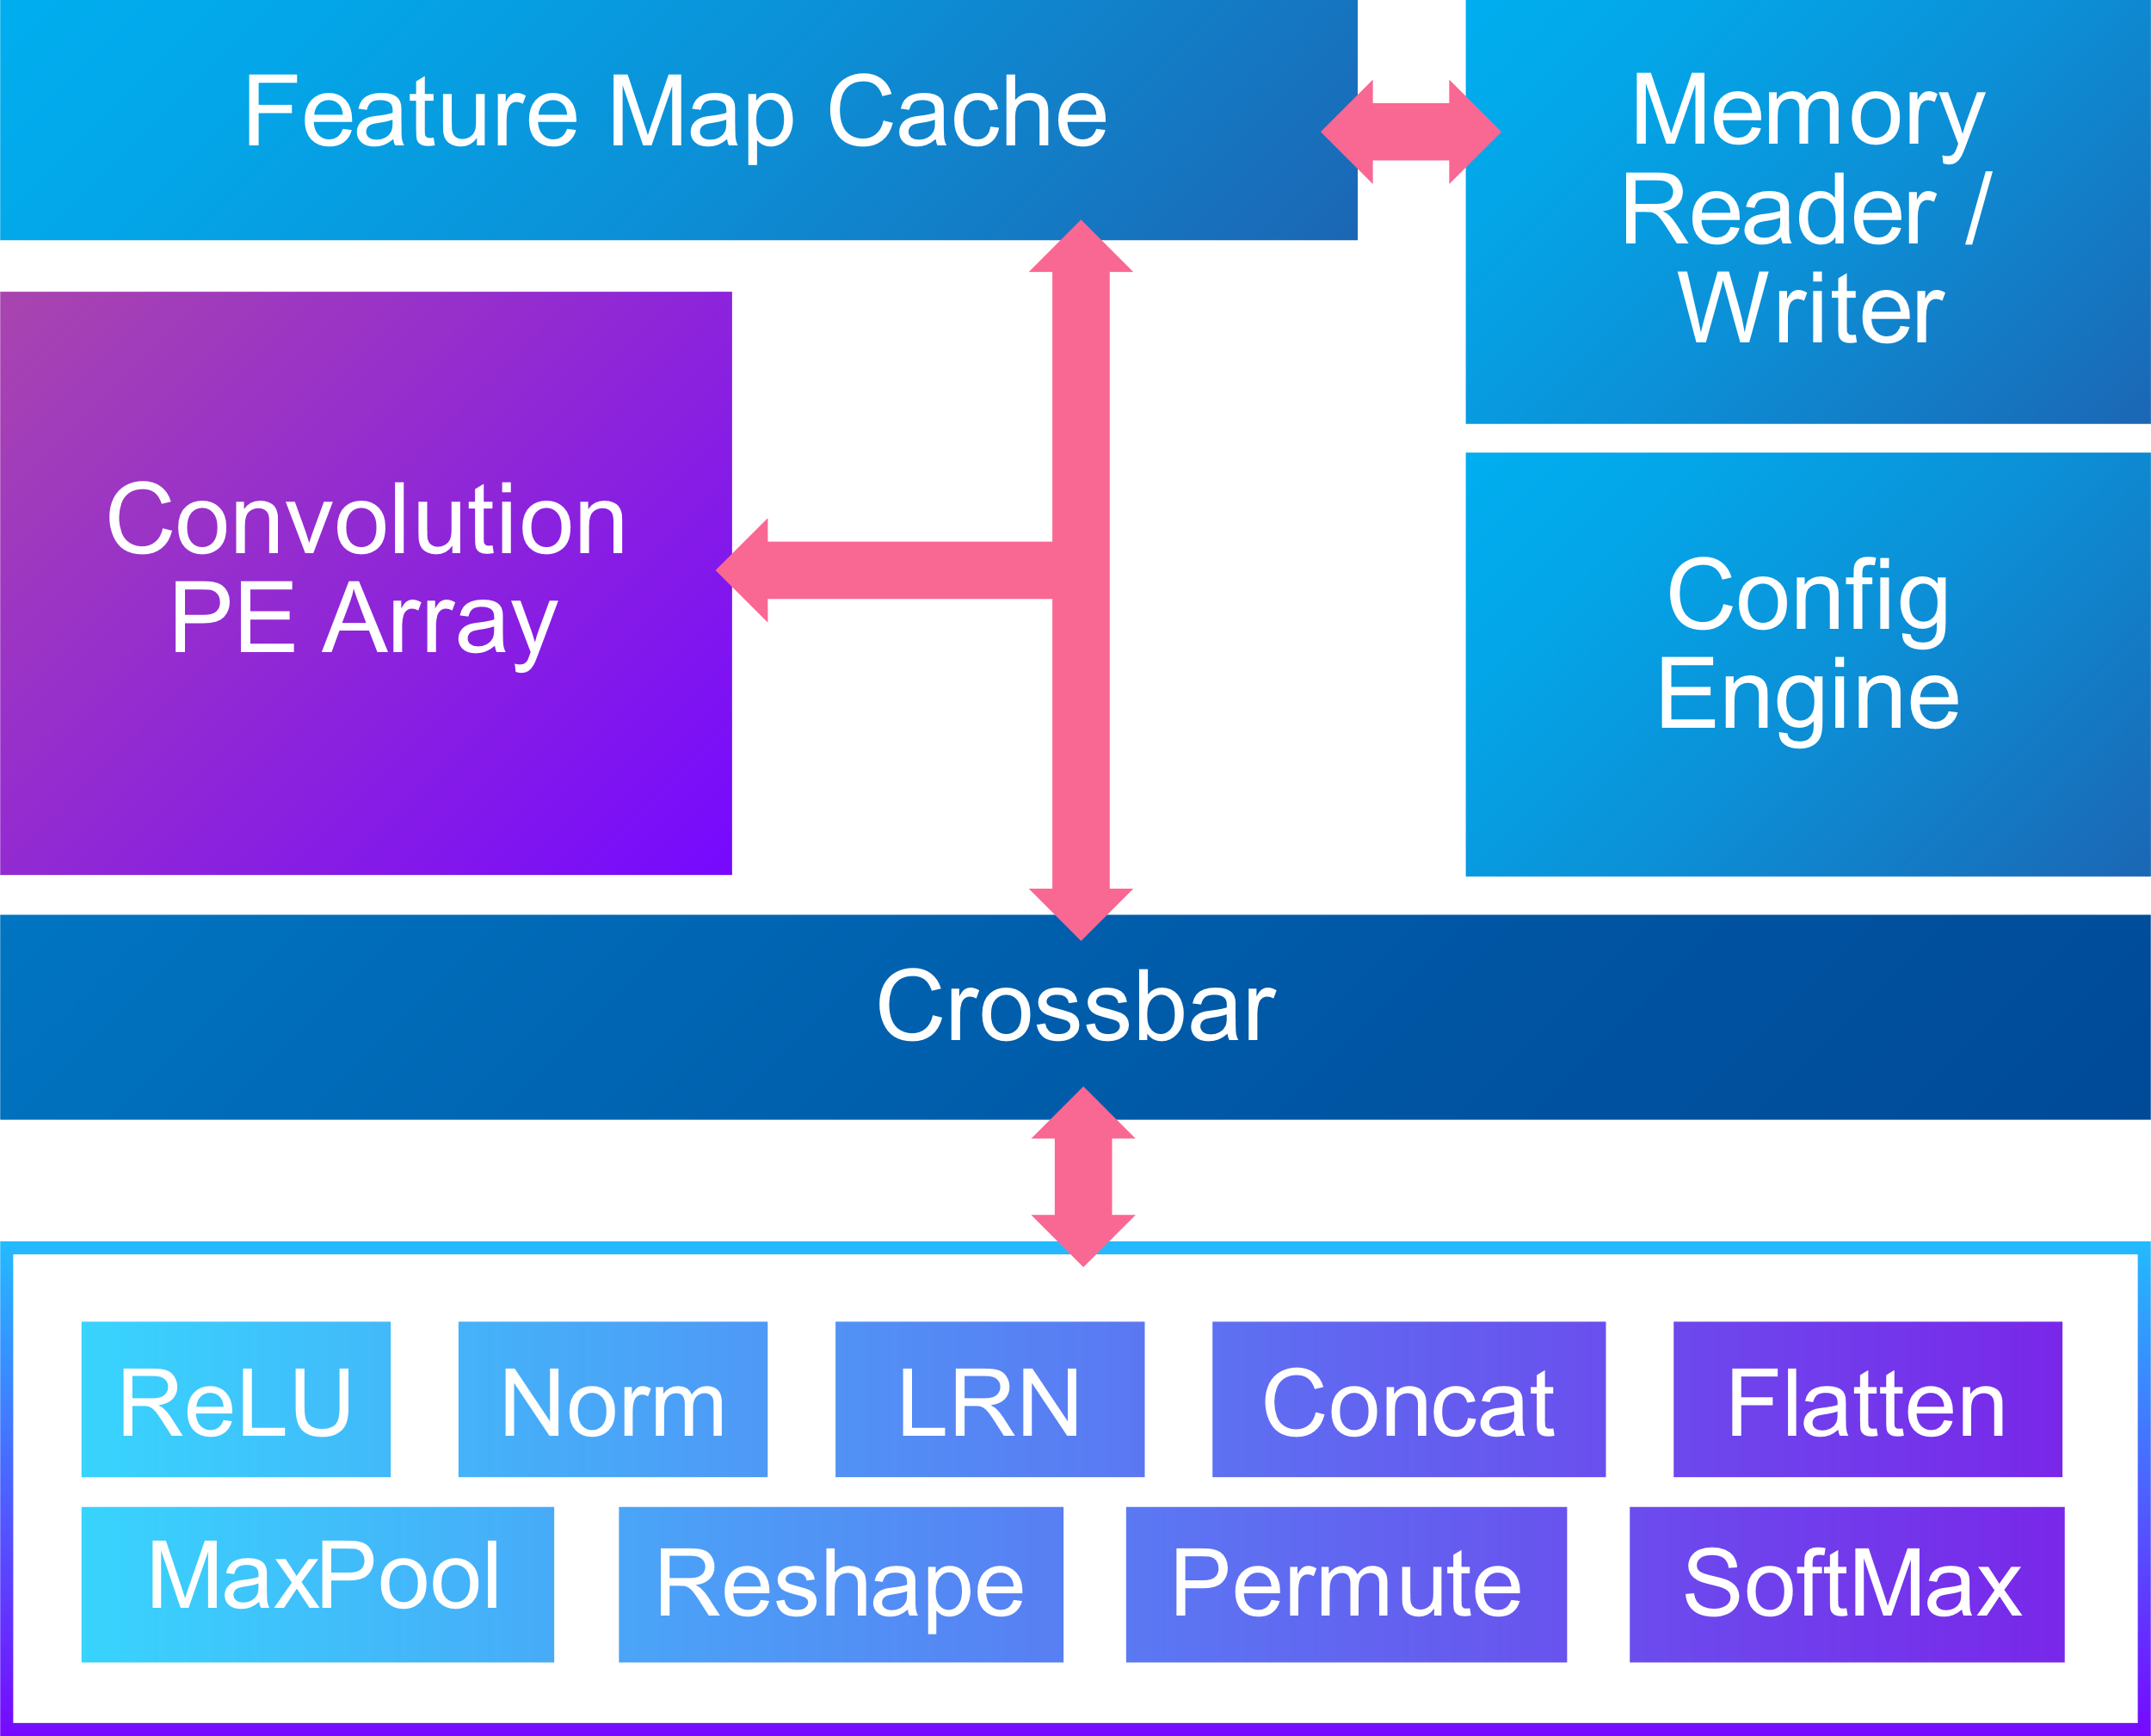
Optimized Bitstream for AlexNet
Mustang-F100-A10
General Purpose Bitstream

Slide 14
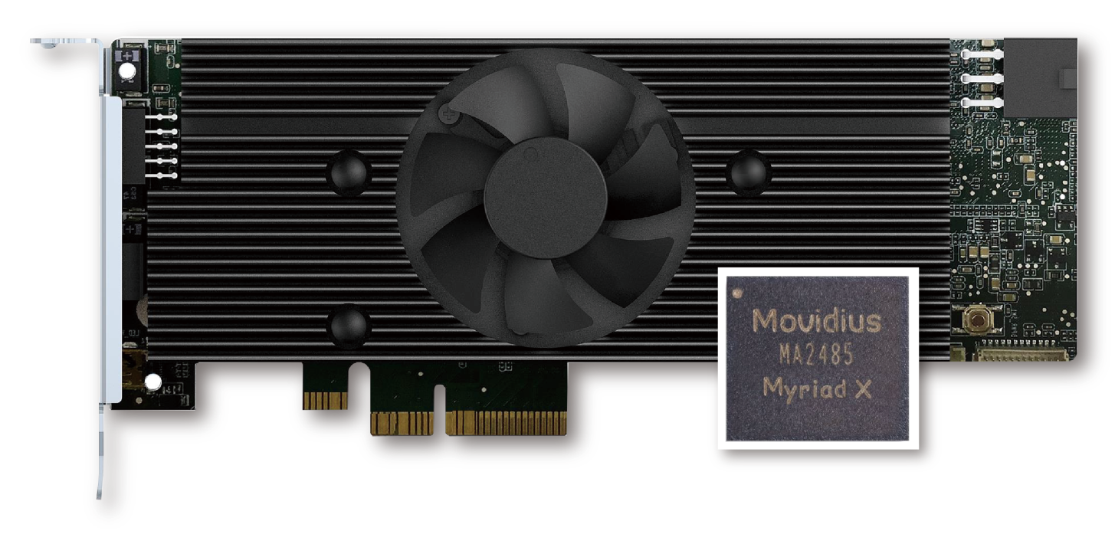
Mustang-V100-MX8
Accelerate To The Future
Intel ® Vision Accelerator Design with Intel ® Movidius™ VPU
A Perfect Choice for AI Deep Learning Inference Workloads

Slide 15
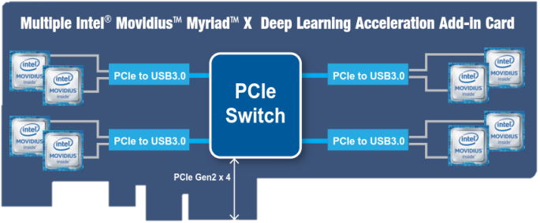
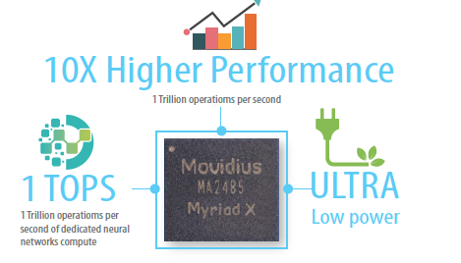
Mustang-V100-MX8
Multi-Tasks Eight myriad X chips can execute eight topologies simultaneously.
Compact Size Half-height, half-length, single slot.
Low power consumption:
Power Economy
Approximate 2.5W for each Myriad X.
25 W for total power consumption
ResNet
GoogleNet
AlexNet

Slide 16
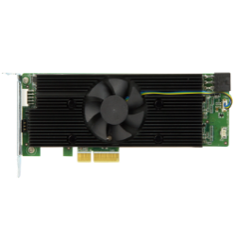
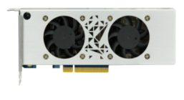
FPGA VS VPU
 | Mustang-V100-MX8 | Mustang-F100-A10
Topology | AlexNet, DenseNet-121, -161, -169, -201 GoogLeNet v1, v2, v3, v4, Inception v1, v2, v3, v4 LSTM: CTPN MobileNetV1/V2 MobileNet SSD ResNet-18, -50, -101, -152 ResNet v2-50, -101, -152 SqueezeNet v1.0, v1.1 SSD MobileNet v1, v2 SSD Inception v2, v3 U-Net SSD300/512 VGG16, VGG19 YoloTiny v1, v2, v3 Yolo v2, v3 | AlexNet, DenseNet-121, -161, -169, -201 GoogLeNet v1, v2, v3, v4, Inception v1, v2, v3, v4 LSTM: CTPN MobileNetV1/V2 MobileNet SSD ResNet-18, -50, -101, -152 ResNet v2-50, -101, -152 Sphereface SqueezeNet v1.0, v1.1 SSD MobileNet v1, v2 SSD Inception v2, v3 SSD ResNet U-Net SSD300/512 VGG16, VGG19 YoloTiny v1, v2, v3 Yolo v2, v3
Floating Point | FP16 | FP16, FP11 (FP9 is coming soon)
Flexibility | Low | High
Latency | 35ms (ResNet) | 3 ms (ResNet)
Power Consumption | 25W Typical | 40W Typical

Slide 18
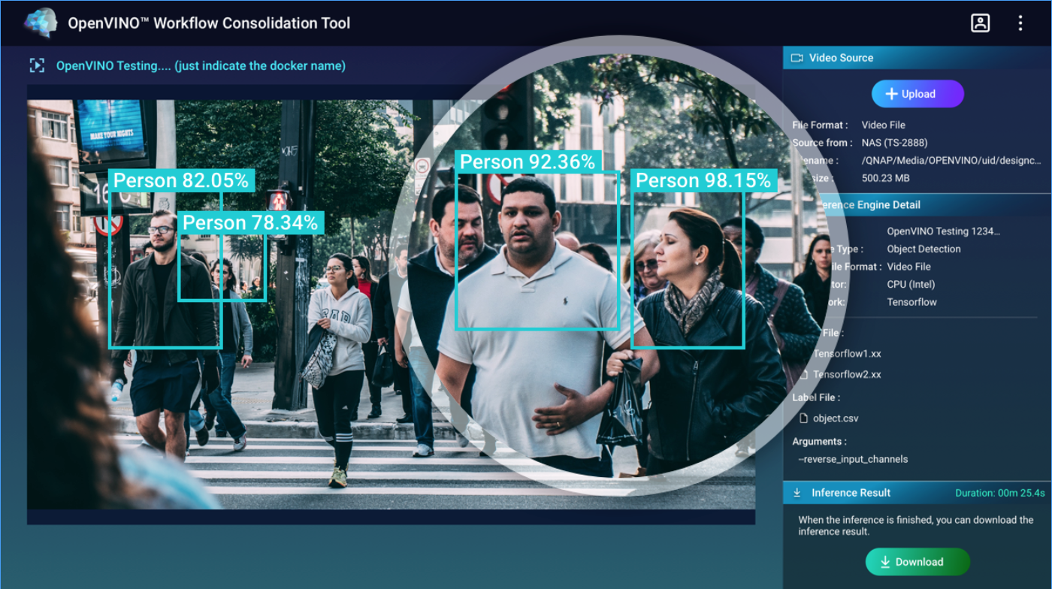
What is OWCT? OpenVINO™ Workflow Consolidation Tool
The OpenVINO™ Workflow Consolidation Tool (OWCT) is a deep learning tool for converting trained models into an inference service accelerated by Intel® OpenVINO™.
Notes:
建議每個網站連結前面，可以加上各個site的代表icon

Slide 19
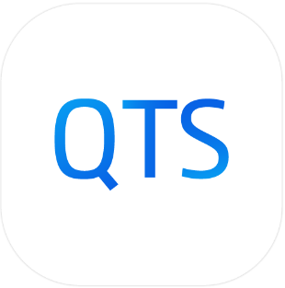
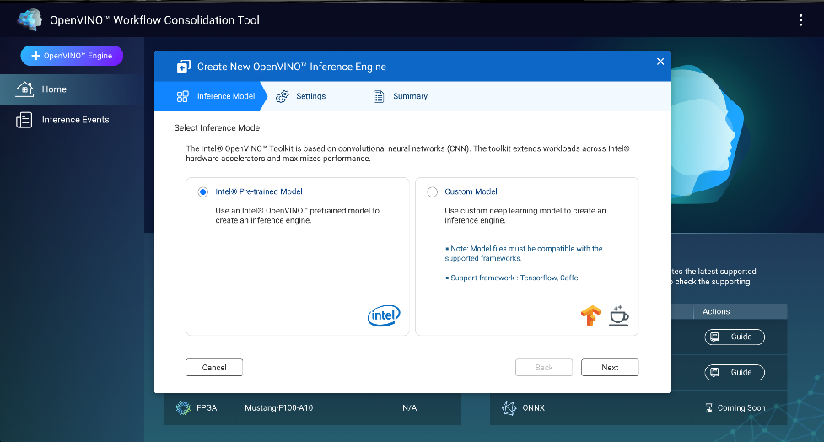
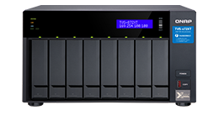
What is OWCT? OpenVINO™ Workflow Consolidation Tool
Feature
Friendly GUI to do video inference
using Intel ® OpenVINO™.
•
•
Upload the video to analyze the object detection using Intel ® CPU/(i)GPU/ VPU/ FPGA on QNAP NAS.
Optimized the model and transferred to standard format (IR)
OWCT
Target Audience
AI beginner for inference and Intel ® OpenVINO™ toolkit.
QuAI
Inference Engine (OWCT)
Transfer AI framework to IR
Provide Intel ® Pre-trained model
Build / Train model
Inference using Intel platform (CPU, iGD, FPGA, VPU)
Pre-trained Model / Data Label, etc.

Slide 20
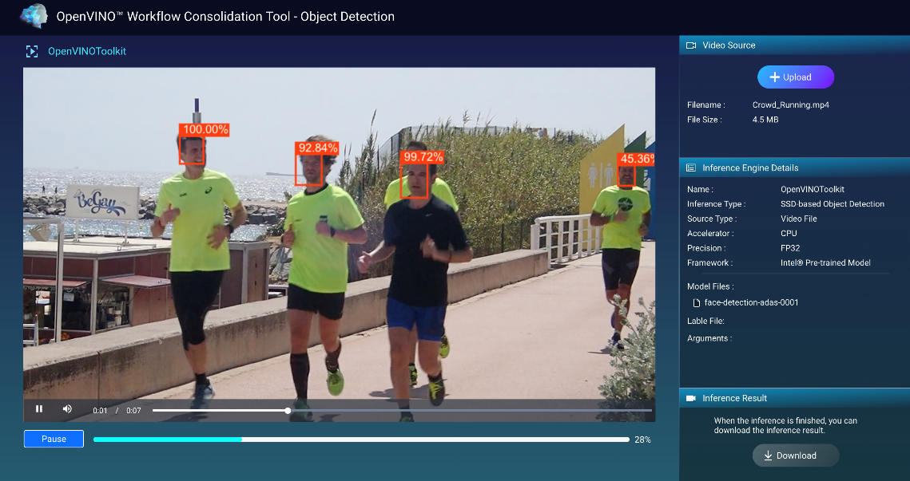
What is OWCT? OpenVINO™ Workflow Consolidation Tool
Wizard
Inference Pre-view Service (Object Detection)
IR Format
Upload AI Model
Model Optimized
Power by
Inference Engine
Notes:
建議每個網站連結前面，可以加上各個site的代表icon

Slide 21
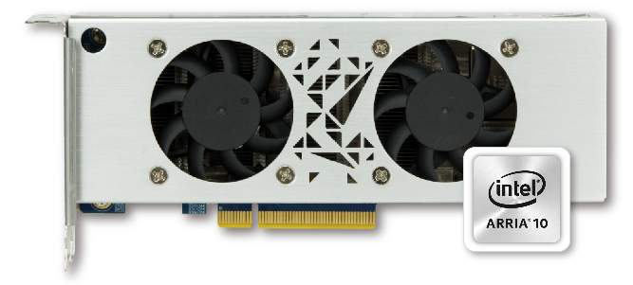
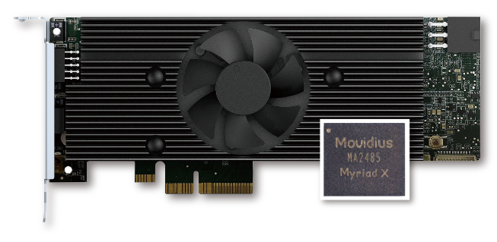
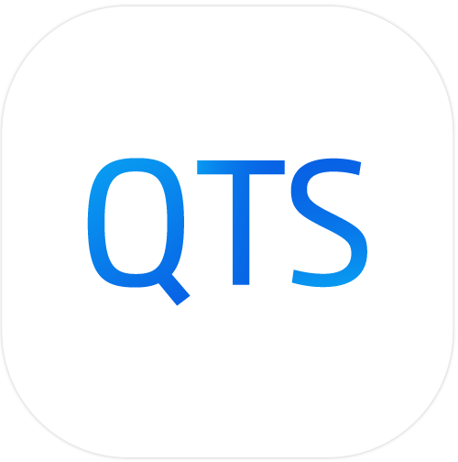
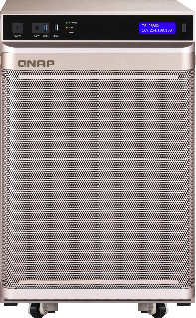
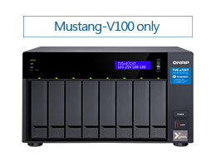
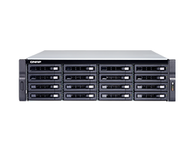
OWCT is Compatible with Mustang Accelerator Series on QTS 4.4.0 Now
Mustang-F100-A10
Mustang-V100-MX8
TS-2888X
TS-X72XT
TS-X72XU
Notes:
建議每個網站連結前面，可以加上各個site的代表icon

Slide 22
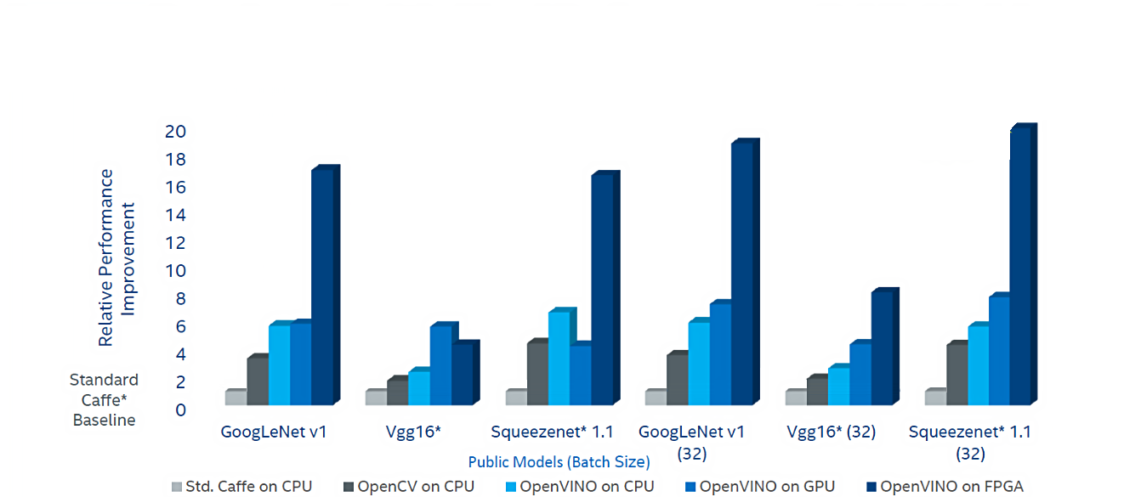
Benchmark
Increase deep learning workload performance on public models using OpenVINO™ toolkit & Intel Architecture
Notes:
建議每個網站連結前面，可以加上各個site的代表icon

Slide 23
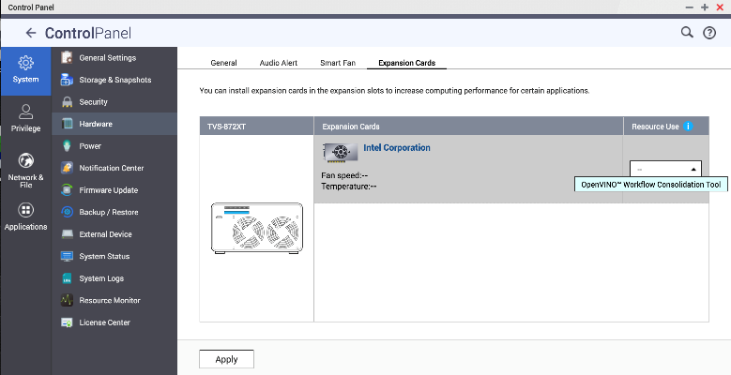
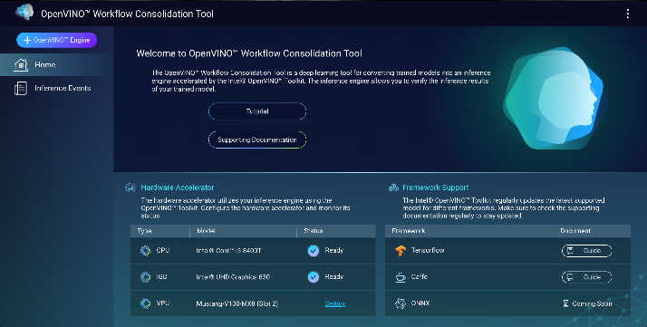
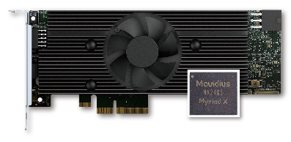
Demo
Analyze the Video File on OWCT
Set up HW Accelerator
Create Inference Engine
Camera Video
Configure and optimized model
Upload video to OWCT
Notes:
建議每個網站連結前面，可以加上各個site的代表icon

Slide 24
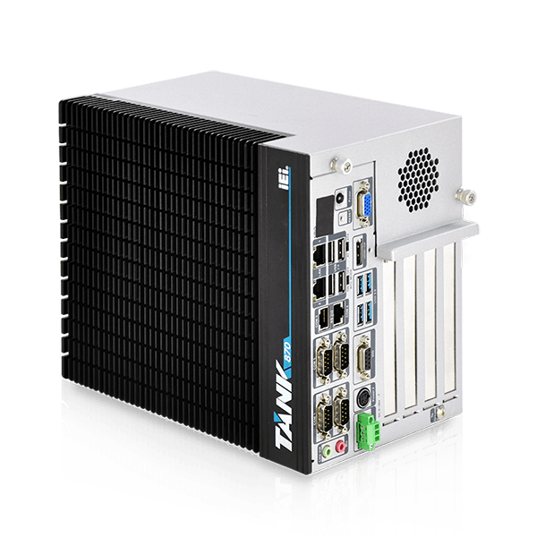
AI Inference Ecosystem
IEI Tank 870
NAS (QTS)
Mustang Accelerator
Ubuntu, Windows
Notes:
建議每個網站連結前面，可以加上各個site的代表icon

Slide 25
More AIoT Application on COMPUTEX 2019
@ J0830 ,Taipei Nangang Exhibition Center, Hall 1
Copyright © 2019 QNAP Systems, Inc. All rights reserved. QNAP® and other names of QNAP Products are proprietary marks or registered trademarks of QNAP Systems, Inc. Other products and company names mentioned herein are trademarks of their respective holders.

