Slide 2
M.2 SSD＋10GbE revealed
NAS/PC supported, experience super speed NVMe SSD
QTS 4.4.1 fully utilize SSD’s performance

Slide 3
M.2 SSD＋10GbE cache card
Revealed

Slide 4

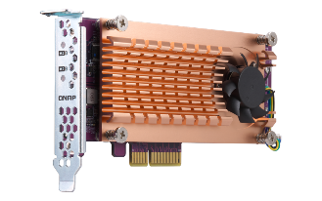
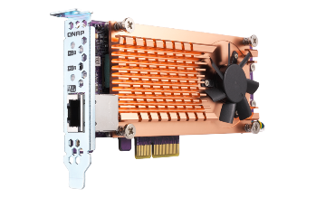

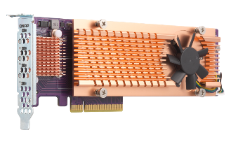
Select the QM2 card you need
M.2 SATA
M.2 PCIe Gen 2
M.2 PCIe Gen 3
QM2-2P-344
QM2-2P-384
QM2-2S-220A
QM2-2P-244A
Support 10GBASE-T port
QM2-2S10G1TA
QM2-2P10G1TA
QM2-4P-342
QM2-4P-384
Expand four M.2 ports
QM2-4S-240
QM2-4P-284
Notes:
3/21, QM2卡直播 P.23

Slide 5
Clear naming rule – featured 10GbE
QNAP M.2 PCIe cache/10GbE card
M.2 SSD + 10GbE
revision
Number of supported M.2 SSD
Supported M.2 SSD connector type
P: PCIe NVMe SSD
S: SATA SSD
10GbE port
Single port BASE-T RJ45 throughput

Slide 6
Clear naming rule - M.2 cache only
QNAP M.2 PCIe cache card
Number of supported M.2 SSD
2: 2 x SSD
4: 4 x SSD
Supported M.2 SSD connector type
P: PCIe NVMe SSD
S: SATA SSD
PCIe interface
34= Gen3 x4
28= Gen2 x8
NVMe SSD slot bandwidth
4= Gen3 x4
2= Gen3 x2

Slide 7
SSD cache and 10GbE in one card
QM2-2P10G1TA
Supports maximum 2 x PCIe NVMe SSD (M-key), provides Gen2 x2 on each slot
QM2-2S10G1TA
Supports maximum 2 x SATA M.2 SSD, provides 6Gb/s on each slot
Notes:
QNA 直播 P.8

Slide 8
Expand cache capacity or 10GbE redundant
TS-1283XU
TVS-672XT
Expand cache capacity by installing QM2 in idle PCIe slots
Provide redundant 10GbE for fail-over
Built-in 10GbE

Slide 9

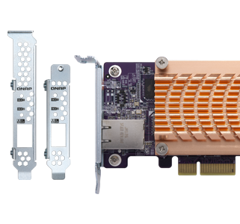
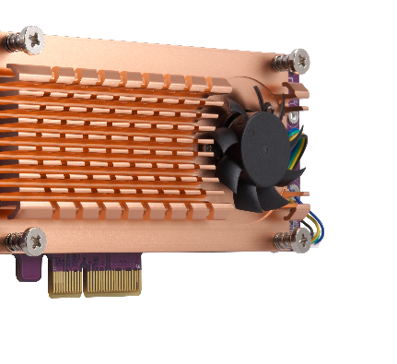

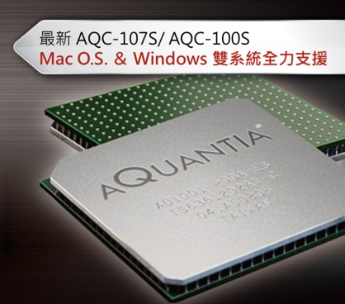






3rd party operating system support
Active cooling module
Compliant with PCIe standards
AQC-107S
Self-monitored with thermal sensors to control the speed of smart fan modules.
Low-profile PCIe add-on cards, bundled with full-height bracket.
Linux & Windows
Dual platform supported
QNAP NAS don’t need to install Driver, Windows/Linux platforms please visit QNAP website to download the driver
Note: M.2 SSD compatibility and function supported depends on the hardware design and platform. Please check with your motherboard manufacturer for details.
Notes:
QM2 直播P.22

Slide 10


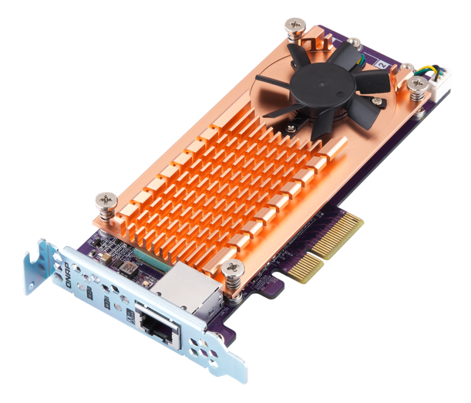
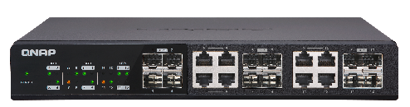
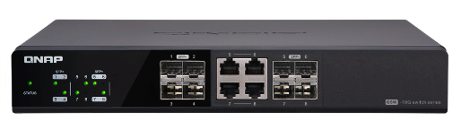
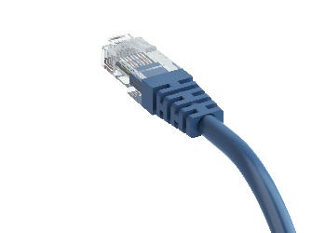

Multi-Gigabit supported
Support Multi-Gigabit NBASE-T standard.
 | CAT 5e | CAT 6 | CAT 6A & CAT 7
100 M | ✓ | ✓ | ✓
1G | ✓ | ✓ | ✓
2.5G | ✓ | ✓ | ✓
5G | ✓ | ✓ | ✓
10G | ✘ | ✓(55M) | ✓
QSW-1208-8C
Provides 12 ports of 10Gbps transfer
QSW-804-4C
Provides 8 ports of 10Gbps transfer
Notes:
QNA 直播 P.9
QM2卡要在NAS裡

Slide 11

Efficient cooling dissipation
10GbE 10GBASE-T port
M.2 slots
Active cooling fan
Fin array heatsink
M.2 thermal pad is bundled, provides more efficient heat transfer

Slide 12



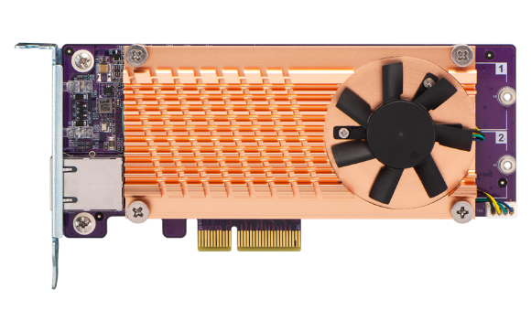




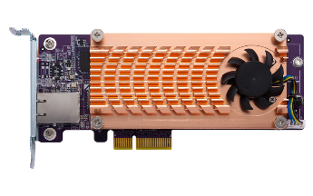
QM2-2P10G1TA performance up
Random read enhanced nearly 25%
QM2-2P10G1TA
272808
205057
203626
200760
QM2-2P10G1TA
QM2-2P10G1T
QM2-2P10G1T
(IOPS)
RR-4K
RW-4K
Iometer on PC, tested in QNAP Lab,
PC Environment
1. CPU: Intel (R) Core(TM) i7-6700 CPU@ 3.40GHz.
2. OS: Windows 10.
3. Memory: 64 GB.
4. SSD: Samsung SSD 860 EVO 1TB M.2 SATA *2, Software-RAID 1.

Slide 13
NAS/PC supported, experience super speed NVMe SSD

Slide 14

Ideal choice to boost performance: M.2 PCIe NVMe SSDs
M.2 PCIe NVMe SSDs have more than 2Xa performance enhancement
You don’t need to change motherboards or HW configurations, just simply install the QM2-2P10G1TA on your PC’s Gen2 x4 slot then you can enjoy the high speed of NVMe SSD
Interfaces
Theoretical Speed
M.2 SATA III
6Gb/s
M.2 PCIe Gen 3 x2
16G/s
M.2 PCIe Gen 2 x4
20Gb/s
M.2 PCIe Gen 3 x4
★ Mainstream
32Gb/s
Notes:
https://www.carmagazine.co.uk/features/car-culture/how-we-ended-up-racing-an-old-sports-car-at-le-mans/

Slide 15
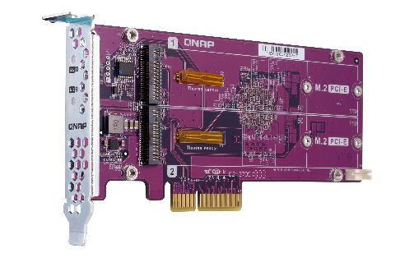
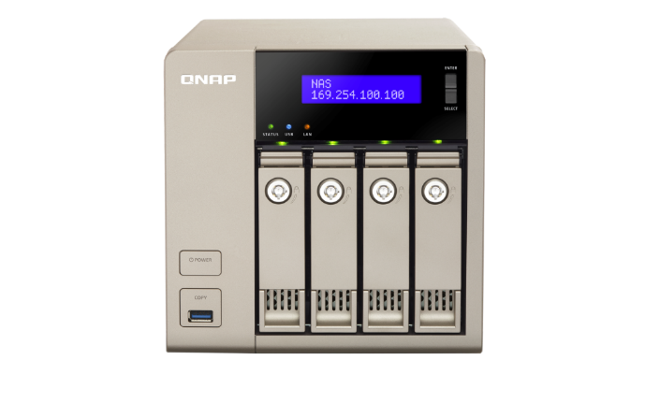
Leave the 3.5” slots for huge capacity HDDs
Without changing existing configurations
Freely upgrade a normal pool to a Qtier pool
without starting over
QM2 SSD RAID
Install NVMe for cache
Huge capacity storage
NAS
PC

Slide 16

High performance NVMe in PC
Upgrade your PC to NVMe!
QM2-2P10G1TA
QM2-2S10G1TA
272808
QM2-2P10G1TA
QM2-2S10G1TA
200760
156973
SSD
SSD
70823
55972
55972
13893
13893
(IOPS)
RR-4K
RW-4K
(IOPS)
RR-4K
RW-4K
PC Environment
1. CPU: Intel (R) Core(TM) i7-6700 CPU@ 3.40GHz.
2. OS: Windows 10.
3. Memory: 64 GB.
4. PC SSD: ADATA Prod_SP550 120GB
5. QM2 SSD: Samsung SSD 970 EVO 256GB M.2 NVMe *2, RAID1;
Samsung SSD 860 EVO 1TB M.2 SATA *2, Software-RAID 1.

Slide 17
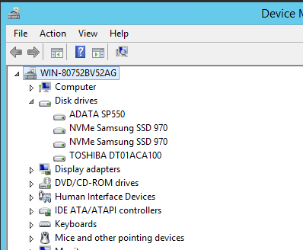
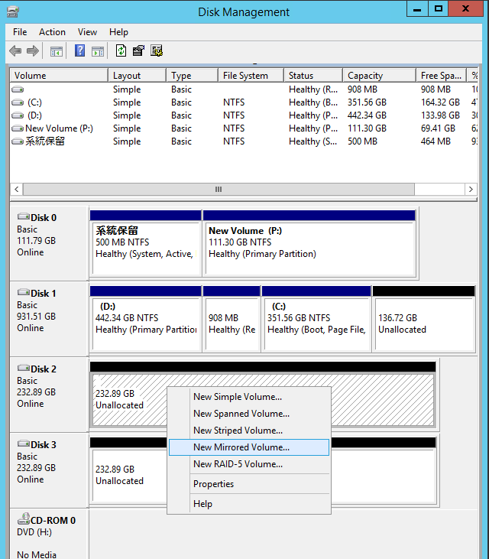
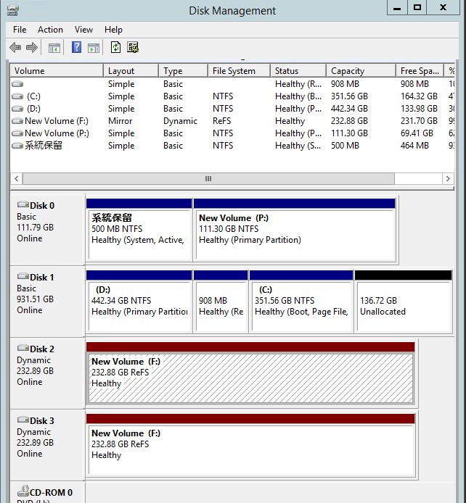
QM2 series on Windows PC
Catch the NVMe SSD information from device manager
Disk partition
Set RAID1 protection

Slide 18


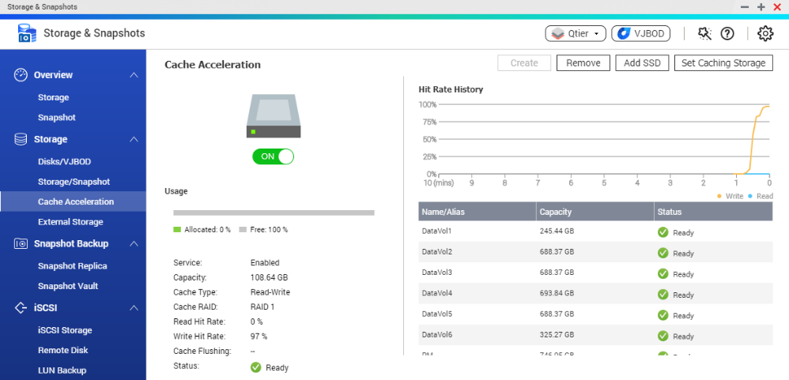
QTS Supports M.2 SSD Cache Acceleration
Reduce I/O latency
Accelerates IOPS performance
Global read-write cache
Applies SSD cache to all volumes and LUNs with a single setup process, or specified volumes only
Read caching
Read/Write caching
Read
Write
Application layer
HDD storage
SSD storage
Notes:
QM2 直播 P.4

Slide 19
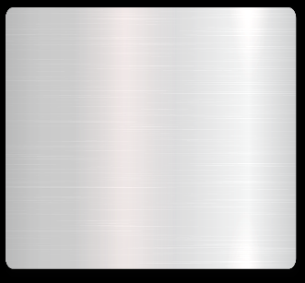

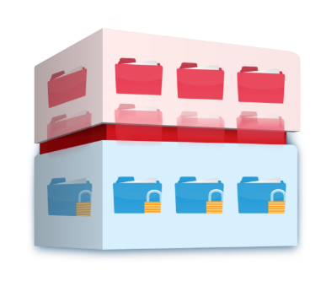
Expand high-speed M.2 SSD tier with Qtier
Qtier 2.0
Read/Write caching
Storage space and SSD caching
Sequential
Keep flexibility to accelerate performance of key data and increase cost/performance ratio
Random
Application layer
I/O aware
HDD storage
SSD storage
Total capacity = hard drives + SSD
Total capacity = hard drives
Tiering on Demand
Hot data & reserved block
Cold and archived data
Notes:
QM2 直播 P.5

Slide 20
Live Demo
Install QM2 on PC to enhance performance

Slide 21
QTS 4.4.1
Fully utilize SSD’s performance

Slide 22


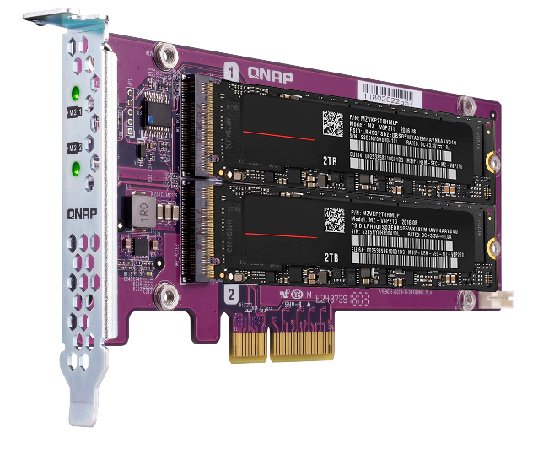
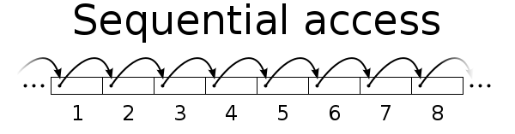
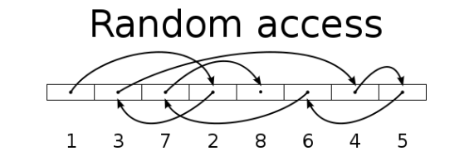
SSD Evolution Trend
QNAP QM2 in QNAP NAS is ideal on sharing data, applications and virtualized server applications for multi users. Install the QM2 on the NAS which has no other HDD slots available then combine with the 10GbE port and QTS 4.4.1’s remove and re-create Qtier solution, keep improving the random access speed (IOPS) to experience dramatic performance improvements.
Disk Type | SW (MB/s) | RW (IOPS)
HDD | 100 | 350
SSD | 300 | 60000

Slide 23

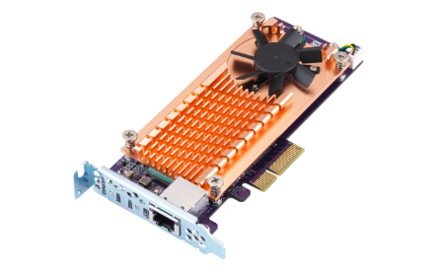
One Global Cache with Three Modes
QNAP SSD Cache can be applied to all volumes and LUNs once set with 3 modes:
Read-Only ➔ Copy frequently used data to SSD
Read-Write ➔ Not only copy data, new data can also be temporarily stored in SSD
Write-Only ➔ Only new data will be written into the cache
How Read-write Cache work:
Data from clients and storage will be cached at the block-level in real time
Write
Write
Read
SSD
Read
IO Intensive
Application
HDD
When SSD Space not enough

Slide 24
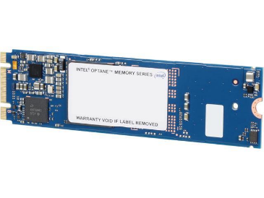

The Write-only Cache Increase ROI of
SSD Cache with high Writing Demand
Write-only cache is promoted by Microsoft
for endurance control.
QNAP believes that Write-only Cache can
increase the ROI of SSD in below scenario:
1. File Server focusing on write operations
2. Database with more write operation
(Such as IoT monitoring server)
3. Use high endurance SSD
(Intel Optane™)
Writes
are cached
Reads
are NOT
NVMe
NVMe
SSD
SSD
SSD
SSD
Reference: https://docs.microsoft.com/en-us/windows-server/storage/storage-spaces/understand-the-cache
Notes:
24

Slide 25
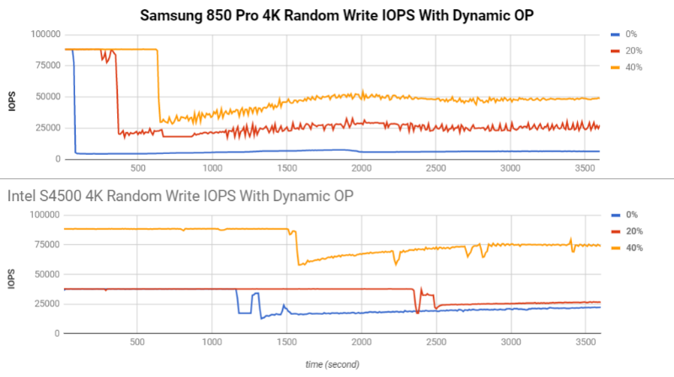
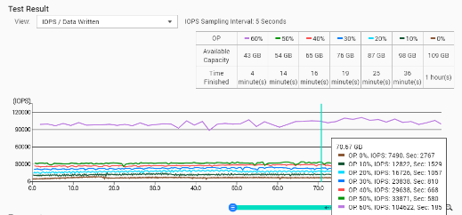
The Advantage of Software-defined Over-provisioning
SSD vendor will reserve 7% or more SSD space for internal operation usage.
QNAP allow user to test and increase the over-provisioning ratio from the software to increase that consist performance and endurance of SSD.
Reference: http://www.atpinc.com/technology/ssd-over-provisioning-benefits-configure
FIO used with parameters: --direct=0 --bs= 4k(random)1M(sequential), --io depth=1(random) 32(sequential), --file size= 90G
Notes:
25

Slide 26
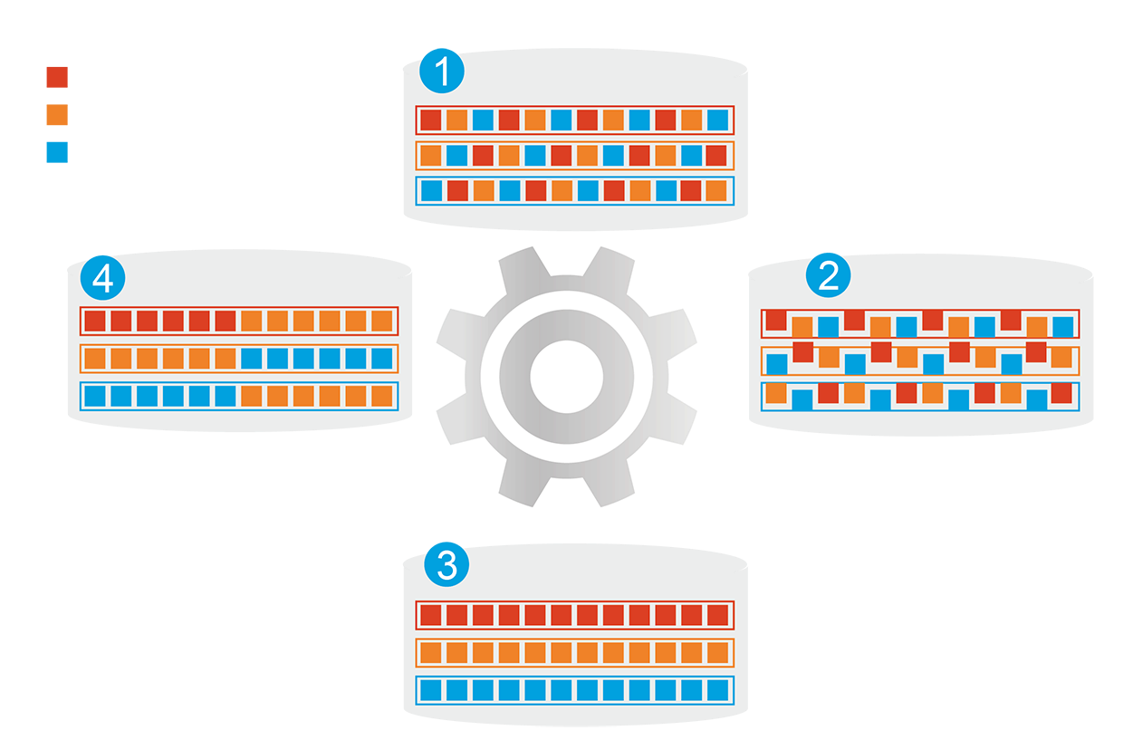


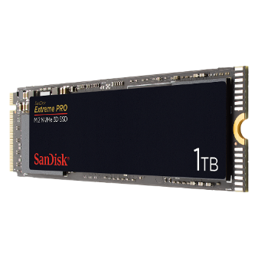
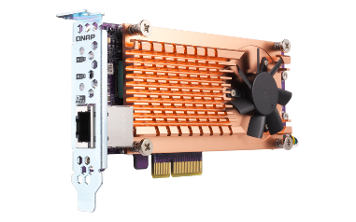

Alternative for Cache: Qtier Tiering Storage
1
Before Tiering
QNAP allows the combination of SSD and HDD RAID into the same pool and migrate data automatically based on accessing pattern.
Hot Data
Warm Data
Cold Data
4
Data Access Pattern Changed
2
Start Tiering
Support SATA, SAS, M.2, QM2 and U.2 SSD with QNAP Over-provisioning.
Qtier
Engine
Provide higher capacity as SSD can be used to store data
After Tiering
3
On QTS, PCIe NVMe SSD can only work as SSD Cache currently.

Slide 27
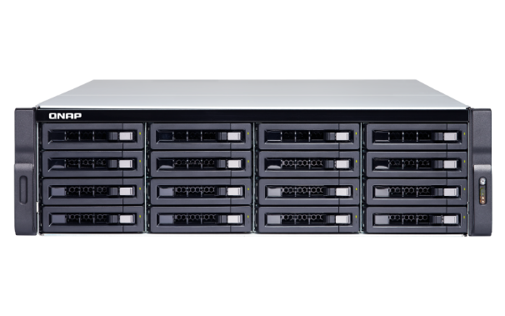



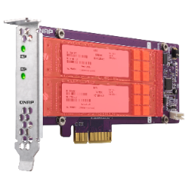
Challenge: Changing SSD Tier Interface
Challenge
While SSD Tier is already created with SATA Disk, how can I replace it with QM2 to expand the NAS while improving the SSD Tier performance?
SSD RAID 5
HDD RAID 6
HDD RAID 6
SSD RAID
SSD RAID
Notes:
32258279

Slide 28


QTS 4.4.1 Support Remove Qtier SSD Tier
QNAP QTS 4.4.1 supports remove Qtier SSD Tier, the users can remove then re-create SSD tier as required.
When removing the SSD tier, all the storage pool data will be retained as data on SSD only to be moved to HDD.
Storage pool
SSD RAID Usage
Pool Metadata
SAS HDD RAID Usage
SSD RAID Usage
Pool Metadata
SATA HDD RAID Usage
SSD RAID Usage

Slide 29

Test of recreating Qtier SSD Tier
In QNAP Lab, 4 250 GB SSD need to be replaced with 500 GB SSD. The operation is conducted with both Replacing Disk & Remove SSD Tier.
The time for removing and re-creating the SSD tier is almost 2 times faster than replacing disk. The replacing disk method also does not support changing SSD on different interface.
Consumed Time (Mins)
Remove and Upgrade SSD Tier
23
Replacing Disk
44
(Mins)
0
5
10
15
20
25
30
35
40
45
50
* Using TVS-1282T with 4 enterprise HDD for testing.
Notes:
35157436

Slide 30
Choose Between SSD Cache & Qtier
The best SSD configuration may only be measurable once it is configured. The SSD Cache and Qtier have different advantages.
SSD Cache
Sequential R/W (MB/s)
Random R/W (IOPS)
Real Time Performance Boost
1. For accessing with burst IO such as file syncing and video editing.
2. Can be changed to Read or Write only with bypass block size.
1050
160000
900
831
830
140000
133402
130388
817
820
120000
750
100000
82823
88022
600
Qtier 2.0
80000
Fully use SSD Capacity
1. For boosting IO with fixed pattern such as mail or database server.
2. With IO Aware Qtier can also support database operations.
450
60000
300
40000
150
20000
0
0
SSD Cache
Qtier
Write
SSD Cache
Qtier
TVS-872XT-i5-16G with QM2-2P10G1TA and Samsung SSD 960 pro 1TB M.2 NVMe *2, RAID 1 , compare SSD cache and Qtier, running Network and SSD transfer at the same time
Read
Notes:
Qtier

Slide 31

QM2 Highlight points with QTS
QTS 4.4.1 fully utilize SSD’s performance
Improve random access performance when the NAS has no idle HDD slots and 10GbE ports
Improve NAS performance by using read only, read-write and write-only 3 type of caches for the whole NAS storage space via QM2
Software-defined Over-provisioning increase Performance and endurance of SSD
QTS Qtier improves both performance and capacity, in QTS 4.4.1，users can easily change the SSD to QM2 in the SSD Tier.
4.4.1 Beta will be released at End of May!

