Slide 2


Strict Regulations for
Data Archiving
The government mandates that important documents of corporations could not be modified once they are are stored.
The following organizations must follow the regulations:​
Government agencies
Medical center
Financial institutions

Slide 3

The US Security and Exchange Commision Clearly Regulates
The US SEC Sarbanes Oxley : Requires data protection and non-changeability
The US SEC rule 17a-4): Mandatory retention period of data
Notes:
https://www.17a-4.com/regulations-summary/
自從2001 年恩隆案以及2009 金融危機發生之後，美國至少訂定了4000 條以上的法規，而且持續在增加，其中對於資料安全以及資料不可否認性特別訂定了SEC 17A-4/SEC Sarbanes Oxley/FDA 21 CFR 第11 部分來強定資料保存的重要性。此法規針對金融業、醫藥業以及各大上市公司都有強制性的規定。

Slide 4





Many Applications Require Big Data Storage and Data Archiving
There is a need to constantly record huge amounts of real-time data in some professional fields.
They also need to protect these records and can be properly retained for future analysis.
Astronomical research
Atmospheric science
Oil exploration
Financial
transaction

Slide 5








Various Files Need to Be Preserved
The data forms the memory of the enterprise.
Picture
Photo
Contract
Order
Financial report
Invoice
Email
Other documents
Notes:
都是一但完成並儲存，就不容許再有任何的更改。

Slide 6

Recently Enterprises Face The Danger of Data Encryption
According to Forbes, the FBI paid close attention to the spread and severity of the ransomware incident in 2016, noting about 1/5 companies have not recovered key files and information even if they paid for it.

Slide 7

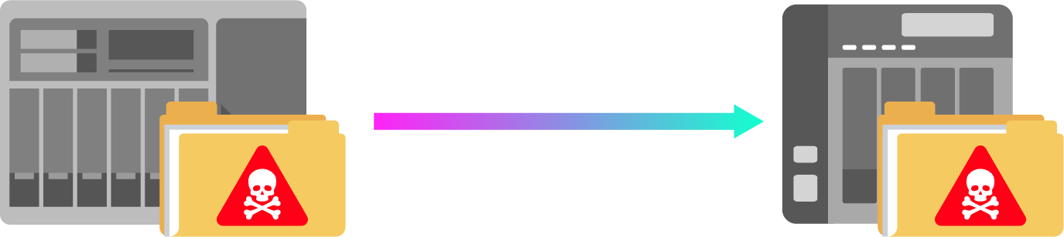
The Backup Copy May Also be Infected with The Ransomware
Blocking the suspicious data encryption from the stored media itself is the fundamental solution.
Data backup

Slide 8

WORM
(Write Once Read Many)
WORM (Write Once, Read Many) is a data storage technology that allows data to be written at a single time, preventing users from unexpectedly changing or deleting data.

Slide 9
The Three Definitions of WORM
Write Once Read Many
Data access is written once, read multiple times
Data Compliance
Data is non-repudiation
File Lock
Files can't be permanently modified, deleted
Notes:
WORM technology can archive data in non-rewritable, non-erasable format. Using this method, recorded data can no longer be overwritten, modified or manipulated.

Slide 10

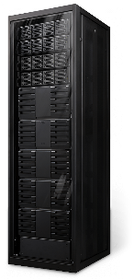
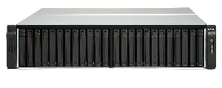
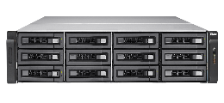
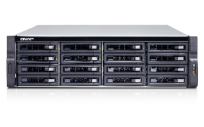

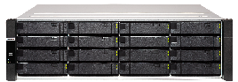
QNAP Provides Two WORM Solutions
Physical WORM
Software WORM
BlueGlacier Tiering Archive Storage
QES ZFS Filesystem
TES-3085U
TES-1885U
TES-1885U
ES1686dc
TDS-16489U R2
Optical Disc Library
Notes:
https://www.ithome.com.tw/tech/129616

Slide 11




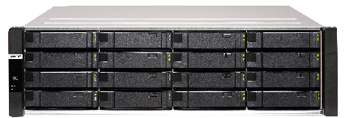
QES Folder-Based WORM
Easy to Integrate Storage Solutions
Server
QES WORM supports standard protocol including SMB/CIFS, NFS and FTP.
It can integrate almost all operating systems (Windows, Linux, Mac).
SMB / CIFS
NFS
FTP
WORM

Slide 12


QES ZFS WORM Storage Solution
Enterprise WORM
Can only be written, but cannot be deleted, modified or restored. You can remove the shared folder through QES or CLI commands.
Compliance WORM
Folders can only be written, but cannot be deleted, modified or restored. To remove a folder, you must take the Storage Pool offline and remove the Pool.

Slide 13
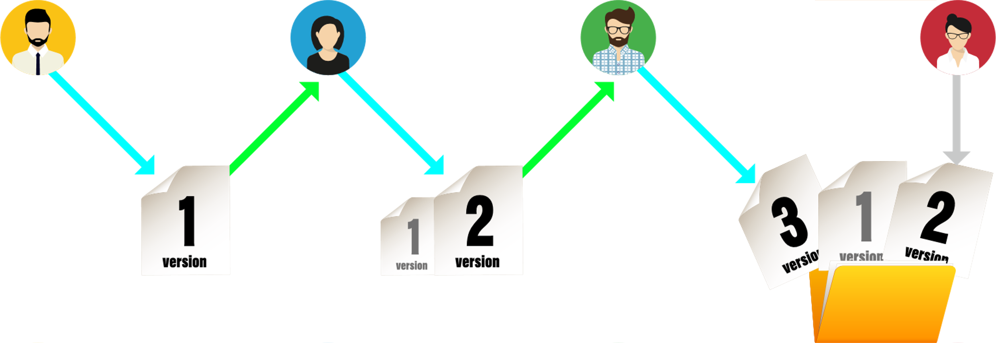


Both Solutions Support Retention Period Management
Once the file is locked in the folder, only the data are readable during this scheduling period to prevent accidental or malicious damage to import data.
Delete
Notes:
對於法規遵循要求企業做到的資料長期保存（Data Retention）， QES也推出了相關的特色，例如支援WORM（Write Once, Read Many）的儲存，可將檔案的存放維持在無法修改的狀態，以符合公司外部的法律，以及產業治理的規定
例如，因應美國證券交易委員會提出的SEC Rule 17a-4法令時，企業可運用WORM的功能，將儲存系統設定為嚴格的遵循模式（Compliance mode），此外，SnapLock還提供了較為寬鬆的企業模式（Enterprise mode）選項，能用於內部的數位資產保護。

Slide 14



WORM is More Secure Than ACL Denial Permissions
Once the WORM folder is set
Even users with the highest privileges ("administrator" or "root") cannot change the WORM status of files contained within.
If a child directory (Child) triggers WORM state, the parent directory will be unable to be renamed and deleted.
When the WORM folder retention period expires, the "remove privilege" and "delete child privilege" will be automatically granted.

Slide 15






QES WORM Provides Advanced Security
Powerful authentication
Flexible access control
Access restrictions
AES-256 data encryption
Encrypted data transmission

Slide 16
You Can Also Use WORM With Other QES Features
Thin Provisioning
Flexibly expand WORM folders on demand
Folder Quota
Properly manage the capacity of WORM folders
Compression
Less space occupied by files in WORM folders
Deduplication
Reduce identical data saved in storage systems
Notes:
All data stored in WORM mode can be encrypted to prevent sensitive data being read by unauthorized personnel

Slide 17


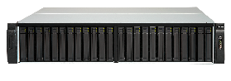
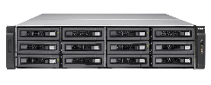
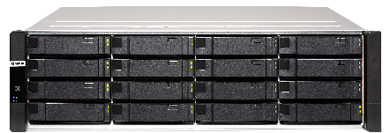
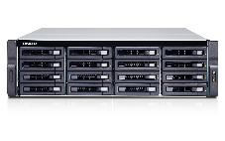
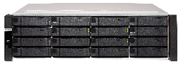
Backup WORM with Snapsync Ensures Data Reliability
SnapSync only makes differential backup, making DR backup space more efficient.
Primary Site
DR Site
WORM
WORM
Snapsync
TES-3085U
TES-1885U
ES1686dc
ES1686dc
TDS-16489U R2

Slide 18

Even SMB users Can Archive Data with a Peace of Mind
Compared with enterprise, SMB and SOHO users can only rely on relatively uncomplicated methods due to limited resources.
QES WORM can solve the risk that SMB have been worried that data was accidentally overwritten.

Slide 19
Live Demo
QES WORM Folder

Slide 20
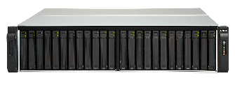
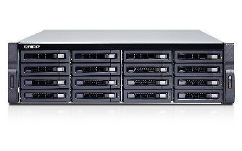
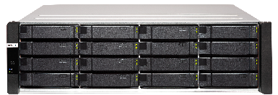
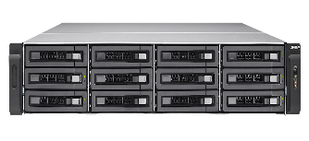
Best Choice For Enterprise
ES1686dc
TES-1885U
TES-3085U
TDS-16489U R2
High-Availability NAS
Powered by QES
Dual OS options
HPC Storage
QES / QTS Ready
Intel ® Xeon ® D processor
Up to 512G DDR4 memory
Dual active-active controllers
On-board M.2 SSD available
Intel ® Xeon ® D processor
Up to 128G DDR4 memory
Dual QNAP OS ready to use
40GbE Ready
Intel ® Dual Xeon ® E5 processor
Up to 1TB DDR4 memory
Dual QNAP OS ready to use
40GbE/25GbE, 12Gb/s SAS, FC adapter, QM2, Graphics, Ready

Slide 21


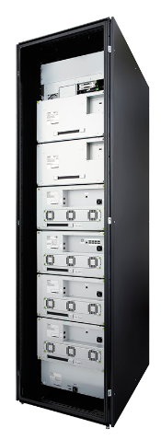

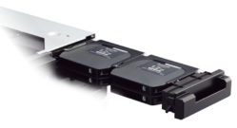

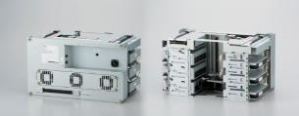


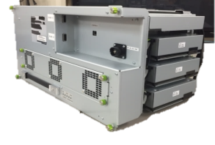
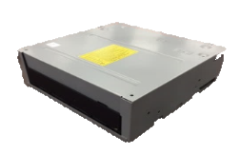

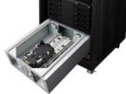
Panasonic Freeze-Ray Modules
Module design for easy maintenance
Magazine Management
Writer Unit
Load 12 Archival Discs per Magazine
Transfer rate up to 360MB/s per writer unit, maximum 1080MB/s with 3 writer units.
Magazine
Drawer
Magazine Carrier Unit
Maintenance can be brought to the bottom module separately.
Drive Unit
Magazine Carrier unit
Notes:
Drive units can be replaced/repaired by module

Slide 22


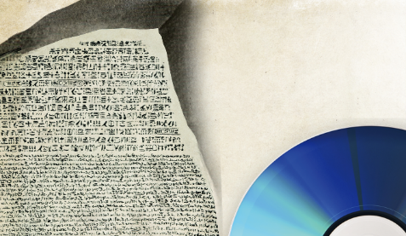



Advantages of Archival Disc
Physical WORM
Highly reliable
No data overwrite
No physical contact
No falsification
Human error free
No components damage
Maintenance free
Notes:
光學儲存媒體本身材料的特性, 提供只允許寫入一次, 資料從此變成唯獨的能力.
這種物理型WORM最大優點是極為可靠, 其防寫措施是建立在儲存媒體的物理性質上, 從根本防止了刪改資料的可能性.
此外, 光碟高壽命的特性, 比磁帶更適合用作長期歸檔的強健媒介.

Slide 23


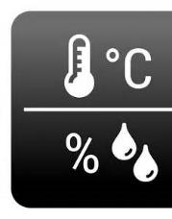


Advantages of Archival Disc
Thermal Tolerant
Disaster Recovery
100 Years
30
70
Tsunami, flood
Electromagnetic wave
No media degradation
No data damage
100 years longevity
Data center anywhere
Business continuity
Restoration free

Slide 24

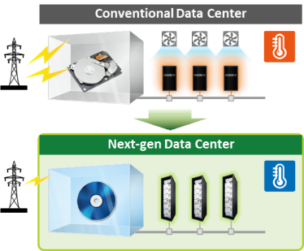
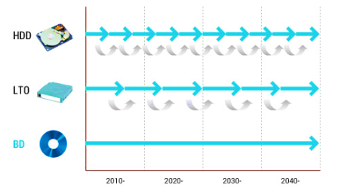
Advantages of Archival Disc
CapEx​
OpEx
Data migration
Optical Storage
No media Obsolescence
Low power consumption
Migration free
One-time investment
Reduce cooling cost
Standby power free

Slide 25












BlueGlacier Solution Architecture
Ecosystem
QNAP Applications
3rd Party App
Hybrid Backup Sync
3rd Party App
Qtier
Qsirch
APIs
Qfiling
Client
SMB/NFS/FTP
Web UI
Cold & Archival Data
Optical Disc Library
File Station
QHAM
DAFS
QTS
BlueGlacier Building Blocks
TES-1885U Enterprise NAS

Slide 26
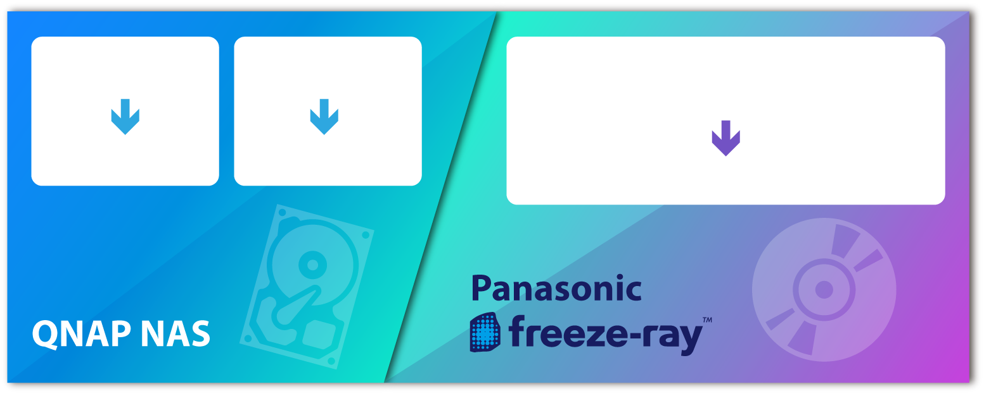
BlueGlacier Supports Qtier to Satisfies All Kinds of Applications
Hot Data
Warm Data
Cold Data
Archives
Offline Archives
SSD + HDD
HDD
Optical disc
Notes:
將SSD用於高I/O作業、HDD用於一般應用，光碟則用於儲存冷資料及長期歸檔。內建的10 GbE 介面則提供高速網路傳輸，提升繁重負載任務的效率，滿足廣泛的儲存應用。

Slide 27

Comprehensive APIs for 3rd Party Integration
Build a Strong Enterprise Storage Ecosystem
File/folder read/write operations API.
freeze-ray system and magazine management API.
Data archival/retrieval job management API.
Data Archival File System (DAFS) management API.
NAS system management API.

Slide 28


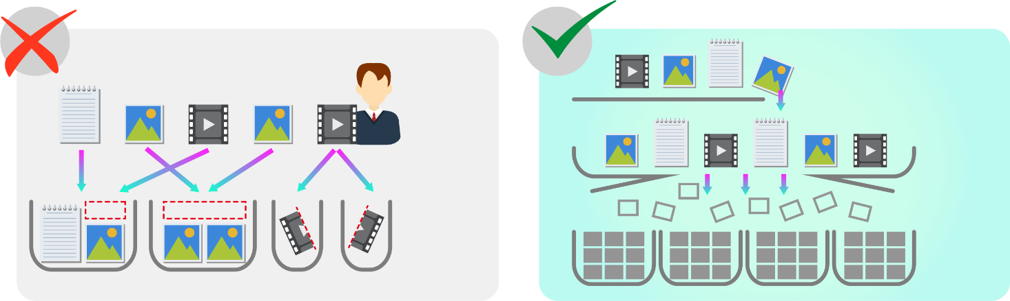
QNAP Data Archival File System (DAFS)
8K Video / Bulk Data / Engineering Drawings
Other Solutions
QNAP DAFS built for cold data storage
Manpower
File
DAFS
Waste
Waste
Tape /
Optical Magazine
Tape /
Optical Magazine

Slide 29
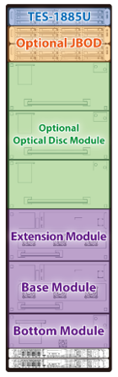

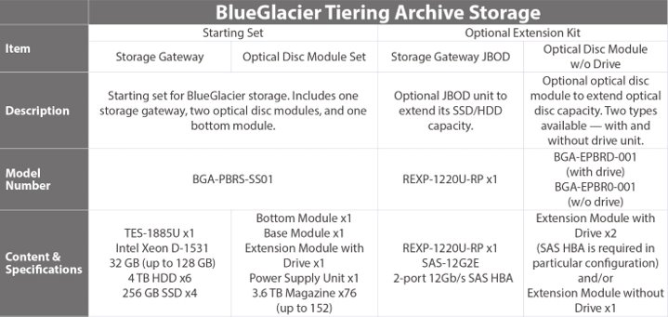
BlueGlacier Product Configuration
  BlueGlacier includes an QHAM application license
42U

Slide 30
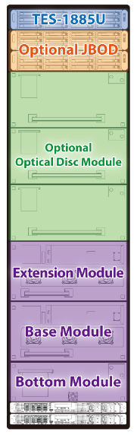
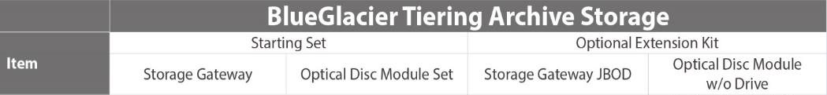

BlueGlacier Product Configuration
42U

Slide 31





QNAP WORM
Multiple Business Advantages
Government Regulations
Ensure that the data storage meets government regulations and avoids penalties.
Corporate Governance
Satisfy company's operational needs and avoid commercial litigations.
Malicious Attacks
Prevent unauthorized malicious tampering or deletion of data, loss of commercial assets.
Efficient Storage
Combine multiple space saving technologies to make data archiving more efficient.

Slide 32

QNAP WORM is your Best Choice
Thank you !
Copyright © 2019 QNAP Systems, Inc. All rights reserved. QNAP® and other names of QNAP Products are proprietary marks or registered trademarks of QNAP Systems, Inc. Other products and company names mentioned herein are trademarks of their respective holders.

