Slide 2
你所能擁有最棒的遠端喚醒小幫手
你為什麼需要 QuWakeUp？
過去如何做到 WOL / WOW？
QuWakeUp 輕鬆進行遠端喚醒
QuWakeUp 操作介面介紹
QuWakeUp 使用前/後情境比較
Notes:
The best remote wake-up helper you can have
Why do you need to use QuWakeUp?
How to WOL/WOW in past?
QuWakeUp can remote wake-up easily
QuWakeUp user interface introduciton
Situational comparison before/after QuWakeUp

Slide 3
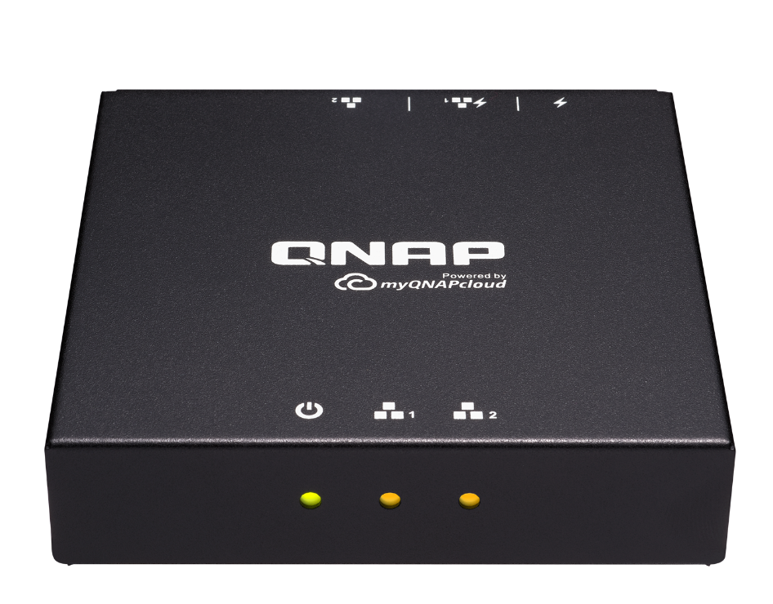
你為什麼需要 QuWakeUp？
Notes:
Why do you need to use QuWakeUp?

Slide 4
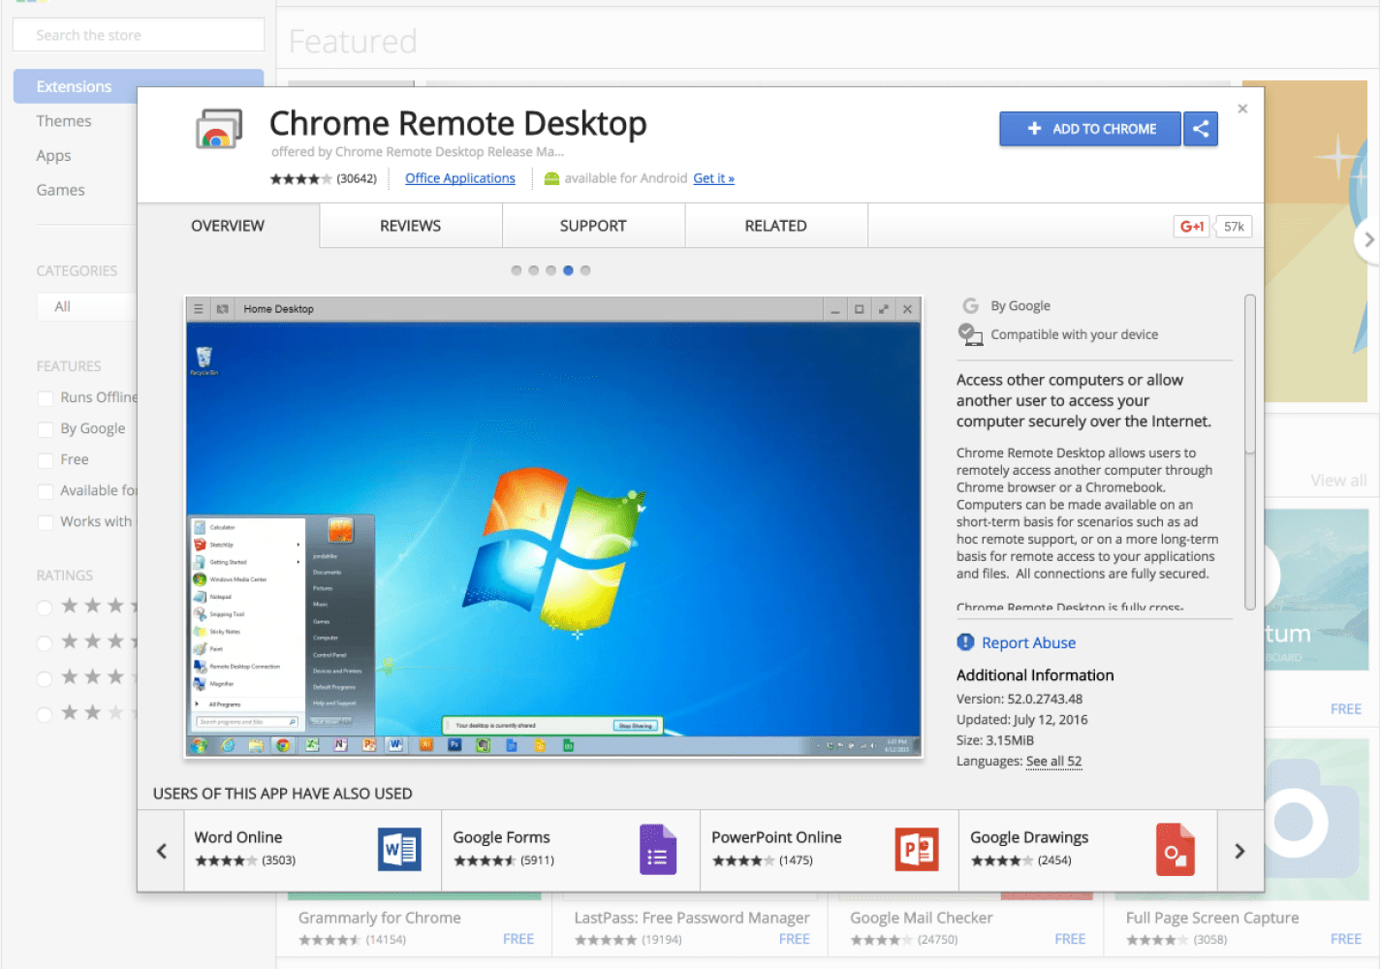
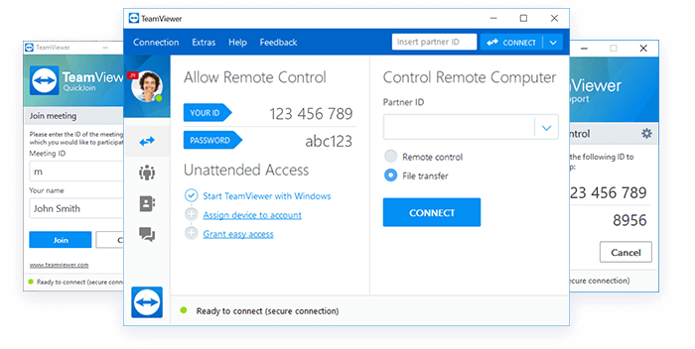
過去我們如何遠端工作
遠端喚醒設備卻相當不容易！
使用各種熟悉的「遠端桌面控制」軟體，但是…
Notes:
How did we work remotely in the past? Use variety of "Remote Desktop Control" software, but...
Remote wake-up devices are not easy!

Slide 5
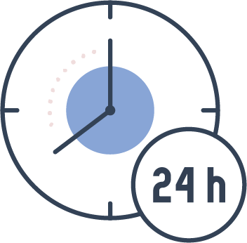
如果你是 NAS 個人/家庭用戶
不在家時臨時要存取資料...
打電話叫家人開機
耗電問題
24HR 不關機
Notes:
If you are a NAS home user...
When you are not at home, you need to access the data temporarily...
Call the family to turn on device
Keep online 24/7
Power consumption issue

Slide 6
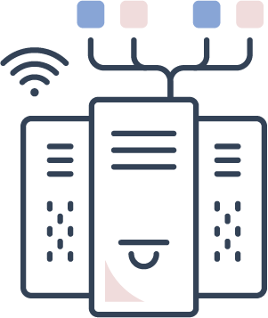
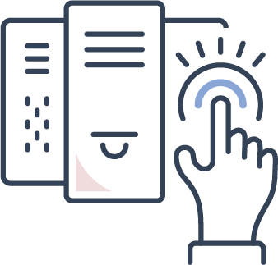
如果你是 IT 專業人員
管理機房內上百台設備不容易...
難以追蹤設備連線情況
設備出狀況總是慢半拍
維修復電親自將每台設備開機
Notes:
If you are management of information system
Managing hundreds of devices is not easy...
Difficult to track device connection
Personally boot each device after repair
Notified late when device is out of situation

Slide 7
你需要的是......
彈性排定喚醒行程
單一介面中控 設備連線狀態​
一次大量喚醒多項設備
遠端喚醒 區網內設備
Notes:
What you need is
Can wake up a large number of devices
Flexible wake-up schedule
Wake up the device in LAN from the Internet remote
View the connection status of each device on a single platform

Slide 8
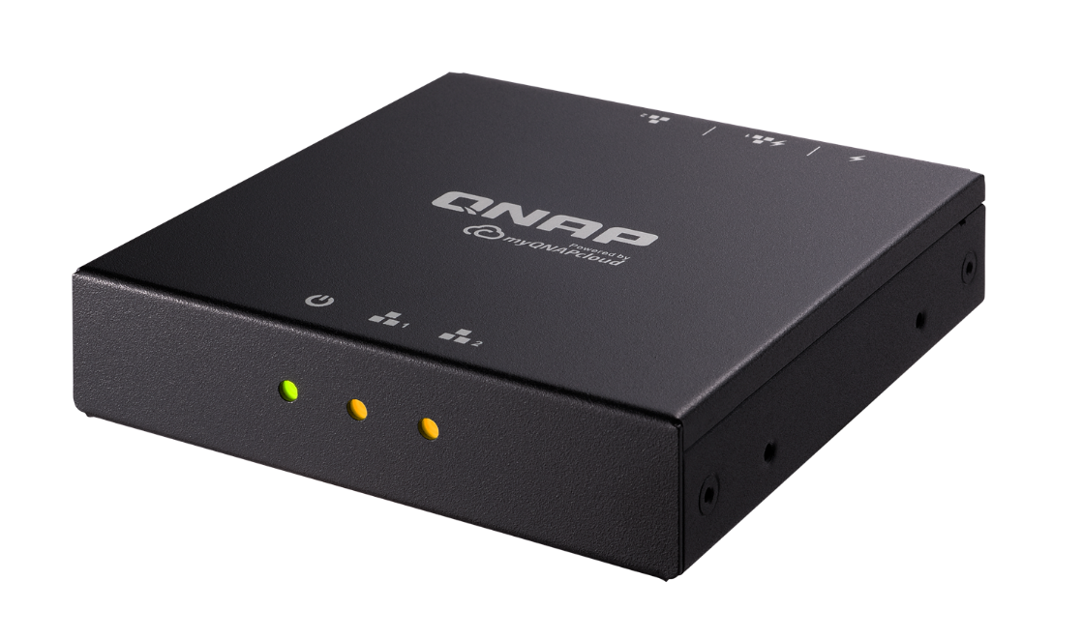
過去如何做到WOL 或 WOW？
Notes:
How to WOL/WOW in past?

Slide 9
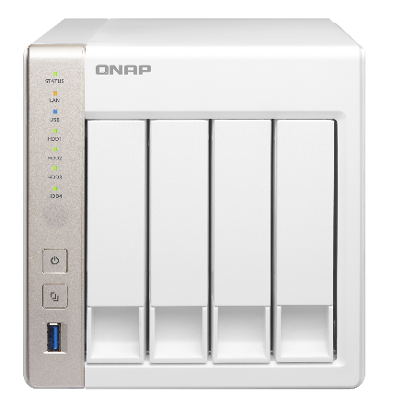
Wake On LAN (WOL) 介紹
電腦在關機狀態時保留網卡運作，網卡仍可接受並監測網路封包，當它收到特殊的封包 (Magic packet) 時，就會觸發開機程序。
高度普及技術
大部分 NAS/PC/Mac 皆有支援
Magic Packet 魔法封包
連續6個“FF”(十六進位，換算成二進位即 11111111)即 FF FF FF FF FF FF，之後是重複 16 次的 MAC 位址資訊。
TS-451
Notes:
When the computer is turned off, the network card operation capability is retained, and the network card can still accept the network packet and monitor the packet. When it receives a special packet (Magic packet), it will trigger the booting process.
Highly popular technology
Most NAS/PC/MAC support
Six consecutive "FF" (hexadecimal digits, converted to binary digits: 11111111): FF FF FF FF FF FF FF, followed by 16 times of MAC address information.
Reference
http://www.wameng.com.tw/index/view?gp=3&sgp=3&pk=-1&id=2

Slide 10
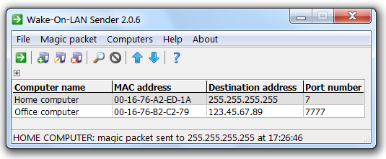
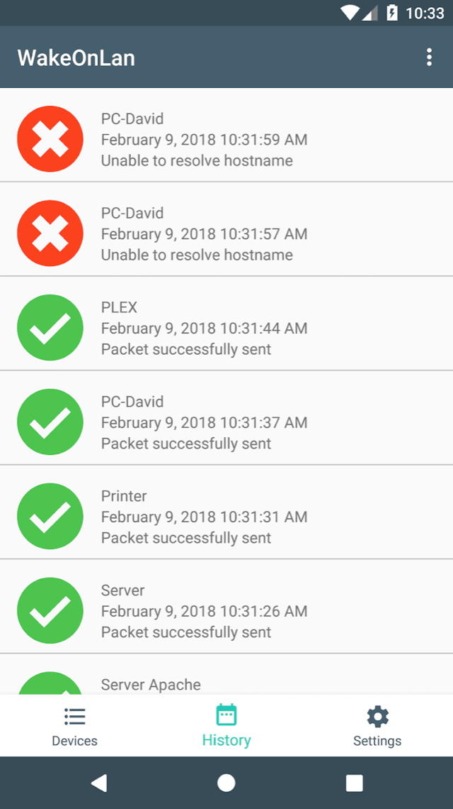
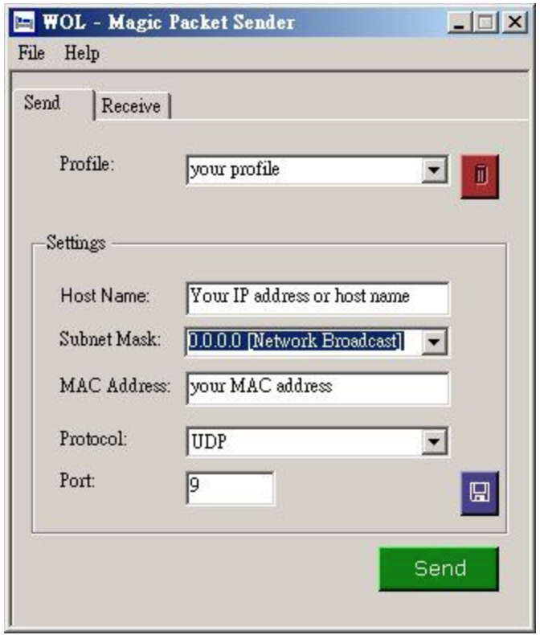
過去你想要進行 WOL，會需要...
尋找合適之發送魔法封包的工具，多為電腦應用程式。
Notes:
In the past, if you wanted to complete WOL, you would need...
Find the right tool to send magic packets, mostly computer utilities

Slide 11
過去你想要進行 WOL，會需要......
透過本機手動操作取得相關資訊，包括 MAC 位址及 IP 位址。
Notes:
In the past, if you wanted to complete WOL, you would need...
Get information through manual operation of this machine, such as MAC address, IP address.

Slide 12
Wake on WAN 的困擾
當你離開區域網路時，例如在街道上或者搭捷運時，如果想要喚醒區域網路中設備，即需要 Wake On WAN (WOW)。
從網際網路發送魔法封包至區域網路內的設備位址，方能完成遠端喚醒。
Magic Packet 魔法封包
Notes:
Wake on WAN troubles
Wake On WAN (WOW) is required if you want to wake up devices in your LAN when you are away, such as on the street or by MRT.
The remote wake-up can be completed by sending a magic packet from the Internet to the device in the local area network address.

Slide 13
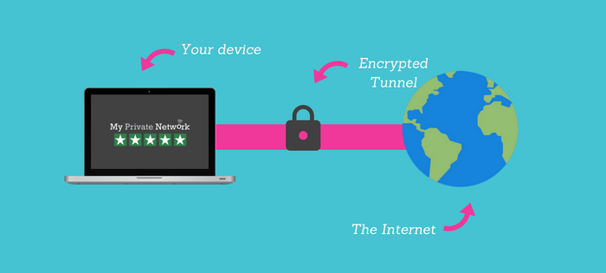
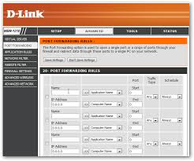
設定流程複雜
Wake on WAN 的困擾
過去常用的方式是：
Port Forwarding
VPN
缺點
需要硬體支援​
不穩定的成效
Notes:
Wake on WAN troubles
The approach we used is:
Disadvantages:
Complicated setting process
Need hardware support
Unstable effectiveness

Slide 14
QWU-100 小巧裝置解決您的困擾
Notes:
A compact box can solve your problems

Slide 15
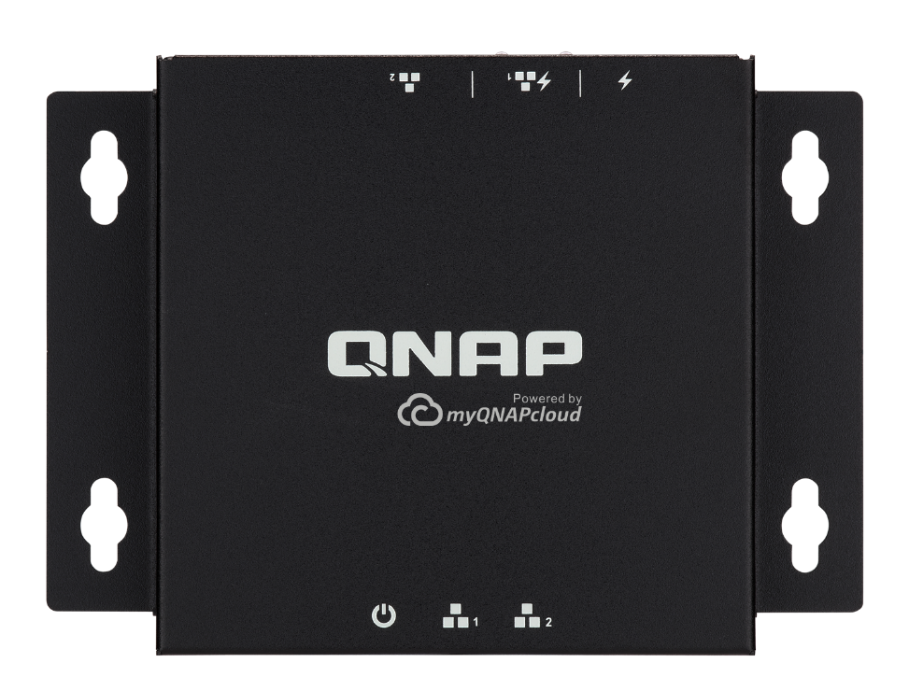
QuWakeUp 輕鬆完成遠端喚醒
Notes:
QuWakeUp can remote wake-up easily

Slide 16
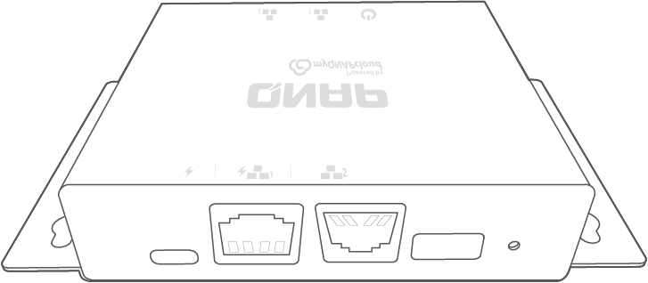
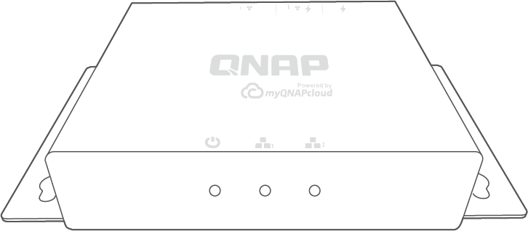
QWU-100 產品介紹
LED 提示燈號
I/O
1
2
3
4
5
1
2
3
1
USB Type-C power input
Status LED
2
RJ45 PoE port (LAN 1)
1
LAN1 LED
3
RJ45 LAN port (LAN 2)
2
USB Type-A port
LAN2 LED
4
3
Reset button
5

Slide 17
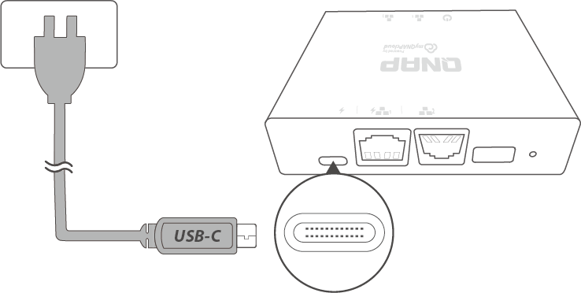
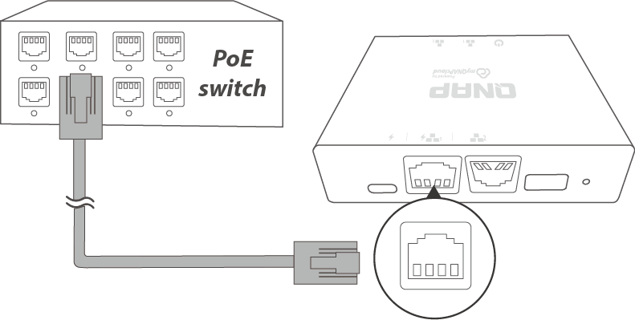
QWU-100 彈性選擇供電方式
a. USB Type C
普及化的 USB Type C 作為供電來源，方便易部署。
b. PoE Port
如果環境有PoE Switch，選擇PoE供電能夠架設最精簡的線材配置。
Notes:
Flexible choice of power supply!
The popular USB Type C is a power source that is easy to deploy.
PoE power will enable the most streamlined wire configuration.

Slide 18
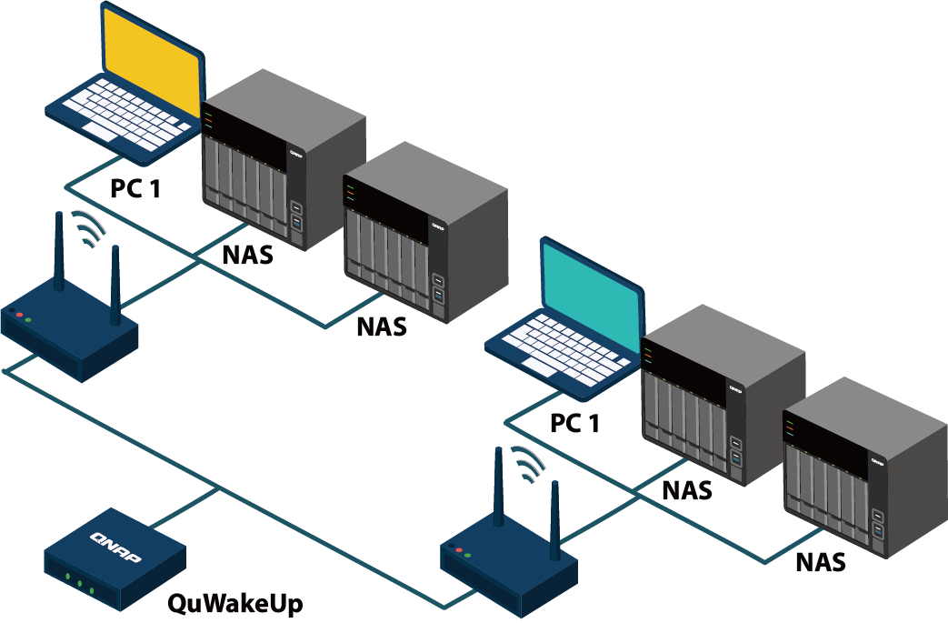
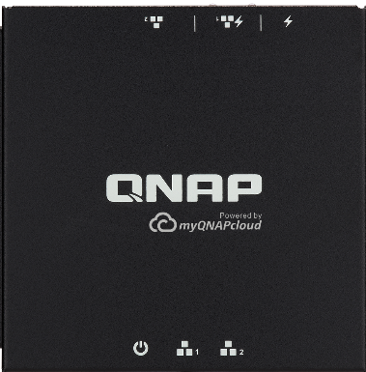
靈活部署，一機多用
尺寸精巧但具備有兩個區域網路埠 一機可做兩個區域網路的設備管理
QWU-100
10cm
10cm
Notes:
Flexible deployment and multiple management
Compact size but with two LAN ports,
Able to manage devices for two regional networks.

Slide 19
QuWakeUp 五大特點
設備易安裝使用
省去傳統繁複步驟​, 使用 QNAP 軟體輕鬆管理
多樣化喚醒設定
無須尋找設備、網卡等相關資訊​, 掃描後自動記憶 IP 和 MAC 位址，更有彈性喚醒排程
行動APP無縫接軌
整合 Qmanager App，透過行動裝置即能掌握設備狀態，更方便
遠端喚醒零距離
透過雲端整合服務，從網際網路也能喚醒設備
跨平台通知
24 hr 監控設備運作情形，出現意外關機、連線異常問題，立即收到通知！
Notes:
Five highlights
Easy to install and use Eliminate traditional complicated steps, easy management with QNAP software.
Versatile wake-up schedule No need to find information about devices, network cards, etc., automatically remember the IP and MAC addresses after scanning, and even flexible wake-up schedule.
Seamless mobile APP Integrate the Qmanger and get the status of the device through the mobile device, which is more convenient!
Remote wake-up directly Through the cloud service integration, devices can also be woken up from the Internet.
Cross-platform notification 24hr monitoring and immediately send a notice when unexpected shutdown, connection abnormality occurs!

Slide 20
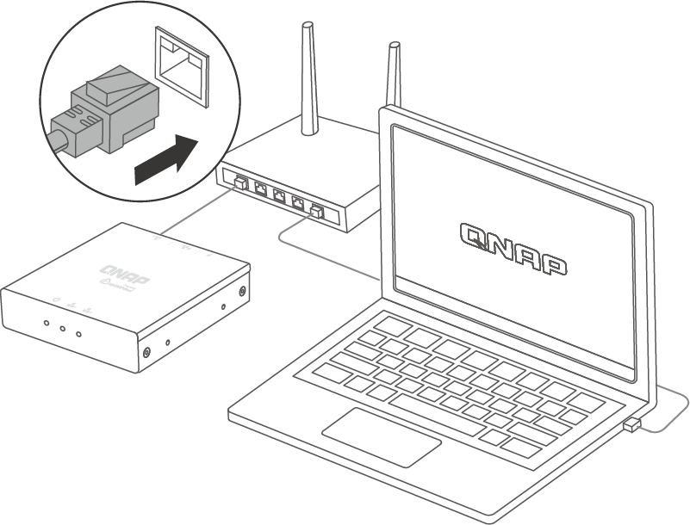
簡單三步驟安裝，輕鬆使用
特點一
1. 安裝
將設備連接於路由器後方
使用輕巧設備
搭配好上手軟體
簡單三步驟完成遠端喚醒設置
Notes:
Easy three-step installation
Compact device with friendly software UI,
three steps to complete the remote wakeup setup quickly
1. Configuration
Connect the device to the router.

Slide 21
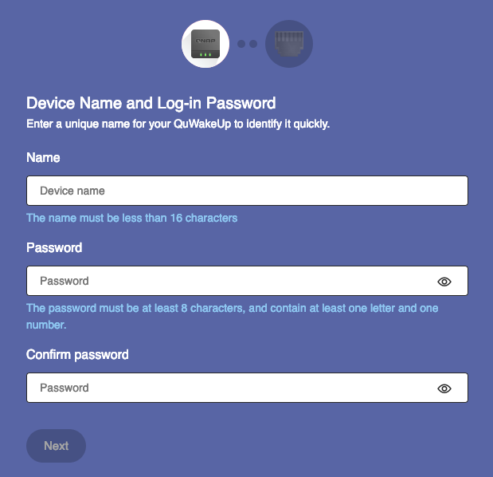
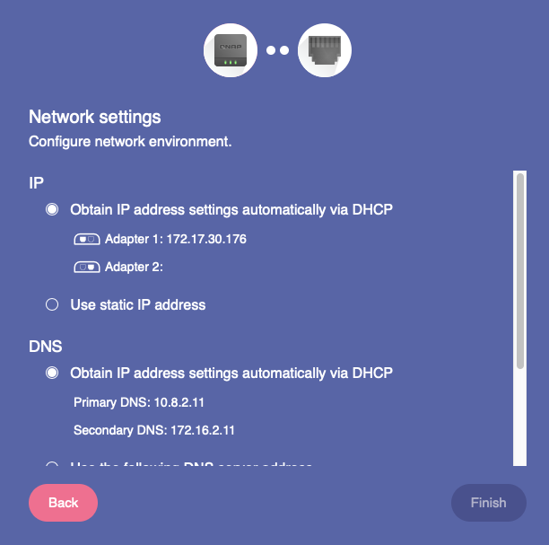
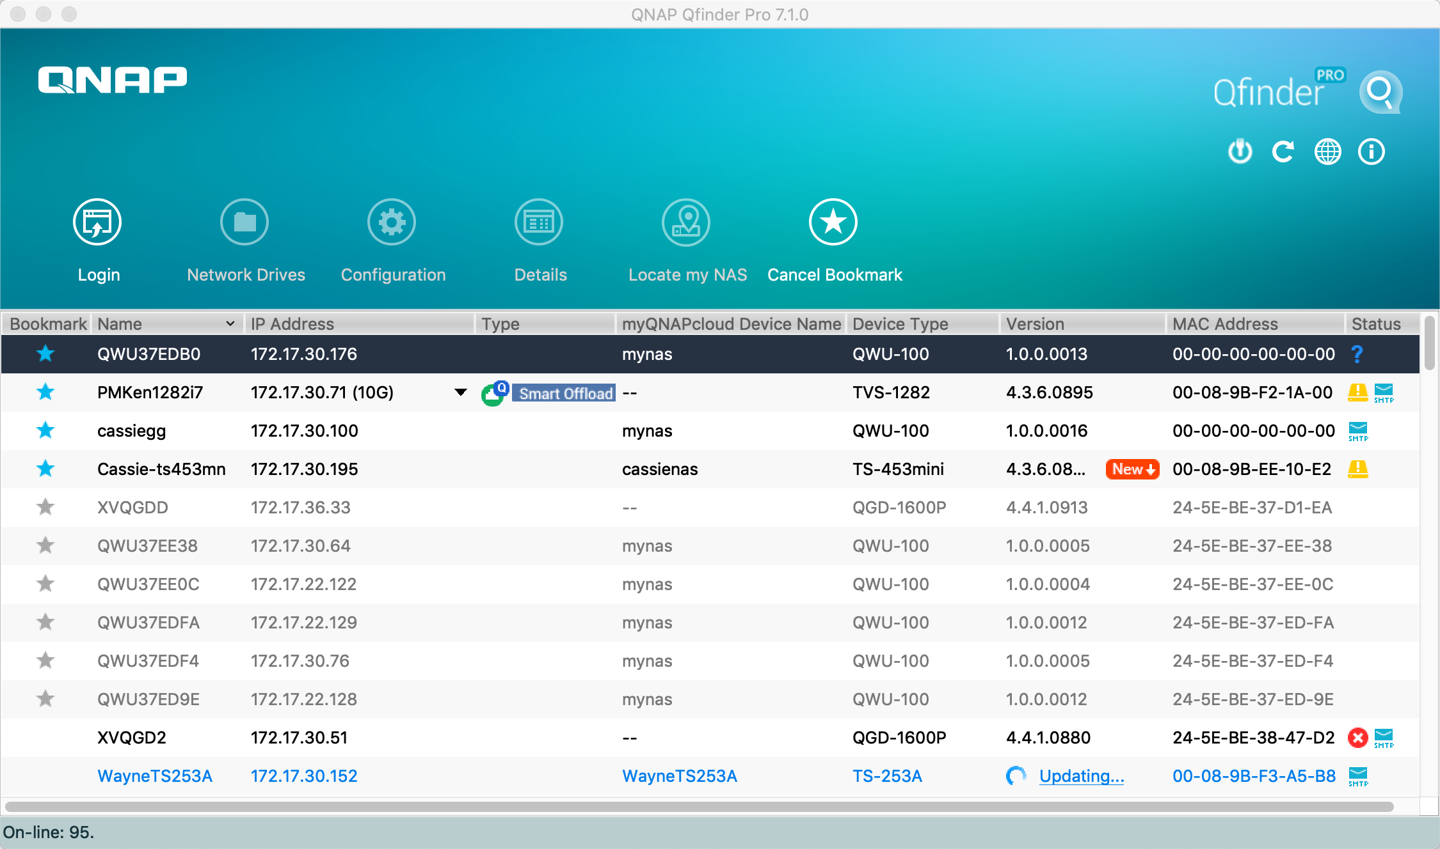
簡單三步驟安裝，輕鬆使用
特點一
2. 搜尋
使用Qfinder找到裝置位址
3. 設定
一分鐘搞定密碼及網路設置
https://www.qnap.com/qfinderpro
Notes:
2. Initial Settings
Get passwords and network settings in one minute.
3. Start to Use
Experience the features of QuWakeUp

Slide 22
滿足多樣化喚醒需求
特點二
你可以對設備發送遠端喚醒指令，分別有立即喚醒與排程喚醒等多樣化喚醒模式。排程喚醒有一次性、每天、每週、每月等選擇，幫助你更彈性管理設備上線的需求。
立即喚醒
每天/每週/每月
排程喚醒
Notes:
Meet diverse wake-up demands
You can send remote wake-up commands with different wake-up modes such as immediate wake-up and scheduled one, which once, daily, weekly, monthly, and other options are included. QuWakeUp help you manage devices to go online flexibly.

Slide 23
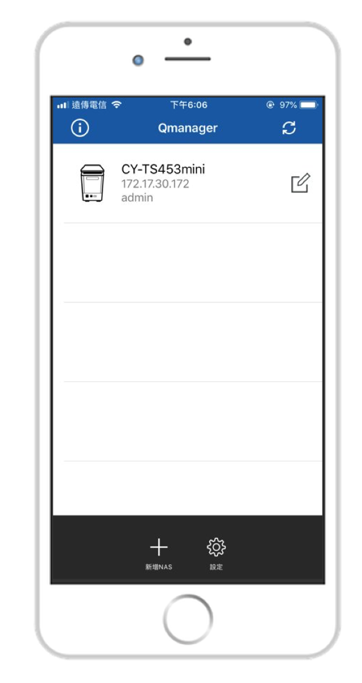
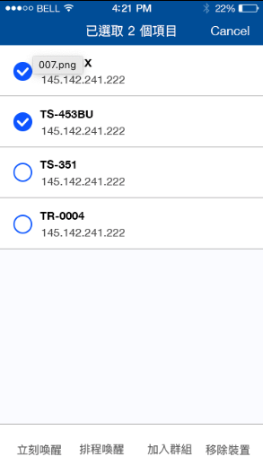
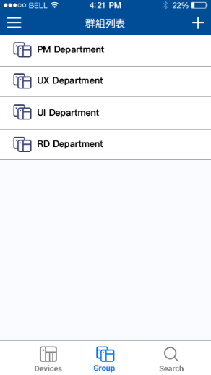
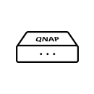
行動APP無縫接軌
QuWakeUp
特點三
Qmanager
將 QuWakeUp 整合於手機應用程式，使用行動裝置管理更便利。不論你在上班途中、搭捷運時，皆能透過隨身的手機來掌握區域網路內設備情況。
QuWakeUp
群組管理
遠端喚醒
一覽設備狀態
Notes:
Seamless mobile APP
Integrating QuWakeUp into a mobile app makes it easier. No matter when you are on the way to work or taking the MRT, you can use the mobile phone to keep track of the equipment in the local network.

Slide 24
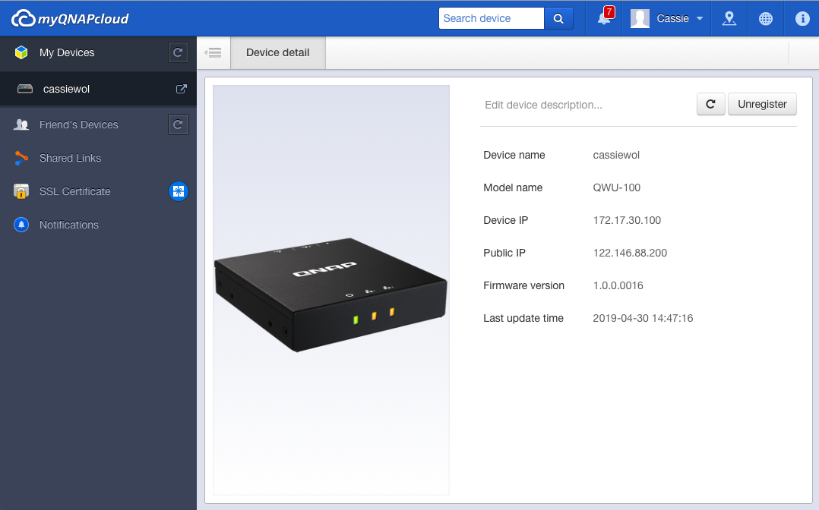
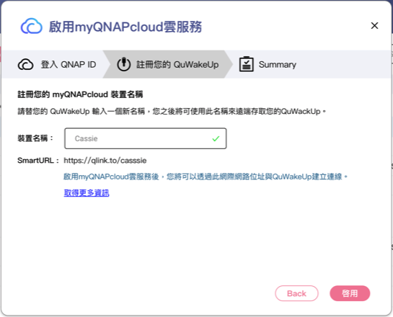
遠端喚醒零距離
特點四
免費雲端連線
myQNAPcloud 為使用者提供了遠端連線解決方案，只要擁有一組 QNAP ID 並將裝置註冊於帳號下，即可使用 SmartURL 遠端連線至區網內的QuWakeUp。
QuWakeUp註冊流程
myQNAPcloud帳號頁面
Notes:
Remote wake-up directly myQNAPcloud provides a remote connection solution. As long as you have a QNAP ID and register the device under the account, you can use the smart URL to connect to the QuWakeUp from Internet.

Slide 25
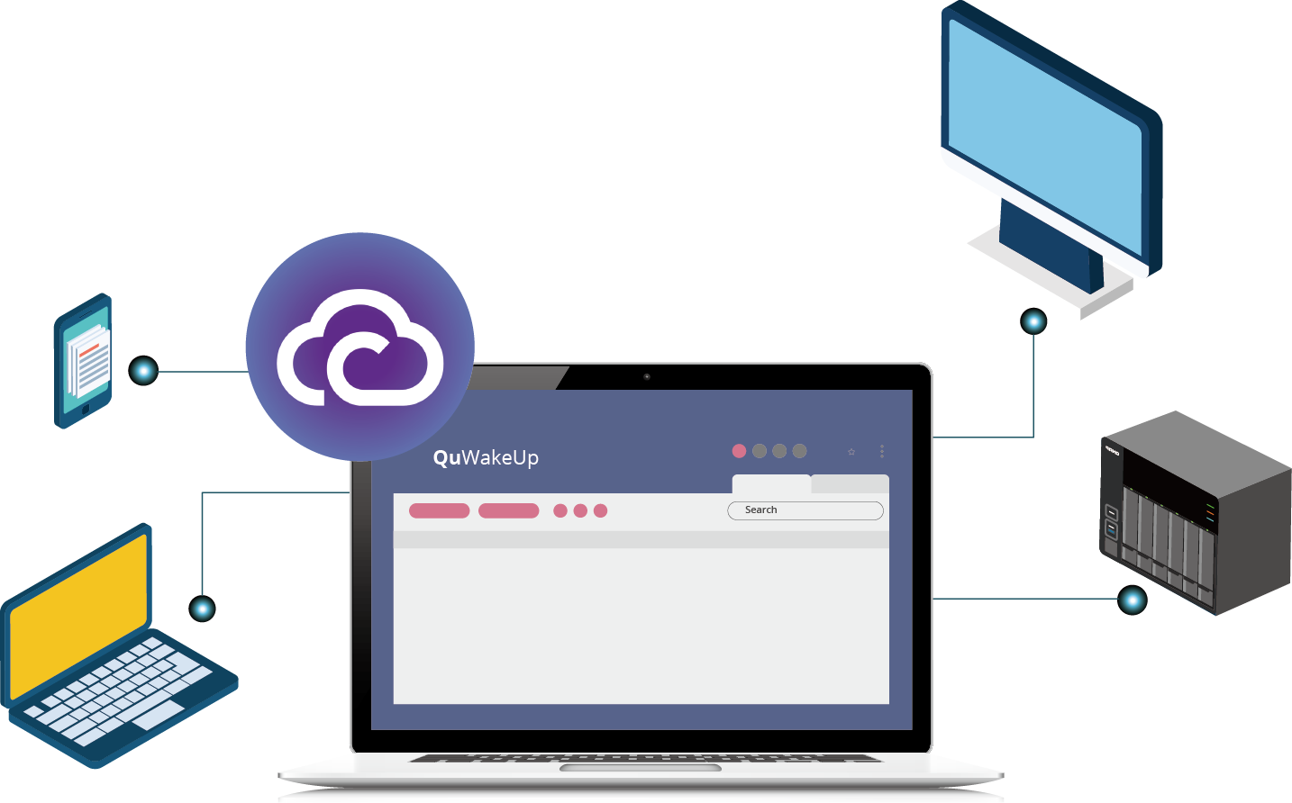
遠端喚醒零距離
特點四
免費雲端連線
你可以透過瀏覽器或行動 App操作，使用 QNAP 雲端連線一覽設備狀態或喚醒設備，隨時隨地掌握設備狀態。
遠端開機？透過 QNAP 雲端服務沒問題！
QuWakeUp
Notes:
Remote wake-up directly You can use the QNAP cloud connection to view the device status, wake up the device anytime, anywhere through the browser or mobile App.

Slide 26
跨平台通知
特點五
重要設備斷線​
當異常情況發生時 (意外關機、連線異常)，24hr 監控設備的 QuWakeUp 即能透過電子郵件或行動裝置推播，讓你能第一時間接收通知，即時處置意外情況。
通知事件
掃描到陌生設備
喚醒失敗
Notes:
Remote wake-up directly
When an abnormal situation occurs: unexpected shutdown, connection abnormality, QuWakeUp monitoring the device 24hr can send notitfication through e-mail or mobile devices, so that you can immediately handle it.
Notification Event:
Lose connection to designated device
Scanned unknown devices
Failed to wake up device

Slide 27
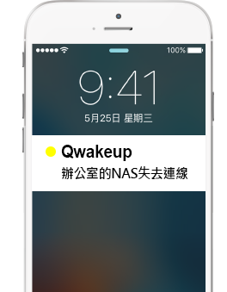
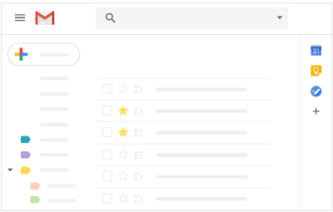
跨平台通知
特點五
電子郵件
行動裝置推播
設定寄送郵件的 SMTP 伺服器，並勾選對應通知事件，即可於電子郵件接收通知。
需將設備註冊於 myQNAPcloud ID，並於 Qmanger 完成與 QuWakeUp 的配對。
[my QuWakeUp Notification]
Time : 2019/02/12 15:07:18
Waking-up Failed
PM Department/ cassie's macbook
©2019 QNAP Systems, Inc.
Notes:
Remote wake-up directly
Email Set the SMTP server to send mail, and check the corresponding notification event to receive notifications in email.
Mobile Push The device needs to be registered with myQNAPcloud ID and paired with QuWakeUp at Qmanger.

Slide 28
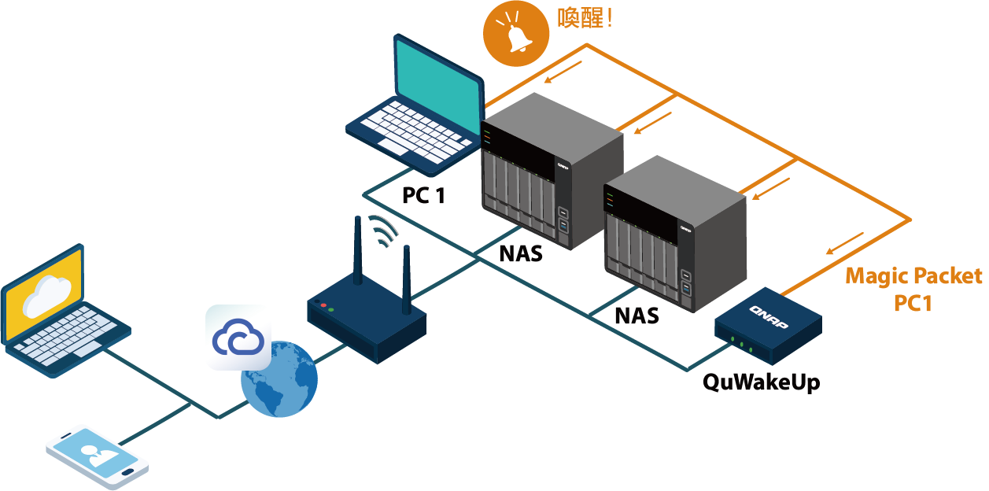
你所能擁有最聰明的遠端喚醒小幫手
幫你省去傳統喚醒的繁瑣程序，簡單點擊即可喚醒設備並檢視設備狀態。
跟 myQNAPcloud 的雲端整合服務，讓你能從遠端網路連線至區域網路內的 QuWakeUp，實現輕鬆管理生活。​
Notes:
The best remote wake-up helper you can have With QuWakeUp remote wake-up helper, you can save the traditional tedious process, wake up the devices and view the status with a simple click. With myQNAPcloud's integration, you can connect to QuWakeUp from the Internet easily.

Slide 29
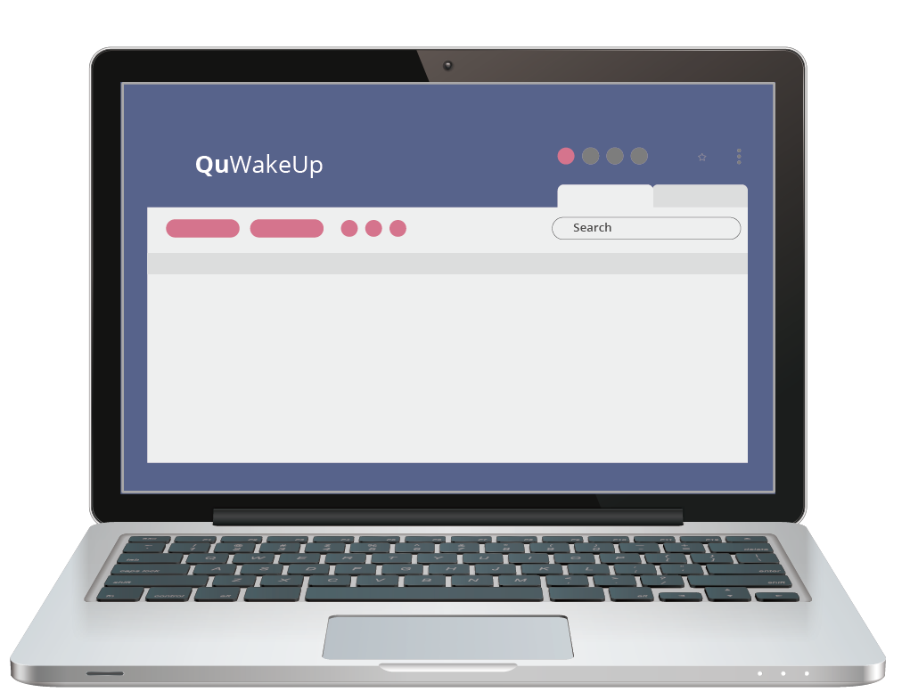
操作介面介紹
Notes:
QuWakeUp user interface introduction

Slide 30
操作介面介紹
系統狀態
系統記錄及通知
myQNAPcloud
首頁
設定
定位裝置
操作列
韌體更新
設備清單
快速導覽
產品資訊
Notes:
Interface Introduction

Slide 31
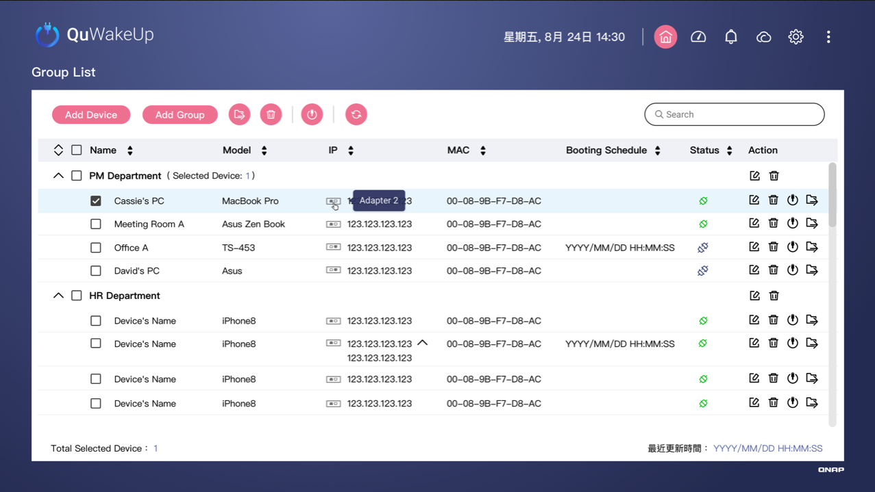
操作介面介紹 - 操作列及設備清單
更新狀態
喚醒
新增設備
使用關鍵字
搜尋設備
群組管理
新增群組
移動裝置
刪除
連線狀態
最近更新 狀態時間
可編輯：名稱及型號
方邊辨識裝置及管理
Notes:
Interface Introduction - Operation menu and device list

Slide 32
Demo

Slide 33
QuWakeUp 使用前/後情境比較
Notes:
Situational comparison before/after QuWakeUp

Slide 34
網路意外斷線如何處理
情境一
裝置斷線不知情，總是接到抱怨電話才急忙處理
如何能更迅速處理，提升工作效率？
Notes:
How to deal with unexpected network disconnection The device was disconnected without knowing it, and it was always rushed to deal with the complaint.
How can I handle it more quickly and improve work efficiency?

Slide 35
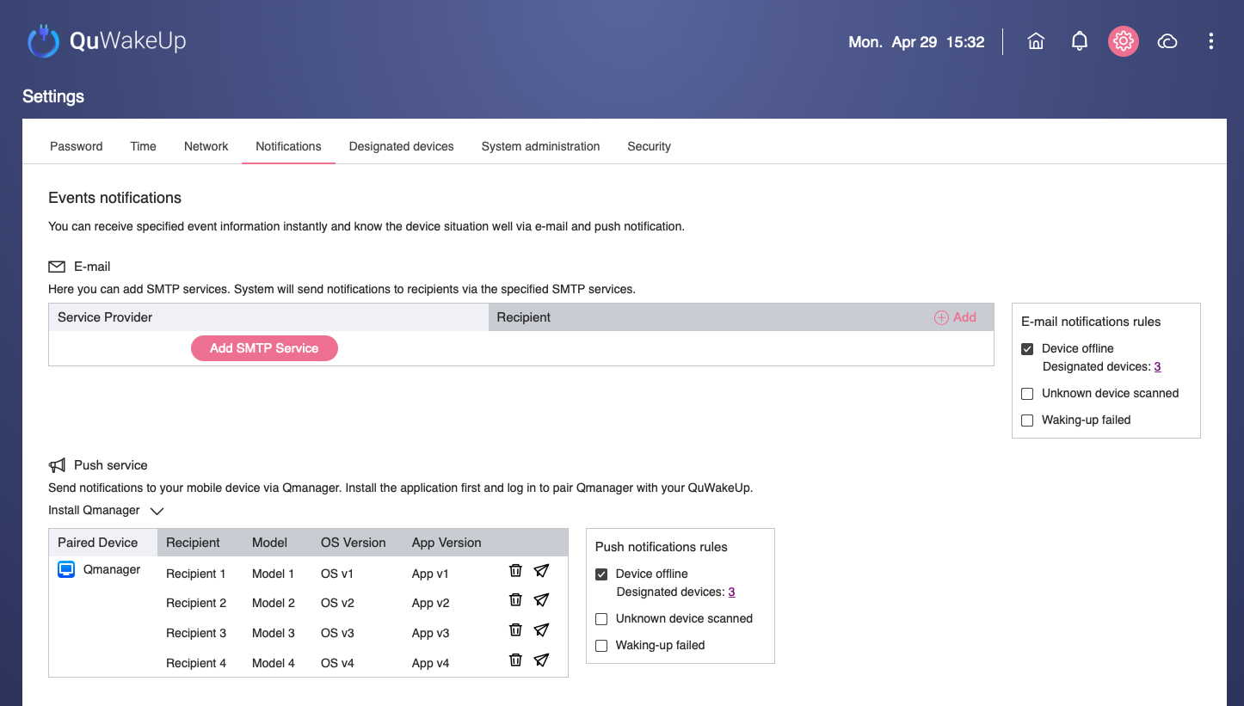
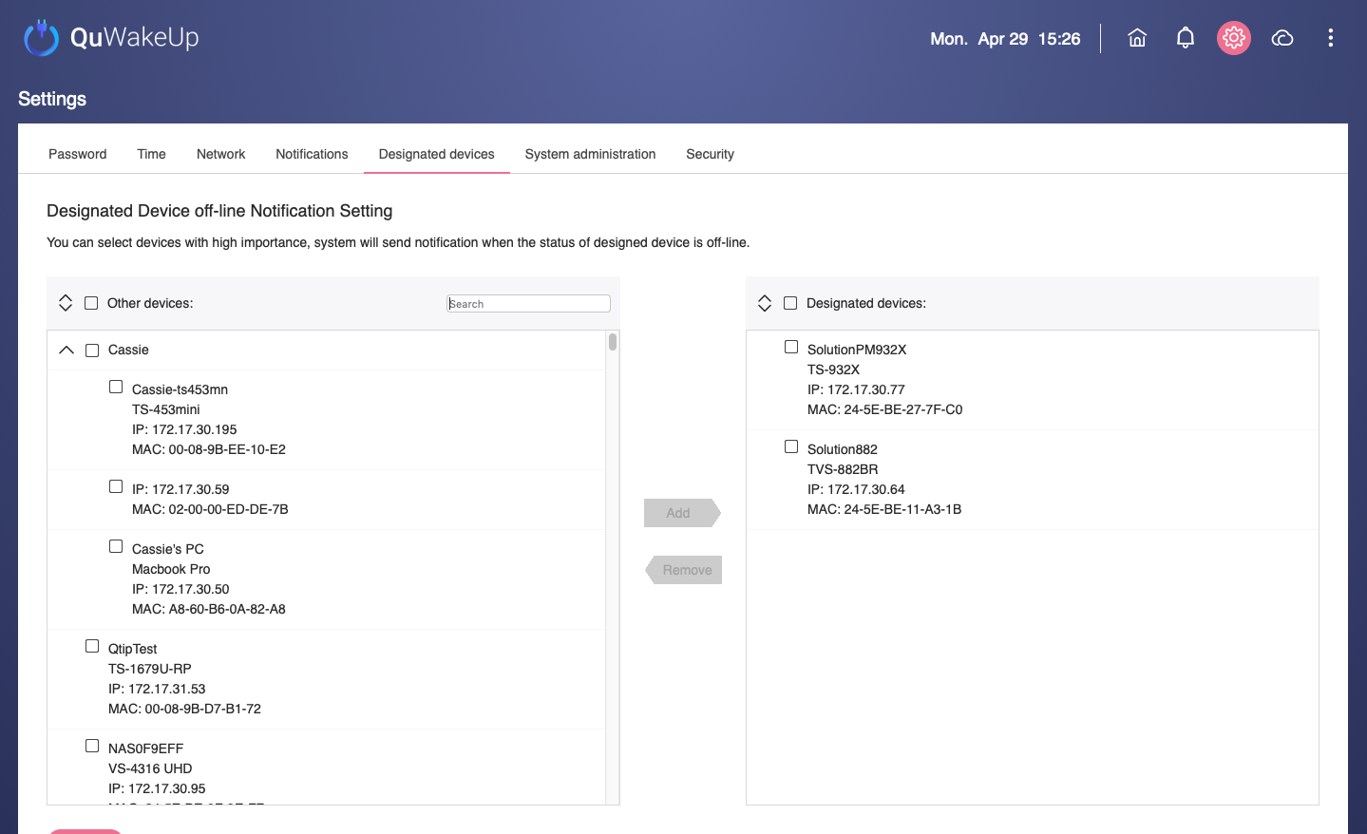
但現在...有 QuWakeUp 不必擔心
問題發現之前及時處置
自動掃描重要設備連線狀態
透過電子郵件或行動裝置接收斷線即時通知
設定 SMTP 服務或 Qmanager 配對
將重要設備加入指定清單
Notes:
But now... no worries with QuWakeUp
Automatically scan device connection status
Receive instant notification of disconnection via email or mobile device

Slide 36
機房停電修繕，復電後如何重啟
情境二
機房停電後，復電後如欲重啟大量設備
只能於停電公告時間內，親自到公司一台一台按開機鍵
Notes:
The server room is powered off and repaired. How to restart after power-on?
If you want to restart a large number of devices after the power is restored,
The only way you can do is personally press the power button on by one.

Slide 37
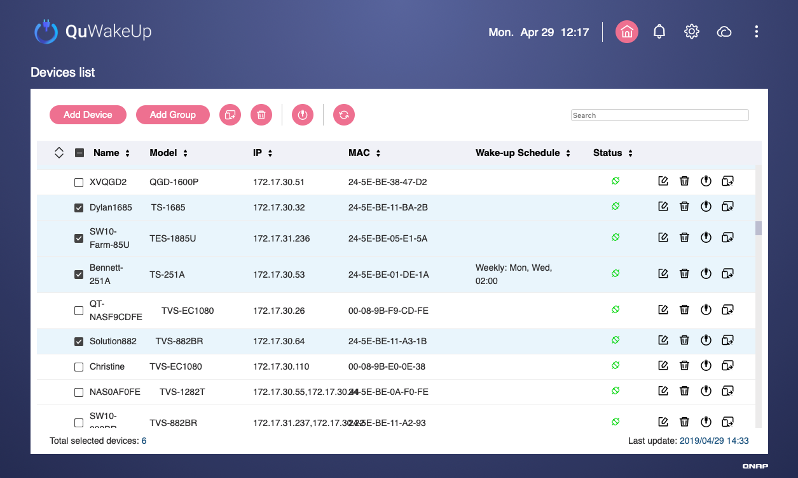
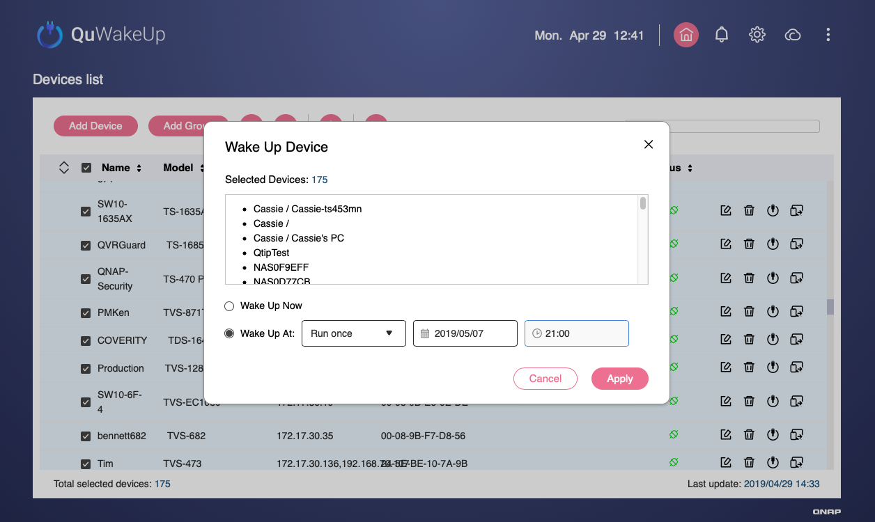
但現在...QuWakeUp 幫你輕鬆搞定
事先排程不慌張
於上班時間事先設定完成，週一上班到公司時，設備已正常運作！
批次勾選大量設備
指定喚醒時間
Notes:
But now...QuWakeUp get it done easily.
It is set during working hours in advance.
The devices have been working normally when you go to work on Monday!
Prior schedule is not flustered

Slide 38
是您最好的選擇！
©2019著作權為威聯通科技股份有限公司所有。威聯通科技並保留所有權利。威聯通科技股份有限公司所使用或註冊之商標或標章。檔案中所提及之產品及公司名稱可能為其他公司所有之商標。

