Slide 1
Notes:
The hand-writing words, nickname for product:
WOL/WOW Helper
Subtitle:
QWU-100 makes you Wake On WAN easily when you go out and wake up the remote device.

Slide 2
Explore The Best Remote Wake-Up Assistant There Is!
Why Do You Need To Use QuWakeUp?
How Was WOL/WOW Done Before?
QuWakeUp Can Remote Wake-Up Easily
QuWakeUp User Interface Introduction
Situational Comparison Before/After QuWakeUp
Notes:
The best remote wake-up helper you can have
Why do you need to use QuWakeUp?
How to WOL/WOW in past?
QuWakeUp can remote wake-up easily
QuWakeUp user interface introduction
Situational comparison before/after QuWakeUp

Slide 3
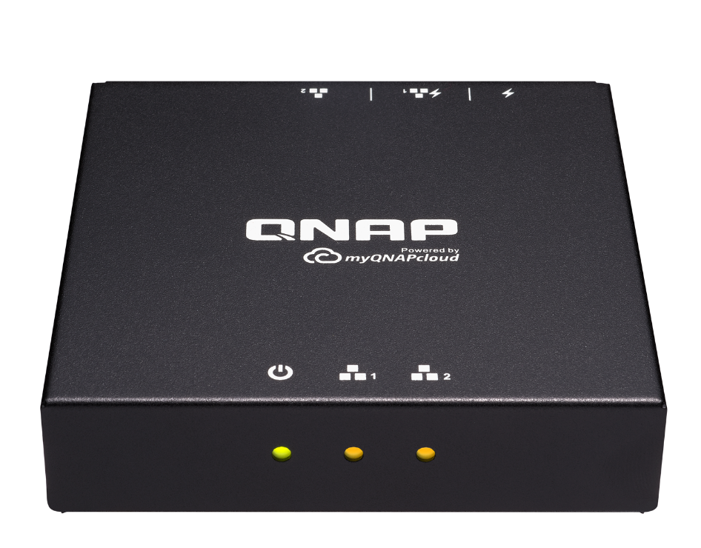
Why Do You Need To Use QuWakeUp?
Notes:
Why do you need to use QuWakeUp?

Slide 4
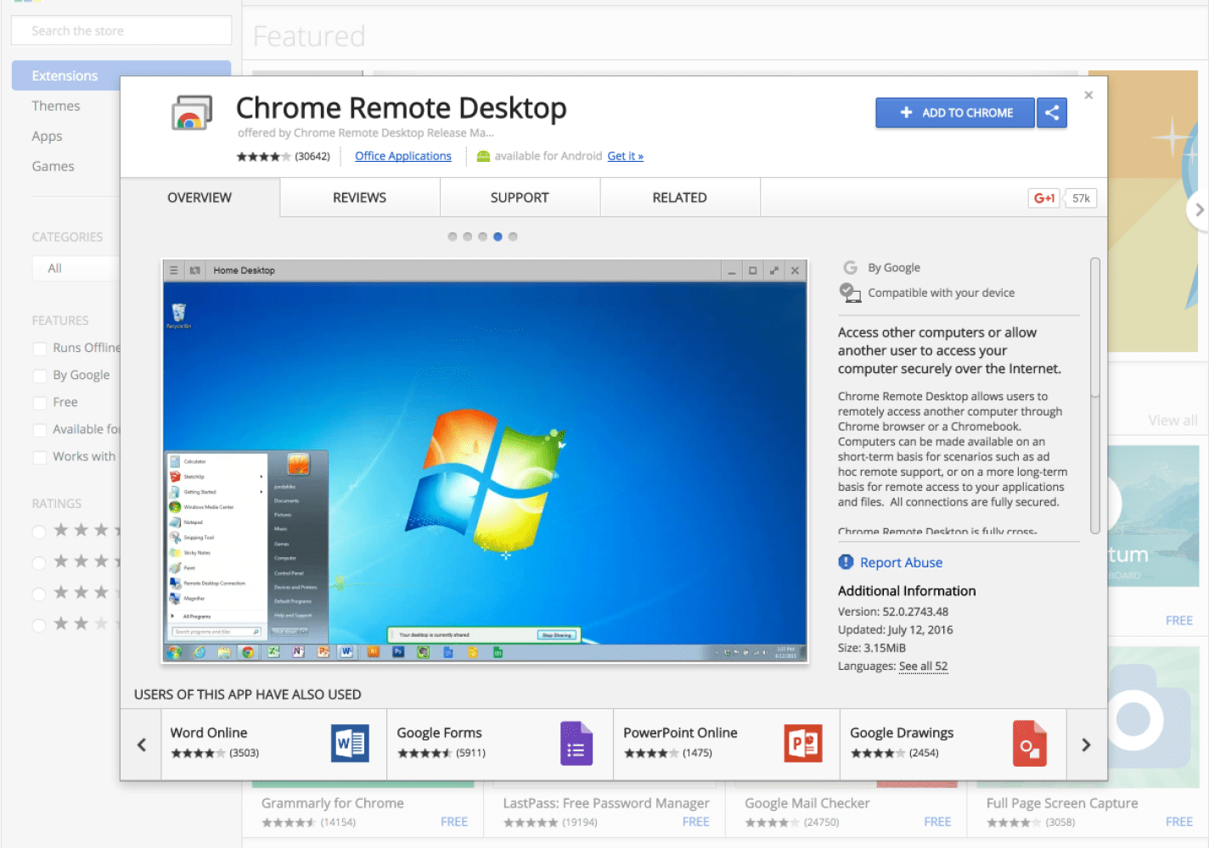
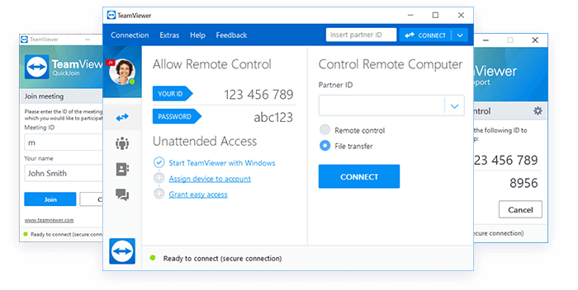
How Did We Remotely Wake Up Devices Before?
Had To Use Different "Remote Desktop Control" Software's.
Remote Wake-Up devices are not easy!
Notes:
How did we work remotely in the past? Use variety of "Remote Desktop Control" software, but...
Remote wake-up devices are not easy!

Slide 5
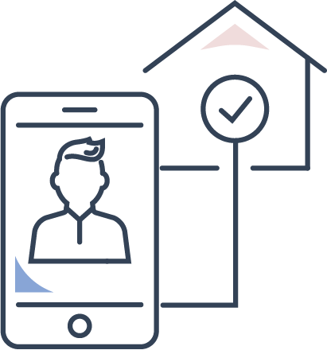
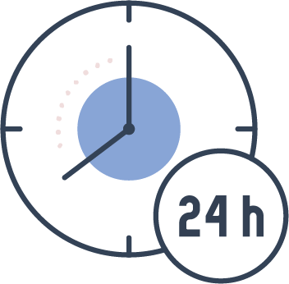
NAS Home Users: Traditional WOL Methods
When you are not at home, you need to temporarily access the data:
Call the family to
turn on device
Power
Consumption issue
Keep online 24/7
Notes:
If you are a NAS home user...
When you are not at home, you need to access the data temporarily...
Call the family to turn on device
Keep online 24/7
Power consumption issue

Slide 6
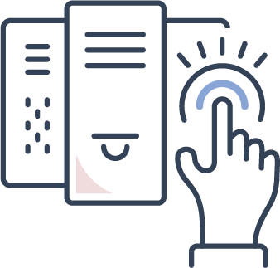
MIS Engineer: Traditional WOL Methods
Managing hundreds of devices is not easy.
Notified late when device is out of situation
Difficult to track device connection
Personally boot each device after repair
Notes:
If you are management of information system
Managing hundreds of devices is not easy...
Difficult to track device connection
Personally boot each device after repair
Notified late when device is out of situation

Slide 7
All we need is "Someone" that:
Can View connection status of each device on a single platform
Has a Flexible wake-up schedule
Can wake up many devices at one time
Can Wake up devices in LAN from the Internet remote
Notes:
What you need is
Can wake up a large number of devices
Flexible wake-up schedule
Wake up the device in LAN from the Internet remote
View the connection status of each device on a single platform

Slide 8
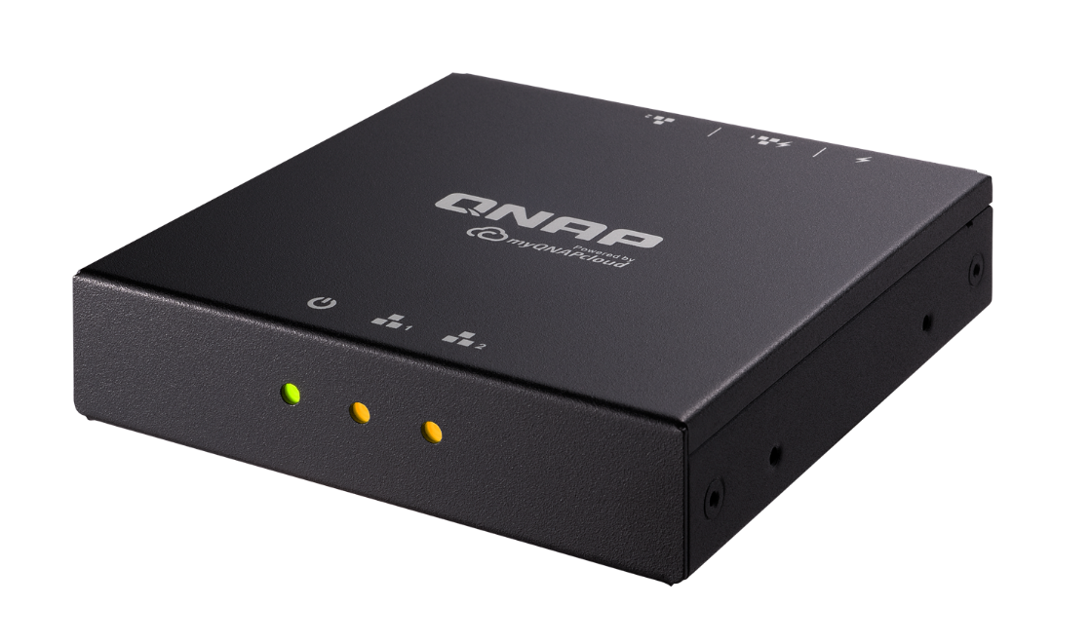
How Was WOL/WOW Done Before?
Notes:
How to WOL/WOW in past?

Slide 9
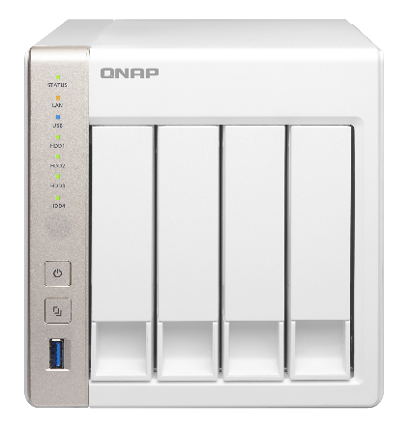
Wake On LAN (WOL) Introduction
When the computer is powered-off, the network operation capability is retained, and the network card can still accept the network packet and monitor. When it receives a special packet (Magic Packet), it will trigger the booting process.
Highly Popular Technology
Most NAS/PC/MAC support
Magic Packet
Six consecutive "FF" (hexadecimal digits, converted to binary digits: 11111111): FF FF FF FF FF FF FF, followed by 16 times of MAC address information.
TS-451
Notes:
When the computer is turned off, the network card operation capability is retained, and the network card can still accept the network packet and monitor the packet. When it receives a special packet (Magic packet), it will trigger the booting process.
Highly popular technology
Most NAS/PC/MAC support
Six consecutive "FF" (hexadecimal digits, converted to binary digits: 11111111): FF FF FF FF FF FF FF, followed by 16 times of MAC address information.
Reference
http://www.wameng.com.tw/index/view?gp=3&sgp=3&pk=-1&id=2

Slide 10
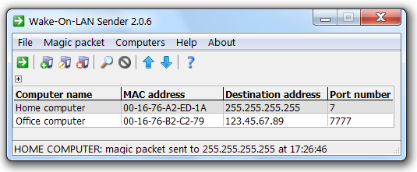
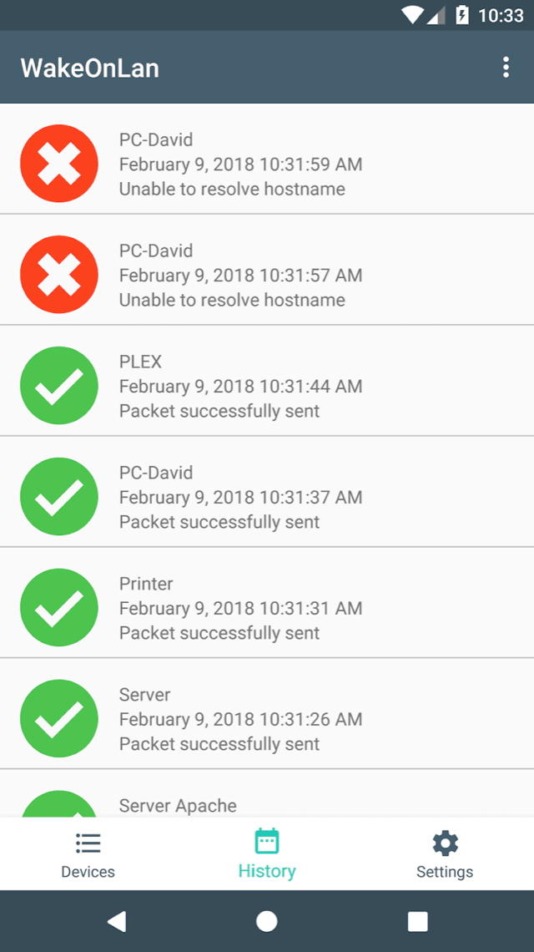
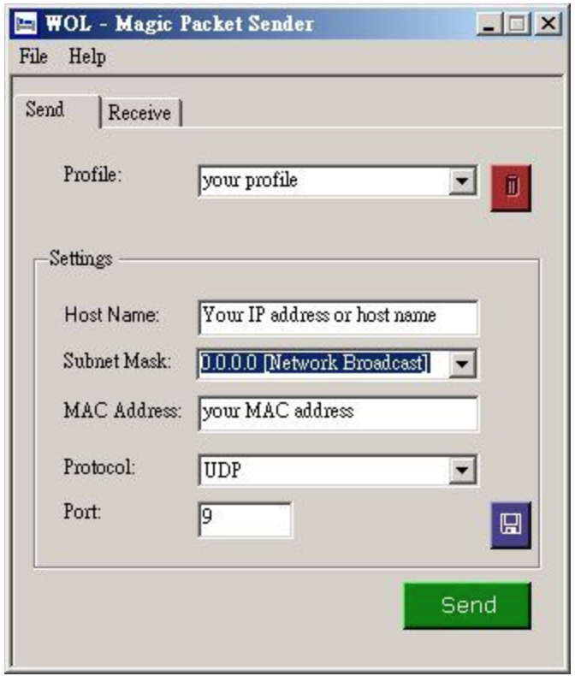
In the past, if you wanted to complete WOL, you would have needed to:
Find the right tool to send magic packets, mostly computer utilities.
Notes:
In the past, if you wanted to complete WOL, you would need...
Find the right tool to send magic packets, mostly computer utilities

Slide 11
In the past, if you wanted to complete WOL, you would have needed to:
Get information through manual operation of the machine, such as MAC address, IP address.
Notes:
In the past, if you wanted to complete WOL, you would need...
Get information through manual operation of this machine, such as MAC address, IP address.

Slide 12
Wake On WAN Troubles
Wake On WAN (WOW) is required if you want to wake up devices in your LAN when you are away, such as on the street or by MRT.
The remote wake-up should be completed by sending a magic packet from the Internet to the device in the local area network address.
Magic Packet
Notes:
Wake on WAN troubles
Wake On WAN (WOW) is required if you want to wake up devices in your LAN when you are away, such as on the street or by MRT.
The remote wake-up can be completed by sending a magic packet from the Internet to the device in the local area network address.

Slide 13
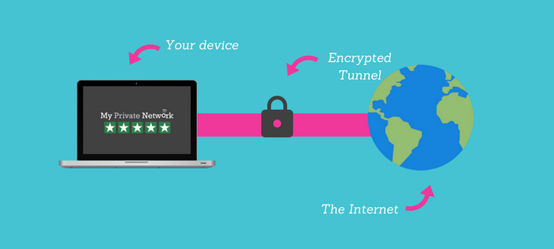
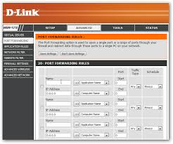
Complicated setting process
Wake On WAN Troubles
The approach we used:
Port Forwarding
VPN
Disadvantages
Need hardware support
Unstable effectiveness
Notes:
Wake on WAN troubles
The approach we used is:
Disadvantages:
Complicated setting process
Need hardware support
Unstable effectiveness

Slide 14
QWU-100 A Compact Box Can Solve Your Problems
Notes:
A compact box can solve your problems

Slide 15
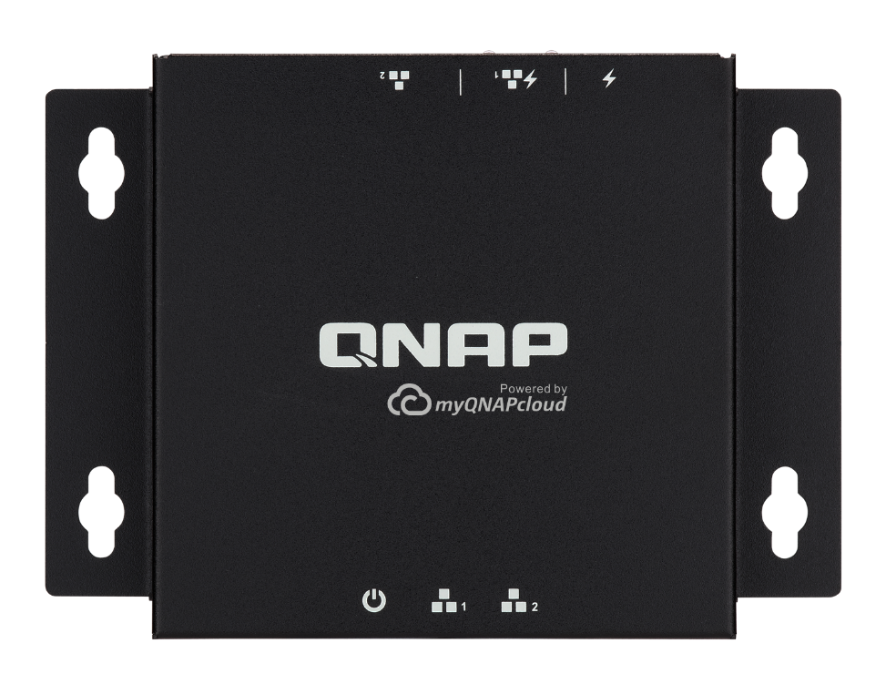
QuWakeUp Can Remote Wake-up Easily
Notes:
QuWakeUp can remote wake-up easily

Slide 16
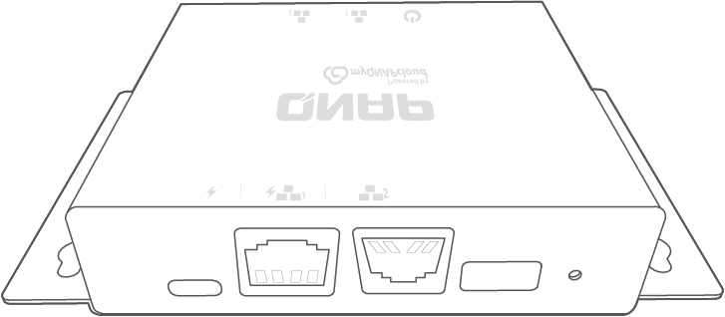
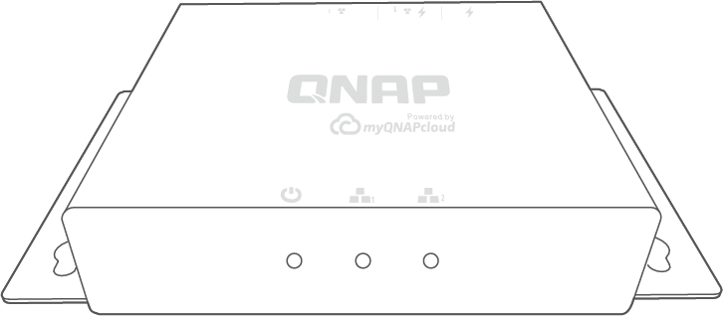
QWU-100 Introduction
LED Light
I/O
1
2
3
4
5
1
2
3
1
USB Type-C power input
Status LED
2
RJ45 PoE port (LAN 1)
1
LAN1 LED
3
RJ45 LAN port (LAN 2)
2
4
USB Type-A port
3
LAN2 LED
Reset button
5

Slide 17
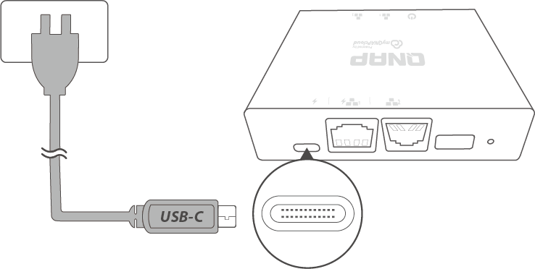
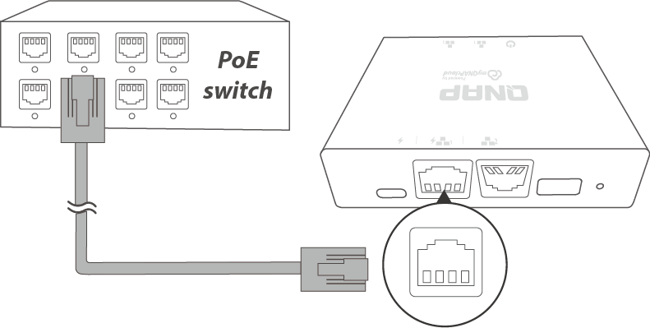
QWU-100 Flexible Options Of Power Supply
a. USB Type C
b. PoE Port
The popular USB Type C is a
power source that is easy to deploy.
PoE power will enable the most streamlined wire configuration.
Notes:
Flexible choice of power supply!
The popular USB Type C is a power source that is easy to deploy.
PoE power will enable the most streamlined wire configuration.

Slide 18
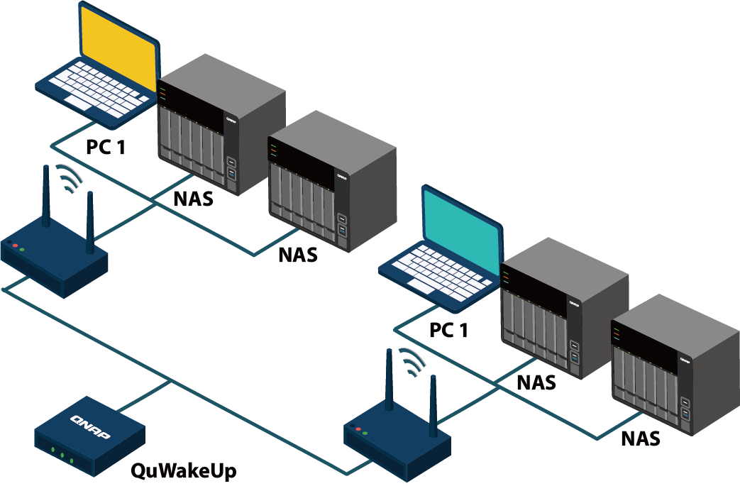
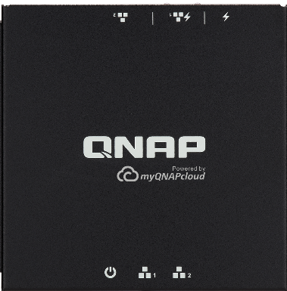
Flexible Deployment And Multiple Management
Compact size but with two LAN ports,
Able to manage devices for two regional networks.
QWU-100
10cm
10cm
Notes:
Flexible deployment and multiple management
Compact size but with two LAN ports,
Able to manage devices for two regional networks.

Slide 19
QuWakeUp Five Highlights
Simple Steps to Install and Use
Versatile Wake-up Schedule
Seamless Mobile APP - Qmanager
Remote Wake-Up Directly via myQNAPcloud
Cross-Platform Notification Supported
Notes:
Five highlights
Easy to install and use Eliminate traditional complicated steps, easy management with QNAP software.
Versatile wake-up schedule No need to find information about devices, network cards, etc., automatically remember the IP and MAC addresses after scanning, and even flexible wake-up schedule.
Seamless mobile APP Integrate the Qmanger and get the status of the device through the mobile device, which is more convenient!
Remote wake-up directly Through the cloud service integration, devices can also be woken up from the Internet.
Cross-platform notification 24hr monitoring and immediately send a notice when unexpected shutdown, connection abnormality occurs!

Slide 20
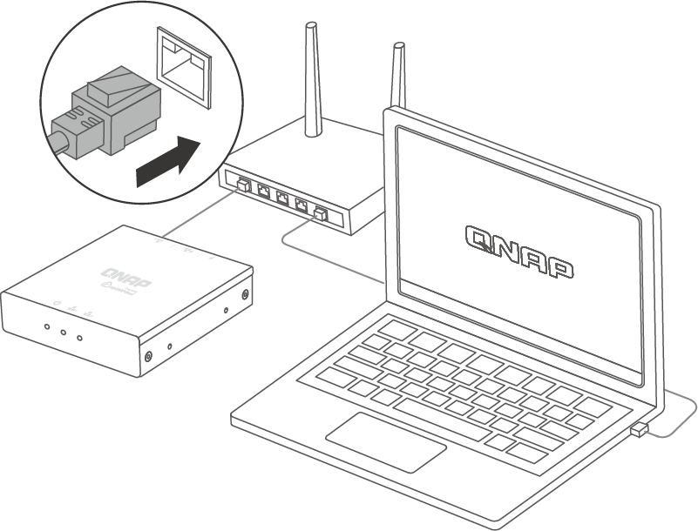
3 Easy Steps Installation
Highlight 1
1. Configuration
Connect the device to the router.
Compact device with friendly software UI,
3 steps to complete the remote wakeup setup quickly.
Notes:
Easy three-step installation
Compact device with friendly software UI,
three steps to complete the remote wakeup setup quickly
1. Configuration
Connect the device to the router.

Slide 21
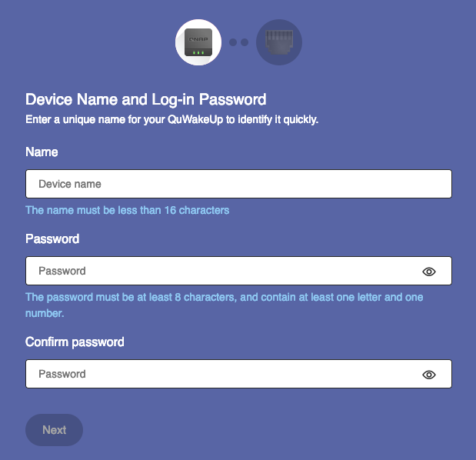
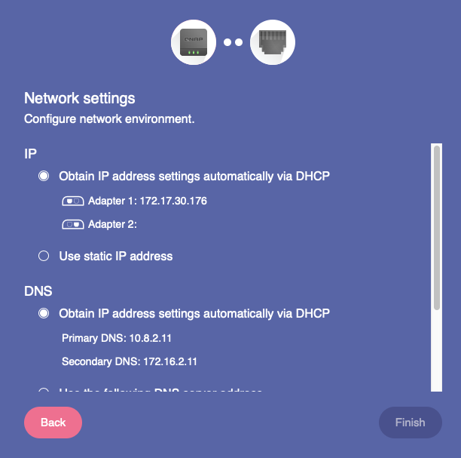
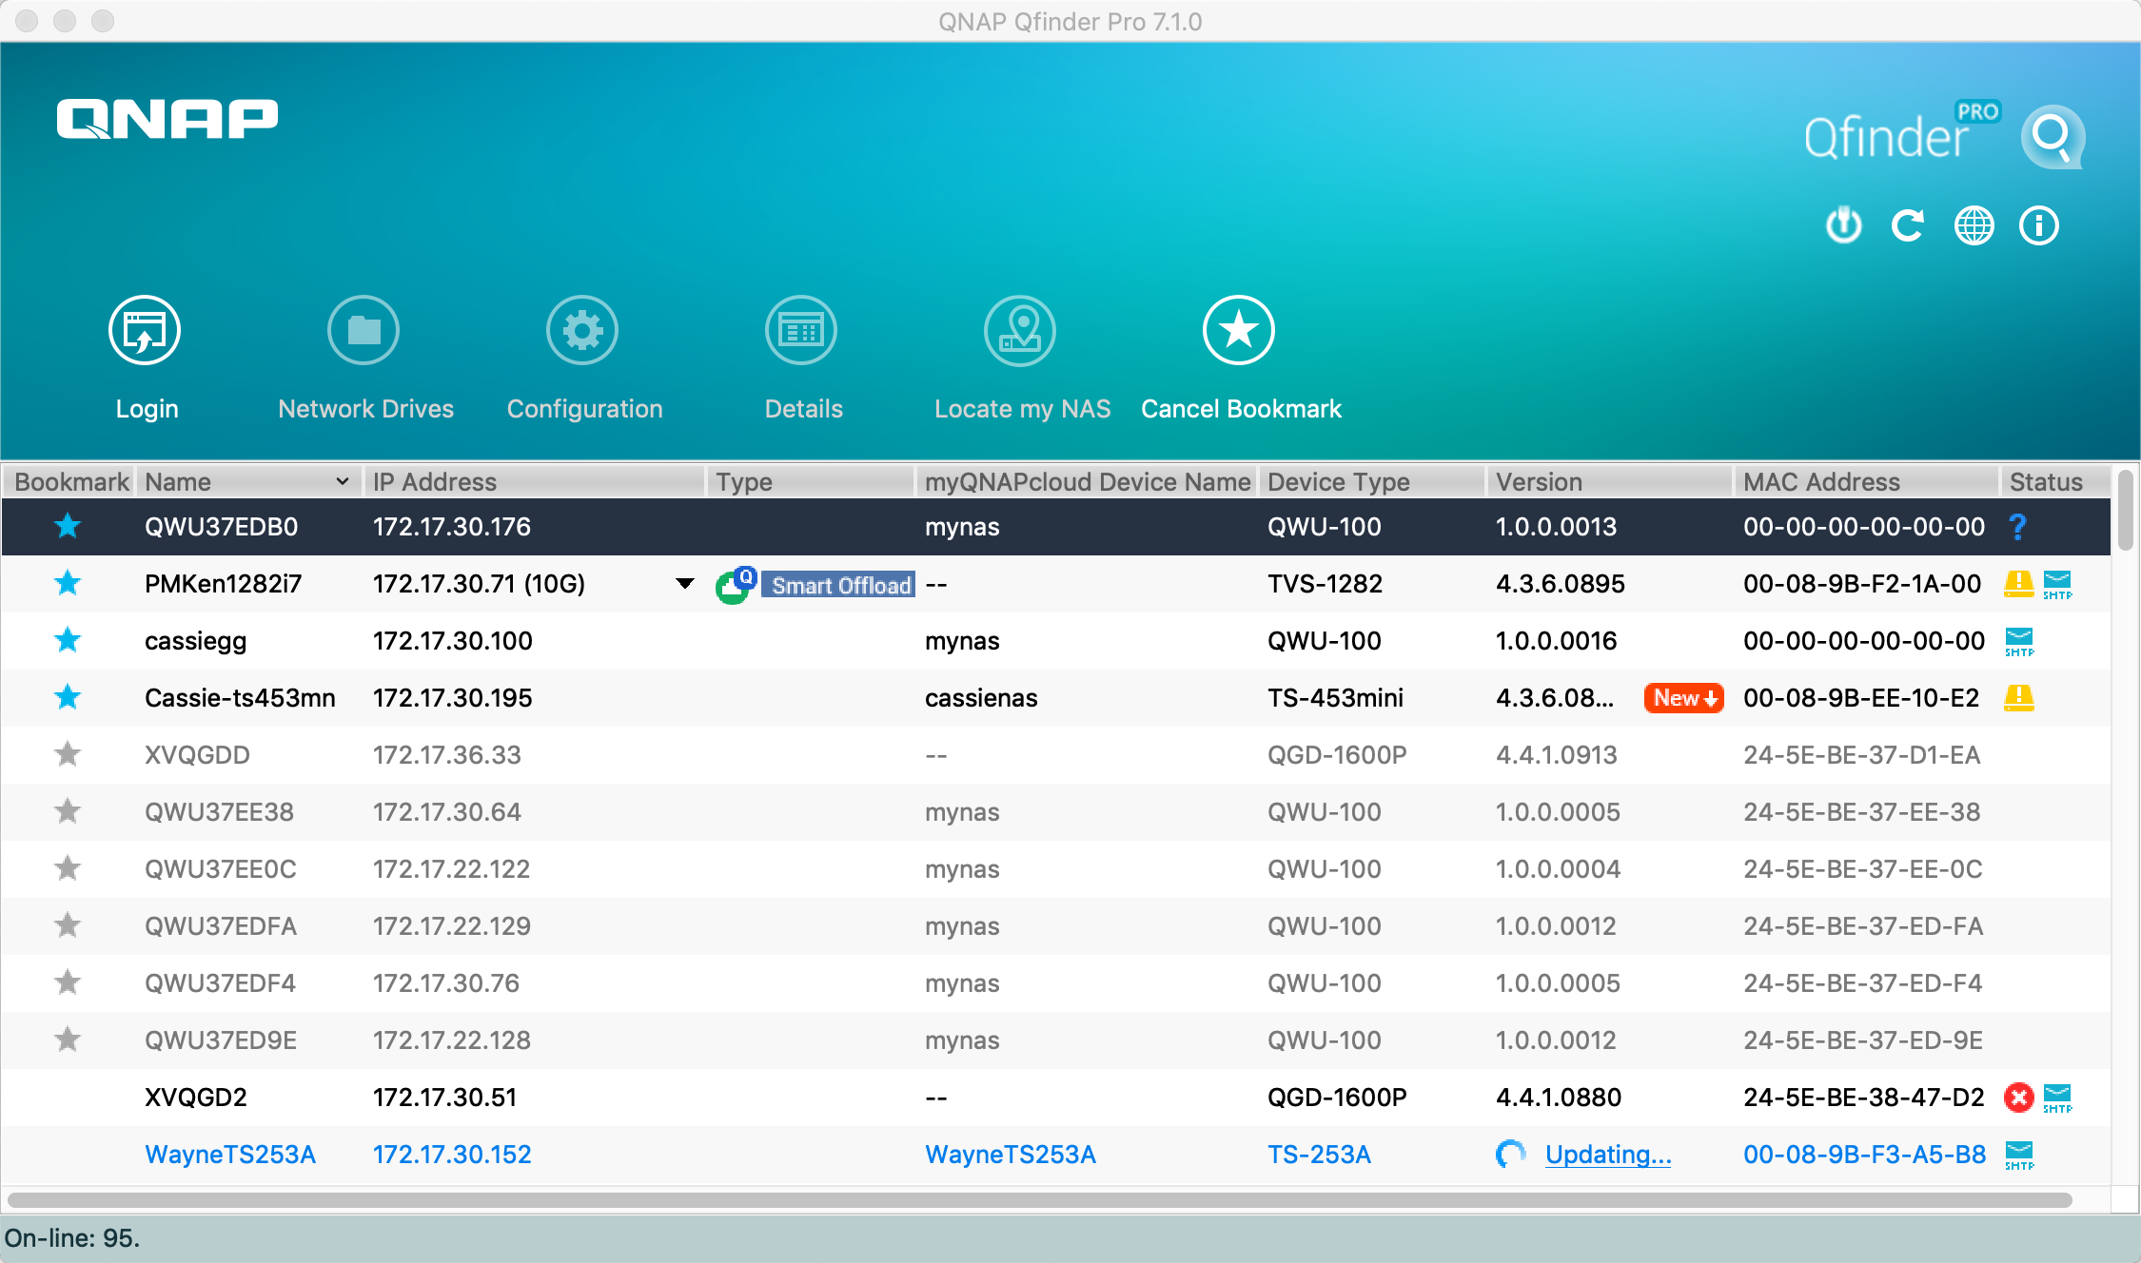
3 Easy Steps Installation
Highlight 1
2. Search
Find address with Qfinder Pro.
3. Initial Settings
Set passwords and network settings in one minute.
https://www.qnap.com/qfinderpro
Notes:
2. Initial Settings
Get passwords and network settings in one minute.
3. Start to Use
Experience the features of QuWakeUp

Slide 22
Meet Diverse Wake-up Demands
Highlight 2
You can send remote wake-up commands with different wake-up modes such as immediate wake-up and scheduled one, which once, daily, weekly, monthly, and other options are included. QuWakeUp helps you manage devices to go online flexibly.
Wake up Now
Daily / Weekly / Monthly
Wake up in Schedule
Notes:
Meet diverse wake-up demands
You can send remote wake-up commands with different wake-up modes such as immediate wake-up and scheduled one, which once, daily, weekly, monthly, and other options are included. QuWakeUp help you manage devices to go online flexibly.

Slide 23
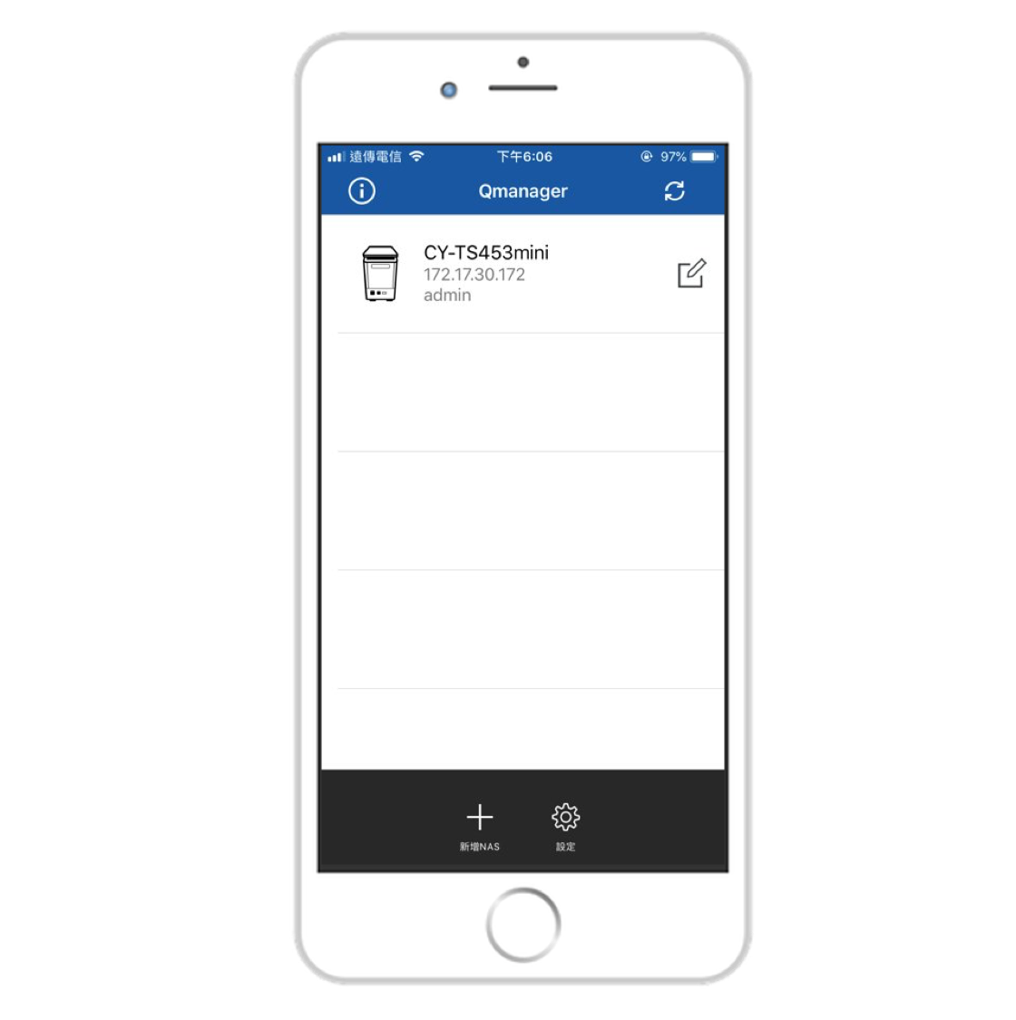
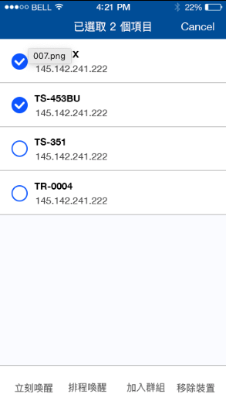
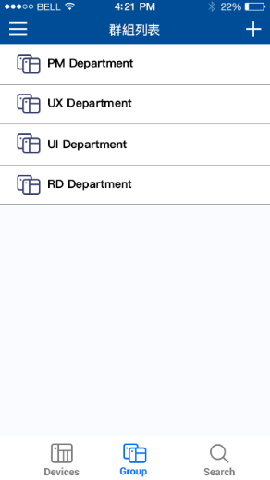
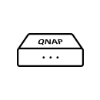
Seamless Mobile APP
Qmanager
Highlight 3
QuWakeUp
Integrating QuWakeUp into a mobile app makes it easier. No matter when you are on the way to work or taking the Metro, you can use the mobile phone to keep track of the equipment in the local network.
QuWakeUp
Management in Group
View Device Status
Wakeup remote
Notes:
Seamless mobile APP
Integrating QuWakeUp into a mobile app makes it easier. No matter when you are on the way to work or taking the MRT, you can use the mobile phone to keep track of the equipment in the local network.

Slide 24
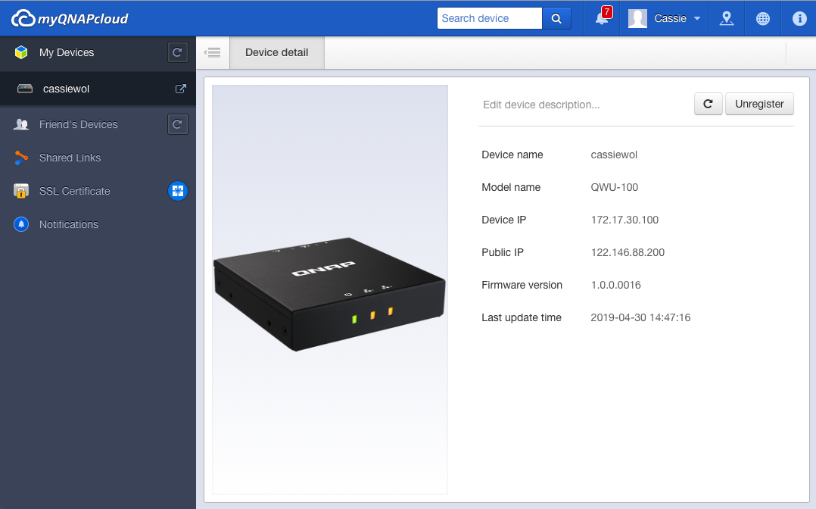
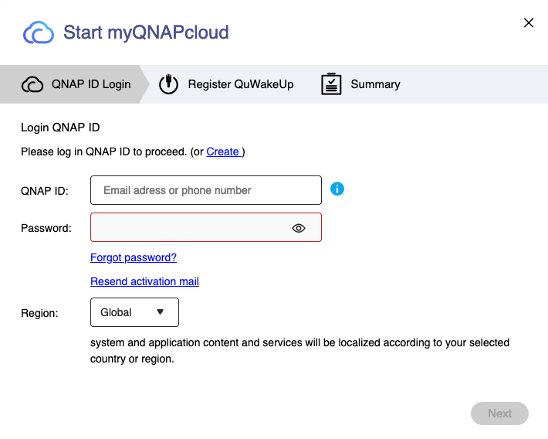
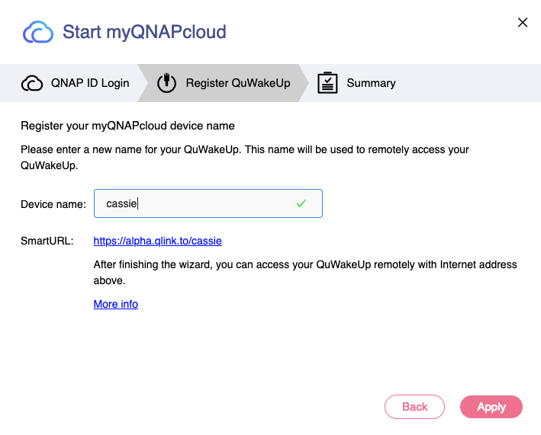
Remote Wake-Up Directly
Highlight 4
Free Cloud Connection
myQNAPcloud provides a remote connection solution. As long as you have a QNAP ID and register the device under the account, you can use the smart URL to connect to the QuWakeUp from Internet.
Registration
MyQNAPcloudAccount Page
Notes:
Remote wake-up directly myQNAPcloud provides a remote connection solution. As long as you have a QNAP ID and register the device under the account, you can use the smart URL to connect to the QuWakeUp from Internet.

Slide 25
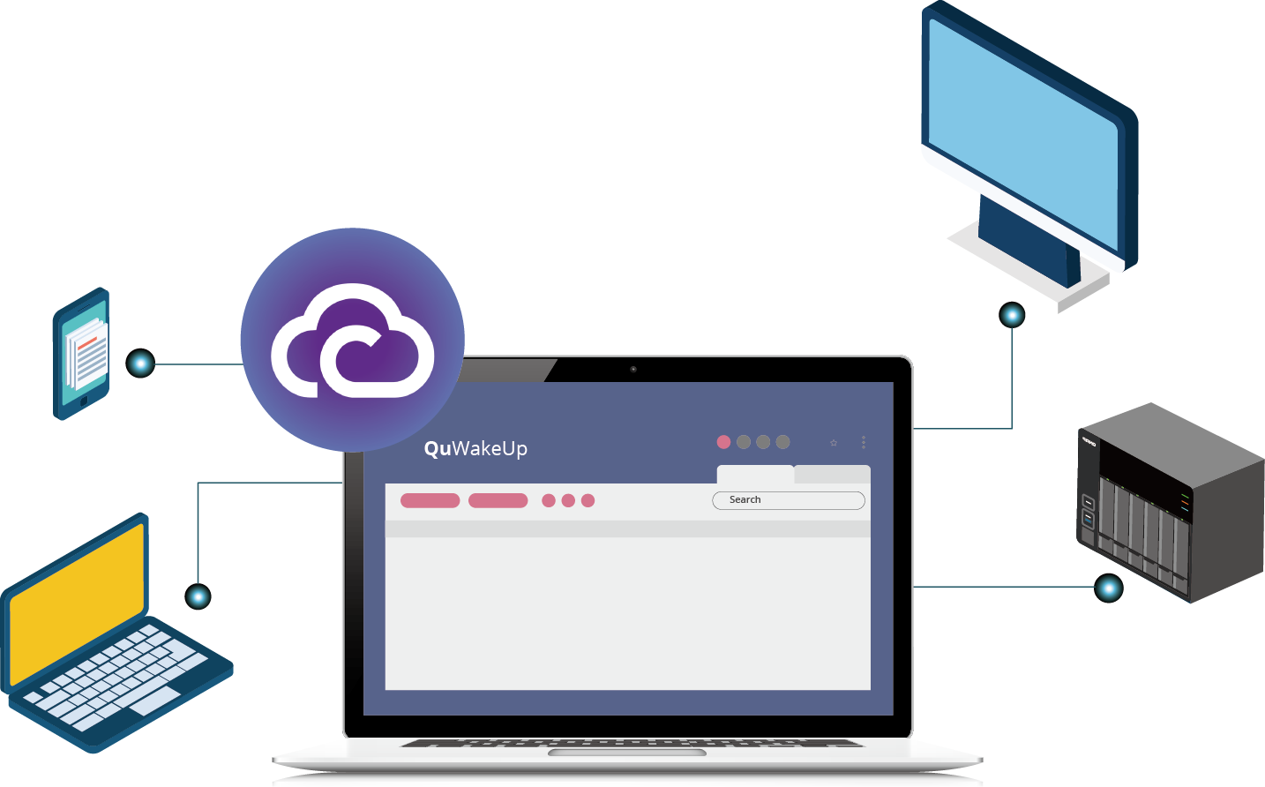
Remote Wake-Up Directly
Highlight 4
Free Cloud Connection
You can use the QNAP cloud connection to view the device status, wake up the device anytime, anywhere through the browser or mobile App.
Wake up remote via myQNAPcloud.
QuWakeUp
Notes:
Remote wake-up directly You can use the QNAP cloud connection to view the device status, wake up the device anytime, anywhere through the browser or mobile App.

Slide 26
Cross-Platform Notificiation
Highlight 5
When an exception occurs: unexpected shutdown, connection abnormality, QuWakeUp monitoring the device 24hr can send notitfication through e-mail or mobile devices, so that you can immediately handle it.
Notification Event
Failed to wake up device
Lose connection to designated device​
Scanned unknown devices
Notes:
Remote wake-up directly
When an abnormal situation occurs: unexpected shutdown, connection abnormality, QuWakeUp monitoring the device 24hr can send notitfication through e-mail or mobile devices, so that you can immediately handle it.
Notification Event:
Lose connection to designated device
Scanned unknown devices
Failed to wake up device

Slide 27
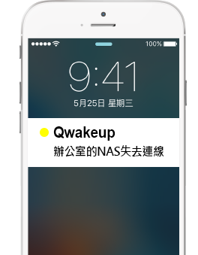
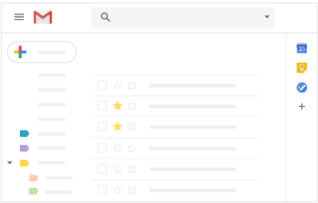
Highlight 5
Cross-Platform Notificiation
Email
Mobile Push
Set the SMTP server to send mail, and check the corresponding notification event to receive notifications in email.
The device needs to be registered with myQNAPcloud ID and paired with QuWakeUp at Qmanger.
[my QuWakeUp Notification]
Time : 2019/02/12 15:07:18
Waking-up Failed
PM Department/ cassie's macbook
©2019 QNAP Systems, Inc.
[NAS Office A] lose connection
Notification Event
Notes:
Remote wake-up directly
Email Set the SMTP server to send mail, and check the corresponding notification event to receive notifications in email.
Mobile Push The device needs to be registered with myQNAPcloud ID and paired with QuWakeUp at Qmanger.

Slide 28
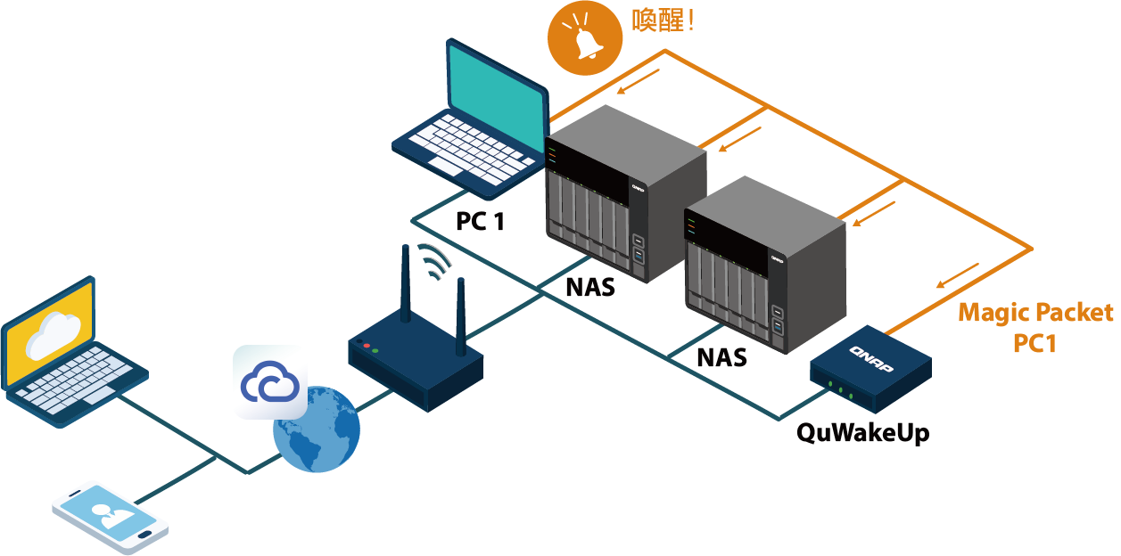
The Best Remote Wake-up Assistant You Can Have
You can save the traditional tedious process, wake up the devices and view the status with a simple click.
Wake up!
With myQNAPcloud's integration, you can connect to QuWakeUp from the Internet easily.
Notes:
The best remote wake-up helper you can have With QuWakeUp remote wake-up helper, you can save the traditional tedious process, wake up the devices and view the status with a simple click. With myQNAPcloud's integration, you can connect to QuWakeUp from the Internet easily.

Slide 29
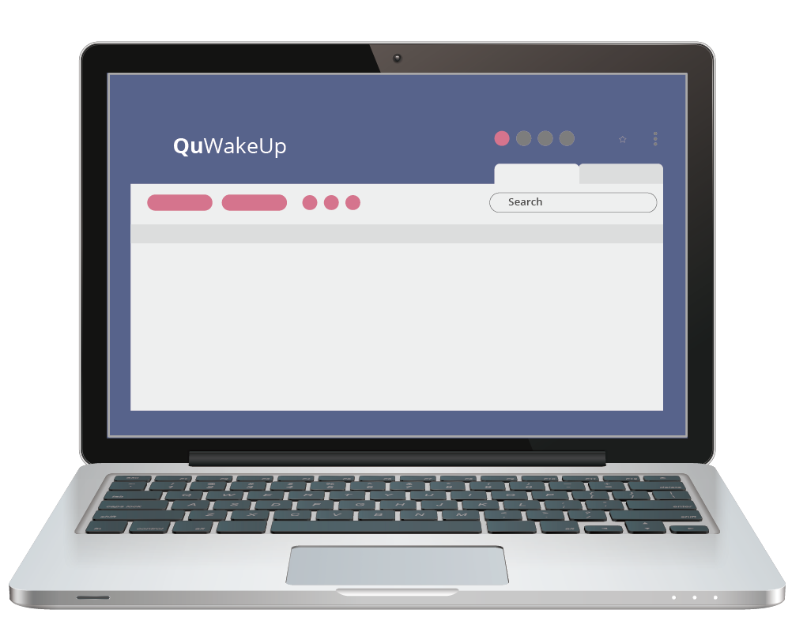
QuWakeUp User Interface Introduction
Notes:
QuWakeUp user interface introduction

Slide 30
Interface Introduction – Open with browser
Homepage
Dashboard
Log
myQNAPcloud
Fri. Aug 24 14:30
Settings
Location
Operation
Menu
Firmware Update
Device list
Quick Start
Info
Last updated :
Notes:
Interface Introduction

Slide 31
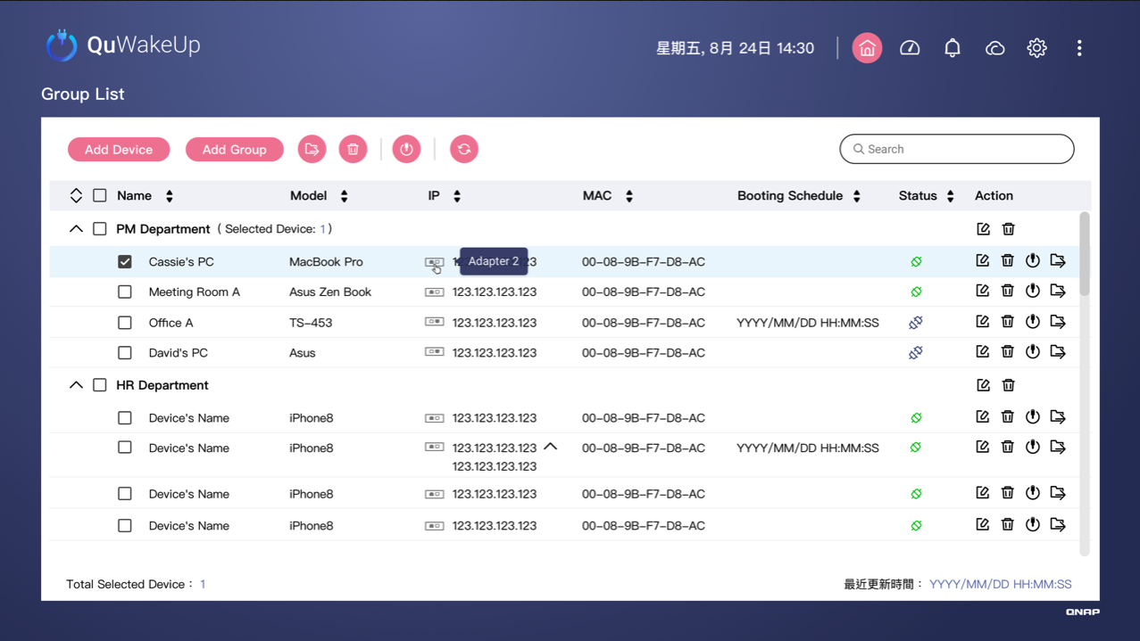
Interface Introduction - Operation Menu and Device List
Refresh
Fri. Aug 24 14:30
Wake up
Add device
Search
With Keyword
Group: Add group Move group
Delete
Connection Status
Name & Model are editable to manage
Latest Update
Last updated :
Notes:
Interface Introduction - Operation menu and device list

Slide 32
Demo

Slide 33
Situational Comparison Before/After QuWakeUp
Notes:
Situational comparison before/after QuWakeUp

Slide 34
How To Deal With Unexpected Network Disconnection
Situation 1
The device was disconnected with notified late, and it was always rushed to deal with the complaint.
How can I handle it more quickly and improve work efficiency?
Notes:
How to deal with unexpected network disconnection The device was disconnected with notified late, and it was always rushed to deal with the complaint.
How can I handle it more quickly and improve work efficiency?

Slide 35
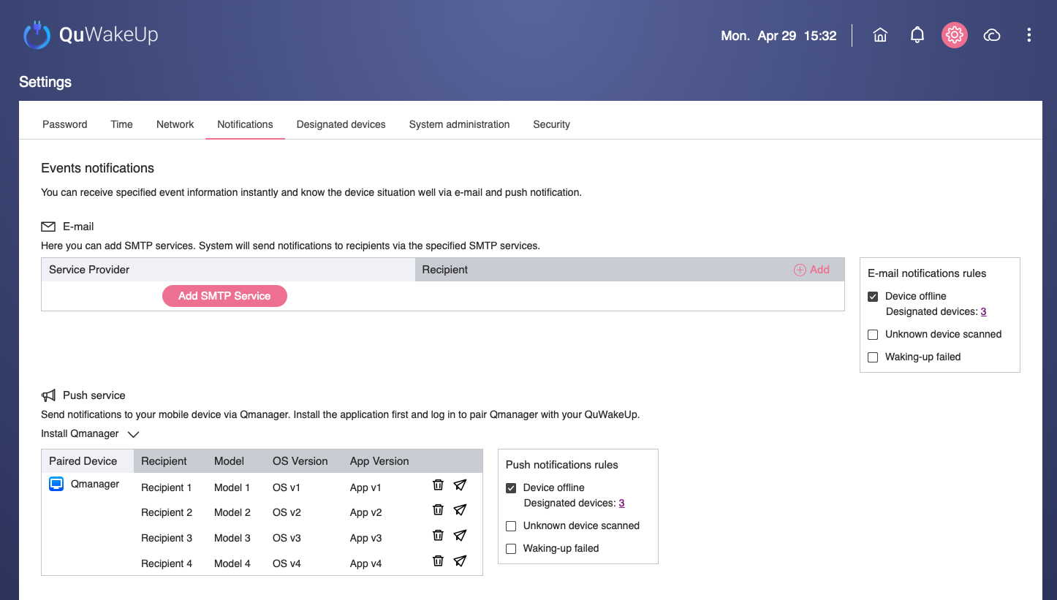
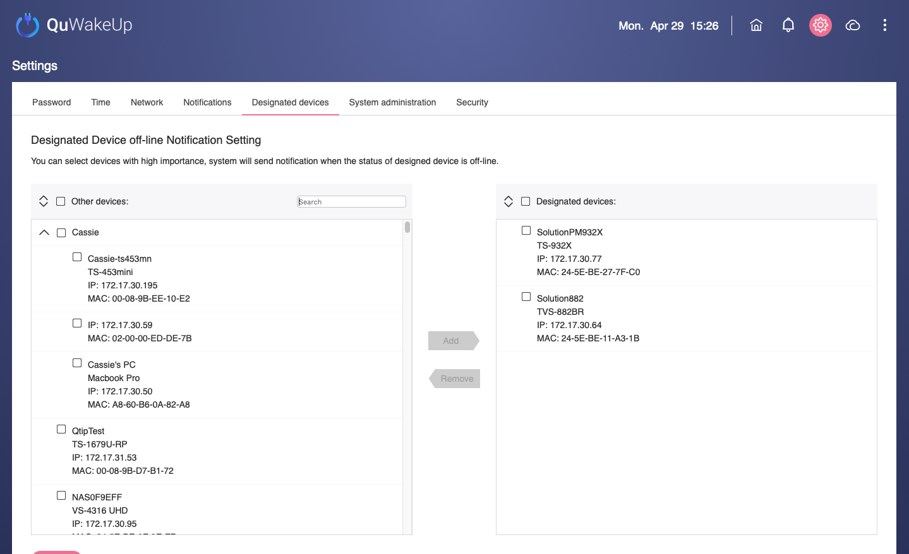
Solution: QuWakeUp
Deal with problems immediatly
Automatically scan device connection status
Receive instant notification of disconnection via email or mobile device
Settting SMTP service or Qmanager pairing
Add improtant devices into designated list
Notes:
But now... no worries with QuWakeUp
Automatically scan device connection status
Receive instant notification of disconnection via email or mobile device

Slide 36
The Server Room Is Repaired. How To Restart After Power-on?
Situation 2
If you want to restart a large number of devices after the power was restored,
The only way you can do is to manually press the power buttons one by one.
Notes:
The server room is powered off and repaired. How to restart after power-on?
If you want to restart a large number of devices after the power is restored,
The only way you can do is personally press the power button on by one.

Slide 37
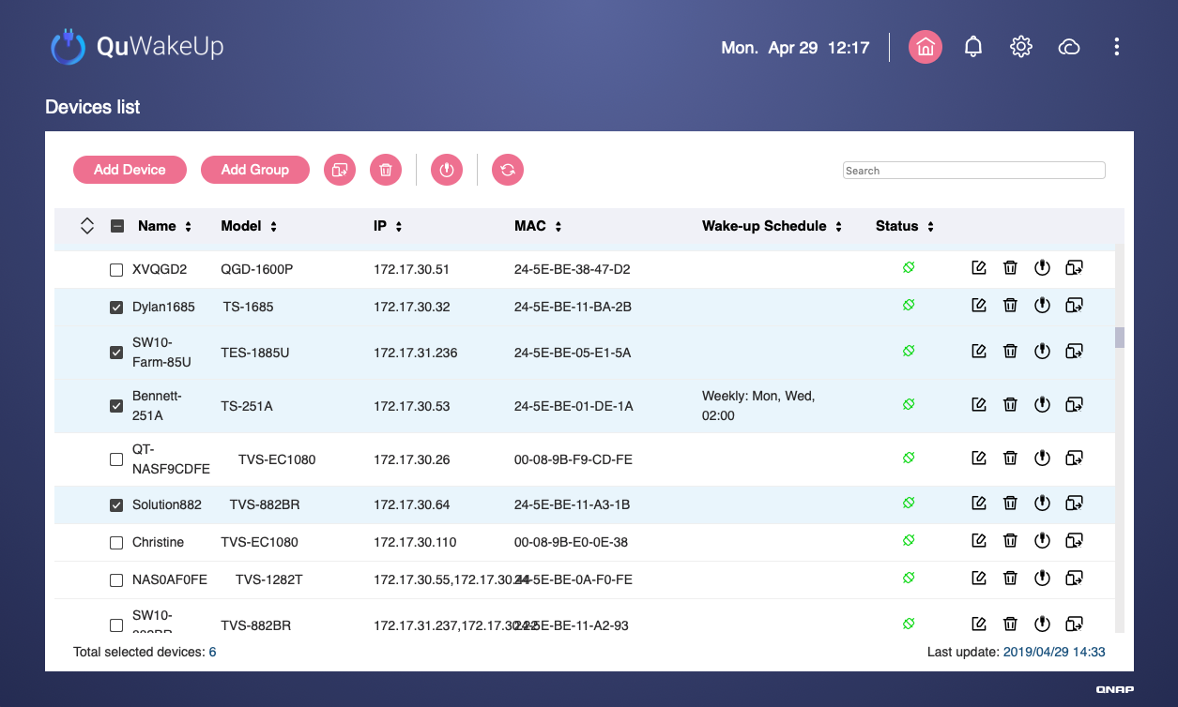
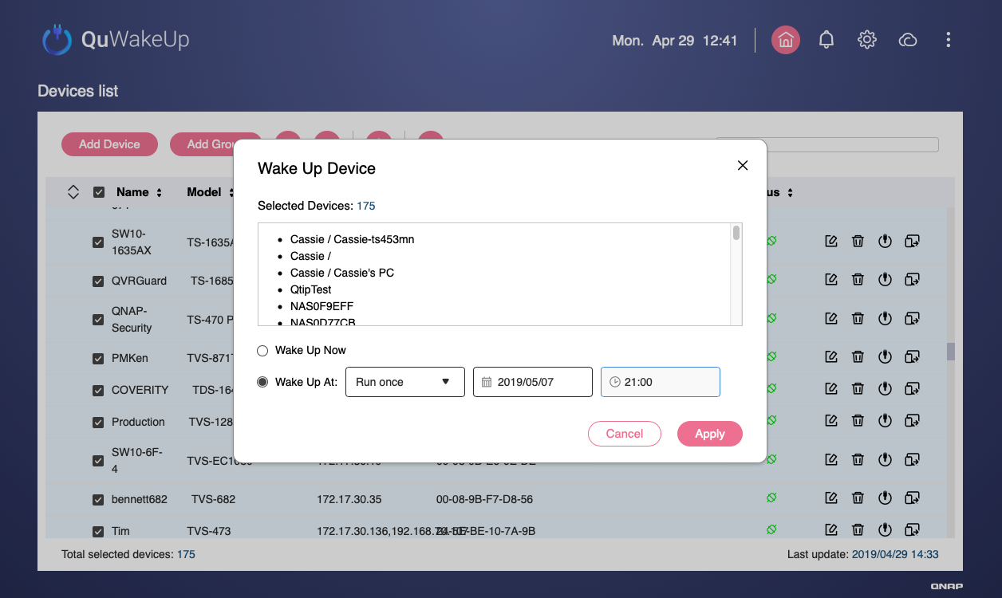
With QuWake-Up Get It Easily Done.
Scheduling is more efficient
It is set during working hours in advance.
The devices have been working normally when you go to work on Monday!
Check multiple devices
Schedule a wake-up rule
Notes:
But now...QuWakeUp get it done easily.
It is set during working hours in advance.
The devices have been working normally when you go to work on Monday!
Prior schedule is not flustered
Be prepared for the worst.

Slide 38
Your Best Choice
Copyright © 2019 QNAP Systems, Inc. All rights reserved. QNAP® and other names of QNAP Products are proprietary marks or registered trademarks of QNAP Systems, Inc. Other products and company names mentioned herein are trademarks of their respective holders.
Notes:
The hand-writing words, nickname for product:
WOL/WOW Helper

