Slide 2
Easy to build a network for your device
Wireless network card advantages
QWA-AC2600
Introduction
Application introduction
Wireless base station setup
Notes:
4章節
1.使用 2. 3.QNAP NAS and Uabuntu PC 4.一些

Slide 3
Wireless Network Card Advantages

Slide 4

What are the advantages of
wireless network card?
Direct access to wireless terminal data, effectively reducing the physical wireless routers loading.
QWA-AC2600 provides 5Ghz and 2.4Ghz dual-band, allows working together at some time.
Flexible configuration and expansion, one single PC/NAS can be configured with 2 or more NICs for expansion.
Create private network applications.
Notes:
在QNAP NAS 或 Ubuntu PC上
1.分流NAS/PC 資料 2.雙IC 3.實體網卡擴充 4.建立安全私有網路

Slide 5
Wireless edge computing
Data collection
Show results
Notes:
網路繁忙時 先將運算資料存放於PC/NAS 等到網路正常時再進行傳輸 以分擔雲端運算工作量 增進效能

Slide 6
Enjoy network optimization
with traffic shunting
Router
over loading
Separate NAS traffic to avoid busy routers slowing down the network
Notes:
在傳統應用上 AP Router 連接所有網路設備 大量傳輸造成 Router 處理負載過高 影響網路速度
透過QWA-AC2600 與 PC/NAS 進行直接資料傳輸 可減緩Router的負載 達到最佳化的網路環境

Slide 7
Set up a flexible wireless environment
Through QWA-AC2600 dual IC design, It allows dual-band working at some time, 1 band as a client and 1 band as an AP.
2.4 G as AP
2.4 G as Client
5 G as AP
Notes:
即可更彈性的架設網路環境

Slide 8
Add multiple expansion wireless
NICs IN A PC/NAS
PC / NAS PCIe slot
Expand more physical bandwidth for more users
Notes:
使用虛擬存取點分享實體網卡，連線品質仍然受到單一網卡頻寬限制，
現在我們可以在Ubuntu PC 或 QNAP NAS上透過擴充實體網卡增加獨立且不會互相干擾實體頻寬

Slide 9
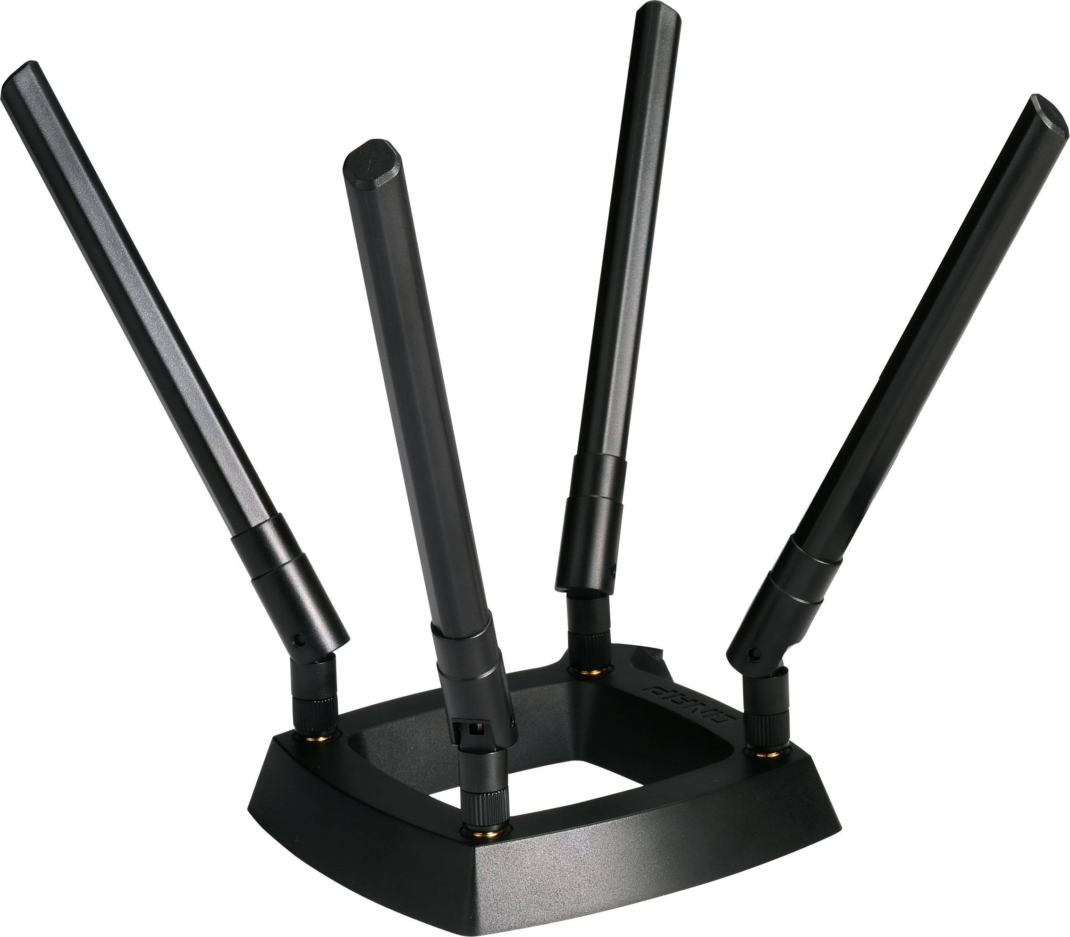

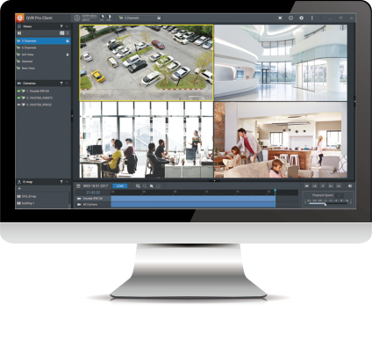

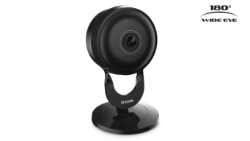
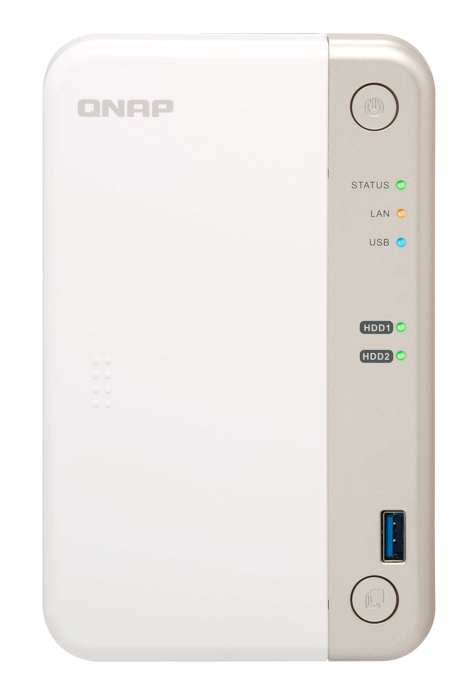




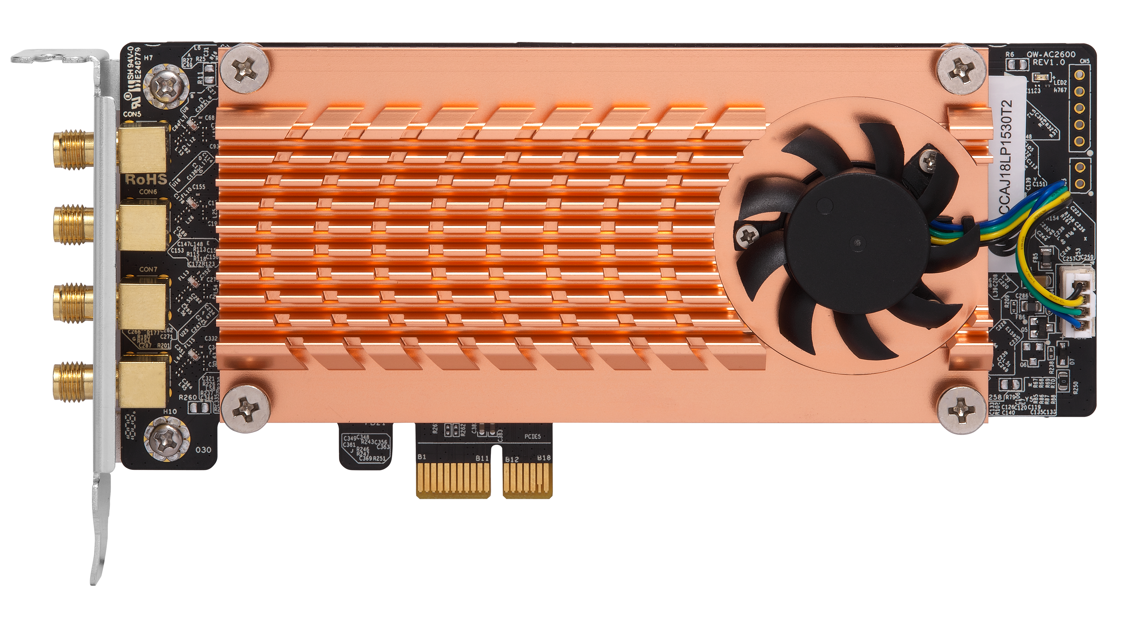









Turn QNAP NAS into wireless AP
WirelessAP Station
QWA-AC2600
TS-251B

Slide 10

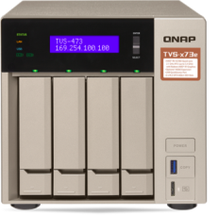
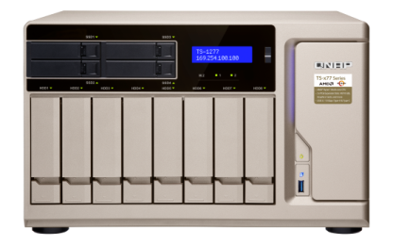
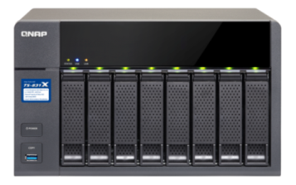
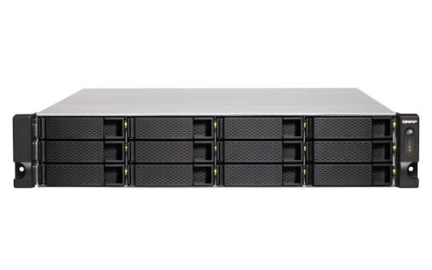
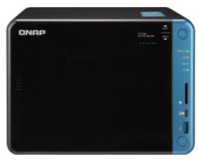
Supports NAS models with PCIe slot(s)
ARM-based processor
x86-based processor
TS-x31XU
TS-832X
TS-1635, TS-1635AX
*TS-531P, TS-531X, TS-831X
TS-x53B/x53Be, TS-x53BU
TVS-x63, TS-x63U
TVS-x73/x73e, TS-x73U
TS-x77
TVS-x82/x82T, TVS-1582TU
*QTS 4.3.5 or newer required
Notes:
可以支援所有PCIe 插槽NAS機種 1.搭配 QTS 4.3.5 或更新版的ARM 架構處理器機種 2. x86架構處理器機種
如 TS-531X ,TS-832,TS-253Be? 非常合適 bundle 這個產品

Slide 11
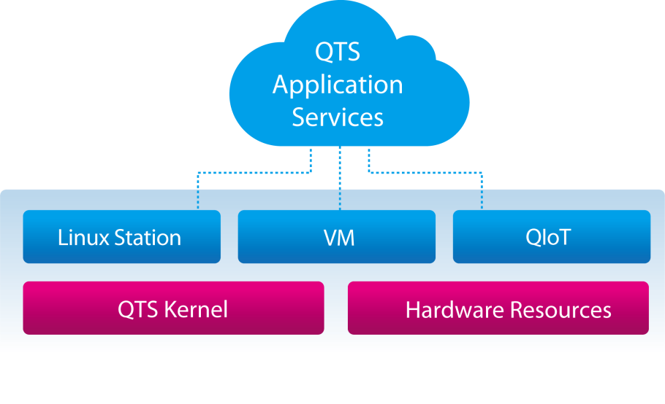
Freely set up an independent and secure wireless connection interface
You can also assign individual NICs to the Container or use different QNAP services as required through integration with QNAP Network & Virtual Switch, and enjoy a separate wireless connection interface.
For example: If you need to set up a private IOT environment, you can set it up to not pass through any other devices, so that your IoT network becomes a highly secure and reliable independent network.
Notes:
當我們需要使用 較高安全性的環境時 例如IOT設備或者監控設備 可以透過虛擬交換器的設定
建置私密的網路環境 提高網路安全性

Slide 12
Introduction

Slide 13
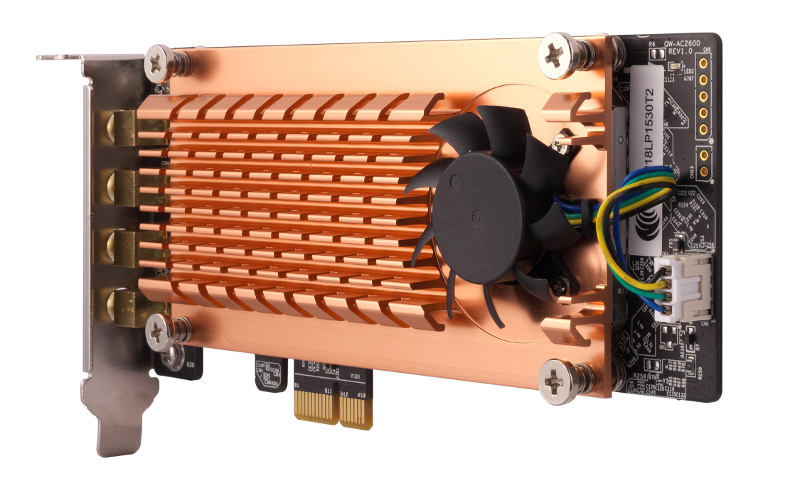
QWA-AC2600 PCIe wireless NIC
4 X Detachable RP-SMA connectors
Active cooling module to ensure the transmission quality
For extending to Quad-antenna magnetic base
Adjust the 3-level fan speed by real time chip temperature
Low profile PCIe
Up to 500 MB/s PCIe bandwidth
3 size bracket for all QNAP NAS (include X70 model)
With a PCIe 2.0 x1 interface
Notes:
1.QWA-AC2600 搭配了四支(可拆式 RP-SMA接口)天線，可以選擇自備的擴充天線，或是使用包裝內附的四支天線
2.PCIe 擴充卡採半高式設計，支援多數QNAP NAS 機種，並貼心附有三種檔板 1.半高式(預設) 2.全高式(機架) 3.特製半高式檔板(部分QNAP)
3.採用高規格散熱風扇，能自主偵測即時監控 IC溫度以調整風扇高中低轉速確保良好傳輸品質
4.採用PCIe Gen 2 x 1 接口 支援高達 500 MB/s 頻寬

Slide 14
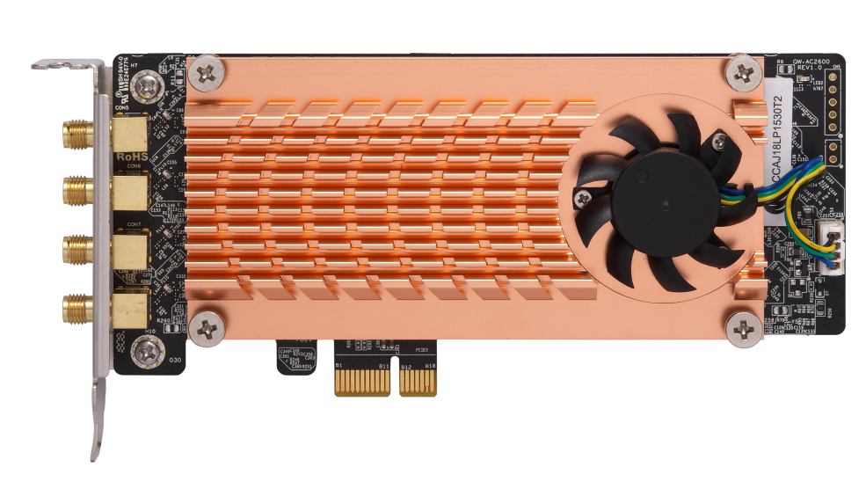
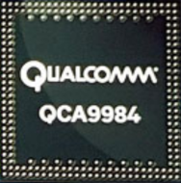
5 GHz and 2.4 GHz dual band
Dual Qualcomm QCA9984 support Dual Band Dual Concurrent
Up to 2600 Mbps total bandwidth
802.11ac (5GHz): up to 1733 Mbps
802.11n (2.4GHz): up to 800 Mbps
Notes:
搭配高通雙晶片提供同步雙頻無線功能 同時使用 5G 2G
QWA-AC2600 = 5G 1733 + 2.4G 600
5G: 1733 Mbps (4*433Mbps)
2.4G: 600 Mbps (4*150Mbps)

Slide 15
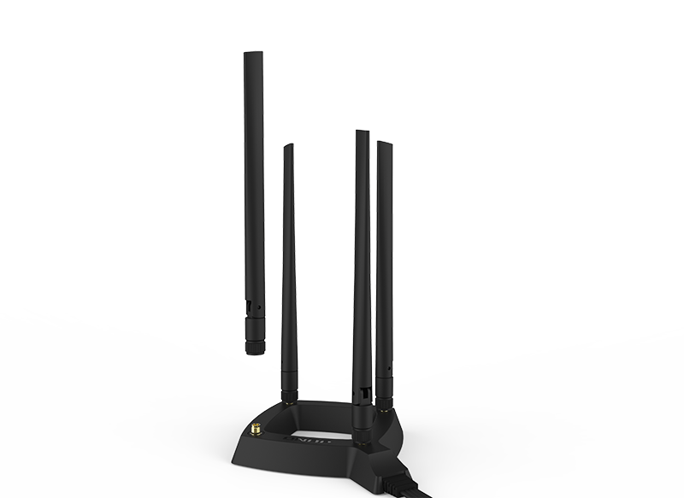
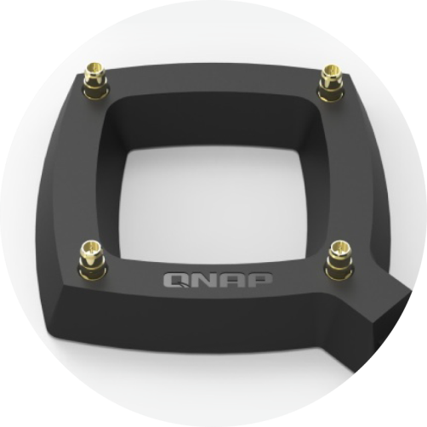
High mobility Quad-antenna base
0.8 m RF high frequency coaxial cable
For optimized antenna placement
4 detachable omni-directional high gain antennas
Upgrade or replace the antenna by demand
Notes:
80公分高擴展性延伸式底座 +4支雙頻全向式的天線 可針對傳輸環境靈活調整天線訊號

Slide 16

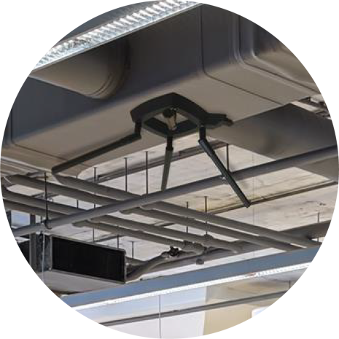



Flexible deployments with the antenna base
Wall-mount
Magnetic
Attached on the wall or ceiling
Attached to metal surfaces
Notes:
1.天線採底座採方框設計並於底部設有壁掛孔 可靈活掛於壁掛上
2.底部彩磁吸式設計 可固定於金屬表面
3.底部附有止滑墊設計 可有效止滑並防止刮傷接觸材質

Slide 17

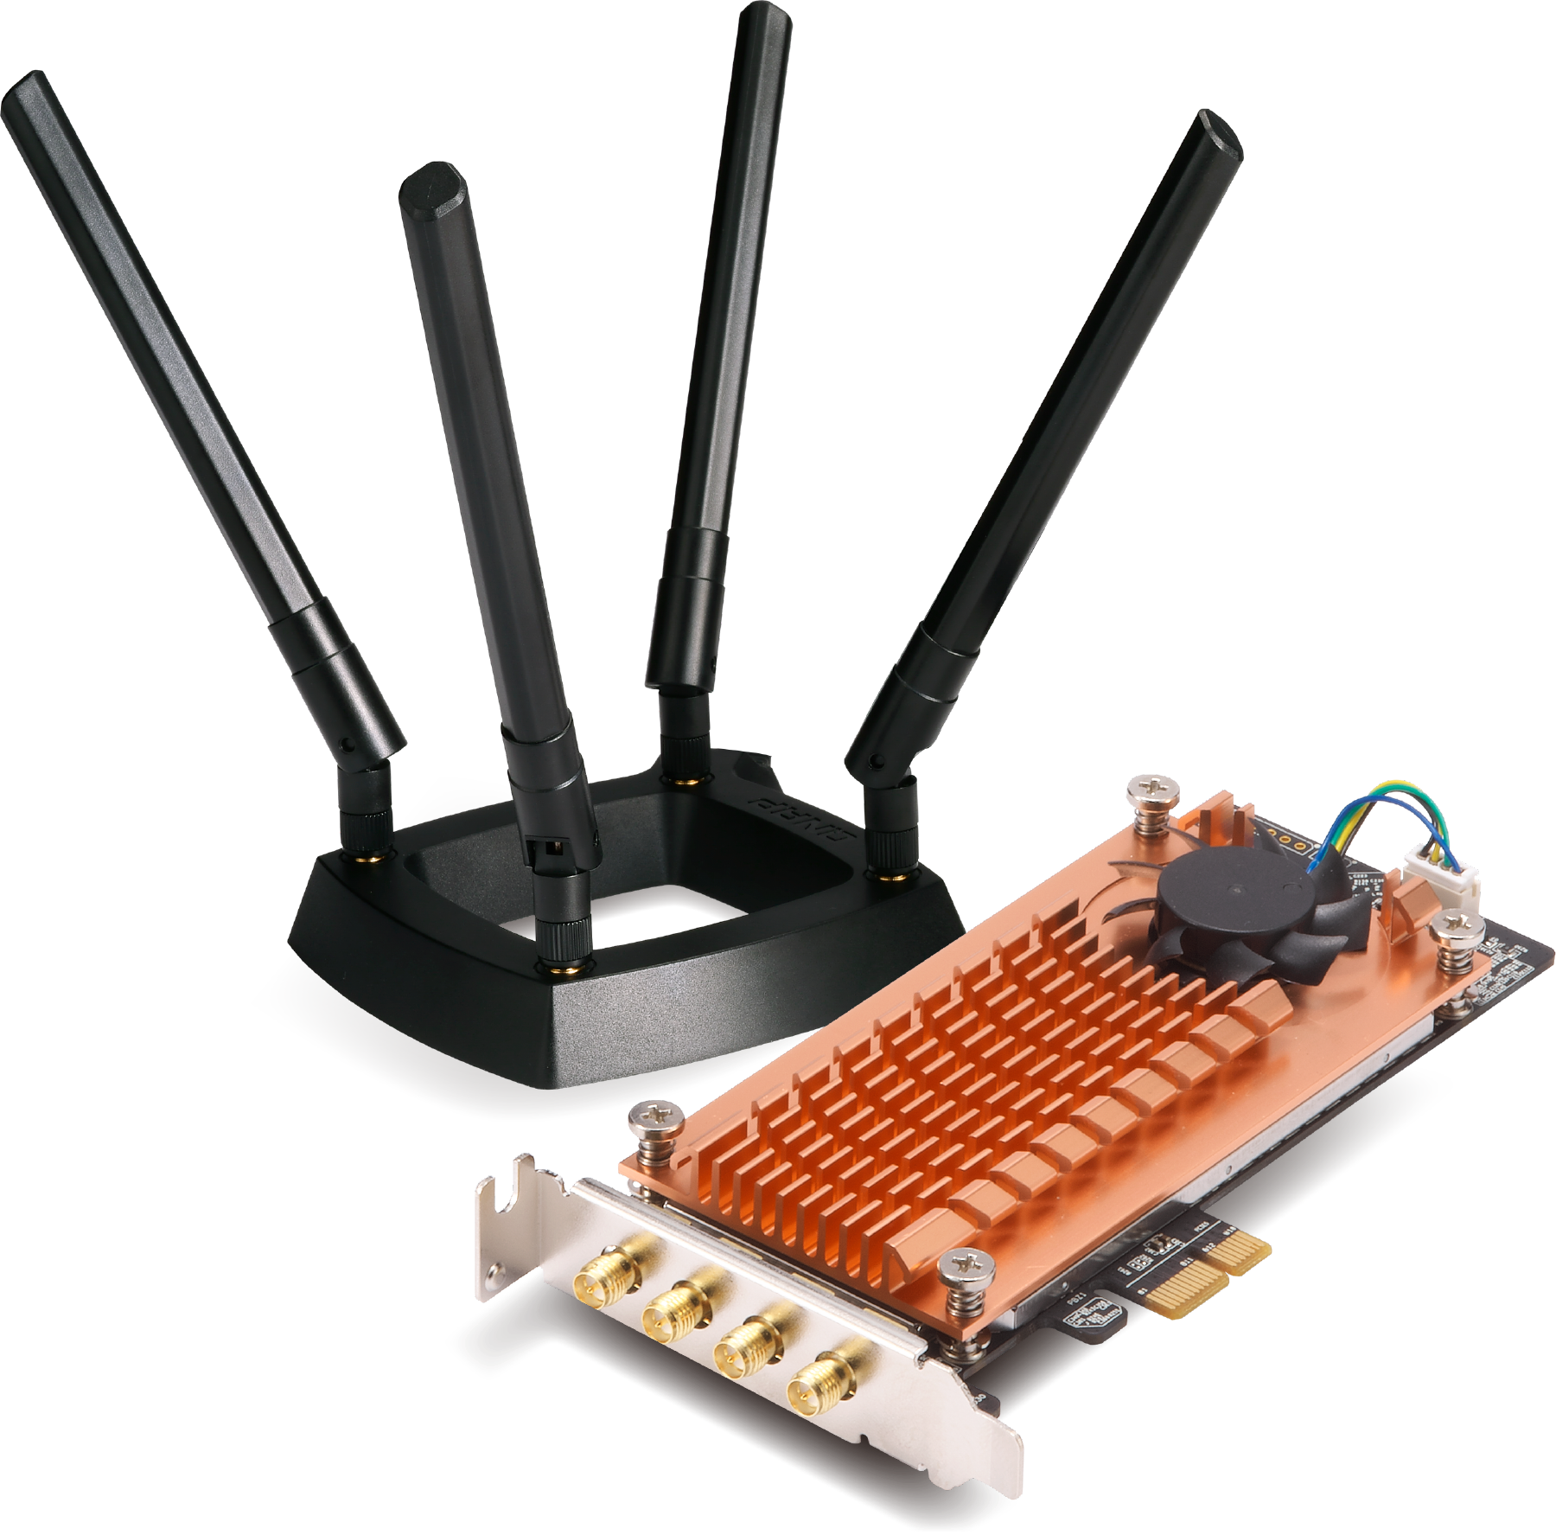

2 Qualcomm QCA9984 wireless NIC
4 x 4 MU-MIMO
Simultaneously communicate with multiple devices
Compliant with IEEE 802.11ac wave 2
Compatible with IEEE 802.11ac, IEEE 802.11n and IEEE 802.11a/b/g
Notes:
採QUALCOMM 高通 QCA9984 高規格晶片 支援 4 x 4 MU-MIMO
可讓 多用戶同時進行資料傳輸並讓無線傳輸速度不打折
支援到IEEE 802.11 ac wave 2 以及 IEEE 802.11ac IEEE 802.11n IEEE 802.11a/b/g

Slide 18
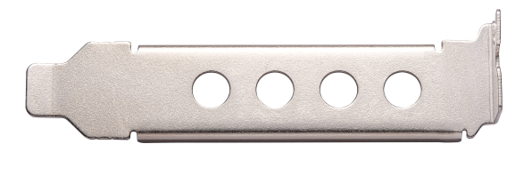
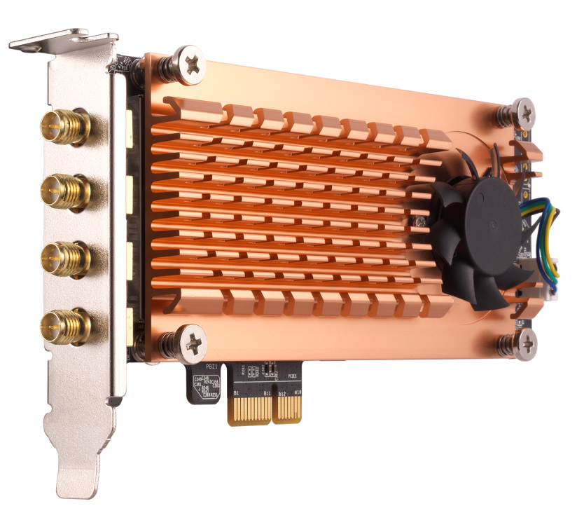
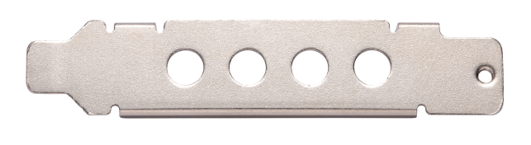
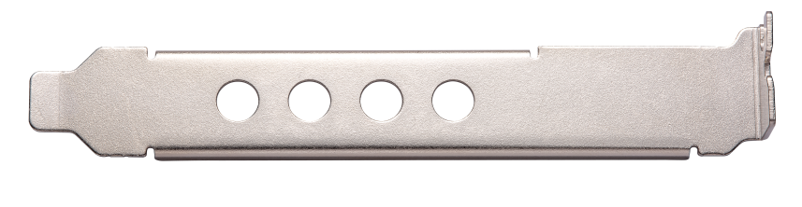
All QNAP NAS PCIe card bracket
Low profile bracket
Low profile PCIe expansion card design
Special half height bracket
(For some QNAP NAS)
Standard full height bracket

Slide 19
Wireless Base Station Setup
■ Build NAS WirelessAP - AP mode
■ Private network environment -
Router mode

Slide 20





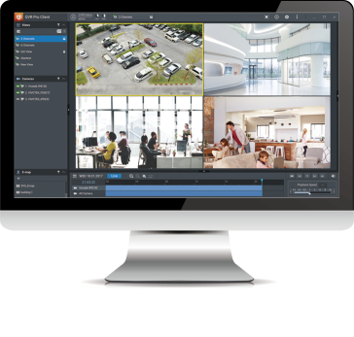
Setting of QWA-AC2600
General application
QNAP NAS wireless AP
Advanced applications on
a private network
environment (Router)
Notes:
基本應用
設定NAS無線網路
進階應用
建置安全監控環境

Slide 21
General
Application

Slide 22
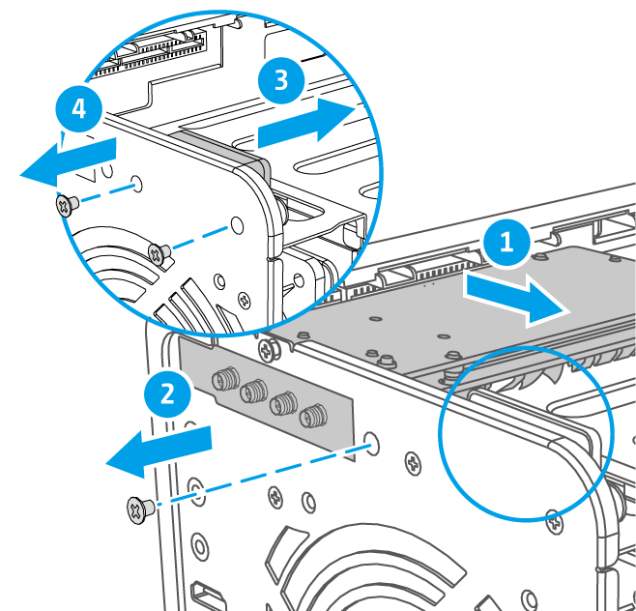
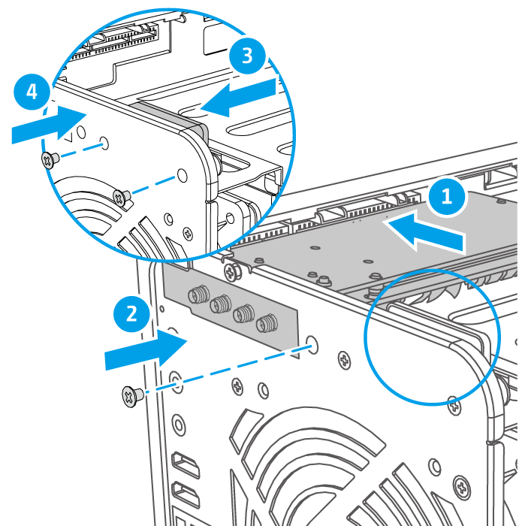

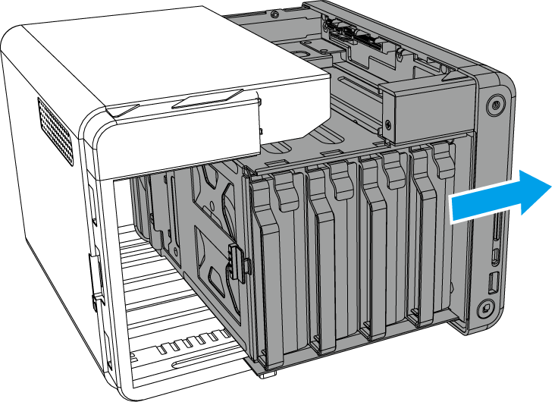
Installation of QWA-AC2600
STEP 1
STEP 2
STEP 3
Remove the cover of TS-253Be
Remove the PCIe cover
Install QWA-AC2600
NOTE 1：Some models may require its speaker to be temporary removed to install QWA-AC2600
NOTE 2：Bracket exchange of QWA-AC2600 is required to be installed on some models
Notes:
首先移除外殼螺絲 => 移除外殼 => 移除 PCIe 插槽檔板 => 安裝 QWA-AC2600 => 裝回外殼

Slide 23

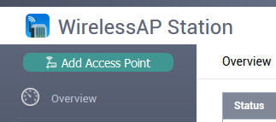
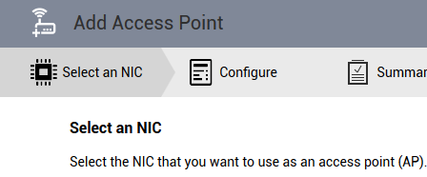
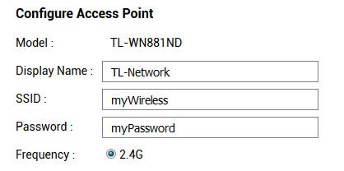
3 Steps to convert a QNAP NAS into an AP
Download and install WirelessAP Station form QTS App Center
STEP 1
STEP 2
STEP 3
Click “Add Access Point”
Select QWA-AC2600
Configure the Access Point
QWA-AC2600
Notes:
接下來我們透過簡單的三個步驟 1.點 「新增存取點」2.選擇 QWA-AC2600 網卡 3輸入 AP 存取點的設定

Slide 24
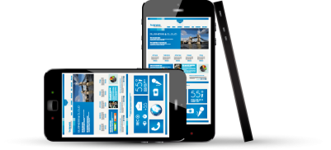
Turn The NAS into a Wireless AP Station
  Now you can freely set up independent and secure wireless connection interface
Notes:
建立 NAS 與裝置間的無線專屬網路，形成小型的私人網路，當我們需要建制隱密性較高的私人物聯網環境時，就可以不用透過其他分享器，直接完成NAS與物連網裝置直接溝通的私有網路。

Slide 25
Advanced
Applications

Slide 26

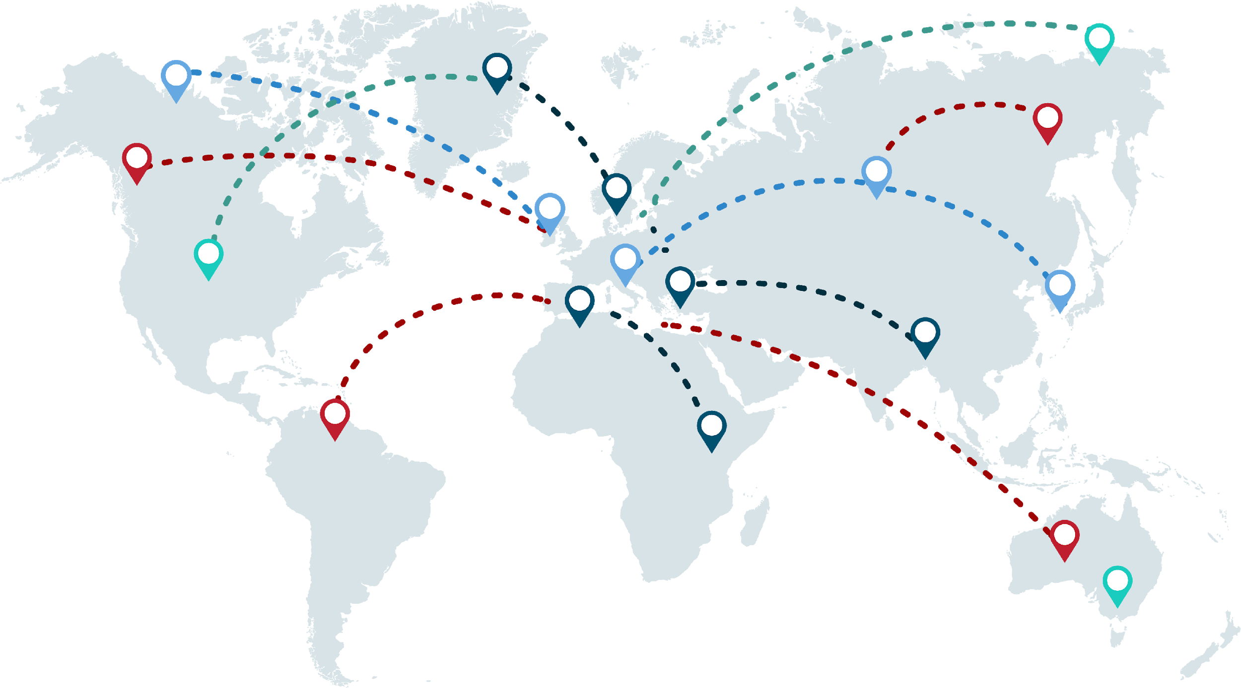

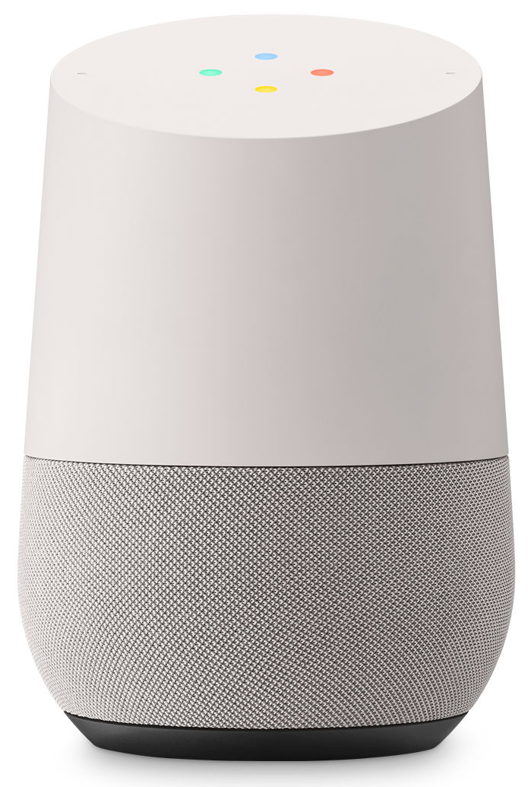
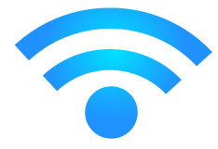



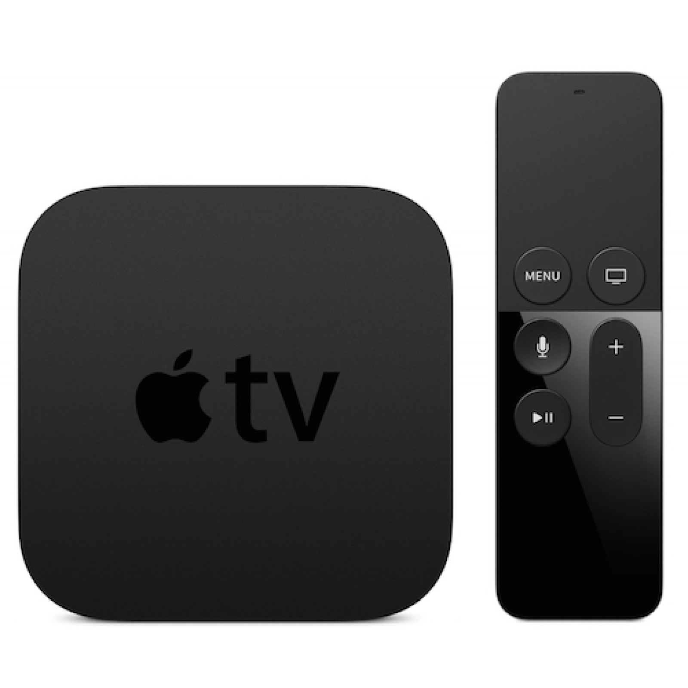


Use QWA-AC2600 to share
VPN wirelessly
2.4G
5G

Slide 27


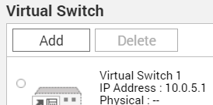
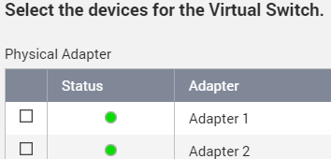

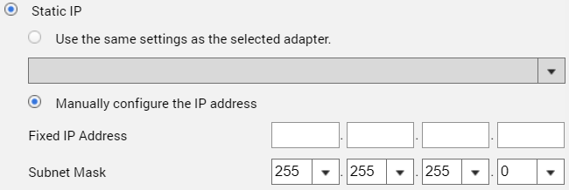
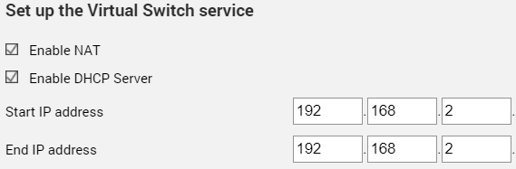
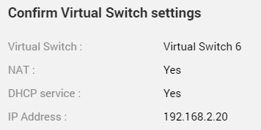
6 steps to set up wireless connection interface
Open Network & Virtual Switch form QTS
Click「Add」
Select Advanced Mode
Select the devices for the Virtual Switch
STEP 1
STEP 2
STEP 3
Set up the Virtual Switch IP address
Set up the Virtual Switch service
Confirm Virtual Switch settings
STEP 4
STEP 5
STEP 6
Notes:
這邊使用網路與虛擬交換器這個選項 設定六個步驟 即可完成安全監控環境的設定

Slide 28
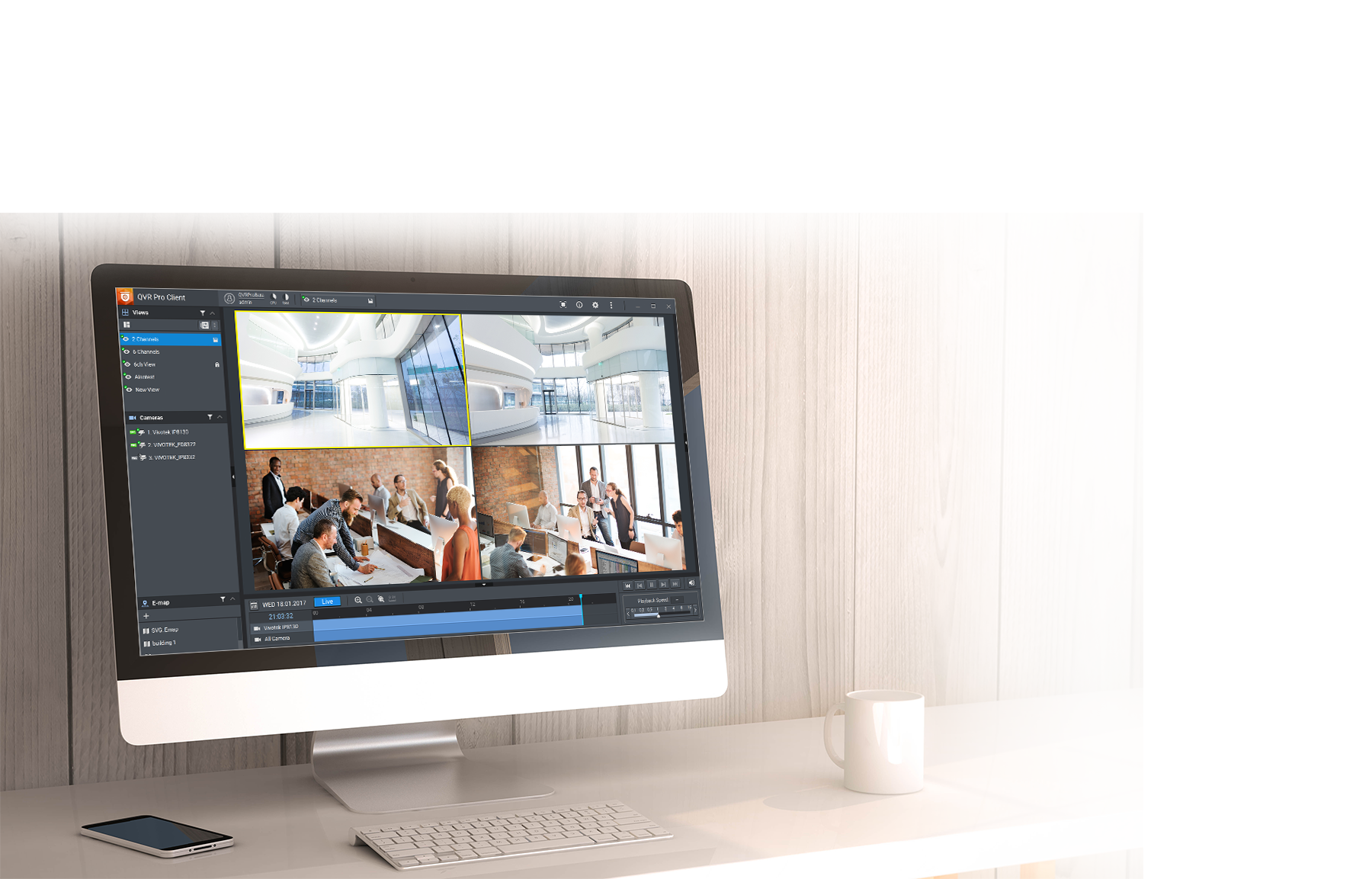

Advanced Applications on Private Surveillance
Connect wireless cameras to the network provided by WirelessAP Station and build a secure and professional surveillance system with QVR Pro
Notes:
當我們在使用監控設備或是較具隱私的IOT設備時 我們必須建置較安全的私有無線網路

Slide 29





Enable DHCP & NAT services to a secure surveillance environment
Create a Virtual Switch to a private network by QTS "Network and Virtual Switch" function
QVR Pro Client
Adapter 1
1 Gbe
10.0.0.3
Virtual Switch 1
Wireless camera
WirelessAP 1
10.0.0.1
10.0.0.2
Set SSID as QVR Pro
Wireless encryption as WPA2
Notes:
使用QTS 網路與虛擬交換器 透過 DHCP 以及 NAT 功能 建置安全監控及IOT環境

Slide 30
IPC/PC
Setting Demo

Slide 31





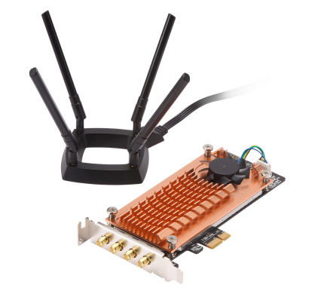


Turn PC or IPC into wireless AP
Build PC or IPC as a wireless access point with QWA-AC2600
Install Ubuntu 17.10
Install QWA-AC2600
Install and setup
AP suite：Hostapd
Client: wpa_supplicant

Slide 32
TANK-870 without AC2600
somewhere

Slide 33
TANK-870 with AC2600
here

Slide 34
Install AP Suite
●AP Suite：Hostapd
○Command: sudo apt-get install hostapd
●Ubuntu default setting will lock the network management function, need to unlock by instruction
○sudo nmcli radio wifi off
○sudo rfkill unblock all
●If require changing the network interface card name (or using default name)
sudo ip link set wlp4s0 name wifiap0
sudo ip link set wlp5s0 name wifiap1
Notes:
這邊使用網路與虛擬交換器這個選項 設定六個步驟 即可完成安全監控環境的設定

Slide 35
Set up Hostapd #1
1.Create /etc/hostapd/hostapd_5G.conf profile
2.Set up Interface
# AP netdevice name (without 'ap' postfix, i.e., wlan0 uses wlan0ap for
# management frames); ath0 for madwifi
interface=wifiap0
Notes:
這邊使用網路與虛擬交換器這個選項 設定六個步驟 即可完成安全監控環境的設定

Slide 36
Set up Hostapd #2
3.Set up Driver
# Driver interface type (hostap/wired/madwifi/test/none/nl80211/bsd);
# default: hostap). nl80211 is used with all Linux mac80211 drivers.
# Use driver=none if building hostapd as a standalone RADIUS server that does
# not control any wireless/wired driver.
driver=nl80211
Notes:
這邊使用網路與虛擬交換器這個選項 設定六個步驟 即可完成安全監控環境的設定

Slide 37
Set up Hostapd #3
4. Set up SSID for Wireless network：
# SSID to be used in IEEE 802.11 management frames
ssid=QNAP-AP
5. Set up Wirelss network operation mode
# Operation mode (a = IEEE 802.11a (5G), b = IEEE 802.11b, g = IEEE 802.11g(2.4G),
# Default: IEEE 802.11b
hw_mode=a
Notes:
這邊使用網路與虛擬交換器這個選項 設定六個步驟 即可完成安全監控環境的設定

Slide 38
Set up Hostapd #4
6. WPA setting：
# Enable WPA. Setting this variable configures the AP to require WPA
# bit0 = WPA
# bit1 = IEEE 802.11i/RSN (WPA2) (dot11RSNAEnabled)
wpa=2
Notes:
這邊使用網路與虛擬交換器這個選項 設定六個步驟 即可完成安全監控環境的設定

Slide 39
Set upHostapd #5
7. Input Password for Wireless network：
# WPA pre-shared keys for WPA-PSK.
wpa_passphrase=QNAP12345
8. #Start up hostapd
sudo /usr/sbin/hostapd -B /etc/hostapd/hostapd_5G.conf
sudo /usr/sbin/hostapd -B /etc/hostapd/hostapd_2.4G.conf
Notes:
這邊使用網路與虛擬交換器這個選項 設定六個步驟 即可完成安全監控環境的設定

Slide 40
Hostapd detail setting information
interface=wifiap0
driver=nl80211
ssid=QNAP-AP-5G
hw_mode=a
channel=0
preamble=1
auth_algs=3
wpa=2
wpa_key_mgmt=WPA-PSK
rsn_pairwise=CCMP
wpa_passphrase=QNAP12345
wmm_enabled=1
uapsd_advertisement_enabled=1
disassoc_low_ack=1
country_code=TW
ieee80211d=1
ieee80211n=1
ht_capab=[HT40+][SHORT-GI-20][SHORT-GI-40][LDPC][TX-STBC][RX-STBC1][DSSS_CCK-40][MAX-AMSDU-7935]
ieee80211ac=1
vht_capab=[MAX-MPDU-11454][RXLDPC][VHT160-80PLUS80][SHORT-GI-80][SHORT-GI-160][TX-STBC-2BY1][RX-STBC-1][SU-BEAMFORMER
][SU-BEAMFORMEE][MU-BEAMFORMER][BF-ANTENNA-2][BF-ANTENNA-3][SOUNDING-DIMENSION-2][SOUNDING-DIMENSION-3][MAX-A-MPDU-LE
N-EXP7][RX-ANTENNA-PATTERN][TX-ANTENNA-PATTERN]
vht_oper_chwidth=1
vht_oper_centr_freq_seg0_idx=0
vht_oper_centr_freq_seg1_idx=0
Notes:
這邊使用網路與虛擬交換器這個選項 設定六個步驟 即可完成安全監控環境的設定

Slide 41
Made for IPC and
QNAP NAS
DBDC PCIe Wireless Adapter
Copyright © 2019 QNAP Systems, Inc. All rights reserved. QNAP® and other names of QNAP Products are proprietary marks or registered trademarks of QNAP Systems, Inc. Other products and company names mentioned herein are trademarks of their respective holder
Notes:
以上是我們本次的介紹 謝謝各位的觀看

